Slide 1


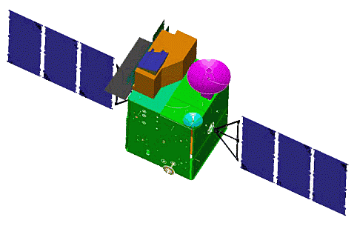
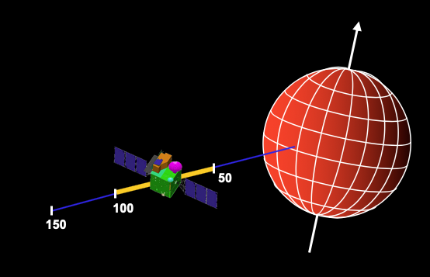
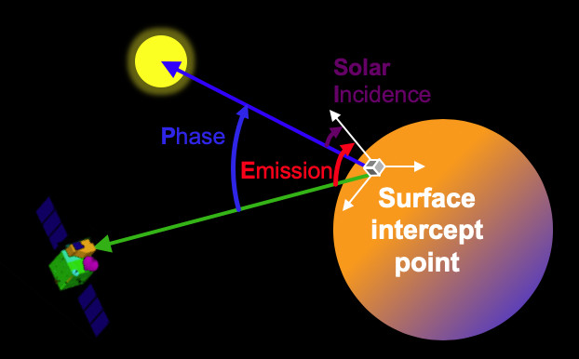
National Aeronautics
and Space Administration
Observation Geometry for SmallSats
Charles Acton
Navigation and Ancillary Information Facility
Jet Propulsion Laboratory/California Institute of Technology
charles.acton@jpl.nasa.gov
When is an object in
transit or occultation?
Positions, velocities, orientations
and field-of-view projections
Lighting angles
When is a spacecraft's
altitude within a given range?
A few examples of the many kinds of space mission
geometry you can compute using NASA's free SPICE system
https://naif.jpl.nasa.gov
The research described in this publication was carried out at the Jet Propulsion Laboratory, California Institute of Technology, under a contract with the National Aeronautics and Space Administration.
© 2020 California Institute of Technology. Government sponsorship acknowledged.

