Slide 1

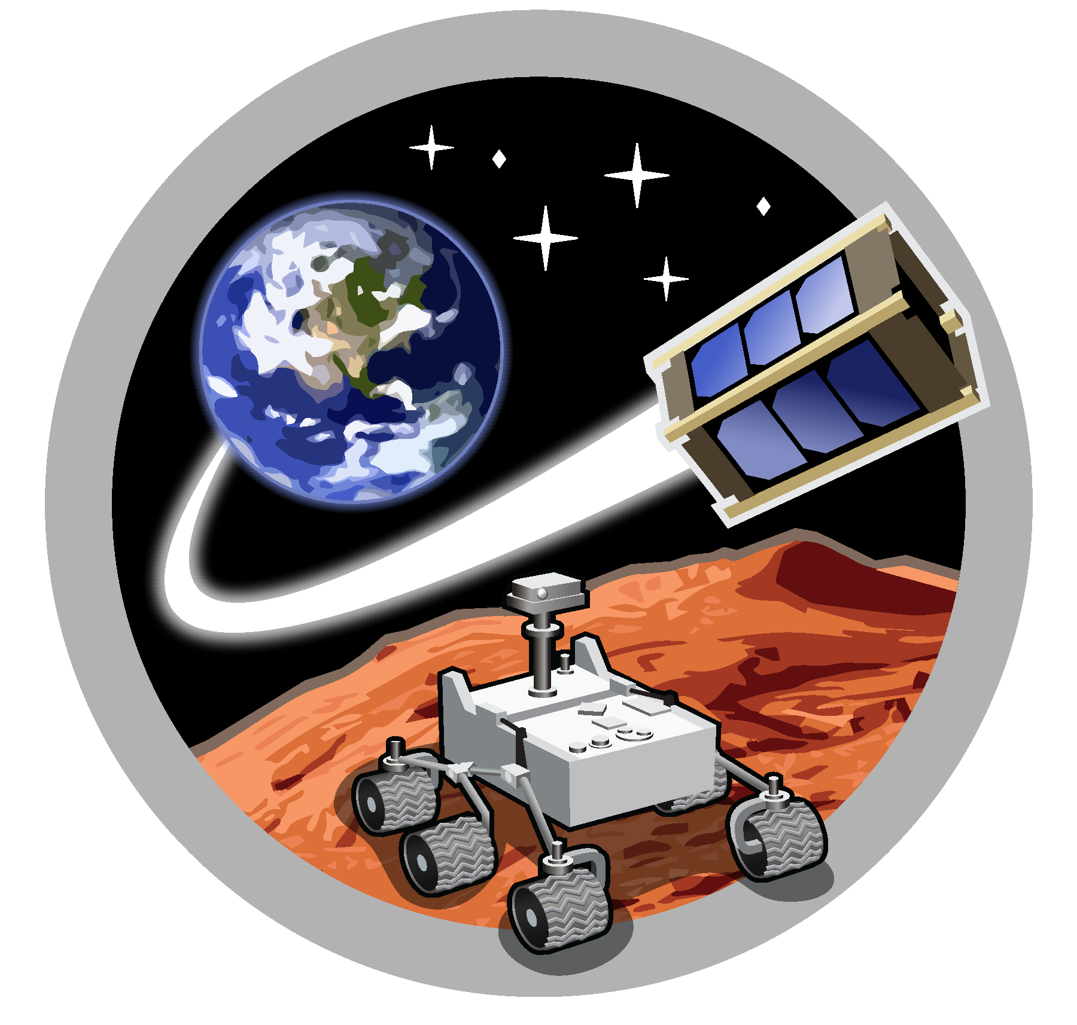
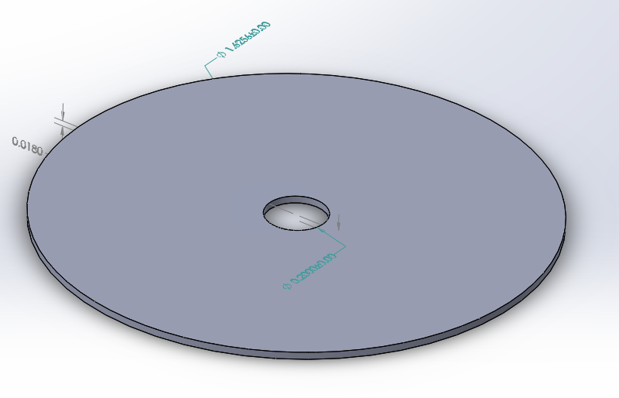
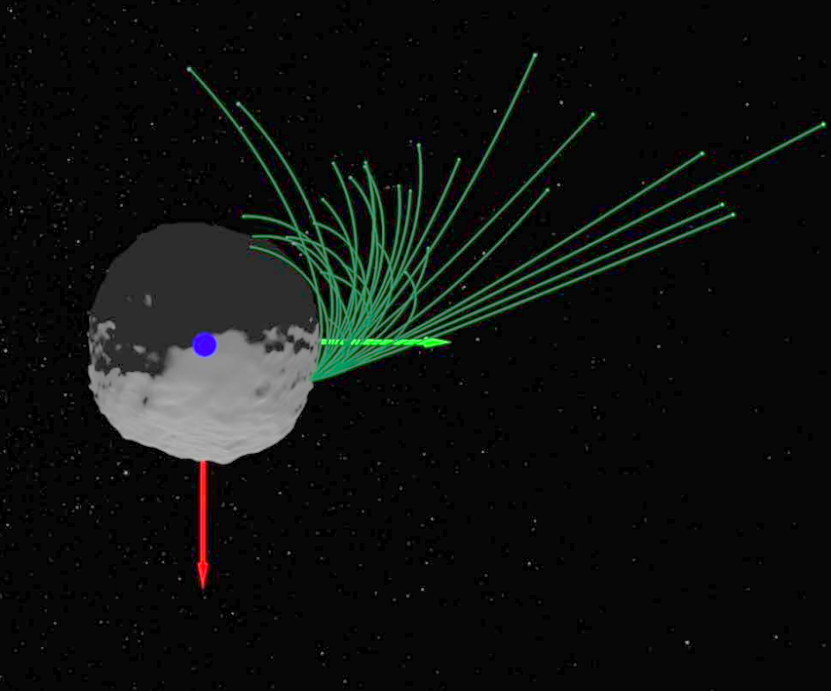
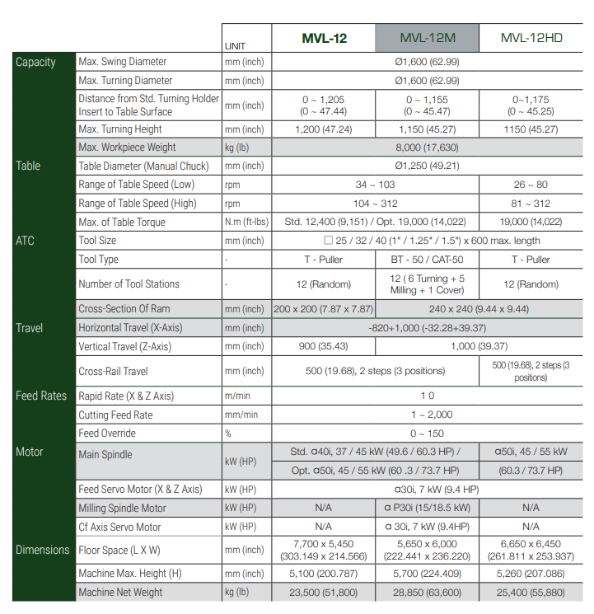
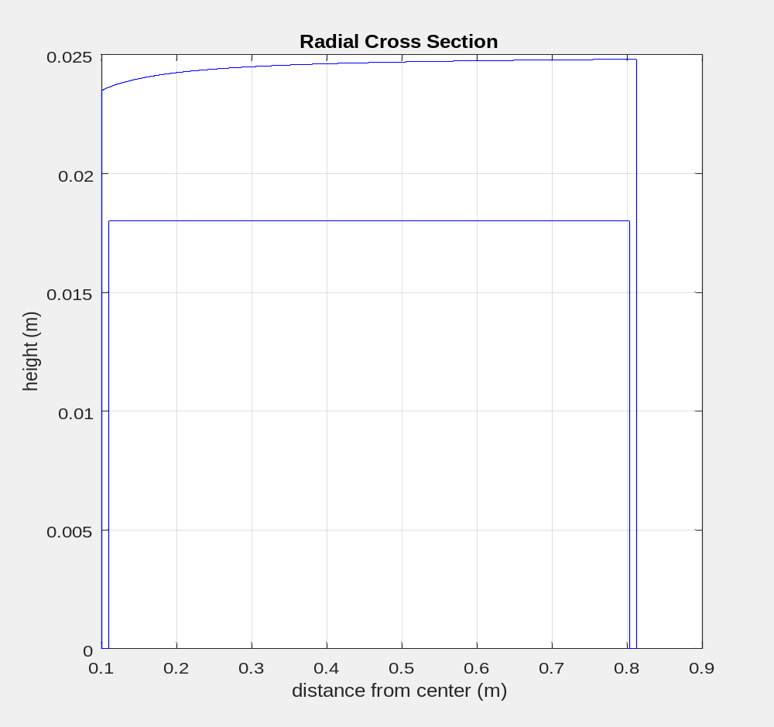
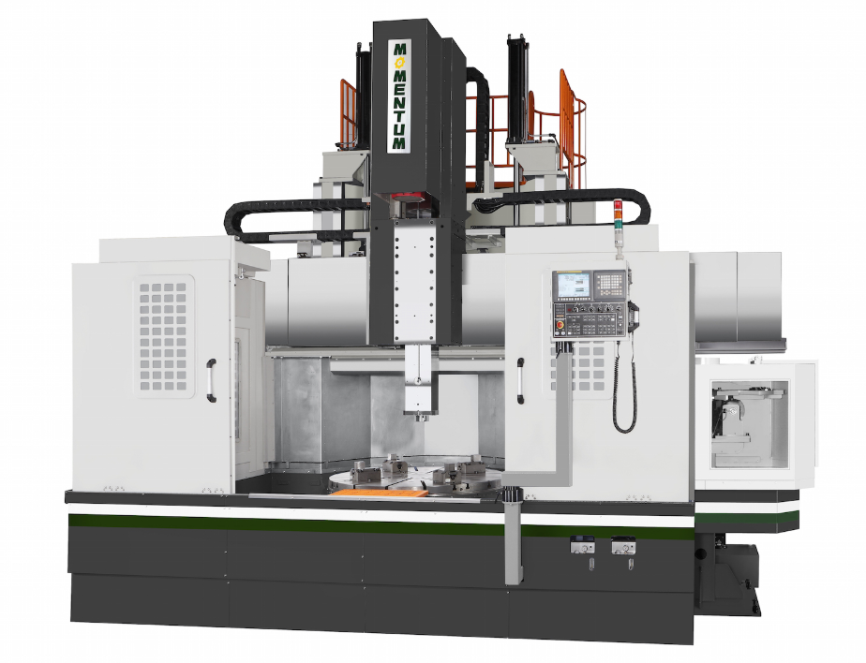
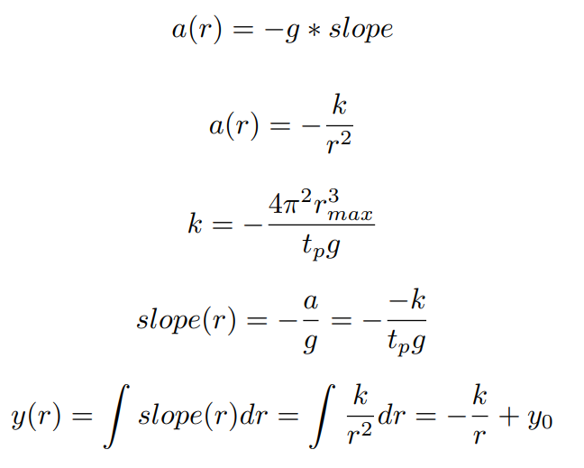
Asteroid Gravity Test System Using a Planar Air Bearing
Leonard Vance
SpaceTREx Laboratory, University of Arizona
Motivation
The size and makeup of near earth asteroids make spacecraft sample and return missions hazardous. Since at least one of these asteroids (101955) Bennu regularly ejects particles, nanospacecraft could be deployed to capture these objects in flight, eliminating the need for touching down on the asteroid itself.
The proposed airbearing table is radially curved to mimic the low gravity of a centrally located asteroid, permitting evaluation of such a mission’s navigation, guidance and docking.
Conclusion
Capture of erupting particles is a plausible alternative to touchdown on the asteroid surface
Creation of a radially symmetric air bearing can reproduce aspects of the dynamic environment for system test
This air bearing table can also be used as a hands on teaching tool for Keplerian dynamics.
Previous Approach
Planar Airbearing allowing 3 degree of freedom motion
Updated Approach
Radially sculpted air-bearing table to mimic a low gravity asteroid environment
Concept of Operations
1.6 m diameter
Orbital period
120 sec (outer edge
5 sec (inner edge)
4) Return to Mothership
Particle Trajectories from 19 Jan 2019 eruption event
3) Rendezvous and capture
1) Observe eruption and choose particle
2) Nano-spacecraft guides to particle
mass = 20 kg Approx.
Airbearing table mimics low gravity system
D.S. Lauretta et al. Episodes of particle ejection from the surface of the active asteroid (101955) Bennu. Science, 2019
Manufacturing
Derivation of Surface
Table requirements well within existing tooling machine capability
Specifications
Table Cross Section
(Vertical Scale Exaggerated)
Diameter is chosen consistent with reasonable max handling size (r_{max} = 1.6m)
Period of max radius orbit limited with ability to level platform (t_{p} = 120 seconds)
Inner radius limited by ability of air bearings to plausibly maintain lift on a curved surface (r_{min} = 0.1m)
Inwards acceleration at max radius
Gravitational model
References
D.S. Lauretta et al. Episodes of particle ejection from the surface of the active asteroid (101955) Bennu. Science, 2019
Value of k for chosen orbital period t_{p}
Slope required for that orbital period
CNC Vertical Turning Lathe Accuracy usually about 0.02mm
Integration of slope to get outline

