Slide 1


SmallSats Beyond Saturn
Without Radioisotopes: A Preliminary Assessment
Interplanetary Small Satellite Conference, Web-hosted from Pasadena, California
2020 May 12
Robert L. Staehle, Alessandra Babuscia, Nacer Chahat, Steve Chien, Corey Cochrane, Courtney Duncan, Henry Garrett, Damon Landau, Paulett Liewer, Pantazis Mouroulis, Neil Murphy, Adrian Tang, Team Xc
Jet Propulsion Laboratory, California Institute of Technology
Jordi Puig-Suari, John Bellardo, Cole Gillespie, Nick Bonafede, Michael Fernandez, Maya Gordon, Cassandra Kraver, Daniel Leon, Liam Mages, Lucas Martos-Repath, Sydney Retzlaff
California Polytechnic University – San Luis Obispo
Kian Crowley/Crowley Aerospace Consulting; Mihir Desai/Southwest Research Institute
Jekan Thangavelautham/University of Arizona
© 2020 All rights reserved.
Pre-Decisional Information -- For Planning and Discussion Purposes Only

Slide 2
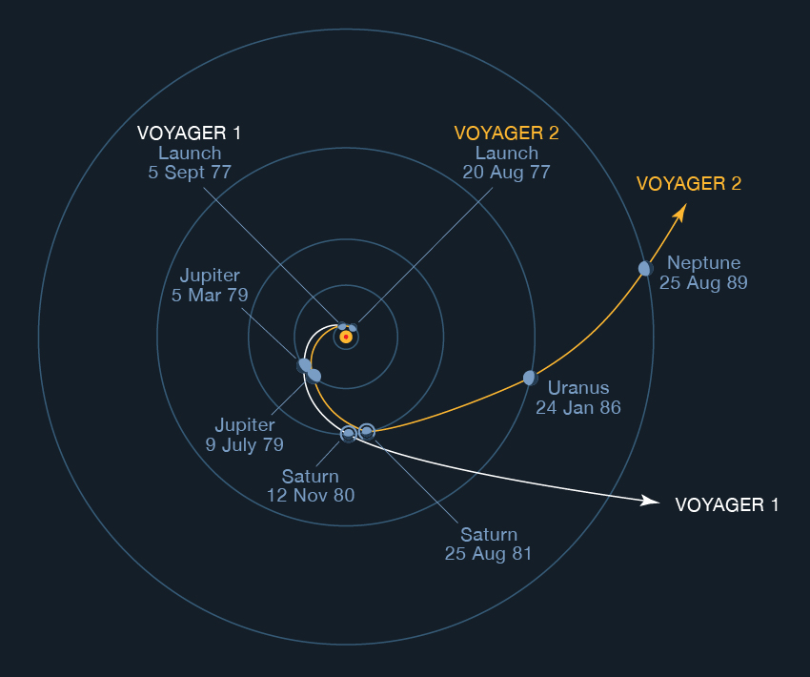
Visits beyond Saturn are rare.
The vast majority of the volume of the Solar System lies beyond Saturn’s orbit, and outside the Ecliptic plane.

Slide 3
How might we learn more, affordably?
Classical approach, with very sophisticated, high-yield missions with broad objectives
New Horizons, Voyager 1 & 2, and Pioneer 10 & 11 are the only spacecraft to venture beyond Saturn’s orbit.
Each weighed >250 kg (some >>250 kg).
Cost >FY19$300 M (most >>$300 M).
Operations teams with 10s of people.
Radioisotope power.
Focused SmallSat approach, very specific objectives
Inspired by the CubeSat/SmallSat revolution in small, low power electronics and miniature instruments.
1/10th the cost* and mass, and
1% of the equivalent continuous power level, and
1% operations staffing of such missions today.
Launched as secondary payloads ridesharing with primary missions to the Outer Solar System.
Use Jupiter swingbys to different targets beyond Saturn’s orbit.
*Cost information contained in this document is of a budgetary and planning nature and is intended for informational purposes only. It does not constitute a commitment on the part of JPL and/or Caltech.
Pre-Decisional Information -- For Planning and Discussion Purposes Only

Slide 4
Innovation: Outer Solar System SmallSats (OS4)
Small solar-powered outer Solar System (OSS) spacecraft could be capable of operating to just beyond the heliopause past Neptune’s orbit.
Could use inflatable UV-rigidized solar collector for power, thermal and RF; low data rate telecom.
Make use of low duty cycle/low-power avionics derived from high-end consumer electronics.
Employ miniaturized magnetic field, plasma, and dust instruments with modest power and data needs.
May enable affordable access to edge of Outer Solar System
  Explore Heliosphere, including high inclinations
  Opportunistic small body flybys
  Focused measurements during Saturn, Uranus, or Neptune flybys might be possible with different instruments.
  Minimal-staff operations thru autonomy.
Pre-Decisional Information -- For Planning and Discussion Purposes Only

Slide 5
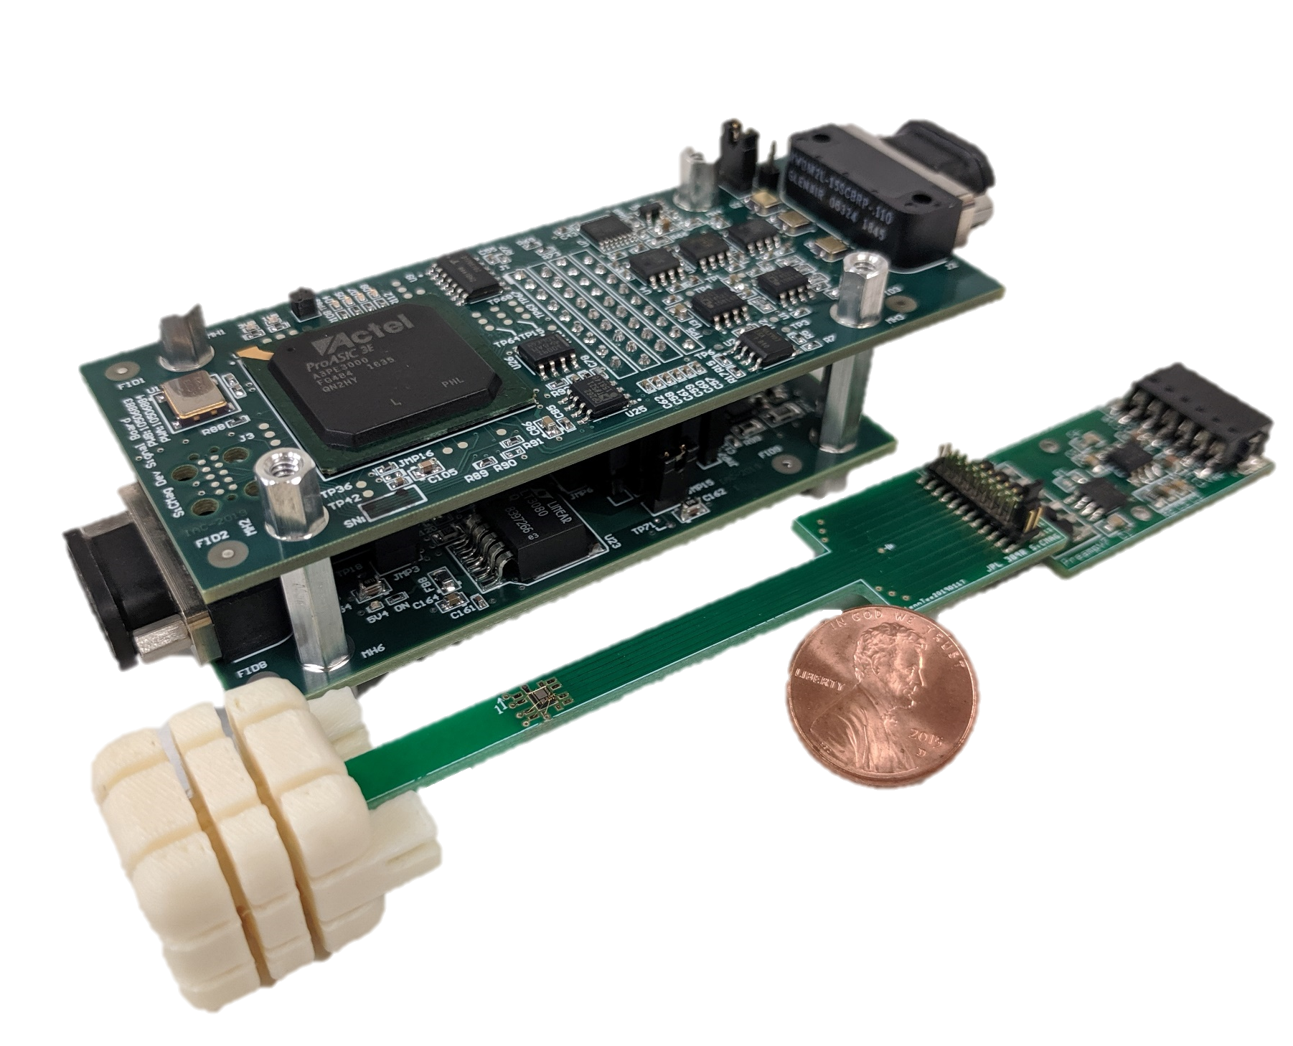
Magnetometer & Plasma Sensors
SwRI Solar Wind Ion & Electron Sensor (IES)
(Mihir Desai, et al./SwRI)
(Rosetta heritage sensor, re-done electronics w/ modern components) [see next slide for placement]
Miniaturized Electron and Ion
Telescope (MeRIT)
(Mihir Desai, et al./SwRI)
(CuSP & CeRES heritage)
SiC Solid-State Quantum Magnetometer
(Corey Cochrane/JPL)
Electronics to be miniaturized to ASIC/SoC
Notes:
IES placement: The red torus in the picture is the instrument entrance aperture. The instrument has a pancake field of view. In the part of the s/c closest to the Sun, and not shaded from the Sun, this toroidal aperture should be placed such that the s/c spin axis, which is to be pointed within a small angular distance of the Sun (for the outer Solar System part of the mission) is parallel to a diameter across the toroid. Thus, the Sun is located with in the pancake field of view, and the pancake is rotating end-over-end about the axis roughly defined by a line from the Sun to the spacecraft, or more precisely defined by the s/c spin axis, or a line parallel and close to the s/c spin axis.
The anti-Sun 90 degree segment of the pancake FOV is to be blocked, that is, +/-45 deg from the anti-Sun direction, to avoid light reflected back from the solar concentrator, and/or blockage by the s/c. No part of the remaining 270 deg FOV should be blocked by any part of the s/c.
A second IES should be similarly placed, with its pancake rotated ~90 deg from the first, also with the Sun always in view, and the anti-Sun 270 deg of its aperture blocked.
MeRIT placement: The axis of the centerline of MeRIT aperture and the cylinder behind it should point perpendicular to the s/c spin axis, and be clear of any view of elements of the s/c +/- ~20 deg on either side of this axis. Thus MeRIT scans 360 deg with every rotation of the s/c about its spin axis. A second MeRIT should be similarly placed, viewing perpendicular to the s/c spin axis, >=45 from the first.
Magnetometer placement: assume that the electronics package show as the upper assembly of the two shown will shrink dramatically, to fit as two more boards stacked on the one that is the wider part of the right-hand portion of the lower assembly (we’ll postulate that we move to an ASIC or SoC). The actual sensor is the white cube to the left of the lower assembly. The distance between the left and right portions should be maintained for now, for magnetic cleanliness.
Six identical magnetometers can be placed in dispersed locations

Slide 6
Cameras for Measuring Holes in Reflector Created by Dust and Taking Periodic Portraits of the Solar System
Mars2020 NavCam
Mars2020 EECAM Camera Specifications
Sensor Capabilities
Type | 20M Pixel CMOS Image Sensor
Array Size | 5120 x 3840
Pixel Size and Pitch | 6.4um2 on 6.4um Pitch
Full well charge | 15ke-
Pixel Dark Noise | 8e- RMS
Windowing | Yes
Shutter | Global
Color | Bayer RGB Color
Pixel Quantization | 12bit
Electrical Interface
Commanding & Data | LVDS
Protocol | MER/MSL/Mars2020 NVMCAM
Power Input | +5.5V (+/- 0.4V)
Power | < 3 W
Memory | 1Gbit SDRAM
FPGA | MicroSemi Rad-Tolerant ProASIC3
Camera Specifications
Mass (CBE, no optics) | < 425g
Volume (CBE, no optics) | 65 mm x 75 mm x 55 mm
Operating Temperature Range | -55C to +50C
Survival Temperature Range | -135C to +70C
Optics Configurations
Navigation Camera | 95°X 71°(H x V), f/12, iFOV < 0.32 mrad/pix
Hazard Camera | 134°X 110°(H x V), f/12, iFOV < 0.46 mrad/pix
Sample Caching System Camera | 0.49 magnification, 130mm stop to plane-of- focus, +/- 5mm Depth of Field
65 x 74 mm at base x 90 mm along optical axis. 700 g
Christophe Basset, Colin McKinney, Mark Schwochert, Justin Boland/JPL, 2017
Notes:
Solar System Portrait Camera placement: somewhere on the sunward side of the Hub, with boresight approximately along the spin axis, pointing in the sunward direction. A small part of the s/c may be in the FOV. The second camera should be similarly positioned, but with boresighted ~45 deg off the spin axis.
Dust Camera placement: on the anti-Sun side of the spacecraft, looking back in the sunward direction at a swath of the aluminized reflector. Its data is a count of the holes, position and intensity of light showing through each hole, and how the hole population increases over time, e.g., from one month to the next.

Slide 7
Big challenges
Getting to the edge of interstellar space inner Edgeworth-Kuiper Belt without radioisotopes for power or heat today is impossible (at least if you want to do anything useful and send a signal back…)
At 125 30 AU, sunlight’s power density per unit area is 1/15,625 900th of the level at Earth.
It may be impossible for at least the next ten years, but we have an approach that might work
  For spacecraft maybe <100 250 kg
  With simple, pre-programmed measurements
  Very limited maneuvers beyond Jupiter
  Capture and store energy from ambient sunlight
  Almost everything “off” almost all the time
  All equipment able to run cold, e.g., -40 C (-40 F), or possibly colder
Pre-Decisional Information -- For Planning and Discussion Purposes Only

Slide 8
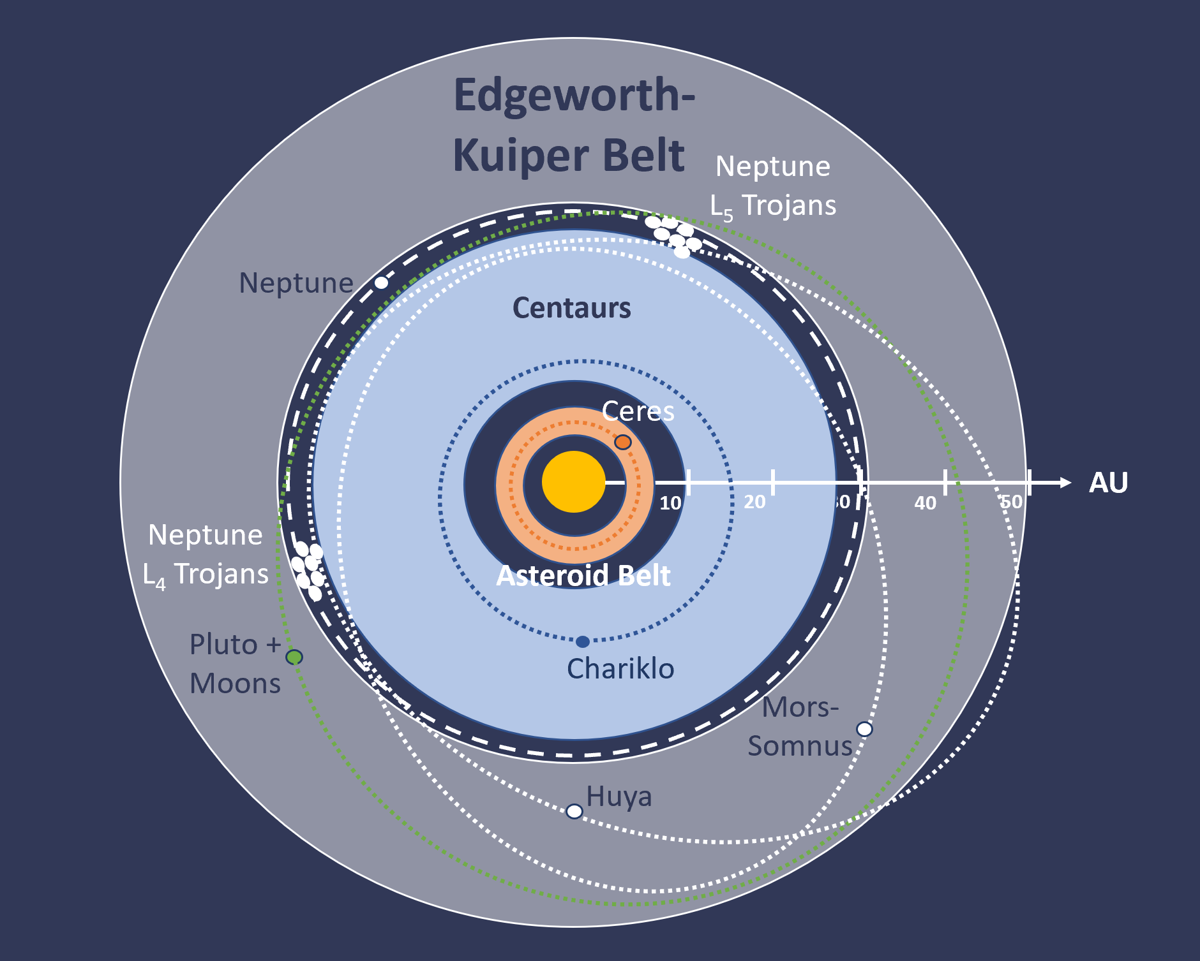
Many Interesting Objects within 30 AU of the Sun...
(orbits of
Jupiter @5 AU,
Saturn @ 10 AU, and
Uranus @19 AU not shown,
for graphic clarity)
Note: arguments of perihelion for example Edgeworth-Kuiper Belt objects are notional for graphic clarity.
Cole Gillespie/CalPoly-SLO, 2020/5/6

Slide 9
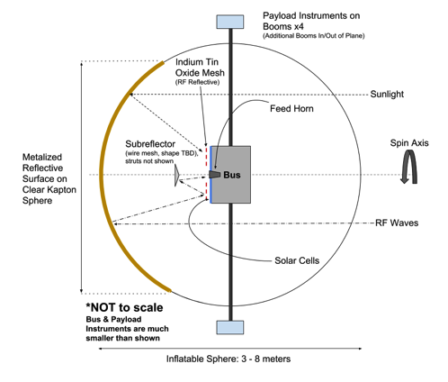
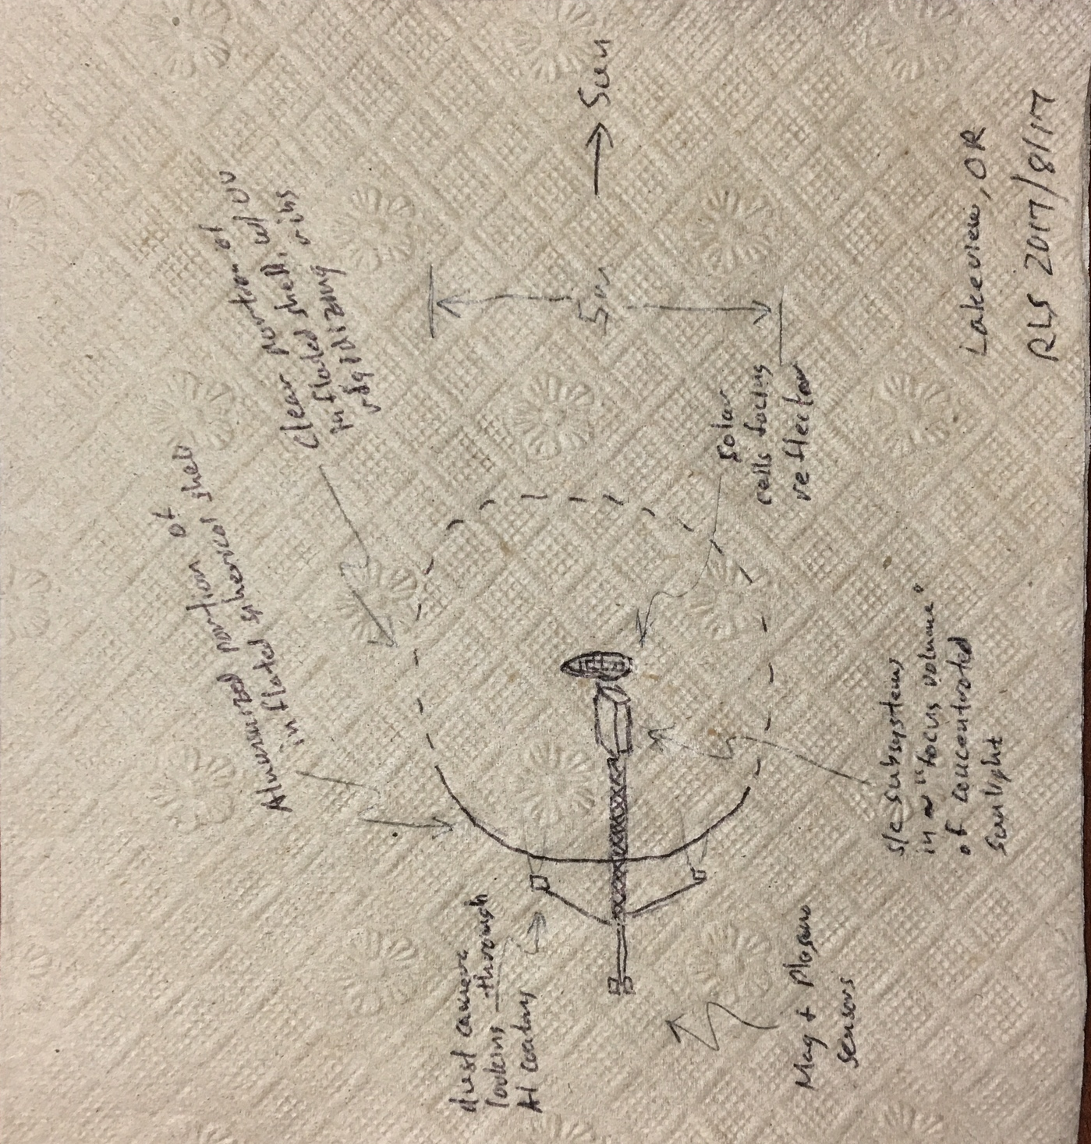
What are napkins for?
Pre-Decisional Information -- For Planning and Discussion Purposes Only
Sebastian Lee Gnagy/CalPoly-SLO, 2018/11

Slide 10
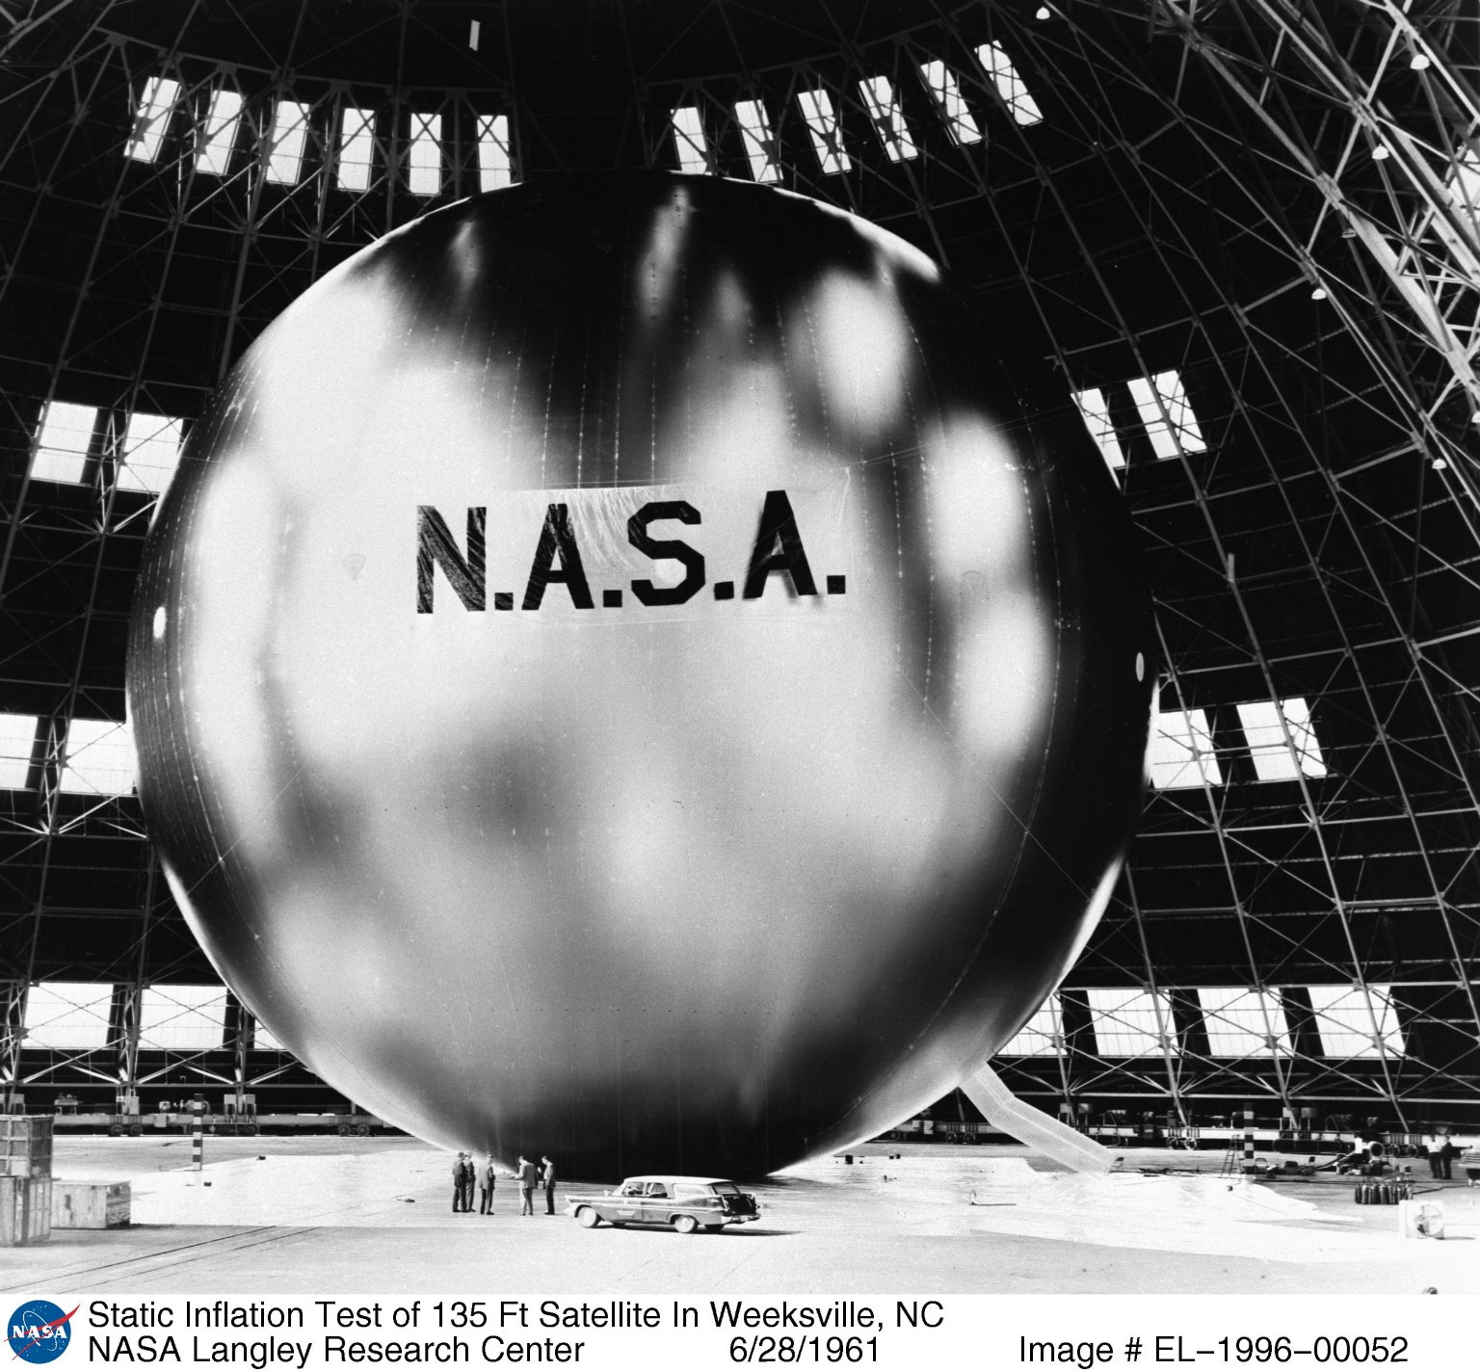
Big inflatable spheres have been in space before:
Echo 1A, 1961
30.5 m diameter
0.2 um (0.5 mil) thick Mylar
71 kg, incl inflation gas

Slide 11
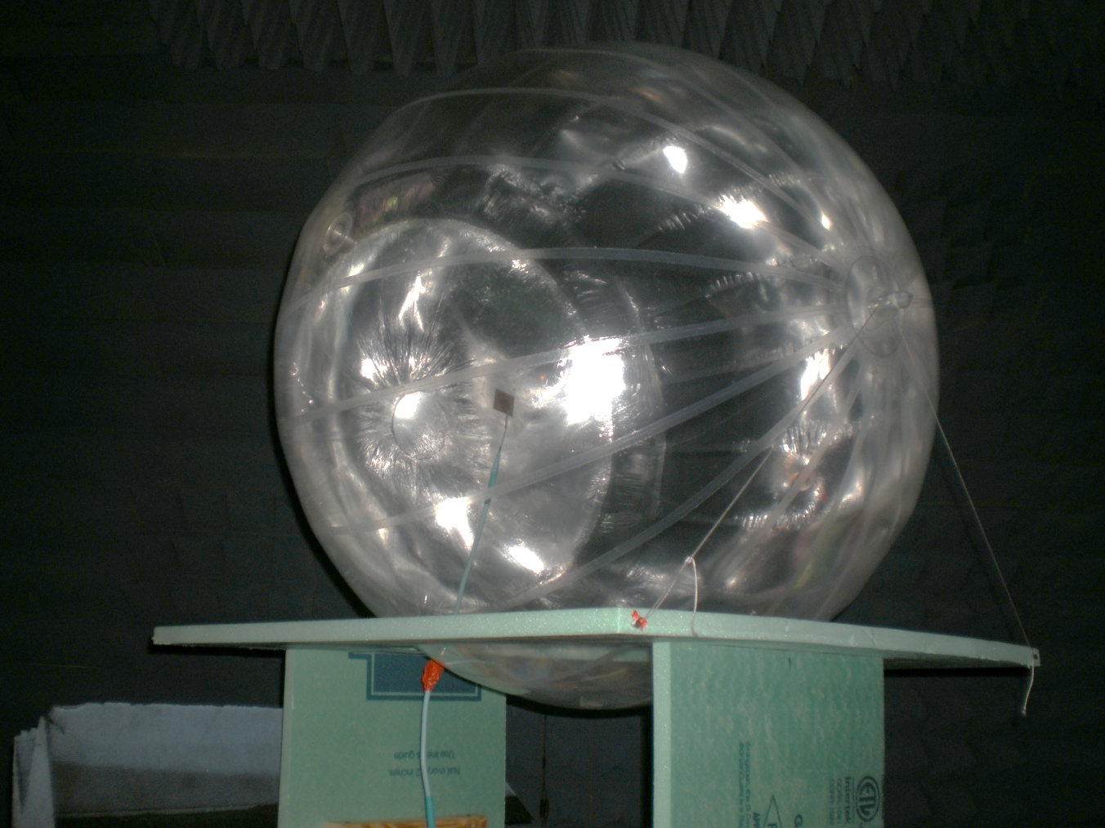
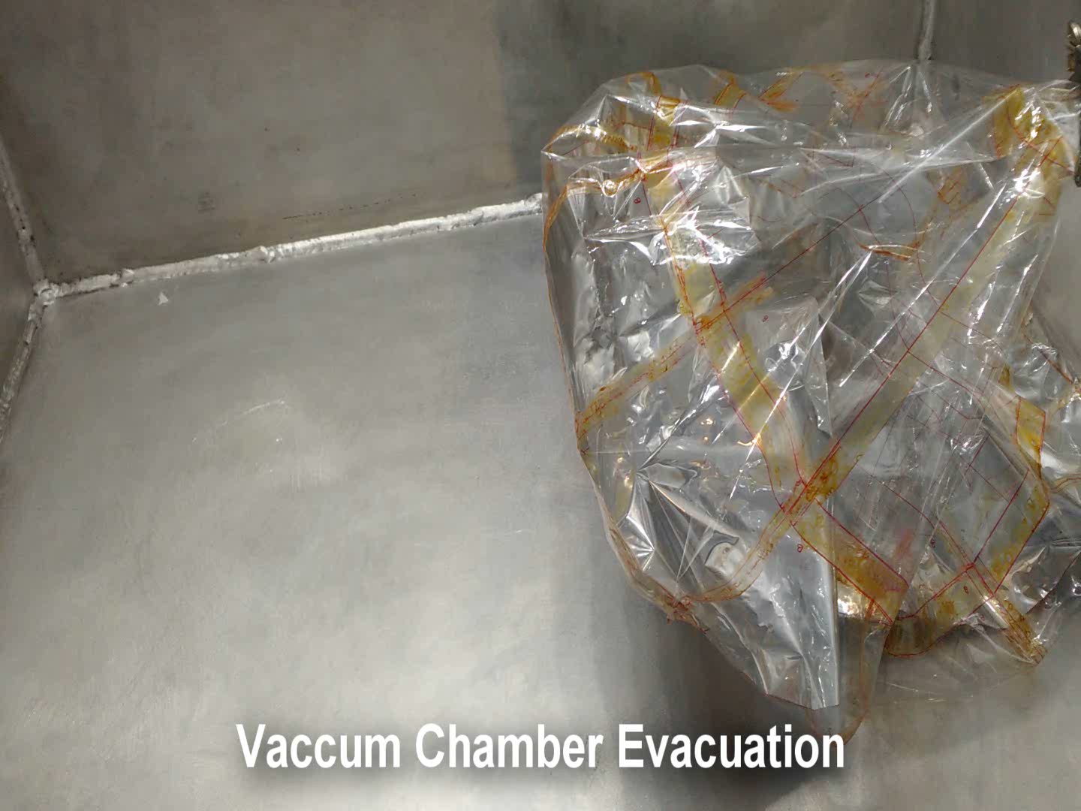
Inflatable Sphere antenna (X-Band design)
A prototype for an inflatable antenna has been developed at JPL
The antenna is a 1m sphere, functional for the X-Band , producing an approximate gain of 31 dB (experimentally measured) for a reflective surface of 70 cm in diameter
Inflation is achieved with sublimating powder (benzoic acid) which allows for a very compact design with no pressure tank and only few grams of powder (approximately 1 gram per year of mission life)
To counteract deflation due to thermal fluctuation and/or micrometeoroid puncturing, a system of rigidization is under development using UV pockets which rigidize with sunlight. An experiment in vacuum chamber is shown in the video
This work was supported by JPL R&D and NASA Center Innovation Fund grants
Spherical prototype of the inflatable antenna
Babuscia, Sauder, Bienert, Chandra, Thangavelautham, Feruglio,” Inflatable Antenna for CubeSats: A New Spherical Design for Increased X-Band Gain”, IEEE Aerospace Conference, Big Sky (MT), 2017.
Rigidization experiment
Pre-Decisional Information -- For Planning and Discussion Purposes Only

Slide 12
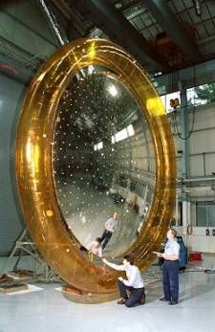
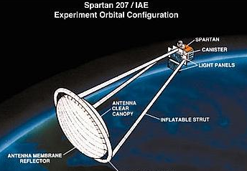
Combined Solar Reflector/High Gain Antenna Configuration is Based on a
1997 Tech Demo
1997 Spartan 207 tech demo to deploy a large reflector with high enough surface accuracy for RF use. L’Garde developed and implemented a capability to mathematically calculate gore shapes, bond segments together, and inflate.
“All the experiment objectives were met with the exception of the inflation of the lenticular reflector structure.” This lenticular construction was to create the surface shape of the aluminized antenna membrane reflector surface, opposed by the antenna clear canopy that together were to enclose the inflated volume.
Thus, no measurement was made in space of the surface accuracy.
Ground testing led to “expected to be on the order of 1 mm rms…”
~5 m
Robert Staehle. 2020/1/22

Slide 13
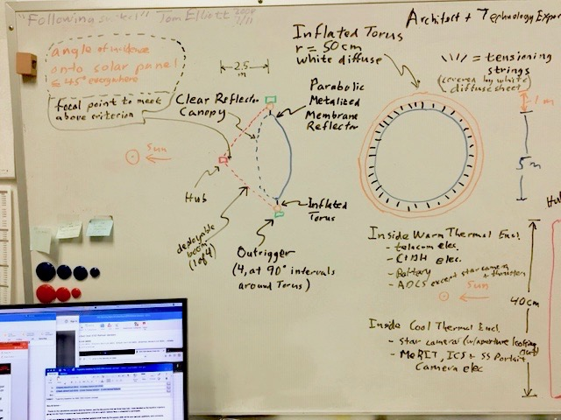
From real Tech Demo to conjecture for a different application...
Orientation shown for outer Solar System cruise.
S/C spins 1-2 rpm (guessing) around axis linking Hub and center of Parabolic Metalized Membrane Reflector.
For telecom passes (weekly to monthly), spin axis is precessed from Sun-point to Earth-point, then back after pass.
Robert Staehle. 2020/1/8
Pre-Decisional Information -- For Planning and Discussion Purposes Only

Slide 14
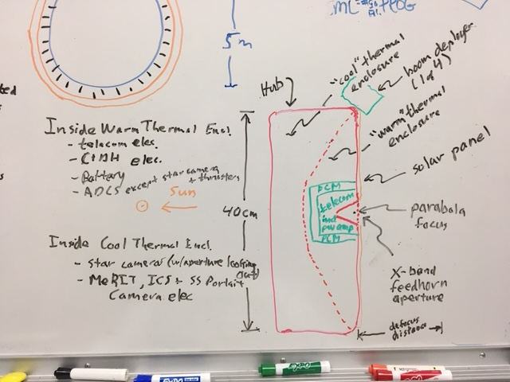
The “Hub” is where most of the operating equipment lives, in relative warmth...
Robert Staehle. 2020/1/8
Pre-Decisional Information -- For Planning and Discussion Purposes Only

Slide 15
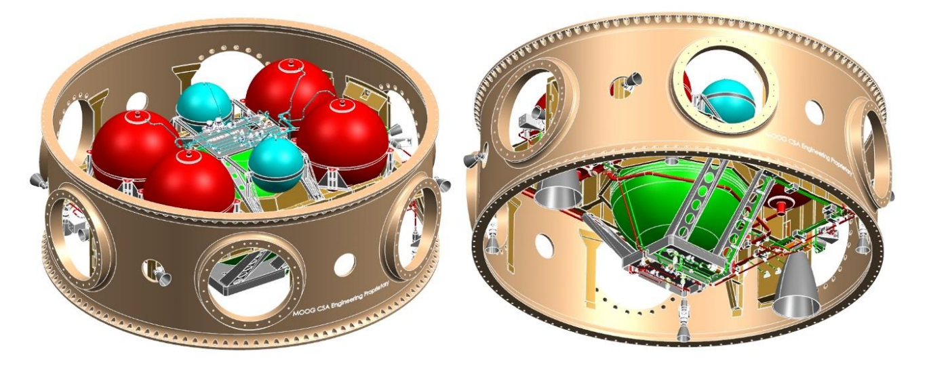
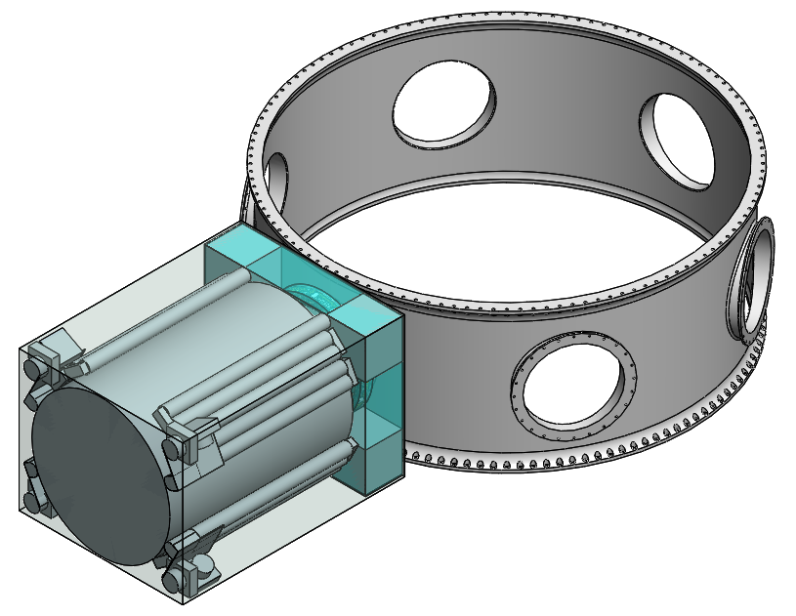
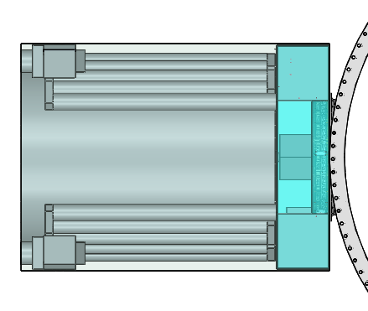
OS4 Hub, Stowed Parabolic Metalized Membrane Reflector, and ESPA Ring
(Inner Solar System Solar Panels not shown)
Moog: used with permission
Marc Lane/Team Xc
2020/1/24
Pre-Decisional Information -- For Planning and Discussion Purposes Only

Slide 16
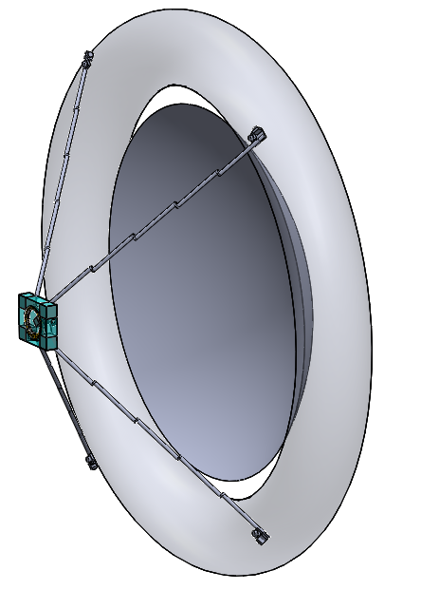
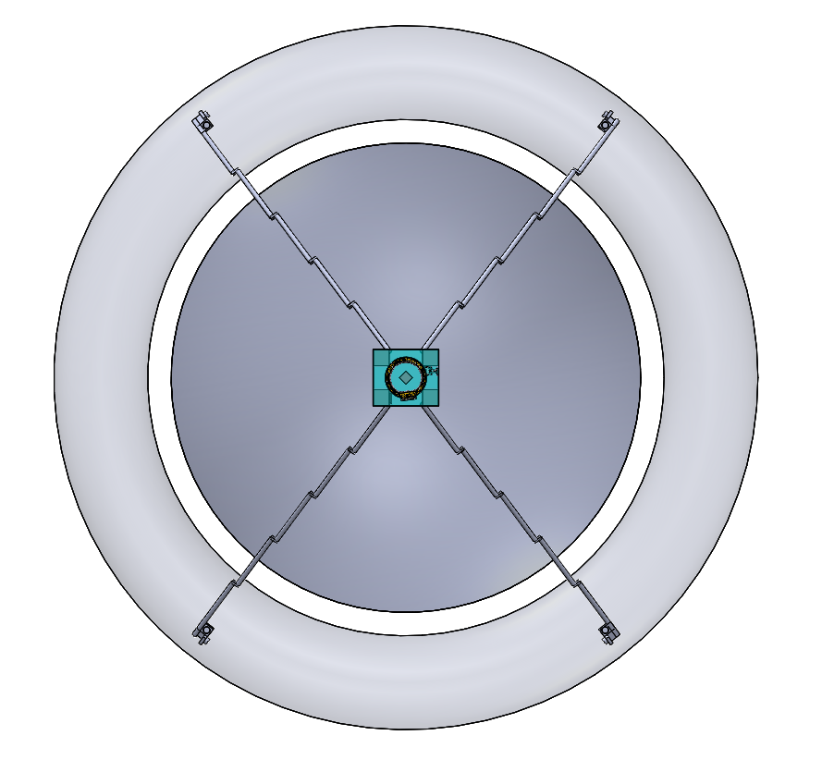
Deployed Parabolic Metalized Membrane Reflector, Torus, and OS4 Hub
5 m
Pre-Decisional Information -- For Planning and Discussion Purposes Only
Nicholas Bonafede/CalPoly-SLO, 2020/1

Slide 17
OS4 configuration
The 5-meter diameter inflatable would be composed of a Parabolic Metalized Membrane Reflector, Clear Canopy, diffuse Torus support, and tensioning straps.
  UV-rigidized after inflation with sublimate.
Extendable booms would provide support and facilitate deployment.
Small pulsed plasma thrusters (PPT) for attitude control would be mounted on four thruster modules at the end of the booms on the Torus.
Hub would contain avionics as well as providing support for the 60-cm diameter concentrated solar array/high gain antenna feed, optical diffuser, and radiator.
  Hub is well insulated with multiple MLI blankets and thermal switches.
Nicholas Bonafede/CalPoly-SLO, 2020/1
Pre-Decisional Information -- For Planning and Discussion Purposes Only

Slide 18
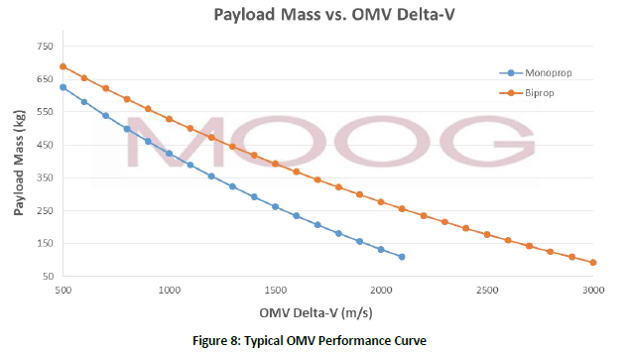
Rideshare and deployment
Propulsive ESPA Ring could perform the 200-1000 m/s trajectory correction burn in the first 30 days of the mission.
Propulsive ESPA would be more than capable of providing the necessary delta-V for OS4 (estimated at 217kg).
OS4 would separate from Propulsive ESPA after final Jupiter targeting maneuver.
Images from “Extending Rideshare: Mission Case Studies Using Propulsive ESPA”
By Marissa Stender, Chris Loghry, Chris Pearson, Eric Anderson, and Joseph Maly of MOOG, April 12, 2015
https://www.spacesymposium.org/wp-content/uploads/2017/10/C.Pearson_31st_Space_Symposium_Tech_Track_paper.pdf
Pre-Decisional Information -- For Planning and Discussion Purposes Only

Slide 19
Proposed Operations Concept
OS4 would rideshare as an ESPA ring secondary payload on a primary mission trajectory to Jupiter.
Within the first 30 days, a maneuver would be performed by the propulsive ESPA ring to target the OS4 flyby timing to optimize “slingshot” momentum exchange for faster trajectory to 30+ AU.
(Primary mission’s launch assumed optimized for Jupiter orbit insertion.)
OS4 would inflate the Parabolic Metalized Membrane Reflector and Torus, extending the booms, and then spin stabilize.
After the flyby, OS4 would enter a monthly data collection and communications cycle.
  Charging mode
  Magnetometers and Plasma Sensor readings for 15 minutes, 12x/month
  Dust cameras 15 minutes, 3x/month
  One 8-hour telecom pass
    2 hour slew from Sun-pointing to Earth-pointing before pass and vise-versa after pass
The mission would last 12 years to Neptune’s orbit.
Pre-Decisional Information -- For Planning and Discussion Purposes Only

Slide 20
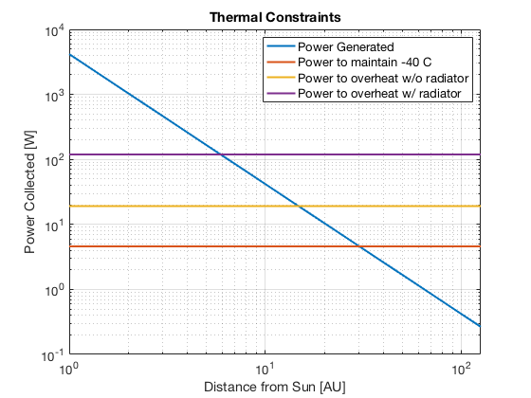
“Cold Case”
Without radioisotope power, the spacecraft would get very cold in the Outer Solar System.
With technological advancements, -40° C is assumed the lower bound for batteries and other avionics. (Might be improved to <~-60 C)
With Double Stack MLI, 4.6 W of continuous power would be needed.
Phase change material would capture waste heat from the transmitter and redistribute it evenly over the duty cycle of the spacecraft between telecom passes.
Power generated by the solar panels as the blue line decreasing over distance. The orange line shows the 3.6W of continuous thermal power lost. The intersection of the lines shows the maximum range.
Nicholas Bonafede & Sydney Retzlaff/CalPoly-SLO, 2020/1
Pre-Decisional Information -- For Planning and Discussion Purposes Only

Slide 21
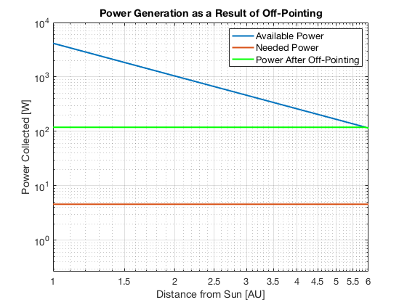
“Hot Case”
During the Inner Solar System Cruise phase, the spacecraft would risk overheating from the solar energy concentrated by the inflatable.
In order to avoid this, the spacecraft must not point directly at the Sun until 16 AU (yellow line in the graph), but a 100 W radiator (purple line) brings this down to ~6AU.
Thermal switches would be used to thermally isolate the radiator for the cold case.
Jupiter Flyby
Nicholas Bonafede & Sydney Retzlaff/CalPoly-SLO, 2020/1; Maya Gordon/CalPoly-SLO, 2020/5
Pre-Decisional Information -- For Planning and Discussion Purposes Only

Slide 22
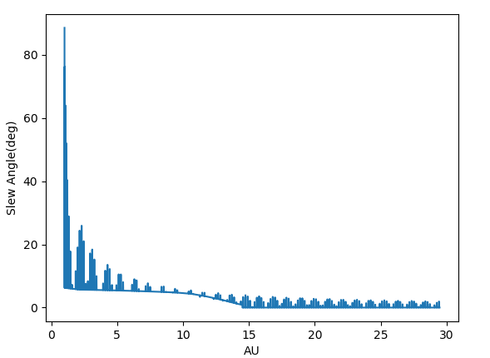
Attitude Pointing On- and Off-Sun (ROM illustration)
Slew angles to track the sun throughout the mission (including keep-out zone).
  This assumes a straight, constant velocity trajectory.
This would total 450 hours of slew time (after 1.25 AU).
Liam Mages/CalPoly-SLO, 2020/1
Pre-Decisional Information -- For Planning and Discussion Purposes Only

Slide 23
Extending operational distance:
A balance between thermal regulation, power draw, and configuration
Team Xc study concluded that a goal of 30 AU could be achievable, but it may be possible to extend the maximum distance.
Preliminary calculations show that replacing the MLI with a more insulated system such as a dewar could get OS4 to 44AU.
  This would increase mass
At that point, power is the limiting factor. If power draw can be cut down, the spacecraft could theoretically reach 60 AU.
  Must assume that the thrusters require no heating power in addition to other power cuts
To get to the heliopause at 125 AU, in addition to the above assumptions, the dish would have to be 10.5 m in diameter.
  No longer a SmallSat, reducing ride-share opportunities
Pre-Decisional Information -- For Planning and Discussion Purposes Only

Slide 24
?Affordably start on a path to explore the outer Solar System with SmallSats a decade from now?
Questions…
Thank you!
Robert Staehle, robert.l.staehle@jpl.nasa.gov
+1 818 967-1750 or +1 626 798-3235
Cole Gillespie, ctgilles@calpoly.edu
Pre-Decisional Information -- For Planning and Discussion Purposes Only

Slide 25
Backup Material

Slide 26
Some modern low-power electronics
Ultra Low Power IoT Microcontroller Families
Series | Vendor | Grade | Architecture | Sleep Power (mW) | Active Power (mW) | min temp active ºC | max temp active ºC
PIC32MX2 | Microchip Technologies | Commerical | RISC_V-32 | 0.297 | 165 | -40 | 85
AtmegaS128 | Atmel | Space Grade | AV-RISC-32 | 0.0825 | 36.3 | -55 | 125
SAM L11 | Microchip Technologies | Commerical | ARM/Cortex | 0.00165 | 2.64 | -40 | 125
Atmega328P | Atmel | Automotive | AV-RISC-32 | 0.00495 | 6.6 | -55 | 125
SAM D | Microchip Technologies | Commerical | ARM/Cortex | 0.14256 | 14.19 | -40 | 125
Adrian Tang/386 2019/9/14
Pre-Decisional Information -- For Planning and Discussion Purposes Only

