Slide 1
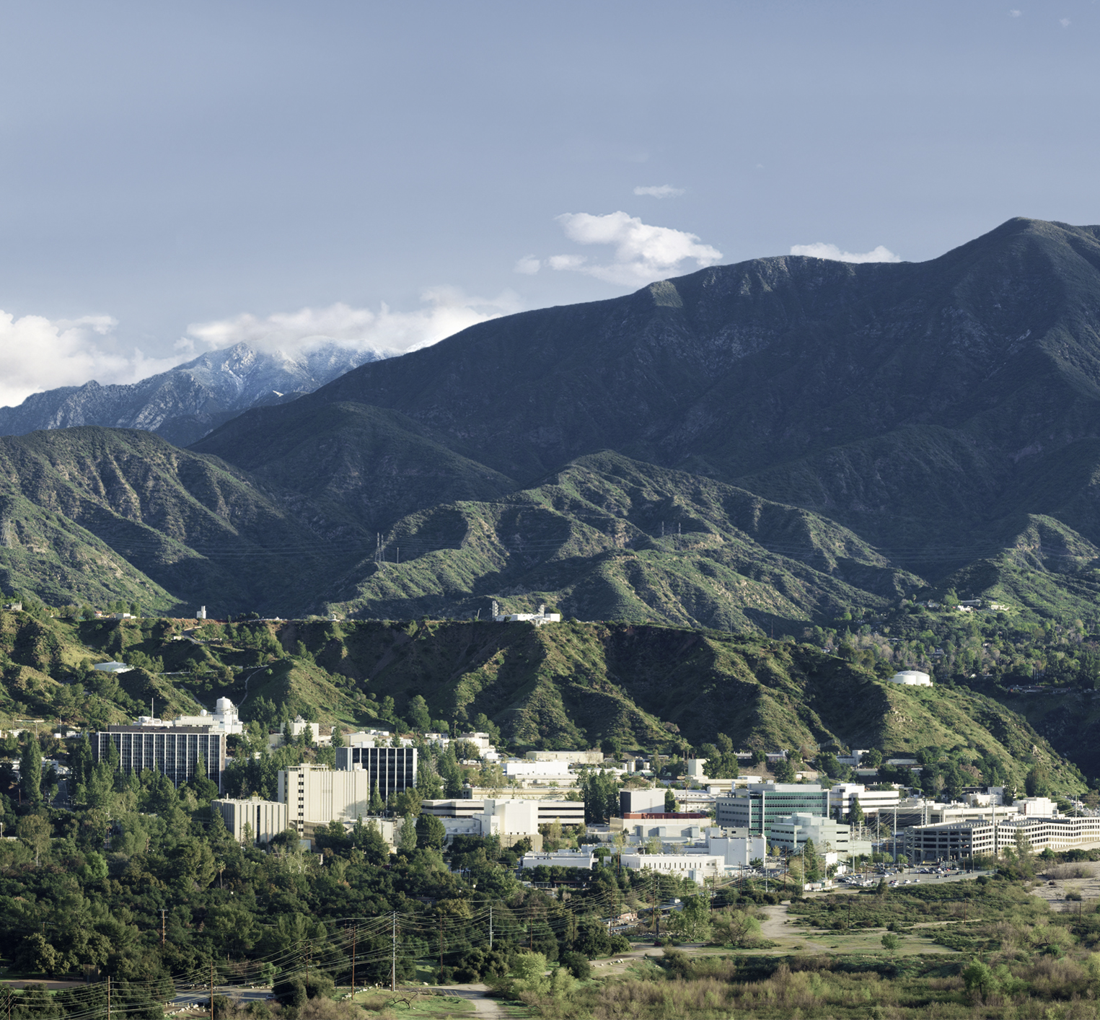
2020 Interplanetary Small Satellite Conference
Thermal Toolbox Elements for Lunar/Planetary Extreme Environments
D. Bugby, J. Rivera
11-12 May 2020
Approved for Unlimited Release

Slide 2
PROBLEM
Science Payload Thermal Control in Extreme Environments
We want to use one of these ...
Carrying one or more of these …
To operate and stay within temperature limits, in Extreme Environments such as these …
Using a thermal control architecture that is …
Rover
Lander
Orbiter
Flyer
Airship
Science
Payload (PL)
253-313 K
Moon (100-380 K, Vac)
Mars (148-293 K, Non-Vac)
Europa (53-113 K, Vac)
Titan (90-94 K, Non-Vac)
Io (105-123 K, Vac)
Venus 70-30 km (173-473 K, Non-Vac)
Low Power
Lightweight
Passive
Compact
Reliable
Affordable
Radioisotope-Free
Extreme Environment operability/survivability
requires 4 improved thermal toolbox elements …
EXTREME
ENVIRONMENT
THERMAL
TOOLBOX
3
1
2
1 – PASSIVE THERMAL SWITCHING SYSTEMS
PL
RAD
ENV
2 – LOW SINK TEMPERATURE RADIATORS
4
3 – LOW EFFECTIVE EMISSIVITY MLI
UV + IR
4 – LOW CONDUCTANCE THERMAL ISOLATORS
CARRIER

Slide 3
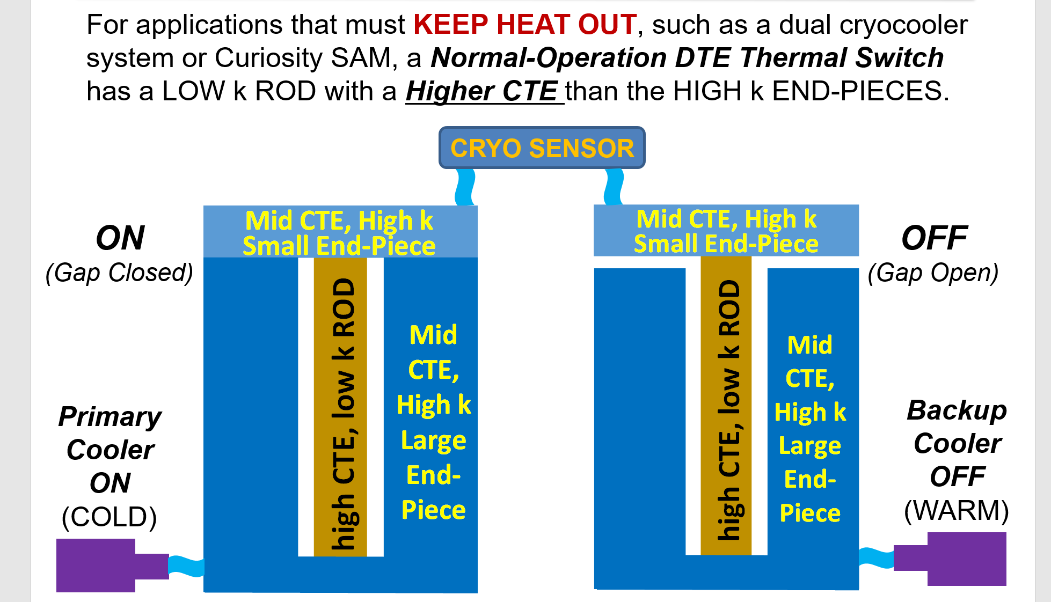
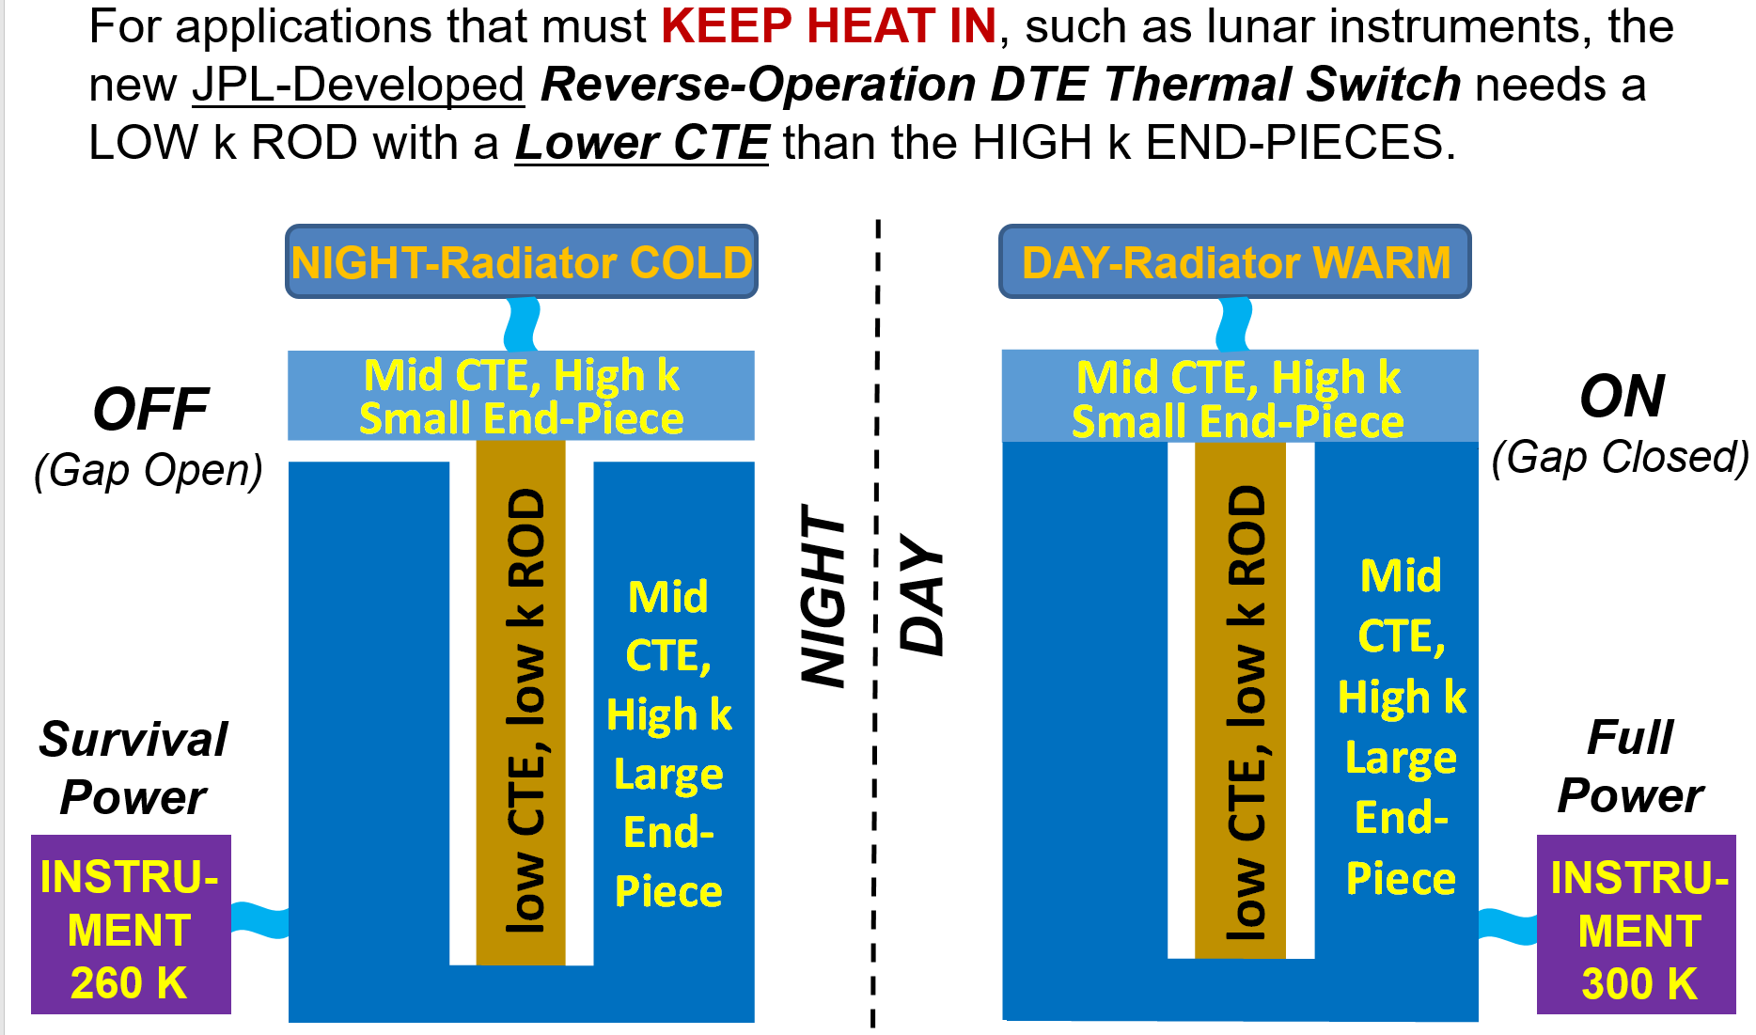
1 – PASSIVE THERMAL SWITCHING
Differential Thermal Expansion (DTE) Actuation
Normal-Operation
Reverse-Operation
Swales Aerospace 2002
Flown on Mars Curiosity SAM Instrument in 2012
SAM thermal switch launched closed at room temp
Typical normal-op design has open gap at room temp
Vibration test at JPL in 2016 reduced ON conductance
JPL 2017
Advanced to TRL6 in 2018 (vibe test OK)
Integral to JPL internal initiative called ARTEMIS
Integral to NASA GCD Project called PALETTE
Two units to fly on Astrobotic Peregrine lander

Slide 4
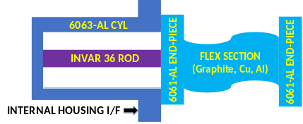
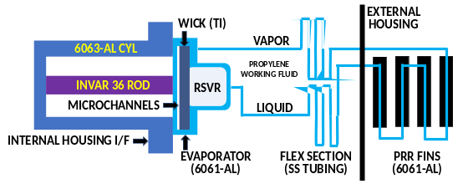
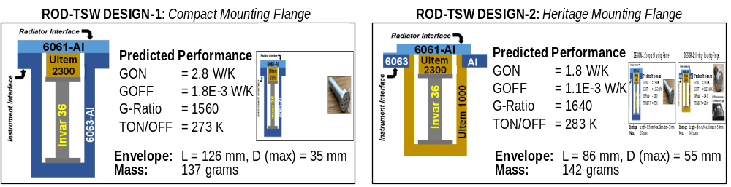
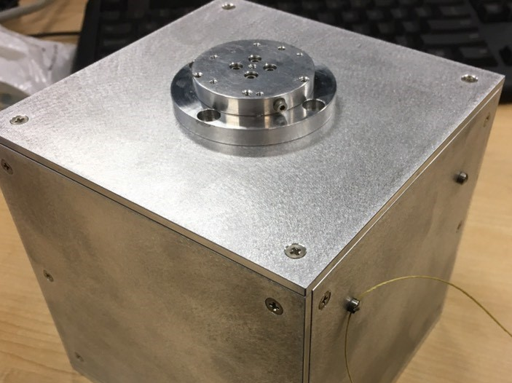
1 – PASSIVE THERMAL SWITCHING (cont’d)
Hyper-Isolative Passive Thermally-Switched Architectures
A. Dual Thermal Switching Enclosure with Reverse-Operation DTE Thermal Switches (ROD-TSWs)
B. Dual Thermal Switching Enclosure with Combined ROD-TSW, Mini Loop Heat Pipe (mini-LHP)
PALETTE NASA GCD New Idea
PALETTE NASA GCD New Idea
SCIENCE
PAYLOAD

SCIENCE
PAYLOAD




●
●
❍
❍
LEGEND
 Thermal Switch
 Radiator (PRR)*
● Kevlar Cables/MLI*
❍ Thermal Isolator*
* shown later
Measured Performance
GON = 5 W/K
GOFF = 0.002 W/K
G-Ratio = 2500
TON/OFF = 273 K
Measured Performance
GON = 5 W/K
GOFF = 0.002 W/K
G-Ratio = 2500
TON/OFF = 283 K

Slide 5
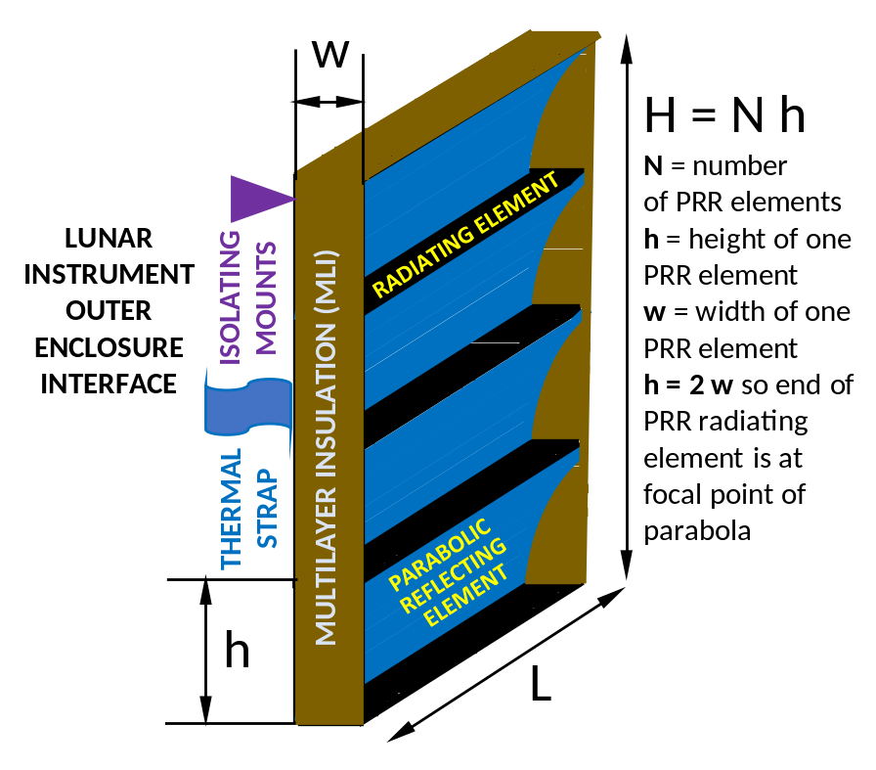
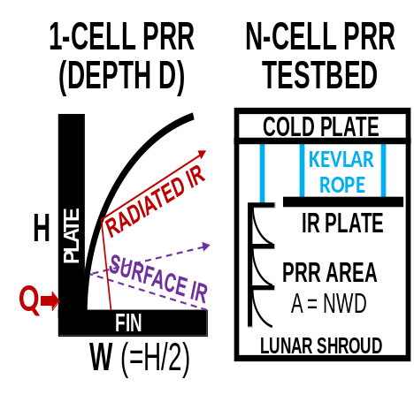
2 – LOW SINK TEMP RADIATORS
Parabolic Reflector Radiators (PRRs) Provide Low Sink Temperature
→
y
y = (4Wx)^{0.5}
x →
Fin Edge
at Parabola
Focal Point

Slide 6
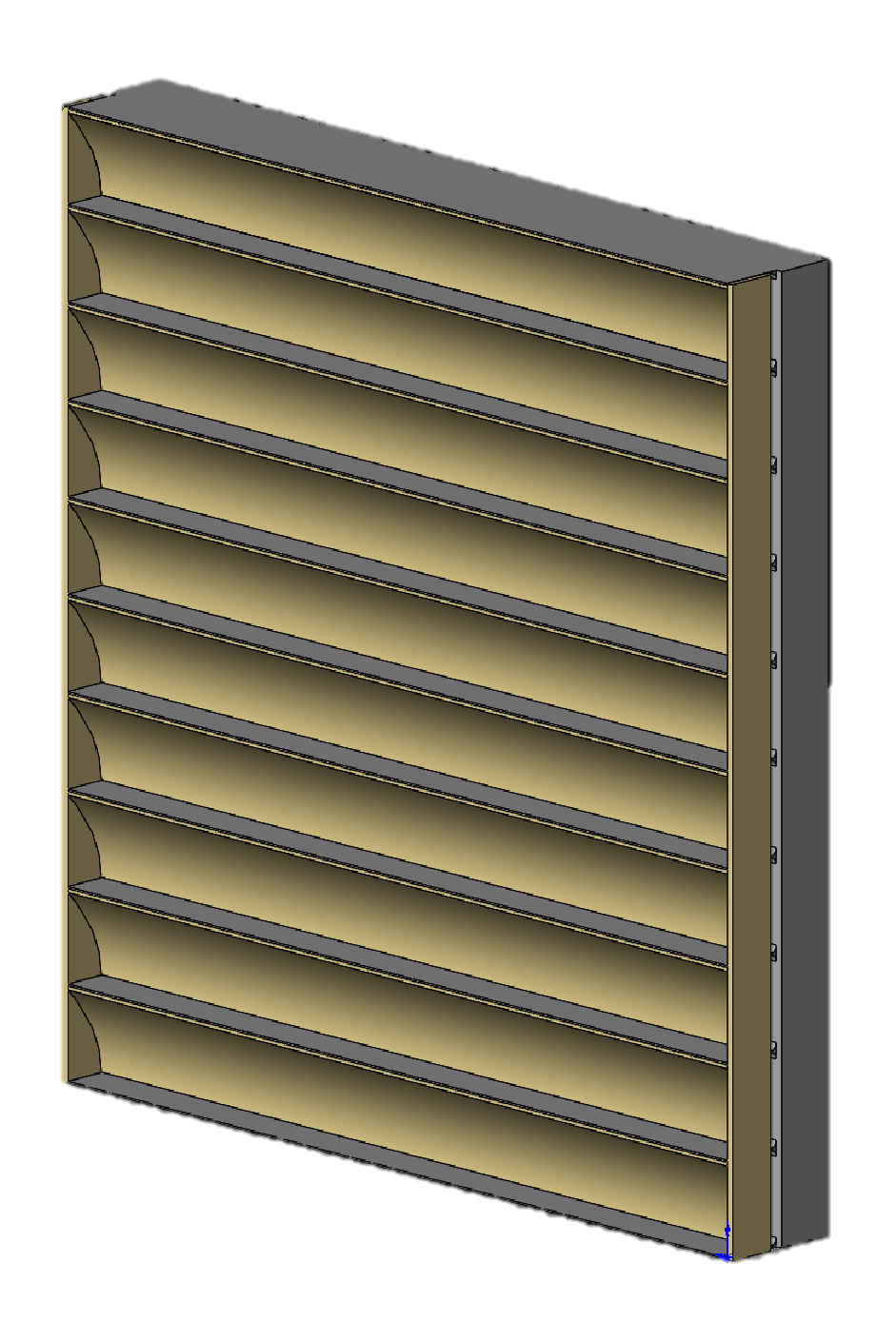
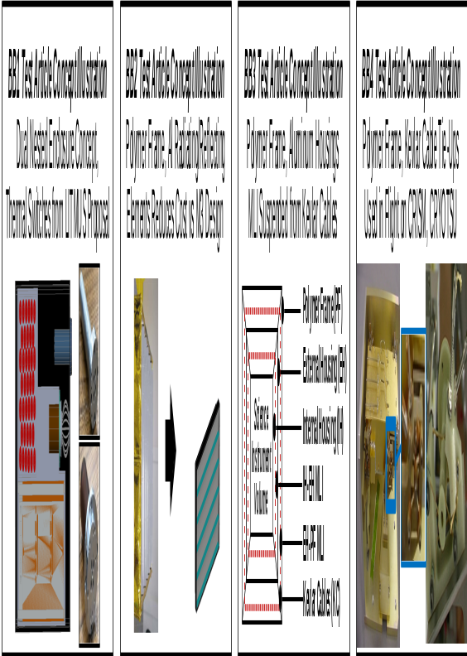
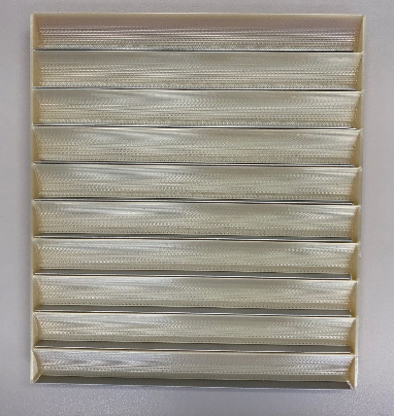
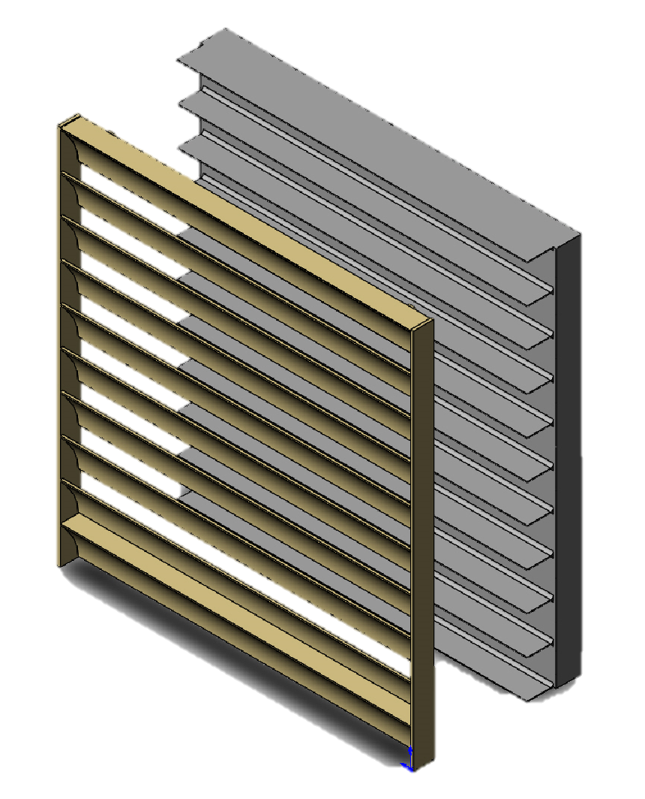
2 – LOW SINK TEMP RADIATORS (cont’d)
3D-Printed PRRs Reduce Fabrication Costs, Provide Low Sink Temp
M3 Cryogenic PRR Cost >> $100K
Ambient PRR to Cost << $20K
2-Piece
Ambient PRR
Design Fully
3D-Printable
Aluminum
Radiator
Plate/Fins
Ultem 1000
Reflector
Array

Slide 7
3 – LOW EFFECTIVE EMISSIVITY MLI
MLI with Spacers Typically has ε* >> 0.02 despite Al-Mylar ε_{Al} = 0.03 on Both Sides
ε* L Q_{LOSS} / [σ A (T_{S}⁴ – T_{E}⁴)] vs ε_{MIN} ~ ε_{Al} / N
N Layers
(5 – 40 typical)
Science
Instrument
at T_{S}
MLI
Environment
at T_{E}
Double-Sided Aluminized Mylar
Dacron Mesh Spacer

Slide 8
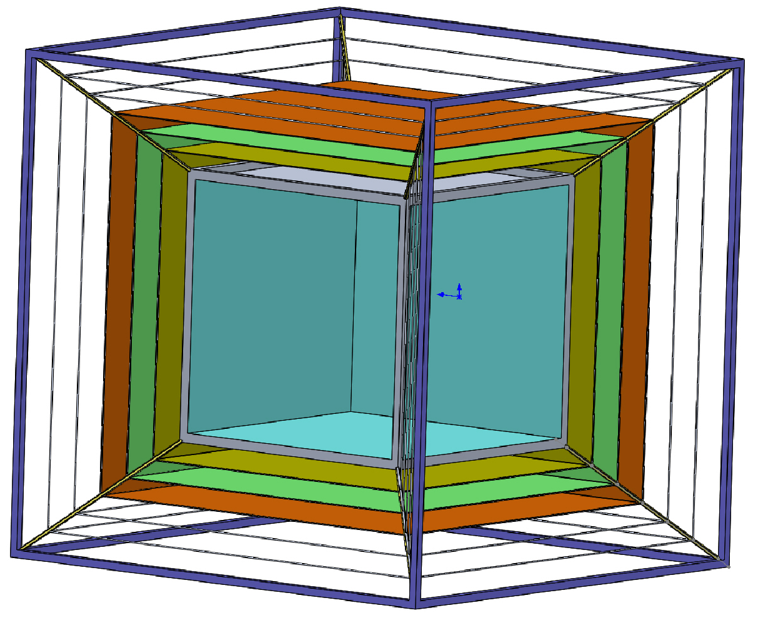
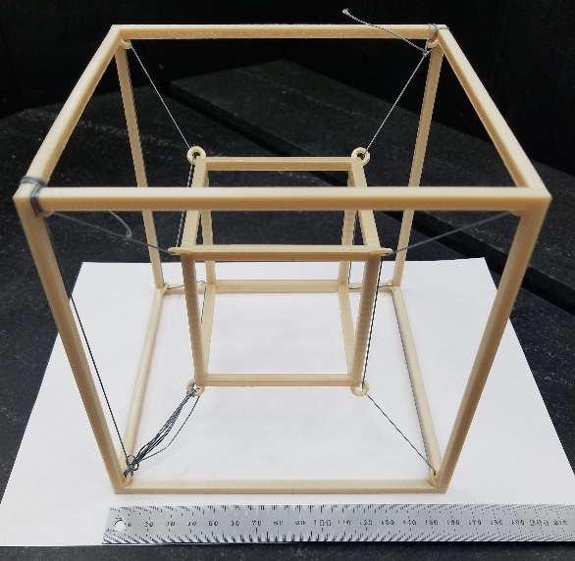
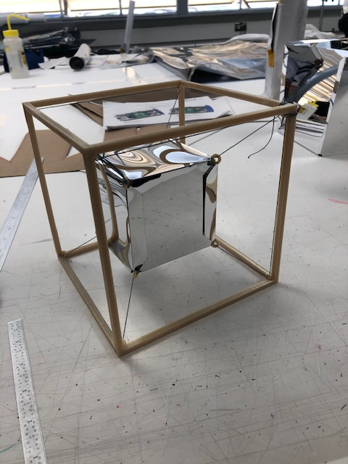
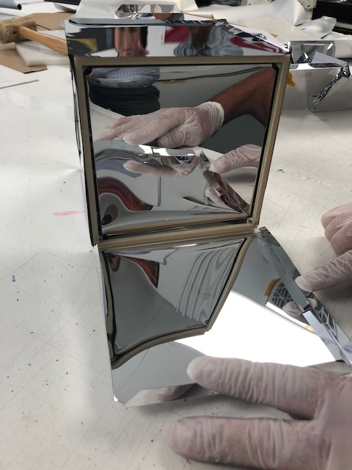
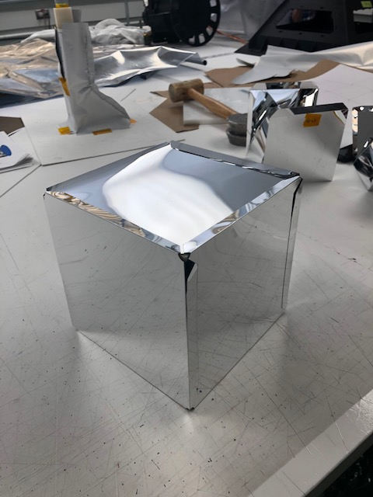
3 – LOW EFFECTIVE EMISSIVITY MLI (cont’d)
“Spacerless” MLI Construction: Performance Target ε* << 0.01
Rigid Exterior Frame/Structure
Spacerless MLI Demo Unit to be
Tested When JPL Reopens
Kevlar Tension
Cables Provide
Rigid Support to
External Loads
Science
Instrument
MLI Layers
Supported by
Kevlar Cables
(No Spacers)

Slide 9
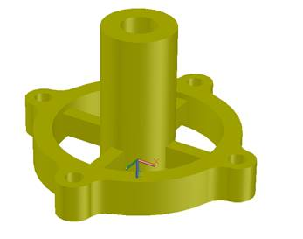
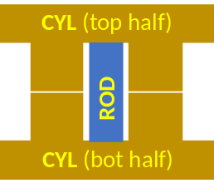

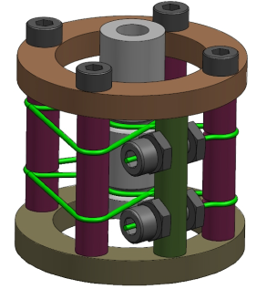
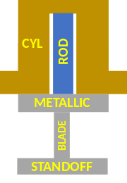
4 – LOW G THERMAL ISOLATORS
Concepts to Outperform Blade Flexures: Performance Target is G << 0.001 W/K
3D-Printable
Ultem 1000
Thermal Isolator
ROD-TSW Based
Thermal Switching
Isolator Concept 1
Notional Metallic
Blade Flexure
Thermal Isolator
Science
Instrument
Kevlar Tension
Cable Supported
Thermal Isolator
ROD-TSW Based
Thermal Switching
Isolator Concept 2

Slide 10
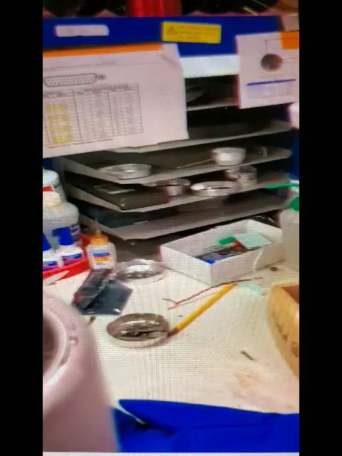
SUMMARY / FUTURE WORK
Operation and survival in extreme environments like the moon (without radioisotopes) requires an improved thermal toolbox.
JPL is currently using internal funds to develop thermal enclosure designs for stand-alone solar/battery-powered lunar magnetometers, seismometers, and IR spectrometers.
In parallel, JPL was recently awarded a 3-year project (PALETTE) by NASA GCD program office to develop advanced thermal toolbox elements for future instruments operating in extreme (planetary/lunar) environments.
PALETTE intends to provide thermal engineers with a full “palette” of TRL6 or higher thermal toolbox elements, focusing on: 1-enclosures; 2-radiators; 3-insulation/MLI; 4-thermal isolators; 5-gimbals; 6-thermal switches; 7-thermal transport devices; 8-thermal storage devices; 9-deployables/antennae; and 10-low heat loss feed-throughs.
Work on PALETTE is just getting started and work on the internal JPL program (known as ARTEMIS-T) is midway through the first year of a 3-year project.
JPL also working on Extended Stroke ROD-TSW for non-vacuum and vacuum environments using DTE between Ultem 1000 and (negative CTE) Allvar … movie shows large 2 mm gap formed when demo unit partly submerged in LN2
Extended Stroke ROD-TSW Demo Unit Creates 2 mm Gap When Partly Submerged in LN2
(1-Minute Movie)

Slide 11
ACKNOWLEDGMENTS
Kevin Anderson
Garry Burdick
Pamela Clark
Mike Dombrower
Dave Eisenman
John Elliott
Sabrina Feldman
Gani Ganapathi
Doug Hofmann
Chris Hummel
Tri Huynh
Bob Kovac
Ying Lin
Virgil Mireles
Mason Mok
Stefano Morellina
Tim O’Donnell
Bart Patel
Hung Pham
Chuck Phillips
Rob Staehle
Kris Stone
Eric Sunada
The authors would like to thank the following JPL managers and engineers for their help in conducting this work. A portion of this work was funded internally by JPL and a portion was funded by a recently awarded 3-year project managed by the NASA Game Changing Development (GCD) program office at NASA Langley Research Center (LaRC) entitled “Planetary and Lunar Environment Thermal Toolbox Elements” or PALETTE.

