Slide 1

Compact Quadrupole Ion Trap (QIT) Mass Spectrometers for Space Applications
F. Maiwald, J. Simcic, D. Nikolic,
A. Belousov, P. Willis, and S. Madzunkov
National Aeronautics and Space Administration
Jet Propulsion Laboratory
California Institute of Technology
URS291939

Slide 2
Content
Air Monitor for Human Space Explorations
  Requirements
  Quadrupole Ion Trap Mass Spectrometer (QIT-MS)
  MEMS Gas Chromatography Components
  Results on ISS
Compact QIT-Mass Spectrometer for Lunar and Planetary Applications
  TRL status of hardware
  Lunar Exospheric Composition
  Requirements
  Results in Laboratory
Ocean Worlds Life Surveyor (OWLS)
  Laboratory Prototypes
  Requirements
Conclusions

Slide 3
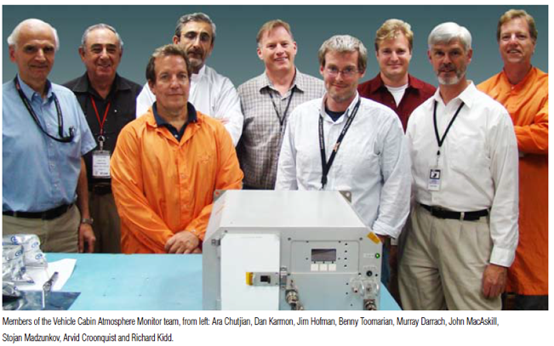
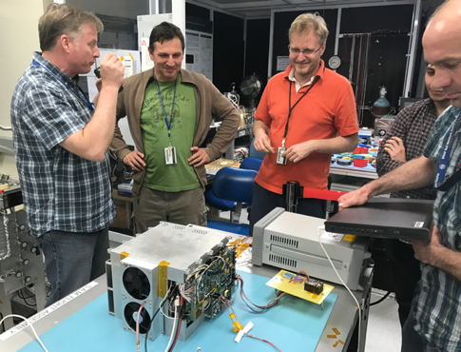
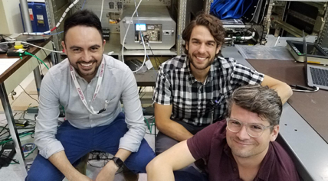
Development of Air Monitor for Human Space Explorations
NASA instrument and JPL strategic funding for:
  GC-QIT-MS for major constituent analyses (MCA) and trace gas analyses (TGA) for ISS cabin health monitoring
    VCAM and S.A.M.
  ESI-QIT-MS for exploring ocean worlds
QIT-MS with applications driven by sample input
  Significant reduction in mass, power, volume, and data rate over past decade
  Focus on TRL enhancement for flight applications and transition to commercialization
MCA (Major Constituent Analysis) with 2 sec updates and fraction of a percent error (performance checkout underway)
TGA (Trace Gas Analysis) with daily 20 minutes runs, down to 10-1000ppb
Dynamic range TGA 3x10⁴
M. Darrach, S. Madzunkov, E. Diaz, B. Moore, R. Kidd, B. Bae, J. Simcic, S. Schowalter, R. Purcell, I. Cisneros, R. Schaefer, F. Cheung, K. Reichenbach, T. Loc, J. Lam, A. Oyake, D. Nikolic, R. Murdock
Vehicle Cabin Atmosphere Monitor (VCAM) ISS deployment in 2010
Funded by NASA AEMC
Spacecraft Atmosphere Monitor (S.A.M.) ISS power on in August 2019
Funded by NASA AEMC & AES

Slide 4
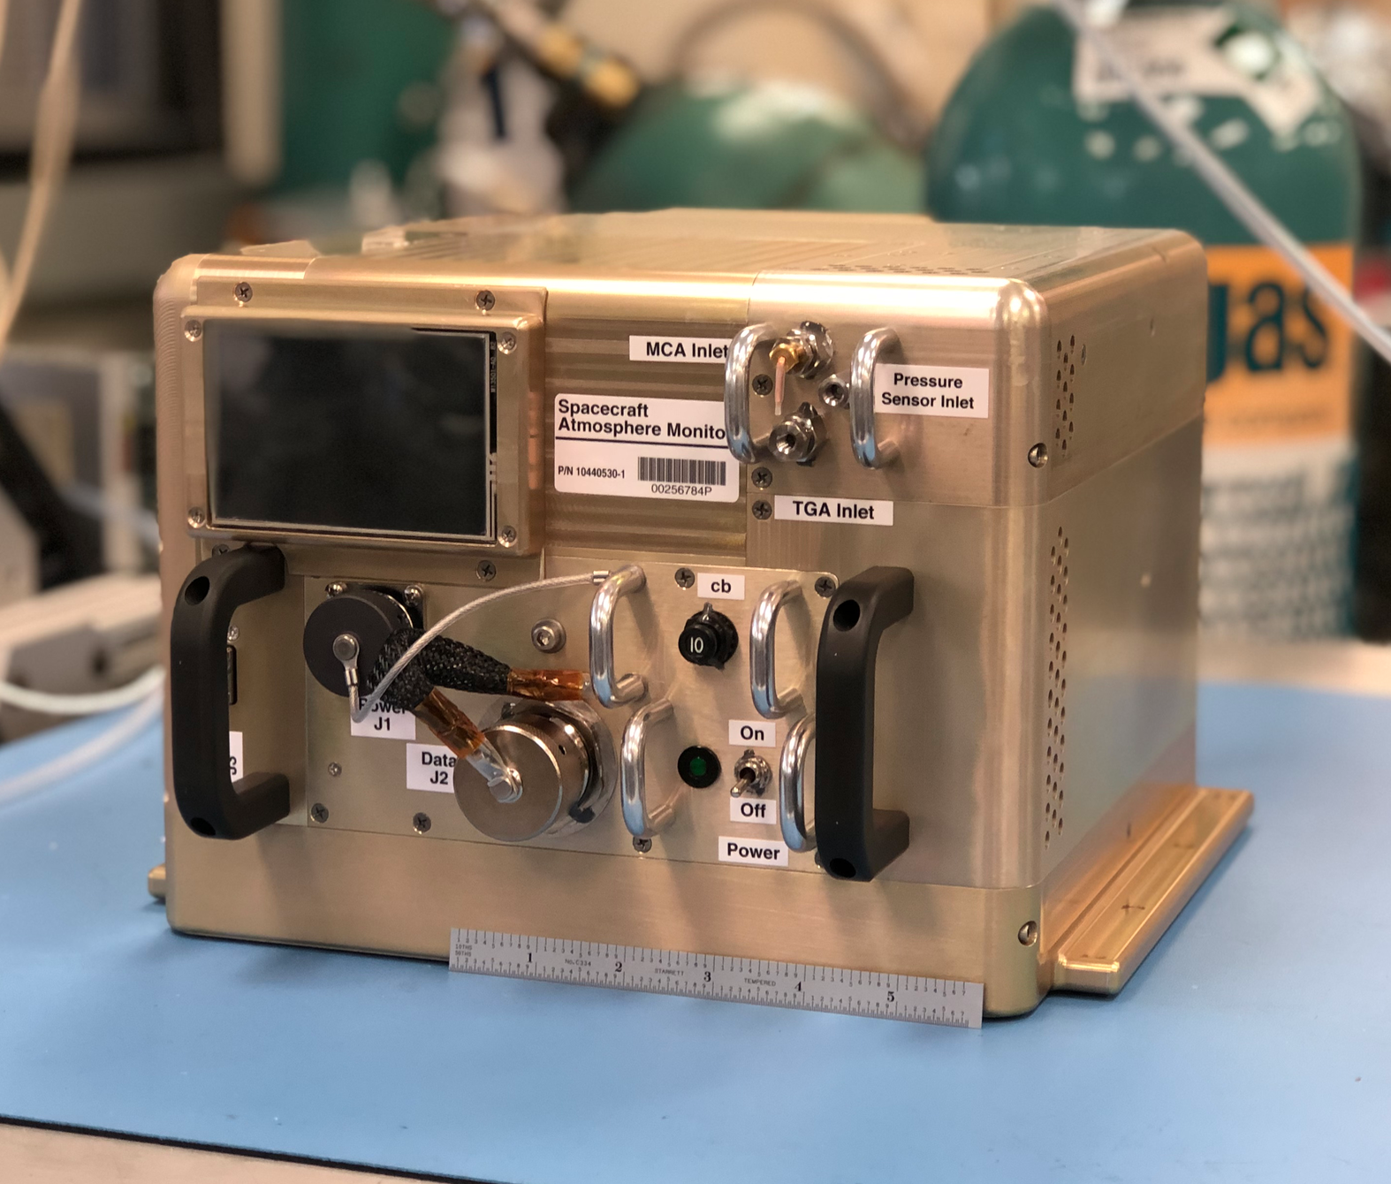
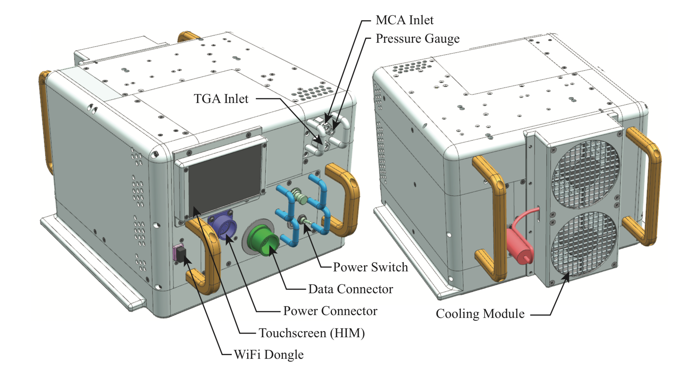
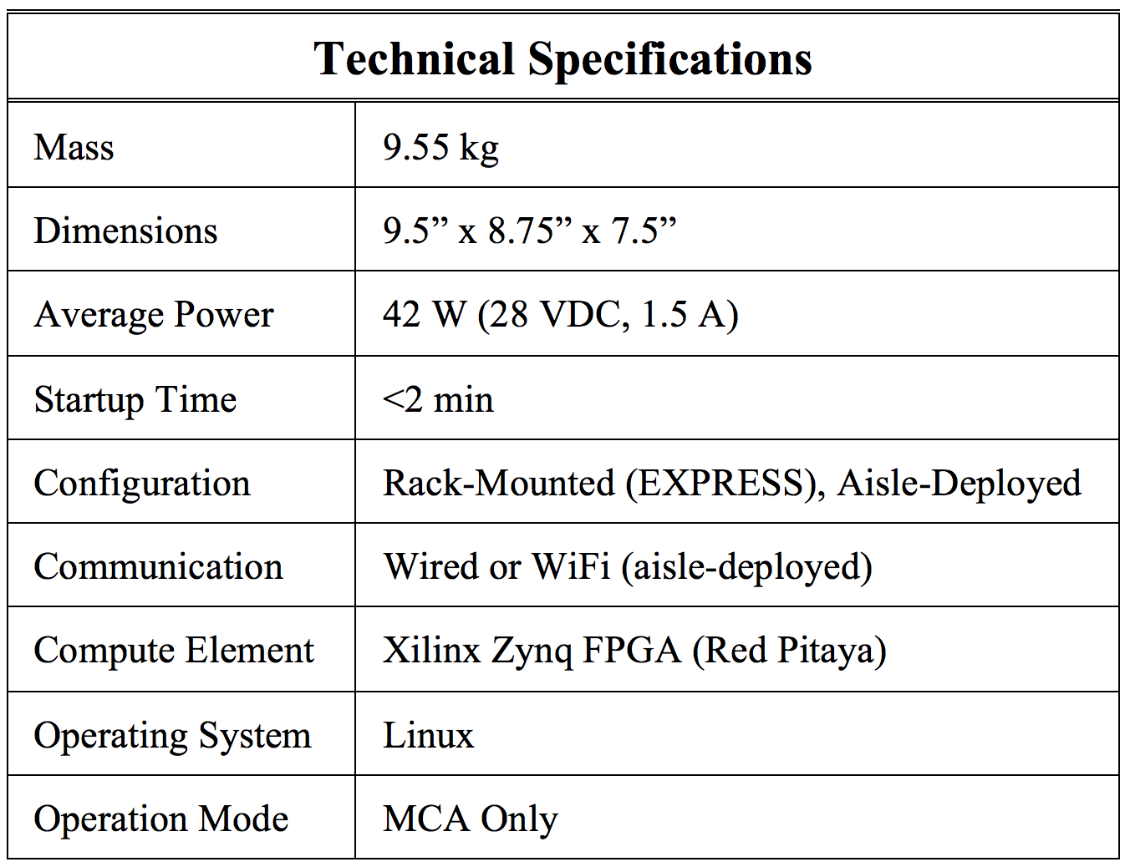
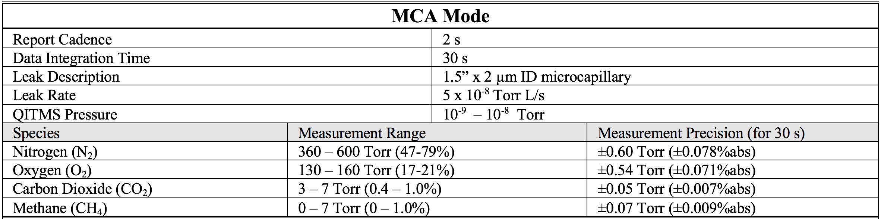
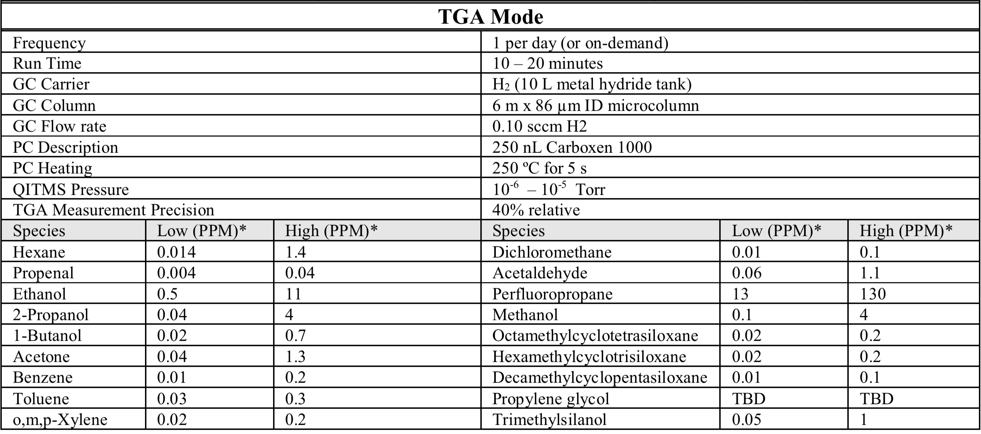
Spacecraft Atmosphere Monitor (S.A.M.) Major Requirements
Cooling Unit
S.A.M. Status
TDU#1 in operation on ISS since Sep. 2019
TDU#2 in development for planned delivery by the end of 2020 (depending on COVID19)

Slide 5
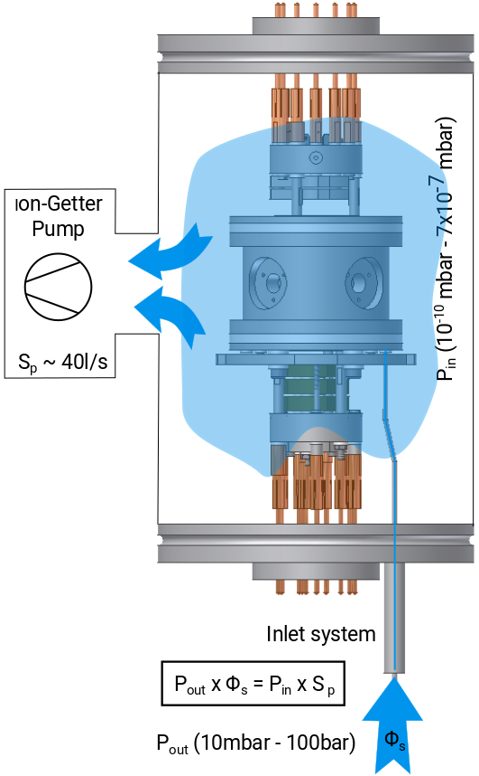
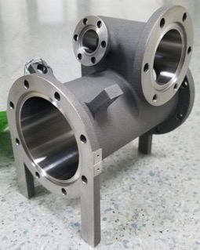
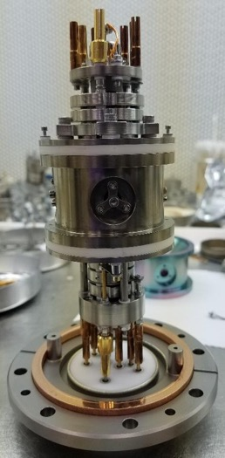
Main Component of QIT-MS
QIT-MS base pressure high 10⁻¹¹ torr
Operates without He buffer gas
Different modes of operation (dynamic, static, resonant ejection)
S.A.M operating pressure starting at 1x10⁻⁵ (collision of N₂) but nominal 5x10⁻⁹ torr
S.A.M. operating sensitivity 5x10¹² cnts /torr/sec (dynamic)
Inlet = fussed silica tube (single)
Allows for MCA every 2 sec
4.7”
Notes
QIT-MS = Quadrupole Ion Trap Mass Spectrometer
S.A.M. = Spacecraft Atmosphere Monitor (launch 2019)

Slide 6
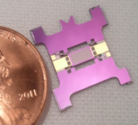
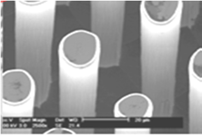


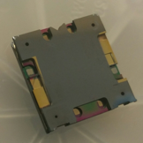


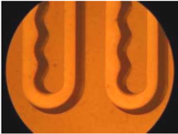
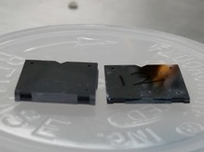
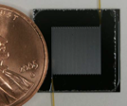
MEMS Gas Chromatography Components
For S.A.M. we developed a variety of chip-based gas chromatography components that can be mixed and matched to give complete systems (or coupled to mass spectrometers) for a variety of planetary and human applications
Pre-Concentrator (PC)
Micro-Valve (MV)
Gas Chromatograph (GC)
Heater/carboxen/inlet-outlet layers
Carboxen 1000
~200 μm particles
~10 Å pore diam.
Four microvalves are integrated in a chip: Sample, Vent, Carrier, and Injection.
All the valves are electrostatic.
1 m length x 86 μm diameter chip dynamically coated.
Serpentine column is superior to spiral design.
A novel turn geometry to counteracts the dean vortices producing lower dispersion.
Chips can be stacked to increase column length.
Other frontend developments in progress to support analyses of water and other liquids, aerosols, and capturing molecules under hypervelocity (˜10km/sec)
Miniaturization of trace gas analyzer inlet system by micromachining

Slide 7



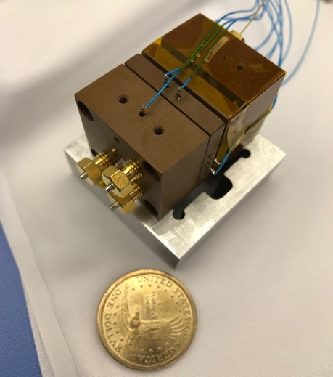
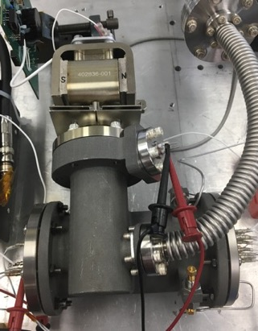
S.A.M. Spacecraft Atmosphere Monitor
PC layer
Valve
layer
GC
column
Flight:
Mass: (2011, VCAM) 30 kg, (2019) 7 kg
Power (2011, VCAM) 100 W, (2019) 30 W
Data rate 3.2 kbits (compressed)
Simple operation
© 2019 California Institute of Technology. Government sponsorship acknowledged.

Slide 8
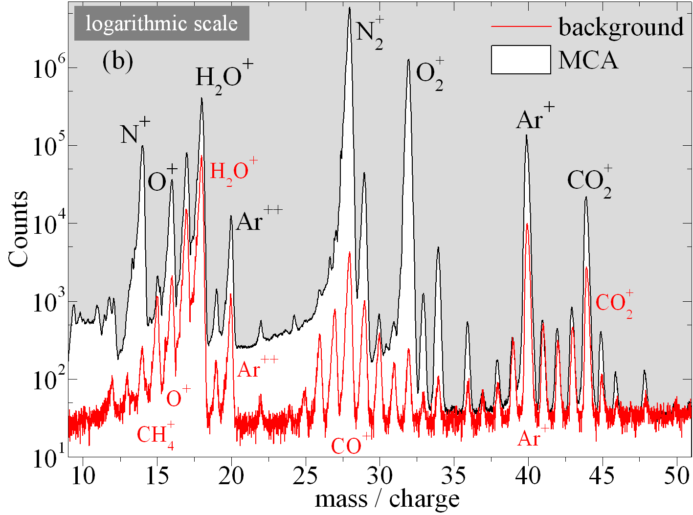
S.A.M. TDU#1 MCA with underlying background (inlet closed)
September 13, 2019
Earth’s magnetic field observed with TDU#1
TDU#2 will have magnetic shielding
No impact on MCA measurements
To be published, S. M. Madzunkov, D. Nikolić, A. Belousov, and M. R. Darrach, “Data Analysis and Isotopic Ratios Measured Onboard the Spacecraft Atmosphere Monitor,” 50th International Conference on Environmental Systems ICES-2020-527, 12-16 July 2020, Lisbon, Portugal
Meeting measurement requirements despite sensitivity to Earth’s magnetic field

Slide 9
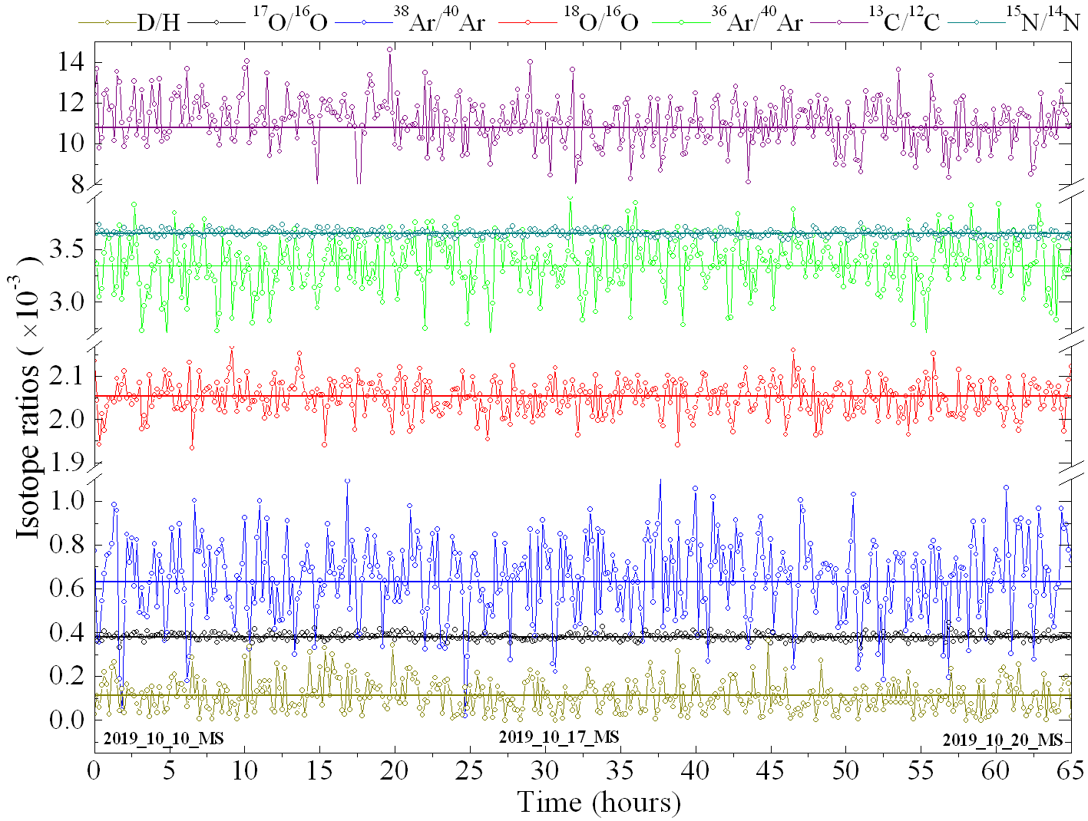
Isotopic long term stability of S.A.M. data (adjusted to Earth reference values)
Results are comparable to
magnetic-sector isotope-ratio mass spectrometers
To be published:
S. M. Madzunkov, D. Nikolić, A. Belousov, and M. R. Darrach, “Data Analysis and Isotopic Ratios Measured Onboard the Spacecraft Atmosphere Monitor,” 50th International Conference on Environmental Systems ICES-2020-527
12-16 July 2020, Lisbon, Portugal
High stability of QIT-MS

Slide 10
Lunar Effort

Slide 11
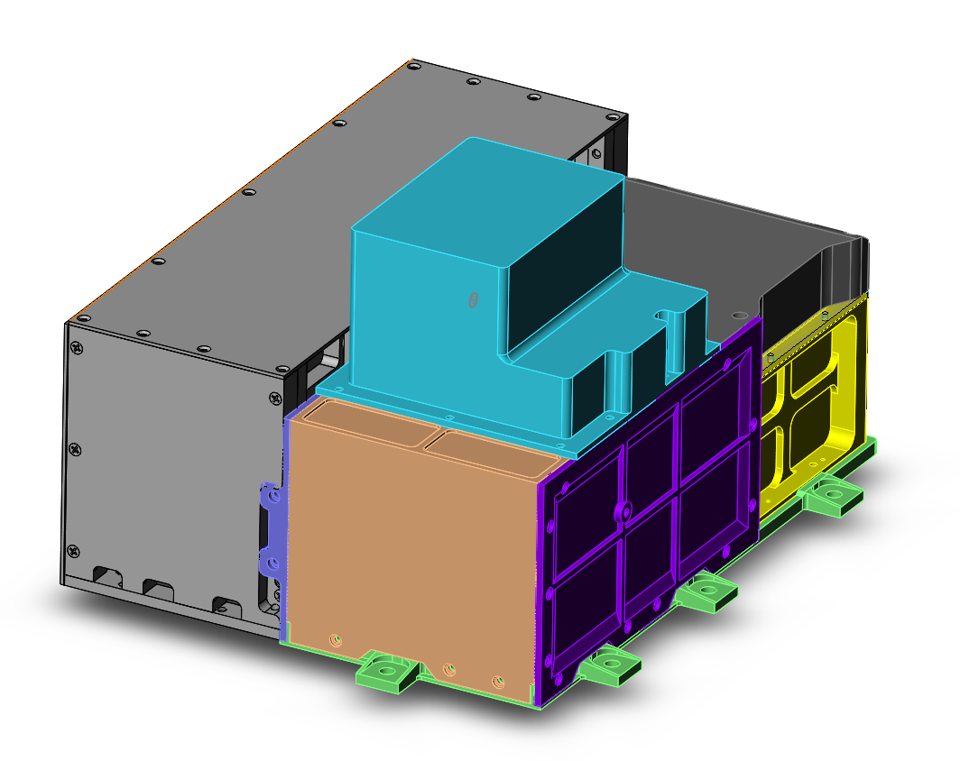
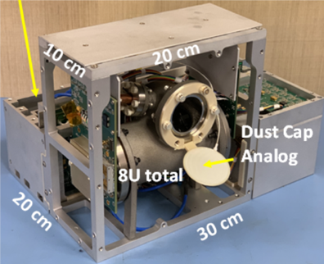
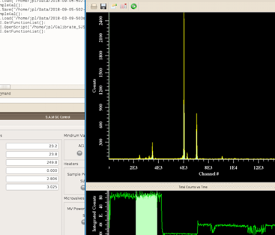
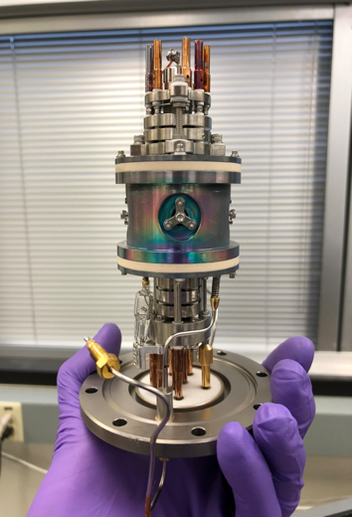

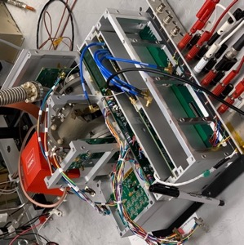
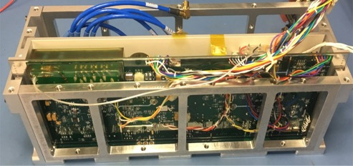
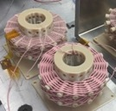
Compact QIT-Mass Spectrometer for Lunar and Planetary Applications
DALI package (fab started)
Integrated Software
Prototype QIT-MS
D. Nikolić, et al., Mass Spectra Deconvolution of Gaseous Mixtures Containing Volatile Organic Compounds, 48th International Conference on Environmental Systems, article 313, 6 pages (2018).
Cap electronics
High Q diamond weave Litz wire coil
Sensor
J. Simcic, et al. Miniature Gas Chromatograph Mass Spectrometer (GCMS) For Planetary Atmospheres In Situ Studies, 3rd International Workshop on Instrumentation for Planetary Missions, 2016
Power and CPU Electronics
Mechanical Integration

Slide 12
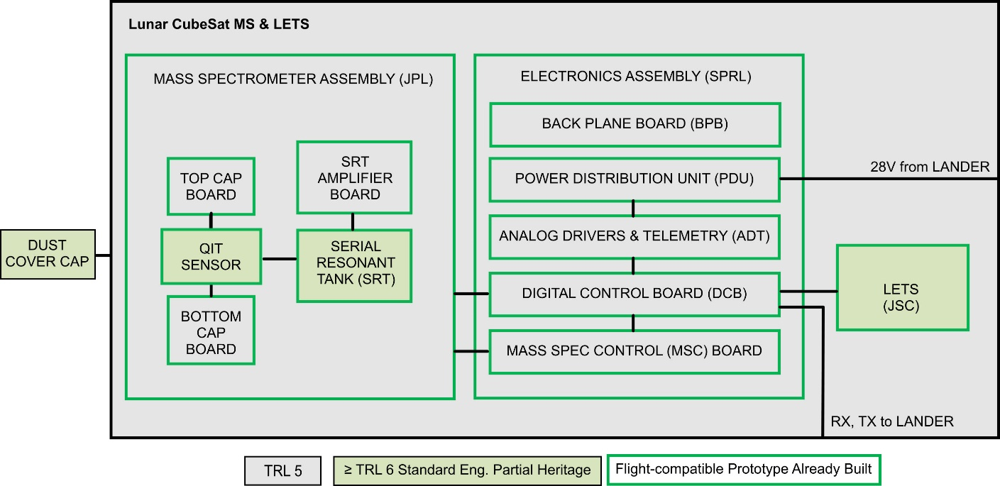
Readiness for Flight Implementation
Development over past years allowed to increase the TRL level of all components to 5 with design implementations to support TRL 6.

Slide 13
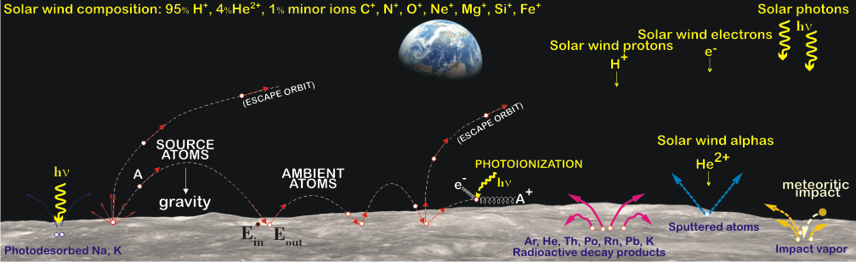
Lunar Exospheric Composition
Observation of time variability of multi-day lunar surface exospheric and radiation changes
Identifying and quantifying exosphere species with abundances ≥ 10 molecules/cm³
  e.g. low abundance of CO and N2; not measured before e.g. Kr, Xe
Primary mechanism for creation of lunar exosphere are:
  Solar wind activities with next expected maximum in 2026+/-2 years
  Radioactive decay
  Meteorite impact
D. Nikolić and M. Darrach, LADEEVIEW: Elemental Composition Analysis of Lunar Surface, 3rd International Workshop on Instrumentation for Planetary Missions, October 24–27, 2016, Pasadena, CA; article 4014, 2pp (2016).

Slide 14
Requirements modeled/demonstrated in the Laboratory
Driving Measurement Requirement | Lunar Surface Observable | Instrument Performance Requirement |  | Projected Performance | Margin
Determine which volatile species are present at the lunar surface at abundances ≥10 cm⁻³ | H, H₂, ³He, ⁴He, Ne, N₂, O₂, Ar, CH₄, CO, CO₂, Kr, Xe, OH, H₂O | Mass Range (Da) | 1-140 | 0.75-230 | 65%
 |  | Mass Resolution (m/Δm FWHM) | 200 | 1000 | 400%
 |  | Sensitivity (molecules/cm³/sec) | 0.001 | 0.0005 | 100%
 |  | Target species partial pressure (Torr), 2:1 SNR | ≤1×10⁻¹⁴ | ≤1.3×10⁻¹⁵ | 700%
To reach Xe isotopes
Low pressure
Sources used in compiling the required LUNAR targets are:
1) 2013-2022 Planetary Decadal Survey, Visions & Voyages, p. 118, critical science goal for the moon and other inner solar system bodies: “Understand the Composition and Distribution of Volatile Chemical Compounds…”
https://www.nap.edu/login.php?record_id=13117&page=https%3A%2F%2Fwww.nap.edu%2Fdownload%2F13117
2) 2007 NRC Report: Scientific Context for Exploration of the Moon
https://www.nap.edu/login.php?record_id=11954&page=https%3A%2F%2Fwww.nap.edu%2Fdownload%2F11954
8a. Determine the global density, composition, and time variability of the fragile lunar atmosphere before it is perturbed by further human activity.
8c. Use the time-variable release rate of atmospheric species such as 40Ar and radon to learn more about the inner workings of the lunar interior.
8d. How water vapor and other volatiles are released from the lunar surface and migrate to the poles where they are adsorbed in polar cold trap.
3) LEAG Specific Action Team Report, Goal 8a: “Systematically detect trace volatile species, like water, OH, and hydrocarbon in the exosphere.”
4) LEAG Specific Action Team Report, Goal 8b: “Detect volatile transport from mid- to high-latitudes as a function of driving space environmental (solar storm, meteor stream) conditions.”
https://www.lpi.usra.edu/leag/reports/vsat_report_123114x.pdf
5) HEOMD / Lunar Human Exploration Strategic Knowledge Gap (SKG) Special Action Team Report, September 2016: I-C, Regolith Volatiles, in situ. “Quality/ quantity/ distribution/ form of H species and other volatiles in nonpolar mare/highlands regolith.”
https://www.nasa.gov/sites/default/files/atoms/files/leag-gap-review-sat-2016.pdf

Slide 15
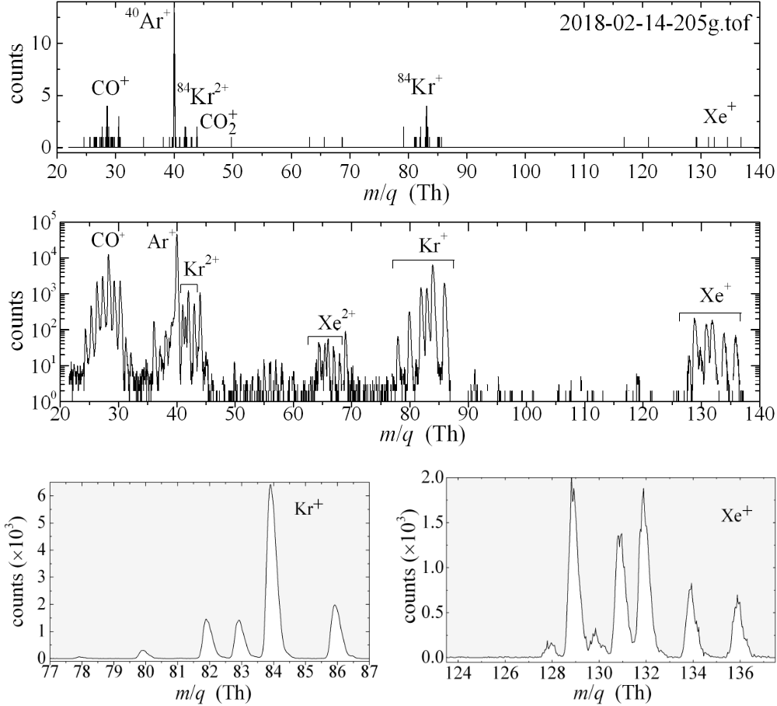
Noble Gas Mass Spectrum
Isotope spectra of an aliquot of calibrating gas (1.7E-10 Torr of Kr and 1.3E-11 Torr of Xe) measured continuously for 7 hours yielded a 0.6 ‰ precision on the 86Kr/84Kr ratio
50 ms
1 minute
*G. Avice, A. Belousov, K. A. Farley, S. M. Madzunkov, J. Simcic, D. Nikolic, M. R. Darrach and C. Sotin, “High-precision measurements of krypton and xenon isotopes with a new static-mode quadrupole ion trap mass spectrometer,” JAAS, Vol 34, January 2019

Slide 16
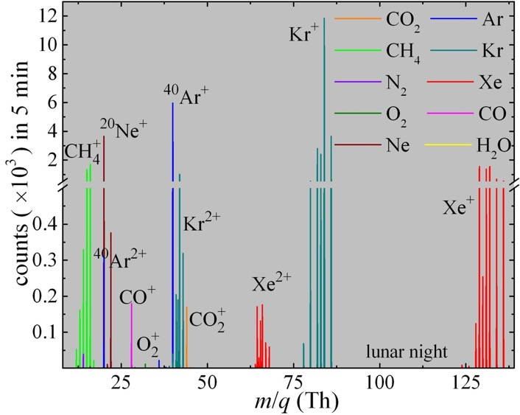
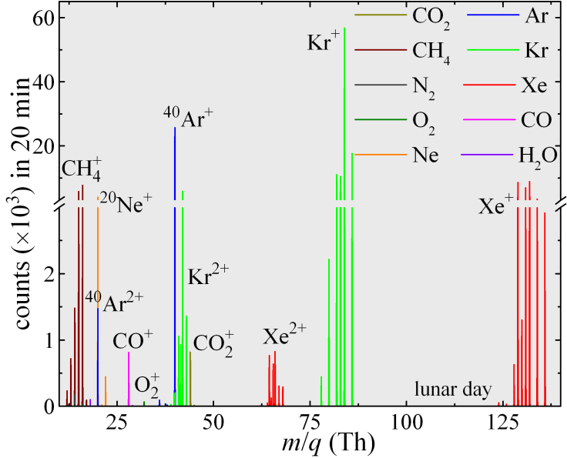
Predicted QIT-MS Response at Lunar Surface (diurnal)
Simulation results with JPL lunar model (based on previously published in peer reviewed journals)
D. Nikolić and M. Darrach, LADEEVIEW: Elemental Composition Analysis of Lunar Surface, 3rd International Workshop on Instrumentation for Planetary Missions, October 24–27, 2016, Pasadena, CA; article 4014, 2pp (2016).
Approx. 30% higher counts during sun exposure (lunar day)
Lunar exosphere model based on past measurements with LADEE is detectable with QIT-MS.

Slide 17
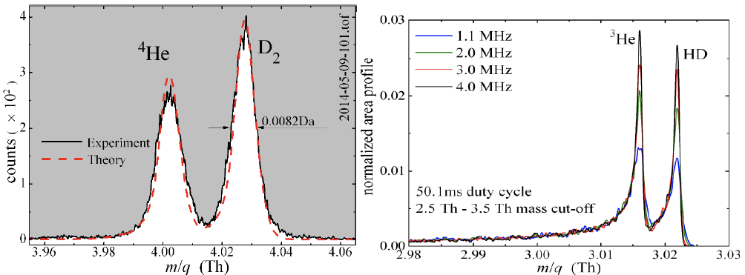
Modelled and Measured High Resolution Mode
Measured and Modeled QITMS Mass Spectra
(Left) Measured QITMS spectra for 4He and D2 (dotted line) with a modeled 4He and D2 spectra.
(Right) Modeled spectra for 3He and HD, at identical abundances, for various RF frequencies. The equal 3He and HD abundances are based on the published isotopic ratios in the lunar regolith [Wiens (2003)] and the expected AtLAS H2 instrument off-gassing after < 1 day of lunar surface bakeout.
Amplitude optimization by tuning RF frequency
Nikolic, D., Madzunkov, S.M., Darrach, M.R., “Computer Modeling of an Ion Trap Mass Analyzer, Part I: Low Pressure Regime”, J. Am. Soc. Mass Spec., 26, 2115-2124 (2015)
Well validated QIT-MS model.
Notes:
Dragan: gauss or Lorentz; is there dynamic channel allocation for high resolution mode? Amplitude

Slide 18
OCEAN World, QIT-Ms coupled with Electrospray liquid input system

Slide 19
Ocean Worlds Life Surveyor (OWLS)
QIT-MS application in the quest of architecting the most capable organic chemical analyzer
The Ocean Worlds Life Surveyor (OWLS) is funded under the JPL NEXT Program initiated in 2018.
  Goal to build and field test (Borup Bjord Pass in the Canadian High Arctic) prototypes in preparation to select instruments for possible missions to Enceladus, or Europa
Mass Spectrometer is part of Organic Capillary Electrophoresis Analysis System (OCEANS)
  Electrospray Ionization coupled to Mass Spectrometry (ESI-QIT-MS) for broad-based detection and characterization of collections of organic molecules.
Life detection hinges upon identifying certain organic molecules
  Amino acids are the building block of proteins and their distribution provide distinct biosignatures.
Prototype of ESI system is ready for testing with laboratory setup and MS in near future
https://microdevices.jpl.nasa.gov/capabilities/in-situ-instruments-chemical-analysis/owls-project/

Slide 20
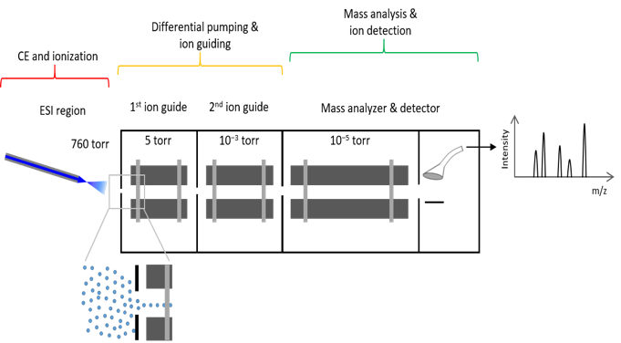
Ocean Worlds Life Surveyor –OCEANS CE-ESI-MS
The goal of OCEANS (Organic Capillary Electrophoresis Analysis System) is to design, build, and demonstrate an in situ chemical analyzer that can detect and characterize organic compounds.
The OCEAN Worlds Life Surveyor (OWLS) is funded under the JPL NEXT Program.
  Goal to build and field test (Borup Bjord Pass in the Canadian High Arctic) prototypes in preparation to select instruments for possible missions to Enceladus, or Europa
Mass Spectrometer is part of Organic Capillary Electrophoresis Analysis System (OCEANS)
  Electrospray Ionization coupled to Mass Spectrometry (ESI-QIT-MS) for broad-based detection and characterization of collections of organic molecules.
  Capillary Electrophoresis (CE) will be coupled to ESI-QIT-MS. It allows to analyze organics at ppb levels, with 2% accuracy for relative amino acid abundances.
Life detection hinges upon identifying certain organic molecules
  Amino acids are the building block of proteins and their distribution provide distinct biosignatures.
*
*A linear ion trap is shown here, but LIT and Paul trap performances will be compared
To be published by Peter Willis

Slide 21
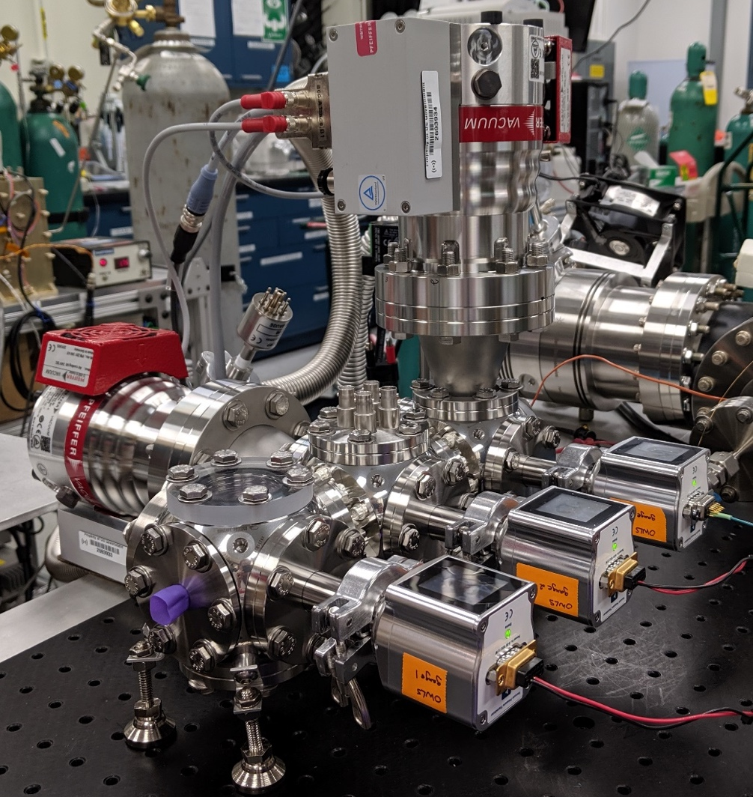
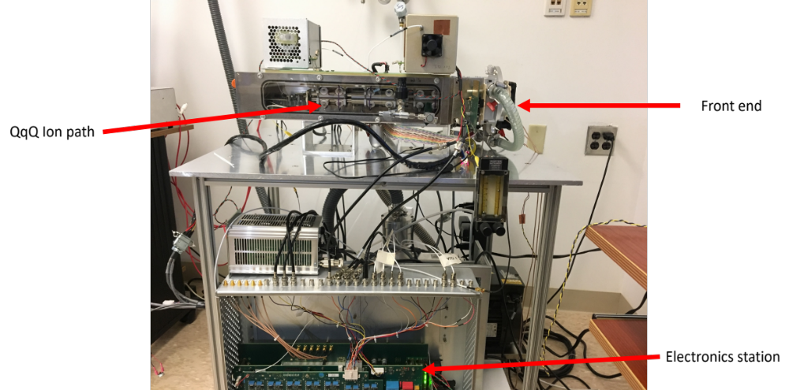
OWLS MS Laboratory Prototypes
Performance comparison of ESI-QIT-MS and ESI-LIT-MS (QqQ config.)
  Difficult to perform decomposition of organic molecules (ex. amino acids) with GC-MS at high temperatures
  ESI transfers organic molecules into gas phase without decomposition/fragmentation
  Transfer of gas from ambient pressure into vacuum requires ion optics and differential pumping (orifices) to interface (completed)
    Developed by Sciex
Sciex QqQ setup
JPL Ion Optics setup efficiency measurements will be extended with QIT-MS

Slide 22
OWLS MS Requirements
Requirements
  Mass range: 70 – 500 Da
  Resolution: 1 Da across range
  Rep rate: 5 Hz
  LOD: 500 nM for organic cations
  Quantitation from: 500 nM –250 µM
MS/MS capabilities a bonus
Status
  Demonstrated electrospray by ion detection
  Completed SIMION simulations of ion optics and ion flow conductance models
  Validation of test bed will start soon

Slide 23
Conclusions
Preparation for Lunar application started with DALI program.
  Further reduction in mass (< 7kg) and power (<30W)
QIT-MS accuracy/precision matches with laboratory size magnetic sector MS at shorter integration times
Proposing for near-future flight opportunities to raise the TRL level
  Discovery and New Frontiers
  Instrument developments
  Internal funding
Future work will focus on sample inlets designs to target different NASA missions
  Development on Electro-Spray frontend for liquid sample
  Investigations of an aerosol separator for high density atmospheres by utilizing the newly developed piezo controlled valve tested up to 69 bars for constant input flow during decent

Slide 24
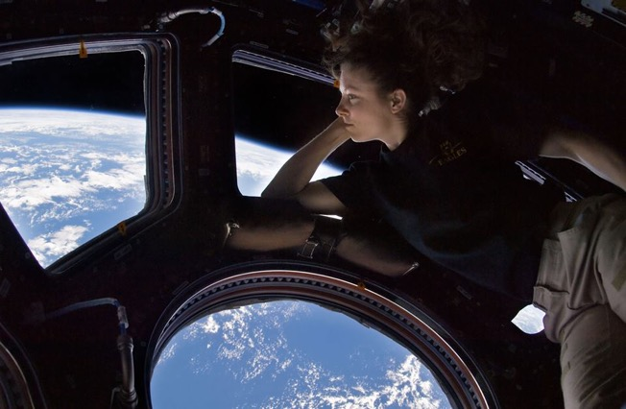

S.A.M. is in the ISS but what is next?
Tracy Caldwell Dyson

Slide 25
Thank you for your attention!
National Aeronautics and Space Administration
Jet Propulsion Laboratory
California Institute of Technology
Questions?

Slide 26
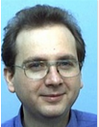










Meet the Core 389Team
Typical Education
Physics
Chemistry
Electronics
Geoscience
Dr. Frank Maiwald
Dr. Stojan Madzunkov
Dr. Jurij Simcic
Dr. Dragan Nikolic
Dr. Richard Kidd
QIT-MS inventor; technical lead
MS component Inventor
Theory, technologist
Chemistry and Biology
Dr. Anton Belousov
Dr. Byunghoon Bae
Marianne Gonzalez
Dr. Max. Coleman
Technologist, Implementor
MEMS component Inventor
Experimentalist
Scientist, inventor
Experience
Physics and Chemistry
Theory and modelling
Instrument development
Publications and proposals
Teamwork
Valeria Lopez
Dr. Bohoon Kim
Student
PostDoc
Notes:
Stojan, inventor
Invetor valve
Place slide

