Slide 1
Next generation of miniaturized high spectral resolution spectrometers
Sona Hosseini
sona.Hosseini@jpl.nasa.gov
Copyright 2020 California Institute of Technology. U.S. Government sponsorship acknowledged
Notes:
I’m Dr. Sona Hosseini and I’m a research and instrument scientist at JPL. There is a critical need for a compact high spectral resolution spectrometers to implement into space missions and in particular in small satellites.
I like, within the next 30 minutes, to introduce an emerging technology and its potential to overcome some of the current instrumentation trade-offs we’re force to make in Planetary Science, Astrophysics and Earth Science missions in general and in particular in compact space platforms.

Slide 2
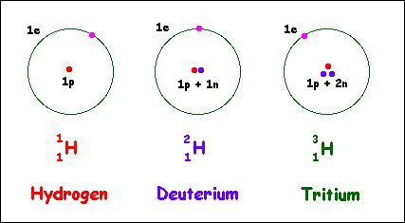
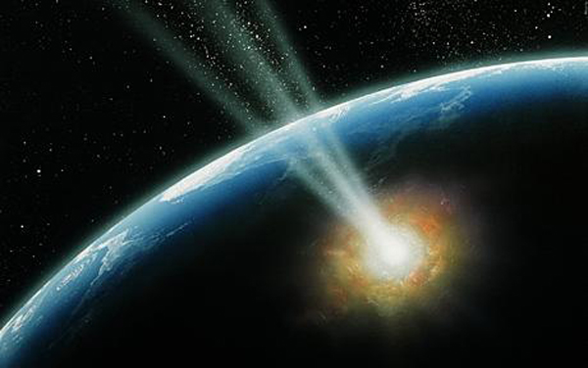
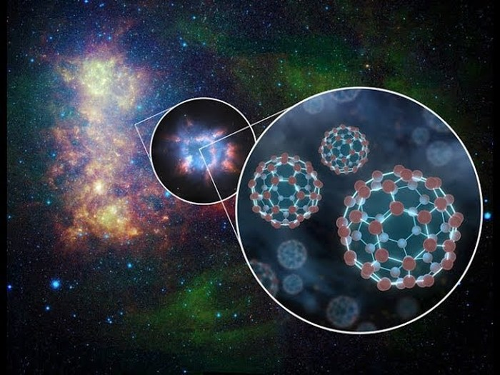
Follow the heavy water!
Tracing the source of Earth’s water is surprisingly complex
“There are numerous debates and models about the source of water and organic compounds on Earth and other terrestrial planets without converging to an agreement.”
- Kathrin Altwegg
The origins of life, as we know, is tied to the origins of water on the Earth.
Notes:
Unlike every other rocky planet in our solar system, Earth’s surface is %70 liquid water, which while useful for life, it is also kindda weird, because everything we know form how and when our planet formed 4.6 billion years ago says, Earth’s surface should be bone dry.
Tracing the source of Earths water is surprisingly complex. If Earth had kept some of it’s original water, then life may have formed much more earlier than previously thought. But if Earth didn’t start off with water, how and when did we end up with such splendid oceans?
The secret answer maybe is in the water isotopic. Hydrogen (H) is the most abundant element. D has an abundance 100,000 times less and this was created when the universe was born and we “think” it has stayed the same since.
------------------------------
We know H2O wasn’t manufactured here because natural processes such as combustion, breathing and photosenteces create and destroy roughly equal amounts of water and either way the amount in questions are so misqual that they can’t account for abundance of water on the planet. Since Earths water was neither part of the original package nor manufactured here it must have flown in from far away on meteorites, or comets or other bodies originated in the outer solar system where they are far enough from the sun for frozen water to survive. In one scenario, water should have been delivered after our planet had cooled down, likely from collisions with comets or asteroids. But the relative contribution of each class of object to our planet's water supply is, however, still debated.

Slide 3
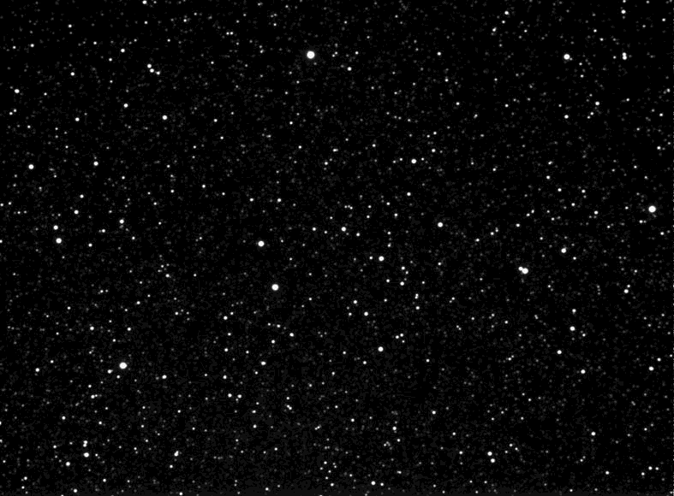
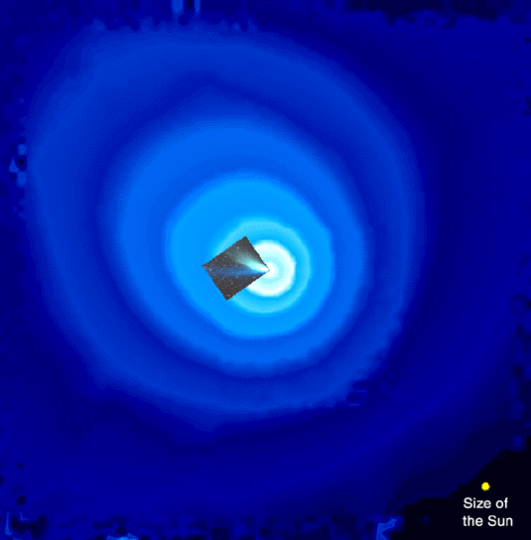
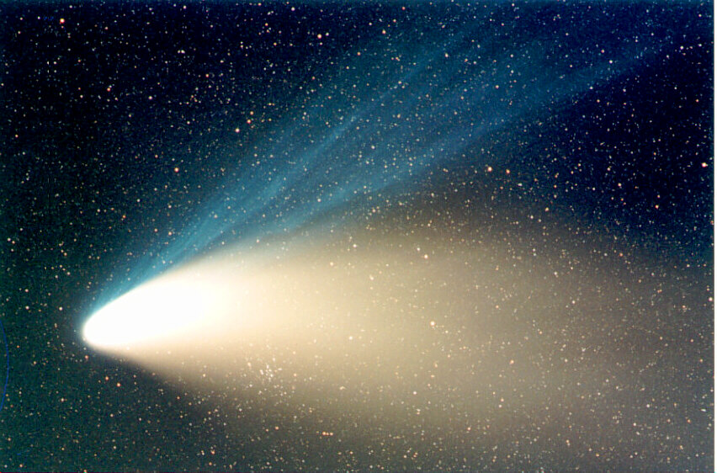
Notes:
Comets are gigantic and in real size they can be as big as the Sun. As the comet approaches the Sun, the solar heating triggers sublimation of gasses, made up of H₂O, CO, CO₂ and complex molecules from the nucleus. Unlike Earth’s atmosphere, gas pressures surrounding comets in number densities are extremely low density and have low pressure, and low temperatures.
Comets change! They can change rapidly! And for that we need to point at them and keep staring at them for a long time.
Targets like comets have very interesting features that are faint, have low brightness, low temperatures and require high sensitive instruments.
-------------------------------
The picture shows: H emissions in Lyman a at 121 nm, Comet Hale-Bopp
Characterize physical properties
Nucleus+coma structure
Rotational dynamics
Track the evolution of its dust coma as it progresses toward perihelion
Yield mass loss and thus information on material strength,
Identify when H₂O sublimation is expressed – lag provides information on surface properties
Determine the D/H of C/2019 K2
D/H is a function of formation temperature, puts constraint on protoplanetary disk temperature
Observations at multiple times and places would increase data analysis robustness (e.g., sublimation effects, source of hydrogen)
---------------------
Observing D/H in comets, or any other environment such as Pluto’s exospheres, or plumes, we require an instrument that has high throughput. Having wide FOV is a great thing for Smallsats because I can tolerate less pointing accuracy: it saves money and has less mass and complexity. An important factor is that we don’t need large aperture telescope coupled to the instrument.
But what if the sources we like to look at are very faint and we have a narrow FOV we are not going to get enough photons unless we have a large aperture telescope that are often not an option. A way to go around it in this case, is to have a larger FOV.
Thus it is necessary to have the suitable instruments to take the specific data that we want. But unfortunately we don’t always have that luxury, not from the ground, not from space and certainly not from smallsats.
--------
Discovered by: Alan Hale / Thomas Bopp
Orbital period: 2,537 years
Predicted next perihelion: 4380
Discovered: July 23, 1995
Last perihelion: April 1, 1997
as the comet approaches the Sun, the solar heating triggers sublimation of gasses, made up of H₂O, CO, CO₂ and complex molecules from the nucleus. As the gas expands, each species is subjected to various physical processes including dissociation, ionization, gas-phase reactions, etc. As a result, the gaseous material is modified to a large extent. Within the coma, the gas densities are very low and the rate of chemical reactions among species is low except very close to the nucleus. This provides a unique opportunity to study the properties of reactive gasses that are difficult to study on the Earth, such as OH. The molecules released by the nucleus, known as parent molecules, ultimately give rise to simpler molecules like CN, C₂, OH, CH, NH₂, etc. that are seen in the comet’s emission spectra [15]. In many cases, the parents of these species are unknown or variable.
Determine what fraction of Earth’s oceans is comet water
2. Determine to what extent comet ice is interstellar vs. condensed in the Solar Nebula
3. Determine to what extent comet nuclei have D/H heterogeneities
4. Determine how D/H varied with heliocentric distance in the Solar Nebula
5. Determine the source regions of the current comet reservoirs

Slide 4
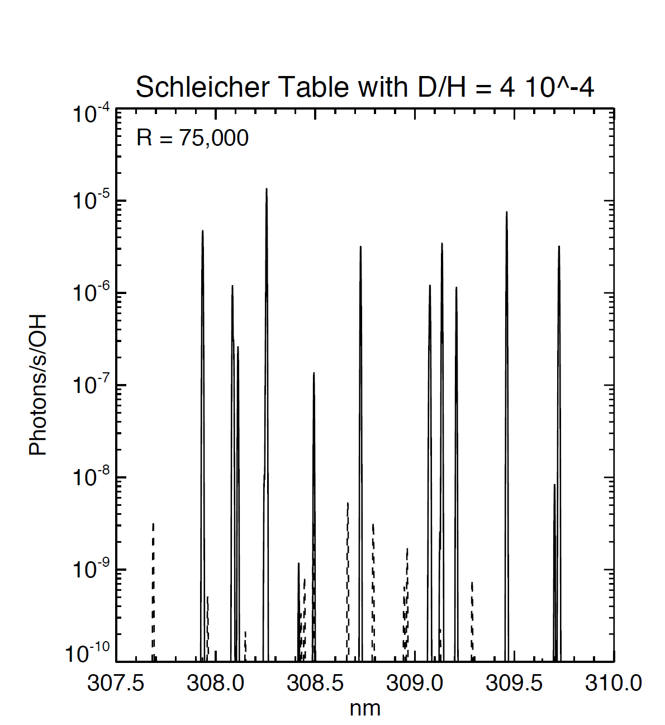
High Spectral Resolution Spectroscopy
High spectral resolution is needed for fine relative motions, multiple sources, isotope ratios, temperature, turbulence, currents, and etc.
OH
Ʊ
OD
Simulated spectra from OH and OD molecules.
Comet Hale-Bopp
4
Notes:
As Scientists we can take data in different ways, more commonly we can take a picture or spectra, all these data may represent the same source but carry different information.
So for most of us the challenge lies not only in building smaller and sensitive instruments but building miniature instruments with desirable science return.
For the type of science I’m interested, I like to take the spectra. Not just any spectra, but high R spectra to study spectral line profiles, and look for fine relative motions in the spectra, isotope ratios, temperature, turbulence, and much more!
But the sources I like to study like comets, lunar exosphere, ISM, are very faint and if we have a narrow FOV we are not going to get enough photons unless we have a large aperture telescope that are often not the easy nor the cheap option. A way to go around it is to have a larger FOV.
Thus it is necessary to have the suitable instruments to take the specific science data that we want. But unfortunately we don’t always have that option, not from the ground, not from space and certainly not from smallsats.
-------------
Sun: 31.6′ – 32.7′
Comets: arcsec to degrees
Mars: 3.4″ – 25″
Jupiter: 29.8″ – 50″
Vesta: 0.2" – 0.6“
-----
http://www.lpap.ulg.ac.be/jupiter/research.html
Ultraviolet spectra using GHRS sampled in July 1995 between 1250 and 1680 Å at spectral resolution ~0.6 Å were reported for characteristically bright regions of Jupiter's morning and afternoon northern aurora (Trafton et al., 1998. We have searched for evidence that the primary precipitating particles exciting the aurora include the heavy ions known to exist in Jupiter's plasma torus and magnetosphere. We have also searched for such ambient heavy ions and neutrals at rest in the auroral ionosphere, the end products of previous precipitation, excited by the auroral cascade. We argue that primary emission would be characterized by a dramatically Doppler-broadened and redshifted line profile resulting from the cascade process and the angle between the line of sight and the magnetic field lines in the atmosphere. In contrast, ambient emission would be distinguished by narrow emission lines. We have modelled the theoretical sulfur and oxygen line shapes for ion precipitation and concluded that electron precipitation is responsible for most of the H₂ emissions (Rego et al., 1998). O ions contributed < 13% of the precipitating energy flux, and S ions contributed < 50%. This dominance suggests that field-aligned magnetospheric currents are more important than energetization of energetic ions and subsequent scattering by plasma waves as a mechanism for generating the Jovian aurora. Differences were observed in the auroral spectral hydrocarbon absorption at different locations, which cannot be interpreted without ambiguity between auroral and atmospheric structural causes. We have found that the brighter emission in an auroral sector consistently shows more spectral hydrocarbon absorption than the dimmer emission.

Slide 5
Spectrometry’s Trade Triangle
What do I really need for my science?
Spatial Heterodyne Spectromter
No, 1D or 2D spatial information
Compact/miniature
Small aperture telescope
Low data volume
All-reflective design
High tolerance (optomechanical, temperature)
Grating spectrometer
1D or 2D spatial information
(data cube capability)
Well known concept/heritage
All-reflective design
Point sources (narrow FOV)
FOV
Spectral resolution
λ/Δλ
Bandpass
Notes:
When we look at spectrometers, it’s often the trade off Between R, FOV, and Bandpass. Grating spectrometers, or imaging spectrometers, are optimized to have high R at narrow FOV.
Now I have been working on a class of spectrometers, that were initially designed to fill the observational gap for temporal high spectral resolution spectrometry at wide FOV from extended diffused gasses, such as comets.
But when we need to study extended diffused gases such as comets, exospheres, plumes, evaporating planetary atmospheres, interplanetary Medium, Nebula and or even the Earth’s atmosphere, Spatial Homodyne Spectrometer allows us to combine wide FOV temporal coverage at high spectral R.
It turns out the technique I developed is inherently small, doesn’t require large aperture telescopes and benefits greatly from higher vibration and temperature tolerances, which makes it a suitable candidate for space on small platforms.
Having wide FOV is a great thing for Smallsats because I can tolerate less pointing accuracy: it saves money and has less mass and complexity. An important factor is that we don’t need large aperture telescope coupled to the instrument.
I am excited at JPL we’re developing it for Planetary Science but also Astrophysics and Earth science missions.

Slide 6

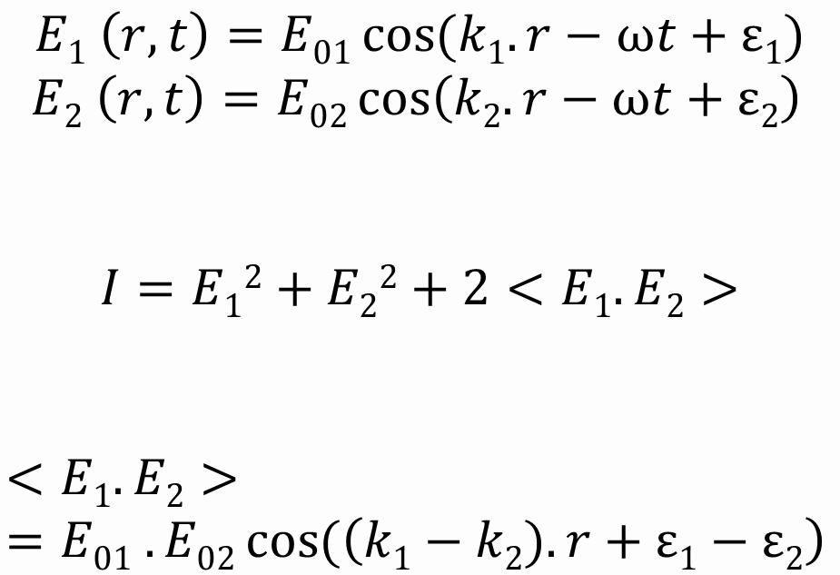
Two factors create an interference pattern
$$E1 \left(r,t\right)=E01\cos{(k1.r−ωt+ε1)}$$
$$E2 \left(r,t\right)=E02\cos\left(k2.r−ωt+ε2\right)$$
$$I=E12+E22+2<E1.E2>$$
$$<E1.E2> =E01 . E02\cos{(\left(k1−k2). r+ε1−ε2\right) }$$
Conventional
Interferometry
SHS
Hosseini, 2019
Notes:
We’re looking at two plane waves interfering with each other.
The fringe pattern on the FLP depends on the Optical path difference between the two arms. Now most interferometers work based on Heidelburgh fringes, that’s when the path is different. SHS, is designed to observe Fizeau fringe that’s when the phase’s are different.
This is clever!

Slide 7
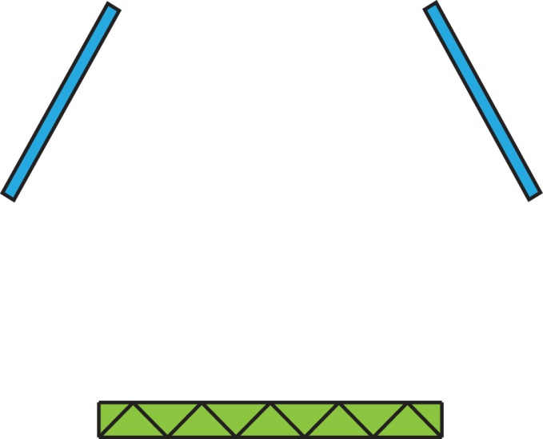
SHS is an interferometer with no moving parts
−2λ − λ 0 +λ +2λ
Grating
Grating
Flat Mirror
Roof Mirror
m= +1
m= -1
m= -1
m= +1
−2λ − λ 0 +λ +2λ
Grating
Notes:
SHS technology was first introduced by replacing the mirrors in a FTS with gratings. By using the gratings at at Littrow angle we can beat the diffracted light against a diffracted light.
In the cyclical design, we have two flat mirrors and a symmetric grating that is not blazed for a specific order. This SHS is two-beam cyclical interferometer. The collimated light that incidents on the grating, diffracts to two +,-1 orders, reflects off the two mirrors, diffracts from the grating for the second time and leaves the interferometer,…
In both designs, for a specific wavelength that is called the Heterodyne Wavelength everything is symmetric and there is no fringes

Slide 8
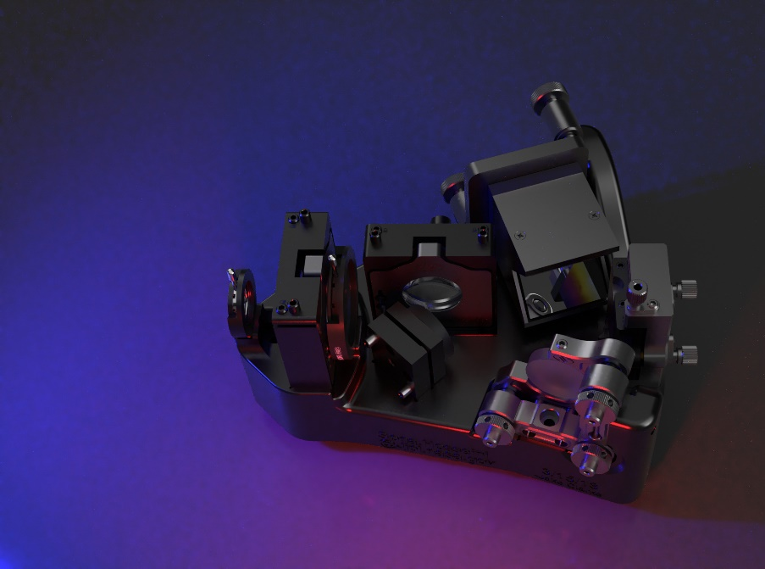
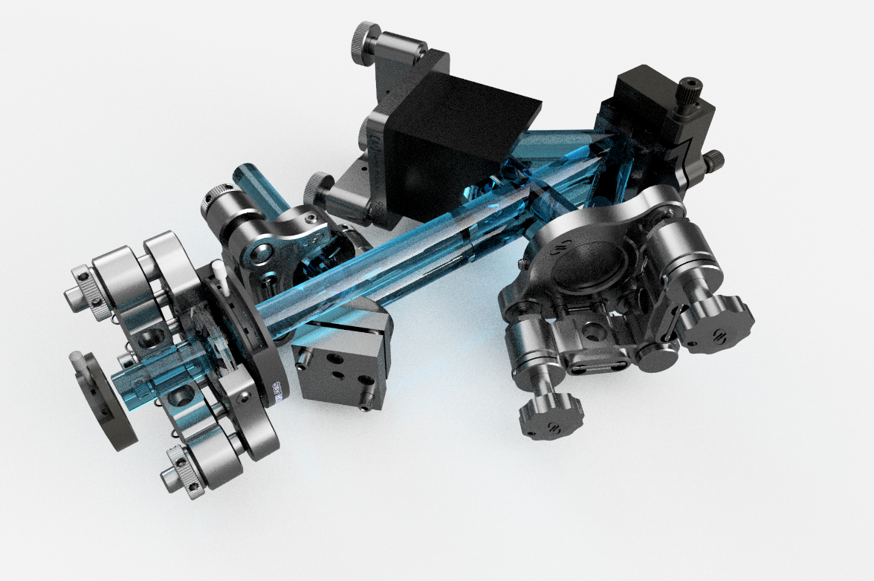
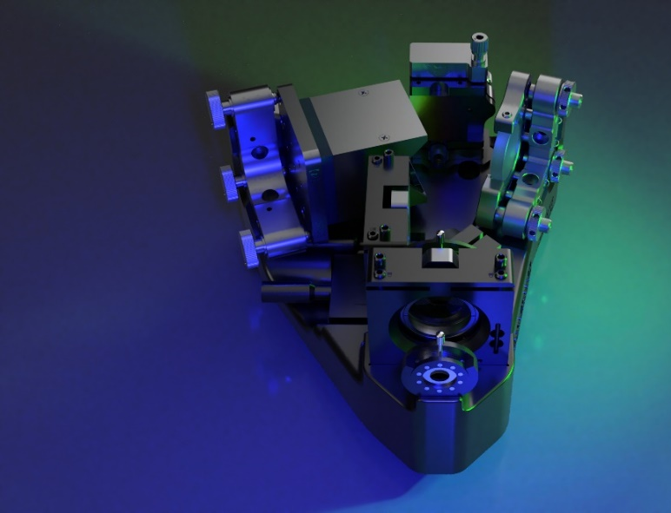
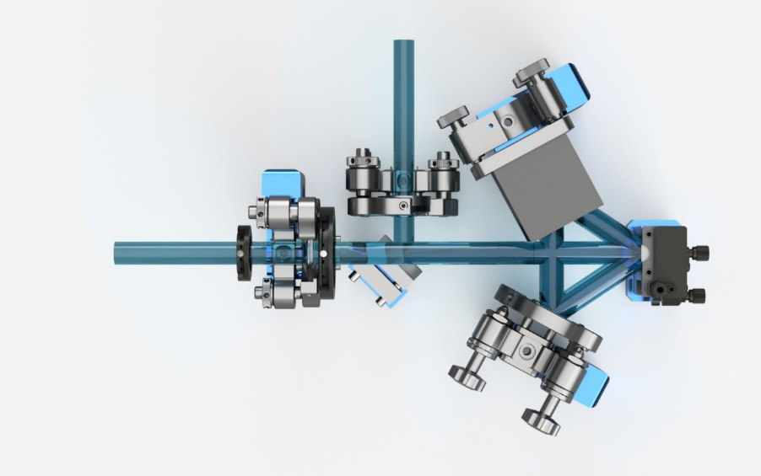
Developing the next generation of miniaturized high spectral resolution spectrometer

Slide 9
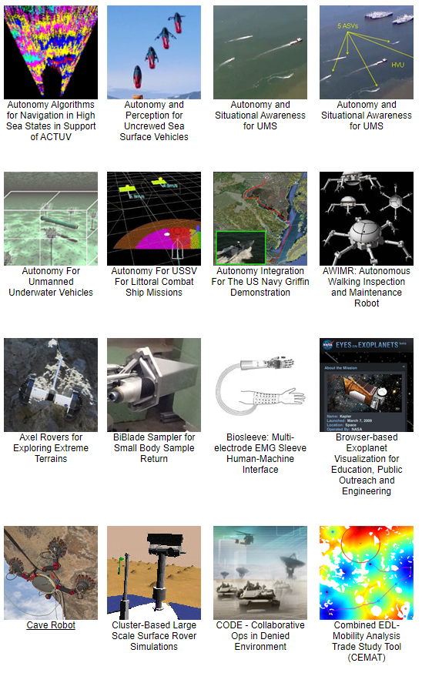
ROBOTICS
robots for everything!
Driving
Flying
Landing
Small Body Orbiting
Subsurface Access
Instrument Placement
Sampling
Onboard Science
https://robotics.jpl.nasa.gov/

Slide 10
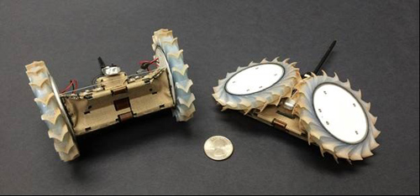
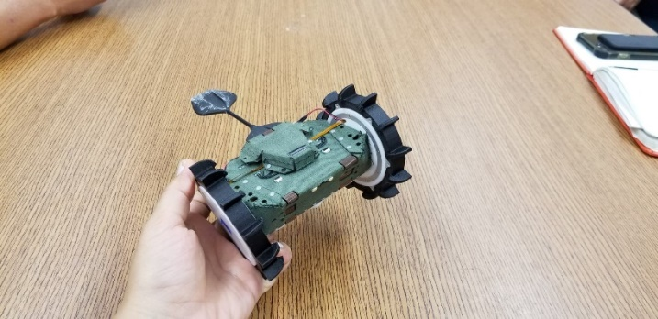
PUFFER will explore the moon, and other planetary surfaces
PUFFER (Pop-Up Flat-Folding Explorer Robot) is an origami-inspired robot that was developed to provide future NASA missions with simple, low-cost access to new high-value, higher-risk extreme terrains.
This project will also focus on developing “multi-agent” autonomy that enables multiple PUFFERs to leverage cooperative mobility, communication, and sensing to operate in ways that are not possible with a single rover.

Slide 11
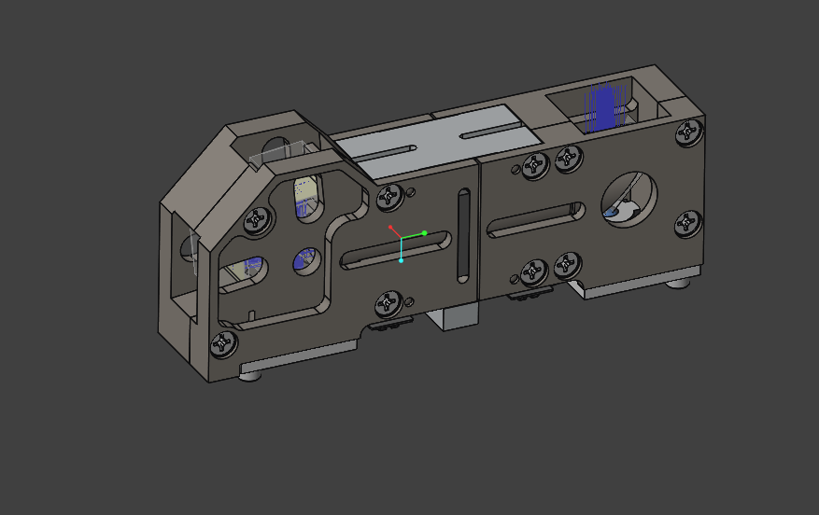
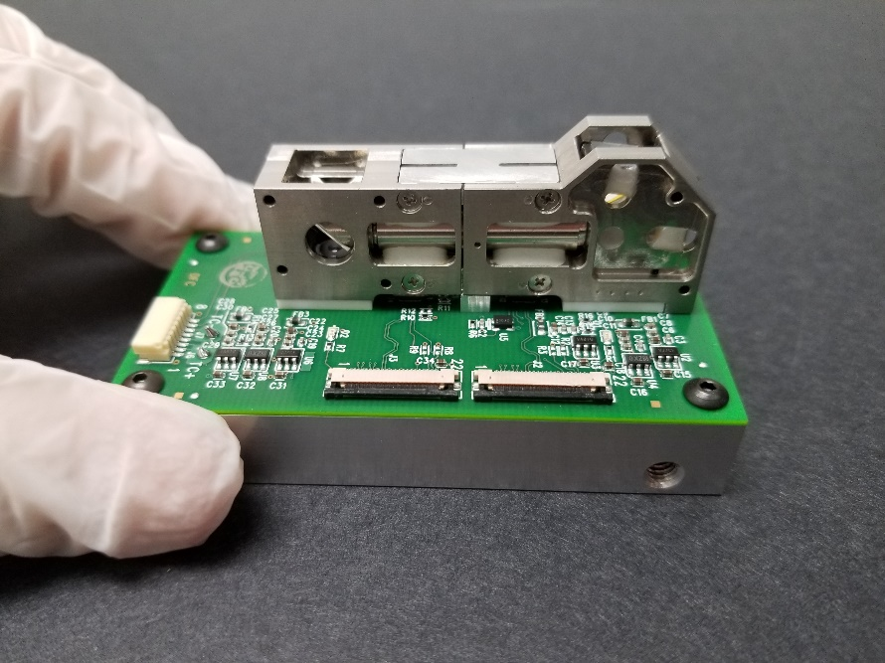
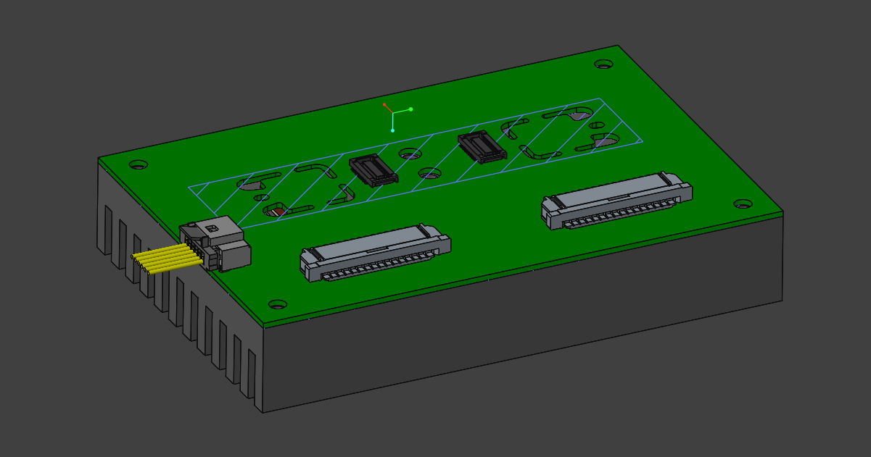
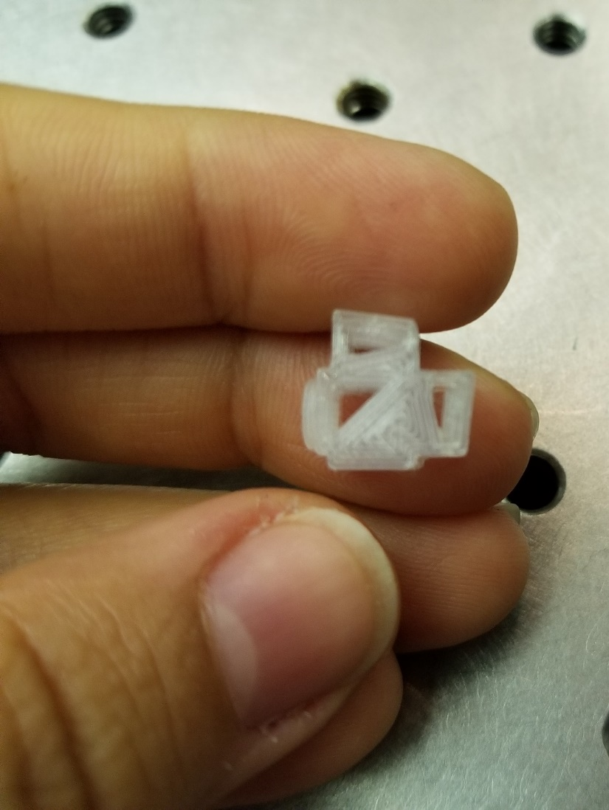
HOLMS (Heterodyne OH Lunar Miniature Spectrometer)

Slide 12
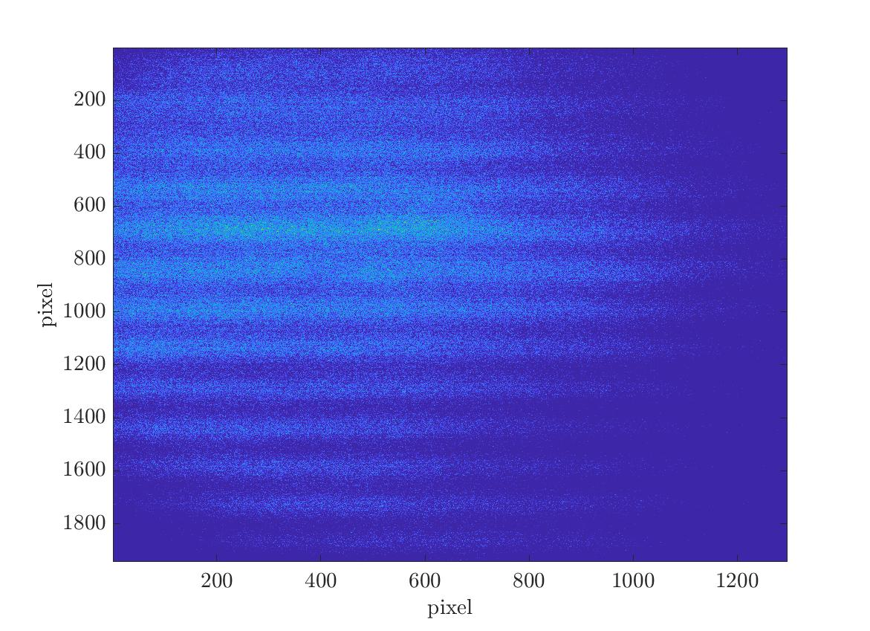
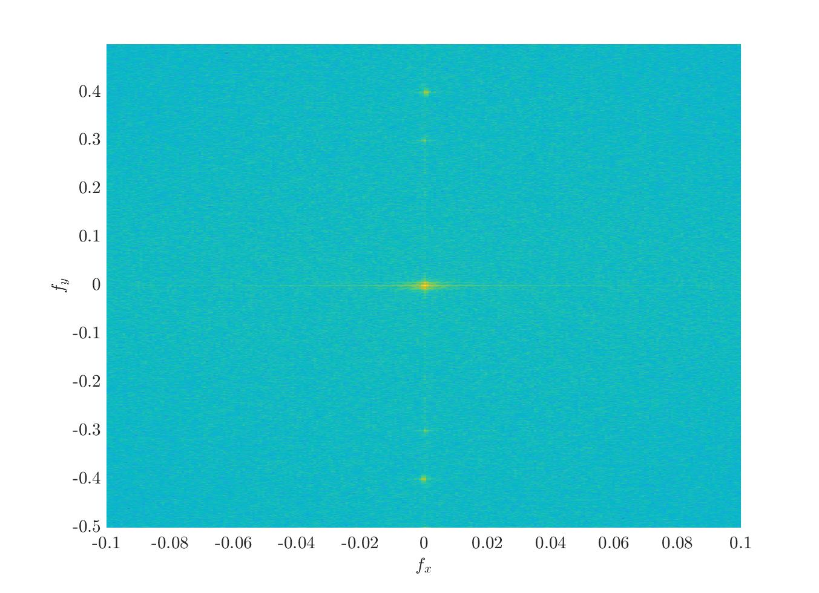
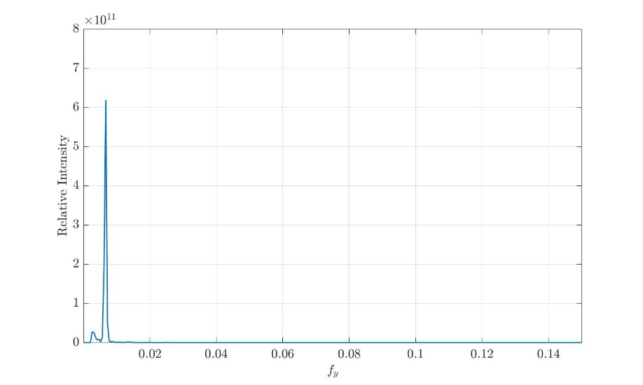
Zn lamp data analysis
2-D FFT
Raw data from Zn hollow cathode lamp at 3075.9 A
Zn spectra at 3075.9 A
Resolving power= 36000
Hosseini, et.al.
under submission

Slide 13
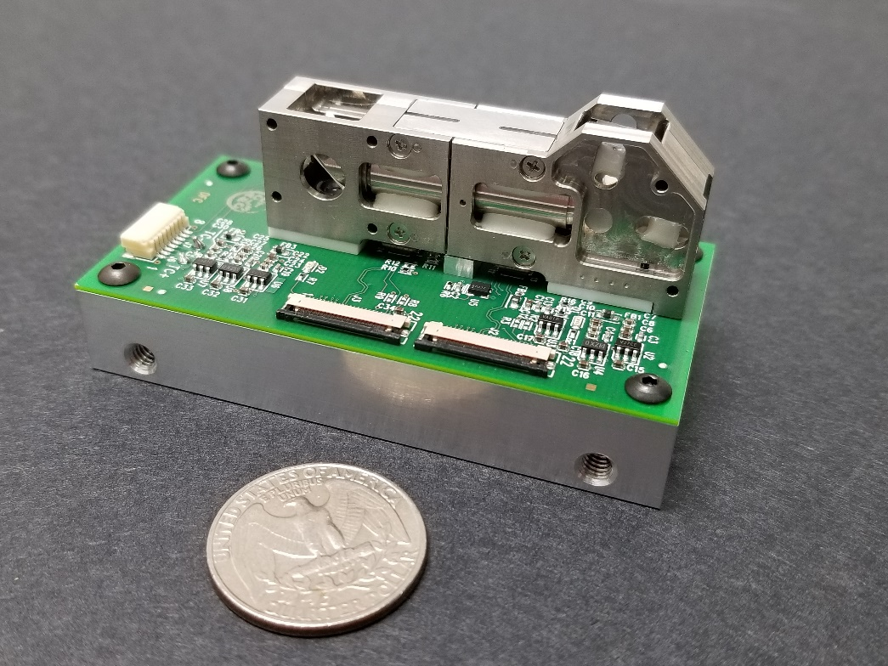
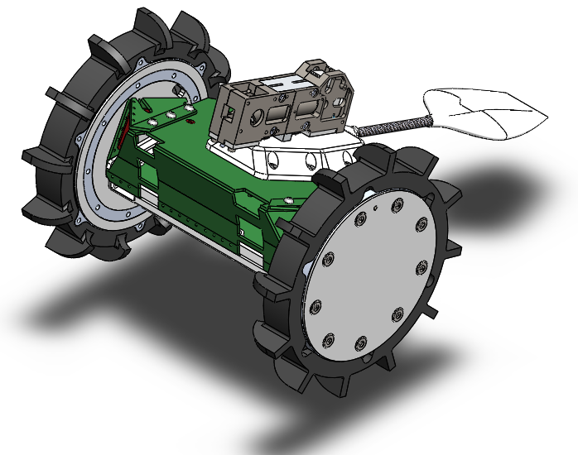
Heterodyne Wavelength | 307.3 nm
Wavelengths of interest | OH: 308.6 Å OD: 307.9 Å
Calibration lines | Zn: 3075.9 A Al: 3093 A
Sensor (TRL4 solution) (TBD) | Sensor size: 2592 x 1144 Pixel size: 1.4 micron
Resolving power | ~33600
Resolution | ~0.09 Å
Bandpass | ~3047.6–3118.3 Å (detector dependent)
FOV (field widen SHS) (TBD) | ~4 x 4 degrees
Specs / Resources
Mass | ~100 gm/channel
Power | ~ 6 W
Volume | ~20 cm x 10 cm x 3 cm per channel
Processing | Onboard FFT (TBD)
Precision/Accuracy | 2 deg. pointing
Each HOLMS unite can observe a narrow bandpass at very high spectral resolution.
Hosseini,
under submission

Slide 14
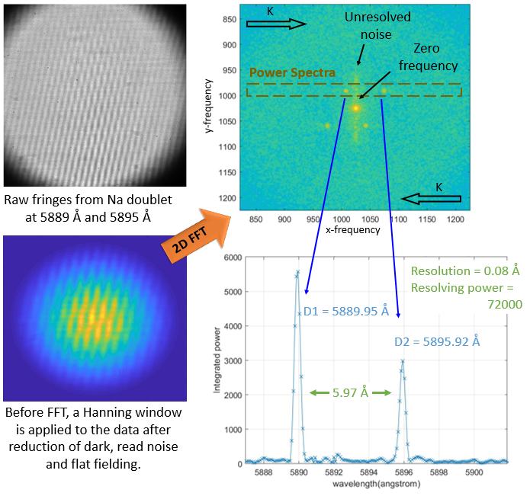
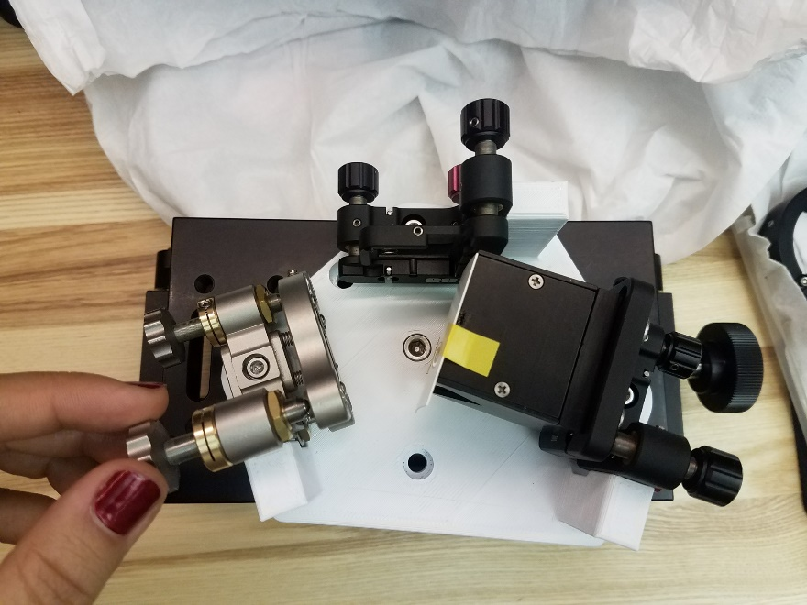
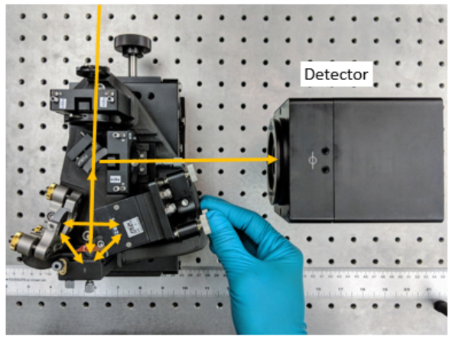
Spatial Heterodyne Spectrometer
Hosseini,
under submission
Notes:
Figure 8: One of the applications of SHS is in observing isotopic ratios and doublets because of its ultra-high spectral resolution. Here we show the raw fringe pattern from Na D lines, in 5889 Å and 5895Å. The power spectra is reduced from the 2D FFT of the fringe pattern. The top half of the 2D FFT is the repetition of the bottom half with an inverse wave-vector sign. In this setup, each D line is in the opposite side of the heterodyne wavelength and can be identified by their fringe tilt.

Slide 15
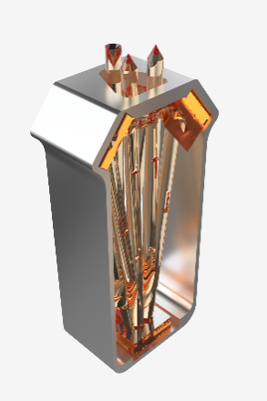
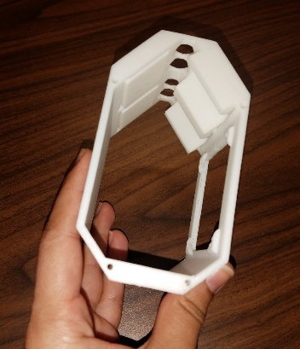
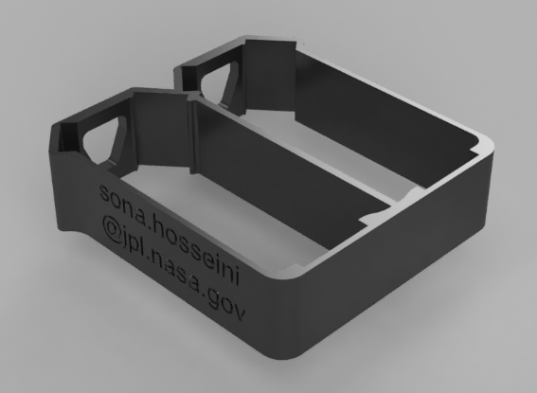
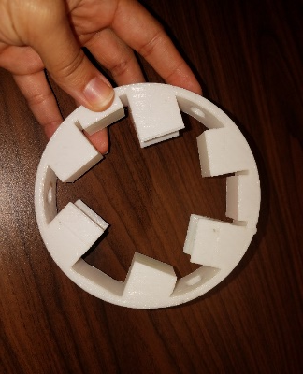
Multi-unit SHS covering multiple species with no moving mechanism
Multi-
units
Isotope ratios
OD/OH | 308 Å separated by ~6 Å
¹⁸O/¹⁶O | ¹⁶OH and ¹⁸OH at 3121 Å separated by < 0.3Å
¹⁵N/¹⁴N | N²⁺ at 3914 Å
Abundance ratios
C₂/CN and CN/OH | C₂ at 5165 Å (¹³CC at 5120-5170Å), CN at 3883Å
CO/OH and CO₂/OH | CO at 1510 Å, CO+ at 3954 Å, CO₂⁺ at 3509 Å, OH at 3090 Å.
Notes:
SNR 100 to 1 will allow me to measure any line to 1%
My uncertainty is 1%
1% equals to 10 per mile
SNR=10 means %10 means 100 per mile is usually good for most things
That argument goes to the weakest line in the measurement
OH: 3086
OD: 3079
We are targeting specifically to measure D/H in cometary coma in various comets preferably as a function on heliocentric distance. But other than D/H we need …… So we can have 3-4 channels and we’re carefully looking to other species such as O or N isotopes that have a key role in solar system disk formation.
I liked what our director Jakob VanZyle said yesterday that to focus on scientific significance in our path for miniaturization.
SHS technology was a science pull concept and if this was a flagship mission, I would showed the same system and said I need this much space… All we care about is the science measurements we can do with SHS. The measurements we’re proposing here have implications for Solar Nebula chemistry vs. heliocentric distance; comet nucleus chemical heterogeneity; the dynamical relation between comet
birth regions and current reservoirs; and the chemical processing of comet material and disk formation by solar heating.
-----------------
1. Determine if carbon-chain depletion in comets is primordial or evolutionary
2. Determine the mechanism that is responsible for carbon-chain depletion.

Slide 16
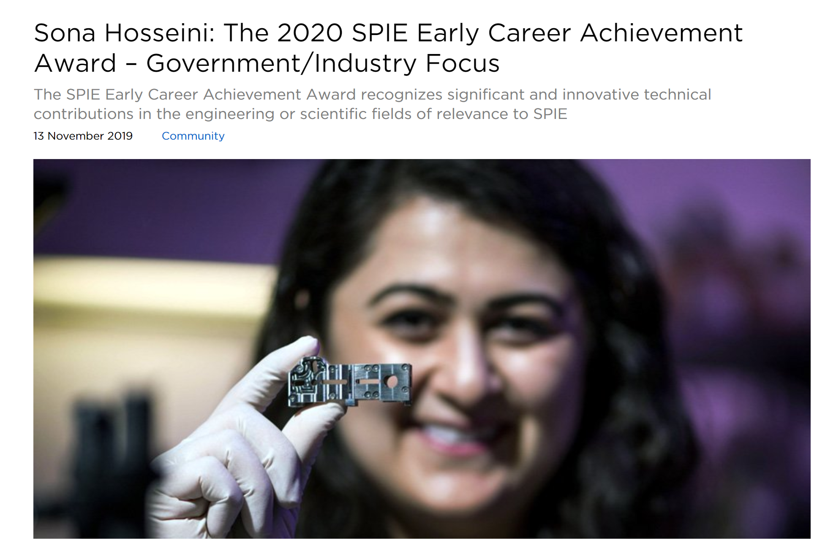
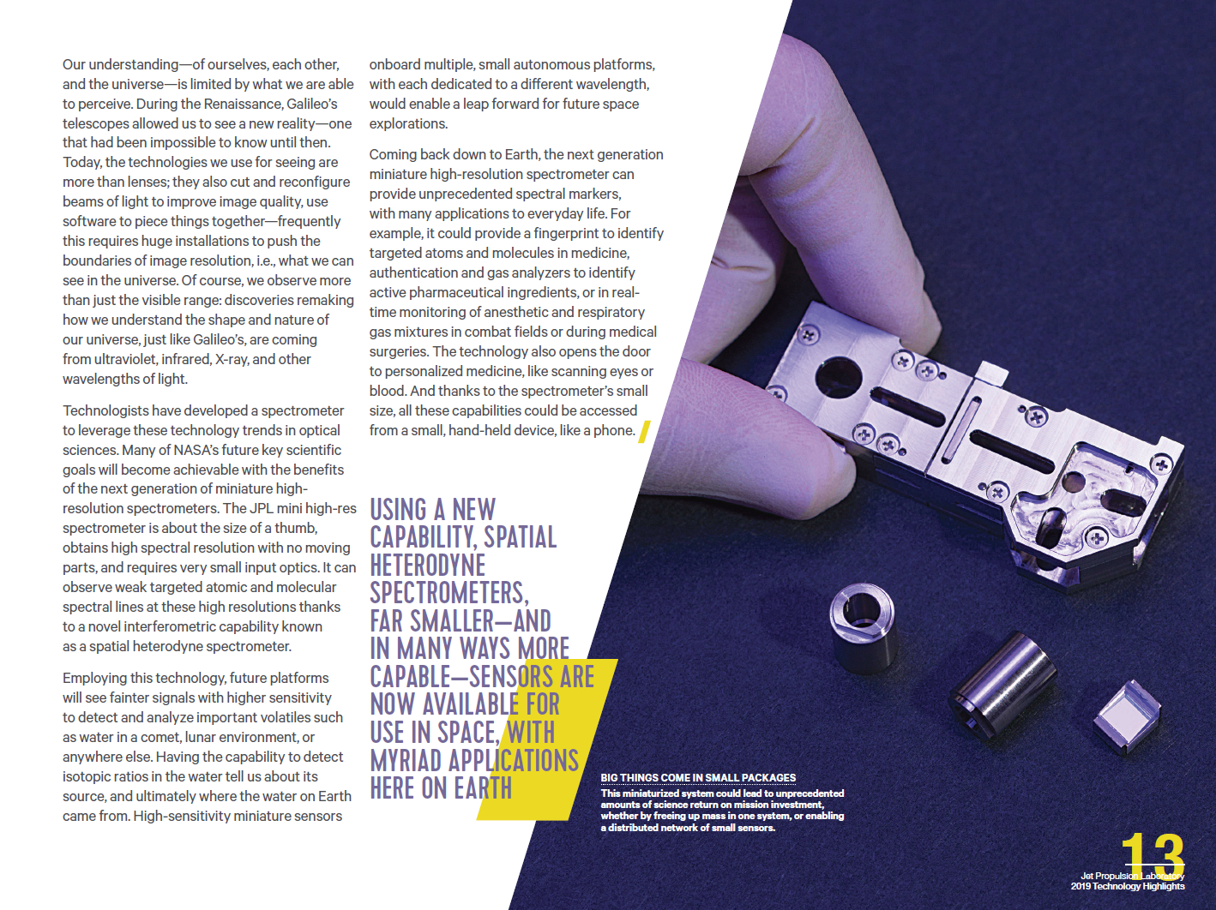


Slide 17
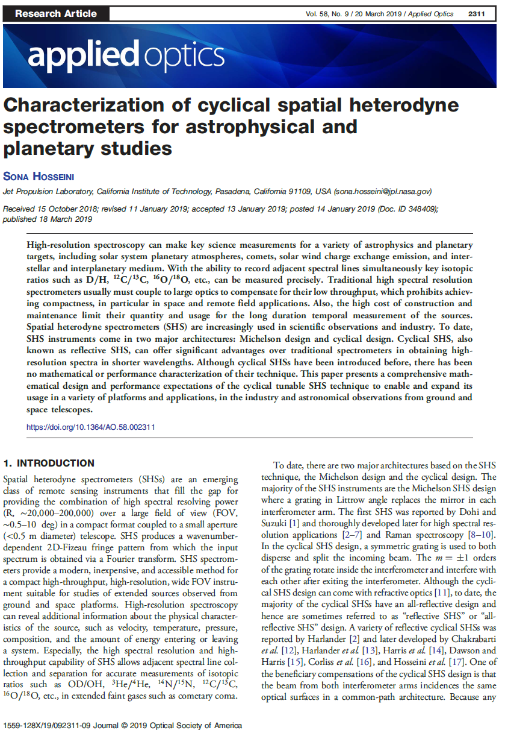

Slide 18
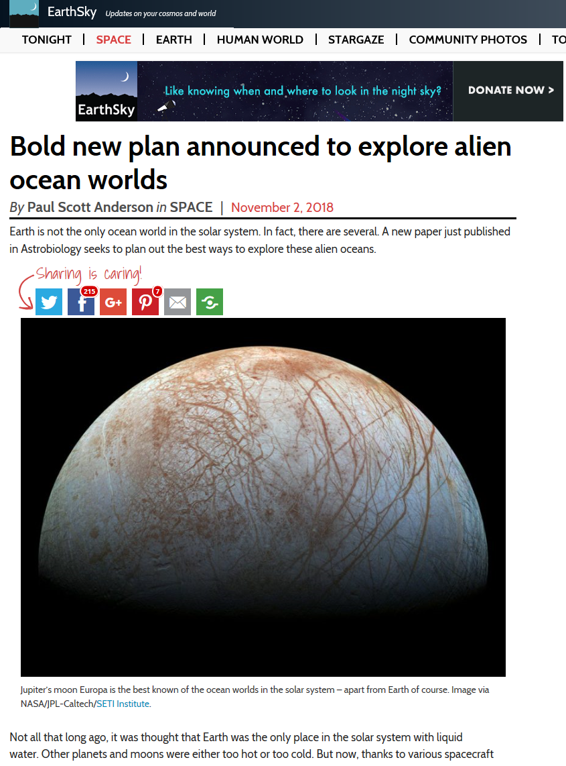
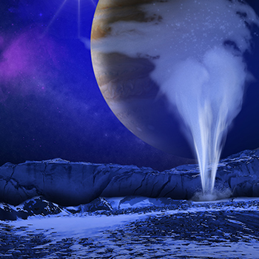
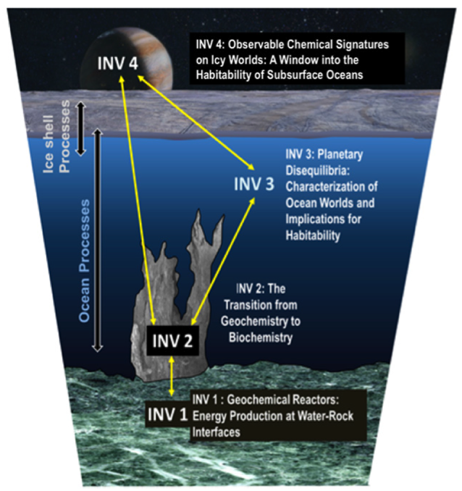
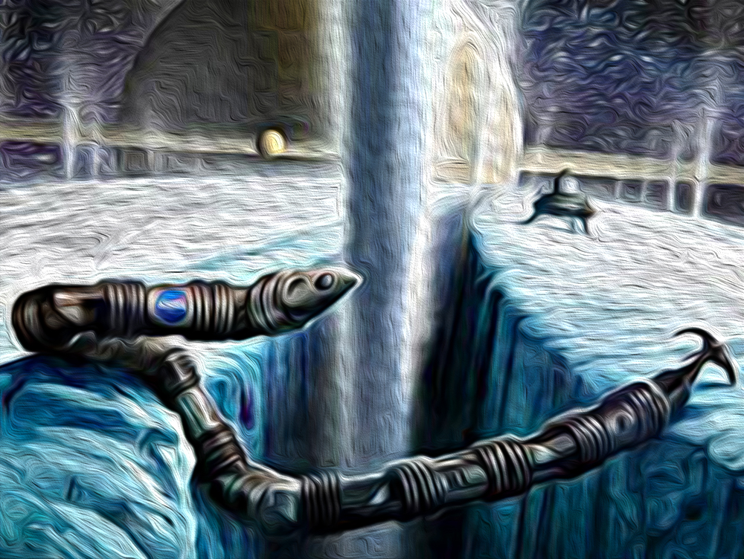
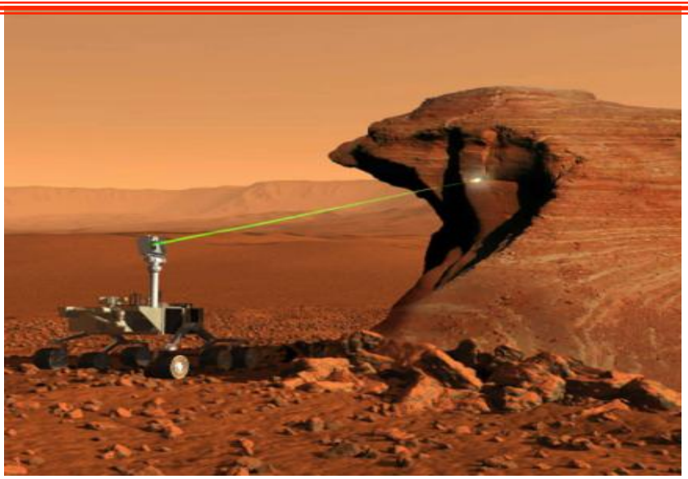
Icy, Ocean, (fill the blank), WORLD

Slide 19
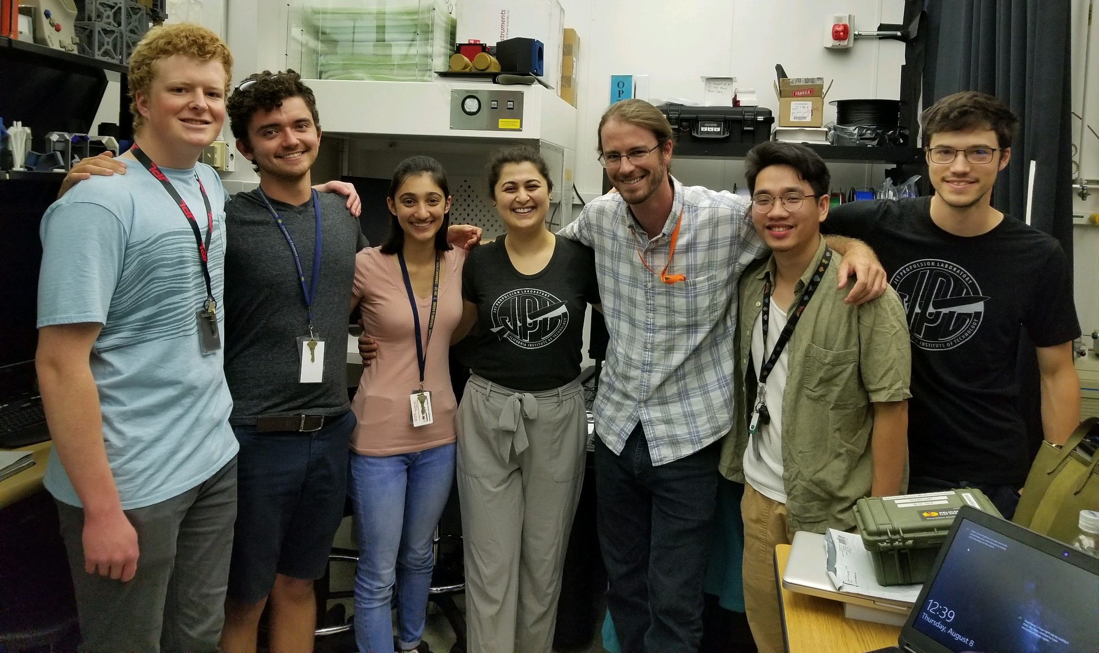


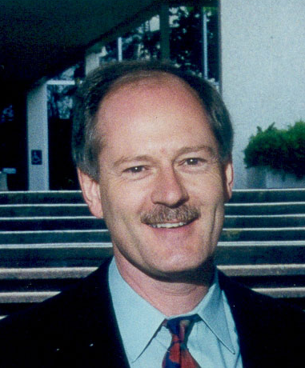

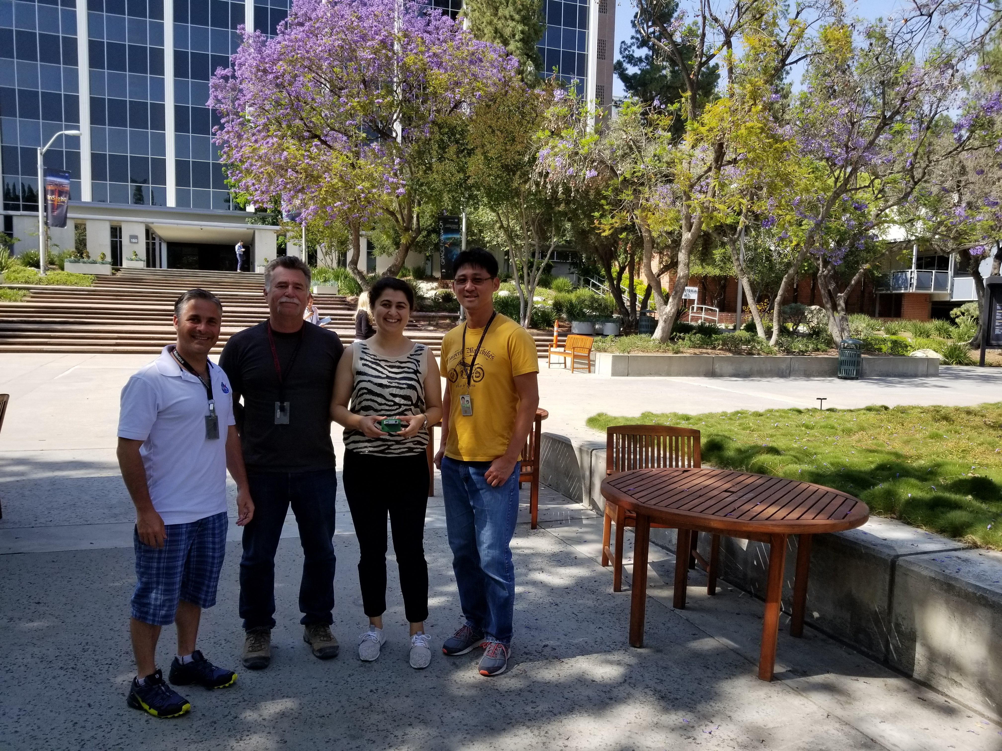
It takes a village
It takes time
It needs $$
sona.hosseini@jpl.nasa.gov
Astrophysics
Interstellar Medium
Lyman-alpha mapping Galaxies
Solar wind interface
Planetary Science
Mars atmosphere
Cometary Coma
Io Plasma Torus
Venus night airglow
Lunar sodium tail
Planetary plums
SHS
SHS
SHS
SHS
SHS
Earth Science
Wind and Temperature profiles
OH and Ozone Measurements
SHS
SHS
SHS
Notes:
In end of my presentation, what I’d like you to take away is that in the case of Spatial Heterodyne Spectrometer the sensitivity doesn’t drop when we go to wider FOV.
It has the capability to obtain spectra over a wide field of view, and high spectral resolution across a broad wavelength range from UV to VIS using small aperture or no coupling telescopes at all. This greatly reduces the mass, volume, cost, and opto-mechanical and temperature issues. Most high R spectroscopy are bound to laboratory studies; SHS can open a new window to do new exciting science in high spectral resolution from compact platforms from space.
Spatial Heterodyne Spectrometers can be tailored to specific mission science objectives on variety of platforms Cubesat, ISS, orbiting spacecraft, and flybys, and we can consider it for Discovery, New Frontiers, Explorer, flagship, in Astrophysics, Planetary Science or Earth Science missions.
With that note, I would be happy to answer your questions.

Slide 20
Backup

Slide 21
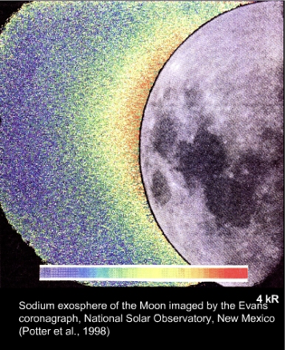
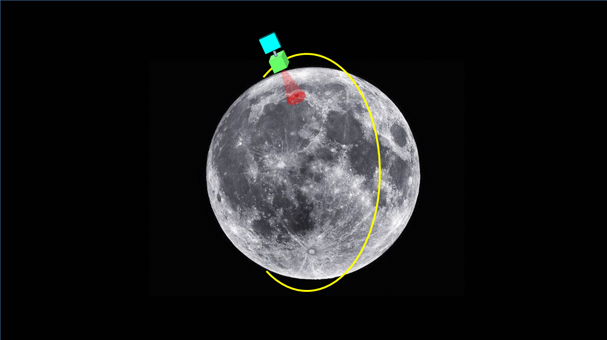
Little is know about the Lunar exosphere
Characterize the existence of a lunar volatiles, i.e., OH
Potential detection of the full extent of the lunar OH tail
Acquire seasonal lunar limb observations
Spatial resolution: 1.7 km
Spectral resolution- Band 307.3 nm
  Resolving power R = 72,000
  Resolution: Δλ ~ 0.1 Å
Exposure time: 7sec
No mechanisms or moving parts
Detector temperature: -20 C
Passive cooling for detector
The goal is to measure OH intensity in 308nm vs.
  Solar photons, Solar Energetic Particles, Solar wind, Meteoric influx, Large impacts
Hosseini, Davidsson
under submission

Slide 22
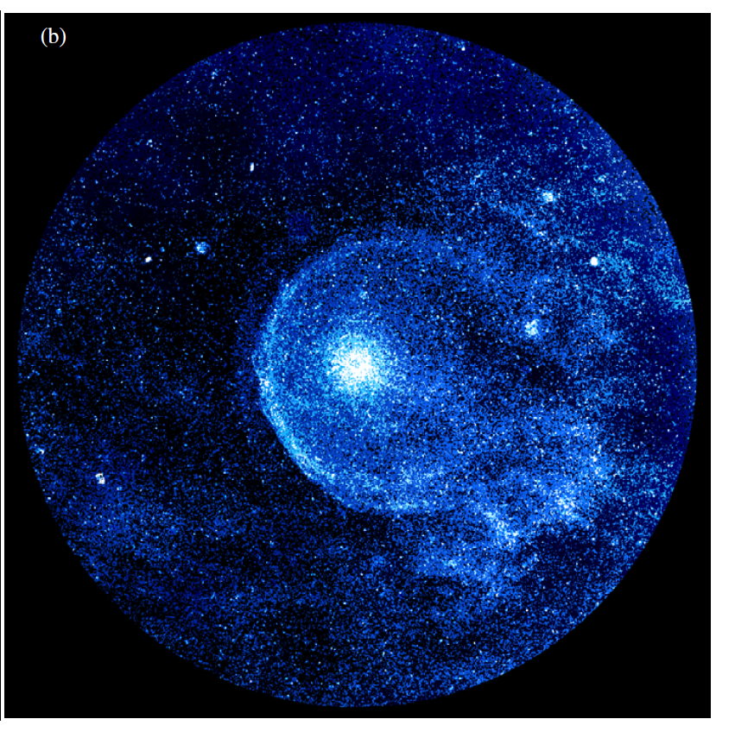
We have no spectra from Astrospheres because they are faint
Deepest imaging study for the most well studied AGB star (Asymptotic Giant Branch Star), IRC+10216 detects the circumstellar envelope to a radius of ∼200 arcsec,
GALEX FUV images detect envelope to 6x radius
Mass lost is > 1.4 M_{sun} over a period > 69,000 yr
FUV emission from astrospheres
likely due to line-emission in the Lyman-Werner emission band of H₂ collisionally excited by hot electrons in shocked gas (from models of low-spectral-resolution GALEX grism spectra of one object).
High-resolution spectroscopy at 1610 Å needed to confirm the nature of the emission, and determine the physical properties of the emitting region.
FUV
20'
GALEX FUV image
Sahai & Chronopoulos 2010
Hosseini, Sahai
under submission
Notes:
The total number of astrospheres detected around mass-losing AGB stars (and a few
supergiants) is about 55, either in the far-infrared (70 micron with Herschel), or in the FUV (with GALEX). Out of these, the number of published FUV objects is 5. I have another
~5 unpublished ones in the FUV. The number of FUV-detected objects is small simply because GALEX didn't do a survey of these, whereas for Herschel, a dedicated survey was carried out, of 78 objects.

Slide 23
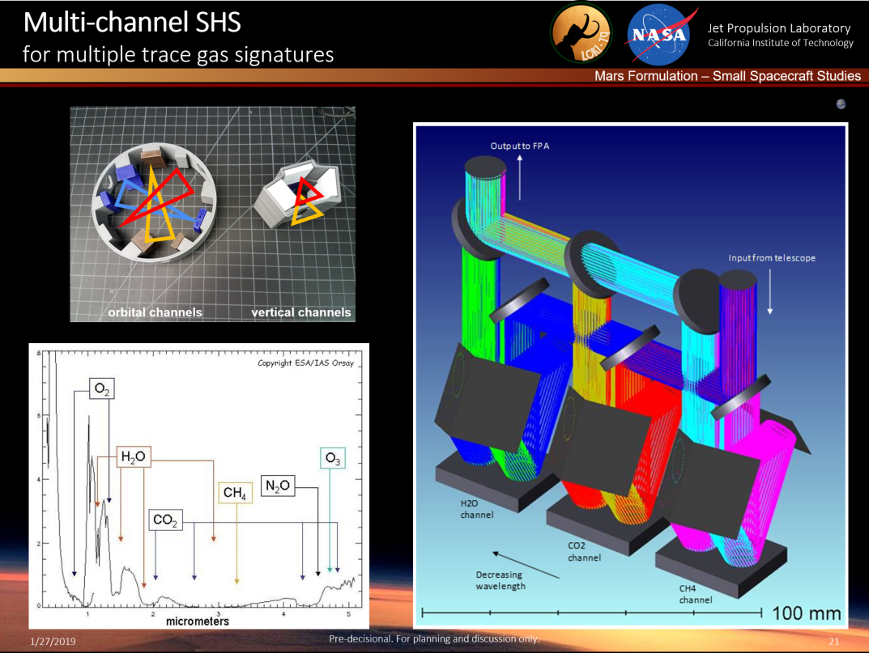
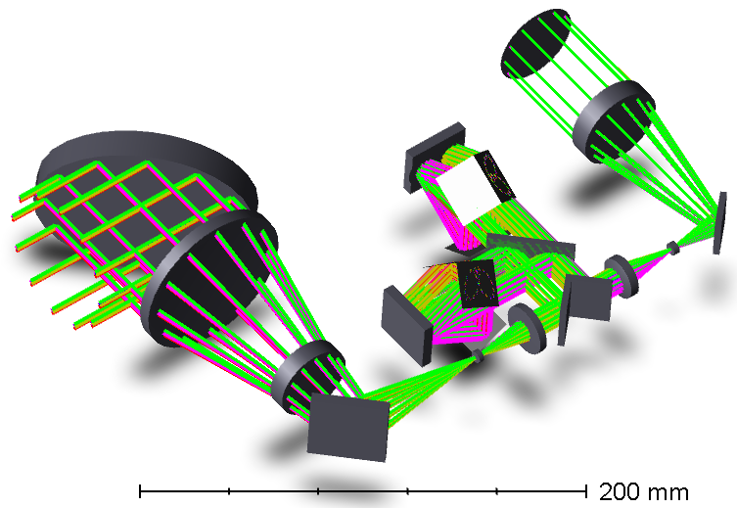

Slide 24
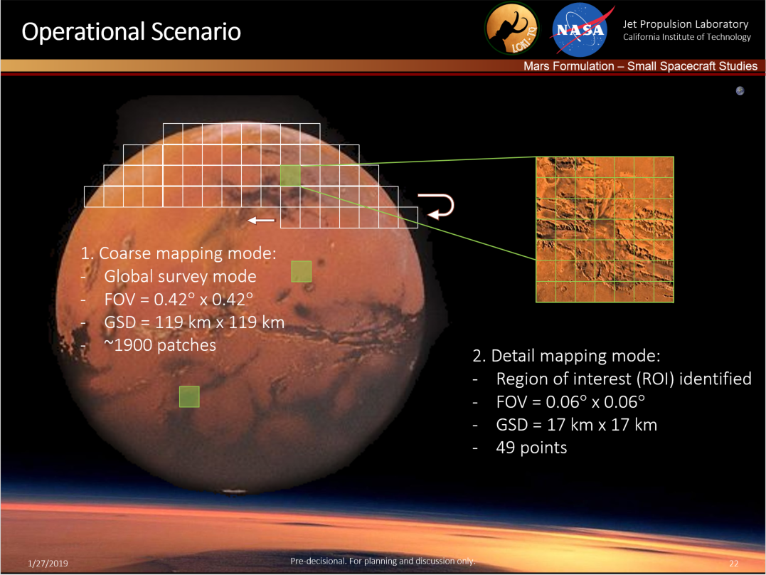

Slide 25
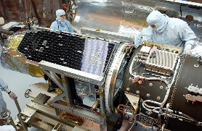



Miniaturization can maintain sensitivity
 | GALEX | HUBBLE - STIS | HUBBLE - COS | SHS
Spectroscopy Technique | Grism and bandpass filters | Dispersive grating | Dispersive grating | Interferometric
Telescope Aperture | 0.5 m | 2.4 m | 2.4 m | 0.3 m
Wavelength | FUV band = 1344–1786 Å | “140M” channel = 1140–1741 Å | “G160M” channel = 1405–1775 Å | 1200–1700 Å
Spatial Resolution | 4.3 arcsec (FUV), 5.3 arcsec (NUV) | 0.2 arcsec | 2.5 arcsec | 45 arcsec
Spectral Resolving Power | 250–300 | 10,000 | 20,000–24,000 | 144,000
Detector QE | MCP, 12% | CsI, 25% @ 1216 Å | MCP 32% @ 1216 Å | CCD, 40–50%
Notes:
Traditional slit-spectrograph have to disperse the low photon flux into a large number of spectral resolution elements, and hence lack the sensitivity for detecting faint FUV emission spectra. AMUSS’s technology combines the high spectral resolution with a wide field of view (FOV) and high throughput. The maximum acceptance FOV in AMUSS is 21 arcmin, 7 arcsec. But for a strawman comparison, the FOV of AMUSS in this table corresponds to when AMUSS is coupled to a 0.3m telescope in a SmallSat form factor. The picture in the last column is a full-scale 3D model of miniaturized reflective SHS for 1610 Å wavelength in AMUSS. The full description of the AMUSS targeted wavelengths is shown in Table 2.

Slide 26

Na lamp D line separation demonstrative the high spectra resolution
D₂=5889.9
D₁=5895.9
R~ 49000
FOV~ 30’ 19”
Hosseini, 2019
Notes:
The SHS data are a set of interference fringes, for every emission line I have a set of fringes and a 2D-FT of the fringes will give us the integrated power spectra over the FOV.
Here is a data I took from the Na Lamp D lines. Look how far apart the (Delta= ) 5.97 Å. I was able to hand tune from one D line to an other D line. The reduction here shows 49000 R at about 30’ FOV.
The data reduction process can be done on board in space or in the ground. For smallsat purposes, an important factor is that because we get the information from all the bandpass at once, the data volume is considerably low.
This data is taken from my first SHS prototype that I’ve built at …

Slide 27

Astro2020 White paper
February 2019

Slide 28

Astrophysics RFI
November 2017

Slide 29

Journal of Telescopes and Astronomical Instrumentation
Under final revision
March 2019

