Slide 1
Developments in Lunar Compact Instrumentation for Small-scale Applications.
Pamela E. Clark¹, Robert L. Staehle¹, David Bugby¹
Acknowledgements: Contributions from the following in compiling information on instruments under development: Robert L. Staehle¹, David Bugby¹, Abigail Fraeman¹, Robert O. Green¹, R. Glenn Sellar¹, Stojan Madzunkov¹, Frank Maiwald¹, Nan Yu¹, Adrian Tang¹, Corey Cochrane¹, Craig Hardgrove², Michael Collier³, Vassilis Angelopoulos⁴
¹Jet Propulsion Laboratory/California Institute of Technology
²Arizona State University, School of Earth and Space Exploration,
³NASA/GSFC
⁴UCLA, Institute for Geophysics and Planetary Physics
Note: This is predecisional information for planning purposes only.
National Aeronautics and Space Administration
Jet Propulsion Laboratory
California Institute of Technology
Pasadena, California
www.nasa.gov
© 2016. All rights reserved.
Government sponsorship acknowledged.
Jet Propulsion Laboratory
California Institute of Technology

Slide 2
Why now?
Goals: High priority interests of NASA HEOMD, SMD, STMD, and Commercial space science and exploration, as well as cislunar space operation interests coincide driven by unexpected discoveries and lunar initiative
Objectives:
determining the global distribution and origin, as well as resource inventory, for water and other potential in-situ resources at local-scale resolution;
Monitoring and modeling the nature of the radiation/charged particle /exosphere/micrometeorite/ surface/subsurface interactions constituting the lunar environment and impacting performance and health of the crew and their equipment;
Monitoring and modeling the lunar interior and constraining the Moon's history and origin with implications for evolution of the Earth Moon system.
Establishing communication and transportation infrastructure in support of assets used to achieve these goals
In response:
JPL and others developing a diverse set of compact instruments and instrument suites, as well as high performance adaptable packaging options suitable for a wide range of instruments
Applicable to orbital or surface handheld, crew-deployed or rover-mounted devices to achieve wide range of goals

Slide 3
Matching Planetary Goals with Instrumentation via the Moon
Planetary Decadal Survey Goal | Measurement Context | Instruments | Examples
Origin of and relationship between terrestrial planets, extrasolar systems | in situ isotopic, elemental, volatiles (molecular), mineralogical, textural, geochonrological, regolith, rocks, ‘new’ sites, dealing with contamination. Reverse stratigraphy observed from mobile platforms. | X-ray spectrometer X-ray imaging Gamma-ray spectrometer Neutron spectrometer Active mass spec (LIBS, LAMS) Active Gamma-ray/Neutron Compact IR spectroscopy Compact IR imaging Compact active near IR imaging In Situ geochronology Mass spec w/ in situ chromatography | MIT REXIS JPL PIXL PSI GRAND U of A LunaHMap LANL ChemCam (JPL MSL) GSFC SINGR GSFC/JPL BIRCHES JPL UCIS, SILVIR JPL Lunar Flashlight JPL RbSr KAr concepts GSFC SAM; JPL QIT-MS
Nebular/Accretion Processes, Early Solar System, Bulk compositions, volatile budgets, differentiation
Crust/mantle/core materials, new rock types, robust sampling,
Early planetary evolution, external processes, and origin and evolution of life
Internal processes involving volatiles, polar deposits | Deployable network interior characterizers, lander or rovers with special attention to past or current ‘active’ regions. Cryogenic sampling. | Compact Cameras MicroImager Ground Penetrating Radar Magnetometer Seismometer Heat Flow Laser Reflector | JPL EECAM, JPL MMI JPL, Natl A&S Museum, GPR JPL/UCLA Fluxgate, VHS JPL SEIS, uSeismometer JPL ALGEP (Banerdt) JPL (Turyshev)
Crust/mangle/core materials, interior structure, stratigraphic record, dynamics, heat loss
Surface Processes: regolith character and formation, impact processes |  | Geotechnical sensors (Mech, EM, thermal) Regolith particle analyzer | KSC MECA, SWRI DART COTS Microbrook Eyetech
Environmental processes: solar wind, plasma, IMF, micrometeoroid, radiation, exosphere interactions | Deployable environmental/ surface safety network monitoring surface dynamics | Mass Spectrometers Particle analyzers (ion/electron) Electric Field Instrument Dust Detector UV Spectrometer Radiation Detector | JPL QIT MS GSFC HALO, SIMS GSFC EPDA GSFC EPDA ARC LADEE UVS UNH DOSEN
technology development, new directions, human exploration | landing low cost, compact deployable packages with 24/7 operation (dynamics, ground truth) or sampling downselect | All in situ instruments especially needing to operate in the dark (polar volatiles) | See Above

Slide 4
Compact Instruments: The table summarizes the target characteristics, including mass, power, and volume, of certain instruments of primary interest already under development via NASA DALI, CLPS/NPLP, GCT and SIMPLEx programs, supplemented by JPL internal funding in some cases.
Some Lunar Surface Instrument and Instrument Suite Candidate Characteristics
Instrument | Type | Mass | Power | Volume
UCIS-Moon | IR Imaging spectrometer 600-3600 nm | 4 kg | 20 W when operating | 4U
NRVSS (VIPER) | Vis to Mid IR Imager, neutron spectrometer | ?? | ?? | ??
HVM3 | IR Imaging spectrometer | 12 kg (includes radiator) | 15 W | 56 cm3
QITMS | Mass Spec | 7 kg | 24W when operating | 8U
MMI | microimager | 1 kg | 5 W when operating | 1U
HOLMS | OH heterodyne spectrometer | ?? | ?? | ??
miniGPR | Ground penetrating radar | 1.5 kg | 1W when operating | 2U
miniNS | Neutron spectrometer | 0.5 kg | 5W when operating | 1U
miniENA, miniESA | Electrostatic analyzer and energetic neutral analyzer | <1 kg each | 1W each | 1U each
Dual magnetometer | VHM and FGM | 0.5 kg FGM, 2 kg VHM + booms | <1W FGM, 2.5 W VHM when operating | <0.5U FGM, 2U VHM
Mini water prospectors | Mini IR camera (filter), miniNS, miniGPR | <3 kg | 8W when operating | 3U
water cycle monitoring stations | IR imager, miniESA, miniENA, miniNS | 5 kg | 2 W night, 9W day when operating | 5U

Slide 5
Types of Instrumentation and Challenges
Physical and compositional properties of local terrains.
Vis/IR cameras and spectrometers, High energy spectrometers, surface to subsurface compositional and mineralogical and volatiles assessment.
Artemis 1 instruments (Lunar Flashlight, LunaH-Map, Lunar Ice Cube (BIRCHES), from which spin-offs proposed
UCIS (DALI) abd HVM3 examples of IR imagers, UCIS with emphasis on selected water absorption bands
NRVSS VIPER Vis to IR and neutron spectrometer package
MMI at soil particle scale mineralogical and petrological assessment, handheld to rover mounted applications
Operational Challenges: viewing apertures (thermal); temperature stability for optics, cryocoolers for Vis/IR
Exospheric species abundances.
Tunable Laser Spectrometer or Mass Spectrometer to assess nature and cyclic variability of exosphere as well as human impact.
Deploy as exosphere monitor network.
could quantify the fall-off in gas emissions from equipment left behind as “atmospheric” conditions return to the natural background.
If surface-exposed volatiles are present, diurnal signal could be detected through the lunar day and night, especially near local sunrise.
Operational Challenges: 24/7 operation, power, apertures (thermal)

Slide 6
ARTEMIS Cubesat Pioneers, DALI example, MicroImager

Slide 7
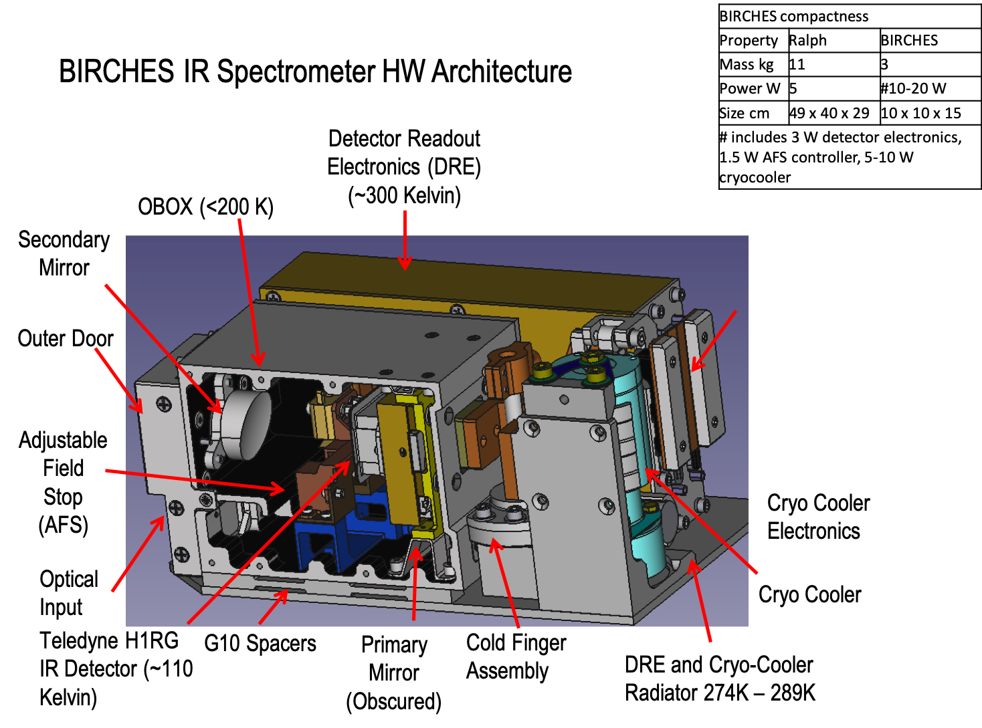
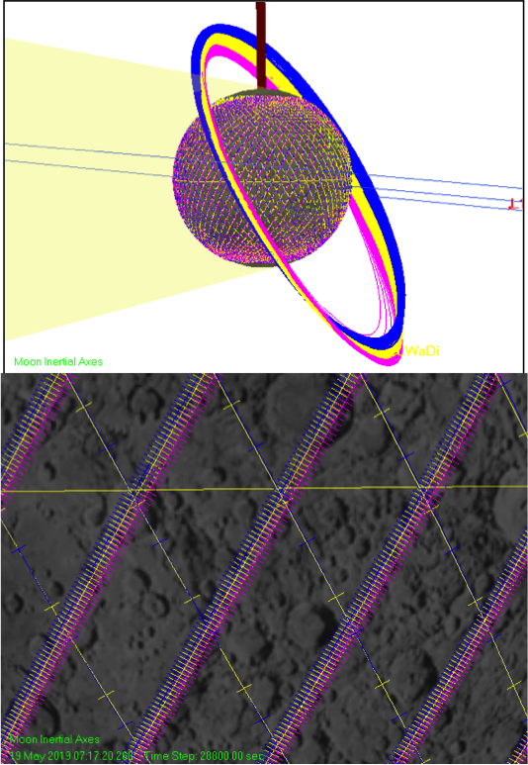
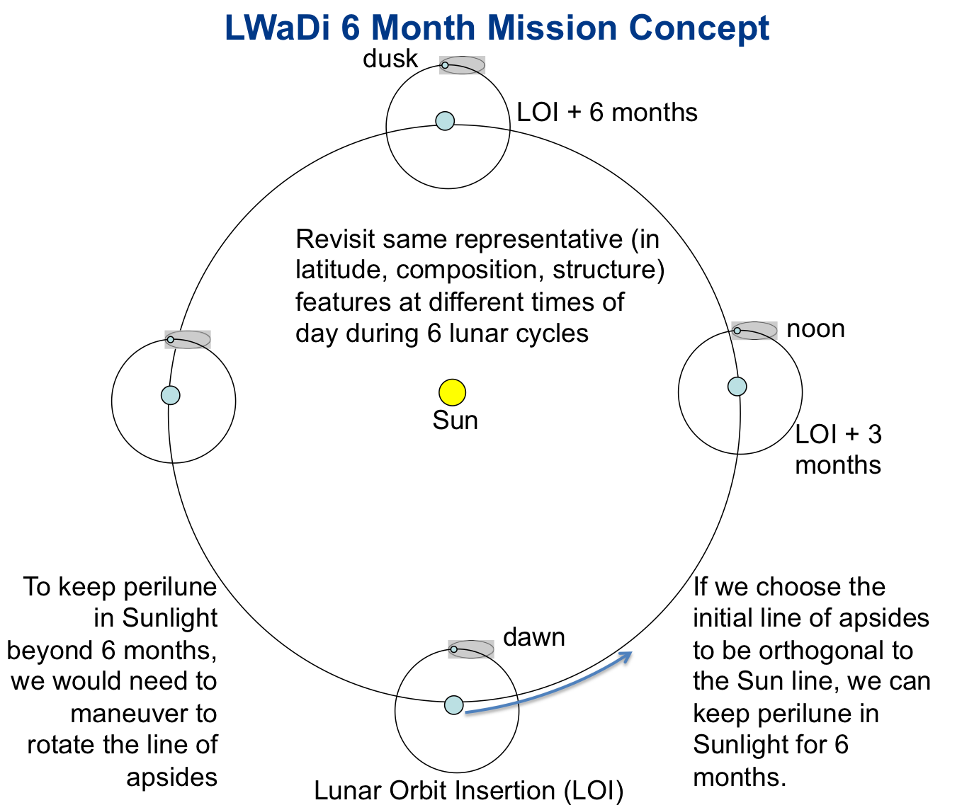
Description: Broadband IR Compact High Resolution Exploration Spectrometer (BIRCHES) on Lunar Ice Cube.
Measurement Advances: Measure forms and components of lunar water as function of time of day, latitude, and terrain from orbit requiring encompassing broad 3 micron band with detection limit >100 ppm and up to 10 km spatial resolution. Applicable as surface monitoring instrument.
Technology Advances: Cubesat (6U) scale point spectrometer, based on Reuter line of LVF/MCT instruments with cryocooler necessary to operate out to 3.5 microns in extremely challenging thermal environment for measuring water components and forms.
Approach/Milestones
Leverage OVIRS (OSIRIS REx) flight spares, utilize first cubesat-scale cryocoolers (AIM/IRIS).
Final Testing of instrument by late winter 2020, Final integration with spacecraft by early autumn 2020.
Team: Clark (Science PI), GSFC: Instrument build and test (Brambora, Hurford, Patel). Morehead State University: Lunar Ice Cube mission (Malphrus PI, Brown)

Slide 8
Description: Compact Neutron Spectrometer on LunaH-Map mission.
Measurement Advances: Measure decrease in epithermal neutron flux (>/= 20%) associated with protons (ice) to 10's cm depth at south pole within <2 degrees of pole with 7.5 km spatial resolution. Applicable in surface prospecting.
Technology Advances: Cubesat scale (6U) neutron spectrometer, with more efficient, and thus compact, CLYC detector.
Approach/Milestones
Leverage advances in neutron detectors (CLYC).
Final Testing of instrument by late winter 2020, Final integration with spacecraft by early autumn 2020.
Team: Hardgrove (PI) (ASU)

Slide 9
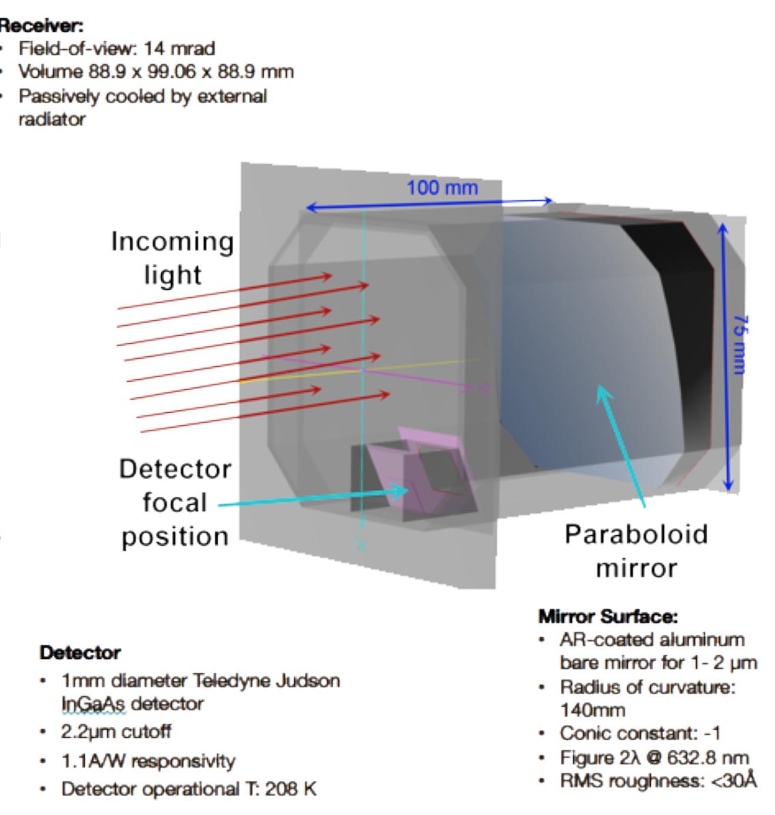
Description: Compact instrument for ice detection through use of optical receiver aligned with lasers emitting at wavelengths associate with water ice absorption and continuum on Lunar Flashlight mission
Measurement Advances: Ratio continuum and absorption reflectance bands to quantify surface ice abundance in permanently shadowed areas at for >0.5 wt % ice with 1 km spatial resolution with. 10 degrees of South Pole. Applicable as surfacd prospecting instrument.
Technology Advances: Cubesat scale (6U) active near IR spectrometer. Use of laser technology in extremely challenging thermal environment.
Approach/Milestones
Leverage advances in laser technology.
Final Testing of instrument by late winter 2020, Final integration with spacecraft by early autumn 2020.
Team: Baker (JPL), Cohen (GSFC).

Slide 10
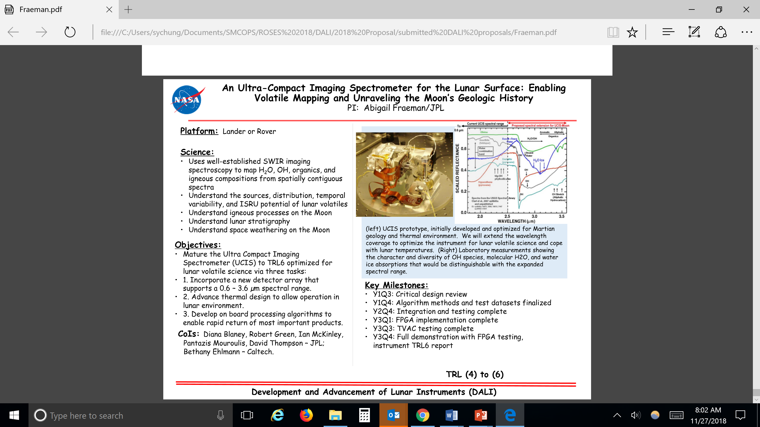

Slide 11
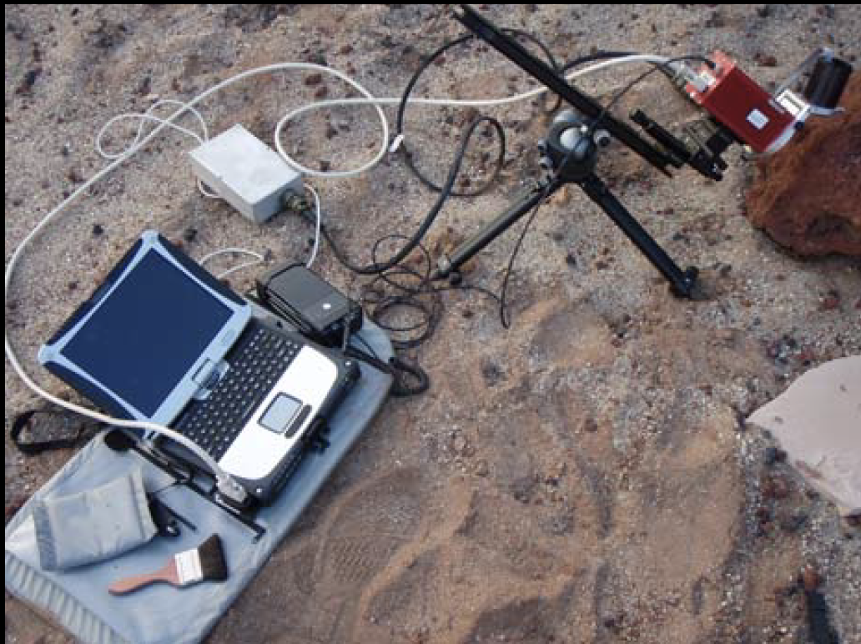
Multispectral MicroImager
Description: Compact, low-cost Multispectral Microscopic Imager (MMI) to provide petrographic (microtextural) information on composition and color to reveal origin and history of sample.
Measurement Advances: Spectrometric capabilities added to MER microscopic imagers (MI). Multiple bands and range (visibile to near IR) extend ability to characterize mineralogy and allow more effective sample screening
Technology Advances: Advance MI to be rugged, portable instrument with built in sources (LEDs) with no moving parts to be mounted on rover or tripod.
Approach/Milestones, TRL 4 to 6
Build and test prototype based on field unit.
Team: Sellar, Farmer (ASU), Nunez (ASU)
Left: MMI 25 x 30 mm subframes A. natural color composite, B. translated color composite, C. mineralogical map. Right top: reflectance spectra of end-member minerals mapped in C. Right bottom: Field unit.

Slide 12
Types of Instrumentation and Challenges
Internally generated and bombardment-induced seismic activity.
Range of small spectrometers being developed via DALI or JPL internal funding, SEIS spinoff from INSIGHT.
As in the case of the mass spectrometer, could be deploy as part of monitor network.
Operational Challenges: thermal stability, deployment including 3D alignment, 24/7 operation
External Environment Fields and particles monitoring
Magnetometers being developed via STMD or JPL internal funding.
Compact particle analyzers being developed elsewhere (electrostatic analyzers, energetic neutral analyzer at GSFC)
Operational Challenges: thermal: booms (magnetometer), stability; aperture (analyzers), 24/7 operation
Extended Resource Prospecting and Resource Cycle Monitoring:
Programmable mini-rovers traverses in areas identified as 'promising' in terms of potential resources
water prospector package characterize surface/subsurface water to a depth of 1 to 2 meters
mini Ground Penetrating radar now under development at JPL, which would yield variations in dielectric constant (and by implication water ice) to a depth of a few meters with a resolution of 10 cm.
Stations with IR imager and neutron spectrometer (surface/subsurface), exospheric species characterizer, solar wind analyzer constrain global water transportation, source, and sink models
Operational Challenges: high power demand, access to PSRs (rovers), 24/7 operation in situ instruments (station), thermal stability (optics) and cryocooler (IR imagers)

Slide 13
Instrument Suites

Slide 14
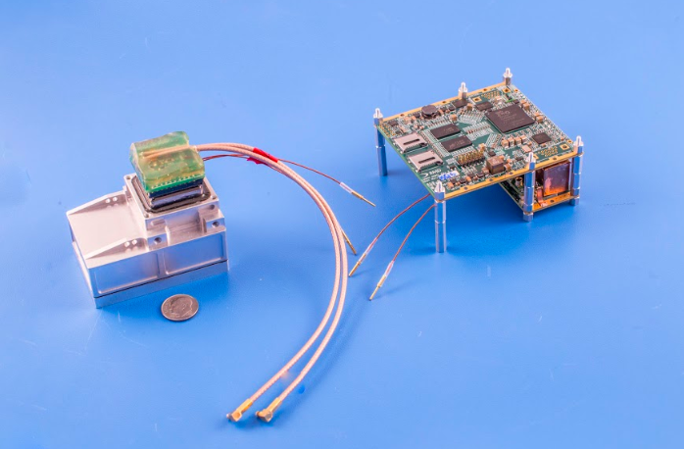
Instr | Surface |  | Depth |  | Specificity | Quantification | Mass | Power
 | coverage | sampling | max | sampling
MIRC | Map (surface) | ~ 0.1 m | surface only | surface only | H₂O | ± 0.5 % (at surface) | 0.5 kg | 5 W (peak)
 |  |  |  |  | other volatiles
NS | Discrete measurement (subsurface) | ~ 10 m | 1 m | integrated | H-bearing species | ± 1 wt % | 0.4 kg | 5 W (peak)
GPR | Continuous traverse (subsurface) | ~ 1 m | 2 m | 0.1 m | dielectric constant | ± 1 % (volume) | 1.5 kg | < 1 W
Mini Water Prospector
Description: Small fleet of prospecting mini-rovers with compact instrument package needed to prove lunar water/ice reserves by acquiring local ground truth in most probable locations (e.g., multiple PSRs).
Measurement Advances: Miniaturized instruments capable of characterizing and constraining water/ice/hydroxyl abundance from surface to ~1 meter depth:
Multi-band InfraRed Camera (MIRC) – designed to see into PSRs using rim-scattered light. Option to add short-range IR LED illumination.
Neutron Spectrometer (NS) – miniaturized for small rovers (leverages NASA investments in LunaHMap, MatISSE)
Ground Penetrating Radar (GPR) – miniaturized for small rovers
Using mini-rover platforms to take measurements separated by meters (resolutions currently >100 m) along traverses to allow discovery, mapping, and grading of locations of lunar ice deposits sufficient to support ext raction of tens of metric tonnes/month.
Technology Advances/Approach:
1) Leverage instrument development of JPL CIRAS HOTBIRD (TRL 5-6) or DALI UCIS detectors (TRL 4-6), ASU Mini-NS (TRL 5-6), JPL GPR (TRL 3-6),
2) Leverage Generic Compact, Low Resource, High Performance Packaging (ARTEMIS/PALETTE);
compact versions relevant instrumentation (above)
3) Low Cost Commercial Landers
Team: Staehle, Sellar, Clark, Tang, Hayne (CU), Hardgrove (ASU)

Slide 15


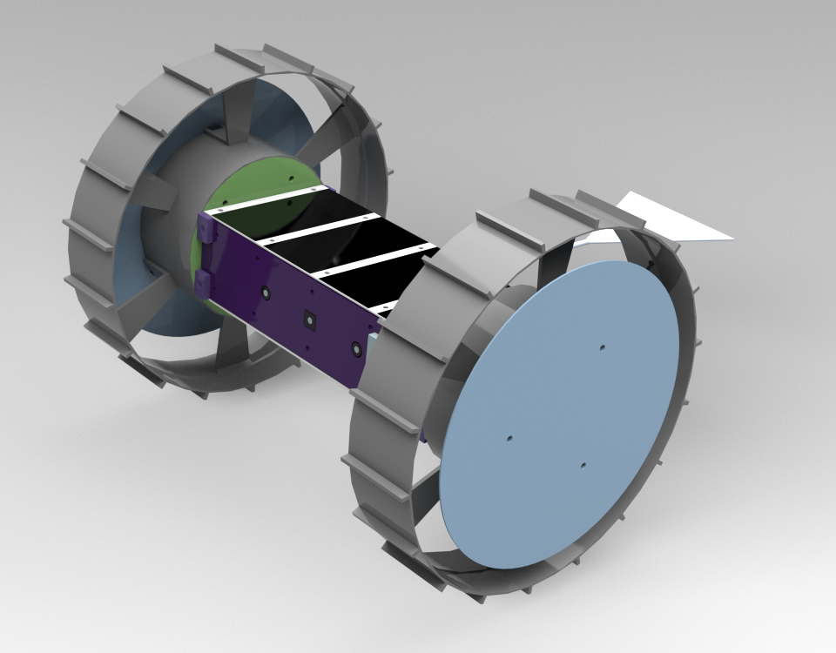
Multi-agent Autonomous Roving Ground-penetrating radar Explorer MARGE
PI: Daniel Nunes, Jet Propulsion Laboratory
Target: Lunar subsurface from 10’s of centimeters to 10’s of meters.
Science:
Detect the presence and map the distribution of water ice in lunar regolith
Detect the presence and map the path, depth and geometry of voids or lava-tubes in the lunar subsurface
Detect the presence and map the distribution of lunar pyroclastic deposits in the regolith
MARGE agent
Objectives:
Integrate ground-penetrating radar, mobility and autonomy into a compact agent
Conduct autonomous multi-agent surveys on the Moon
Characterize the science targets with a lateral resolution of at least 0.5 m and a depth resolution of 15 cm.
Key Milestones:
Test integration of TRL-4 subsystems into the prototype platform (Yr-1) and functionally test it.
Develop MARGE-1 agent, followed by environmental and field testing.
Develop MARGE-2 agent, followed by environmental and field testing.
Field multi-agent test MARGE-1 and MARGE-2
CoIs: Kalind Carpenter, JPL; Neil Chamberlain, JPL; Jean Pierre de la Croix, JPL; Mark Haynes, JPL; Soon Sam Kim, JPL
TRL 4 to 6
Development and Advancement of Lunar Instrumentation Program (DALI)
Notes:
NASA’s next Mars surface mission to follow MSL will advance the search for signatures of habitability and begin focusing on detection and structural characterization of a wider range of complex organic compounds, both volatile and nonvolatile, in carefully selected samples. The knowledge to be gained with MSL on the host environment, preservation, concentration, and complexity of organics found at Gale Crater may lead to a highly streamlined sample search and selection process at a future landing site. An organic analysis investigation would then have the significant opportunity to examine not only the bulk organic inventory, but the detailed structural diversity and fine spatial distribution of that inventory, directly informing critical aspects of habitability and feeding forward to Mars Sample Return. At the same time, given very limited expected payload resources, an appropriately advanced organics analysis capability must be realized with instrumentation miniaturized well beyond the current state-of-the-art in flight hardware. Moreover, the associated investigation must now be sufficiently well-defined to achieve technology readiness level (TRL) 6 in the next two-to-three years, depending on the mission opportunities, severely limiting the range of potential advanced approaches. We propose to develop to TRL 6 a next-generation Linear Ion Trap Mass Spectrometer (LITMS) investigation that directly and
fully addresses these measurement and development objectives. LITMS combines two extremely powerful approaches to organics analysis, those of pyrolysis gas chomatography/mass spectrometry (GCMS) and Mars-ambient laser desorption mass spectrometry (LDMS), linked through a single, highly-miniaturized linear ion trap (LIT) mass analyzer. The LITMS effort will take advantage of the significant recent development (also to TRL 6) by our team of the Mars Organic Molecule Analyzer - Mass Spectrometer (MOMA-MS) for the 2018 ExoMars mission. LITMS will feature further miniaturization and substantial analytical enhancements, identified during
the MOMA-MS development but not realized due to schedule or mission architecture limitations. These include the ability to analyze both positive and negative ions, the extension of the mass-to-charge (m/z) range to lower values to detect elements, and enhanced performance with tandem mass spectrometry (MS/MS) for structural analysis of complex organics. In addition, LITMS will include integrated development in conjunction with newly-developed sample processing and handling technology, that will enable direct pointby- point laser analysis of nonvolatile organics along the length of an extracted drill core, without having to remove or process fines and
thereby without any fundamental limitation on the number of such analyses during the mission.

Slide 16
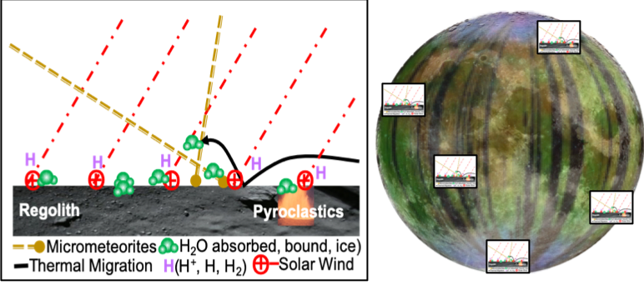
Mini Water Cycle Monitor
Description: Global Lunar Organized Water In-Situ Network (GLOWIN) is a multi-platform Lander mission concept that would provide simultaneous globally distributed lunar in situ spectral and particle measurements essential for wholistic understanding of volatile processes resulting from high energy particle/surface/ subsurface/exosphere interactions.
Measurement Advances: Current understanding of lunar water is derived from spectral and remote (orbital or ground-based observations. The nature of in situ local-scale regolith interactions is lacking. A network of lander in situ measurements for at least a year would provide the basis for a high-fidelity global water model. Lander packages would consist of instruments capable of providing: solar wind flux (source of H+) (ESA electrostatic analyzer e.g. ESA); the state (ice, liquid, vapor) of surface adsorbed or bound OH, H2O (IR imager e.g. SILVIR or UCIS; exospheric hydrogen, (energetic neutral atom imager e.g. ENA); subsurface water, (neutron spectrometer e.g. mini-NS) and micrometeorite bombardment detector (candidate: acoustic detectors).
Technology Advances: Generic Compact, Low Resource, High Performance Packaging (ARTEMIS/PALETTE);
compact versions relevant instrumentation (above);
Low-cost commercial landers
Approach/Milestones TRL 4-6, 2-3 years to prototype
1 Leverage STMD GCT high performance packaging
2 Leverage ESA, ENA, mini-NS, IR imagers already flight qualified or being flight qualified for other programs
3 Create and qualify 'manufacturable' prototype package
4 Have partner produce multiple protoype-based packages
Team: PI Pamela Clark, CoI’s Bugby, Henegan, Fraeman, Collier (GSFC), Killen (GSFC), Farrell (GSFC), Hurley (APL), LI (U Hawaii)
UCIS
ESA
Mini-NAS

Slide 17
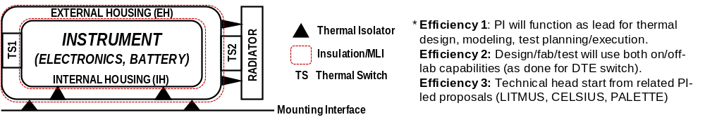
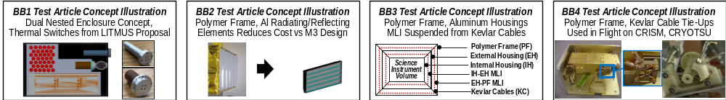
Types of Instrumentation and Challenges
Generic yet Reconfigurable Packaging for Extreme Environments:
A major challenge for small packages, particularly on the lunar surface, is thermal packaging to protect the payload from the lengthy temperature extremes without the need for active control systems requiring power and thus significantly increasing mass and volume needed for batteries during lunar night.
In addition, each type of instrument has challenges peculiar to that type, as indicated above. Is it possible to develop generic yet reconfigurable approaches widely applicable by configuring the same high performance components?
High performance thermal component packaging based on passive thermal design that will allow operation on at least limited duty cycle during lunar night is now being developed and tested through the STMD-funded Planetary and Lunar Environment Thermal Toolbox Elements (PALETTE) project.

Slide 18
Description: Compact Stand Alone Autonomous Instrument Package utilizing Dual Magnetometer Requirements as Example (Program: Team X Study)
Point Design: Team X
Lead: John Elliott

Slide 19
Summary JPL Sensor and Supporting Subsytem Development
JPL and others developing compact sensors and sensor suites tailored for lander decks and legs and requiring minimal sample handling.
  Examples: UCIS-based Low-light imaging spectrometer, mini-QIT Mass spectrometer, INSPIRE/CuSP-derived magnetometer, SEIS INSIGHT-derived broadband spectrometer
JPL developing supporting subsystems (mechanical/thermal/power) package for a range of minimal-resource competitive instrument suites that can survive and operate multiple lunar days without radioisotopes.
  Example: PALETTE
Implicitly development of smart strategies to mitigate the downlink bandwidth bottleneck.
  Example: Operate in 'snapshot' or 'time lapse' modes.

