Slide 1


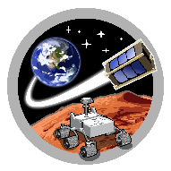
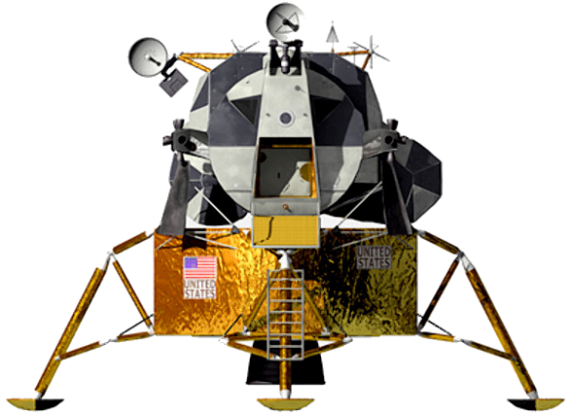
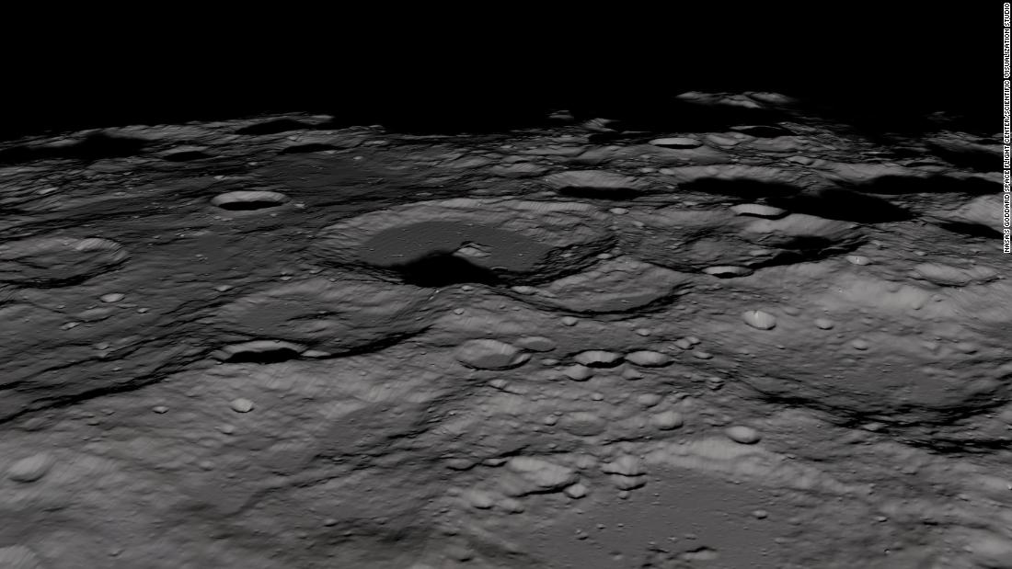
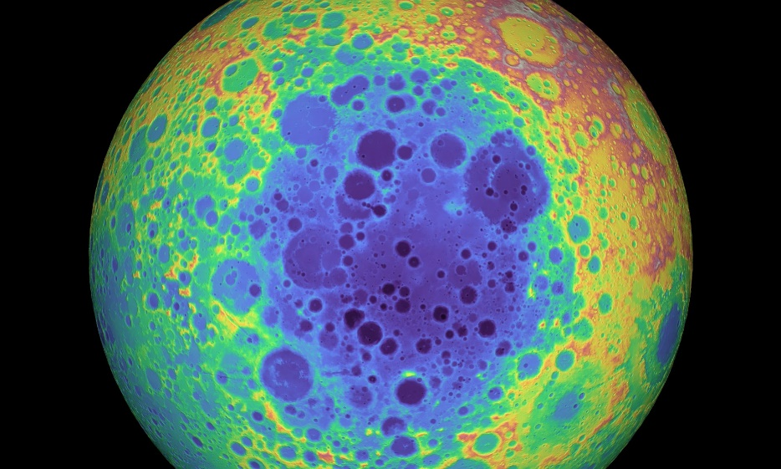


SpaceTREx
NASA Big Idea 2020: Lunar Autonomous Scalable Emitter and Receiver (LASER) System –FemtoSat Design
Álvaro Díaz-Flores Caminero, Jose María Fernández Moreno, Jekan Thangavelautham & The LASER Team
Space and Terrestrial Robotic Exploration (SpaceTREx) Laboratory
Aerospace and Mechanical Engineering Department
University of Arizona

Slide 2
Introduction
We have been studying the surface of the Moon since the mid-1960s – “surface bone dry”.
2009 NASA’s M³ onboard the Chandrayaan-1 detected water and results were confirmed in 2018
New evidence for evolution of water on the Moon
  Transport from mid-latitude to poles over eons.
Water on the Moon is a “make or break” moment in terms of space economics.
Renewed hope lunar resources will kick-start the space economy.

Slide 3
Motivation
Burgeoning tendency to miniaturization
  Reduced cost and weight
Secondary payloads
  Advance science at reasonable cost
LASER aims to charge a Smart device positioned in the PSR using a laser beam
  How to use something small and cheap for this? → FemtoSats
Looking for new opportunities

Slide 4
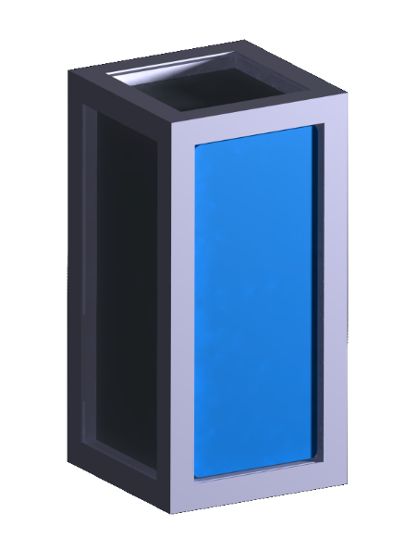
Objective
Design a 2F FemtoSat
  RF localization
  Charge battery
  Data transmission
  Keeping it low-cost

Slide 5
Related work
Femto concept → SunCube
Solar panel miniaturization → DHV technologies
Charge devices with laser → ASU/Univ. of Arizona (2014), Univ. of Washington (2018)
Arduino platform

Slide 6
Mission Requirements
Survive the extreme temperatures: [-153, 107] ºC
Charge a battery with a laser
RF localization
UHF data transmision
Perform tasks for at least 12 hours
Total mass per FemtoSat under 100g
Cost under $350
Low cost approach to obtaining first look inside PSR region.
Notes:
RF localization between 2 and 20 meters

Slide 7


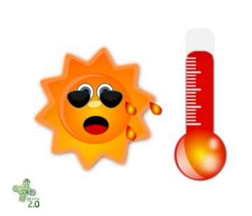
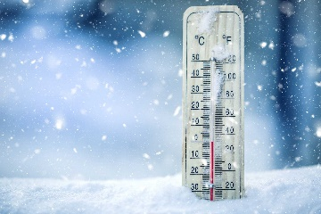
Challenges
Technology limitations
Coupling
Extreme conditions
It is never easy
Notes:
Tech limit explain that there are no current solar cells that provide the voltaje required

Slide 8
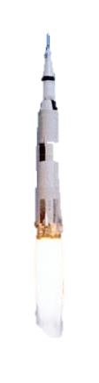

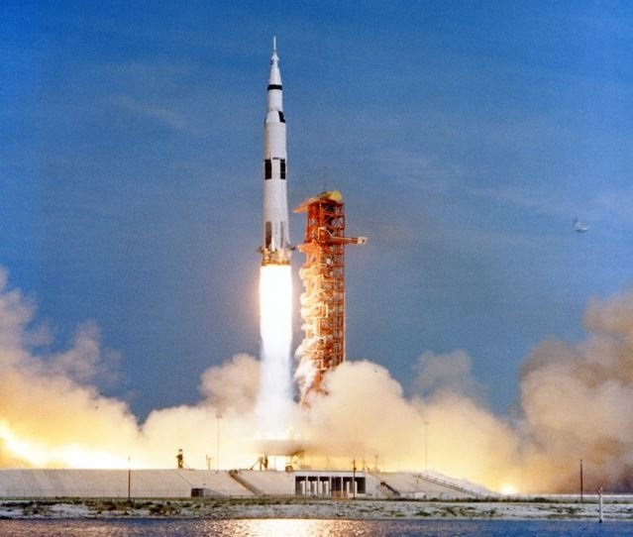

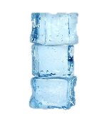
Concept of Operation
Launch + 5.5 days
t=0
t=3h
t=3.5h
t=12 days
Launch
Landing
Deployment
Data recollection
Disposal

Slide 9
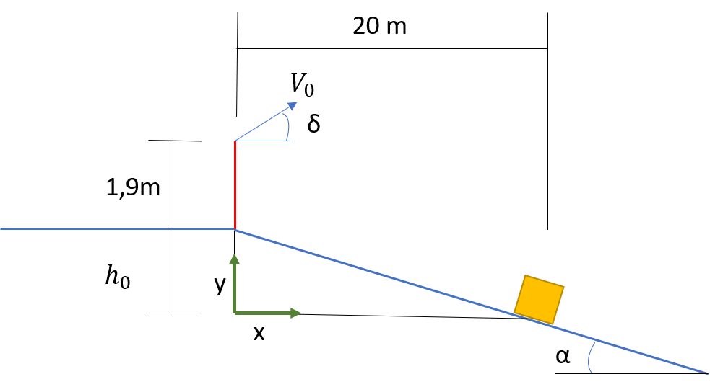
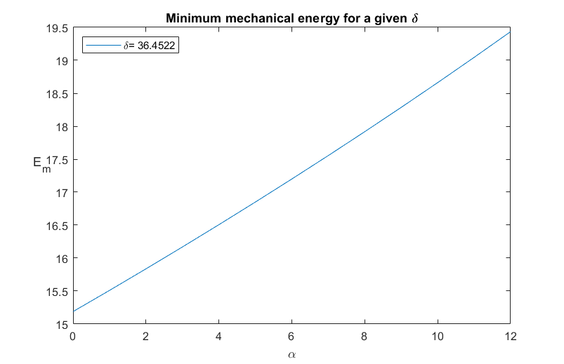
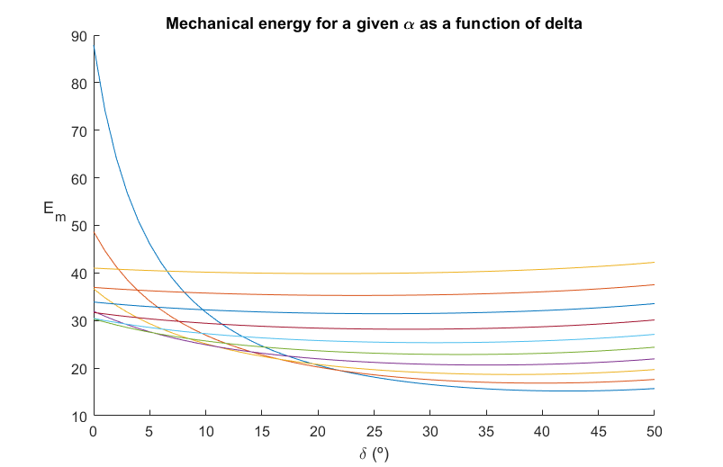
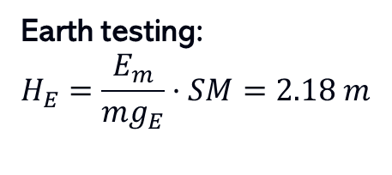
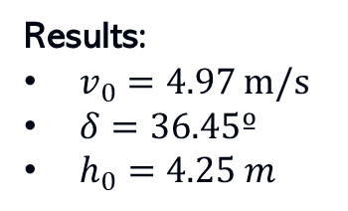
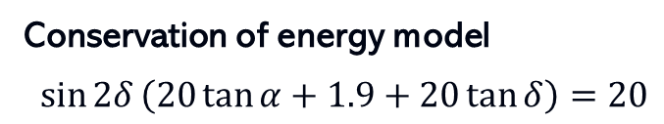
Design Part I: launching survival
Conservation of energy model
$$\sin{2δ}\left(20\tan{α}+1.9+20\tan{δ}\right)=20$$
Results:
$v_{0}=4.97$ m/s
$δ=36.45º$
$h_{0}=4.25 m$
Earth testing:
$$H_{E}=\frac{E_{m}}{mg_{E}}·SM=2.18 m$$
Minimizing impact forces…

Slide 10
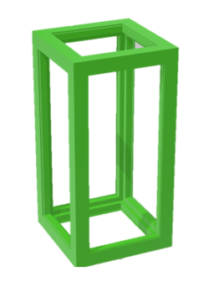
FemtoSat Architecture
Dimensions: 2F (60mm x 30mm x 30mm)
Elements:
Case (green) [60,30,30]
Gorilla glass [54.8, 24.8, t: 0.4]
Solar panels [51, 21, t: 1.6]
Aluminum box [54.8, 23.8, 23.8, t: 0.5]
Insulation (MLI) [53.8, 23.8, 23.8, t: 2,3]
Hardware [20, 20, 30]
All dimensions are in mm

Slide 11
FemtoSat Architecture
Group | Element | Mass (g) | Volume (mm)
Hardware | Processor board (TinyZero) | 1.4 | 20x20x2.9
 | Processor board (TinyDuino) | 1.10 | 20x20x2.9
 | IMU | 1 | 20x20x5.11
 | Radio + (antenna) | 1.15+0.26 | 20x20x5.11 (+177)
 | Battery (150 mA, 3.7V) | 3.77 | 20x20x5
 | Proto Board | 0.85 | 20x20x5.11
Solar array | Charger controller | 0.54 | 14x9x3.7
 | Short panels (Test) 2x | ~5.6 | 21x21x2
Structure | Long panels (Test) 4x | ~27 | 51x21x2
 | TPU case | 9 | 60x30x30
Insulation | Box (aluminum) | 9 | 54.8x24.8x24.8 (t=0.5)
 | MLI |  | 53.8x23.8x2 23.8x23.8x2
Total | Aerogel
 |  | 53.97 | 60x30x30 (2F)
Notes:
Then let’s move piece by piece

Slide 12
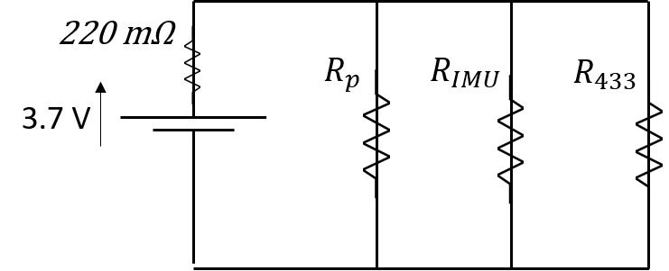
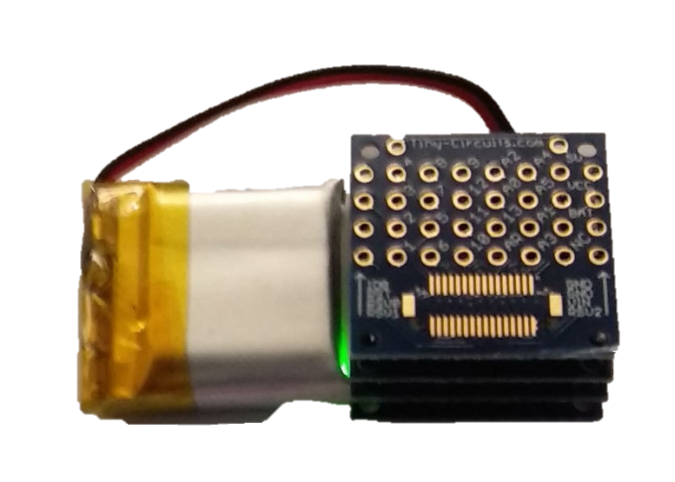
Circuit Design
Panel 1
Panel 2
Panel 3
Panel 4
Proto board
Charger controller
Radio 433MHz
Battery
IMU
Processor
Notes:
Let’s go part by part

Slide 13
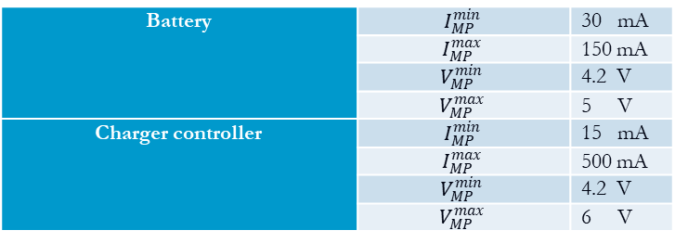
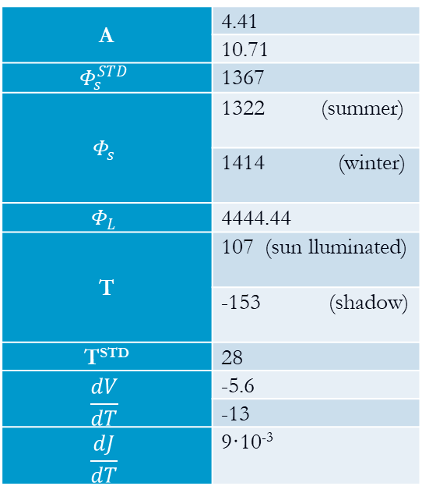
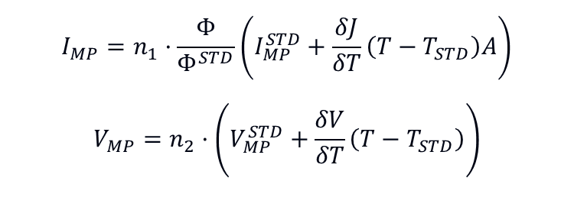
Solar panels design
Requirements:
Boundaries:
A | 4.41
 | 10.71
$$Φ_{s}^{STD}$$ | 1367
$$Φ_{s}$$ | 1322 (summer)
 | 1414 (winter)
$$Φ_{L}$$ | 4444.44
T | 107 (sun lluminated)
 | -153 (shadow)
T^{STD} | 28
$$\frac{dV}{dT}$$ | -5.6
 | -13
$$\frac{dJ}{dT}$$ | 9·10⁻³
Battery | $$I_{MP}^{min}$$ | 30 mA
 | $$I_{MP}^{max}$$ | 150 mA
 | $$V_{MP}^{min}$$ | 4.2 V
 | $$V_{MP}^{max}$$ | 5 V
Charger controller | $$I_{MP}^{min}$$ | 15 mA
 | $$I_{MP}^{max}$$ | 500 mA
 | $$V_{MP}^{min}$$ | 4.2 V
 | $$V_{MP}^{max}$$ | 6 V
Equations:
$$I_{MP}=n_{1}·\frac{Φ}{Φ^{STD}}\left(I_{MP}^{STD}+\frac{δJ}{δT}\left(T−T_{STD}\right)A\right)$$
$$V_{MP}=n_{2}·\left(V_{MP}^{STD}+\frac{δV}{δT}\left(T−T_{STD}\right)\right)$$

Slide 14


Solar panels design
One cell (n₁=1, n₂=1)
Area | Phi | dV/dT | T | Imp | Vmp
4,41 | 1322 | -5.6 | 107 | 30,11 | 4,2
4,41 | 4444 | -5.6 | 107 | 101.23 | 4.2
4,41 | 4444 | -5.6 | -153 | 67,68 | 5.65
4.41 | 1414 | -5.6 | 107 | 32.21 | 4.2
10,71 | 1322 | -5.6 | 107 | 34.44 | 4,2
10,71 | 4444 | -5.6 | 107 | 115.79 | 4.2
10,71 | 4444 | -5.6 | -153 | 34.31 | 5.65
10,71 | 1414 | -5.6 | 107 | 36.84 | 4.2
$$I_{MP}^{STD}$$ | 28 mA
$$V_{MP}^{STD}$$ | 4.64 V
Four cells (n₁=2, n₂=2)
Area | Phi | dV/dT | T | Imp | Vmp
4,41 | 1322 | -5.6 | 107 | 64.09 | 3.1
4,41 | 4444 | -5.6 | 107 | 215.46 | 3.1
4,41 | 4444 | -5.6 | -153 | 148.36 | 6.01
4.41 | 1414 | -5.6 | 107 | 68.55 | 3.1
10,71 | 1322 | -5.6 | 107 | 72.75 | 3.1
10,71 | 4444 | -5.6 | 107 | 244.59 | 3.1
10,71 | 4444 | -5.6 | -153 | 81.63 | 6.01
10,71 | 1414 | -5.6 | 107 | 77.82 | 3.1
$$I_{MP}^{STD}$$ | 28 mA
$$V_{MP}^{STD}$$ | 1.99 V
Notes:
Here explain that the best solution would be n1=1 and n2=2
Insert the results for the conclusión at -98ºC

Slide 15
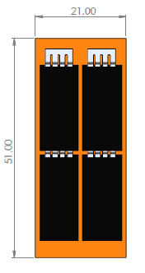
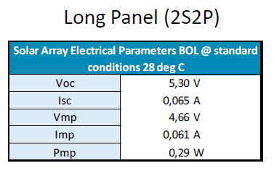
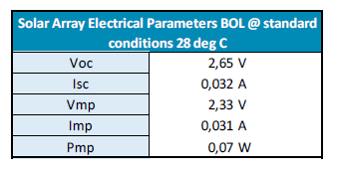
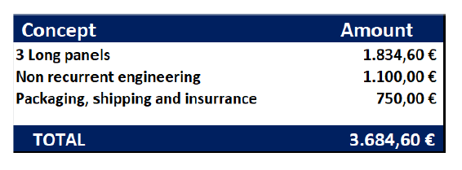
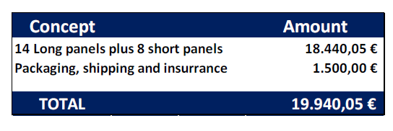
Solar panels: market analysis (DHV technologies)
DHV technologies a viable option for Deep Space Exploration
Data from DHV technologies

Slide 16













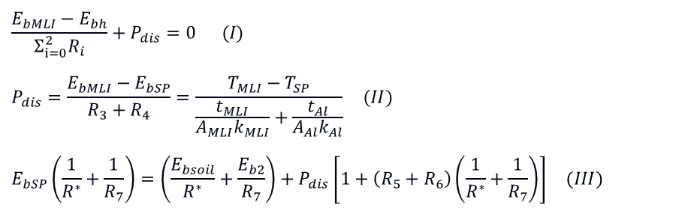













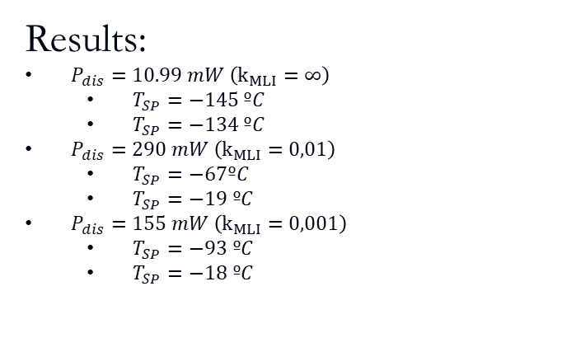
Thermal Analysis
$$E_{bh}$$
$$E_{bMLI}$$
$$\frac{E_{bMLI}−E_{bh}}{Σ_{i=0}^{2}R_{i}}+P_{dis}=0 (I)$$
$$P_{dis}=\frac{E_{bMLI}−E_{bSP}}{R_{3}+R_{4}}=\frac{T_{MLI}−T_{SP}}{\frac{t_{MLI}}{A_{MLI}k_{MLI}}+\frac{t_{Al}}{A_{Al}k_{Al}}} (II)$$
$$E_{bSP}\left(\frac{1}{R^{∗}}+\frac{1}{R_{7}}\right)=\left(\frac{E_{bsoil}}{R^{∗}}+\frac{E_{b2}}{R_{7}}\right)+P_{dis}\left[1+\left(R_{5}+R_{6}\right)\left(\frac{1}{R^{∗}}+\frac{1}{R_{7}}\right)\right] (III)$$
$$P_{dis}$$
$$R_{0}$$
$$R_{2}$$
$$R_{1}$$
$$R_{3}$$
$$J_{h}$$
$$J_{MLI}$$
$$E_{bAl}$$
$$R_{4}$$
Results:
$P_{dis}=10.99 mW \left(k_{MLI}=∞\right)$
  $T_{SP}=−145 ºC$
  $T_{SP}=−134 ºC$
$P_{dis}=290 mW \left(k_{MLI}=0,01\right)$
  $T_{SP}=−67ºC$
  $T_{SP}=−19 ºC$
$P_{dis}=155 mW \left(k_{MLI}=0,001\right)$
  $T_{SP}=−93 ºC$
  $T_{SP}=−18 ºC$
$$R_{11}$$
$$J_{L}$$
$$R_{10}$$
$$E_{bSP}$$
$$E_{bg}$$
$$R_{6}$$
$$R_{5}$$
$$E_{bsoil}$$
$$J_{g}$$
$$J_{SP}$$
$$R_{9}$$
$$R_{8}$$
$$R_{7}$$
$$E_{b2}=J_{2}$$
Simplyfied model for thermal anlysis

Slide 17


Radio frequency localization
Clock transmission and triangulation: too much error. Need new method for localization
Decawave: DWM1000 – UWB Localization → However, antenna too big
  Foldable?
Option for new development

Slide 18

Arduino platform
RX on
Temperature
Laser
$$ΔV$$
TX on
Time/ Low battery
TX and RX off
Send data
Data:
Address
Working panel
Input Volatage
IMU
Battery percentage
TX send
RX on

Slide 19
Discussion
Future work:
  Close future: build a model for laser testing
  Iterate on the thermal design to minimize power consumption
  Upgrade the FemtoSat equipment to perform more complex mission.
  Locate the FemtoSat

Slide 20
Conclusions
Improvement in technology gets us closer to FemtoSat design
Highly coupled systems but feasible design
Attempt to extend solar panel miniaturization
Limited working temperatures range

Slide 21
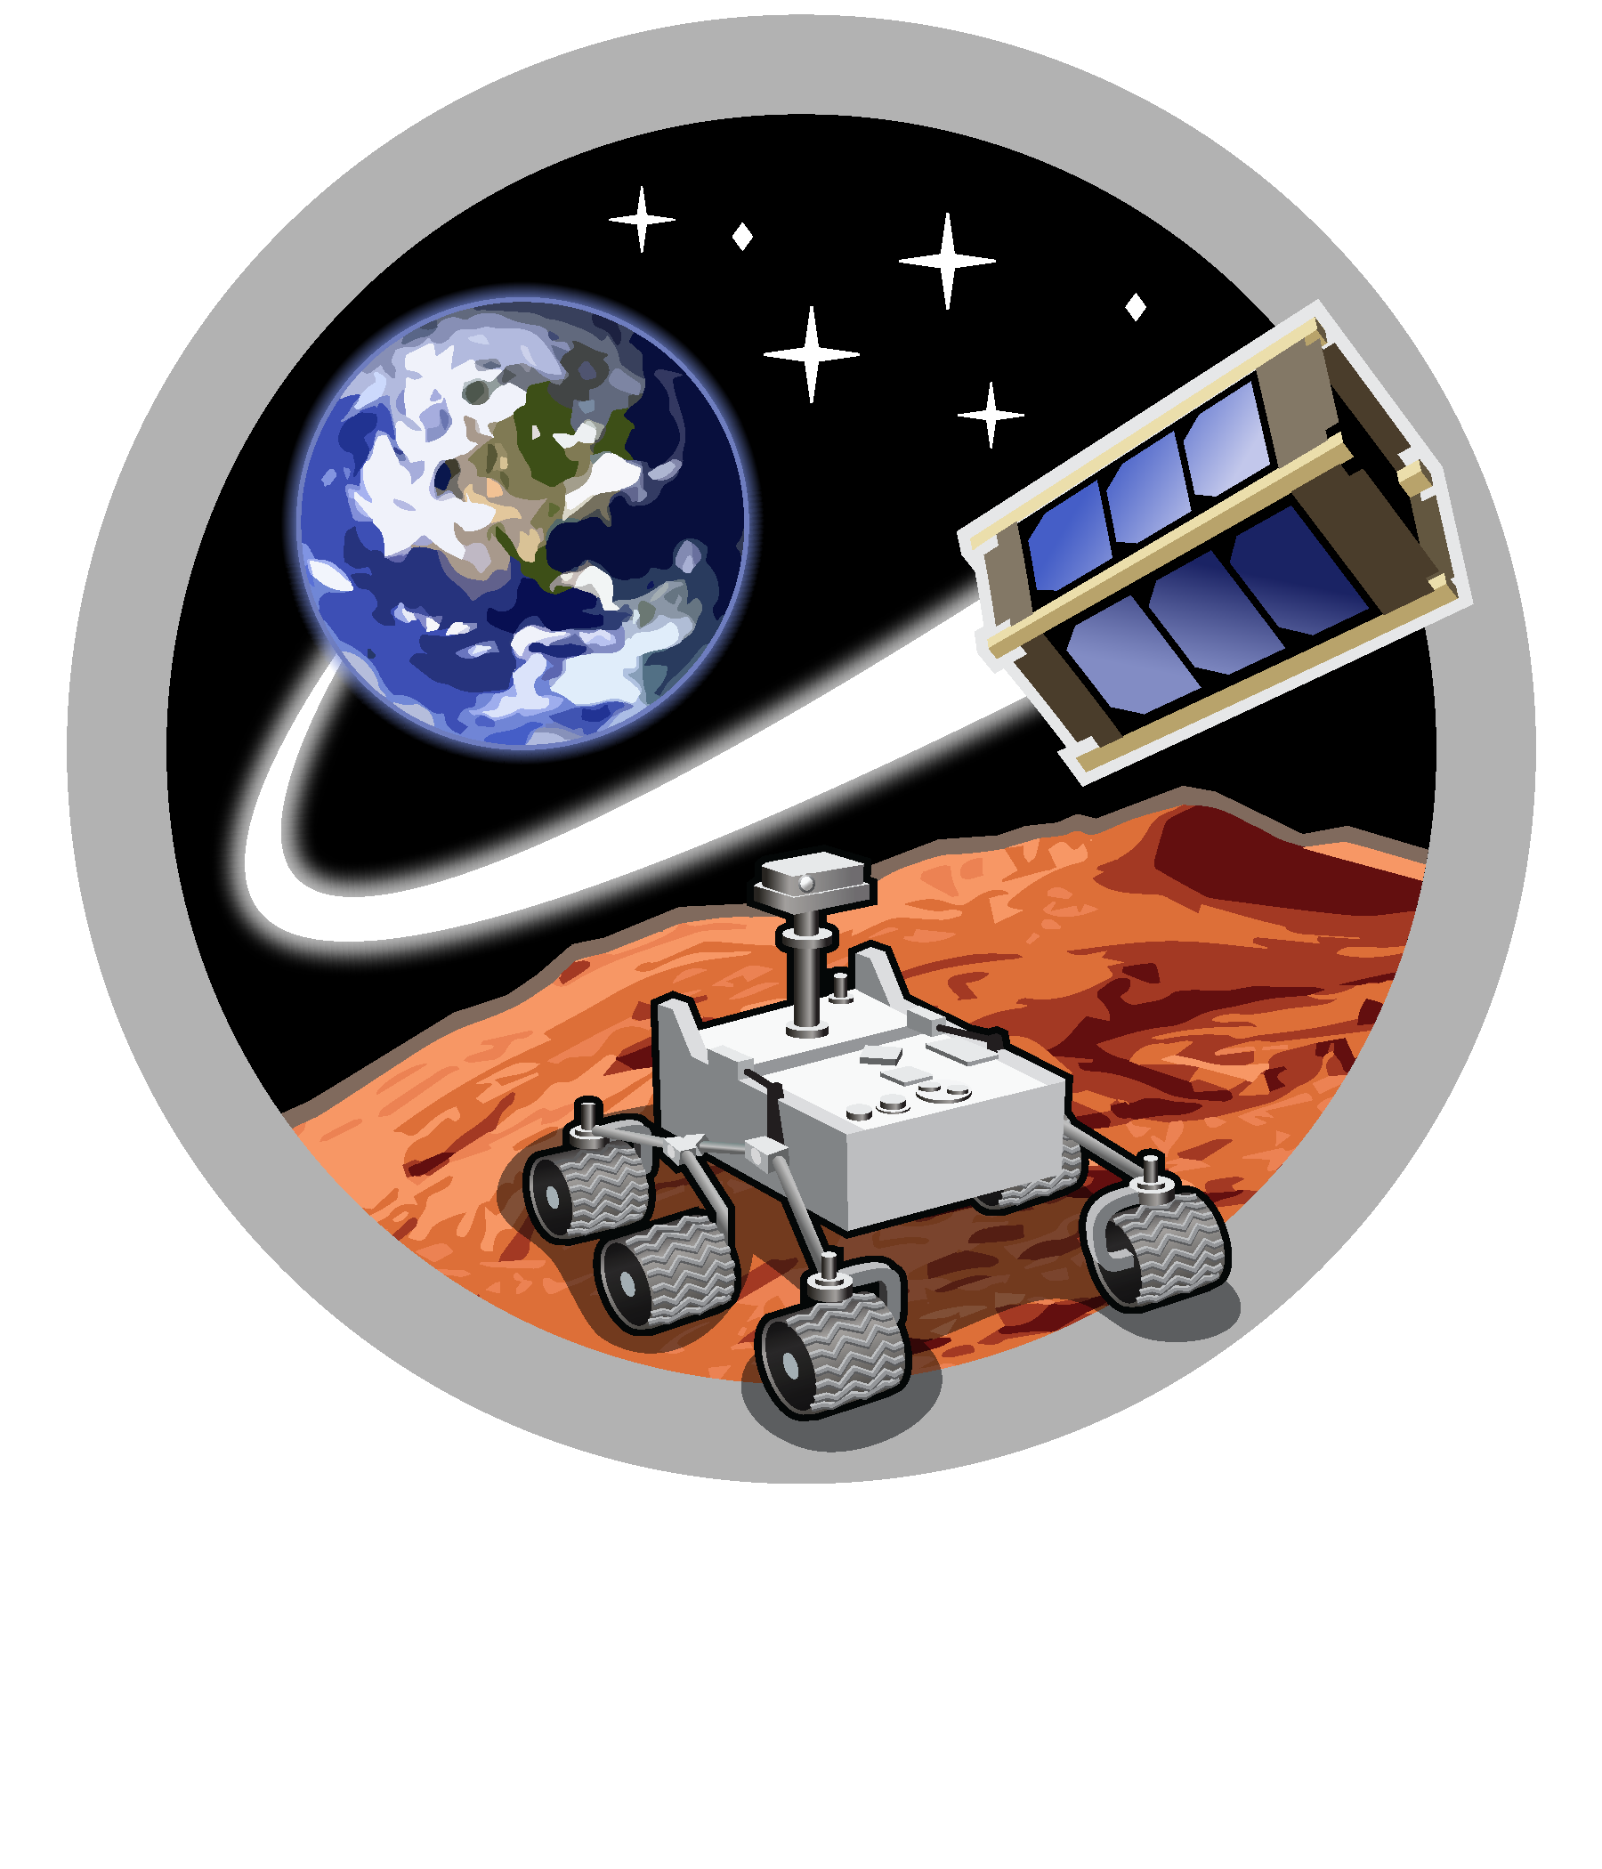
Space and Terrestrial Robotic Exploration (SpaceTREx) Laboratory

Slide 22
