Slide 1


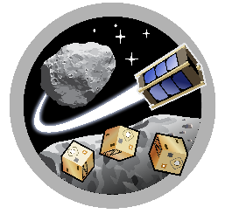
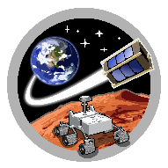
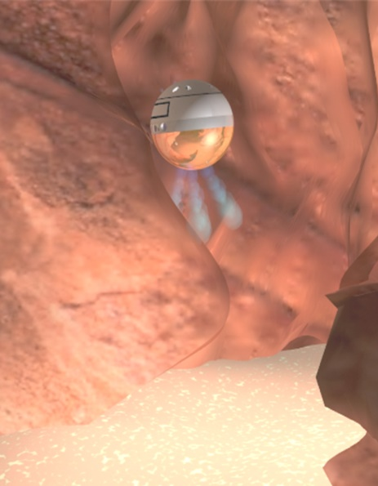
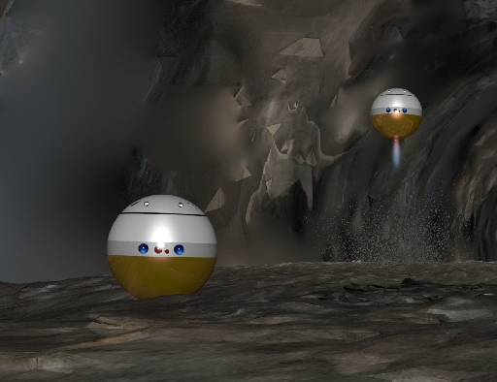
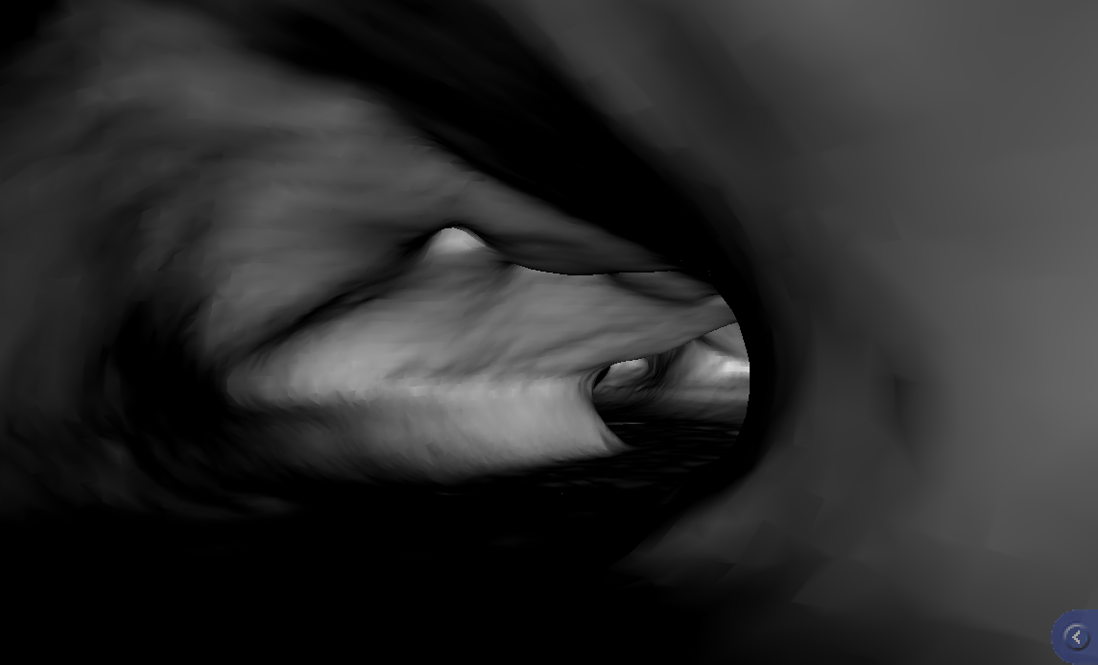
ASTEROID
SpaceTREx
End to End Strategies for Exploring Lunar/Martian Caves
Himangshu Kalita and Jekan Thangavelautham
Space and Terrestrial Robotic Exploration (SpaceTREx) Laboratory
Aerospace and Mechanical Engineering Department
University of Arizona

Slide 2
Outline
Introduction
Motivation
SphereX Bot
Mapping and Navigation
Sensor Placement Strategies
Communication Strategies
Power Transfer Strategies
Conclusion

Slide 3
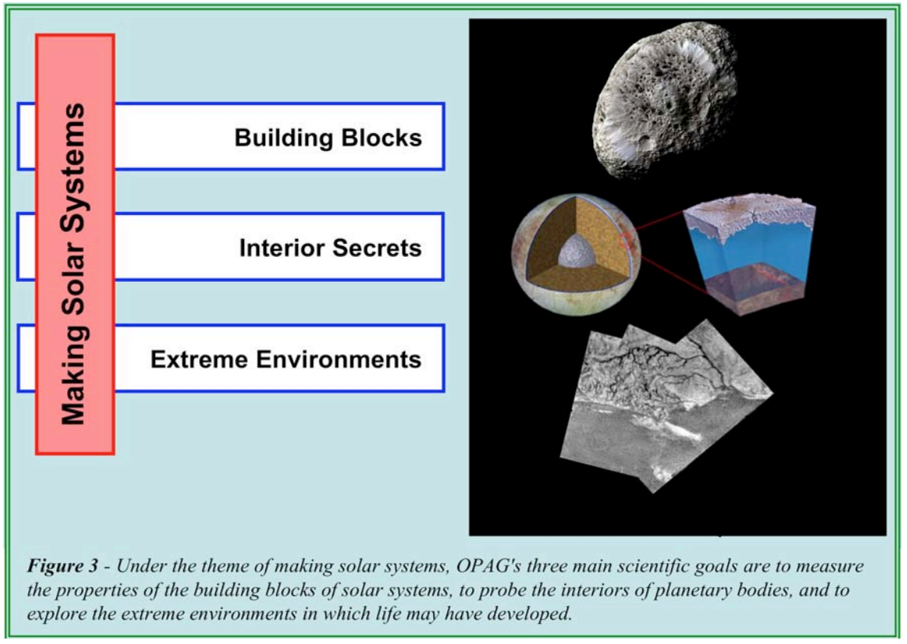
Introduction
Science goals identified by Outer Planets Assessment Group (OPAG) with Planetary Decadal Study [1],[2].
Extreme Environments: Ascertain the range of conditions that can support life.
Extreme Environments: Identify planetary processes that are responsible for generating and sustaining habitable worlds.
[1] National Academies of Sciences, Engineering and Medicine (2011)
[2] Scientific Goals and Pathways for Exploration of the Outer Solar System (2006)

Slide 4
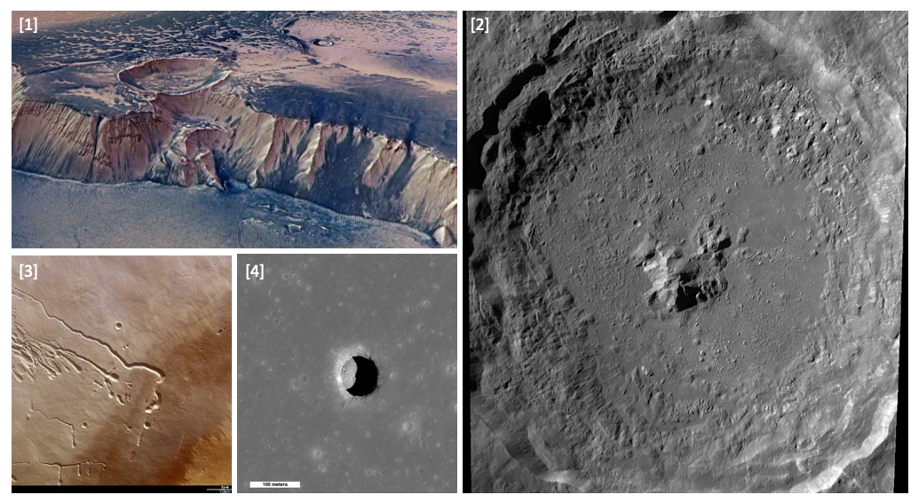
Extreme Environments on the Moon and Mars
Extreme Environments of Moon and Mars: Cliffs, craters, lava tubes, pits, caves.
These environments are rich targets of origin studies.
Caves, pits and lava tubes offer natural shelter from radiation and insulated from varying high and low external temperatures.
[1] High Cliffs Surrounding Echus Chasma on Mars (nasa.gov)
[2] Tycho Crater on Moon (NASA/Goddard/Arizona State University)
[3] Lava Tubes on Pavonis Mons on Mars (ESA)
[4] Mare Tranquilitatis pit on Moon (NASA/GSFC/Arizona State University)

Slide 5
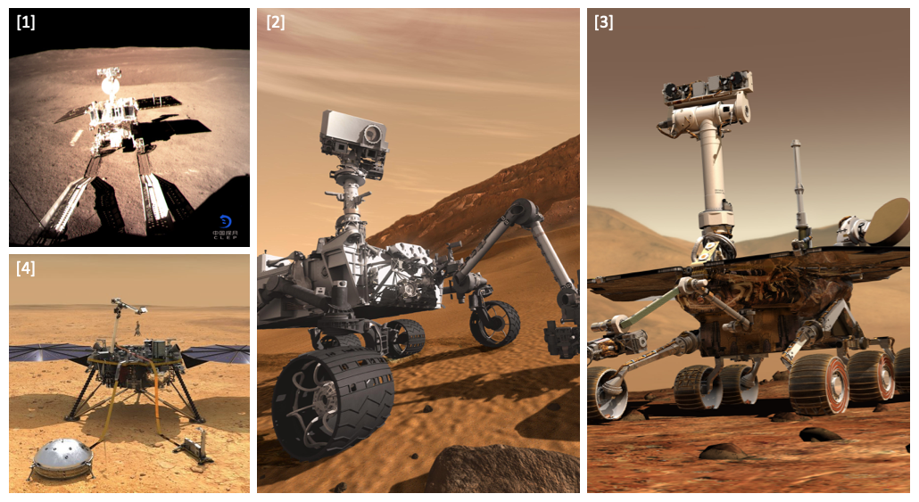
Problem with exploring Extreme Environments?
Current landers and rovers are unable to access these areas of high interest
  Limitations in precision landing
  Inability to traverse rugged environments
  Operations culture where risks are minimized at all costs
[1] Yutu-2 on Moon (space.com)
[2] Curiosity Rover on Mars ( nasa.gov)
[3] Opportunity Rover on Mars (nasa.gov)
[4] InSight Lander on Mars (spacenews.com)

Slide 6
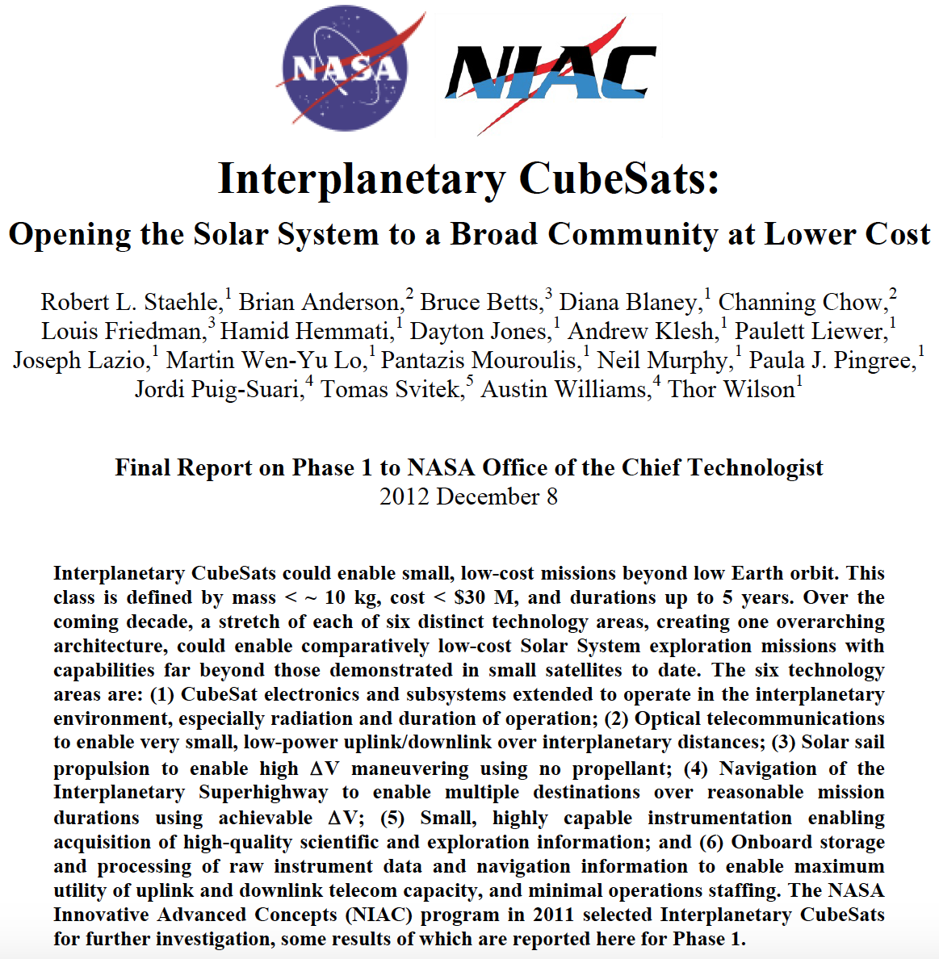
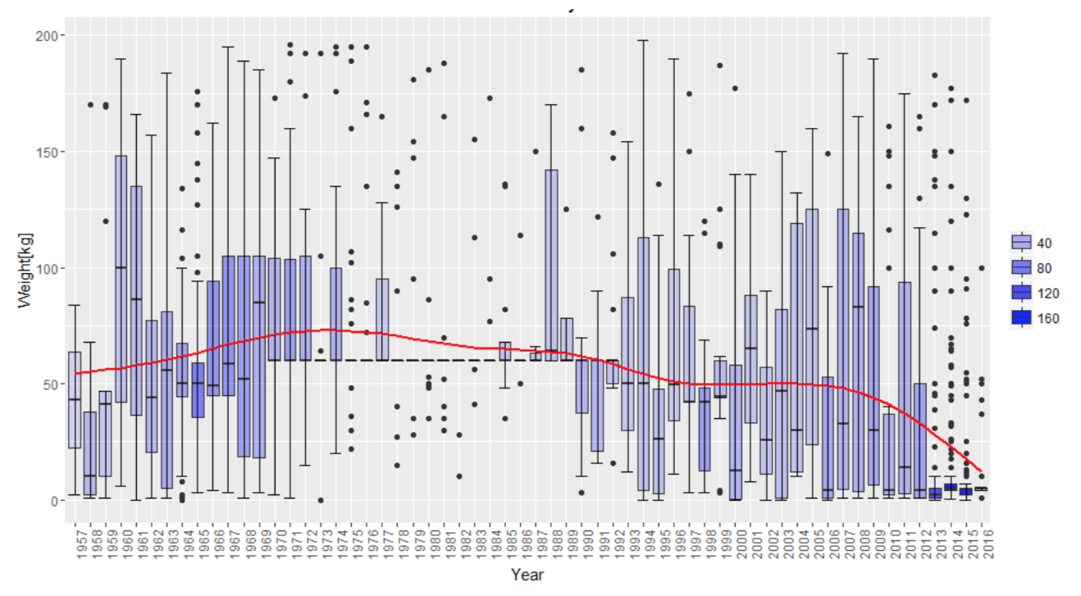
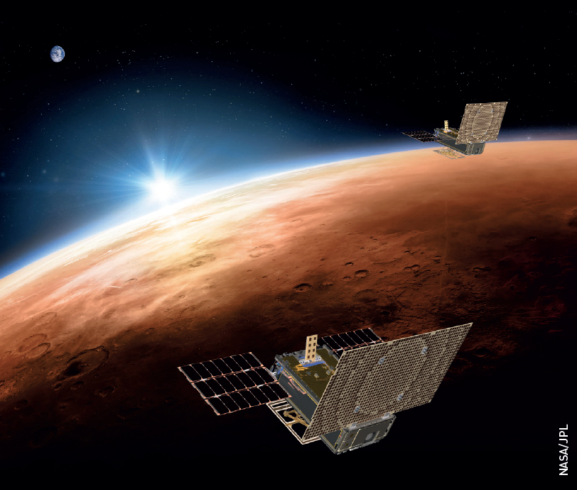
Motivation - I
Commercially-Off-The-Shelf (COTS) components
Mass of all satellites under 200 kg launched from 1957 to 2016 [B. Lal et al (2017)]
Inset: Artist’s rendering of NASA’s twin Mars Cube One (MarCO) spacecraft flying over Mars with Earth in the distance

Slide 7
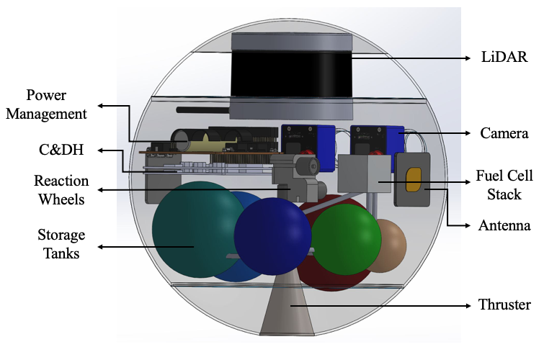
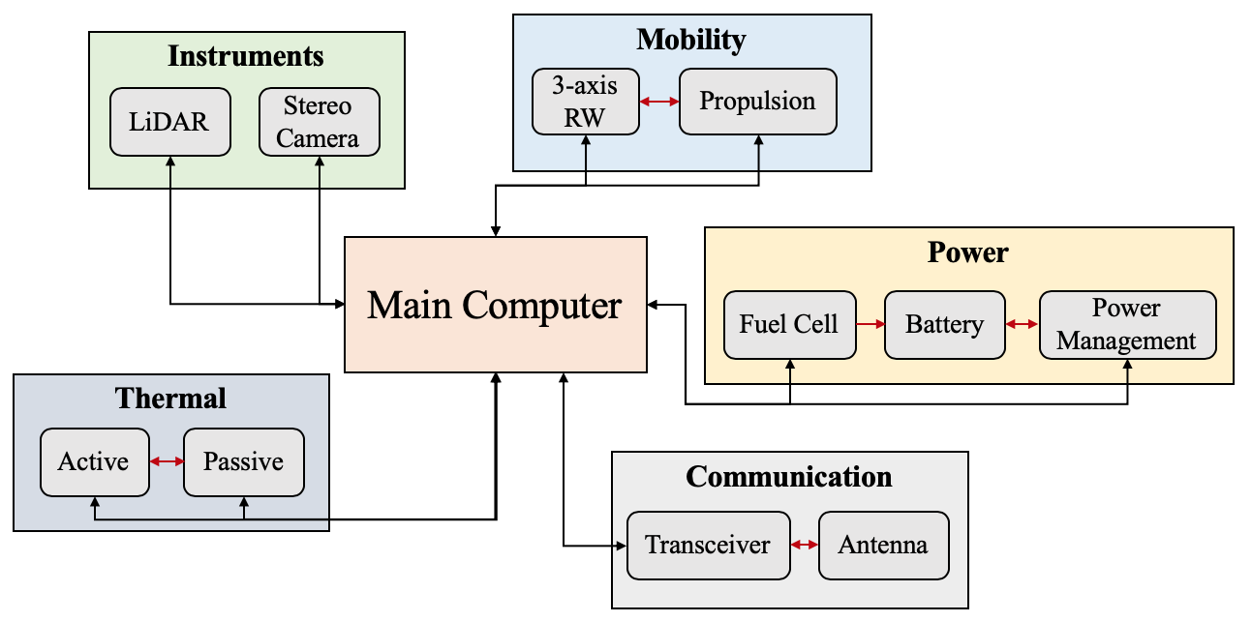
Proposed Solution: SphereX
Small low-cost, modular spherical robot (SphereX)
  Mobility system for exploration
  Space-grade electronics
  Power system for power generation
  UHF/S-band antennas for communication
  Thermal and Shielding system for survival
  Outer shell for structural robustness
  Payload capacity for science instruments
Credit: Rachel Moses

Slide 8
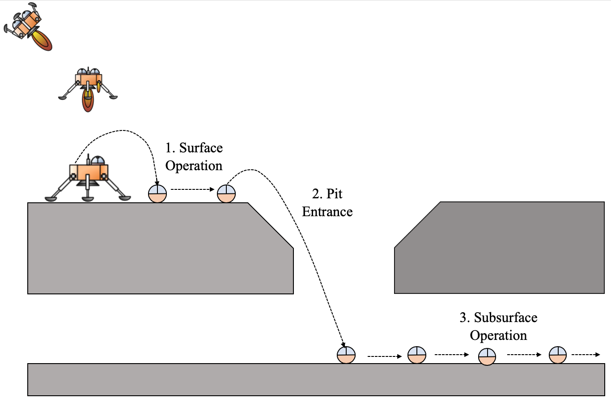
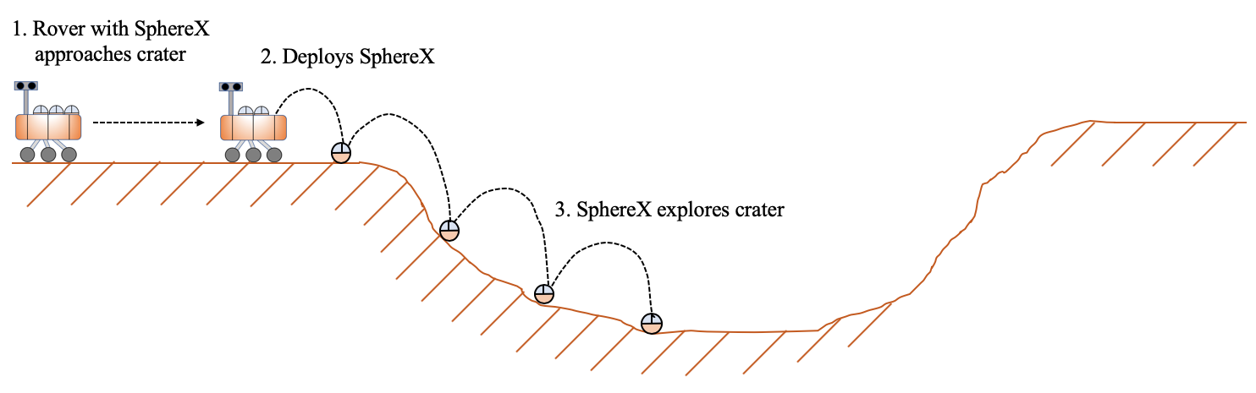
Exploration of Pits, Lava Tubes and Craters
Concept of Operations for exploring planetary pits/lava tubes
Concept of Operations for exploring planetary craters

Slide 9
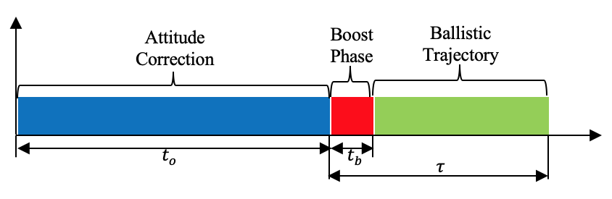
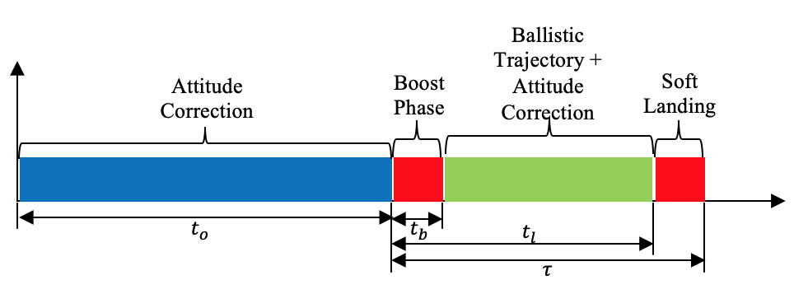
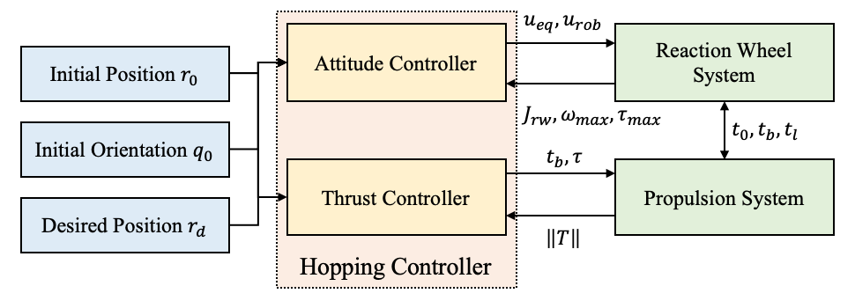
Mobility System
Time Diagram
Mode of Mobility: Hopping
Hopping achieved through:
  Miniaturized propulsion system
  3-axis reaction wheel system
2 modes of Hopping Mobility
  Hard-landing mode
  Soft-landing mode
Control System Architecture

Slide 10
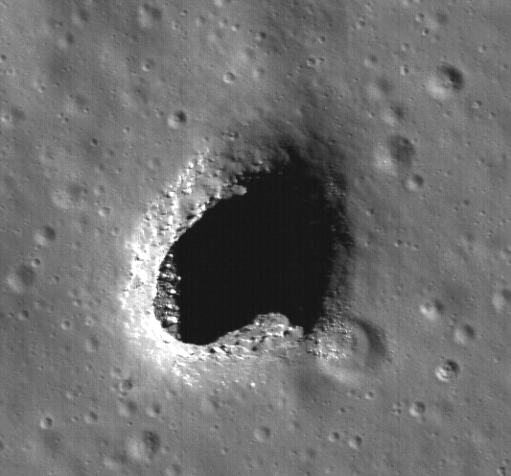
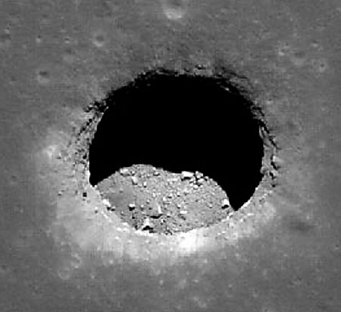
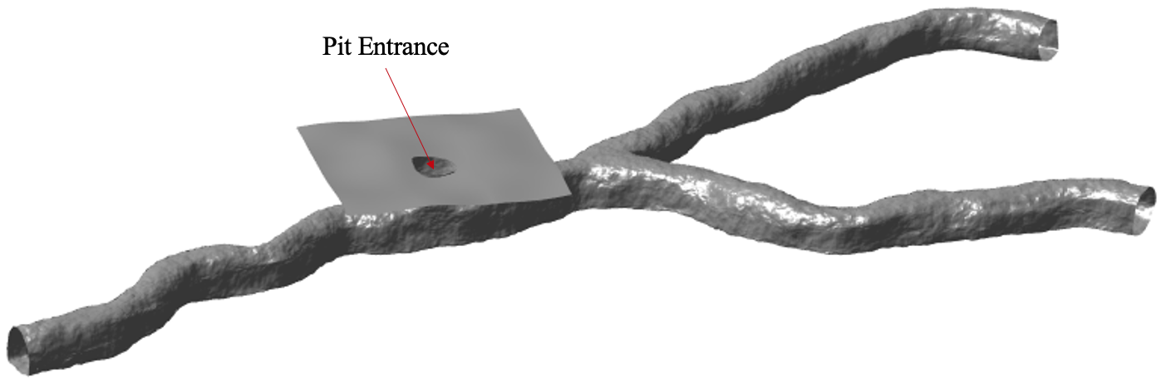
Lunar Pits
Recently discovered lunar mare “pits” are key science and exploration targets.
Ready made shelter for future lunar explorers, benign T (-25º C)
Pristine preservation
  Flow features
  Sublimate minerals
  Regolith? Water?
Mare Ingenni
Mare Tranquilitatis
Marius Hills
Test Model: modelled in Blender

Slide 11
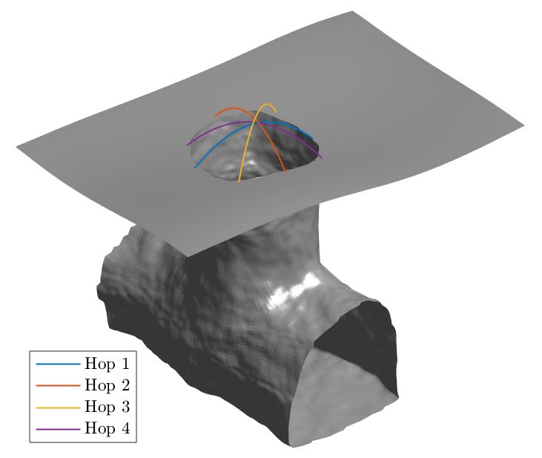
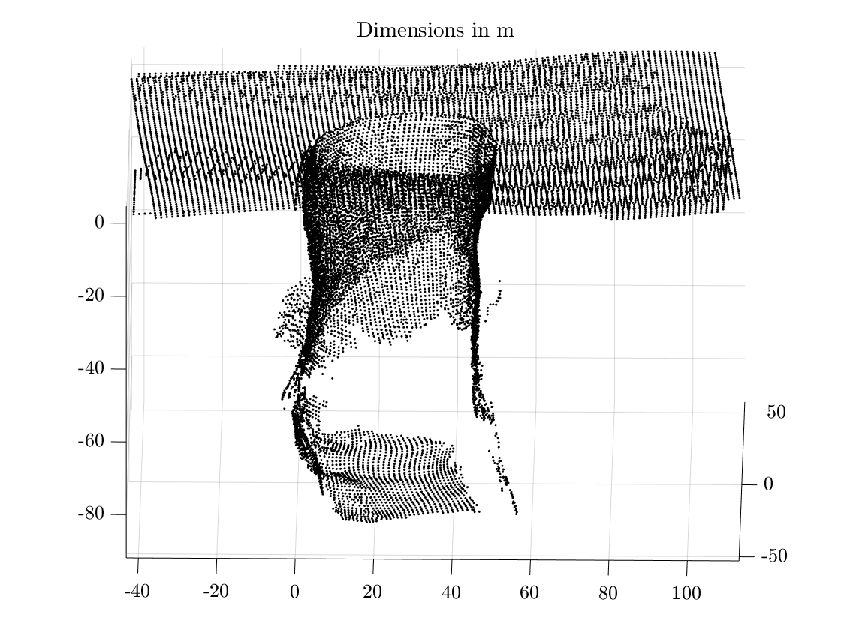
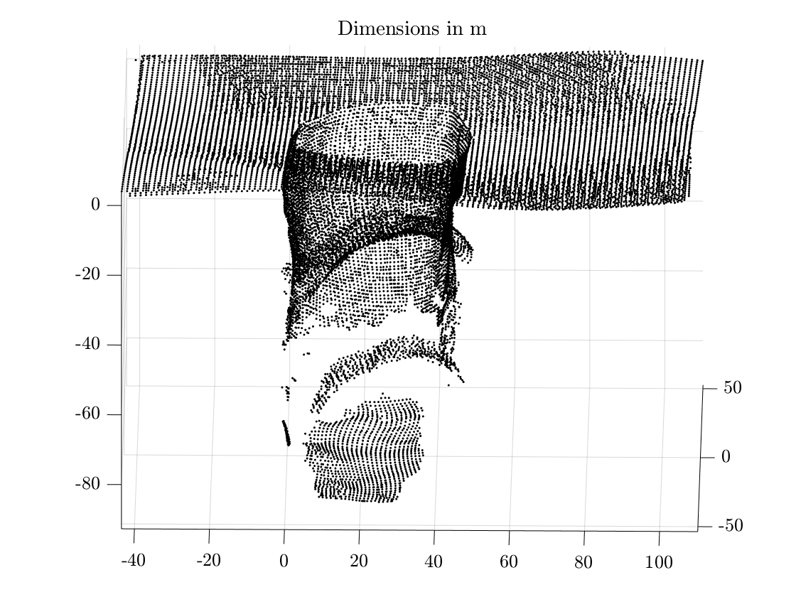
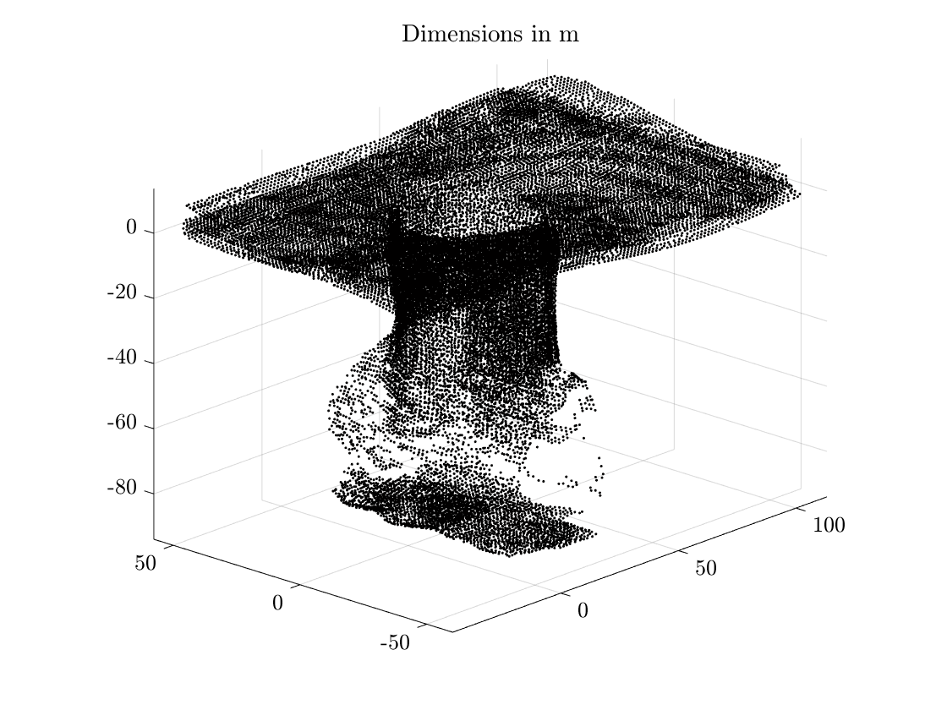
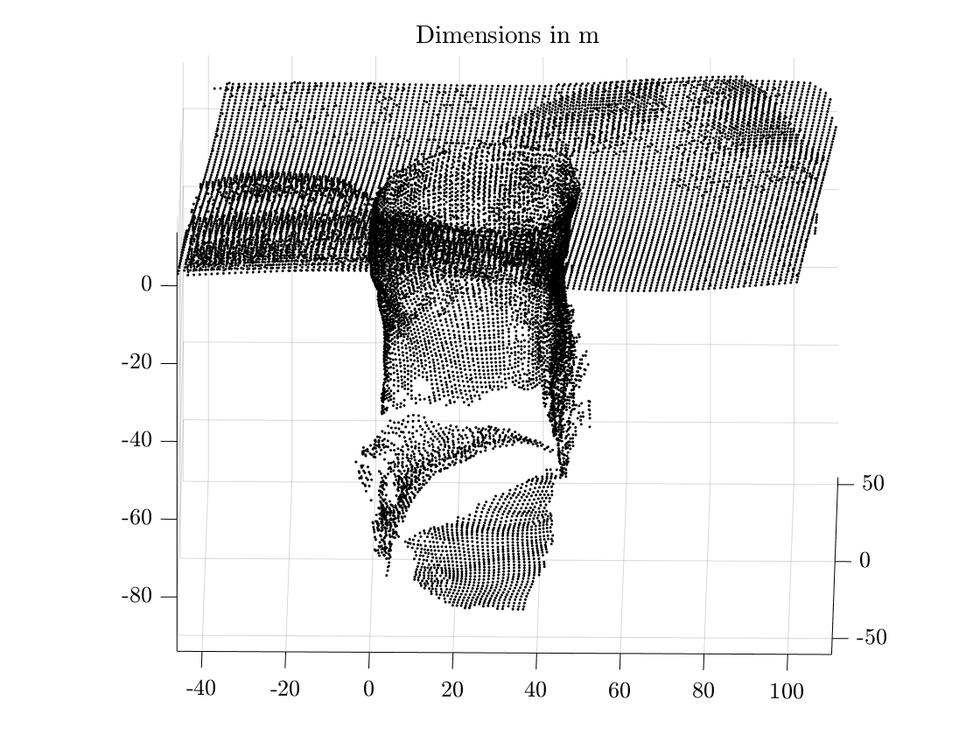
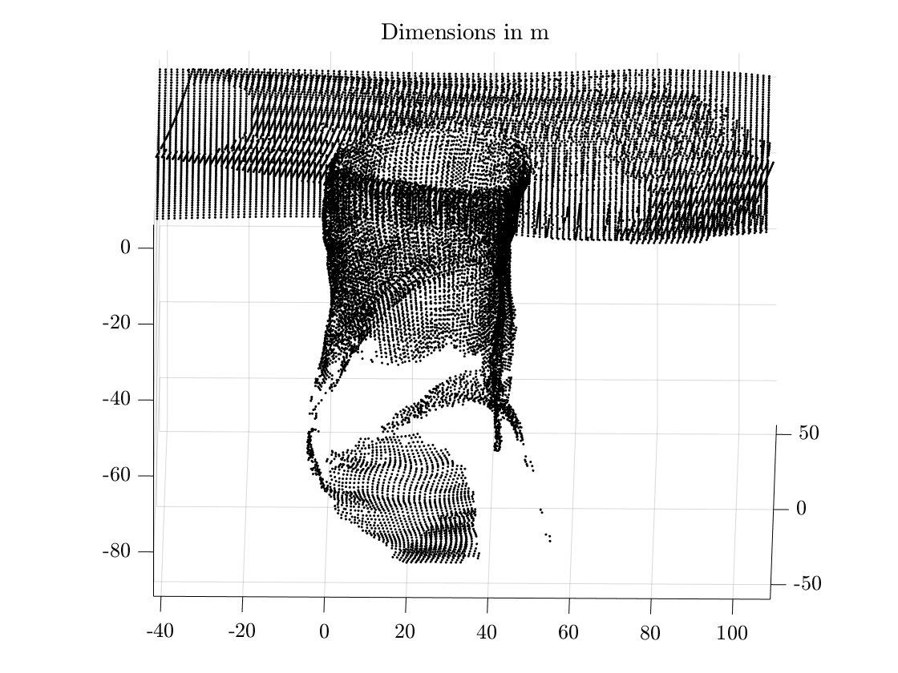
Pit Entrance Survey
Hop 1
Hop 2
Hop 3
Hop 4
Combined Map

Slide 12
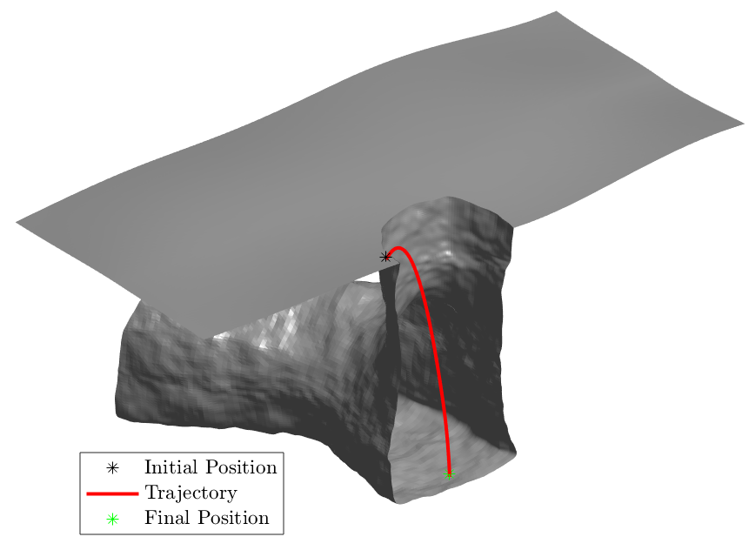
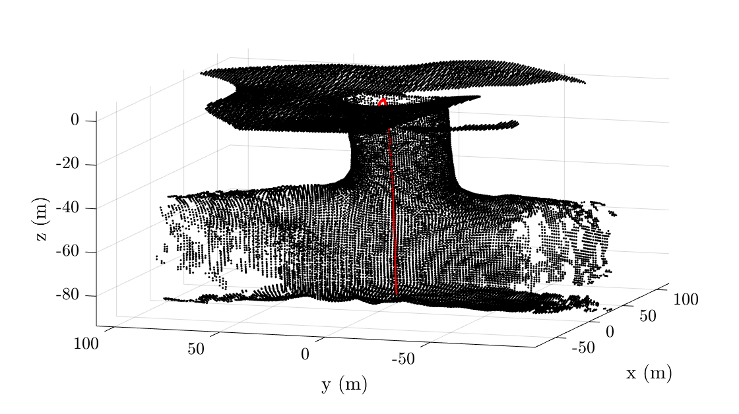
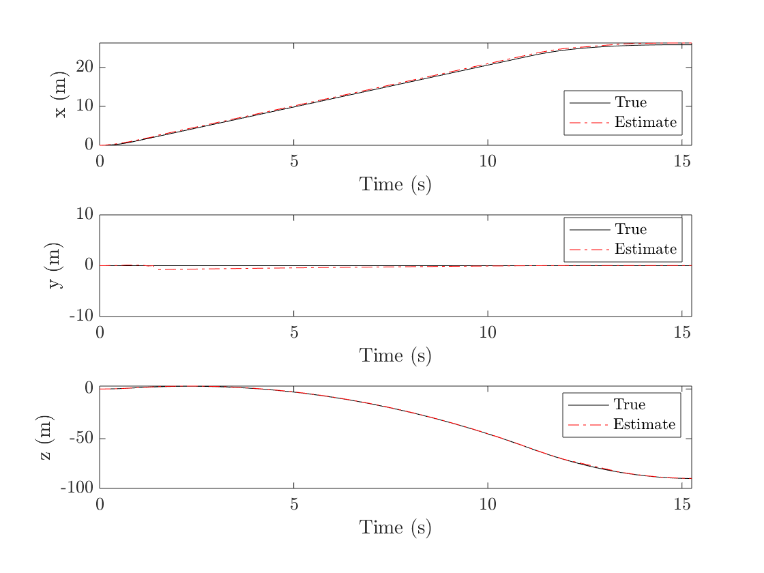
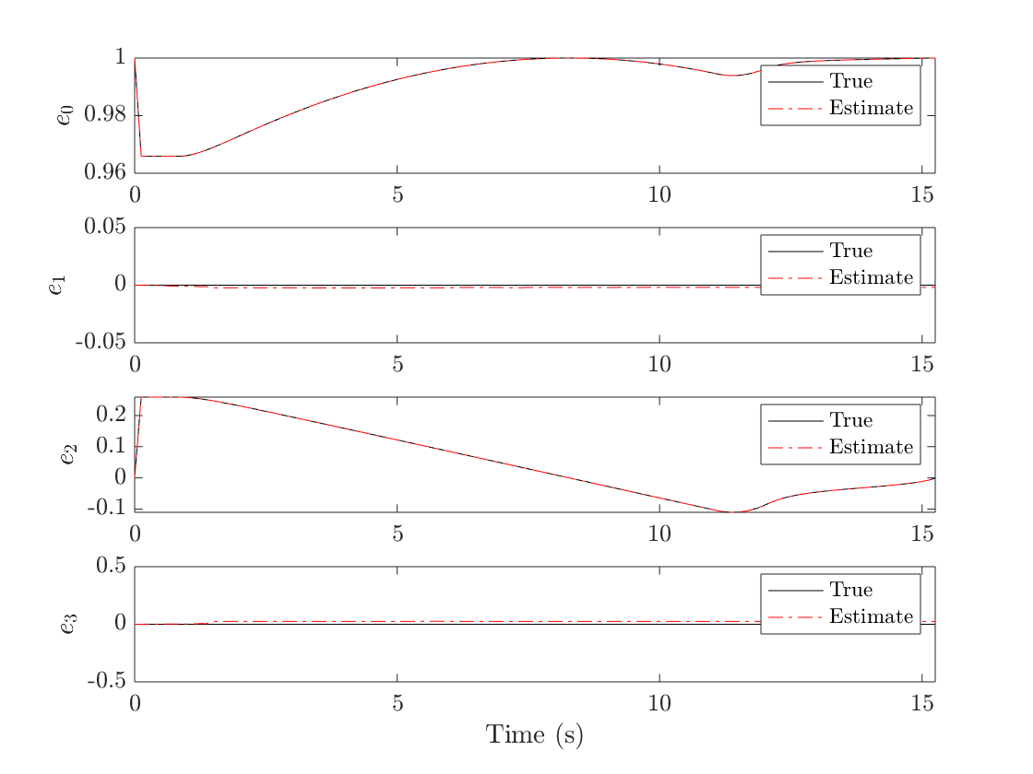
Pit Entrance
Map Generated
Position Estimate
Orientation Estimate

Slide 13
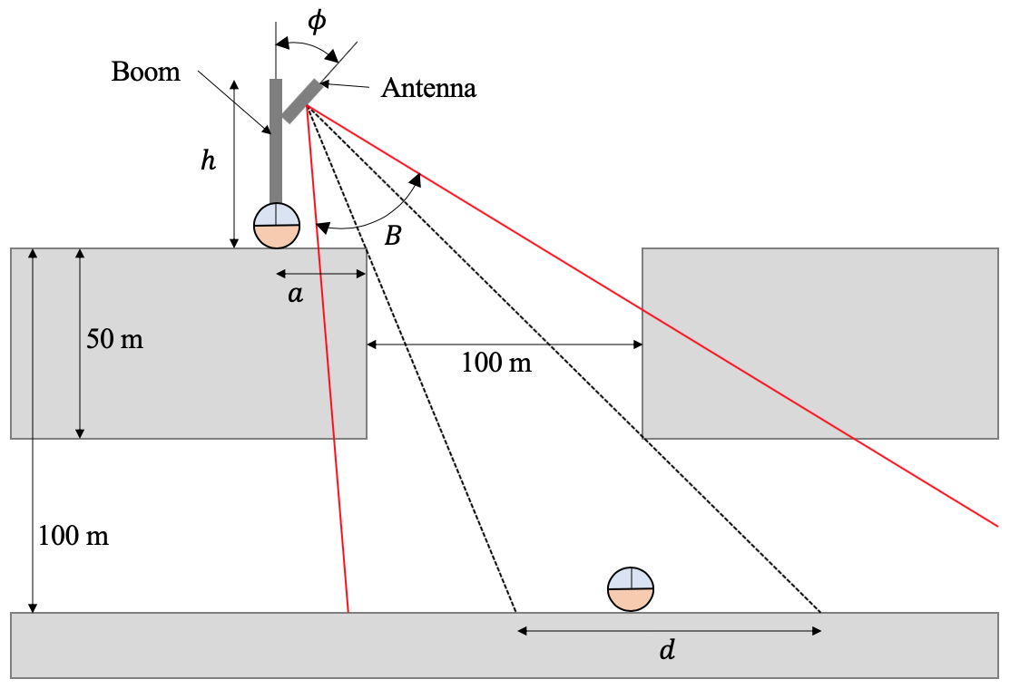
Line-of-sight Analysis
Line-of-sight from pit surface to pit floor

Slide 14
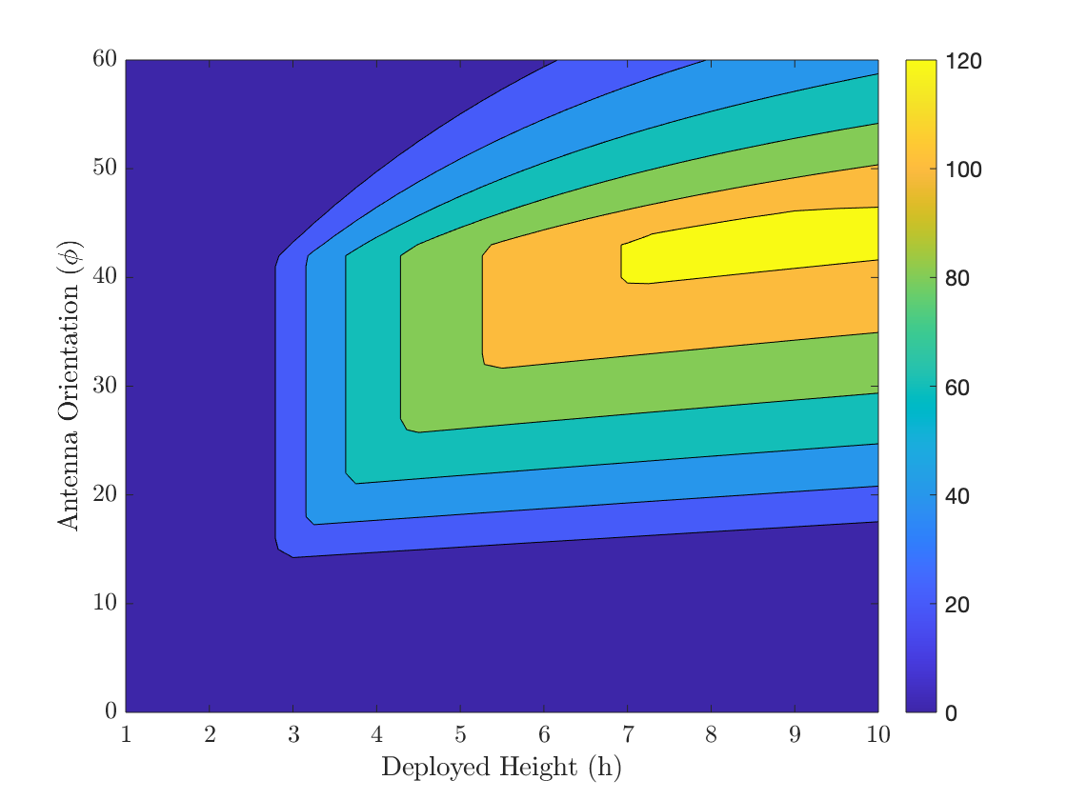
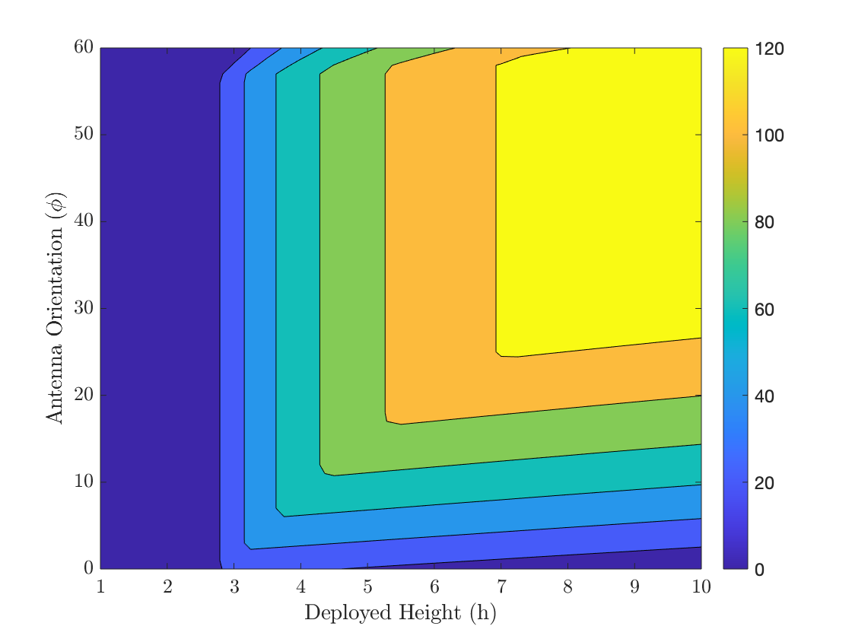
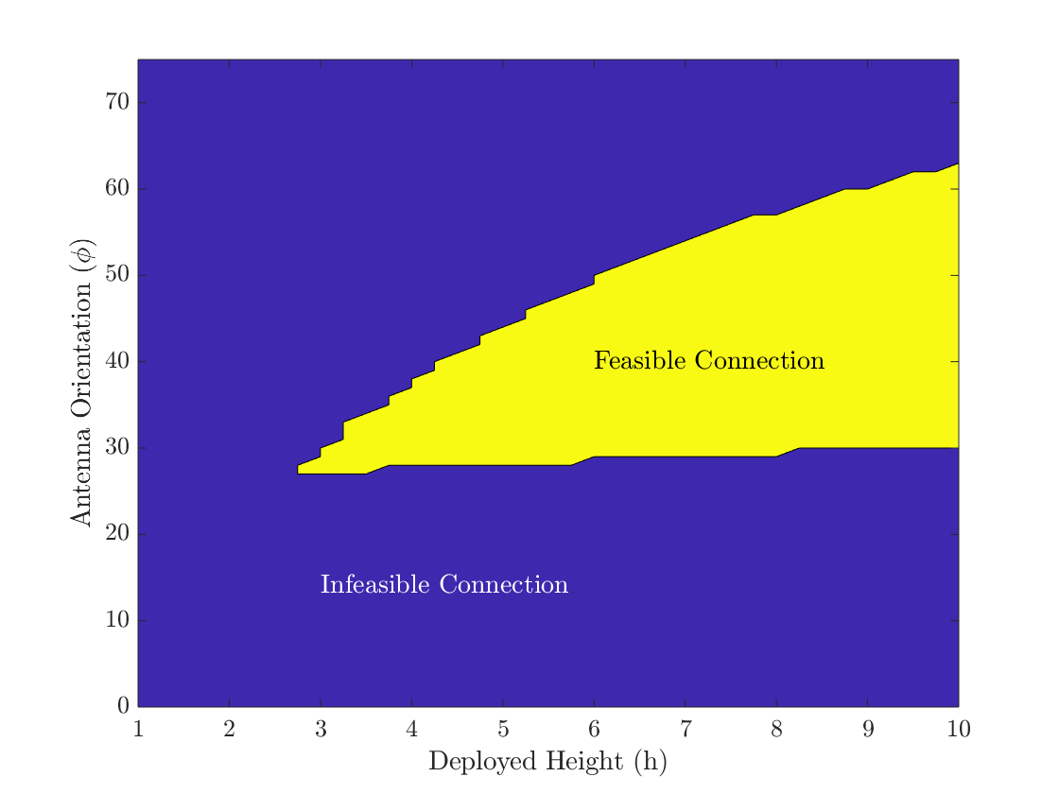
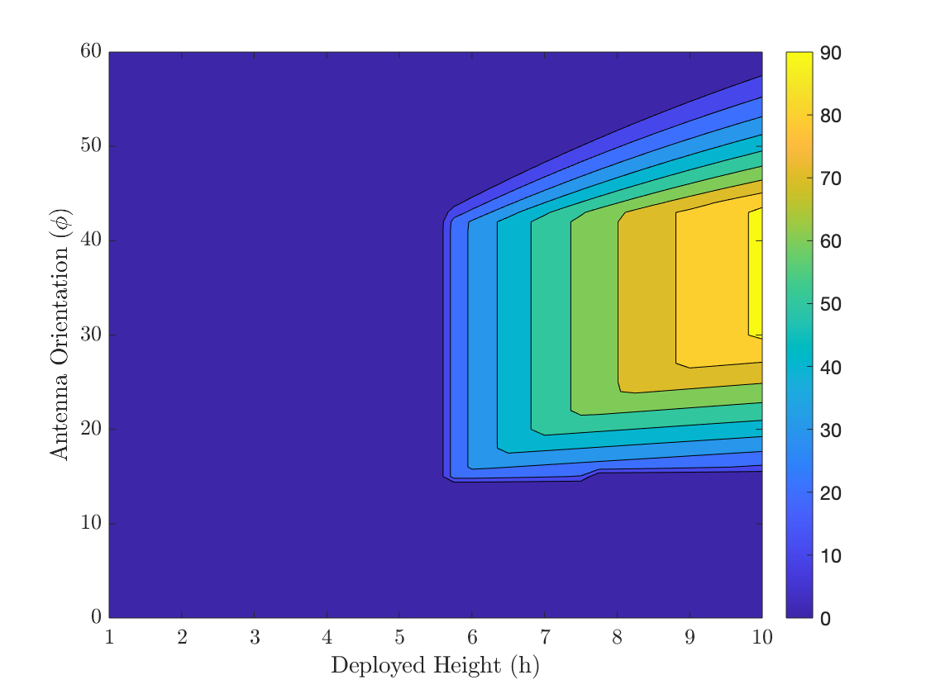
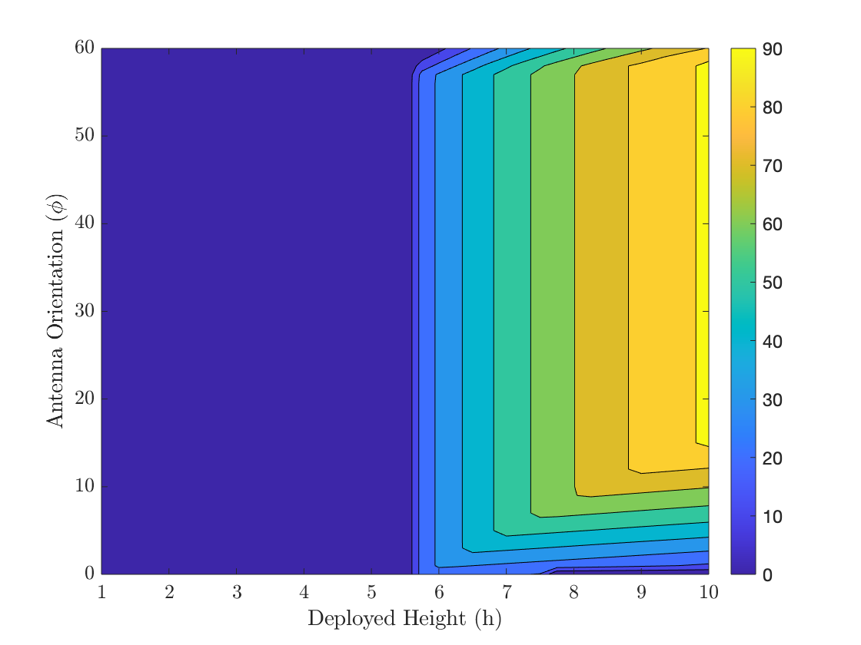
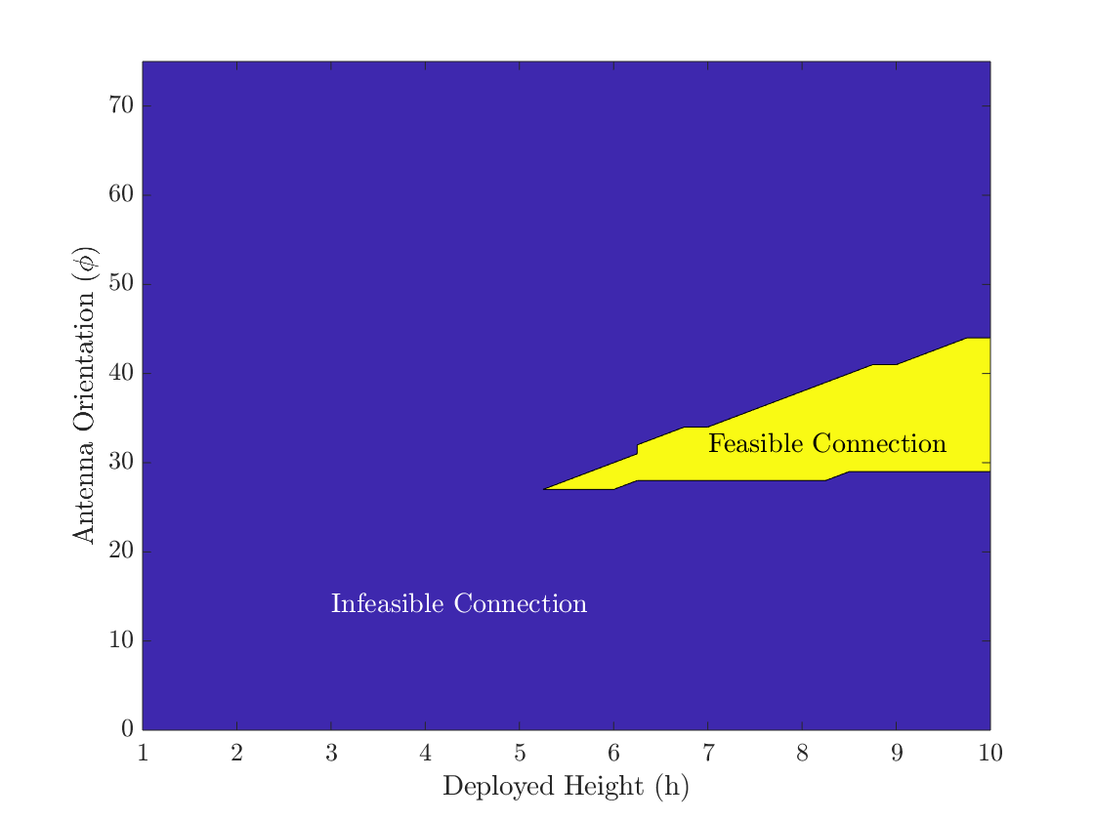






Line-of-sight Analysis
$a=5$m
BW$=30°$
BW$=60°$
Laser
$a=10$m
BW$=30°$
BW$=60°$
Laser

Slide 15
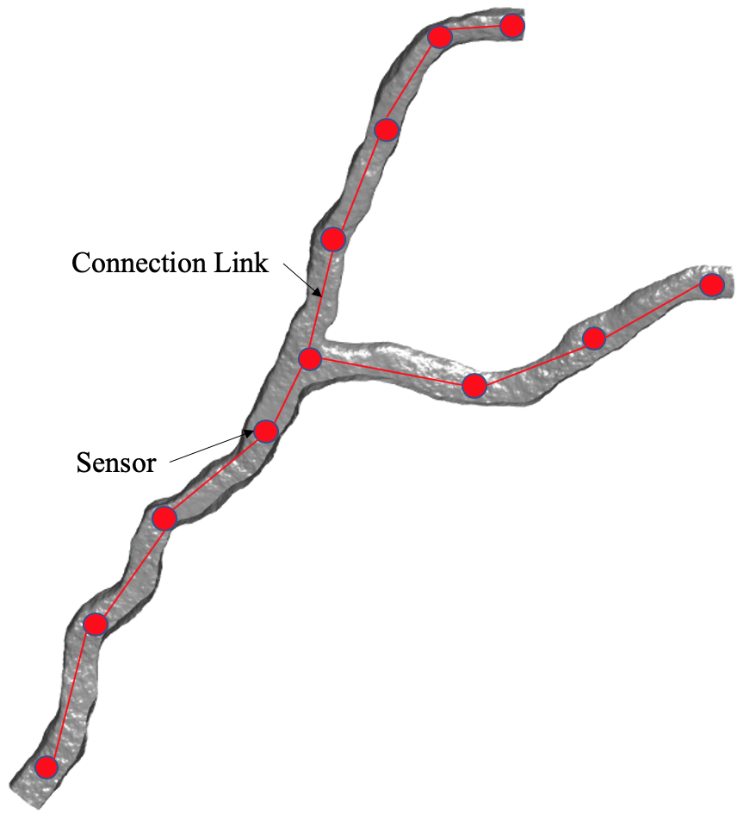
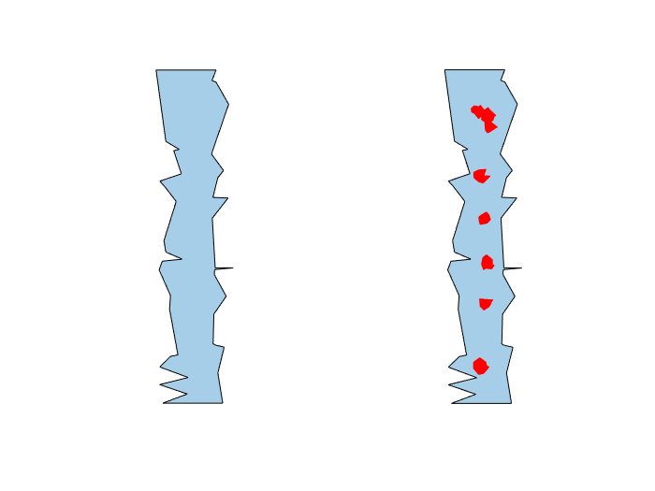
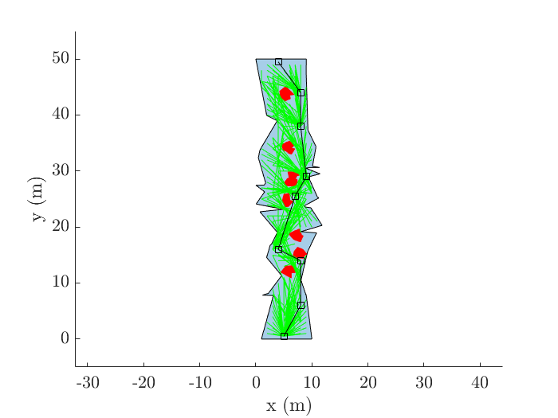
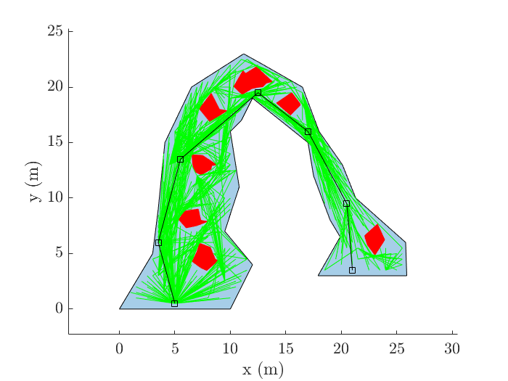
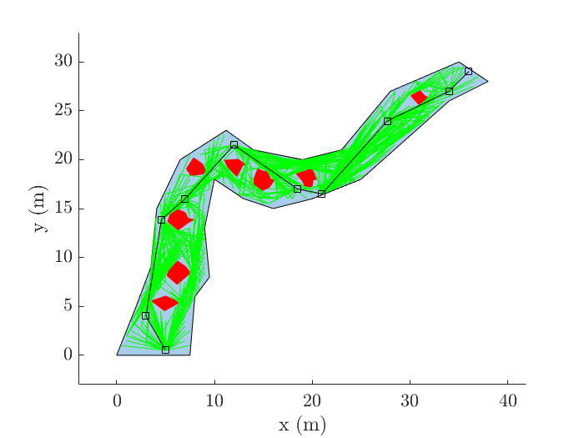


Sensor Placement
$$ℙ_{cave}$$
$$ℙ_{obs}$$
Optimal Sensor Placement using RRT*

Slide 16
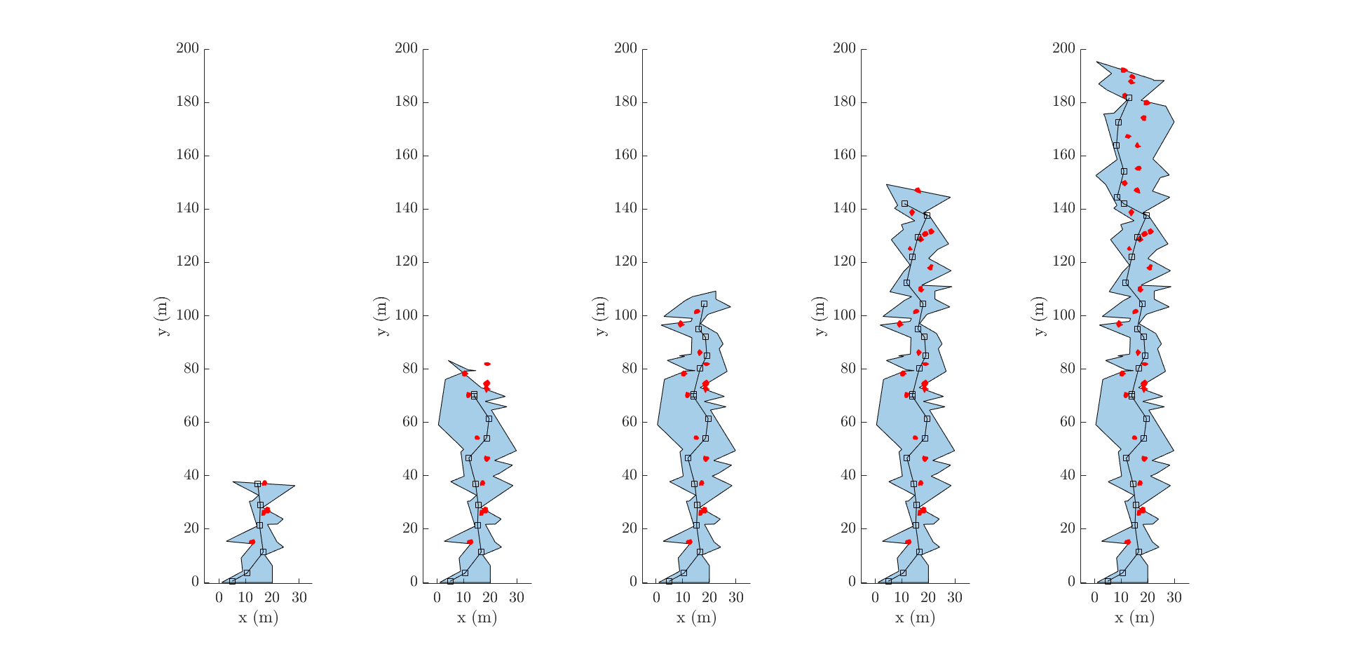

Sensor Placement
Optimal Sensor Placement using RRT* in an unknown cave through 5 successive Explore$→$Place sensor cycles

Slide 17
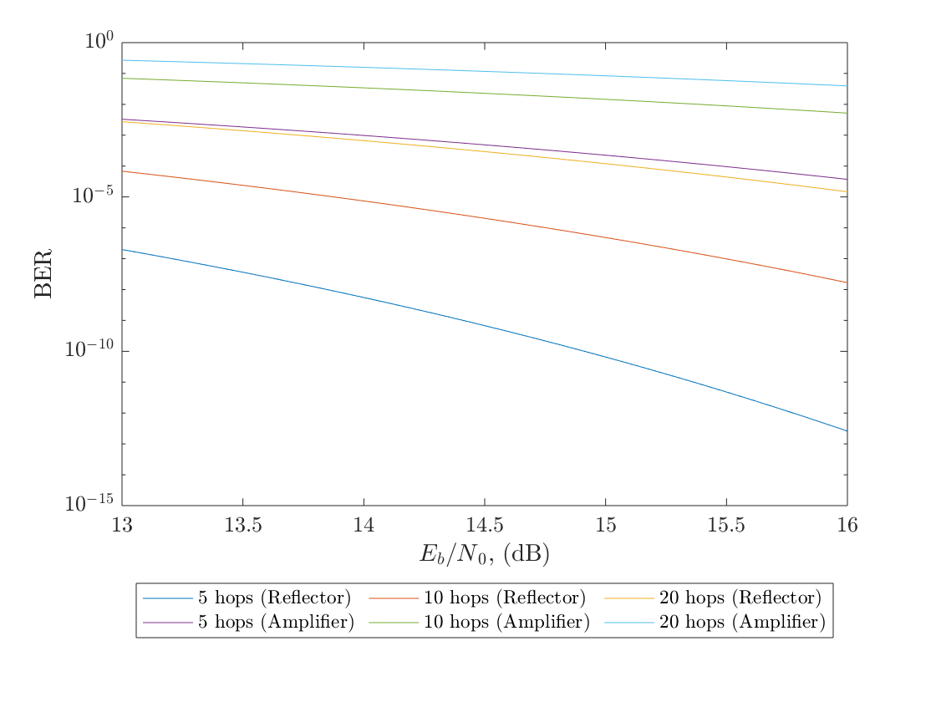
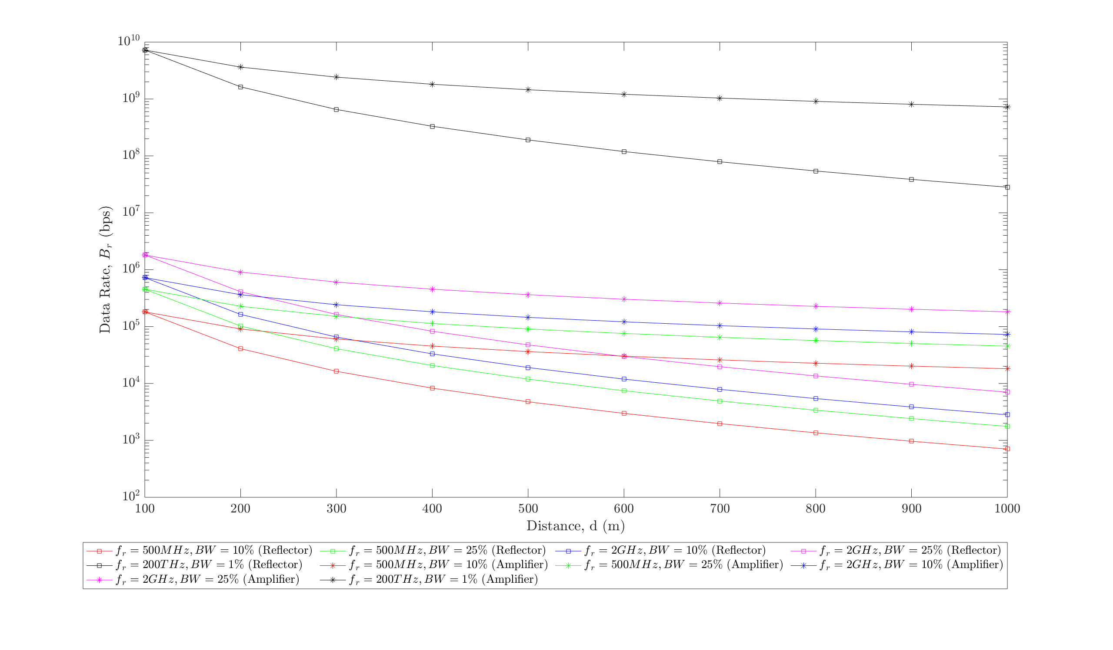
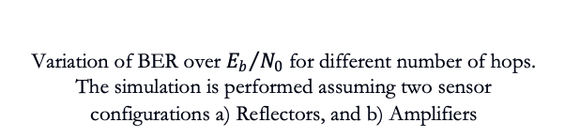
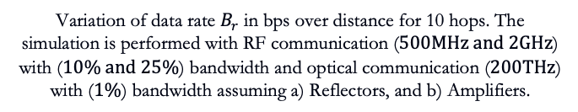
Communication
Two types of sensors modeled
  Reflectors (Inactive)
  Amplifiers (Active)
Variation of BER over ${E_{b}}/{N_{0}}$ for different number of hops. The simulation is performed assuming two sensor configurations a) Reflectors, and b) Amplifiers
Variation of data rate $B_{r}$ in bps over distance for 10 hops. The simulation is performed with RF communication ($500MHz and 2GHz$) with ($10\% and 25\%$) bandwidth and optical communication ($200THz$) with ($1\%$) bandwidth assuming a) Reflectors, and b) Amplifiers.

Slide 18
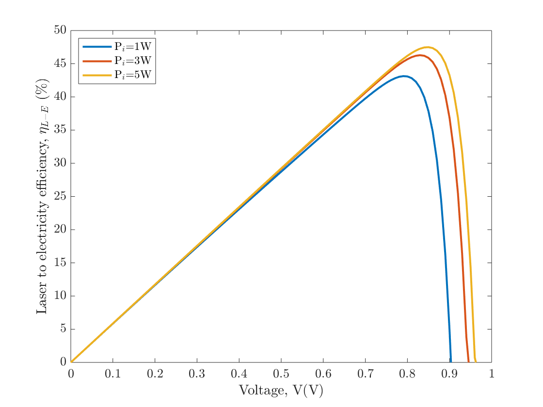
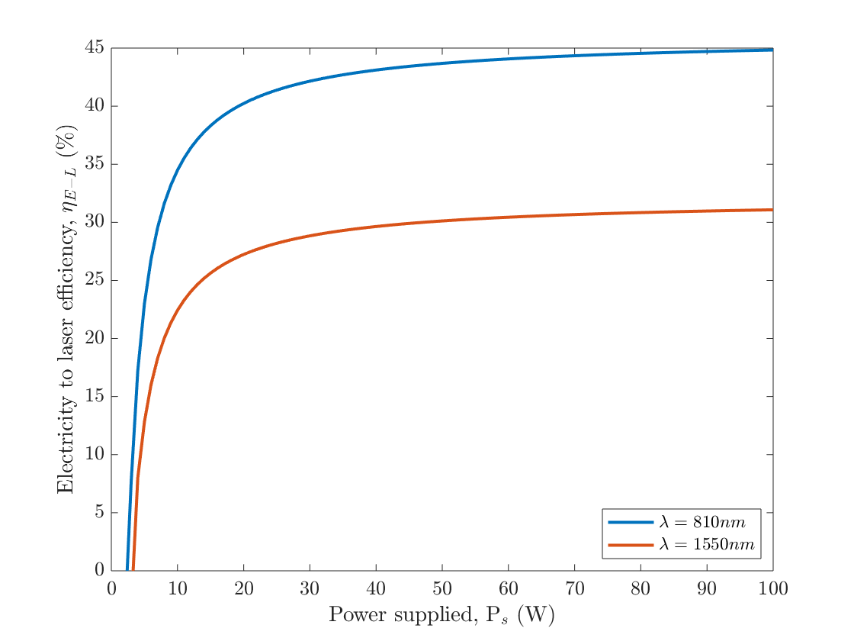






Power Transfer
Wireless power transfer through Lasers
  Electricity to Laser Conversion
  Laser Transmission
  Laser to Electricity Conversion (P-V cells)
Variation of laser to electricity conversion efficiency $η_{L−E}$ of a solar cell over voltage
Variation of electricity to laser efficiency $η_{E−L}$ over supplied power $P_{s}$
Variation of laser transmission efficiency $η_{T}$ over distance $d$
Variation of laser to electricity conversion efficiency $η_{L−E}$ of a solar panel over incident power $P_{i}$

Slide 19





Power Transfer
LineSpec | Property
Color – ‘red’ | $$P_{s}=100 W$$
Color – ‘blue’ | $$P_{s}=250 W$$
Color – ‘black’ | $$P_{s}=500 W$$
LineStyle – ‘Solid’ | $$d=50 m$$
LineStyle – ‘Dashed’ | $$d=100 m$$
LineStyle – ‘Dash-dot’ | $$d=250 m$$
Marker – ‘Square’ | Converters
Marker – ‘Asterisk’ | Reflectors
Two types of sensors modeled
  Reflectors
  Converters
Laser wavelength $λ=810$ nm
Variation of transmitted power over distance for $P_{sensor}=5 W$
Variation of transmitted power over distance for $P_{sensor}=5 W$

Slide 20



Power Transfer
LineSpec | Property
Color – ‘red’ | $$P_{s}=100 W$$
Color – ‘blue’ | $$P_{s}=250 W$$
Color – ‘black’ | $$P_{s}=500 W$$
LineStyle – ‘Solid’ | $$d=50 m$$
LineStyle – ‘Dashed’ | $$d=100 m$$
LineStyle – ‘Dash-dot’ | $$d=250 m$$
Marker – ‘Square’ | Converters
Marker – ‘Asterisk’ | Reflectors
Two types of sensors modeled
  Reflectors
  Converters
Laser wavelength $λ=1550$ nm
Variation of transmitted power over distance for $P_{sensor}=5 W$
Variation of transmitted power over distance for $P_{sensor}=5 W$

Slide 21
Conclusion
Presented Strategies for exploring Lunar/Martian caves that includes
  Mobility
  Mapping and Navigation
  Communication
  Power Transfer
Use of multiple sensors to maintain a direct line-of-sight connection link for both wireless communication and power transfer
Use of Lasers for both communication and power transfer has an advantage

Slide 22

Thank You

Slide 23
Questions ?

