Slide 1

CurrentRF
Dynamic Power, SWaP Reduction, and Transceiver Sensitivity Enhancement in Interplanetary Small Satellites
(The Noise Activated, CC_100 Power Optimizer/Silicon Super Capacitor)
Michael Hopkins
Founder and CEO
Notes:
Play the slide show for this presentation to listen to the audio commentary by Peter Walsh and view slide timings. Or, click the sound icon on a slide for controls that you can use to hear the audio at your own pace.
A little organization will go a long way to enhancing your PowerPoint presentation.
Your title slide should be catching and relevant to your audience – offer something in the title that your audience wants.
Keep some basic principles in mind:
Your slides should complement what you have to say, not say it for you.
Keep slides direct and to the point - less is more!
Choose a background color or design that enhances and complements your presentation rather than competes with it.
Don’t get too fancy - a simple font, elegant color scheme and clear message is more important than lots of information (clutter!) on the slide.
Keep it simple! The purpose of the PowerPoint slide is to keep the mind of your audience focused – fewer words are better.
Note: You understand that Microsoft does not endorse or control the content provided in the following presentation.

Slide 2
The Problem:
ISS CubeSat Embedded DSP Increases System Dynamic Power
Dissipation and Injects High Frequency Noise into Sensitive
Analog and RF Systems, Decreasing System Sensitivity

Slide 3
Dynamic Power Dissipation–
What is It and Why is It Important?
CMOS Inverter Based Overlap Current
The Primary Source of Digital Power
Dissipation

Slide 4
Our Solution: Reduction in Dynamic Power-
Dynamic Power-The Source of Processor Power Dissipation
Supply
Line
Time
Domain
Plots
4

Slide 5
Our Solution:
Embedded DSP Dynamic Power Dissipation is Decreased with
the CC_100 PO/SSC IC (36% SWaP Reduction), Resulting in
Cleaner, More Sensitive ISS CubeSat Sensors and Transceivers
Patented Technology

Slide 6
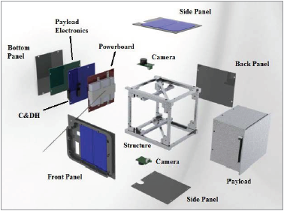

Advantages of the CC_100 PO/SSC IC in ISS CubeSats
Increased RF
and Analog
Sensor Signal
Sensitivity
20% to 36%
Reduction
In Size, Weight,
and Power
(SWaP)
(Batteries,
Solar Panels)
20% to 36%
Reduction In SWaP
(Solar Panels)

Slide 7
Additional Advantages of Using the CC_100 PO/SSC IC & IP in ISS CubeSat
Systems
Internal Energy Harvesting (Up to a 36% Reduction in Dynamic Current and Power)
RF Emissions Reduction(Up to a 36% Reduction over Standard DCAPs)
Power Integrity Enhancement
EMI Reduction-EMC Improvement
2X Small Signal Effective Capacitance increase over Standard Capacitors
600X Large Signal Reservoir Capacitance Increase over Standard Capacitors
A 25% reduction in Effective Series Inductance (ESL)
Enhanced System PSRR(Cleaner System Spectral Outputs)
Draws No Operational DC Power
CC_100 IC and IP can be shaped into any form factor
CC_100 IC and IP used as a standard Capacitor
Customizable Design

Slide 9
Performance-Time Domain Dynamic Power Reduction
(SWaP Reduction in ISS CubeSats)
Power Op/Silicon Super Capacitor IC
Equals PowerStic/Exodus—Just Different Packaging
Supply
Line
Time
Domain
Plots

Slide 10
Performance-Dynamic Spectral and DC Power Reduction
(SWaP Reduction in ISS CubeSats)
Power Op/Silicon Super Capacitor IC
Equals PowerStic/Exodus—Just Different Packaging
Supply
Line
Spectral
Plots

Slide 11
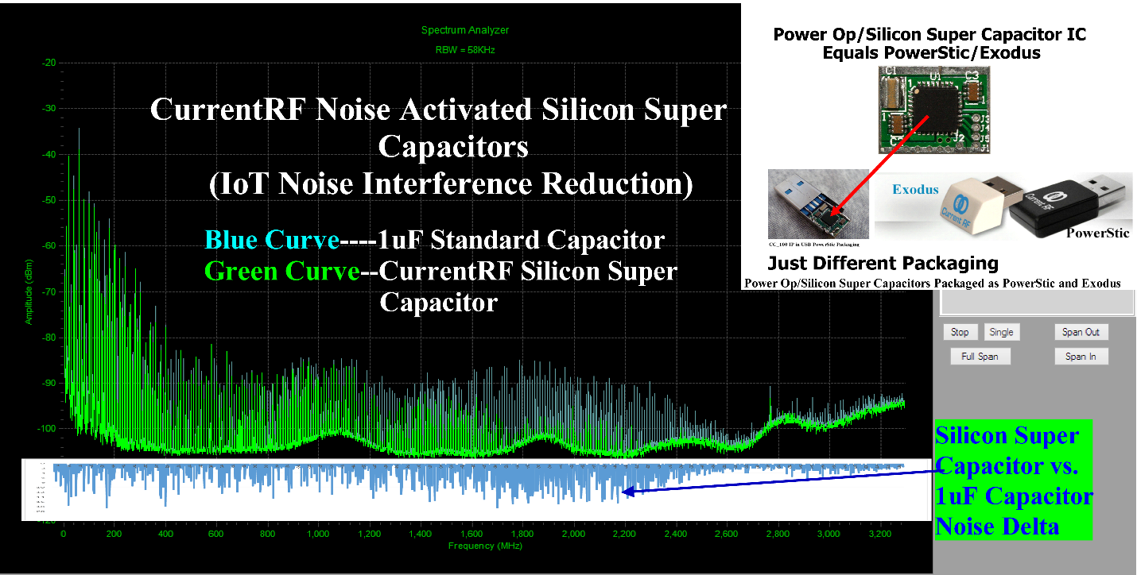
Performance-System RF and Analog Sensitivity Enhancement
Power Op/Silicon Super Capacitor IC
Equals PowerStic/Exodus—Just Different Packaging
Supply
Line
Spectral
Plots

Slide 12
Performance-System RF and Analog Sensitivity Enhancement
Power Op/Silicon Super Capacitor Design
Increases RF Amplifier Sensitivity
ADC
Time
Domain
Plots

Slide 13
Integration into Existing ISS CubeSat Designs
The CC_100 PO/SSC IC and Reference Design Module
2 Connections- Power (Vplus Shorting Bar) and Ground
(Board Bottom onto an existing Ground Plane)

Slide 14
Easy to Integrate into Existing ISS CubeSat Designs
2 Connections- Power and Ground anywhere in the System

Slide 15
ISS CubeSat Probing & Post Processing Capabilities for CC_100
PO/SSC IC Integration into Existing ISS CubeSat Design &
Placement Optimization
Post
Processing
Delta (Power
Sensitivity)
System Power Delta Plot, CC_100 Inserted Vs. Extracted

Slide 16
ISS CubeSat Probing & Post Processing Capabilities for
CC_100 PO/SSC IC and PowerStic Integration into
Existing ISS CubeSat Design & Optimization

Slide 17
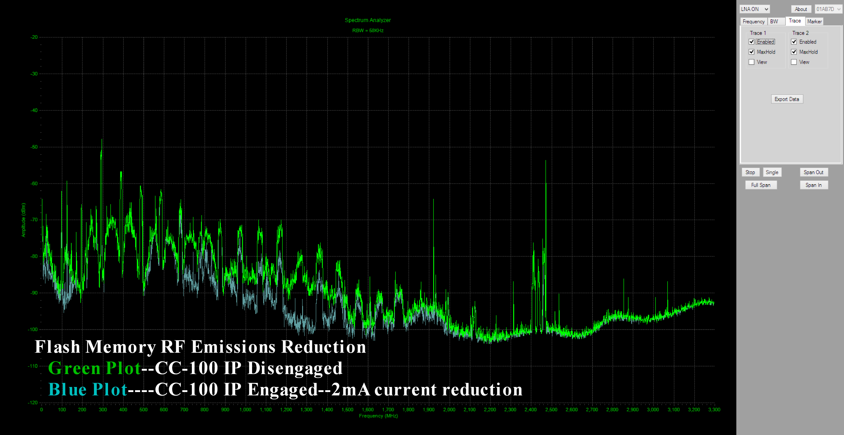
Integration into New System Designs
CC_100 PO/SSC IC Flash Memory Power and Emissions
Reduction

Slide 18
Integration into New ISS CubeSat Designs
CC_100 PO/SSC IC Behavioral Model and Testbench for
ISS CubeSat Simulation--Saving up to 36% in Dynamic Power & Enhancing ISS CubeSat Sensitivity with the CC_100 PO/SSC IC

Slide 19
Integration into New ISS CubeSat Designs
CC_100 PO/SSC IC Behavioral Model for System Simulation
Saving up to 36% in Dynamic Power and
Enhancing ISS CubeSat Sensitivity with the CC_100 PO/SSC IC

Slide 20
Integration into New ISS CubeSat Designs
CC_100 PO/SSC IC Behavioral Model for ISS CubeSat
Simulation Saving up to 36% in Dynamic Power and
Enhancing ISS CubeSat Sensitivity with the CC_100 PO/SSC IC
Patented Technology

Slide 21
Integration into New ISS CubeSat Designs
System Capacitor->Silicon Super Capacitor
Replacement (Same Form Factor/Size)
Patented Technology

Slide 22
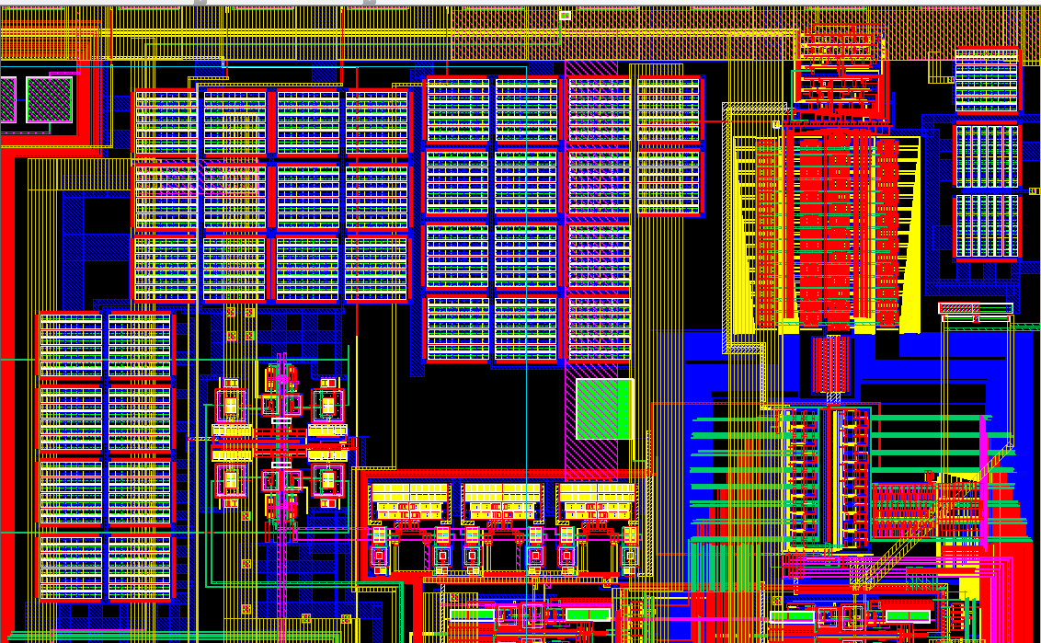
Integration into New ISS CubeSat Designs
Silicon Super Capacitor->On-Chip DCAP
Replacement (Same Form Factor/Size)

Slide 23
Commercialization Expertise & Strategy
Using a Design Services and IP Strategy Targeted at Both Military and Commercial Entities:
Promote the use of the CC-100 PO/SSC IC in Power Saving and Sensitivity Enhancement Applications.
Present the CC_100 PO/SSC IC Power Saving and Sensitivity Enhancement Applications at Trade Shows and Conferences.
Promote and Design the CC_100 PO/SSC IC Devices into PCB efforts at the System Level (CubeSats, etc.).
Promote and Design the CC_100 PO/SSC IC and IP Devices into IC efforts at the Integrated Circuit Level.
CurrentRF at Trade Shows

Slide 24
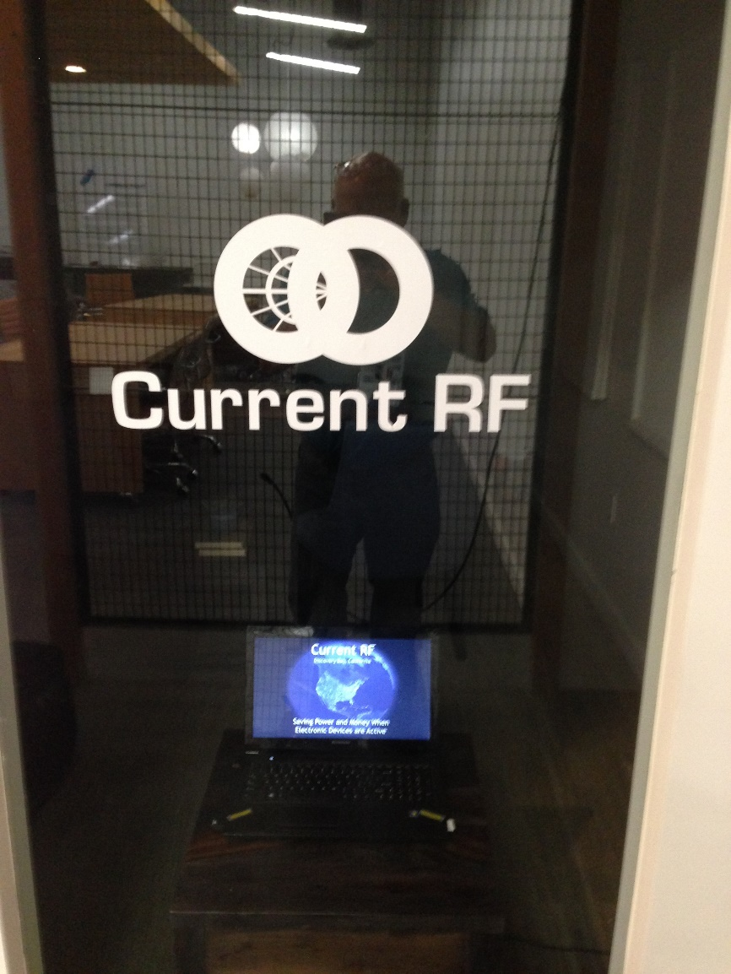
CurrentRF Logistics
Key Personnel:
Mr. Michael Hopkins: PI and CurrentRF CEO
Ms. Tami Hopkins: CurrentRF CFO
Dr. Peter Gize: PhD Advisor and Sales/Marketing
Mr. Jonathan Hopkins: IT Manager– CurrentRF
Ms. Savannah Ford: Media Specialist—CurrentRF
MidStreet Marketing: Sales and Marketing
No Foreign Citizens
No Sub-Contractors/Consultants
No Prior, Present, or Pending Support
Facilities: Office, Development, and Testing
Facilities—Huntington Beach, Ca.

Slide 25

8656 Fresno Circle
Huntington Beach, Ca. 92646
http//:www.CurrentRF.com
(209)-914-2305
Michael.Hopkins@CurrentRF.com

