Slide 1

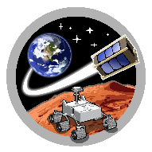

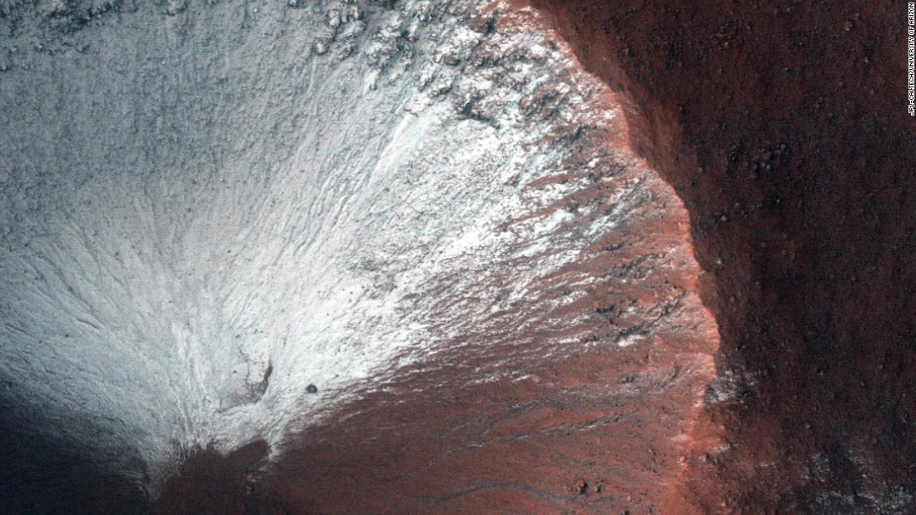

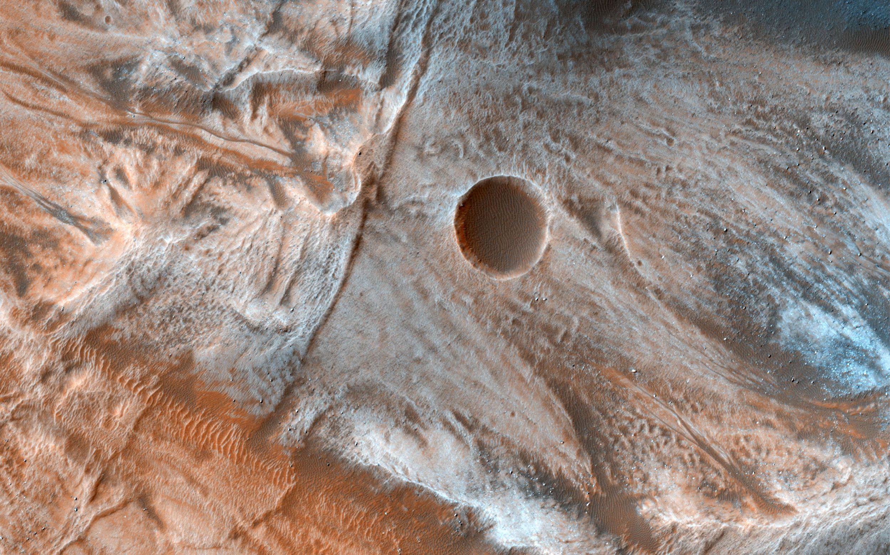
SpaceTREx
Mars Exploratory Balloon (MEB) CubeSats
Tristan Schuler, Kairav Kukkala, Virupakshan Vilvanathan, Sergey Shkarayev, Jekan Thangavelautham
University of Arizona
ISSC - May 12, 2020
Notes:
1
1

Slide 2
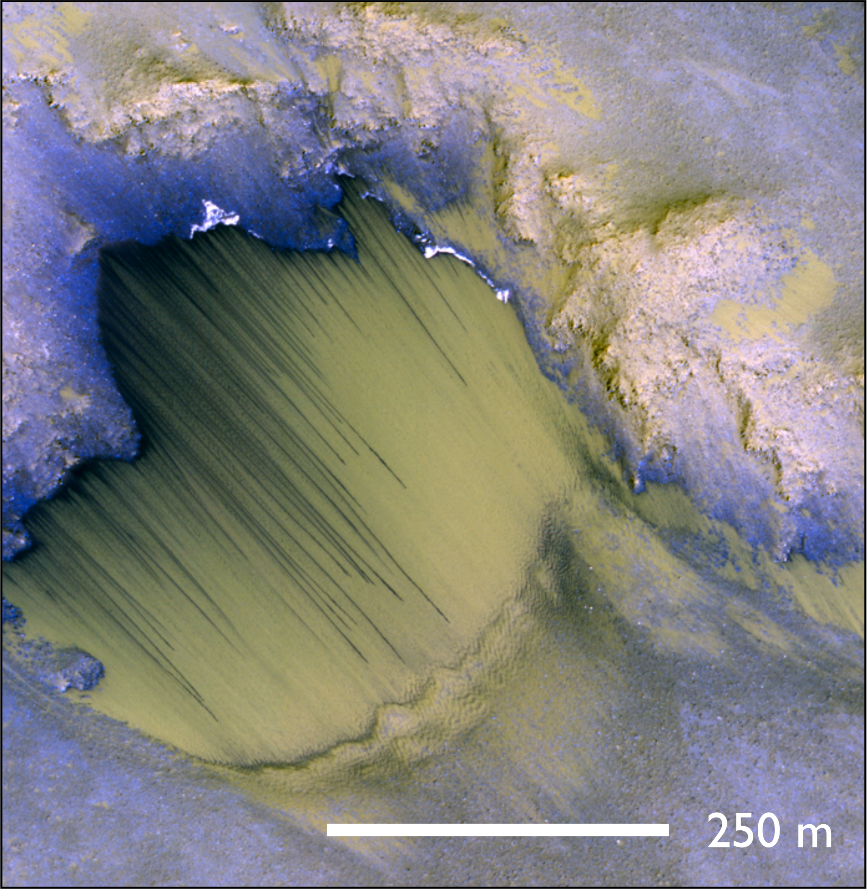
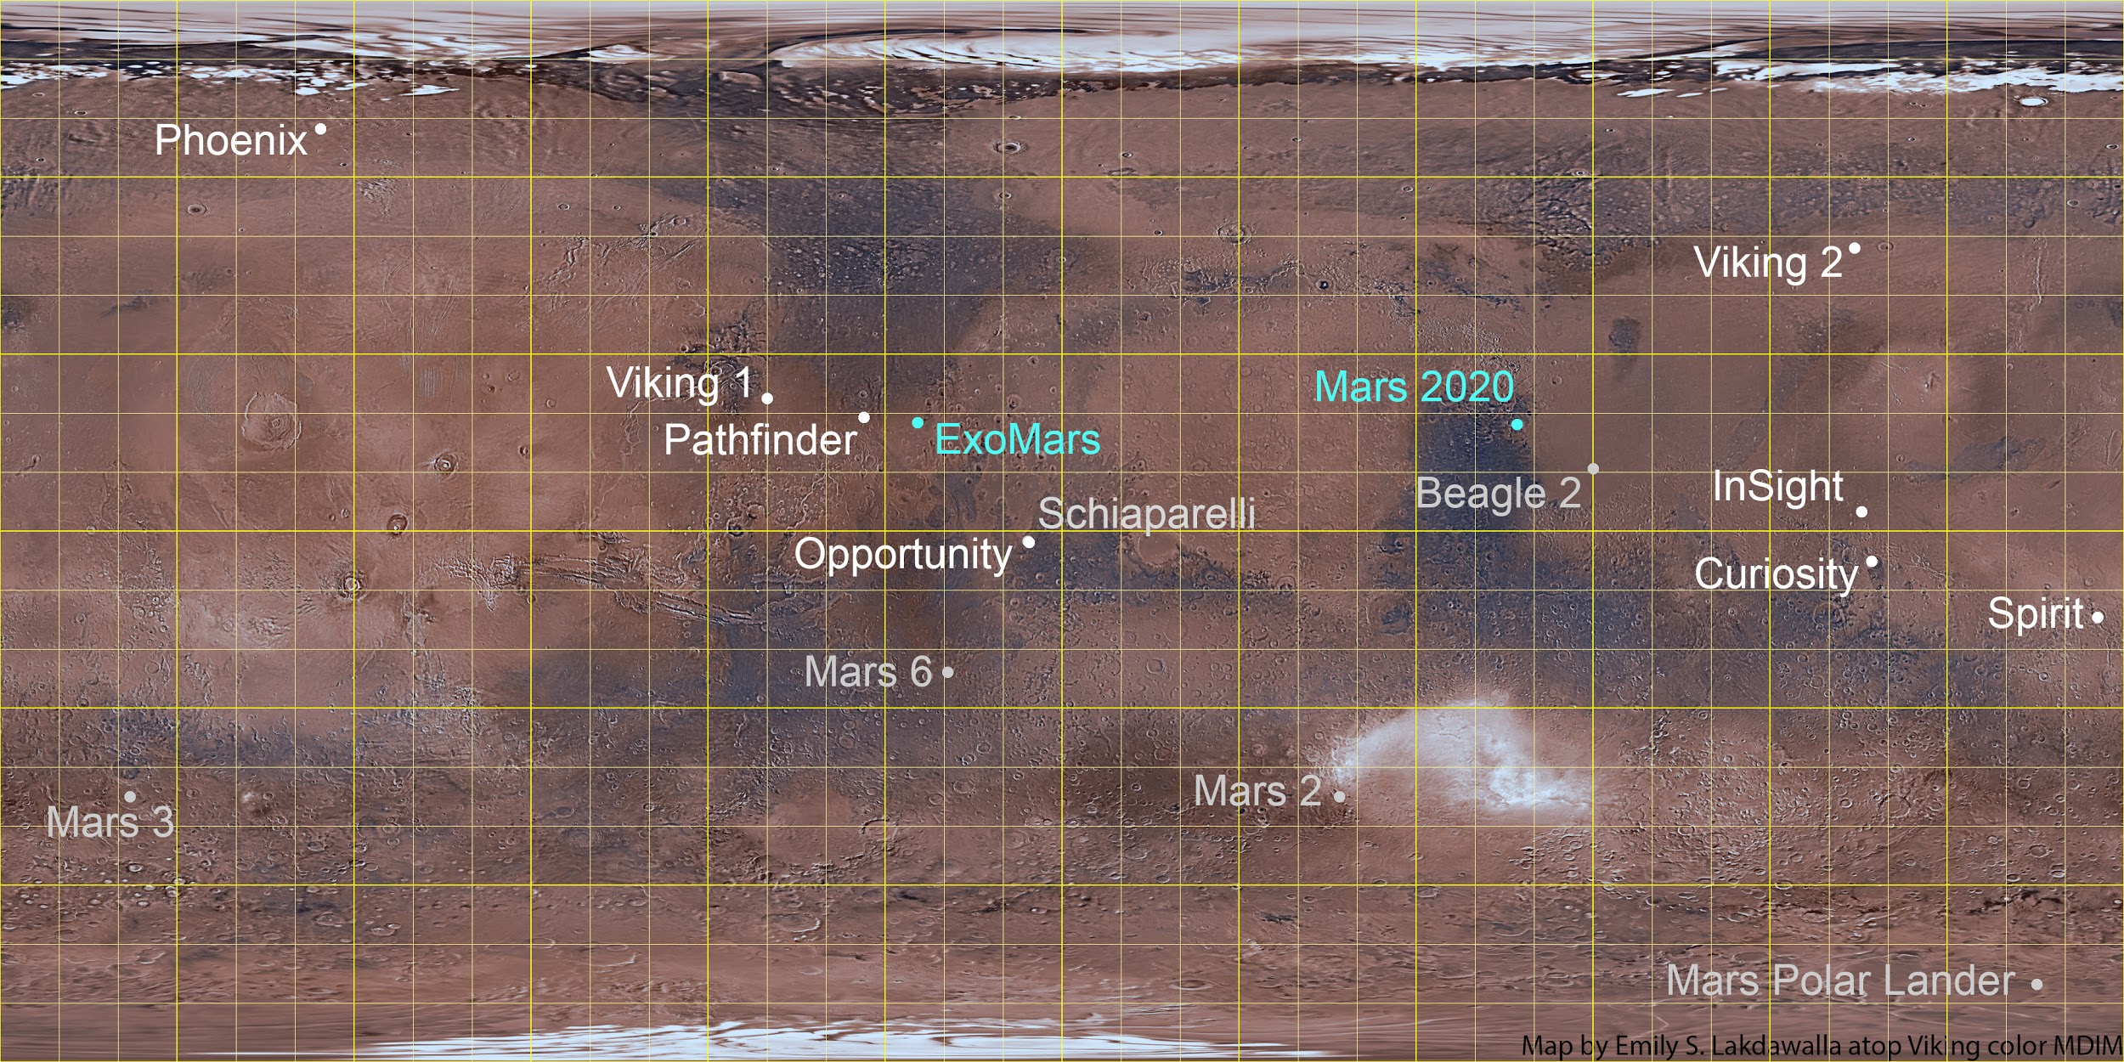
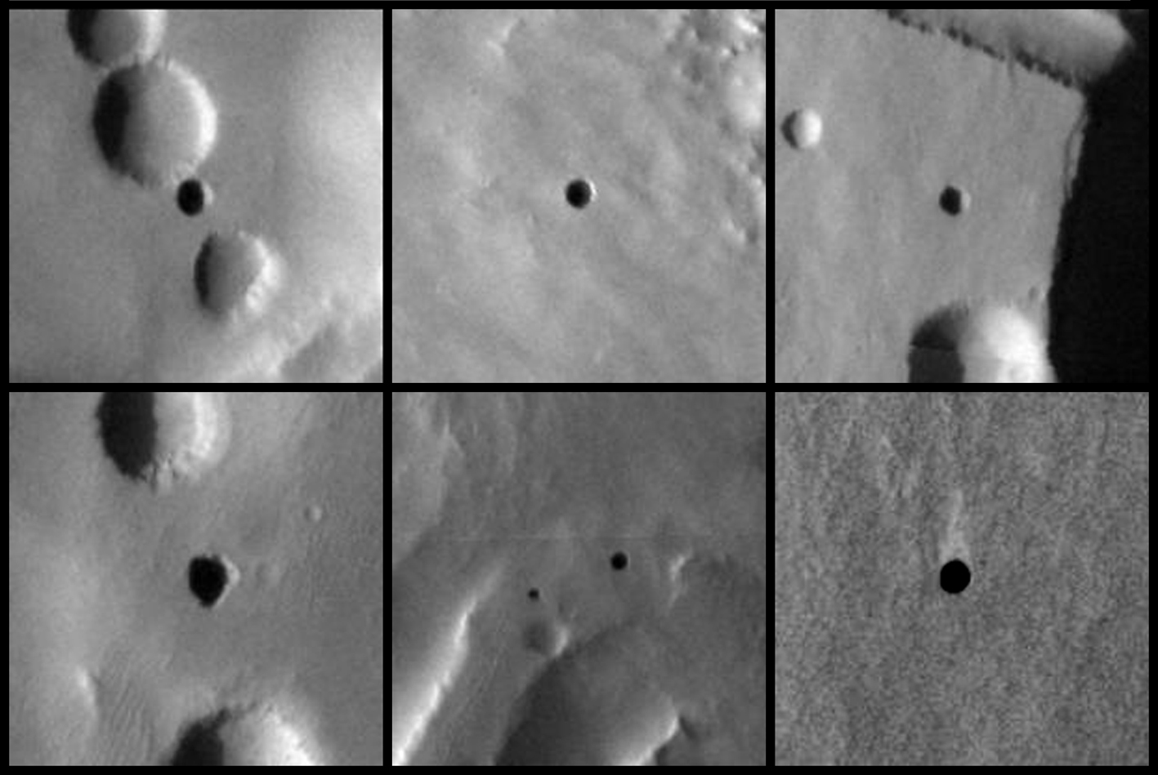
Mission Objective
Less than 1% of Mars has been explored. Aerial vehicles provide a method to explore rugged terrain, cliff/canyon walls, RSL, and skylights
1

Slide 3
Outline
Overview
Concept of Operations
CubeSat System Design
Altitude Control Model
Discussion
Future Goals
Conclusion
2

Slide 4
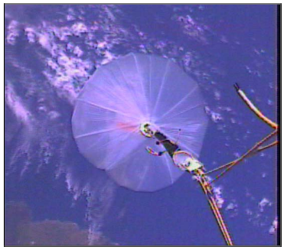
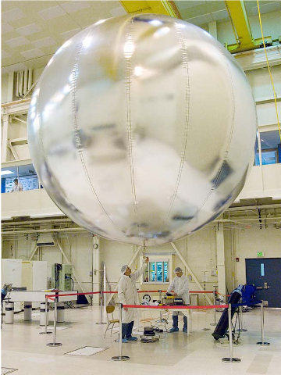
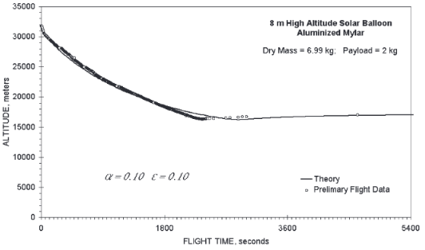
Related Research
Hall, Jeffery, et al. "Flight test results for aerially deployed Mars balloons." AIAA Balloon Systems Conference. 2007.
Jones, Jack A. "Inflatable robotics for planetary applications." (2001).
Jones, Jack, and Jiunn Wu. "Solar montgolfiere balloons for Mars." International Balloon Technology Conference. 1999.
Farley, Rodger. "Balloon Ascent: 3-D simulation tool for the ascent and float of high-altitude balloons." AIAA 5th ATIO and16th Lighter-Than-Air Sys Tech. and Balloon Systems Conferences. 2005.
3

Slide 5
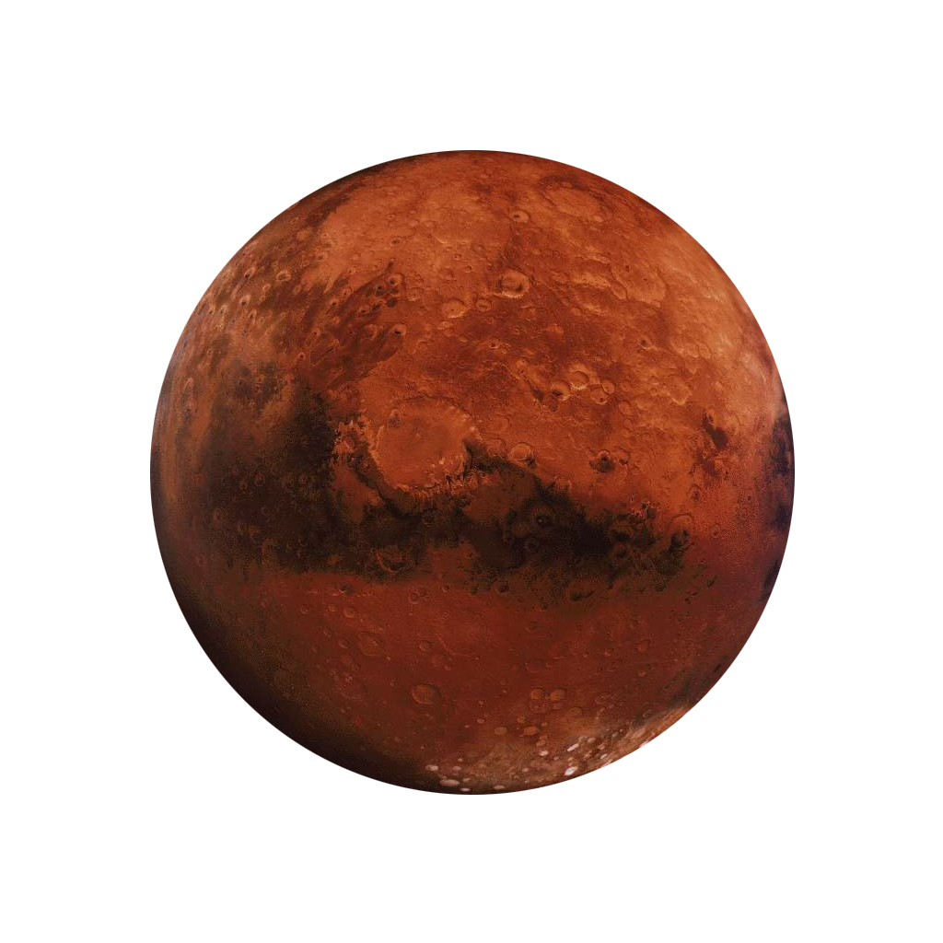

Atmospheric Comparison
 | MARS | EARTH
Atmospheric Pressure | 636 Pa | 101325 Pa
Surface Level Temperature | 210 K | 288.15 K
Air Composition | 95% CO2 | 78% Nitrogen
Distance from Sun | 1.524 | 1 AU
Gravity | 3.711 m/s² | 9.81 m/s²
The atmospheric pressure on Mars is less than 1% of Earth’s, resulting in difficult flying conditions for LTA vehicles. However, flight is feasible.
4

Slide 6
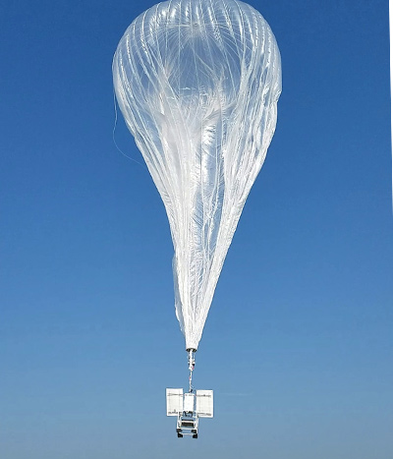
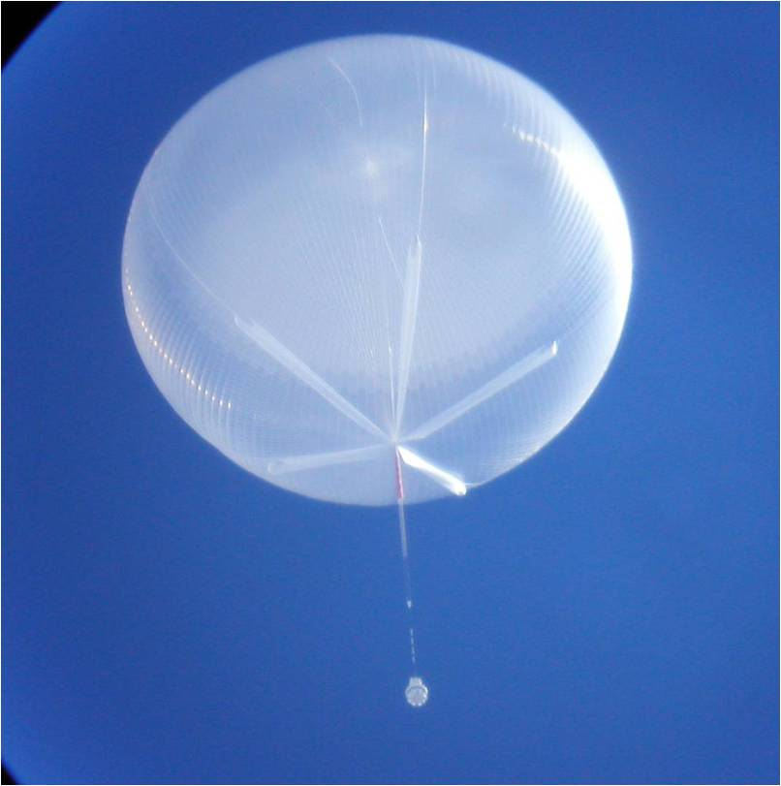
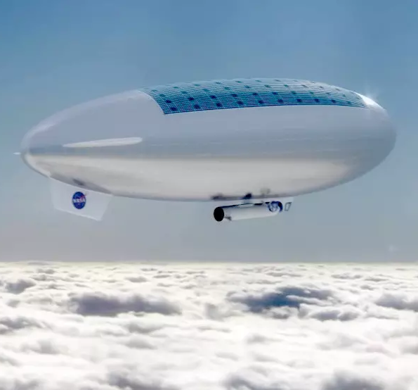
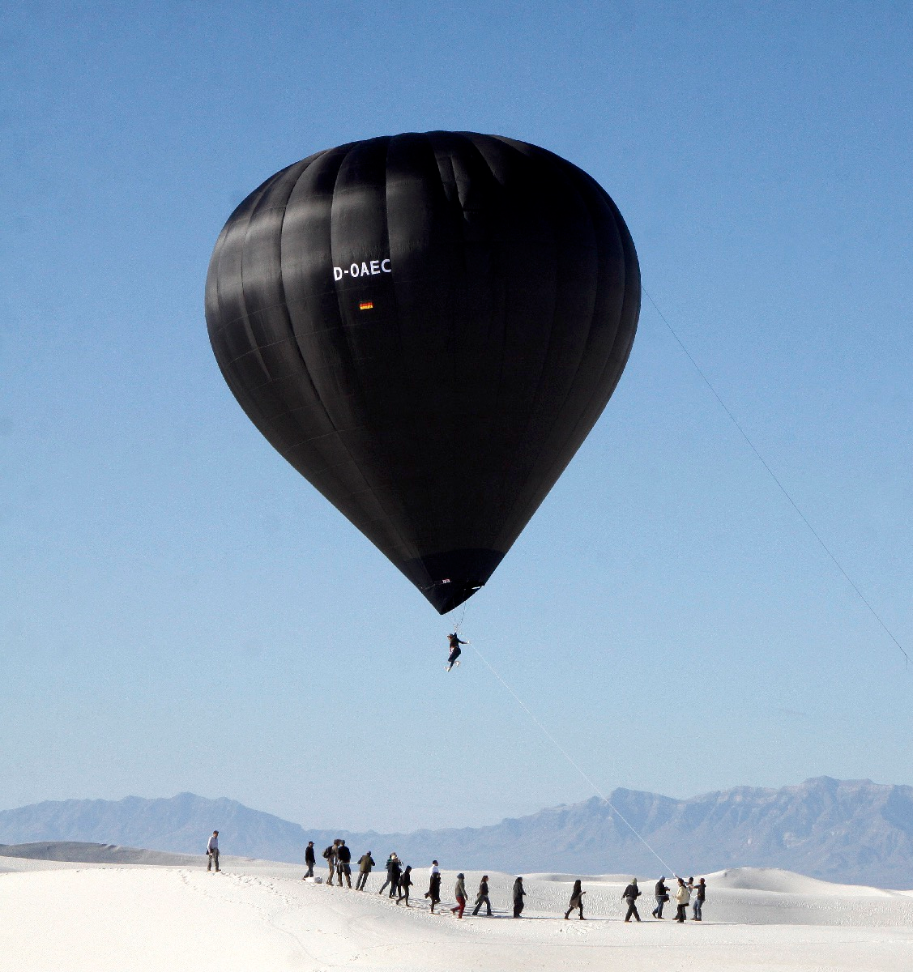
Types of Balloons
Super Pressure Balloon
Zero Pressure Balloon
Vacuum Airship
Solar Montgolfiere
5

Slide 7
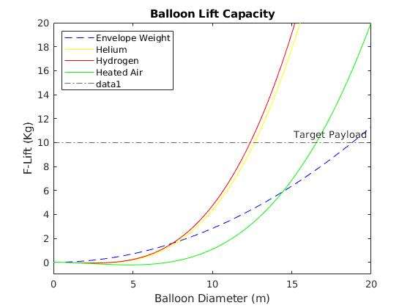
Lift Capacity - Various Gasses
Helium and Hydrogen balloons can lift a 10kg payload at approximately 12m diameter. Solar balloons can lift the same payload at ~17m diameter
6

Slide 8
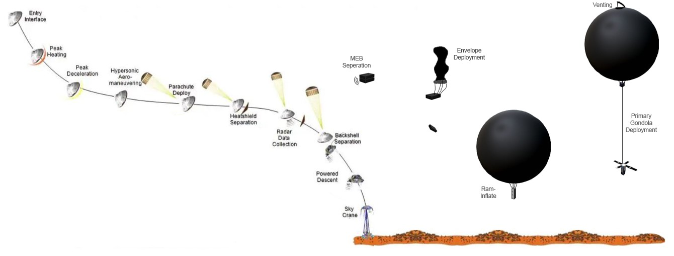
Concept of Operations
With a light enough payload, and pre-heating of the envelope, the MEB can achieve buoyancy during EDL.
7

Slide 9
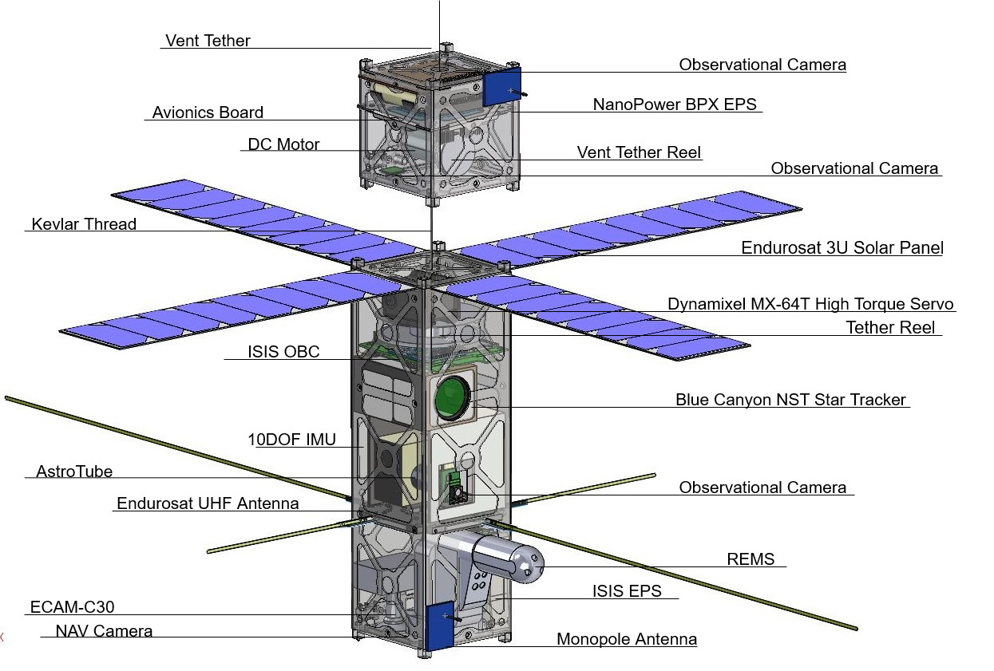
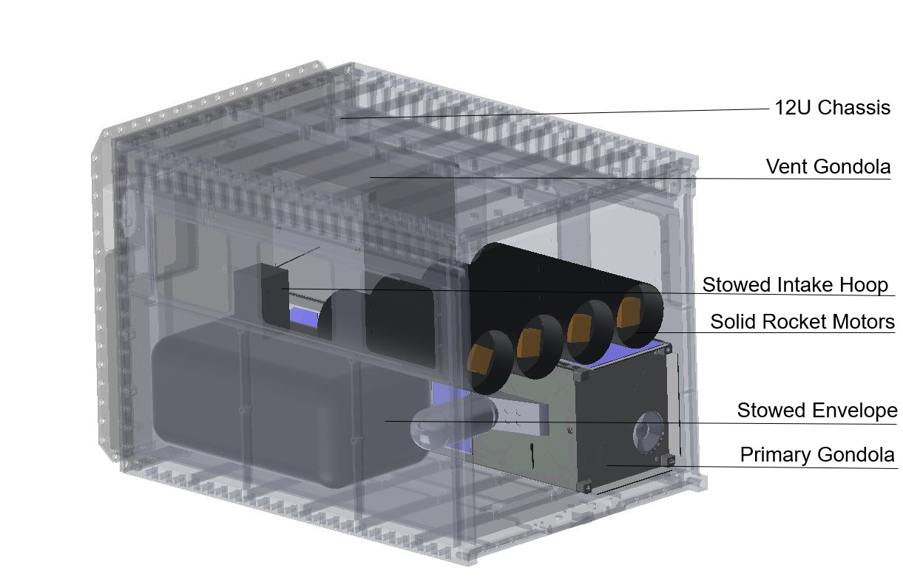
MEB CubeSat System Design
MEB Stowed 12U Configuration
MEB Deployed Primary & Vent Gondolas
8

Slide 10
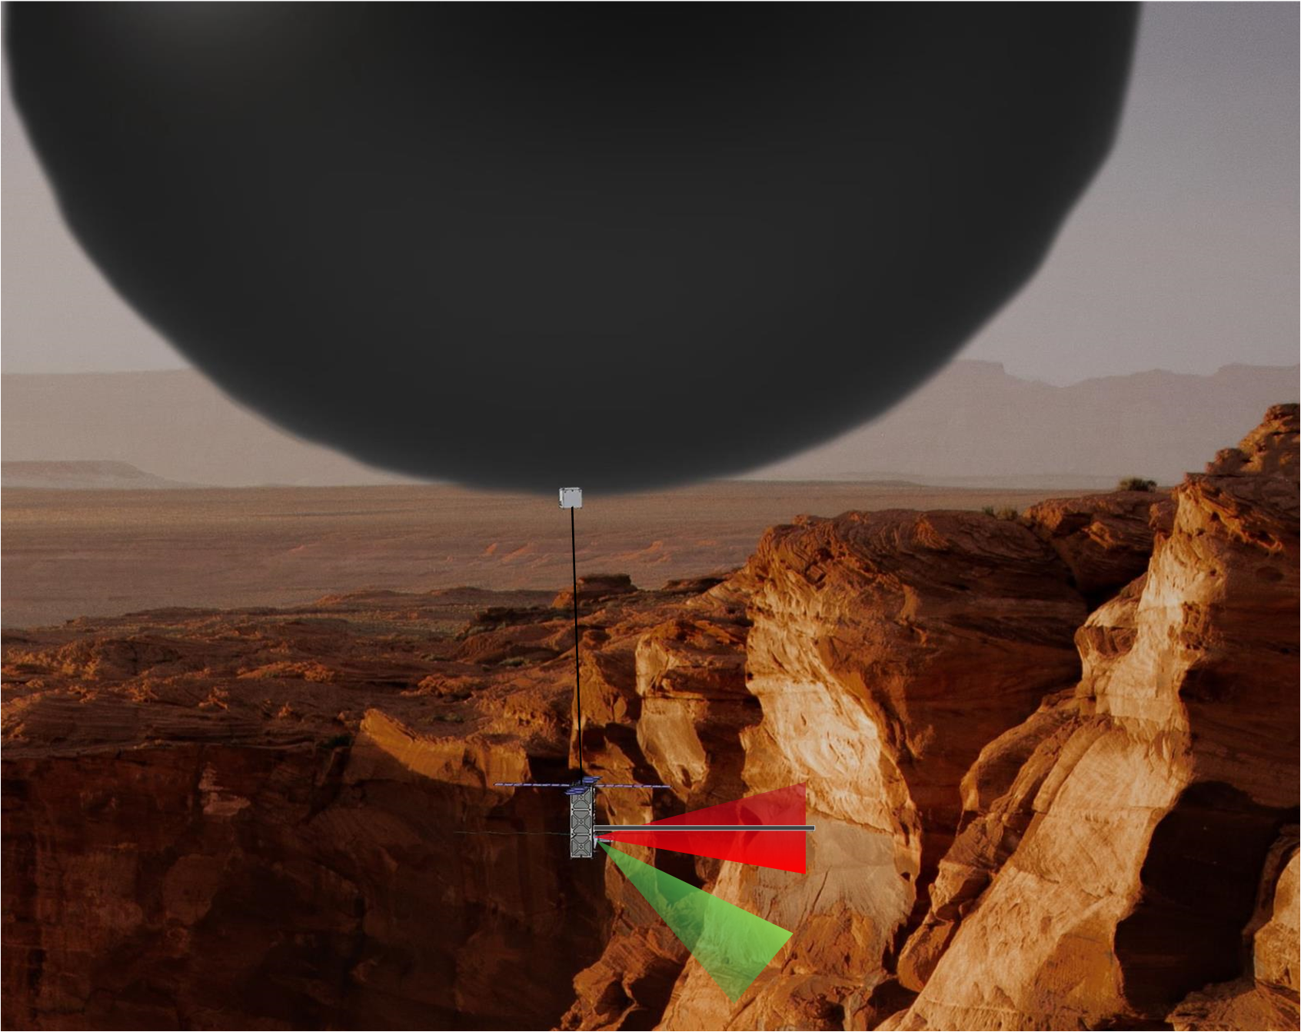
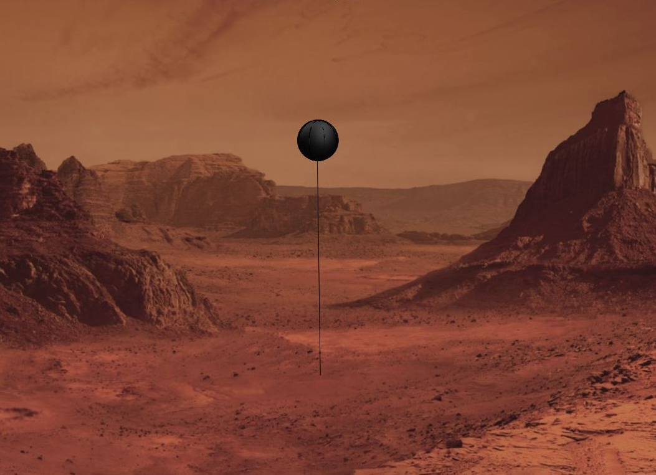
Exploring Mars
MEB collecting science data on an exposed Martian cliff wall: high res-imagery, stratigraphy, core sampling, LIDAR
Anchored MEB, collecting extended atmospheric data and imagery, 1 km above the surface
9

Slide 11


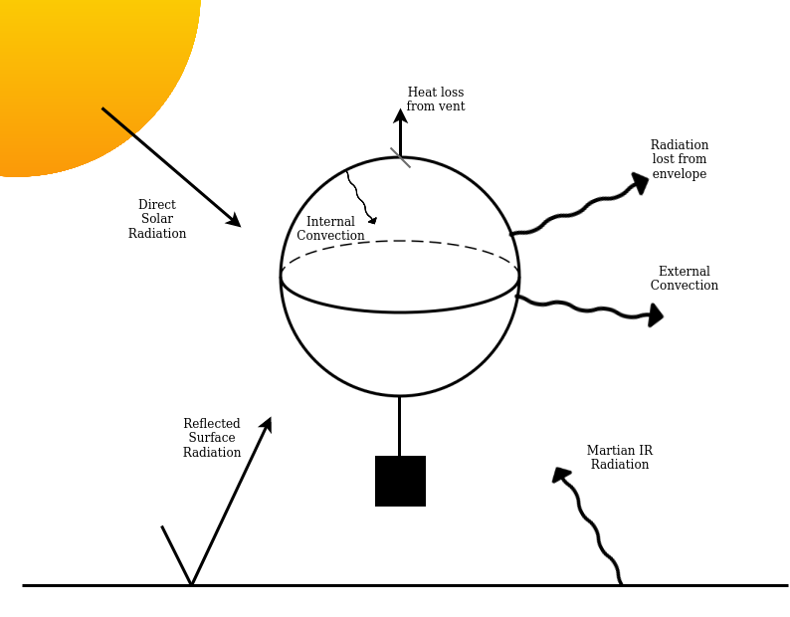

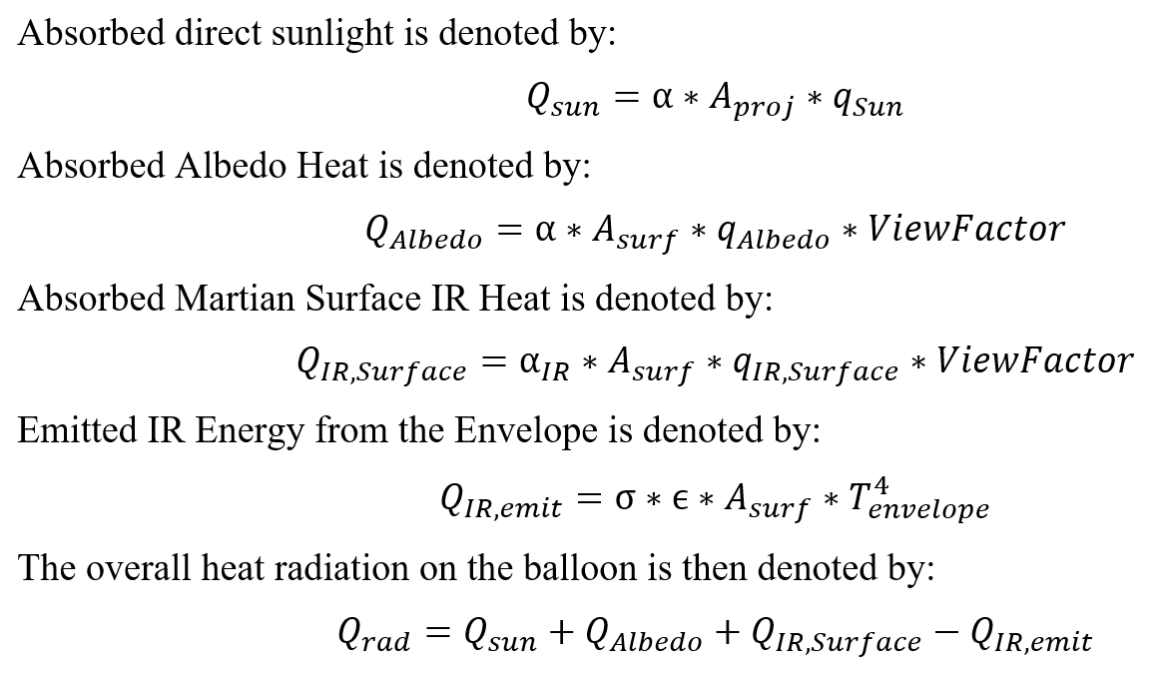
Envelope Radiation Model
10

Slide 12

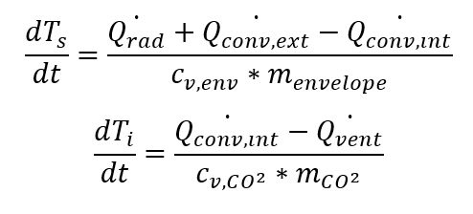
Energy Balance Equations
Venting for Altitude Control
Envelope Temperature
Internal Temperature
These equations provide the dynamic temperature response as a function of time.
11

Slide 13
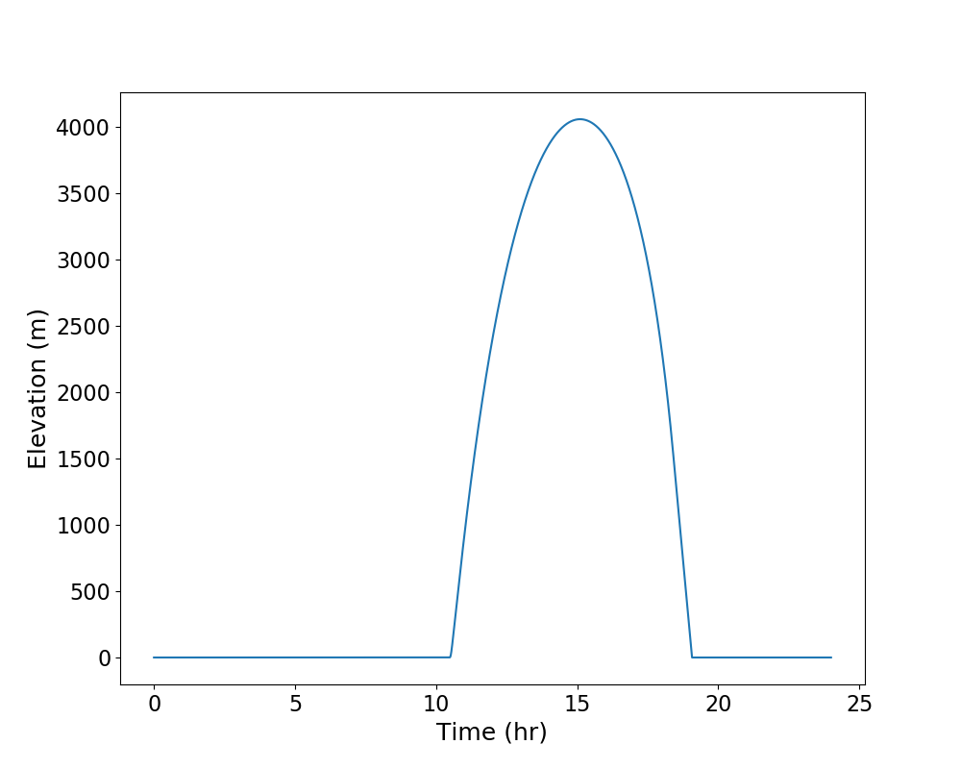
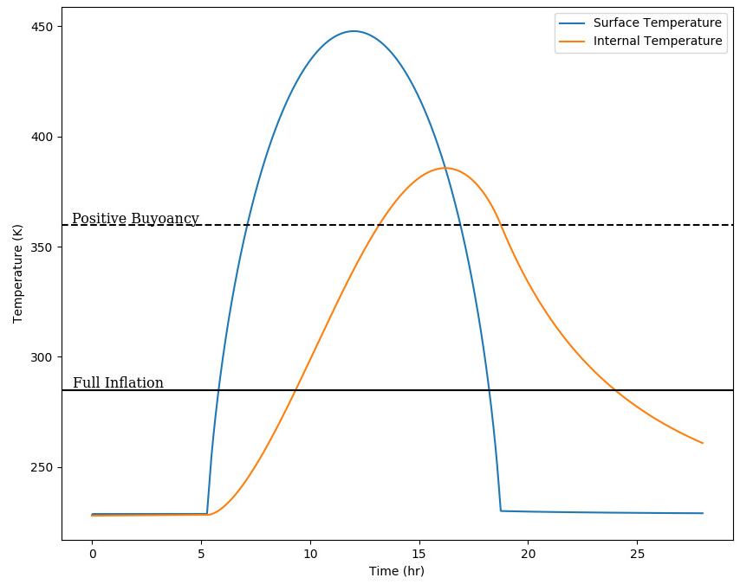
Trajectory for Baseline Balloon Model
Temperature
Elevation
A smaller envelope-to-payload ratio results in longer flight times as well as higher maximum achievable altitude.
12

Slide 14
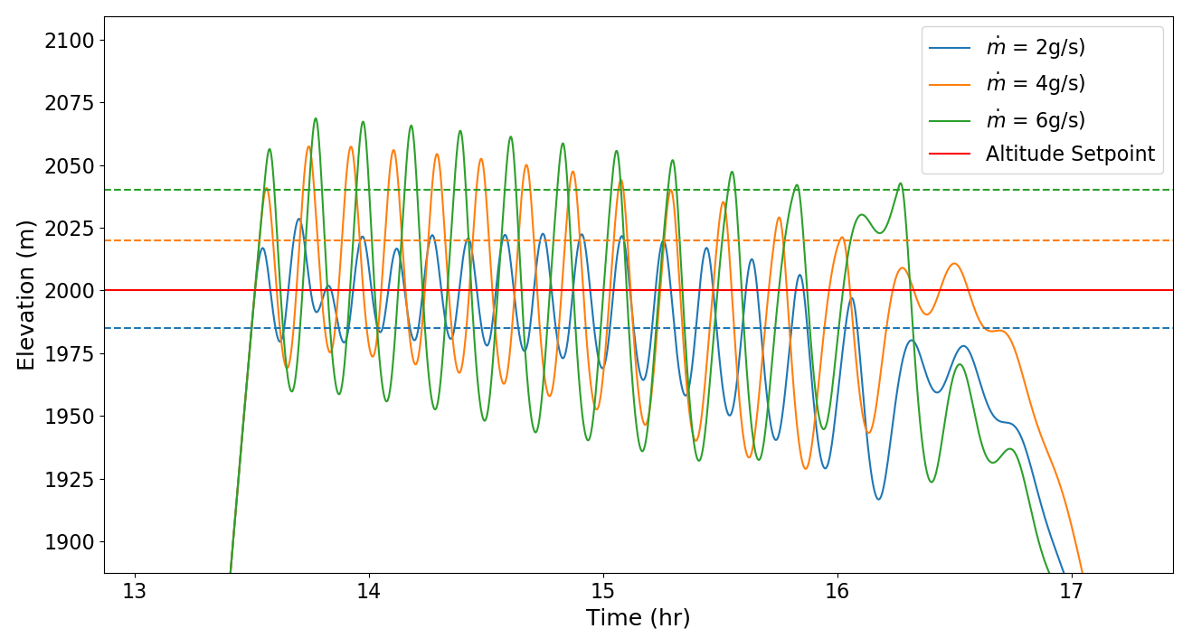
Altitude Position Control for Baseline Model - With Venting
A smaller vent results in smaller limit cycle, but more vent openings.
As vent size increases, “deadzone” for altitude control increases as well.
13

Slide 15
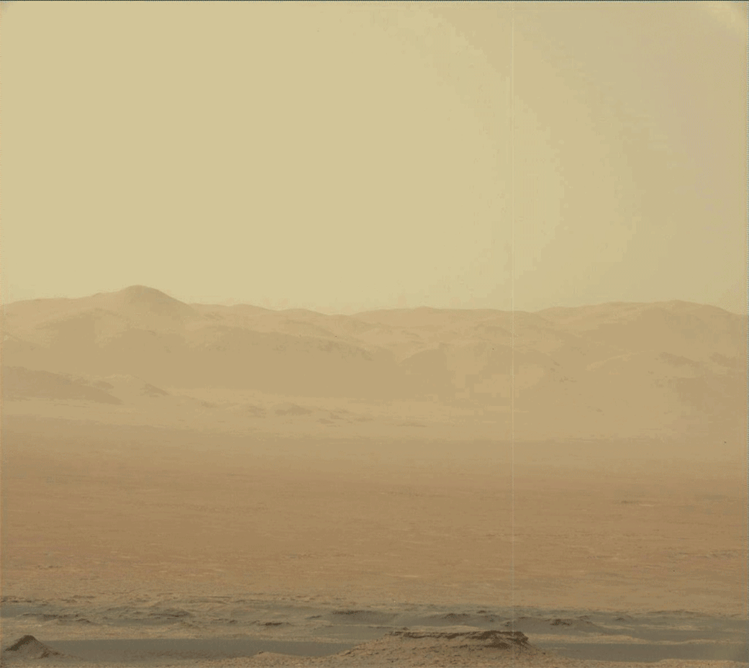
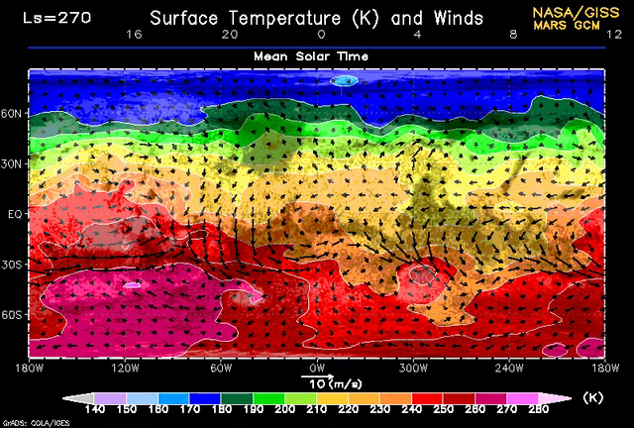
Discussion
Extended sunlight from exploring poles in summer/winter results in longer flights without anchoring
Mars is a breathing planet, seasonal climate change and winds
Can compliment other surface vehicles
Biggest Challenge: Multi-day flights
14

Slide 16
Conclusions
Flying solar balloons on Mars is challenging but this model shows feasibility of the platform.
Highly customizable and can be designed for specific missions.
Future work:
  3D control model
  Terrestrial experiments
  Swarm and Multi-Agent Systems
15

Slide 17
