Slide 1

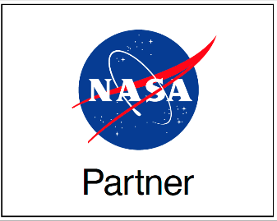
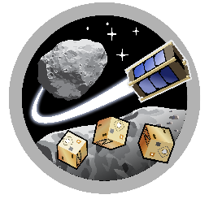
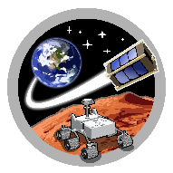
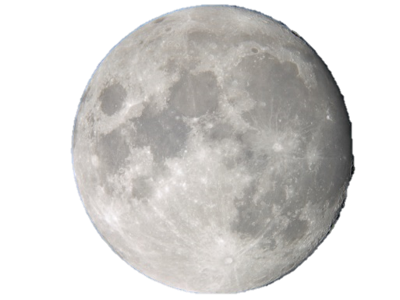
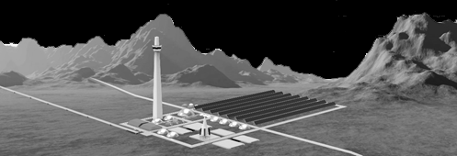

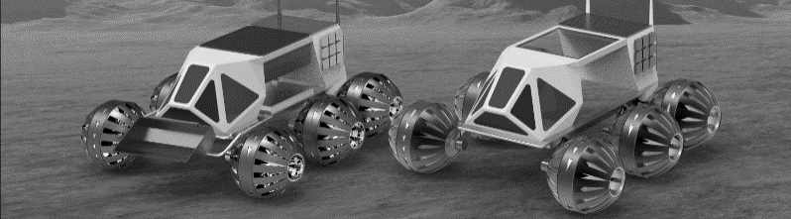
ASTEROID
SpaceTREx
Lunar Mining and Base Construction and Operations Using Teams of Small Robots
Jekan Thangavelautham
Space and Terrestrial Robotic Exploration (SpaceTREx) Laboratory, ASTEROID Center
Aerospace and Mechanical Engineering Department
University of Arizona

Slide 2
Outline
Motivation
Challenges
Objectives
Approach
Simulation Results
Experiments
Discussion
Conclusions

Slide 3
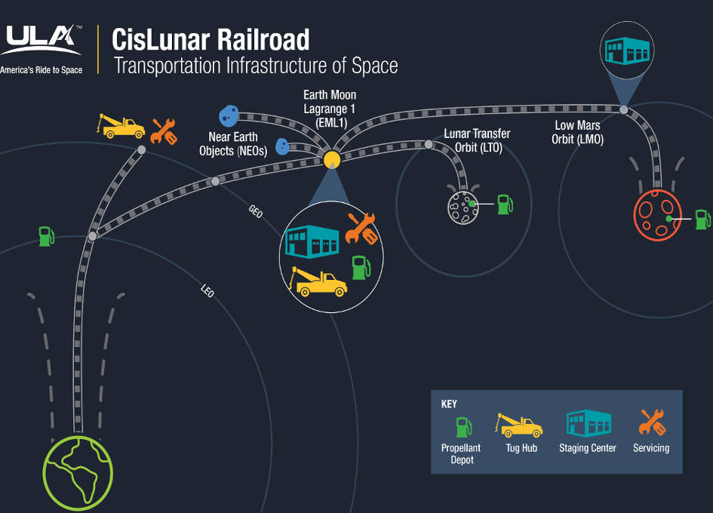
Motivation

Slide 4
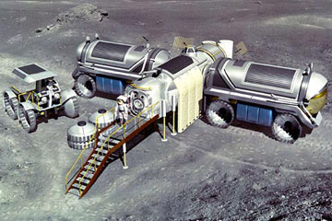
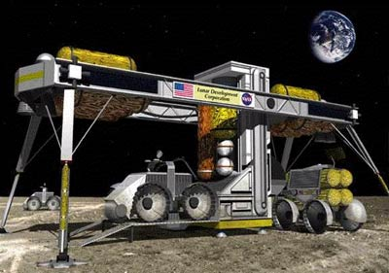
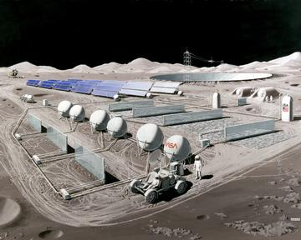
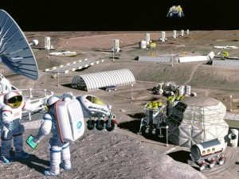
Motivation
Refueling base at various locations in cis Lunar space
Water electrolyzed to produce H₂ and O₂
Fuel and raw material for transport, construction and manufacturing

Slide 5
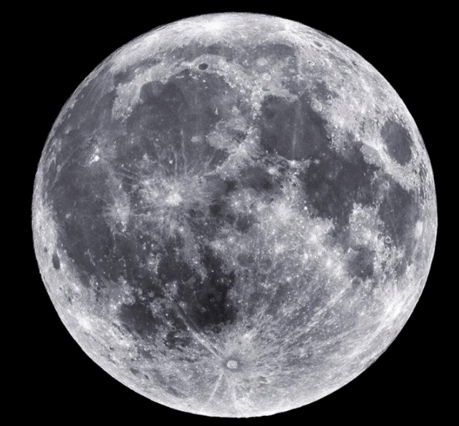
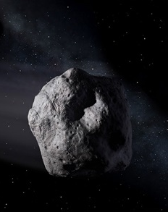
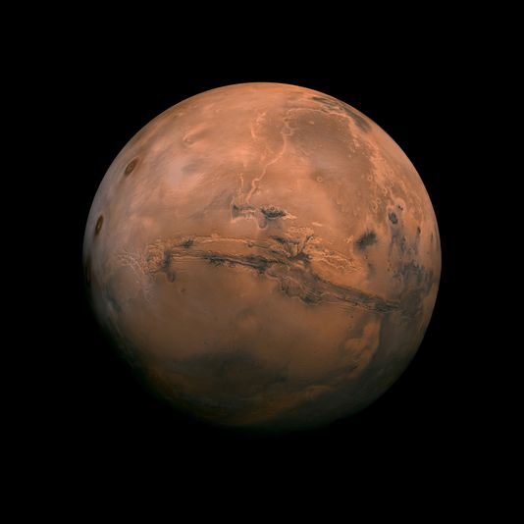
Export Economies
Low gravity of the Moon, asteroids and Mars facilitates rise of export economies.
Substantial reserves of water found
Matter of extraction and processing.

Slide 6
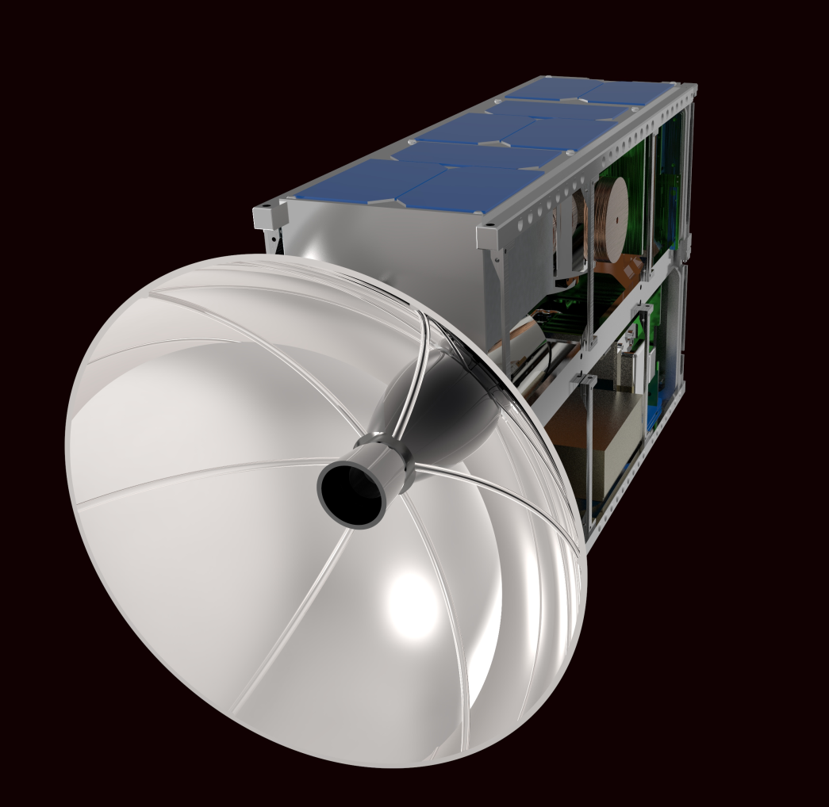
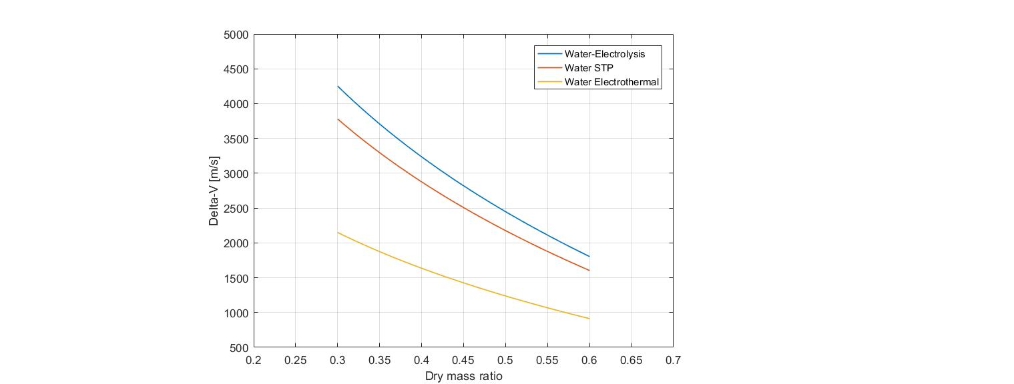
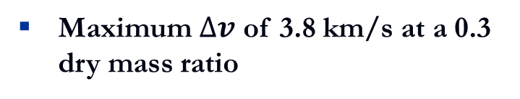

Performance Comparison of Water (Propellant)
Delta-v
Tsiolkovsky rocket equation
$$∆v=v_{e}\ln{\frac{m_{0}}{m_{f}}}$$
Maximum $∆v$ of 3.8 km/s at a 0.3 dry mass ratio
It approaches water electrolysis propulsion systems
Offer a superior performance than water electrothermal propulsion

Slide 7

Multifunctional Materials - Water
“Near Universal” Solvent
Propellant
Energy Carrier
Hydrogen Storage
Radiation shield
Thermal storage device
Coolant
Life-support
Needed for metal refining

Slide 8
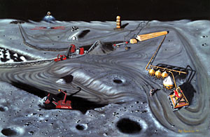
Base Construction and Operation
Terrain preparation
Facilities construction
Water, oxygen, fuel production
Metal extraction and refining
Excavation

Slide 9
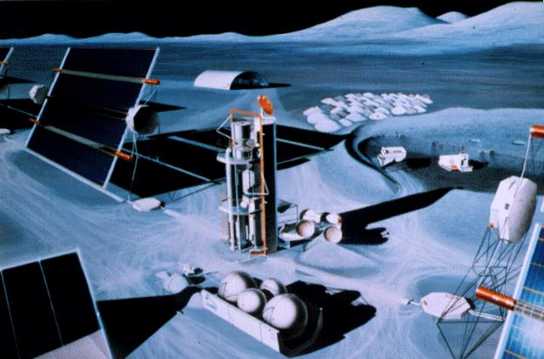
Key to Base Operation
Autonomous Control
  Unstructured environments
  Minimal supervision and task decomposition
  In-situ adaptation
Multiple robots - increases
  Parallelism
  Redundancy
  Robustness
  Simplicity
Control development
  Decentralized, adaptive, robust, no onsite support

Slide 10




Evolvable Systems
Space Systems Design Goal: Meet Requirements
“Design” Goal: Survival
Evolution
Artificial Evolution
Millions of years
JPL
JPL

Slide 11
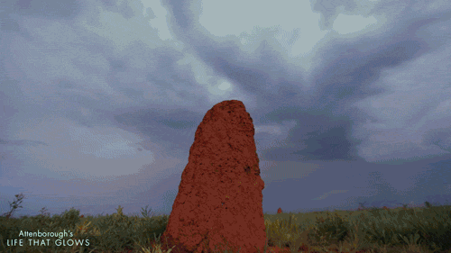
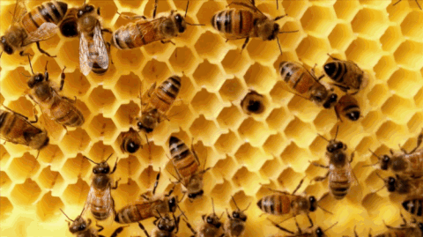
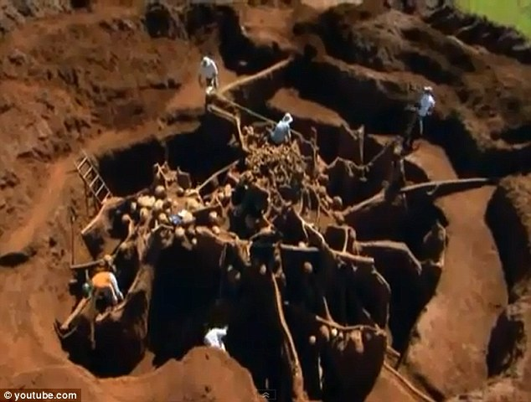
The Engineering Model: Social Insects
“Whole greater than the sum of the parts” -Koffka
Solve a complex task using many individuals.
Individuals are simple, low-cost, disposable.
They have survived for 400+ million years

Slide 12
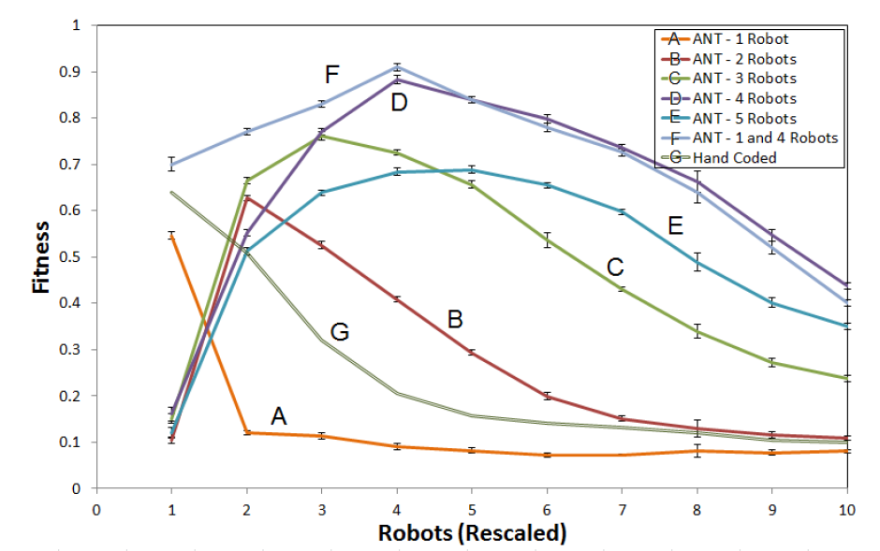
Teams of Autonomous Robots for End to End Operations

Slide 13
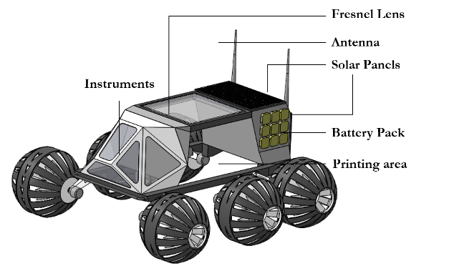
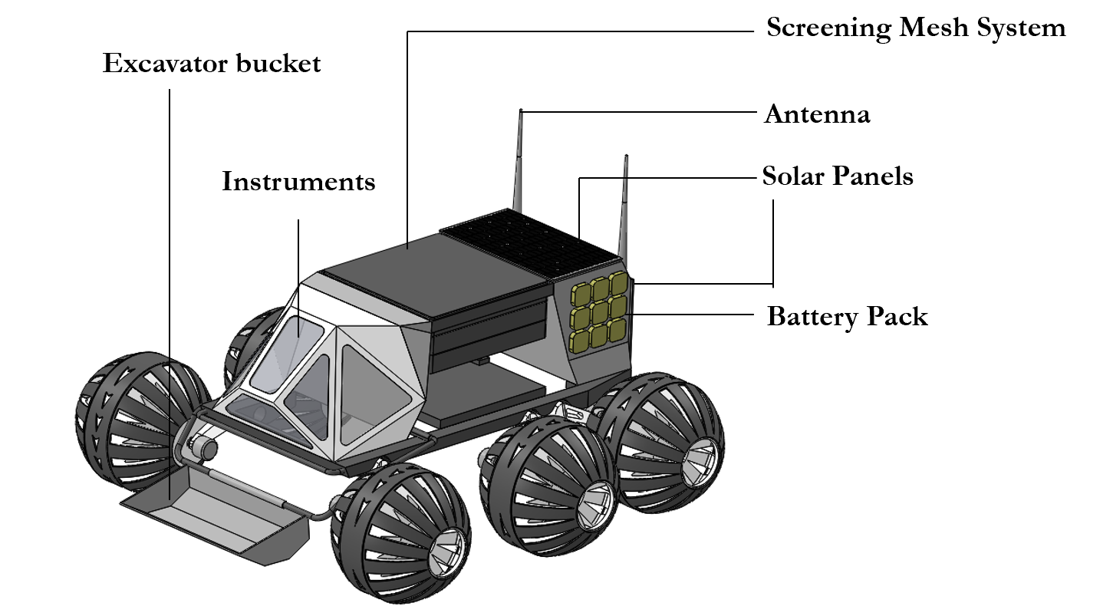

Robot Teams

Slide 14
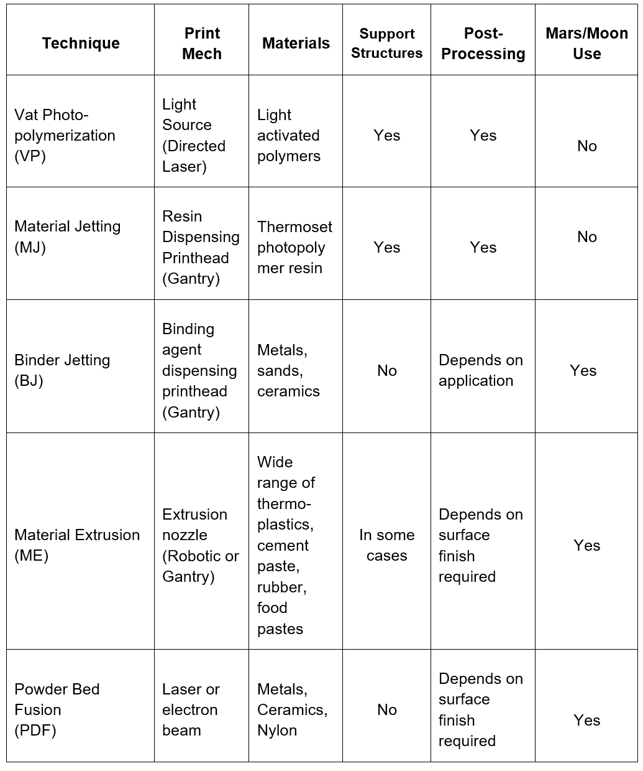
Additive Manufacturing Off-world

Slide 15
Objective
Develop an energy model for the construction and operation of a mining base. Compare overall feasibility of developing a base on the Moon and outline the need for new technology.

Slide 16
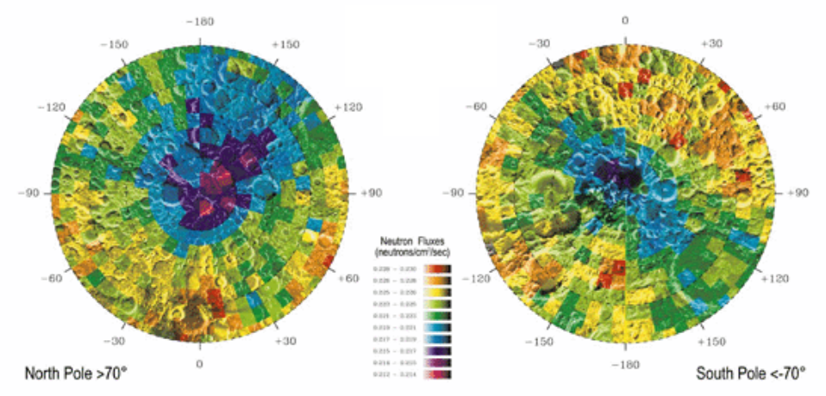
Water Ice or Hydrate Deposits on the Moon
LCROSS Data, NASA Ames

Slide 17
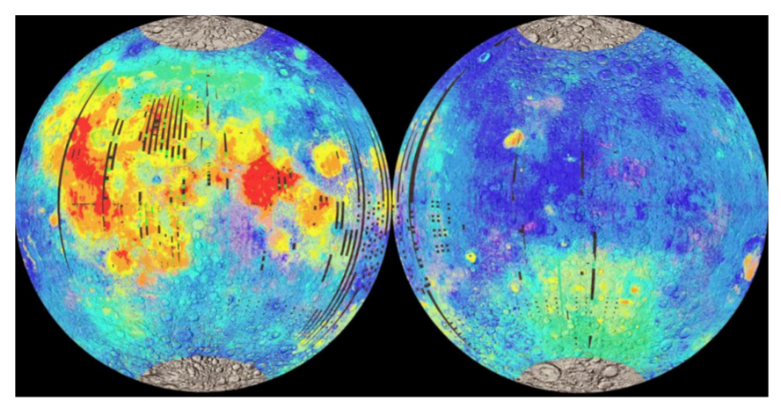
Ilmenite Deposits on the Moon
(Spudis/LPI, 2002)

Slide 18
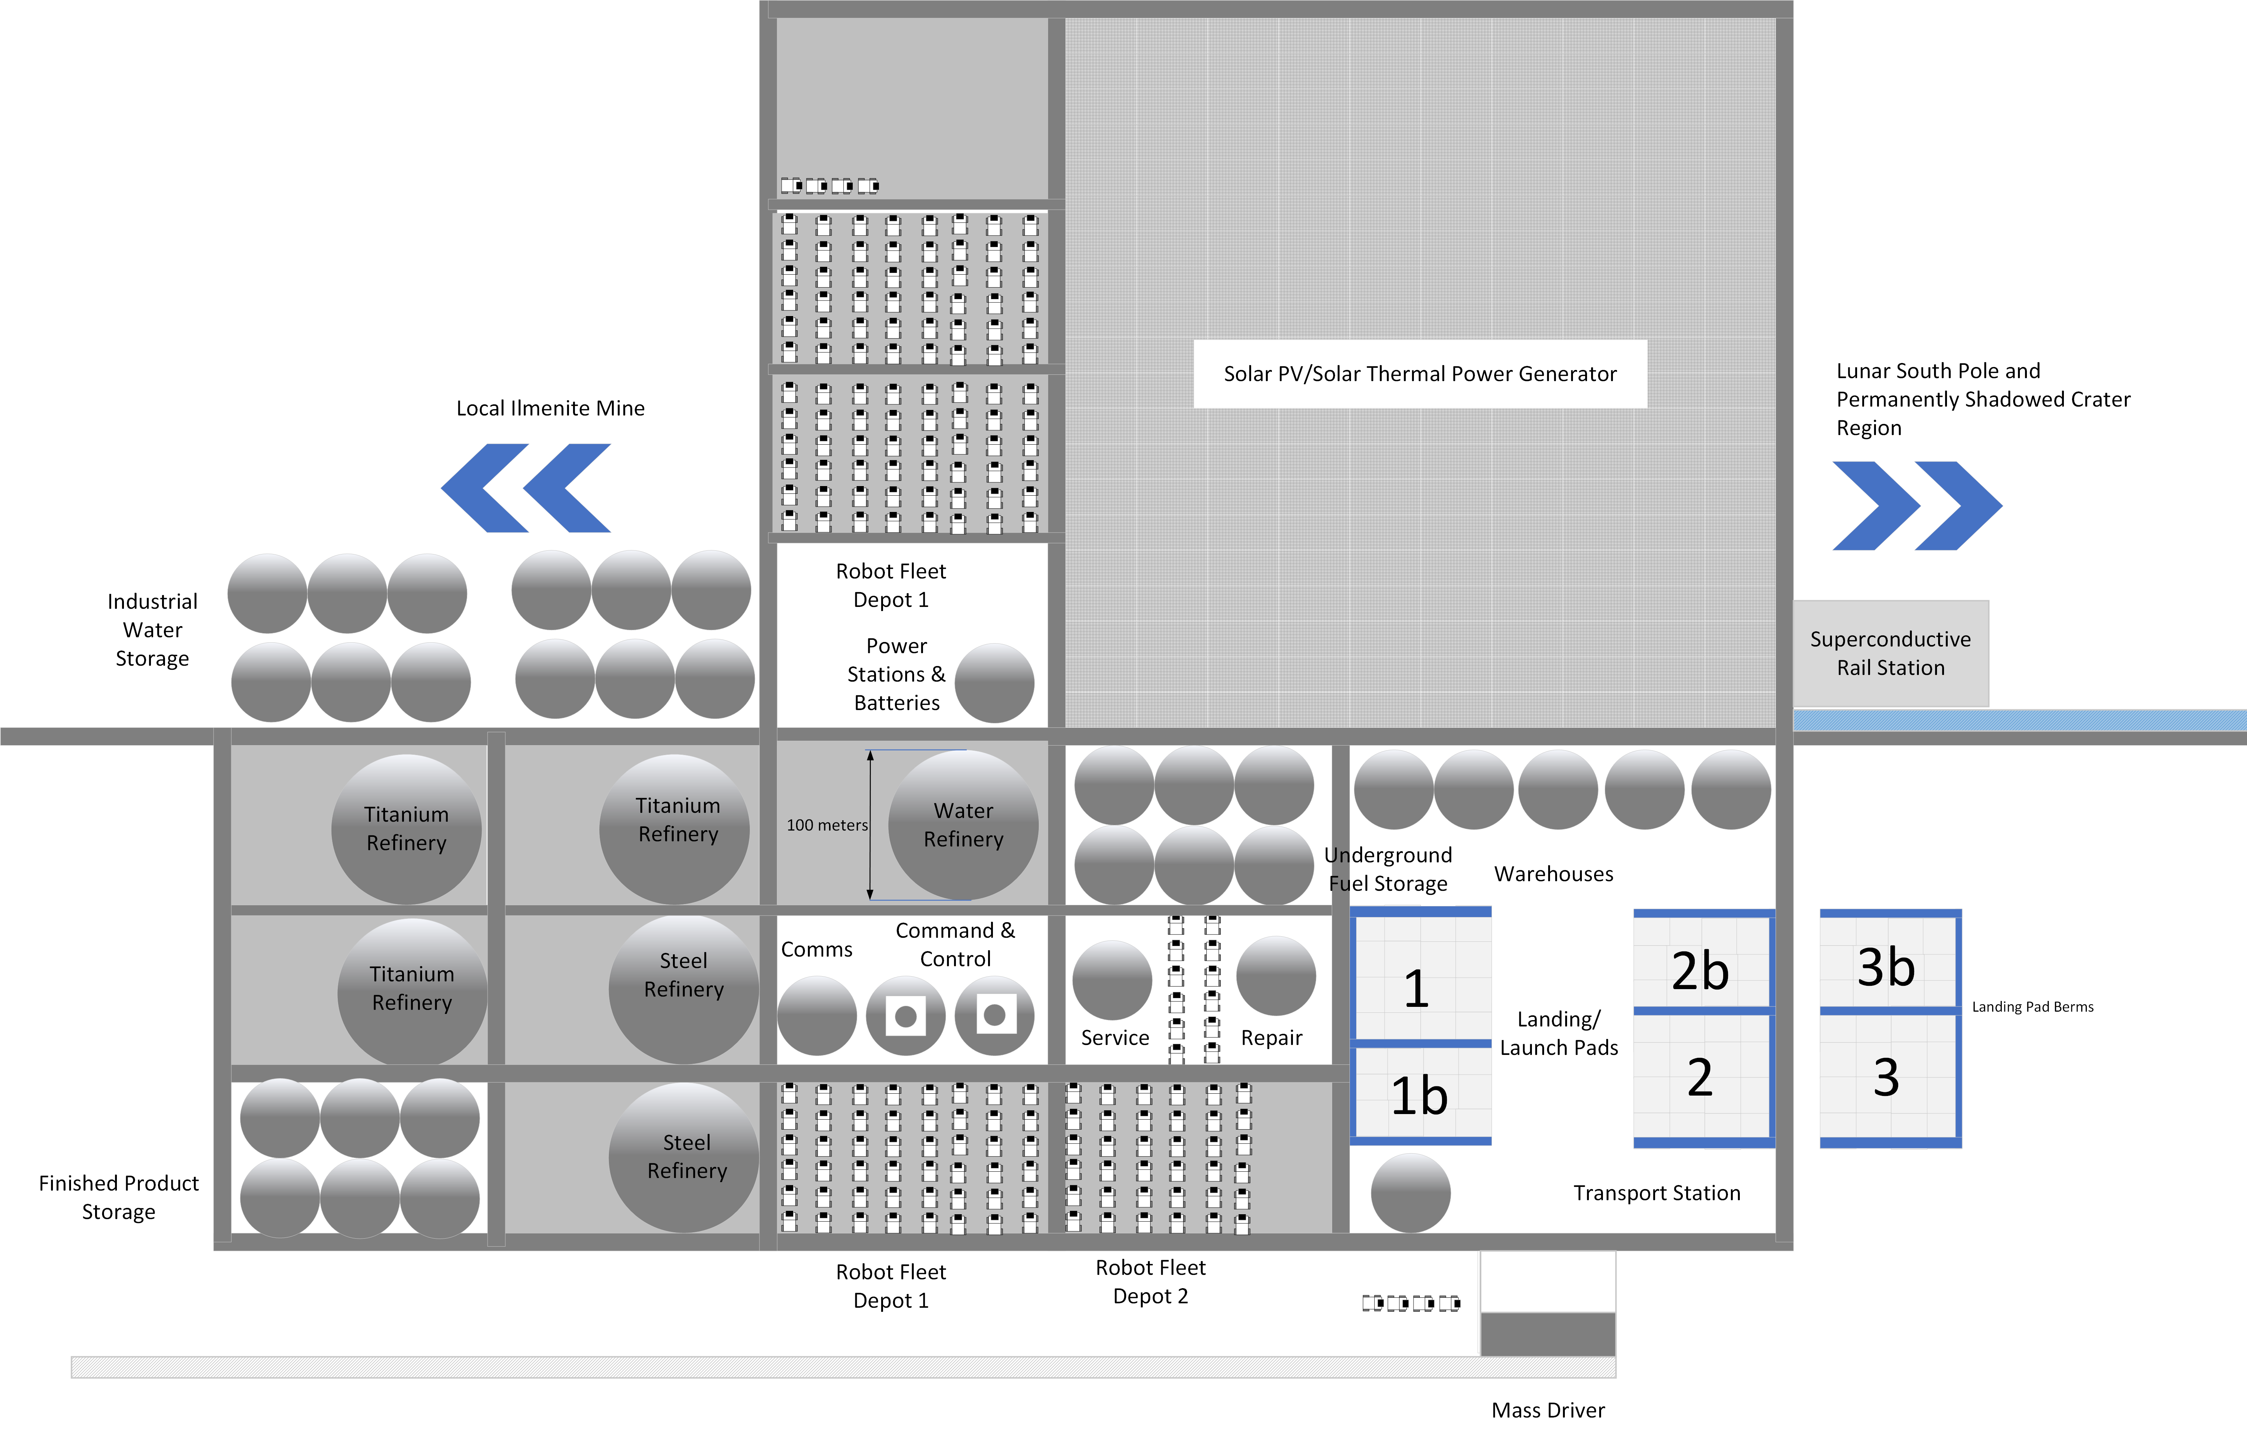
Mining Base – 100 tons of H₂O, Ti, Fe day

Slide 19
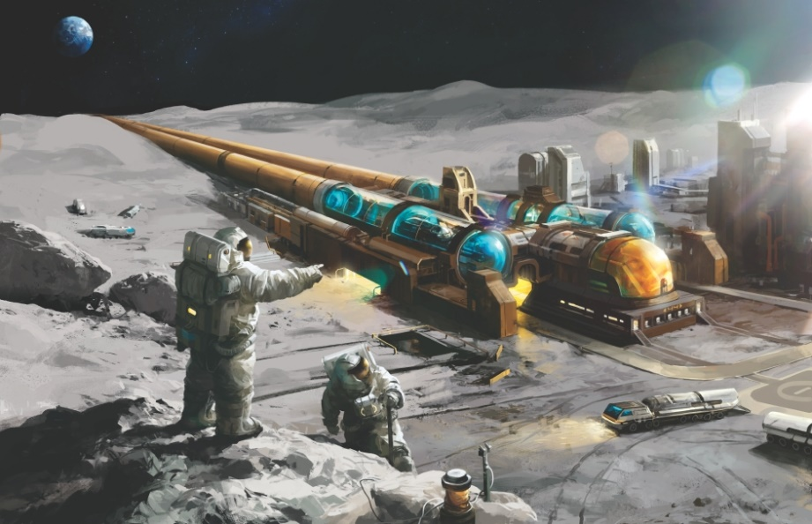
Mass Driver for Material Export
Utilize solar energy to power mass driver using electro-magnets.
Potential for efficiency improvement using superconductors.
Avoid use of fuel produced.
Export material then
needs to be caught.

Slide 20
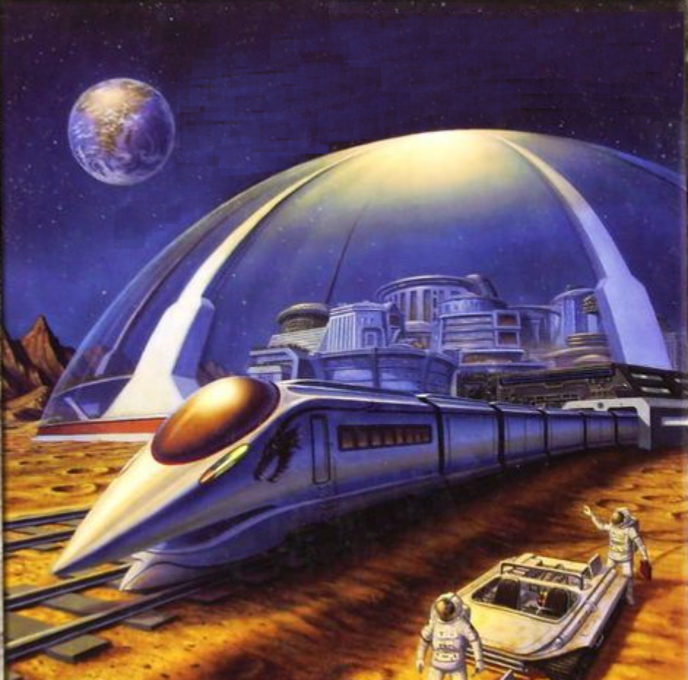
Maglev Train – Raw Material Transport
Exploit cold temperatures to use superconductive magnets to transport ice from PSRs/poles to mid-latitude region.
Need to build elevated rail-line to enable smooth transport at high speeds
Serve as transport backbone to other development activity

Slide 21
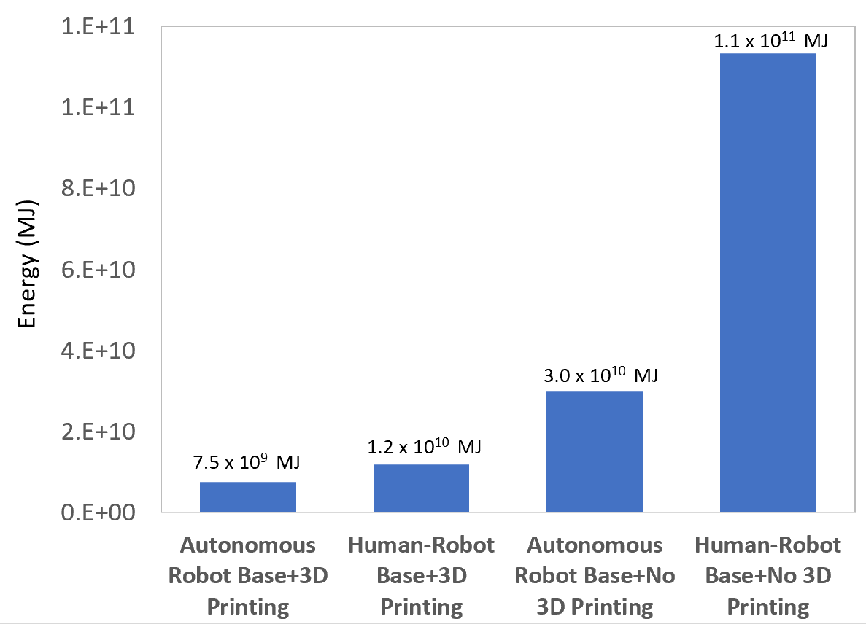
Energy Model Summary - Moon
Ensuring a robot base built using 3D printing results in 15-folds energy savings in terms of construction.

Slide 22
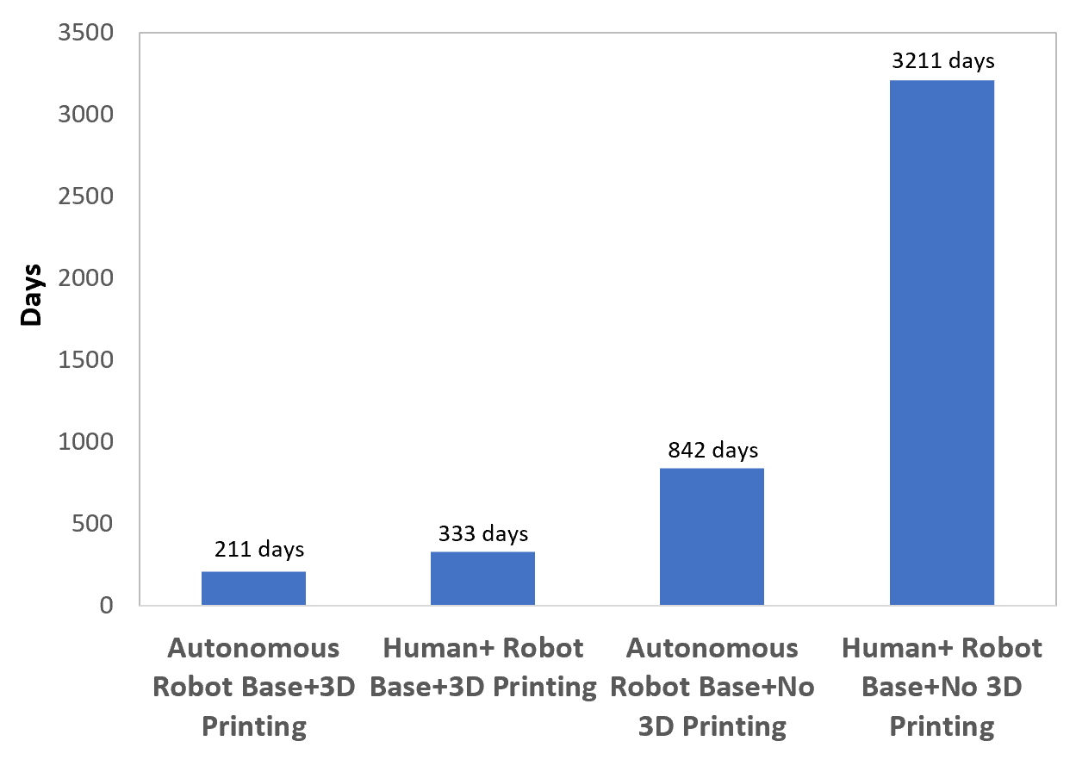
Time Taken to Complete Base

Slide 23
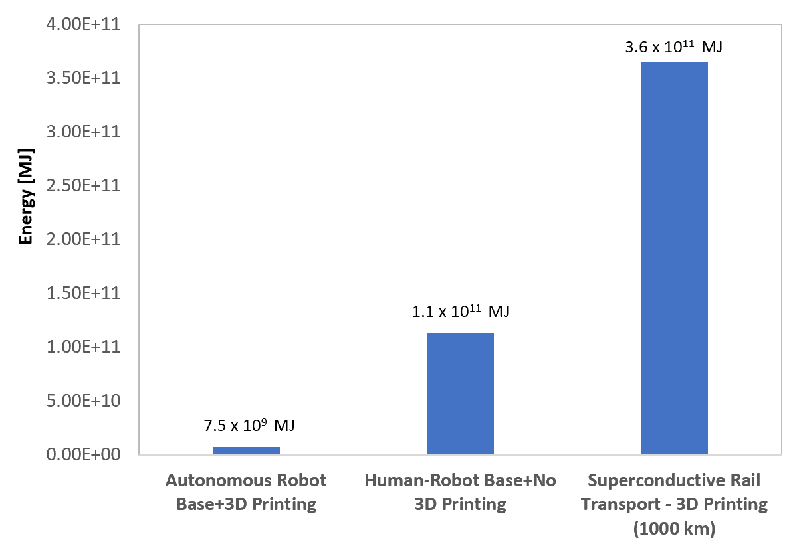
Infrastructure Requirements
Bigger infrastructure investment needed on the Moon to get water ice to mid-latitudes for processing.

Slide 24
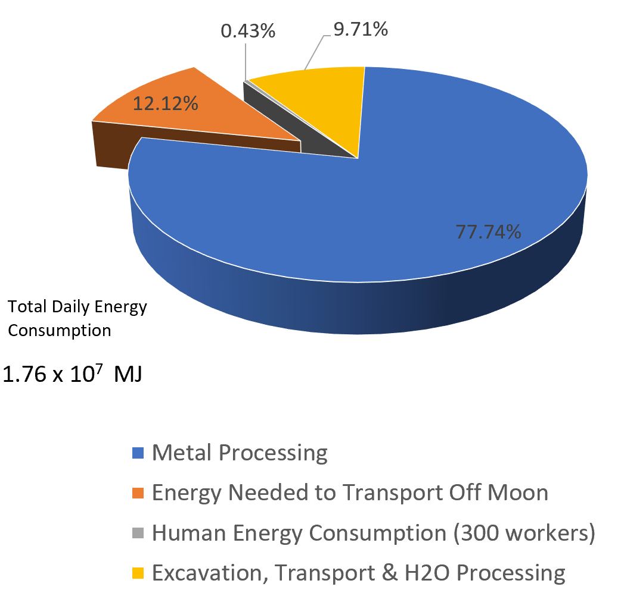
Energy Required for Base Operations

Slide 25
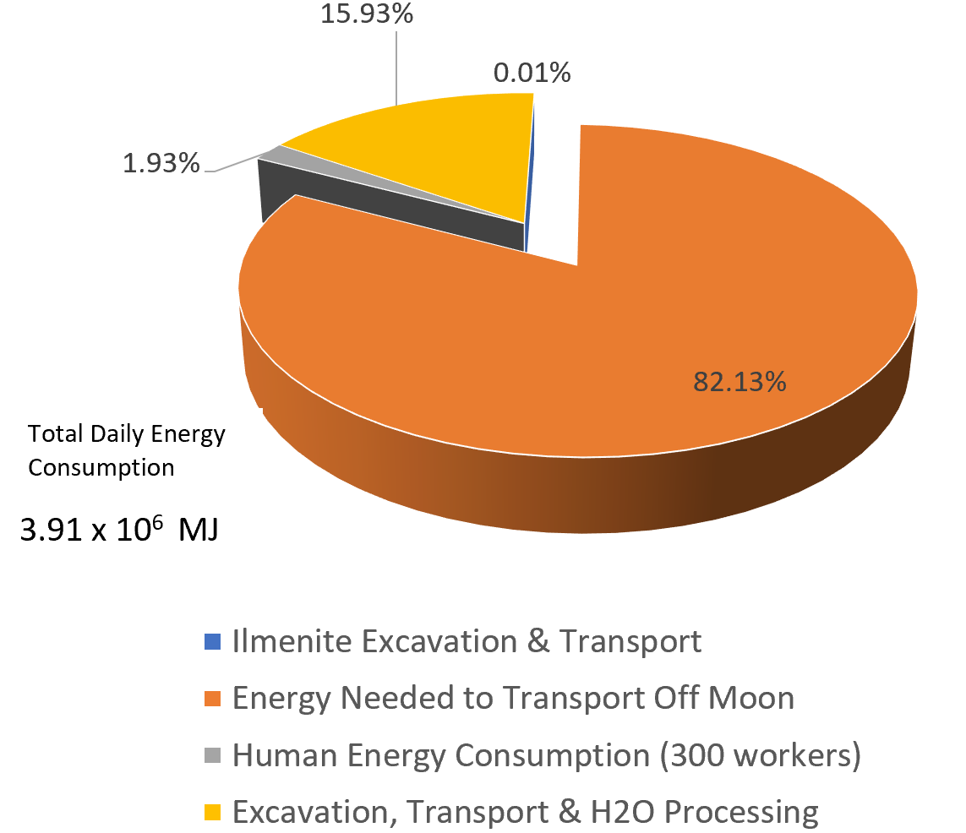
Energy Required for Base Operations – Raw Export

Slide 26
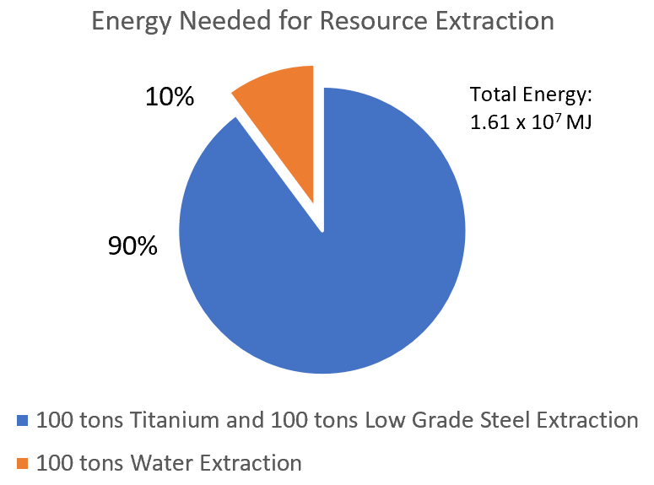
Water Extraction vs Metal Extraction
Requires 4.2 times more energy to export resources from Mars compared to Moon.
With the right infrastructure, water extraction expected to be low-cost compared to metal extraction on the Moon.

Slide 27
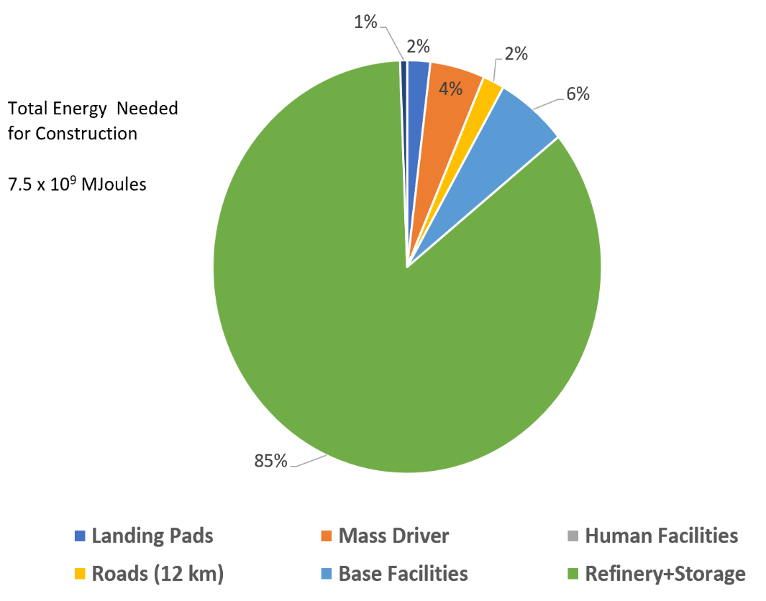
Energy Consumed for Construction – Robot base
For a robot base, big energy consumer is the construction of the refinery and storage space

Slide 28
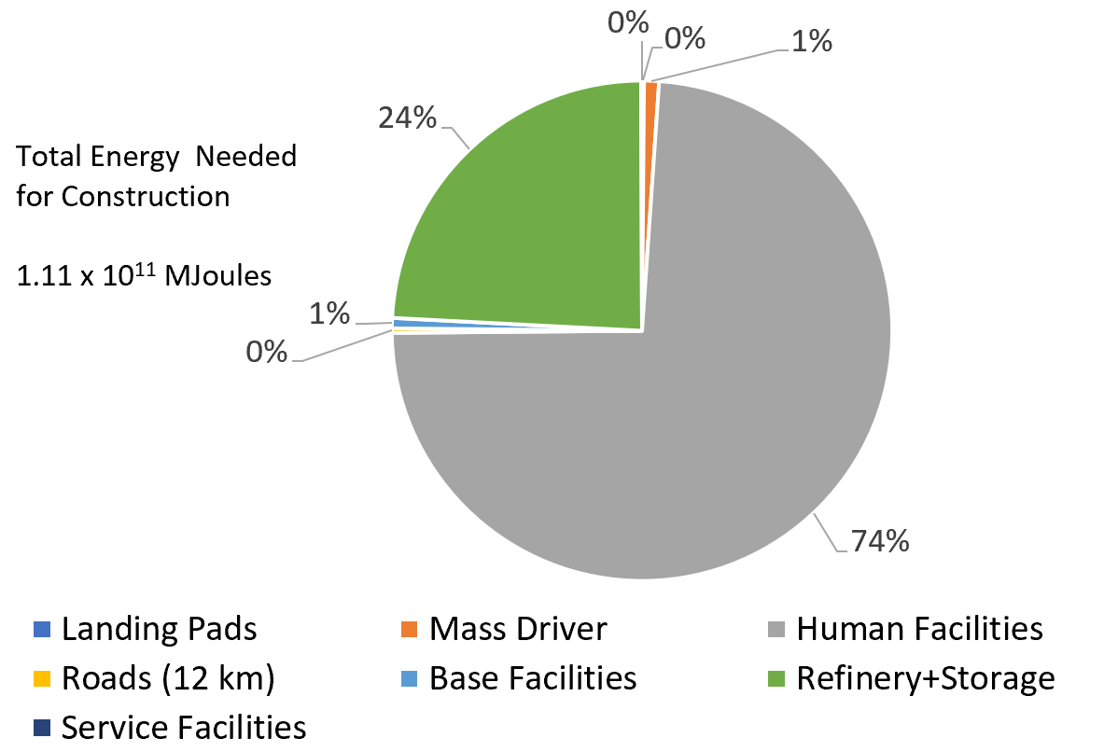
Energy Consumed for Construction – Human Base
For a human base, biggest energy consumers are human facilities and life-support infrastructure

Slide 29
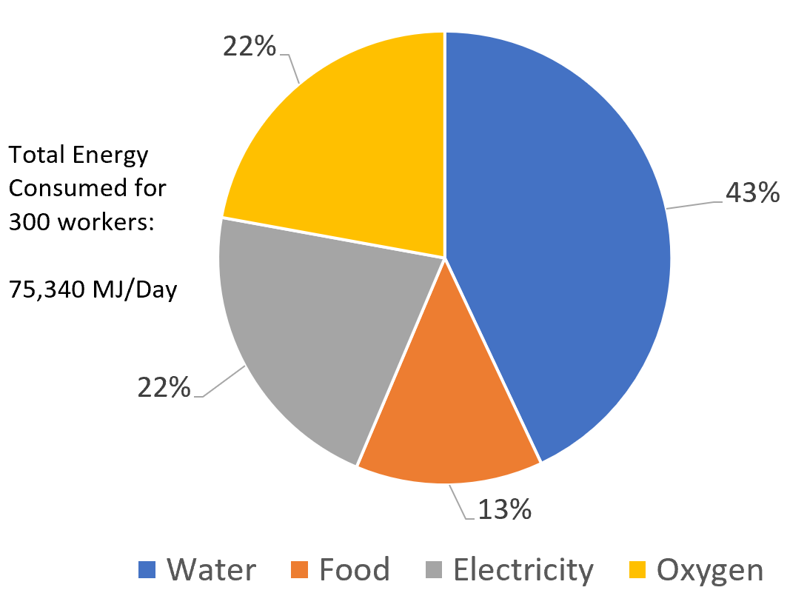
Distribution of Operating Energy Consumed by Human Workers

Slide 30
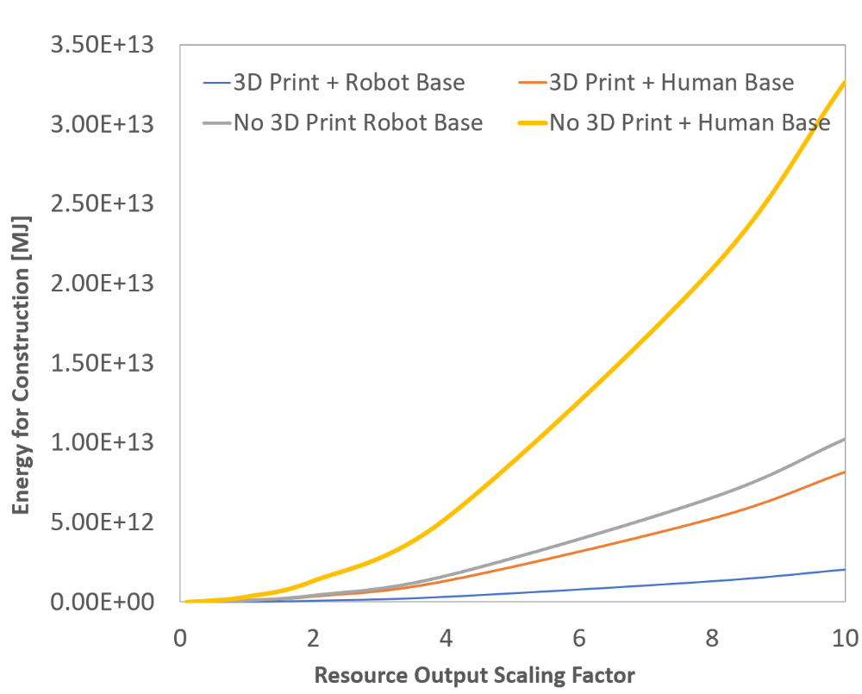
Scaling Up Export of Materials
3D Printing and Running a Robotic Base most scaleable, avoids exponential “blow-up” in resources needed.

Slide 31
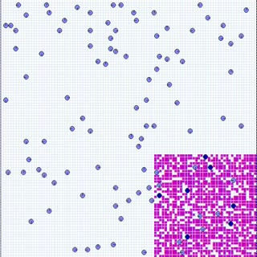
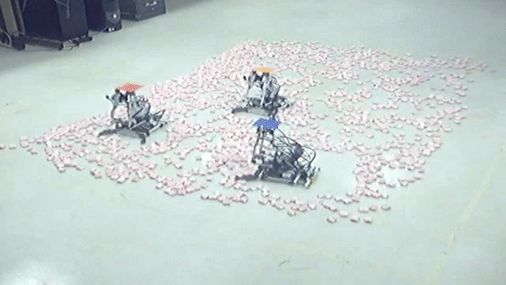
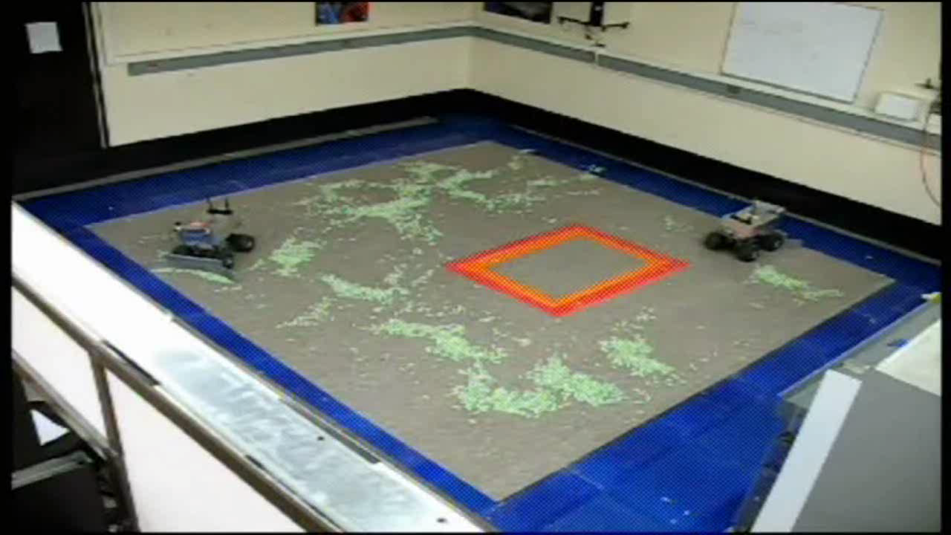
Laboratory Experiments
Robust system with imperfect individuals…

Slide 32
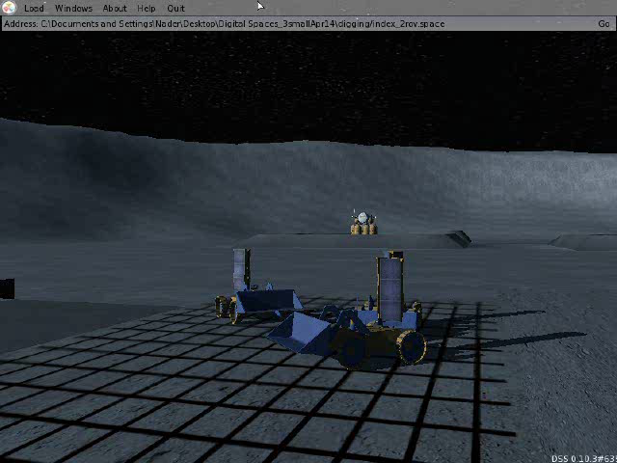
High Fidelity Simulations
Robust system with imperfect individuals…

Slide 33
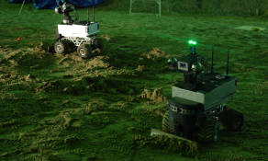
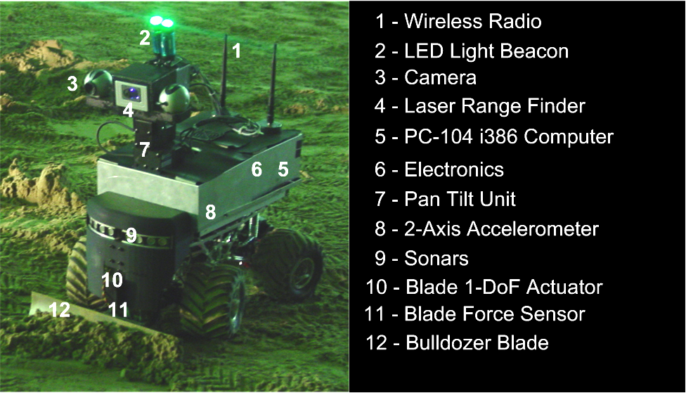
Field Experiments

Slide 34
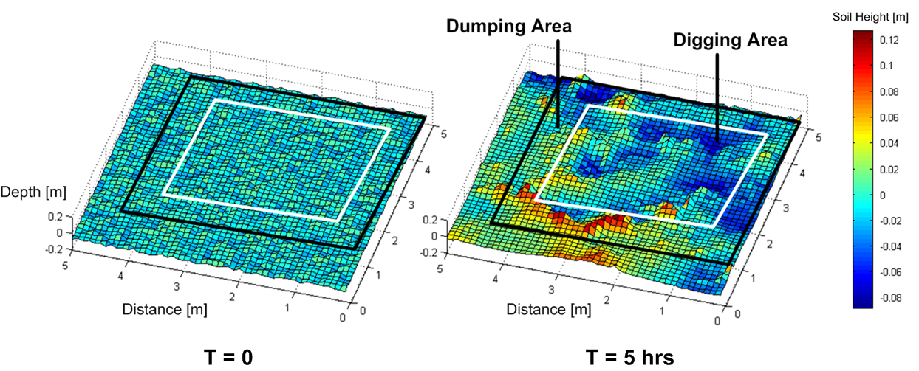
Multirobot Excavation in Controlled Environment..

Slide 35
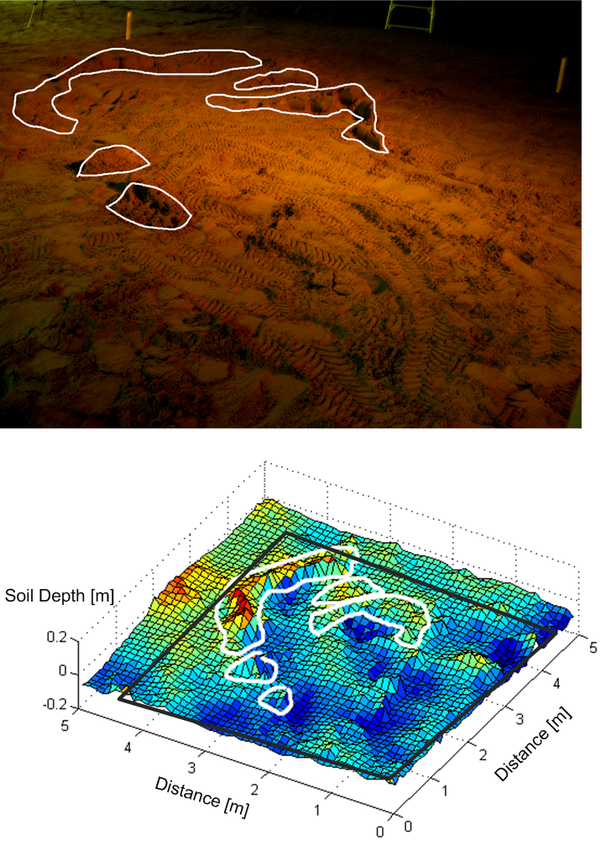
Multirobot Excavation in Controlled Environment..

Slide 36
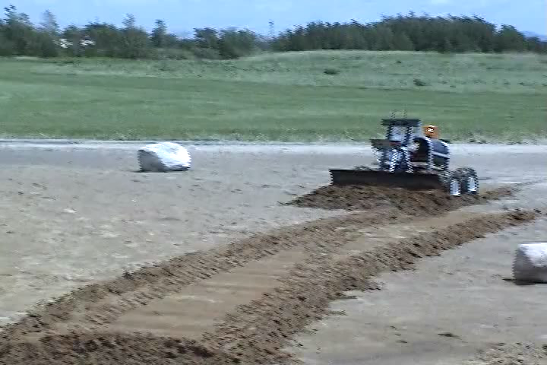

UNAMEEP
Large Excavation Platform
Demonstrate excavation outside of controlled field tests.
ARGO
8 wheel field ready amphibious wheel platform for dev. of the Muskateer rovers for excavation, ISRU)
Multirobot Excavation in the field..

Slide 37

Multirobot Excavation in the field..

Slide 38


Berms
Road Way
Multirobot Excavation in the field..

Slide 39

Landing Pad…

Slide 40
Discussion
Game-changing benefits from 3D printing and total end-to-end autonomy using teams of robots
End to end robotic construction and operation of mining base possible.
  Modelled from social insect colonies
  Robust results from teams of “mediocre individuals.”
  Exploit energy advantage of low-gravity, particularly the Moon.
Scaling up shows human base very energy intensive.

Slide 41
Discussion: Moon
Important barrier for the Moon is extracting water ice from the PSRs.
  How big are the reserves ?
  Feasibility of Maglev rail line.
Otherwise a significant game-changer than depends on very good water recycling capability.
Use of robots on the Moon to construct and run the base is a good fit due to expected health hazards of having humans on the Moon for prolonged time.
    Low gravity

Slide 42


Discussion
Big benefits come from Earth applications…
2019
2069

Slide 43
Conclusions
Identified role of multirobot systems to perform tasks too expensive and dangerous for humans.
Energy model shows game-changing benefit from 3D printing and autonomy.
10 years of laboratory to field experiments identify pathway for future development.
Extended duration operation needs further R&D
Transformational applications on Earth

Slide 44
Future Work
Extended comparison with mining base on Phobos and Deimos.
Automated design approach to mining base development that enables scalability
Develop a holistic energy-cost model that identifies optimal locations to mine critical resources.

Slide 45

Thank You!

Slide 46
Questions ?

