Slide 1
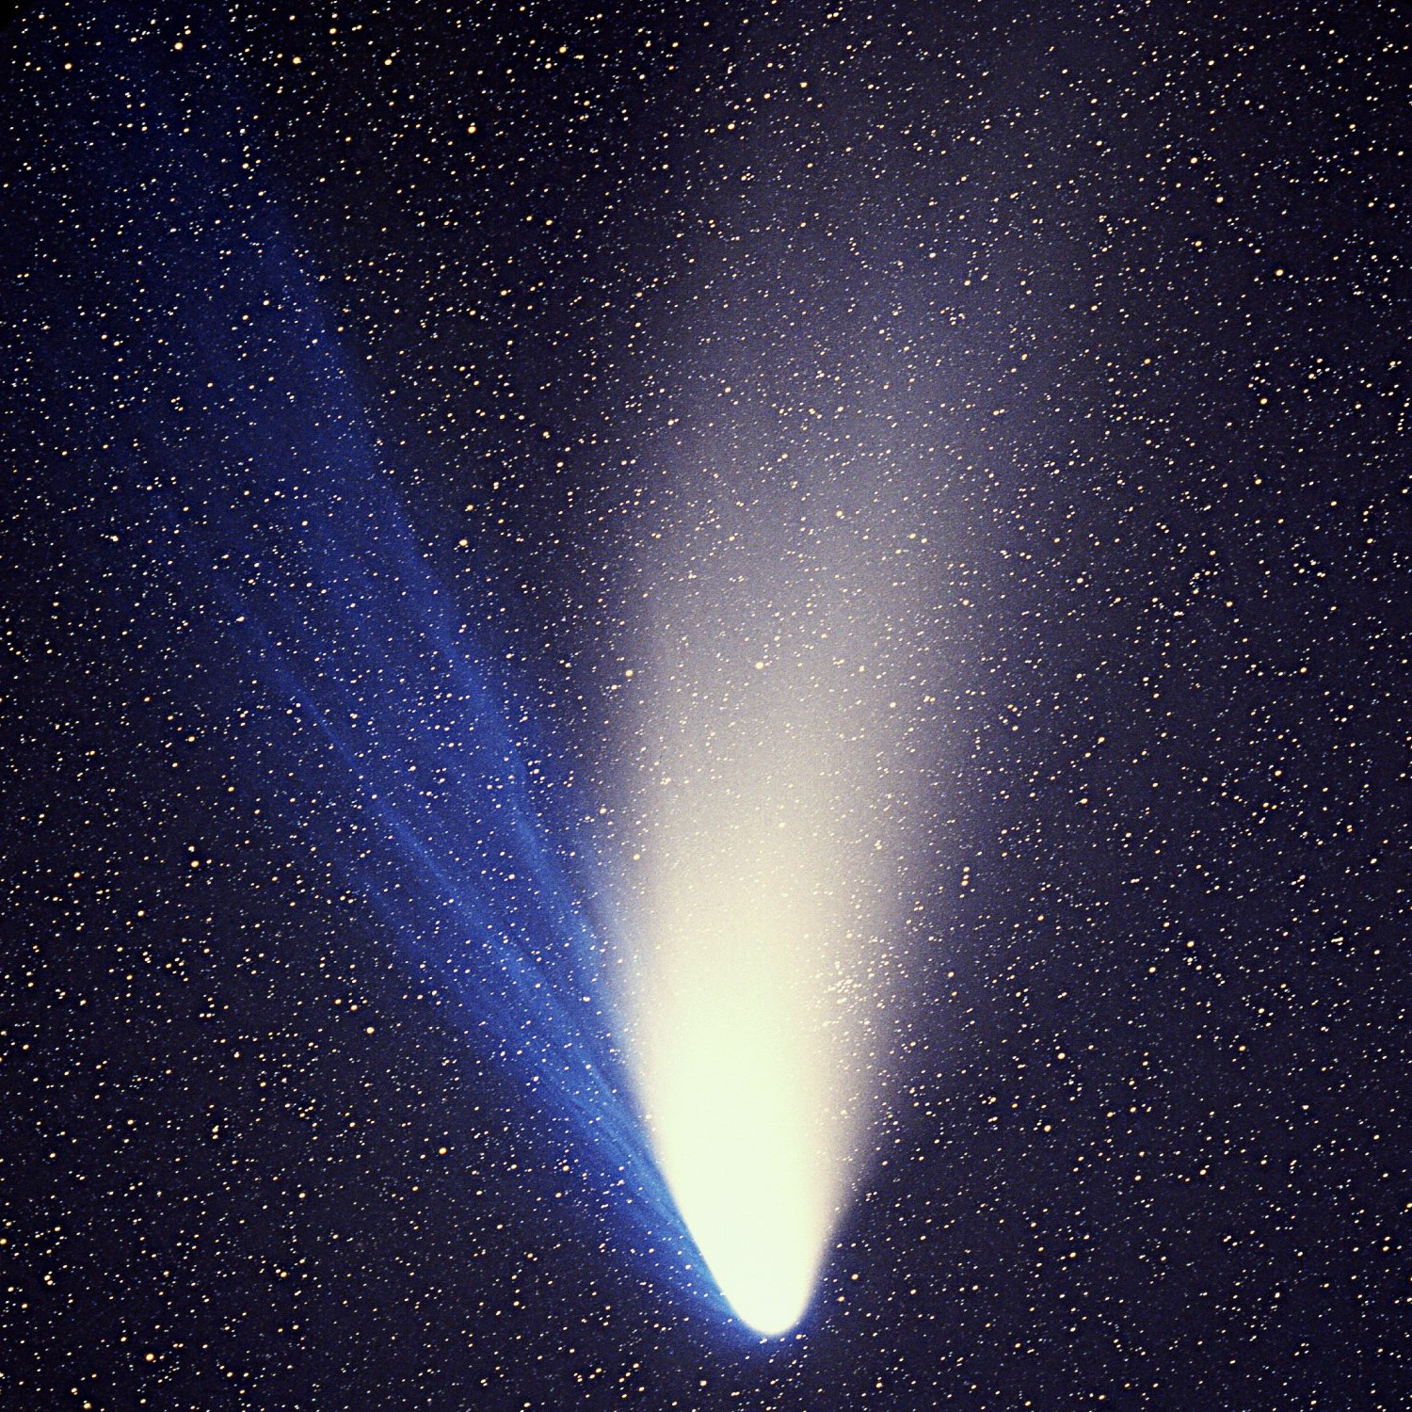
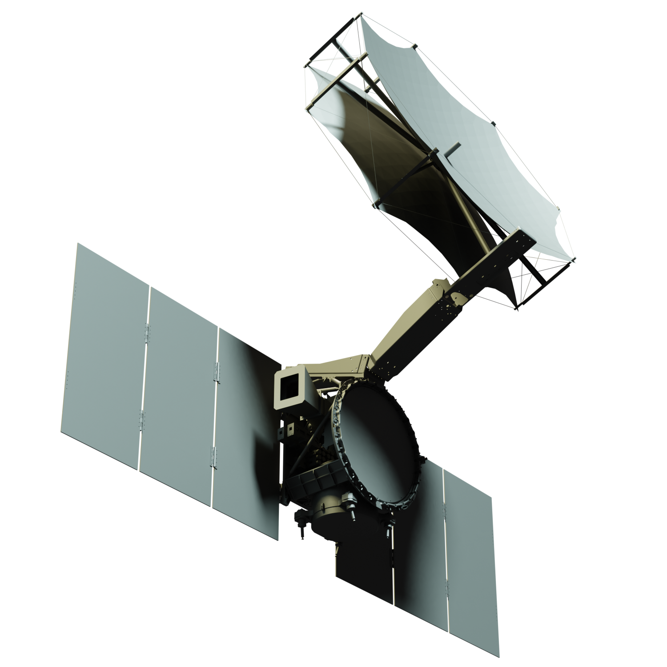

Xenia
SmallSat Rapid Response Flyby to Oort Cloud Comets and Interstellar Objects
Presenter: Benjamin Donitz
Jet Propulsion Laboratory,
California Institute of Technology
Interplanetary SmallSat Conference
May 12th, 2020

Slide 2
Authors
Benjamin Donitz¹
Steve Matousek¹
Julie Castillo-Rogez¹
Tibor Balint¹
Robert Miller¹
David Tuman¹
Matt Kowalkowski¹
Roger Klemm¹
John Mann¹
Aadil Rizvi¹
Kevin Ortega¹
Mark Wagner¹
Autumn Lui¹
Anne Marinan¹
Diana Chu²
Cassandra Smith³
Taylor Sun⁴
Lauren St. Hilaire¹
Kyle Waters¹
Eric Lundgren⁵
Zubin Olikara¹
Stewart Sherrit¹
¹Jet Propulsion Laboratory, California Institute of Technology
²Cornell University
³Rensselear Polytechnic University
⁴University of Michigan
⁵Aerospace Corporation

Slide 3
Note on Terminology
Oort Cloud Comet (OCC) – Comet that originated in the Oort Cloud, a region of the solar system ~2,000-200,000 AU characterized by the abundance of icy small bodies
Long Period Comet (LPC) - Comet that originated in the Oort Cloud and eventually developed a shorter period through interaction with the giant planets. An OCC is a “fresh” LPC.
Interstellar Object (ISO) – A small body that originated from outside our solar system, i.e. on a hyperbolic solar trajectory. Can be actively outgassing (like 2I/Borisov) or asteroid-like (like 1I/Oumuamua)
Notes:
HTC = Halley type comet
Damocloids are a class of minor planets such as 5335 Damocles and 1996 PW that have Halley-family or long-period highly eccentric orbits typical of periodic comets such as Halley's Comet, but without showing a cometary coma or tail.
All previous comet missions have been to short-period comets that have passed the Sun many times
➔ Targets were relatively evolved, with thick dust mantles
A mission to an OCC would encounter a pristine comet, with surface ices preserved from the Solar System’s formation and primordial isotopic markers

Slide 4
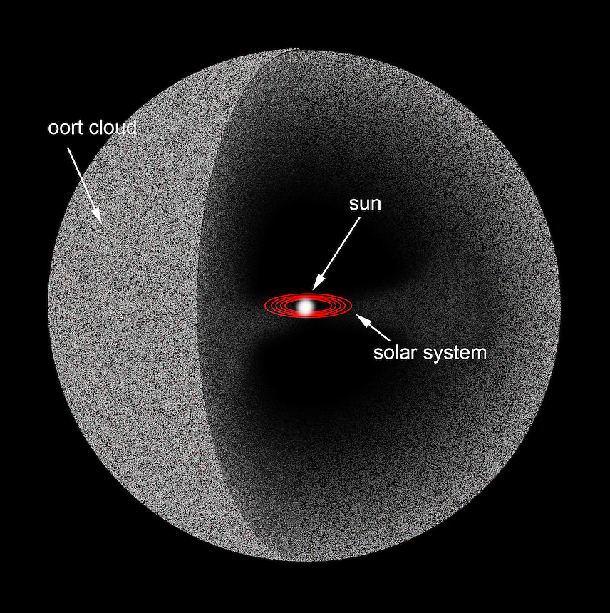
47,000 times farther from the Sun than Earth
You are here

Slide 5
Why do we Want to Explore OCCs?
Bound the temperature of the protoplanetary disk from volatile isotope markers and noble gasses
Determine the makeup of the early solar system including volatiles, organics, and refractory material
Understand the nature of the diversity among comets
Notes:
HTC = Halley type comet
Damocloids are a class of minor planets such as 5335 Damocles and 1996 PW that have Halley-family or long-period highly eccentric orbits typical of periodic comets such as Halley's Comet, but without showing a cometary coma or tail.
All previous comet missions have been to short-period comets that have passed the Sun many times
➔ Targets were relatively evolved, with thick dust mantles
A mission to an OCC would encounter a pristine comet, with surface ices preserved from the Solar System’s formation and primordial isotopic markers

Slide 6
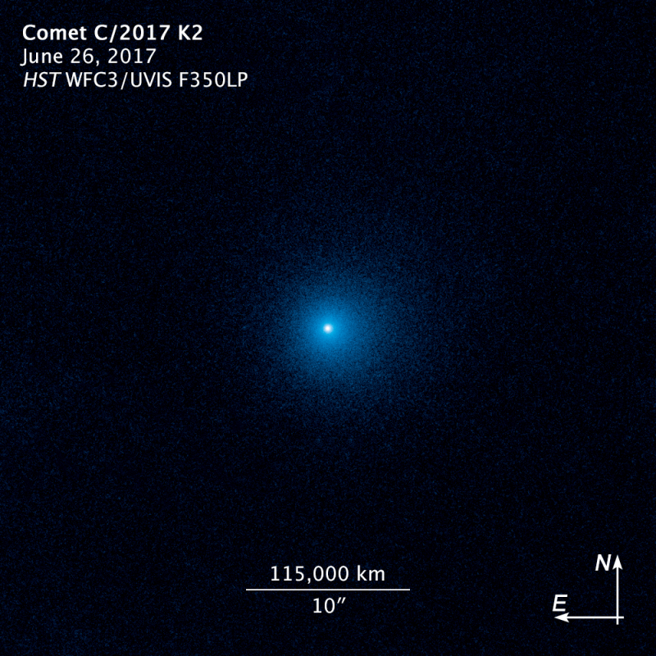
Example Comet:
C/2017 K2 – A Gift from the Sky
C/2017 K2 (C2K2) is a “great” comet with nucleus between 50-80 km
Perihelion in Dec. 2022 at 2.1 AU from Earth, 2.3 AU from Sun
C2K2 will visit once in our lifetime but there will be more comets like C2K2
  No guarantee those would be accessible
  C/2010 U3, another record comet had perihelion at 8 AU (Feb 2019)
All comets are interesting!
  Concept discussed today can be applied to many future targets
At ~2.5 Billion km

Slide 7
I = 87.6º
Qualifies as “Great” comet (50-80 km large)
~1-3 million year orbit (inbound)
Notes:
“Most comets are discovered much closer to the Sun, near Jupiter’s orbit, so by the time we see them, these surface volatiles have already been baked off. That’s why I think K2 is the most primitive comet we’ve seen.” D. Jewitt

Slide 8
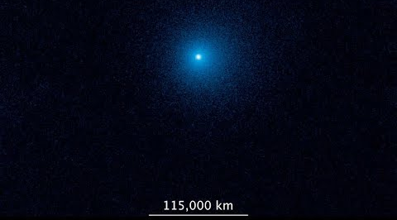
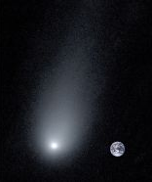
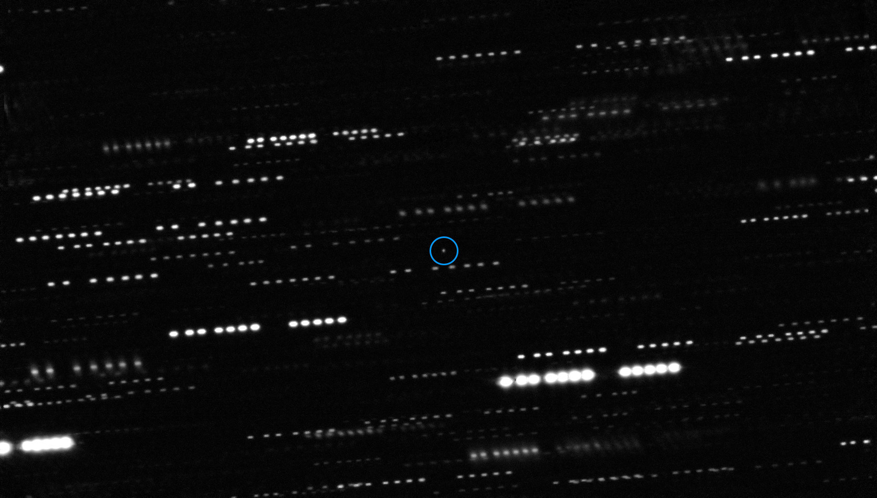
Future Visitor Exploration
C2K2, 2017
Image credit: Jewitt, 2017
Borisov, 2019
Hale-Bopp, 1995
Image credit: Jewitt, 2019
Image credit: Kolmhofer, 1997
Ouamouamoua, 2017
Image credit: Meech, 2017
Notes:
“Most comets are discovered much closer to the Sun, near Jupiter’s orbit, so by the time we see them, these surface volatiles have already been baked off. That’s why I think K2 is the most primitive comet we’ve seen.” D. Jewitt

Slide 9
Xenia Mission Concept
Scientists and engineers at JPL worked to develop the Xenia mission concept
  Rapidly build, test, and launch mission to encounter C2K2
  <18 months from project start to ATLO
Conclusion: technically, development is feasible but requires new technology development and parts availability
  MarCO demonstrated rapid development process
  Availability of COTS parts streamlines the design and build process
  Enabling technology is actively in development, if not yet flown
Programmatically, there was no place for a rapid response mission
  Too large for SIMPLEx and cadence is not conducive to reactivity

Slide 10
Xenia Scientific and Programmatic Goals
Science
  Explore a long-period comet up close and understand the nature of the diversity among comets
  Constrain the temperature of the edge of the protoplanetary disk
Notes:
Demonstrate reactive approach to low-cost space exploration
Comet/Asteroid close approach to Earth occur on regular basis

Slide 11
Xenia Scientific and Programmatic Goals
Science
  Explore a long-period comet up close and understand the nature of the diversity among comets
  Constrain the temperature of the edge of the protoplanetary disk
Pathfinding
  First close approach of a long period comet
  First “reactive” mission, with many applications down the line
  Scout is important for assessing risk (~38 km/s, 10⁵ kg/s dust ejected)
Notes:
Demonstrate reactive approach to low-cost space exploration
Comet/Asteroid close approach to Earth occur on regular basis

Slide 12
Xenia Scientific and Programmatic Goals
Science
  Explore a long-period comet up close and understand the nature of the diversity among comets
  Constrain the temperature of the edge of the protoplanetary disk
Pathfinding
  First close approach of a long period comet
  First “reactive” mission, with many applications down the line
  Scout is important for assessing risk (~38 km/s, 10⁵ kg/s dust ejected)
Outreach!
  Public will see the comet with their naked eye from Earth and up close from Xenia
Notes:
Demonstrate reactive approach to low-cost space exploration
Comet/Asteroid close approach to Earth occur on regular basis

Slide 13
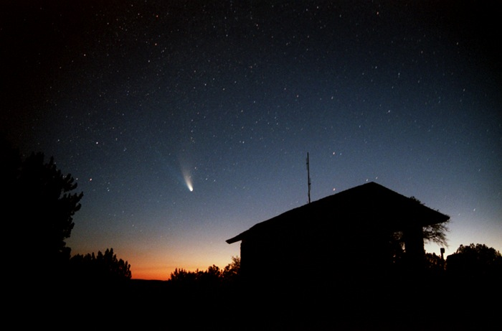
Credit: Cherie Benoit at Flickr

Slide 14
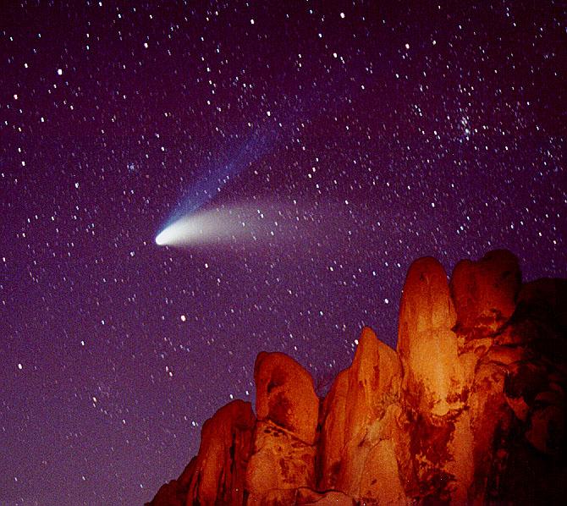
Credit: Wally Pacholka

Slide 15
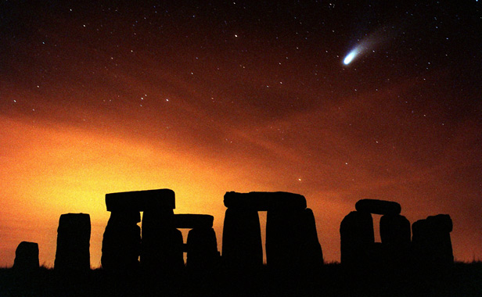
Credit: Paul Sutherland

Slide 16
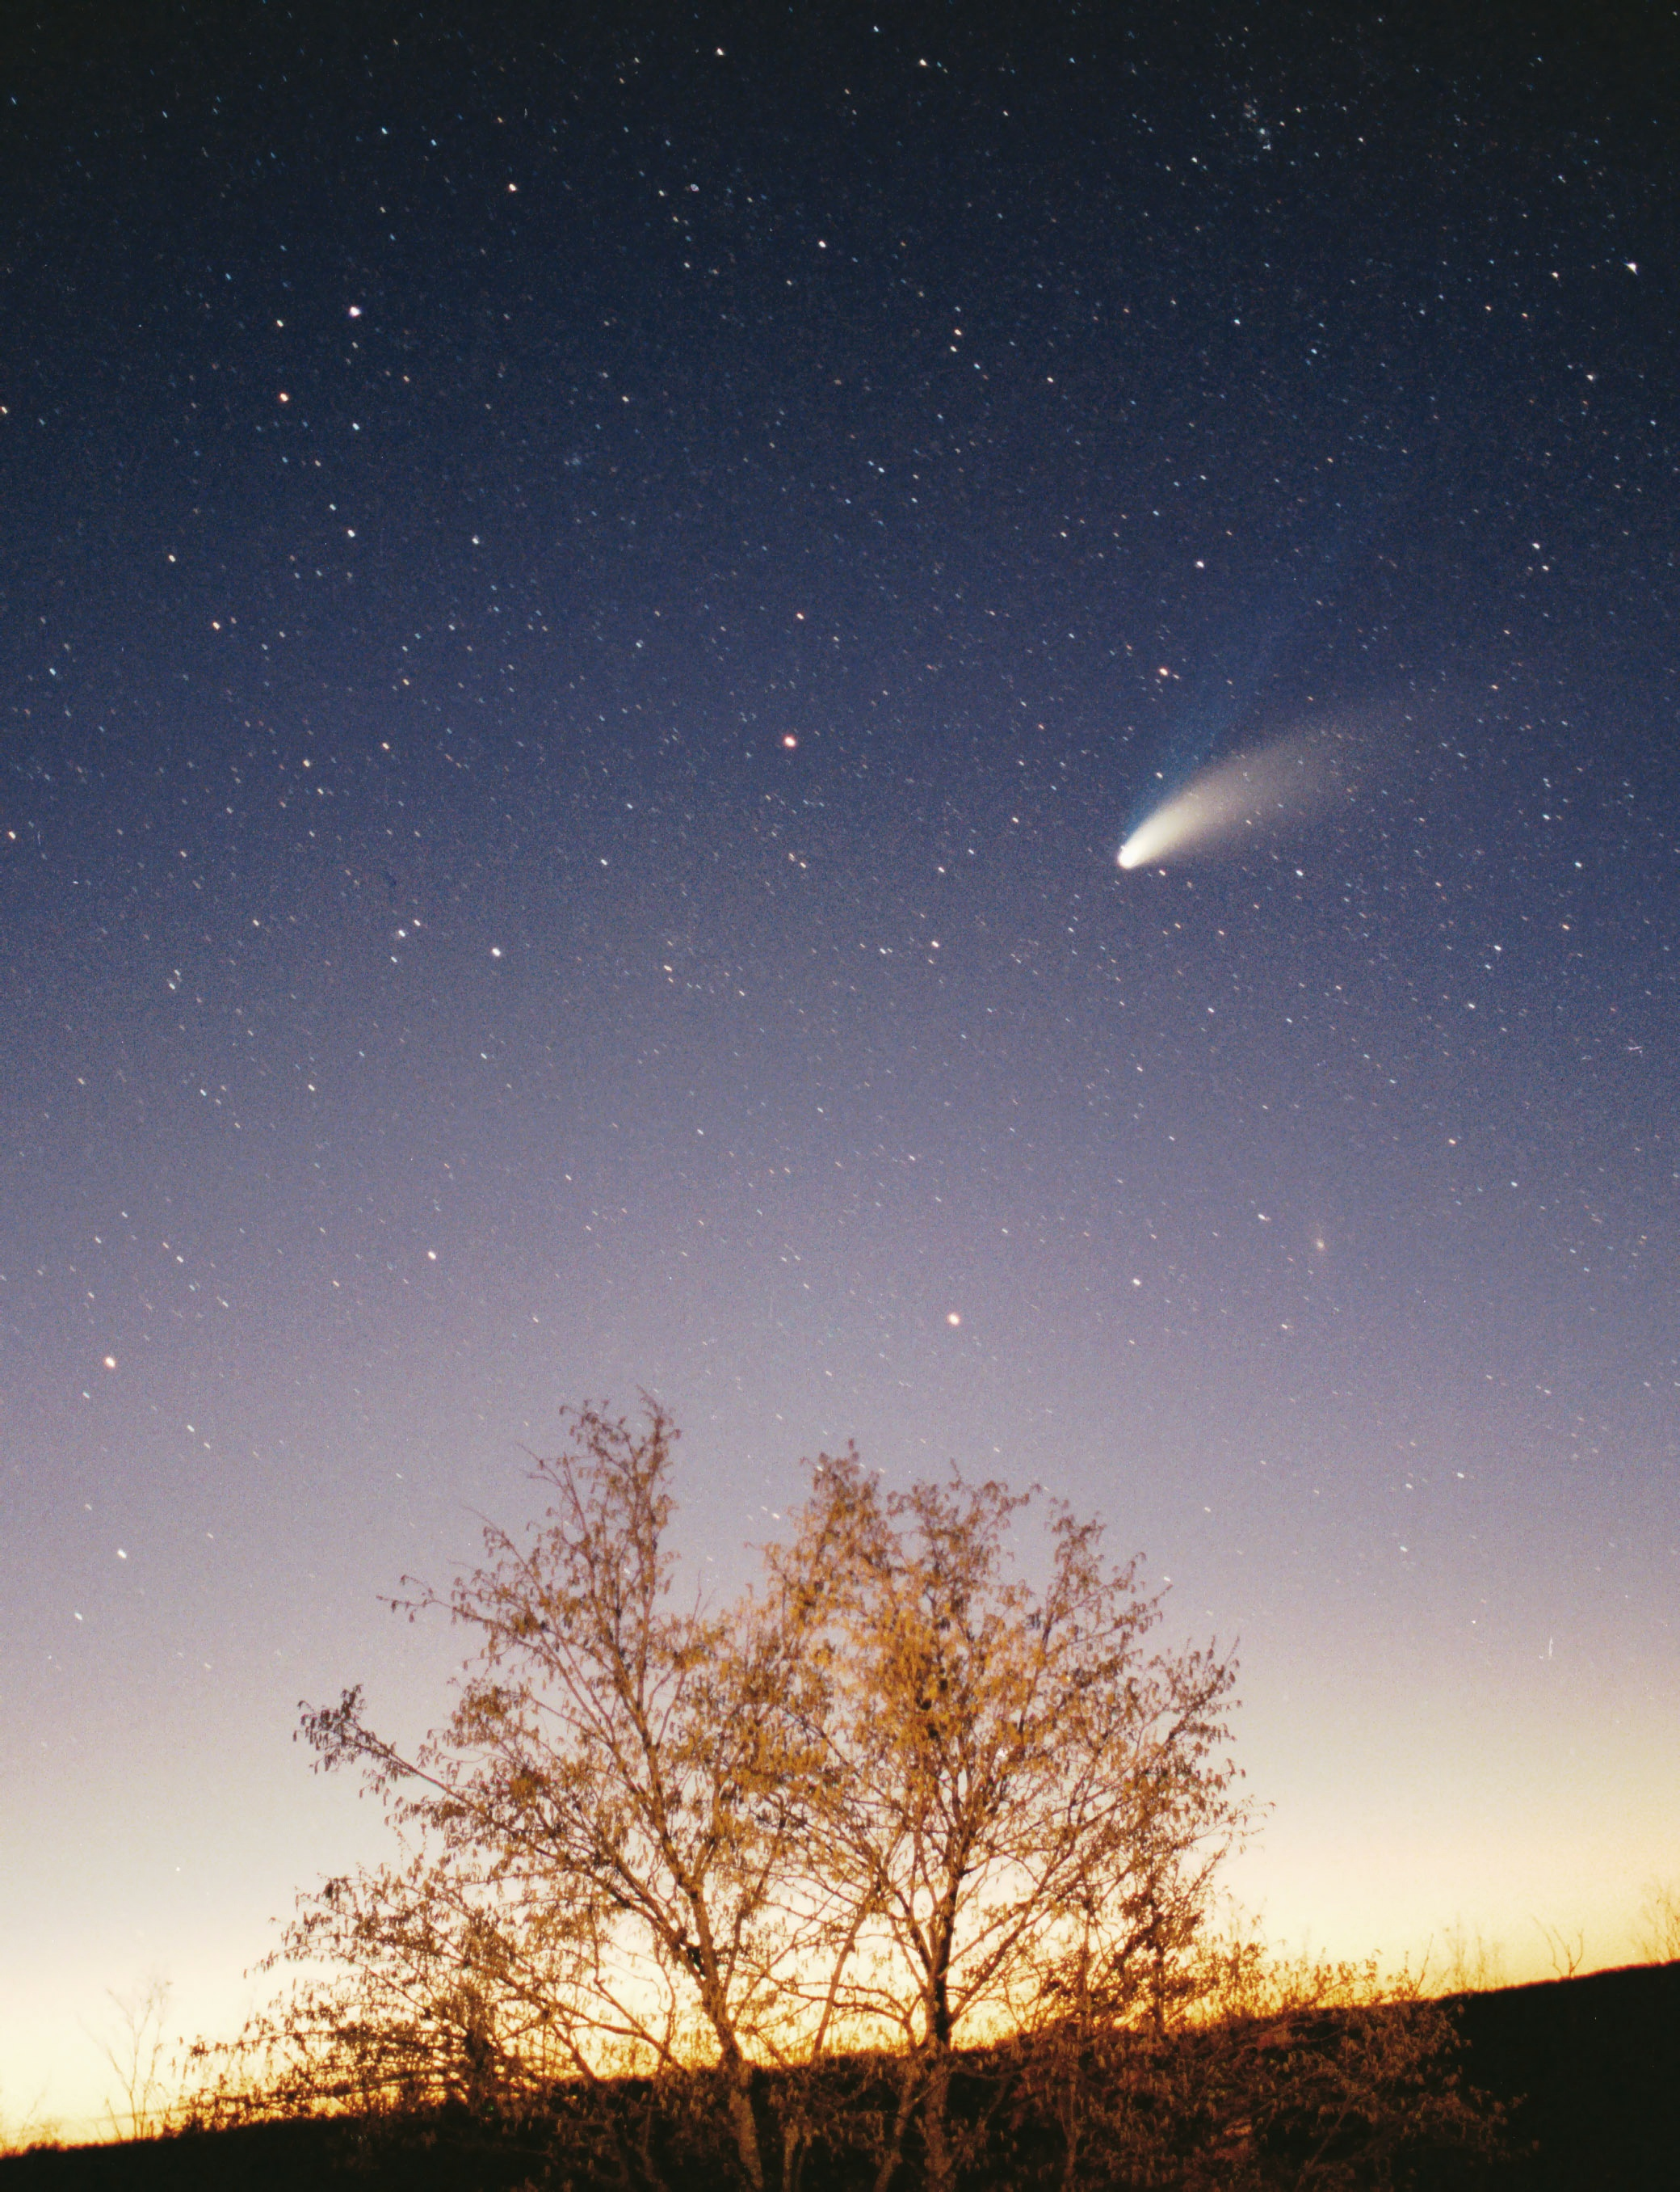
Credit: Philipp Salzgeber

Slide 17
Xenia Scientific and Programmatic Goals
Science
  Explore a long-period comet up close and understand the nature of the diversity among comets
  Constrain the temperature of the edge of the protoplanetary disk
Pathfinding
  First close approach of a long period comet
  First “reactive” mission, with many applications down the line
  Scout is important for assessing risk (~38 km/s, 10⁵ kg/s dust ejected)
Outreach!
  Public will see the comet with their naked eye from Earth and up close from Xenia
Technology demonstration opportunity
  Autonomous science data return
  Deep-space SmallSat propulsion
Notes:
Demonstrate reactive approach to low-cost space exploration
Comet/Asteroid close approach to Earth occur on regular basis

Slide 18
Xenia mission goals are enabled by using small spacecraft
05/12/2020
Pre-Decisional Information – For Planning and Discussion Purposes Only
© 2020. All rights reserved.
18
18

Slide 19
Driving Requirements
Short Name | Requirement | Drives
Mass | The mass of each spacecraft shall not exceed 75 kg (150 kg total) | Flight system and payload
Launch Energy | The launch vehicle shall directly inject the two spacecraft on an intercept trajectory with an energy of >57 km²/s² | Flight system and navigation
Launch Date | The spacecraft shall launch no later than February 2022 | Schedule (all)
Post-Encounter Data Return | The spacecraft shall return at least 1 Gb of data from the encounter before end of mission | Flight and ground systems
SmallSat

Slide 20
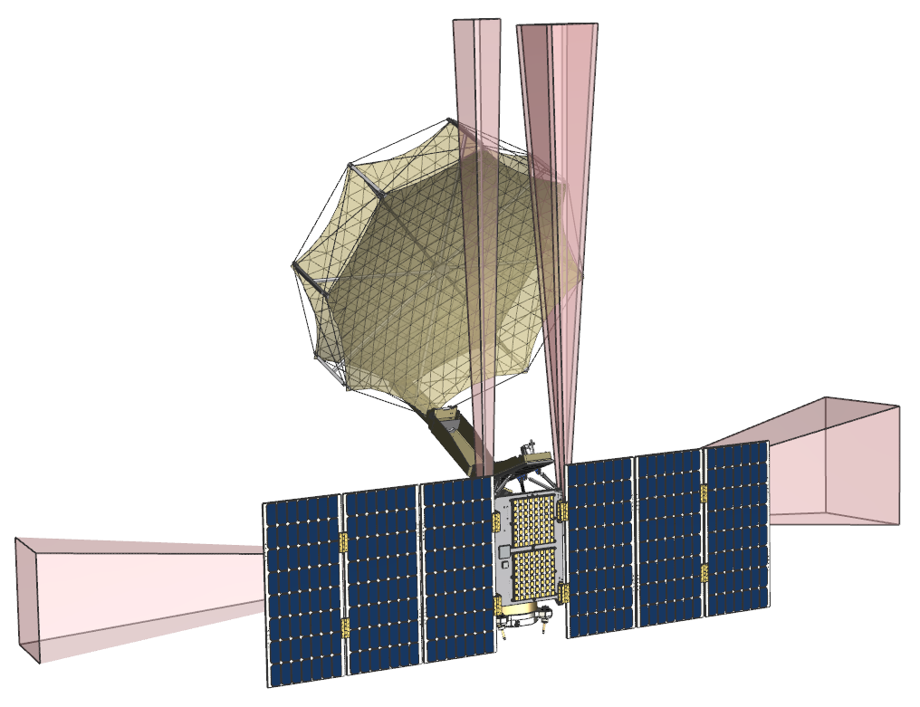
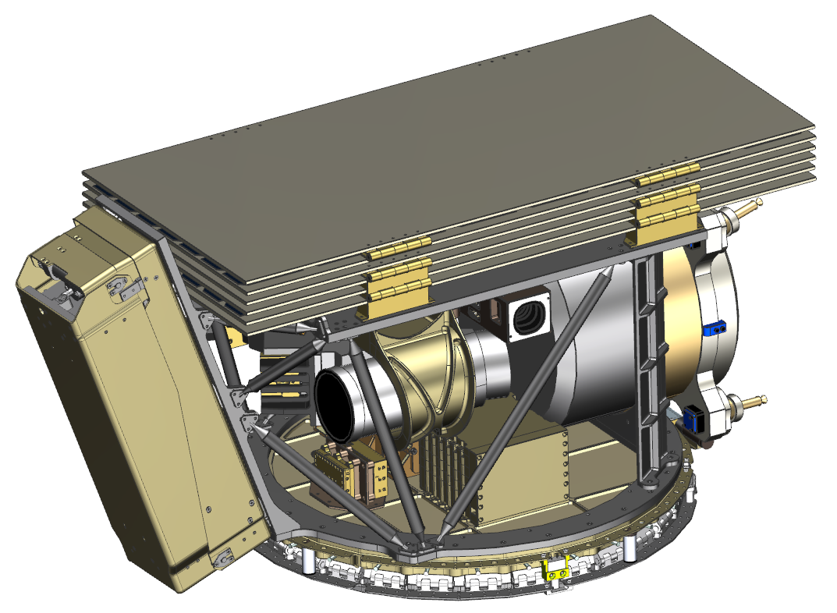
Current Configuration
Artist’s Concept
Narrow-Angle
Camera
UV Spectrometer
Stowed
High-Gain
Antenna
Wide-Angle
Camera
Star Tracker
Solar Arrays
Medium- & Low-
Gain Antennas
05/12/2020

Slide 21
Paradigm Shift in SmallSat Exploration | Constraints
Extremely rapid turn-around time (~24-month project from start to launch)
  Need all subsystems to be ready for integration
Large amounts of launch energy required to encounter (C₃ of >57 km²/s²)
  These types of opportunities almost never land in launch energy-friendly places
High-risk, high-reward exploration to time-limited visiting body
  Schedule slip means missing the opportunity!

Slide 22
Enabling Capabilities for Rapid SmallSat Exploration
Efficient SmallSat deep space propulsion (Isp > 200)
  Several companies and institutions who are trying, but no existing, flight proven systems
Flight-proven, stowable HGAs and autonomous data return
  Need capability to return science data after fast fly-by
Rapid turnout for COTS subsystems and components capable of use in deep space
  E.g. SDL IRIS radio
No programmatic opportunity for rapid response missions
  Existing AO scheme does not allow for missions to take advantage of fleeting opportunities like visiting a passing by comet

Slide 23
Summary (1)
OCCs and ISOs hold some of the most pressing secrets about the formation of our solar system but are not easy to get to
Missions of opportunity are often characterized by high energy and inclination orbits and quick time to respond
Need the capability to respond to incredible science opportunities
We are eager for our first flyby of an OCC or ISO!

Slide 24
Summary (2)
Need to leverage commercial parts and rapid development cycles to respond to infrequent, fleeting opportunities with great science potential
Reactive mission to OCC is technically feasible; design can be adapted for other far-away visitors like OCCs and ISOs
Programmatic elements are not in place to quickly mobilize to respond to an opportunity like a passing OCC or ISO
We need to get ready to respond to an approaching OCC or ISO!

