Slide 1

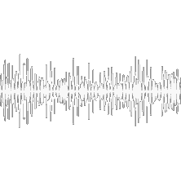

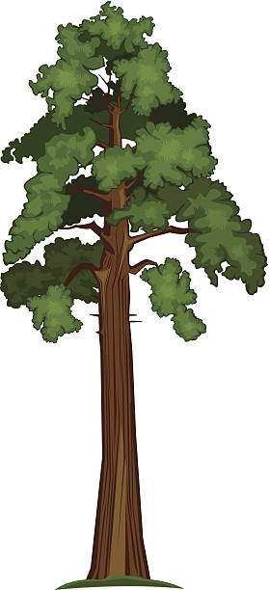
TREE OF LIFE
DEVELOPED BY
JULIA CHRISTENSEN +
A-TEAM @ JPL
JANUARY 16, 2020

Slide 2
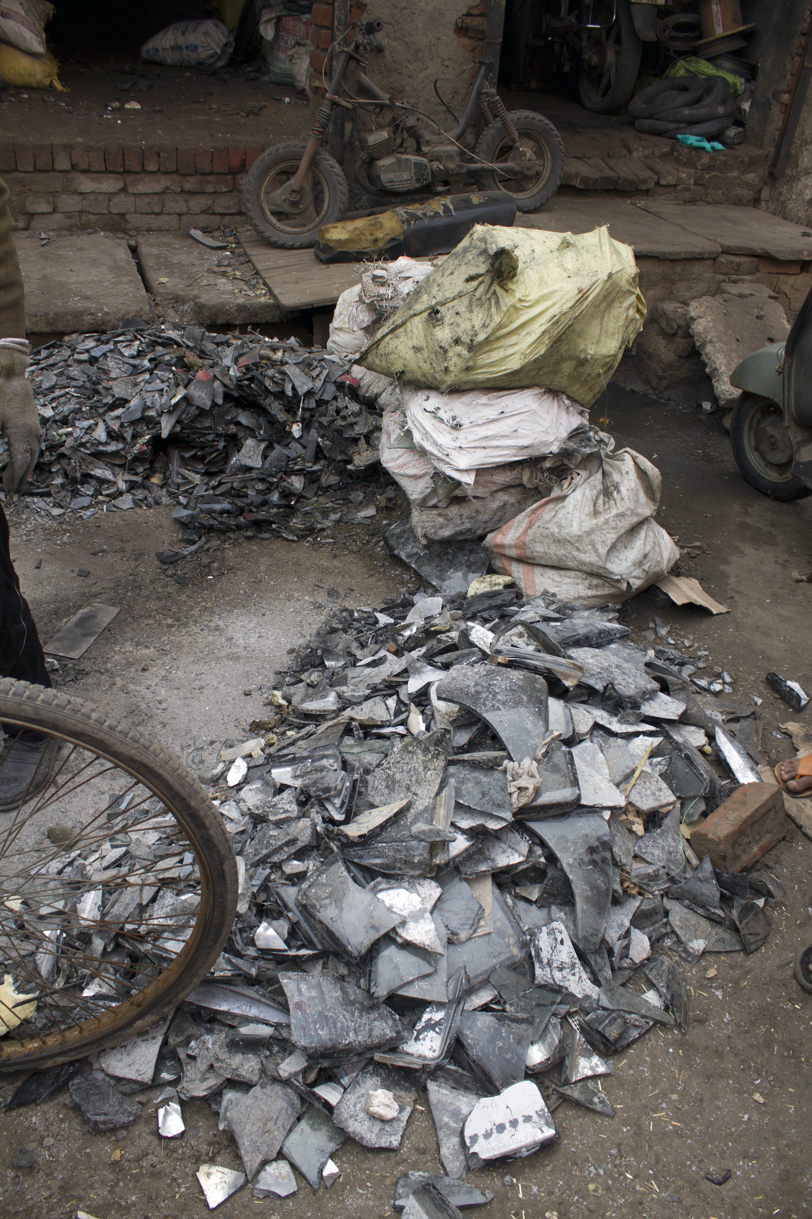
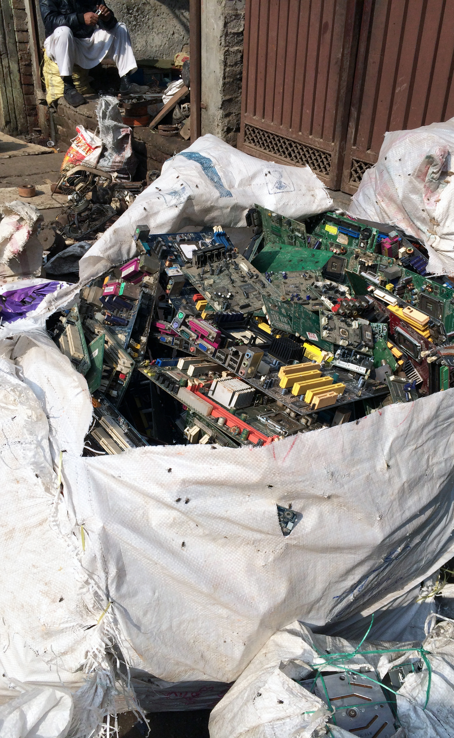
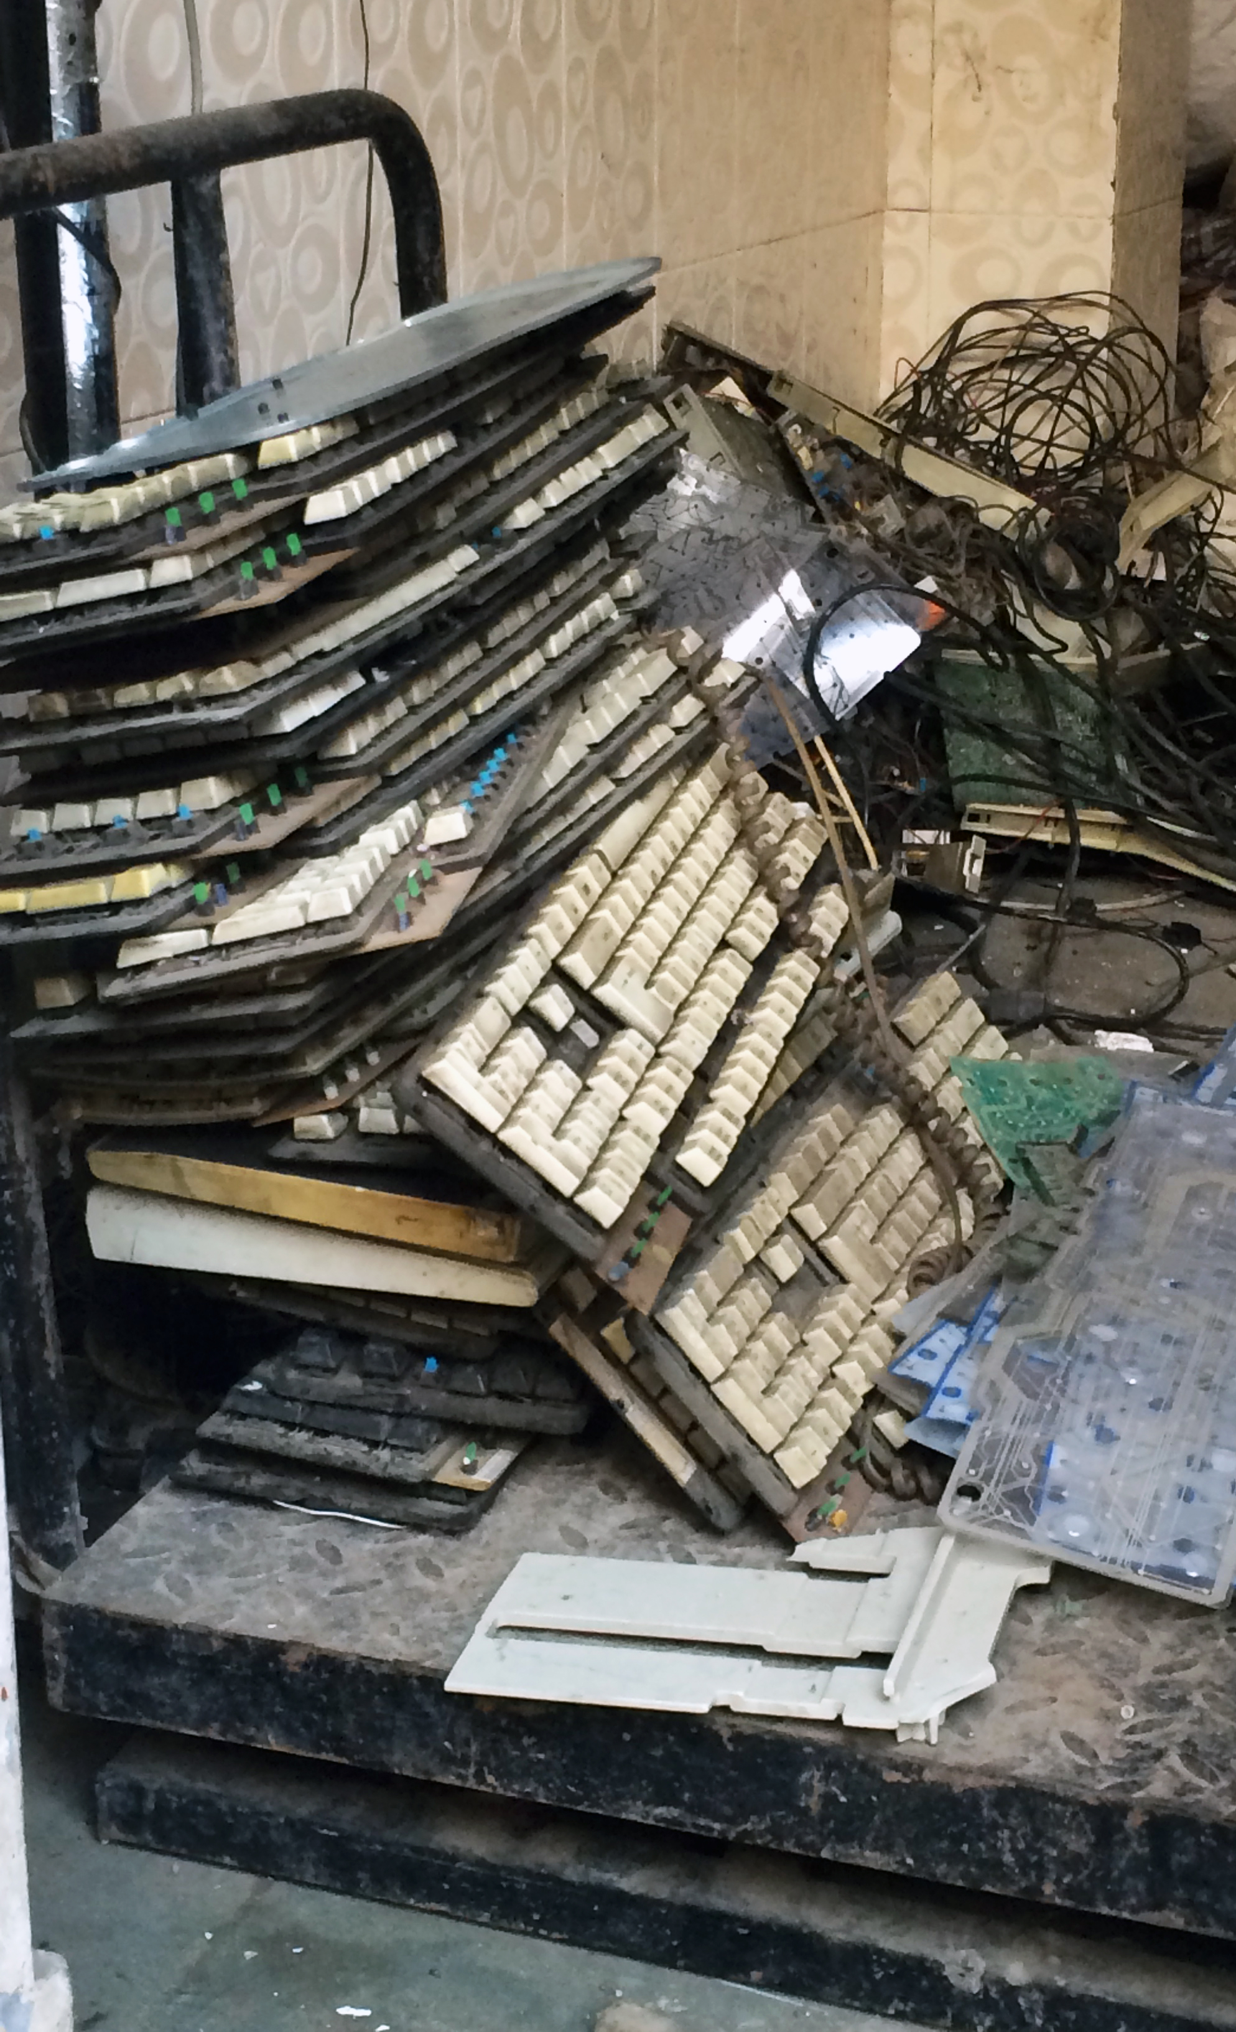
Notes:
The work that led me to this project actually began in 2013, when I visited my first electronic trash processing center in India.
I began making artwork that investigates sustainable design, and our public habits with electronics…

Slide 3

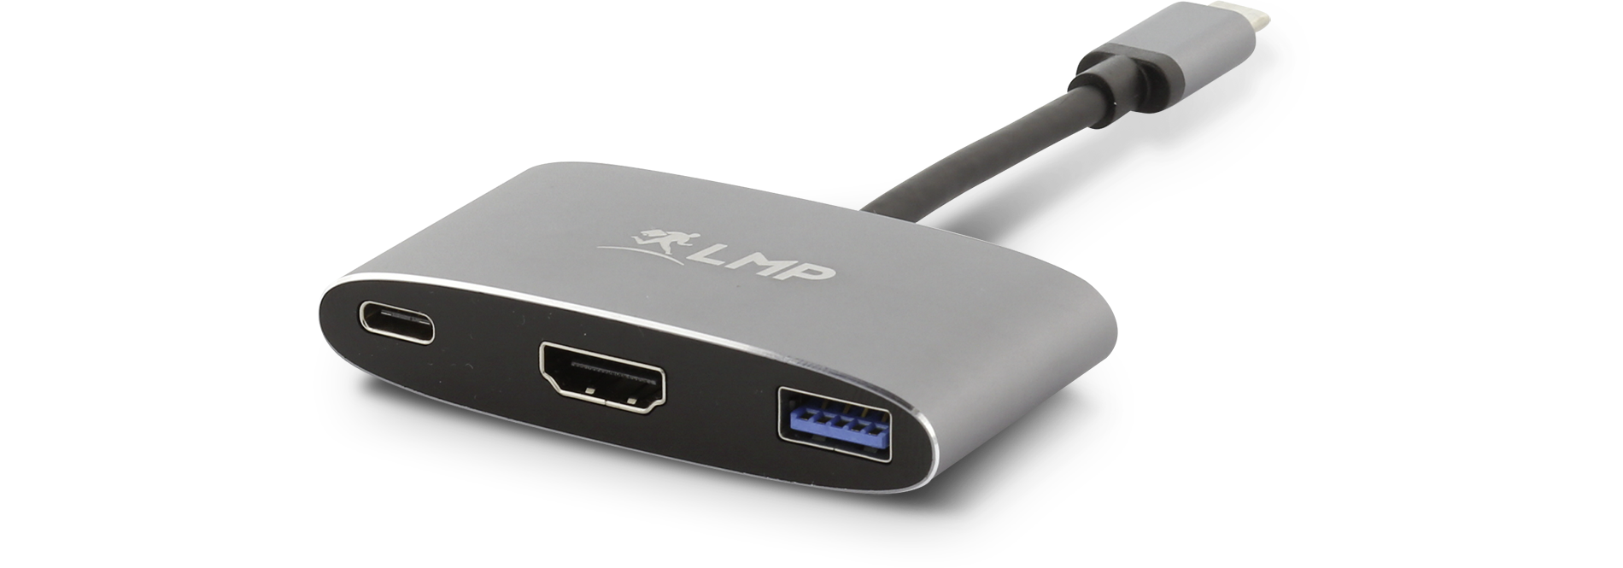
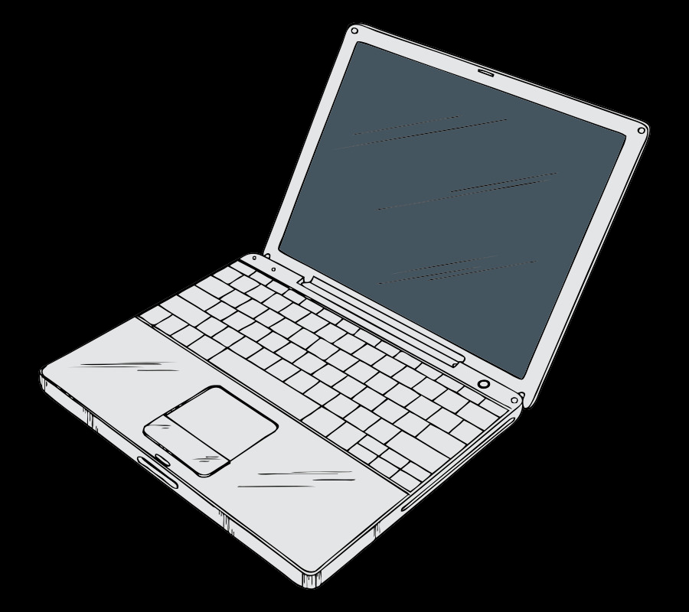
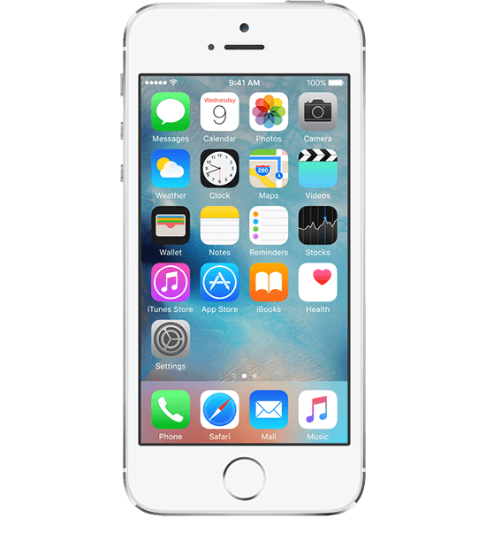
Notes:
Short term thinking– our technology constrains the public imagination, emphasizes lightning fast change, impacts life on many levels.

Slide 4
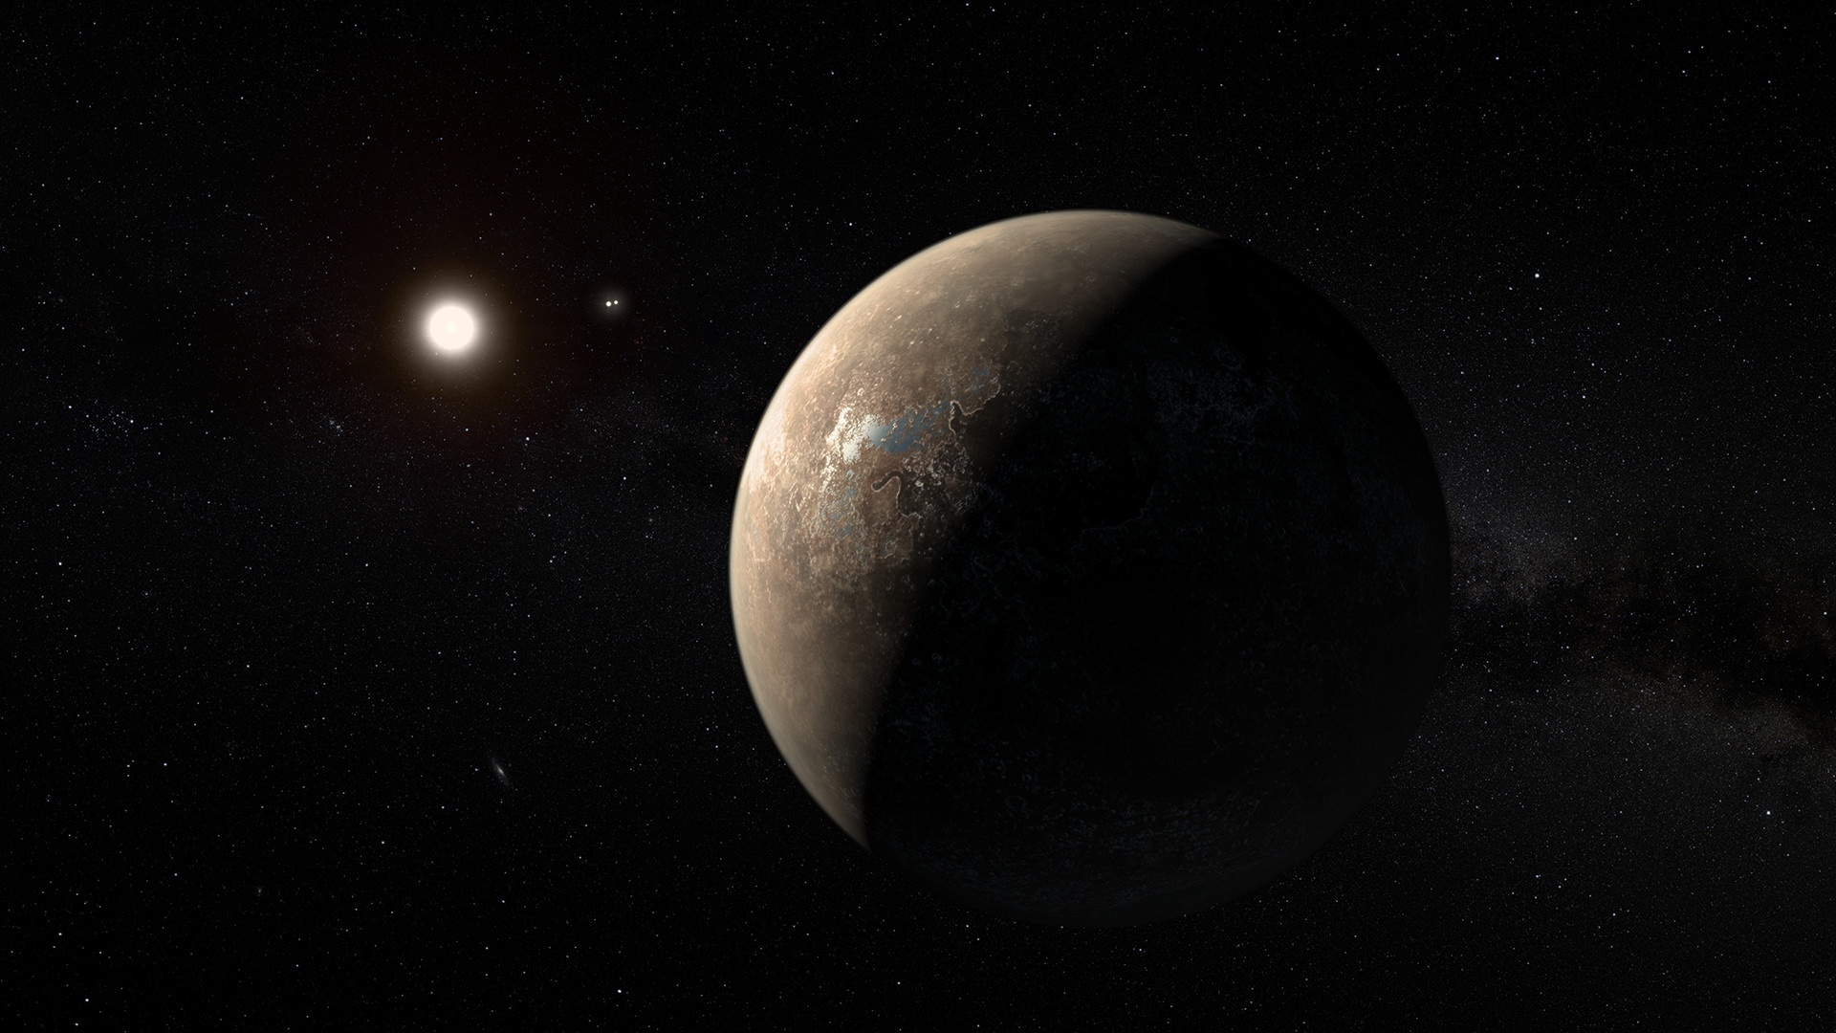
Notes:
Tony Freeman, then-director of the Innovation Foundry.
Tony had just given his paper about a spacecraft concept he had recently been working on with the A-Team, which is meant to travel to Proxima B. The exo-planet is 4.2 light years from Earth. 2069. 1/10 the speed of light, to reach the destination in about 42 years. 2111.
5 phases of the journey require vastly different technological operations, meaning the craft will necessarily have to change over time.
My ongoing research and artwork about short-term thinking, technological design, and public habits would create a innovative collaboration with the scientists thinking about this very long-term mission. How could my participation offer a different access point for the public?

Slide 5
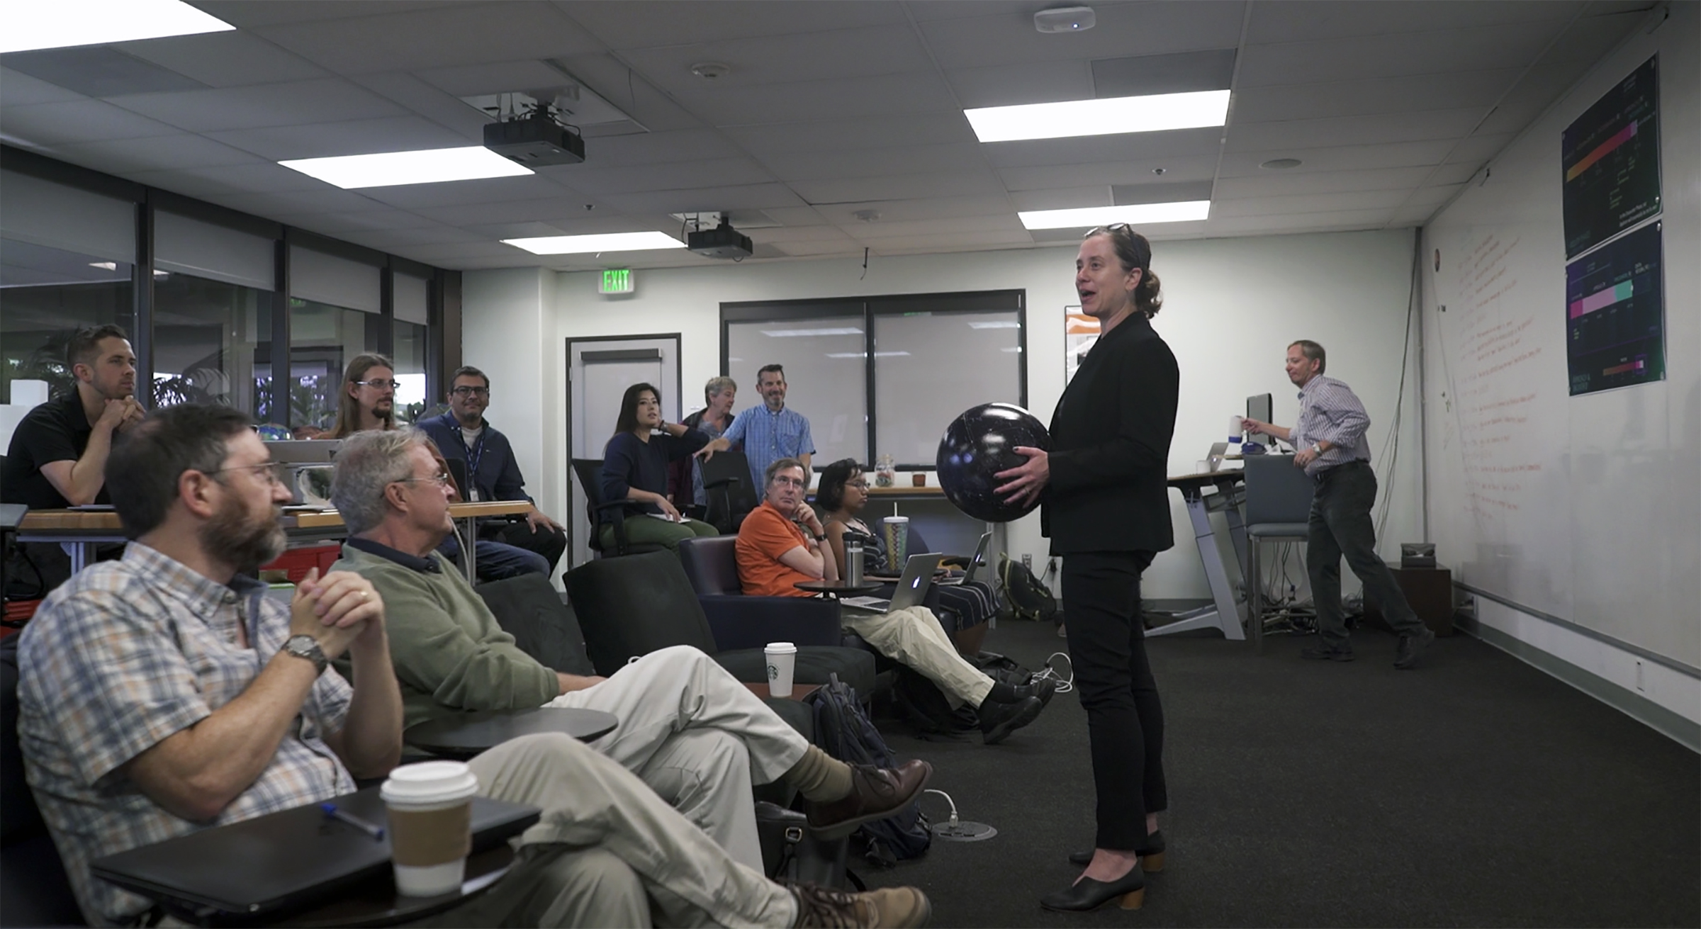
Notes:
There is a place where art and science meet– where we all engage in creative thought.
Here we are at our first A-Team meeting together, where we studied the Proxima B mission, and a potential creative element that would communicate the meaning imbued in this science and technology:
A new Golden Record that can tell a story about sustainability, technological and scientific change over long periods, public engagement over decades or centuries…

Slide 6
PROXIMA B
CUBESAT
2069-2111
CREATIVE
CULTURAL
SOCIETAL
ELEMENT
NOW
Propulsion
Autonomy
Interstellar Medium
Longevity
Upgrade issues
Long-term public interest
LONGEVITY
Notes:
So at the end of that A-Team meeting, we had come up with a list of fairly clear obstacles science needs to overcome to reach the mission—
And we also came up with an idea to develop a mission NOW, using a CubeSat to address the overarching challenge related to all of these obstacles:
LONGEVITY. We need to figure out how to address these obstacles not just once, but in a flexible, adaptable manner that can play out over a long period of time. This includes…
The creative, cultural, societal element. We need public buy-in over a long period of time, and we have to work against the tremendous force of short-term thinking, which increasingly guides the public.

Slide 7
MOVING MEANING INTO THE FUTURE
IS DIFFERENT THAN
MOVING DATA
Notes:
And another piece of this is that moving meaning into the future is different than moving data. How can a creative element act as an entry point to engage the public over long periods of time? We can start thinking now about the creative element to be embedded on the Proxima B craft, as a way of interfacing with the public about the value of long-term thought, long-term science, and long-term sustainability.
Humans come and go, and there are species that will be alive for the duration of the mission. We should create a system that allows those other species to tell a story about life on Earth over a long period of time.

Slide 8
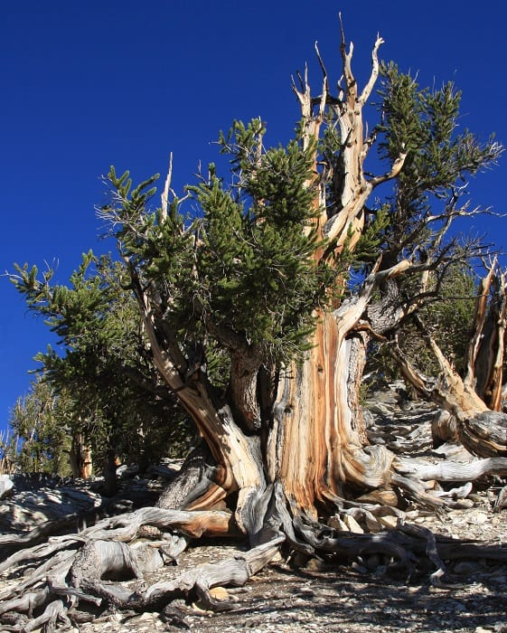
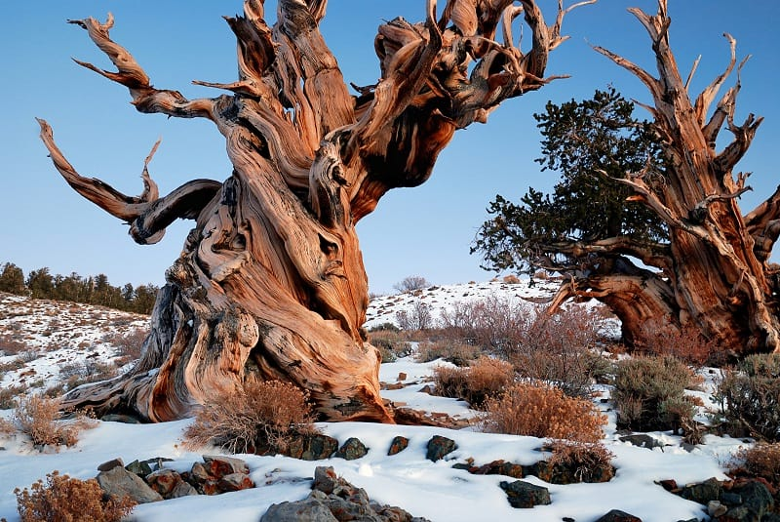
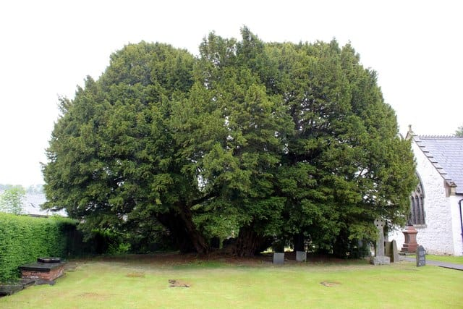
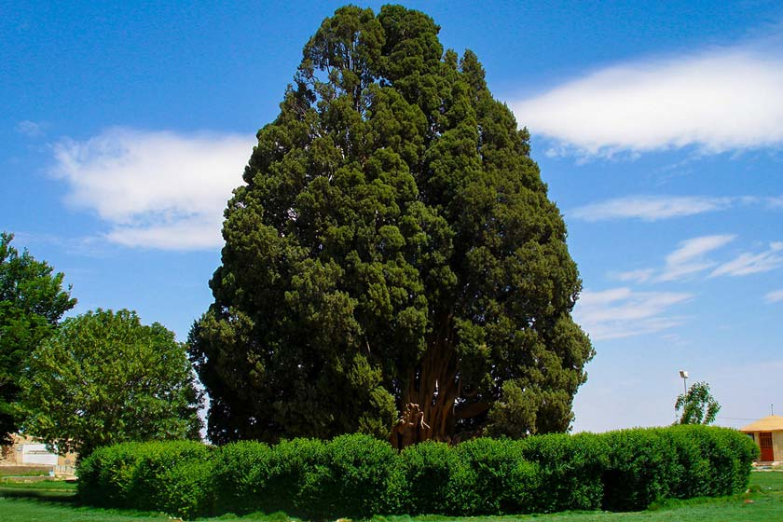
1. Bristelcone Pine,
California, USA
5,067 years old
2. Methesula,
Bristlecone Pine,
California, USA
4,849 years old
3. Llangernyw Yew
Wales, UK
4,000-5,000 years old
4. Sarv-e Abarkuh
Abarkuh, Iran
4,000-5,000 years old
Notes:
Trees!
We decided to collect long-term data sets at the site of trees on Earth, which can be used to create an artwork that plays out over time.
Decided to use sound instead of visuals– sound is meant to play out over time.
What data points will we collect?

Slide 9
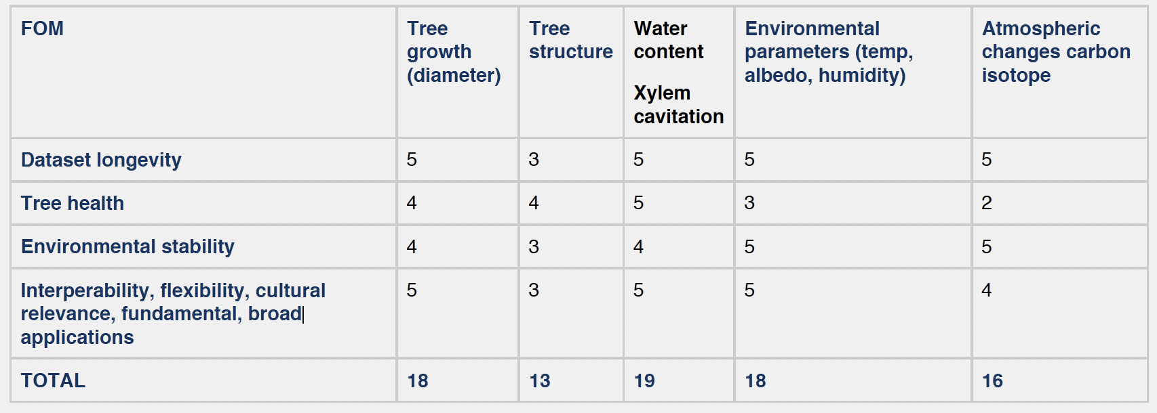
TREE SCIENCE FIGURES OF MERIT / A-TEAM, MAY 21, 2019
Notes:
What data points will we collect?
“If we were the tree scientists of the future, what data will we be glad someone started collecting decades or centuries ago?”

Slide 10

Notes:
In this piece climate data has been “sonified” or turned into sound. Take a listen. The pitch of the tone you hear represents CO2 concentration in the atmosphere, while the pitch and intensity of the plucked strings represent temperature averages. Notice how the the rise in CO2 drives a rise in temperature.
Chris Chafe, director of Stanford's Center for Computer Research in Music and Acoustics composed the piece of music based on data compiled by Hal Gordon, Kate Pennington and Valeri Vasquez at Berkeley.

Slide 11
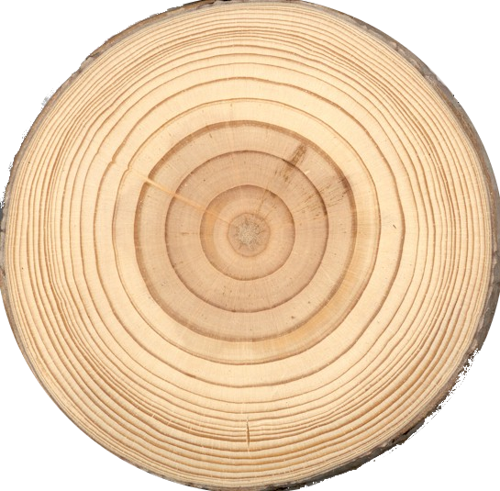
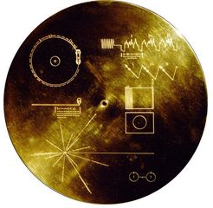

Slide 12
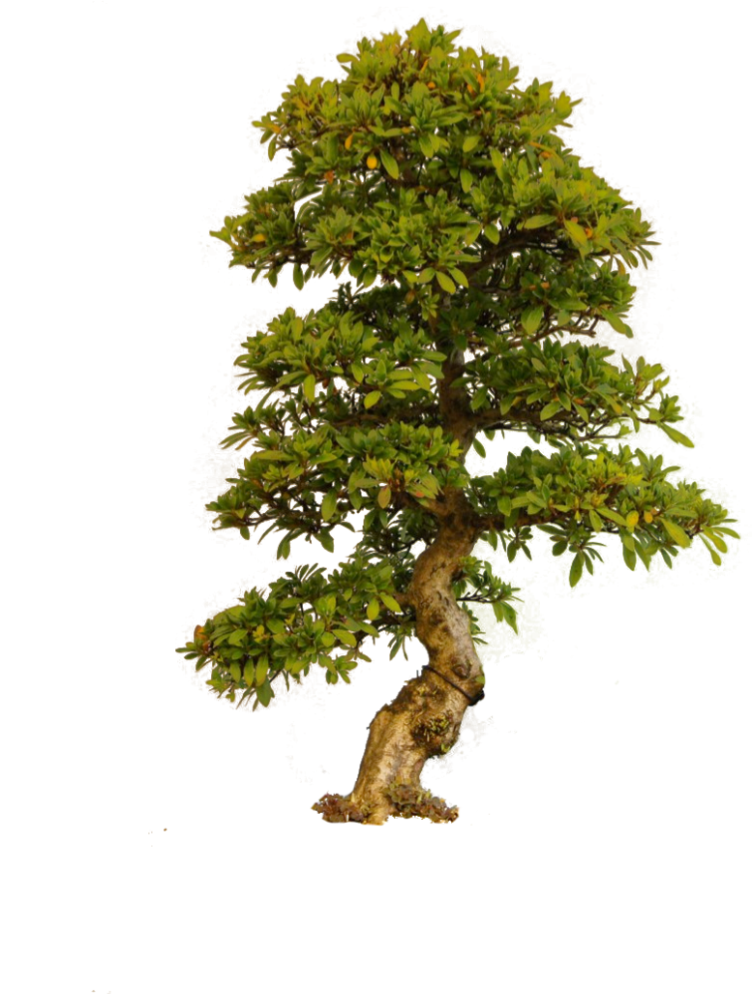

Notes:
So we have our tree sites. The trees are singing their data.

Slide 13

Notes:
What if the trees were also in communication with our space-borne technology? TREE ANTENNA. We can harness the dialectic properties of a living tree to turn it into an expanded antenna system–

Slide 14
Notes:
using Alessandra and her interns’ antenna design, we can receive signals from space-borne craft. We have planning to perform an experiment this spring to, presumably, get a ping from a CubeSat already in space– Our current design is for the UHF band, but it can be tweaked to work for L-Band as well.

Slide 15

Notes:
This song– this data set – will have scientific relevance, especially as it plays out over time.
Remember, the data points that we are interested in have increasing relevance over years, decades, and centuries.
Meanwhile, consistent pings from the CubeSat tell us about the longevity of technical components upon the spacecraft.

Slide 16

Notes:
And it will also be an access point for the public.

Slide 17
SHARED GOALS:
CHANGES IN EARTH’S SURFACE OVER A RANGE OF TIME SCALES
(ESPECIALLY LONG-TERM).
LONGEVITY OF SPACECRAFT OPERATION IN SPACE.
SCIENCE AS A MEANS OF GENERATING SOCIETAL BENEFIT AND
CULTURAL ENGAGEMENT.
ART EMPHASISES THE CRITICAL IMPORTANCE OF THINKING
LONG-TERM ABOUT DATA, TECHNOLOGY, SCIENCE, HUMANITY
AND PLANET EARTH.
Notes:
TREE OF LIFE

Slide 18
BENEFITS OF T.O.L. INSTALLATION:
MEASUREMENTS AT THE SITE OF TREES SONIFIED FOR PUBLIC
CONSUMPTION, ALLOWING A CREATIVE ACCESS POINT TO DATA
IN-SITU MEASUREMENTS AT TREE COULD PROVDIDE DATA
CALIBRATION FOR DATA GATHERED BY SPACE-BOUND VEHICLE.
HARNESSING LIVING TREES TO CREATE A TERRESTRIAL ANTENNA
NETWORK MERGES SCIENCE, TECHNOLOGY, AND THE PUBLIC
IMAGINATION.
THE SONG OF THE TREES WILL BE AVAILABLE ON-LINE, IN REAL
TIME, FOR GENERATIVE PUBLIC CONSUMPTION + CREATIVITY.
Notes:
TREE OF LIFE AS A HYPOTHETICAL PUBLIC LINK TO OTHER MISSIONS

Slide 19
LONGEVITY IS THE COIN OF THE REALM.
Notes:
As Steve said so poetically at an A-Team meeting…

Slide 20
Notes:
The end goal here is to create a work that merges art and science to play out over a very long time. Back to the Proxima B spacecraft– eventually, the data song of the trees can be inscribed on the surface of that spacecraft to act as a new Golden Record. But this time, the song is mediated through the trees on this planet that support human life, and the sustainable technology that we create.

Slide 21
TREE OF LIFE
JPL A-TEAM / JULIA CHRISTENSEN

