Slide 1
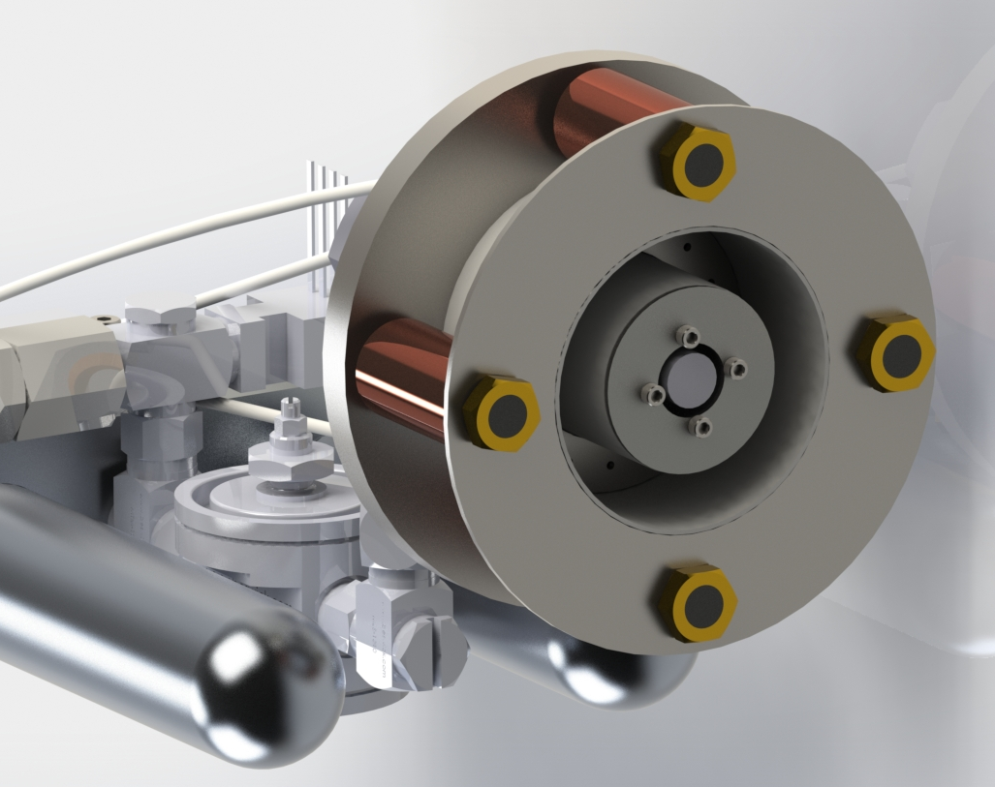
An Accessible CubeSat Hall Effect Thruster for Interplanetary Missions
Colin Warn
Washington State University
Interplanetary Small Satellite Conference
Online Web Conference

Slide 2
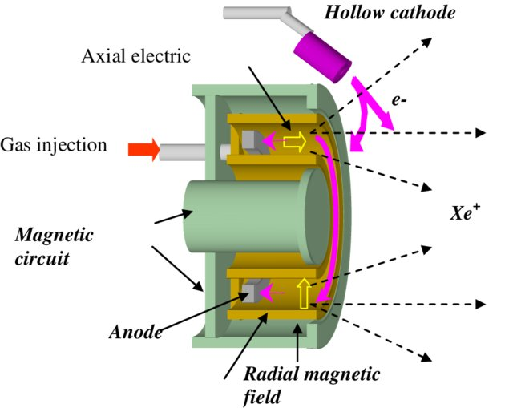
Hall Effect Thrusters
Sea of circulating electrons ionizes inert gas.
Historically used for orbital insertion, station-keeping and de-orbiting.
Has seen use in interplanetary missions. European Space Agency’s “Smart-1.”
Problem: Flight-ready versions are historically very expensive to procure.
“View of a Hall Effect Thruster,” M Dudeck, Plasma propulsion for geostationary satellites for telecommunication and interplanetary missions
colin.warn@wsu.edu

Slide 3
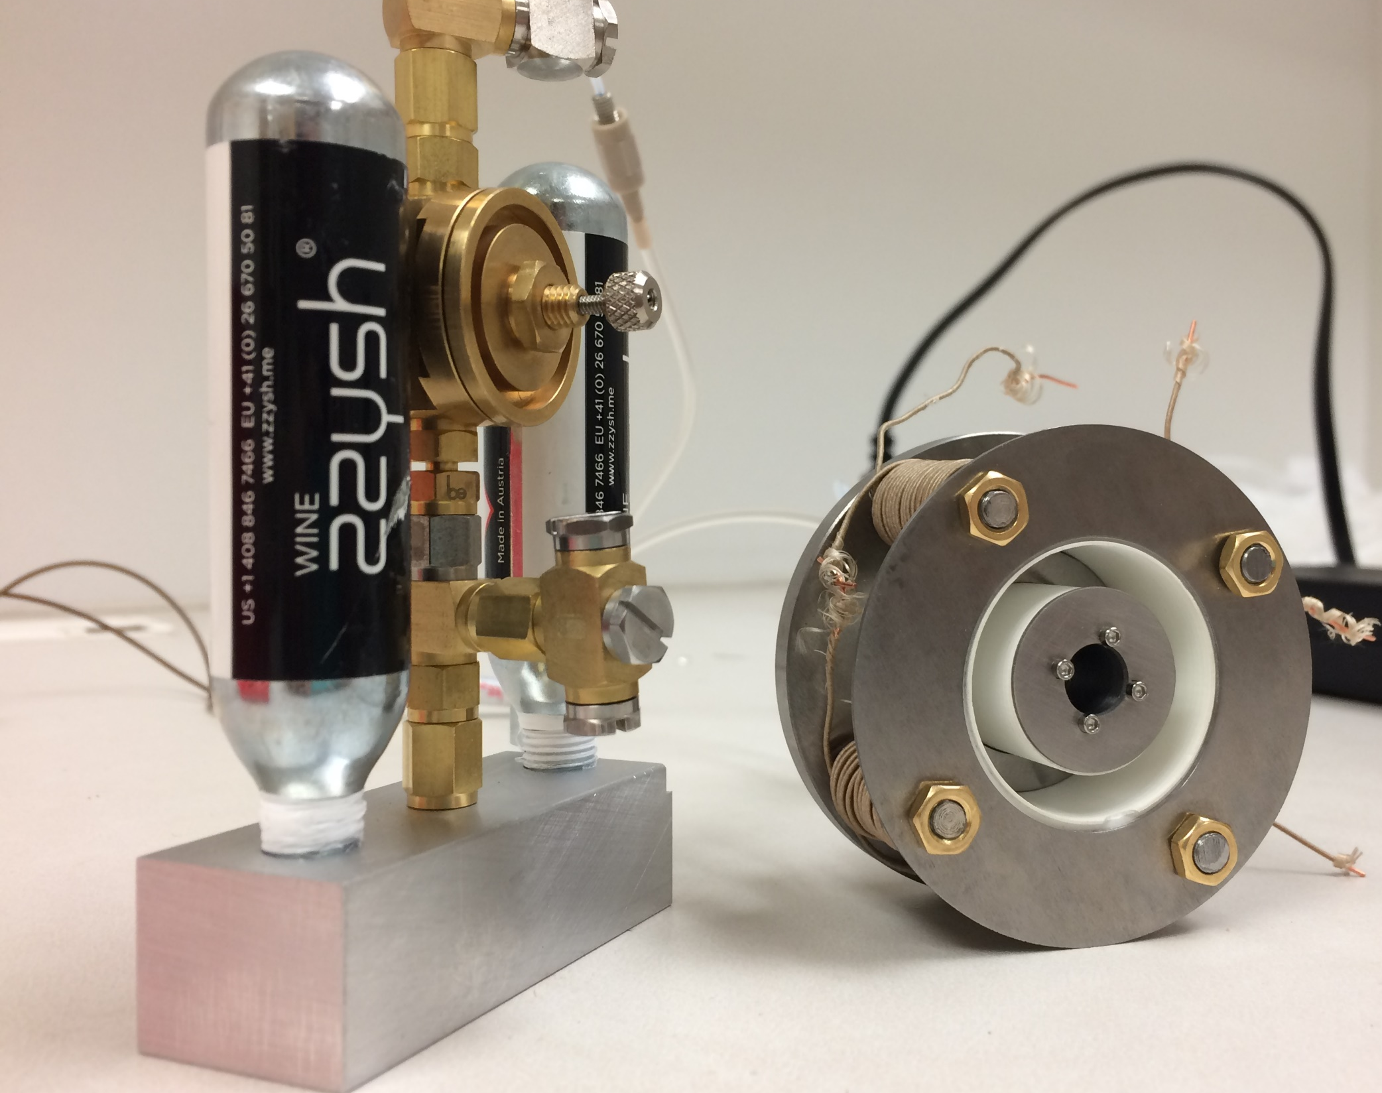
Accessible CubeSat Hall Effect Thruster
CougDrive-I
Based on previous work done by Cal Poly and Western Michigan University.
$10,000 to build goal.
Release design and build guide.
Aiming for flight-ready.
colin.warn@wsu.edu

Slide 4
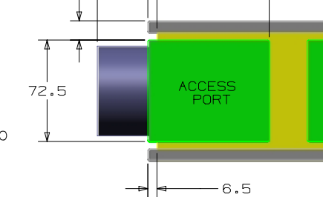
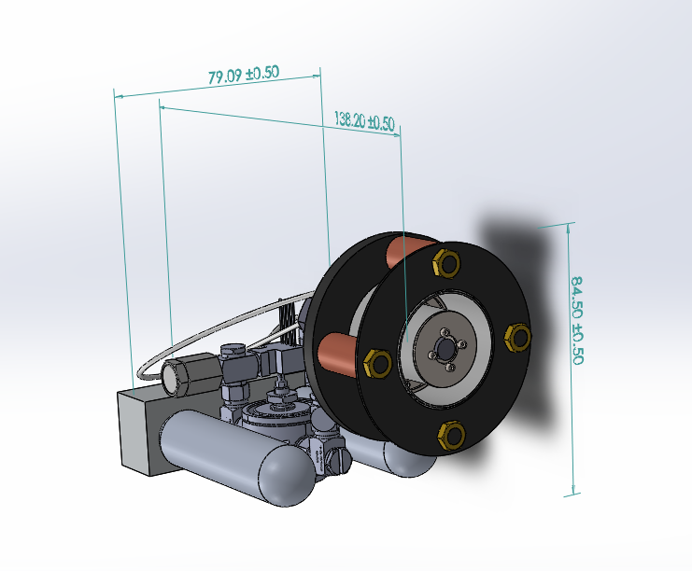
CougDrive-I Design Parameters
80mm wide, 138mm long, 85mm tall
Optimized for 3U+ configuration
Nominal Power | 100-200 W
Target Thrust | 6-8 mN
Target Specific Impulse | 1000-1400s
Target Discharge Voltage | 200-300 V
Mass Flow Rate | 0.6-0.7 mg/s
Propellant | Xenon, Argon
Dry Mass | 350 g
Cathode | HeatWave Hollow Cathode
Cathode
Propellant tank
colin.warn@wsu.edu

Slide 5
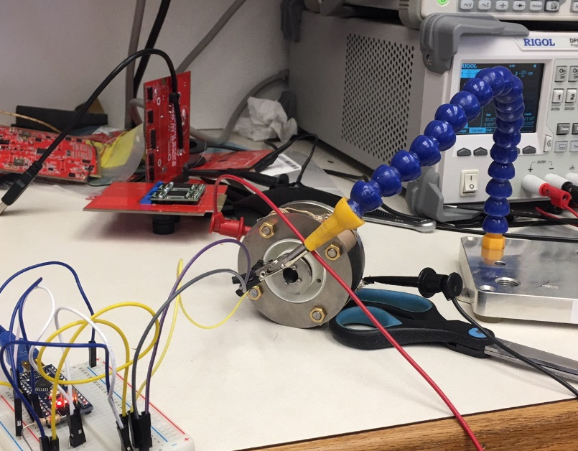
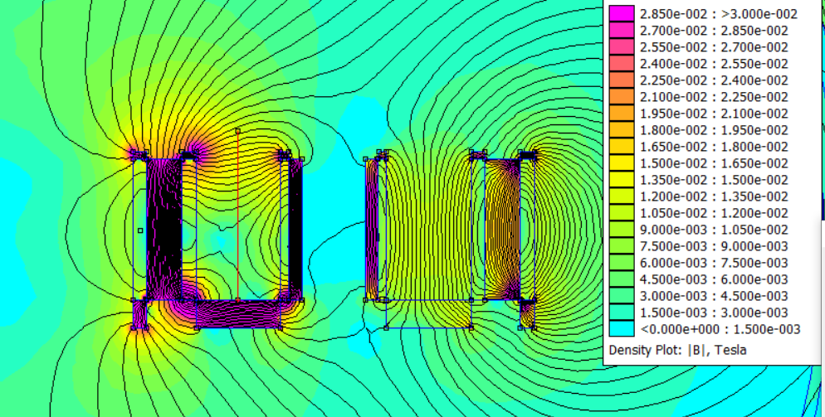
Magnetic Field Testing
Experimental Measurements
FEMM Theoretical Values
colin.warn@wsu.edu

Slide 6
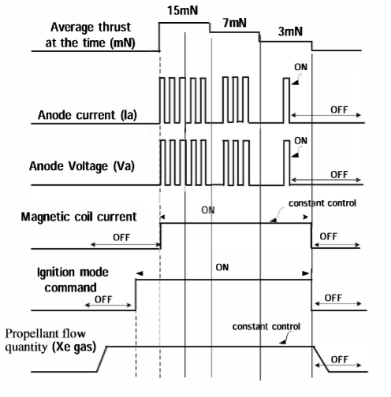
Power Processing Unit
Current System Requirements
Unit | Voltage (V) | Current (A) | Power (W) | Tolerance
Anode | 200-300 | 0.5 | 100-200 | C.V ± 5%
4x Inductor Cores | 1 | 2 | 2 | C.C ± 3%
1x Central Core | 1 | 2 | 2 | C.C ± 3%
Keeper | 48-50 | 1.5 | 72-75 | C.C ± 5% C.V ± 5%
Heater | 1.5-1.6 | 14-16 | 21-25.6 | C.C ± 3%
1x Solenoid | 1.6-12 | .025-0.160 | 0.250 | C.V + 5%
 |  | Total | 197-300
Work is underway, but help needed.
Preliminary work based on
Mitsubishi Electric Corporation work.¹
1- Hiroyuki Osuga and Fujio Kurokawa, “Power Processing Unit for the Next Generation Satellite”
colin.warn@wsu.edu

Slide 7
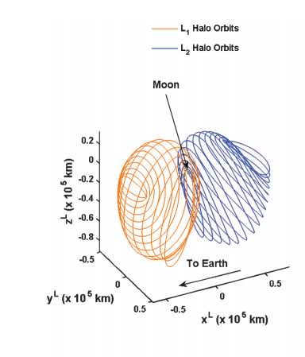
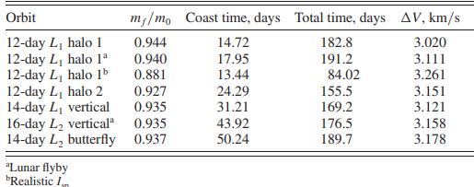
Potential 3U Lunar Relay Communication Application
Starting in Earth Parking Orbit (20,000 km).
Maneuver to halo orbit for Lunar south pole communications relay.²
colin.warn@wsu.edu
2 - Howell and Ozimek, “Low-Thrust Transfers in the Earth–Moon System, Including Applications to Libration Point Orbits”

Slide 8
3U Communication Hardware
Cost Assessment
Component: | Mass (g): | Cost ($):
3U Structure | 1100 | 3,000
CougDrive-I | 300 | 10k-50k
Xenon | 900-1200 | 2,000
Batteries | 300-400 | 50
Power Processing Unit | 100 | 1,000
Gemini Space Panel Double Deployable Solar Panels for 3U | 420 | (30,000?)
NanoAvionics Reaction Wheels | 155 | (30,000?)
Endurosat X-Band Communications | 350 | 30,000
EnduroSat Computer | 75 | 3,000
Payload | 0-300 | N/A
Rocket Launch Cost | - | 60k-240k
Total | 4 kg | $109k-400k
Assumes Isp ranges from 1000-1400s
Target dV ≈ 3.3 km/s
Estimated hardware cost: $109-400k
colin.warn@wsu.edu

Slide 9
To-Do
Lab test for first plasma.
Develop flight-ready power processing unit.
Flight-ready configuration lab tests.
Demonstration mission.
Look for grants and collaboration opportunities.
colin.warn@wsu.edu

Slide 10
Thank You
Colin Warn
Washington State University
colin.warn@wsu.edu
Special thanks to Dr. Dan Lev for being an advisor for this project.

