Slide 1
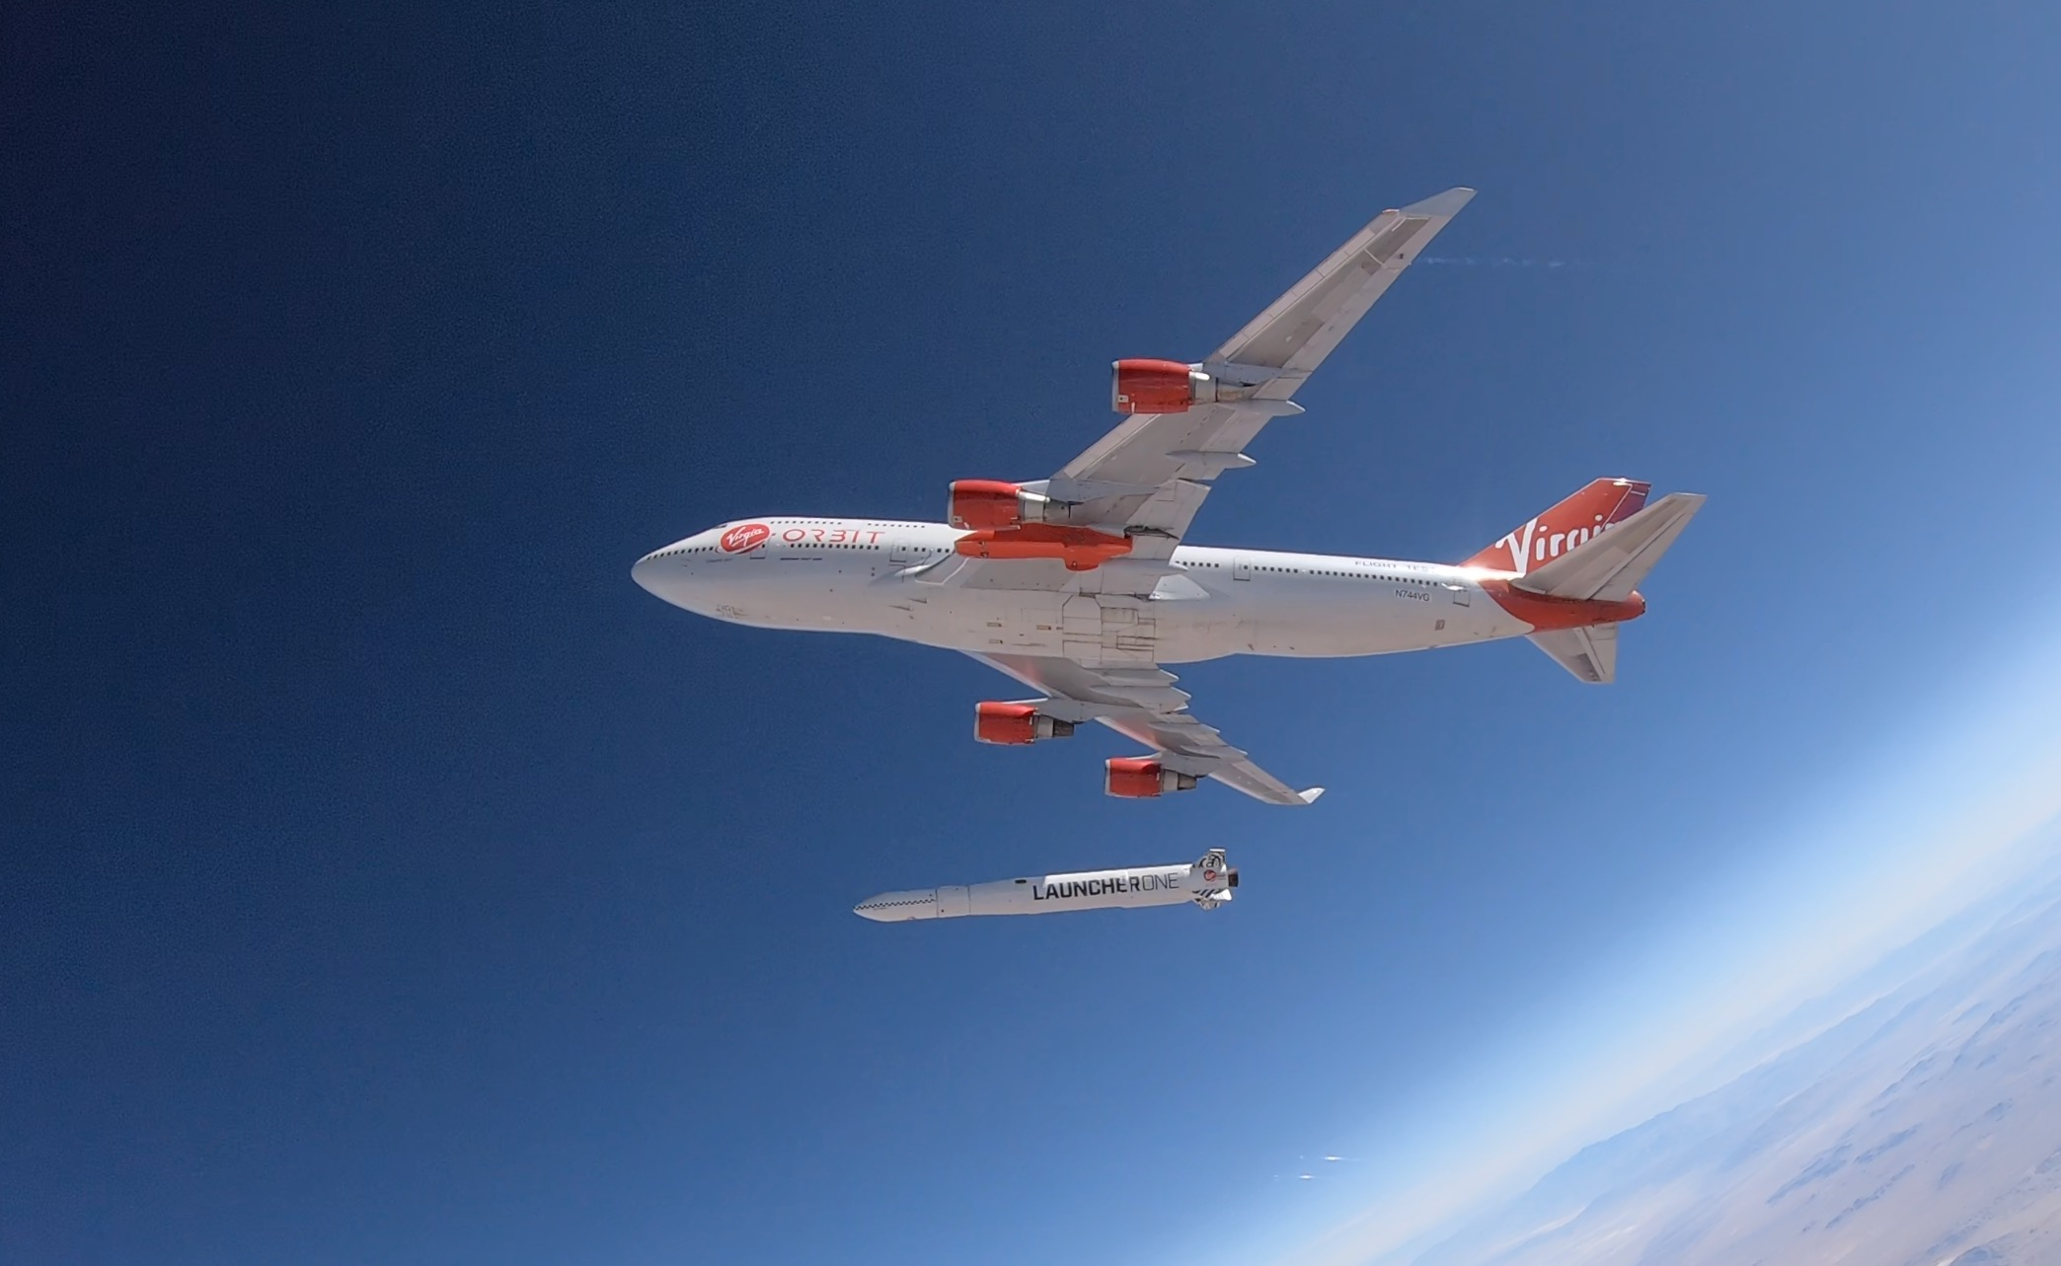
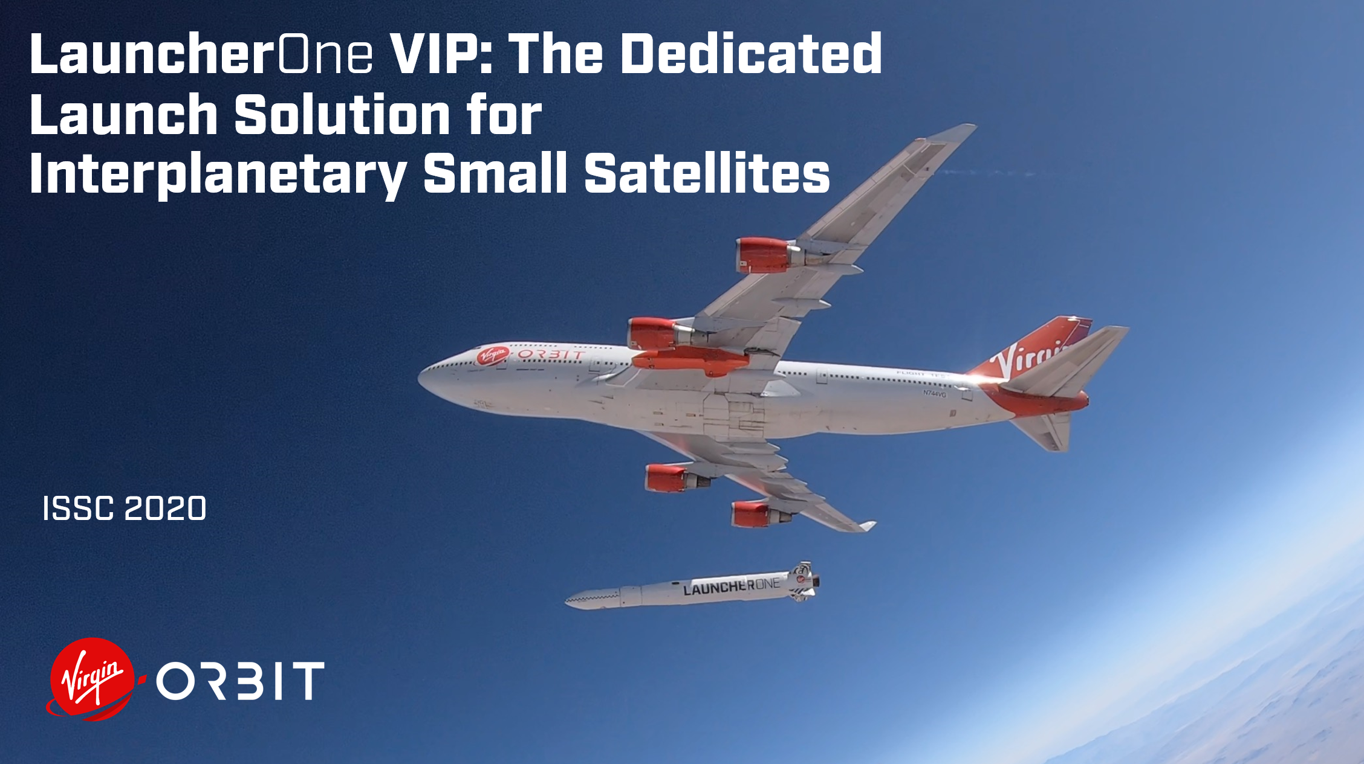

LauncherOne VIP: The Dedicated Launch Solution for
Interplanetary Small Satellites
ISSC 2020

Slide 2


LOW COST
ON DEMAND
AT ANY TIME
TO ANY ORBIT

Slide 3





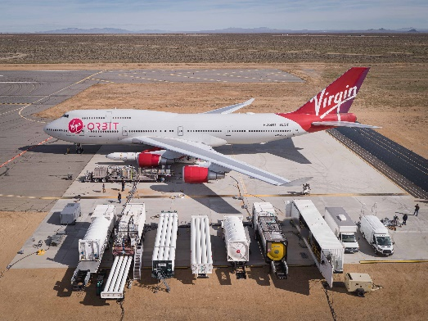
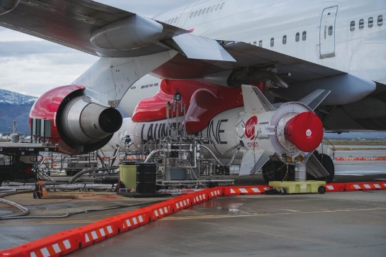
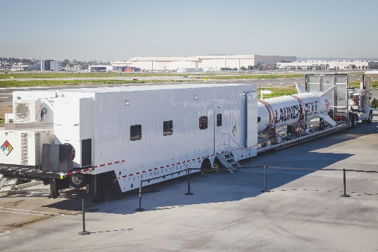
Launch From Anywhere
Ultimate portability:
  Aircraft as launch platform
  Trailerized ground support equipment
  Mobile mission control
Multiple launch sites for flexibility and resiliency
  Mojave, CA
  Shuttle Landing Facility, FL
  Guam
  Oita, Japan
  Cornwall, UK

Slide 4
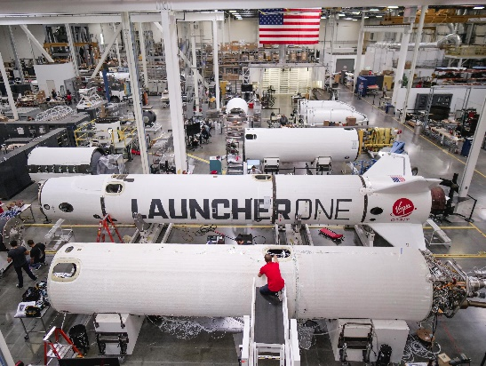
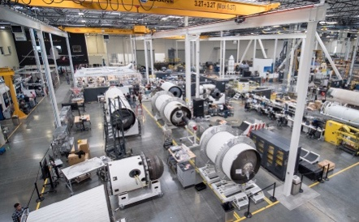

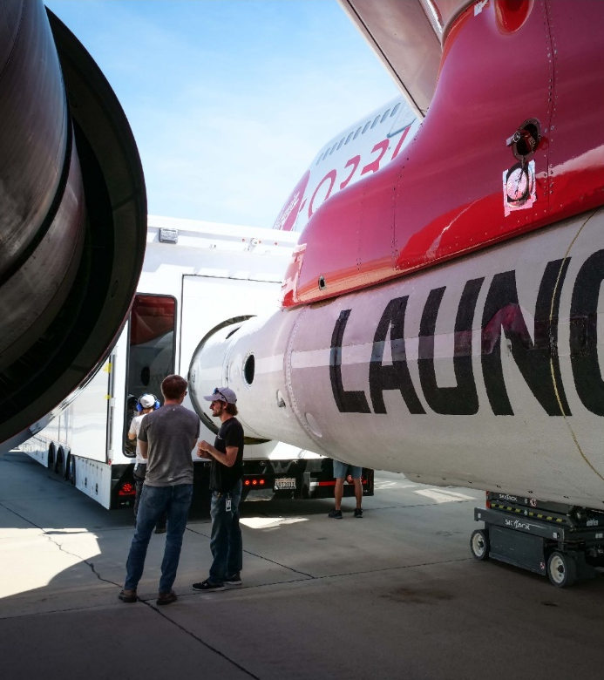
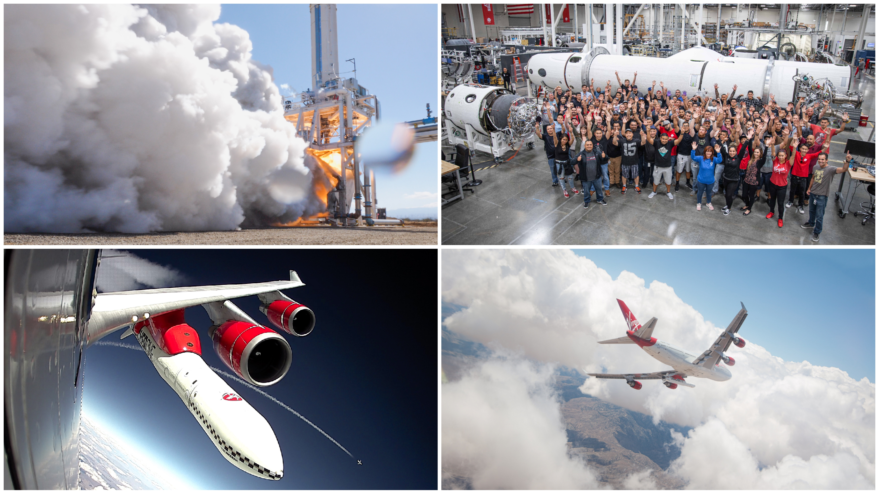
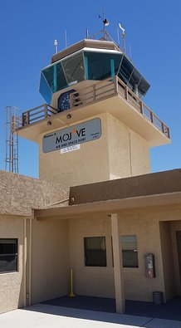




Responsive Launch: Founded on a Modular Approach
Vertically-integrated and high rate manufacturing base
Globally transportable support assets
Fully mobile launch pad in the sky
Growing network of international spaceports

Slide 5
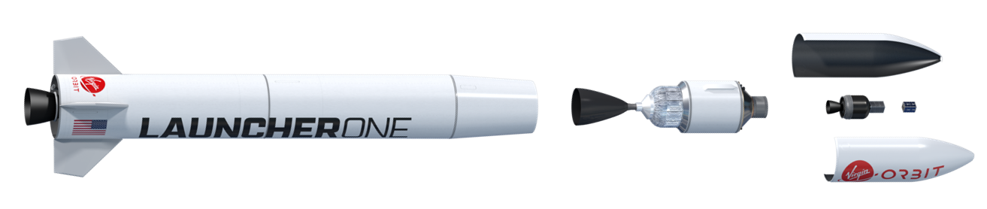
L1 “VIP” Exploration 3-Stage Variant for Interplanetary Missions
Encapsulated Upper Stage
(EUS)
L1 paired with an “EUS” third stage shown forms an ideal exploration class launcher
Requires minimal changes to the existing 2-stage, mature L1 flight architecture
Ample packaging opportunity within existing L1 fairing volume
System fields from various low-inclination spaceports to further tailor inclination/declination targets of launch windows

Slide 6


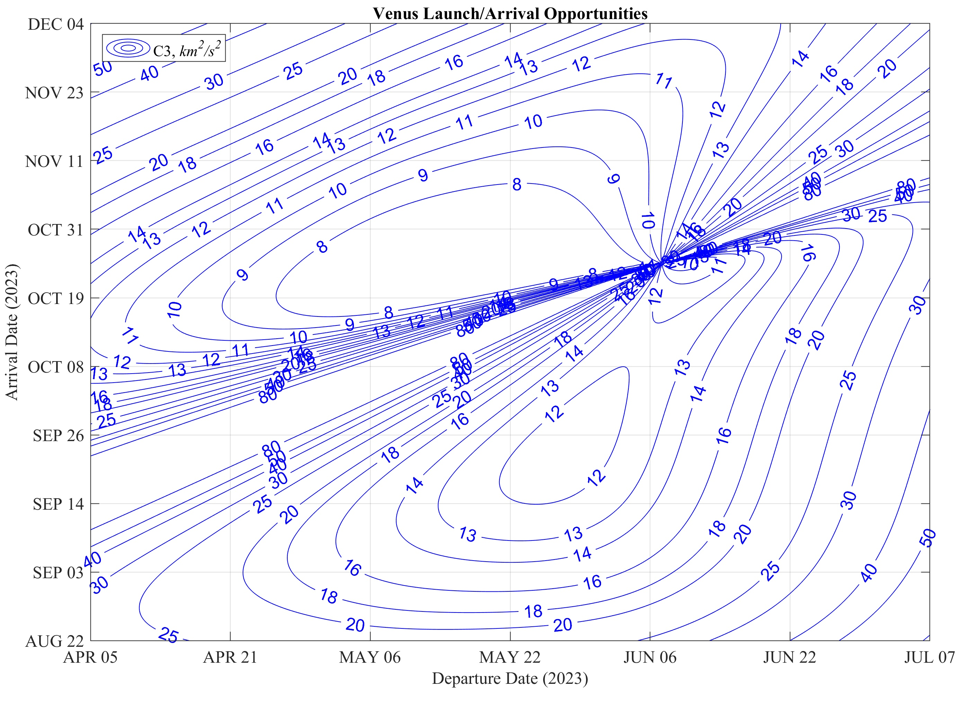
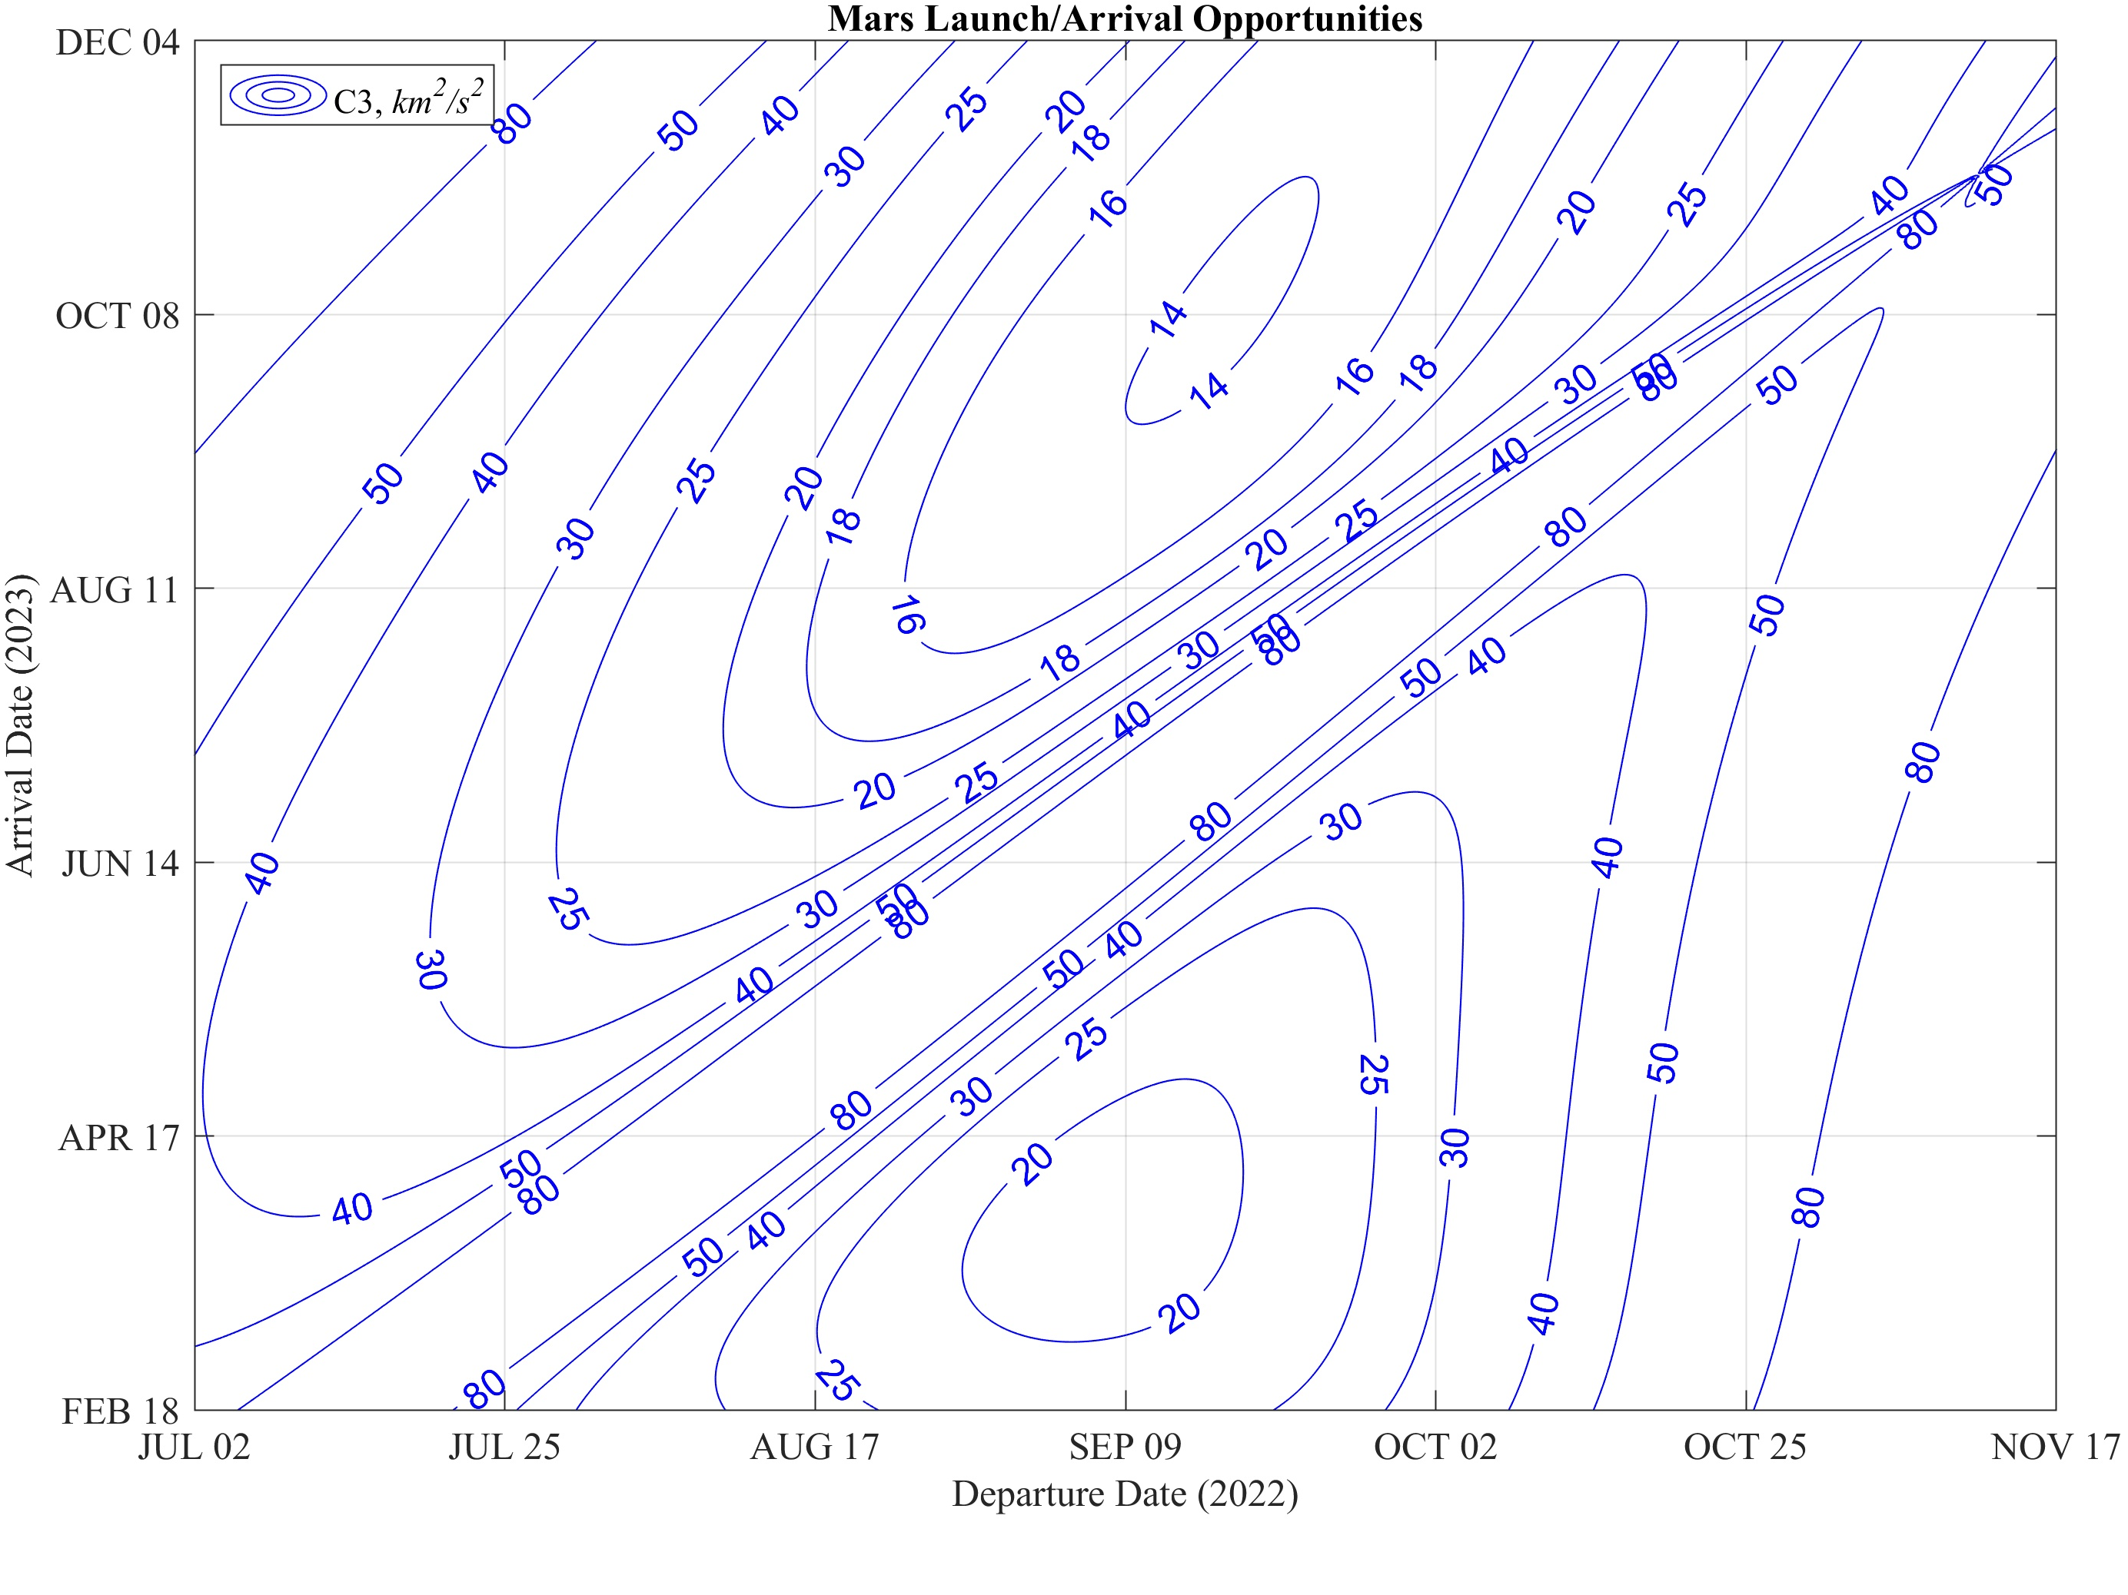
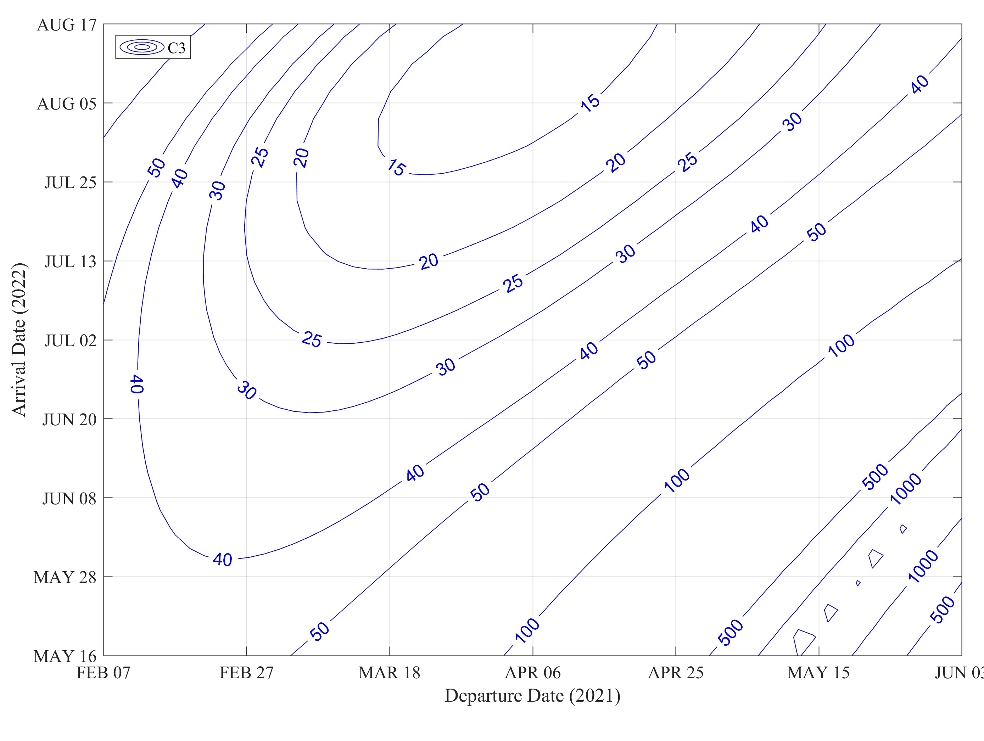
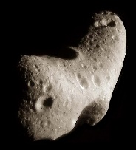


L1 “VIP” Exploration 3-Stage Variant for Interplanetary Missions
L1 air-launch ability enables high degree of access to low declinations at maximum performance, enabling longer launch windows and tailored access to various solar system targets
Launch Window & Performance Examples
Daily Cis-Lunar TLI or Lagrange Access
C3: -1 to 0 km²/sec²
Up to ~100 kg payload
Venus 2023
C3: ~8 to 14 km²/sec²
Up to ~70 kg payload
Mars 2023
C3: ~14 to 20 km²/sec²
Up to ~50 kg payload
Eros Asteroid 2021
C3: ~14 to 20 km²/sec²
Up to ~50 kg payload

Slide 7
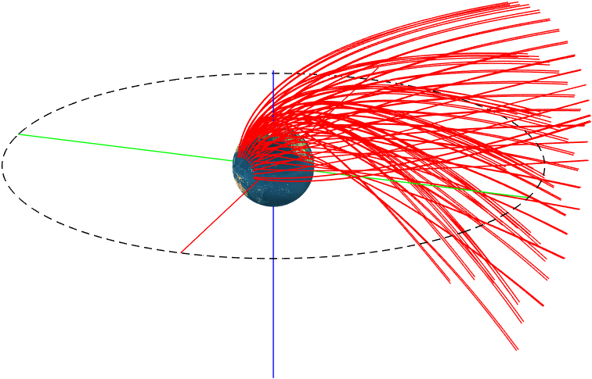
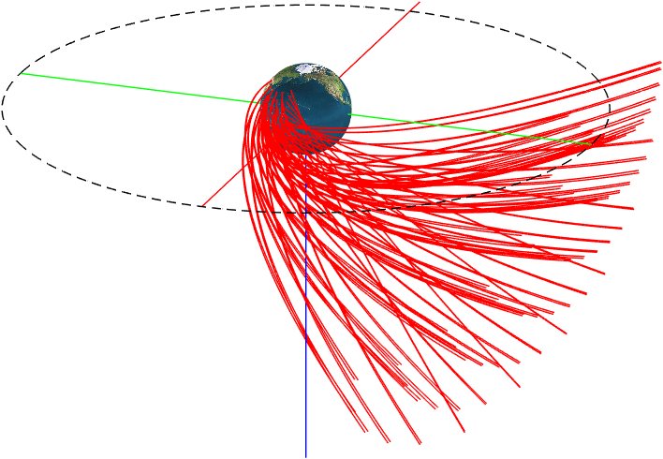
Air-Launch Enables Highest Degree of Exploration Access
Air-launch can send interplanetary spacecraft where other vehicles sometimes cannot
Varying the rocket release site enables high degree of precision in optimizing interplanetary launch
Escape trajectories can reach azimuths and inclinations that ground vehicles cannot due to launch corridor restrictions or population overflight
Result: Maximized payload performance, increased precision, and longer launch windows when targeting missions far beyond Earth orbit
Launches to Northern Azimuths
Launches to Southern Azimuths

Slide 8
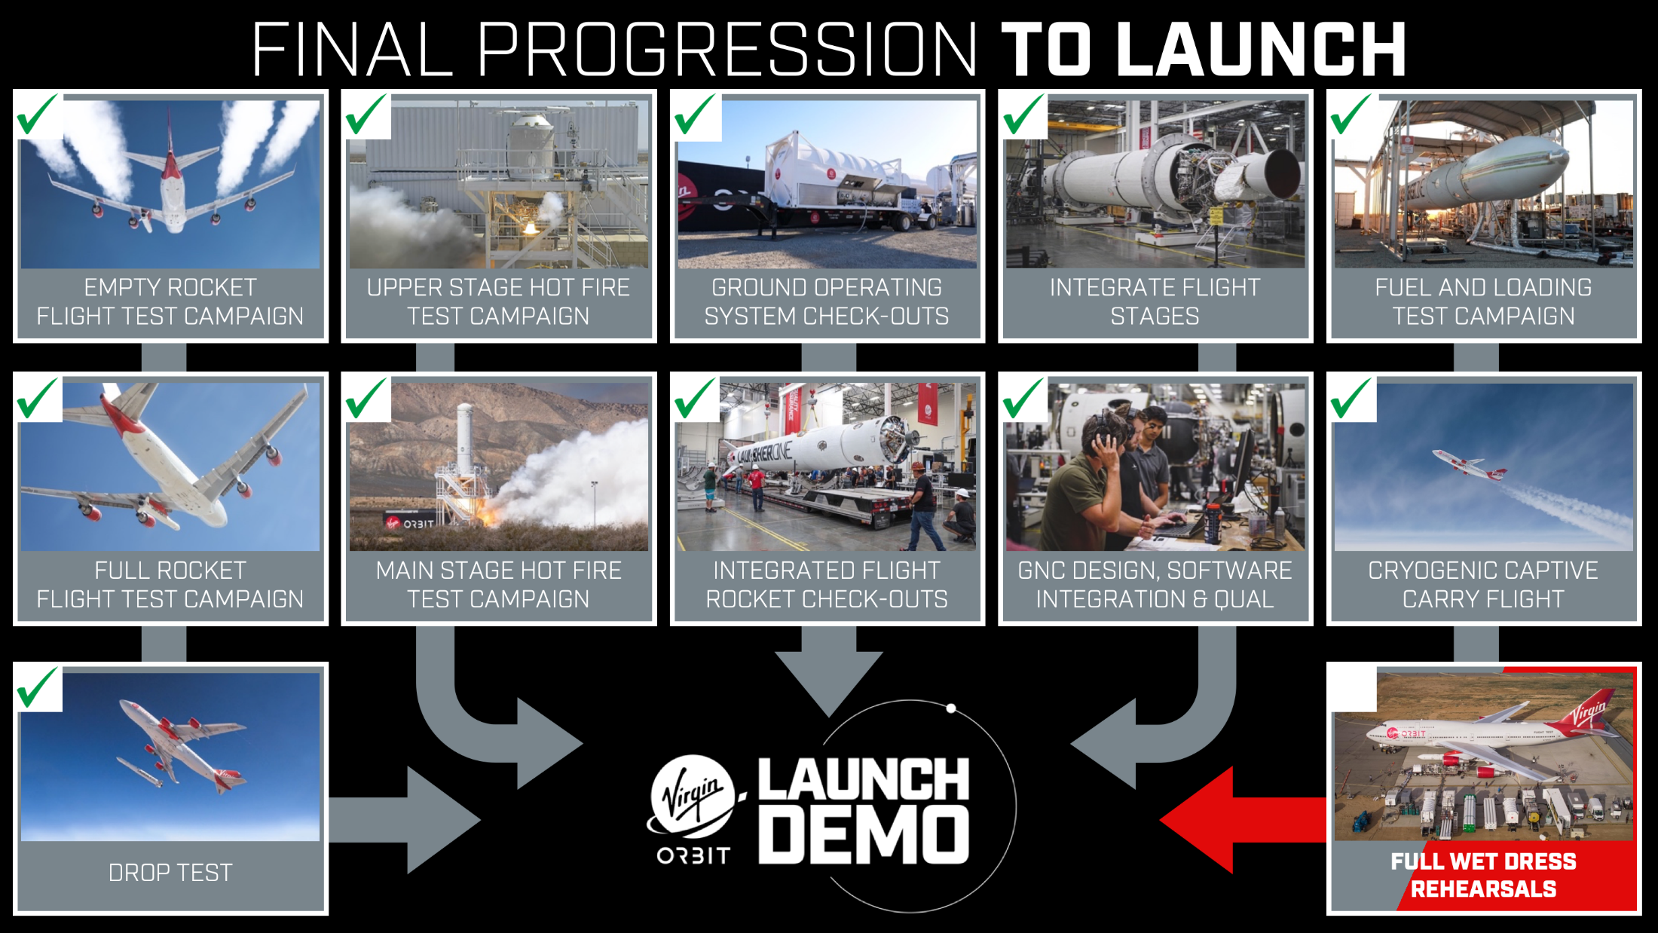

Slide 9
Thank You

