Slide 1

Long-Lasting Tree Antennas
Initial Development and Challenges
Thomas Choi
Ingie Baho
Alessandra Babuscia
Notes:
Hello everyone, my name is Thomas Choi and I am an academic part time intern at the Jet Propulsion Laboratory.
Today, I would like to discuss about an interesting project called “long-lasting tree antennas”. I will talk about the initial development and challenges regarding this project.
I have worked on this project with the previous summer intern who preceded me, Ingie Baho, and my mentor, Alessandra Babuscia.
(0:20)

Slide 2
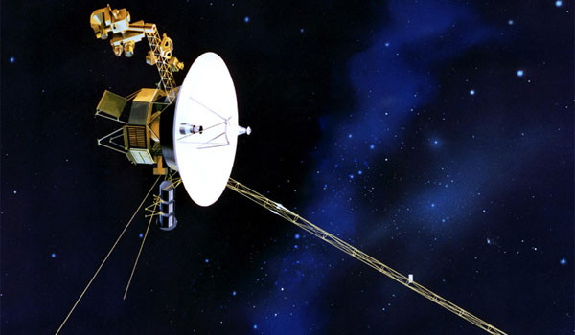

Motivation: Longevity of Space Missions
Voyager 1
Proxima Centauri b
Credit: NASA
Credit: ESO/M. Kornmesser
Notes:
The motivation of this project is as follows. With the development of deep space technologies, as we have seen from the missions like Voyager, and new findings in science, such as Proxima Centauri B exoplanet, researchers are developing novel ideas of long-term space missions which would normally last over human life-span.
The development of long-term spacecraft triggers the development of long-term ground station. This triggers the establishment of an organic terrestrial ground station, which can possibly endure as long as the space missions and also serve as an enduring means of human presence in space.
For both the technological interest of combining the antenna technology with organic plants as well as the poetic reasons of binding technology and art, the tree antenna was investigated.
(1:15)

Slide 3
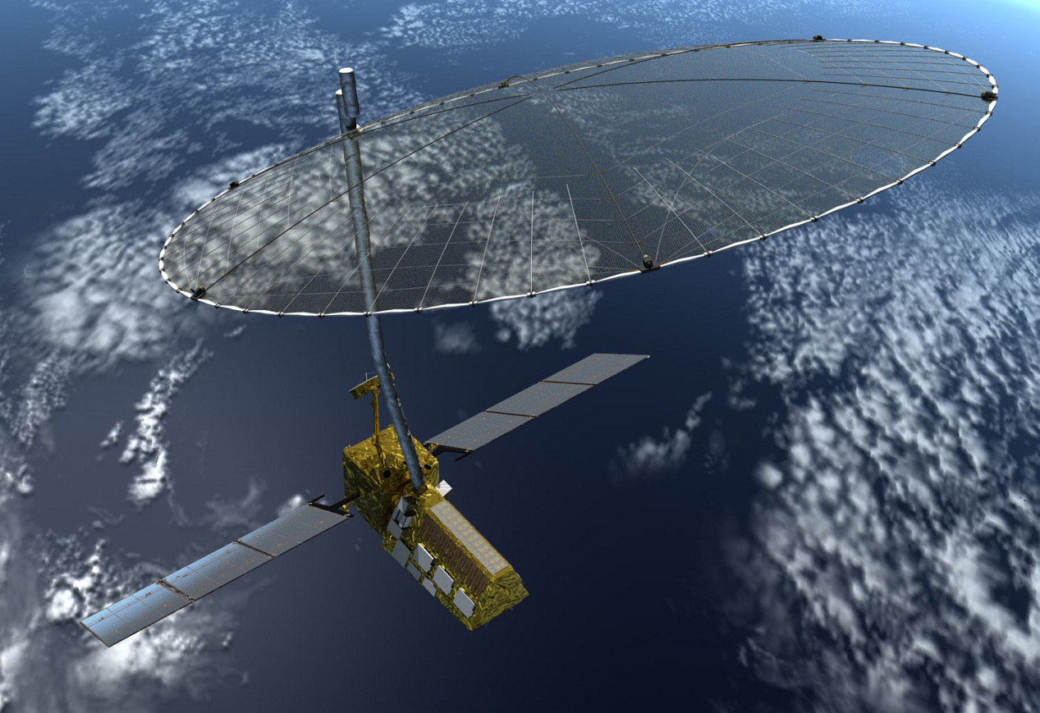
Goal: Talk to CubeSat in LEO for 200 Years
NISAR
Smaller Goal:
Receive UHF/L-band signals
from CubeSats
Credit: NASA
Notes:
Among long-term space missions, we wanted to focus on small spacecraft missions, especially the ground station side to support the future long-term small spacecraft missions.
In order to reach this rather far-fetching goal of supporting a single mission for decades or centuries, an initial prototype development must be done to reach a much smaller goal first.
For us, the smaller goal was to build a prototype tree antenna to receive UHF/L-band signals from CubeSats, such as NISAR mission which will launch in 2022.
(2:00)

Slide 4
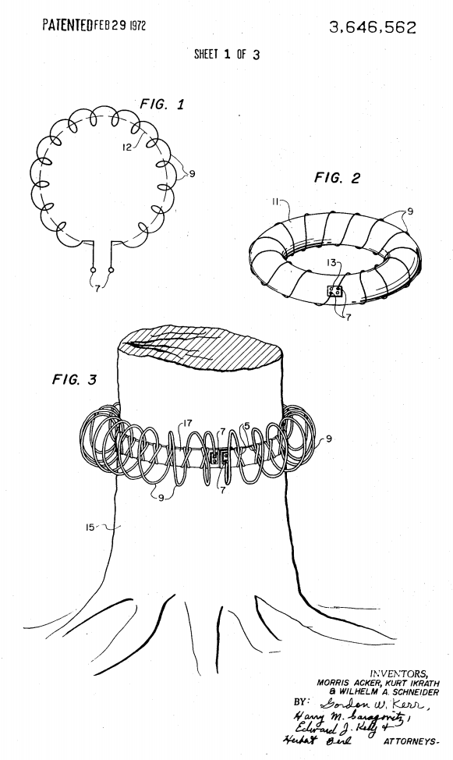
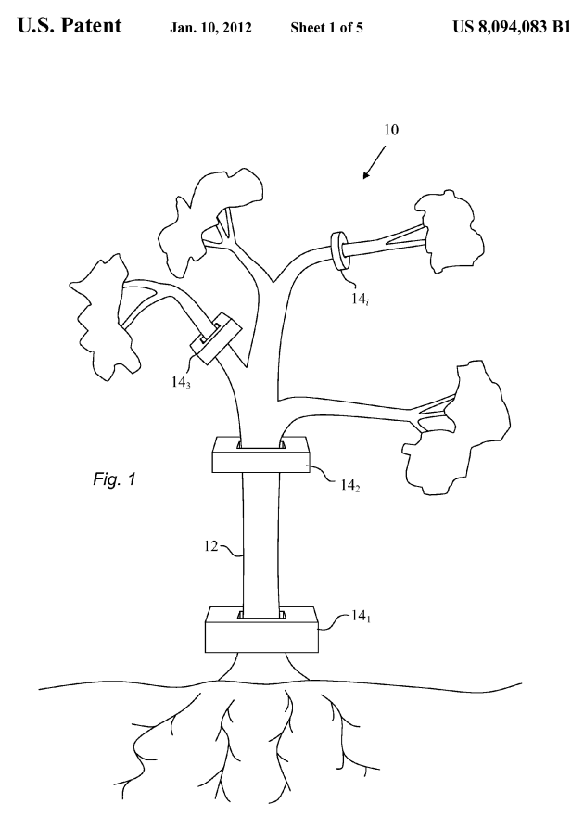
Literature Review
[1]
[2]
Notes:
We are actually not the first people to look into the tree antennas.
The tree antenna concept was first proposed in 1919 by George Squire, by driving a nail into a tree, which was connected to a receiver.
Since then, there were many other ideas, and I am just highlighting the two.
The first one on the left, which is termed the Hybrid Electromagnetic Antenna Couplers, looks like a toroidal antenna hugging the tree. This antenna was used in conjunction with jungle trees in Vietnam to receive and transmit in the lower end of the HF band during the Vietnam War.
The second one on the right was patented in 2012 by John Rockway and Daniel Tam. This patent had multiple current probes, to radiate at multiple frequency bands depending on the size of the tree branch radius. This is very similar to the loop antenna which we have developed.
(2:50)

Slide 5
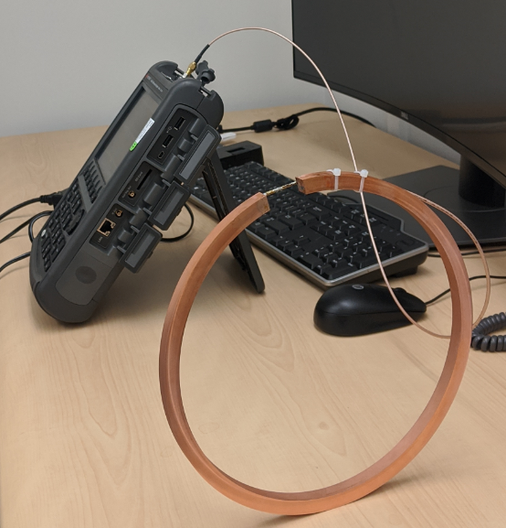
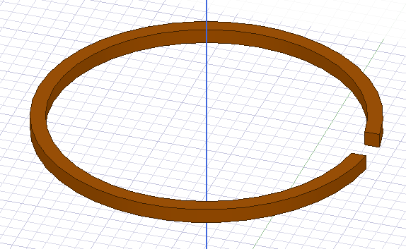
Our Design: A Loop Antenna
Notes:
Among many possible options we have described in the previous section, we have opted for a loop antenna as you see from the slide.
Loop antennas have following advantages. First, the antenna can be used easily as long as the whole copper is heated, by soldering a RF cable signal on one side and RF cable shield on the other side of the antenna gap.
Second, it was expected to provide similar performance between the simulated antenna and the manufactured antenna due to its rigid shape.
Lastly, it provided the highest gain and best matching during the simulation compared to the toroidal coil antenna or the probe antenna from the previous section.
(3:40)

Slide 6
Design Consideration Regarding Trees
Dielectric constant of the tree
Modeling the tree
Attenuation from the leaves
Radius of the tree trunk/branches
How tight the antenna fits with the tree
Notes:
There were several considerations regarding the development of the tree antennas.
First, every antenna tree has a different dielectric constant, and depending on which tree the antenna was mounted, the performance would differ.
Second, the modeling the tree as accurately as possible, is very difficult.
Third, the leaves, which are mainly composed off water, alters the performance of the antenna.
Fourth, depending on the width of the tree, the antenna diameter would differ, which affects the resonant frequency.
Fifth, depending on how tight the antenna fits, the characteristics of the antenna varies. Related to this, we also have to take into account of tree growth for a longer term.

Slide 7
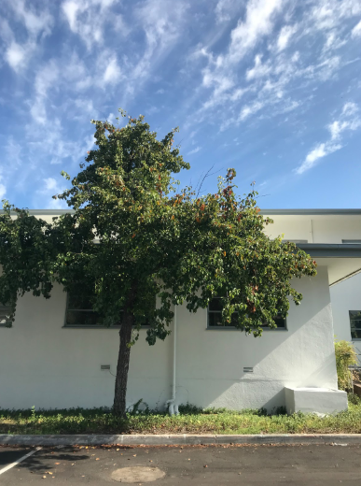
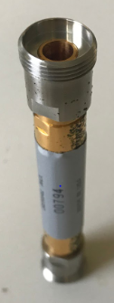

Dielectric Constant of the Tree
Parameter | Value
Real Permittivity | 4.4
Imaginary Permittivity | 0.54
Real Permeability | 1
Imaginary Permeability | 0
Dielectric Loss Tangent | 0.122
[3]
Notes:
First factor affecting the performance of a tree antenna is the dielectric constant. Antenna is very sensitive to the dielectric constant value, so it is important to tailor the tree antenna to a specific tree it is mounted to.
We have selected an ornamental pear tree from the lab, to measure its dielectric constant parameters, we machined the tree to fit into a coaxial fixture, which is shown on the second photo. Then, by using the network analyzer, we could calculate the permittivity, permeability, and dielectric loss tangent of the tree.
We made sure to use the values we calculated when we were simulating the tree antennas.

Slide 8
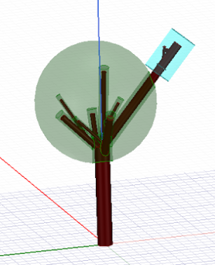
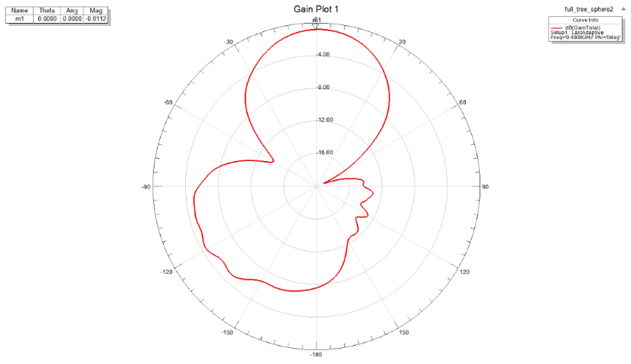
Simulation of the Trees / Attenuation From the Leaves
Gain pattern alters
Peak gain reduced by 5 dB
Even when the branch sits outside the leaves
Notes:
Another difficulty of creating the tree antennas is modeling the tree. Because the antenna is very sensitive to what is around it as well as the shape of the surroundings, it is important to model the tree accurately. However, trees change shapes every day, and modeling the tree perfectly is not possible. Also, even if we model the tree perfectly, the simulation takes a very long time for a big structure like trees.
Another thing that is related to the performance of the antenna is water. The leaves are mostly composed of water, and they attenuate the gain patterns.
While it’s hard to see, the peak gain was reduced by 5 dB, by having the leaves around, even though the tree was sticking out of the leaves.
Because of these variations, it is best to model the tree to have antenna mounted toward the end of the branch. However, it is still not that simple.

Slide 9
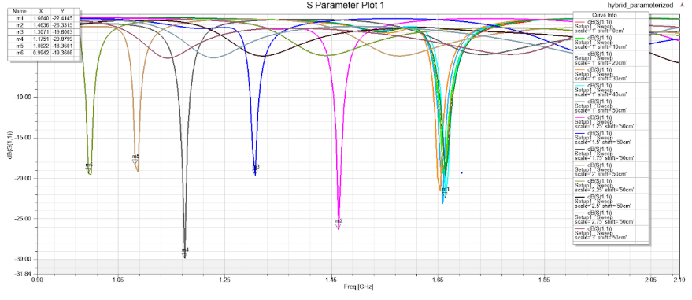
Radius of the Branches/Antennas
Depending on changing radius of the tree + antenna,
resonance frequency is altered
Notes:
In this slide, we see that the resonant frequency is altered by changing the radius of the tree and the antenna. Sometimes, it won’t resonate at all, like the curves you see on the top. Choosing the right radius of the tree trunk or branch becomes important to receive or send signal at the desired frequency.

Slide 10
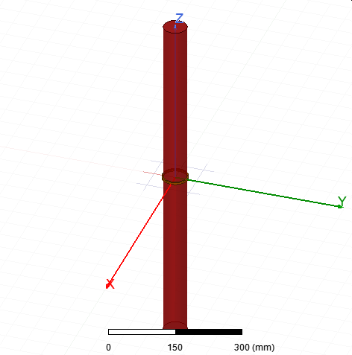
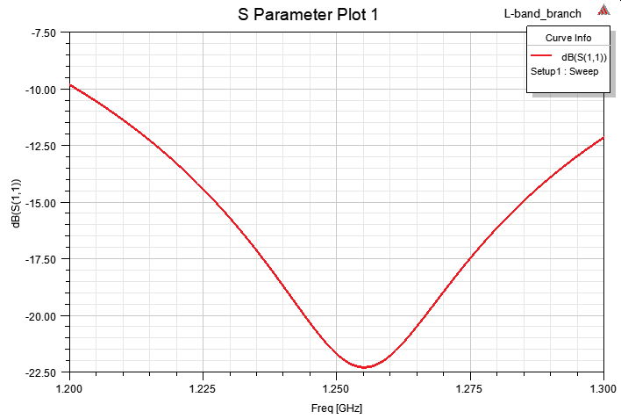
Antenna Tightness to the Tree: Tight
Well resonant at desired frequency:
1.2-1.3 GHz
Notes:
The previous slide assumed that the antenna size is same as the branch size, as you see on this slide. This branch for example, has a resonant frequency at the L-band, between 1.2 to 1.3 GHz looking at the -10 dB mark on S11 plot.

Slide 11
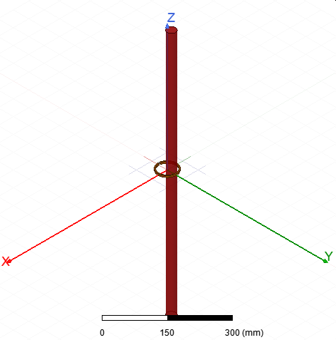
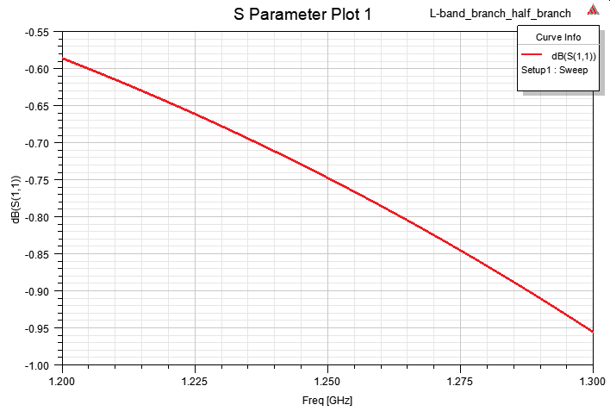
Antenna Tightness to the Tree: Loose
Same antenna dimensions were used,
The branch radius reduced
No more resonant at the desired frequency
Notes:
Now if we reduce the radius of the tree, we see that the antenna is no where close to resonant at that frequency, as the S11 becomes very high. This shows that the antenna is very sensitive to the how thick the tree is compared to the antenna.

Slide 12
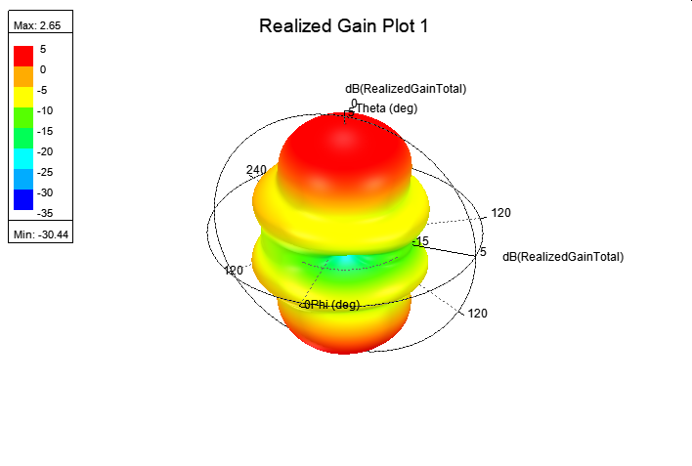
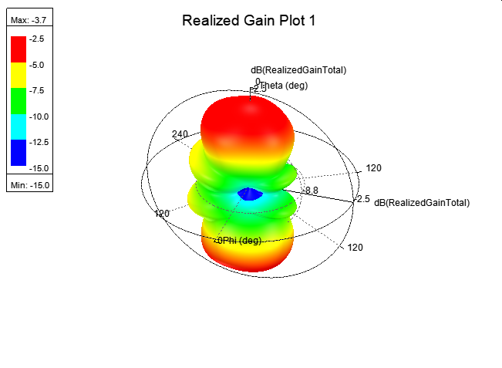
Antenna Tightness to the Tree: Tight vs. Loose
Peak gain reduced by 7 dB
Notes:
This is a 3D radiation plot of the previous two antennas, one with the full tight branch and one with the loose branch. It shows that the gain is also largely influenced. While the pattern is similar looking, the peak gain reduced by 7 dB, which could largely influence the link budget.

Slide 13
Tree Selection is the Most Difficult Part
Everything has to match perfectly
The tree has to be simulated as accurately as possible
Best to operate the antenna without the leaves
Perfect branch must be selected at the desired frequency range
Antenna must adaptively fit to the branch
Notes:
Now I will summarize and provide recommendations about the tree antennas. The biggest difficulty can be described as the need to match everything perfectly.
First the tree has to be simulated as accurately as possible. The inability to grow tree according to a desired shape is hard, and the actual radiation pattern of the tree is hard to measure. This may be accompanied by a drone or something.
Second, the antennas are affected easily by the leaves and it is best to operate without the leaves. However, the performance may change over he seasons as the leaves come and go.
Third, the perfect branch must be selected at the desired frequency range. There needs a lot of effort to choose the right tree and the branch first, before fabricating the antenna.
Fourth, the antennas must adaptively fit to the branch, to adjust according to its growth.

Slide 14
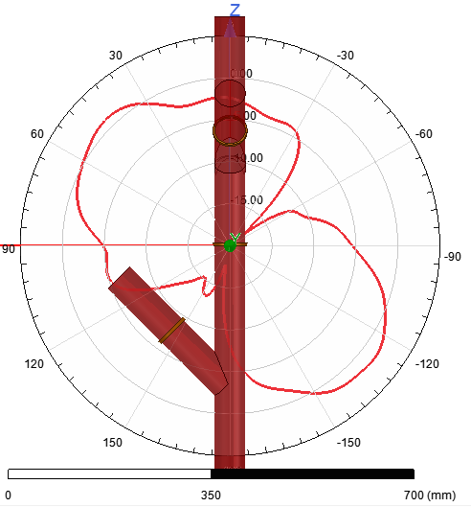
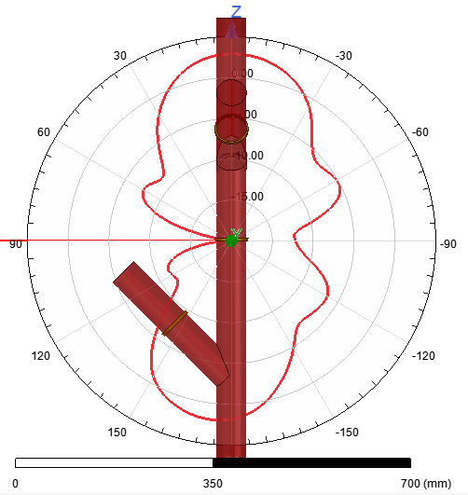
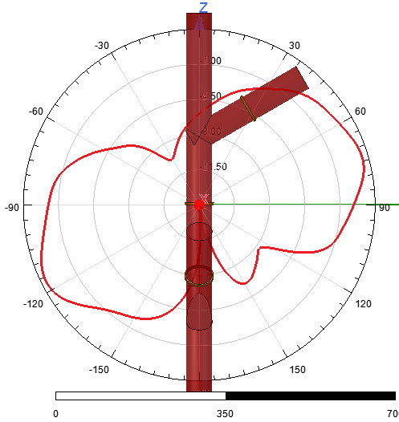
Other Research Directions Regarding Trees
Beamwidth of the station may be limited with one antenna only
- Create a switched array with many antennas during a satellite pass
Notes:
The last research direction is about creating the antenna array. Because the tree can’t rotate according to satellite’s movement, it might be best to have multiple antennas on a tree in the operational perspective. By switching through the antennas with the highest received power, we could try to meet the link budget for a longer period of time. In this slide, we show three antennas on a tree, which are pointing toward different directions. They may be switched through during the pass, to cover all areas.

Slide 15
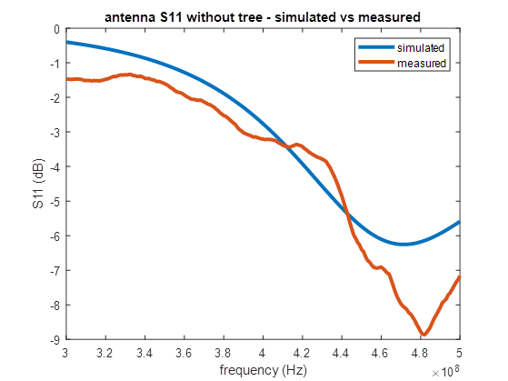
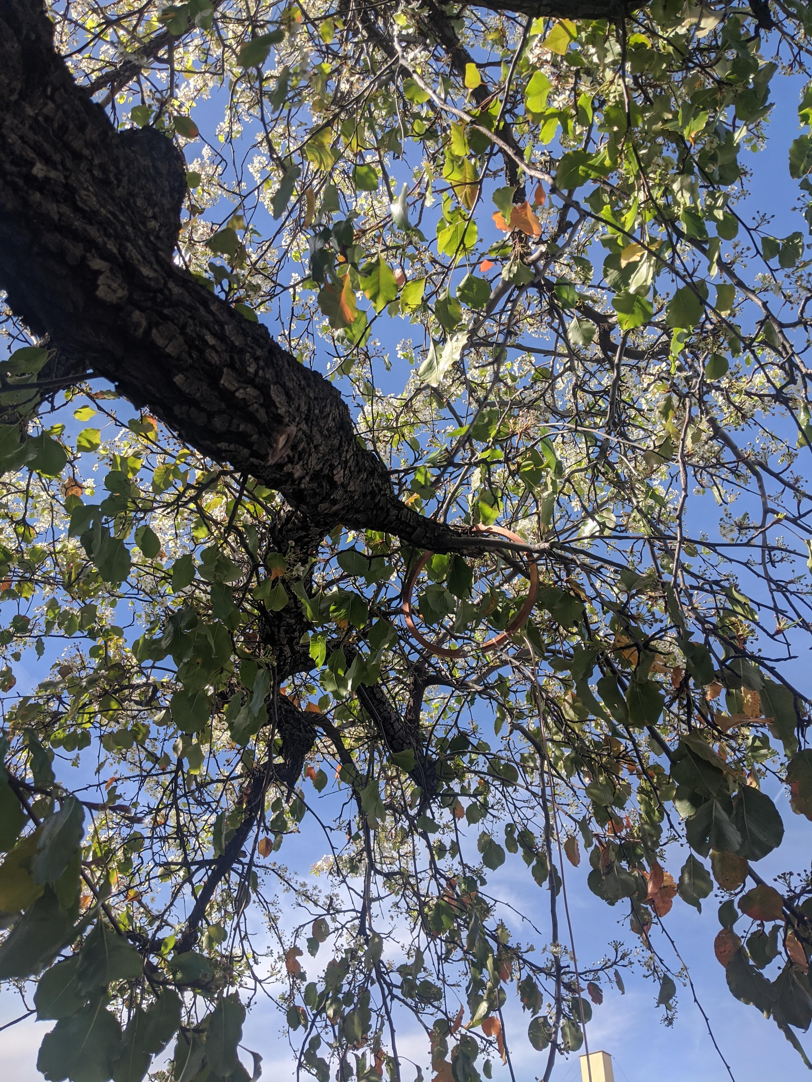
UHF Antenna Prototype
Notes:
Before I wrap up, I briefly want to discuss the prototype which we have built, and tried mounting onto the tree. We show that this tree has S11 plot, where the measured results match with the simulated results.

Slide 16
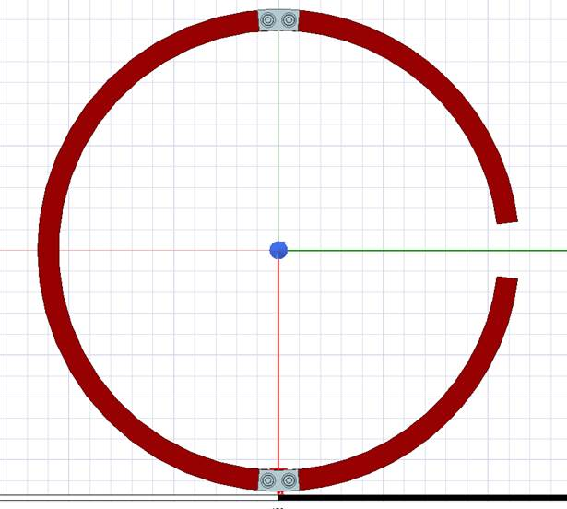
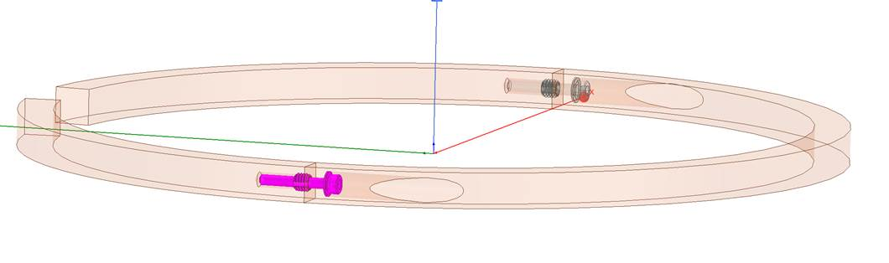
Structural Development
Notes:
Lastly, it should be developed structurally as well. We have several ideas to easily mount the antenna onto the tree and get it off, using screws and the mounts.

Slide 17
Acknowledgements
Co-authors: Ingie Baho, Alessandra Babusica
Supervisor: Mazen Shihabi
Antennas: Emmanuel Decrossas
Structure: Hunjoo Kim
Soldering: Tuyen Long
Administrative: Nerissa Laserna

Slide 18
References
[1] US Secretary of the Navy, "Helical coil coupled to a live tree to provide a radiating antenna", US3646562A, 2019.
[2] J. Rockway and D. Tam, "Multi-band tree antenna", US8094083B1, 2008.
[3] I. Baho, “Tree of Life: Designing and Simulating the Antenna Tree”, Internal Report, 2019.

