Slide 1

Inter-Planetary Small Satellite Conference 2020
Validating the Optimization of Mission Operations for the Lunar IceCube Mission Using Delay-Tolerant Networking
Co-Authors: Jay Wyatt (JPL), Scott Burleigh (JPL), Leigh Torgerson (JPL), Brenda Lyons (JSC), Ben Malphrus (MSU), Chloe Hart (MSU), Nate Fite (MSU), Sean McNeil (MSU)
Nate Richard, Telecommunications Engineer, Jet Propulsion Laboratory, California Institute of Technology

Slide 2
ISSC 2020
Lunar IceCube Mission Overview
Delay/Disruption-Tolerant Networking Introduction
DTN Benefits
Work to Date
Future Work
In-flight Experiment

Slide 3
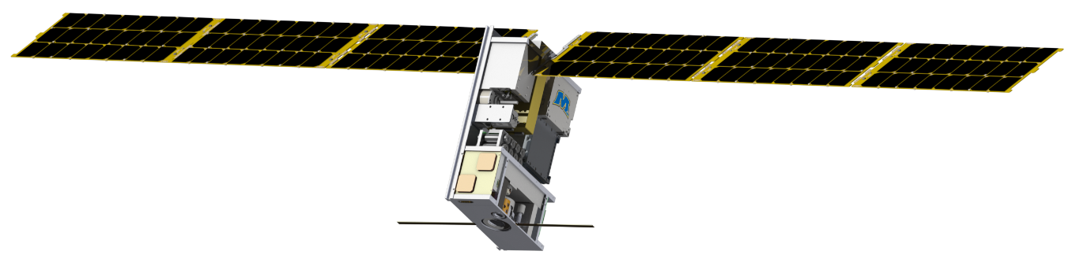
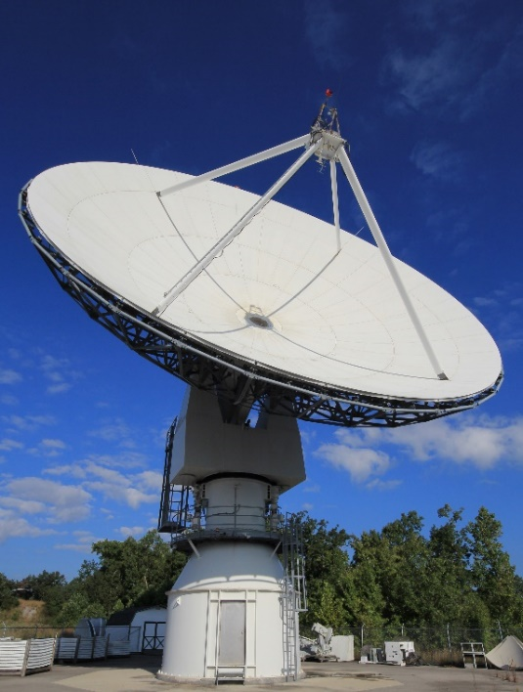
Lunar IceCube Mission Overview
ISSC 2020
Artemis-1 CubeSat
Mission is to study water ice and other volatile distribution and interaction on the Moon
180-day coast phase offers the opportunity to flight validate DTN for the first time on a CubeSat in deep space without interfering with the primary mission
Morehead operates a DTN-compatible ground station capable of communicating at lunar distances
Lunar IceCube Interplanetary CubeSat
Morehead State University’s DSN-Affiliated Station DSS-17

Slide 4
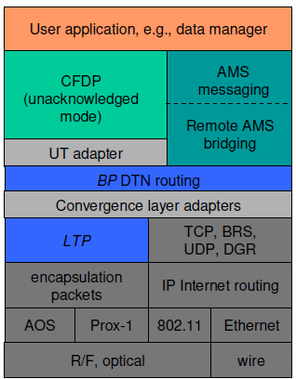
Delay/Distruption-Tolerant Networking Introduction
ISSC 2020
Bundle Protocol
To provide network connectivity in space, a method that scales better than point-to-point links needs to be developed
Enter the Bundle Protocol (BP)
  Data transmission is via bundles which provide built-in security, integrity, and quality service
  Overlays existing networking and link technology
  Handles loss & delay via store and forward mechanism
  Deals with the routing needs of underlying network
Generic Protocol Stack

Slide 5
Delay/Distruption-Tolerant Networking Introduction
ISSC 2020
DTN Related to Lunar IceCube
Terrestrial networking will be handled by Interplanetary Overlay Network (ION)
  Suite of software providing DTN capabilities developed at JPL
  https://sourceforge.net/projects/ion-dtn/
Interface for mission operations software provided by pyION
  Python 3 package
  https://github.com/msancheznet/pyion
Spacecraft networking provided by a Goddard-developed core Flight Software App
  Originally developed for PACE mission
  Underlying library is open-source: https://github.com/nasa/bplib
Downlink
Uplink
Bundle
Space Packet
AOS
TC
Coding
RF
LIC Protocol Stack

Slide 6
DTN Benefits
ISSC 2020
Automation
BP has two methods of providing automatic end to end reliable transfer to a link
  Leave it to an underlying protocol
  Custody Transfer
Custody Transfer can be augmented using aggregate custody signaling (ACS) to reduce uplink traffic
Two potential automation benefits will be explored in the Lunar IceCube mission
  Automatic retransmission of unacknowledged bundles
  Free up spacecraft resources by deletion of acknowledged bundles

Slide 7
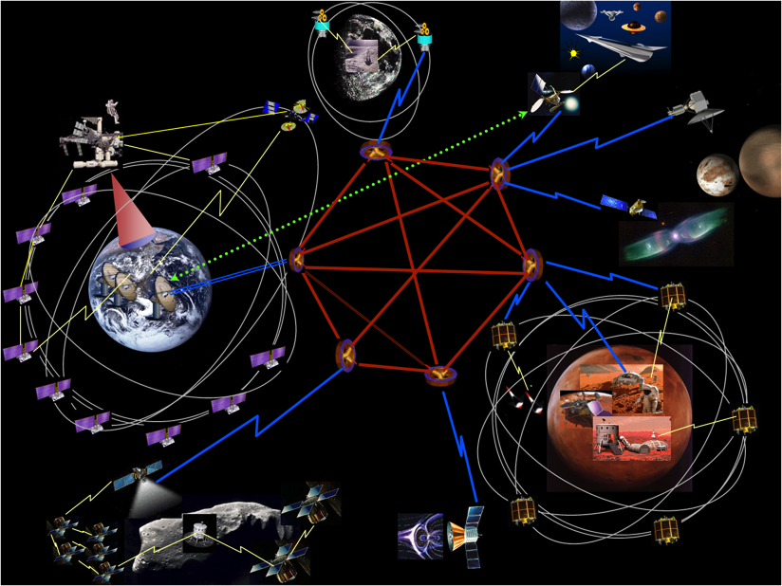
DTN Benefits
ISSC 2020
Networking
BP offers standardized mechanism to transfer data over different network topologies
Since BP overlays existing IP networks, bundles can be forwarded to a DTN destination on an IP network
Lunar IceCube has several partners at different locations, so any relevant data can automatically be forwarded upon reception on the ground
REF: “Operations Concept for a Solar System Internetwork”, Interagency Operations Advisory Group (IOAG), 15 Oct, 2010.

Slide 8
Work to Date
ISSC 2020
Demonstrations
2018: Proof of Concept Demonstration
September 2019: Prototype End-to-End Demonstration
March 2020: Flight-like Demonstration
May 2020: Uplink Functional Demonstration
TBD 2020: Stability Test
✔
✔
✔
2018
September
2019
March
2020
May
2020
TBD
2020
TBD
Launch
L+4 Months
Experiment

Slide 9
Work to Date
ISSC 2020
Prototype End-to-End Demonstration
An end-to-end demonstration of the prototype system was performed successfully in September 2019
Demonstration utilized LIC’s flight radio (a JPL-developed Iris 2.1) and its ground station processing hardware
Goals
  Receive bundles from spacecraft
  Ingest bundles into ground network
  Forward bundles to DTN node standing for MOC

Slide 10
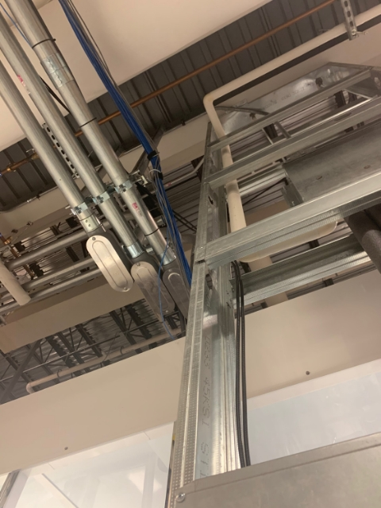

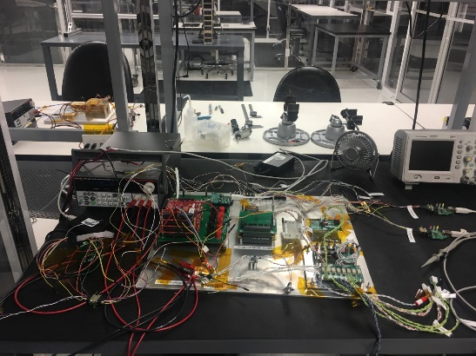
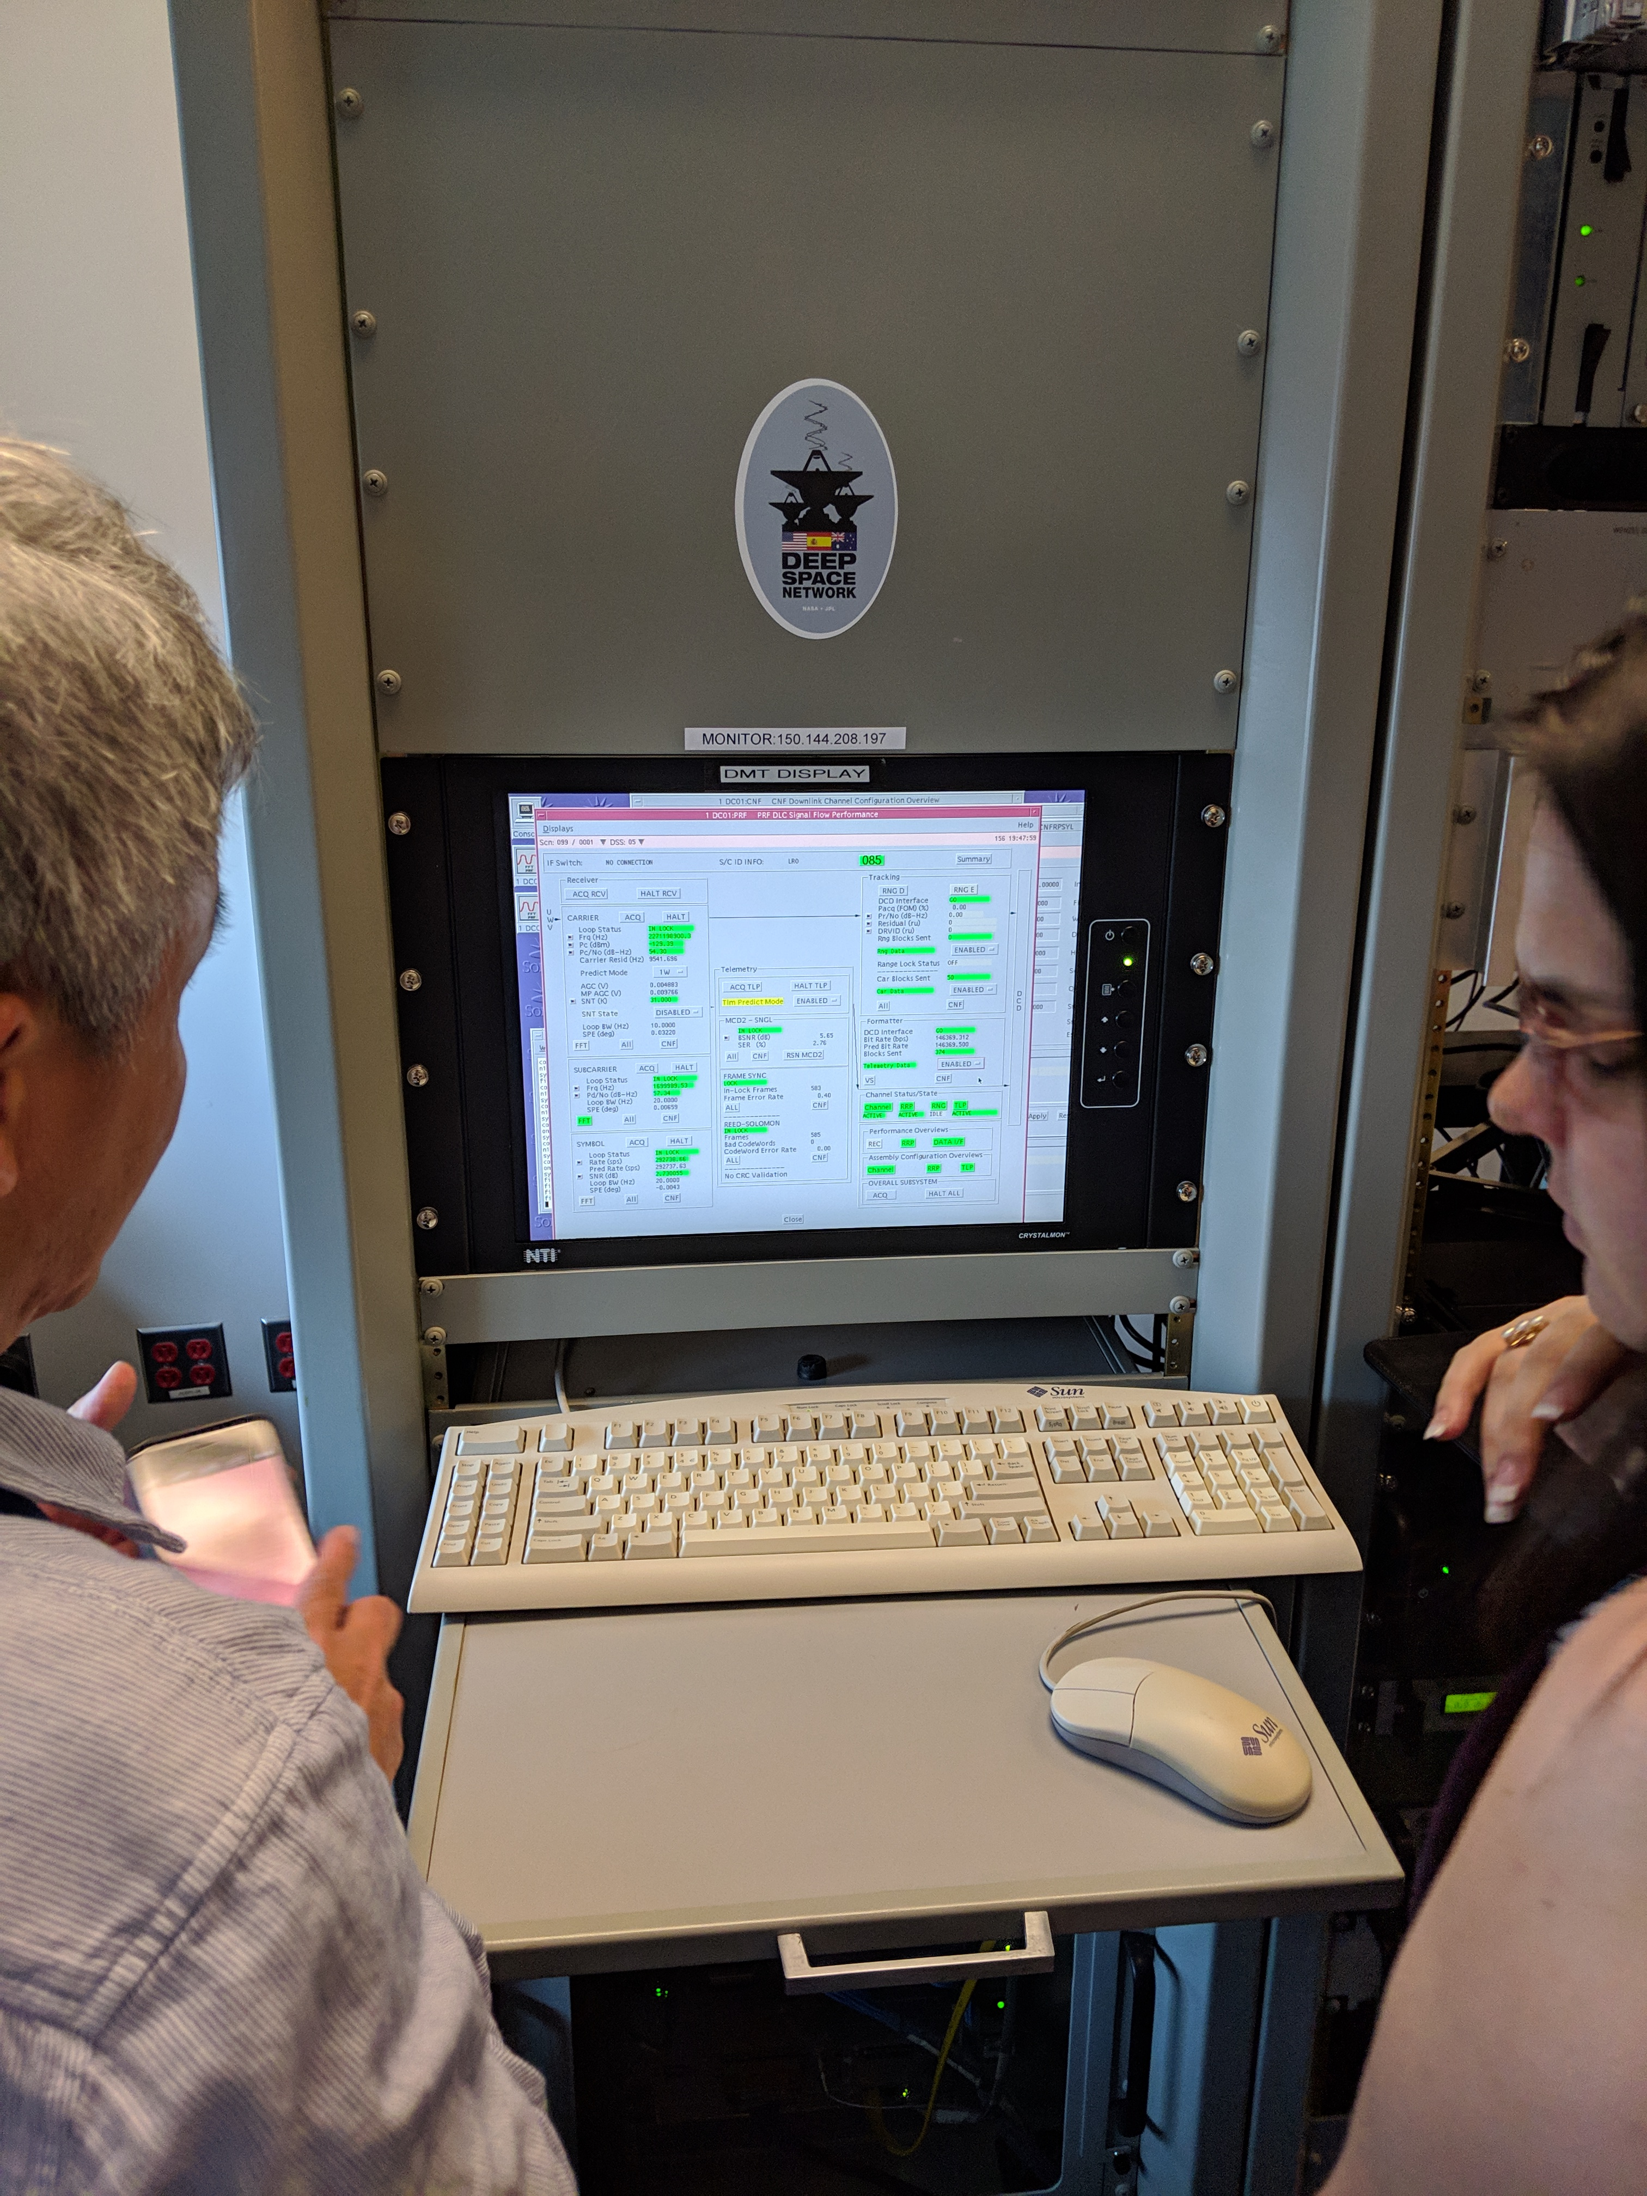
Work to Date
ISSC 2020
Prototype Block Diagram
JPL DTN Uplink
MSU Ground Station Uplink
Attenuator
DTN
Node 21
BCH &
CLTU
Framing
Uplink
Processor
Signal
Generator
Up-
Converter
Bundles Not Received
LIC
Flat-sat
MSU DTN Downlink
ACS Bundles
MSU Ground Station Downlink
DTN
Node 20
Data Capture
Signal
Processor
Down- Converter
Telemetry Bundles
Demo-1: To file
Query
DTN
Node 23
Data
Capture
Console
MSU MOC
Demo-2: To file
MSU DSN Subsystem

Slide 11
Work to Date
ISSC 2020
Prototype Demonstration Results
Successfully flowed bundles from spacecraft into DTN network
Generated acknowledgements for bundles
As planned, acknowledgments were transmitted but not received
Timing across the network was an issue

Slide 12
Work to Date
ISSC 2020
Flight-like Demonstration
A downlink functional test was successfully performed March 11th, 2020
The demo was an extension of the September demonstration, and incorporated the mission operations software
Goal was to repeat prototype demo, but display telemetry with Mission Operations Software

Slide 13
Work to Date
ISSC 2020
Flight-like Block Diagram
JPL DTN Uplink
MSU Ground Station Uplink
Attenuator
DTN
Node 21
BCH &
CLTU
Framing
Uplink
Processor
Signal
Generator
Up-
Converter
Bundles Not Processed
LIC
Flat-sat
MSU DTN Downlink
ACS Bundles
MSU Ground Station Downlink
DTN
Node 20
Data Capture
Signal
Processor
Down- Converter
Telemetry Bundles
Query
Mission
Ops SW
DTN
Node 23
Data
Capture
Console

Slide 14
Work to Date
ISSC 2020
Flight-Like Demonstration Results
Successfully flowed bundles from spacecraft into DTN network
Generated acknowledgements for bundles
As planned, acknowledgments transmitted and received, but not processed
pyION was unable to serve as a direct interface due to Python version differences, so an extra hop was added between the network and mission ops software

Slide 15
Future Work
ISSC 2020
Uplink Functional Demonstration
Similar to downlink functional demonstration
Planned for later this month
Goals:
  Spacecraft reception of ACS bundles
  Spacecraft deletion of acknowledged bundles
  Spacecraft reception of at least one bundle containing a command
  Spacecraft execution of command

Slide 16
Future Work
ISSC 2020
Uplink Functional Block
JPL DTN Uplink
MSU Ground Station Uplink
Attenuator
DTN
Node 21
BCH &
CLTU
Framing
Uplink
Processor
Signal
Generator
Up-
Converter
LIC
Flat-sat
MSU DTN Downlink
ACS Bundles
MSU Ground Station Downlink
DTN
Node 20
Data Capture
Signal
Processor
Down- Converter
Telemetry Bundles
Query
Mission
Ops SW
DTN
Node 23
Data
Capture
Console

Slide 17
Future Work
ISSC 2020
Stability Test
Impacted by pandemic, originally planned for July
Longer than previous demonstrations
Simulate an actual pass
Verify stability of entire network
Better understand performance of whole system

Slide 18
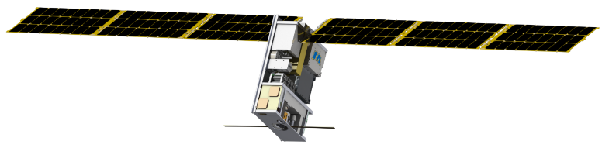
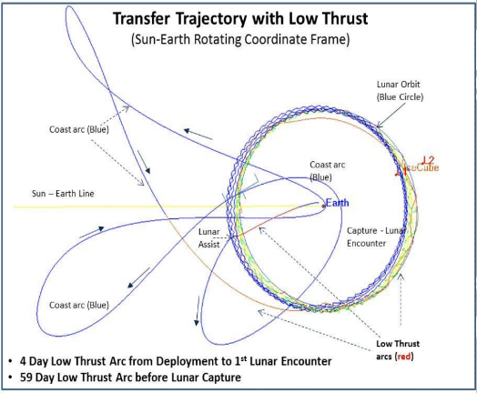
In-Flight Experiment
ISSC 2020
DTN LIC Experiment is set to take place four months after launch during LIC cruise phase
With four months of operations before the experiment we’ll be able to compare the exact impact DTN could have on LIC’s mission operations
In addition to the previously ascribed benefits, CFDP demonstration with DTN is planned to show that it can support LIC’s use of CFDP
Planned ESA cross-support demonstration
Create a Flight Validation Report

