Slide 1
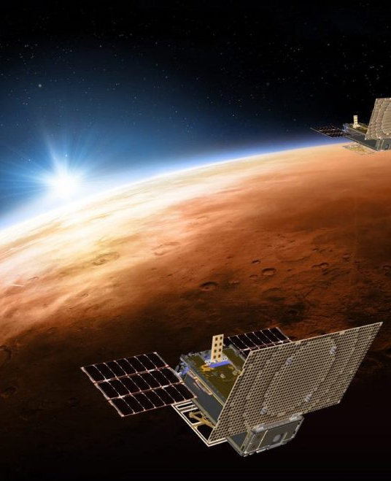
Comparing Radio Occultation Results from MarCO with Mars Reconnaissance Orbiter and MAVEN: Achievable Radio Science with a CubeSat
Dustin Buccino⁽¹⁾, Yu-Ming Yang⁽¹⁾, Paul Withers⁽²⁾, Kamal Oudrhiri⁽¹⁾, Norman Lay⁽¹⁾, Paolo Tortora⁽³⁾, and Daniel Kahan⁽¹⁾
(1) Jet Propulsion Laboratory, California Institute of Technology, Pasadena, CA, USA
(2) Boston University, Boston, MA, USA
(3) University of Bologna, Italy
2020 Interplanetary Small Satellite Conference
May 11-12, 2020
© 2020. California Institute of Technology. Government sponsorship acknowledged.

Slide 2
Outline
Introduction – Radio Occultations
Introduction – MarCO Mission
MarCO’s Radio Instrumentation
MarCO Radio Occultation Performance Analysis
Future Radio Science Missions using CubeSats
Summary

Slide 3


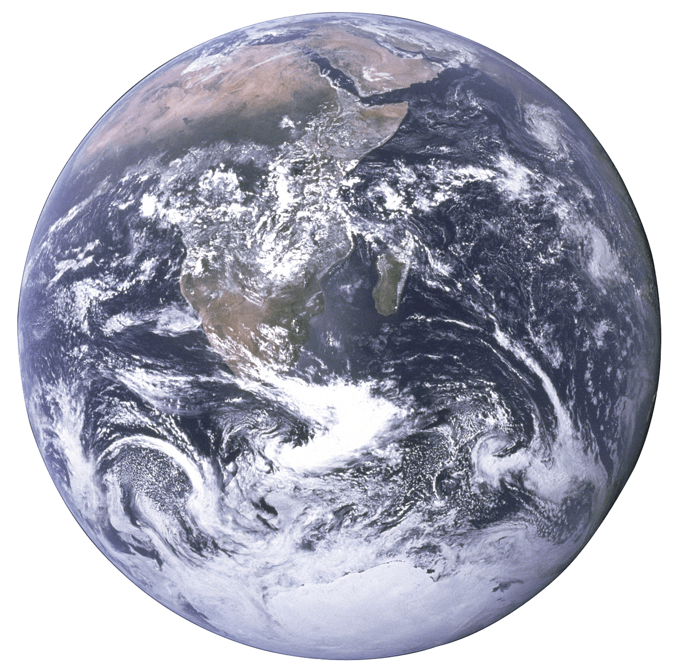
Radio Occultation Geometry

Slide 4
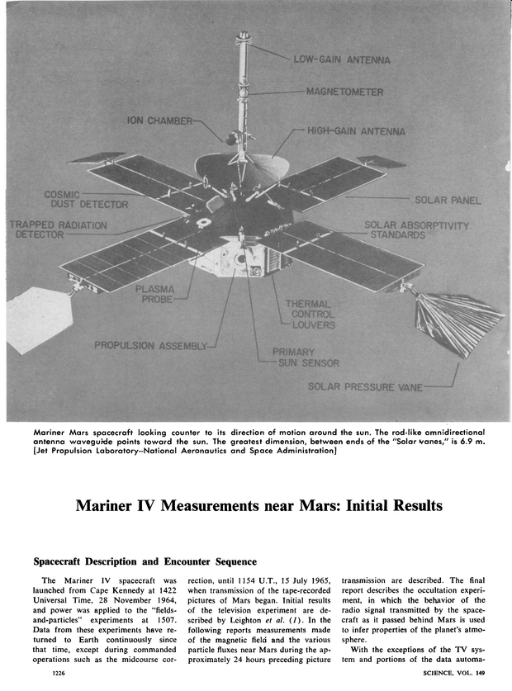
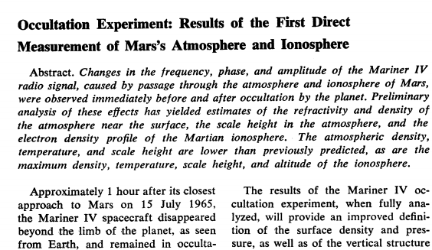
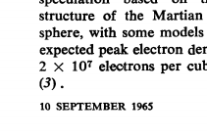


Occultations & The First Interplanetary Science
Signal Frequency or Phase (ϕ)
$${\left(∇φ\right)}^{2}=n^{2}{f^{2}}/{c^{2}}$$
Refractivity (n)
$$T=\frac{n_{b}T_{b}}{n}+\frac{m}{nk}\int{n\left(r\right)g\left(r\right)dr}$$
Temperature/Pressure (T/P) Profile

Slide 5
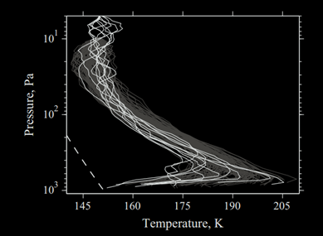
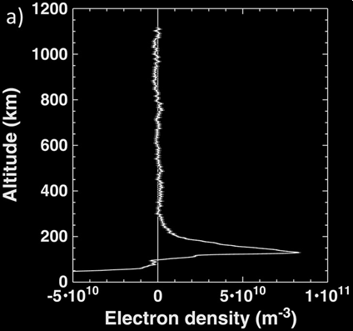
Radio Science at Mars: Classic Results
Mars Reconnaissance Orbiter
MAVEN
Over 5000 radio occultations from 2008-2019
Atmosphere detectability up to ~90 km
Ionospheric occultations up to 900 km altitude
Ionosphere detectability up to ~288 km
Hinson et al, Initial results from radio occultation measurements with
the Mars Reconnaissance Orbiter, Icarus, 2014.
Withers et al, First Ionospheric Results from the MAVEN Radio
Occultation Science Experiment, JGR Space Physics, 2018

Slide 6
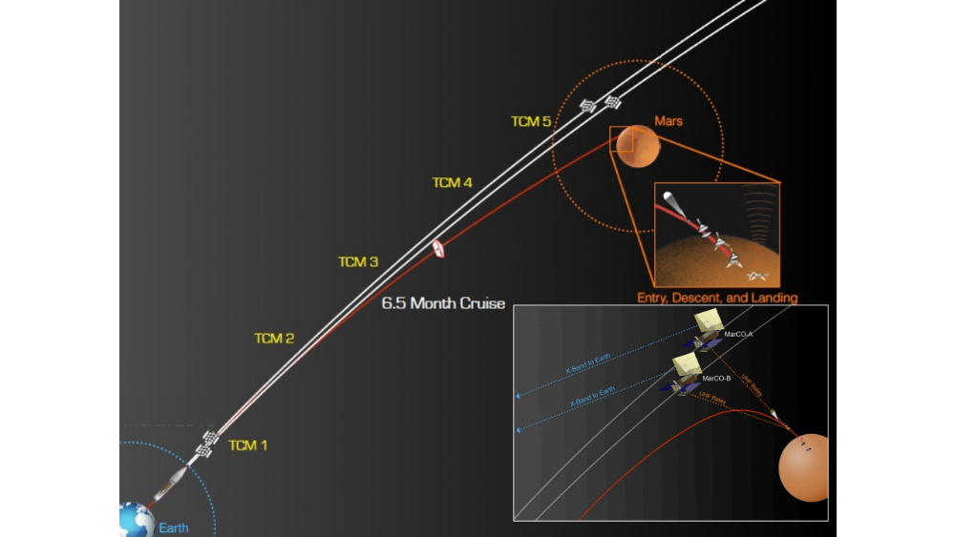
Introduction – MarCO Mission
Mission Objectives:
  Survive the deep space environment
  Communicate and navigate with the Deep Space Network
  Advance miniaturized telecommunications components
  Support InSight during EDL

Slide 7
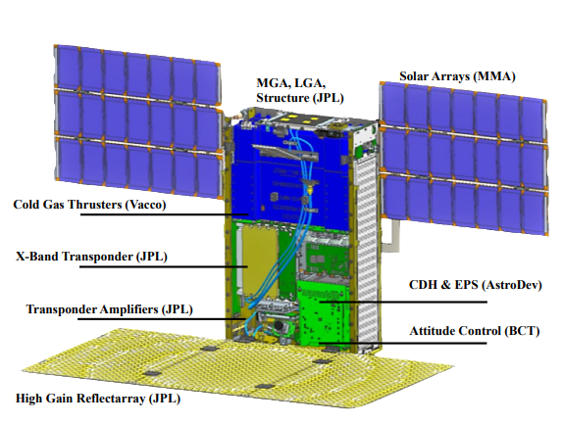
MarCO Radio Communication
Iris V2 Transponder
  1.2 kg, ~0.5 U
Antennas
  A low-gain (LGA) patch antenna (for near-Earth communications)
  A medium gain (MGA) patch array antenna (for communications during safe mode)
  A high gain (HGA) reflect-array antenna for normal operations and relaying data during InSight’s EDL
  A UHF loop antenna to receive InSight’s signal during EDL

Slide 8
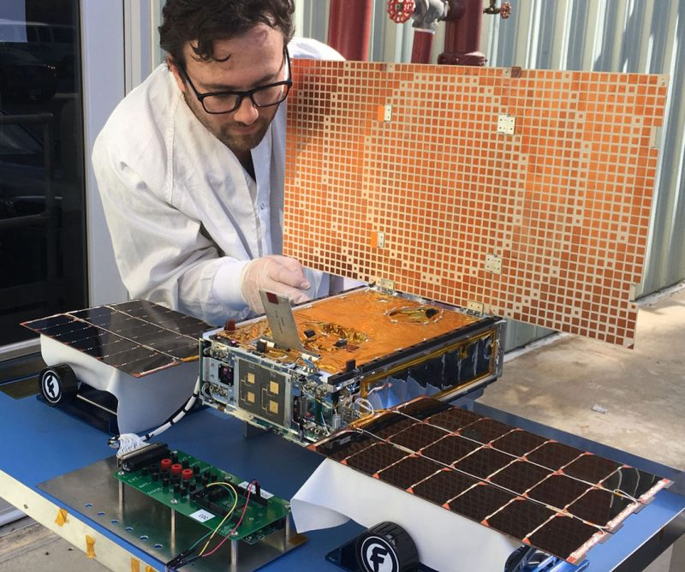
MarCO Foldable Reflectarray
Challenge: bent pipe communication at 1.04AU from Earth – i.e. receive and transmit at the same data rate (8kbps)
Main requirements:
  Stowage volume: 12.5mm × 210mm × 345mm
  Gain of at least 28dBic
Required aperture: 335mm × 587mm

Slide 9
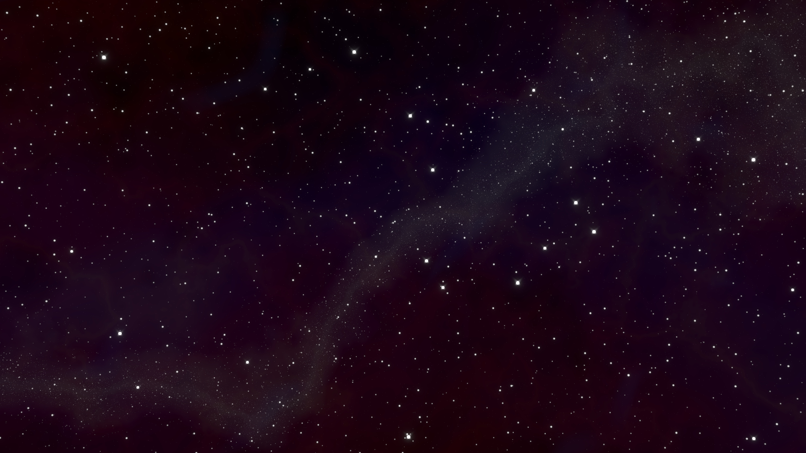
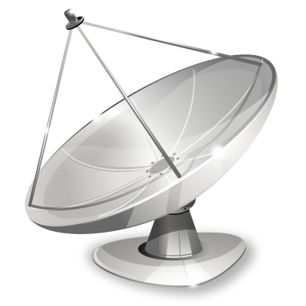
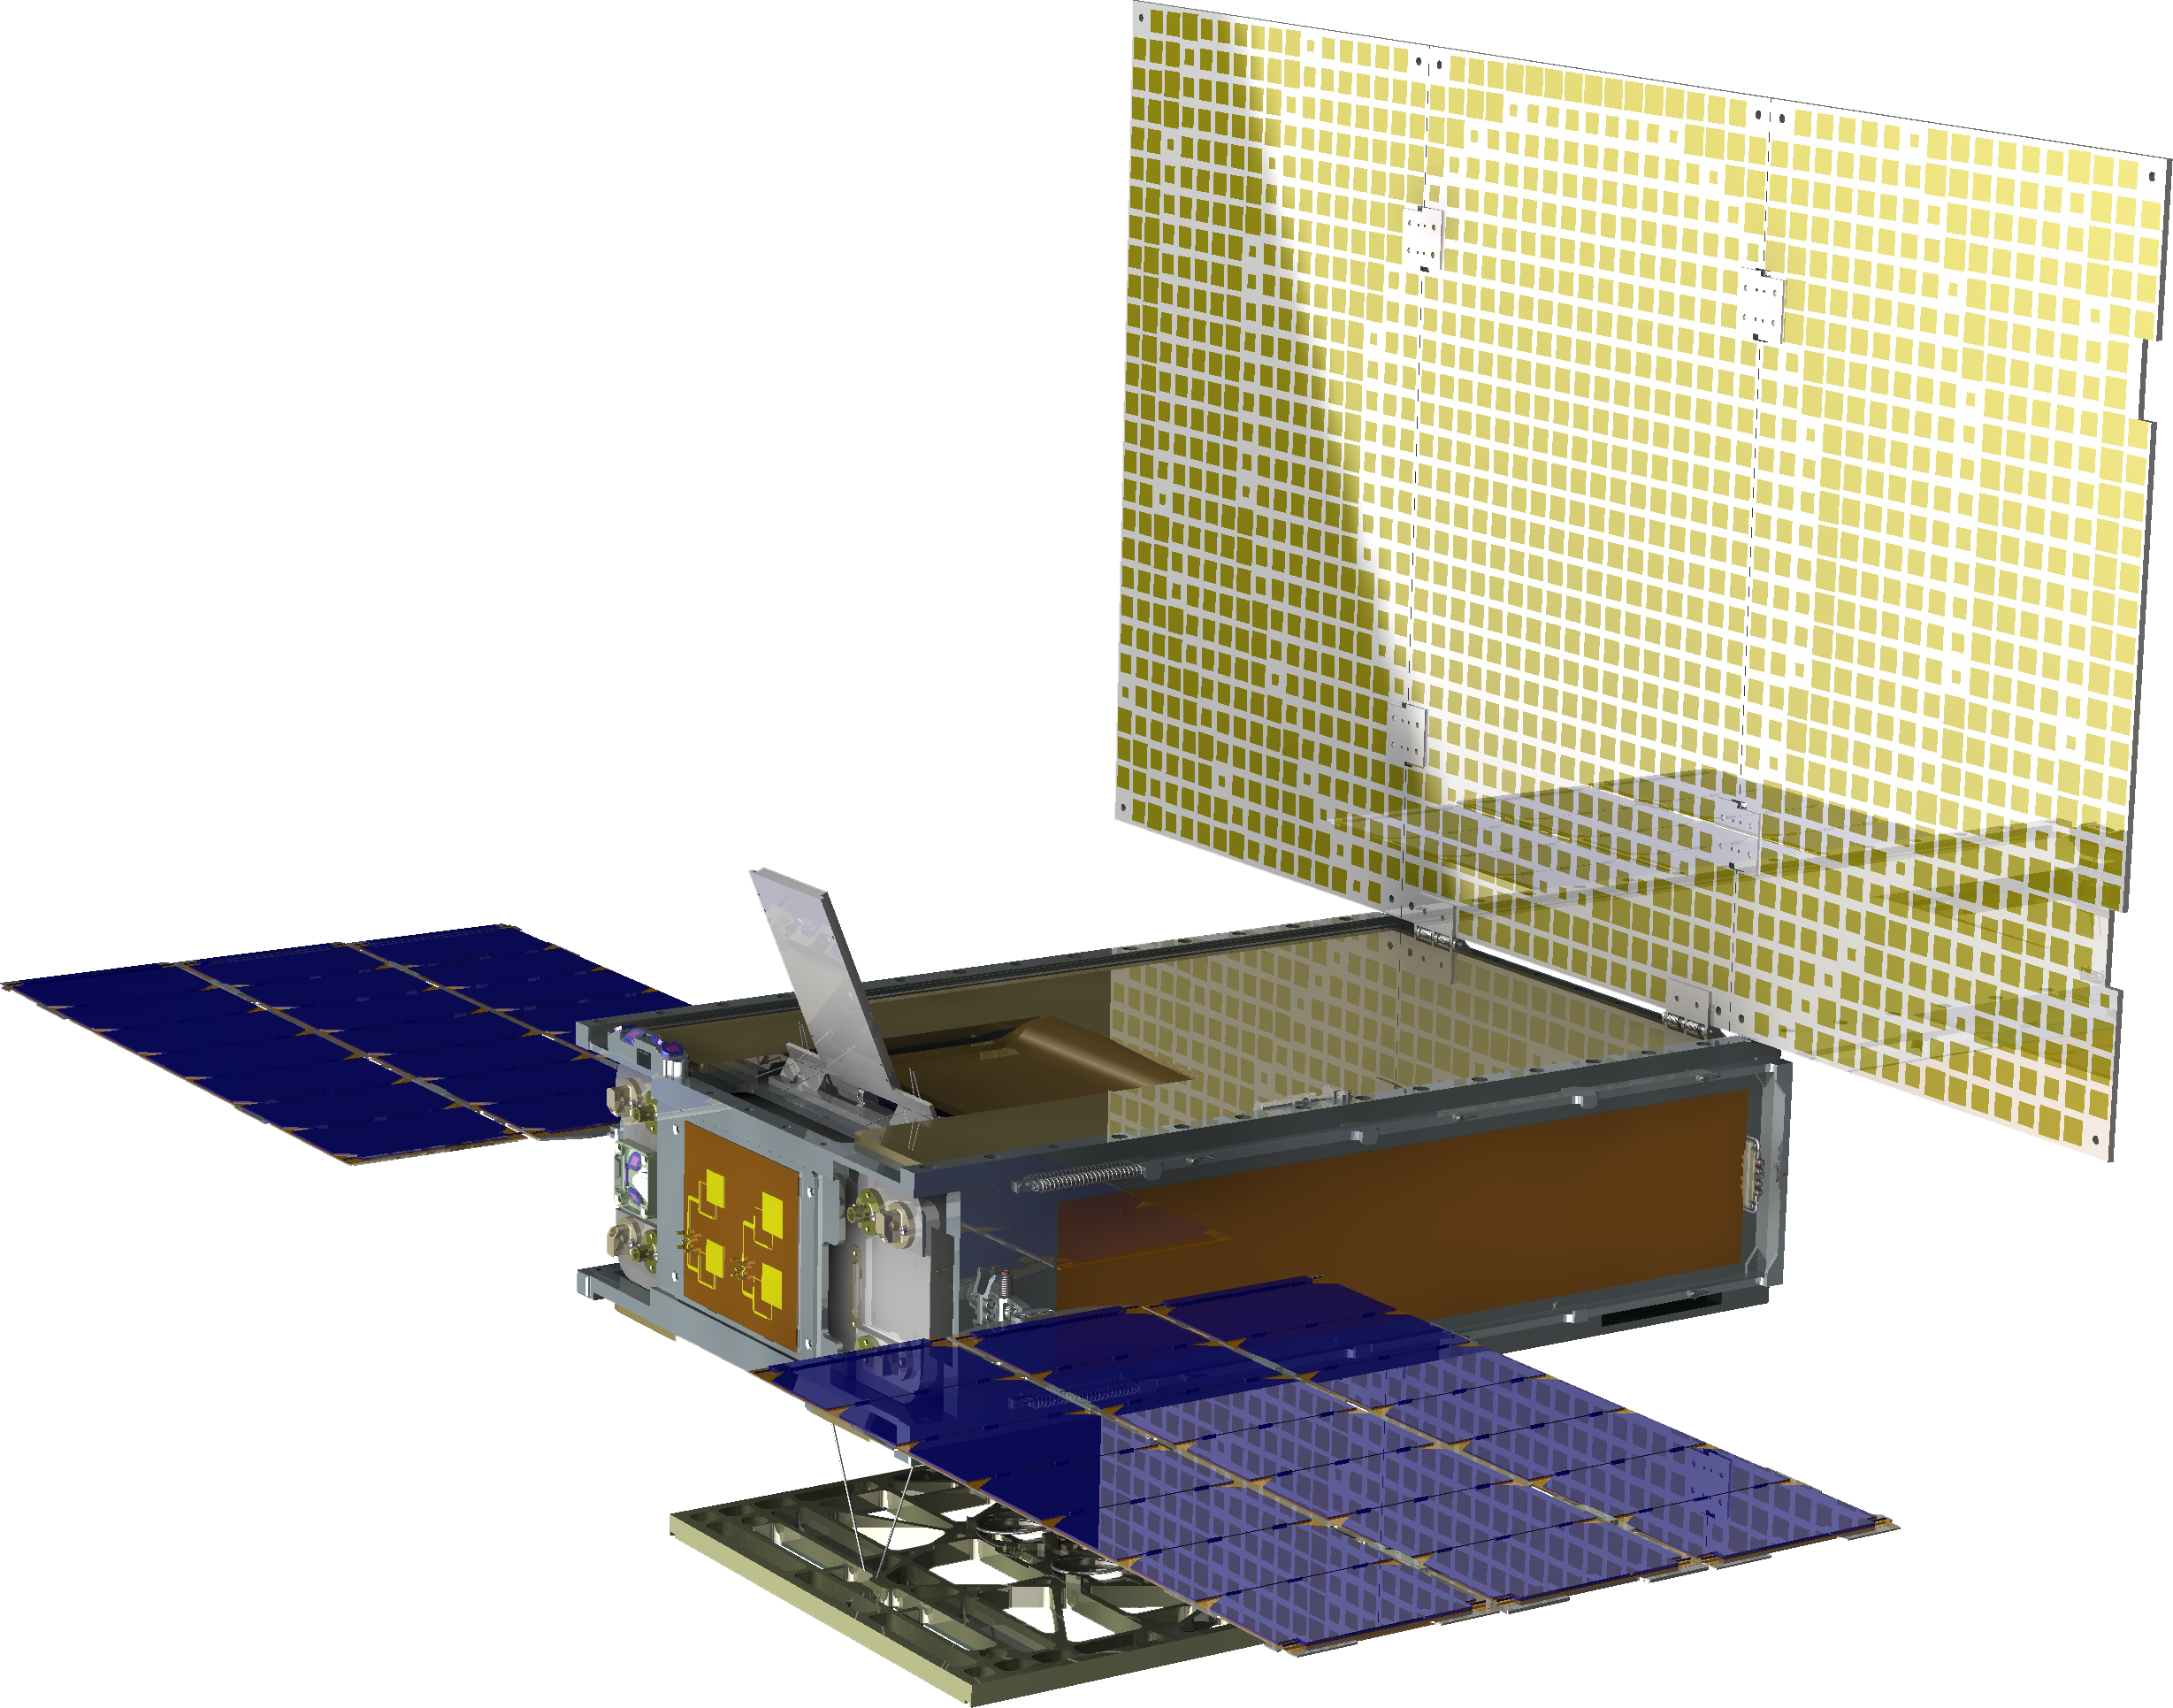
Radio Occultation Experiment
X-band
MarCO-A
X-band
MarCO-A
20:52 ERT Turn Away from Earth-Point
21:33 ERT
RO ingress (2-way)
Time (UTC-ERT) | Event
14:15:00 | Begin Open-Loop Recordings
19:17:48 | DSS-63 Acqusition
19:53:09 | InSight Landing
20:51:56 | Turn Away from Earth-Point
20:52:00 | DSS-63 Loss of Signal
21:33:19 | Geometric Occultation Ingress
23:43:07 | Turn to Earth-Point
23:39:09 | Geometric Occultation Egress
23:46:48 | DSS-26 Acquisition, 1-Way
00:48:10 | DSS-26 Loss of Signal
01:00:00 | End Open-Loop Recordings
23:39 ERT
RO egress
(1-way)
23:43 ERT Turn to Earth-Point

Slide 10
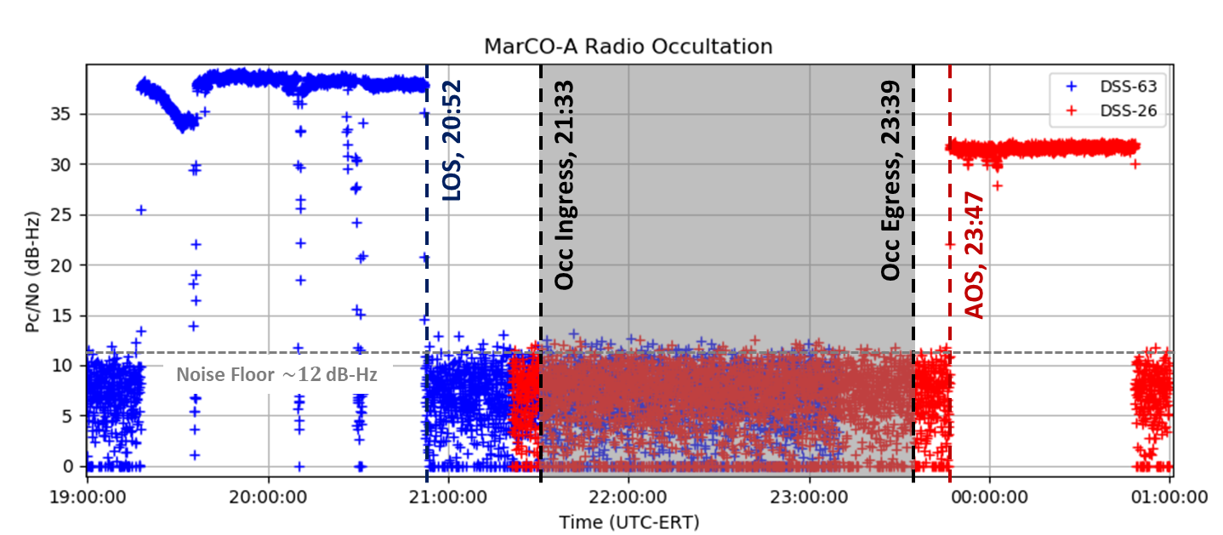
Data Analysis of the MarCO Occultation

Slide 11
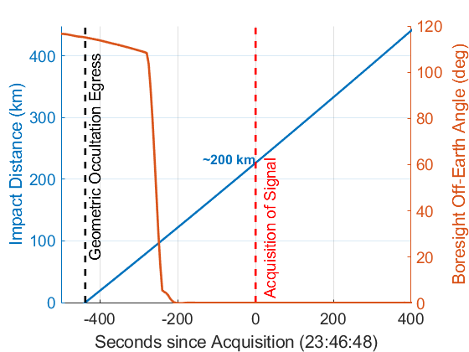
MarCO Occultation Geometry
Radio Ray Path
Impact Parameter
Neutral Atmosphere Detectable to 90 km (MGS & MRO – Hinson et al 1999)
Ionosphere Detectable to 288 km (MAVEN – Withers et al 2018)

Slide 12
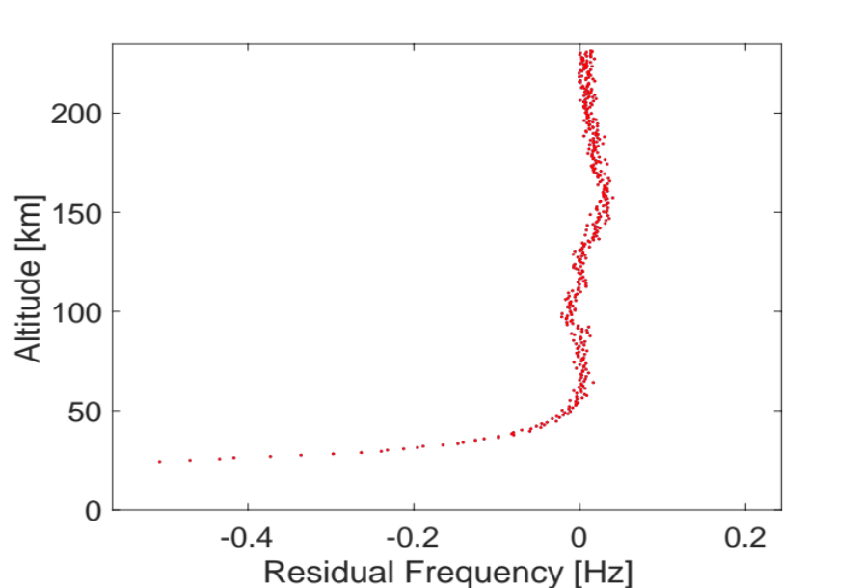
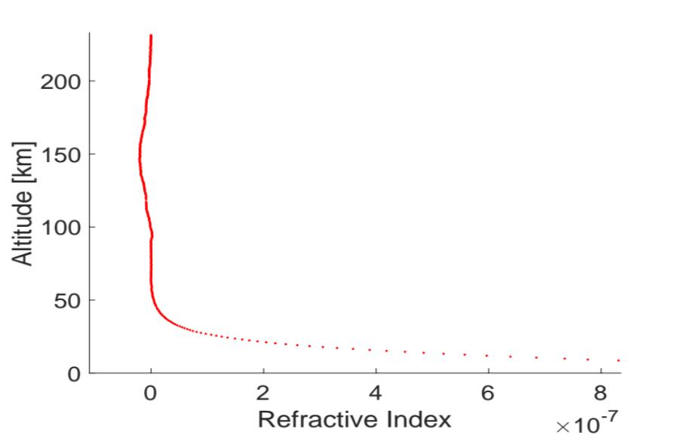

Modeling of the MarCO Radio Occultation
Simulated MarCO RO Residual Frequency
Simulated MarCO RO Refractive Index
ionosphere
ionosphere
Atmosphere
Atmosphere
These atmospheric and ionospheric profiles are retrieved from the refractive ($N(h)$), which is defined as: $N\left(h\right)≈\left(n\left(h\right)−1\right){10}^{6}=130.6\frac{P\left(h\right)}{T\left(h\right)}−(40.3∙{10}^{6})\frac{n_{e}\left(h\right)}{f^{2}}$
where $n$is the unitless refractivity index, $h$ is the altitude in km, $n_{e}$ is ionospheric electron density, P is the pressure of the atmosphere, and T is the air temperature in Kelvin.

Slide 13
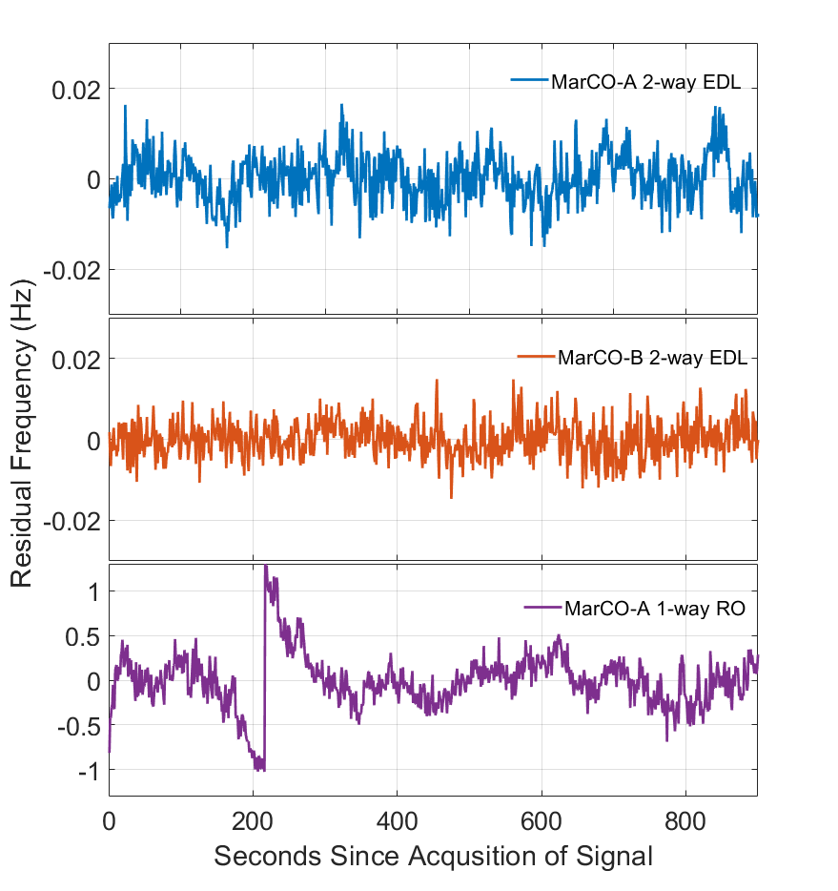
Frequency Performance
0.004 Hz
0.005 Hz
0.42 Hz

Slide 14
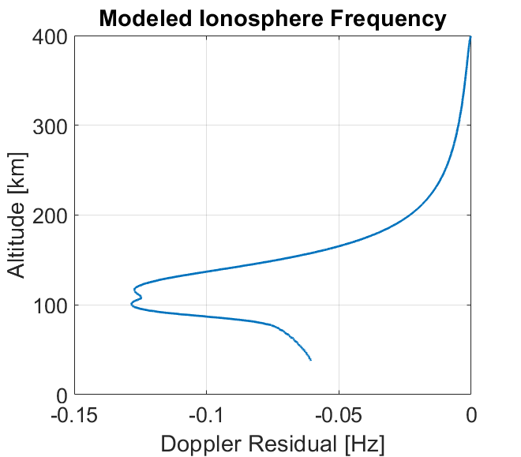
Occultation Assessment
Mars Ionosphere was not detectable during the MarCO radio occultation
Mars Ionosphere could have been detected in 2-way mode but not in 1-way mode
Neutral atmosphere could have been detected if the spacecraft was pointed to Earth at geometric occultation egress <35 km

Slide 15
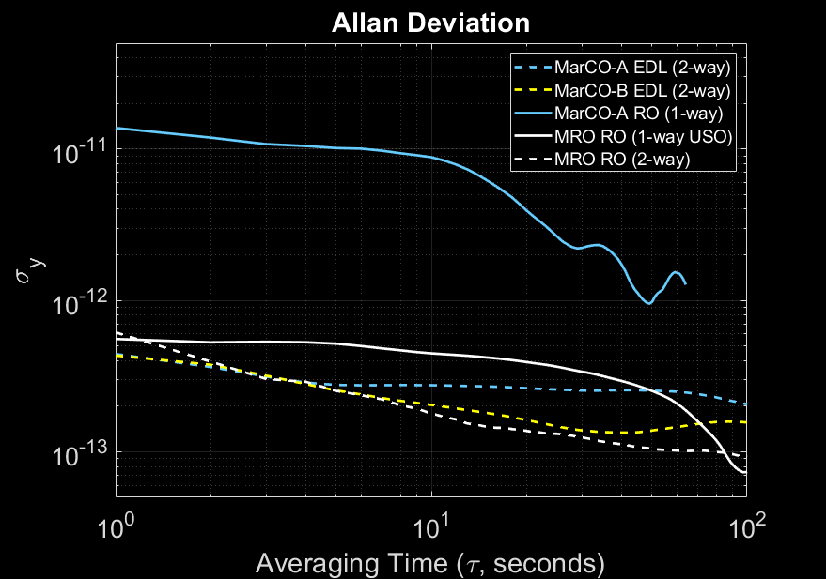
Frequency Stability & Comparison with MRO

Slide 16
Impact on Future SmallSat Radio Science
Frequency Stability – MarCO’s 1-way signal is not sufficient for precision radio science measurements
    Typically, an Ultra Stable Oscillator (USO) is required for precision radio science measurements
    USO’s are heavy (1-2 kg) and consume power (1-10 W)
    For missions without a USO, 2-way occultations are possible and have been proven on multiple missions (e.g. MRO, Cassini)
Geometry – MarCO’s signal was not acquired until well above the atmosphere and in the ionosphere
    Ingress occultations are more favorable, particularly in 2-way mode
    At other planets, atmosphere is denser and limb tracking maneuvers may be required for deep atmospheric occultations

Slide 17
Summary
MarCO-A Radio Occultation did not detect the Mars atmosphere or ionosphere during the flyby
An assessment of the MarCO flyby and RO data indicates that the MarCO 2-way data has a stable frequency residual and performance is in the same order of MRO 2-way data.
Modeling results suggest that the 2-way MarCO radio signal could have been able to have a positive detection of the atmosphere and ionosphere comparable to MRO
Frequency residual measurements derived from MarCO X-band radio links confirm that the 1-way X-band data could have detected the neutral atmosphere but not the ionosphere

Slide 18
© 2020. California Institute of Technology. Government sponsorship acknowledged.

