Slide 1
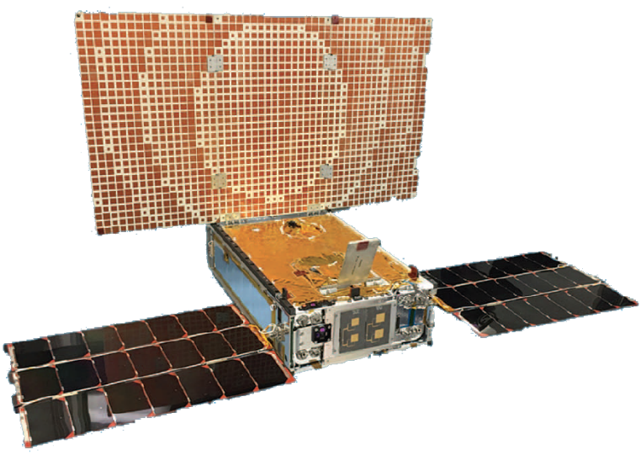
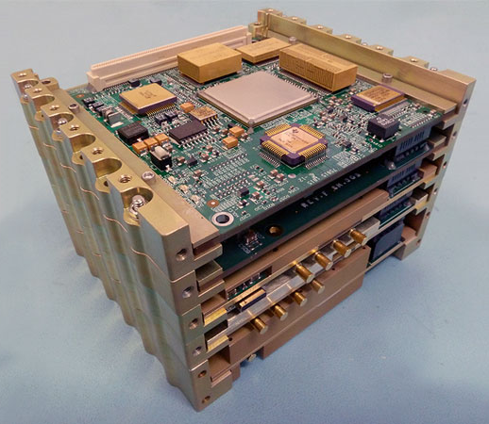
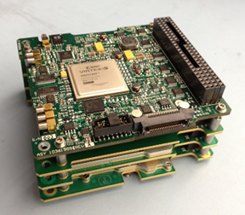
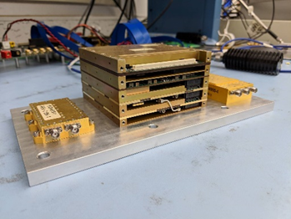
Iris Deep-Space Transponder for Artemis-1 Payloads
Inter-Planetary Small Satellite Conference
Pasadena, California
11-12 May 2020
Presenter: Mazen Shihabi*
Co-authors: C. Duncan*, Z. Towfic*, B. Burgett*, S. Holmes*, M. Chase*, and D. Sorensen^
*Jet Propulsion Laboratory, Caltech ^Space Dynamics Lab, Utah State University

Slide 2
Outline
History of Iris
  V 1.0 (INSPIRE Version), V 2.0 (MarCO Version), & V 2.1 (Artemis -1 “formerly EM-1” Version)
V 2.2 (Enhanced version of V 2.1 that also is available to Artemis-1 CubeSat Missions)
High Level Design Description: HW, SW, and available modes
Performance Testing at DSN Testing Facility DTF-21
  Over-the-Air Programmability
  Pseudo-Noise (PN) Delta DOR & PN Regenerative Ranging
  Higher Downlink & Uplink data rates
  QPSK and OQPSK
Missions used/using Iris
  MarCOs, and Artemis-1 (formerly EM-1)
Future Enhancements that are considered for Lunar Communication and navigation applications

Slide 3

What is in the name Iris (Iρις)
Not an acronym
Iris – a goddess associated with communication, messages, the rainbow and new endeavors
“Little Sister” to Electra
  Electra is a JPL SDR UHF Relay Radio.
Cousin of Cassandra (Cassy)
  Ground Support Equipment (GSE) that is used for testing Iris
The Iris: an Illuminated Souvenir (1852), upload.wikimedia.org/wikipedia/commons/4/49/1852_Iris_Illuminated_Souvenir.png.
Public Domain

Slide 4
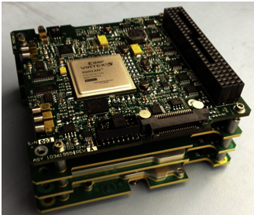
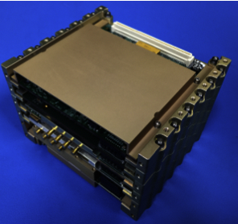
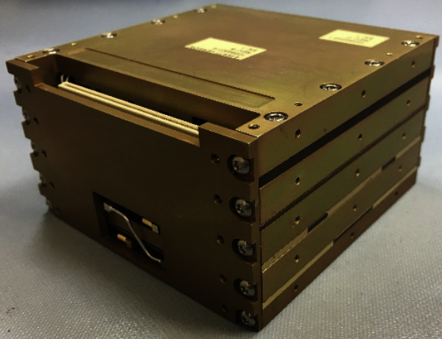
Iris Transponder Evolution History
Iris V1.0: To extend CubeSat/SmallSat deep space capability, JPL introduced the Interplanetary NanoSpacecraft Pathfinder In Relevant Environment (INSPIRE) mission¹, coupled with the first-generation of Iris deep-space transponder². Modular Design (4-slices)
Iris V2.0: The radio was further developed, matured, and in 2018 successfully flown onboard Mars Cube One (MarCO), to support InSight’s Mars Entry, Descent, and Landing (EDL)³. Five slices (including an UHF receive slice).
Iris V2.1: The latest version of Iris includes design updates that support Artemis-1 CubeSats missions⁴.
10.1 x 10.1 x 4.5 cm
Iris V1.0 Stack
10.1 x 10.1 x 7.5 cm
Iris V2.0 Stack
10.1 x 10.1 x 5.6 cm
Iris V2.1 Key Specifications⁴
Iris V2.1 Stack
¹ A. Klesh et al., “INSPIRE: Interplanetary NanoSpacecraft Pathfinder In Relevant Environment,” in AIAA SPACE Conf. and Expo., San Diego, CA, 2013.
² C. B. Duncan et al., “Iris Transponder – Communications and Navigation for Deep Space”, in Small Satellite Conf., Logan, UT, 2014.
³ A. Klesh et al., “MarCO: Early Operations of the First CubeSats to Mars,” in Small Satellite Conf., Logan, UT, 2018.
⁴ M. M. Kobayashi et al., “Iris Deep-Space Transponder for SLS EM-1 CubeSat Secondary Payloads”, IEEE Aerospace and Electronic Systems Magazine, Volume 34, Issue 9, pp 34-44, September 1, 2019.

Slide 5
Artemis-1 Iris (V2.1)
The only small deep space transponder that is compatible with the NASA standard deep space signal and protocol stack.
Four slices:
  Digital: Virtex 6 (Defense-grade) with embedded CPU (SPARC V8: LEON3-FT softcore) running at 50 MHz
  Power Supply Board
  X-Band Exciter
  X-Band Receiver
1 MHz SPI Interface
2-ch LNA: 7 x 4.8 x 1.3 = 44 cc
3-ch SSPA: 8.7 x 4.3 x 1.8 = 68 cc
Receiver Noise Figure: 3.5 dB
62.5 bps to 6 Mbps (uncoded), CCSDS Deep Space
Doppler, Seq. Ranging, Delta DOR
Radiation Tolerance: 23 krads TID
Licensed to Space Dynamics Laboratory (SDL) for manufacturing and sale.
Digital
Triple
SSPA
Power
Dual
LNA
5.6
cm
Exciter
10.1 cm
Receiver
10.1 cm
10.1 x 10.1 x 5.6 cm = 0.57 U, 0.86 kg,
28 - 34 W DC (Tx/Rx), 5W RF Output
V 2.1 is shown here for a reference. Missions that are interested in updating from V 2.1 to V 2.2 need to update the new FW/SW on the ground in order to have the Over-the-Air Programmability capability built-in.

Slide 6
Iris Generational Specification Summary
Iris Specification | Units | Iris V1.0 INSPIRE Version | Iris V2.0 MarCO Version | Iris V2.1 Artemis-1 Version
Digital Processor |  | Xilinx Virtex-5 (commercial-grade) | Xilinx Virtex-6 (Industrial-grade) | Xilinx Virtex-6 (defense-grade)
Embedded CPU |  | N/A | SPARC-Based Leon3-FT Softcore | SPARC-Based Leon3-FT Softcore
No. Of Slices |  | 4 | 5 | 4
Mass (excl. SSPA/LNA) | grams | 450 | 1200 | 860
Volume (excl. SSPA/LNA) | U | 0.46 | 0.77 | 0.56
Memory |  | 32 Mbit NOR-Flash 128 Mbit Phase-Change Memory chip for the SPI interface | 32 Mbit NOR-Flash 16 Mbit SRAM 4 Mbit EDAC SRAM | 32 Mbit NOR-Flash 16 Mbit SRAM 4 Mbit EDAC SRAM
S/C Interface |  | 1 MHz SPI± | 1 MHz SPI | 1 MHz SPI
Bus Power Interface | Vdc | 6.4 - 8.4 | 10.5 – 12.3 | 9.0 – 28.0
DC Power | W | 13.0 | 30.0 (including 5-W SSPA) | 30.0 (including 5-W SSPA)
RF Output Power | W | 1.0§ | 5.0 | 5.0
Receiver Noise Figure | dB | 5.0 – 6.0 | 3.5 | 3.5
Receiver Sensitivity | dBm | -135 @ 70 Hz LBW | -139 @ 70 Hz LBW | -151 @ 20 Hz LBW
Downlink Frequencies | MHz | 8400 - 8500 | 8400 - 8500 | 8400 - 8500
Uplink Frequencies | MHz | 7145 - 7235 | 7145 - 7235 | 7145 - 7235
Turn-around Ratio |  | 880/749 | 880/749 | 880/749
Uplink Date Rates | bps | 1,000 | 62.5 & 1,000 | 62.5 - 8,000
Downlink Data Rates | bps | 62.5 - 64,000 | 62.5 & 1,000 & 8,000 | 62.5 - 256,000
UHF Receive Freq | MHz | N/A | 390 - 405 | N/A
UHF Rertun Link Rate | bps | N/A | 8,000 | N/A
Modulations Waveforms |  | PCM/PSK/PM w/ subcarrier PCM/PM w/ biphase-L, BPSK | PCM/PSK/PM w/ subcarrier PCM/PM w/ biphase-L, BPSK | PCM/PSK/PM w/ subcarrier PCM/PM w/ biphase-L, BPSK
Telemetry Encoding |  | Conv & Reed Solomon | Turbo 1/6 | Conv & Reed Solomon Turbo ½, 1/3, 1/6
Navigational Support |  | Doppler, SR* | Doppler, SR, DDOR† | Doppler, SR, DDOR
Radiation Tolerance | krads | N/A | 15.0 TID‡ | 23.0 TID
±SPI: Serial Peripheral Interface bus
§ For the INSPIRE mission, the PA was backed off to 0.2 W to save power
* SR: Sequential Ranging
†DDOR: Delta Differential One-way Ranging
‡TID: Total Ionizing Dose

Slide 7
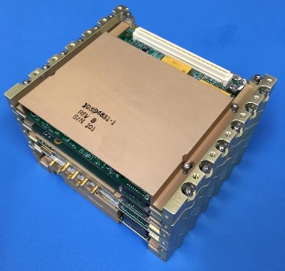
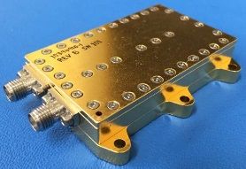
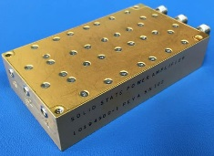
High Level Hardware Overview
Iris LNA
Iris Transponder Stack
Modular MIC assembly
Reduce noise figure by shortening cable length from antenna
Separate gain cavities between LNA and Rx (risk of oscillations)
Digital Processor
Xilinx Virtex
-
6
FPGA
Leon
3
SRAM
FT Softcore
50
MHz
Processor
TCXO
U
/
L DATA
RX PLO
Command
X
50
MHz
AGC
Decoder
-
Band LNA
X
X-Band Uplink
VVA
ADC
Tracking
-
Loops
D
/
7145 – 7235 MHzk
L DATA
7145
–
7235
MHz
Pre
Image
-
Select
SAW Filter
X
-
X-130 dBm to -70 dBmk
band Receiver
-
130
dBm to
-
70
dBm
Reject
I
-
Iris SSPA
DAC
X
-
Band SSPA
X
-
Band Exciter
X
DDS
DDS
Telemetry
-X
X Band Downlink
DAC
Generator
Modulator
8400 -
3
–
-8500
MHz
Isolator
TX PLO
DDS Input
.
8
4 W BOL
Filter
Modular MIC assembly
Provide superior heat dissipation path to structure/radiator
Chip-and-wire assy to reduce losses for higher efficiency
Q
-
DAC
Modular stacked-slice assembly
Superheterodyne receiver with single-downconversion stage to 112.5 MHz IF
Digitally closed tracking loops (carrier, subcarrier, symbol)
Direct Digital Synthesis (DDS) reference for downlink carrier Doppler tracking
Baseband telemetry modulated direct at X-band
Embedded softcore processor (Leon3-FT) for configuration and protocol mgmt

Slide 8
Software Specs / Architecture
Single-threaded using SPARC V8 instruction set, targeted for LEON3-FT soft core processor
SRAM: 2 MB total
  Program size:
    Text: 99.7 kB
    Data: 2.9 kB
Running at 50 MHz
Internal Interrupt
Reset
SRAM EDAC Error Handler
INIT
CDH Peek Cmd Handler
Execute C&DH CMD
DMA Complete Handler
N
DMA DONE / READY
Y
Traps
Tx Data
Trap Handlers
Notes:
-DMA Done/Ready (and subsequently Tx Data) will only occur in Tx-Only and Tx/Rx modes

Slide 9
Available Modes and Some Configuration Parameters
Mode | Receiver | Transmitter | Ranging | DDOR | Coherency
X-Band Receive-Only | LNA, 62.5 bps, PCM/PSK/PM 16 kHz sine | -- | -- | -- | --
X-Band Transmit-Only | -- | SSPA, 62.5 bps, PCM/BPSK/PM 25 kHz square | Off | Off | Off
X-Band Transmit/Receive | LNA, 62.5 bps, PCM/PSK/PM 16 kHz sine | SSPA, 62.5 bps, PCM/BPSK/PM 25 kHz square | Off | Off | On
Ranging – No Data | LNA, 62.5 bps, PCM/PSK/PM 16 kHz sine | SSPA | On | Off | On
DDOR – No Data | -- | SSPA | Off | On | Off
Other Modes | Additional commands may be used to configure the Iris into modes not defined above. For example, if Ranging with Data is desired, command Iris to Tx/Rx mode, and then send a command to enable ranging.
Configuration Parameter | Available Settings
Uplink Data Rate | 62.5, 125, 250, 500, 1000, 2000, 4000, 8000 bps
Downlink Data Rate | 62.5, 125, 250, 500, 1000, 2000, 4000, 8000, 16000, 32000, 64000, 128000, 256000 bps
Downlink Data Encoding | Turbo 1/2, Turbo 1/3, Turbo 1/6
AOS Frame Length | 8920 or 1784 bits
Exciter Mod Index | Subcarrier: 0 to 138 degrees Direct carrier: 0 to 135 degrees
Other parameters include subcarrier frequency, coherency, antenna selection, etc.
Note that the configurations in the modes above are the default settings, and can be changed with additional commands.

Slide 10
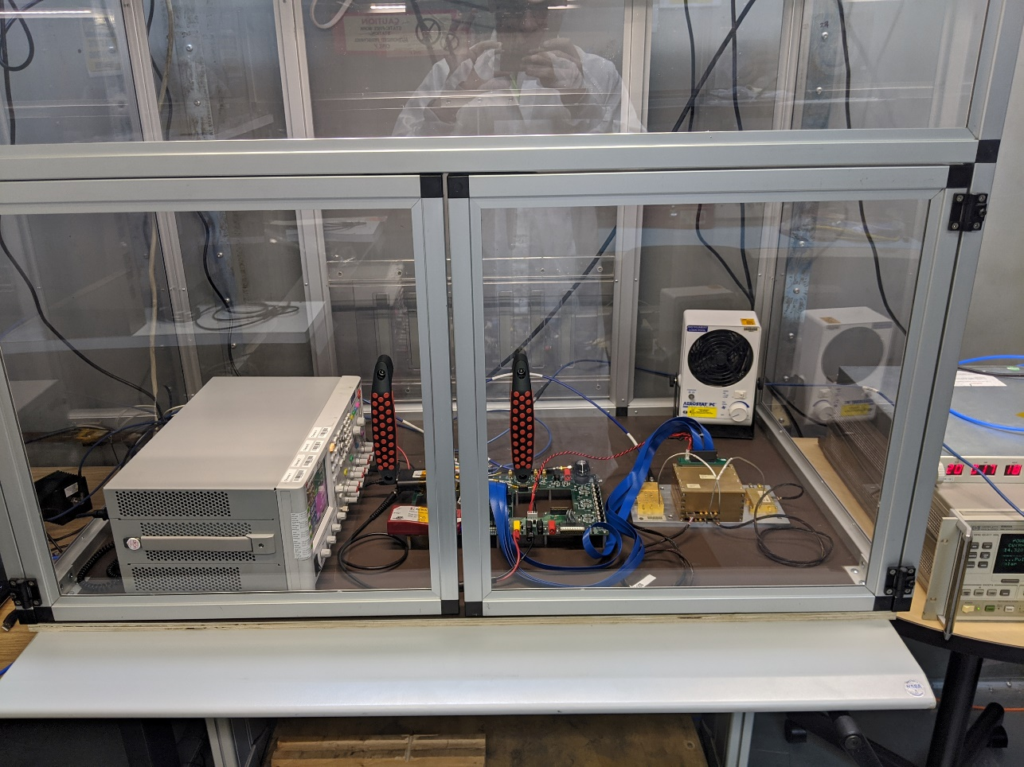
Overview of Iris V 2.2 Features
Over-the-Air Programmability
PN Delta DOR
PN Regenerative Ranging
SCID Filter Functionality
High Rate Uplink
High Rate Downlink
QPSK
Iris setup at DSN Testing Facility DTF-21 in protective box (January 2020)
Missions that are interested in updating from V 2.1 to V 2.2 need to update the new FW/SW on the ground in order to have the Over-the-Air Programmability capability built-in.

Slide 11
Over The Air Update (OTAU) Summary
OTAU Process Demonstrated – Driven by C&DH
  Upload new image (via Iris) to C&DH
    Iris never holds the complete image except in flash due to memory limitations
  Erase Target Flash Stripe 1 or 3
  Move image from C&DH to target stripe over SPI
  Checksum image on stripe
  Warm boot to target stripe
    Iris always cold boots to stripe 2
    Iris always falls back to stripe 0 on any boot failure
Artemis-1 Delivered
With OTAU
Missions that are interested in updating from V 2.1 to V 2.2 need to update the new FW/SW on the ground in order to have the Over-the-Air Programmability capability built-in.

Slide 12
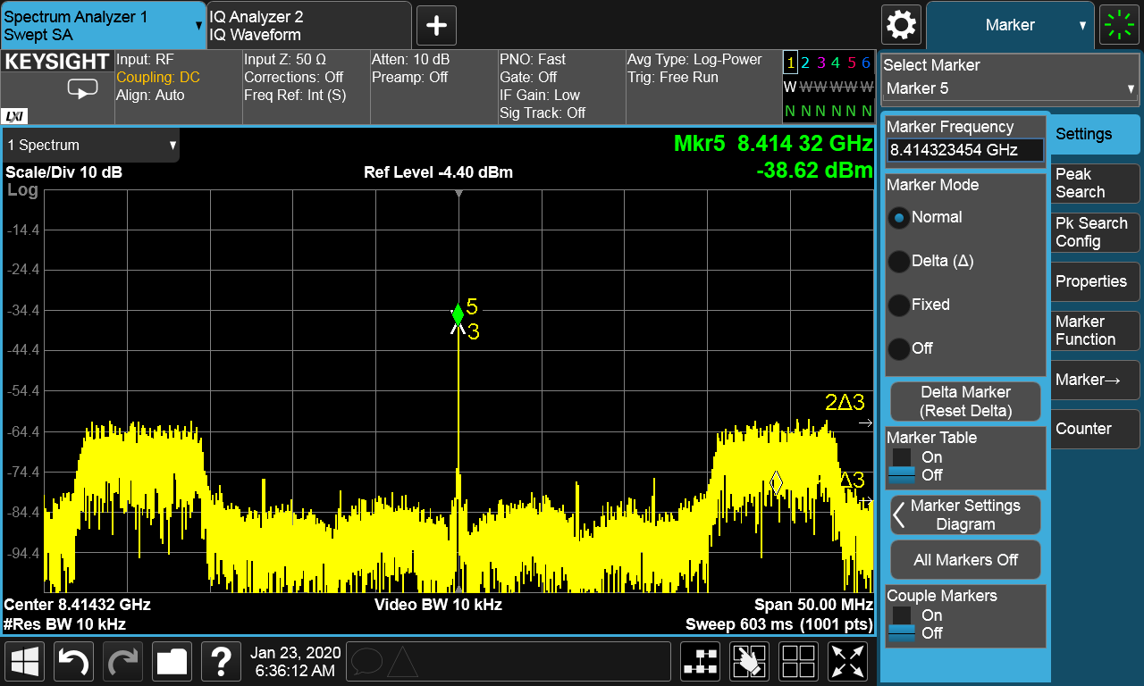
Pseudo-Noise (PN) Delta DOR¹ Tests
Improve ∆DOR measurement accuracy by replacing sinusoidal tones with a spread spectrum signal.
Improved ∆DOR accuracy is needed for missions with tight targeting requirements such as Mars sample return missions and deep space manned missions.
PN Delta DOR transmissions with the three different Gold Code were captured by Open Loop Recording (OLR) in DTF-21 and found to be working as intended in post processing.
¹ Z. Towfic, C. Volk, J. Border, T. Voss, and M. Shihabi, “Improved Signals for Differential One-way Range,” IEEE Aerospace and Electronics Systems Magazine, Volume 35, Issue 3, pp 70-79, March 2020.
PN DDOR spectrum

Slide 13
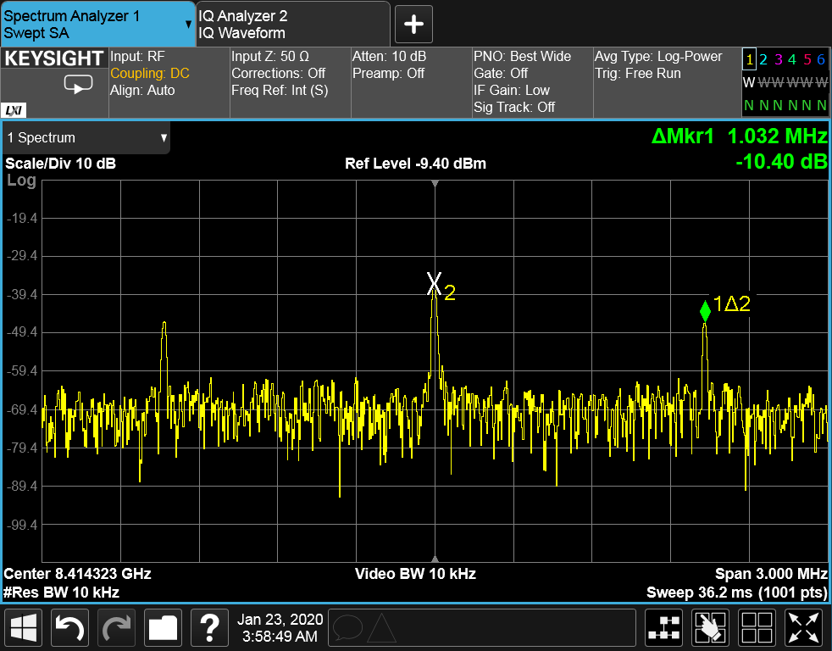
PN Regenerative Ranging²
The ability to do ranging while also doing telecom.
More efficient in the use of link power than is the current approach, nonregenerative ranging
Primary advantage over classical sequential ranging is orders of magnitude improvement in ranging SNR threshold.
The New Horizons mission to Pluto with extremely large propagation loss, and the BepiColombo mission with ultra-high navigation precision requirements had to use regenerative ranging
The improved ranging SNR can also equate to system trades for reduced transmit power, reduced ranging modulation index, or smaller antenna aperture, all of which are of prime interest to SmallSats.
Regenerative Ranging spectrum (DTF-21)
² K. Angkasa et al., “Regenerative Ranging for JPL Software-Defined Radios”, IEEE Aerospace and Electronic Systems Magazine, Volume 34, Issue 9, pp 46-55, September 1, 2019.

Slide 14
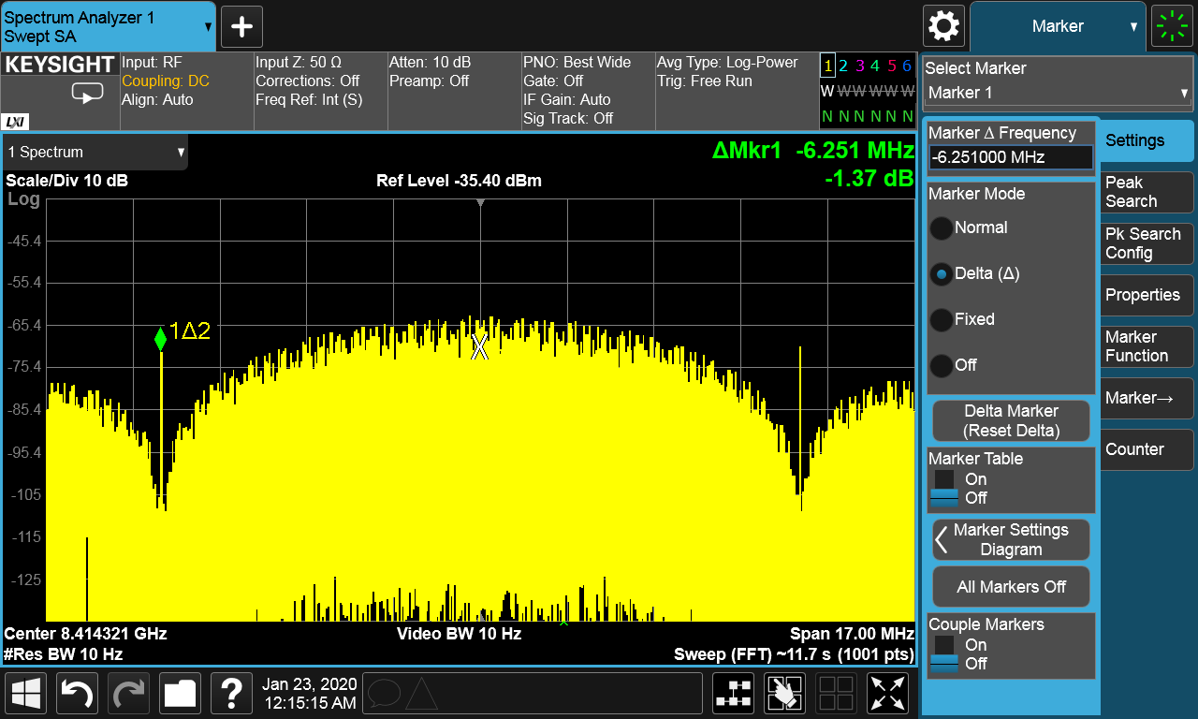
Downlink Telemetry Tests
Verified the maximum symbol rate on Iris at 6.25 Msps for Turbo 1/2, 1/3 and 1/6.
QPSK is working currently when coupled with convolutional code rate = ½
  Need additional work to have QPSK working with the other coding schemes.
Gathered the threshold data at each downlink configuration
6.25 Msps spectrum

Slide 15
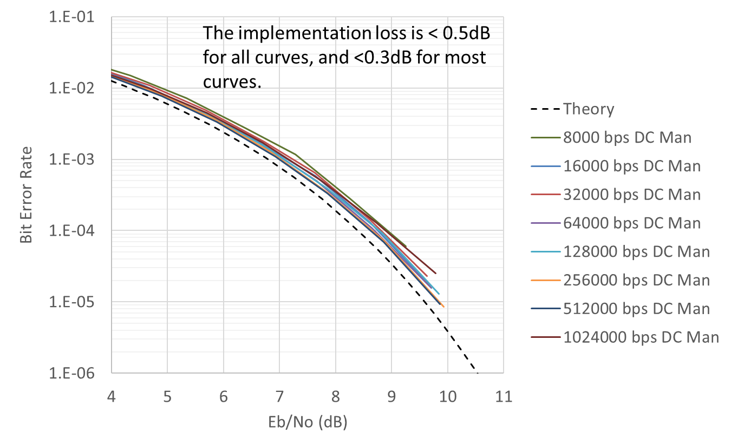
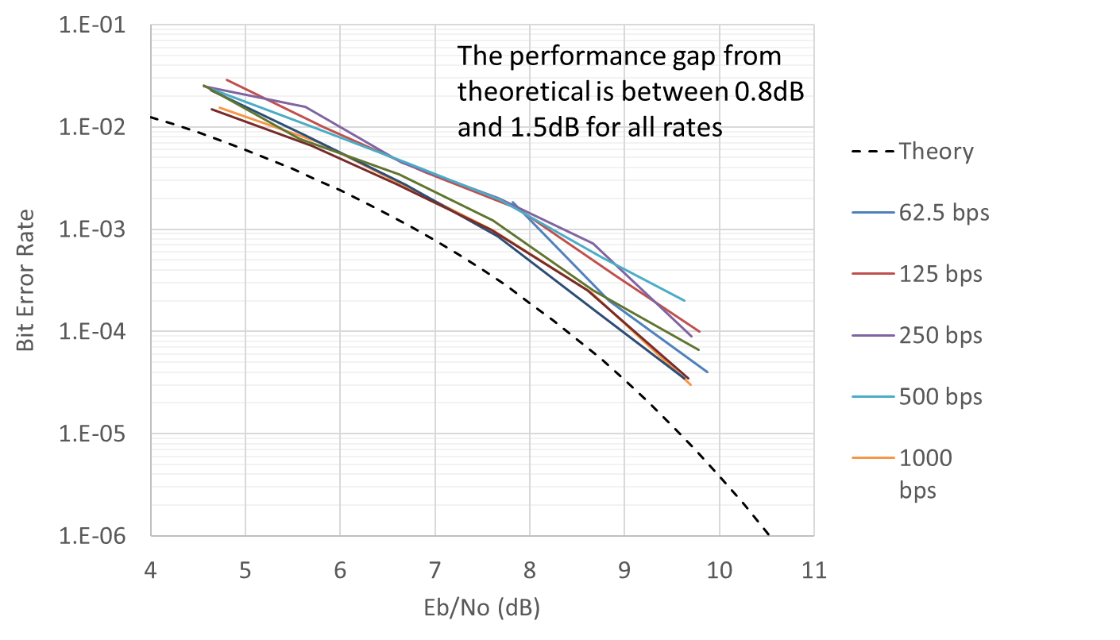
Uplink Performance
Carrier Tracking Threshold from -146 to -155 dBm depending on LBW
Command threshold for 62.5 bps at -141 dBm (DTF-21)
Demonstrated up to 1 Mbps with the direct carrier mode.
Added a spacecraft identification (SCID) Filter
  Demonstrated at DTF-21 that when SCID filter is enabled, only the correct SCID message was received, then when disabled, both messages make it through.
Direct-Carrier Residual Carrier Mode Uplink Results
Subcarrier Mode Uplink Results

Slide 16
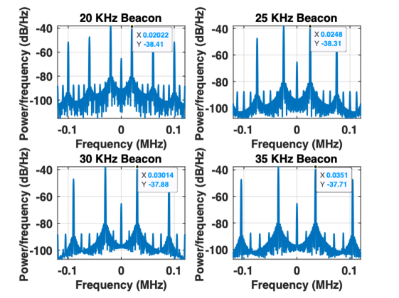
Beacon Mode
Iris can generate Beacon Tones using pokes command
Below are a demonstration of 4 beacons for 20, 25, 30, 35 KHz
These are generated in the Squarewave Subcarrier Mode (and fully suppressed carrier)
Need to convert the pokes commands into software (C&DH) commands for use in flight operation.

Slide 17
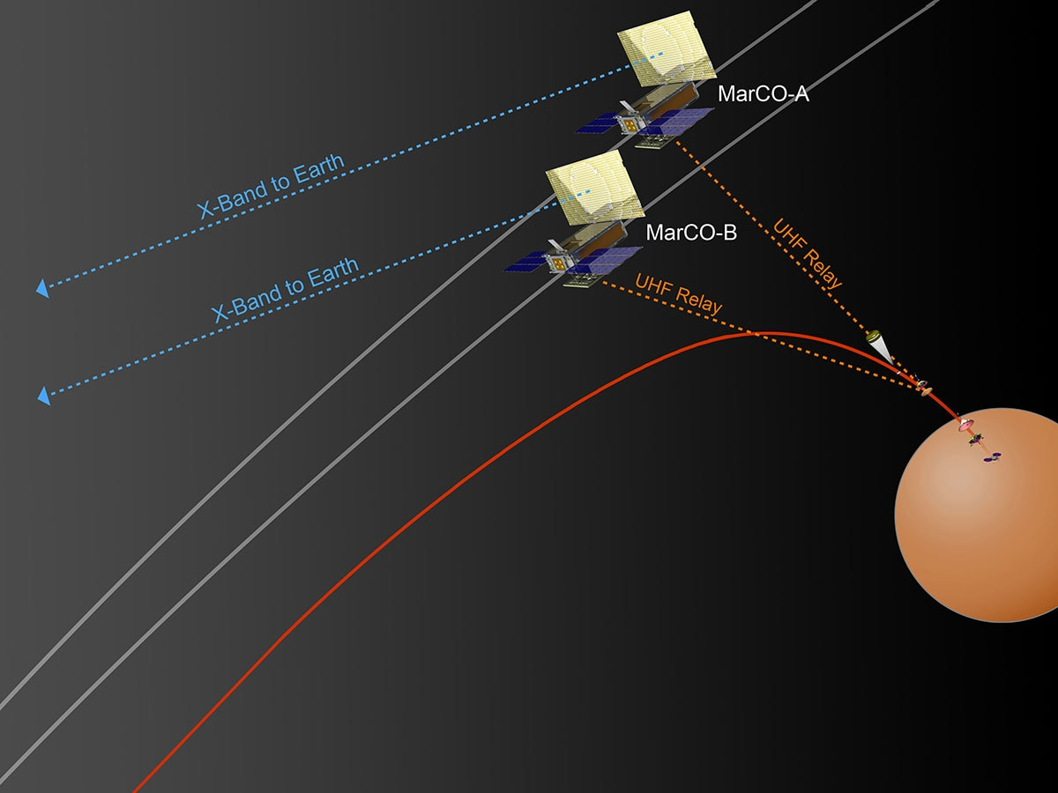
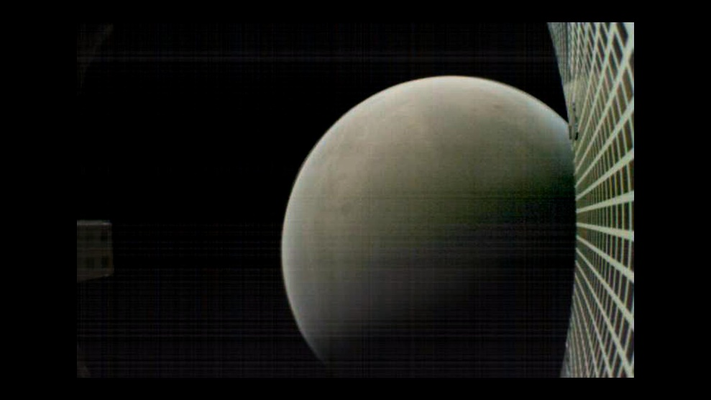
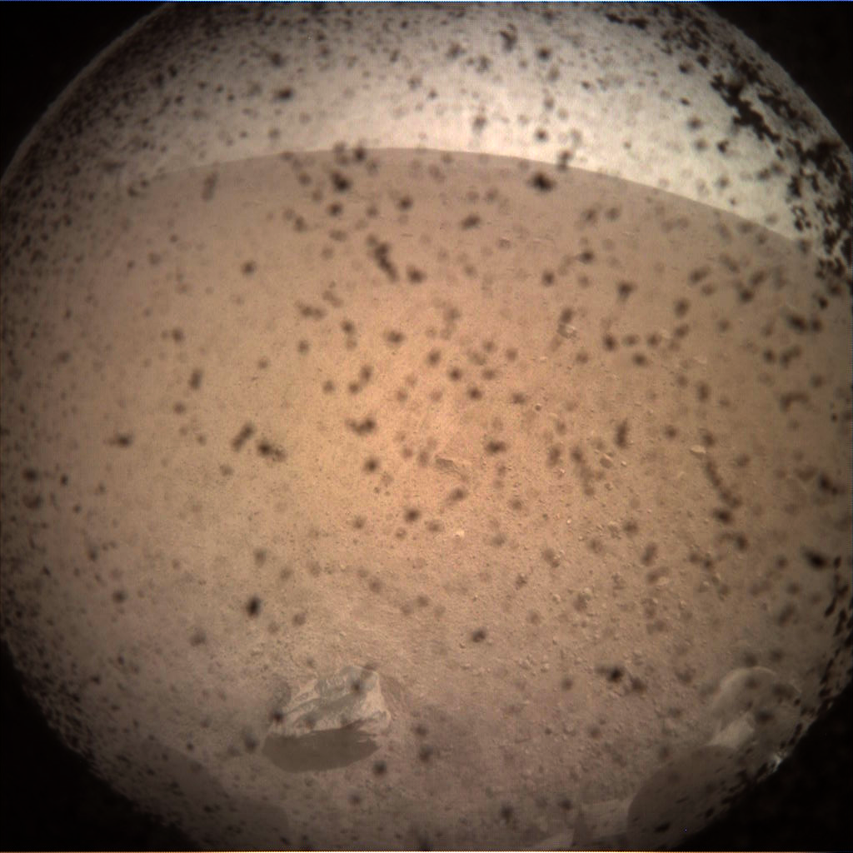
MarCO Mission Overview (2018)
Provided “real-time” data relay during EDL of InSight to Mars
Bent-pipe:
  UHF receive of EDL data
  X-band transmit Direct-to-Earth
Two MarCOs for redundancy
First deep space CubeSats
MarCOs launched with InSight but traveled independently to Mars
Successfully completed EDL
with zero data loss
MarCO enabled quick reception of InSight’s first image on Mars (on the right)
  Also, an image of Mars & the reflect array HGA with the feed showing (on the left).
Notes:
“real-time” refers to 7+ min delay from Mars
MRO is reliable open-loop recording of EDL data and verification of InSight landing success, but goes behind Mars just after EDL
Emphasize that MarCO is flyby – doesn’t enter Mars orbit or land

Slide 18
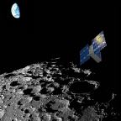
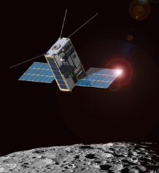
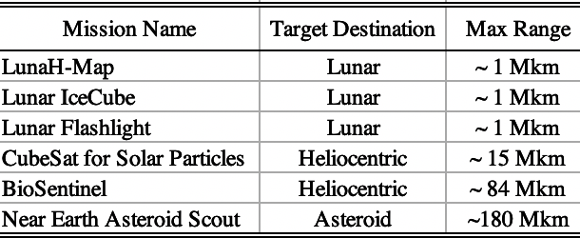

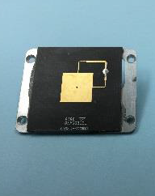

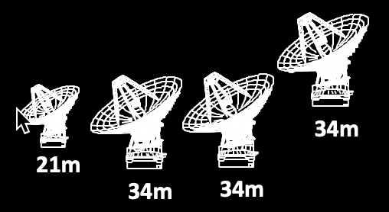
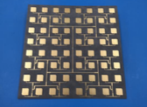
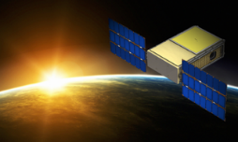
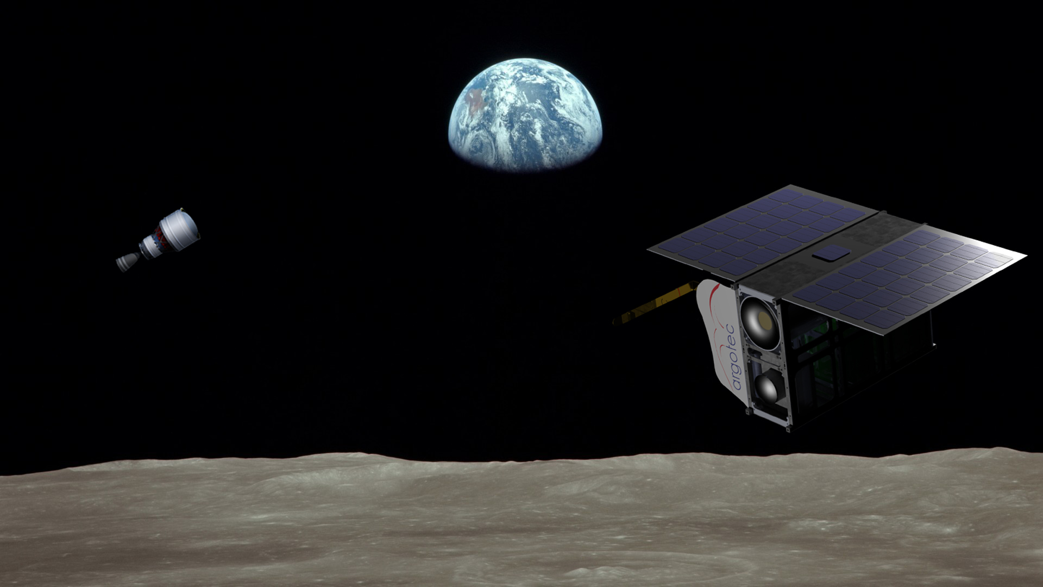

6 Artmeis-1 CubeSats Using Iris
(2020~)
7 Artemis-1 CubeSats have baselined to use Iris for basic telecom & navigations.
  For the 6 NASA missions, JPL managed the contract with SDL
  ArgoMoon Iris was purchased directly by Agotec from SDL.
They share common Telecom Hardware (Iris Radio, LNA/SSPA, Rx/Tx antennas) with different science goals & target destinations.
LunaH-Map
Lunar IceCube
Low Noise Amplifier
(LNA)
Rx LGA
Lunar Flashlight
Iris Radio
Tx LGA
DSS-17
Morehead
CuSP
Solid State Power Amplifier
(SSPA)
Tx MGA
DSS-54
Madrid
DSS-34
Canberra
DSS-13
Goldstone
BioSentinel
Artemis-1 CubeSat Telecom Hardware Using Iris
Deep Space Network (DSN)
ArgoMoon is an Italian 6U CubeSat to be injected in a high elliptic – high apogee orbit. Several Moon fly-bys and imaging of the surface will be performed.
ArgoMoon
NEA Scout

Slide 19
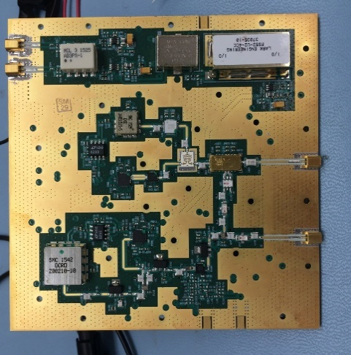
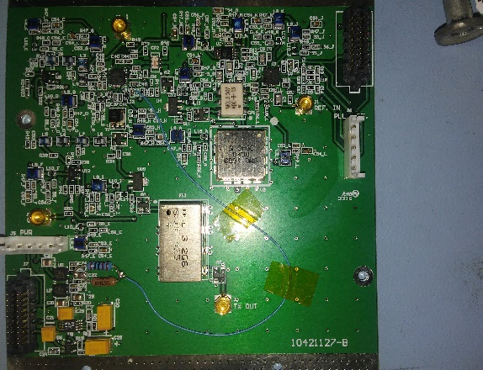
Future Considerations for Iris
Other frequency bands (S, Ka)
Low-Density Parity-Check (LDCP) code
  More efficient on relatively large code rates (e.g. 3/4, 5/6, 7/8) than Turbo codes
Reliable space-link protocols for relay functionality (CCSDS Prox-1 protocol)
Delay/Disruption Tolerant Networking
SpaceWire interface for high-rate data transfers to S/C C&DH unit
Higher efficiency SSPA
  Lower DC power in general
TRL-4 Ka- (and S-) Band exciter
TRL-4 UHF exciter

Slide 20
Backup

Slide 21

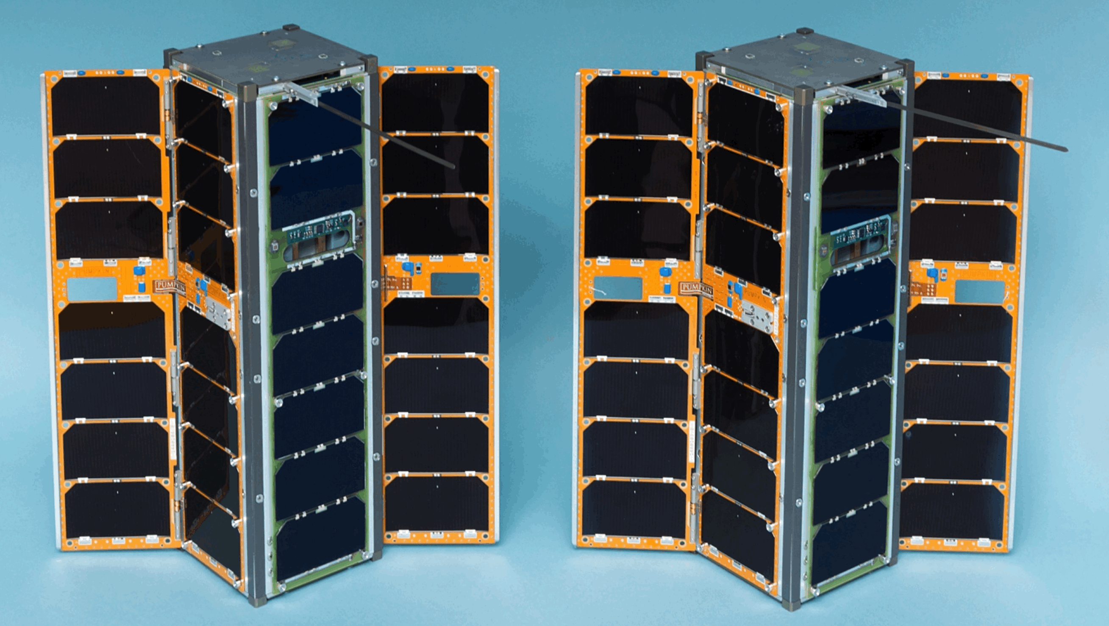
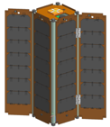
Deep-Space Missions Used/Using Iris
INSPIRE
Interplanetary Nano Spacecraft Pathfinder in a Relevant Environment (2014)
INSPIRE Mission Concept
Provide reduced size/cost components to enable
a new class of interplanetary explorers
Up/Downlink
Up/Downlink
Crosslink
INSPIRE-A
INSPIRE-B
Lithium UHF
INSPIRE-A
INSPIRE-B
INSPIRE was funded by NASA's Planetary Science Division (PSD) as a collaboration between the Jet Propulsion Laboratory (JPL), California Polytechnic-San Luis Obispo (CalPoly), Goldstone-Apple Valley Radio Telescope (GAVRT), Massachusetts Institute of Technology (MIT), University of California – Los Angeles (UCLA), University of Michigan (UMich), and University of Texas-Austin (UTexas).
(Did not Launch; before a flight could be arranged, the goals of INSPIRE became obsolete)

