Slide 1
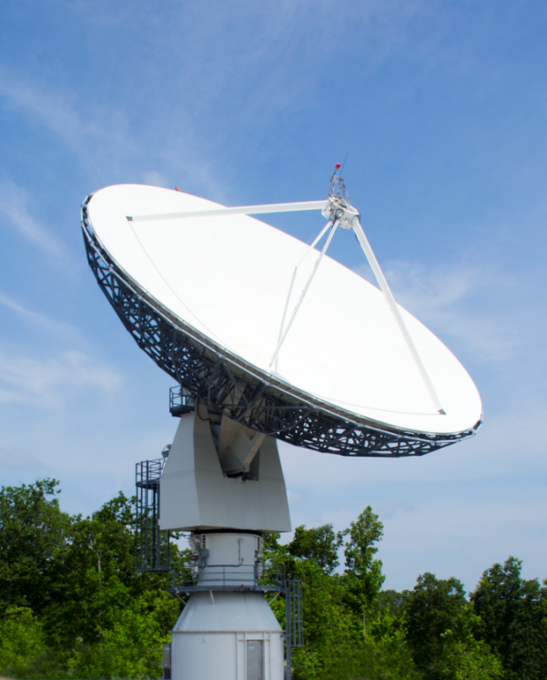
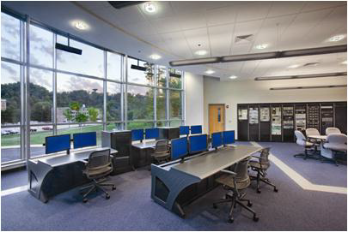
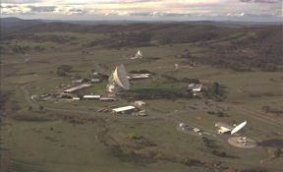
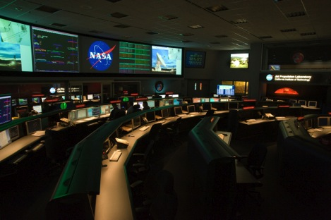
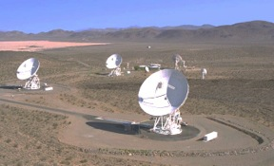
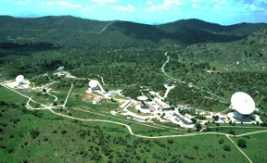


Deep Space Station 17: A University-Operated Affiliated Node on the NASA Deep Space Network Providing Telemetry, Tracking and Command Services for Interplanetary SmallSat Missions
Interplanetary Small Satellite Conference
May 11, 2020
Ben Malphrus, Jeff Kruth (MSU)
Tim Pham, Jay Wyatt, (JPL)
In Partnership with

Slide 2
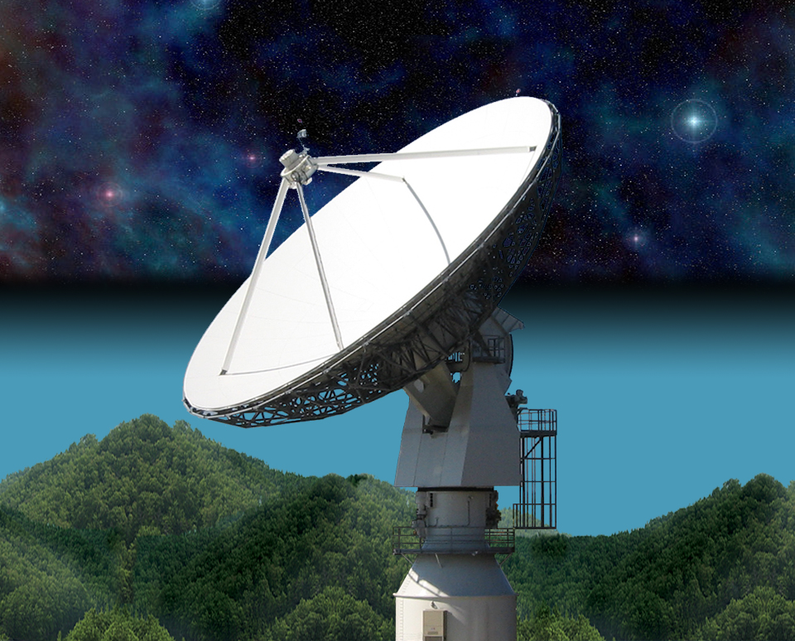
21 Meter Space Tracking Antenna
at Morehead State University
Conceived and by MSU faculty with NASA assistance
Dual Purpose Instrument
  Ground Station for Smallsats
  Radio Telescope for Astronomy Research
Built and Installed by VertexRSI (General Dynamics)
Operational in 2006- has supported LRO, ISEE-3, Planet Labs, KySpace
Program Funded by AES in 2016 to Upgrade the 21 m Toward DSN Compatibility
Recently provided tracking support to JPL’s Asteria Mission

Slide 3

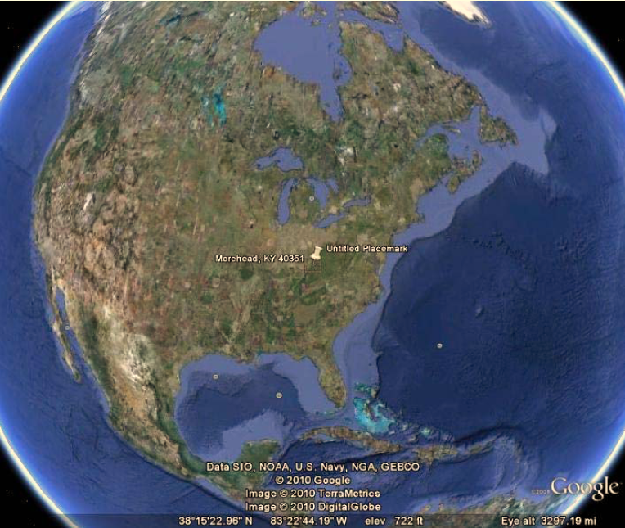
The Morehead State University Ground Station
Relatively Quiet RFI Environment in Eastern Kentucky
21 m Ground Station (few in the US large enough for DSN Work)
Staff Experienced in Mission Operations
Experienced RF and Telecom Engineers and Scientists
Talented, Intrepid Students

Slide 4
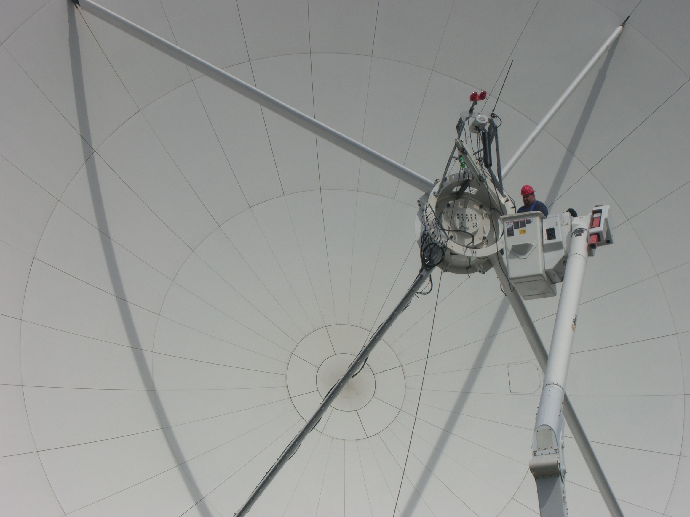
21 M Operations
Satellite Ground Station for Morehead State SmallSat Missions and Others
JPL ASTERIA Ground Station
Radio Telescope Mode for Research in Astrophysics
Test-Bed for Experimental Communication Systems

Slide 5
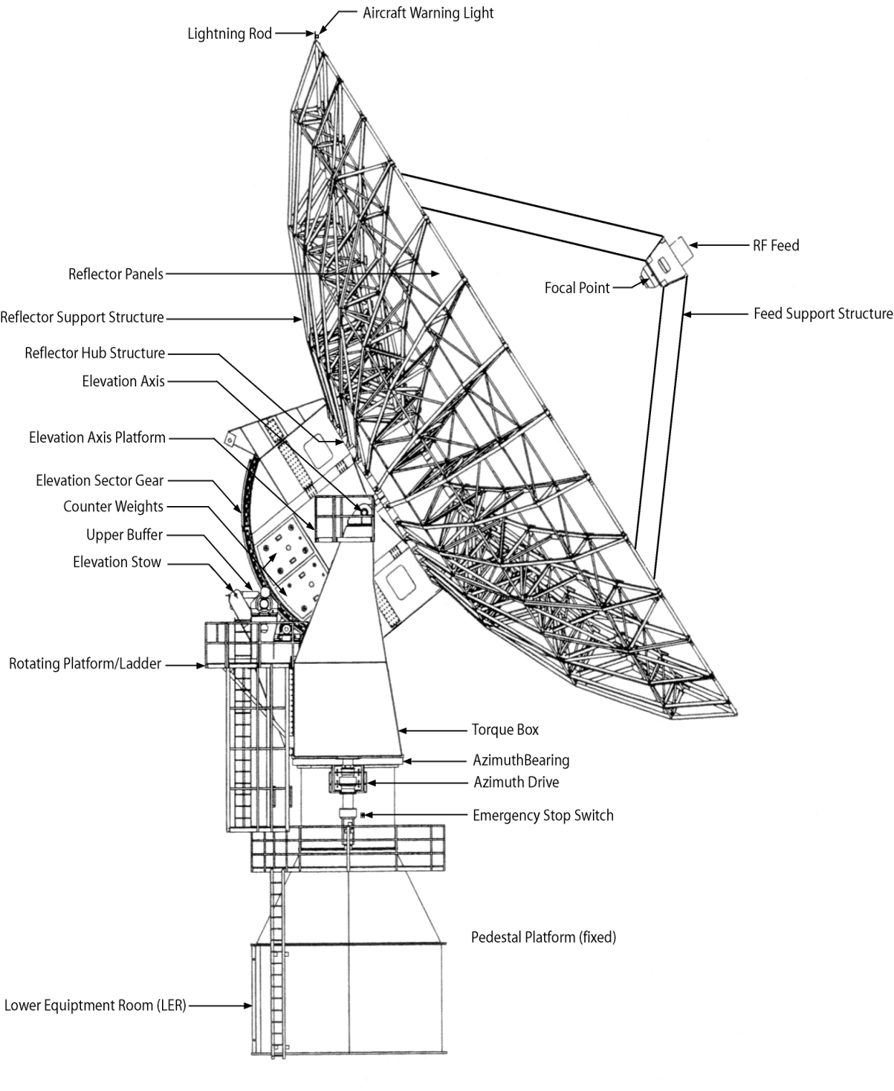
21 M Overview
Parameter | Measured Values
Axis Slew Velocity
Azimuth | > 3.0 º/sec minimum
Elevation | > 1.6 º/sec minimum
Polarization | > 0.7 º/sec minimum
Axis Acceleration
Azimuth | 1.0 º/sec²
Elevation | 0.6 º/sec²
Travel Range
Azimuth | ± 269.8º
Elevation | 1.0º to 90.3º
Polarization Range | ± 90º
Pointing Accuracy | 0.005º RMS
Tracking Accuracy | 0.0004º RMS
Aperture Efficiency, η (L/Ku) | 0.653/0.563
Surface Tolerance @ 35 mph wind | < 0.020” RMS

Slide 6


AES Program: 21 m DSN Station (DSS-17)
Project Description and Objectives Demonstrate a cost-effective process for expanding DSN capabilities by utilizing non-NASA assets to provide communication and navigation services to small spacecraft missions to the Moon and inner solar system, thereby enabling interplanetary research with small spacecraft platforms.
Technical Approach Develop and implement a strategy to transfer Deep Space Network (DSN) processes and protocols to the MSU 21 m antenna system to enable integration into the DSN as an auxiliary station to support small spacecraft missions. Implement deep space communications, tracking and navigation techniques as well as adoption of CCSDS standards. Implement systems upgrades, conduct tests/demonstrations, and transition to an operational capability.
Benefits Serves as a test-case for other non-NASA ground stations to provide auxiliary deep space navigation and tracking support for small spacecraft missions. Develops an 2020 timeframe Transparent to Missions Being Supported | Targets Full DSN Compatibility Scheduled by DSN Support CCSDS-SLE DSN Tracking and Ranging Support Lunar, NEA, Lagrange Point Missions at 64-256 kbps

Slide 7
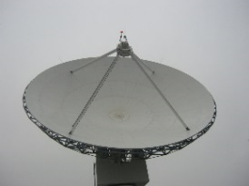
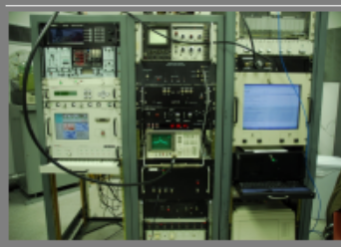
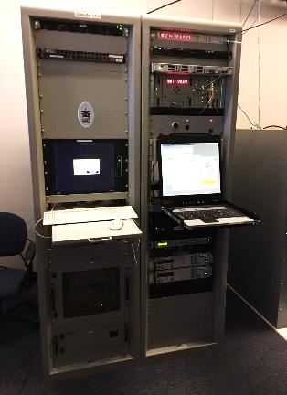
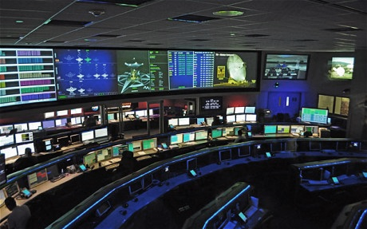
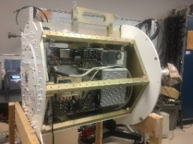
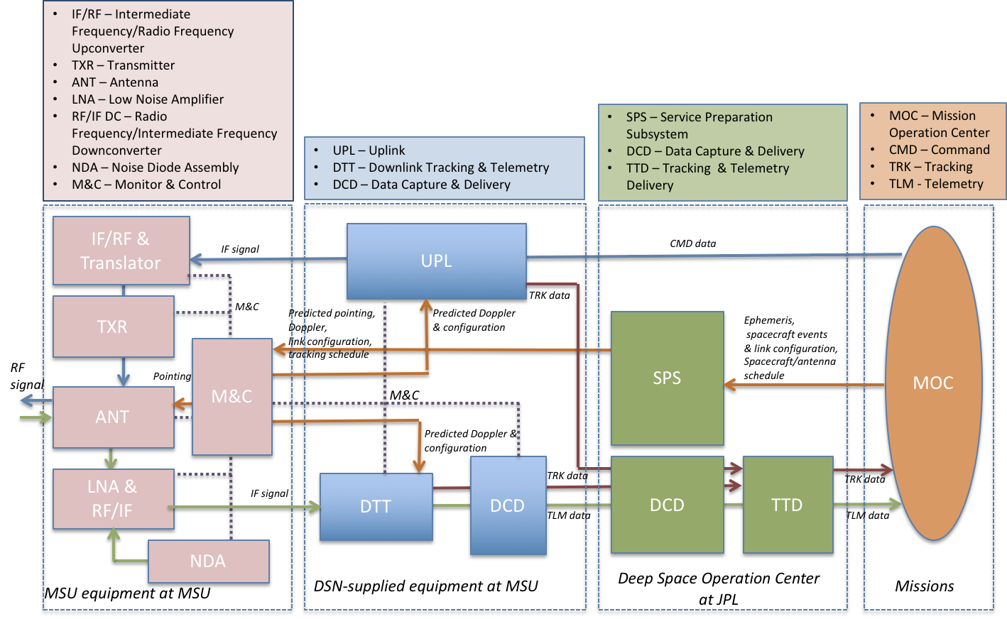
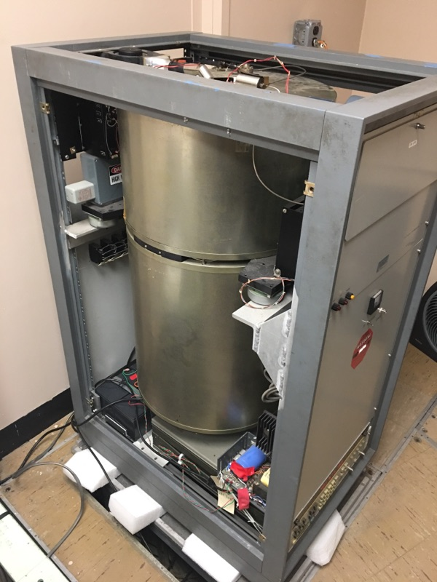

Morehead State University 21m Upgrade to DSN Compatibility MSU DSS-17 System Architecture
“Lite” Version of DSN Block 6 Exciter System Developed for Morehead State
Morehead State 21 m Antenna System
21 m Antenna Control System
Deep Space Operation Center- JPL Mission Control
Updated Cryogenic X-Band Feed
H- MASER
Morehead State University Mission Operations Center

Slide 8


Enabling Interplanetary Smallsat Ground Support- Toward DSN Compatibility
Incremental Delivery and Testing
Delivery Increment | Test Focus
DSN-provided Uplink, Downlink and Data capture & delivery | Generation of command data Generation and correlation of ranging signal, for both sequential and pseudo-noise ranging Extraction of telemetry data Data transfer between the uplink and downlink equipment and the Data Capture & Delivery
Connection to NASA Mission Backbone Network | IP connection (after IT Security scan) Data delivery between the MSU DCD and JPL DCD (verifying all routing permissions in the firewall setting, both for MSU & JPL) Simulated data flow from DTT (at MSU) to TTD (at JPL)
Installation of downlink RF equipment at the antenna | Extraction of telemetry and delivery to JPL
Installation of uplink RF equipment and Transmitter at the antenna | Generation of command data with Transmitter in the loop, with connection from SLE user to MSU Uplink equipment Correlation of ranging signal, including the Transmitter and LNA components Radiometric (Doppler/Ranging) data delivery to JPL

Slide 9
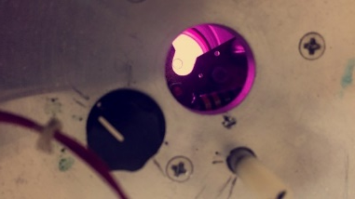
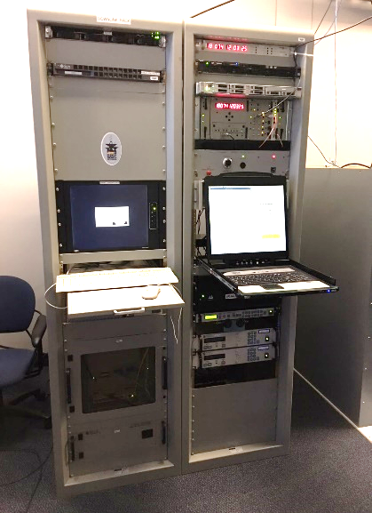

Morehead State University 21m Upgrade to DSN Compatibility Detailed Project Status and Remaining Tasks
Major Tasks Completed
  System Architecture Design Complete
  DSN Designation Assigned: DSS-17
  Connection to NASA Backbone Network Complete
  DSN Equipment Installed and Tested
  Hydrogen MASER in Operation (on semi-permanent loan from MIT)
  Antenna Control Systems Tested
  All Hardware Complete and Installed: X-Band Feed, kPA, DSN Equipment
  Station Monitor System Designed and Hardware Installed
  Major Tasks Remaining
  Install/Test new gearbox (maintenance activity)
  Complete Characterization of System Performance
    Characterize Doppler and ranging performance
    Test command performance over space link
  Complete Staff and Student Training
  Implement Monitor Control System Updates
  Conduct Series of Validation Demonstrations
  Conduct Operational Readiness Review
  Complete Preparations for Artemis-1 CubeSat Support
Antenna Feed Swap
Hydrogen MASER
Purple Glow from the Hyperfine Transition of Atomic Hydrogen
DSN Equipment
Antenna Operations Center

Slide 10
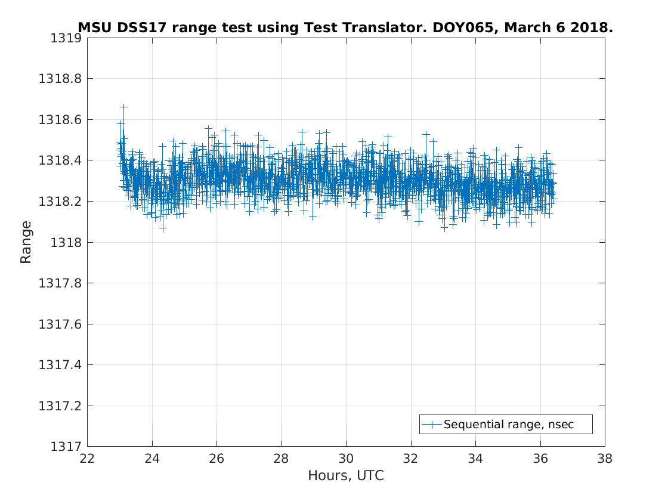

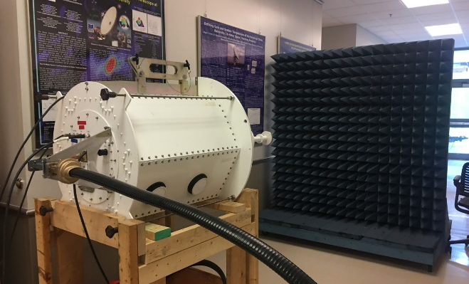
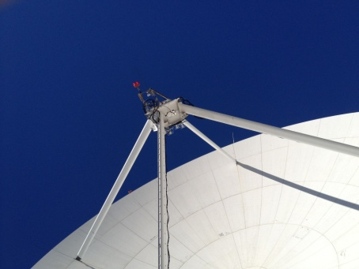
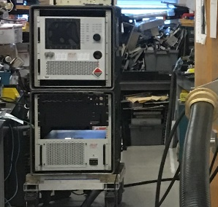
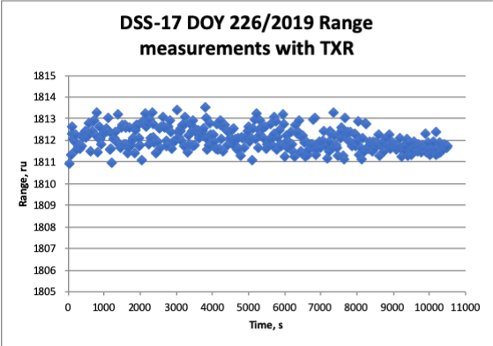
Morehead State University 21m Upgrade to DSN Compatibility Recent Technical Accomplishments
X-band Feed
High Power Amplifier
Ranging
Initial Transmit and Ranging laboratory tests proved successful
Custom X-band feed is based on a cryogenically cooled LNA that operates at <20K.
DSS-17 Ranging Stability Results- measurement stability over > 13 hours exceeds requirement
DSS-17 Ranging Results- precision within +/-1 range unit (0.94 ns). Implies 1 meter accuracy ranging at the Moon
X-band Feed is located at the prime focus
3 kW High Power Amplifier under test

Slide 11
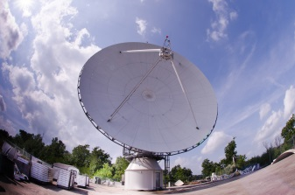
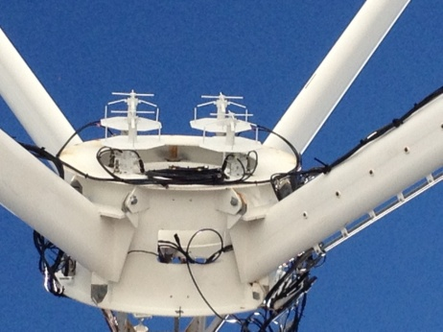
21m Performance
Performance Measure | Pre-Upgrade | Post-Upgrade
X-Band Frequency Range | 7.0 – 7.8 GHz | 7.0 – 8.5 GHz
LNA Temperature | 70 K | < 20 K
System Noise Temperature | 215 K | <100 K
Antenna Gain | 62 dBi (@7.7 GHz) | 62.7 dBi (@8.4 GHz)
System Noise Spectral Density | -175 dBm/Hz | <-178 dBm/Hz
G/T at 5° Elevation | 37.5 dB/K | 40.4 dB/K
Time Standard | GPS (40 ns) | Hydrogen maser (1 ns/day)
EIRP | N/A | 93.7 dBW
HPBW | 0.124 deg | 0.115 deg
SLE Compliance | N/A | Yes
CCSDS Compliance | N/A | Yes
Forward Error Coding | Reed Solomon/Convolutional | Reed Solomon/Convolutional, Turbo, Low Density Parity Check
Radiometric | Angle, Doppler | Angle, Doppler, Ranging

Slide 12
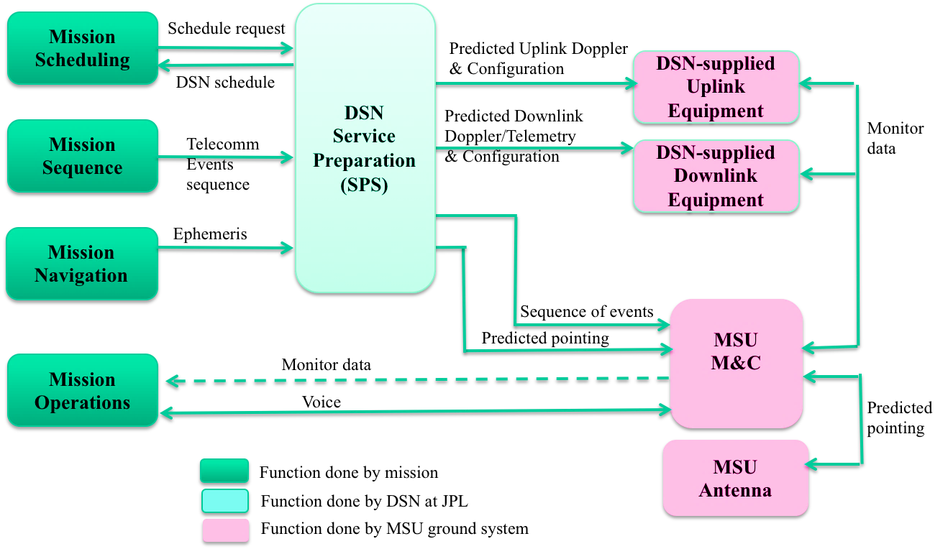
Service Management Data Flow
For NASA Missions

Slide 13
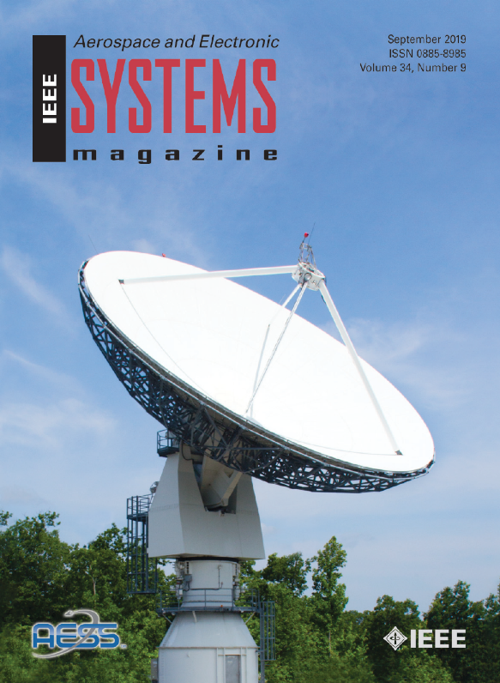
Morehead State University 21m Upgrade to DSN Compatibility
X-Band Downlink Capability Developed and Tested with Real Spacecraft, including Stereo, Osiris Rex, and MAVEN
Telemetry connection to JPL over NASA Mission Backbone Network Operational
  Enables telemetry and commanding in the same manner as other DSN antennas
X-band Transmit and Ranging
  Initial Ranging Measurements Successful
    Results imply 1m ranging accuracy at the Moon
Conducted MarCO Downlink Demonstration Using Software Defined Radio (SDR) based receiver system
Conducted first OMSPA Demonstration with a CubeSat using the X-band Feed and custom SDR-based Multiple Receiver System
Successfully conducted approximately 1,000 S-band Asteria Mission passes
  Enabled staff and students to obtain significant operational experience
DSS-17 on the Cover of the IEEE Aerospace and Electronic Systems Magazine Special Issue on Artemis 1 (September 2019)
Critical Milestones
ΔSRR | NMB Connection | Downlink Demo | Uplink Demo | Ranging Demo | ORR | Operational | Mission Ops | Mission Duration | Project Complete for Artemis 1
01/15/2016 | 6/15/2018 | 5/5/2018 | 9/1/2020 | 9/15/2020 | 10/15/2020 | 11/30/2020 | Artemis-1 | Artemis 1 CubeSat Mission Duration | Artemis 1 CubeSats Closure
ISEE-3 Carrier During Lunar Fly-by Sept 2014
© 2020. All Rights Reserved

Slide 14
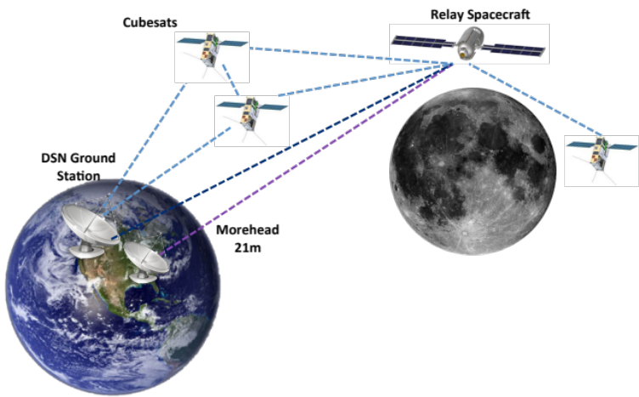
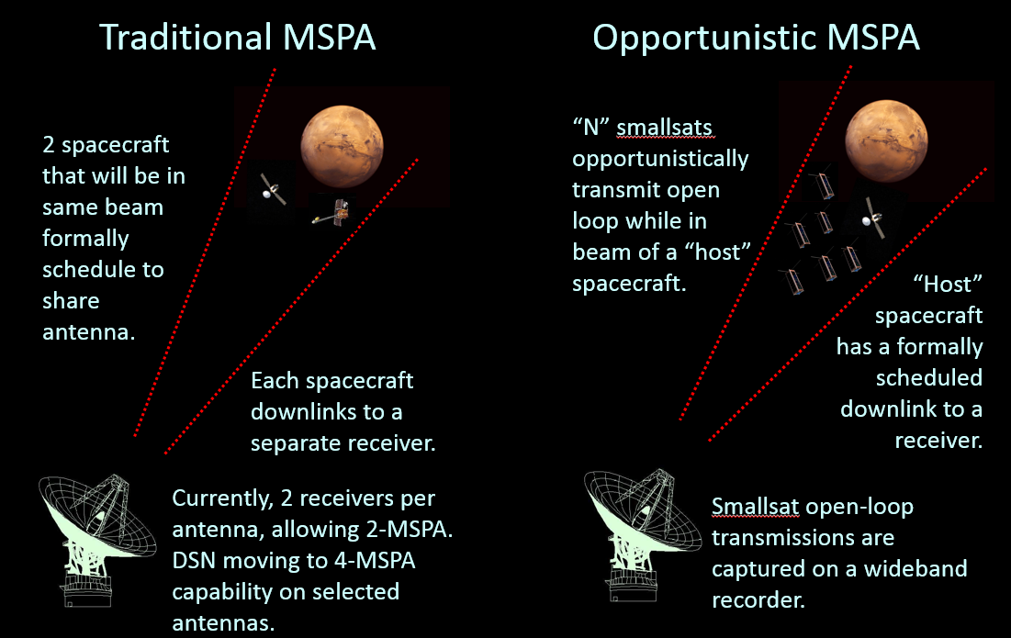
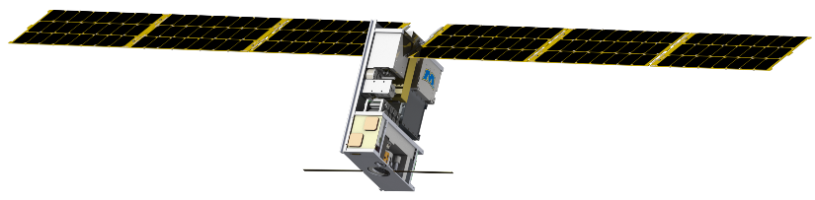
Future of DSS-17
Possible Extensions and Adaptations
Multiple Spacecraft per Aperture (MSPA) and Opportunistic MSPA (OMSPA)-
  Past and Future Experiments
Delay/Disruption Tolerant Networking (DTN
  Ground Demonstrations in 2018 and 2019, 2020
  Lunar IceCube Demonstration in 2021
Beacon Tone Service Demonstrations at Mars and Beyond
Support for Space Networking
OMSPA was demonstrated at MSU on the MarCO spacecraft. For more information, see “InSight/MarCO Opportunistic Multiple Spacecraft Per Antenna (OMSPA) Demonstration” ( https://ieeexplore.ieee.org/document/8741775)
Lunar IceCube, managed by MSU, will demonstrate the DTN Bundle Protocol (BP) using NASA”s Core Flight Software (cFS) implementation onboard and NASA’s ION DTN implementation on the ground during its 180 day cruise phase. ISSC paper by Nat Richard et al. 5/11/2020.

Slide 15



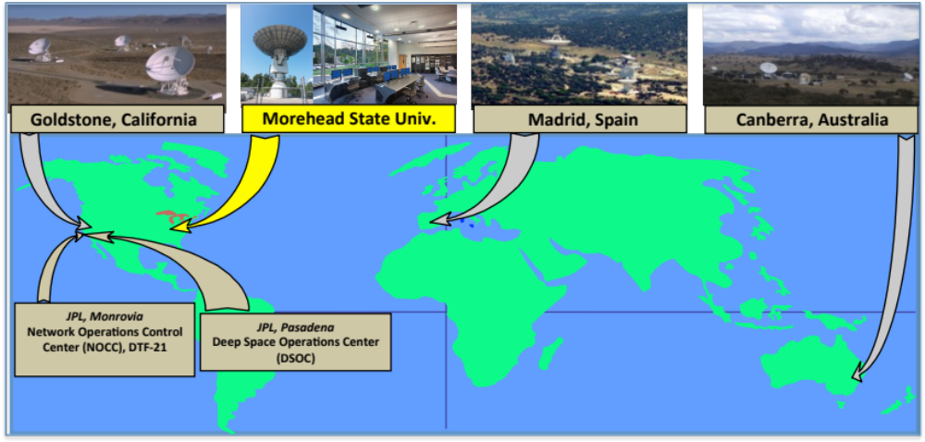
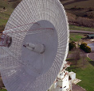
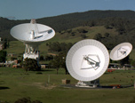
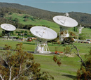
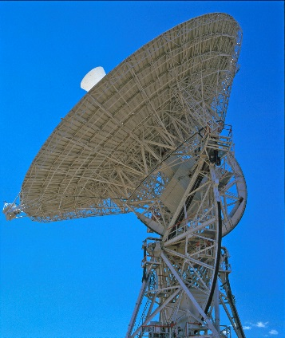
DSS-17 Affiliated Station
Fig. 1: LH2 Tank Installed at Test Site
Fig. 3new: C&C Trailer
Notes:
15

Slide 16
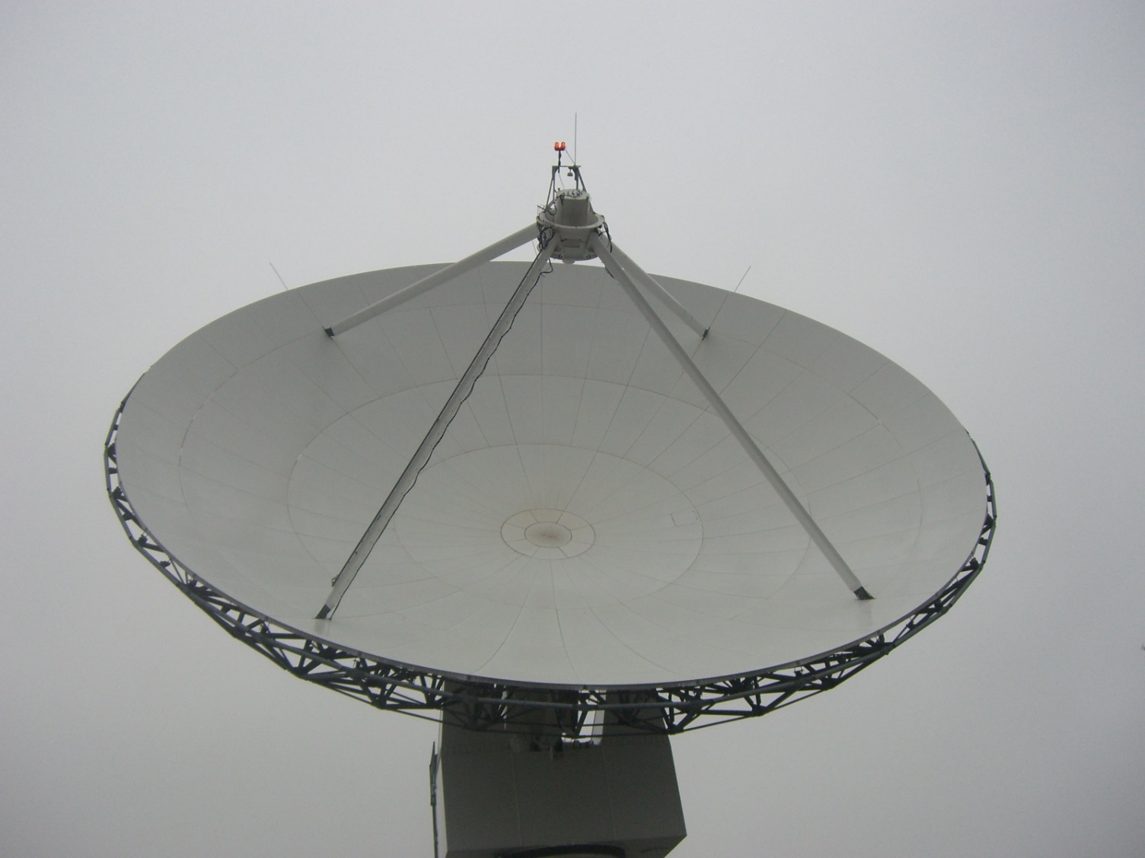
Questions?

