Slide 1
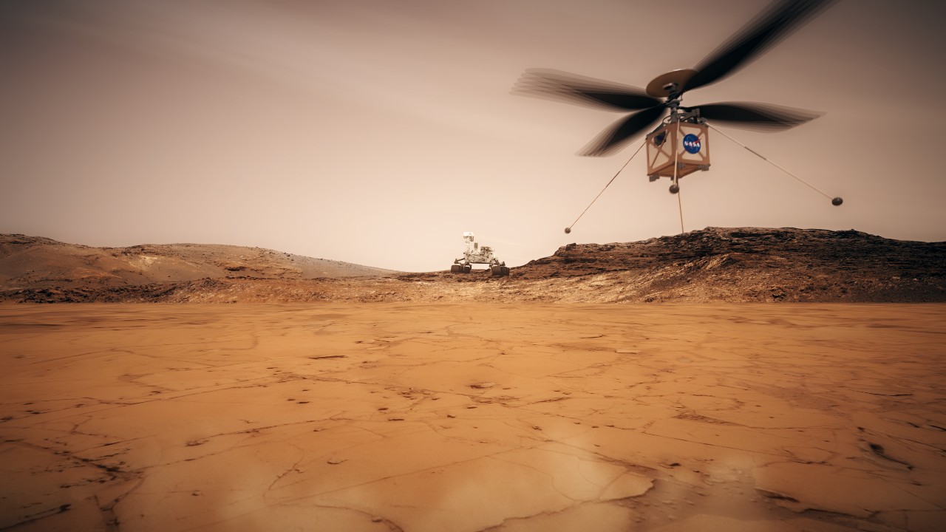

Joint effort of Jet Propulsion Laboratory, Ames Research Center, Langley Research Center, Glenn Research Center, and AeroVironment Inc.
Ingenuity Mars Helicopter Technology Demonstration
Courtney Duncan, Jet Propulsion Laboratory – California Institute of Technology
May 11, 2020 Interplanetary SmallSat Conference Streaming

Slide 2
Ingenuity Mars Helicopter Technology Demonstration
The Mars Helicopter Technology Demonstration is now in final preparation for launch to Mars with JPL's Mars 2020 Rover in July 2020. The helicopter plans to execute the first heavier-than-air flight on another planet in April-May 2021. This presentation will overview the helicopter mission and requirements; the design and special circumstances of flight in the thin, cold air of Mars; and some of the commercial off the shelf technologies used.
  With an emphasis on the telecom connection to the Perseverance Rover
JPL URS292031 clearance number CL#20-1956

Slide 3
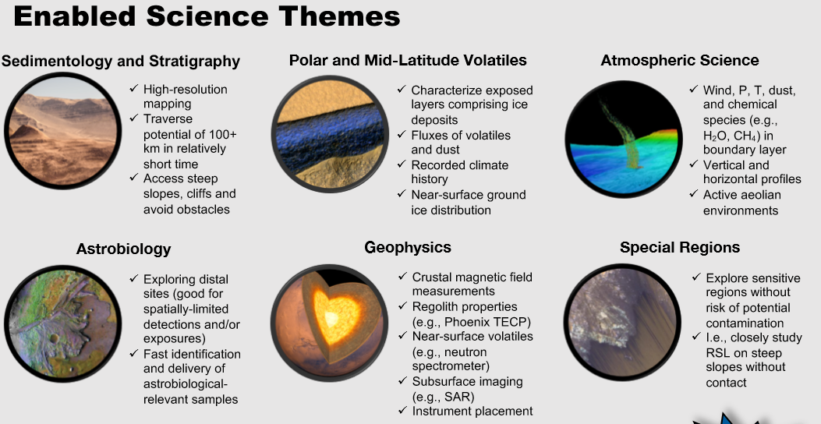
Why Do Planetary Helicopters?
From https://mepag.jpl.nasa.gov/

Slide 4
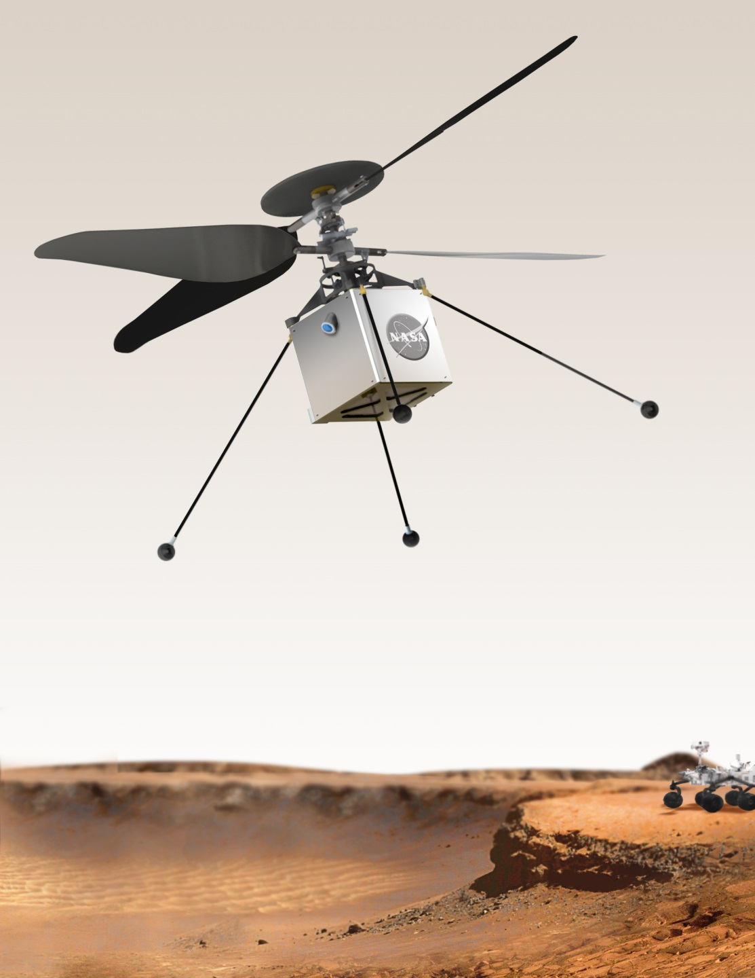
Mars Helicopter Technology Demonstration on Mars 2020
Capable of flight in thin Mars atmosphere (~1% of Earth, equiv. 30 km)
“Co-axial” Helicopter
Blades 1.2-meter tip-to-tip
Mass ~1.7 Kg
Solar powered – up to 90-second flight per sol
Flight distances up to 300 m
Heights up to 10 m
Autonomous flight & landing
Up to 5 flights
Telecommunication to Base Station on Rover
Self-sufficient thermal control (nights < -100C)

Slide 5
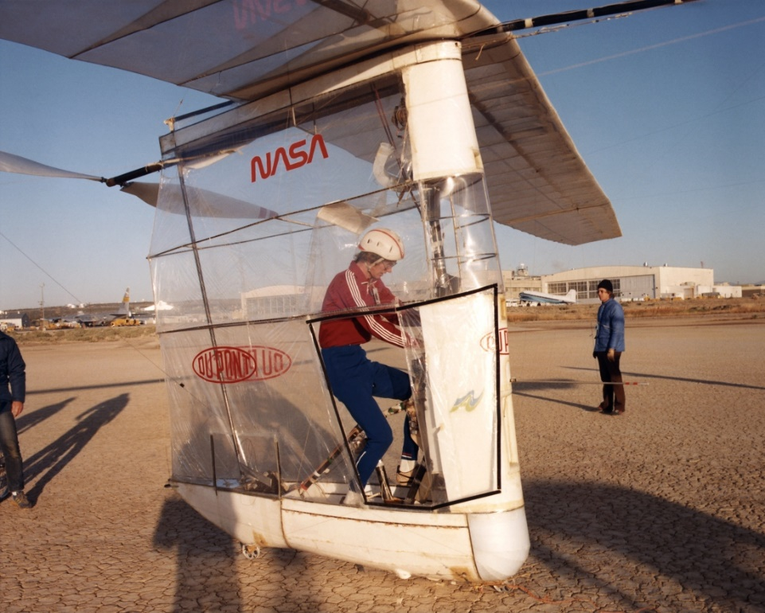
AeroVironment – Major Industrial Partner
Founded by Paul MacReady
  Designer of the human-powered Gossamer Condor that won the Kremer Prize
  And the Gossamer Albatross that crossed the English Channel
    Piloted by Bryan Allen, now at JPL
Simi Valley, CA
  Unmanned electric aerial vehicles, drones
  Experience with unusual designs and environments
  Military systems, precision agriculture, etc.
Mars Helicopter rotors, motors, servos, mast & wiring, landing gear

Slide 6
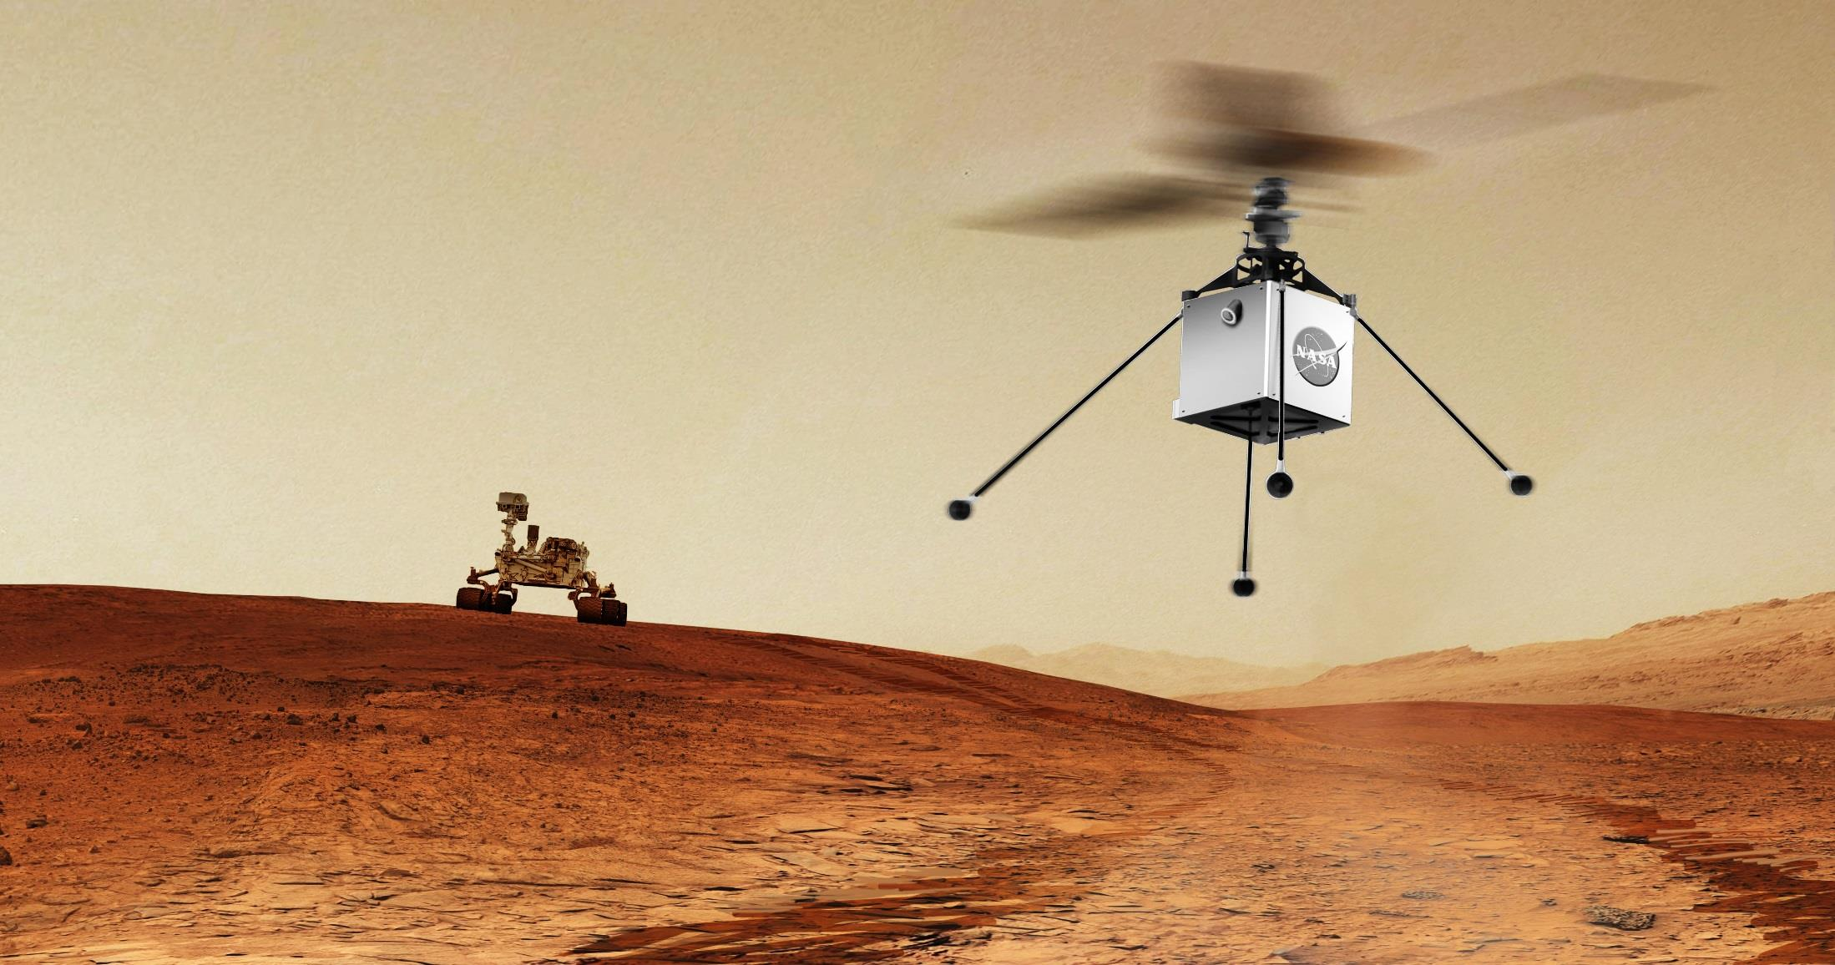
After Deployment from Rover,
Ingenuity Operates in Stand-Alone Fashion, with Radio Link to Base Station on Perseverance
Solar powered
Radio Link to Helicopter Base Station on Rover
Relay data back to Earth through rover
Closed-loop thermal control for cold Martian nights

Slide 7


Five Technology Demonstration Flights at Mars (TBR)
To be completed within 118 sols of Rover landing
To be completed within 30 sols of deployment from Rover in a 10m x 10m “parking lot” meeting Mars Helicopter technology demonstration requirements
Fly out ~500m away
5m
5-10m
Fly ~50m out and back
3m
Fly to new “parking lot” ~50m away
Flight 1
Ascend, hover, land
Take picture of Rover
Rover takes picture of Helicopter in flight
Flight 2
Fly higher vertical ascent & descent and modest lateral motion
Flight 3
Fly large lateral flight path that returns to starting point
Perform scout function to image terrain far ahead of “parking lot”
Certify new “parking lot” (on Earth)
Flight 4-5
Contingency for Flights 1-3
If contingency flights are not needed, then consider the following options:
Fly to new “parking lot”
Fly away to maximum distance that the vehicle can fly (~500m). Note: destination landing site will not have been surveyed.
Minimum Mission Success

Slide 8
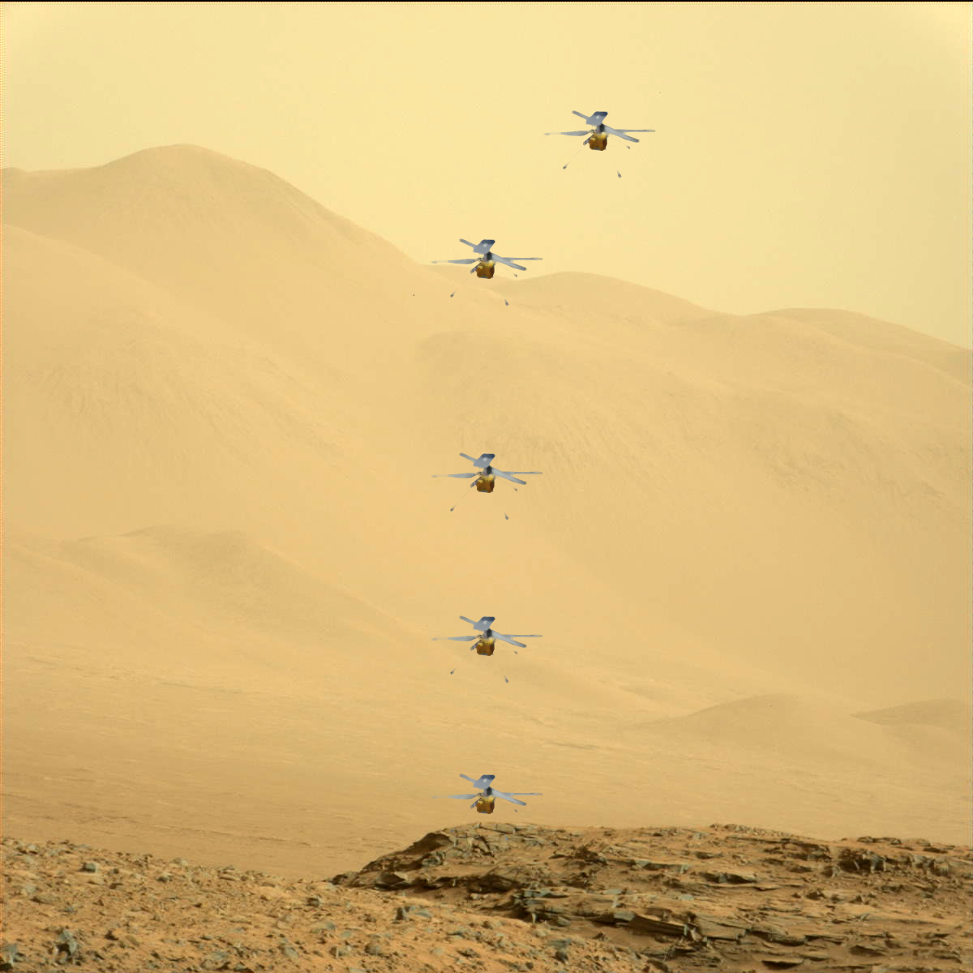
Potential Images From Rover
Mastcam-Z
(Full Res) w/ some noise)
Blades are ~ 145 pixels at full zoom
Body Cube ~ 19 pixels at full zoom
NavCams at 100m:< 3.5 cm/pixel
At highest resolution:
  Blade length = 36/5120 pixels
  Body cube = 3.6/5120 pixels
NavCam Imaging Plan Proposal:
  2x2 & 2x2 tile exposed and read out every ~ 6 seconds
  7 cm/pixel

Slide 9
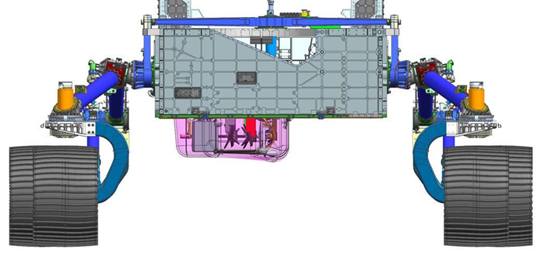
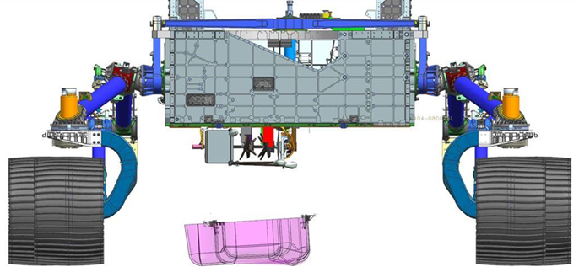
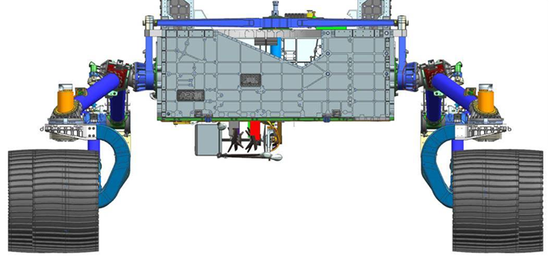
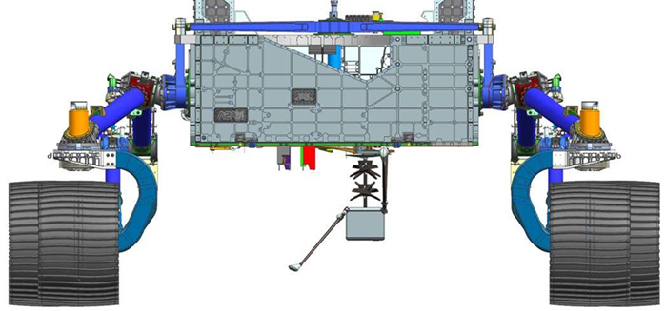
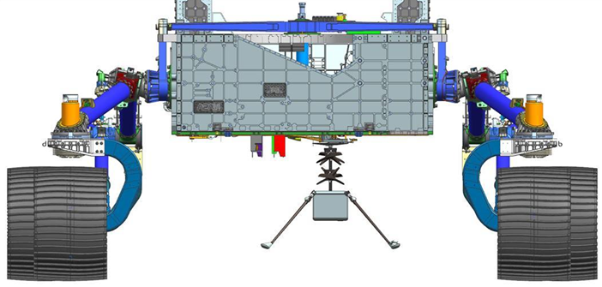
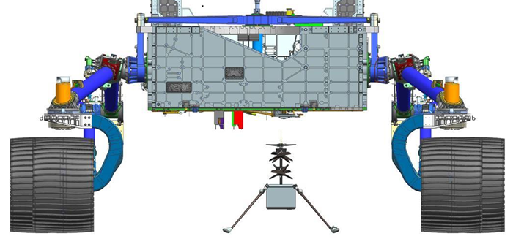
Deployment….
A: Jettison Debris Shield ¼” Cable Cutter Pyros fired severing restraint cables that allows the Debris Shield to drop from the Rover. After drop Rover executes forward drive to prepare for rest of deployment activities
B: Heli Launch Lock Release Frangibolt energized releasing lower Heli Launch Lock Restraint. Egress Arm / Heli Assy held in place by Egress Arm Restraint
C: Egress Arm Restraint Release and Egress Arm Deploy Cable Cutter Pyro fired releasing MHDS Egress Arm. Egress Arm Release initiates rotation of Egress Arm & Heli with actuator in dynamic braking mode. Near the end of the deploy motion the actuator completes the arm deploy motion by driving to the hardstop and latching.
D: Leg Restraint Release Cable Cutter Pyro fired releasing Helicopter Leading Legs allowing them to spring into their fully deployed state. Helicopter is fully configured for drop after this event.
E: Primary Heli Restraint Release & Heli Drop Frangibolt energized releasing Helicopter from Rover & Egress Assy. Helicopter drops to Martian Surface below Rover. After nominal drop is confirmed via telemetry and imagery review Rover executes forward drive to allow Heli Solar Arrays to resume charging

Slide 10
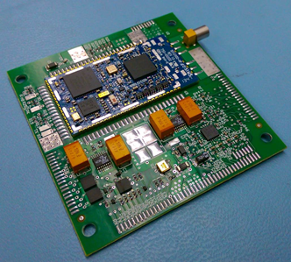
Ingenuity Telecom Specifications
Cost: $60 per unit
Mass prepped: ~3.5g
Power Out: 29 dBm (0.8 W)
Band: 906-924 MHz (10 ch.)
Antennas: 1 or 2
10 gram mass
  Includes antennas and cables
  13.3 grams achieved (helicopter side)
Rover side (HBE) uses the same electronics boards
Telecom up to 1000 m., two-way
  NFZ is 100 m. radius
  no radio-navigation
Over-the-air rates 20 kbps, 250 kbps
DC power: TX < 3 W, RX < 0.2 W
Temperature -40 to +85 C, -50 C non-op
Protocol modified from ZigBee (IEEE 802.15.4)
UART connection to SnapDragon “NAV” computer
COTS Part Selection Criteria
  Very Low Mass suggests COTS ISM
  Low frequency for lowest omni to omni path loss, 900 MHz is lowest ISM band
  “High Power” – most ISM parts run a few 10s of mW, want closer to a watt
  Diversity – possibility of > 1 antenna
SiFlex COTS Radio

Slide 11
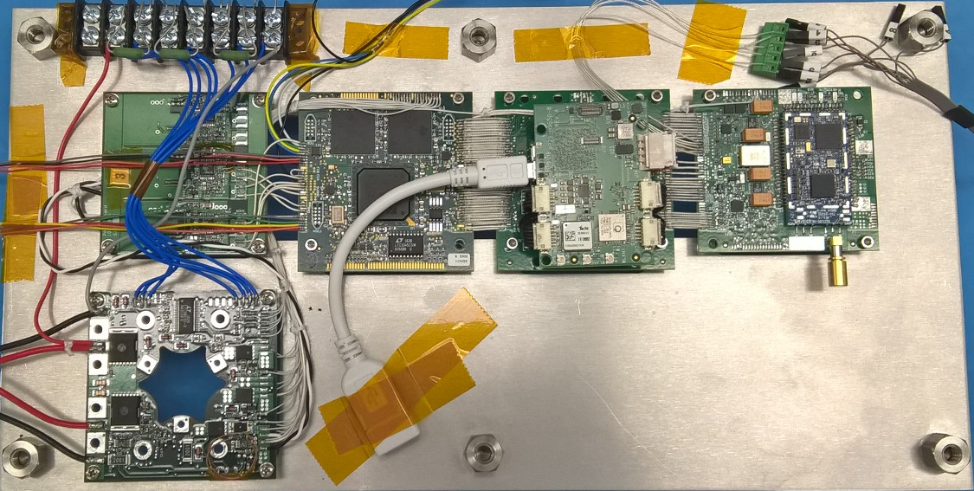
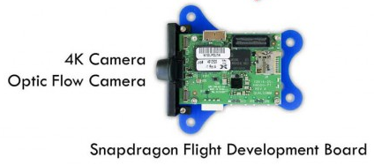
Helicopter FlatSet
Electronics Core Module (ECM)
Helicopter Power Board (HPB)
Flight Control Processor
TMS570LC4357 (x2)
Nav Carrier Board (NCB)
Telecom Board
(TCB)
“cube” style in helicopter
“wallet” style in base station
Qualcomm Snapdragon 801
Processor
SiFlex Modem
FPGA Flight Control Board (FFB)
Servo FETs
FPGA
Actel A3PE3000L
Battery Interface Board (BIB)
11
MHS Flatset 001

Slide 12
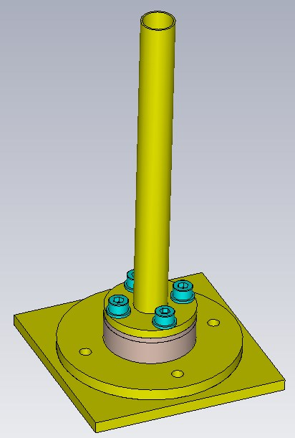
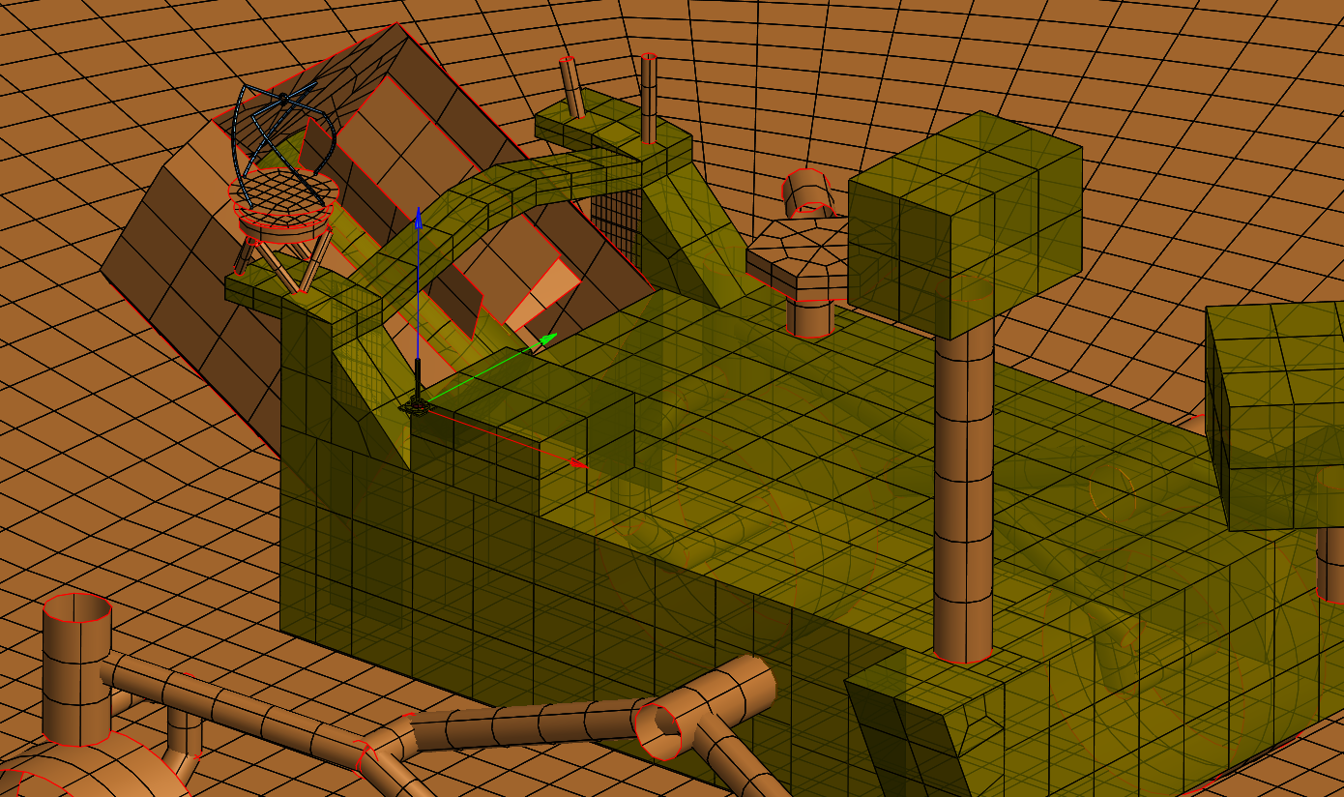
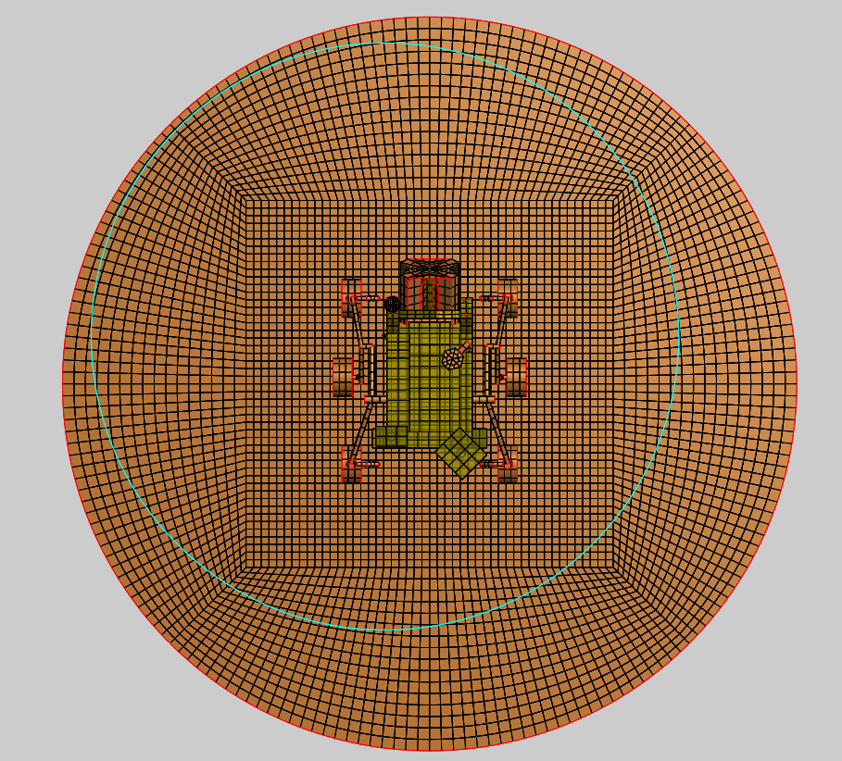
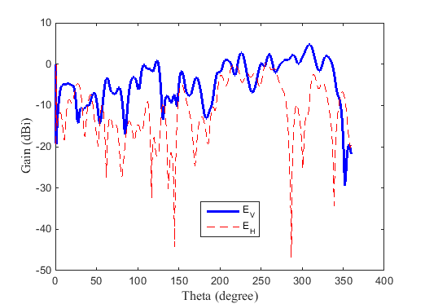
HBS Antenna performance on Mars2020 rover
HBA1
Antenna
θ
Antenna design
Antenna on M2020 Rover
Coordinate system
Helicopter Base Station Antenna (HBA) radiation pattern
Interpretation of results:
Shadowing effects
Multipath (reflections)
Suffers from a very small ground plane
Larger ground plane and/or location would improve the result

Slide 13
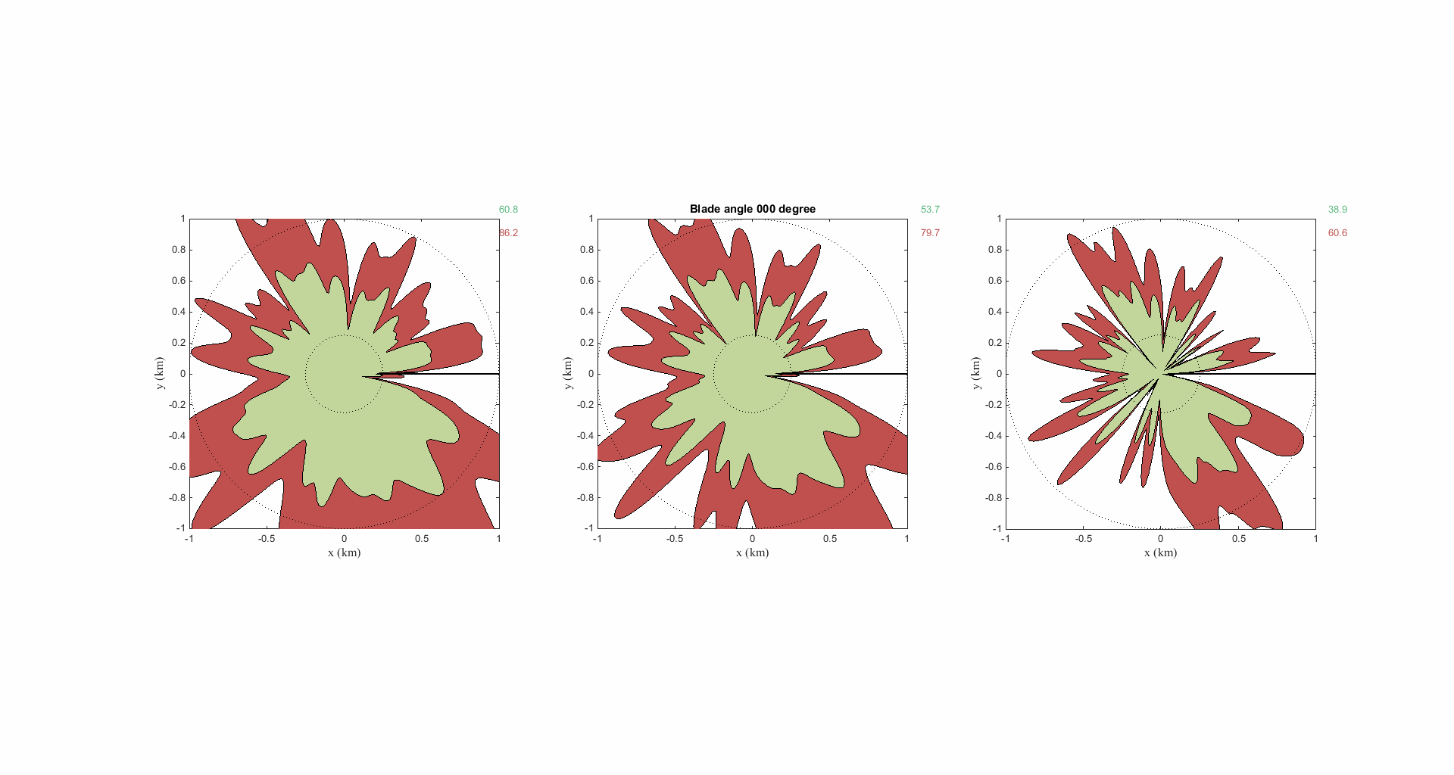
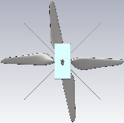
Map Coverage Around M2020 Rover on the Surface
Map coverage assuming min, mean, max polarization loss with blade rotating.
The math is done for all azimuth angles around the helicopter.
These results were obtained using Bullington with h_{t}=0.48m and h_{r}=1.23m.
Note: For best results, park the Rover in a “for comm” orientation.
Received power of >-94dBm ⬄ 250kbps
Received power of [-102, -94] dBm ⬄ 40kbps
No link
5%
1.0 km
0.25km
Min polarization loss
Mean polarization loss
Max polarization loss
Link geometry
Rover
x
Azimuth angle θ_{h} = [0°-359°]
z
θ_{h}

Slide 14
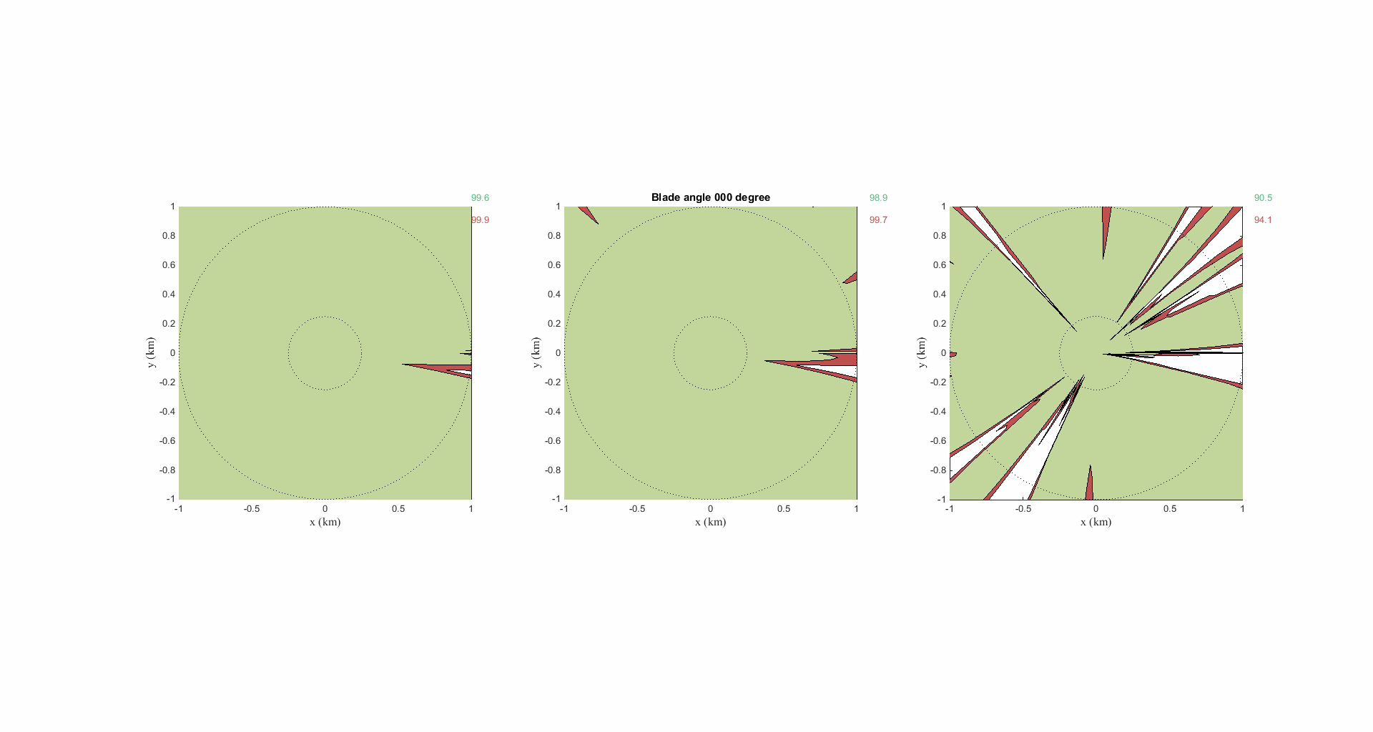
Map Coverage Around M2020 Rover Flying
Map coverage assuming min, mean, max polarization loss with blade rotating.
The math is done for all azimuth angles around the helicopter.
These results were obtained using Bullington with h_{t}=10m, h_{r}=1.23m, and Req = [0.25 - 1] km.
Received power of >-94dBm ⬄ 250kbps
Received power of [-102, -94] dBm ⬄ 40kbps
No link
5%
1.0 km
0.25km
Min polarization loss
Mean polarization loss
Max polarization loss
Link geometry
Rover
x
Azimuth angle θ_{h} = [0°-359°]
z
θ_{h}

Slide 15
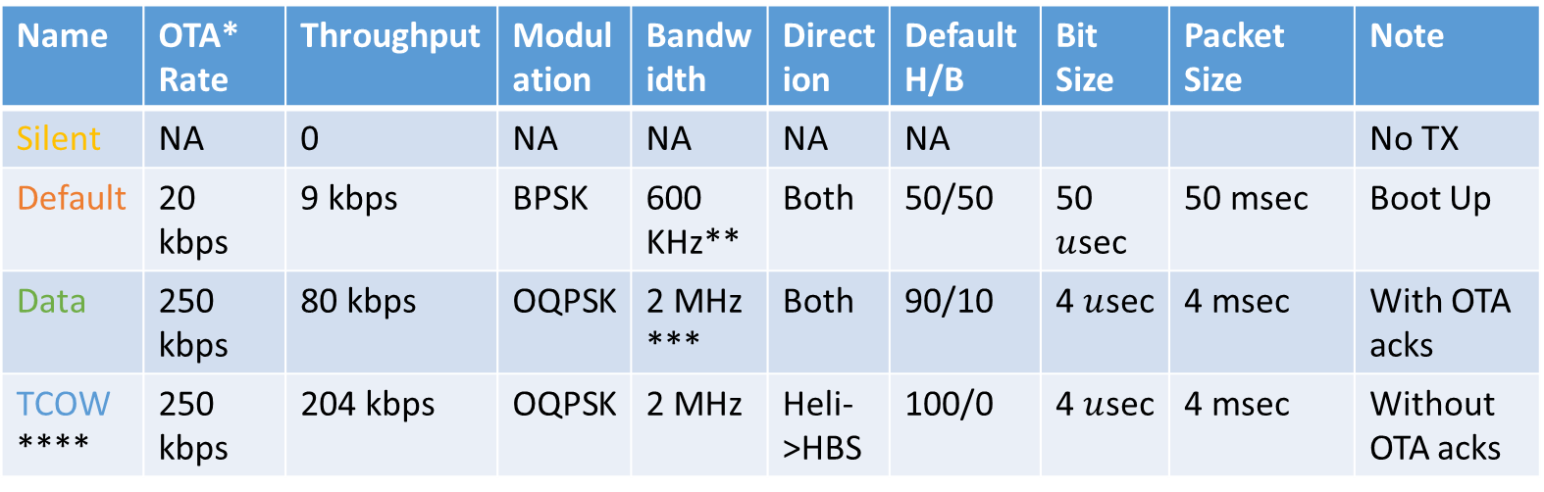
Operating Modes
Name | OTA* Rate | Throughput | Modulation | Bandwidth | Direction | Default H/B | Bit Size | Packet Size | Note
Silent | NA | 0 | NA | NA | NA | NA |  |  | No TX
Default | 20 kbps | 9 kbps | BPSK | 600 KHz** | Both | 50/50 | 50 $u$sec | 50 msec | Boot Up
Data | 250 kbps | 80 kbps | OQPSK | 2 MHz *** | Both | 90/10 | 4 $u$sec | 4 msec | With OTA acks
TCOW **** | 250 kbps | 204 kbps | OQPSK | 2 MHz | Heli->HBS | 100/0 | 4 $u$sec | 4 msec | Without OTA acks
“Silent” under HBS ‘beacon’ control (two node “Mesh” under modified 802.15.4)
* OTA: Over the Air
** Due to 15 chip spreading code
*** Due to Mcps signaling scheme
**** TCOW (Time Critical One Way); VOMIT (Vulnerable, One-way, MHS Information Transfer)

Slide 16
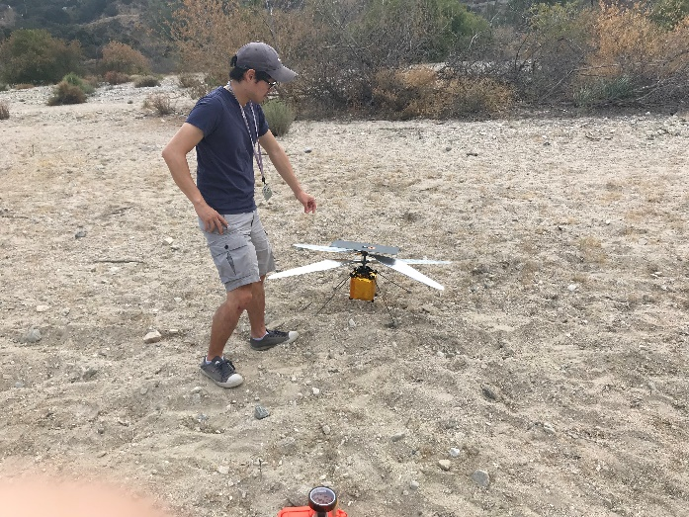
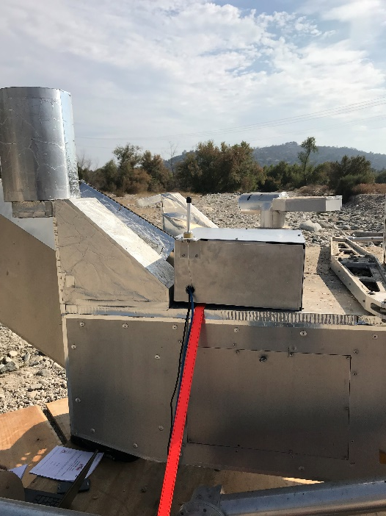
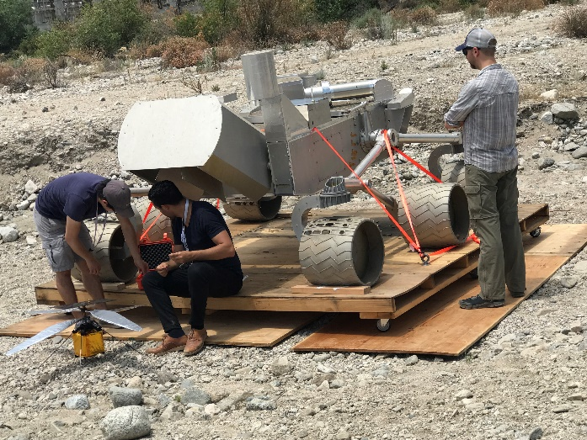
Field Test (JPL Arroyo)
Helicopter Mockup with Antenna
Rover Mockup
View from Rover Mockup antenna to Helicopter Mockup

Slide 17
Questions?

