Slide 1
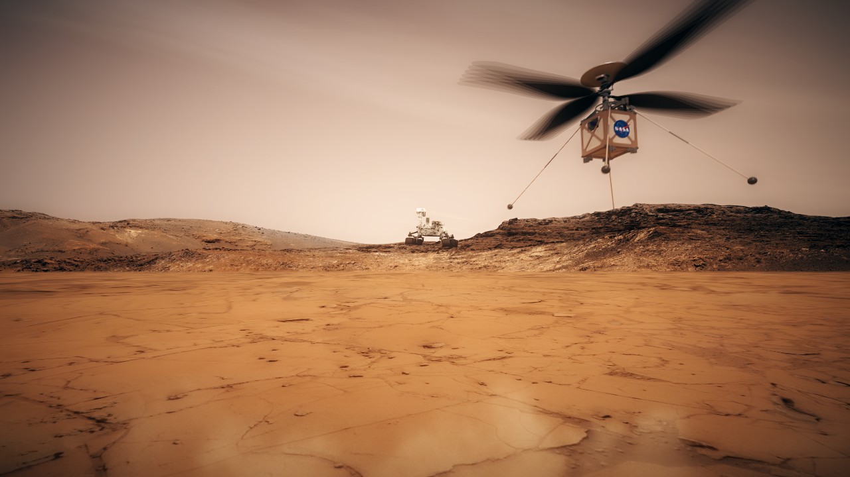

Joint effort of Jet Propulsion Laboratory, Ames Research Center, Langley Research Center, Glenn Research Center, and AeroVironment Inc.
Ingenuity Mars Helicopter Technology Demonstration
Courtney Duncan, Jet Propulsion Laboratory – California Institute of Technology
May 11, 2020 Interplanetary SmallSat Conference Streaming

Slide 2
Ingenuity Mars Helicopter Technology Demonstration
The Mars Helicopter Technology Demonstration is now in final preparation for launch to Mars with JPL's Mars 2020 Rover in July 2020. The helicopter plans to execute the first heavier-than-air flight on another planet in April-May 2021. This presentation will overview the helicopter mission and requirements; the design and special circumstances of flight in the thin, cold air of Mars; and some of the commercial off the shelf technologies used.
  With an emphasis on the telecom connection to the Perseverance Rover
JPL URS292031 clearance number CL#20-1956

