Slide 1
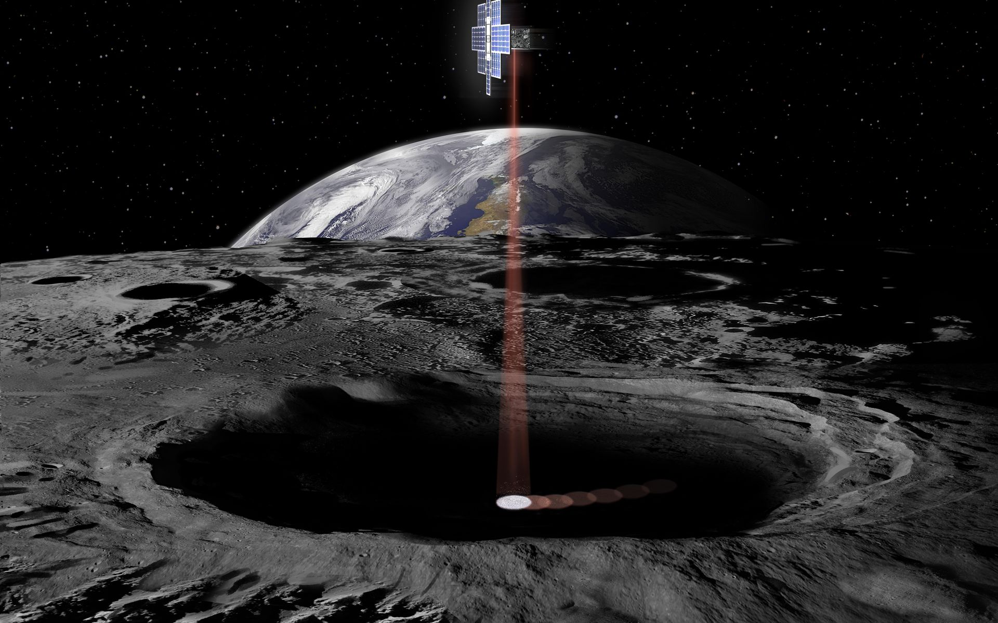

Lunar Flashlight Mission Overview
Daniel Grebow, Stefano Campagnola, Robert Haw, Theodore Sweetser
© 2019 California Institute of Technology. Government sponsorship acknowledged.

Slide 2
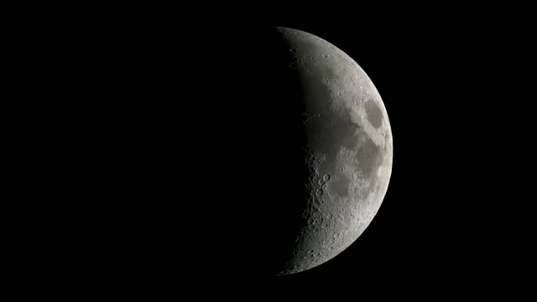
Lunar Flashlight
One of several CubeSats launching with Artemis I
Objective: determine the presence and abundance of water ice in cold traps at the south pole by shining lasers into shaded regions and measuring surface reflection
Science orbit is a northern Near-Rectilinear Halo Orbit (NRHO)
Video credit: NASA/Goddard Space Flight Center
Notes:
Include graphic for lunar flashlight

Slide 3
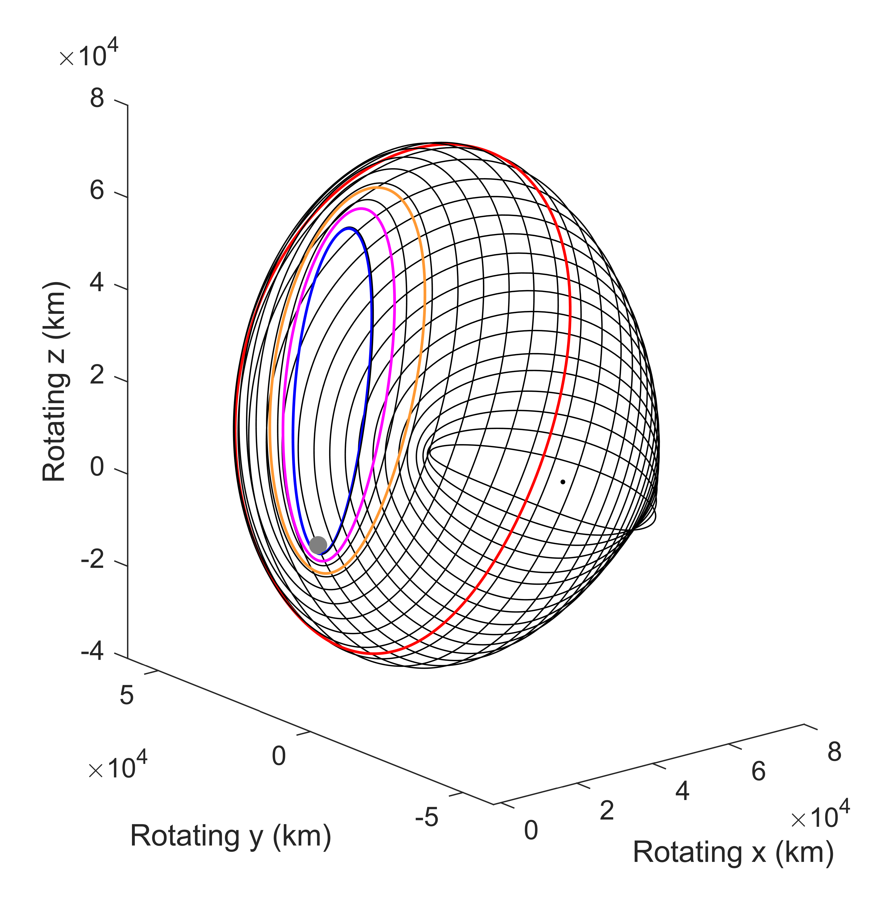
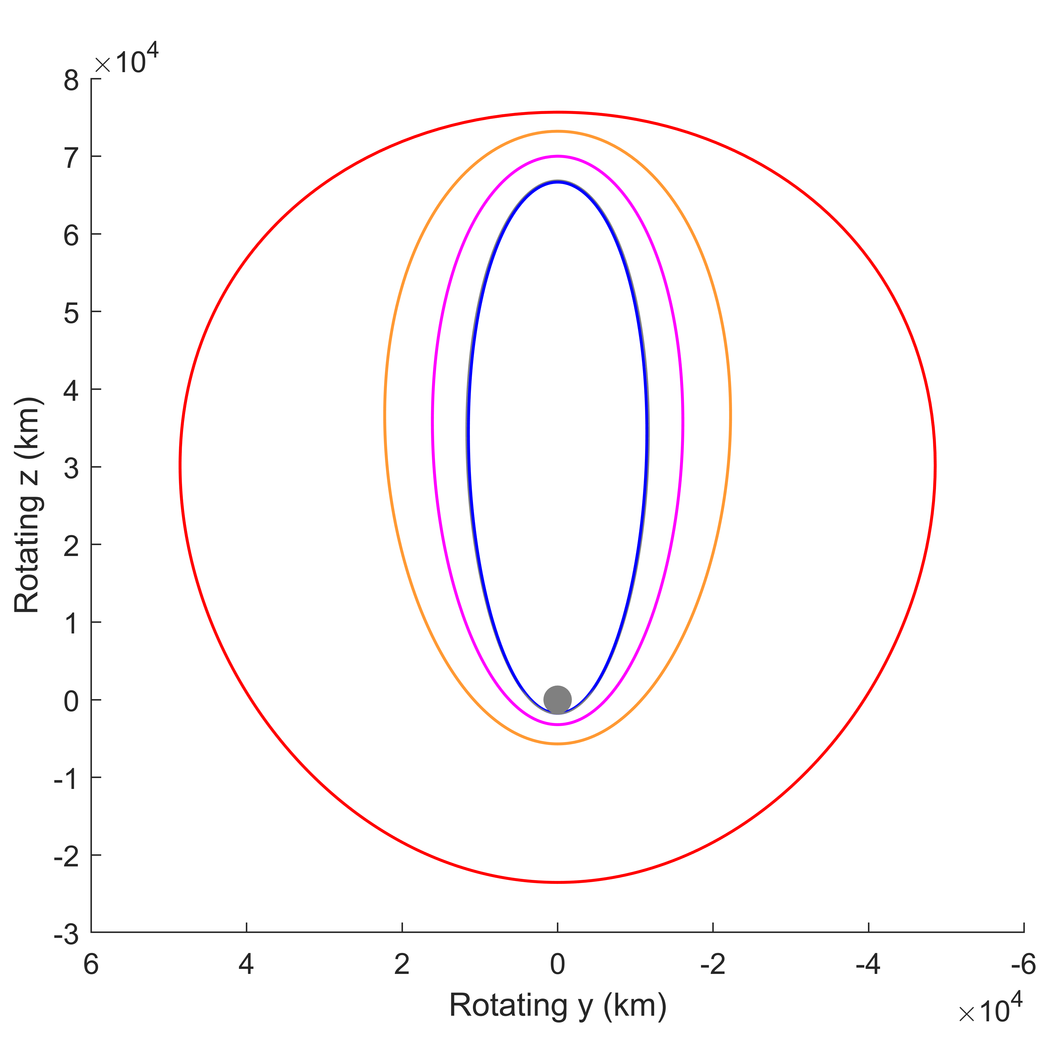
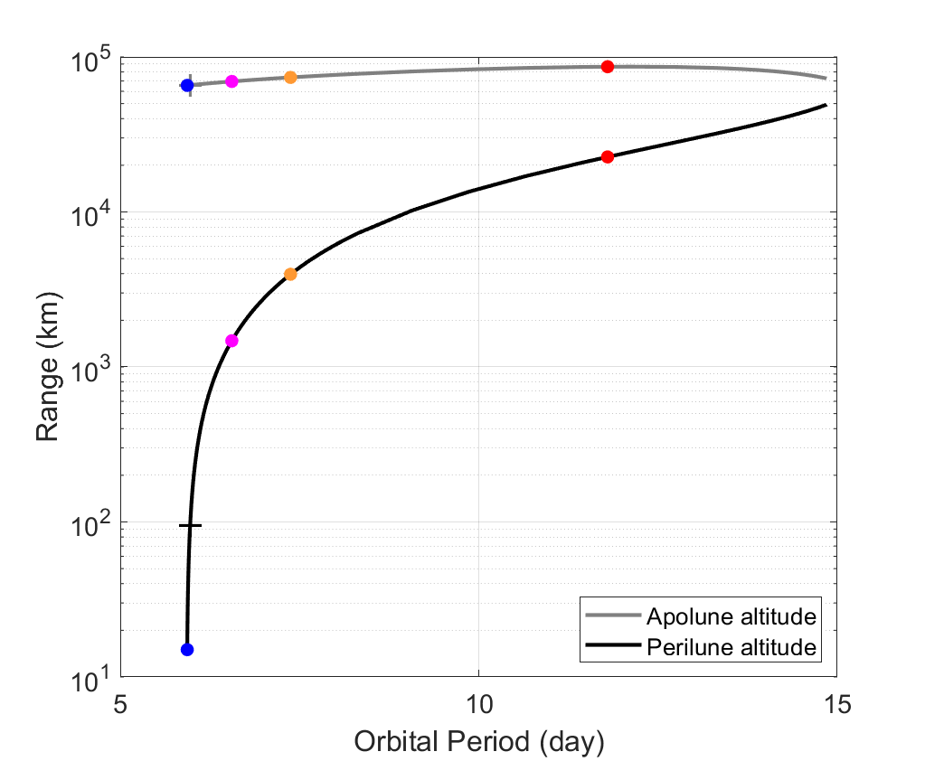
Earth-Moon L₂ Northern Halo Orbit Family
CR3BP
3D View
View from Earth
Apse Altitude vs. Orbital Period
5:2
5:2
|ν|_{max} = 18
4:1
|ν|_{max} = 3
4:1
9:2
|ν|_{max} = 2
9:2
Stability change (bifurcation with period doubling family)
Moon
LF
L₂
Lunar Flashlight
|ν|_{max} = 1
to Earth
Spacecraft always has direct line-of-sight with Earth, orbital direction of motion is clockwise as viewed from Earth, views above are in Moon-centered Earth-Moon-rotating coordinates.
Notes:
YES

Slide 4
Transitioning NRHO to Full Ephemeris Model
Variables:
Δt₁/2
`
`
`
. . .
`
x_{b,2}
r_{i} , v_{i} , t_{i}
Δv_{f,i} , t_{f,i}
Δv_{b,i+1} , t_{b,i+1}
x_{f,1}
Constraints:
Δv_{f,1},t_{f,1}
Δv_{b,2},t_{b,2}
x_{b,i+1} - x_{f,i} = 0
r_{i} · v_{i} = 0
r_{low} ≤ ǁr_{i}ǁ ≤ r_{upp}
t_{i} + t_{bnd} ≤ t_{f,i} ≤ t_{i} + Δt_{i}/2
t_{i+1} - Δt_{i}/2 ≤ t_{b,i+1} ≤ t_{i+1} - t_{bnd}
Objective:
t_{bnd}
t_{bnd}
r₁,v₁,t₁
r₂,v₂,t₂
r_{n},v_{n},t_{n}
min J = ∑ ǁΔv_{f,i}ǁ² + ǁΔv_{b,i+1}ǁ²
Initial guess for r_{i}, v_{i}, t_{i} from CR3BP periodic orbit
Notes:
YES
Mention that tbnd is 24 hours

Slide 5
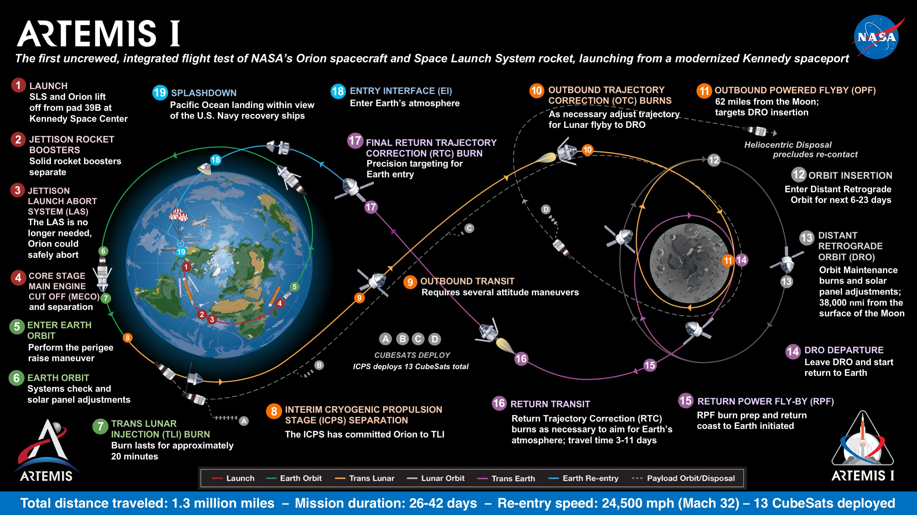
Image credit: NASA
Notes:
Con ops?
Include graphic
Is TCM-1 based on

Slide 6
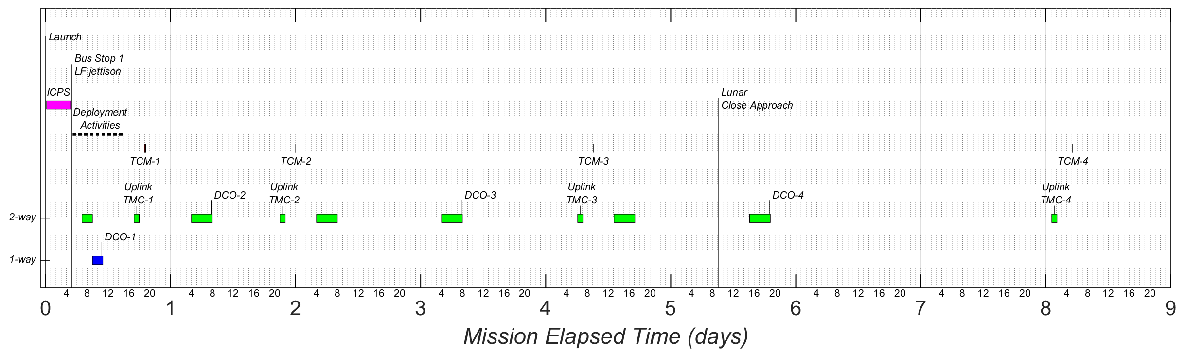
Post-Launch Notional ConOps

Slide 7
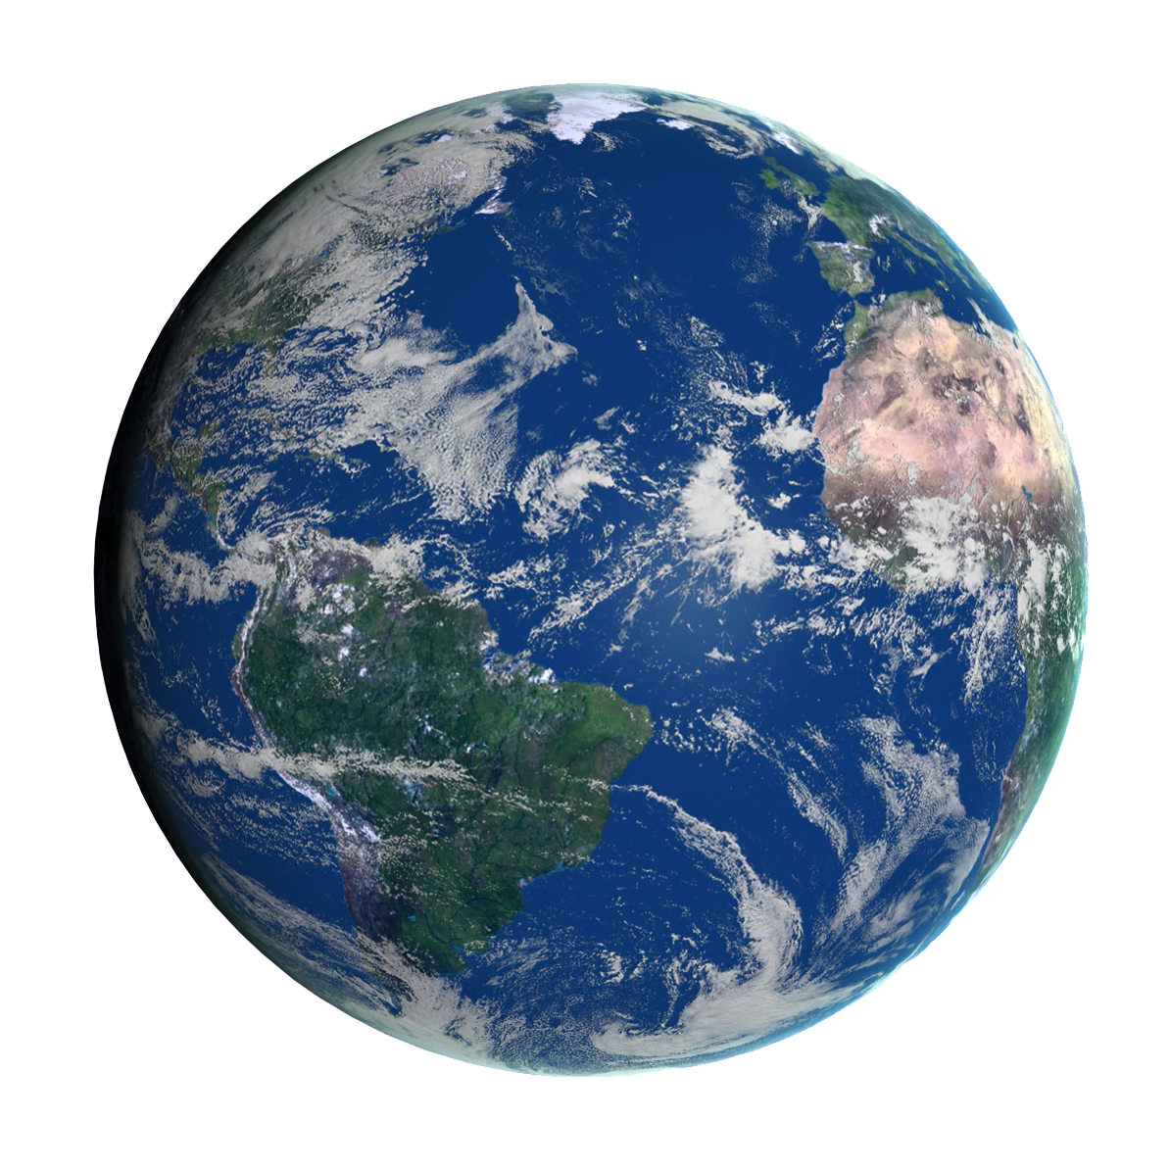
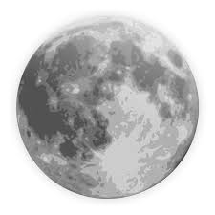
Transfer trajectory – design approach
Create database of trajectories, propagated forward from interim cryogenic propulsion stage (ICPS) separation and backward from Lunar Orbit Insertion (LOI)
  NASA’s Advanced Concepts Organization delivered Oct 2019 ICPS post-disposal states ranging 11/6/2020 – 10/14/2021
  From data selected Aug 14, 2021 as ‘notional’ launch for study
Patch trajectories with similar states at apogees, optimize
This robust approach is adaptable for automation, which is critical for LF due to the need to compute one or more different solutions per launch day
Heritage from EQUULEUS
Patching Apogee
12 h
Launch
ΔV1
Optionally:
Multiple revs,
Multiple lunar flybys
separation from ICPS
LOI
Notes:
100 points 10-day prop to filter out lunar crashes
50,000 points and remove crashing points
20 points of dv 1-20 m/s
Couple of hours on 20 cores

Slide 8
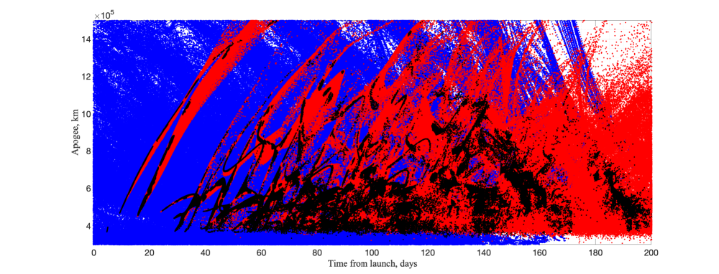
Patching databases for notional launch on Aug 14, 8 pm UTC
Notes:
States and times are close 100,000 km
12 hours

Slide 9
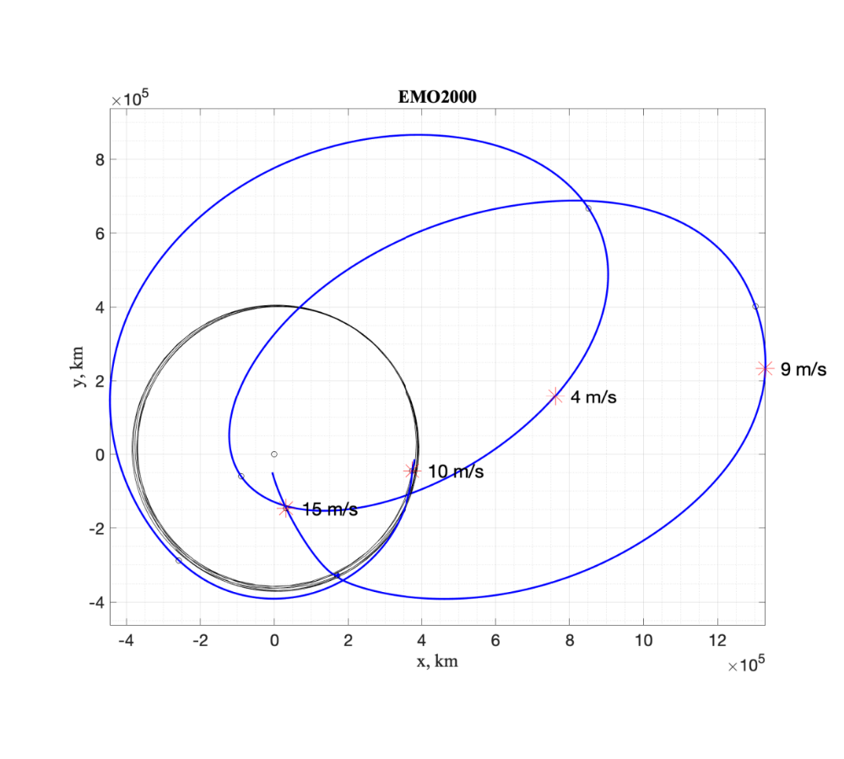
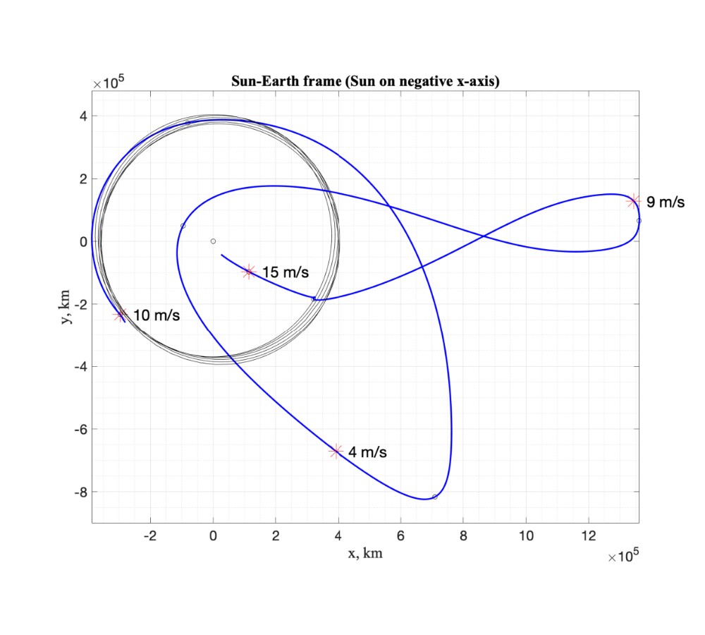
Notional Lunar Flashlight Transfer
Flight time: 173 days
Launch
Aug. 14, 2021
Sep. 27, 2021
LOI
Feb. 4, 2022
LOI
Feb. 4, 2022
Dec. 3, 2021
Launch
Aug. 14, 2021

Slide 10
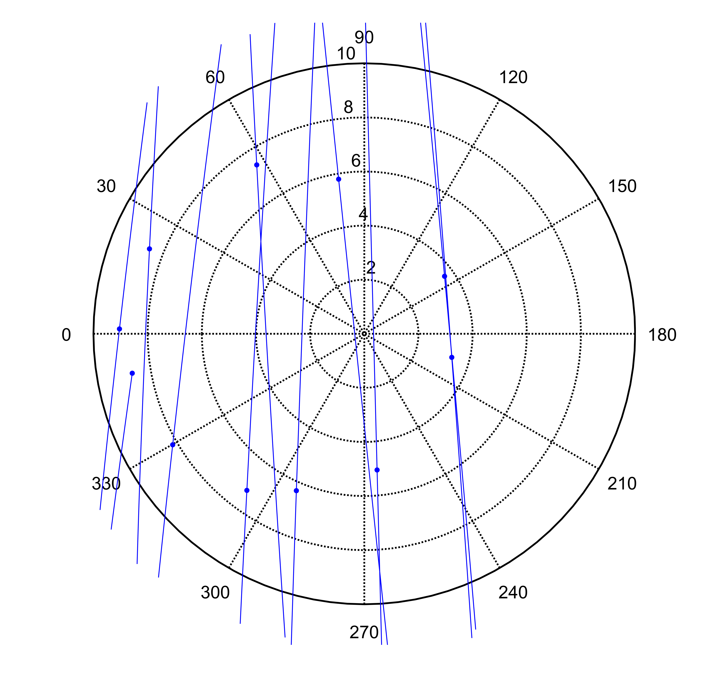
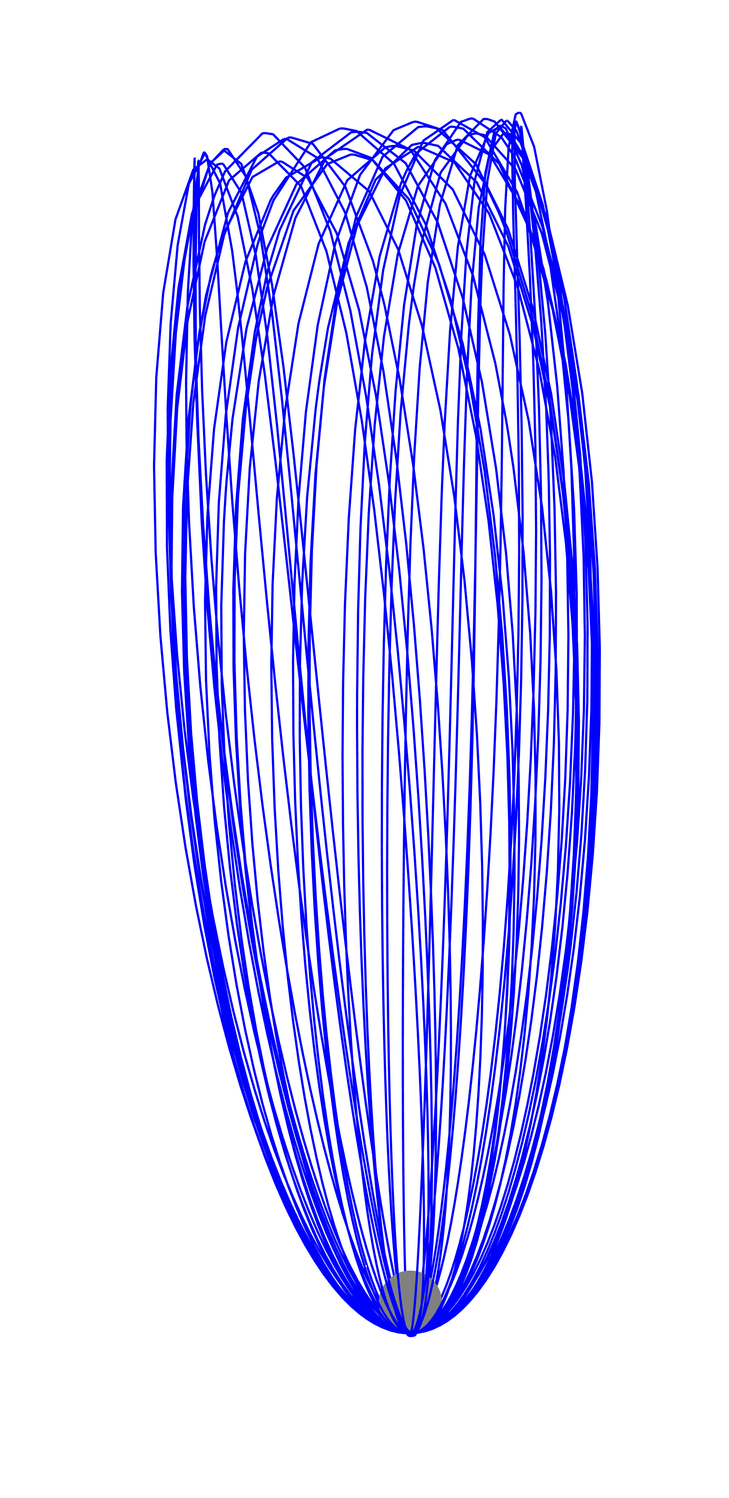
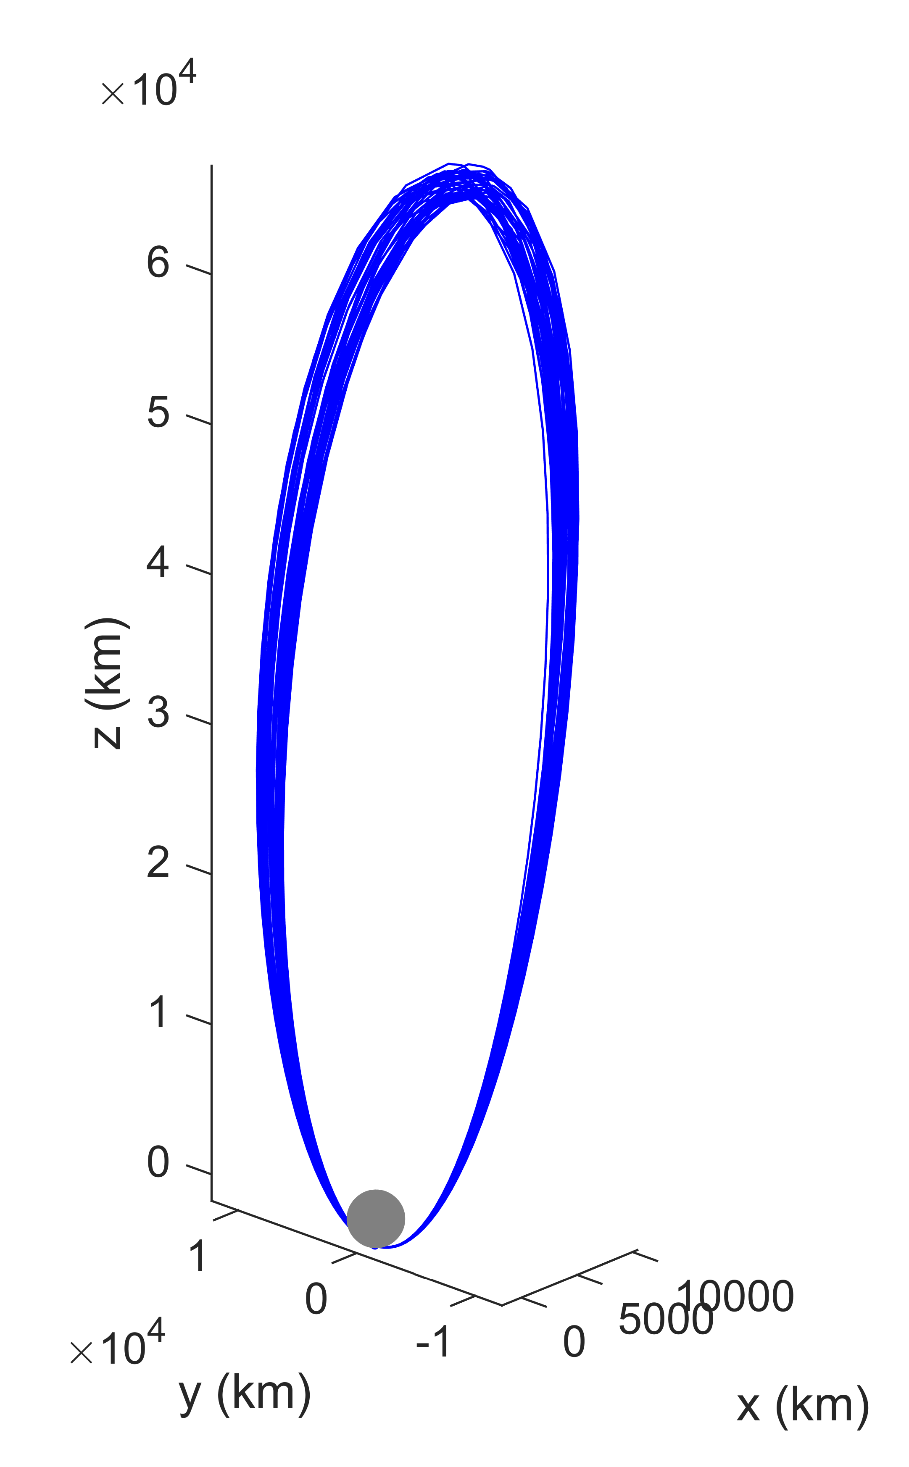
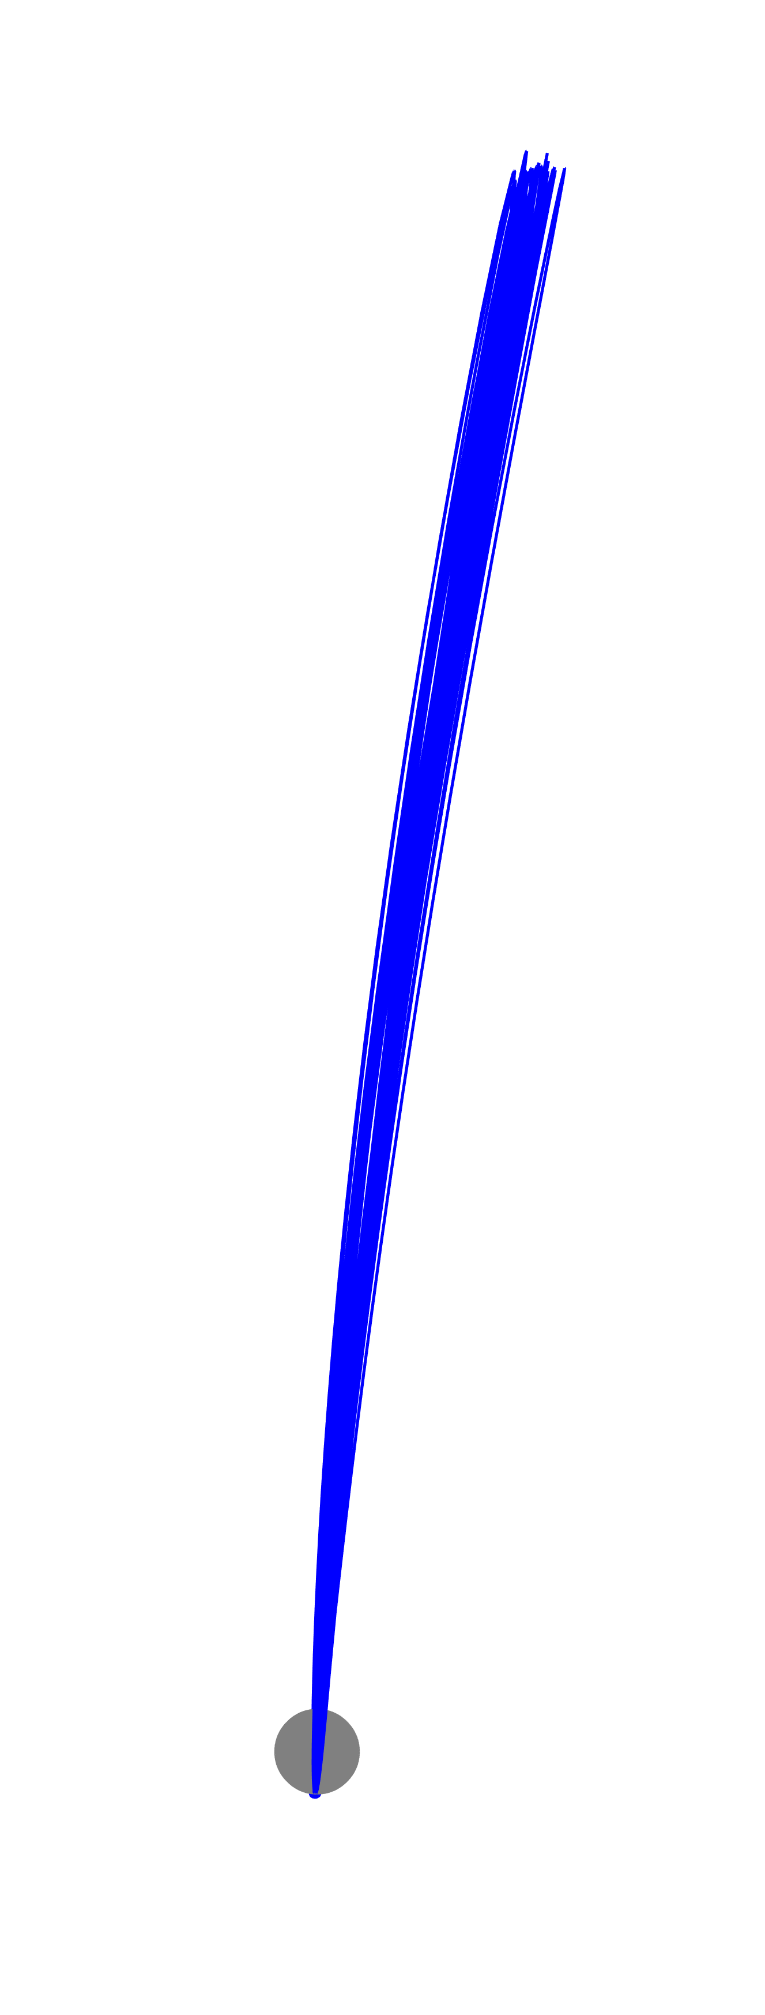
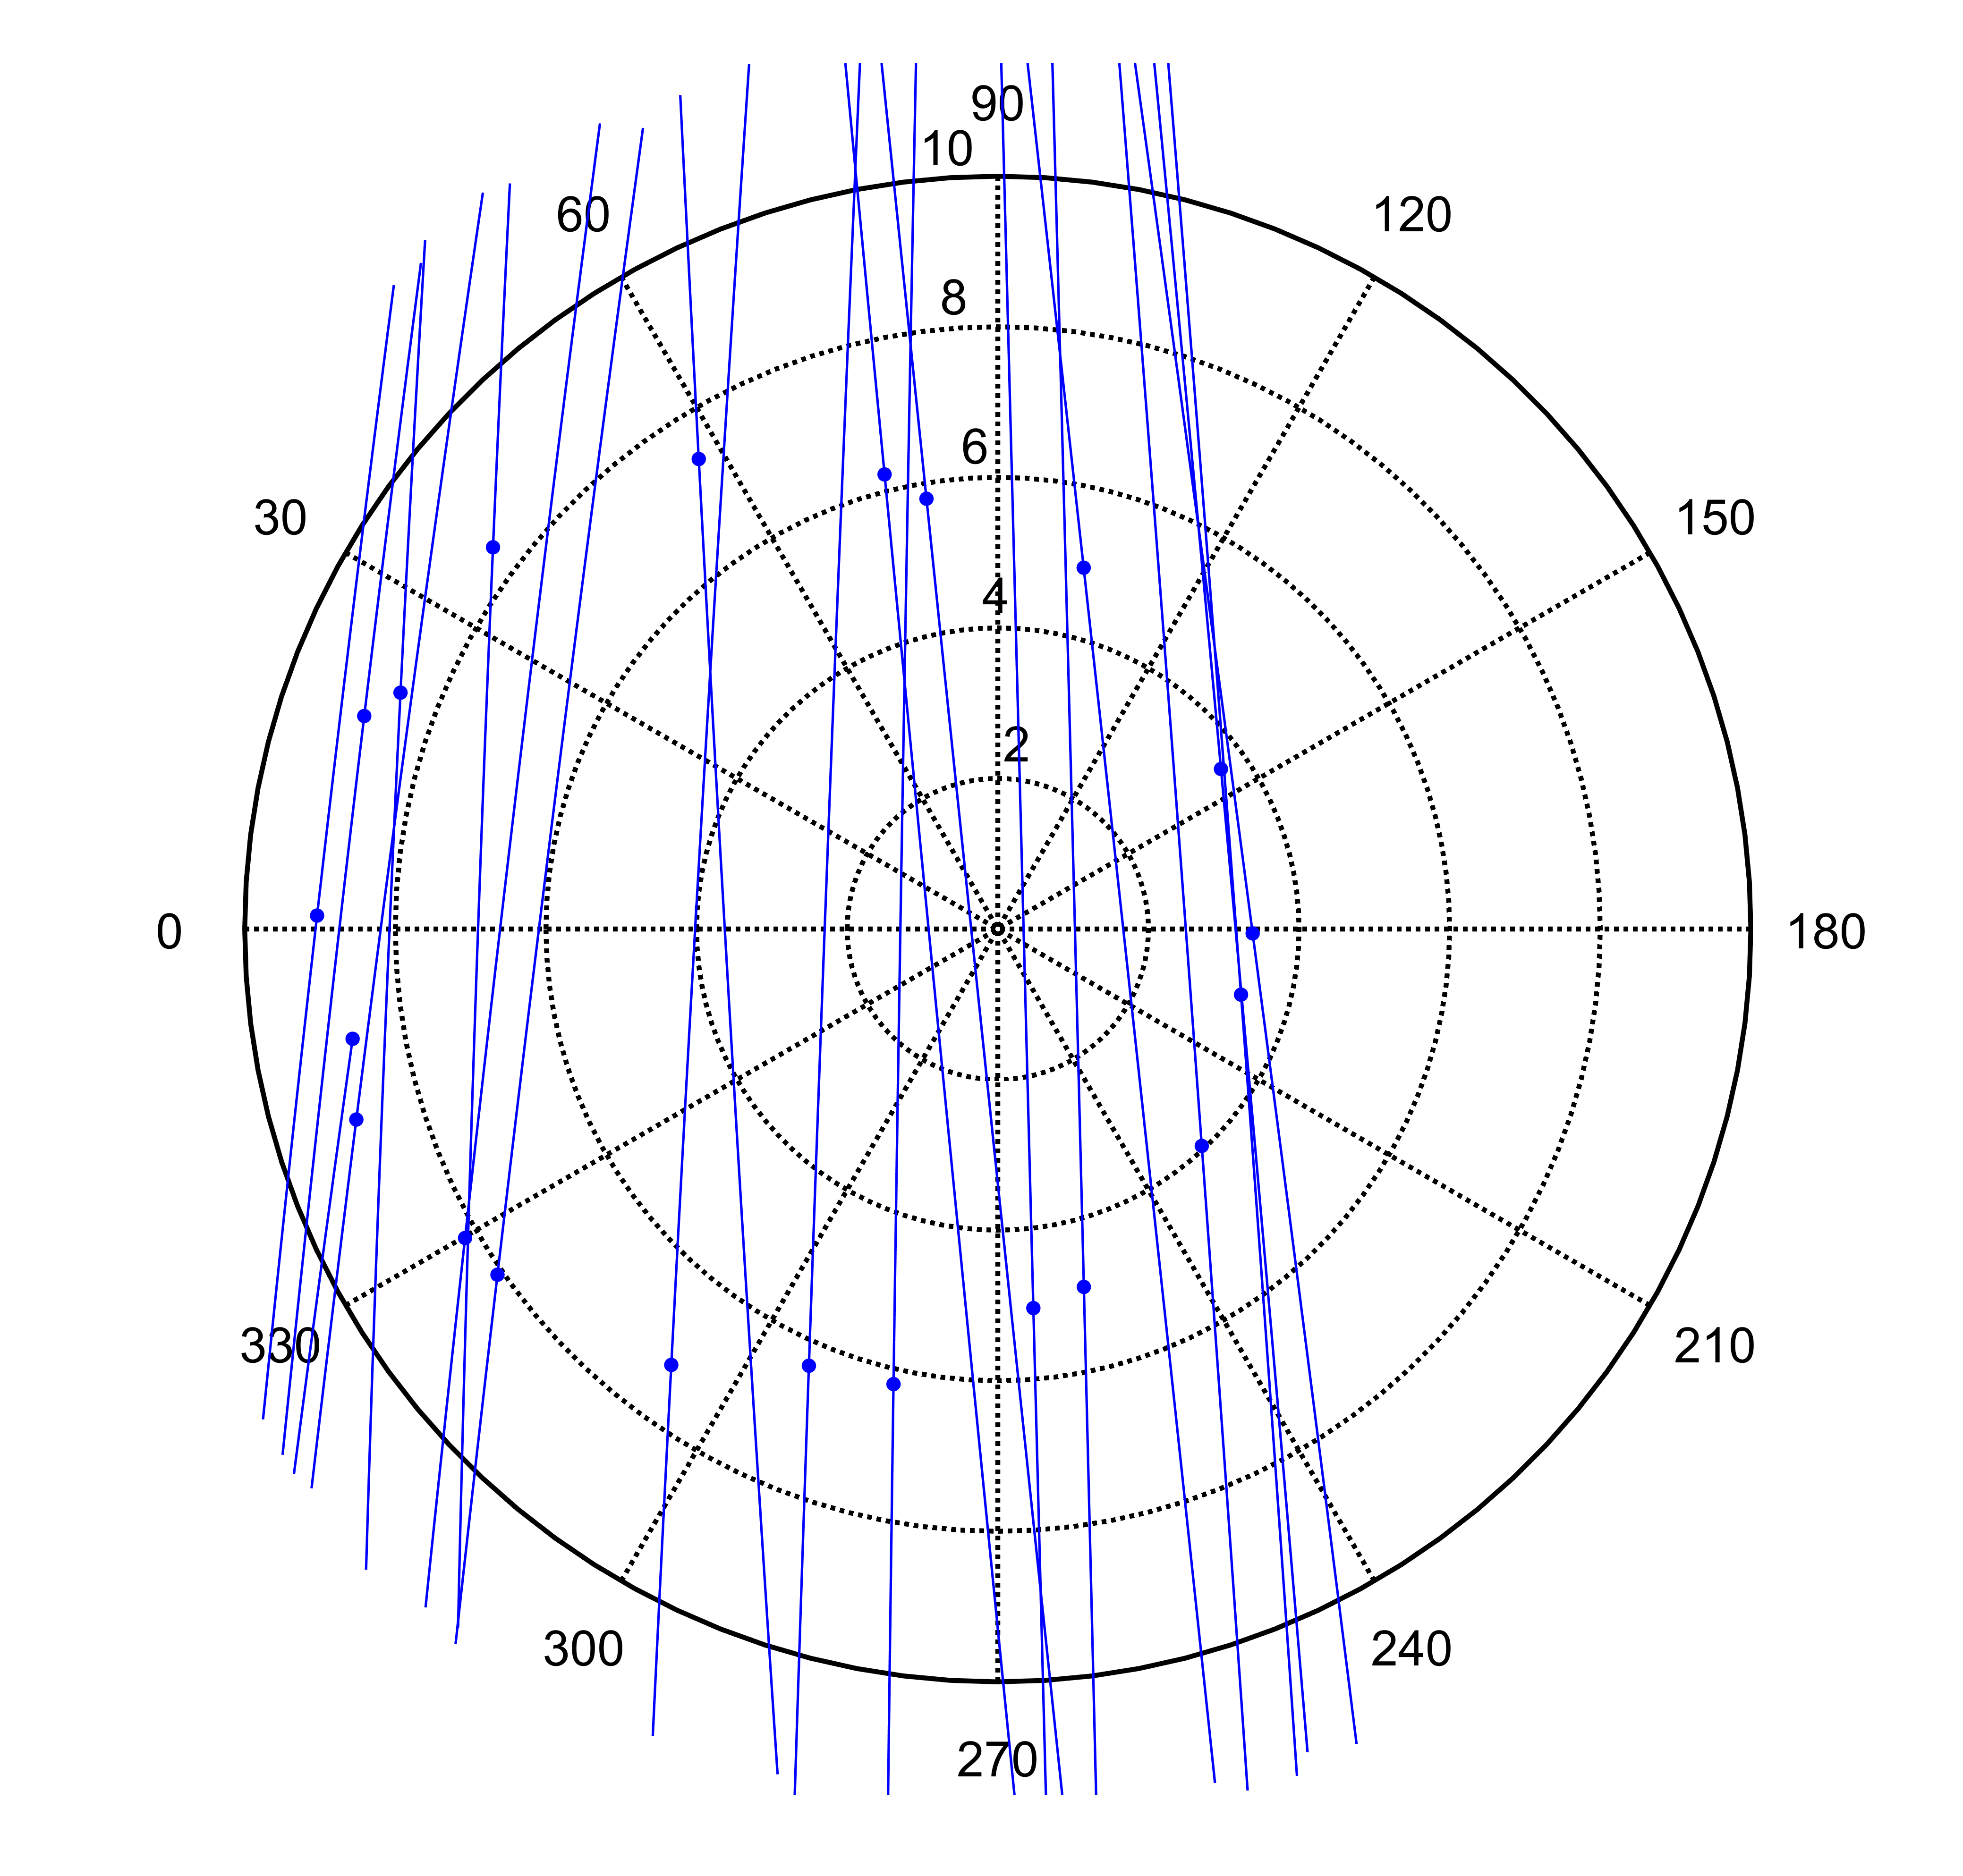
10 passes
Notional Lunar Flashlight Science Orbit
60-day nominal science orbit duration, or 10 close approaches
Earth-Moon
Rotating frame
Rotating frame
Side view
Inertial frame
Δv
0.7 m/s/rev
20 passes
to Earth
to Earth
Orbital Period
5.7-6.1 days
Perilune altitude
15 km ± 0.5 km

Slide 11
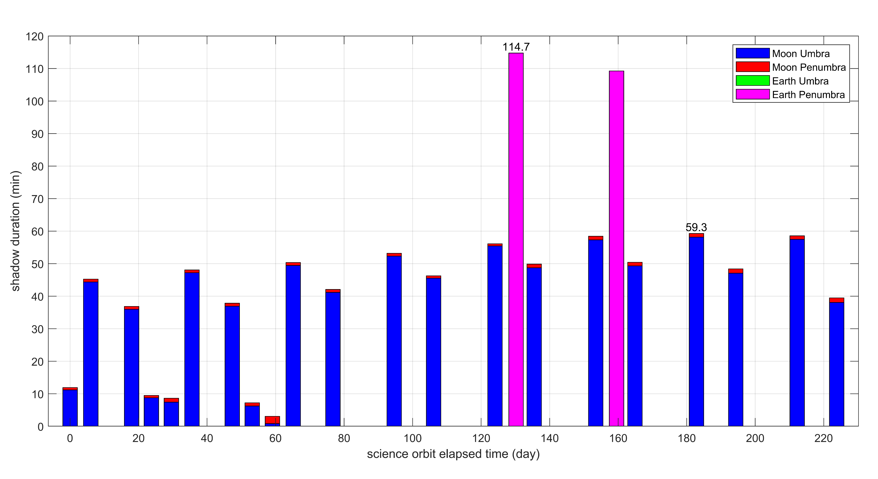
Shadow Times for Notional Science Orbit
June 14
Earth penumbra
Earth shadows never overlap Moon shadows
July 13
Max shadow time for nominal mission ≤50 min
Earth Eclipse Season May 16 – Nov 8
<10-hr windows every month potential eclipse
Feb 4
LOI
science orbit elapsed time (days) since LOI on 2022-02-04
Notes:
Combine this with other slide (shadow graphic)? Make new slide for this?

Slide 12
Mission Duration & ΔV Budget
Total mission duration (< 8-month requirement): 7.8 months
Total notional ΔV: 87 m/s
∆V uncertainty 1-sigma assumed at 25% of each maneuver allocation
 | Notional Reference ΔV (m/s) | Mission Design Allocation ΔV (m/s) | 1-sigma (m/s)
TCMs lunar targeting | 15 | 20 | 5
DSMs | 13 | 50 | 12.5
LOI | 10 | 12 | 3
Science maintenance | 7 | 10 | 2.5
Total (uncertainty RSSed) | 45 | 92 | 14
Total + 3-sigma | 87 | 134 | N/A
Total spacecraft ΔV capability: ~300 m/s

