Slide 1
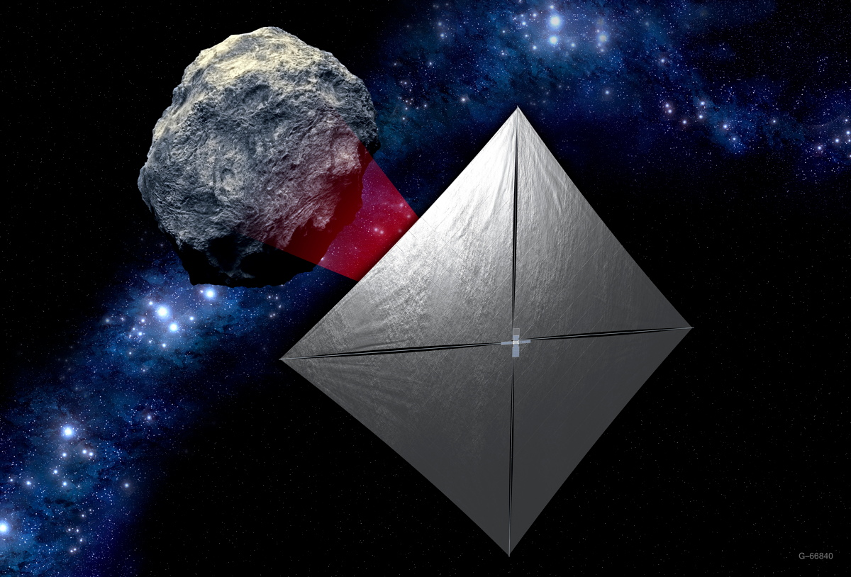
­­Near Earth Asteroid Scout
(NEA Scout) Science Concept of Operations Utilizing Onboard Data Analysis
Jack Lightholder
David R. Thompson
Julie Castillo-Rogez
Christophe Basset
Jet Propulsion Laboratory,
California Institute of Technology
4800 Oak Grove Dr.
Pasadena, CA 91109
626-710-3246
Jack.a.lightholder@jpl.nasa.gov
This research was carried out by the Jet Propulsion Laboratory, California Institute of Technology, under a contract with the National Aeronautics and Space Administration.

Slide 2
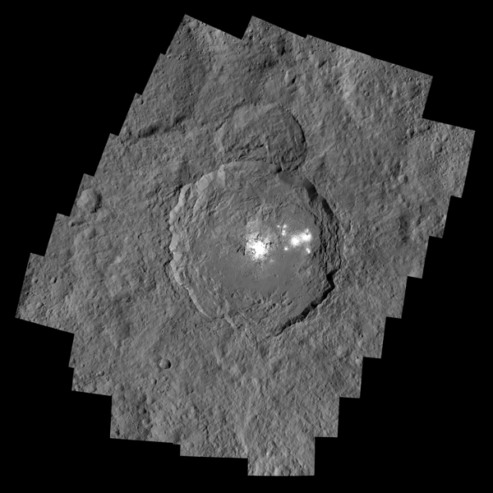
The Agile Science Paradigm
  Analyze data acquired onboard spacecraft and respond based on analysis
Spacecraft Points/
Slews
Plan Execution
Data Acquisition
Analysis results in new imaging goal(s)
Potential volatiles on Ceres
Re-Plan
Data Analysis

Slide 3
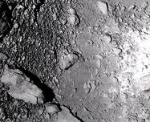
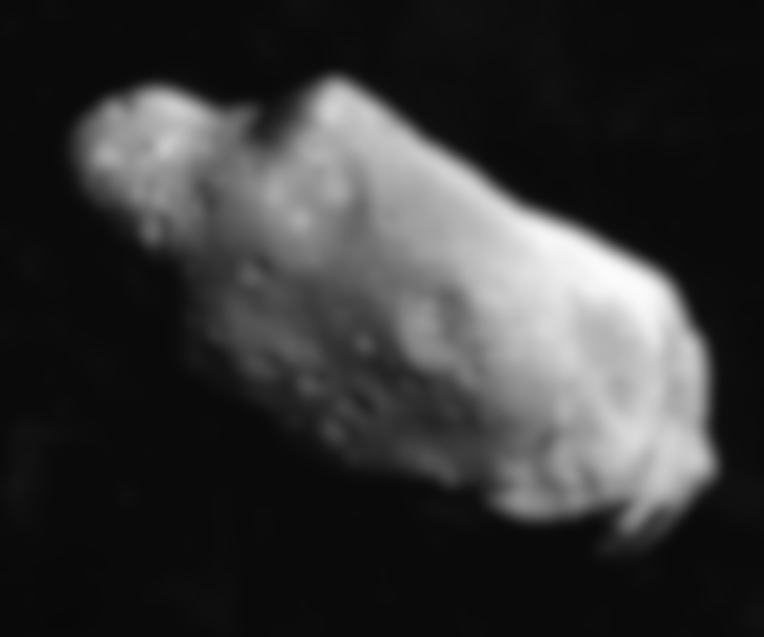



Near Earth Asteroid Scout
  GOALS
  Characterize one candidate NEA with an imager to address key Strategic Knowledge Gaps
  Demonstrates low cost capability for HEOMD for NEA detection and reconnaissance
  Measurements: NEA volume, spin and orbital properties, address key physical and regolith mechanical SKGs.
MSFC/JPL/LaRC/JSC/GSFC/NASA
6

Slide 4
NEAScout Concept of Operations

Slide 5

Imaging Challenges
Target
Reference stars
Target Detection and Approach
Ephemeris determination
Medium Field Imaging
Shape, spin, and local environment
Close Proximity Imaging
Local scale morphology, terrain properties
Target Position Uncertainty
Short Flyby Time
(<30 minutes)
Data Value Analysis and Sorting
Spacecraft Pointing and Camera Limitations
Uncertain Environment
Short Time at Closest Approach (<10 minutes)
Limited downlinks of 30 minutes at 1 Kbps
7

Slide 6
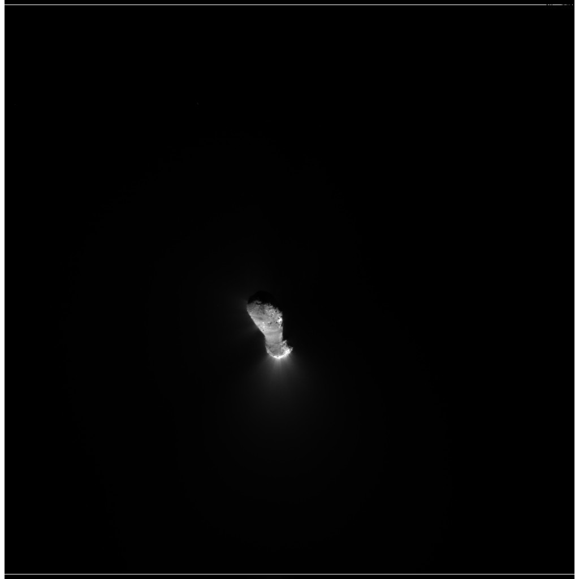
Mission Operations Flexibility
Calibration
Dark Current Subtraction
Flat field / Radiometric calibration
Onboard Feature Detection
Reference Star Detection
Target Detection
Cosmic Ray Removal
Follow-Up Actions
Prioritize Data for Downlink
Downlink
“Quick-Look” Data Products

Slide 7
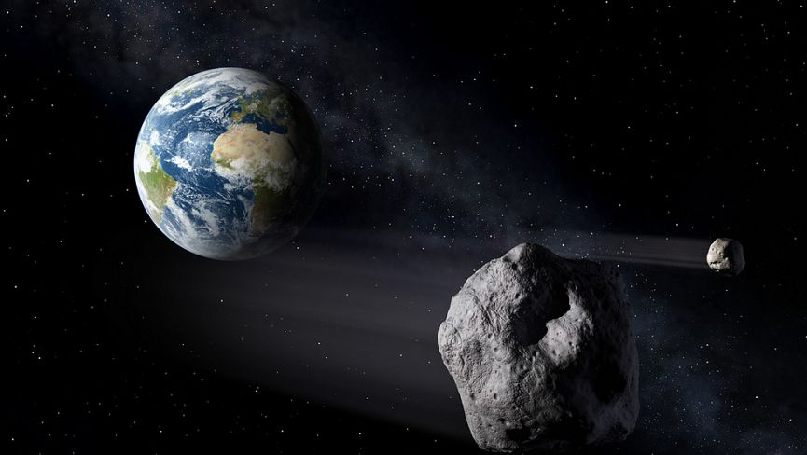
Instrument Calibration
Notes:
https://independentaustralia.net/environment/environment-display/the-mystery-of-earth-companion-1991-vg,7702
Image via: http://www.cosmosup.com/

Slide 8
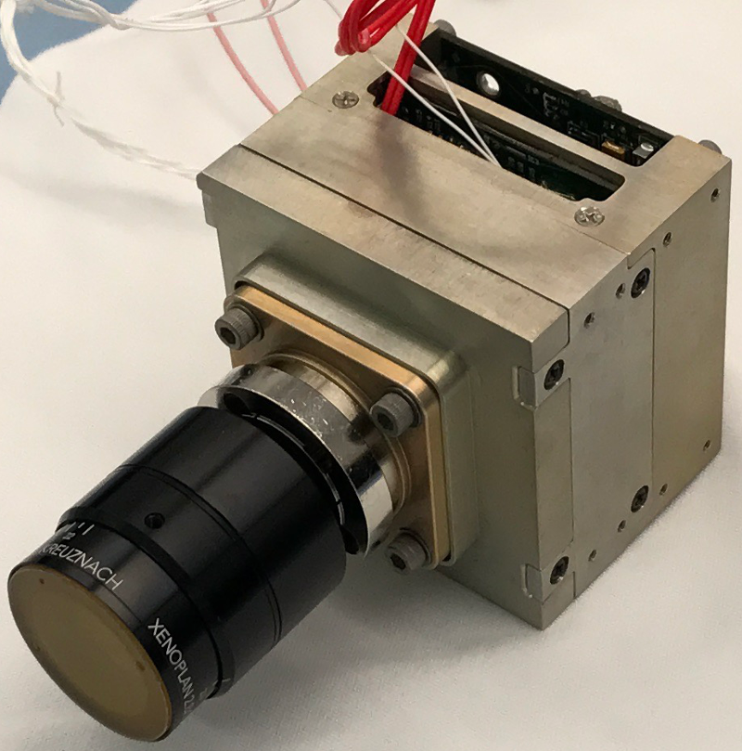
NEA Scout Camera
Sensor Capabilities
Type | 20M pixel CMOS image sensor
Useful array size | 3840 x 3840 pixels
Pixel size | 6.4µm²
Full well | 15,000e⁻
Dark noise | 8e⁻ RMS
Windowing | Y-direction only
Shutter | Global
Color | Monochrome (with microlenses)
Quantization | 12-bit per pixel
Electrical interface
Physical | LVDS
Protocol | Spacewire RMAP
Power | < 3 Watts
Memory | 64Mbits
FPGA | Microsemi Rad-tolerant ProASIC3
Camera Specifications
Mass | 390g
Volume | 63mm x 63mm x 71mm
Operating temperature | -25C to +50C
Survival temperature | -35C to +70C
Optics | 27° FOV, f/2.8, 50.2mm iFOV=0.09mrad/ pix
NEA Scout flight camera, based on Orbital Carbon Observatory 3 (OCO-3) mission context camera.

Slide 9
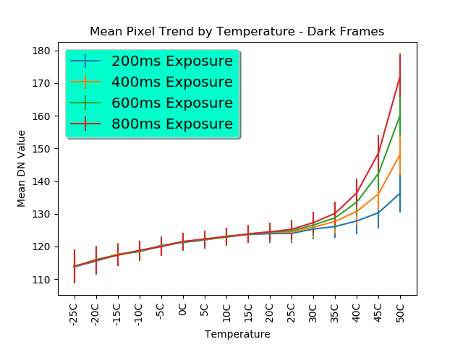
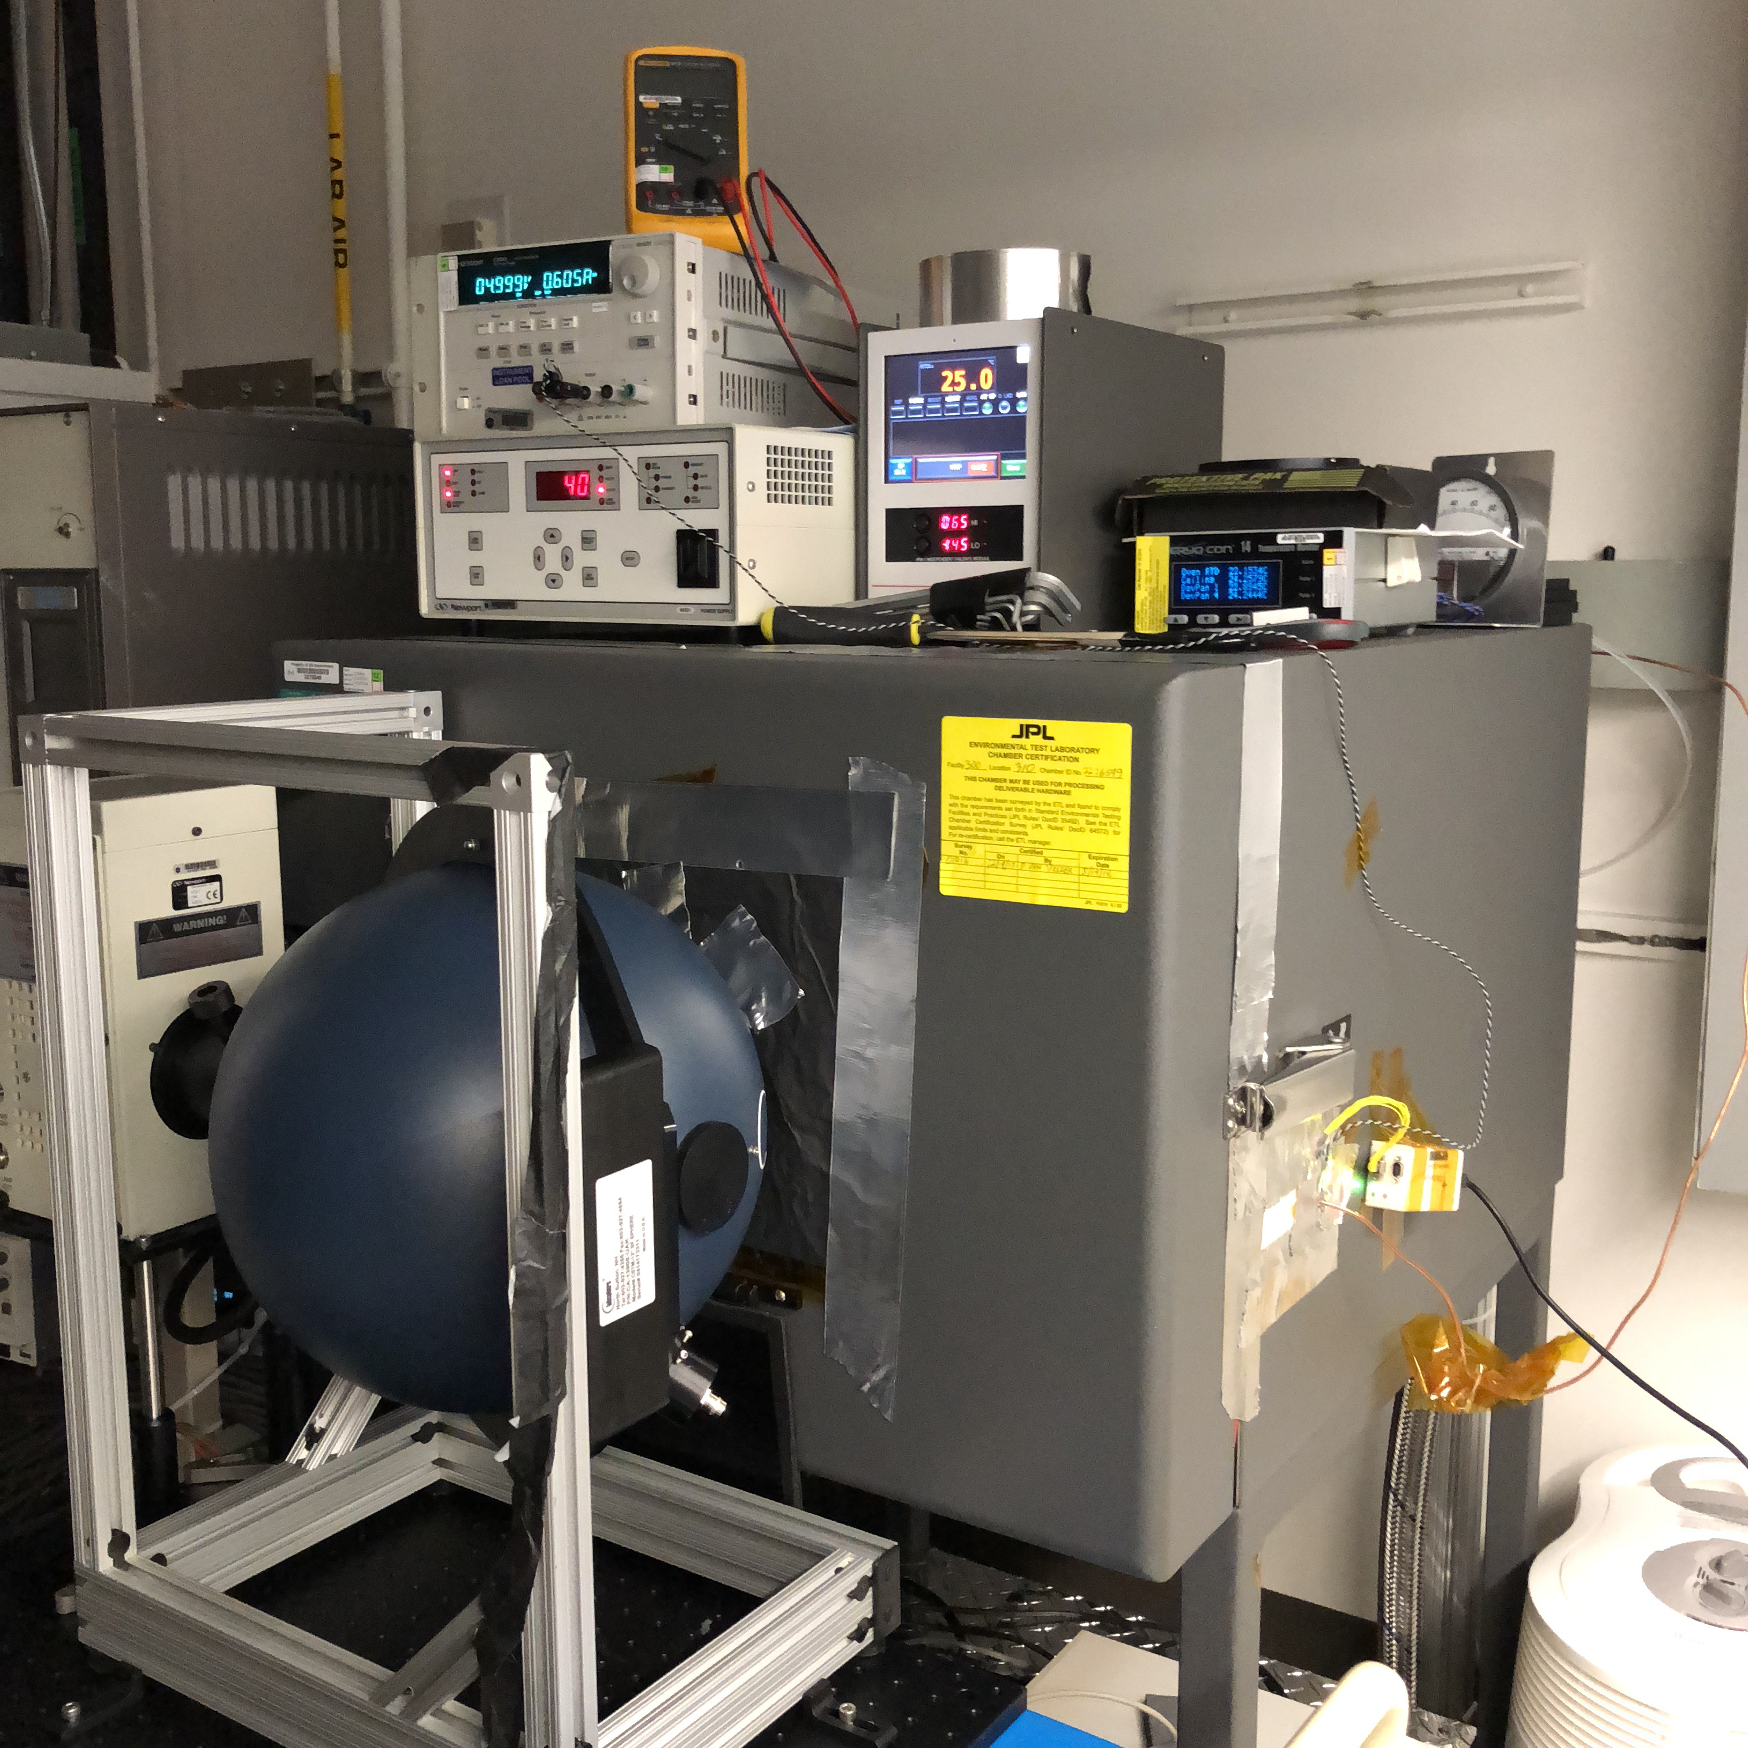
Onboard Image Calibration
Onboard L1 calibration including:
  Flat field normalization
  Dark current subtraction
  Bad pixel mask application
Lab calibration products dynamically applied based on camera temperature at acquisition.
Linear interpolation applied between calibration products bounding the raw image temperature.
Ability to apply flat fields and dark current maps acquired in flight.
Laboratory calibration trends, across camera allowable flight temperatures
Calibration laboratory setup

Slide 10
Target Detection
Notes:
https://independentaustralia.net/environment/environment-display/the-mystery-of-earth-companion-1991-vg,7702
Image via: http://www.cosmosup.com/

Slide 11
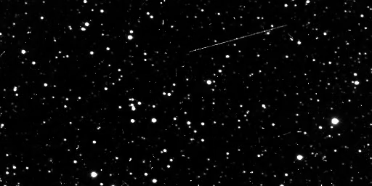
Raw Data is Messy
Rosetta OSIRIS Narrow Angle Camera Detection of 2867 Steins

Slide 12
Raw Data is Messy
Rosetta OSIRIS Narrow Angle Camera Detection of 2867 Steins

Slide 13



Cleaning Up the Noise
Column Shift
Target
Reference stars
Row Shift
Sub-windowing around reference stars makes the problem computationally reasonable for flight hardware.
Onboard co-registration of images improves SNR and reduces downlink requirements
[Thompson et al. 2015]

Slide 14
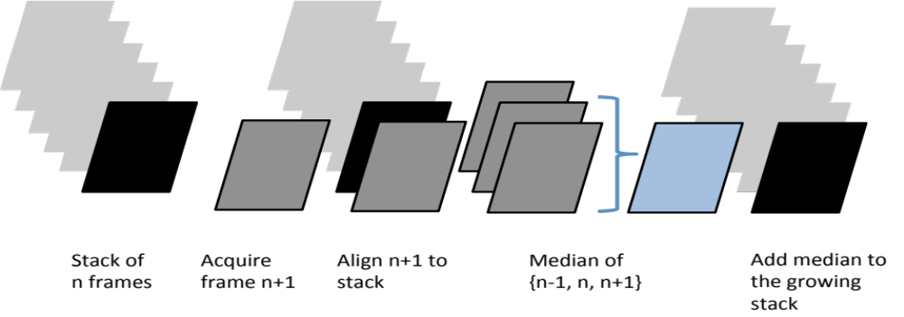
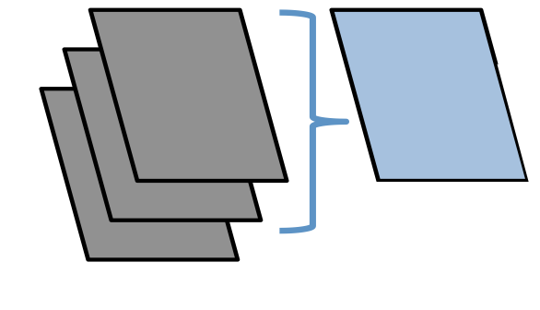

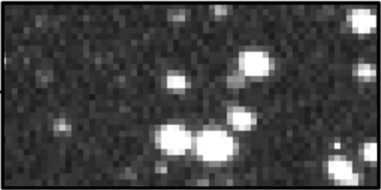
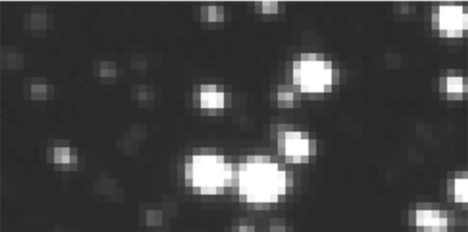
Computation is additionally constrained by onboard memory limitations.
< 100 MB RAM
Pick Data to Co-register
Process in Batches of 3
Place Temporal Median on Output Stack
Raw Image Stack
Images Being Processed
Temporal Median Values
Output Image
Before
After
Stepwise processing keeps the necessary memory small.
[Thompson et al. 2015]
13

Slide 15
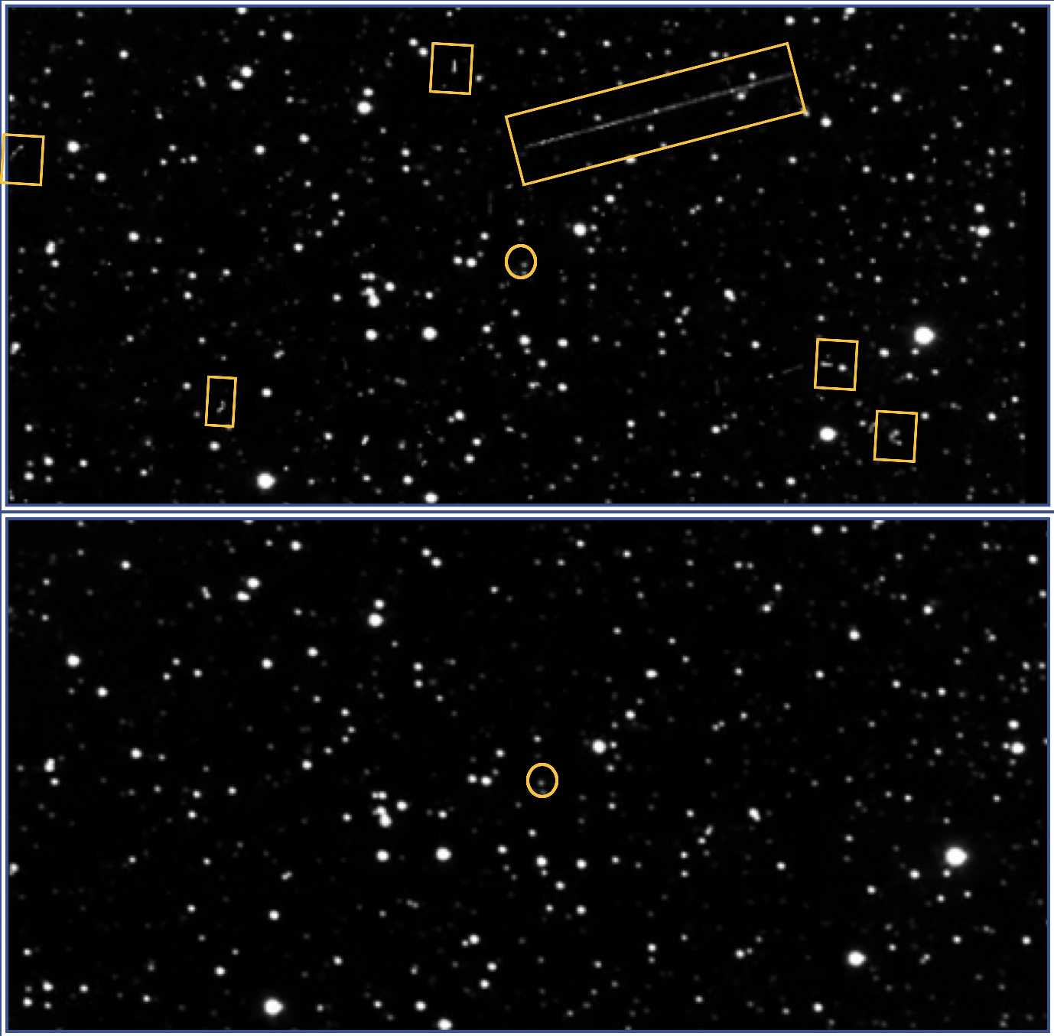
Cleaning Up the Noise
Increase signal to noise without long exposure imaging.
Decreases spacecraft pointing requirements.
Removal of transient artifacts, such as cosmic rays.
6

Slide 16
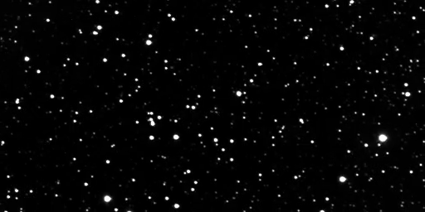
Processed Data
Rosetta OSIRIS Narrow Angle Camera Detection of 2867 Steins

Slide 17
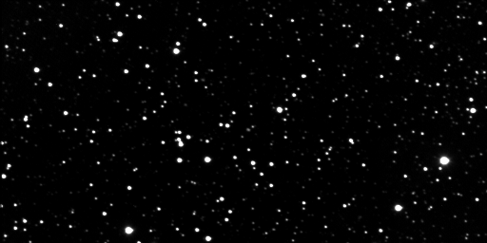
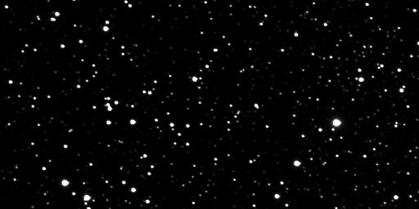

Identify Targets with Onboard Image Subtraction
-
=
Target Uncertainty Ellipse
Determine the shift between two images, subtract with (x,y) offset.
This type of information has many mission applications.
Current trajectory verification and refinement
Automated target tracking
Target of opportunity detection
Target survey and classification
17

Slide 18

Does Your Target Look “As Expected”?
New Horizons Long Range Reconnaissance Imager Detection of Pluto/Charon

Slide 19
Target Approach and Flyby
Notes:
https://independentaustralia.net/environment/environment-display/the-mystery-of-earth-companion-1991-vg,7702
Image via: http://www.cosmosup.com/

Slide 20
Optical Navigation Products
Reconstructed optical navigation ground product resulting from window snapshots of uncertainty ellipses for target and reference star regions.

Slide 21
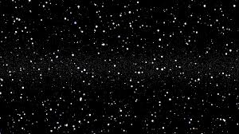
Flyby Data Curation & Prioritization
Extremely limited bandwidth (1 kpbs) for future data downlink
Limited flyby time (<1 hour)
Limited image acquisition rate (15/min)
No auto-exposure of camera
  Utilize exposure bracketing
Onboard image statistics to assess quality with limited data volume
  Contrast calculation
  Pixel histogram
  Header information
Data Prioritization Strategies:
Box crop around brightest pixel
Box crop around specified coordinates
Downsample
ICER Compression (Lossy & Lossless)

Slide 22
Conclusions
Software techniques can supplement spacecraft hardware limitations to achieve comparable science objectives.
  reduced pointing precision
  limited bandwidth volume
Distilling science data return enables increased focus of attention by human operations, reducing turnaround time for critical decision making.
Onboard data analysis enables new mission profiles which are not possible with traditional methods for analyzing science return.
Onboarding image processing enables target location quantification and imaging using small amounts of bandwidth.
  Enables new smallsat mission scenarios, where communications passes are short and infrequent.

