Slide 1
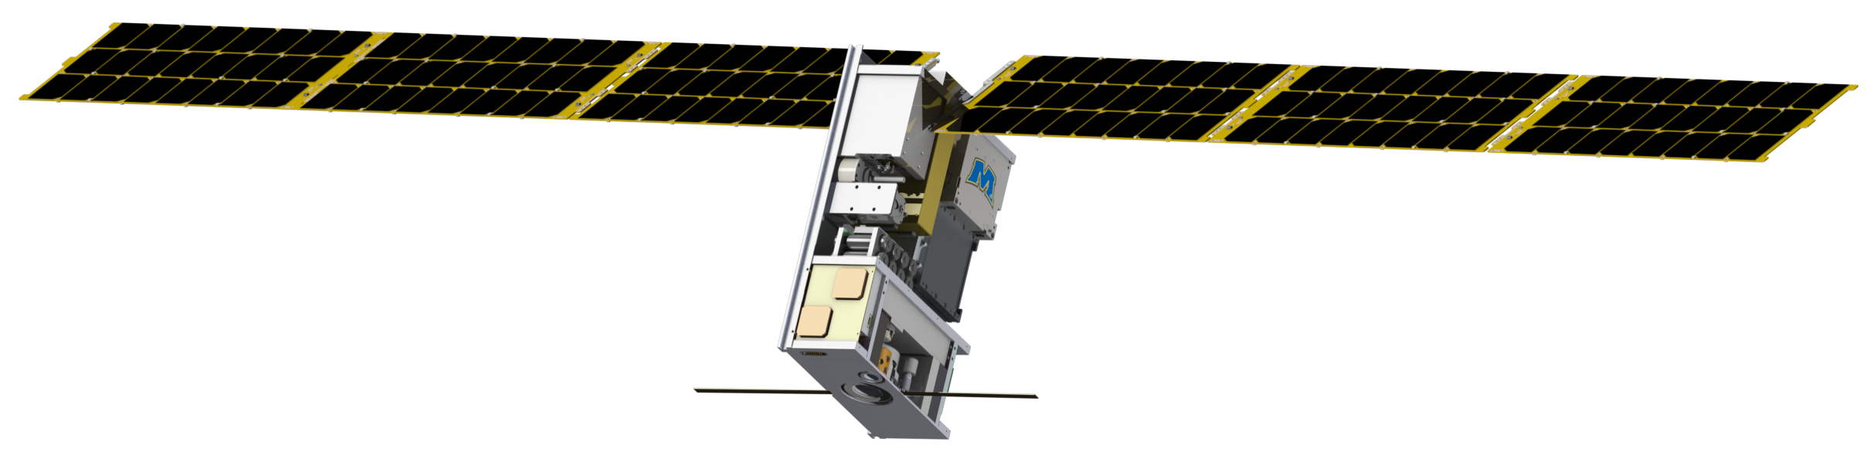
Lunar Ice Cube: Ongoing Development of First Generation Deep Space CubeSat Mission with Compact broadband IR Spectrometer
P.E. Clark (Science PI) (CalTech/JPL),
B.Malphrus (PI), K. Brown (SE), J. Schabert, S. McNeil, B. Micula (Morehead State U),
C. Brambora, G. Young, N. Gorius, T. Hewagama, D. Patel, T. Hurford, D. Folta, P. Mason (NASA/GSFC)
and members of the Lunar ICe Cube Team
National Aeronautics and Space Administration
Jet Propulsion Laboratory
California Institute of Technology
Pasadena, California
www.nasa.gov
© 2016. All rights reserved.
Government sponsorship acknowledged.
Jet Propulsion Laboratory
California Institute of Technology

Slide 2
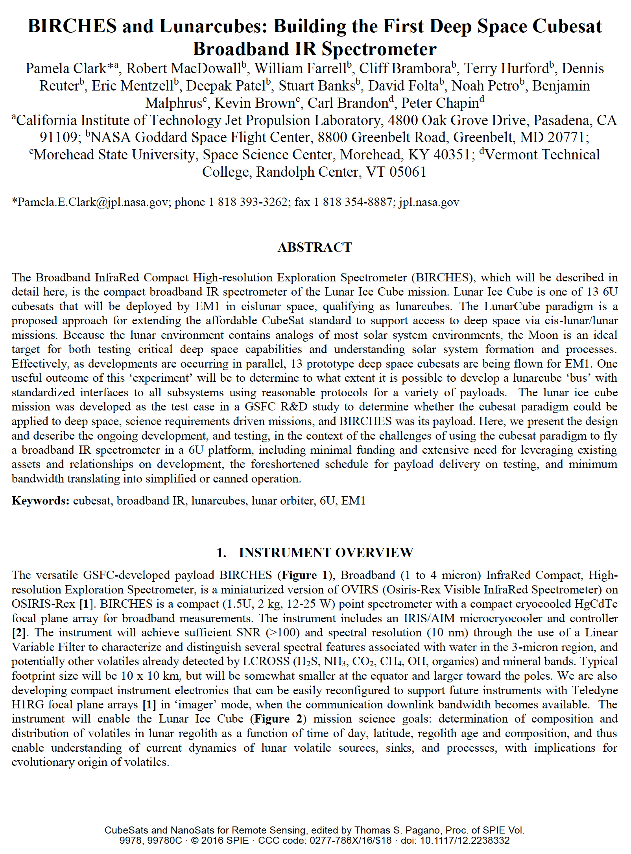
Current Status
Shutdown delay.
EM1 Launch now late 2021.
Publications (Source): Online Presentations, Short papers from 2015 at LPSC, LEAG, CDW, and Interplanetary SmallSat Conference. Papers, Clark et al, 2016, 2018, 2019, SPIE Optics; 2018 Small Satellite Conference.
Performing I&T for Lunar Ice Cube subsystems as delivered to Morehead. BIRCHES now undergoing optical, digital, and radiometric calibration in simulated environment
FlatSat with emulators testing all subsystems
End to End tests scheduled for fall.
Ready for Data System testing for Level 0 data production this fall. Level 1 data analysis software under development.

Slide 3
Significance of Water
Relevance to NASA | Growing Evidence for Global Distribution
HEOMD Strategic Knowledge Gaps: 1) Temporal Variability and Movement Dynamics of Surface-Correlated OH and H2O deposits toward permanently shadowed area retention (Lunar Ice Cube) 2) Composition, Form and Distribution of Polar Volatiles (Lunar Flashlight, LunaH Map) 3)Quality/quantity/distribution/form of H species and other volatiles in mare and highlands regolith (Lunar Ice Cube) at >30 degrees latitude SMD Decadal Survey: understanding solar system formation, and evolution of the lunar surface and atmosphere by further establishing the role of surface volatiles SMD Scientific Context for Exploration of the Moon: Using the Moon to study regolith, exosphere (including water vapor) processes on airless bodies | Evidence for surface ice near both poles (cold traps). Evidence for bound water in surface volcanic deposits. Evidence for surface hydroxyl (OH) and water varying as function of of temperature (local time of day) and illumination (slope orientation) in 100's of PPM range. Evidence for polar region bulk water down to 1 meter depth 100 PPM range, unknown distribution

Slide 4
Table 1: Water-related absorption features. Yellow: features ~3 microns. Blue: Prominent water-related features near 1.5 and 2 microns.
Species | μm | description
Water Form, Component
water vapor | 2.738 | OH stretch
 | 2.663 | OH stretch
liquid water | 3.106 | H-OH fundamental
 | 2.903 | H-OH fundamental
 | 1.4 | OH stretch overtone
 | 1.9 | HOH bend overtone
 | 2.85 | M3 Feature
 | 2.9 | total H2O
hydroxyl ion | 2.7-2.8 | OH stretch (mineral)
 | 2.81 | OH (surface or structural) stretches
 | 2.2-2.3 | cation-OH bend
 | 3.6 | structural OH
bound H2O | 2.85 | Houck et al (Mars)
 | 3 | H2O of hydration
 | 2.95 | H2O stretch (Mars)
 | 3.14 | feature w/2.95
adsorbed H2O | 2.9-3.0 | R. Clark
ice | 1.5 | band depth-layer correlated
 | 2 | strong feature
 | 3.06 | Pieters et al
Other Volatiles
NH3 | 1.65, 2. 2.2 | N-H stretch
CO2 | 2, 2.7 | C-O vibration and overtones
H2S | 3
CH4/organics | 1.2, 1.7, 2.3, 3.3 | C-H stretch fundamental and overtones
Mineral Bands
pyroxene | 0.95-1 | crystal field effects, charge transfer
olivine | 1, 2, 2.9 | crystal field effects
spinels | 2 | crystal field effects
iron oxides | 1 | crystal field effects
carbonate | 2.35, 2.5 | overtone bands
Sulfide | 3 | conduction bands
hydrated silicates | 3-3.5 | vibrational processes
anticipate wavelength of peak for water absorption band to be structural<bound<adsorbed<ice.

Slide 5
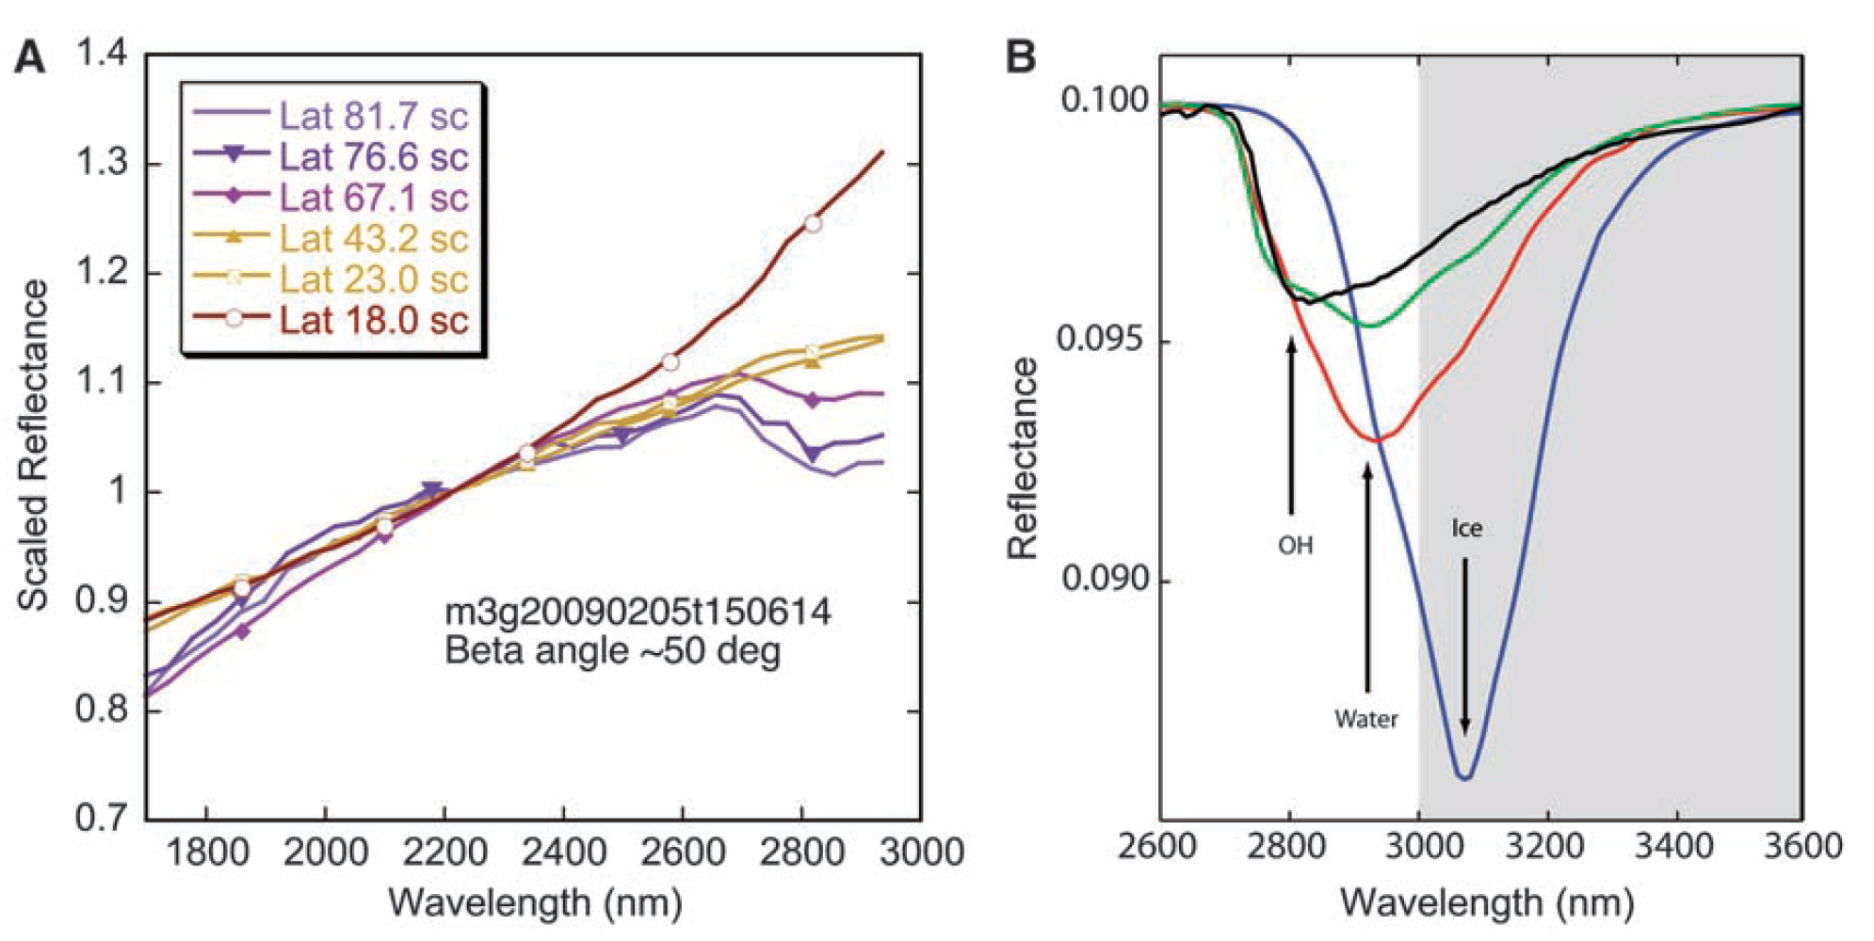
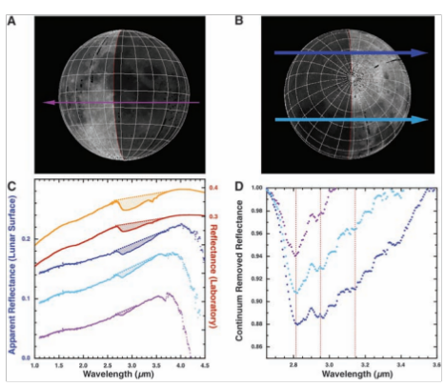
Evidence for Water
Reflectance spectra showing water and hydroxyl aborption features (near 3 microns) depth as a function of latitude. Chandrayaan M3, Pieters et al 2009
Water and Hydroxyl on Moon. Combined Red (Pyroxene), Green (Reflectance continuum), Blue (water and hydroxyl absorption) bands. Blue, Cyan, Magenta, Pink water indicators. Chandrayaan M3, Pieters et al 2009
Reflectance spectra with absorption feature strength correlated with time of day. Deep Impact Epoxi. Sunshine et al 2009

Slide 6
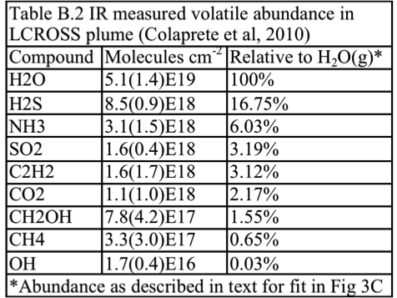
Evidence for Water

Slide 7
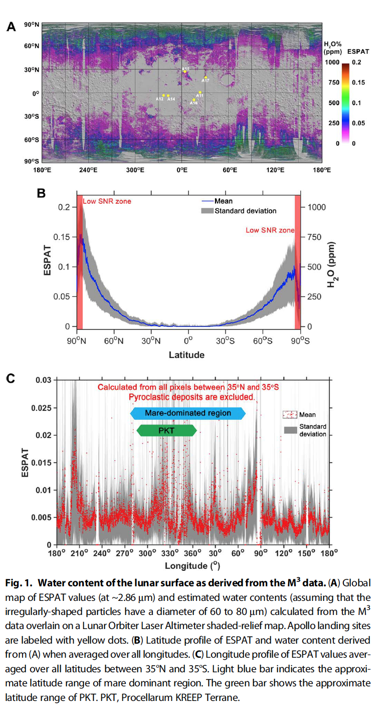
Further Evidence for Water
Map of 2.85 u Effective Single Particle Absorption Thickness (ESPAT) derived from M3 at low lunar latitudes. Features apparently associated with pyroclastic deposits, lending credence to hypothesis of volatile-rich (hundreds ppm) sources in mantle. A aristarchus; O orientale, RB Rima Bode, SG Sulpicius Gallus, TL Taur-Littrow. Milliken and Li, 2017.
M3 calculated ESPAT estimated water content (Apollo landing sites in yellow) map (A), all longitude-averaged latitude profile (B), and +/- 35 degree latitude-averaged longitude profile (C). Li and Milliken, 2017.
M3 calculated ESPAT estimated water content (Apollo landing sites in yellow) map (A), all longitude-averaged latitude profile (B), and +/- 35 degree latitude-averaged longitude profile (C). Li and Milliken, 2017.

Slide 8
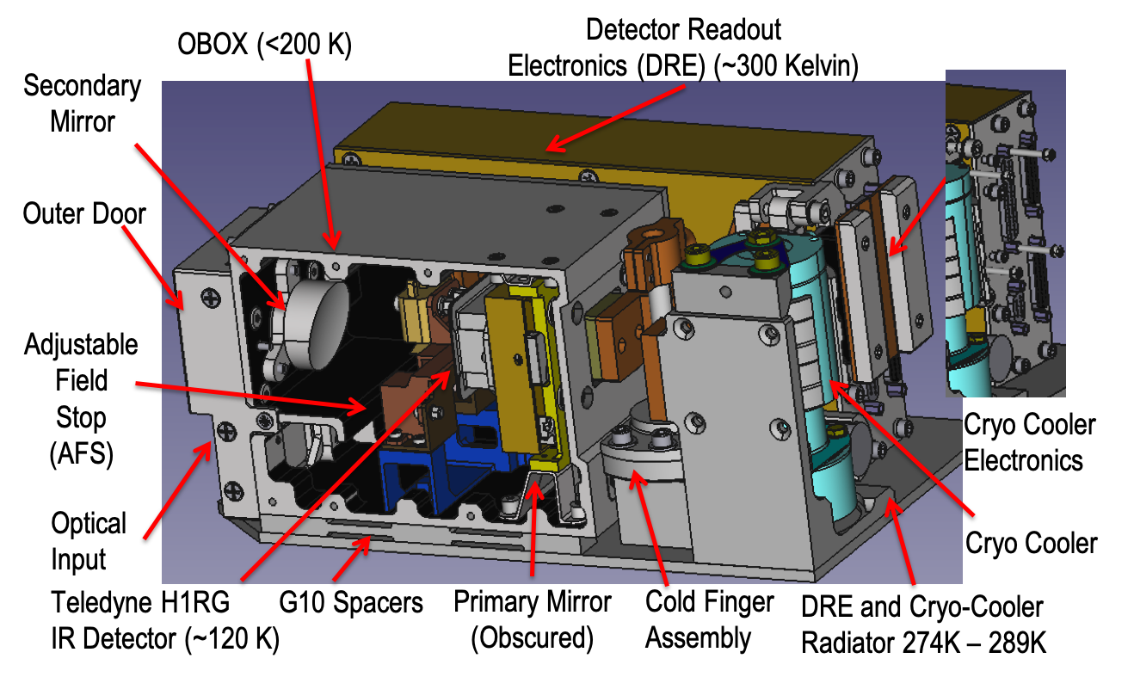
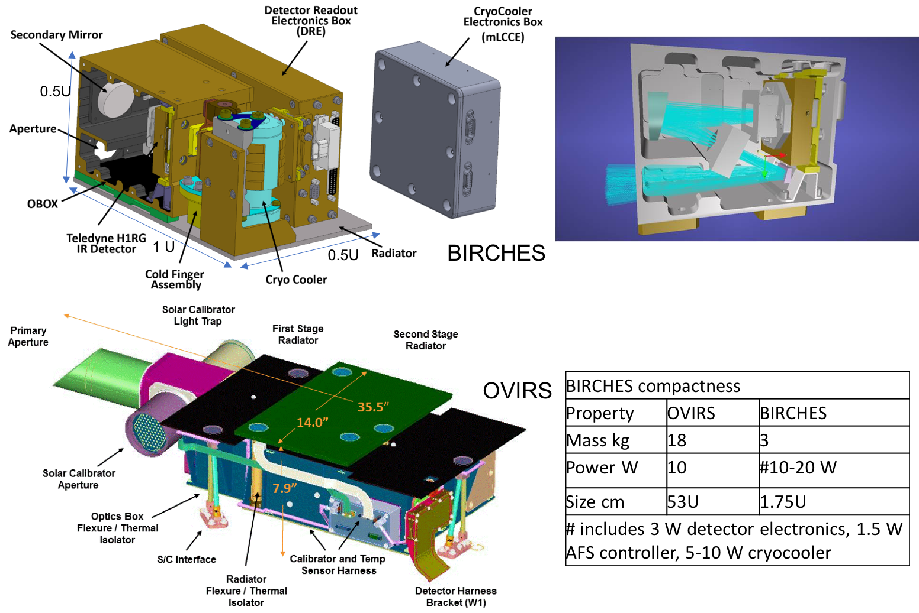
BIRCHES compactness
Property | OVIRS | BIRCHES
Mass kg | 18 | 3
Power W | 10 | #15-20 W
Volume U | 53 U | 2 U
# includes 3 W detector electronics, 1.5 W AFS controller, 10-15 W cryocooler

Slide 9
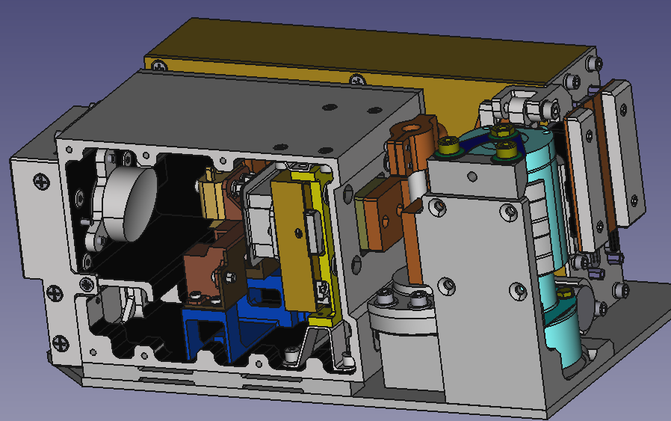
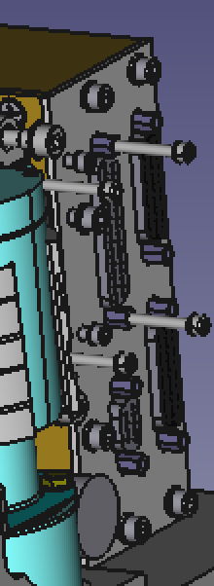
BIRCHES IR Spectrometer HW Architecture
OBOX (<200 K)
Detector Readout
Electronics (DRE) (~300 Kelvin)
Secondary
Mirror
Outer Door
Adjustable
Field
Stop
(AFS)
Cryo Cooler Electronics
Optical Input
Cryo Cooler
Teledyne H1RG
IR Detector (~120 K)
G10 Spacers
Primary Mirror
(Obscured)
Cold Finger
Assembly
DRE and Cryo-Cooler
Radiator 274K – 289K

Slide 10
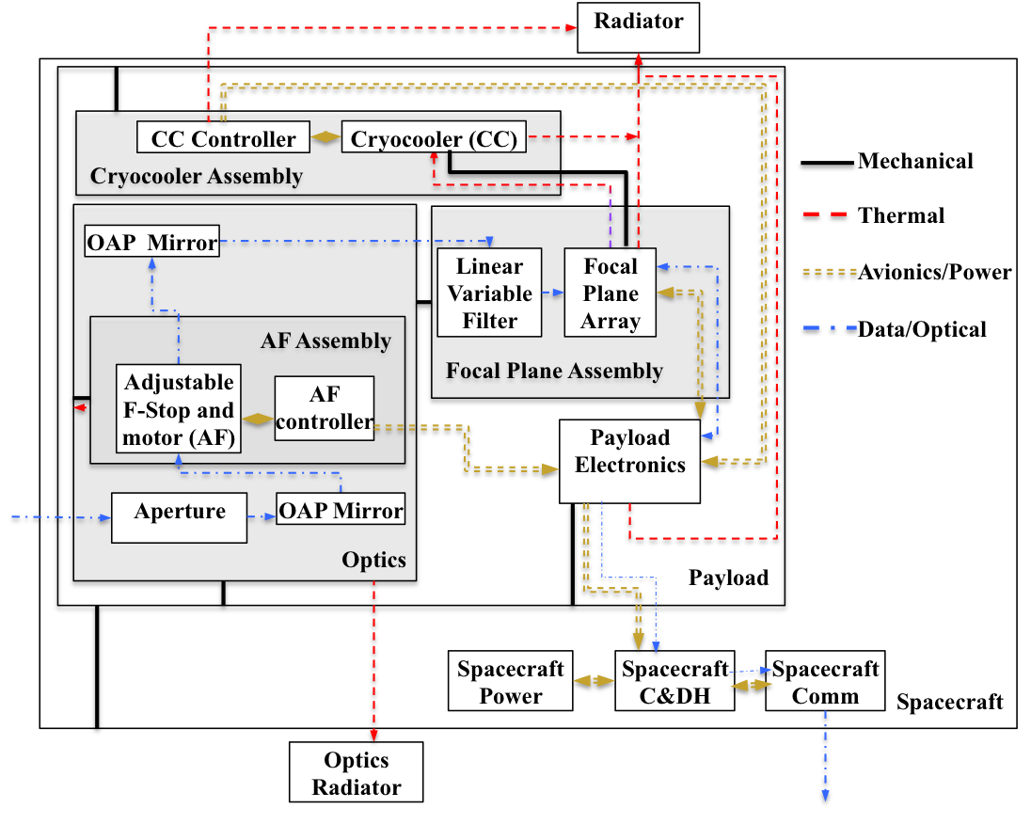
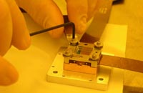
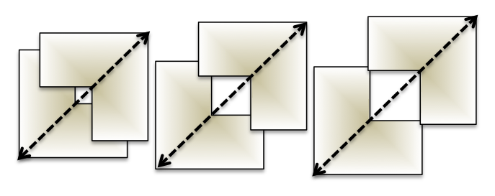
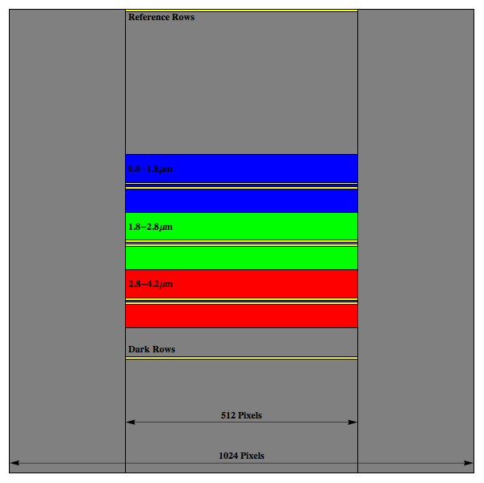
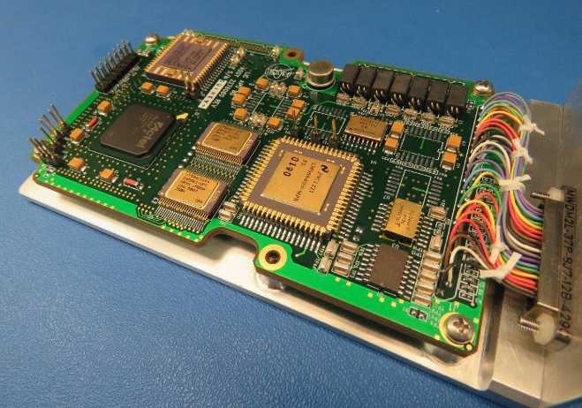
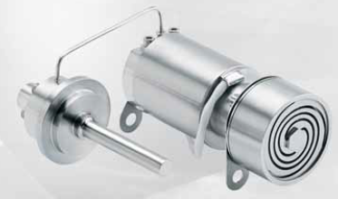
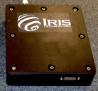
Spectrometer Schematic and Components
BIRCHES utilizes a compact Teledyne H1RG HgCdTe Focal Plane Array and JDSU linear variable filter leveraging OSIRIS REx OVIRS.
Adjustable Iris maintains footprint size at 10 km by varying FOV regardless of altitude
Linear Variable Filter Segments over H1RG focal plane array with reference, dark, segment 1, segment 2, and segment 3 rows (yellow lines) superposed.
BIRCHES Analog Processing Unit (APU) (top)
COTS AFRL developed AIM SX030 microcryocooler with cold finger to maintain detector at ≤115K and iris controller

Slide 11
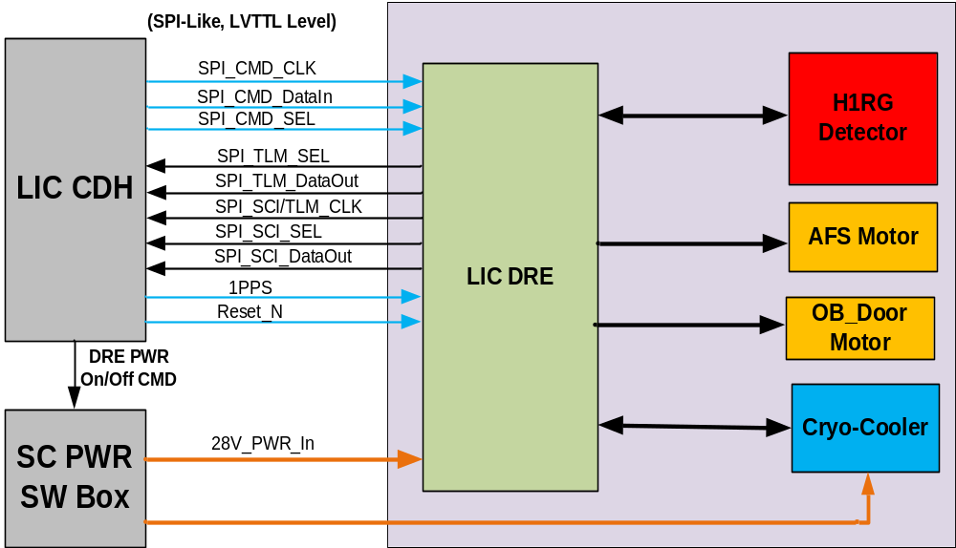
BIRCHES Functional Block Diagram
W1
W2
W2
W3

Slide 12
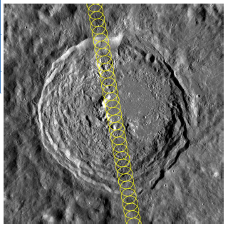
Because of the adjustable field stop, BIRCHES, with its 6 degree FOV, is capable of maintaining at 10 x 10 km footprint over the range of predicted altitudes (100 to 1000 km).
At 100 km altitude, observations, taken every second, are separated by ~2.5 km, allowing alongtrack overlap and oversampling.
Near the poles, the effective SNR is also intrinsically lower, but consecutive orbits overlap. The combination of the adjustable field stop sized to increase the effective FOV and the orbital overlap allow improved statistics through ‘sliding averages’ as well as continuous coverage in an area where water-related features are anticipated to be relatively abundant.
BIRCHES overlapping along-track observations with 10 km footprint maintained by AFS over Vasilov Crater (100 km diameter).

Slide 13
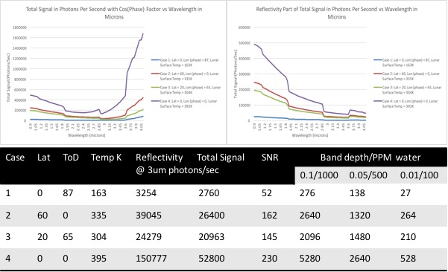

Slide 14
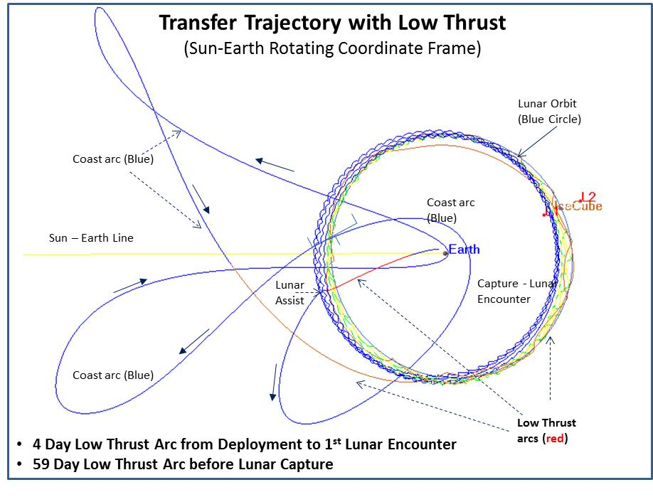
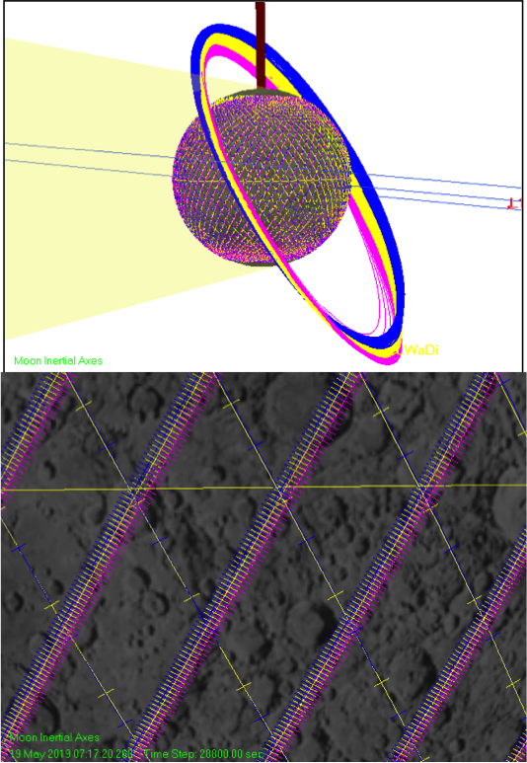
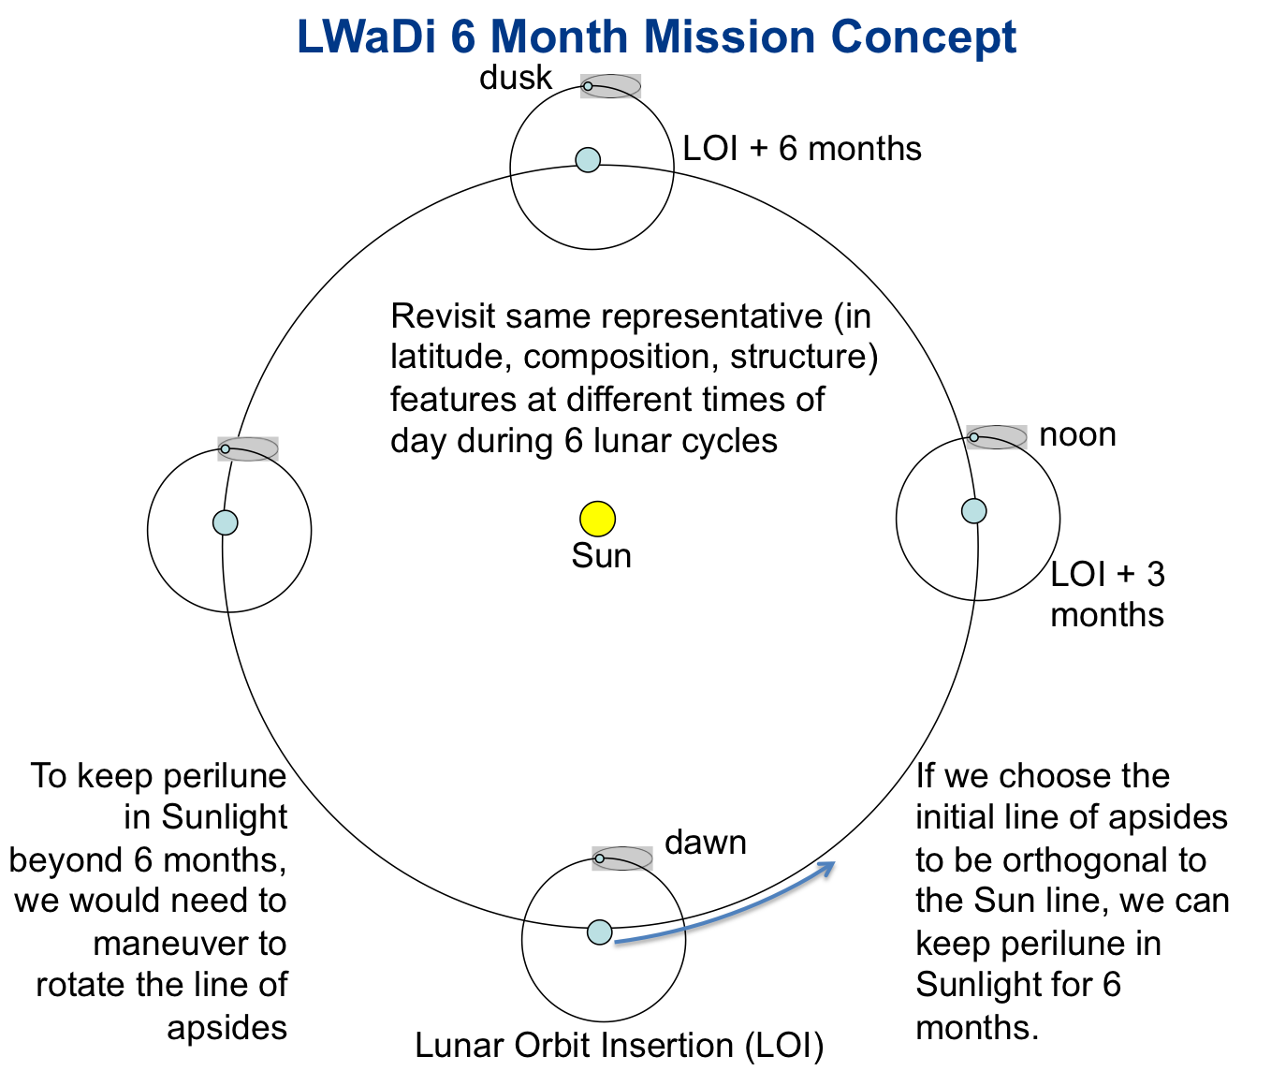
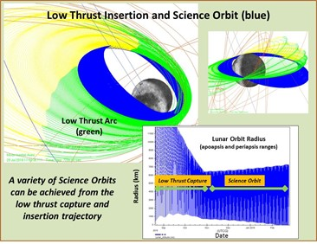
Lunar Ice Cube MIssion Concept

Slide 15
Challenges Summary
Challenges and Mitigations
Thermal design (on-orbit heat removal an issue for 6U, and on-surface heat retention during lunar night an issue if minimum resource (including cost) solutions sought: In future, take advantage of High performance thermal solutions now being developed. Additional work (remove some stand offs, modify detector surfaces, add small dedicated deployable radiator, variable thickness radiator) to reduce heat transfer to detector to reduce pixel saturation without increasing mass.
Development process: version controlled design and interface control documentation, and scheduled essential reviews and deliverables. Learning curve for 'first deep space qualification'. Define 'threshold' early and go to threshold as cost cap issues arise.
Team membership: high turn over and no guaranteed backups for student team. In future, would appoint staff mission operations and ground data system managers.
Dealing with external management with 'Class A+' orientation or 'out of scope' requests: Be prepared to leverage collaborations, identify and scramble for sources of additional funding
Non-scalable (in cost and schedule) development and operation: Support and utilize design, subsystem simulation and driver tools, operating systems, operations facilities, and data delivery pipeline tools already developed or under development for cubesats.

Slide 16
Conclusions
Lunar Ice Cube is the most operationally complex cubesat to date.
Lunar Ice Cube goal to provide measurements from which liquid water, ice, OH distribution across the lunar surface can be derived to understand function of time of day (temperature and illumination) at a variety of representative locations.
Regardless of the degree of overlap with other missions (LunaH-Map and Lunar Ice Cube) in space or time, these measurements when combined will provide far more systematic understanding of the water cycle, and the accessibility of water as a resource on the Moon.
We are doing what cubesats are supposed to do: creating an innovative and tailored solution with a standard platform.

Slide 17
On to the Moon in 2021!
Join us for LunarCubes Workshop and Interplanetary Small Satellite Conferences next year!
Your challenging payload requirements needed
pamela.e.clark@jpl.nasa.gov

