Slide 1
Iris Deep Space Transponder Testing at
Space Dynamics Lab (SDL), Jet Propulsion Lab (JPL), and DSN Test Facility (DTF)-21
2019 Interplanetary Small Satellite Conf.
San Luis Obispo, California, USA
29-30 April 2019
K. Angkasa, A. Babuscia, L. McNally, B. Burgett, and J. Lux
Jet Propulsion Laboratory at the California Institute of Technology

Slide 2
Outline
History of Iris Deep Space Transponder
6 EM-1 CubeSats Using Iris
  Lunar Polar Hydrogen Mapper (LunaH-Map)
  Lunar IceCube
  Lunar Flashlight
  CubeSat for Solar Particles (CuSP)
  BioSentinel
  Near-Earth Asteroid Scout (NEA Scout)
Iris vendor testing at Space Dynamics Lab (SDL)
Iris mission-specific testing at Jet Propulsion Lab (JPL)
Iris DSN RF Compatibility at DSN Test Facility (DTF)-21

Slide 3
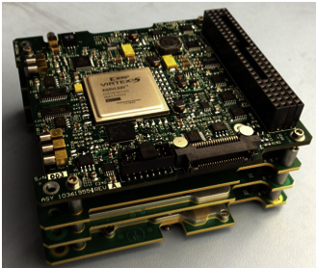
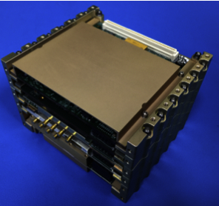
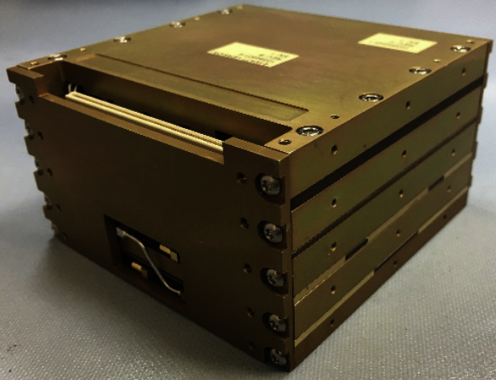
Iris History
Iris V1.0: To extend CubeSat/SmallSat deep space capability, JPL introduced the Interplanetary NanoSpacecraft Pathfinder In Relevant Environment (INSPIRE) mission¹, coupled with the first-generation of Iris deep-space transponder².
Iris V2.0: The radio was further developed, matured, and in 2018 successfully flown onboard Mars Cube One (MarCO), to support InSight’s Mars Entry, Descent, and Landing (EDL)³.
Iris V2.1: The latest version of Iris includes design updates that support EM-1 CubeSats missions⁴.
Iris V1.0 Transponder Stack
Iris V2.0 Transponder Stack
Iris V2.1 Key Specifications⁴
Iris V2.1 Transponder Stack
¹ A. Klesh et al., “INSPIRE: Interplanetary NanoSpacecraft Pathfinder In Relevant Environment,” in AIAA SPACE Conf. and Expo., San Diego, CA, 2013.
² C. B. Duncan et al., “Iris Transponder – Communications and Navigation for Deep Space”, in Small Satellite Conf., Logan, UT, 2014.
³ A. Klesh et al., “MarCO: Early Operations of the First CubeSats to Mars,” in Small Satellite Conf., Logan, UT, 2018.
⁴ M. M. Kobayashi, “Iris Deep-Space Transponder for SLS EM-1 CubeSat Missions,” in Small Satellite Conf., Logan, UT, 2017.

Slide 4
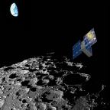
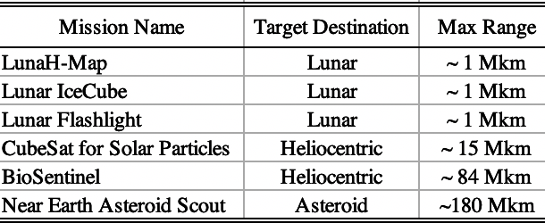
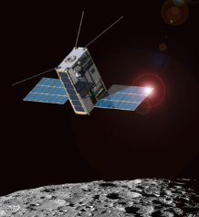
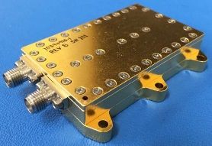
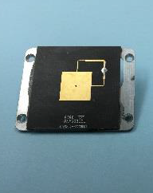
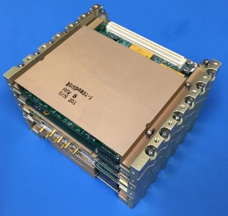
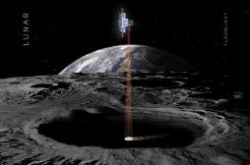
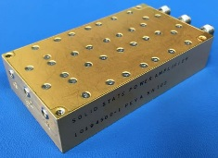
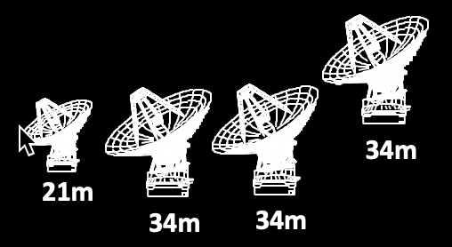

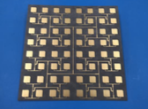
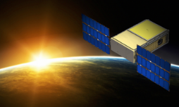

6 EM-1 CubeSats Using Iris
6 EM-1 CubeSats have baselined to use Iris for basic telecom & navigations.
They share common Telecom Hardware (Iris Radio, LNA/SSPA, Rx/Tx antennas) with different science goals & target destinations.
LunaH-Map
Low Noise Amplifier
(LNA)
Rx LGA
Lunar IceCube
Iris Radio
Tx LGA
Lunar Flashlight
Solid State Power Amplifier
(SSPA)
Tx MGA
Deep Space Network (DSN)
CuSP
EM-1 CubeSat Telecom Hardware Using Iris
As such, the next few slides show the different test approaches, taken at the various test facilities (SDL, JPL, DTF-21) based on the commonality of Telecom Hardware and/or mission-specific requirements combined such as,
  Higher data rates for lunar missions vs. heliocentric missions
  Use of turn-around ranging, as opposed to Delta-DOR
BioSentinel
NEA Scout

Slide 5
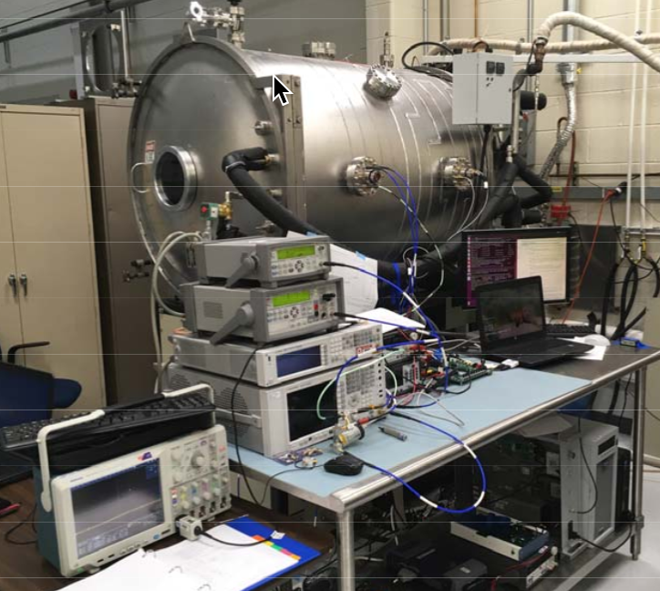
Iris Vendor Testing at SDL
Making the most of the commonality of the EM-1 CubeSat Telecom Hardware, testing at the Iris vendor (SDL) takes on the following approach:
  Environmental Testing using the Engineering Unit (EDU)
    TVAC Test at Qual. Temp. (-35C,+25C,+70C)
    Vibration Testing
    EMC Testing
  And performed on each Flight Unit (FM)
    Thermal Test at AFT (-20C,+25C,+50C)
Test reports are captured in the respective EDU/FM
End Item Data Package (EIDP) from SDL.
TVAC Test with EDU
Sample of Performance Test List
• Boot
• In-Rush & Pwr. Consumption 9V, 12V, 18V, 24V
• Firecode
• Coherency
• Transmit Spectrum
• Downlink Data Test
• BER
+Qual Hot
Functional
Functional
Functional
+AFT Hot
Performance
+25C
Performance
AFT
Qual. Temp
Vibration Test with EDU
Sample of Functional Test List
• Boot
• In-Rush & Pwr. Consumption 12V
• Firecode
• Coherency
• Transmit Spectrum
• Downlink Data Test
-AFT Cold
Performance
-Qual Cold
Functional
Functional
Functional
Temperature Profile
EMC Test with EDU
(performed at JPL facility)

Slide 6
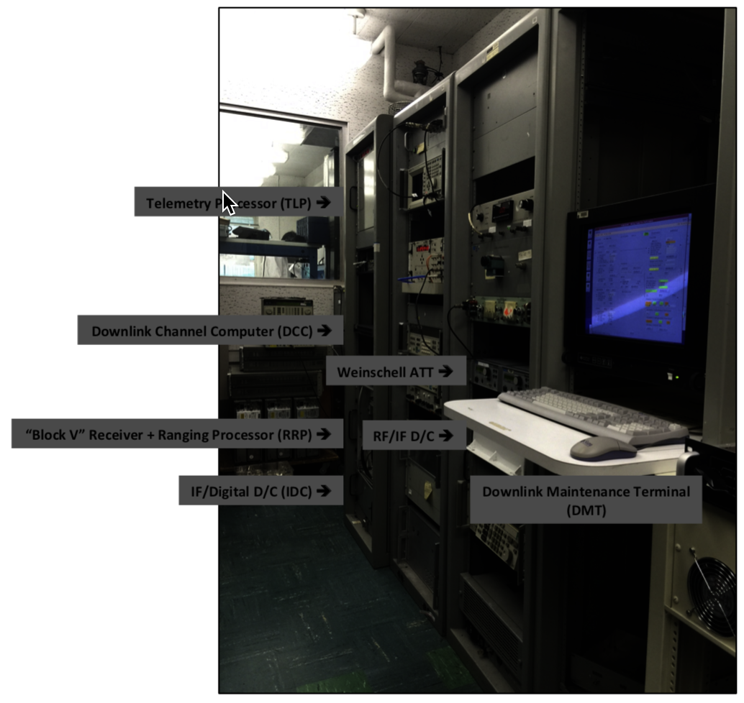
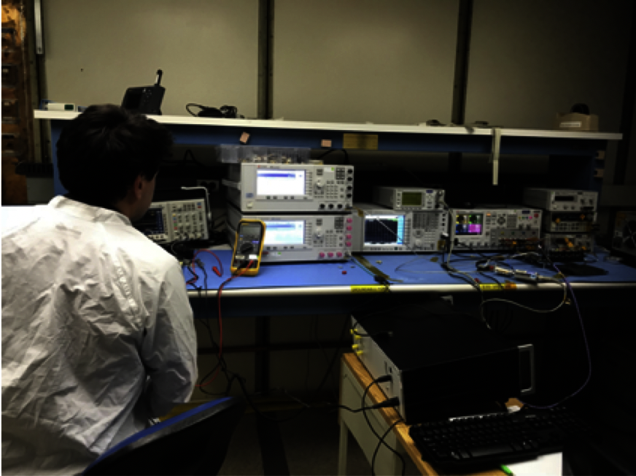
Iris Mission-Specific Testing at JPL
After delivery from SDL, mission-specific tests can be performed at JPL such as,
  Higher data rate tests for the lunar missions e.g. downlink 256kbps Turbo code testing, using the JPL-lab equipped DSN Block V Receiver.
  This is a useful “precursor” to the DSN RF Compatibility Test at DTF-21, which is to include, not only the downlink/telemetry test (using the DSN Block V Receiver), but also the uplink/commanding & ranging tests using the DSN Uplink & Ranging Assemblies.
Test reports are captured in the respective JPL Hardware Review and Certification Record (HRCR) for each mission.
Iris Hardware Inside the Screen Room
(adjacent to DSN Block V Receiver)
JPL-lab Equipped - DSN Block V Receiver

Slide 7
Iris RF Compatibility Testing at DTF-21
The RF Compatibility Test is performed to verify compatibility with the Deep Space Network, which takes place at the DSN Test Facility (DTF)-21 in Monrovia, CA.
This is a spacecraft level test for approximately 1 week.
At the time of this writing, thirty percent of the 6 EM-1 CubeSats using the Iris Deep Space Transponder, have gone through the DSN RF Compatibility Testing successfully.
Test reports are available through the respective DSN Mission Interface Manager (MIM) at JPL.
Sample of RF Compatibility Test List

