Slide 1
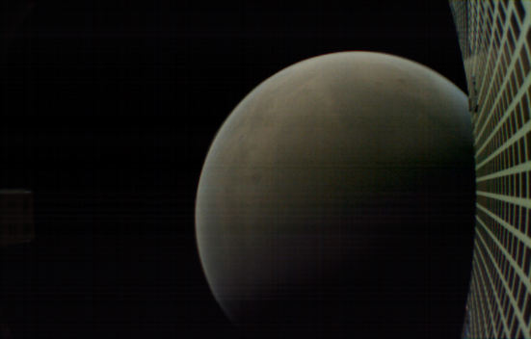
2019 Interplanetary Small Satellite Conf.
San Luis Obispo, CA, USA, 29-30 April 2019
Iris at Mars:
First Flight Use of Iris
Deep Space Transponder on MarCO
Sarah Holmes
M. Michael Kobayashi
Mazen Shihabi
Jet Propulsion Laboratory
at the California Institute of Technology

Slide 2

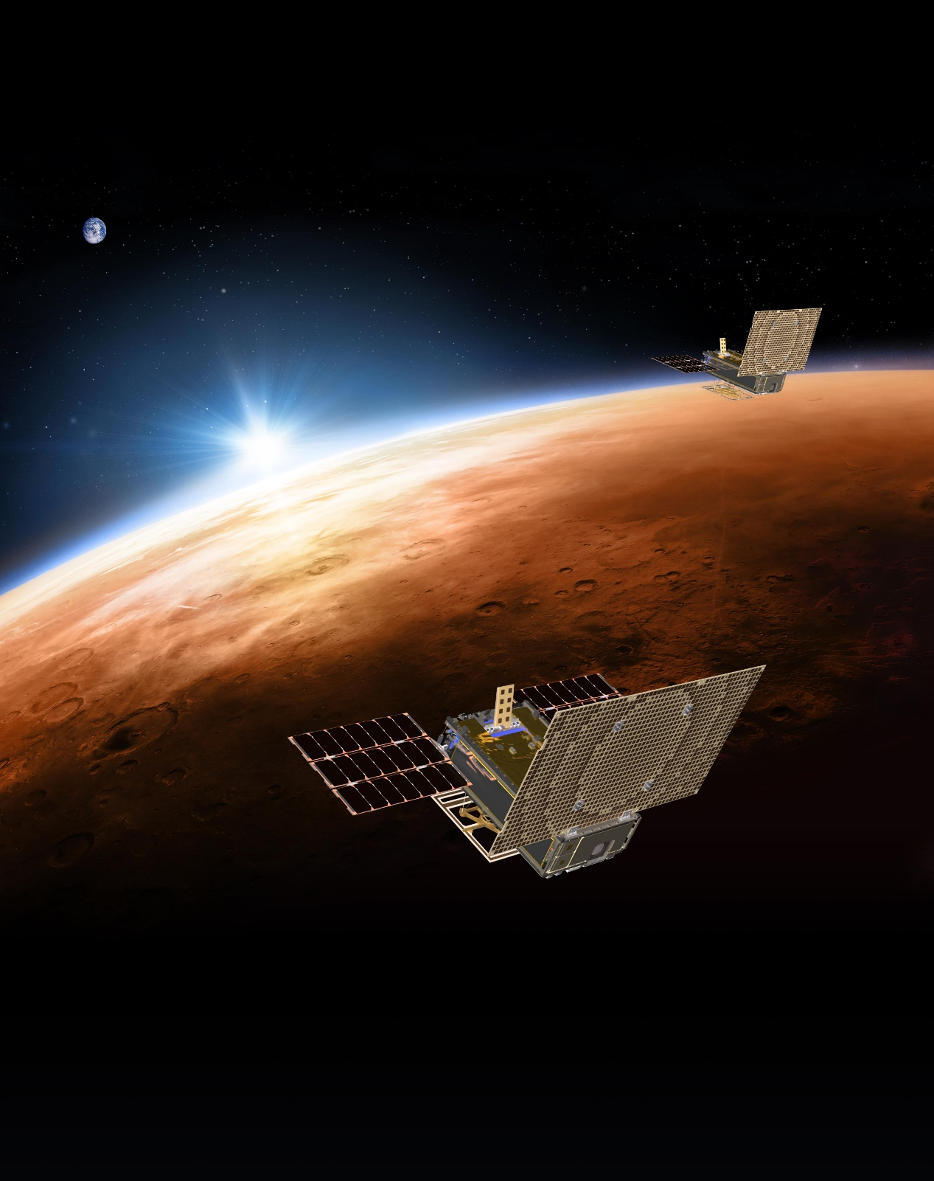
Contents
MarCO Mission Overview
Iris Overview
Iris Testing for MarCO
Activities on Launch Day
Activities During Cruise
Post-Launch Updates
Achievements at Mars
Current State of MarCO and Iris
Copyright (c)2019 California Institute of Technology. Government Sponsorship Acknowledged.
Notes:
Abstract:
In 2015, the Jet Propulsion Laboratory developed the second version of the Iris Deep-Space Transponder to be used on the Mars Cube One (MarCO) mission. Iris is a software-defined radio (SDR) which interoperates with NASA’s Deep Space Network (DSN) on X-Band frequencies (7.2 GHz uplink, 8.4 GHz downlink) while in a package size designed for CubeSats. For MarCO, it successfully performed bent-pipe relay direct to Earth during entry, descent, and landing (EDL) of the InSight lander, including InSight’s first image from the surface of Mars. This talk will discuss the development of Iris for the MarCO mission, including key features and requirements, as well as the testing and behavior of Iris during MarCO’s cruise and on EDL day.

Slide 3
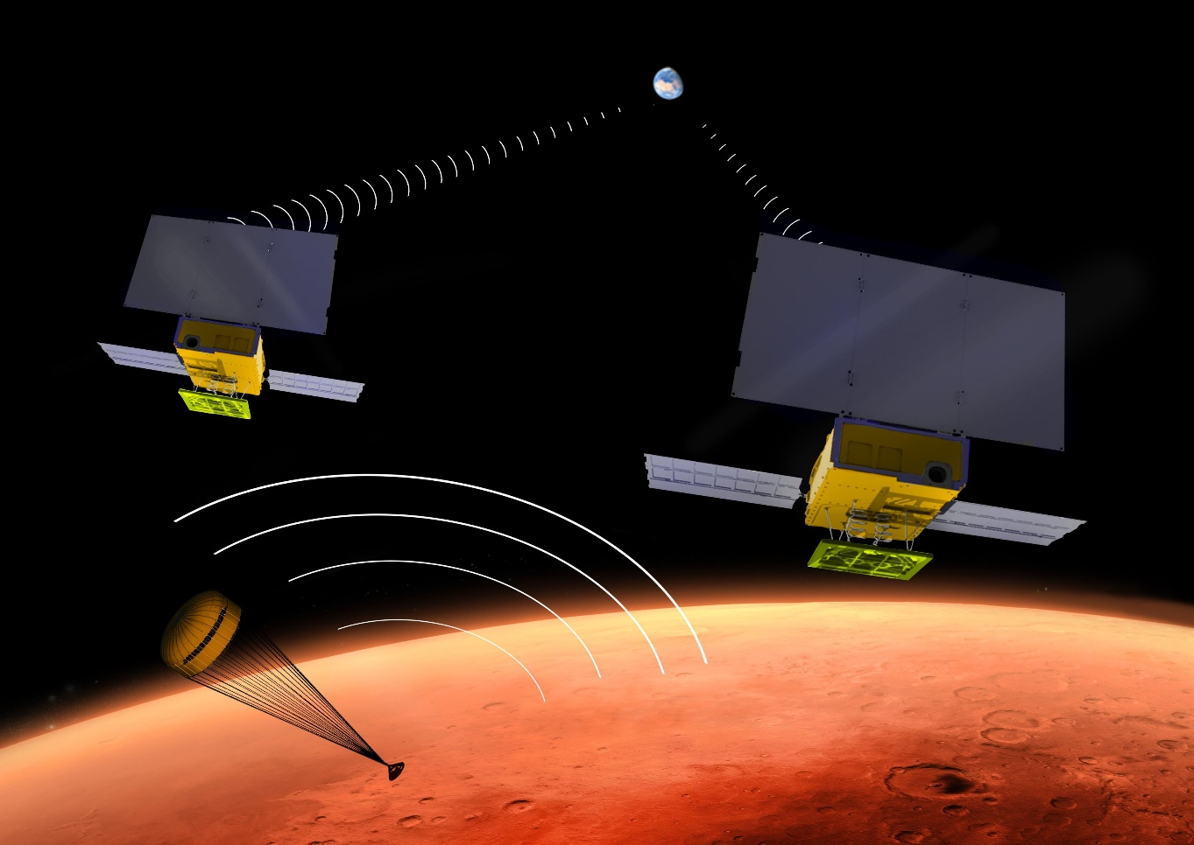
MarCO Mission Overview
Provide “real-time” data relay during EDL of InSight to Mars
Bent-pipe:
  UHF receive of EDL data
  X-band transmit Direct-to-Earth
Two for redundancy
Tech demo – InSight’s success is
independent of MarCO’s success
First deep space CubeSats
MarCOs launch with InSight
but travel independently to Mars
Copyright (c)2019 California Institute of Technology. Government Sponsorship Acknowledged.
Notes:
“real-time” refers to 7+ min delay from Mars
MRO is reliable open-loop recording of EDL data and verification of InSight landing success, but goes behind Mars just after EDL
Emphasize that MarCO is flyby – doesn’t enter Mars orbit or land

Slide 4
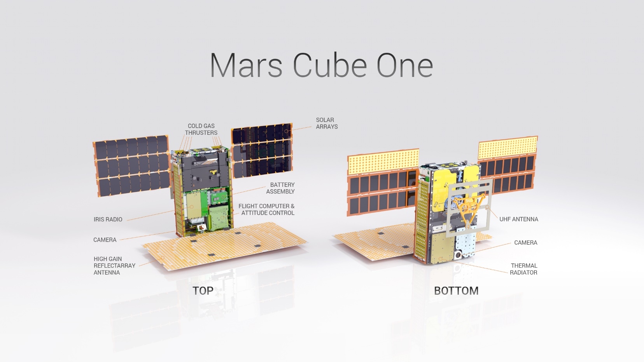
MarCO Specifications and Subsystems
6U (10x20x30cm)
13.5kg (30lbs)
Subsystems:
  Propulsion (VACCO)
  Flight Computer
  (Astronautical Dev. LLC)
  Electronic Power System
  (Astronautical Dev. LLC)
  Solar Panel System
  (MMA Design LLC)
  Attitude Control System
  (Blue Canyon Tech.)
  Cameras
  Telecom (JPL)
Copyright (c)2019 California Institute of Technology. Government Sponsorship Acknowledged.
Notes:
Total cost: ~$18.5 million

Slide 5
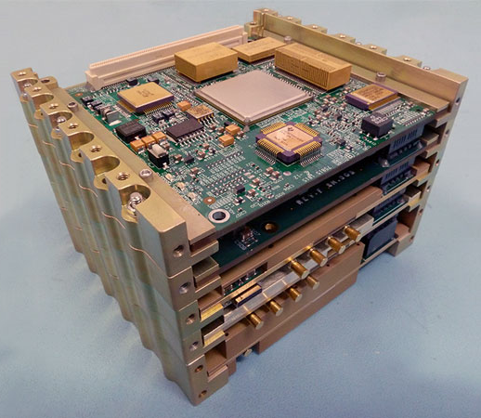
Iris Overview
Specs: 0.77U, 1.2kg, 35W (Tx/Rx),
4W RF output
Communicates with DSN at X-Band
  CCSDS: AOS (down), TC (up)
V2 design consists of five boards:
UHF receiver, X-band receiver,
X-band exciter, power, digital
Virtex 6 with LEON3-FT softcore
Copyright (c)2019 California Institute of Technology. Government Sponsorship Acknowledged.
Notes:
X-band frequencies: 7.2 GHz up, 8.4 GHz down
Talk specifically about upgrades from V1 (embedded softcore processor)

Slide 6
Iris Testing for MarCO
X-band
X-band
Ambient and Block V Rx at JPL
  Downlink with Block V (DSN)
InSight compatibility at Lockheed Martin
  Pre-integration with MarCO
DSN compatibility at DTF-21
  Post-integration with MarCO
Iris
Cassy*
Iris
Block V**
UHF
X-band
InSight
Iris
Cassy*
* Cassy: GSE developed with Iris, supports commanding and telemetry (tx/rx)
** Block V: 5th generation DSN receiver currently used at all DSN complexes
X-band
MarCO
DSN
Copyright (c)2019 California Institute of Technology. Government Sponsorship Acknowledged.
Notes:
- “Iris” is using a MarCO C&DH emulator as well

Slide 7
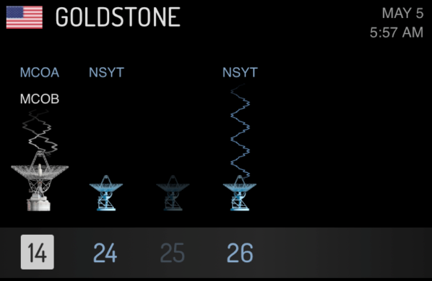
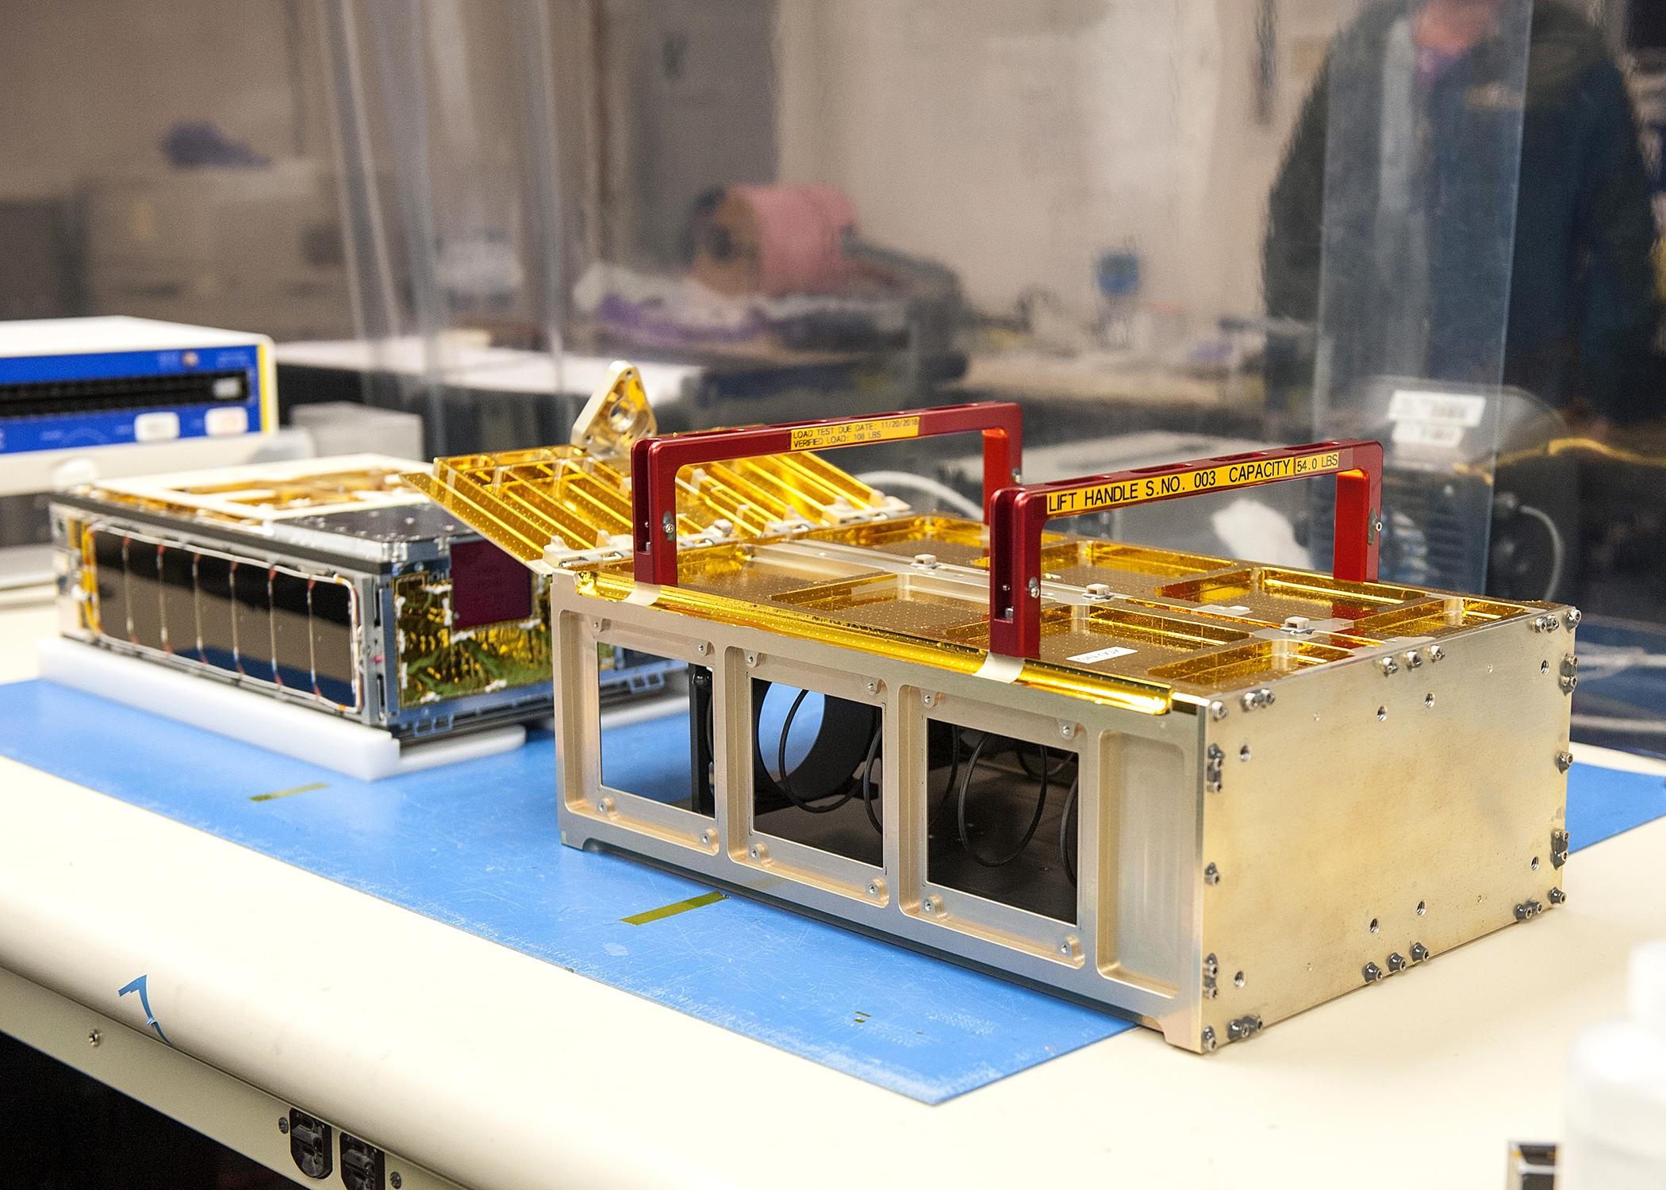
Activities on Launch Day
May 5, 2018, from Vandenberg Air Force Base near Lompoc, CA
MarCOs deployed after InSight
First Contact:
  Transponder beacons to
  indicate aliveness
  Transmits telemetry data
  MarCO-A: ~5:55am, 5 mins
  MarCO-B: ~6:05am, 5 mins
  Nominal telemetry on both SC
Commanding performed during
later pass
Successful deployment of X-band
reflectarray and UHF loop antenna
Copyright (c)2019 California Institute of Technology. Government Sponsorship Acknowledged.
Notes:
DSS-14 (Goldstone) in MSPA (Multiple Spacecraft Per Antenna) mode
First pass is too short for uplink command

Slide 8
Activities During Cruise: Continuous
Commanding (uplink data)
  Pre-loaded command sequences in flight computer, allowing for some autonomous functionality
  Uplinked new command sequences from ground as desired
Telemetry (downlink data)
  Downlinked telemetry data containing spacecraft health and status
  Also downlinked images as available
Navigation
  Ranging Mode receives ranging signal (carrier tone) from ground and retransmits ranging signal back to Earth
  DDOR Mode (delta differential one-way ranging) generates and transmits DDOR tones, which are received by multiple ground stations
Copyright (c)2019 California Institute of Technology. Government Sponsorship Acknowledged.
Notes:
Ranging: two way light time for how long it takes for carrier to get there and back
Doppler: how fast it’s moving

Slide 9
Activities During Cruise: Special Cases
HGA characterization
  Verification that HGA in good condition after launch (performed on both SC)
  Point the antenna to different attitudes and measure how the receive power changes on the ground
    Nominal boresight, then +/- 2 degrees on different axes
In-flight test of bent-pipe (EDL) mode
  Verification that UHF antenna in good condition after launch
  UHF transmit from Stanford ground station (simulating InSight) to Iris,
  X-band transmit from Iris to DSN
Receive tests with Morehead State University ground station
Copyright (c)2019 California Institute of Technology. Government Sponsorship Acknowledged.

Slide 10
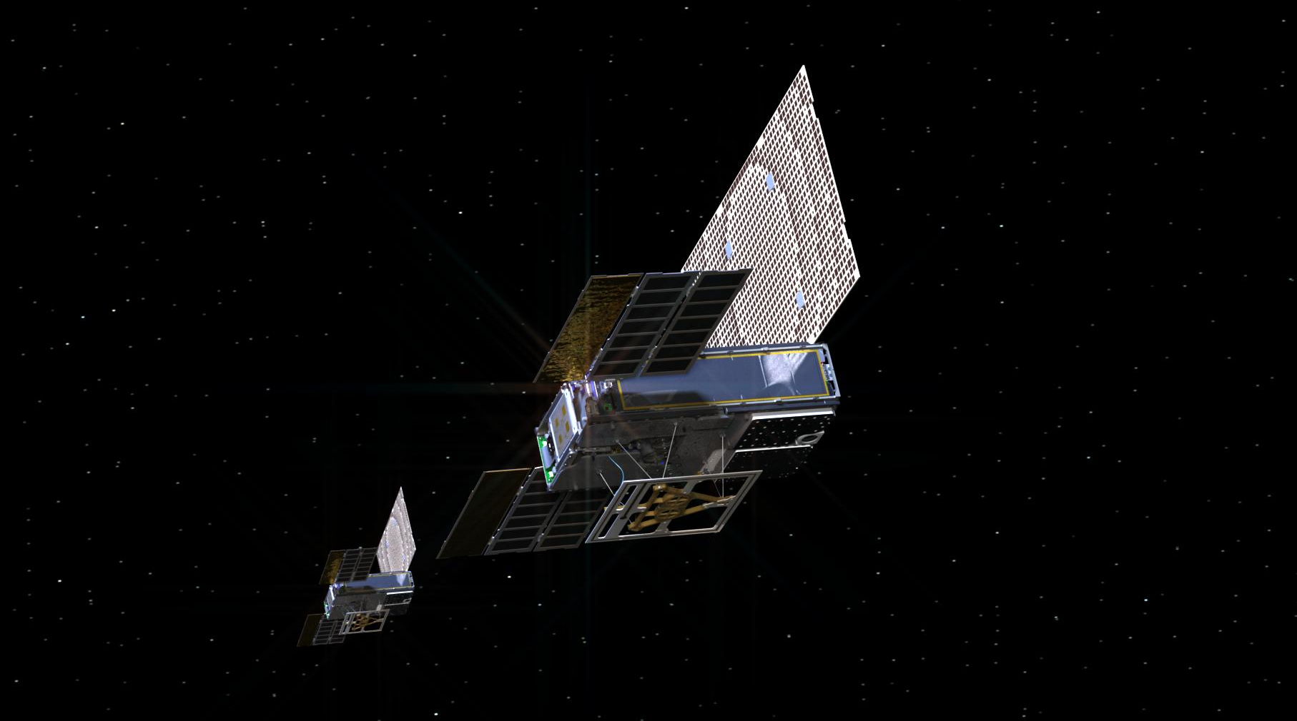
Post-Launch Updates
Command sequences for a variety of new Iris configurations
Verified on MarCO Iris spare unit with Cassy GSE,
and on MarCO SC testbed
Examples:
  Additional Data Rates
  Tx/Rx with Ranging
  Carrier-Only Downlink
  Adjusting Data Arbitration
Copyright (c)2019 California Institute of Technology. Government Sponsorship Acknowledged.

Slide 11
Post-Launch Updates in Detail
Higher data rate required alternate encoding scheme
  Nominal encoding of Turbo 1/6
  Requested configuration for downlink data rates including 8 kbps and 16 kbps
  Turbo 1/6 at 16 kbps (192 kHz) violates MarCO’s spectrum allocation license
  To comply with NTIA license agreement, instead provided:
    Turbo 1/6 at 8 kbps (96 kHz)
    Turbo 1/3 at 16 kbps (96 kHz)
Adjustable data prioritization
  Data arbitration allows for alternate prioritization of EDL data vs TLM data
  Not configurable or accessible through pre-defined register
  Single-threaded software means deterministic locations of variables
  Disassembled flight software image to find memory location for data arbitration variable
Copyright (c)2019 California Institute of Technology. Government Sponsorship Acknowledged.

Slide 12
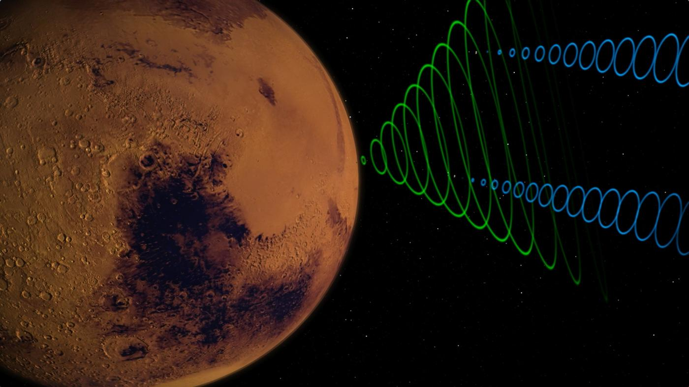
Mission Success at Mars
Successfully completed EDL
with zero data loss
  Iris transmitted all data
  that it received
EDL data recorded:
  MarCO-A: 694 KB
  MarCO-B: 712 KB
  (more than MRO!)
Performed retransmission
post-EDL
Copyright (c)2019 California Institute of Technology. Government Sponsorship Acknowledged.

Slide 13
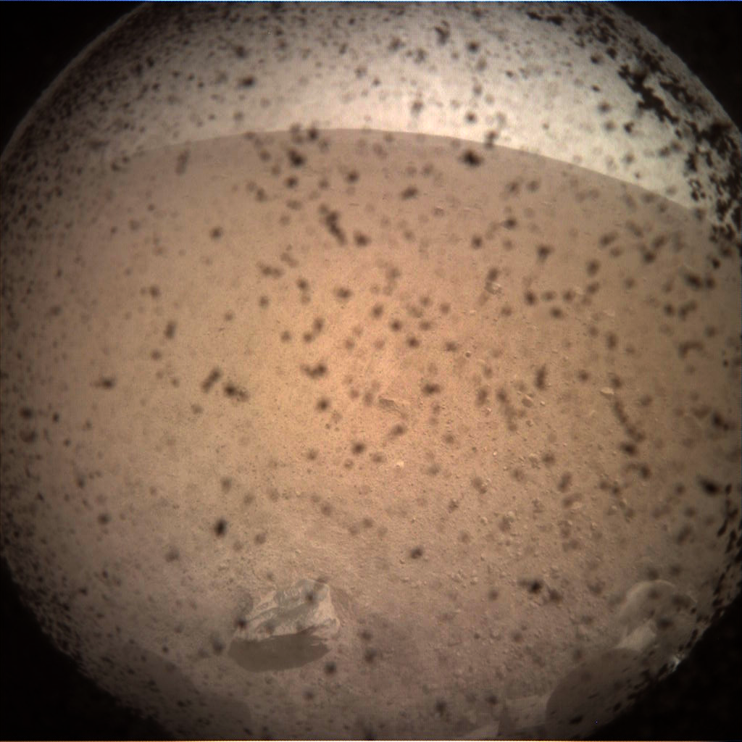
First Image from
InSight Lander
MarCO enabled quick reception
of InSight’s first image on Mars
Utilized post-launch updates,
including arbitration scheme
adjustments and increased data rates

Slide 14
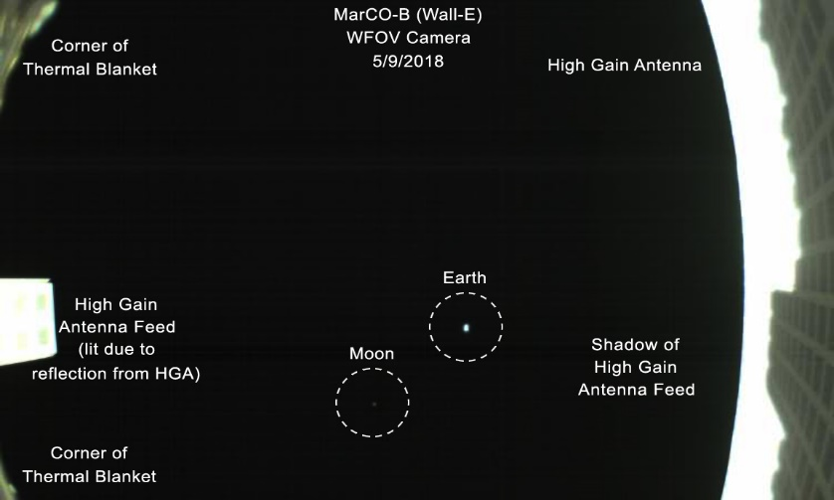
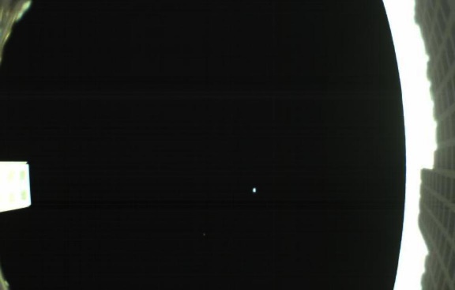
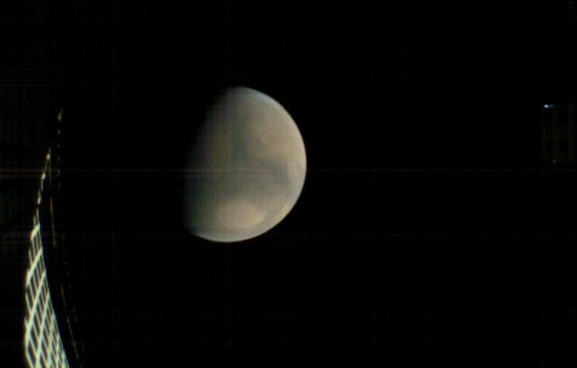
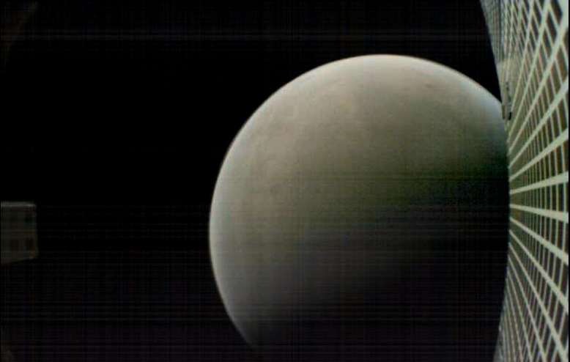
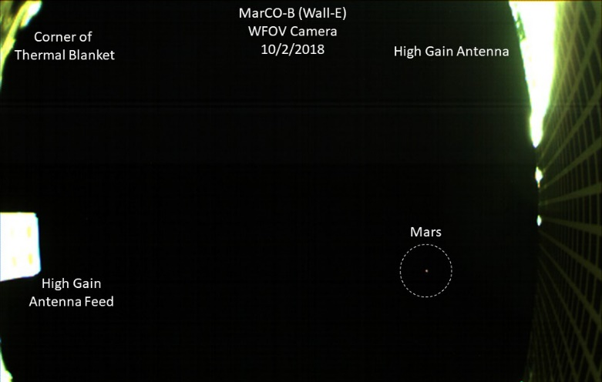
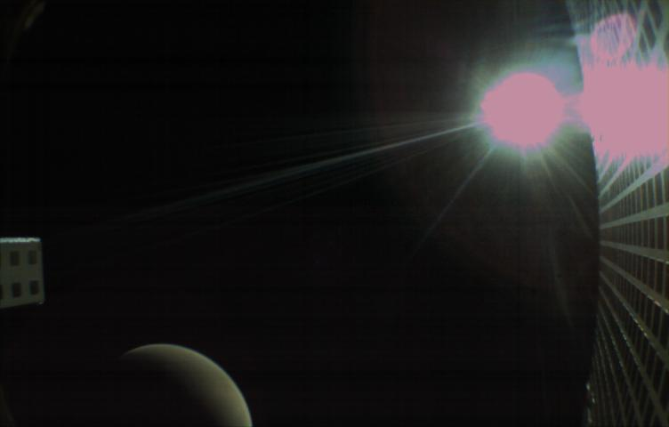
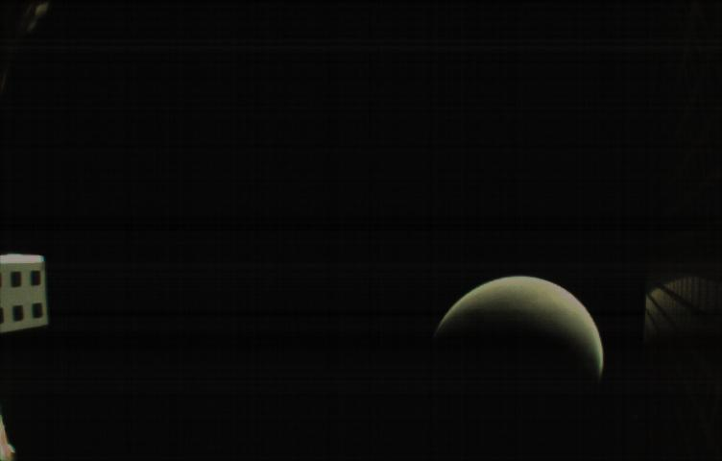
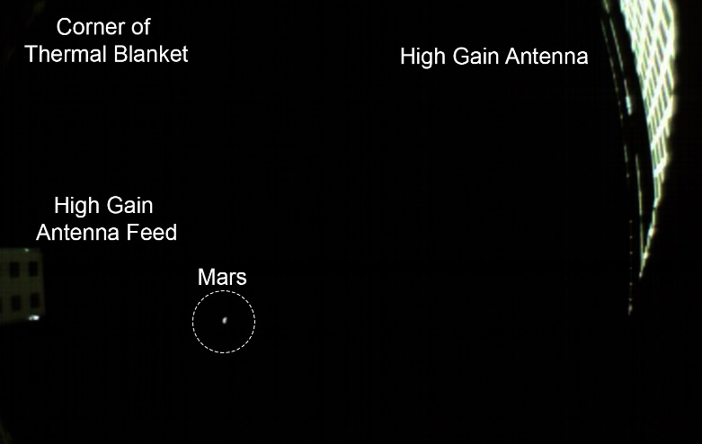
MarCO-B Images
Corner of Thermal Blanket
High Gain Antenna
Earth
High Gain Antenna Feed
Copyright (c)2019 California Institute of Technology. Government Sponsorship Acknowledged.

Slide 15
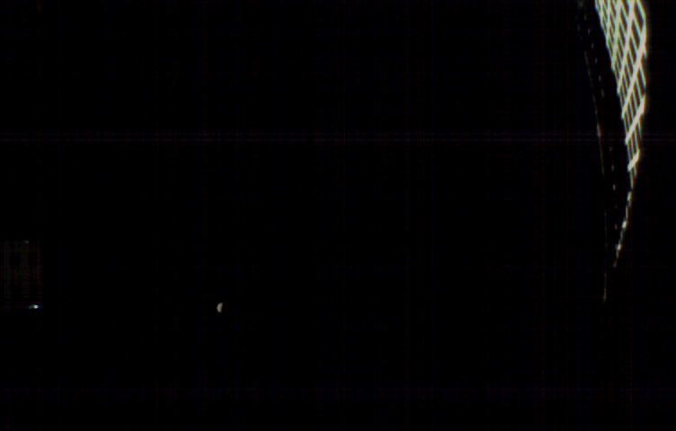
Approach to Mars
Copyright (c)2019 California Institute of Technology. Government Sponsorship Acknowledged.
Notes:
(gif)

Slide 16
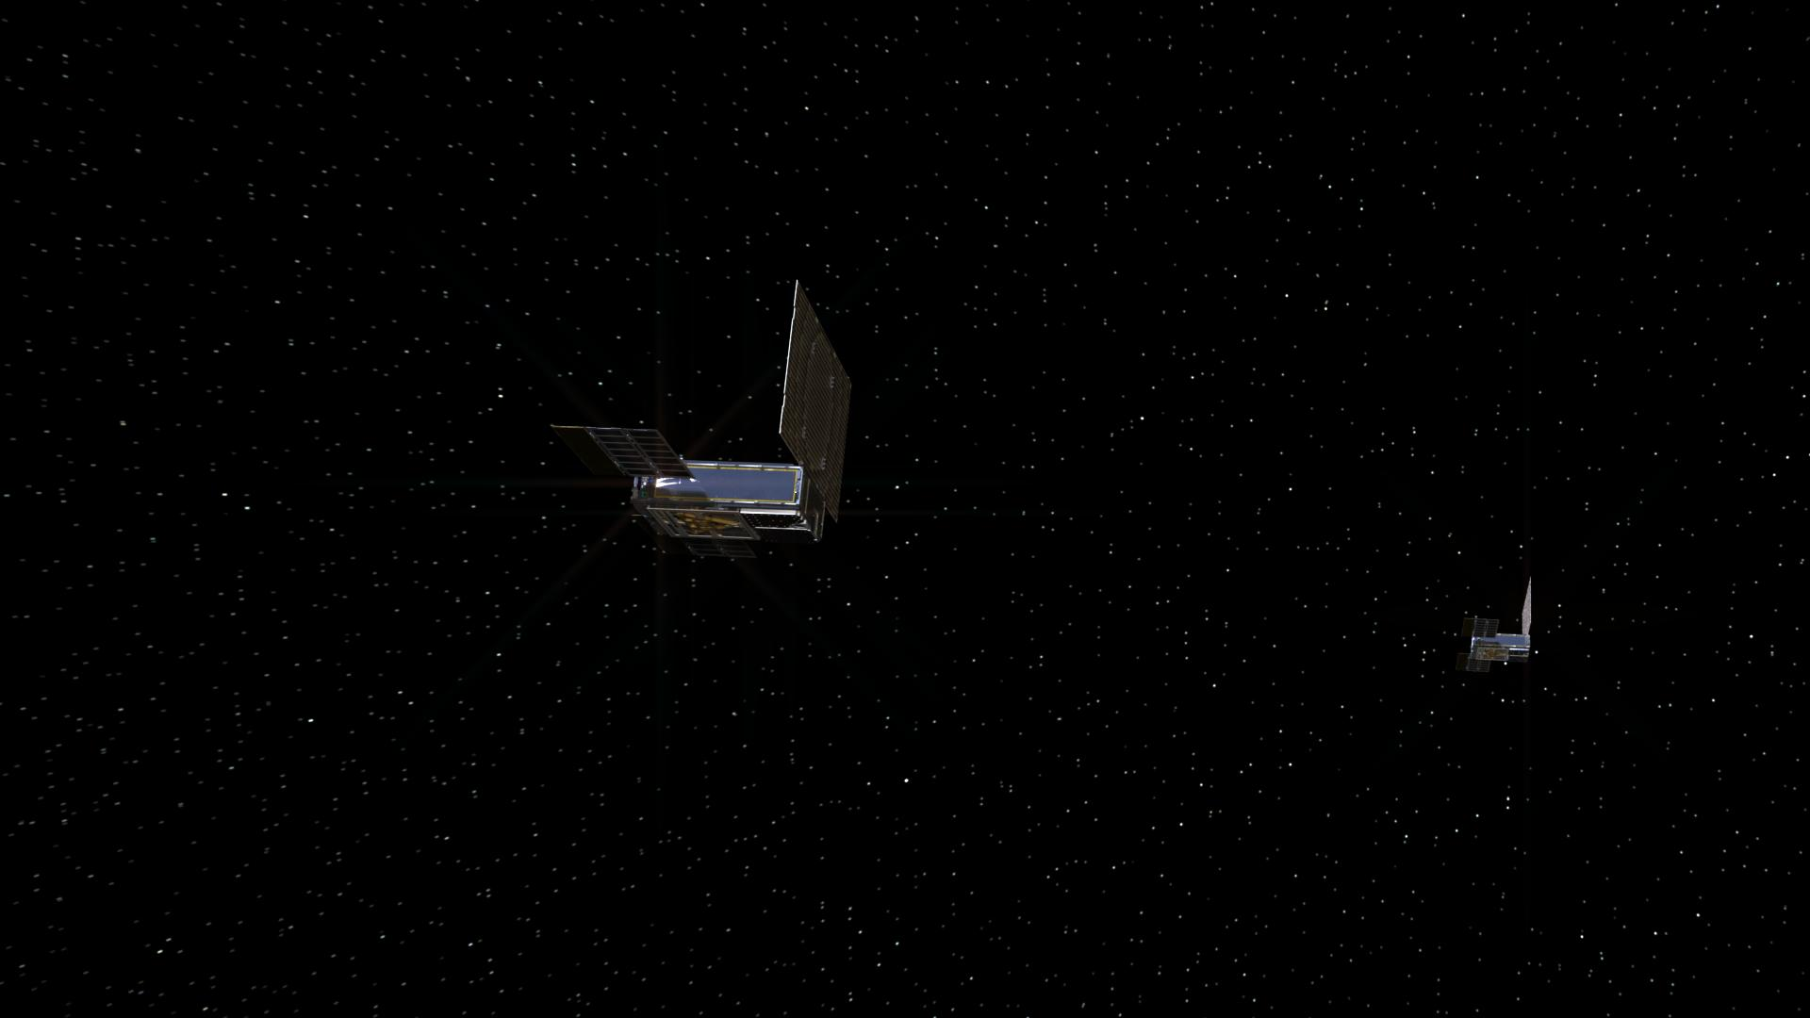
Current State of MarCO and Iris
Lost contact a few weeks after EDL
  MarCO-B: Dec. 29 2018; MarCO-A: Jan. 4, 2019
  Current theory:
    Issues on brightness sensors
    leading to attitude control
    trouble (greater distance
    requires more precise
    pointing) and inability
    to recharge batteries
Heliocentric orbit; team
may attempt to re-engage
in early summer 2019
Next version of Iris has
been delivered to several
CubeSat missions for EM-1
Copyright (c)2019 California Institute of Technology. Government Sponsorship Acknowledged.
Notes:
“Brightness sensors”: star tracker and solar arrays
Unable to point to sun (star tracker), unable to recharge batteries (solar arrays)

Slide 17
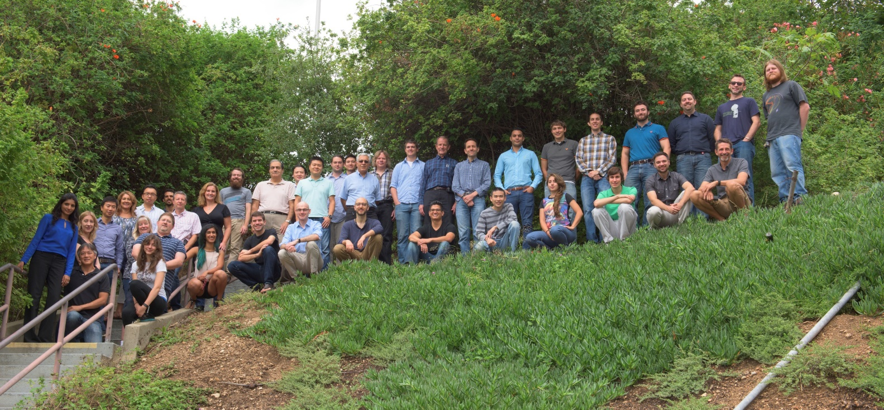
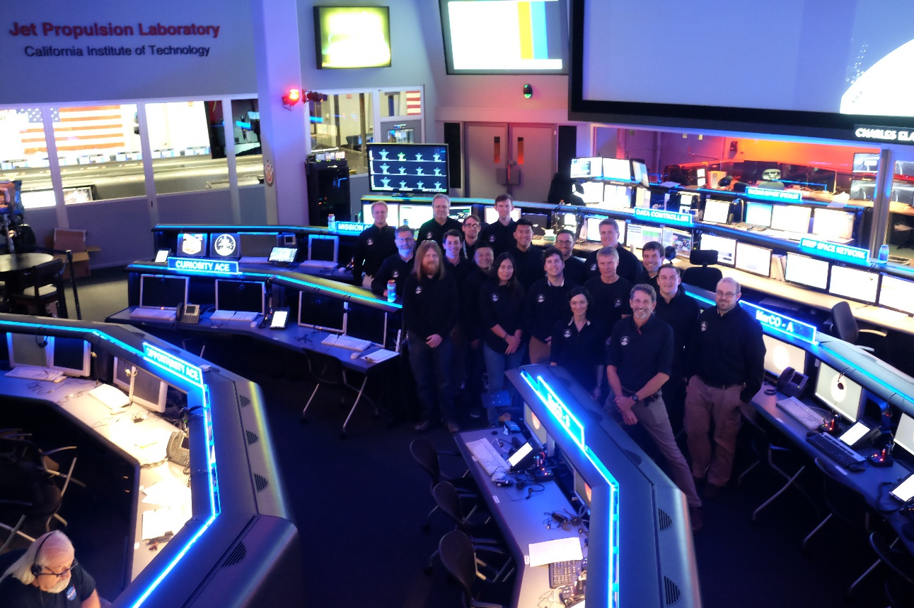
MarCO and Iris Teams
And many more not pictured!
Copyright (c)2019 California Institute of Technology. Government Sponsorship Acknowledged.

Slide 18


