Slide 1


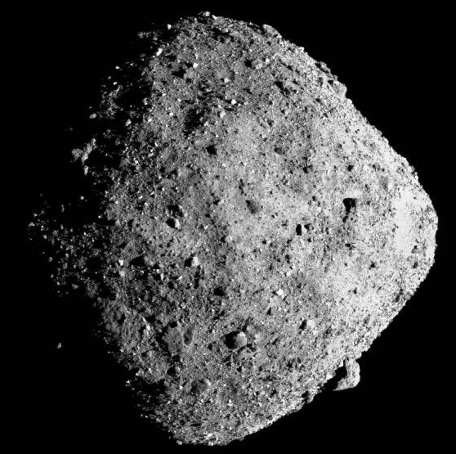
Towards Development and Testing of an Engineering Model for an Asteroid Hopping Robot
Greg Wilburn¹, Leonard Vance¹
¹ Space and Terrestrial Robotic Exploration (Space TREx) Lab
Aerospace and Mechanical Engineering, University of Arizona
4/30/2019
Interplanetary Small Satellite Conference
San Luis Obispo, CA
Notes:
1

Slide 2
Introduction
Why asteroid exploration is important
Surface mobility and AMIGO Overview
Engineering Model Testing
Sublimate Propulsion
Nozzle geometry design
MEMS Fabrication Methods

Slide 3
Motivation: Asteroid Exploration

Slide 4
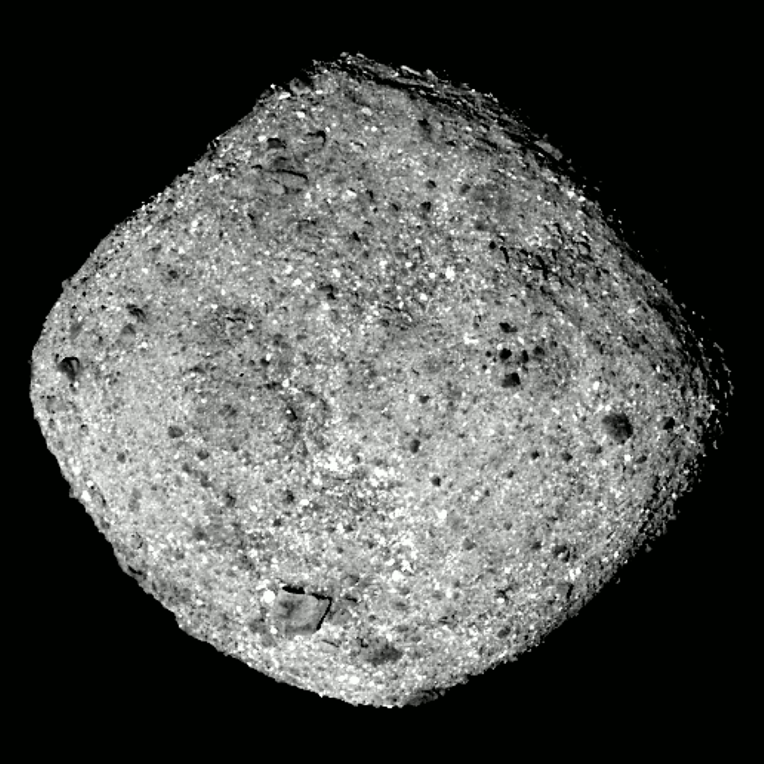
Asteroid Exploration
Planetary Science Decadal Survey highlights key questions asteroids can answer
In-situ analysis required for in-depth analysis on internal structure, surface regolith, thermal effects, etc.
Figure: Bennu Arrival from OSIRIS-Rex
(Credit: NASA, Goddard, University of Arizona)

Slide 5
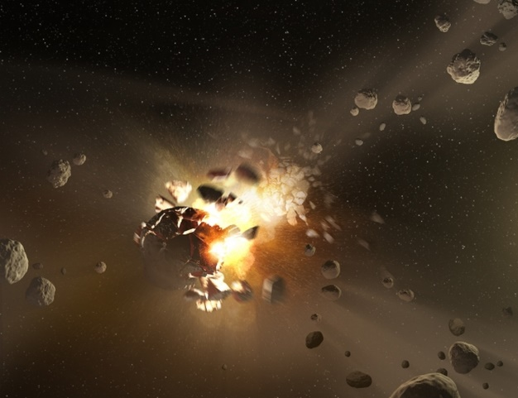
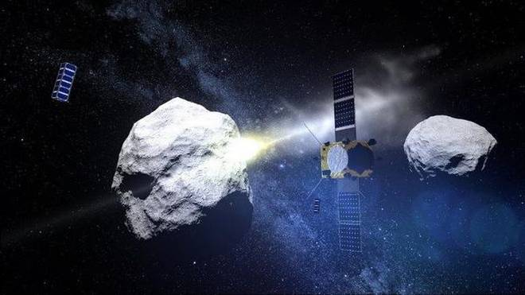
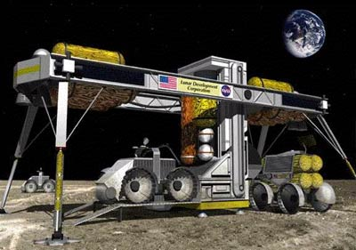

Asteroid Surface Exploration
Geohistory
Security/Deflection
ISRU
Short, focused, high-risk, high-return…
Complements flyby and orbital observation science.

Slide 6
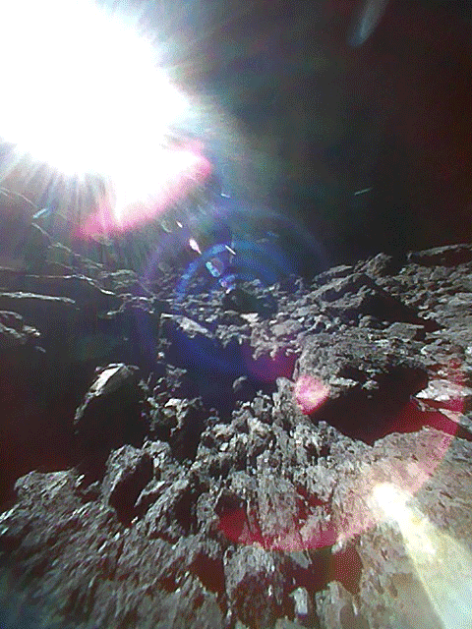
Asteroid Surface Hopping
Collect science data at multiple locations
Mobility through:
  Roving
  Internal actuation
  Mechanical systems
  Thrusting
Figure: Surface of Ryugu from MINERVA-II 1B (Credit: JAXA, University of Tokyo et al.)

Slide 7
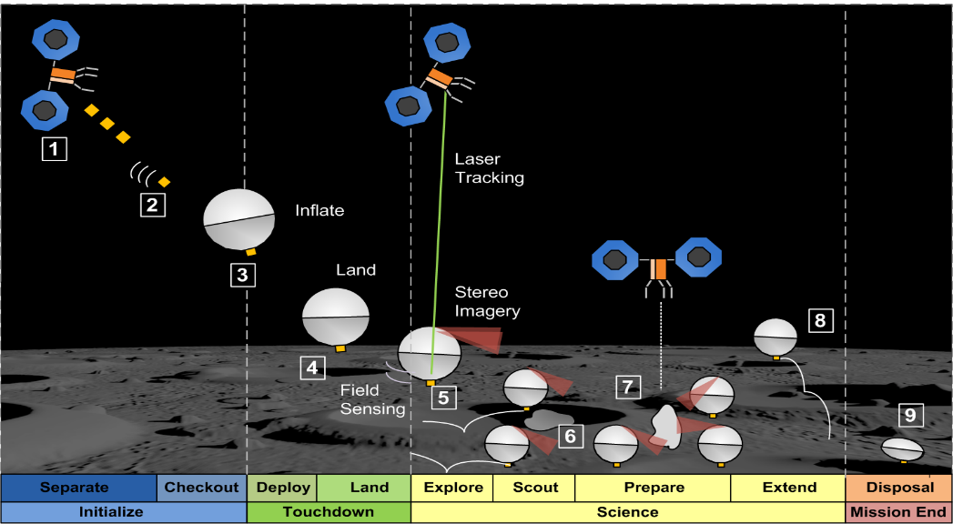
AMIGO ConOps

Slide 8
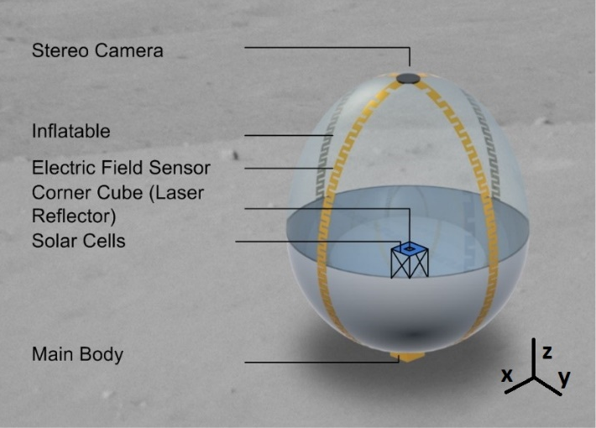
AMIGO Mission Concept
Stereo imaging
Geologic imaging
Thermal fatigue
Seismic sensing
Electric field measurements
Complements orbital science and flyby missions
Figure: AMIGO Overview

Slide 9
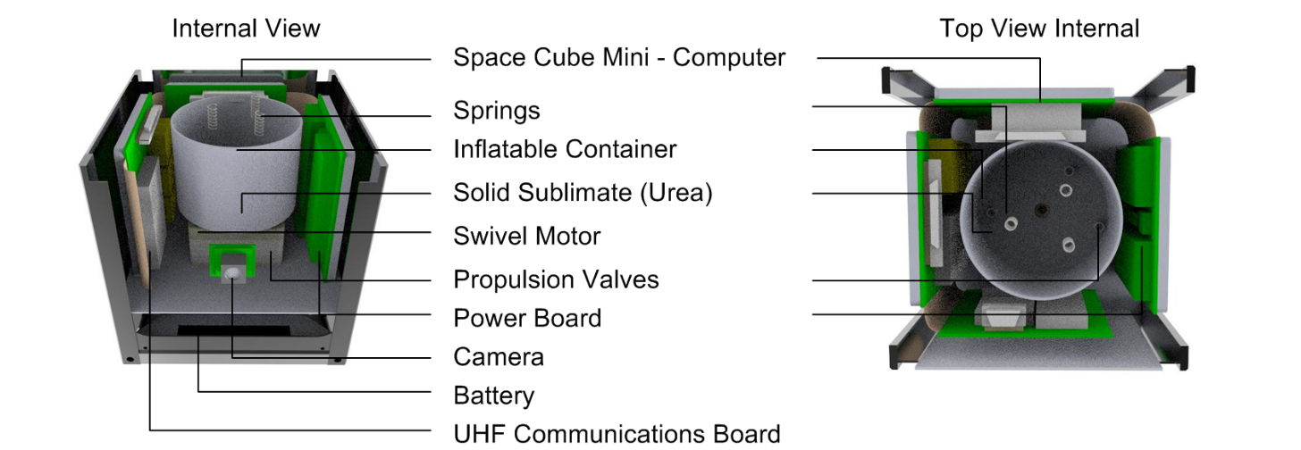
AMIGO Internals
Housing for:
  Computer/ power system
  Inflatable deployment
  Science instruments
  Propulsion components
Figure: AMIGO Internals

Slide 10
Engineering Model

Slide 11
Components
Parallel effort to develop low cost 1U cubesat for general use
Avionics: ¼ U
  Computer: Teensy Board
  Batteries: Li-Ion 18650 (~17 WHr)
Propulsion: ¼ U
Inflatable structure: ¼ U
Mock science instruments: ¼ U
Figure: AMIGO Internals

Slide 12
Testing
Microgravity simulation: helium filled pseudo-inflatable
Simulant regolith to understand surface interaction
Test path planning algorithm from top mounted camera
Use micro-thrusters for hopping

Slide 13
Sublimate Micro-Propulsion

Slide 14
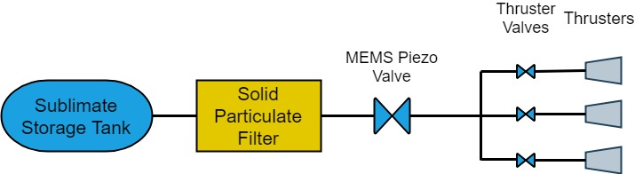
Sublimate Propulsion
Extension of cold gas systems
Usable with low-cost, readily-available chemicals
Store propellant as solid – higher storage density
Control chamber pressure by heating elements
Lower pressure than conventional cold gas
Figure: Sublimate Propulsion System Block Diagram

Slide 15
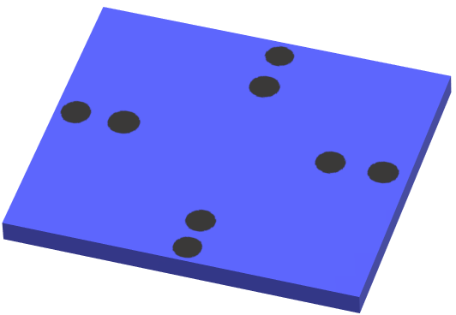
Thruster Chip
Bottom mounted MEMS thruster chip for hopping
x-y control authority
Discretized micro-nozzles allow three saturation modes by individual actuation
Figure: Thruster Chip

Slide 16
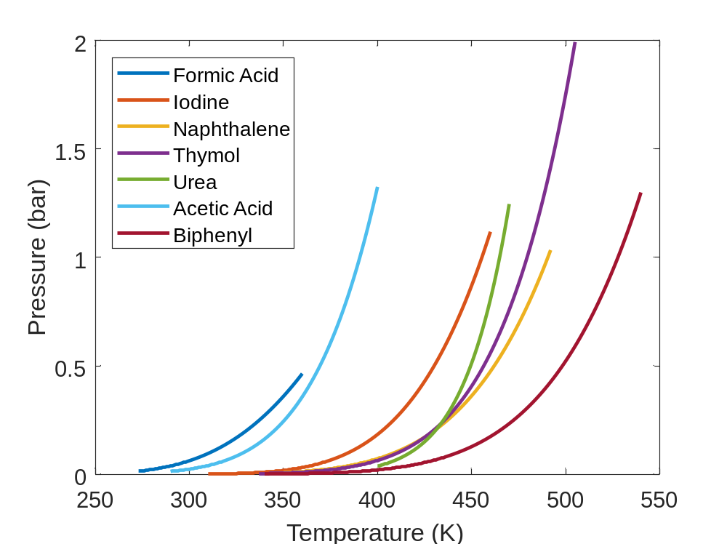
Sublimate Propellant Candidates

Slide 17
Nozzle Geometry Design

Slide 18
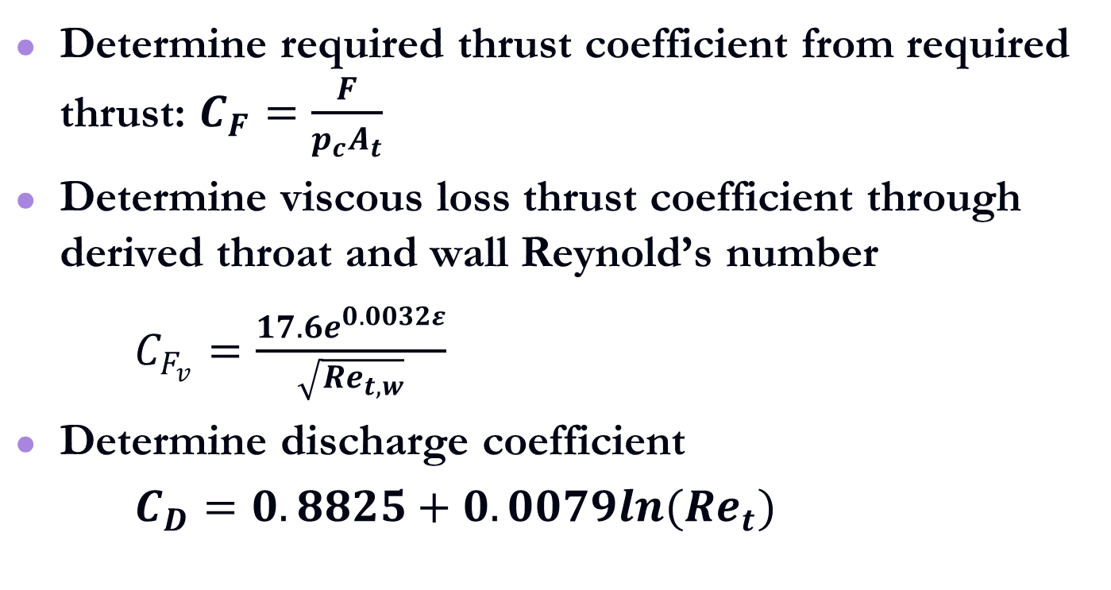
Algorithm Flow
Determine required thrust coefficient from required thrust: $C_{F}=\frac{F}{p_{c}A_{t}}$
Determine viscous loss thrust coefficient through derived throat and wall Reynold’s number
$C_{F_{v}}=\frac{17.6e^{0.0032ε}}{\sqrt{{Re}_{t,w}}}$
Determine discharge coefficient
$C_{D}=0.8825+0.0079ln({Re}_{t})$

Slide 19
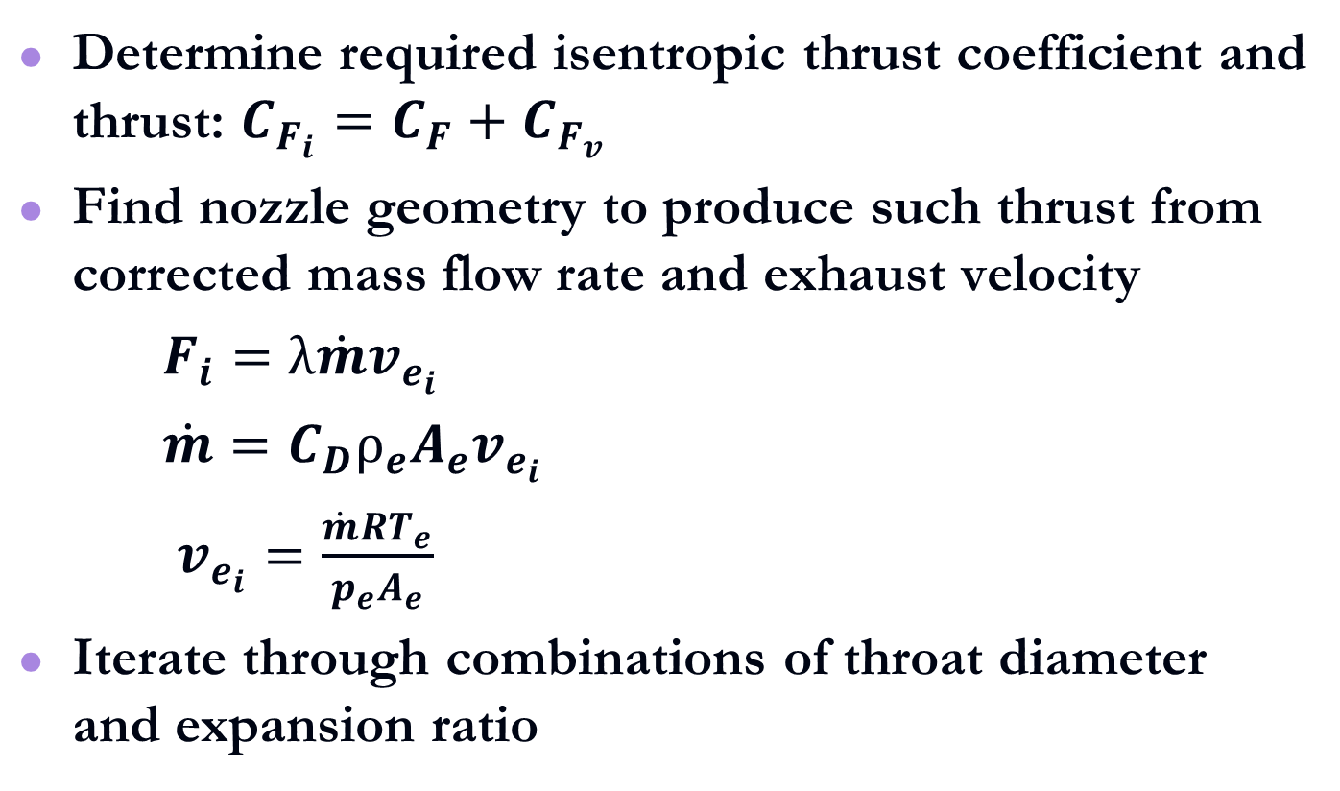
Algorithm Flow
Determine required isentropic thrust coefficient and thrust: $C_{F_{i}}=C_{F}+C_{F_{v}}$
Find nozzle geometry to produce such thrust from corrected mass flow rate and exhaust velocity
$F_{i}=λ\dot{m}v_{e_{i}}$
$\dot{m}=C_{D}ρ_{e}A_{e}v_{e_{i}}$
$v_{e_{i}}=\frac{\dot{m}RT_{e}}{p_{e}A_{e}}$
Iterate through combinations of throat diameter and expansion ratio

Slide 20
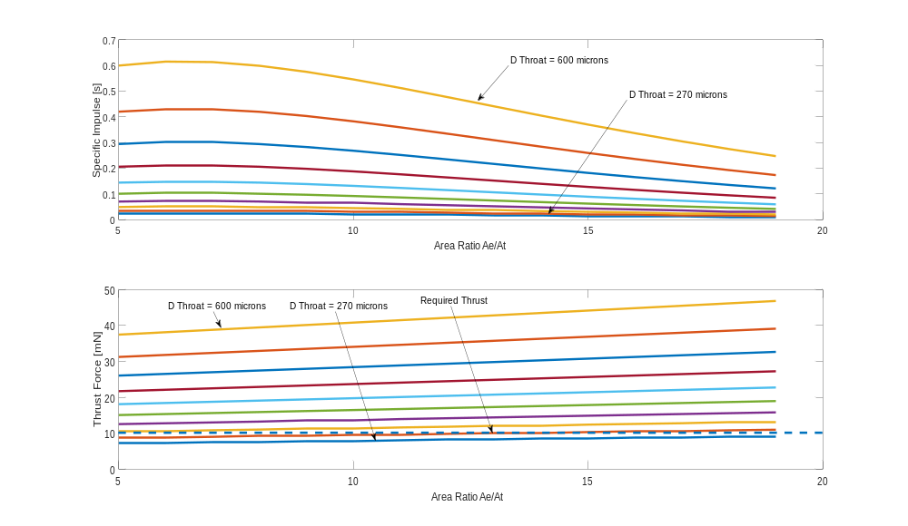

Slide 21
MEMS Fabrication

Slide 22
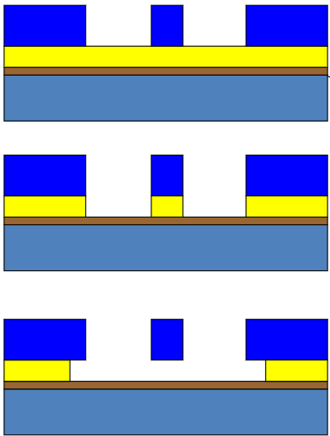
Etching Techniques
Dry etching: deep reactive ion etching
Wet etching:
  Anisotropic: Si reaction with KOH
  Isotropic: Si reaction with HF and HNO₃
Figure: Anisotropic vs Isotropic Etch

Slide 23
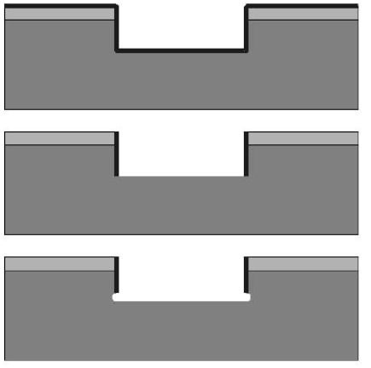
DRIE
Step 1: polymer deposition
Step 2: ion bombardment to expose bottom face
Step 3: isotropic etch
Decrease etch time each step to make conical geometry
Very expensive
Figure: DRIE Etching Process

Slide 24
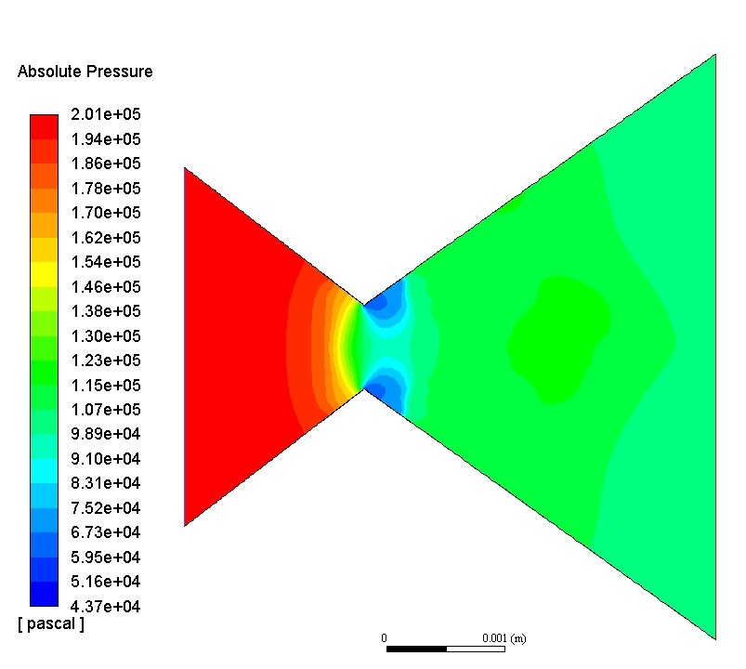
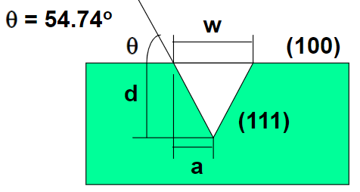
Anisotropic Etching
Exploit crystal structure to etch along certain lattices
Easily creates quasi-conical nozzles
Semi-vertex angle fixed by crystal plane etched
Figure: Anisotropic Etch of Silicon <100> Face
Figure: CFD of 35° Nozzle

Slide 25
Isotropic Etching
Etch along each crystal face at equal rates
Better for larger, simple geometries
Not limited to quasi-3D shapes
Downside: requires nitride deposition, not readily available at UA facilities

Slide 26
Micro-Milling
Micron-level precision
Able to produce rounded nozzle throats to mitigate separation
Most feasible machining option for the simple conical nozzles

Slide 27
Conclusion
Showed reasoning behind an asteroid surface hopping robot
Benefits of sublimate-stored, cold gas thrusting system shown
Method for designing micro-nozzles has been developed
Fabrication methods explored based on traditional MEMS manufacturing

Slide 28
Thank You
Acknowledgement: Dr. Eniko Enikov

