Slide 1
A small spacecraft to explore the Sun’s control of Jupiter’s magnetosphere
Frank Crary and Fran Bagenal
University of Colorado
Laboratory for Atmospheric and Space Physics

Slide 2
Jupiter’s Magnetosphere and the Sun
Jupiter’s magnetosphere is big
  Magnetopause at 75 R_{J} (Earth’s is at 10 R_{E})
Dynamics are mostly driven by Io
  ~1000 kg/s of sulfur and oxygen ions
  Coupling to planet’s rotation
  Transport out of plasma torus
But what does “mostly” mean?
  99%? 75% 51%
  Observations also show solar wind driver
  Aurora and auroral radio emissions
  Connected to regions deep in magnetosphere
How? Theoretically very hard to explain

Slide 3
Limits to Current Data
From Nichols et al., 2017
Few frequent, long-term data sets
  Propagation from Earth is uncertain ±20 hr. or worse
  In situ solar wind measurements
  near Jupiter are rare
  Large amounts of observing time on major telescopes is hard to get
    Exception is Hisaki (but unresolved)
Example: Juno approach phase
  Best available data set
  47 Hubble orbits (~30 min)
    Roughly 1/day
  56 days of solar wind data
    With a 14-day gap
  Only one clear event

Slide 4
Slow Jovian Flyby Mission Concept
Small spacecraft to observe near Jupiter
  Near Jupiter but not in orbit, within 1000 R_{J} (~0.5 AU)
  Near-Continuous observations for 300 days (135 inside 500 R_{J})
ESPA Grande secondary payload launched to C₃ ~ 0
  For example, SIMPLEx mission launched with IMAP (Oct. 2024)
Slow flyby of Jupiter
  Image Jupiter’s aurora at HST-quality resolution (< 500 R_{J})
    8 times per rotation (74.4 min.), 90% duty cycle due to downlinks
  Observe solar wind conditions continuously
Return minimum data set during encounter
Return full data set after encounter, when Earth is closer
  All data returned by NEO departure +2245 days (6 years)

Slide 5
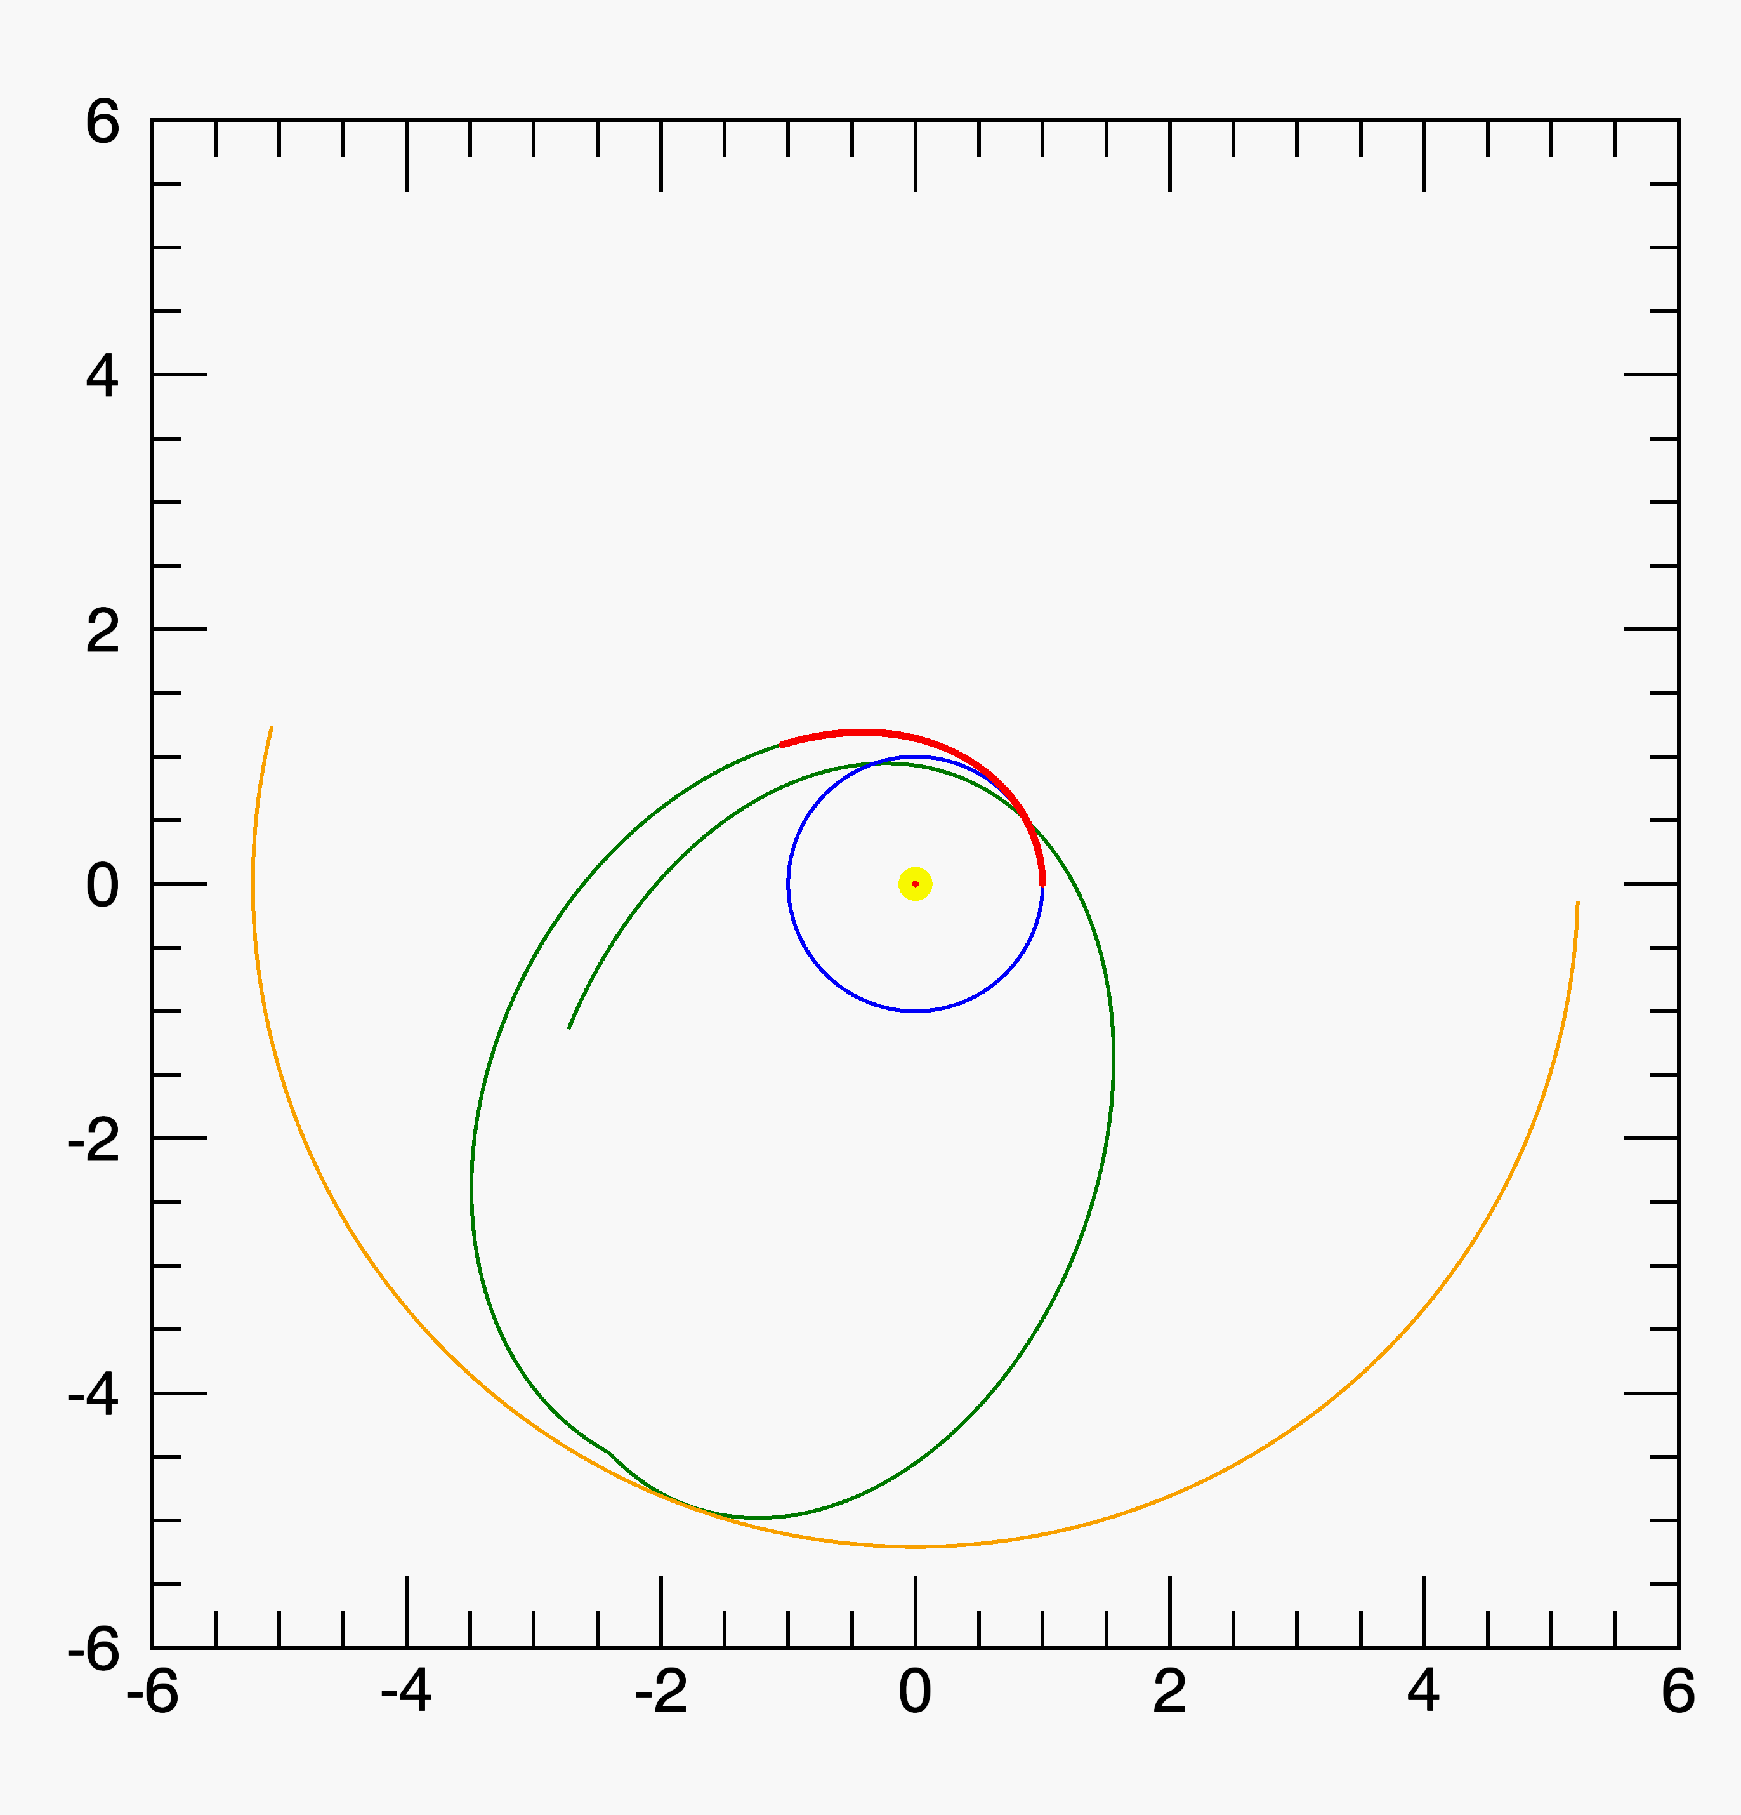
Trajectory
Secondary payload launched to C₃ = 0
Commission in Near Earth Orbit
Wait for departure window
  Flexible launch as secondary payload
Solar electric propulsion
  Raise aphelion to 5.1 AU
  148 days under thrust
  80% duty cycle
  Large solar arrays for SEP also power spacecraft at aphelion
Eject SEP stage after thrust arc
  Electric propulsion and magnetic cleanliness
Jupiter encounter: Departure + 1070 days
Next perigee: Depature + 2175 days
Earth
Jupiter
Spacecraft (thrust arc)
Spacecraft (cruise)

Slide 6
Payload and Measurements near Jupiter
Far ultraviolet auroral imager (est. 5 kg)
  37.5 km/pixel at 250 R_{J} (0.5 mrad/pixel)
  Better than Hubble Space Telescope STIS at 500 R_{J}
  Two filters, Lyman and Werner bands of H₂ (120-165 nm)
  Frame edited to 1.5 x 0.75 R_{J} images (north and south aurora)
  Compressed to 4 bits/pixel (average, 3:1)
Solar wind ion spectrometer (est. 1 kg, <15 bps)
  High energy resolution (<3%) over 500 eV to 8 keV
  Limited angular resolution, 5-minute time resolution
  On-spacecraft calculation of density, speed, temperature
Magnetometer (est. 1 kg plus boom, <10 bps)
  Low time resolution (20 s) with high rate mode, ±10 pT
  2 meter boom (2x spacecraft bus dimensions)
Other instruments desirable but not in baseline
  E.g. auroral radio emissions, EUV spectra of Io plasma torus

Slide 7
ESPA Grande Secondary Payload
4 secondary payloads per ESPA ring
24” diameter port, 42” x 46” x 38” maximum volume
  106 x 116 x 96 cm volume
  Approximately 10 x 11 x 9 U (990 U)
180 kg maximum mass
  NASA SIMPLEx AO gives 180 kg limit for ESPA Grande
    That is actually mass limit for ESPA, ESPA Grande is 320 kg
  That’s ok. Surface area and volume are more constraining
The current concept is not fully optimized
  Number of thrusters is quantized
    Adding more without adding power to operate them doesn’t help
  Surface area can be used to solar arrays or antenna area
  Result is viable, but could be improved

Slide 8
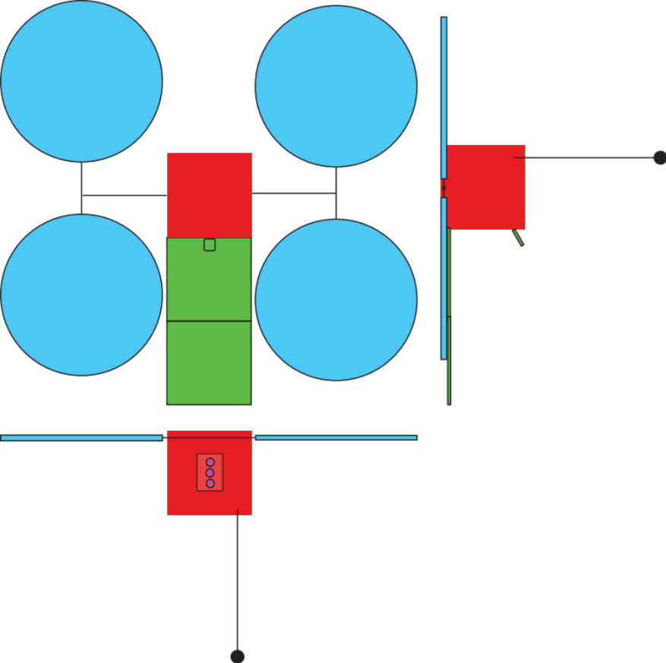
Solar power
Power SEP inside 1.5 AU: 2525 W at 1 AU
Power spacecraft at 5.2 AU: 90 W at 5.2 AU
4, Northrop Grumman UltraFlex arrays
  1.95 m diameter
  17 kg total mass
  ~ 4 x (1 m x 0.12 m x 0.12 m) stowed
1 axis articulated to stay Sun pointed with
  Telescope-to-Jupiter
  HGA-to-Earth
  SEP pointing
Accommodating full articulation is difficult
  Seems to fit, but with little margin
  Antenna area (width) versus clearance

Slide 9
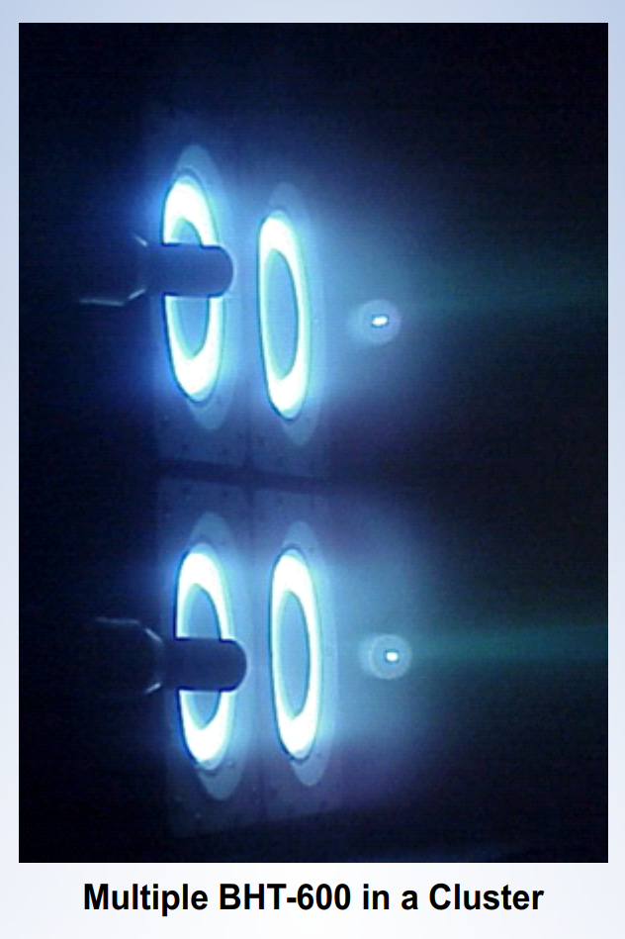
Solar Electric Propulsion System
3, Busek BTH-600
  200-800 W each
  39 mN at 600 W
  I_{sp} of 1500 s
  Iodine propellant
  8.5 kg (3 thrusters+cathode)
Assumes 80% duty cycle
Throttled and switched off as solar power decreases
< 3200 hours on time per thruster
Ejected at end of thrust arc
  Greatly simplifies EM cleanliness

Slide 10
Telecommunications
Modeled on MarCO, except:
IRIS transponder, 35 W input
  Assumes Ka not X band
Larger retroreflector antenna
  1.7 x 1 meter
Use 34 not 70-m DSN stations
  One 8-hour track every 99 hrs.
    10 Jovian rotations
1 kbps during Jupiter encounter
Up to 128 kbps after encounter
  Near perihelion, at 0.6 AU range
Difference from MarCO | Gain
Ka instead of X band | +6 dB (approx.)
34-m instead of 70-m | -6 dB (approx.)
1.7 m² instead of 0.18 m² | +9.75 dB
Free space loss | +3.22 dB at 0.6 AU
 | -17.06 dB at 6.2 AU
Net | +13.0 to -7.3 dB
Downlink data rate | 128 kbps at 0.6 AU
 | 1 kbps at 6.2 AU

Slide 11
The Rest of the Spacecraft
Item | Mass [kg]
Propulsion
3, Busek BTH-600 Hall effect thrusters | 8
Iodine propellant | 86
Fuel tank | 8.5
Power, 4, 1.9 m dia. UltraFlex arrays | 18.25
Payload | 7
“Everything Else” | 32.5
Margin | 19.75
Total | 180
“Everything else” includes:
Attitude control
  Reaction wheels
  Star trackers
  Cold gas thrusters (desat.)
  Use BCT-based system?
Command & Data Handling
  Normal functions plus:
  Image compression
  Frame editing
  Solar wind moment calculations
>100 Gbits data storage
  12 Gbytes ($25 memory stick…)
Mechanical structures
  Booms for solar & magnetometer
Margin assumes
  10% for existing (COTS) systems
    Solar arrays and thrusters
  30% of new systems
  What is the margin policy for COTS hardware?

Slide 12
Conclusions
Understand solar wind’s influence on Jupiter’s magnetosphere
  Small Spacecraft making focused observations near Jupiter
  Slow flyby rather than orbit, but near-continuously for ~10 months
ESPA Grande secondary payload launched to C₃ ~ 0
  Checkout in solar near Earth parking orbit
  No conflict between primary and secondary launch windows
Electric propulsion to a 1.1 x 5.1 AU orbit, aphelion near Jupiter
Power for Hall thruster @1.5 AU = power for spacecraft @5.1 AU
Only transmit small fraction of data during Jupiter encounter
  Performance floor: 1 edited image set per rotation and solar wind data
Return all data by departure +2175 days (5.95 years)
  Mostly near perihelion, spacecraft-Earth range down to 0.6 AU

