Slide 1

Mars Areo TGL
Interplanetary Small Satellite Conference, 2019
Notes:
I’m representing the University of Michigan team working in collaboration with JPL engineers and scientists on a conceptual mission called Mars AREO TGL

Slide 2
Collaboration Background
This concept study was developed as an educational exercise for UM students, as part of a year-long SURP collaboration, with the goal of providing them exposure to a real-world mission concept. The mission concept was selected as the context for this study to provide boundary-conditions based on realistic scientific interests
All allocations provided to the student team were based on reasonable assumptions by the JPL support team; they are pre-decisional and are for planning and discussion purposes only
At JPL, the SURP effort was supported by Adrian Arteaga-Garcia, Nathan Barba, Serina Diniega, Danielle Marsh, Bogdan Oaida, Rick Redick, Vlada Stamenkovic, and Ryan Woolley
At UM, the SURP effort was supported by Prof. Nilton Renno, and the SPACE 582/583 students: Ryan Whitney, Vishnu Saravanan, James Apfel, Taylor Morton, James Cooney, Shawn Lu, Sotirios Dedes, Nirmal Patel
Notes:
SURP = Strategic University Research Partnership
Thank you to JPL and SURP for collaborating with us on this mission concept. Learnt a lot etc

Slide 3
Science Objectives
MSL (Curiosity) found seasonal shifts in background levels of methane near Gale Crater over three Martian years
  Methane observation confirmed by Mars Express one day after MSL
  Column abundance (15.5±2.5 ppbv) greater than that predicted from either UV degradation of impact-delivered organics on surface or annual surface pressure cycle
ExoMars mission was sent to investigate the atmospheric composition of Mars, but has yet to find evidence
Mars Areo TGL would be capable of localizing the sources and sinks of any methane observations
Notes:
Suggest biological origins after talking about column abundance
ExoMars has not conducted a seasonal review of same area
Discuss what areostationary is and how it helps after last bullet
Mars AREO TGL would be inserted in an areostationary orbit over the gale crater region in an attempt to localize any sources or sinks of methane
Alternatives to biological sources of methane =
methane clathrates
“black smoker vents” (subsurface geothermal activity)
Serpentinization

Slide 4
Mission Objectives
Determine diurnal and seasonal variations of methane and its isotopologues
Demonstrate feasibility of electric propulsion (EP) for interplanetary small satellites
Make a case for Direct-to-Earth (DTE) communication at Mars for small satellites
Notes:
diurnal + seasonal variations
feasibility of electric propulsion
case for DTE

Slide 5
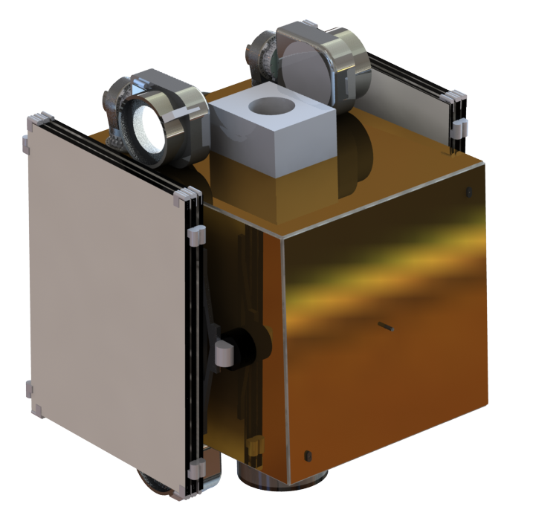
Mission Concept
SmallSat launched as a secondary payload with the ESPA Grande Ring Interface.
Mass:
  270 kg wet
  185 kg dry
Form Factor: less than 1m x 1m x 1m stowed
Payload: Ultra-High Sensitive (UHS) Miniaturized Spectrometer
Stowed Spacecraft Configuration
Notes:
The proposed concept is considerably smaller and cheaper than other orbiter missions to Mars.
350 kg with margin while ESPA Grande is rated for 465 kg (didnt go with espa or espa heavy due to ring height and mass cap)

Slide 6
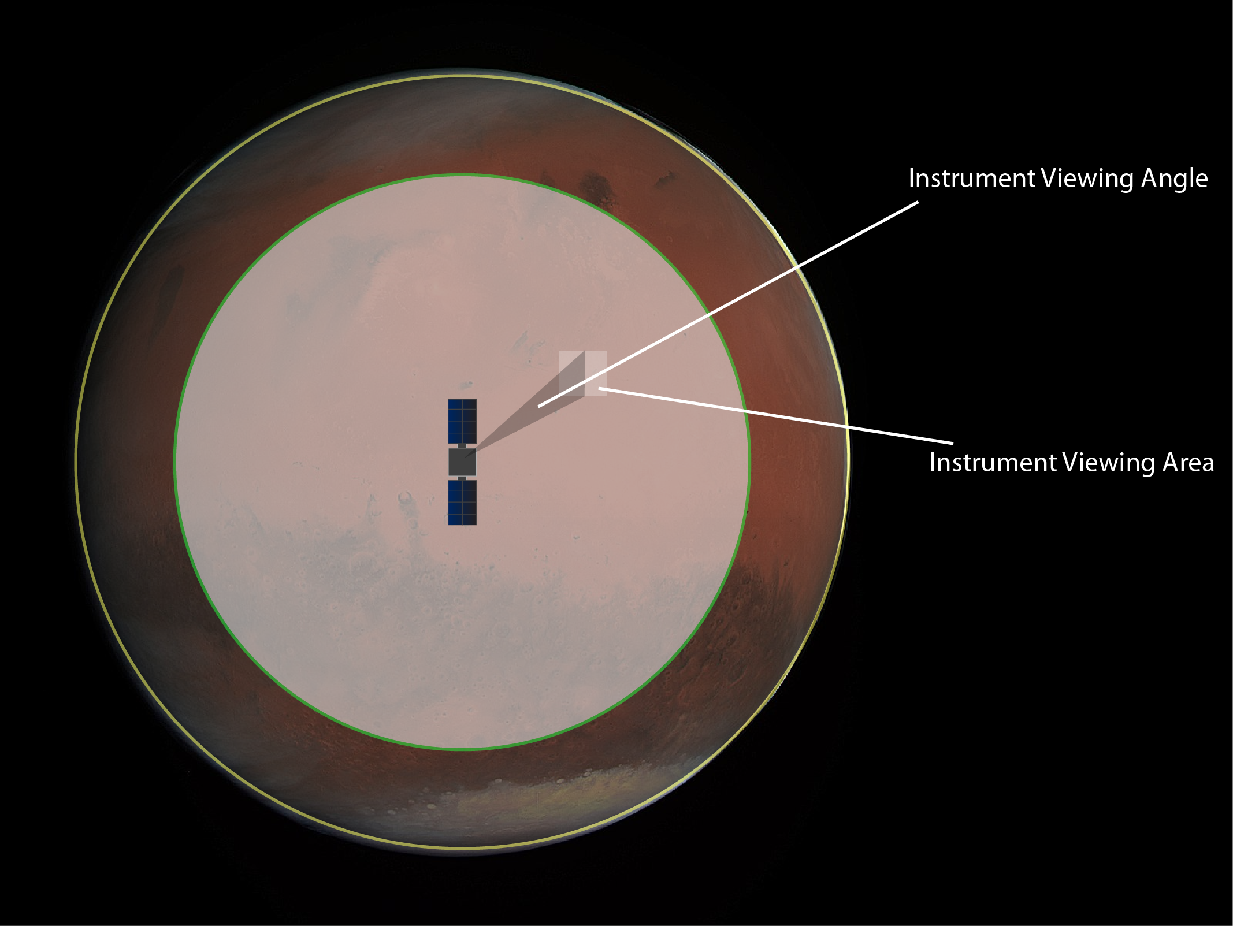
Payload - UHS Miniaturized Spectrometer
Surface Scan (Coarse Mode)
Target area | 57.2x10⁶ km²
Pixel Resolution | 30 m²/pixel
Max Image Resolution | 166 km²
# of Images | 2069
Time to image | 10 sec
Slew Rate | 0.15 deg/sec
Time to scan target area | ~ 7.4 hours
Fine Mode
Pixel Resolution | 4.6 m²/pixel
Max Image Resolution | 27 km²
Other Specifications
Duty Cycle | 78%
Max Image Resolution | 3.45 Gb/sol
Notes:
Area Covered Per Image: Coarse, 166 km^2
Images Taken: 2070.
Time Needed to Scan, With Slewing: 7.4 hours.

Slide 7
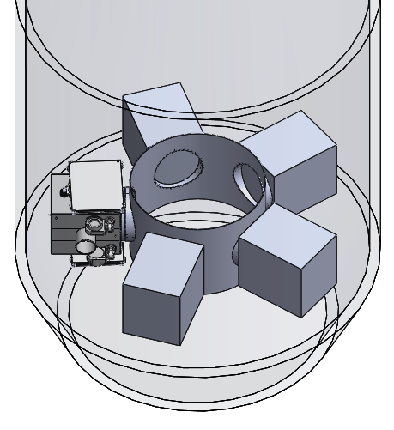
Bus Subsystem Design
ADCS
2x Star Trackers
4x Gyros
6x Sun Sensors
4x RWAs
0.003 deg Pointing Accuracy
C&DH
2x BAE RAD 5545 flight computer
Mechanical
Aluminum frame (7075)
Honeycomb panels
Propulsion
1x RIT 2X
4X RIT 10 EVO
105 Kg Capacity Xenon Tank
PPU
Spacecraft within 4m fairing
Notes:
main thing here is propulsion
1 large central thruster, 4 smaller gimballed thrusters
large central tank + PPU allocation

Slide 8
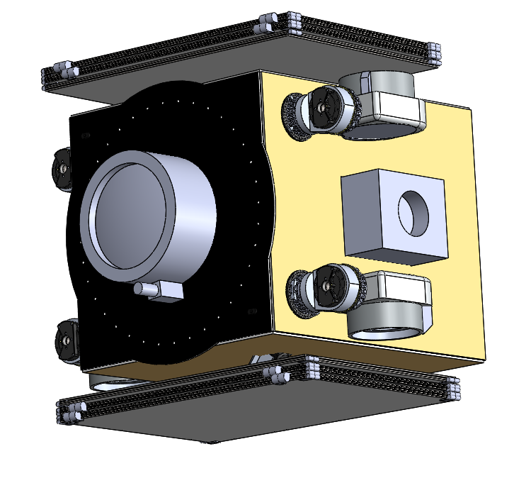

Bus Subsystem Design
Thermal
Z93 white paint
Internal zone heaters
No radiators required
EPS
2x deployable articulated solar arrays (14.3 m² total)
8x Li-ion battery cells with total capacity of 312 W-Hr
Stowed configuration
Communications
Ka-band 1.2 m deployable high gain antenna
TWTA
Small Deep Space Transponder
Spacecraft deployed configuration
Notes:
Communications will be a Ka Band 1.2 m deployable dish for DTE communications to 34m DSN

Slide 9
Previous Mars Missions
Mission | Mass (kg) | Communications | Propulsion
Mars Odyssey | 758 | DTE | Chemical
Mars Express | 1120 | DTE | Chemical
Mars Reconnaissance Orbiter | 2180 | DTE | Chemical
Mangalyaan | 1337 | DTE | Chemical
MAVEN | 2454 | DTE | Chemical
ExoMars | 3755 | DTE | Chemical
Mars Areo TGL | 350 | DTE | Electric
Notes:
mostly been chemical propulsion but DTE with a much larger mission/mass
we’re aiming to do this with half the mass of the next smallest mission

Slide 10
Communications: Direct-To-Earth
Current communication options from Mars to Earth:
  Relay via MAVEN/MRO
  DTE
MRO and Maven considerations
  MRO on fourth extension of mission lifetime (to 2021)
  MAVEN on first extension of mission lifetime (to Sept 2019)
Notes:
So why DTE instead of a relay? MRO and MAVEN are the current options
both are on extensions and so cannot be expected to be there

Slide 11
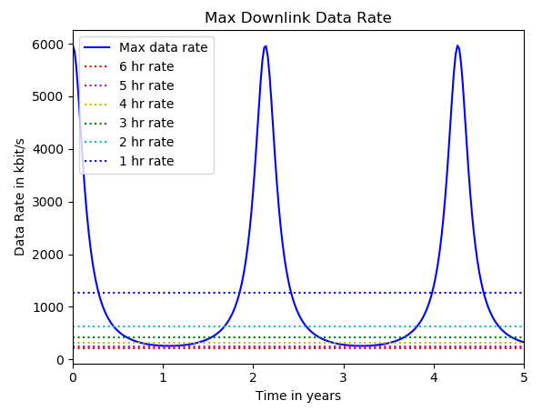
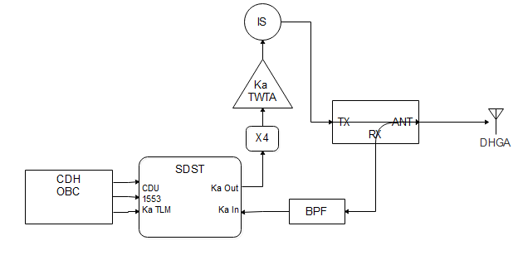
Communications: Ka-band Architecture
Communications Architecture Block Diagram
Notes:
downlink rate in first image as a function of Earth-Mars distance over their respective orbits essentially
second image shows the communications subsystem interactions

Slide 12
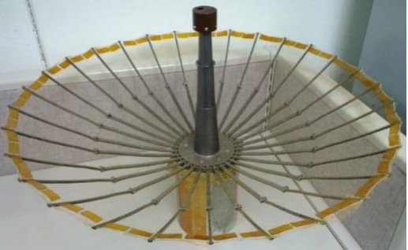
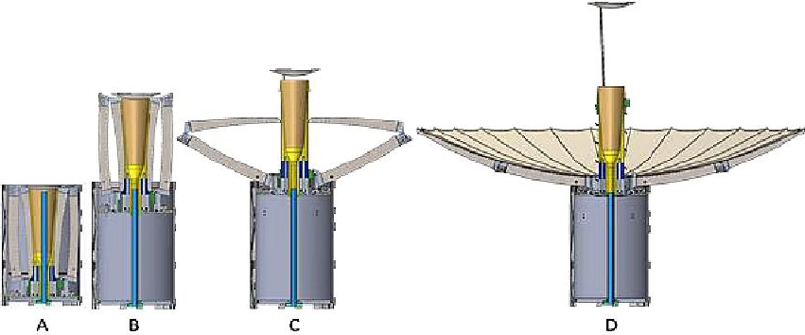
Communications: Antenna
Deployable Ka-Band High Gain Antenna
Mass: 5 kg
Vol (stowed): 2.5 x 2.5 x 3.5 U
Diameter: (deployed): 1.2m
Data Rate: 0.2-5.9 Mbit/s
Input Power: 400 W
RainCube DHGA Heritage
Images: Sauder, J. F., and Thomson, M. W., “The Mechanical Design of a Mesh Ka-band Parabolic Deployable Antenna (KaPDA) for CubeSats,” 2nd AIAA Spacecraft Structures Conference, 2015.
Notes:
antenna linearly scaled off of 1m JPL prototype to a deployed diameter of 1.2m
400W input power
has RainCube DHGA heritage

Slide 13
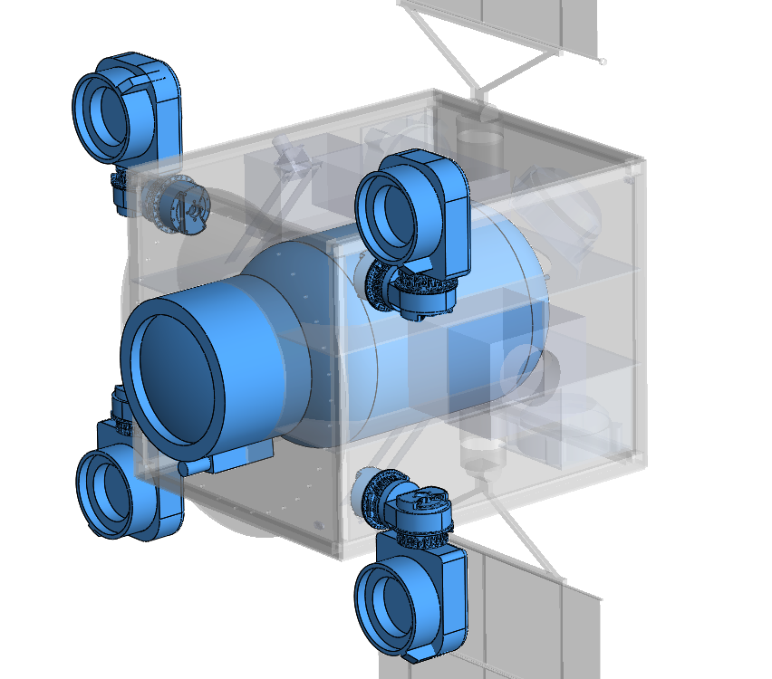
Propulsion Architecture
1 RIT 2X
  Earth Escape
  Interplanetary Transit
4 RIT 10 Evos
  2 burn at a time
  Mars Capture
  Stationkeeping
  Momentum Dumping
4 RIT 10 Evo Thrusters
1 RIT 2X Thruster
1 DS400 Xenon Tank
Notes:
RIT 2X for Earth escape and interplanetary transit
turns off only the 4 RIT 10 Evos used for any orbital maneuvers at Mars capture and beyond

Slide 14
Thruster Parameters
RIT 2X Specifications
 | Low Power |  | High Power
Power (W) | 2000 - 2500 |  | 4000 - 4500
Thrust (mN) | 70 - 88 |  | 151 - 171
ISP (s) | 3400 - 3500 |  | 3300 - 3500
Throughput |  |  | ~350 Kg
Fuel |  |  | Xenon
Mass |  |  | < 10 Kg
RIT 10 Evo Specifications
 | Low Power |  | High Power
Power (W) | 435 |  | 760
Thrust (mN) | 15 |  | 25
ISP (s) | > 3000 |  | > 3200
Throughput |  |  | ~35 Kg
Fuel |  |  | Xenon
Mass |  |  | 1.8 Kg
Notes:
specifications: RIT 2x can be used with high end of high power, but simulations were run with low end of high power
RIT 10 evos are used in high power mode for their functions
throughput = how much mass can be pushed through before cathodes are too degraded

Slide 15
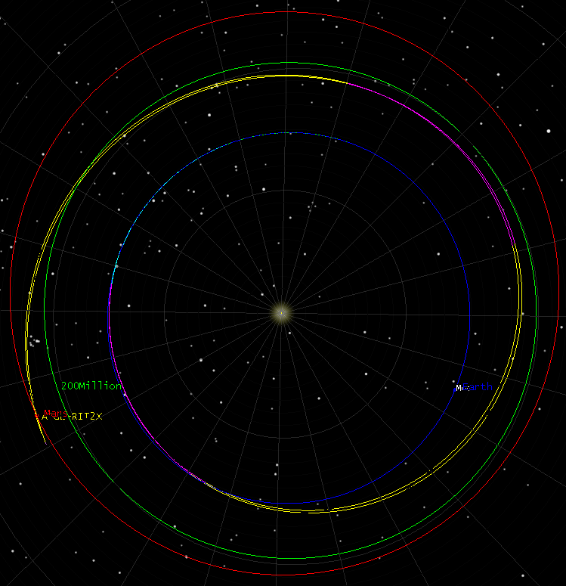
Orbital Maneuvers
Orbit Phase | Prop Mass (kg) | Time (days)
Earth Escape | 26.5 | 61
Interplanetary Transit | 33.0 | 544
Mars Capture | 8.0 | 38
Total | 67.5 | 643
Notes:
Earth escape then interplanetary transit with two burn/coast pairs but need more to properly close the mars capture
have margin in propellant to compensate since this simulation is very preliminary
total delta V = little under 10 km/s

Slide 16
Summary
Localization of methane could be conducive to delineating between biotic and abiotic sources
Electric propulsion has great utility and should be further developed for interplanetary missions
Deployable antenna technology will become increasingly significant for small satellite missions

Slide 17
Questions?

Slide 18
Backup Slides

Slide 19
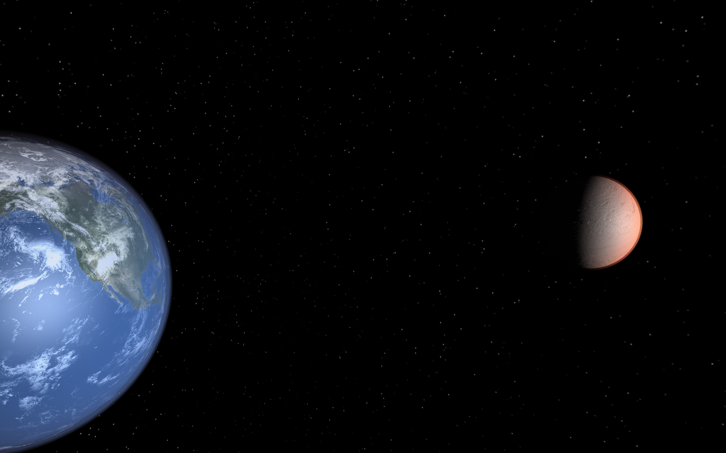
Concept of Operations
*MY = Martian Years
S/C integrated with ESPA Grande and launched on Atlas V as secondary payload. Atlas V will take ESPA Grande to GTO and deploy S/C.
Upon escaping Earth's gravity, S/C will cruise to Mars and spiral into areostationary orbit.
LAUNCH (1 hour)
Interplanetary Transit (18.5 months)
EOL
Earth Escape (2.5 months)
OBSERVATION (3 MY*)
In GTO, S/C will separate from ESPA Grande and conduct performance checkout. Then, S/C will deploy solar arrays and build velocity for escape to Mars.
In areostationary orbit S/C will conduct another performance checkout. Then, S/C will begin scientific observation + data collection with direct to Earth communications

Slide 20
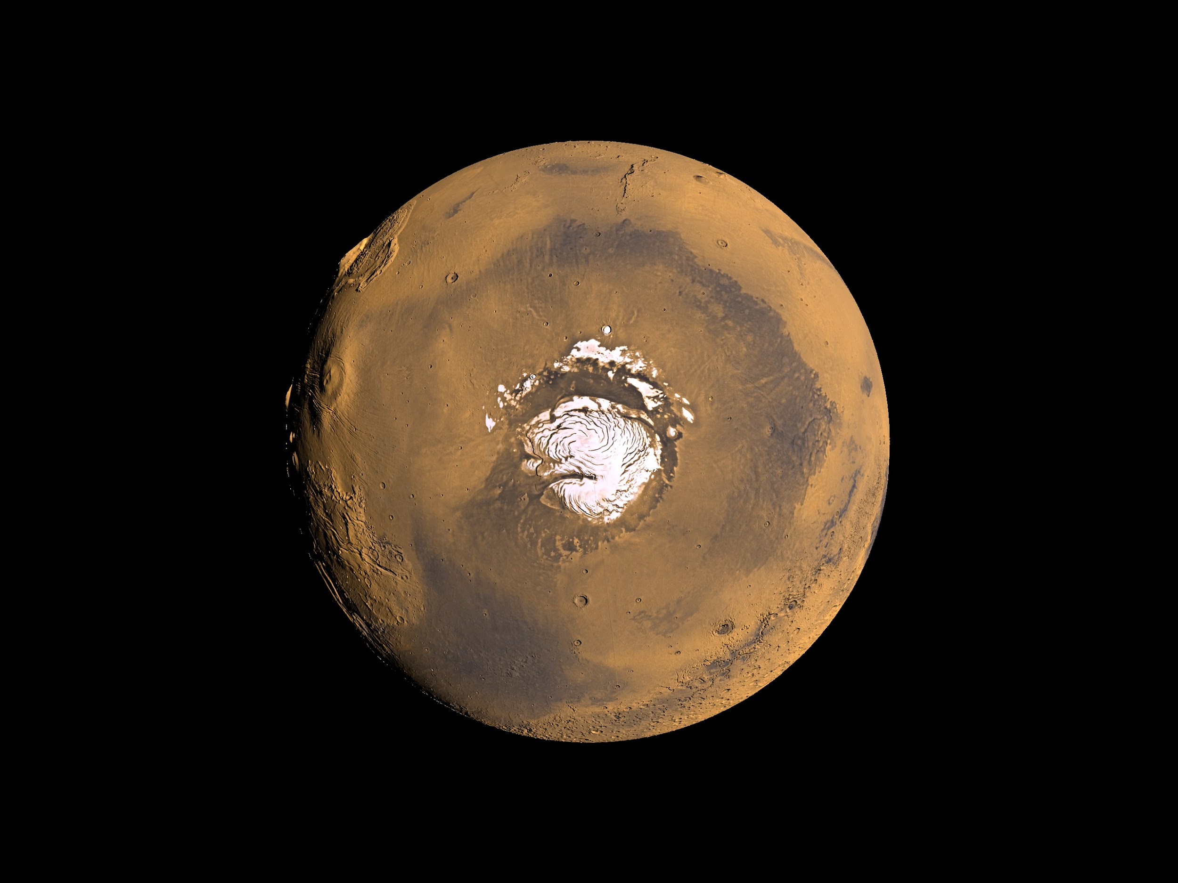
Day in the Life - Nominal Ops
00:00
1
S/C DTE Communication
1
3
2
Science Observation
3
S/C DTE Relay
18:00
06:00
2
12:00 (Sun-side)

Slide 21
Day in the Life - Worst Case
00:00
1
1:00
23:00
1
ECLIPSE
2
6
2
S/C DTE Communication
3
5:00
19:00
S/C Momentum Dumping + Stationkeeping
18:00
3
06:00
4
Science Observation
7:00
17:00
5
5
S/C Stationkeeping
6
S/C DTE Communication 2 + Relay
4
12:00 (Sun-side)

