Slide 1


LUNET platform concept: bootstrapping lunar mission services
ISSC 2019
29-30 April 2019, San Luis Obispo
Laura Mullin, LUNET Mission Services Ltd, ISSC 2019

Slide 2
Proposal context
Space agencies
Commercial lunar ride-shares
Various small-size missions
Agency lunar ride-shares
Various proposals
CNSA, ESA, ISRO, JAXA, KARI, NASA, Roscosmos
Astrobotic, Blue Origin, iSpace, Lunar Pathfinder, Moon Express, PT Scientists, Team Indus
EM-1, +?
eg, Lunar Flashlight, Lunar IceCube
eg, ILOA, OLFAR, mining & resource utilization, space tourism
ILD
UNOOSA International Lunar Decade
Increasing interest in lunar exploration
Laura Mullin, LUNET Mission Services Ltd, ISSC 2019

Slide 3
Proposal context
Space agencies
Commercial lunar ride-shares
Various small-size missions
Agency lunar ride-shares
Various proposals
CNSA, ESA, ISRO, JAXA, KARI, NASA, Roscosmos
Astrobotic, Blue Origin, iSpace, Lunar Pathfinder, Moon Express, PT Scientists, Team Indus
EM-1, +?
eg, Lunar Flashlight, Lunar IceCube
eg, ILOA, OLFAR, mining & resource utilization, space tourism
ILD
UNOOSA International Lunar Decade
Increasing interest in lunar exploration
Role for infrastructure
Laura Mullin, LUNET Mission Services Ltd, ISSC 2019

Slide 4
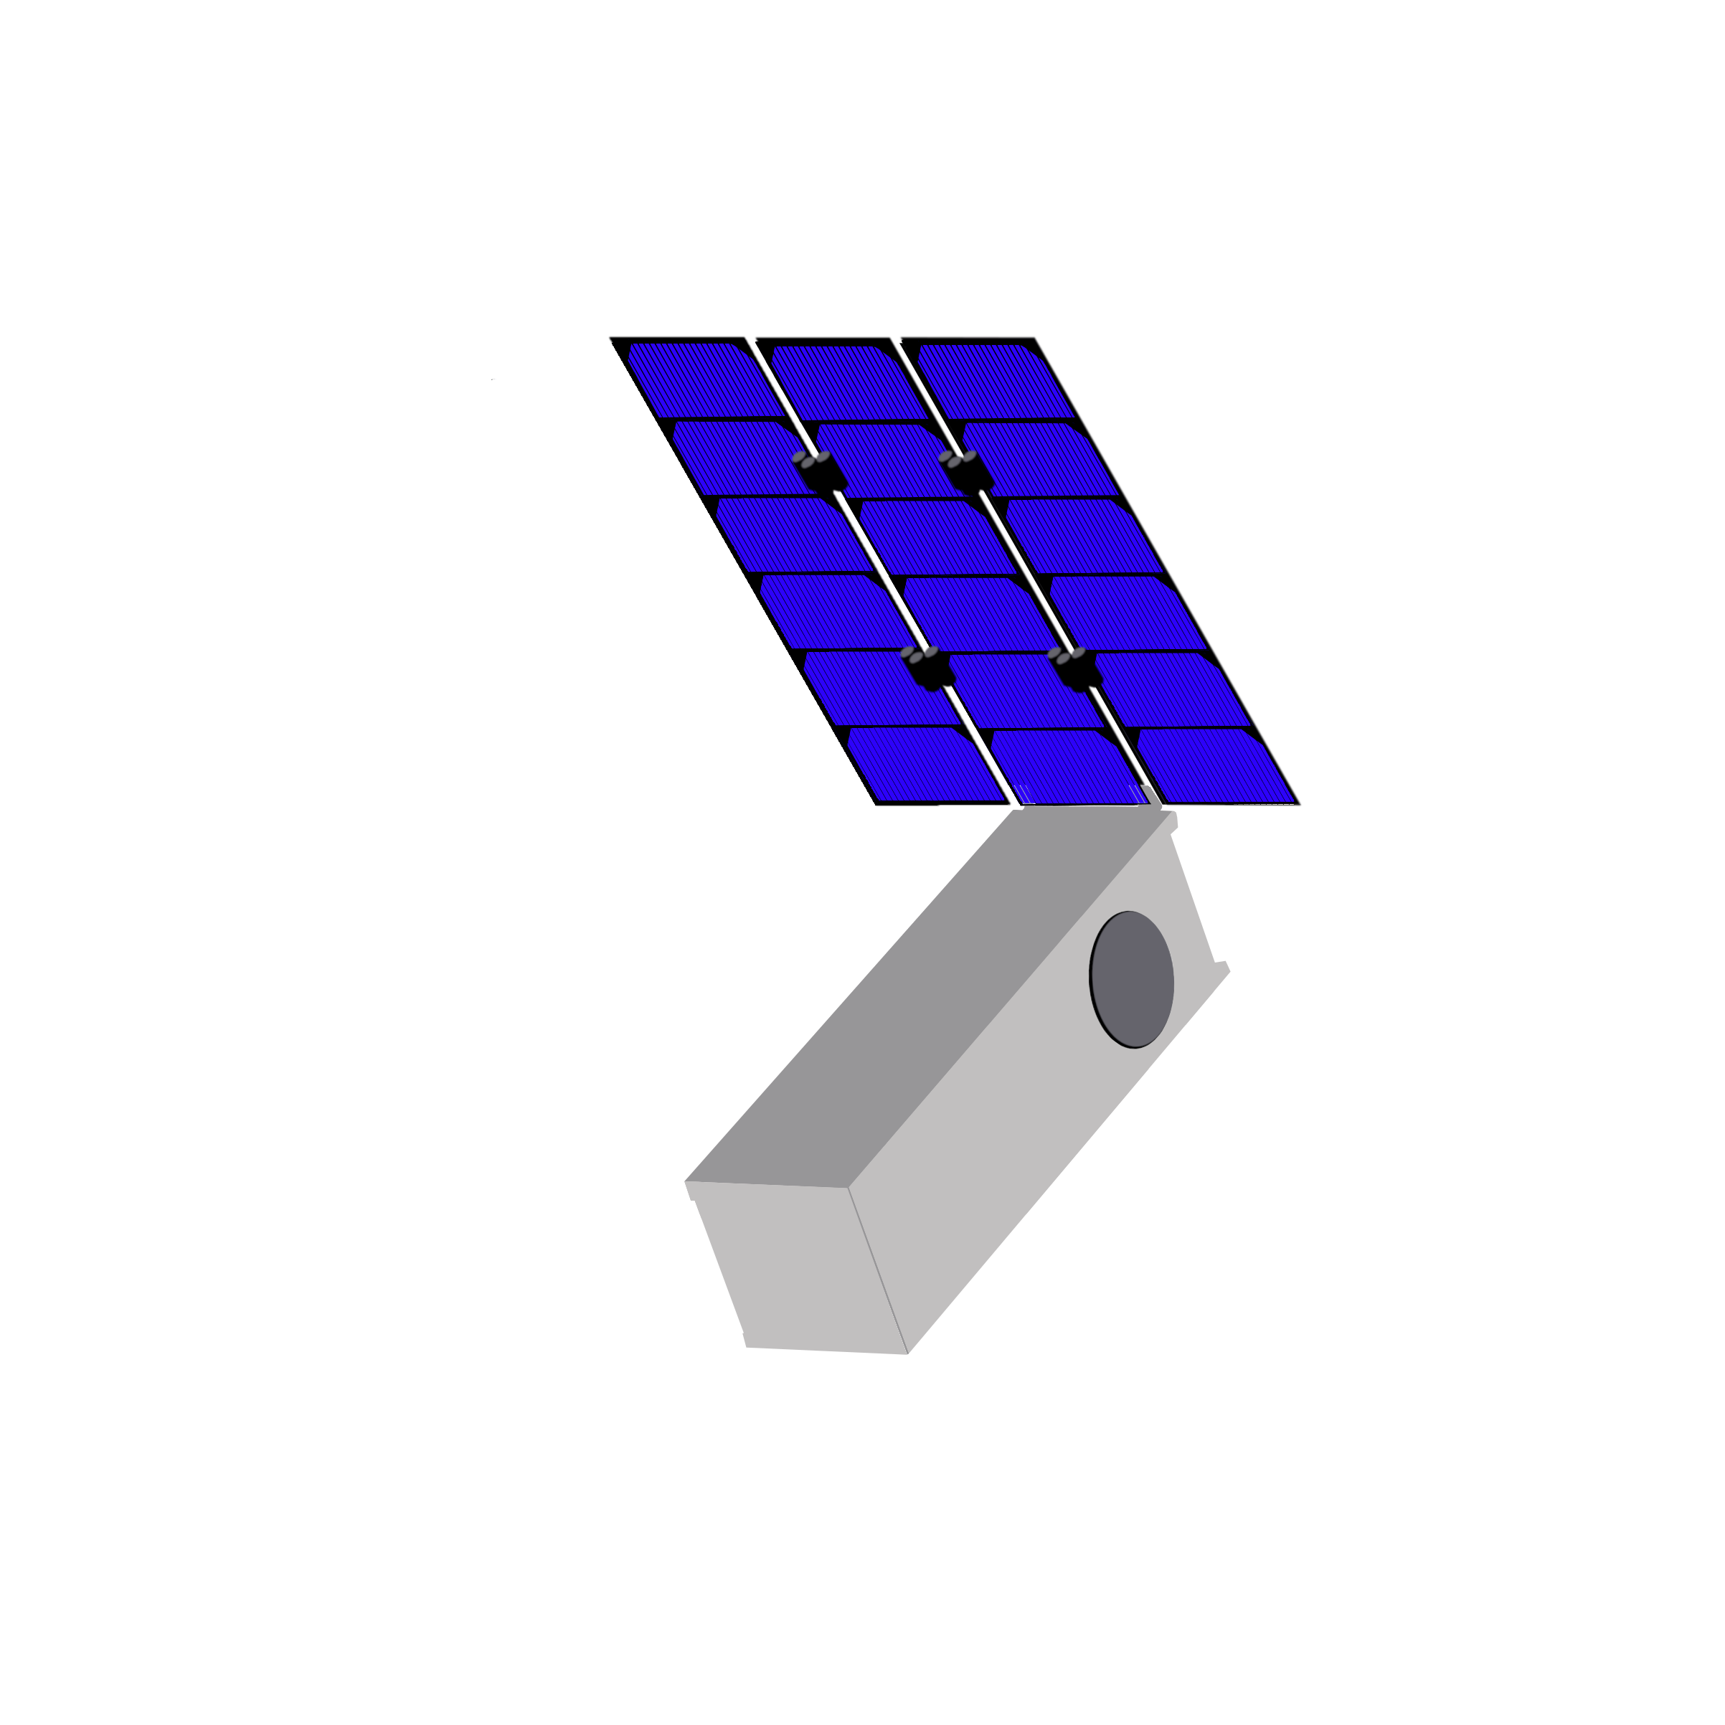
Proposal context
Space agencies
Commercial lunar ride-shares
Various small-size missions
Agency lunar ride-shares
Various proposals
CNSA, ESA, ISRO, JAXA, KARI, NASA, Roscosmos
Astrobotic, Blue Origin, iSpace, Lunar Pathfinder, Moon Express, PT Scientists, Team Indus
EM-1, +?
eg, Lunar Flashlight, Lunar IceCube
eg, ILOA, OLFAR, mining & resource utilization, space tourism
ILD
UNOOSA International Lunar Decade
Increasing interest in lunar exploration
Role for infrastructure
Developing CubeSat capabilities; DSS
Laura Mullin, LUNET Mission Services Ltd, ISSC 2019

Slide 5

LUNET platform DSS
Networking performance
availability, reliability
data volume
position accuracy
timing accuracy
Diverse needs
wide coverage, redundancy
high performance
Networking module(s)
High data rate terminal(s)
Position reference
Timing reference
Modular, fractionated & federated DSS
Laura Mullin, LUNET Mission Services Ltd, ISSC 2019

Slide 6
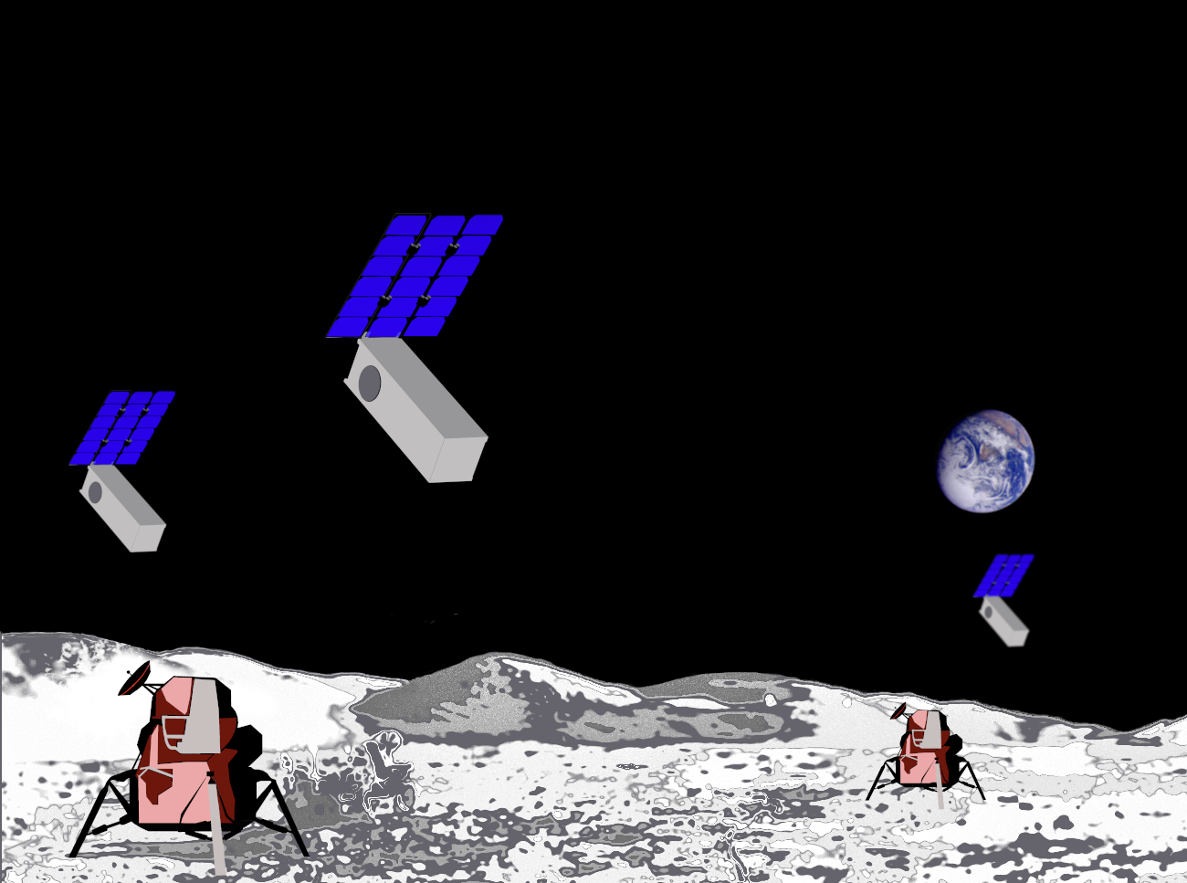
LUNET platform concept
Laura Mullin, LUNET Mission Services Ltd, ISSC 2019

Slide 7
1st generation LUNET platform MVP
Anchor customer base:
technology demonstration,
operations validation,
auxiliary data services,
adjunct missions
Core module
Laura Mullin, LUNET Mission Services Ltd, ISSC 2019

Slide 8
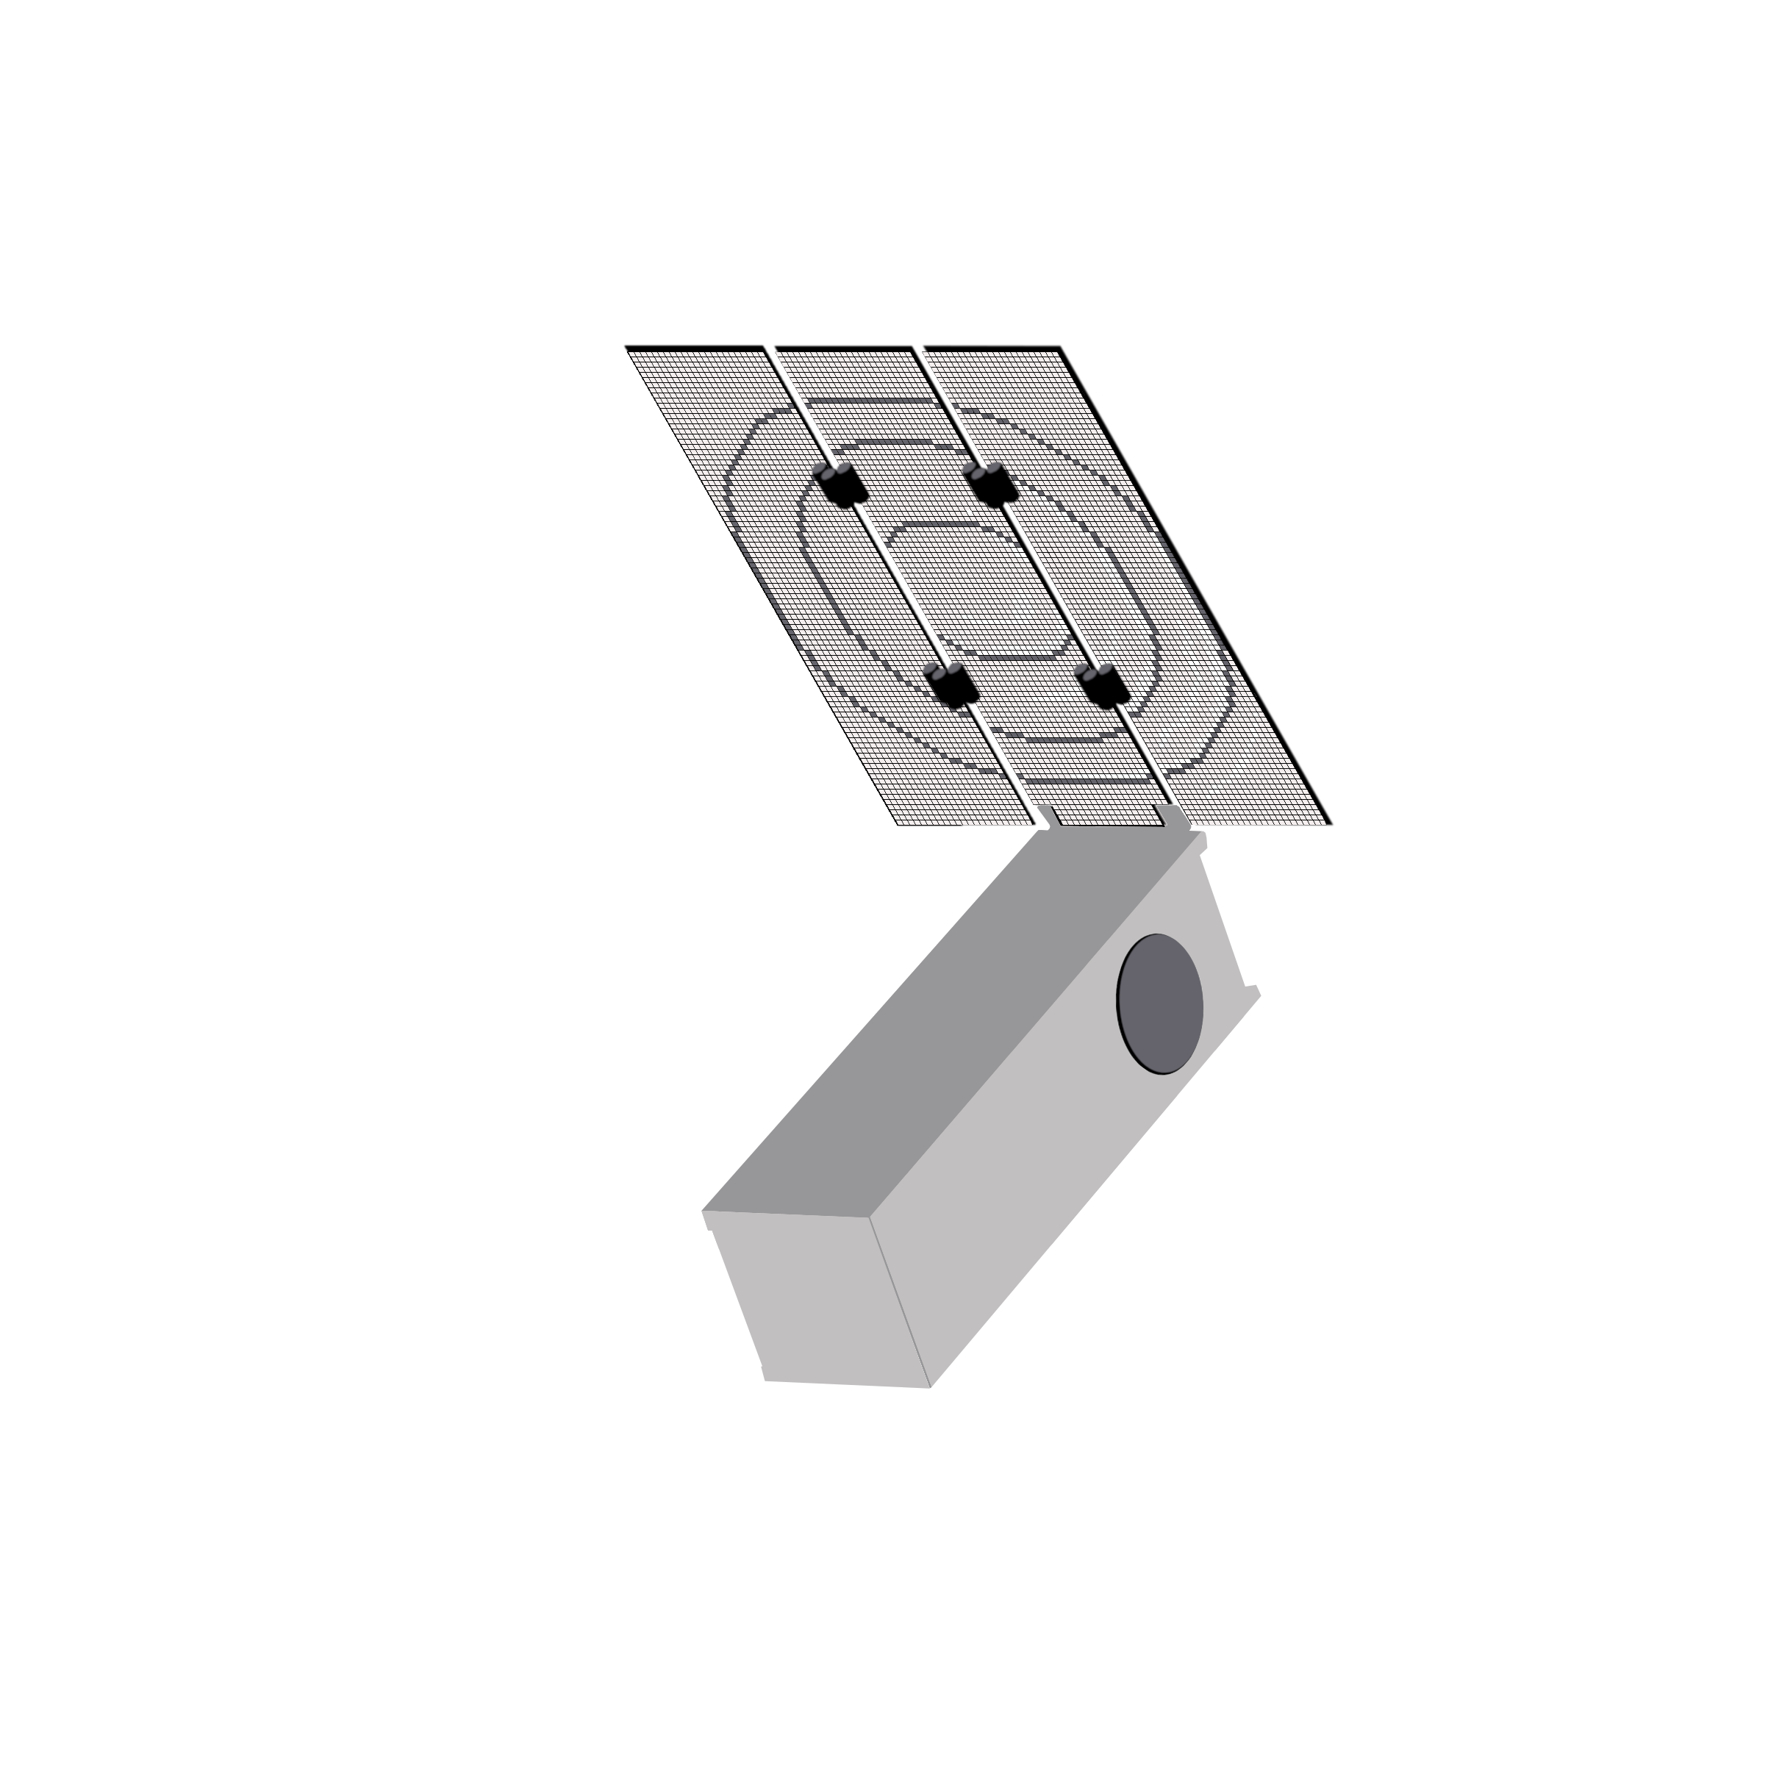
1st generation LUNET platform MVP
Anchor customer base:
technology demonstration,
operations validation,
auxiliary data services,
adjunct missions
High gain antenna
Transponder
Core module
1st generation modules
Mission 1
Laura Mullin, LUNET Mission Services Ltd, ISSC 2019

Slide 9
1st generation LUNET platform MVP
Anchor customer base:
technology demonstration,
operations validation,
auxiliary data services,
adjunct missions
+
Auxiliary service offerings
under utilized capacity
Adjunct mission opportunities
Hosted payload/ technology demonstrations
Laura Mullin, LUNET Mission Services Ltd, ISSC 2019

Slide 10
LUNET Platform roadmap
High gain antenna
Transponder
Core module
1st generation modules
Next generation core
+ new nodes
(not restricted to 3U)
Mission 1: MVP for anchor customer base
Missions #: opportunities
to scale (anchor customer base + general users)
Missions #: commercial platform development and scaling
Laura Mullin, LUNET Mission Services Ltd, ISSC 2019

Slide 11
1st generation functionality
XPDR,
X SRS
TRX other bands
S band SRS, S band SOS ISLs
Other frequencies: UHF, X, Ka
On-board computer processing and data storage
Tracking by ground station (2/3-way Doppler, ∆-DOR), autonomous OD (optical) and SST
Attitude control
Minimal OTM, station keeping. Active disposal end-of-life
Power generation and management
TRX S
SRS/SOS
Watchdog
Processor(s)
EPS/battery
AD&CS
AD&CS
Doppler module
internal configuration
Core module/ HGA module
internal configuration
Propulsion
Propulsion
HGA/ deployable solar array
External configuration
Laura Mullin, LUNET Mission Services Ltd, ISSC 2019

Slide 12
Questions?
For further information
on potential collaboration or partnerships
visit our booth in the conference exhibition
Laura Mullin, LUNET Mission Services Ltd, ISSC 2019

Slide 13
Back-up slides
Laura Mullin, LUNET Mission Services Ltd, ISSC 2019

Slide 14
LUNET module DRM
Timeline: L = launch, D = deployment in lunar orbit, St = start of core mission.
Milestones: [1] delivery of FM to ride-share provider, [2] LSP pre-launch readiness review, [3] launch of module, [4] deployment of module into lunar orbit, [5] acquisition of ground link, [6] completion of commissioning phase, [7] achievement of operational orbit, [8] end of core mission, [9] module end-of-life.
Phases: pre-launch, launch and early operations, commissioning, transfer, nominal operations, extended operations, disposal.
Modes: Integration and launch, boot, de-tumble, acquisition, commissioning, propulsion control, nominal operations, on-orbit storage, safe.
Laura Mullin, LUNET Mission Services Ltd, ISSC 2019

Slide 15
Project phasing
Laura Mullin, LUNET Mission Services Ltd, ISSC 2019

Slide 16
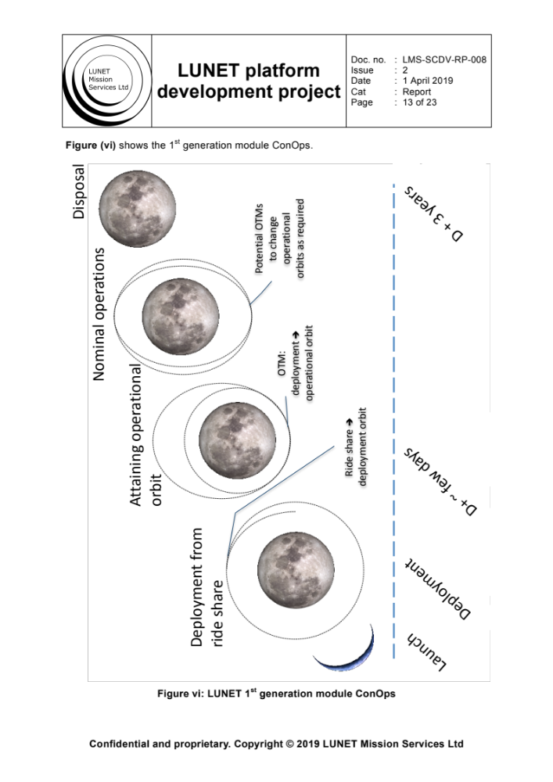
LUNET platform module ConOps
Laura Mullin, LUNET Mission Services Ltd, ISSC 2019

Slide 17
LUNET platform DSS functional decomposition
Networking module(s)
RF HGA module(s)
Optical module(s)
Doppler tracked module(s)
GNSS capable module(s)
DSAC module(s)
Availability, reliability
Data volume
Position accuracy
Timing accuracy
Laura Mullin, LUNET Mission Services Ltd, ISSC 2019

Slide 18
LUNET platform roadmap
Laura Mullin, LUNET Mission Services Ltd, ISSC 2019

