Slide 1


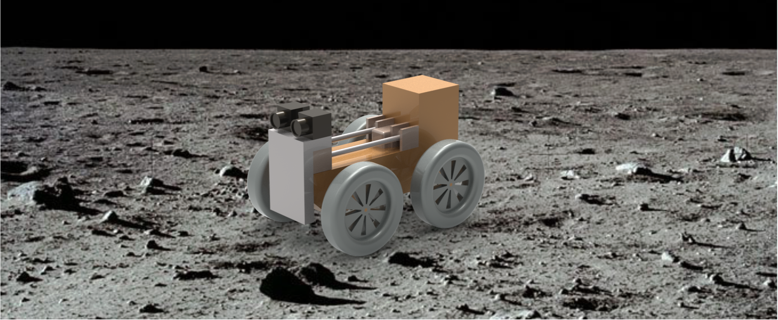
CubeSat based Micro-Rovers
Rachel Moses, Tommy Dailey, Jekan Thangavelautham
Space and Terrestrial Robotic Exploration Laboratory
Department of Aerospace and Mechanical Engineering
University of Arizona, Tucson
Notes:
1

Slide 2
Outline
Introduction
Motivation
Challenges
Objectives
Approach
Results and Discussions
Conclusion

Slide 3
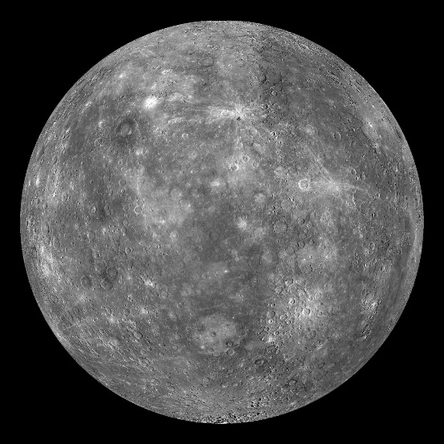
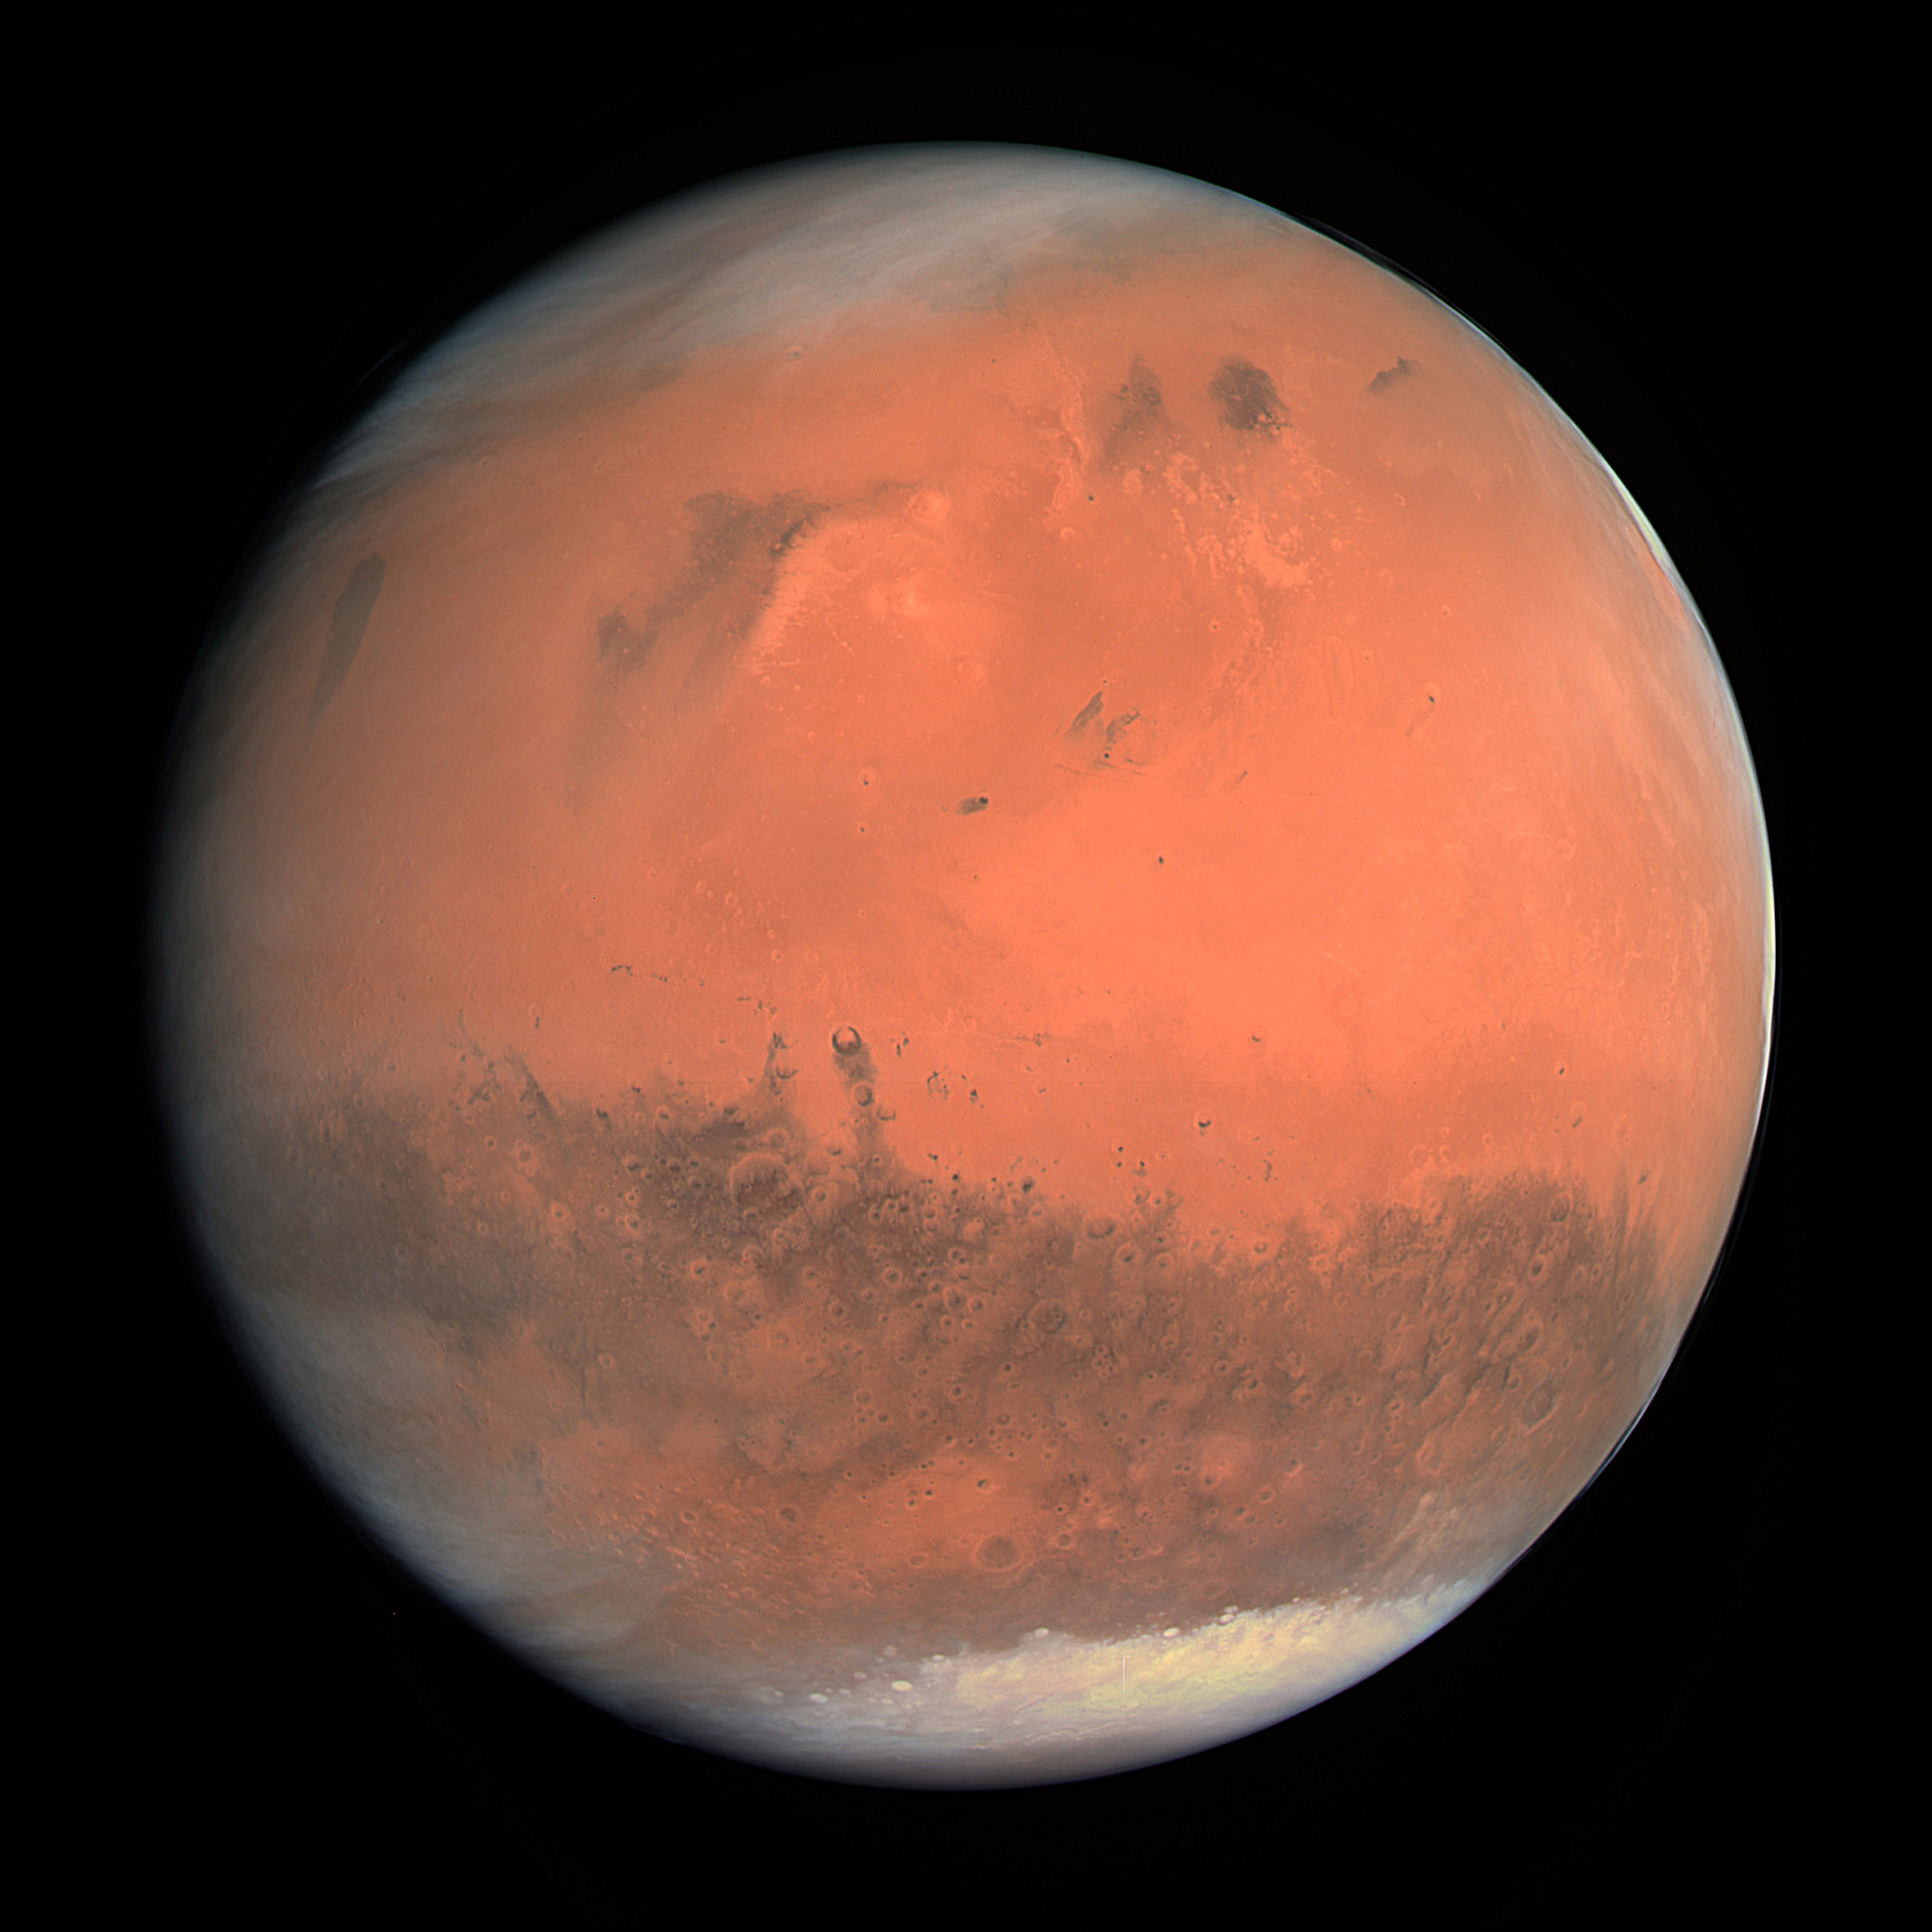
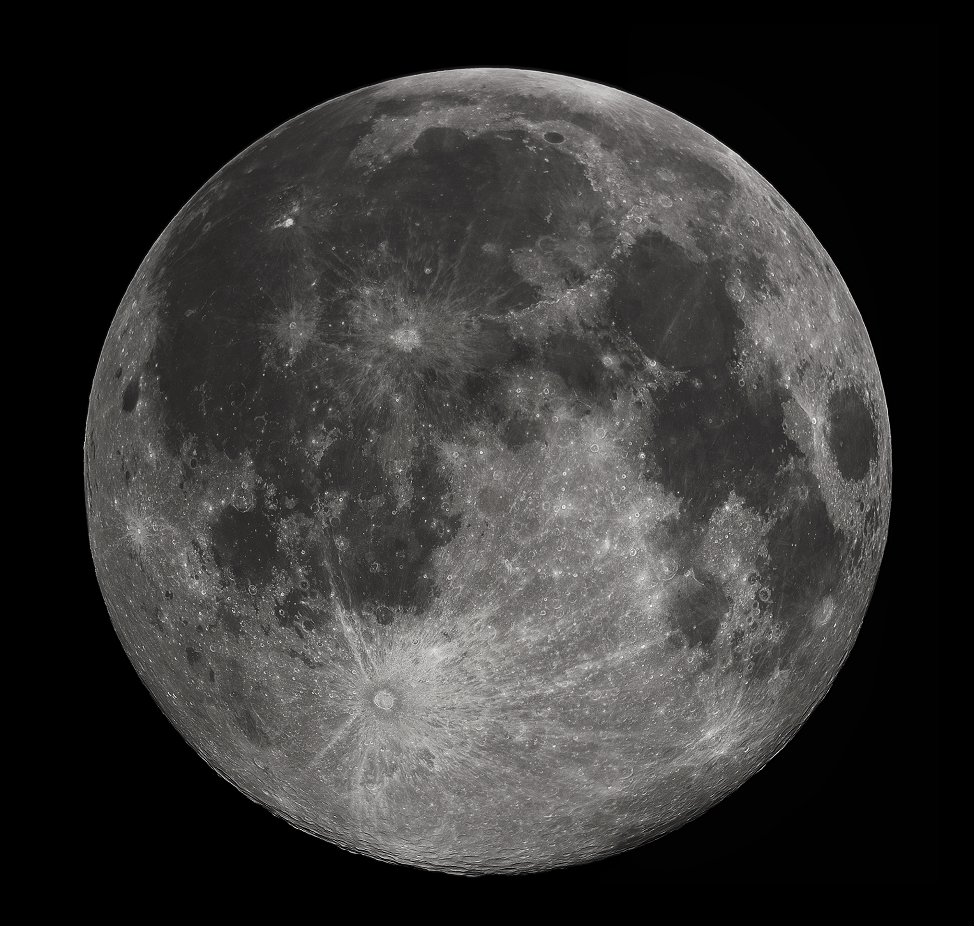
Low Gravity Environments
Notes:
So what are low gravity environments? Basically any rocky body in our solar system, it turns out Earth is pretty big.
A few examples are the asteroids, the moon, mars, and europa
Why are these places important?
They give us insight into how our solar system formed, and may one day contain human settlements
Before that happens, we need to know more about the geological structure and formation of these bodies

Slide 4
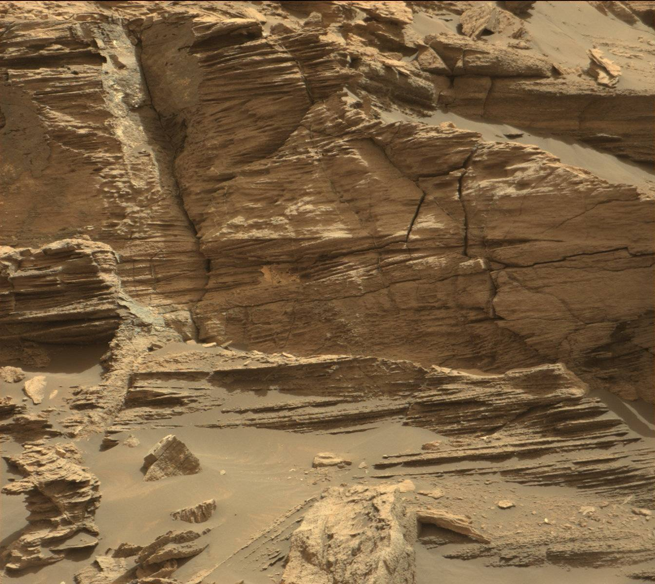
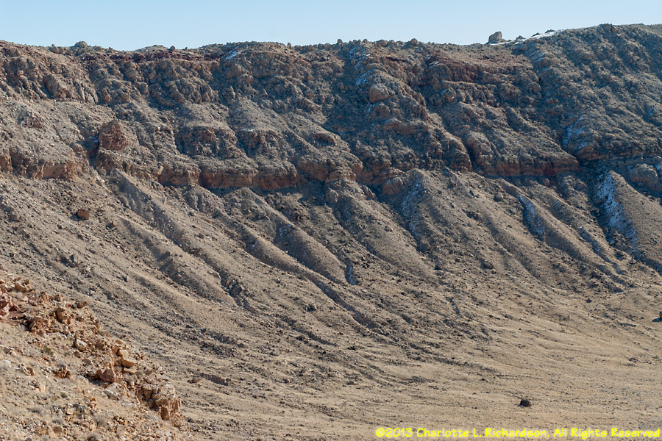
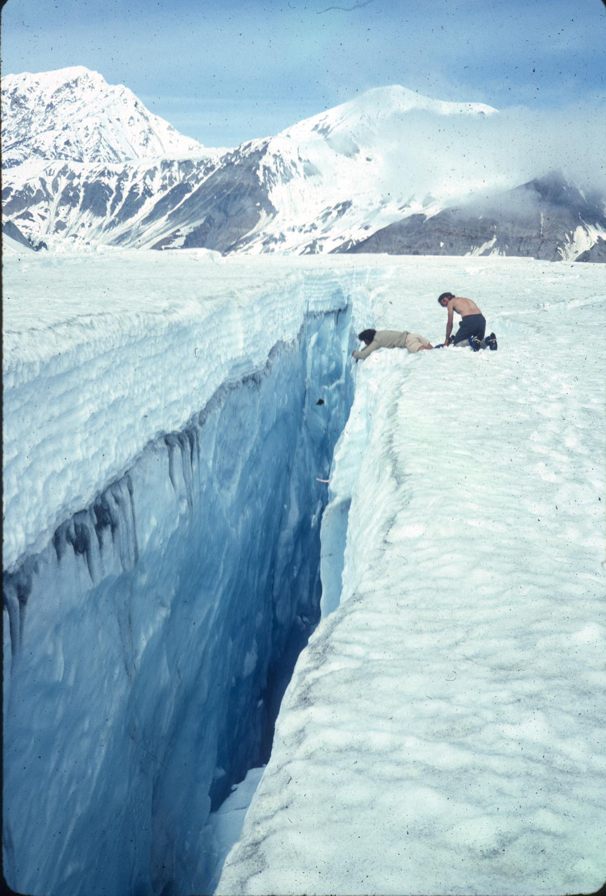
Motivation
Miniaturization of landers and rovers. Payload can be dropped anywhere. Needs to be mobile to make up for lack of precision landing.

Slide 5
Micro-rover Advantage
Low mass and volume
Disposable
Deployed in-insitu when near interesting science target
Pursue high-risk, high-reward strategy.
Return maximized with many small rovers.

Slide 6
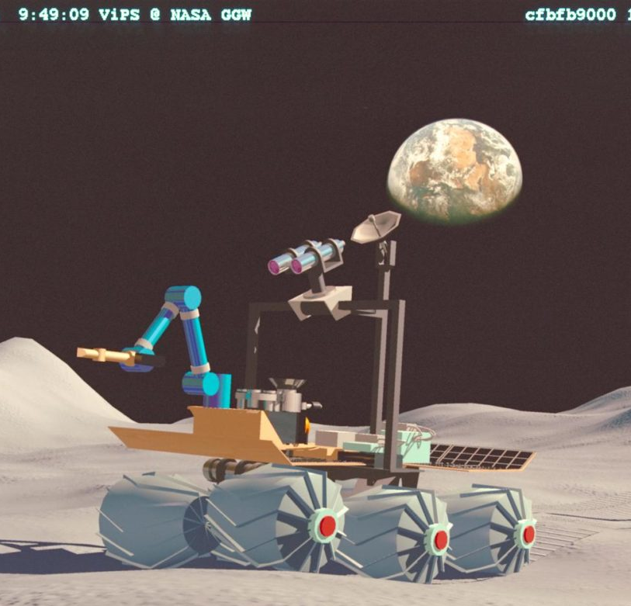
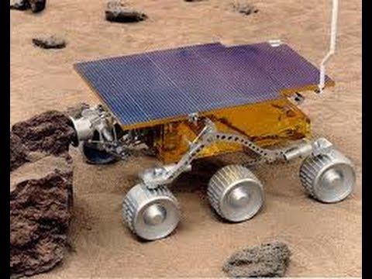
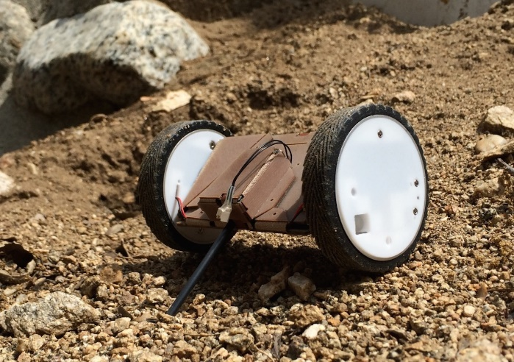
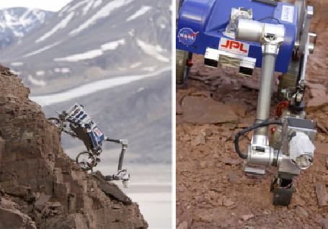
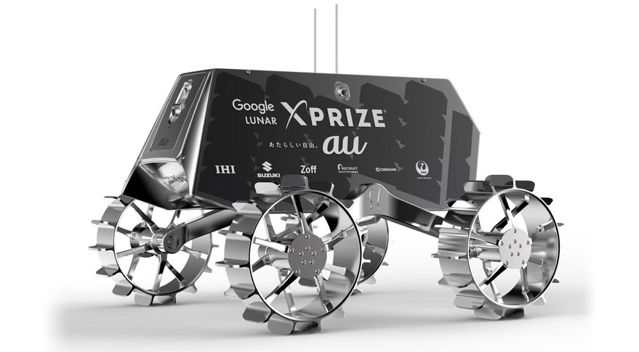
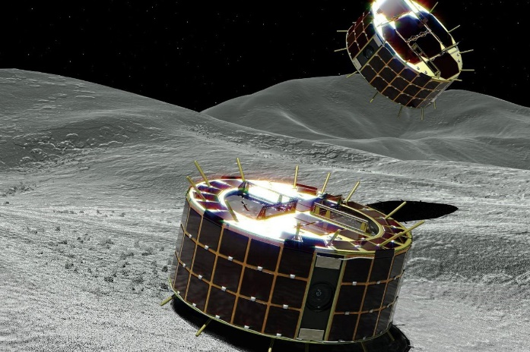
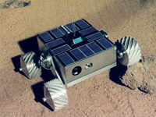
Related Work
Marsakhod (ESA/RC)
Sojourner (JPL)
Puffer (JPL)
Hakuto (iSpace)
MUSES CN (JPL)
TRESSA (JPL)
MINERVA II (JAXA)

Slide 7
Design Pathway
Expands exploration opportunities :
  Simple mobility system with excellent camera view angles
  Minimize cost and reduce overall loss due to use of swarms
  Ability to explore caves and craters in group or side-missions of its own
7

Slide 8
Challenges
Fit within 12U CubeSat mass and volume constraints
Keeping design simple, low mass, and adaptable for rough terrains and obstacles
Optimize mobility of legs while maximizing wheel diameter (work in progress)

Slide 9
Objectives
Design and develop a simple rover chassis design that fits inside a 12U CubeSat deployer, provides excellent camera view and houses miniature science instruments
Numerically analyze the structural behavior of the chassis

Slide 10
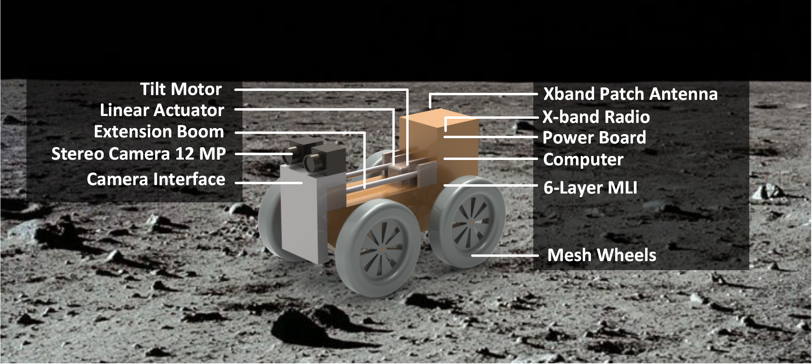
System Layout

Slide 11
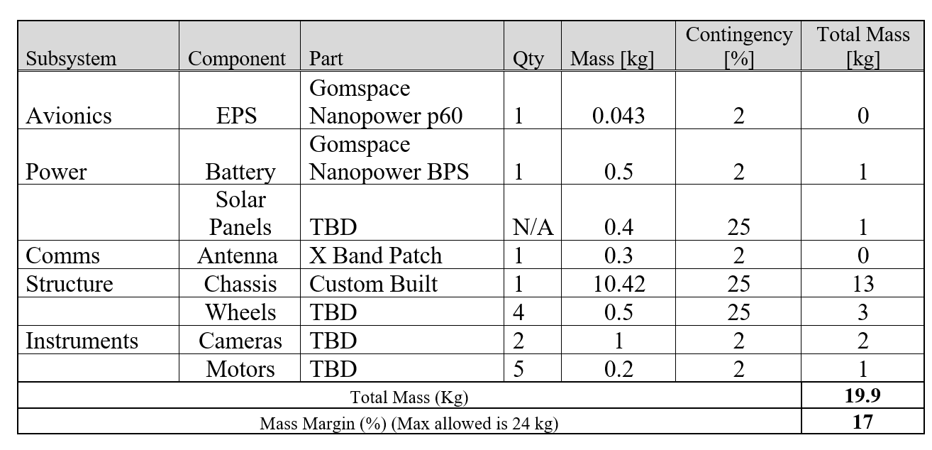
System Description - Mass Budget (12U)

Slide 12
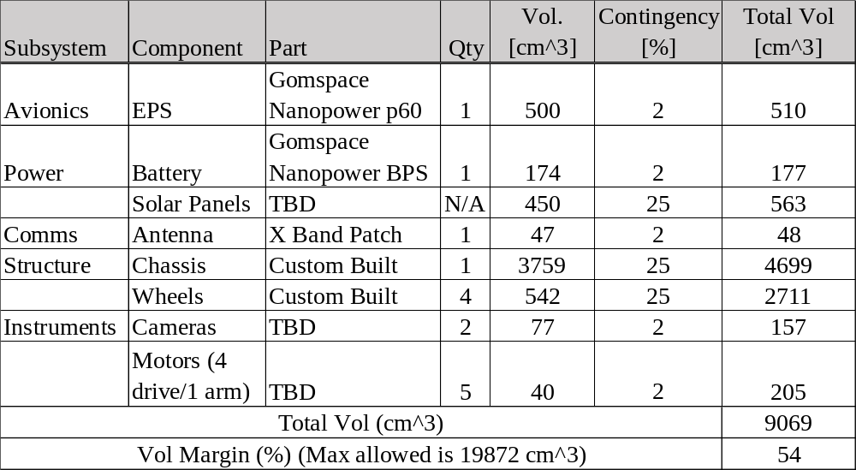
System Description – Volume Budget (12U)

Slide 13
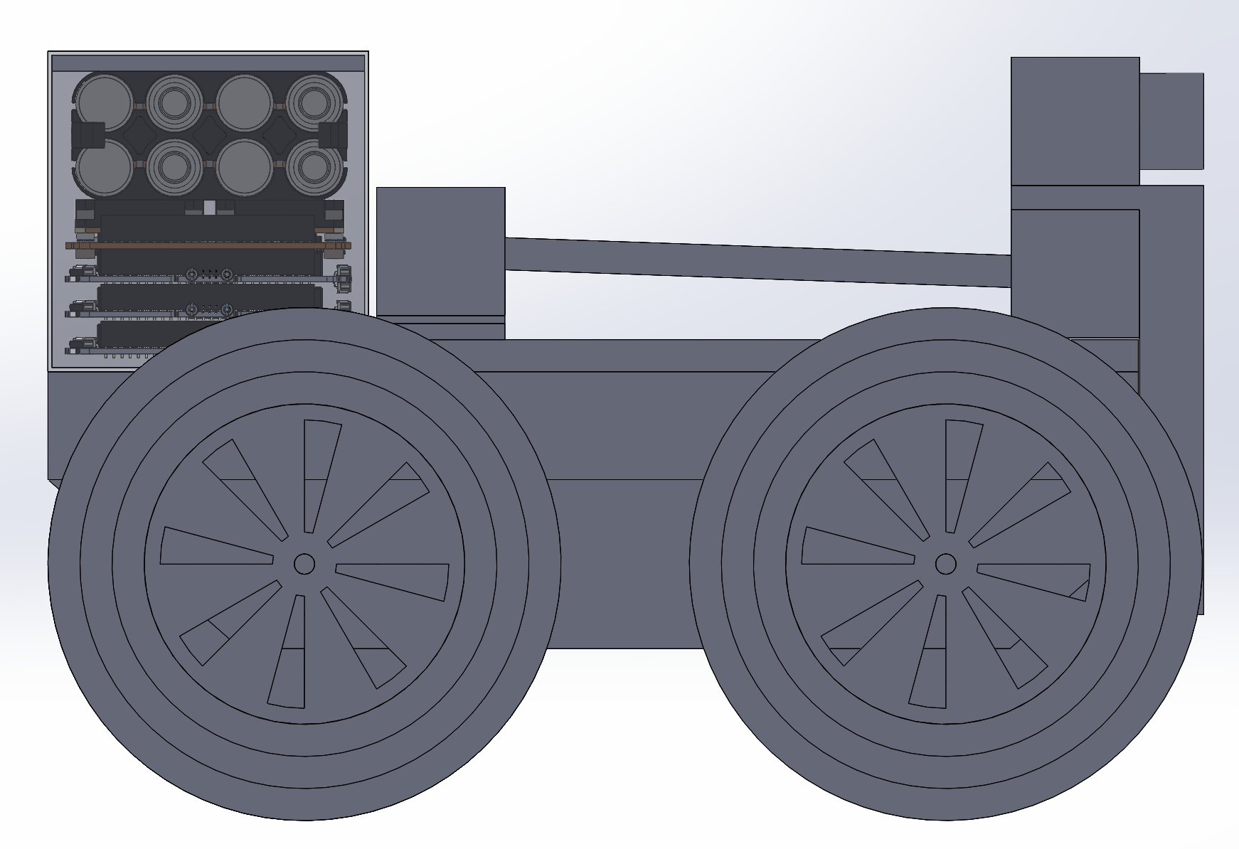
Side Layout

Slide 14
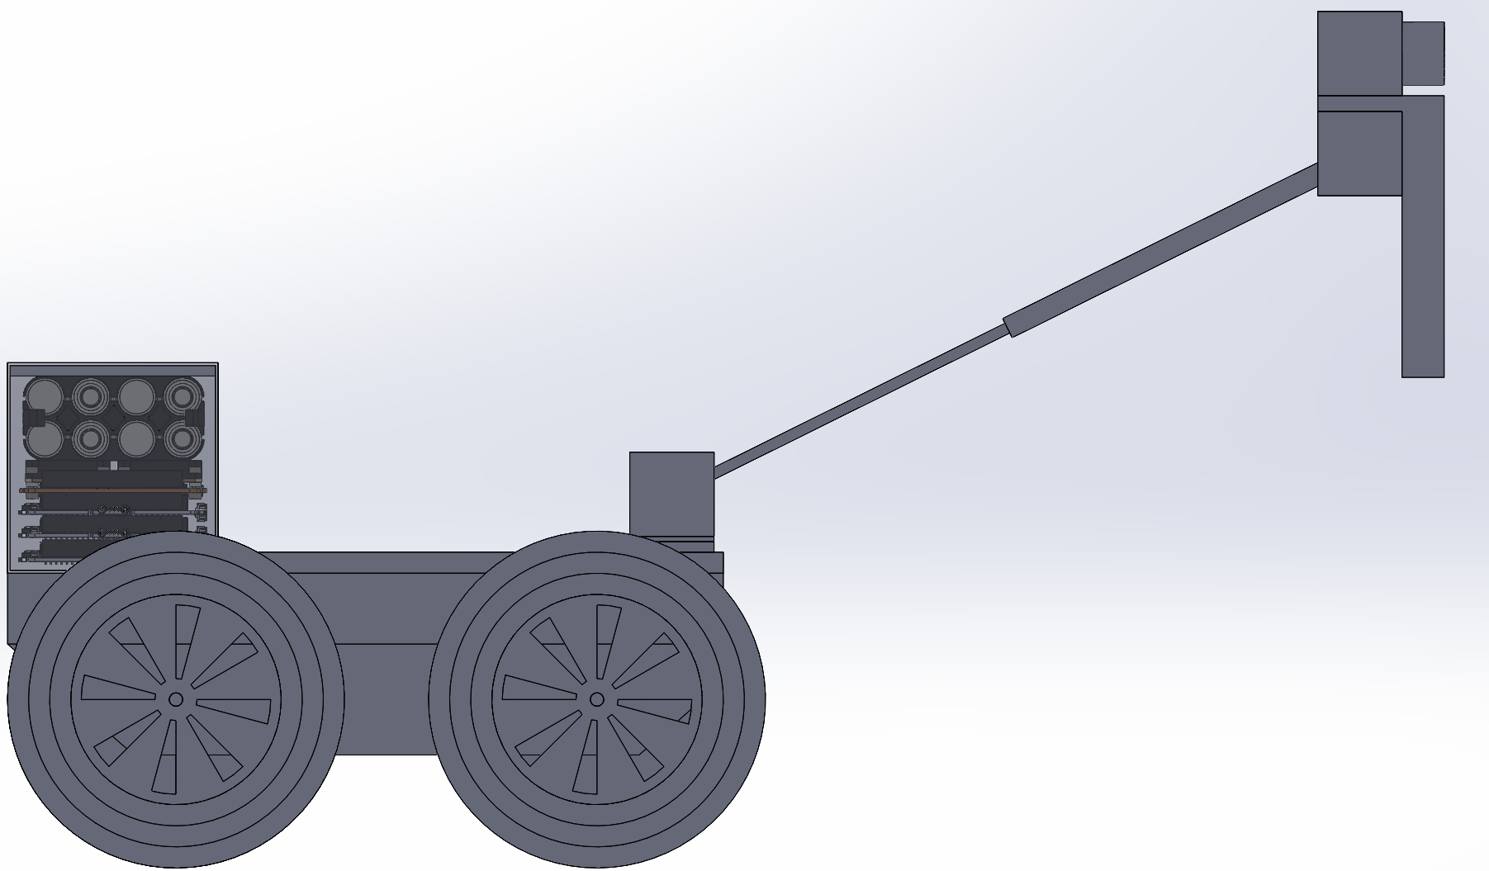
Boom Extended

Slide 15
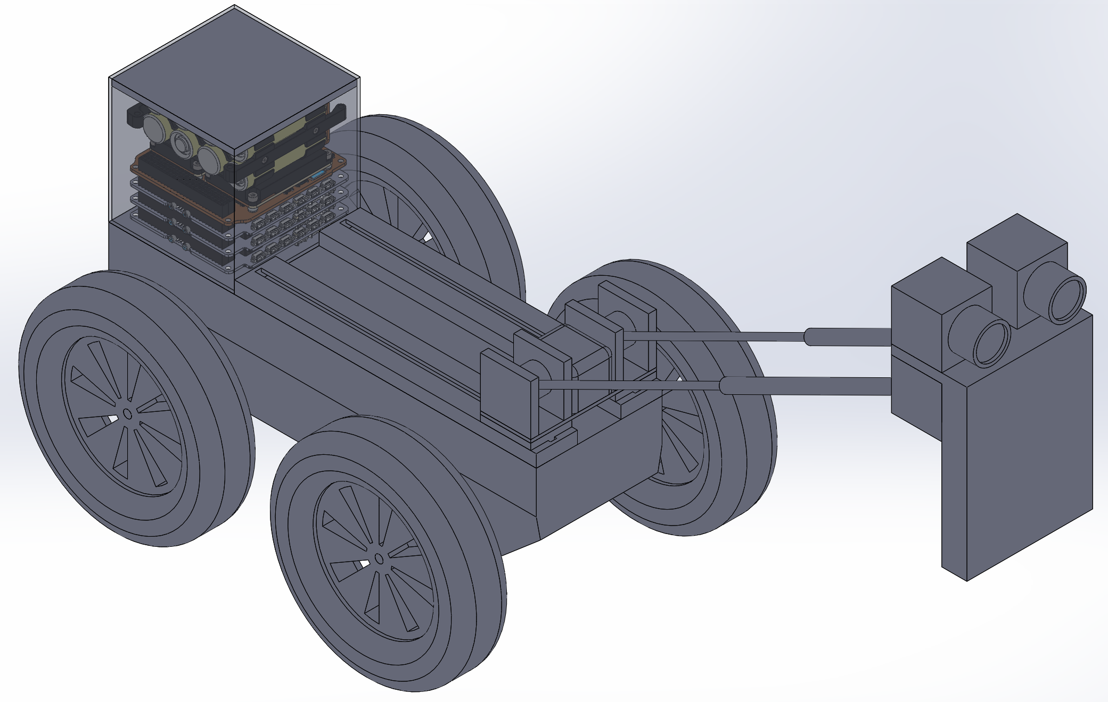
Boom Extended

Slide 16
Discussion
Proposed a micro-rover that can fit inside 12U deployer.
Rover can be carried as secondary payload to lunar surface.
Includes extendable boom to position stereo camera for pan shots and close-ups of the ground.
Uses standard COTS with 100 mil Al shielding
Wheel uses mesh-wires.

Slide 17
Conclusions
First of several CubeSat-sized rovers being designed.
Focus has been on providing platform for camera to take pan and close-up shots.
Conventional mesh-wire wheel system.
Considering other chassis design to enable better traversal over obstacles.

Slide 18
Thank you

