Slide 1
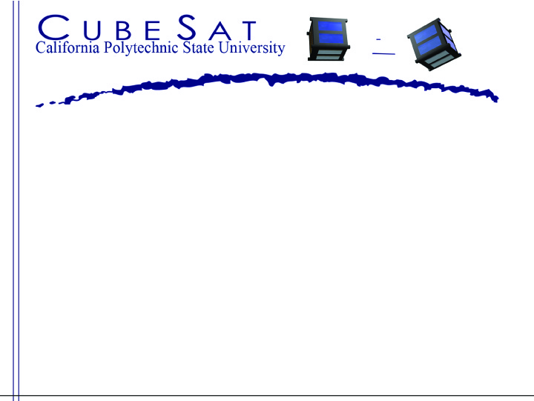
CubeSat Deployment System Concept for Interplanetary Missions
Dave Pignatelli
California Polytechnic State University, San Luis Obispo
Staff
2019 Interplanetary Small Satellite Conference
April 29th, 2019

Slide 2
Deep Space CubeSat Mission Concepts
Psyche
Proteus
BASiX
CoRE
Many others!
All Image Credit: NASA JPL (“JPL’s Advanced CubeSat Concepts for Deep Space Exploration”, CubeSat Workshop, August 2015)

Slide 3
Deep Space CubeSat dispenser Motivation
Current CubeSat deployment systems are designed to deploy CubeSats near Earth
MarCO – deployed near Earth, makes transit to Mars outside of dispenser
  Dispensers for MarCO did not need to perform in a capacity beyond typical Earth orbiting CubeSat deployment systems
Potential design challenges for long term interplanetary missions:
  Communications: Dispenser may need to participate in data transfer from CubeSat to Earth
  Thermal: Maintaining operational/survival temperatures
  Radiation: Minimizing dose to both CubeSat and Dispenser electronics
  Deployment accuracy and predictability
  Cold welding between CubeSat and dispenser interfaces
A standard platform with flight heritage is a critical piece in making interplanetary mission architectures involving secondary payloads (CubeSats) truly practical
4/24/2019
Notes:
----- Meeting Notes (4/18/16 15:51) -----

Slide 4
Assumed Dispenser Functions
Pre-launch/Launch
  No change from typical CubeSat missions
Post separation from Launch Vehicle/Transit
  Power on, thermal control, CubeSat/Dispenser diagnostics, communicate any health concerns to primary
Upon receiving deployment signal
  Deploy CubeSat, verify deployment, and communicate to primary
Post deployment
  Receive CubeSat data and transfer to primary spacecraft to relay to Earth
4/24/2019

Slide 5

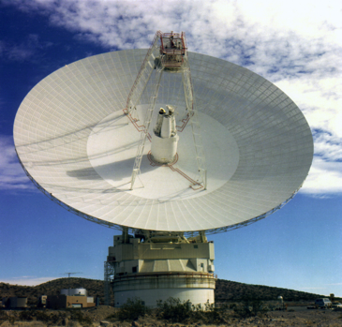
Communications System
Deep space communications hardware is very large
CubeSat data must get back to Earth
  Primary spacecraft high gain antenna (HGA) can be used to send data in order to make use of the large antenna that is available
In order to minimize any operational requirements on the primary, the dispenser can have its own low power communications system
  Send/receive data from the CubeSat
  Onboard dispenser avionics can then transfer the data to the primary spacecraft through a wired interface
Above solution makes use of deep space communications systems already in place for the primary mission
HGA Antenna Example
Credit: NASA JPL
Earth Deep Space Antenna Example
Credit: NASA
4/24/2019

Slide 6
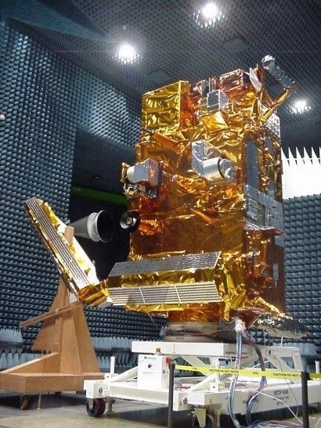
Thermal System (1)
Thermal system control objective:
  Maintain temperatures between -10° C to 40°C
Utilize heaters to maintain minimum temperature in shaded/cold conditions
Select insulation properties for optimal temperature range
  Balancing act between minimize power required in cold case to maintain temperature range and minimizing temperature in the hot case
3 different MLI configurations were examined:
  α = 0.12, ε = 0.11 (COTS)
  α = 0.14, ε = 0.07 (COTS)
  α = 0.04, ε = 0.04 (theoretical)
Multi-layer Insulation in use
Credit: ESA
4/24/2019

Slide 7
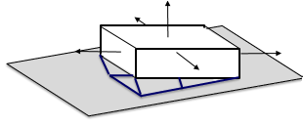
Thermal System (2)
Cold Case Assumptions:
  Dispenser shaded by Primary spacecraft (no thermal interaction)
  All other surfaces radiate to space
  No view factors with sun, distance from the sun is not relevant
Hot Case Assumptions
  Solar radiation incident on largest panel at 0.89 AU
  No thermal interaction with primary
Dispenser Thermal Model (Cold Case)
Solar Radiation
Dispenser
Config | α | ε | Max Temperature | Heater Power Required
1 | 0.12 | 0.11 | 42.8 °C | 11 Watts
2 | 0.14 | 0.07 | 94.0 °C | 7 Watts
3 | 0.04 | 0.04 | 36.0 °C | 4 Watts
Thermally Isolated
Dispenser Thermal Model (Hot Case)
4/24/2019

Slide 8
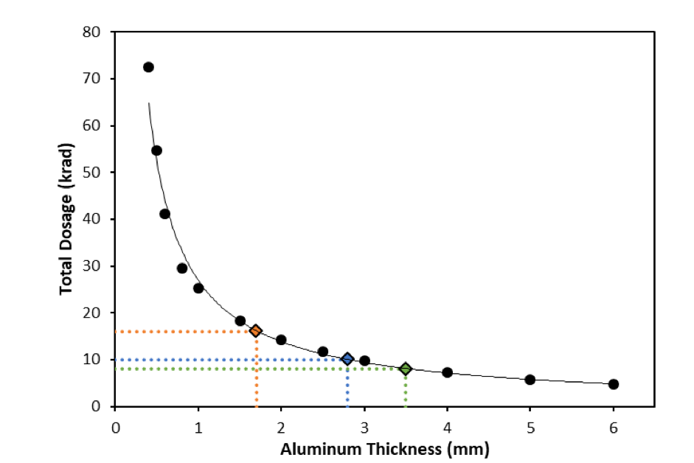
Radiation Concerns
16 krad typical allowable ionizing dose of radiation for CubeSat components¹
  Targeted 10 krad and 8 krad for factor of
  safety
Shielding entire CubeSat with
Dispenser vs just Dispenser
components
  CubeSat can shield itself where
  necessary to save mass
Assuming Aluminum dispenser body:
  16 krad: 1.7 mm wall thickness (similar to thickness of existing dispensers)
  10 krad: 2.8 mm wall thickness
  8 krad: 3.5 mm wall thickness
Data from SPENVIS model
4/24/2019
¹Byrne, James, and K. Cahoy, Resource-Constrained Avionics Design for CubeSats, 2016.

Slide 9
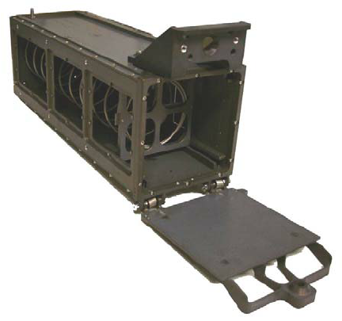
Deployment Accuracy
Mechanical springs are a popular method of deployment for CubeSat dispensers
  Very reliable compared to other options
  Long-term stowed state raises concerns of spring relaxation
    Spring relaxation can cause a loss of spring stiffness of at least 1-2%
Spring relaxation can be mitigated using a process called heat setting
  Holding the spring under high stress at elevated temperatures
Spring will undergo its relaxation on the ground where it can be measured
  Ensures accurate deployment velocity
P-POD with Coil Spring
4/24/2019

Slide 10
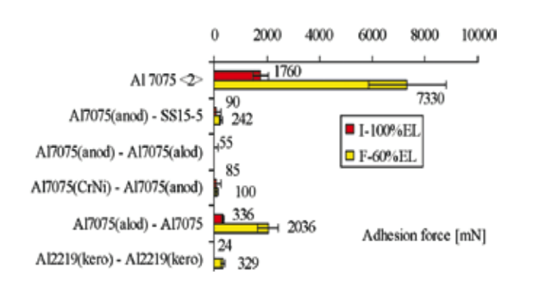
Cold Welding Concerns
CubeSat deployment systems typically have a metal on metal interface between CubeSat and dispenser
  This raises concerns about cold welding
  Long-term contact raises chances of cold welding between two similar, flat, materials
Using different material coatings greatly mitigates the adhesion forces
Uncoated materials see large adhesion force
Coated materials see small adhesion forces
Different adhesion forces under impact and fretting for a selection of materials. Credit: ESA³
4/24/2019
³A. Merstallinger, M. Sales, E. Sermerad, B.D. Dunn, Assessment of Cold Welding between Separable Contact Surfaces Due to Impact and Fretting under Vacuum (ESA STM-279 November 2009), ESA Communications Production Office, 2009.

Slide 11
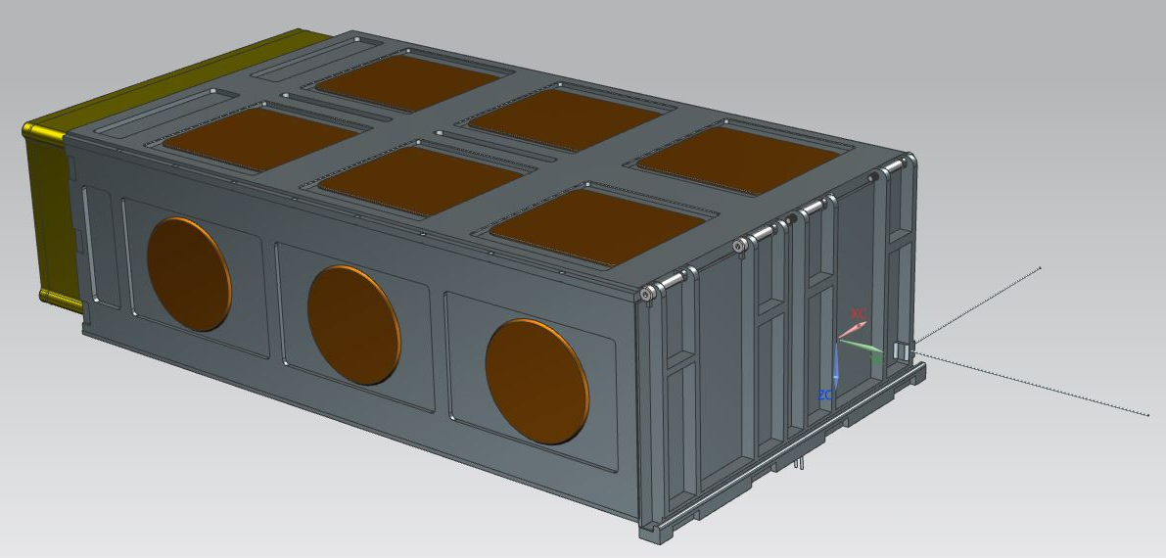
Preliminary Design Concept
Electronics Box
Contains system computer, transceiver, thermal controller, data storage, and primary spacecraft interface electronics for power and data transfer
Door Stops in Hinge Assembly
Spring loaded plunger engages in slot to stop and lock door in place
Antenna
Omni-directional for pointing flexibility
Heaters
(Dispenser to be wrapped in MLI)
Door Release Mechanism
Pin Puller on underside unlatches door
4/24/2019

Slide 12
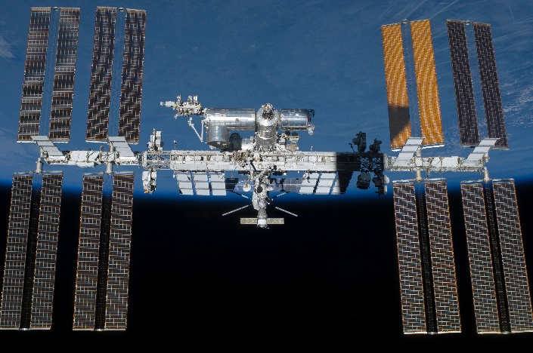
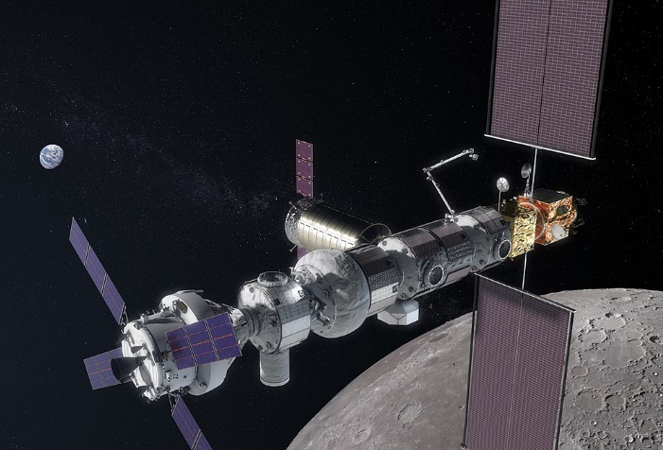
Testing for Flight Readiness
Potentially send on EELV launch prior to long term testing to help qualify for longer term tests
Potential long term test beds include ISS, GEO spacecraft or Lunar Orbital Platform-Gateway
Develop payload to stimulate CubeSat in various power state modes
  Allows full thermal system testing to ensure temperature regulation is reliable
  Allows for full deployment system test to ensure reduced risks of cold welding or other deployment malfunctions
  Allows for full communication system test to ensure communication architecture behaves as expected
  Indicates total ionizing dose transmissibility from dispenser exterior to payload
International Space Station
Credit: NASA
Lunar Orbital Platform-Gateway
Credit: NASA

Slide 13
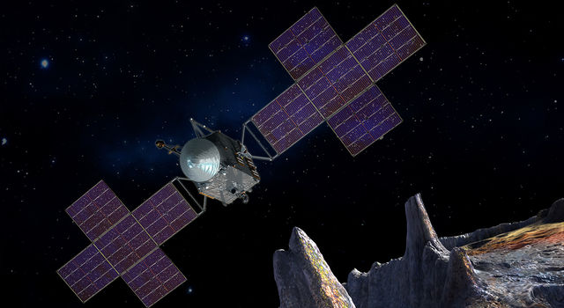
Conclusion
Proposed functions on a CubeSat deployment system are feasible
  Individual functions have been in practice for a long time
  The challenges arise when bringing these functions together in a system that works for a secondary payload interface
Most significant change from available CubeSat dispensers will be the added avionics package to handle thermal control, communications, command and data handling, etc, to the CubeSat dispenser
Special thanks to NASA JPL for funding and support of the preliminary studies to springboard this effort!
4/24/2019
Image Credit: NASA JPL

