Slide 1
Low SWaP Radiation Sensor Development and Characterization at JPL
Wousik Kim and Insoo Jun
Jet Propulsion Laboratory, California Institute of Technology
April 29, 2019
ISSC 2019
Copyright 2019 California Institute of Technology. Government sponsorship acknowledged.

Slide 2
Topics
JPL’s Radiation Monitors
Sensors
Summary

Slide 3
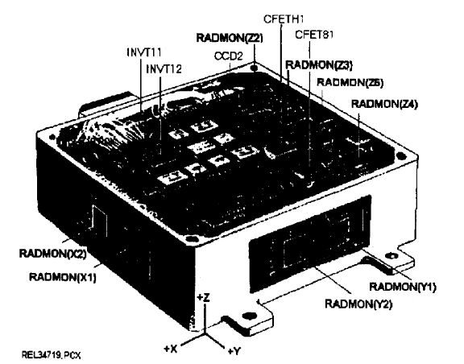
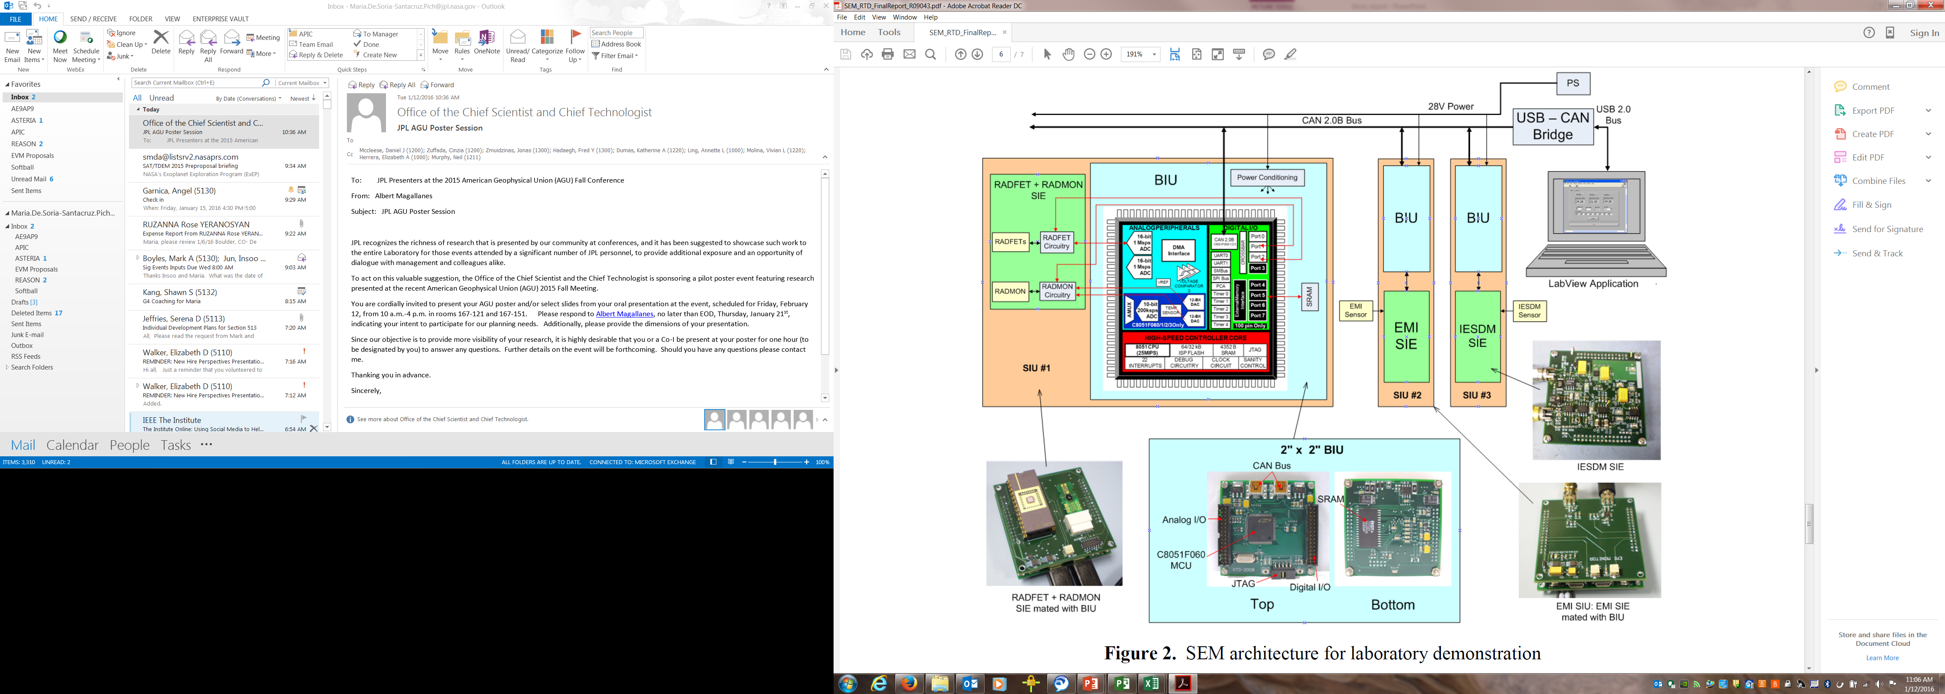
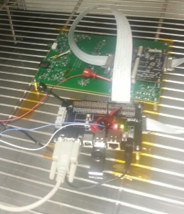
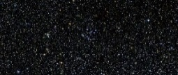
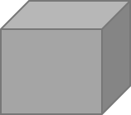

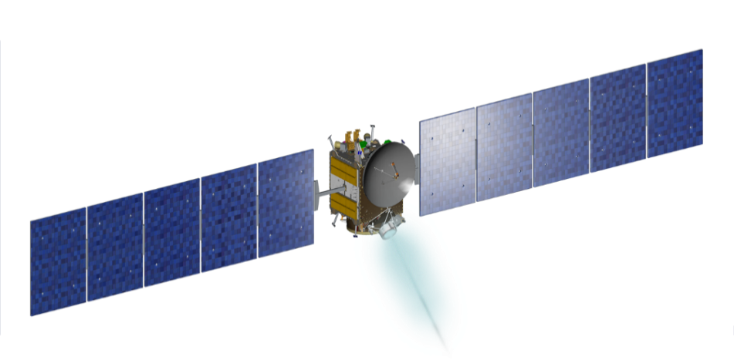
JPL’s Radiation Monitor Heritage
RRELAX
Strategic Initiative 2008
Demonstration of a network of environmental monitoring sensors including design, fabrication and test of a breadboard system
Instrument successfully flew on the Clementine mission in 1992
Monitored the SEU rates and Total Ionizing Dose (TID)
Managed by H. B. Garrett
Measurements of TID, SEU, and a prototype Electrostatic Discharge Monitor
CREAM
CREAM Sensor Board
Black Box 2016
CREAM was an instrument suite part of the MISSE-X CubeSat
CREAM included TID, temperature, and UV measurements
CREAM passed PDR at JPL at the time of the MISSE-X cancellation in August 2013
small environment monitor designed to support mission planning, anomaly investigations, and the design of future JPL missions
TID, SEU, Charge monitors, and Camera

Slide 4
Environmental Sensors
Sensor | Environment Quantified | Operation Overview | Calibration
Atomic Oxygen (AO) Fluence Monitor | Flux (atoms/cm²⋅sec), Fluence (atoms/cm²) | Provides time-based AO arrival data by using the erosion of a pair of pyrolytic graphite wedges over an ambient lit photodiode. | To improve calibration accuracy, two Kapton covered photodiodes (different film thickness) will provide in-flight calibration verification.
UV Sensor (140 nm - 1100 nm) | Sun-hour from the broad band intensity (W/cm²) measurement | Measure the current generated by the photodiode responding to the broad band sun spectrum. | Calibrate the photodiode using the solar simulator lamp.
Total Ionizing Dose (TID) | energy deposition by ionizing radiation (J/kg = Gy, rad = cGy) | The threshold voltage of RADFET is shifted according to the total deposited energy in the gate oxide. | Calibrate the threshold voltage shift on ground using known radiation sources such as Co-60 and/or electron beam.
Temperature Transducer | Local temperature (K) | Temperature transducer is an Intergtated Circuit (IC), the design of which results from the fact that semiconductor diodes have temperature-sensitive voltage vs. current characteristics. | The output current is proportional to absolute temperature. ( 1 µA/K) Will be calibrated on ground.
X-ray Sensor (Soft x-rays: 10-1 nm proposed) | X-ray intensity (W/cm²) | X-ray Photodiode generated the currents proportional to X-ray intensity. Lower energy photons (UV, VIS, and IR) is blocked by a filter which defines the spectral range. | Calibrate the X-ray photodiode output current with the X-ray source with a known intensity.
Contamination Monitor | Mass of a contamination deposited (g/cm²) | The frequency of a Quartz Crystal Microbalance (QCM) decreases as the mass deposited on the QCM surface increases.
Single Event Upset (SEU) Sensor | Number of upset per unit time due to proton flux | Counts the number of bits upset in a memory chip (SDRAM or DRAM) after a unit time and reset the bit value to the original one. Ready for next upset counts. | At the exact flight condition, calibrate the memory chip against the different proton energies and fluences.
Surface Charge Monitor | Potential on sensor surface w.r.t. the S/C ground (V) | The electric field generated by the potential on the surface is attenuated through the hole on ground plane. The attenuated field is sensed using a vibrating electrode driven by a tuning fork that is closed-loop controlled. | The know potential is applied to the sensor plate from a power supply.
Internal ESD Monitor (iESD) | Potential as a function of depth (V) | The potentials along the depth of he dielectric plate are measured through a thin metal meshes imbedded in dielectrics. | The measured potentials are compared with a theoretical model such as NUMIT.

Slide 5
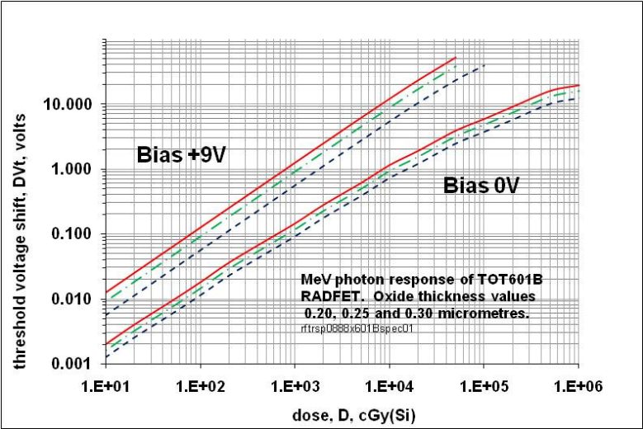
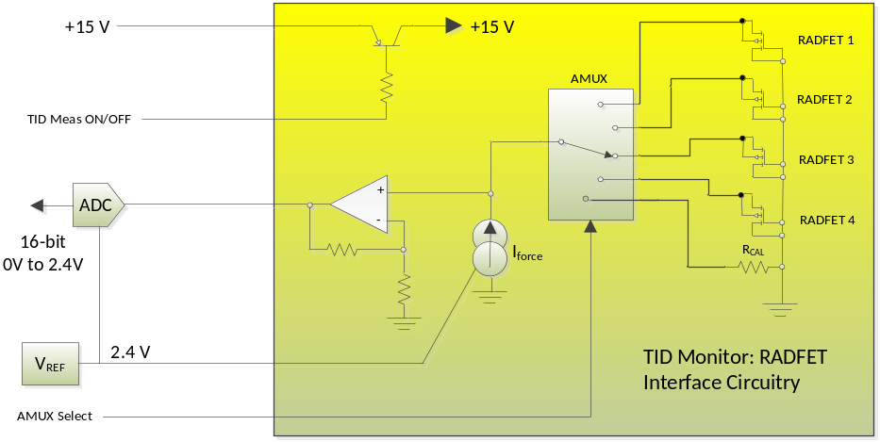
TID – RADFET
RADFET from REM was used
  Size of chip carrier: 1.7 x 0.87 cm², mass: < 1 g
Example Usage
Responsivity, Range, and Resolution
  Responsivity: 0.2 mV/rad(Si) at low dose
  0.02 mV/rad(Si) at high dose
  Range: Sensor 1 Mrad (25 V)
  ISS Environment < 250 krad (1 year)
  Resolution: dose resolution
  (50 rad= 1 mV)
  (dose during one orbit, 1.5 hours)
  A/D converter: 16 bit
Example Circuitry

Slide 6
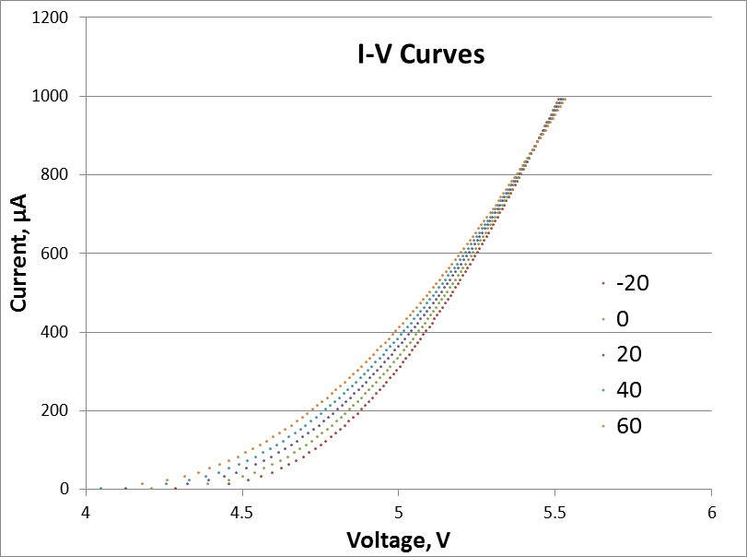
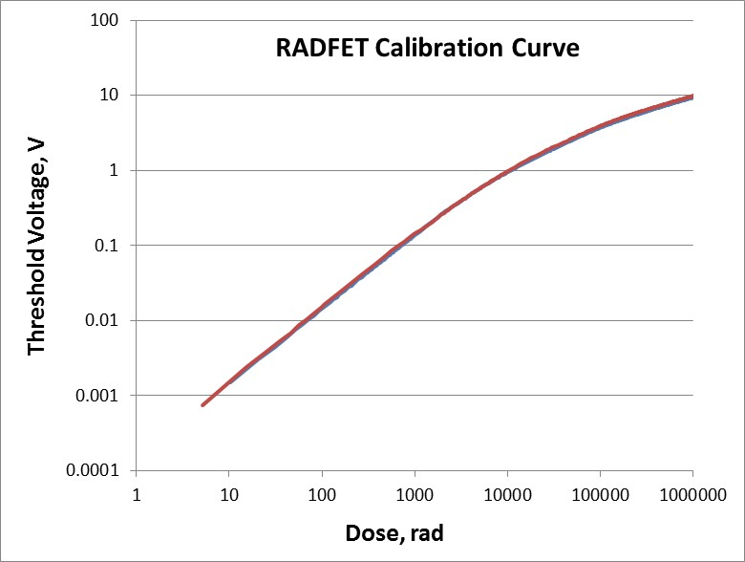
Calibration of TID sensor
I-V curve at several temperatures
zero temperature coefficient (ZTC) point
  Measurement current
  ZTC changes with dose
  used for the preselection of RADFETs
Temperature (°C)
Calibration curves for two RADFETs
Zero bias
Room temperature
Current at ZTC point
Pre-selected based on I-V curve
Two RADFETs showed similar curves

Slide 7
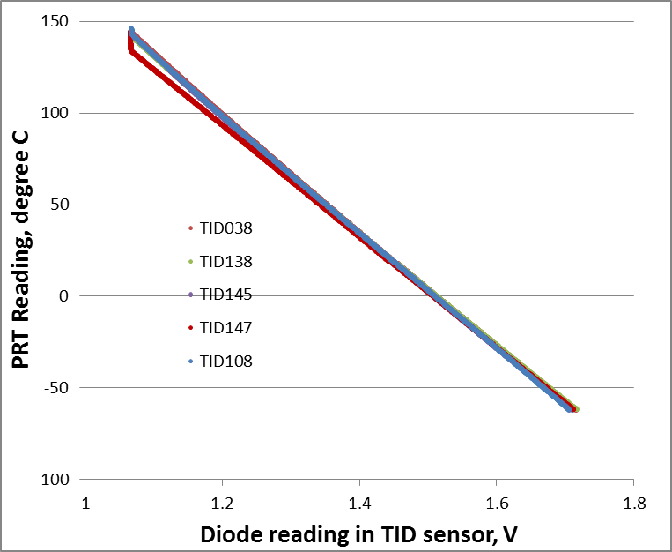
Calibration – built-in diode in TID sensor
TID Sensor Designator | Slope | Intercept
038 | -316.98 | 479.92
138 | -312.76 | 473.46
145 | -314.08 | 473.53
147 | -303.15 | 457.00
148 | -314.07 | 475.16
155 | -312.49 | 473.38
158 | -312.25 | 472.45
160 | -317.45 | 480.63
165 | -318.11 | 481.33
108 | -318.31 | 480.65
  TID 147 shows large deviation. The rest nine sensor show similar curves.
  The diode outputs show linear relationship with the temperature except for high temperature region (130 ~ 150 ˚C).
  TID sensors with similar temperature calibration curves (and similar I-V characteristics) were selected for the further tests.

Slide 8
Low SWaP Adjustable Dosimeter
Developing with ASU (Hugh Barnaby and David Allee)
A low size (<25 cm²), weight (<200 g), and power (<1 W) dosimeter system which is capable of adjusting its sensitivity (and maximum range) between 10 mrad (10 krad) and 1 rad (1 Mrad).
Designing proto-type adjustable dosimeter system using REM Model TOT601B RADFETs combined with a dual slope Nyquist-rate A/D converter with built-in sync filter assembled with radiation hardened components.
System will be able to sample between 2 rad and 1 Mrad of ionizing dose

Slide 9
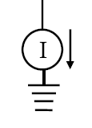
Internal Electrostatic Discharge Monitor
(IESDM)
The IESDM was designed to emulate a multi-layer circuit board. Very thin metallic layers (meshes) were inserted between the dielectric layers
IESDM Box
About 10 pairs of layers
Incoming Electrons
Dielectric
Conductor
High Impedance Resistor
Interface to Computer
Electrometer

Slide 10
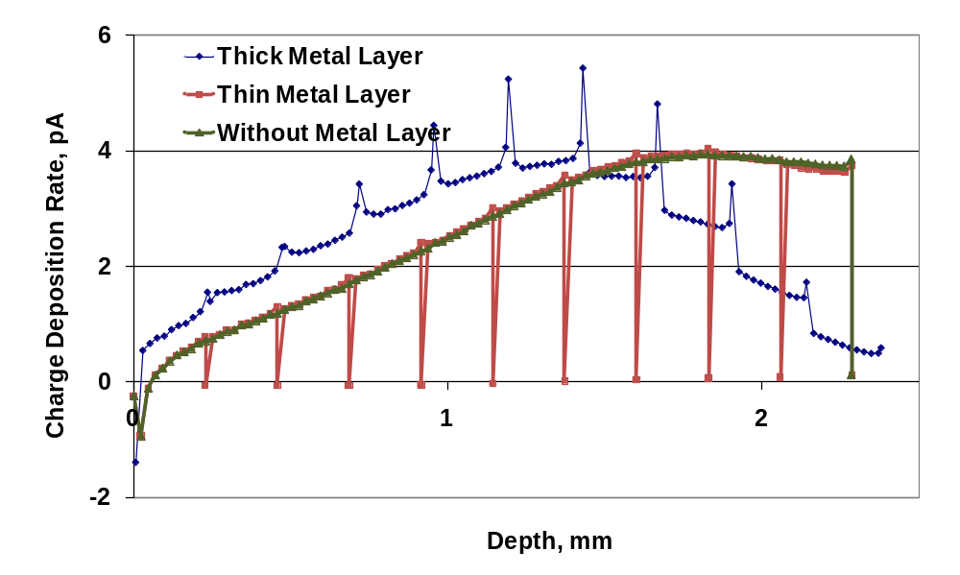
Internal Electrostatic Discharge Monitor
Example Monte Carlo (TIGER) simulation result – 1 MeV, 300 pA
Show that insertion of thin metal layers does not change the charging profile

Slide 11
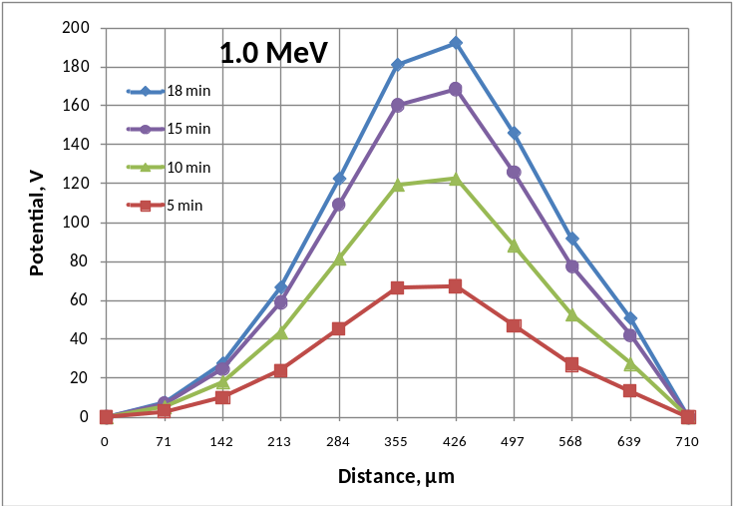
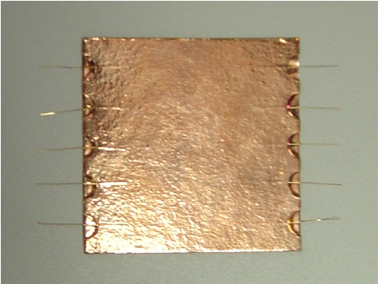
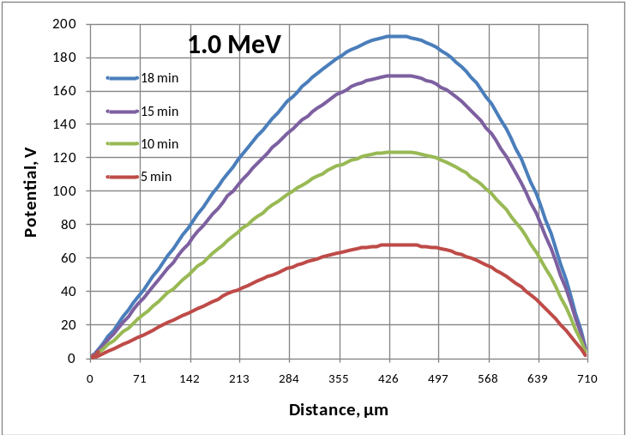
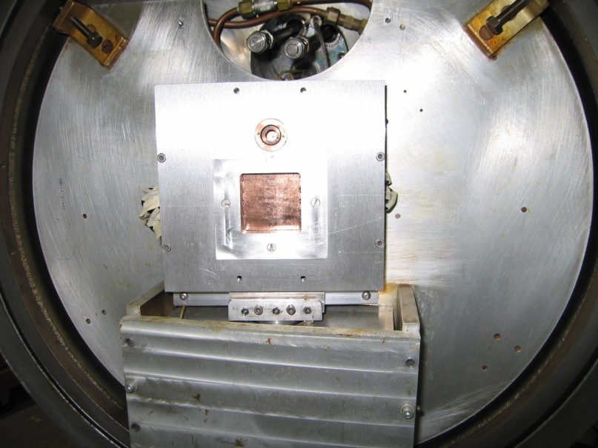
Internal Electrostatic Discharge Monitor
(a) Test
Prototype IESDM
Test Setup
(b) Simulation
Dark conductivity: 3.1x10⁻¹⁶ ohm⁻¹m⁻¹
RIC coefficient: 2.0x10⁻¹⁶ sec ohm⁻¹m⁻¹rad⁻¹

Slide 12
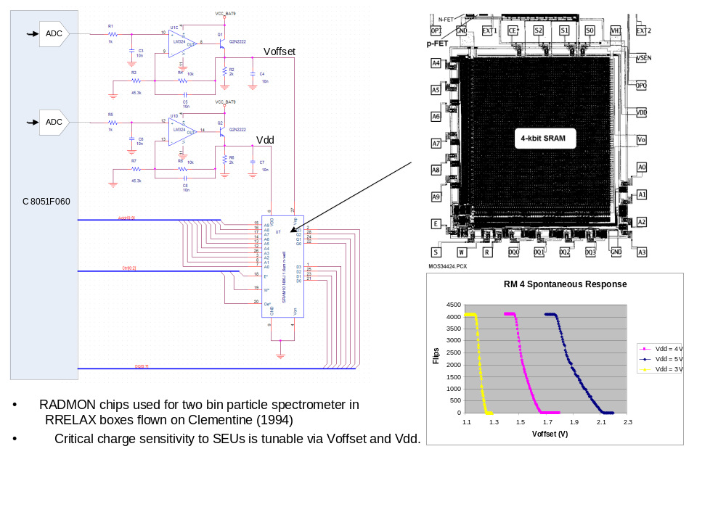
SEU Sensor
Will use a commercial SRAM. This SRAM can be sensitized to SEUs by lowering V_{dd} (as was done for the RADMON). So we eliminate the V_{offset} adjustment channel, but keep the V_{dd} adjustment channel. If we only want two values (nominal V_{dd} value for read/write and lower sensitizing value for SEU “stare” time), the DAC can be replaced with a 2-1 AMUX feed by voltage dividers.

Slide 13
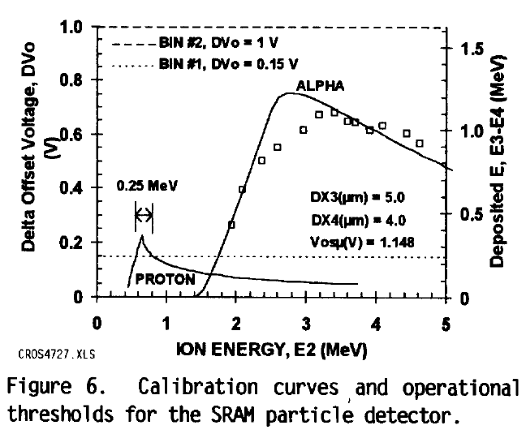
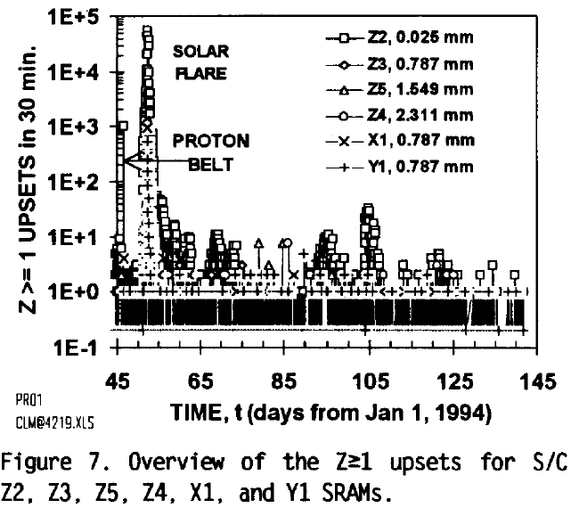
SEU Sensor - RRELAX
A signal level will strongly depend on shielding, integration time, pixel size, radiation hardness, threshold voltage as well as an exposed environment.
Refer to the previous experiment; RADMON on Clementine RRELAX (4 kbit)
With the threshold voltage of 0.15 V, Protons with 0.55 MeV < E < 0.8 MeV and heavier ions upset the RADMON.
Upset Rate of RADMON;
Solar Flare: up to 6E4 SEU/30min
Normal: ~ 2 SEU/30min
M. G. Buehler, G. A. Soli, B. R. Blaes, J. M. Ratliff, and H. B. Garrett, “Clementine RRELAX SRAM Particle Spectrometer,” IEEE Transaction on Nuclear Science, vol. 41, pp. 2404, 1994.

Slide 14
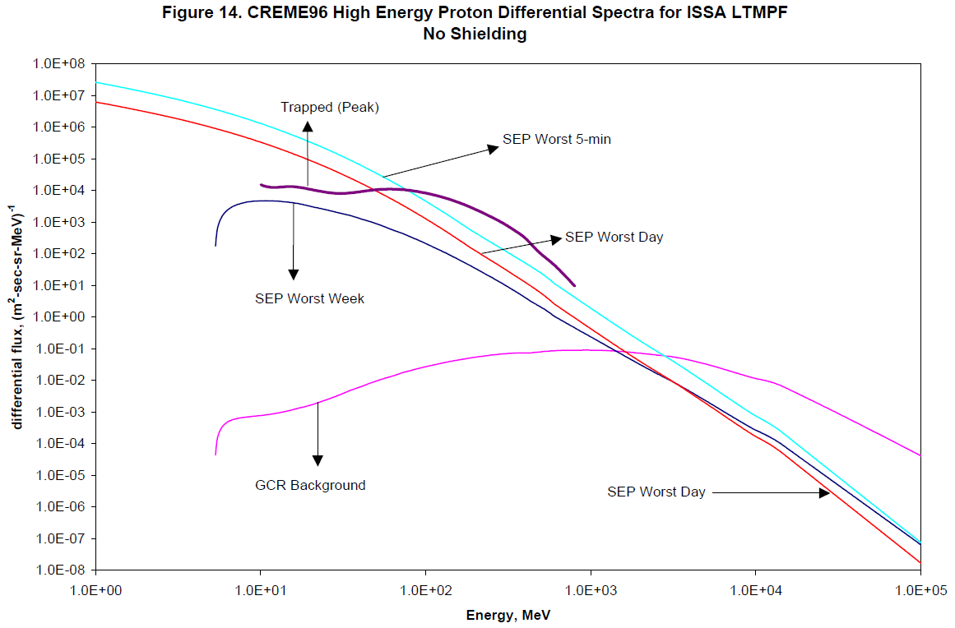
SEU Sensor
Typical modern memory chip has 4 Mbit (1000 time higher than RADMON) and area of about 1 cm².
Expected upsets calculating from RADMON data;
Solar Flare: up to 2E6 SEU/min
Normal: ~ 70 SEU/min
Calculation from Proton Environment:
Bin flux between 0.5 MeV < E < 1 MeV (twice of that of RADMON case)
No Shielding
Normal
AP8MAX: 9.5E2 hits/min
AP8MIN: 8.6E3 hits/min
Solar flare
From the left graph
proton flux is ~ 3E7/(m² s sr MeV)
Converted to 5E5 /(cm² min)
Assuming 1% upset per measurement,
2E6 SEU/min can be done by a measurement per every second
Insoo Jun, “Ionizing Radiation Environment for the ISSA Low Temperature Microgravity Physics Facility (LTMPF)”, JPL IOM 5132/5052-01-122, May 31, 2001

Slide 15
UV Sensor
A photodiode UVG12 from OptoDiode Corp. was selected
  A direct measurement of the UV irradiance will be strongly interfered with by “contamination”.
  Measure broad band UV-VIS irradiance
    Very small interference from contamination
    Depends on the sun angle and shade
    Measure Sun-Hour
  Extract Ly-α irradiance from the measured sun hour and the reported daily Ly-α irradiance
    The daily Ly-α irradiance is being measured in SOLSTICE instrument on SORCE satellite and reported in the website http://lasp.colorado.edu/lisird/sorce/sorce_ssi/.
  Some flight histories, Readily available
  Spectral range: 140 ~ 1100 nm
  Apply reverse bias (0 – 50 V) and read a current
  Size: 1.0 x 1.0 cm², mass: < 10 g
  At normal, the expected irradiance is ~ 0.1 W/cm².

Slide 16
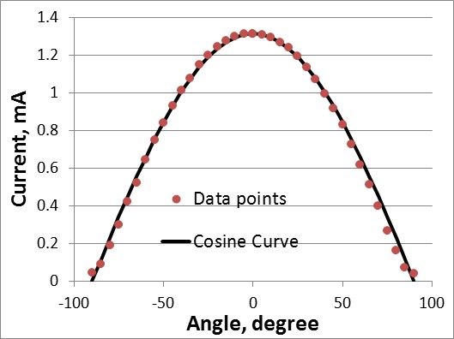
UV Sensor Calibration - Angle
Measured the output current at 1 AU irradiance
Current measured as a function of the angle of the UV sensor.
  Follows the cosine curve well
Good for the local UV irradiance measurement

Slide 17
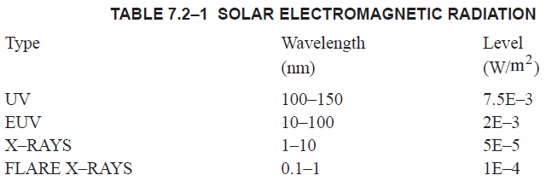
X-ray Sensor
Expected environment from SSP 30425
Energy
(keV)
1.2 – 0.12
12 – 1.2
There are two possible cases depending on spectral range of interest.
1 nm – 10 nm (1.2 keV – 0.12 keV)
Difference with and without flare is only few times.
Too many hits to use a pulse counting mode.
→ Current Measurement
0.1 nm – 1 nm (12 keV – 1.2 keV)
Difference with and without flare is several orders of magnitude.
Current due to electron and proton is larger than the current due to x-ray in normal condition (without flare)
→ Pulse Counting

Slide 18
X-ray Sensor
Contamination from electrons and protons.
(From AE8MAX and AP8MIN and stopping powers from NIST)
Assuming the detector (Si) thickness of 100 µm
Energy deposition due to electrons: 6.6 E6 keV/(cm² s)
Energy deposition due to protons: 2.8 E5 keV/(cm² s)
Total ~ 6.9 E6 keV/(cm² s) which is ~ 1 E-5 W/m²
Case 1), current measurement mode,
the contamination due to the electrons and protons will be less than 20 %.
Case 2), pulse counting mode,
the contamination from electron and proton can be distinguished by different pulse height.
X-ray: less than 10 keV
Electron: 50 – 100 keV
Proton: 100 – 1000 keV

Slide 19
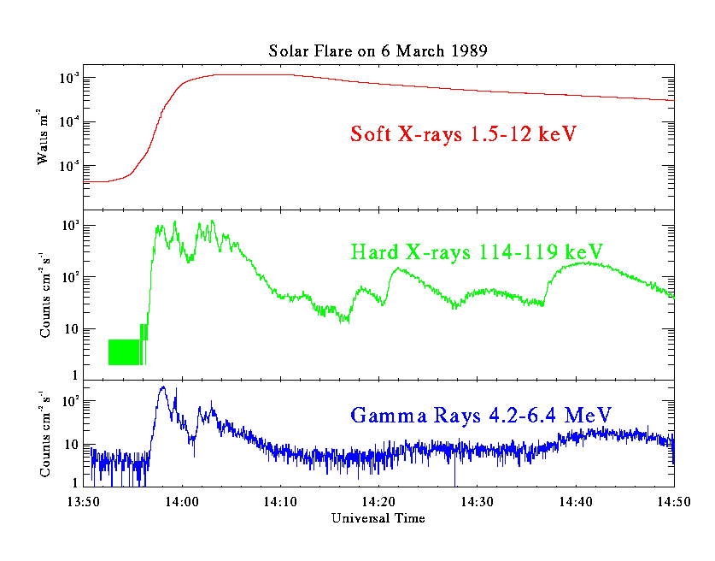
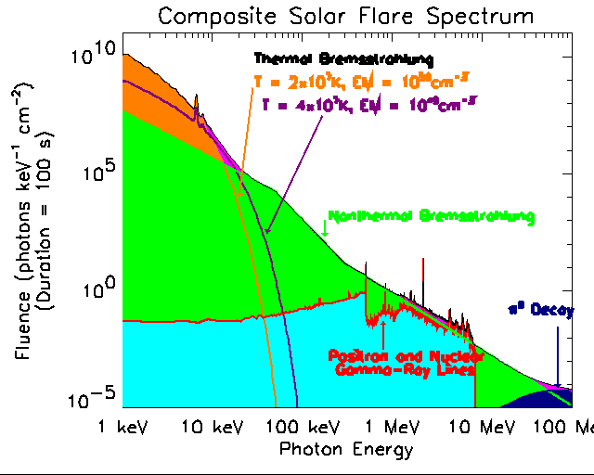
X-ray Sensor
Normal
4E-6 W/m²
Flare
1E-3 W/m²
X20 Flare
Case 1) about 1E8 photons/(cm² s)
Case 2) about 5E6 photons/(cm² s)
From http://hesperia.gsfc.nasa.gov/hessi/flares.htm

Slide 20
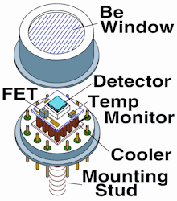
X-ray Sensor
Case 1)
Sensor: AXUV100 from OptoDiode Inc,
sensor area 1 cm², Responsivity 0.28 A/W
Expected current: 1.4 nA
Case 2)
Sensor: Si-PIN from Amptek,
sensor area 6 mm², thickness 500 µm,
1.0 mil Be Window
Maximum pulse counting rate: 1 E6 pulses/sec
Expected pulse rate at solar flare: 3E5 pulses/sec

Slide 21
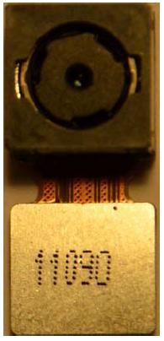
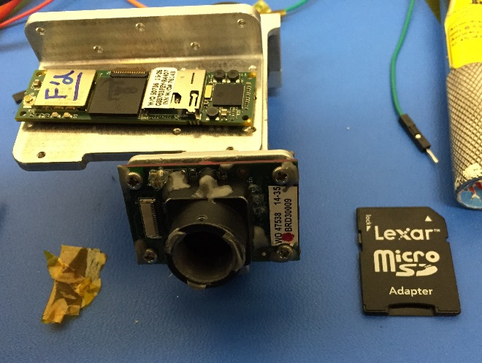
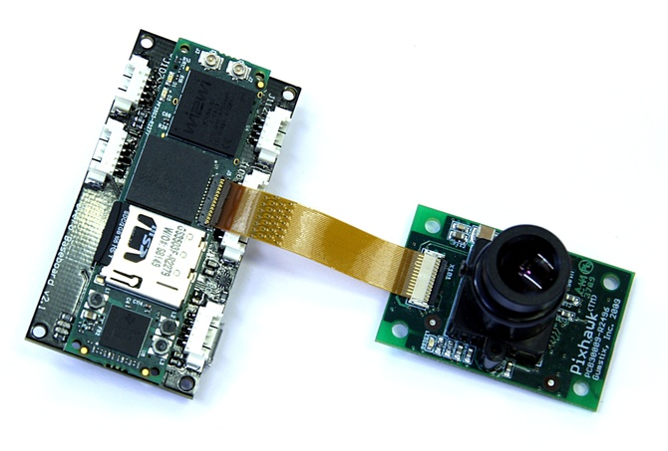
Camera
Optional module
Low mass, volume, and power
Could include Gumstix (image processing) and local memory within the module
Candidate detectors:
  5MP Aptina MT9P031
  Mouser 931-LI-5M05CMAF
  0.3 MP Aptina MT9v032 (MarCO’s detector)
Autofocus vs fixed lens
58 mm
17 mm
Gumstix module and 5 MP Aptina-based camera module
Mouser 931-LI-5MO5CMAF
MarCO camera
(Gumstix module and 0.3 MP Aptina-based camera module)

Slide 22
Summary
At JPL, compact radiation monitor activities have been going on.
Several sensor were considered and calibrated.
In a future, we hope that every JPL missions have the radiation monitor.

Slide 23
Thank You!
Questions?

Slide 24
BACKUP

Slide 25
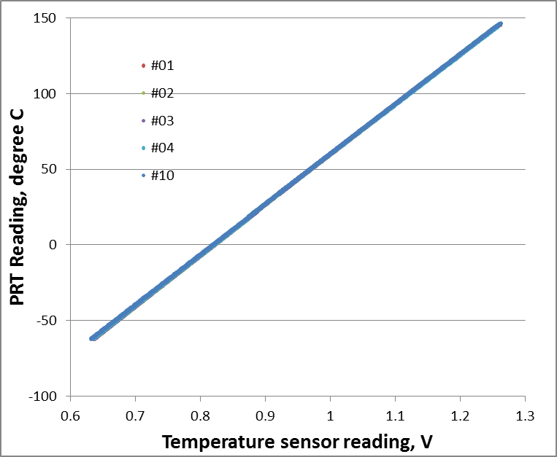
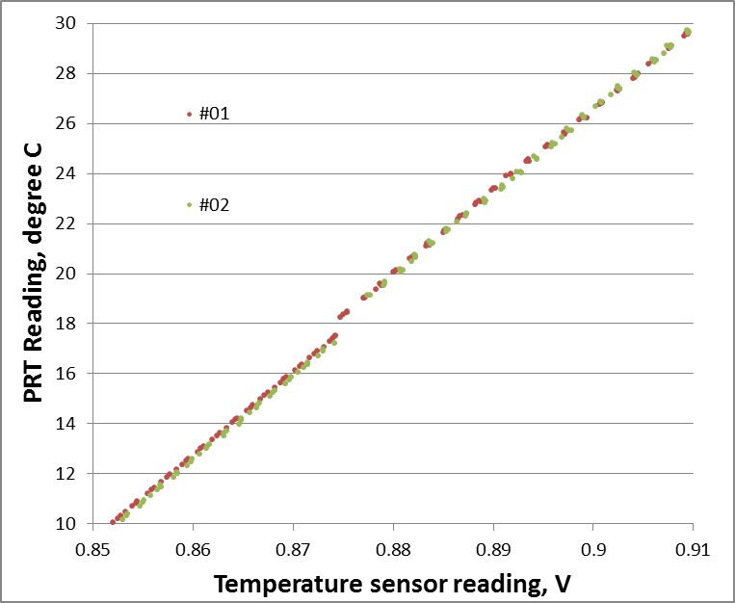
Test Results – Temperature sensor
Temp Sensor Designator | Slope | Intercept
1 | 332.25 | -273.06
2 | 333.10 | -273.85
3 | 333.79 | -273.99
4 | 331.07 | -271.86
5 | 333.89 | -274.01
6 | 332.85 | -273.47
7 | 332.08 | -272.88
8 | 332.72 | -273.43
9 | 332.75 | -273.45
10 | 330.78 | -271.13
  All ten sensors show very similar calibration curves.
  There is a small discontinuity at 20 ˚C.
  Most likely due to configuration difference between high and low temperature calibration setups.
  Final temperature calibration is needed as the final flight configuration: Test As You Fly (TAYF)

Slide 26
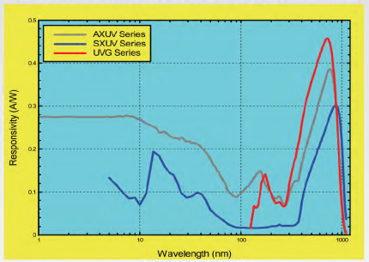
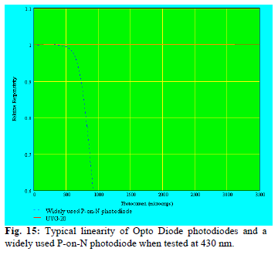
UV Sensor – UVG12
Responsivity, Range, and Resolution
  Average Responsivity: 0.25 A/W
  Expected maximum signal (when the surface is normal to Sun): 3 mA
  Range: Sensor 10 mA (linear up to 3.1 mA)
  Environment 3 mA
  Resolution: ~ 10 µA
  A/D converter: minimum 8 bit
Responsivity
Responsivity w.r.t intensity
3 mA

