Slide 1


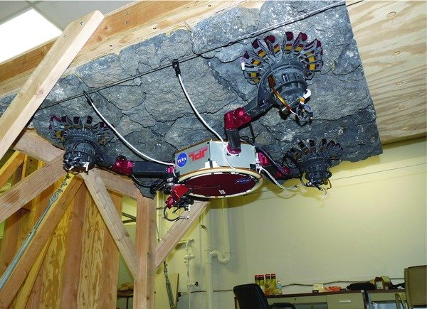
Parness et al., 2013
Advancing Microspine Gripper Modelling for Microgravity Climbing
Steven Morad
SpaceTREx, University of Arizona
Notes:
1

Slide 2
Outline
Introduction
Background
Objective
Method
Conclusion
Future Work
Depending on time: Future Work - Scoring Grips

Slide 3
Introduction – Microgravity Surface Mobility
What is microgravity surface mobility?
  Moving about the surface of small bodies such as asteroids, comets, and artificial satellites

Slide 4
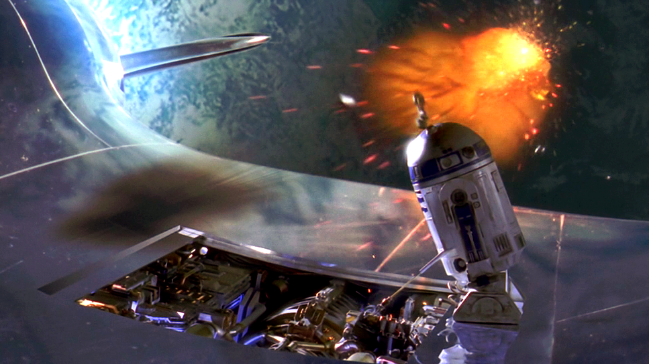
Introduction – Case for Microgravity Mobility
Microgravity surface mobility opens the door to surface operations on small bodies
  Small body science and analysis
  Small body in-situ resource utilization
  Satellite/ISS/spacecraft repair and servicing
Lucasfilms, 1999

Slide 5
Background – Mobility Methods
Mobility on microgravity bodies is difficult
Wheels can’t get traction, reaction torque sends rovers into a tumble
Hopping robots can inadvertently escape the body
  Especially with nonuniform gravity
Hovering requires corrections which use fuel over time, and in the case of asteroids blows regolith everywhere, obscuring cameras
What about climbing?

Slide 6
Background – Define Climbing
We define climbing as an incremental process where part of the climber is always in contact with the body
  Does not require fuel
  Cannot escape body unless grip fails
  Allows for momentum transfer to body
    Can damp motion from reaction forces/torques generated moving around

Slide 7
Background – Anchoring Methods
How do we keep the climber in contact or “anchored” to the body?
  Electroadhesion
  Microspines

Slide 8
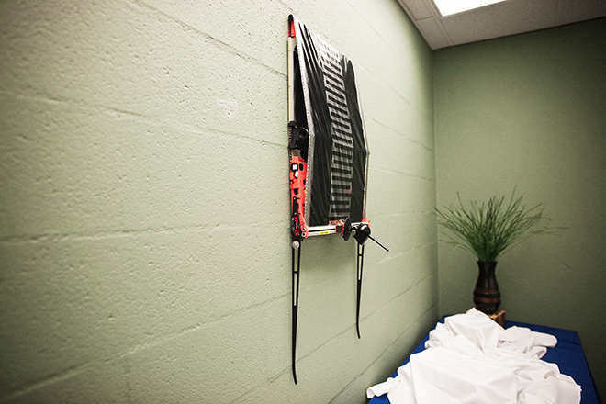
Background - Electroadhesion
Electroadhesive Pads
  Run current through it, gets sticky
  Requires constant power to maintain hold
  Relatively weak adhesive force
    0.1-1 N/cm^2
Tweney/SRI, 2011

Slide 9
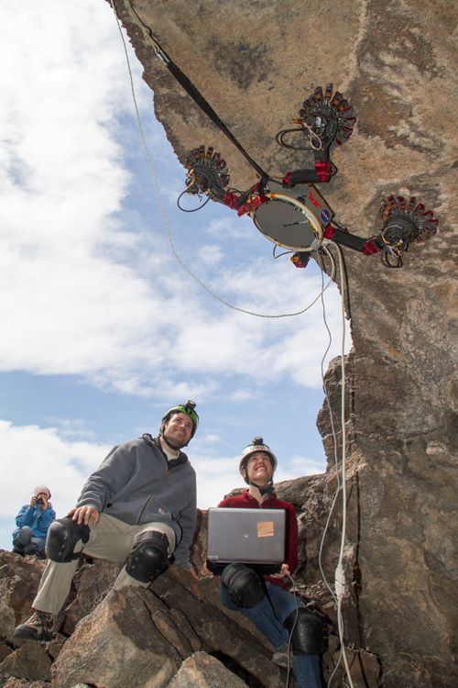
Background - Microspines
Microspines
  No power required to maintain hold
  Relatively strong adhesive force (1-2N per spine)
  Does not work well on microscopically smooth surfaces
    Rare in nature
Parness et al., 2017

Slide 10
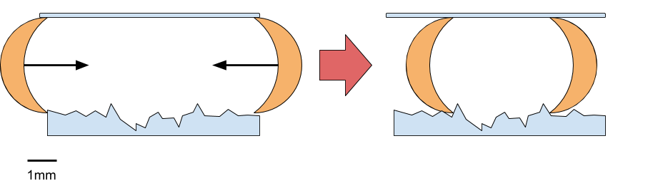
Background – Microspine Mechanism
Hooks/spines grip onto surface imperfections (asperities)
Retracting the spines creates a grasp

Slide 11
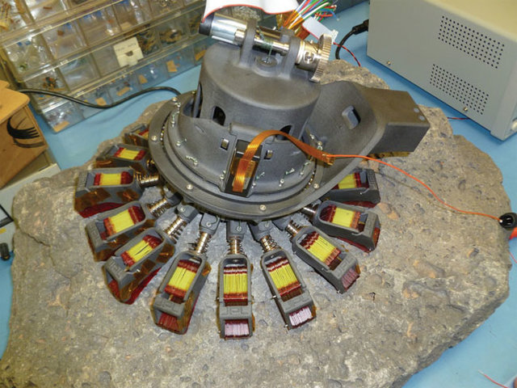
Background – Microspine Gripper
Spines are arranged radially into grippers
  Resists larger torques/forces in many directions
Parness et al., 2013

Slide 12
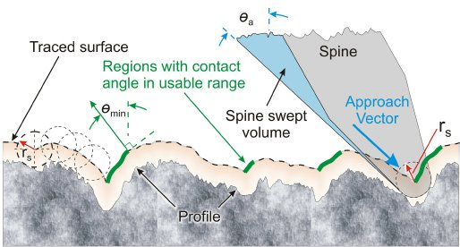
Background – Theoretical Microspine Model
Original model depends mostly on surface normal and approach angle
Model breaks down in real world
  No guarantee which green region will be gripped
Asbeck et al., 2005

Slide 13
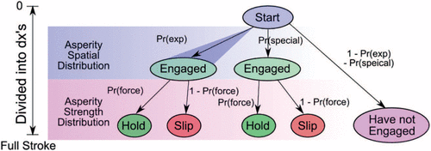
Background – Stochastic Microspine Model
Extends original model to better simulate real world conditions
Provides probability of engaging over a planar surface
Jiang et al., 2018

Slide 14
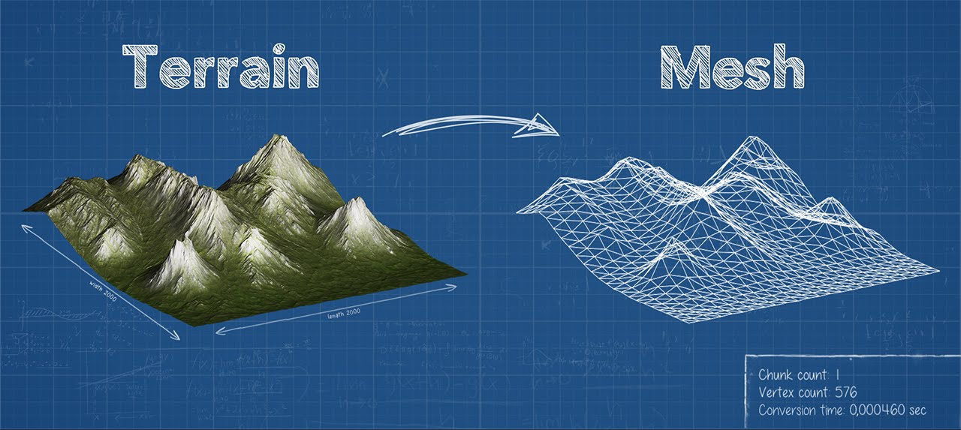
Objective
Extend the planar probabilistic microspine model to large scale surface geometry (an arbitrary polygon mesh)
  From 3D scans or real-time with LiDAR
Nakisdashvili, 2016

Slide 15
Method - Introduction
We are going to focus on a single spine at first
  Method extends to all spines
Operating on a 3D mesh made of triangular or rectangular faces

Slide 16
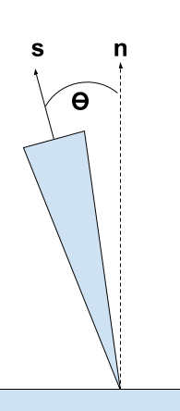
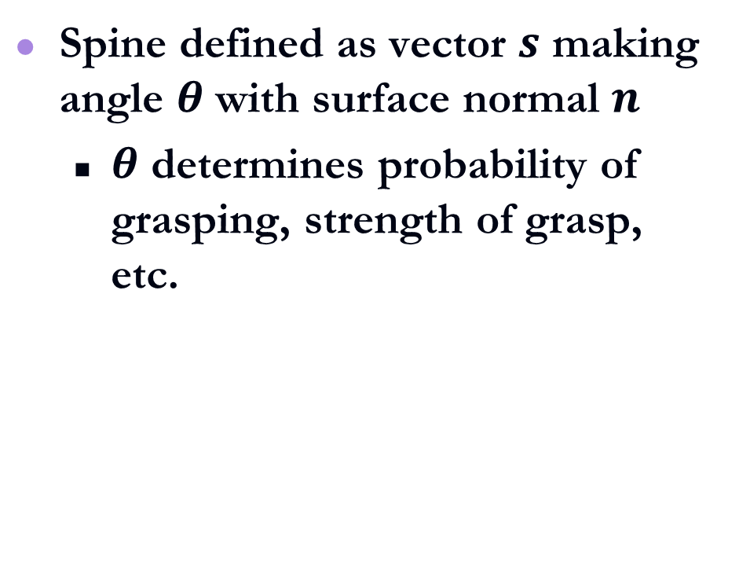
Method – Spine Geometry
Spine defined as vector $s$ making angle $θ$ with surface normal $n$
  $θ$ determines probability of grasping, strength of grasp, etc.

Slide 17
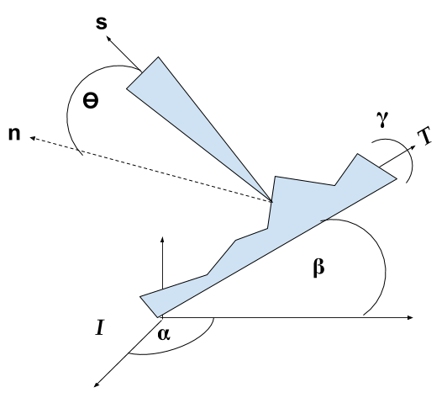
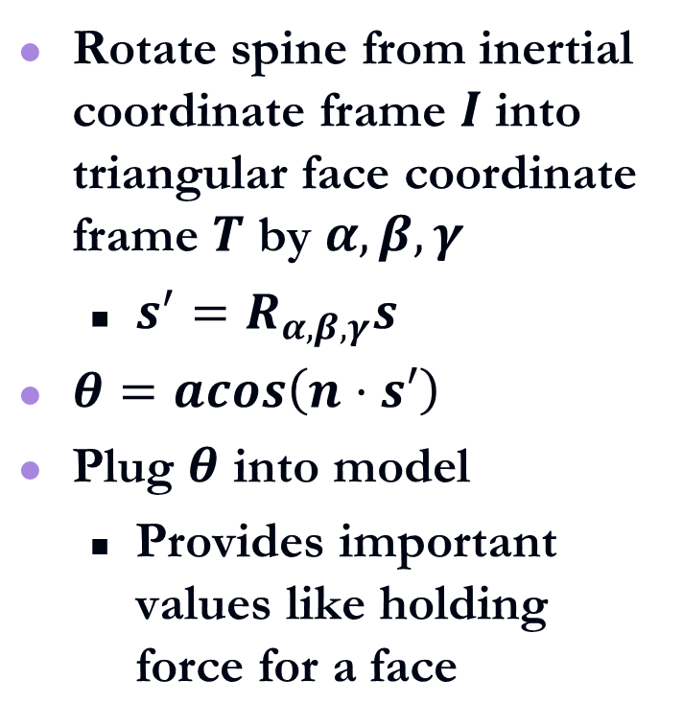
Method – 3D Rotation
Rotate spine from inertial coordinate frame $I$ into triangular face coordinate frame $T$ by $α, β, γ$
  $s^{′}=R_{α, β, γ}s$
$θ=acos\left(n⋅s′\right)$
Plug $θ$ into model
  Provides important values like holding force for a face

Slide 18
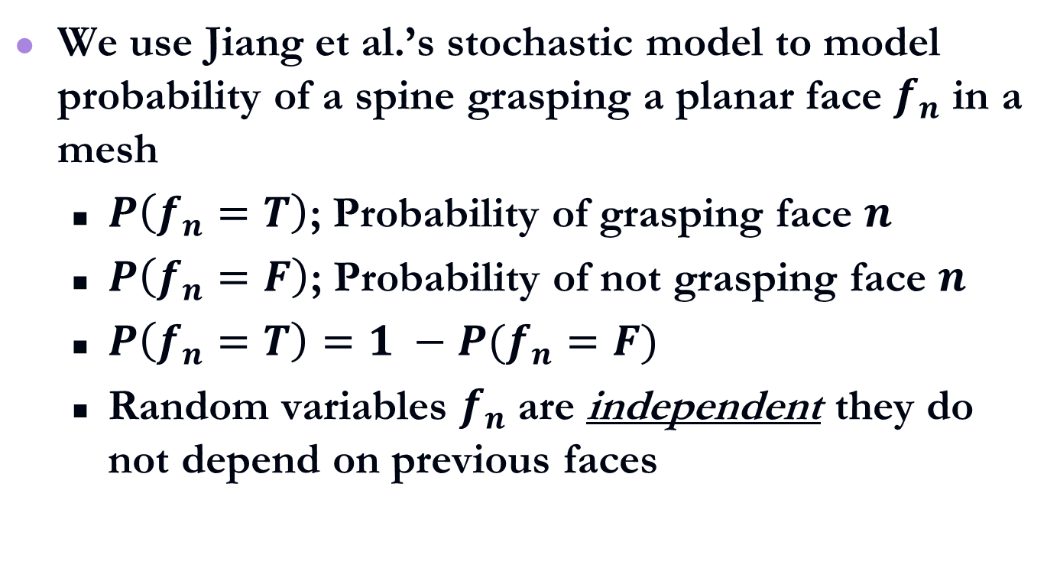
Method – Probabilistic Contact
We use Jiang et al.’s stochastic model to model probability of a spine grasping a planar face $f_{n}$ in a mesh
  $P\left(f_{n}=T\right)$; Probability of grasping face $n$
  $P\left(f_{n}=F\right)$; Probability of not grasping face $n$
  $P\left(f_{n}=T\right)=1 −P(f_{n}=F)$
  Random variables $f_{n}$are independent they do not depend on previous faces

Slide 19
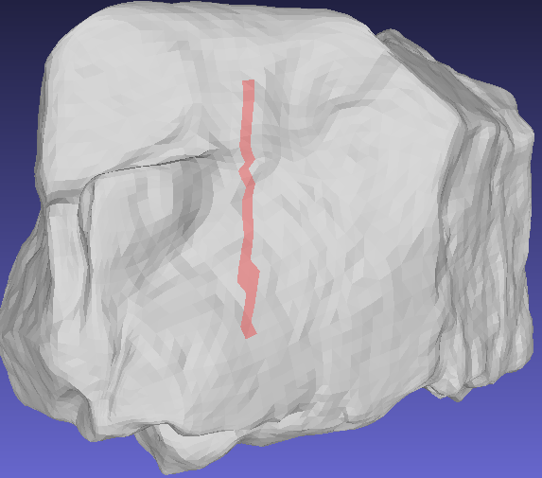
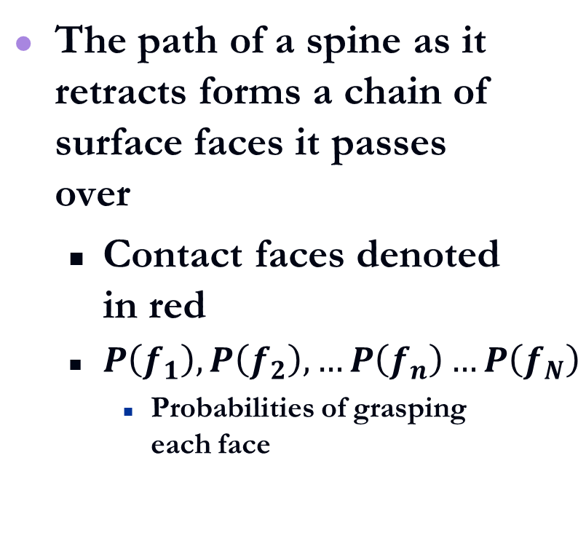
Method – Probabilistic Contact Chain
The path of a spine as it retracts forms a chain of surface faces it passes over
  Contact faces denoted in red
  $P\left(f_{1}\right), P\left(f_{2}\right),…P\left(f_{n}\right)…P\left(f_{N}\right)$
    Probabilities of grasping each face

Slide 20
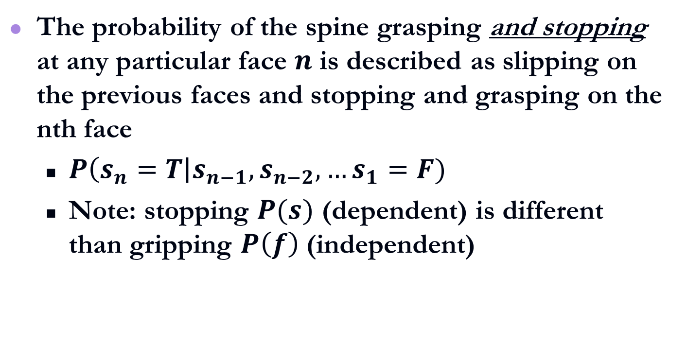
Method – Grasp Probability Derivation
The probability of the spine grasping and stopping at any particular face $n$ is described as slipping on the previous faces and stopping and grasping on the nth face
  $P\left(s_{n}=T\right|s_{n−1},s_{n−2},…s_{1}=F)$
  Note: stopping $P(s)$ (dependent) is different than gripping $P\left(f\right)$ (independent)

Slide 21
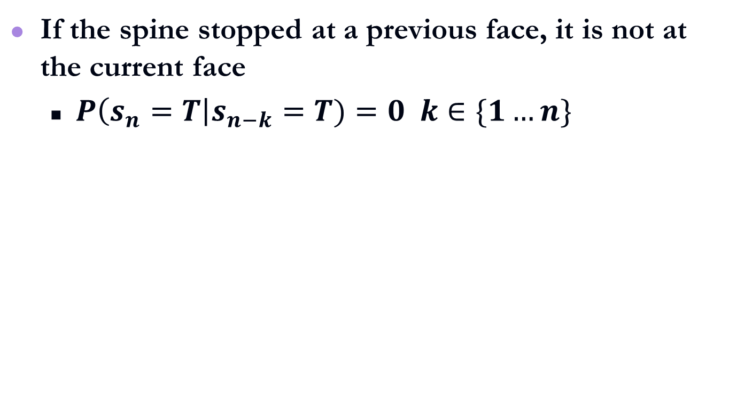
Method – Conditional Dependence
If the spine stopped at a previous face, it is not at the current face
  $P\left(s_{n}=T\right|s_{n−k}=T)=0 k∈\{1…n\}$

Slide 22
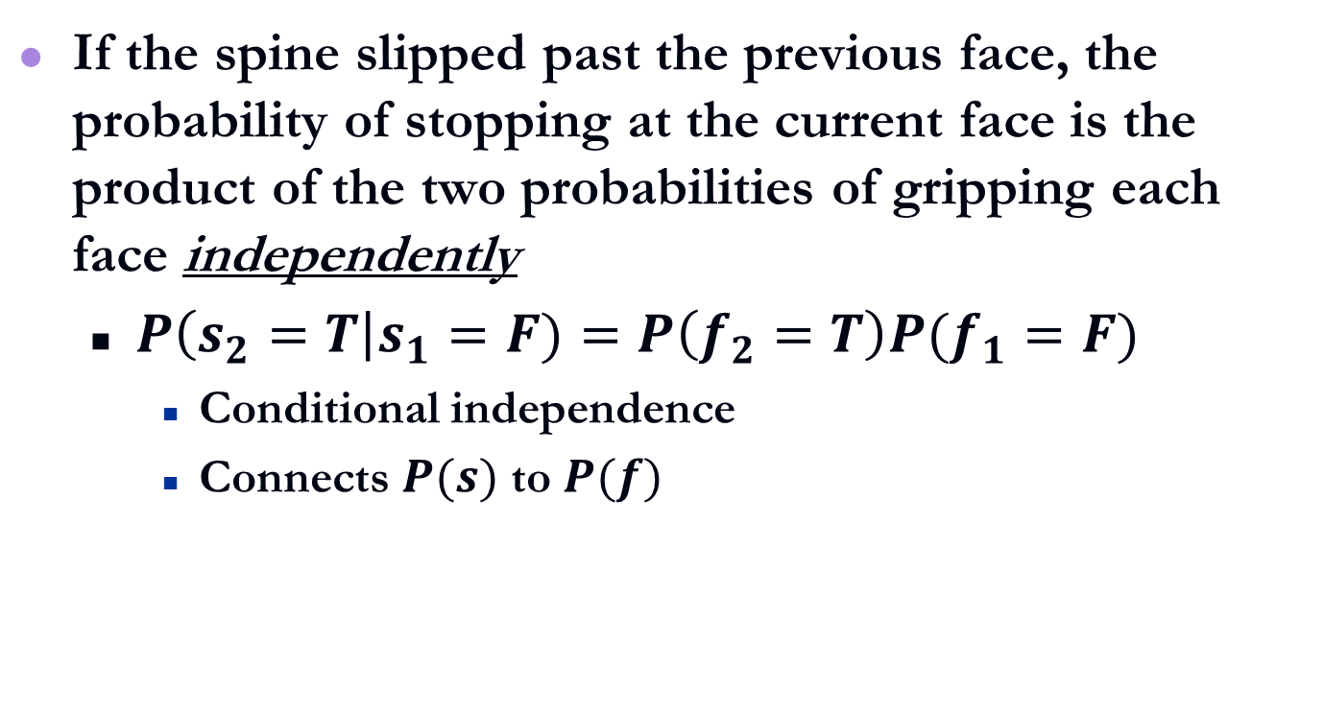
Method – Conditional Independence I
If the spine slipped past the previous face, the probability of stopping at the current face is the product of the two probabilities of gripping each face independently
  $P\left(s_{2}=T\right|s_{1}=F)=P\left(f_{2}=T\right)P(f_{1}=F)$
    Conditional independence
    Connects $P(s)$ to $P(f)$

Slide 23
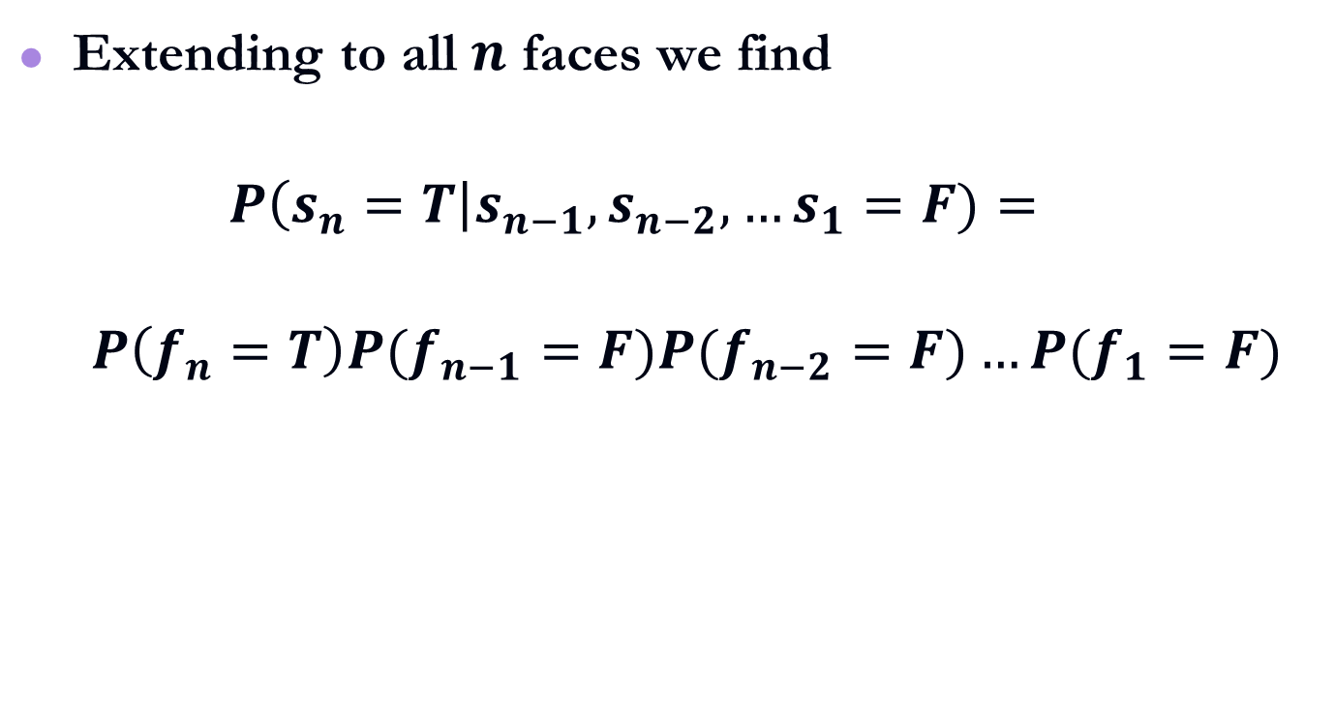
Method – Conditional Independence II
Extending to all $n$ faces we find
  $$P\left(s_{n}=T\right|s_{n−1},s_{n−2},…s_{1}=F)=$$
  $$P\left(f_{n}=T\right)P(f_{n−1}=F)P(f_{n−2}=F)…{P(f}_{1}=F)$$

Slide 24
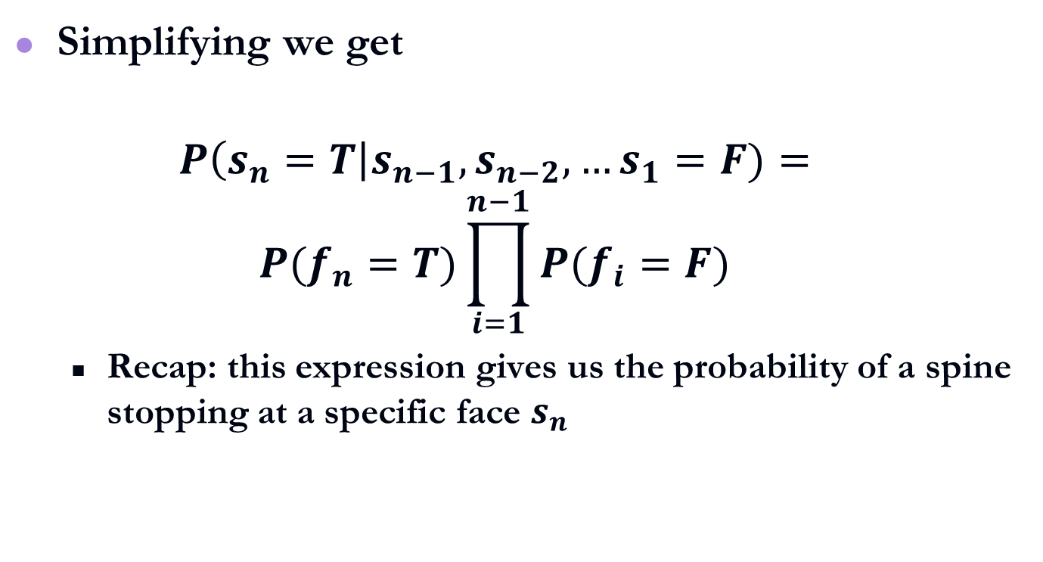
Method – Grasp Probability Expression
Simplifying we get
  $$P\left(s_{n}=T\right|s_{n−1},s_{n−2},…s_{1}=F)=$$
  $$P(f_{n}=T)\prod_{i=1}^{n−1}{P(f_{i}=F)}$$
  Recap: this expression gives us the probability of a spine stopping at a specific face $s_{n}$

Slide 25
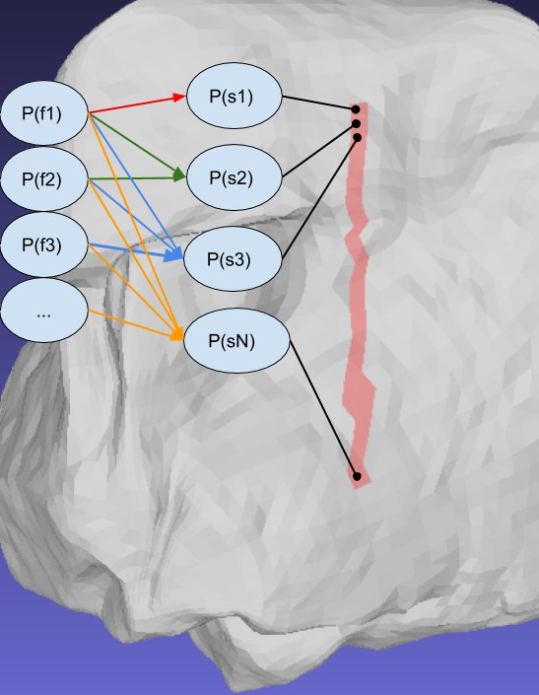
Method – Bayesian Network
This expression can be represented as an acyclic Bayesian network
  Visual representation of the math
  Network nodes are the probabilities of the random variable

Slide 26
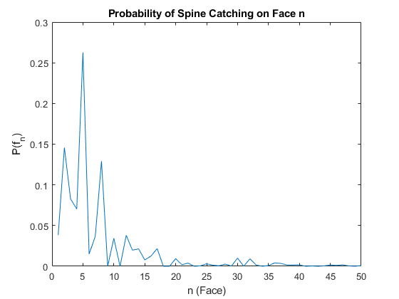
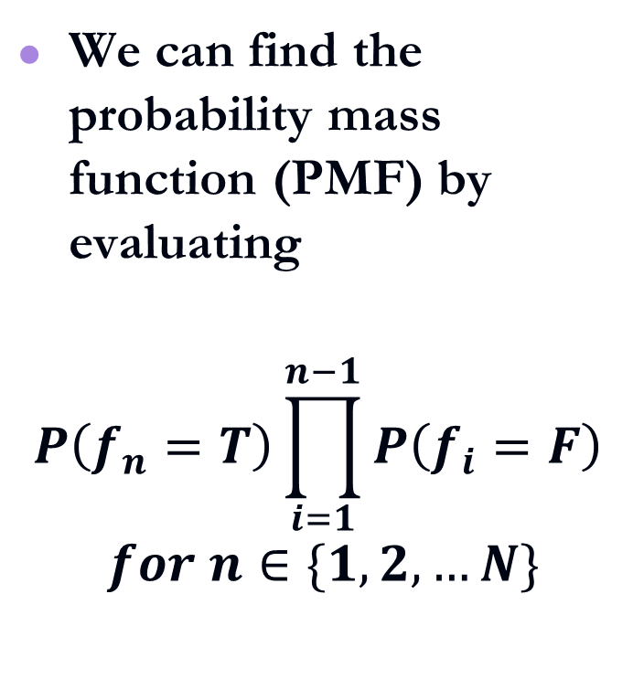
Method – Belief Propagation
We can find the probability mass function (PMF) by evaluating
$$P\left(f_{n}=T\right)\prod_{i=1}^{n−1}{P\left(f_{i}=F\right)}$$
$$for n∈\{1,2,…N\}$$

Slide 27
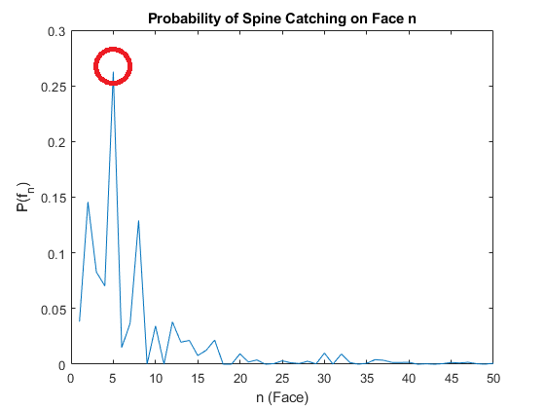
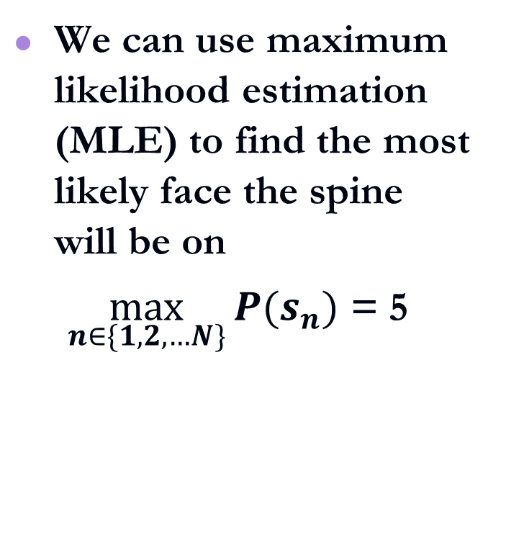
Method – Maximum Likelihood Estimation
We can use maximum likelihood estimation (MLE) to find the most likely face the spine will be on
  $\max_{n∈\{1,2,…N\}}{P(s_{n})}$ = 5

Slide 28
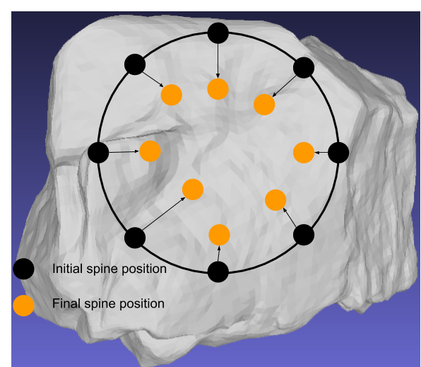
Method – MLE Gripper Arrangement
Running MLE on each spine will produce the most likely arrangement of the gripper

Slide 29
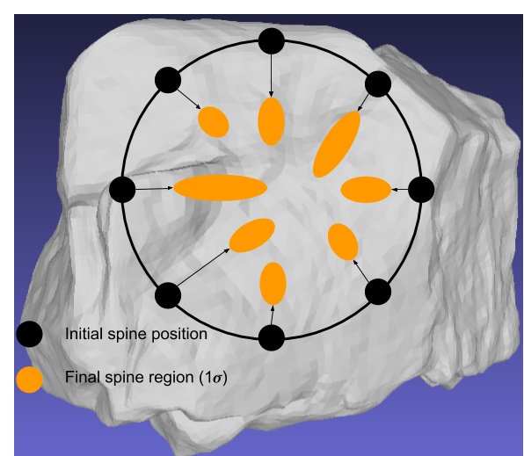
Method – High Probability Regions
More importantly, we have the per-spine probability distribution
We can define likely grasp regions for each microspine
We can evaluate a grip by the likely regions instead of just single points
  More robust to uncertainty than a single point

Slide 30
Summary
We extended probabilistic microspine model to work on large, complex 3D meshes
  Rotated spines to the 3D mesh faces
  Derived an expression for a spine stopping at a specific face
  Found PMF (discrete probability distribution) of spine a stopping over all faces
  Combined PMFs for all spines to model the entire gripper

Slide 31
Future Work
Still a work in progress
Experimental validation
Scoring the grip
  Integration into a motion planner for climbing robots

Slide 32
Questions?

Slide 33
Future Work - Scoring Grips
Want a way to “score” grips for robotic climbers
  Multiple locations to grip, scoring lets us select the best location to place the gripper
  Is a grip risky? How much force/torque can it hold?

Slide 34
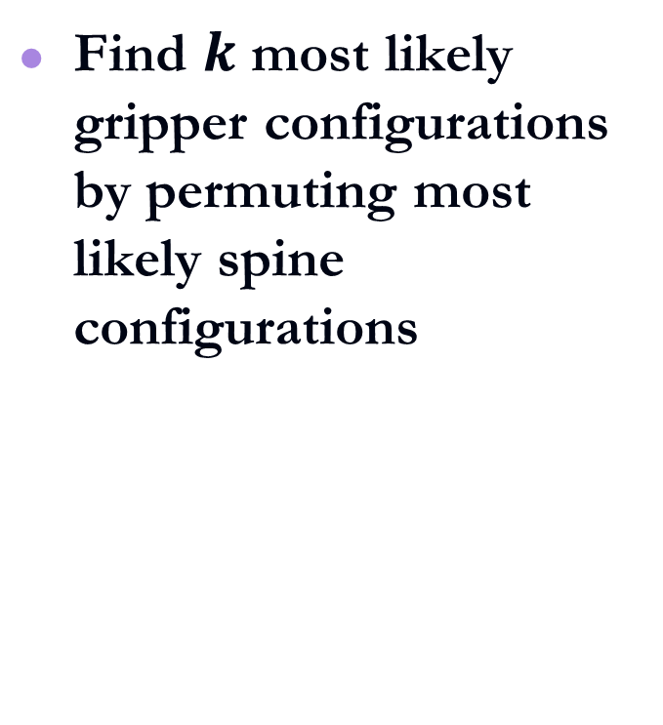
Future Work - Scoring Grips
Find $k$ most likely gripper configurations by permuting most likely spine configurations

Slide 35
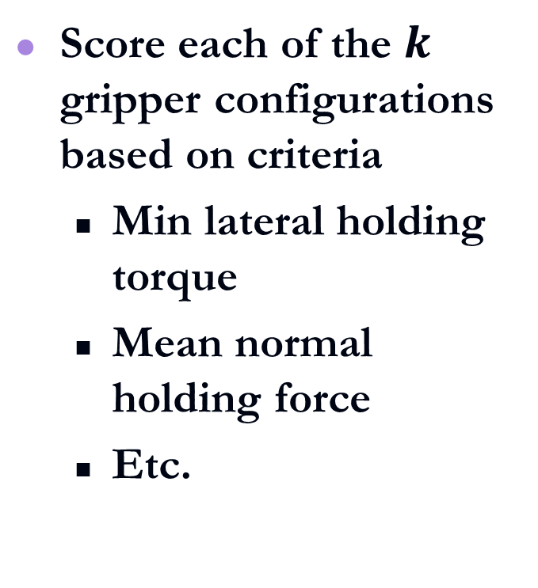
Future Work - Scoring Grips
Score each of the $k$ gripper configurations based on criteria
  Min lateral holding torque
  Mean normal holding force
  Etc.

Slide 36
Future Work - Scoring Grips
Gripper configuration score fed to motion planner
  Avoid risky grips

