Slide 1
Recovering Time and State for Small Satellites in Deep Space
Interplanetary Small Satellite Conference Presentation
Andrew Dahir
Dr. Scott Palo
Dr. Dan Kubitschek
April 29th, 2019

Slide 2
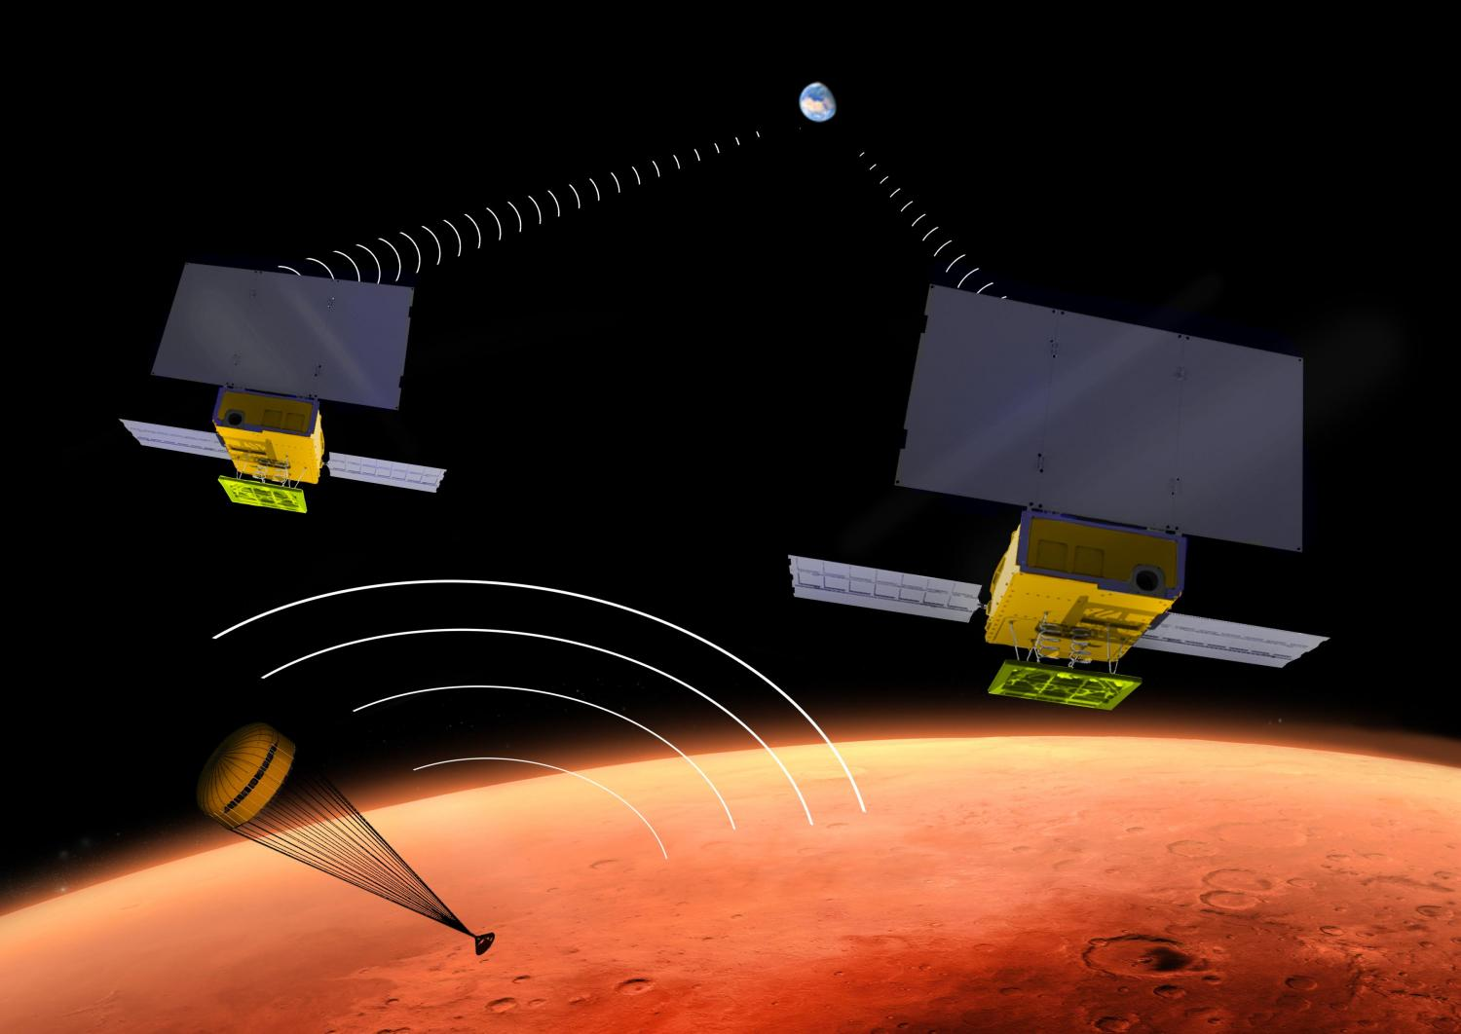
Overview of Problem
Motivation
To develop the architecture to demonstrate the complete, autonomous cold-start determination (Lost-In-Space) of time and state (Position and Velocity) for interplanetary autonomous optical navigation systems. (1)
Advancing autonomous navigation can ultimately reduce the cost of mission operations, including ground analysis. (2)
Robustness and reduction in time-to-recovery of faulted systems (1)
Reduced mission risk for both manned and unmanned spacecraft
Helps enable small spacecraft missions for deep space
NASA MARCO Cubesats. Credit: NASA JPL
Notes:
Overview of Problem
To develop the architecture to demonstrate the complete, autonomous cold-start determination (Lost-In-Space) of time and state (Position and Velocity) for interplanetary autonomous optical navigation systems.
Motivation:
Reduce cost of mission operations
Advance time-to-recovery of faulted systems
Reduced mission risk
enable small spacecraft missions for deep space

Slide 3
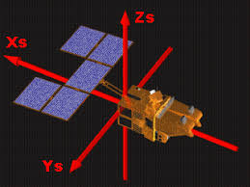
Overview of Problem
Lost in Space Problem
Satellites primarily exist in two main locations, Earth orbiting, or in deep space.
Earth Orbiting
GPS
Ground Based Tracking
Deep Space
Radiometric
Optical Measurements
There are two meanings when referring to the “Lost-In-Space” problem
  Attitude
  Orbit Determination
Notes:
Earth Orbiting
GPS
Ground based tracking
Deep Space
Radiometric
Optical Measurements
Earth satellites, can be recovered by GPS if they have a faulted state
Deep space satellites cannot.
STEREO-B. 25 attempts with DSN, each attempt took over 10 hours to complete with 70 m dish.
As more satellites exist, DSN will not be able to support that type of recovery efforts, especially not for small spacecraft.
Lost-In-Space
Attitude
Orbit Determination

Slide 4
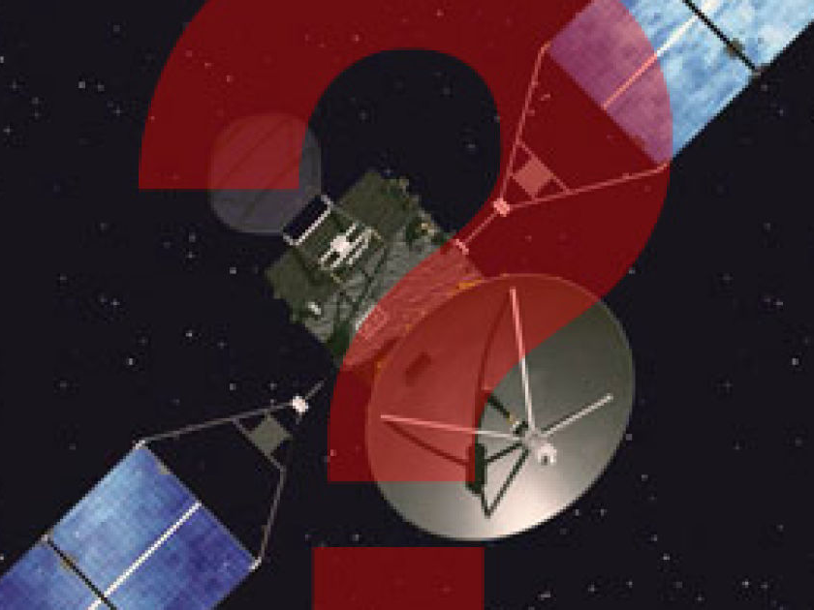
Lost in Space Problem
Attitude “Lost-In-Space” problem
  Solved via star trackers.
Current furthest solution for Orbit Determination “Lost-in-Space” problem solves for position in a closed-form environment. (8)
  Need Time, Position and Velocity (PVT)
Notes:
LOS Problem
Attitude
Solved via Star Trackers
Star Catalog Ephemeris to compare visual data to
Lost-In-Space
Current furthest solution (and only solution)
Solves for position, with no time, therefore only achieving a relative position and not an absolute one.

Slide 5
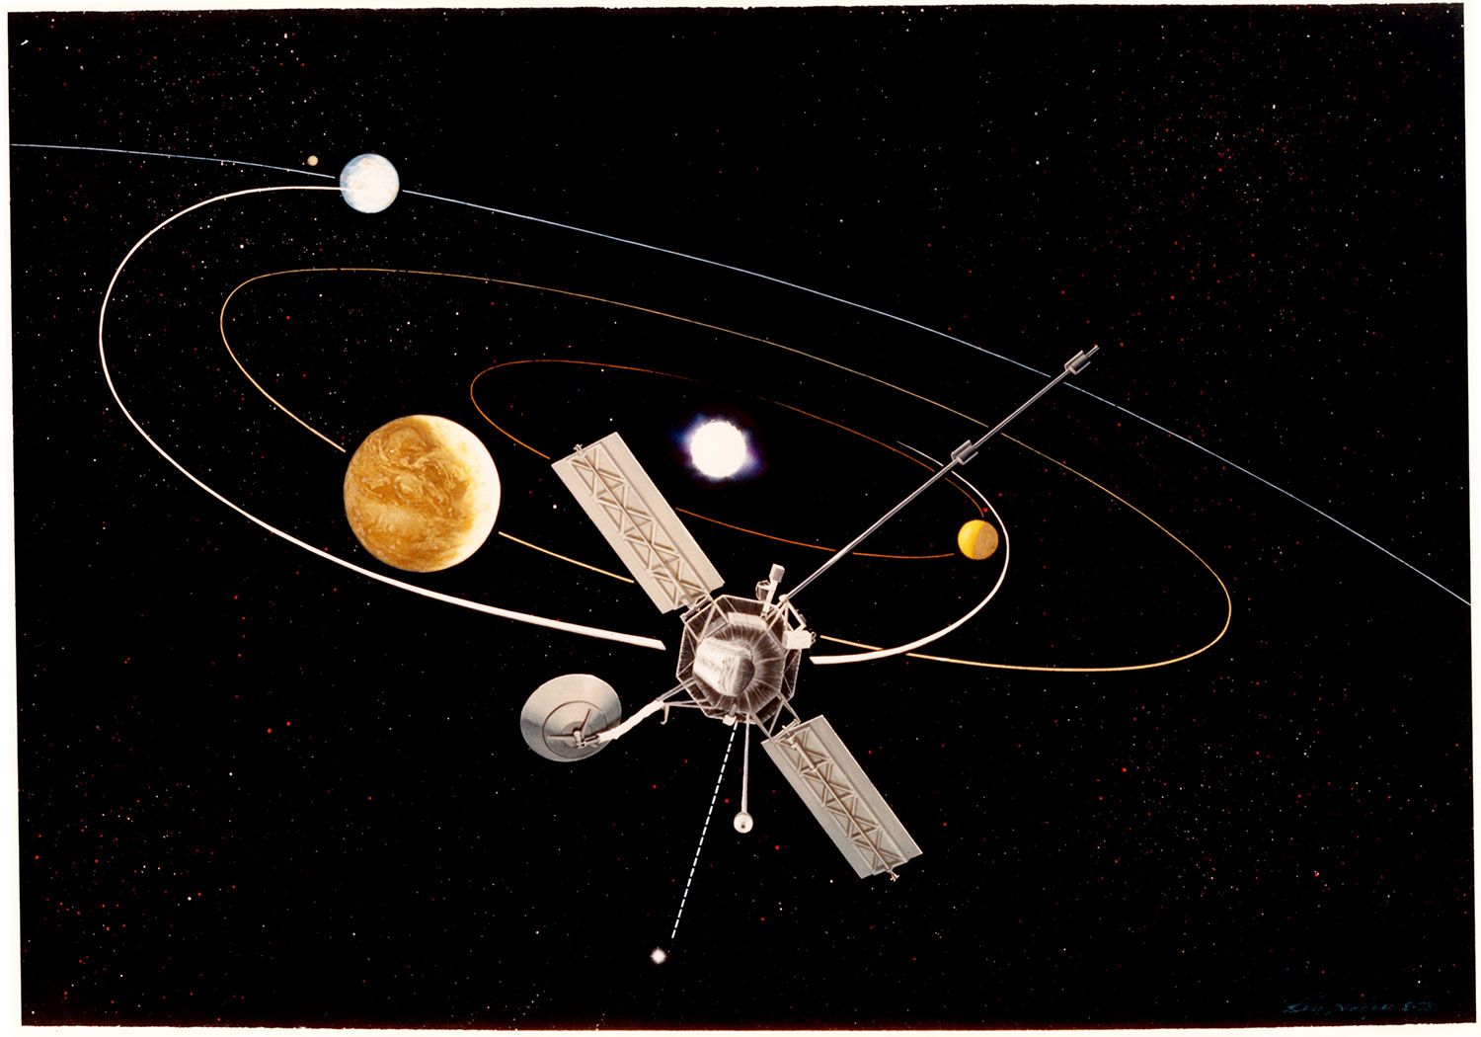
Lost in Space Problem
Processor Reboot
  Watchdog Timer
  Power loss
Software Bug
Initialization State
  Rideshare
    EM-1 Launch
Memory Corruption
  Single Event Upsets
?
Notes:
Lost-in-Space
Processor Reboot
Watchdog Timer
Power loss
Software Bug
lose of time, saving error, restart cycle
Initialization State
Rideshare
EM-1 Launch (No time or state given), could sit on shelf for months
Currently trying to work out a way for the satellite to get back in communication with Earth once it is deployed. It is possible it may be able to detect the earth via the star tracker and communicate with Earth, but it will have no information on time or state.
Memory Corruption
Single Event Upsets

Slide 6
Autonomous Navigation
Autonomous Navigation is described by the following features, (3)
  Self-Contained
  Operating in Real Time
  Nonradiating (Not producing signals that aid in navigation, i.e. range/range rate between spacecraft)
  Not depending on outside operations
When applied to a spacecraft you obtain a system that is considered autonomous when navigation is performed onboard an orbiting spacecraft in real time without ground support. (4)
Notes:
Autonomous Navigation is described by the following features, (3)
Self-Contained, all internal to the spacecraft
Operating in Real Time, no delay in information
Nonradiating (Not producing signals that aid in navigation, i.e. range/range rate between spacecraft)
Not depending on outside operations, no GPS or ground communication
When applied to a spacecraft you obtain a system that is considered autonomous when navigation is performed onboard an orbiting spacecraft in real time without ground support. (4)

Slide 7
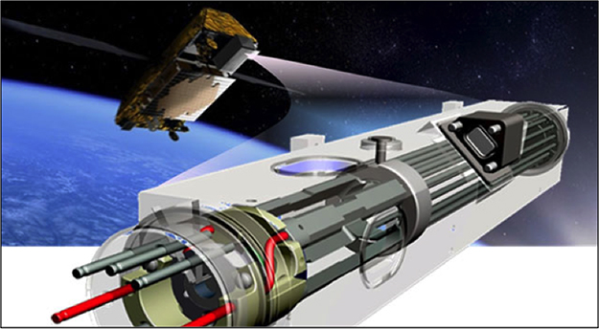
Autonomous Navigation Background
AutoNav
Deep Space 1
Deep Impact
STARDUST
Deep-Space Positioning System (DPS)
Deep Space Atomic Clock
OpNav
In-Situ
  Voyager 1
  Voyager 2
(7)
Notes:
AutoNav - multimission, autonomous, onboard navigation system
utilizing images of the target comet nucleus, computing the spacecraft position, and correcting the camera-body pointing to keep the comet nucleus in view.
Deep Space 1
Deep Impact
STARDUST
Needs knowledge beforehand
OpNav, Using optical images to do planning of flybys and viewing objects
In-Situ
Voyager 1
Voyager 2
Needs knowledge beforehand and ground communication
Deep-Space Positioning System (DPS)
Deep Space Atomic Clock
Requires Constant Power and previous knowledge of time

Slide 8
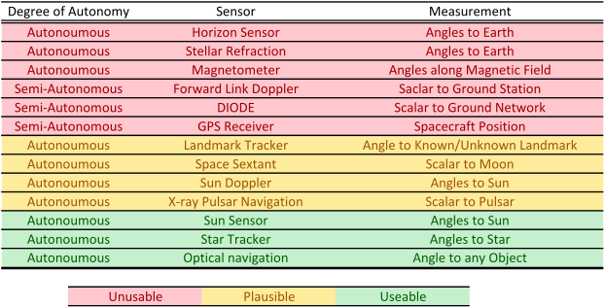
Possible Sources
Vast knowledge of autonomous navigation in existence
Notes:
Most options cannot be used in deep space, as they require resources that are
not available once you leave the Earth-Moon system, these are indicated in red.
The options presented in yellow only work in specific applications,
but could become usable depending on the scenario.
The final options presented in green are most favorable to deep space navigation because they use objects
that can be seen from any location.
The items selected are also those that require the least amount
of specialized equipment to work, both Sun doppler and X-ray navigation were lowered to the
plausible category because of this reason.

Slide 9
Constraints
Solution will be low Size Weight and Power (SWaP) and will be able to fit on a cubesat form factor
A star tracker will be used on the spacecraft, limit 7.5 magnitude
The spacecraft is solar powered
The spacecraft is located in deep space between 1 AU and 5 AU
The spacecraft is within ± 5° of the ecliptic
Notes:
Solution will be low Size Weight and Power (SWaP) and will fit be able to fit on a cubesat form factor
A star tracker will be used on the spacecraft, limit 7.5 magnitude
The spacecraft is solar powered
The spacecraft is located in deep space between 1 AU and 5 AU
The spacecraft is within ± 5° of the ecliptic

Slide 10
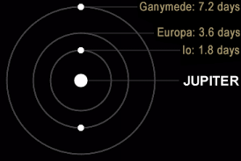
Solution - Find Jupiter
Why?
  Jupiter offers multiple targets by finding one object
  Periods of Galilean Moons offer higher fidelity.
  Jupiter is a bright object in the sky
  Inner planets are harder to locate
Time, Position, and Velocity?
  Just position and velocity gives relative, not absolute
  Communication schedules would be based on time
Notes:
Why?
Jupiter offers multiple targets by finding one object
Periods of Galilean Moons offer higher fidelity.
Jupiter is a bright object in the sky
Inner planets are harder to locate
Time, Position, and Velocity?
Just position and velocity gives relative, not absolute
Communication schedules would be based on time

Slide 11
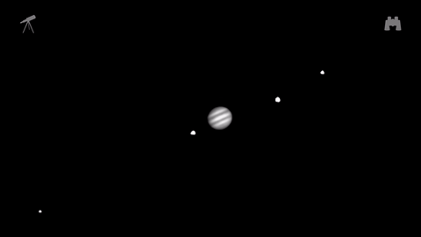
Lost-In-Space Concept of Operations
Determine attitude (star tracker)
Locate sun-line direction (fine sun sensor)
Obtain min/max distance from Sun
Estimate spacecraft distance from Jupiter
Compute search/scan angle to find Jupiter
Scan with star tracker, then image process
Detect Jupiter and estimate location
Stare at the Jovian system
Estimate Time, Position, and Velocity
Notes:
Determine attitude (star tracker)
Locate sun-line direction (fine sun sensor)
Obtain min/max distance from Sun, irradiance measurement from solar panels
Estimate spacecraft distance from Jupiter geometrically using known variables Aphelion and Perihelion of Jupiter
Compute search/scan angle to find Jupiter, Minimum and maximum angles from the spacecraft to bound star tracker search area
Scan with star tracker, then image process
Detect Jupiter and estimate Jovian location
Stare at the Jovian system
Detect and estimate the location of the Jovian moons
Estimate PVT

Slide 12
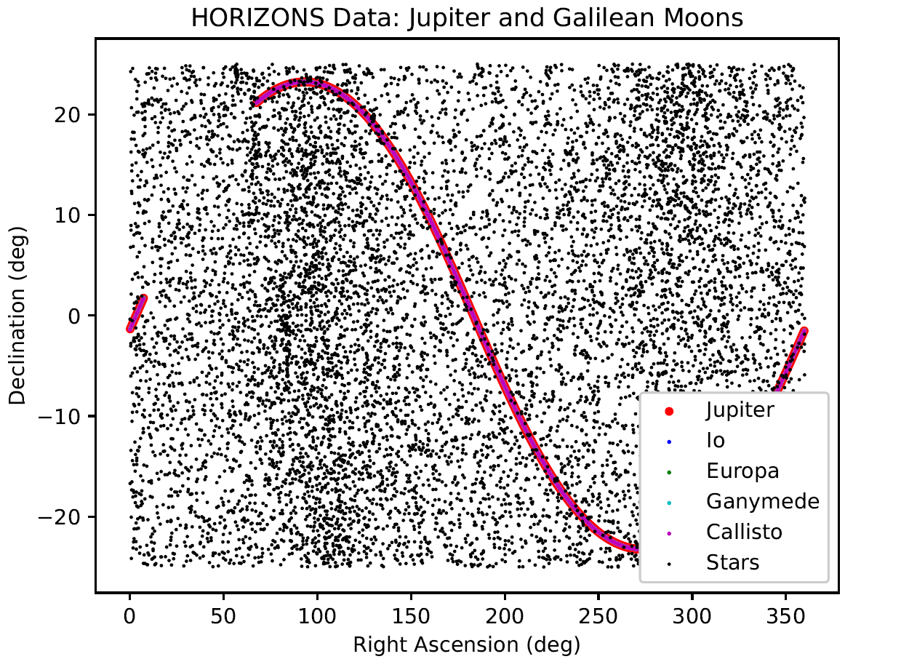
Current
Time Solution
HORIZONS Database used as Ephemeris
  NASA JPL
Located at Solar System Center
  Non-Moving Satellite
Jupiter Only
  Nearest Neighbor Search
Closest two used for higher fidelity search
5 day time step plotted
Notes:
HORIZONS Database used as Ephemeris
NASA JPL
Located at Solar System Center
Non-Moving Satellite
Jupiter Only
Nearest Neighbor Search
Closest two used for higher fidelity search
5 day time step plotted

Slide 13
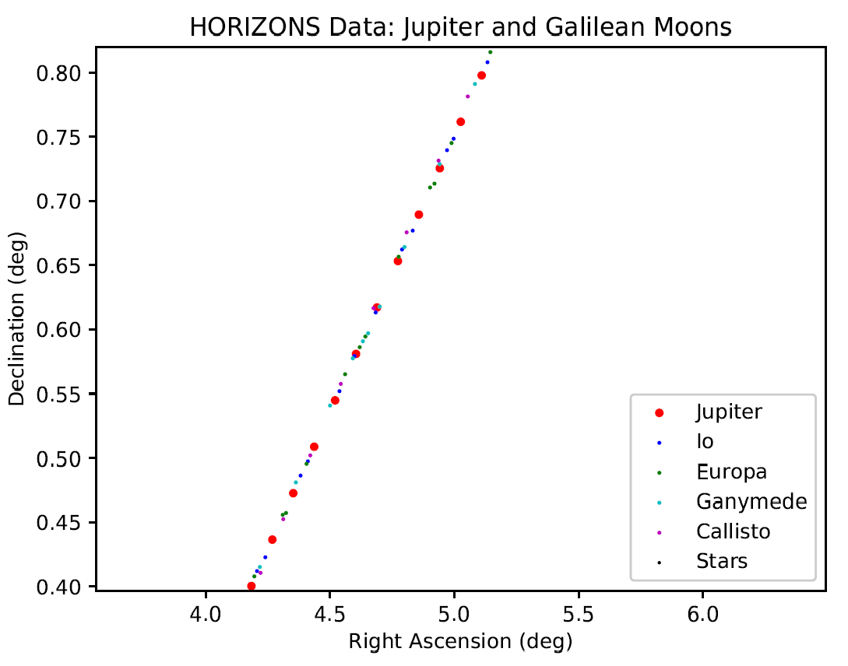
Best Ephemeris
Time Solution
1 day time step plotted
Closest two points taken to move to higher fidelity
Notes:
1 day time step plotted
Closest two points taken to move to higher fidelity

Slide 14
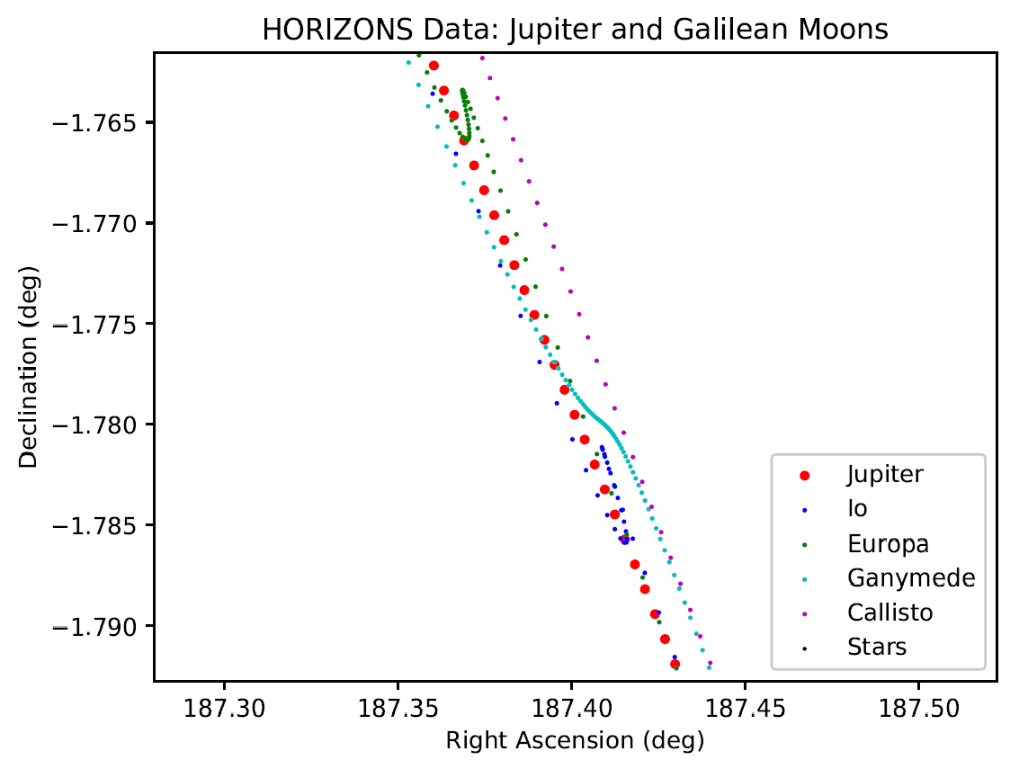
Best Ephemeris
Time Solution
1 hour time step plotted
Closest two points taken to move to higher fidelity
Notes:
1 hour time step plotted
Closest two points taken to move to higher fidelity

Slide 15
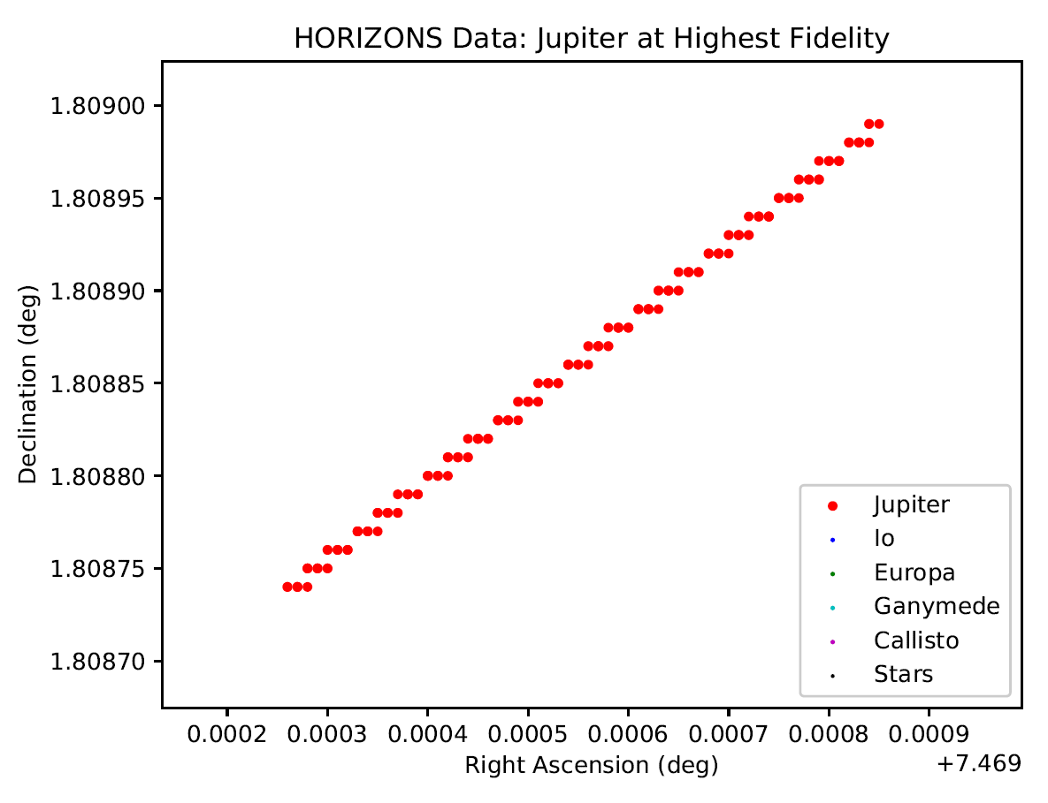
Best Ephemeris
Time Solution
Highest fidelity from astroquery python module.
  5 decimal places in RA/DEC
Corresponds to highest fidelity of 24 seconds.
Notes:
Highest fidelity from astroquery python module.
5 decimal places in RA/DEC
Corresponds to highest fidelity of 24 seconds.

Slide 16
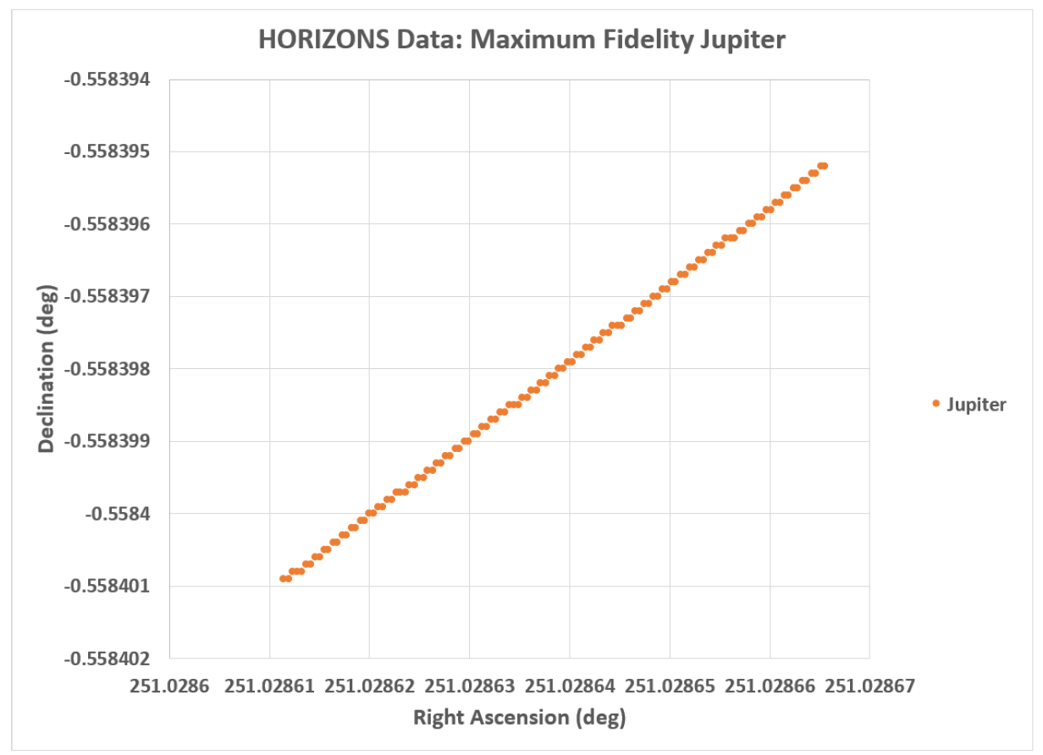
Best Ephemeris
Time Solution
Highest fidelity from HORIZONS database
  7 decimal places in RA/DEC
Corresponds to highest fidelity of 500 milliseconds.
Notes:
Highest fidelity from HORIZONS database
7 decimal places in RA/DEC
Corresponds to highest fidelity of 500 milliseconds.

Slide 17
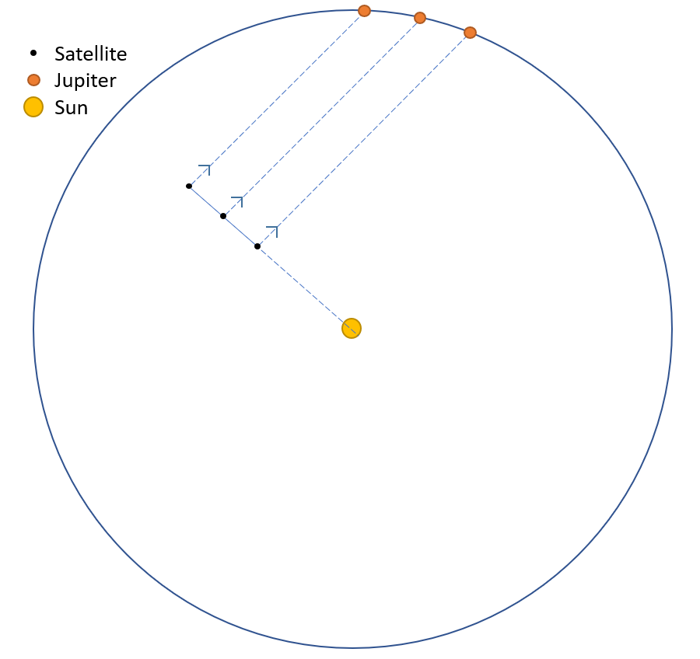
Stationary Time
Solution
(x_{j},y_{j},z_{j})
Once initial satellite position is calculated
Calculated satellite position difference from ephemeris truth data, (vector direction)
Compare to vector star tracker data (vector direction)
Match closest to get time
  Nearest Neighbor
Upper and Lower bound based on irradiance
(x_{s},y_{s},z_{s})
Notes:
Once initial satellite position is calculated
Calculated satellite position difference from ephemeris truth data, (vector direction)
Compare to vector star tracker data (vector direction)
Match closest to get time
Nearest Neighbor
Upper and Lower bound based on irradiance
Move on to Jovian Moons

Slide 18
Advanced Time
Solution
(x_{j},y_{j},z_{j})
(x_{s},y_{s},z_{s})
Stationary Solution for Time
 | .1% Error | 1% Error | 5% Error | 10% Error
1 AU | 1.5 hours | 16 hours | 74 hours | 6 days
2 AU | 3 hours | 30 hours | 6 days | 11.4 days
3 AU | 4.5 hours | 42 hours | 8.6 days | 16.5 days
4 AU | 5.5 hours | 54 hours | 11 days | 21.2 days
Notes:
Once initial satellite position is calculated
Calculated satellite position difference from ephemeris truth data, (vector direction)
Compare to vector star tracker data (vector direction)
Match closest to get time
Nearest Neighbor
Upper and Lower bound based on irradiance
Move on to Jovian Moons

Slide 19
Multi-Mission Optical Navigation Program (ONP)
ONP
  Used for Optical Navigation since Mariner 9
  Developed by NASA JPL
    Maintained by the Optical Navigation Group
Three Main Programs
  Trajectory Geometry Program (TGP) - Picture prediction tool
  Optical Observables and Partials Generator (OOPG) - analyzes observations before the filtering process
  Optical Data Analysis Program (ODAP) - Filtering tool
Notes:
Basilisk (BSK) astrodynamics toolkit is the backbone of the project
Open source project written in Python, C, and C++
Jointly developed by CU’s AVS lab and LASP
More information is on Dr. Schaub’s website http://hanspeterschaub.info/bskMain.html
How will this project use it?
As propagator
Lighting simulation for looking at Jupiter and the Galilean moons
As the central hub of the final project
All work will be developed as modules that can be added to the BSK framework

Slide 20
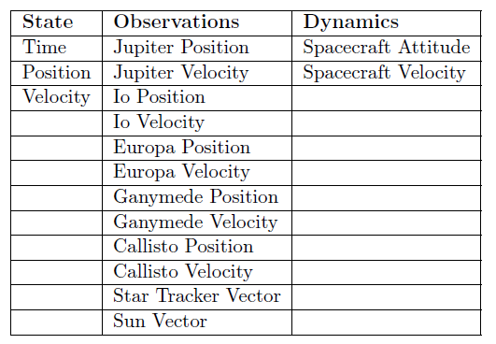

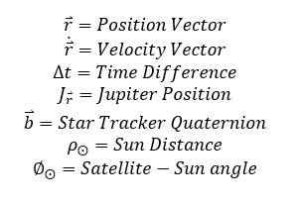

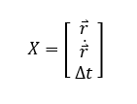
Algorithm Approach
Last saved state <24 Hours
Start with perfect position and velocity knowledge and see how good we can resolve time.
Batch Estimation
  Initial time, position, and velocity.
Notes:
Batch Estimation
Initial time, position, and velocity.
Publication 1
Feasibility
Trade Studies
Time Solution to Date
Publication 2
Time solution into absolute position and velocity
Algorithm approach and
Publication 3
Final simulation
Drop a satellite and it can solve for time, position and velocity

Slide 21
Questions?

Slide 22
Sources
Time Out – Recovering Time & State for Autonomous Navigation Systems in Deep Space, SURP Concept Paper FY2018, Daniel Kubitschek, Research Faculty – Laboratory for Atmospheric & Space Physics (LASP)
https://www.nasa.gov/sites/default/files/atoms/files/2015_nasa_technology_roadmaps_ta_5_communication_and_navigation_final.pdf
Chory, M. A., Hoffman, D. P., Major, C. S., and Spector, V. A., “Autonomous Navigation - Where We Are in 1984,” AIAA Guidance and Control Conference, AIAA, Seattle, WA, Aug. 1984, pp. 27-37, AIAA Paper 84-1826.
Autonomous Navigation in Libration Point Orbits, Keric A. Hill, University of Colorado Boulder
Autonomous Optical Navigation (AutoNav) DS1 Technology Validation Report, J.E. Riedel Et. All, JPL
Autonomous Navigation for Deep Space Missions, Shyam Bhaskaran, JPL
https://scienceandtechnology.jpl.nasa.gov/research/research-topics-list/communications-computing-software/deep-space-navigation
Sergei Tanygin. Closed-form solution for lost-in-space visual navigation problem. Journal of Guidance, Control, and Dynamics, 37(6):1754{1766, 2014.
https://www.jpl.nasa.gov/blog/2015/2/dawns-approach-takes-shape-as-the-face-of-ceres-is-revealed
https://www.researchgate.net/publication/267220910_USING_EARTH_OBSERVATION_PAYLOAD_RESOURCES_FOR_AUTONOMOUS_ON-BOARD_NAVIGATION_OF_LEO-SATELLITES

