Slide 1

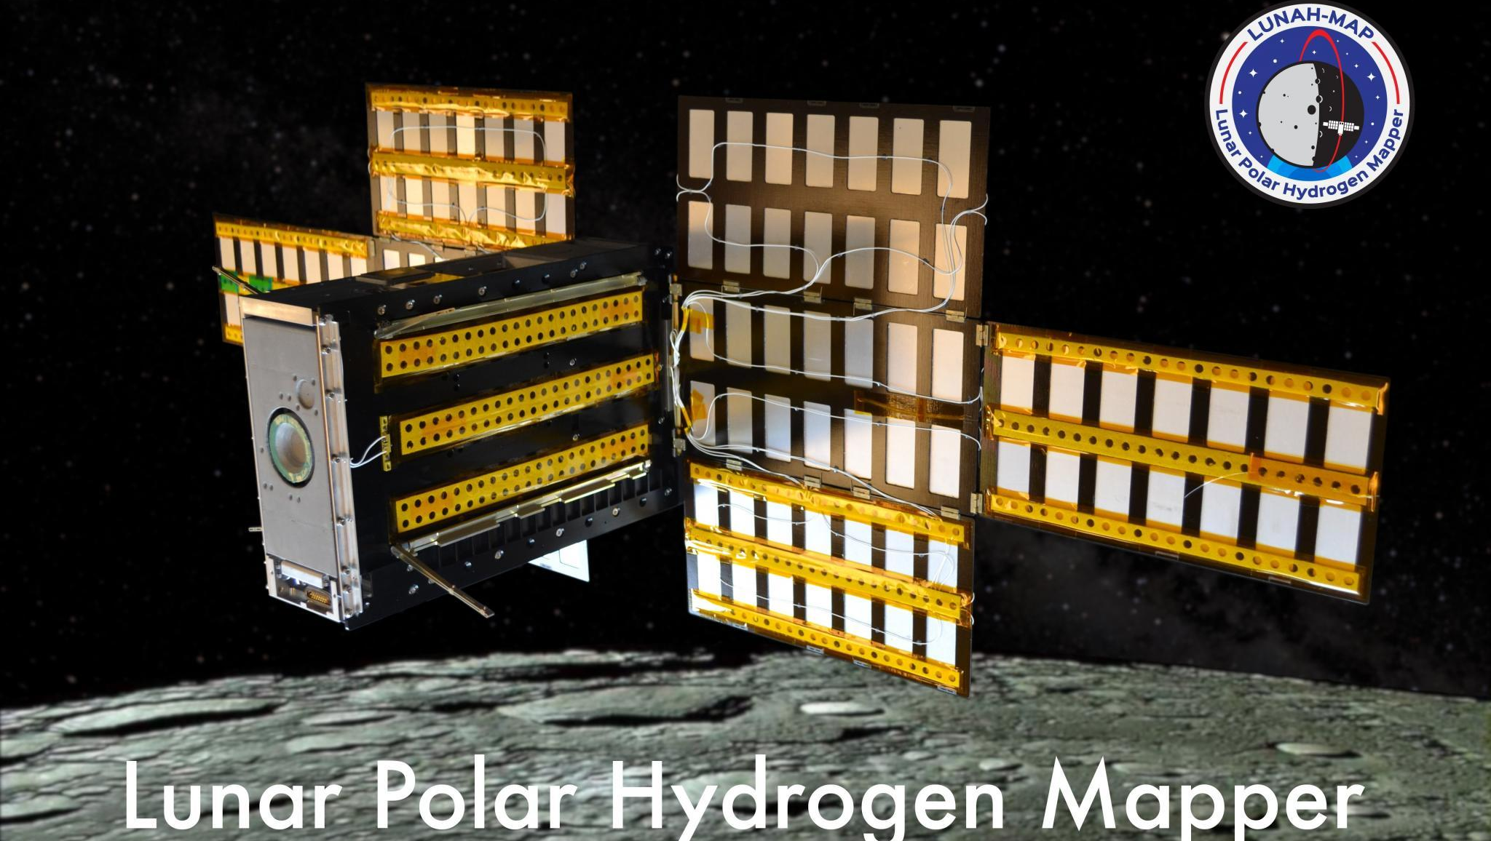

The Lunar Polar Hydrogen Mapper Mission: Low-Altitude Planetary Neutron Spectroscopy
Craig Hardgrove
LunaH-Map Principal Investigator – Assistant Professor, School of Earth and Space Exploration, ASU

Slide 2
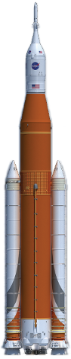
LunaH-Map Mission Overview
NASA SMD SIMPLEx 2015 mission led by ASU
6U+ CubeSat form factor to launch on SLS EM-1
Science Objective: Map hydrogen enrichments within PSRs at the lunar south pole at spatial scales <20 km²
Tech Objectives: Deep space navigation and operations using ion propulsion on a small sat

Slide 3
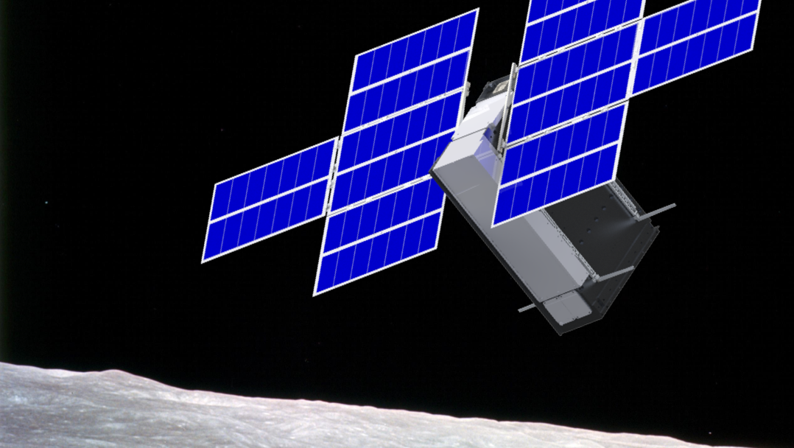
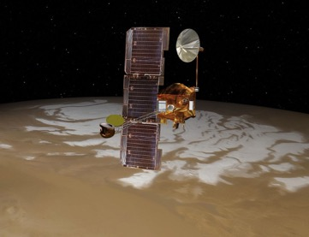
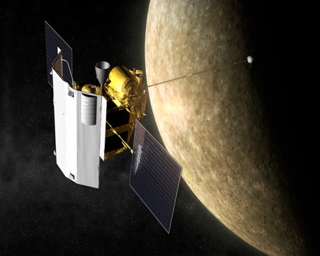
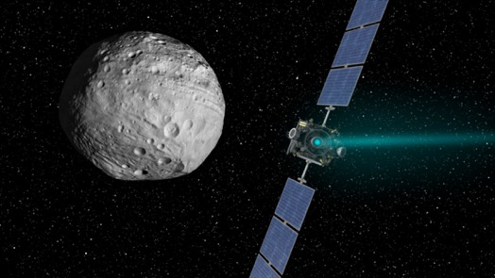
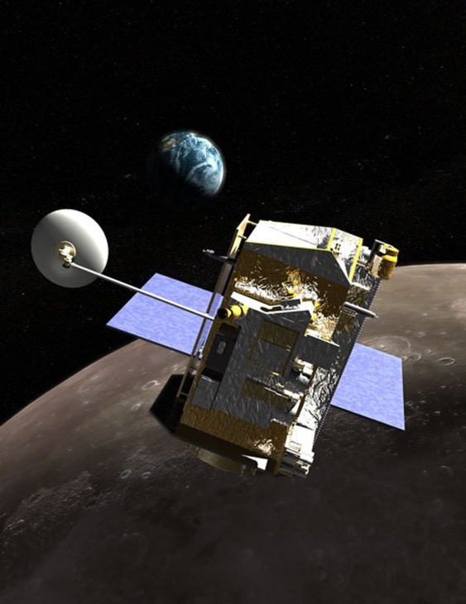
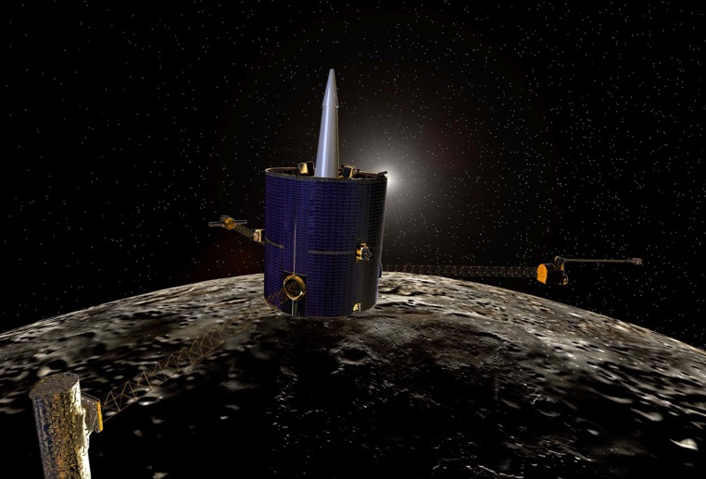
Notes:
Introduce as grad student/PSE

Slide 4
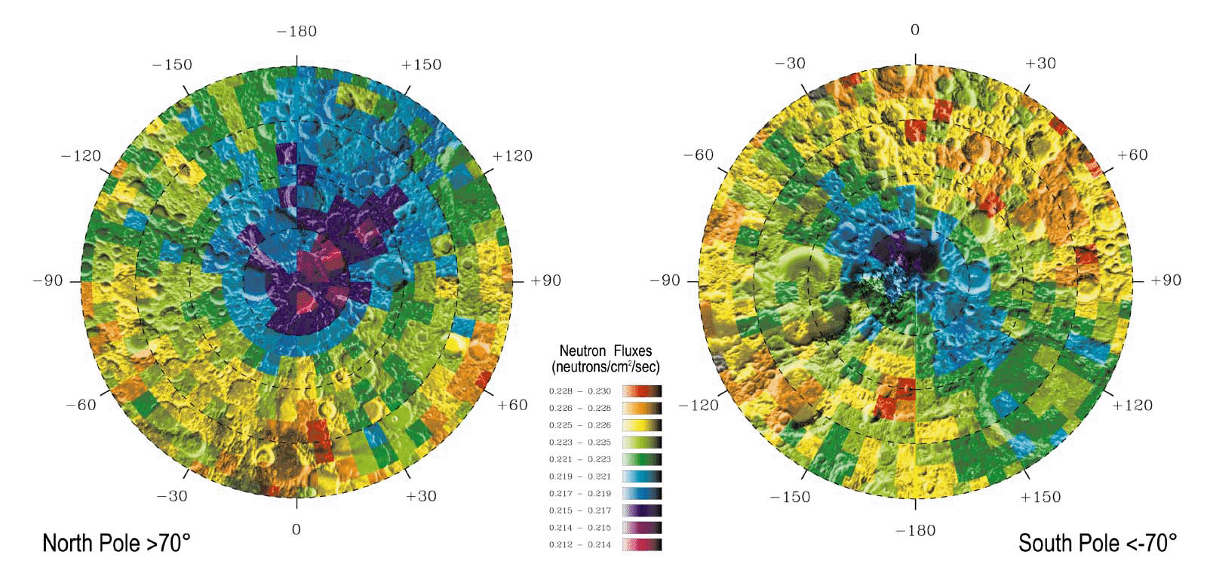
Hydrogen Distributions from Neutron Spectroscopy
~150 km² pixels
Neutron measurements are sensitive to bulk hydrogen distributions at 1 meter depth
Uncollimated neutron detector ‘footprints’ are approximately 1½ times orbital altitude
Lunar hydrogen abundances within PSRs broadly ranging from 200 ppm up to almost 40 wt% could be consistent with LPNS data depending on spatial distribution, extent of coverage, and burial depth [Lawrence et al 2006].
*Feldman et al., Science, 281, 1496, 1998
Notes:
LP – launch 1998, 30/100 km, 19 mos (12 @ 100, 7 @ 30)
LRO – launch 2009, 50/100km as low as 30

Slide 5
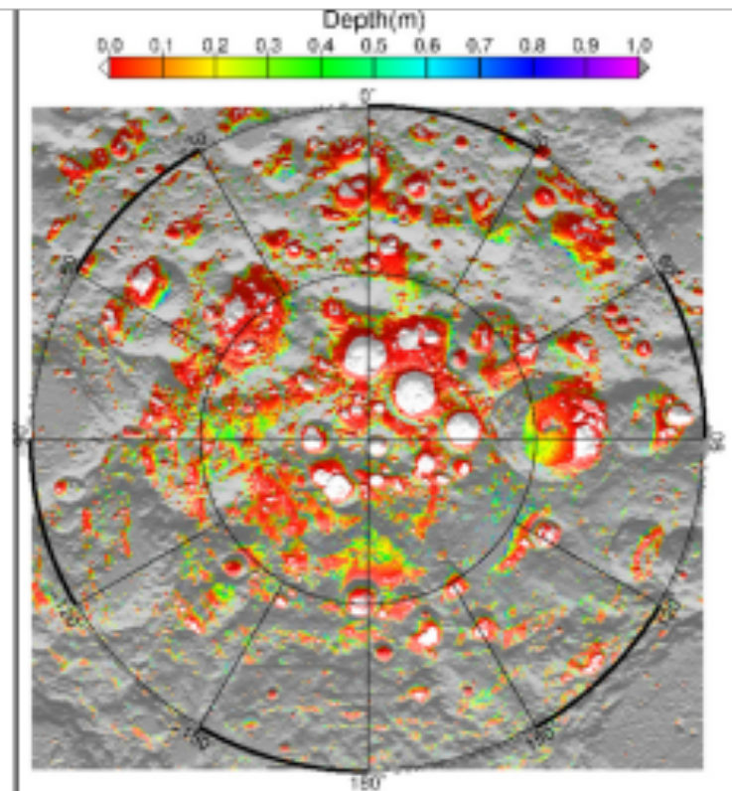
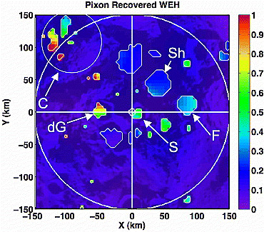
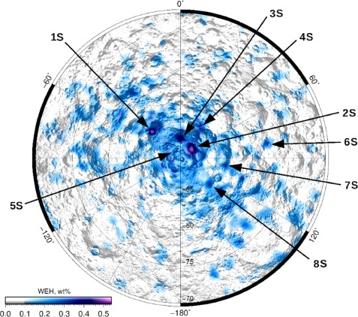
Bulk Lunar Hydrogen at Smaller Spatial Scales
Pixon-based reconstruction of LPNS data (Elphic et al 2007) reveals high WEH abundances in Cabeus (near 1 wt%) and lower abundances in Shoemaker, Haworth, and Faustini (~0.3 wt%)
Analysis of LEND data (Sanin et al 2017) reveals higher WEH abundances (~0.5 wt%) in south polar craters Shoemaker, Haworth, and Faustini
Figure 1 Map of current day ice stability depth from Siegler et al [2015] as used in constraint map development
Notes:
LP – launch 1998, 30/100 km, 19 mos (12 @ 100, 7 @ 30)
LRO – launch 2009, 50/100km as low as 30

Slide 6
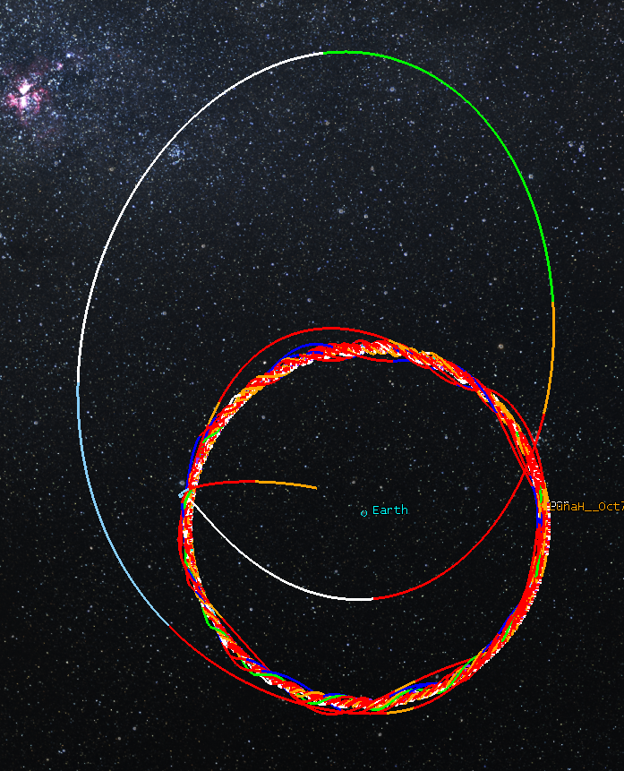
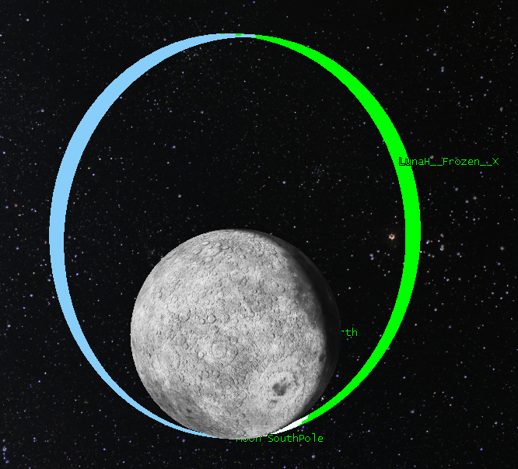
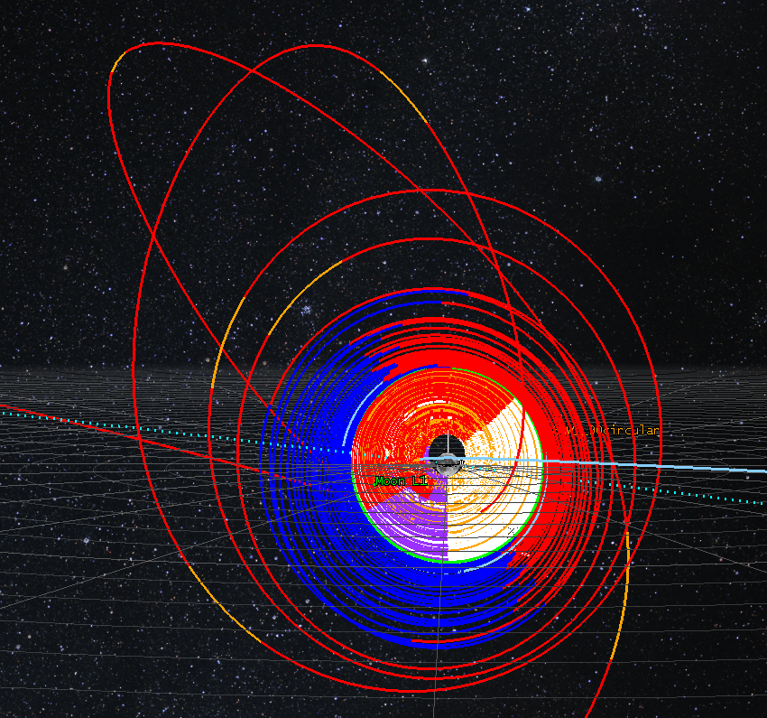
Trajectory Design
1
3
Period | 4.76 hour
Aposelene Altitude | 3150 km
Periselene Altitude | RAAN dependent 15-25 km
Inclination | 90°
Argument of Periselene | 273.5°
2
Genova, A. L. and Dunham, D. W. (2017) 27th AAS/AIAA Space Flight Mechanics Meeting 17-456.

Slide 7
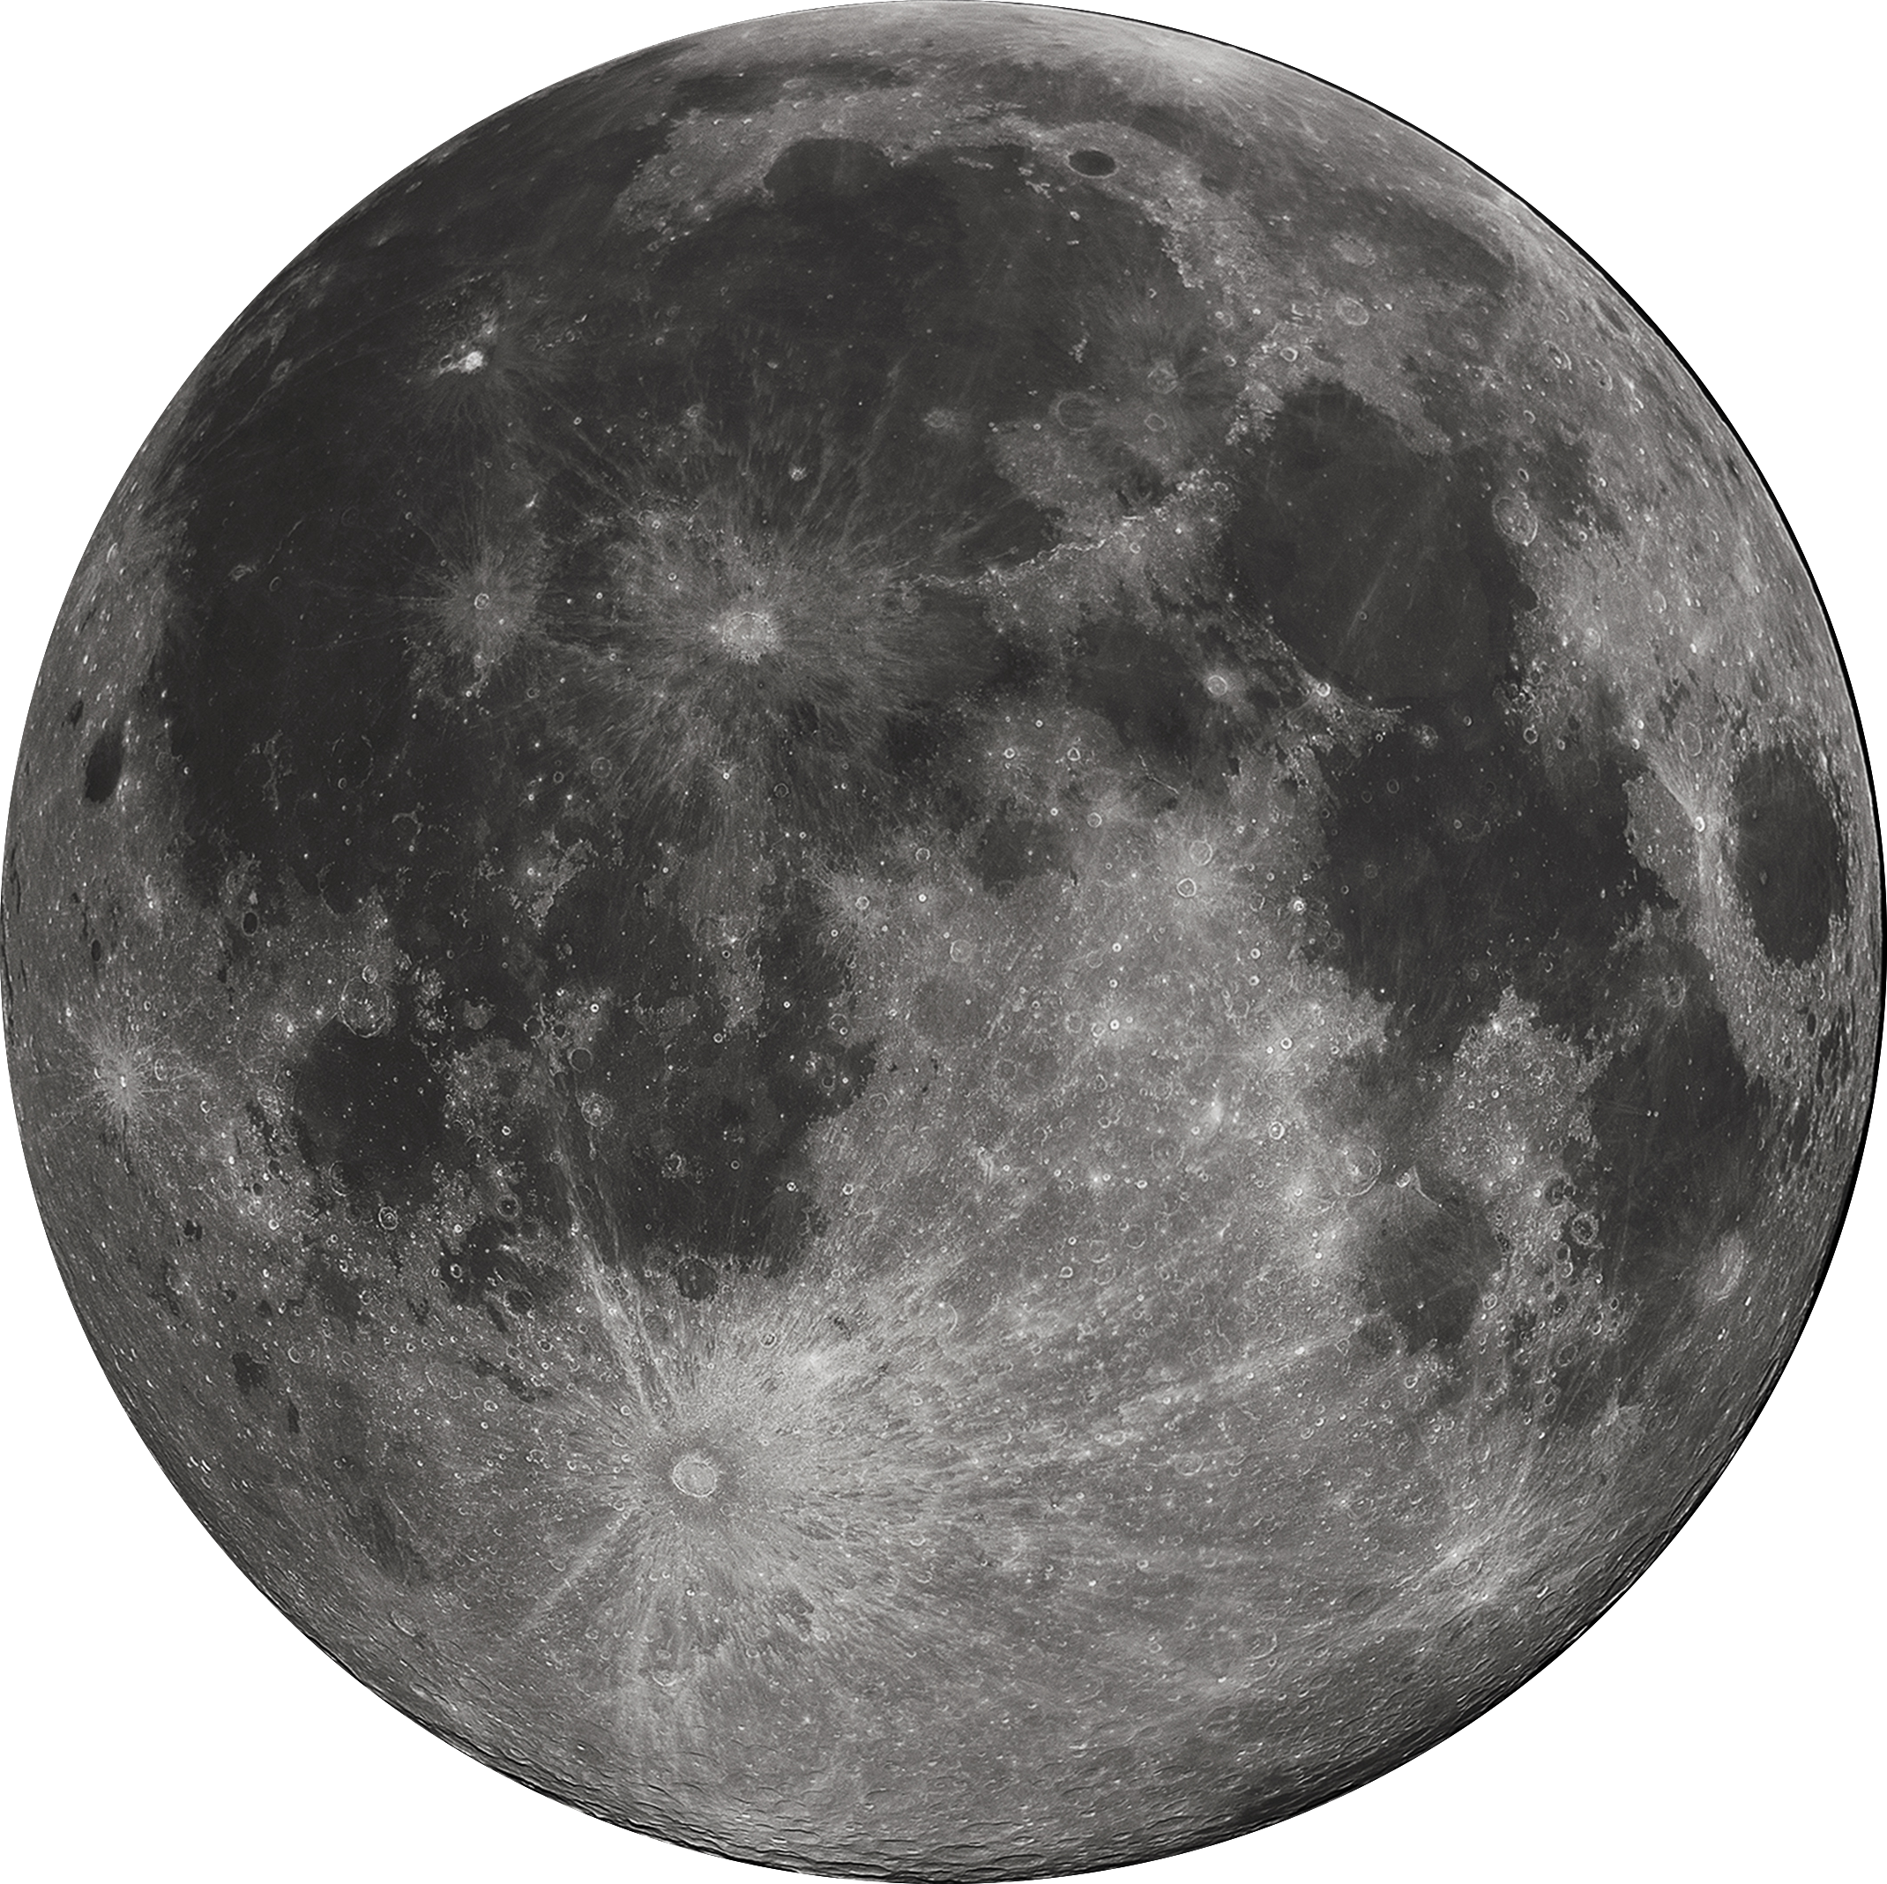
Day in the Life - Science
Statistical aposelene manuever (every 3-5 days)
Tracking/Communication
Tracking/Communication
Eclipse (beta angle dependent) – no operations
Mini-NS active ~30 min centered around periselene
Notes:
Shorten blue bar....
Highlight stuff

Slide 8
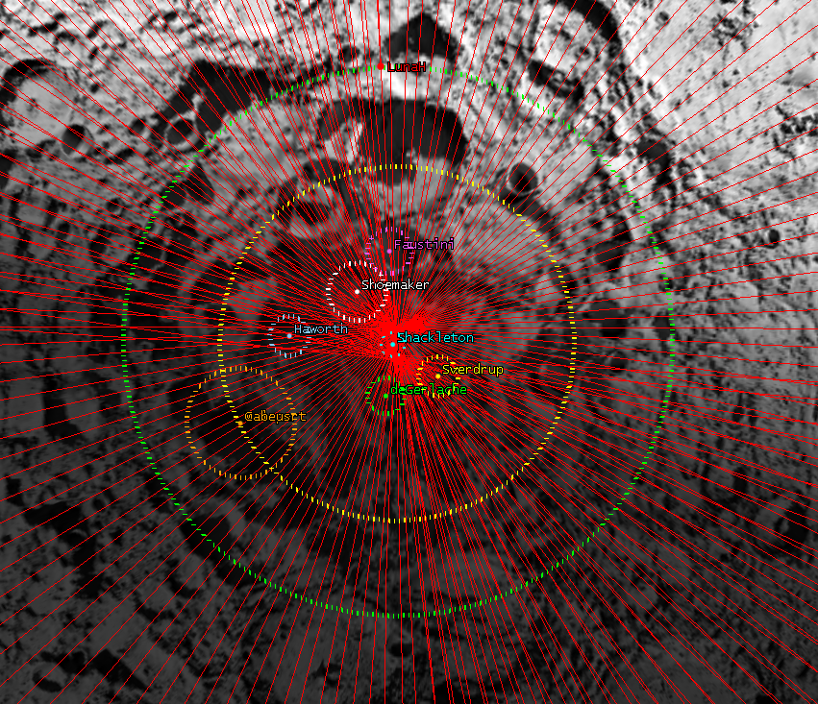
Science Phase
Period | 4.76 hour
Aposelene Altitude | 3150 km
Periselene Altitude | RAAN dependent 15-25 km
Inclination | 90°
Argument of Periselene | 273.5°
Genova, A. L. and Dunham, D. W. (2017) 27th AAS/AIAA Space Flight Mechanics Meeting 17-456.

Slide 9
Neutron Measurements of the Moon
Science
Low-altitude (< 20 km) uncollimated measurements of lunar neutrons will:
  Determine the bulk hydrogen content and depth within PSRs (at spatial scales of < ~35km)
These data will:
  Constrain sources and sinks for polar volatiles
  Constrain models of lunar polar wander
  Identify landing sites for future landed missions at the lunar South Pole
  Complement LP-NS and LRO LEND neutron data
Requirements
To determine bulk hydrogen abundance, LunaH-Map needs to measure only epithermal neutrons:
  Short mission duration requires a large (200 cm²)and efficient detector array
  Ability to discern signal from background and custom electronics to count neutrons once per-second
  No off-the-shelf solution available, so we developed, built and calibrated our own Miniature Neutron Spectrometer (Mini-NS)
Notes:
LP – launch 1998, 30/100 km, 19 mos (12 @ 100, 7 @ 30)
LRO – launch 2009, 50/100km as low as 30

Slide 10
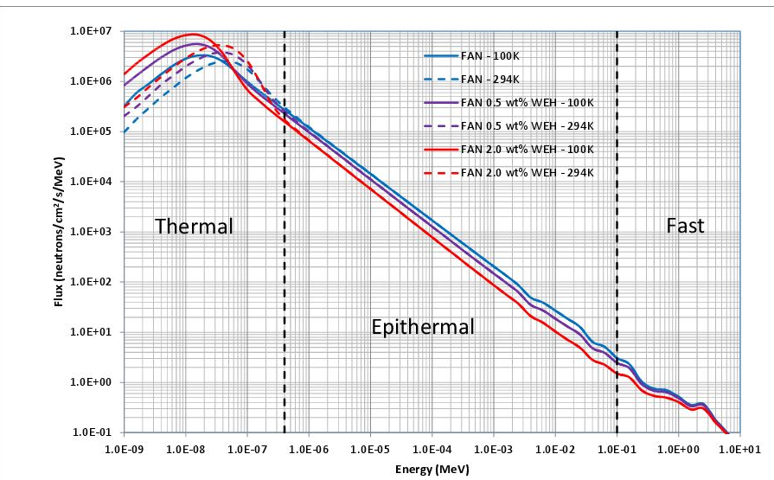
Instrument Development - FAN Neutron Energy Spectrum
Increased hydrogen suppresses epithermal neutrons (E > 0.4 eV) and increases thermal neutrons (E < 0.4 eV)
LunaH-Map’s signal is the difference between dry epithermal count rate and enriched epithermal count rate

Slide 11
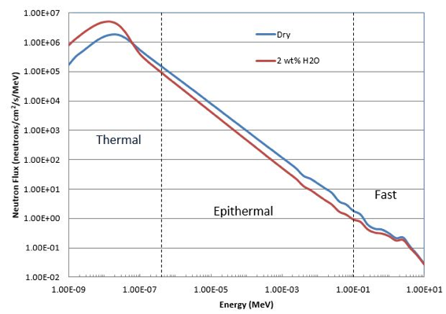
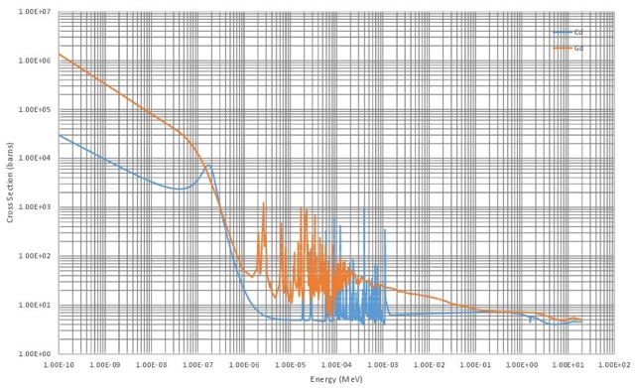
Neutron Detector Shielding
epithermal
thermal
fast
Neutron Absorption Cross Sections for Cd (blue line) and Gd (orange line)

Slide 12
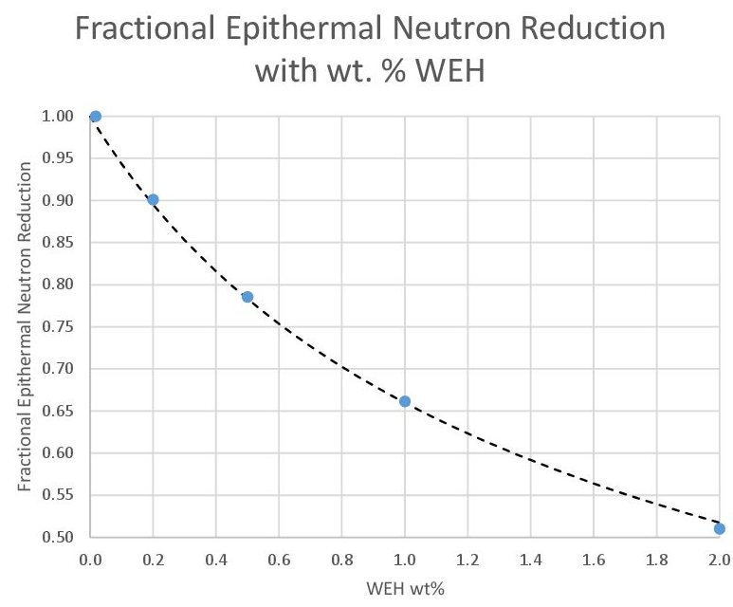
Increased hydrogen suppresses epithermal neutrons (E > 0.4 eV) and increases thermal neutrons (E < 0.4 eV)
LunaH-Map’s signal is the difference between dry epithermal count rate and enriched epithermal count rate

Slide 13
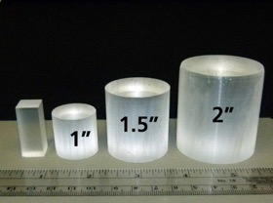

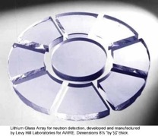
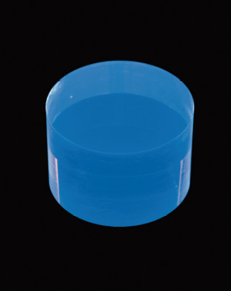
Neutron Sensitive Materials
Neutron Capture Isotopes: ³He, ⁶Li, ¹⁰B
  ³He: noble gas proton, triton 0.75 MeV
  ⁶Li: alkali metal alpha, triton 4.8 MeV
  ¹⁰B: metalloid alpha, ⁷Li, g (94%) 2.8 MeV
Detector materials
Boron-Loaded
Plastic
He-3 Tube
Li-Glass
CLYC

Slide 14
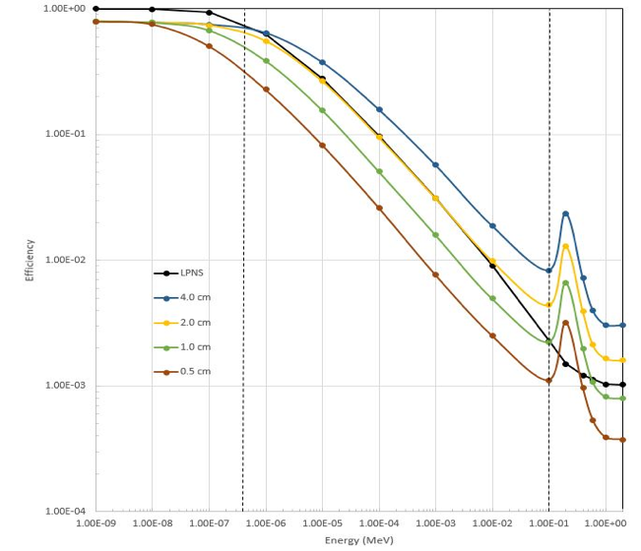
Detection Efficiency
Thermal
Efficiency of 2-cm thick CLYC matches LPNS 5.7-cm diameter He-3 counter.
Epithermal
Fast

Slide 15
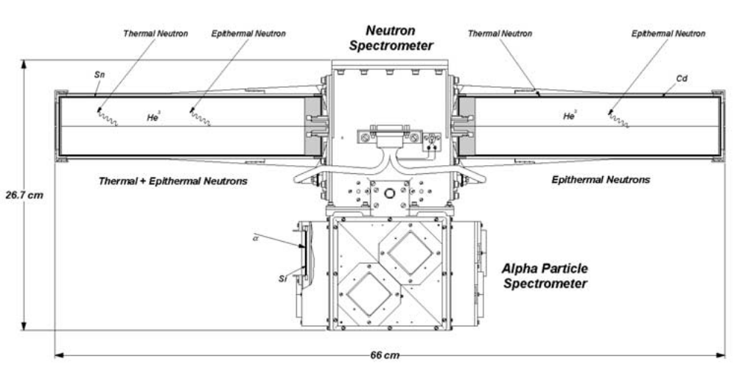
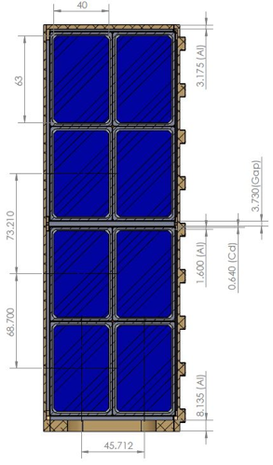
Detection Area
LPNS
Effective area of one LPNS He-3 tube is ~100 cm².
He-3 tube gas pressure 10 atm, ~0.0014 g/cm³
Epithermal count rate ~20 s⁻¹.
5.7 cm
20 cm
Mini-NS
Total area of eight Mini-NS CLYC modules is ~200 cm².
CLYC density ~3.3 g/cm³
Epithermal count rate ~40 s⁻¹.

Slide 16
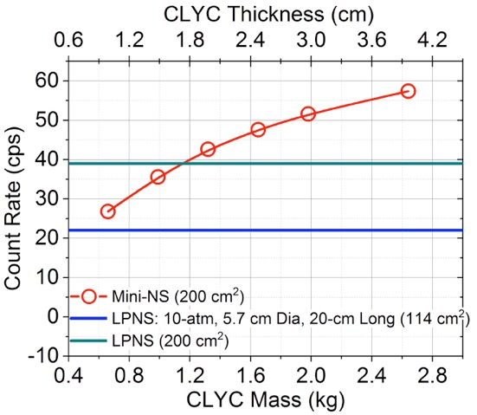
Modeling of Expected Count Rates
Using lunar neutron input spectrum from 10 km altitude

Slide 17
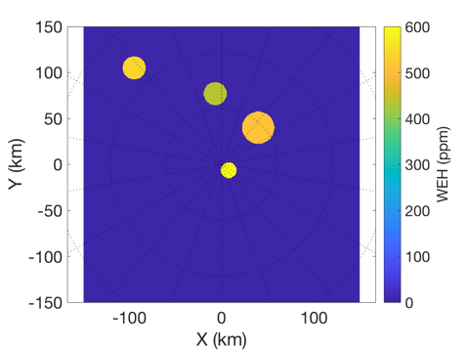
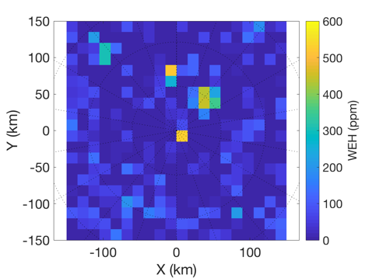
South Polar Volatile Mapping
C
H
Sh
S
LunaH-Map 2 month science phase ground tracks
Simulation maps made from 15 x 3150 km science orbit. Basemap combines LEND high H regions (Sanin et al., 2017) and the Shackleton enrichment from pixon-reconstructed LPNS data (Elphic et al, 2007) to illustrate the type of map LunaH-Map will be able to create (West et al., LPSC 2017).

Slide 18
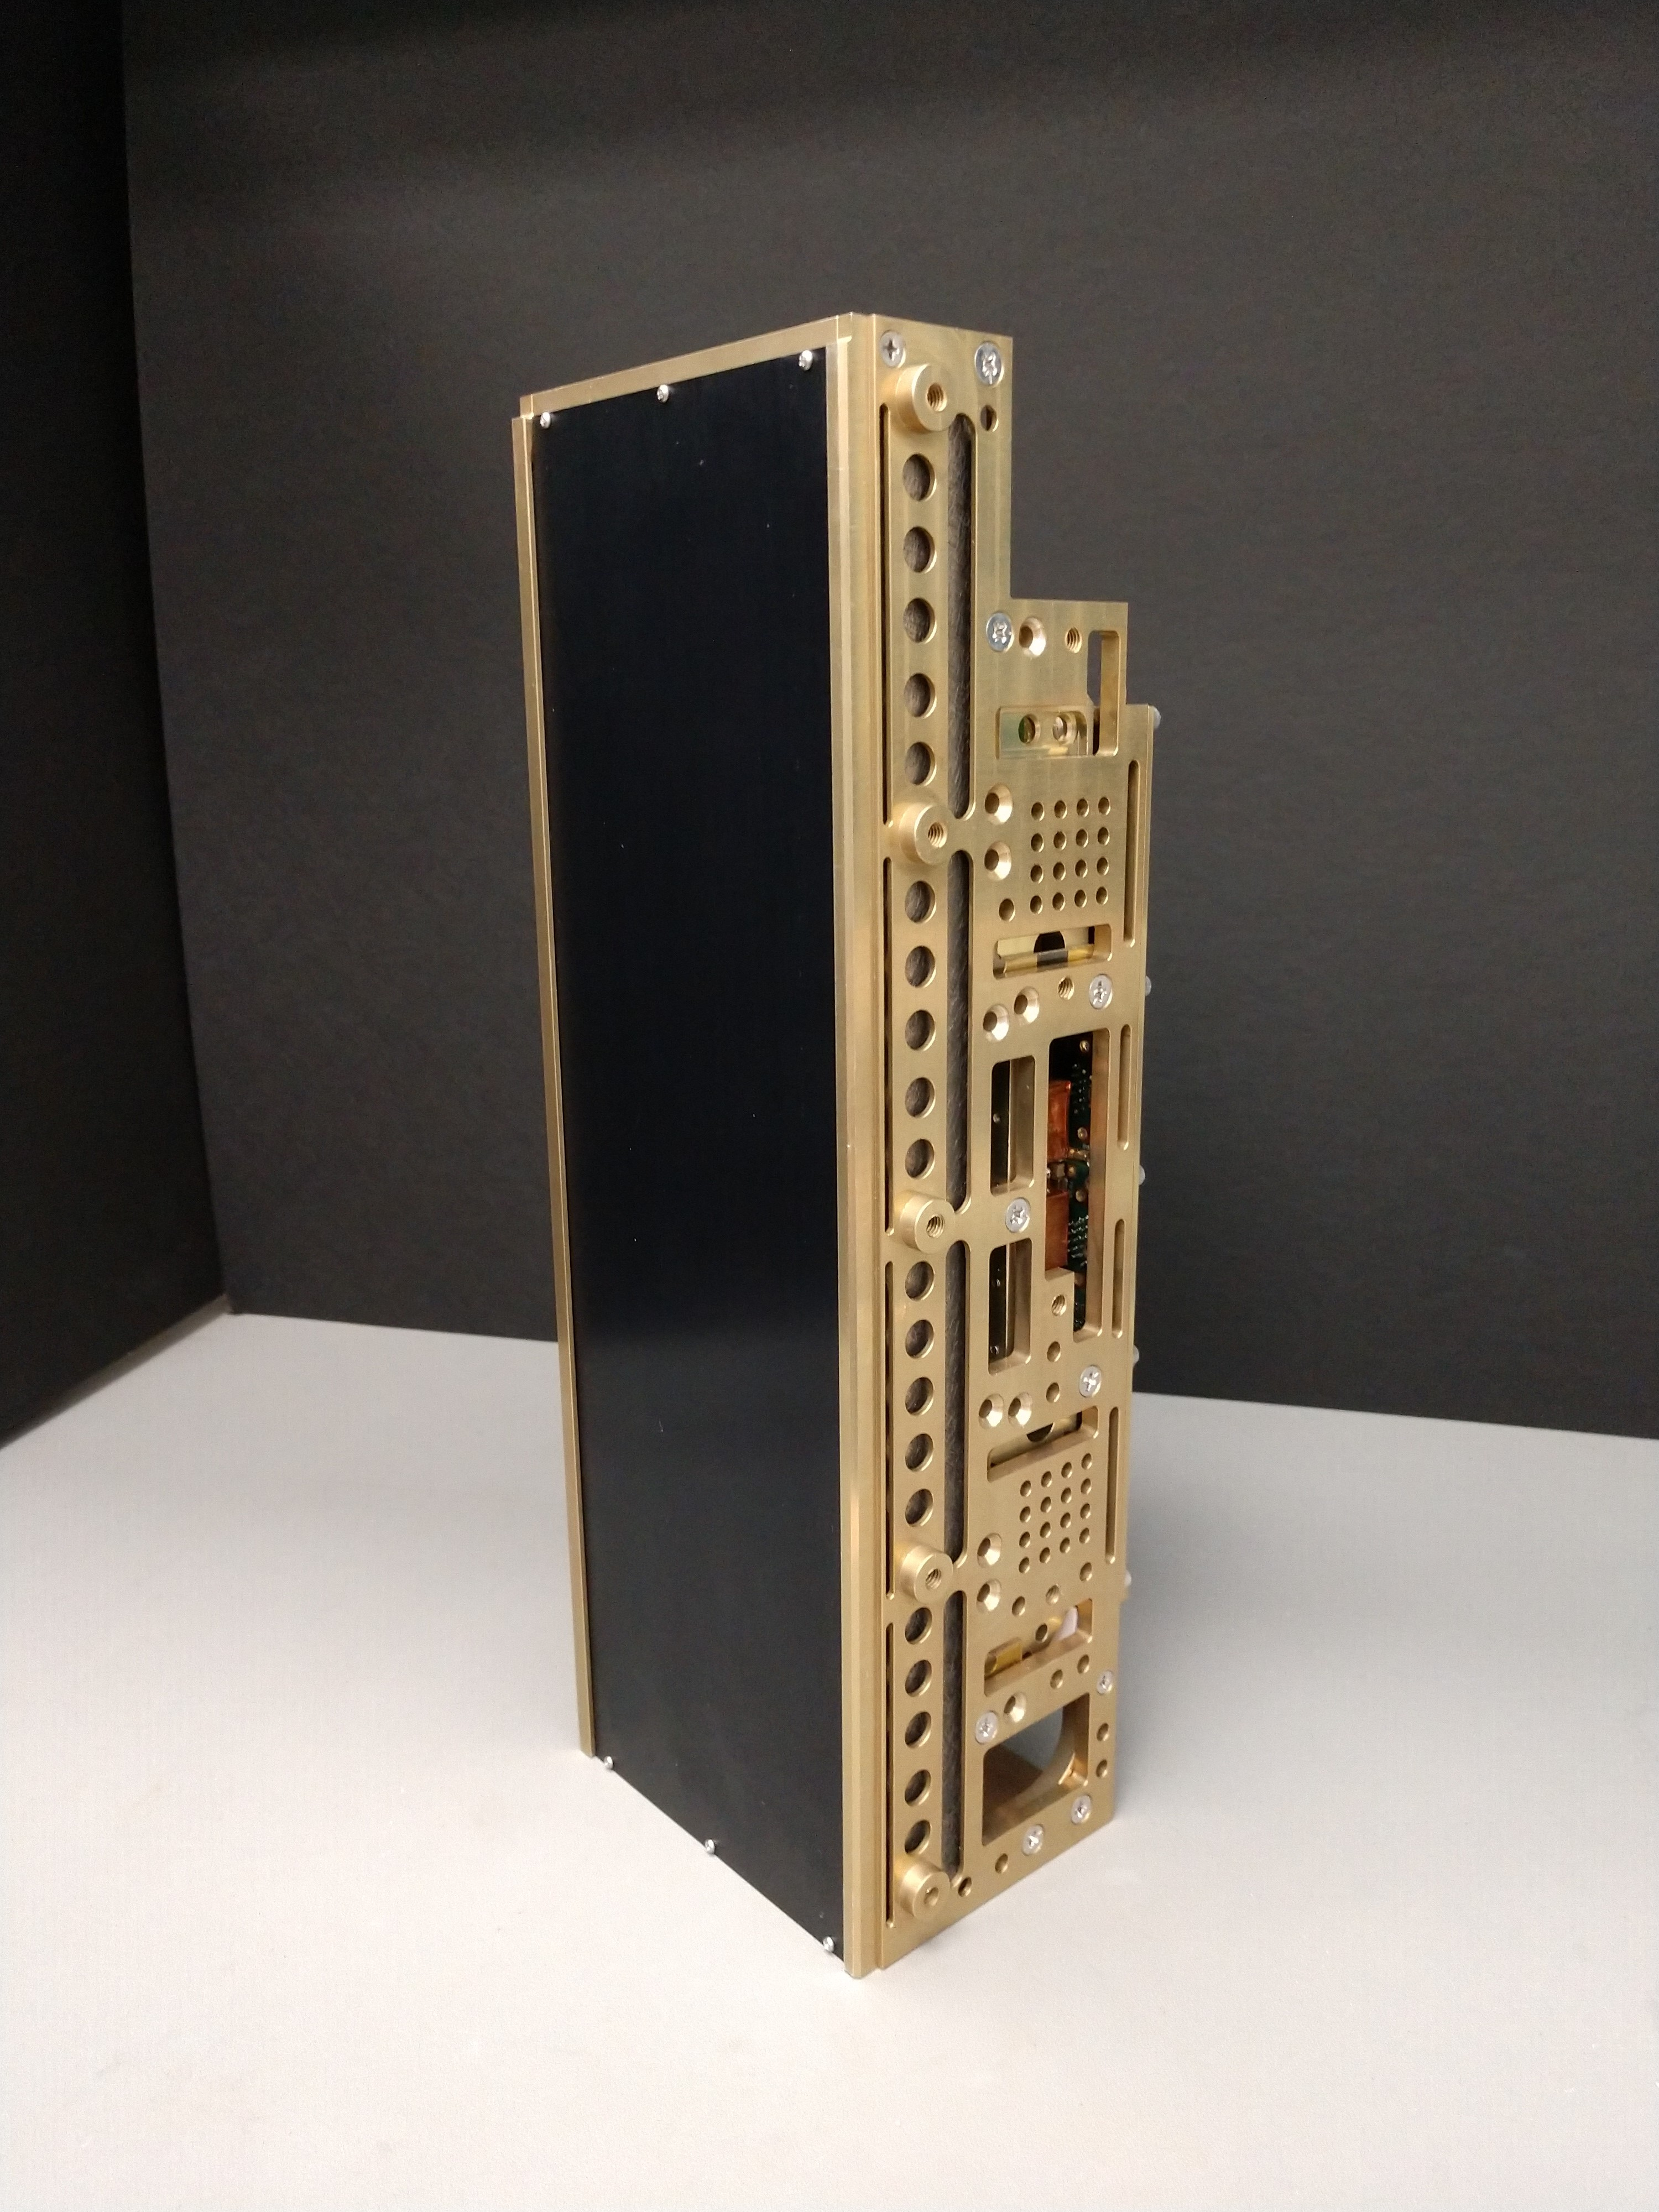
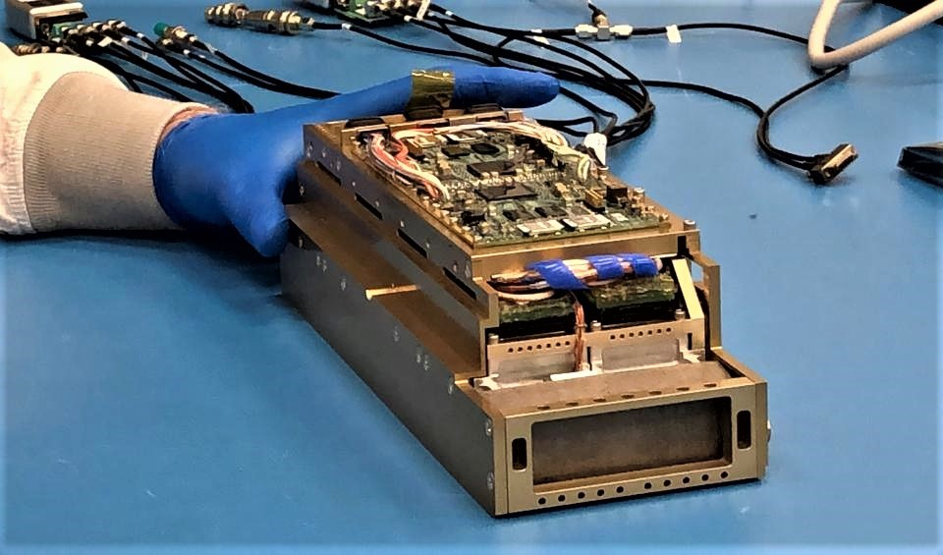

Mini-NS: Miniature Neutron
Spectrometer
Mini-NS Flight Unit

Slide 19
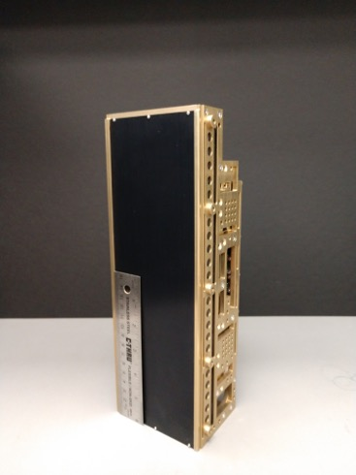
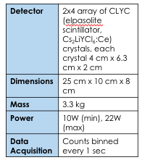
Miniature Neutron Spectrometer for CubeSats and SmallSats – Flight Unit
Mini-NS Flight Unit delivered and calibrated at Los Alamos National Lab Neutron Free In-Air (NFIA) facility in late Fall 2018
Notes:
Yes add graphic

Slide 20
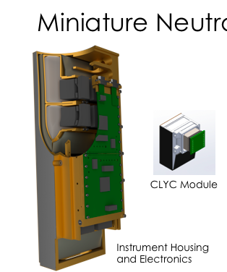
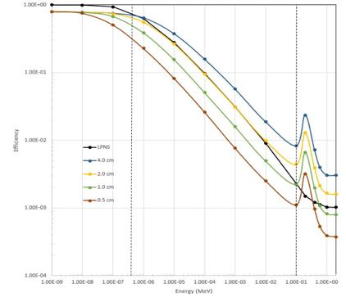
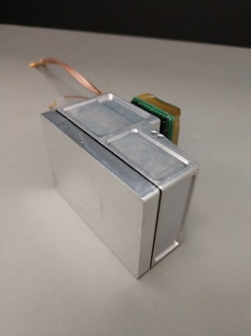
Miniature Neutron Spectrometer for CubeSats and SmallSats
Thermal
Epithermal
Fast
Individual CLYC module, PMT and housing (x8)

Slide 21
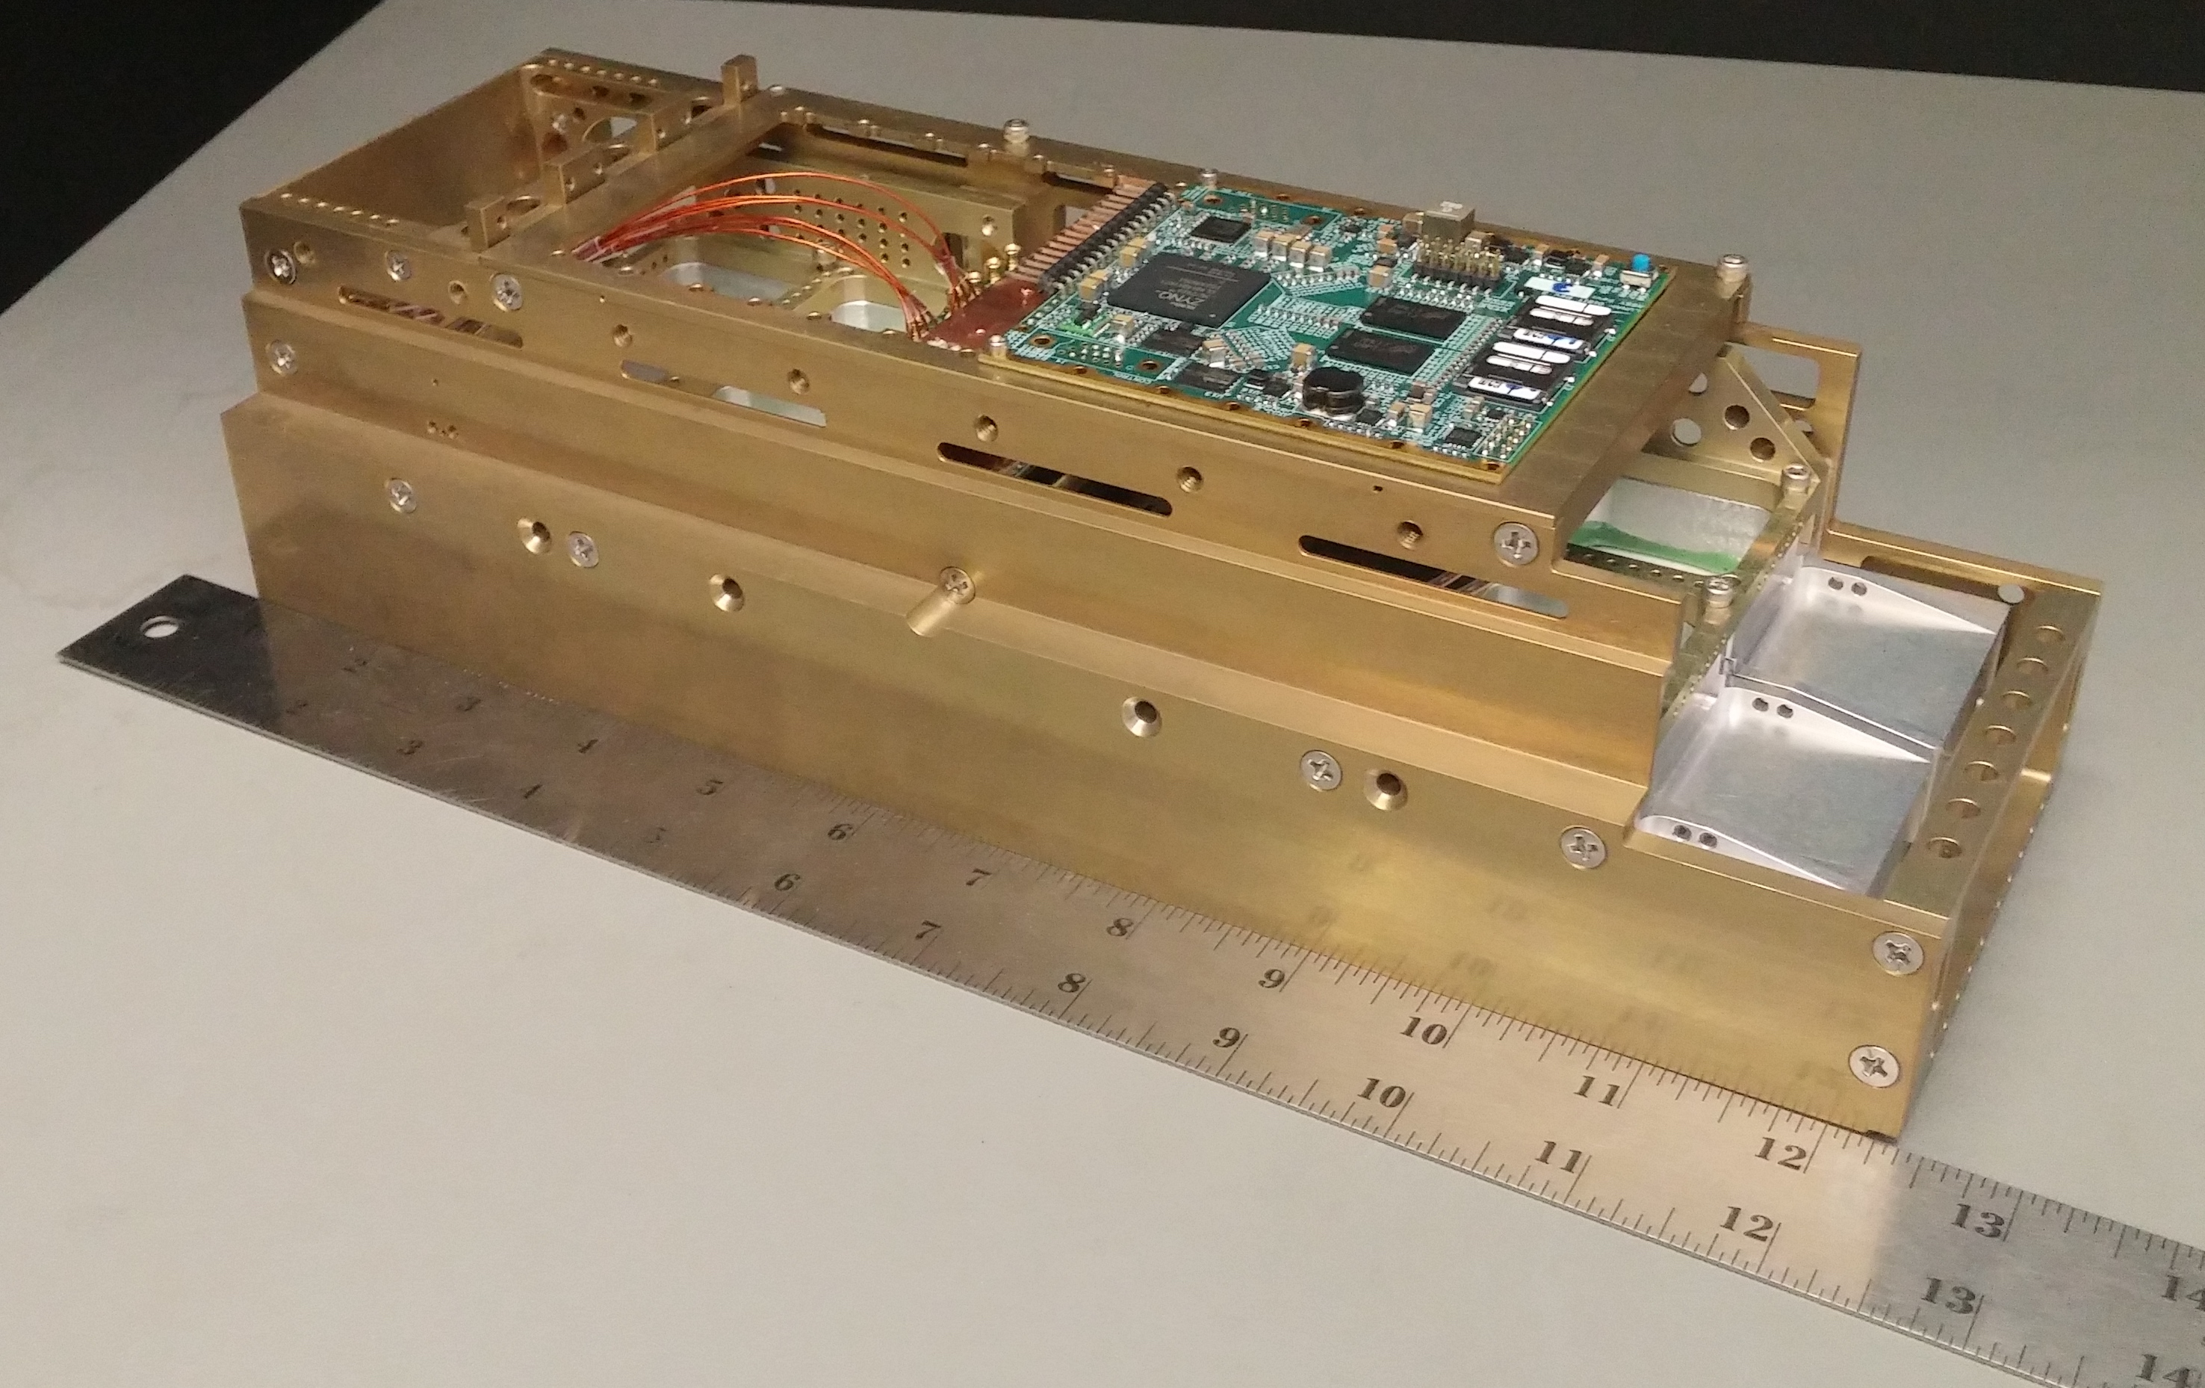
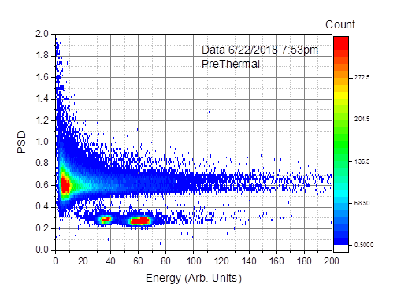
Each Mini-NS detector module (CLYC) is sensitive to both neutrons and characteristic gamma-rays
Neutrons and gamma-rays can be separated using pulse discrimination in the detector electronics
LunaH-Map protoflight Miniature Neutron Spectrometer (Mini-NS) unit with a subset of the 8 detector modules, analog and digital boards populated prior to final assembly and qualification.
Notes:
Yes add graphic

Slide 22
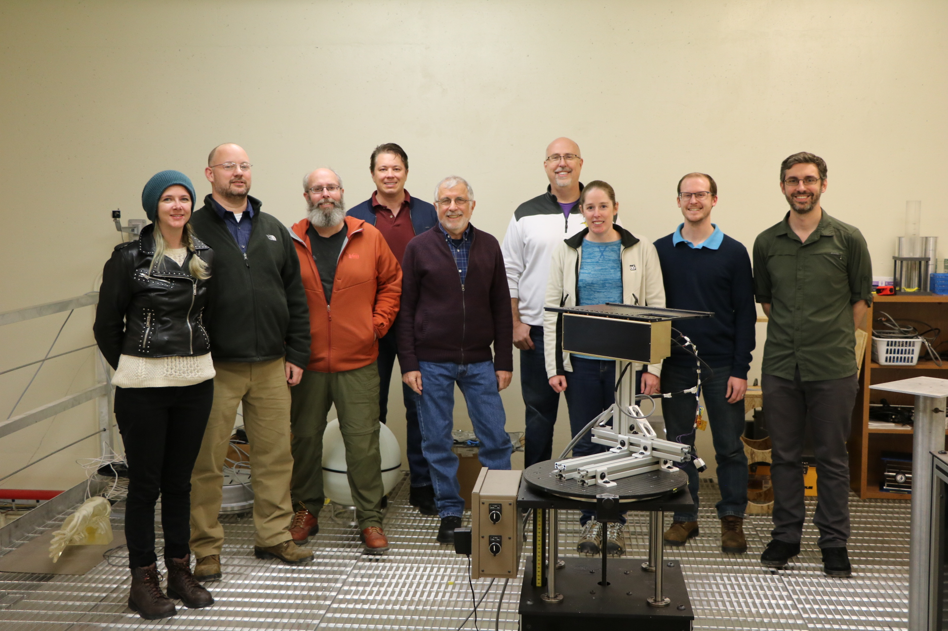
Mini-NS calibration team at Los Alamos National Laboratory Neutron Free In-Air Facility – December 2018
left to right: Lena Heffern (ASU), Erik Johnson (RMD), Tom Prettyman (PSI), Joe DuBois (ASU), Richard Starr (NASA GSFC), Bob Roebuck (AZST), Katherine Mesick (LANL), Graham Stoddard (RMD), Craig Hardgrove (ASU)

Slide 23
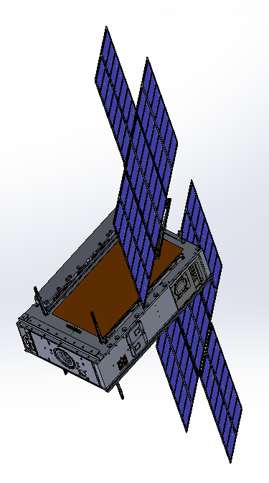
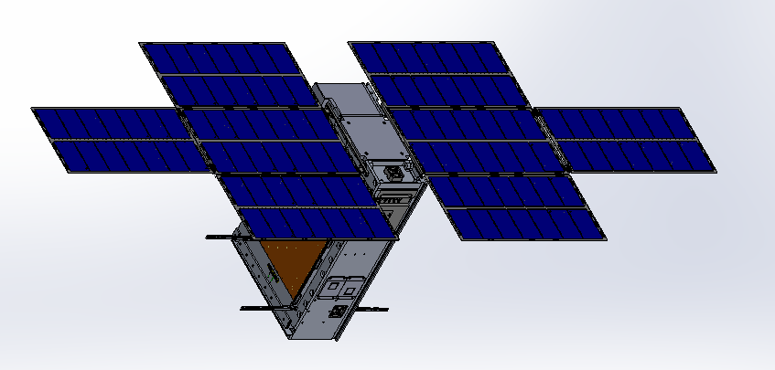
LunaH-Map Spacecraft
Single Axis
Solar Array Drive
Spacecraft Specs
Mini-NS
Instrument
Dimensions: (stowed) | 10x20x30cm
Mass | 14 kg
Power | 90W BOL 56W-hr Battery
Propulsion | Busek BIT-3 Ion Thruster
Comm. | JPL Iris Deep Space Transponder
C&DH / GN&C | BCT XB1-50
LGA
BCT XB1-50 /
Star Tracker
Solar Array
Hold Down
Arms
Primary Coarse
Sun Sensor
LGA
Separation
Connector
BIT-3 Thruster
Coarse Sun Sensor

Slide 24
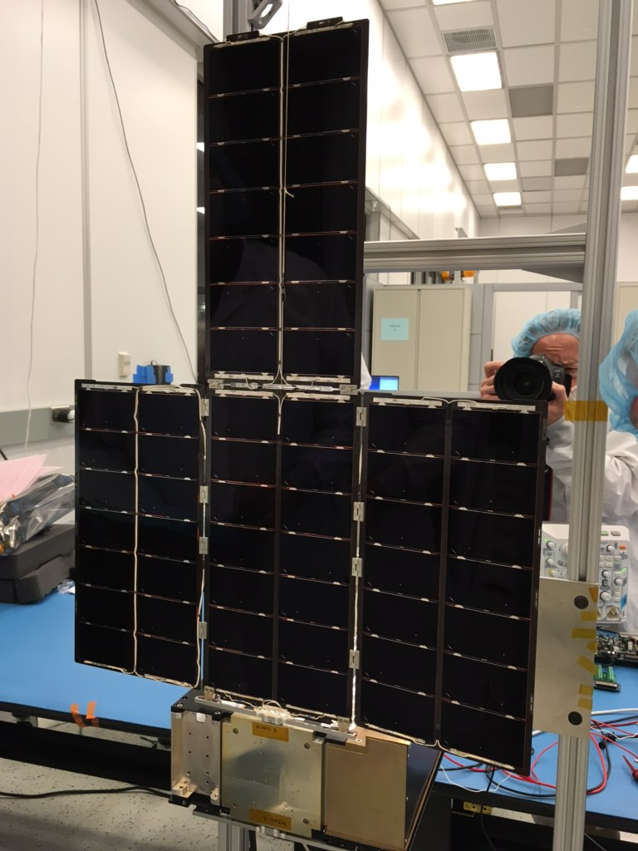

LunaH-Map MMA eHawk+ Flight Solar Arrays – Delivered February 2019

Slide 25
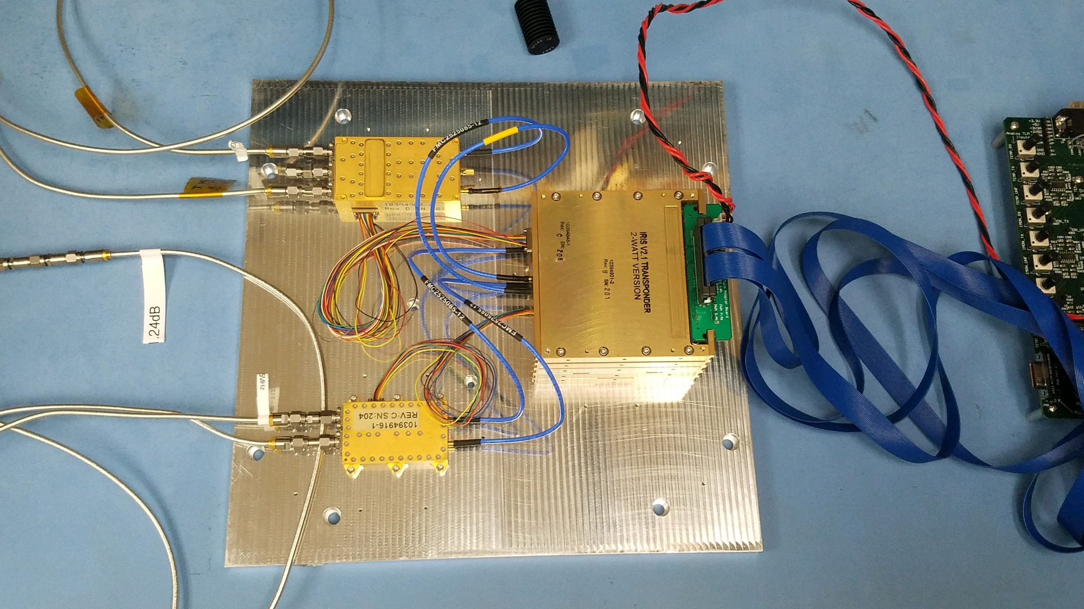
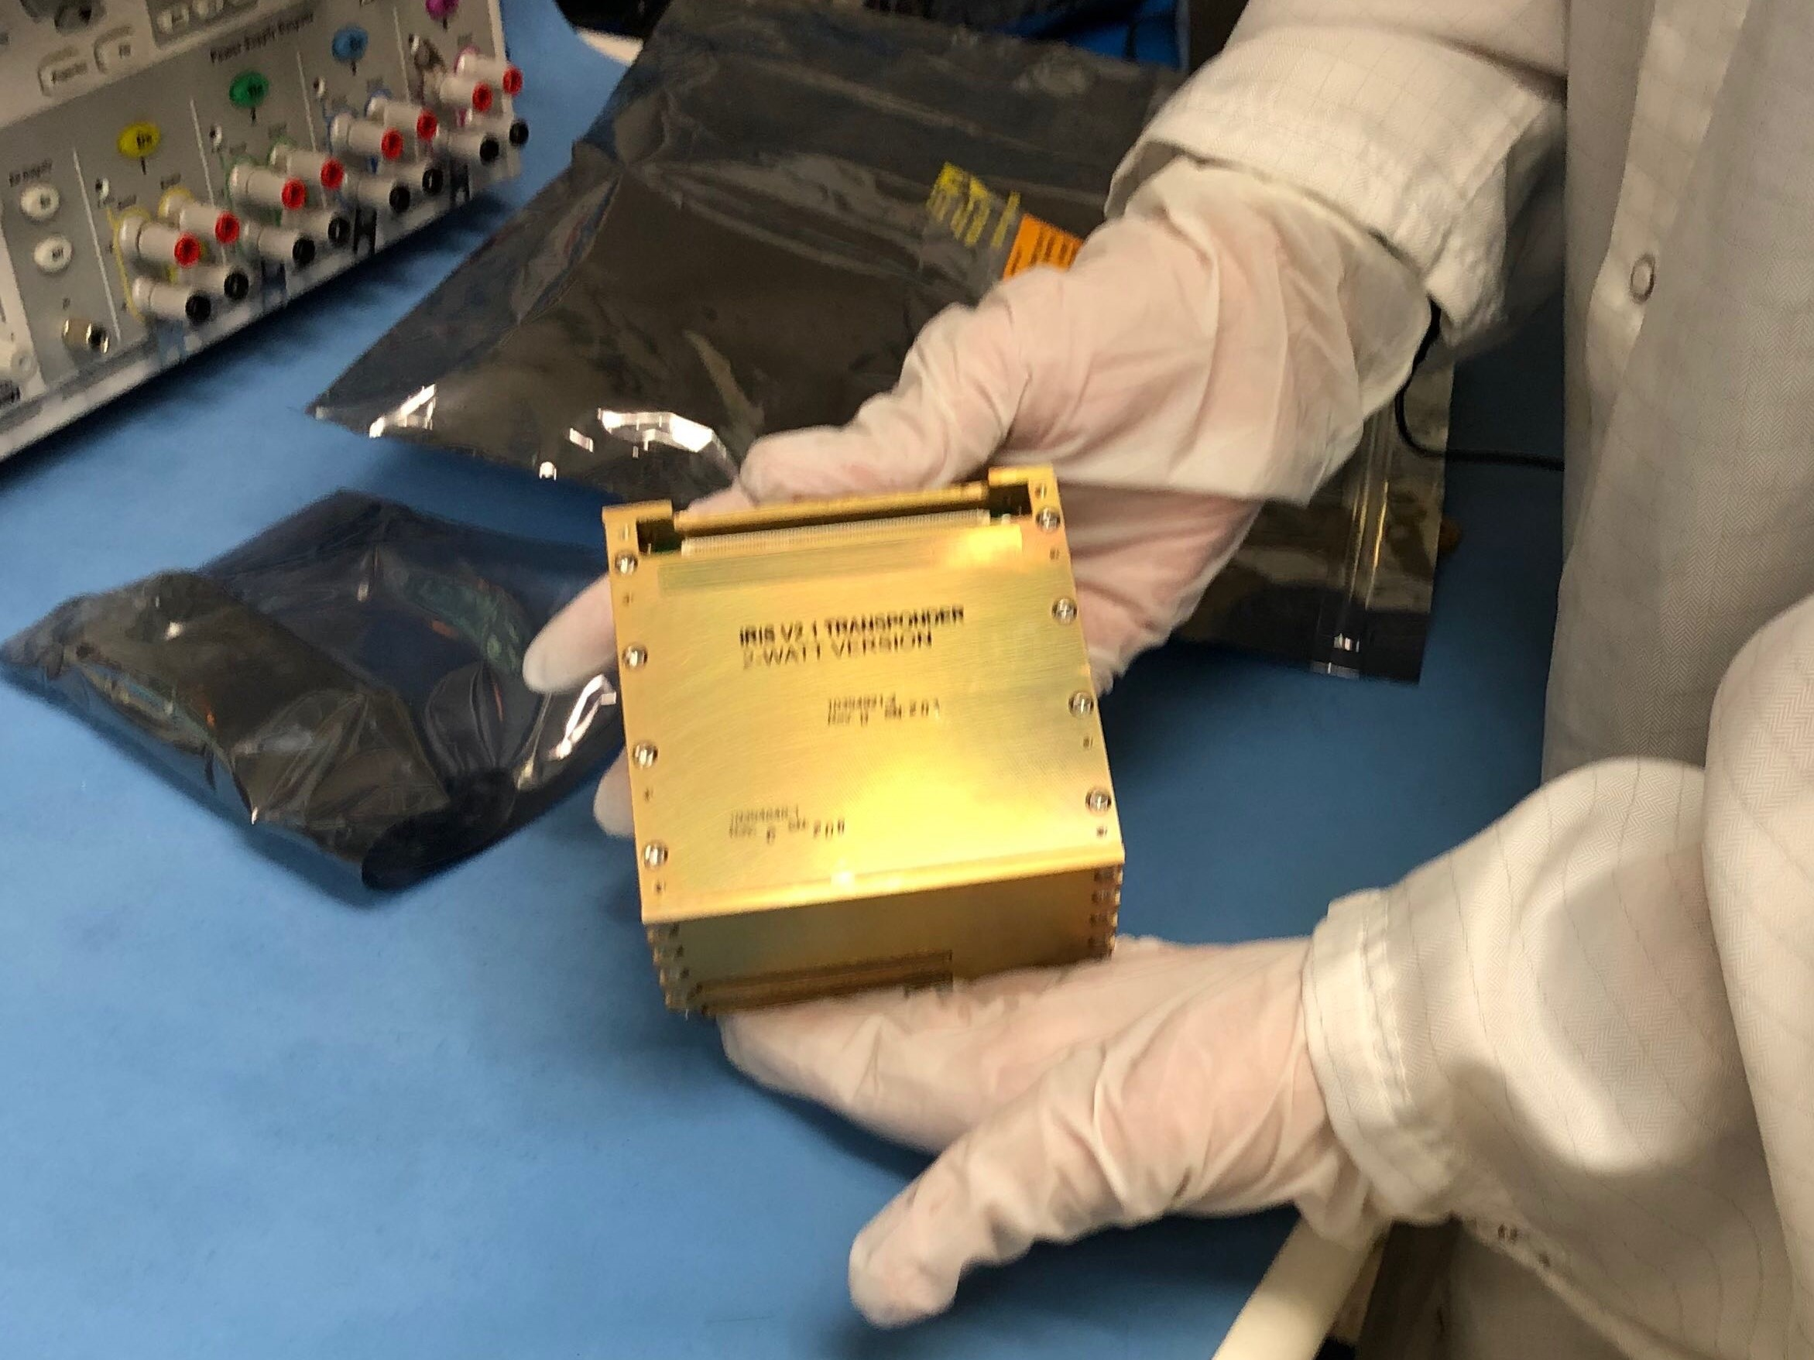

LunaH-Map Flight Iris radio – Delivered February 2019

Slide 26
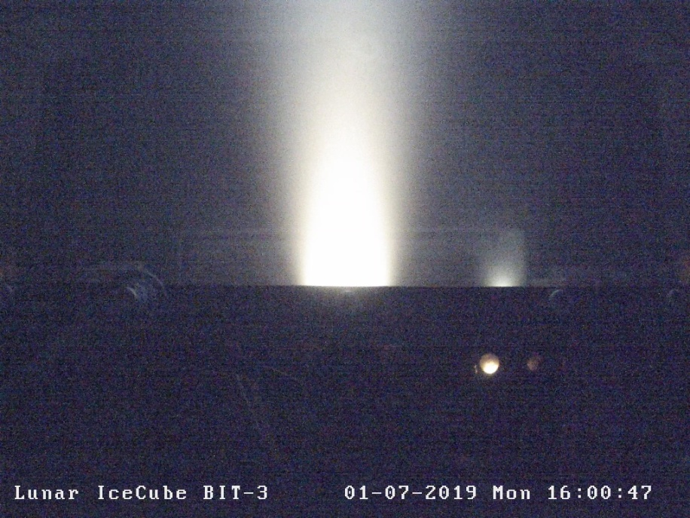
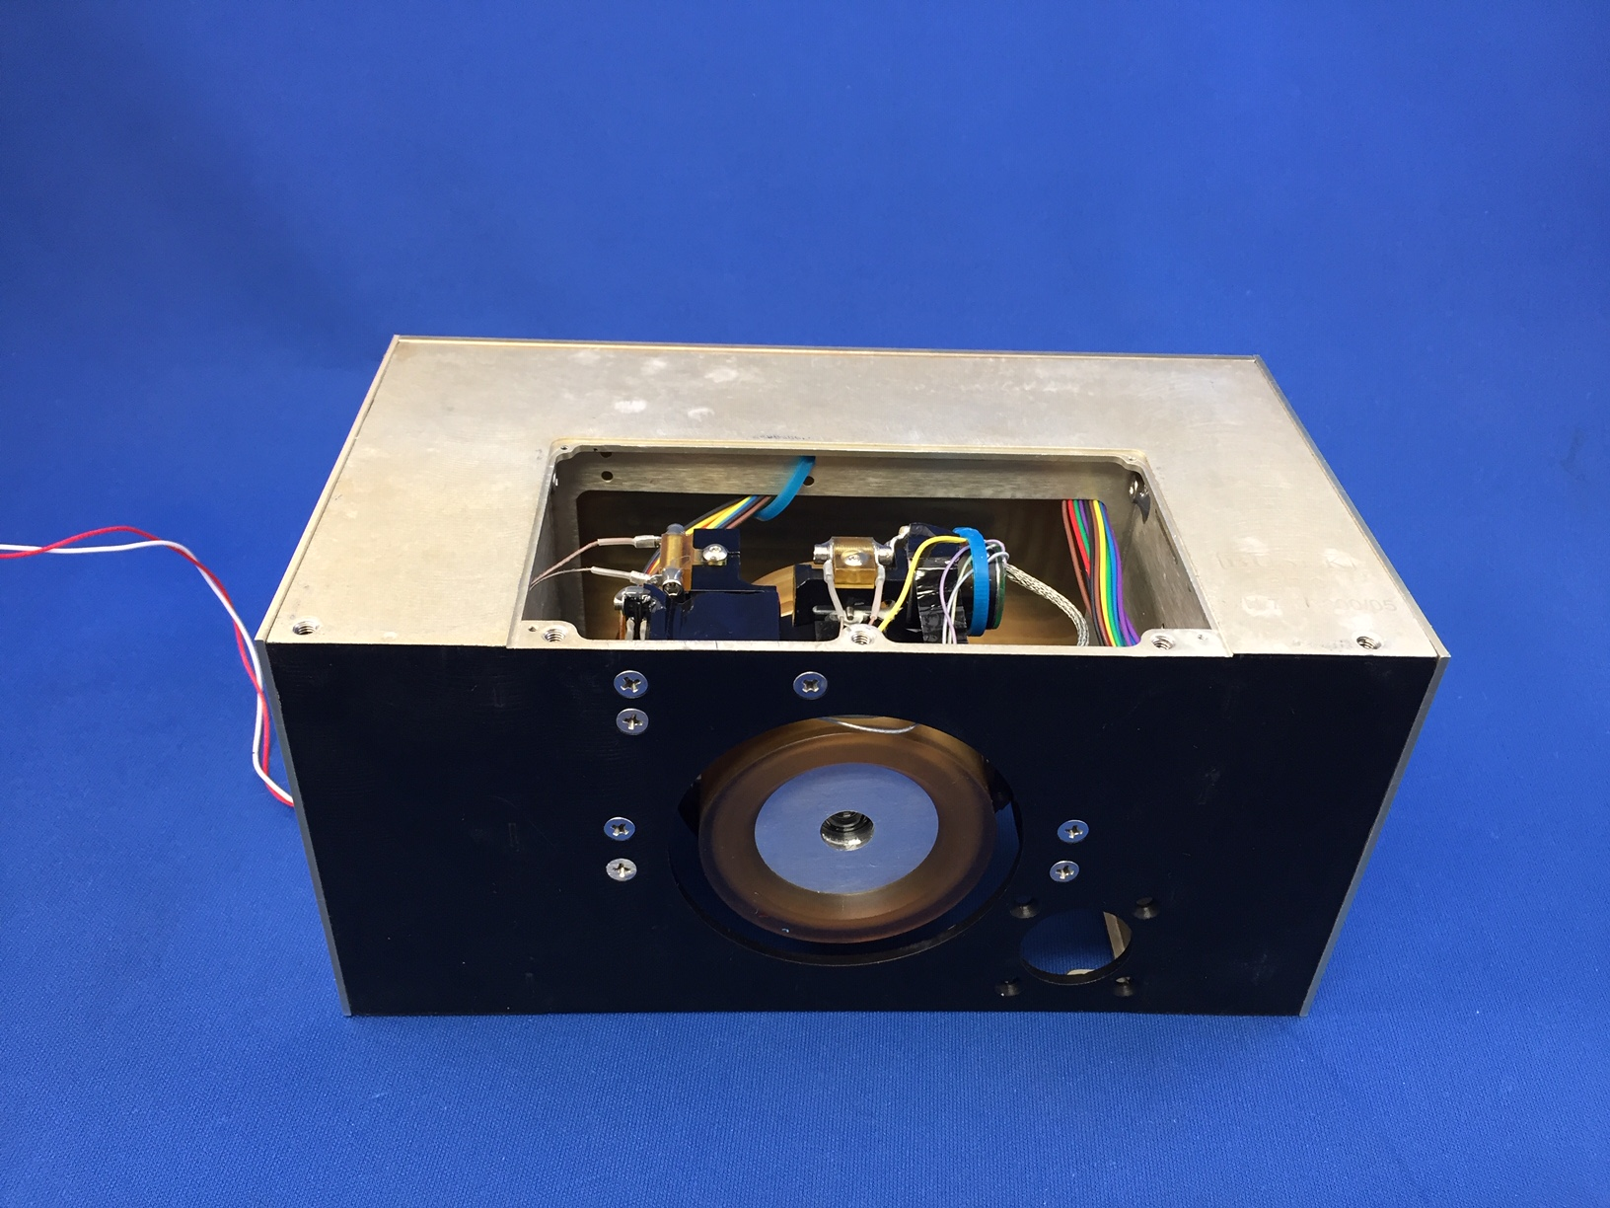
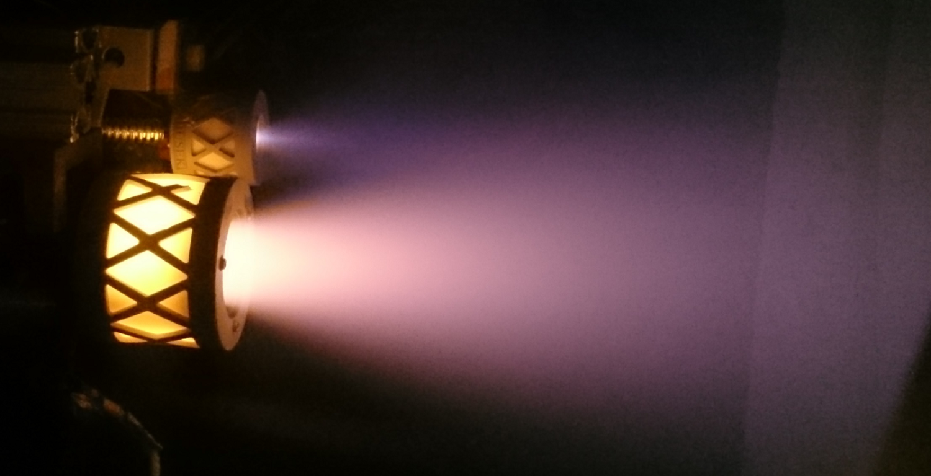

BIT-3 QM Hot Fire Iodine Testing
LunaH-Map Flight BIT-3

Slide 27
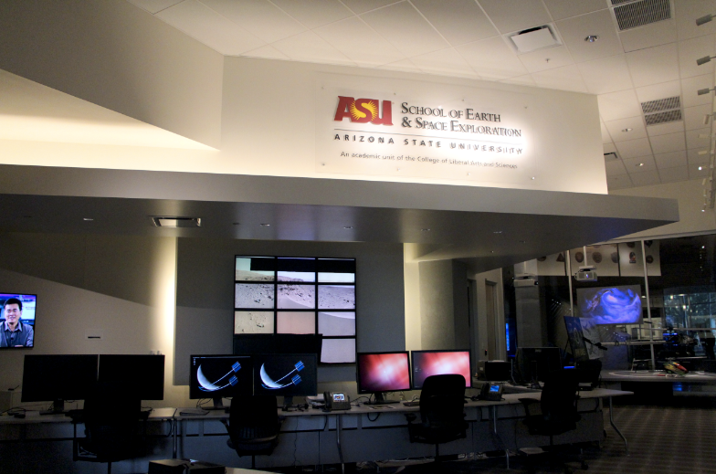

MOC co-located in ASU’s shared operations facility
JPL AIT for spacecraft uplink and downlink
KinetX provides mission navigation
ASU science/instrument ops development coincident with Mars 2020 and Psyche missions

Slide 28
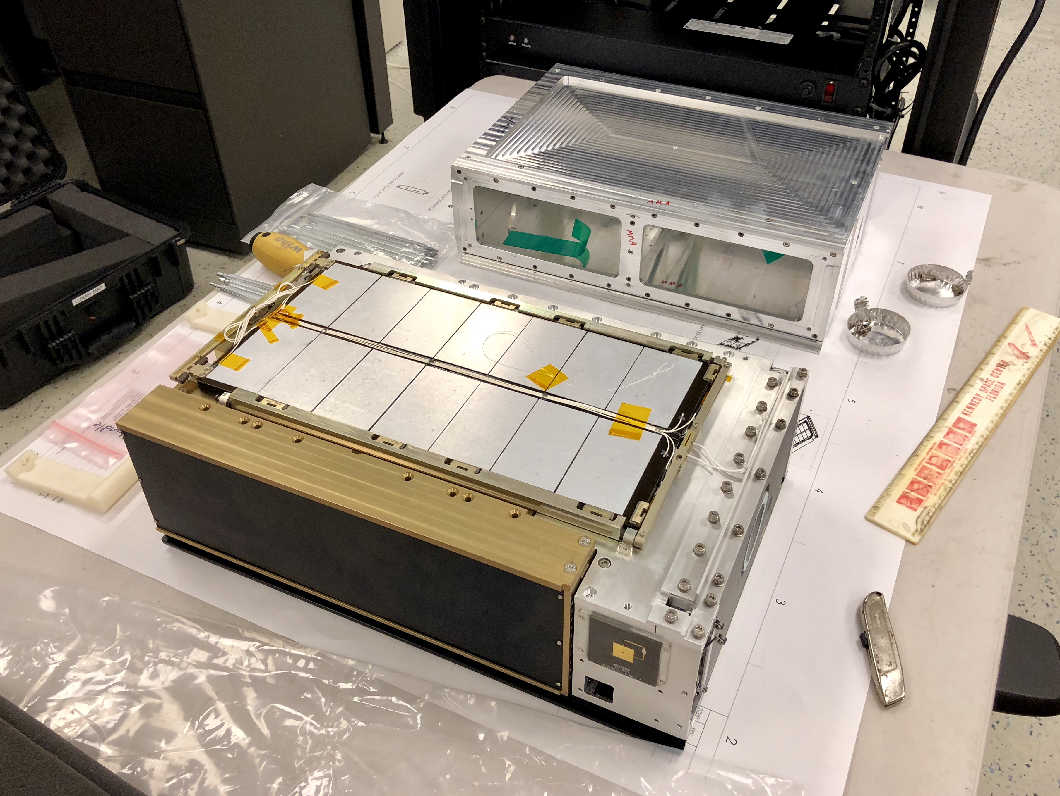

LunaH-Map Spacecraft EDU
Flight instrument chassis machined for fit checks in spacecraft EDU at ASU
Fit check in SLS EM-1 dispenser at NASA MSFC
Notes:
Yes add graphic

Slide 29

LunaH-Map Status
Solar array EM and SATA EM
All subsystem EM units delivered and integrated into the LunaH-Map flatsat (labeled in image)
On schedule for delivery in late 2019
Current Engineering Team Activities
Electrical I&T of flight units,
EM unit testing
Developing AIT command/telemetry tools
Mini-NS interface EM (x2)
XEPS EM
Iris emulator
XB1-50 EM
BIT-3 EM

Slide 30


Twitter: @lunahmap
lunahmap.asu.edu/foldyourown_lunahmap.pdf

Slide 31
Road to Launch
Initial Accommodation Audit – completed on December 11, 2015
Delta IAA – completed on February 24, 2016
System Requirements Review – completed on April 8, 2016
Phase 1 Safety Review – completed on June 21, 2016
Preliminary Design Review – completed on July 25, 2016
Critical Design Review – completed June 29, 2017
Phase 2 Safety Review – completed on November 9, 2017
Systems Integration Workshop – completed on December 7, 2017
Flight Instrument Delivery – November 8, 2018
Flight Solar Array Delivery – February 22, 2019
Flight Radio Delivery – March 20, 2019
Enter Assembly, Integration, and Test – Q1 2019
  AI&T Review/Workshop with review board – completed on December 7, 2017
Flight Propulsion Delivery – scheduled on April 30, 2019
Flight GNC and C&DH System – scheduled on May 15, 2019
Phase 3 Safety Review – scheduled on September 25, 2019
Spacecraft Delivery to Tyvak – scheduled on October 30, 2019
Launch-SLS EM-1 – scheduled on June 26, 2020
LunaH-Map Program Milestones to Date
IAA | 11 December 2015 | Δ-IAA REQUIRED
Δ-IAA | 24 February 2016 | PASSED with RFAs
SRR | 8 April 2016 | PASSED with RFAs
I-PDR | 9 June 2016 | PASSED with RFAs
Phase 1 SR | 21 June 2016 | PASSED
M-PDR | 25 July 2016 | PASSED with RFAs
CDR | 29 June 2017 | COMPLETED
Phase 2 SR | 9 Nov 2017 | COMPLETED
Integration Workshop | 7 Dec 2017 | COMPLETED
Review Board Members: Dr. Andrew Klesh, Jet Propulsion Laboratory (Review Board Chair), Dr. Thomas Werne, JPL, Dr. Travis Imken, JPL, Dr. Juergen Mueller, JPL, Dr. Eric Gustafson, JPL, Dr. Thomas Prettyman, Planetary Sciences Institute, Dr. James Bell, Arizona State University, Dr. Jordi Puig-Suari, California Polytechnic State University, Richard Elphic, NASA Ames.

