Slide 1
Near Earth Asteroid Scout
Mission Update
Anne Marinan, Calina Seybold, Julie Castillo-Rogez
  NASA Jet Propulsion Laboratory, California Institute of Technology
Les Johnson, Joe Matus, Tiffany Lockett, Matt Pruitt
  NASA George C. Marshall Space Flight Center
© 2019. All rights reserved.

Slide 2
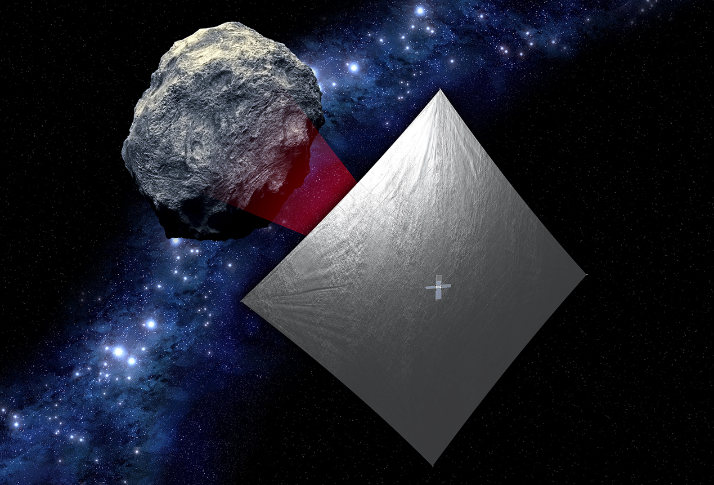
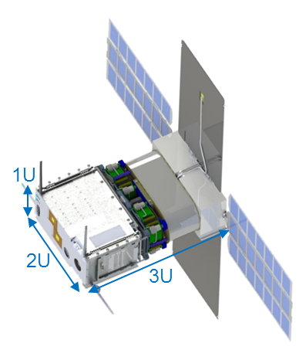
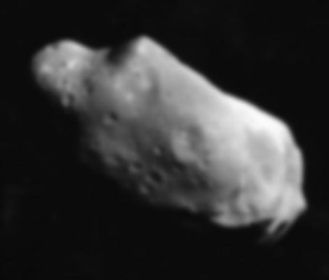
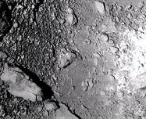
Near Earth Asteroid Scout Mission Overview
The Near Earth Asteroid Scout Will
Image/characterize a NEA during a slow flyby (~m/s)
Demonstrate a low cost asteroid reconnaissance capability
Key Spacecraft & Mission Parameters
6U CubeSat
~86 m² solar sail propulsion system
Manifested for launch on the Space Launch System (EM-1/2020)
1 AU maximum distance from Earth
Leverages: combined experiences of MSFC and JPL with support from GSFC, JSC, & LaRC
Target Reconnaissance with medium field imaging
Shape, spin, and local environment
Close Proximity Imaging
Local scale morphology, terrain properties, landing site survey

Slide 3
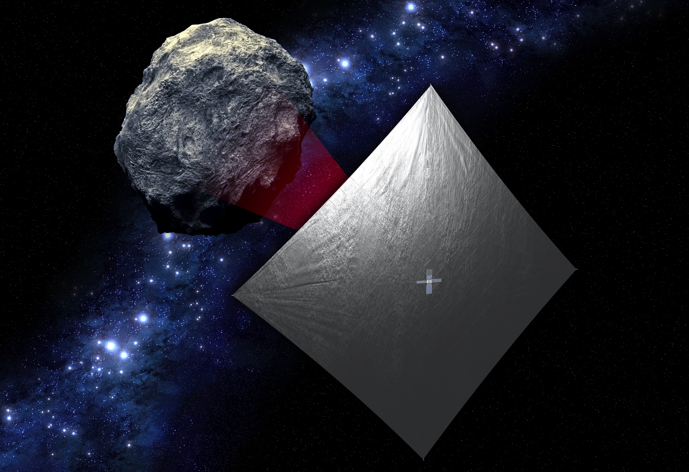
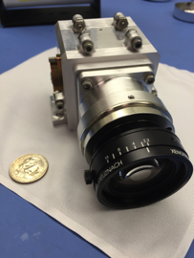
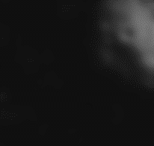

Near Earth Asteroid Scout Science Overview
3. Close Proximity Science
High-resolution imaging,
10 cm/px over >30% surface
Strategic Knowledge Gaps (SKGs): Local morphology
Regolith properties
JPL
2. NEA Reconnaissance
<100 km distance at encounter
50 cm/px resolution over 80% surface
SKGs: volume, global shape, spin properties, local environment
Target
Reference
stars
1. Target Detection and Approach:
50K km, Light source observation
SKGs: Ephemeris determination and composition assessment
Notes:
Update background pic with new one. Update camera pic. Took science pieces from design iteration review charts for science.

Slide 4
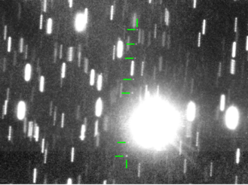
Baseline Target Asteroid: 1991 VG
Diameter ~ 5 -12 meters
Rotation period between a few minutes and less than 1 hour
Unlikely to have a companion
Unlikely to retain an exosphere or dust cloud
  Solar radiation pressure sweeps dust on timescales of hours or day
Note: target will change with new trajectory baseline from SLS (in process of selecting)
Near-Earth Asteroid 1991VG (marked with green lines) on 2017 May 30. This is a composite of several images obtained with the ESO VLT. The images have been combined in 7 stacks tracking the position of the asteroid, resulting in the object appearing as 7 dots as it moves in front of the background stars. The stars appear trailed due to the motion of the asteroid during each series. Credit Hainaut/Micheli/Koschny

Slide 5
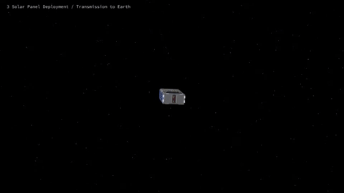
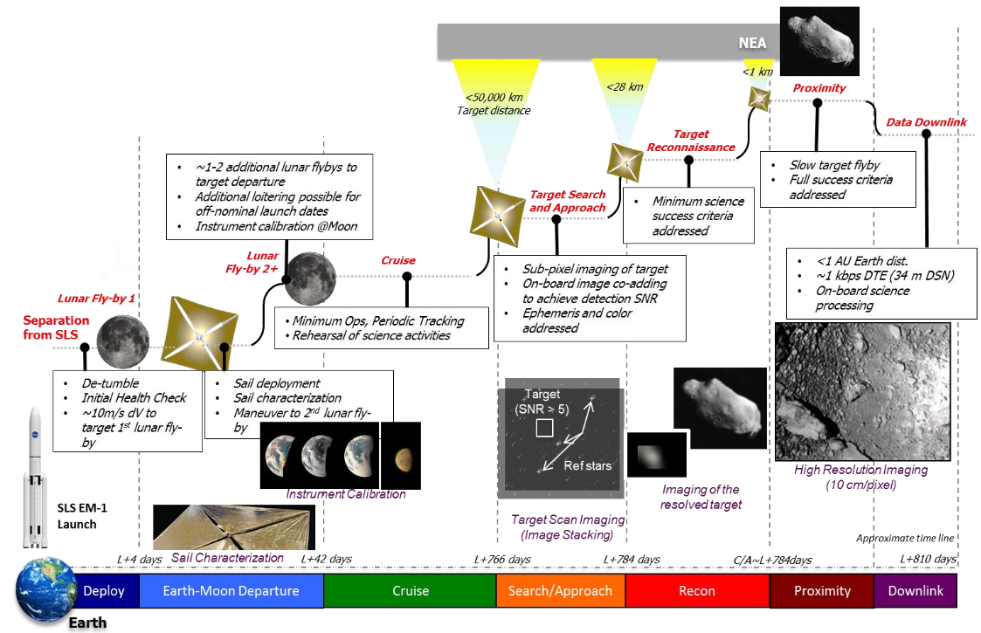
Concept of Operations Overview
Credit: Planetary Society, Jason Davis

Slide 6
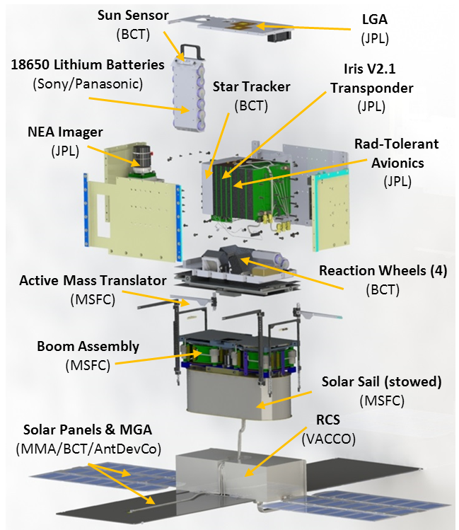
Flight System Overview
Payload | Updated OCO3 Context Camera
Mechanical & Structure | “6U” CubeSat form factor <14 kg total launch mass Modular flight system concept
Propulsion | ~86 m² aluminized CP-1 solar sail (based on NanoSail-D2)
Avionics | Radiation tolerant architecture
Electrical Power System | Trifold deployable solar arrays with GaAs cells (~51.2 W EOL at 1 AU solar distance) 6.2 Ah Battery 10 -12.3 V unregulated, 5 V/3.5 V regulated
Telecom | JPL Iris 2.1 X-Band Transponder; 4 W RF output power supports doppler, ranging, and D-DOR 2 pairs of INSPIRE-heritage LGAs (RX/TX) 8x8 element microstrip array MGA (TX); ~1 kbps to 34m DSN at 0.8 AU
Attitude Control System | 15 mNm-s (x4) Active mass translation system VACCO R-236fa (refrigerant gas) Reaction Control System Nano StarTracker, Coarse Sun Sensors & MEMS IMU for attitude determination

Slide 7
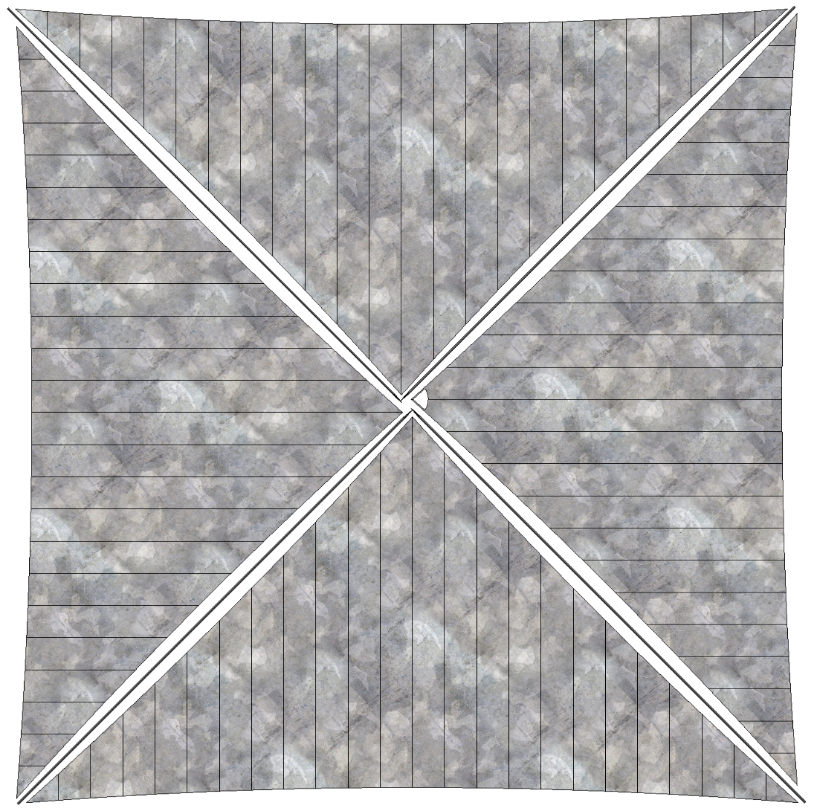



NEA Scout Approximate Scale
Deployed Solar Sail
Credit: NASA MSFC
Deployed Solar Sail
Folded, spooled and packaged in…
Human
6U Stowed Flight System
School Bus

Slide 8
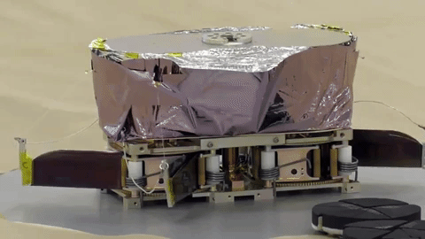
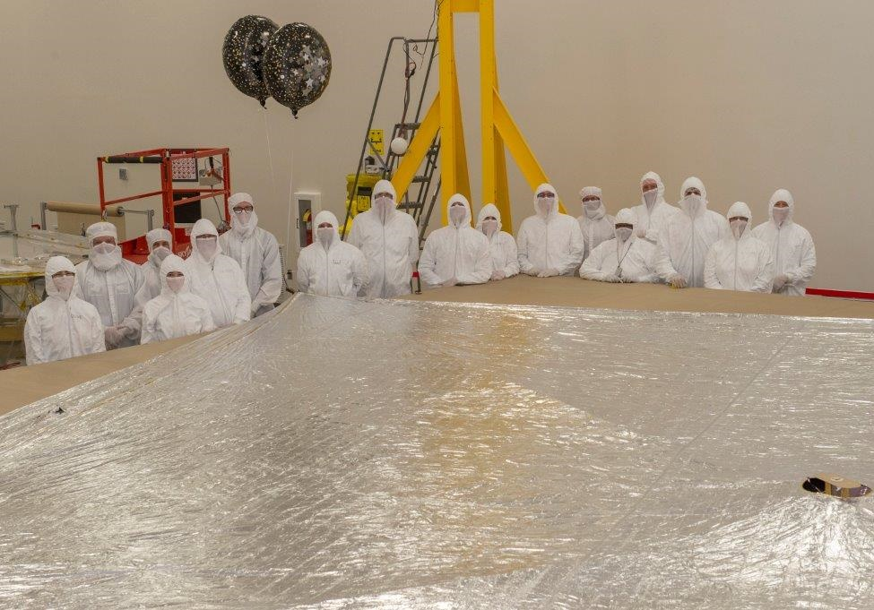
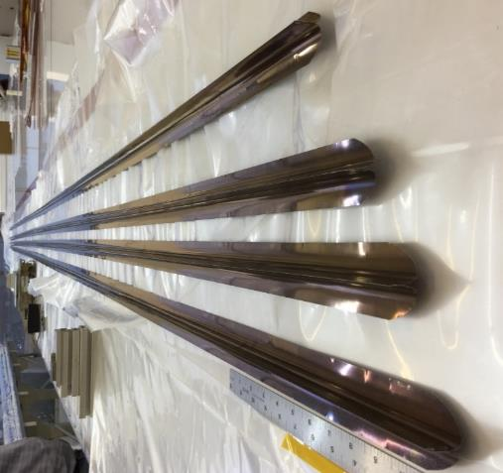
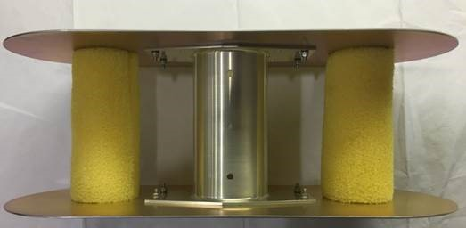
Solar Sail Construction and Deployment
Credit: Planetary Society, Jason Davis
Credit: NASA MSFC
Credit: NASA MSFC
Credit: NASA MSFC

Slide 9
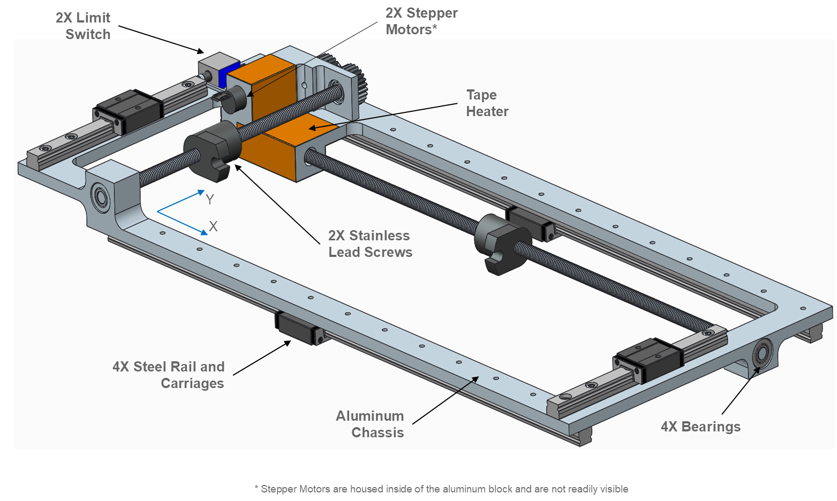
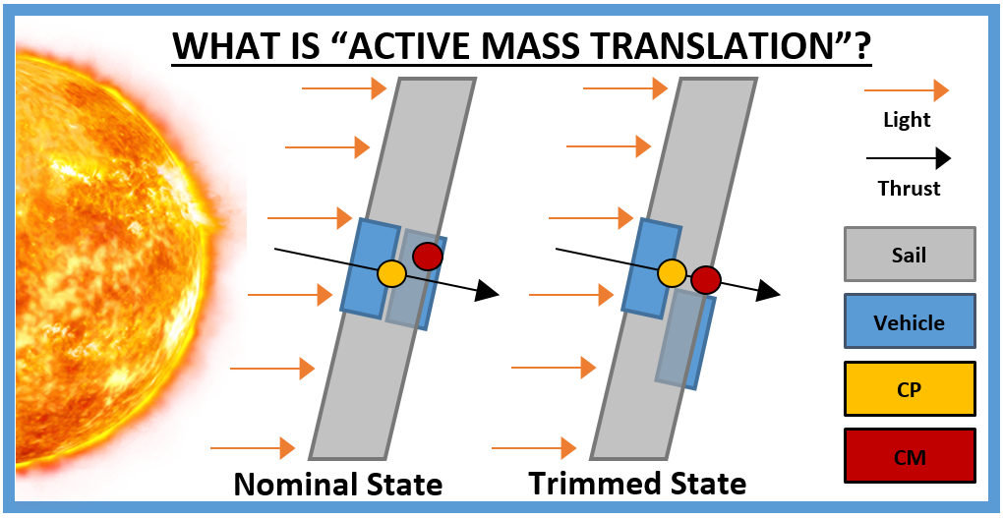
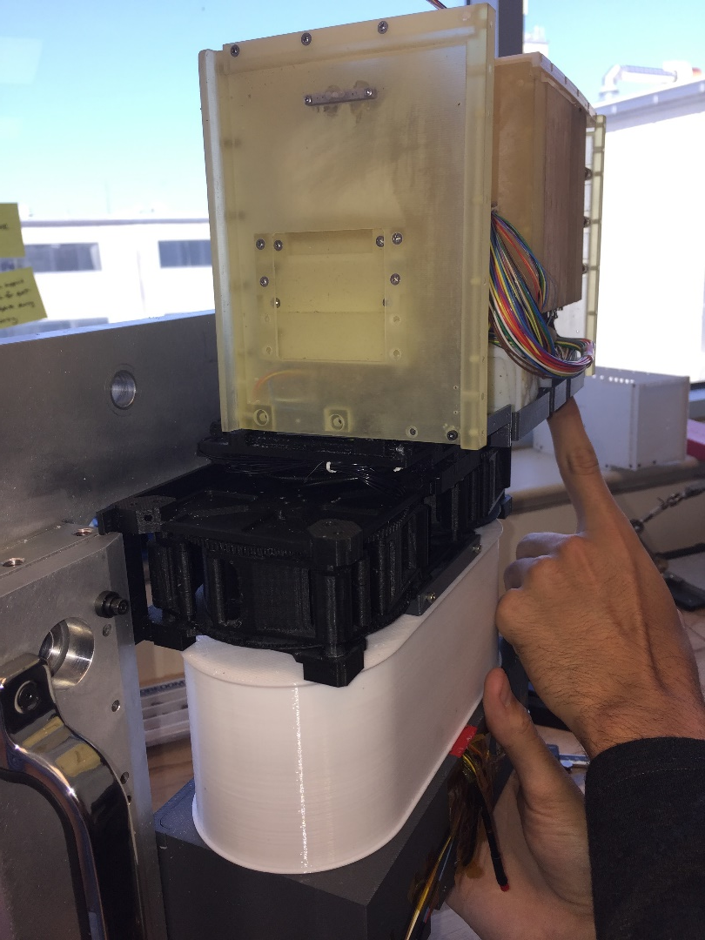
Active Mass Translator
Credit: NASA MSFC
Credit: NASA MSFC
The AMT will move one portion of the NEA Scout relative to the other.
This translation of mass will alter the inertial properties of the vehicle and align the Center of Pressure (CP) and Center of Mass (CM)
Check-out of AMT translation on a 3D printed model

Slide 10
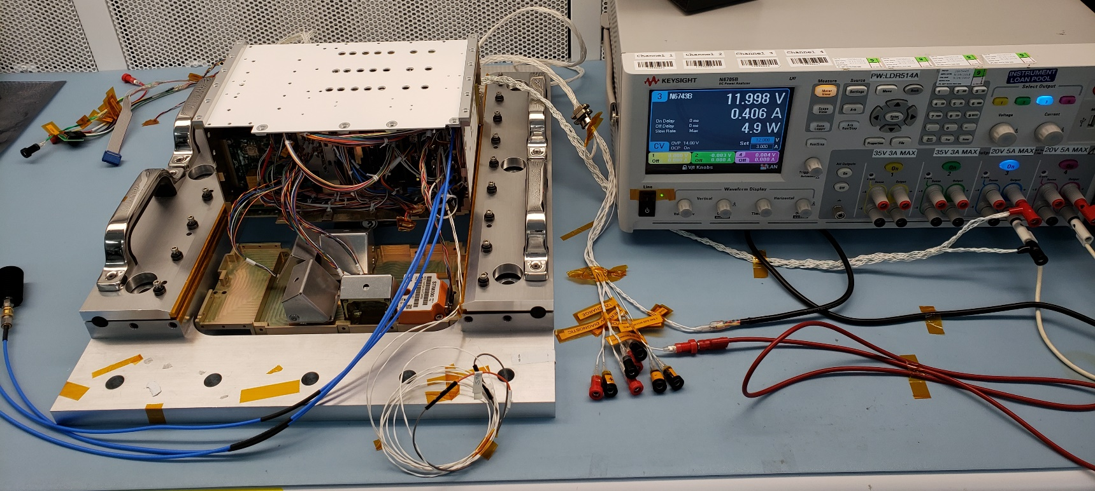
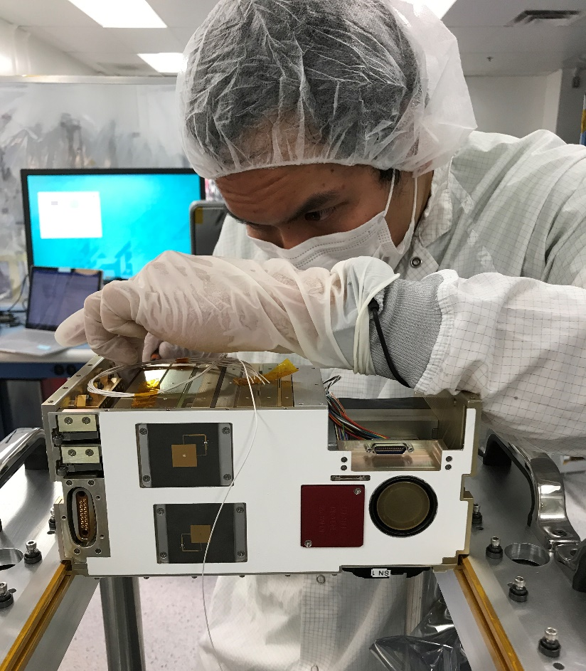
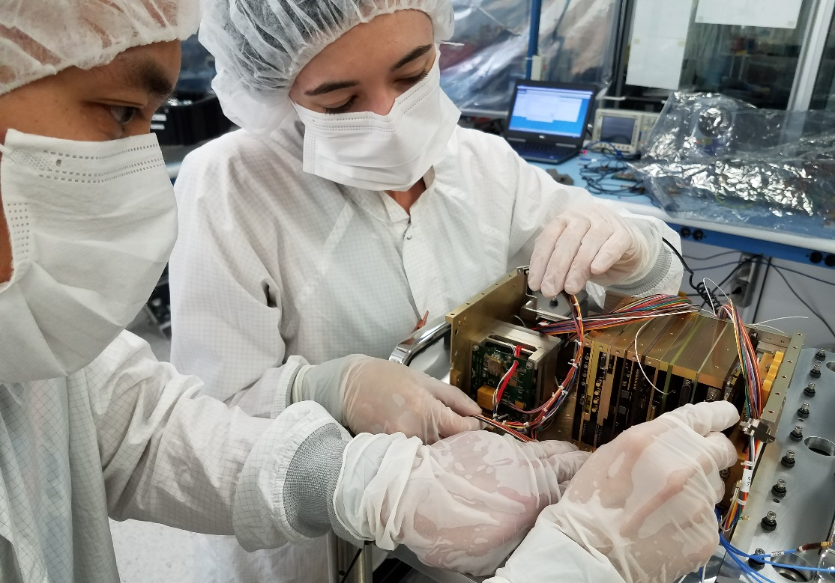
Avionics Box Assembly and Testing
All flight hardware in-hand
  Camera
  Iris radio (just passed DSN compatibility testing!)
  Star tracker, reaction wheels, IMU, sun sensor
  JPL Sphinx rad-hard processor
  Custom interface board
  EPS, battery
  Interface board
  Chassis
Mechanical fit checks completed
Final flight assembly and functional test campaign before delivery to full spacecraft integration (summer 2019)
NASA/JPL
NASA/JPL
NASA/JPL

Slide 11
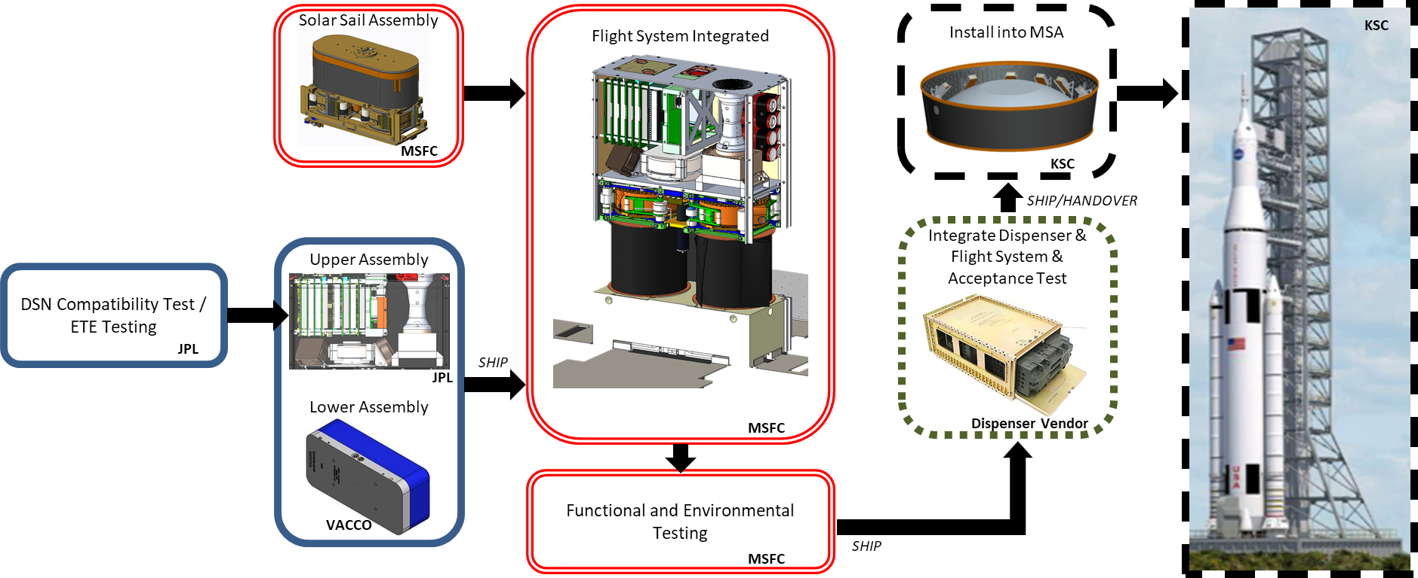
Assembly, Integration, and Test (AI&T) Overview

Slide 12
Questions?
© 2019. All rights reserved.

