Slide 1
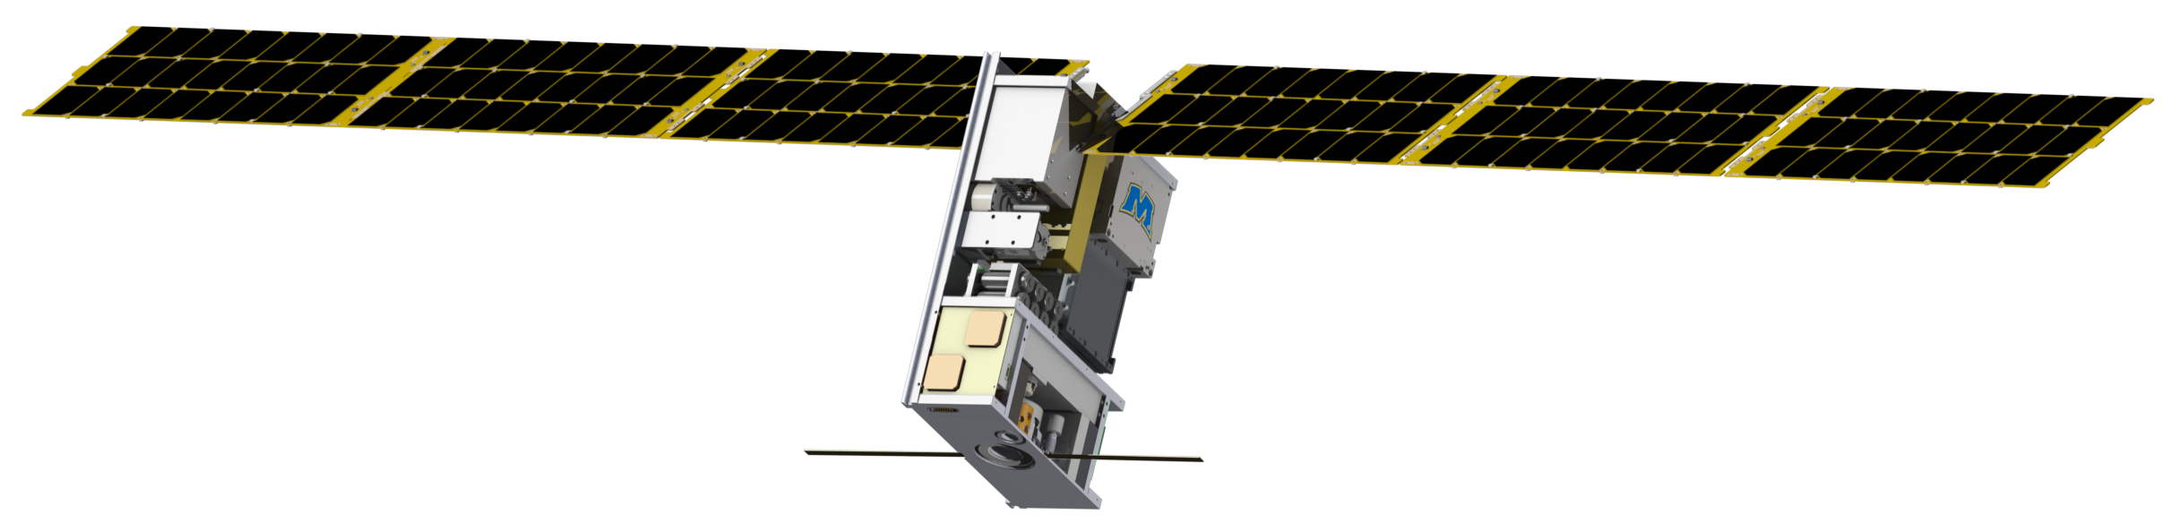
The Lunar Ice Cube Missions
P.E. Clark (CalTech/JPL),
B.Malphrus (Morehead State University),
W. Farrell, N. Petro, R. MacDowall, T. Hurford, and C. Brambora (NASA/GSFC)
and members of the Lunar ICe Cube Team
National Aeronautics and Space Administration
Jet Propulsion Laboratory
California Institute of Technology
Pasadena, California
www.nasa.gov
© 2016. All rights reserved.
Government sponsorship acknowledged.
Jet Propulsion Laboratory
California Institute of Technology

Slide 2
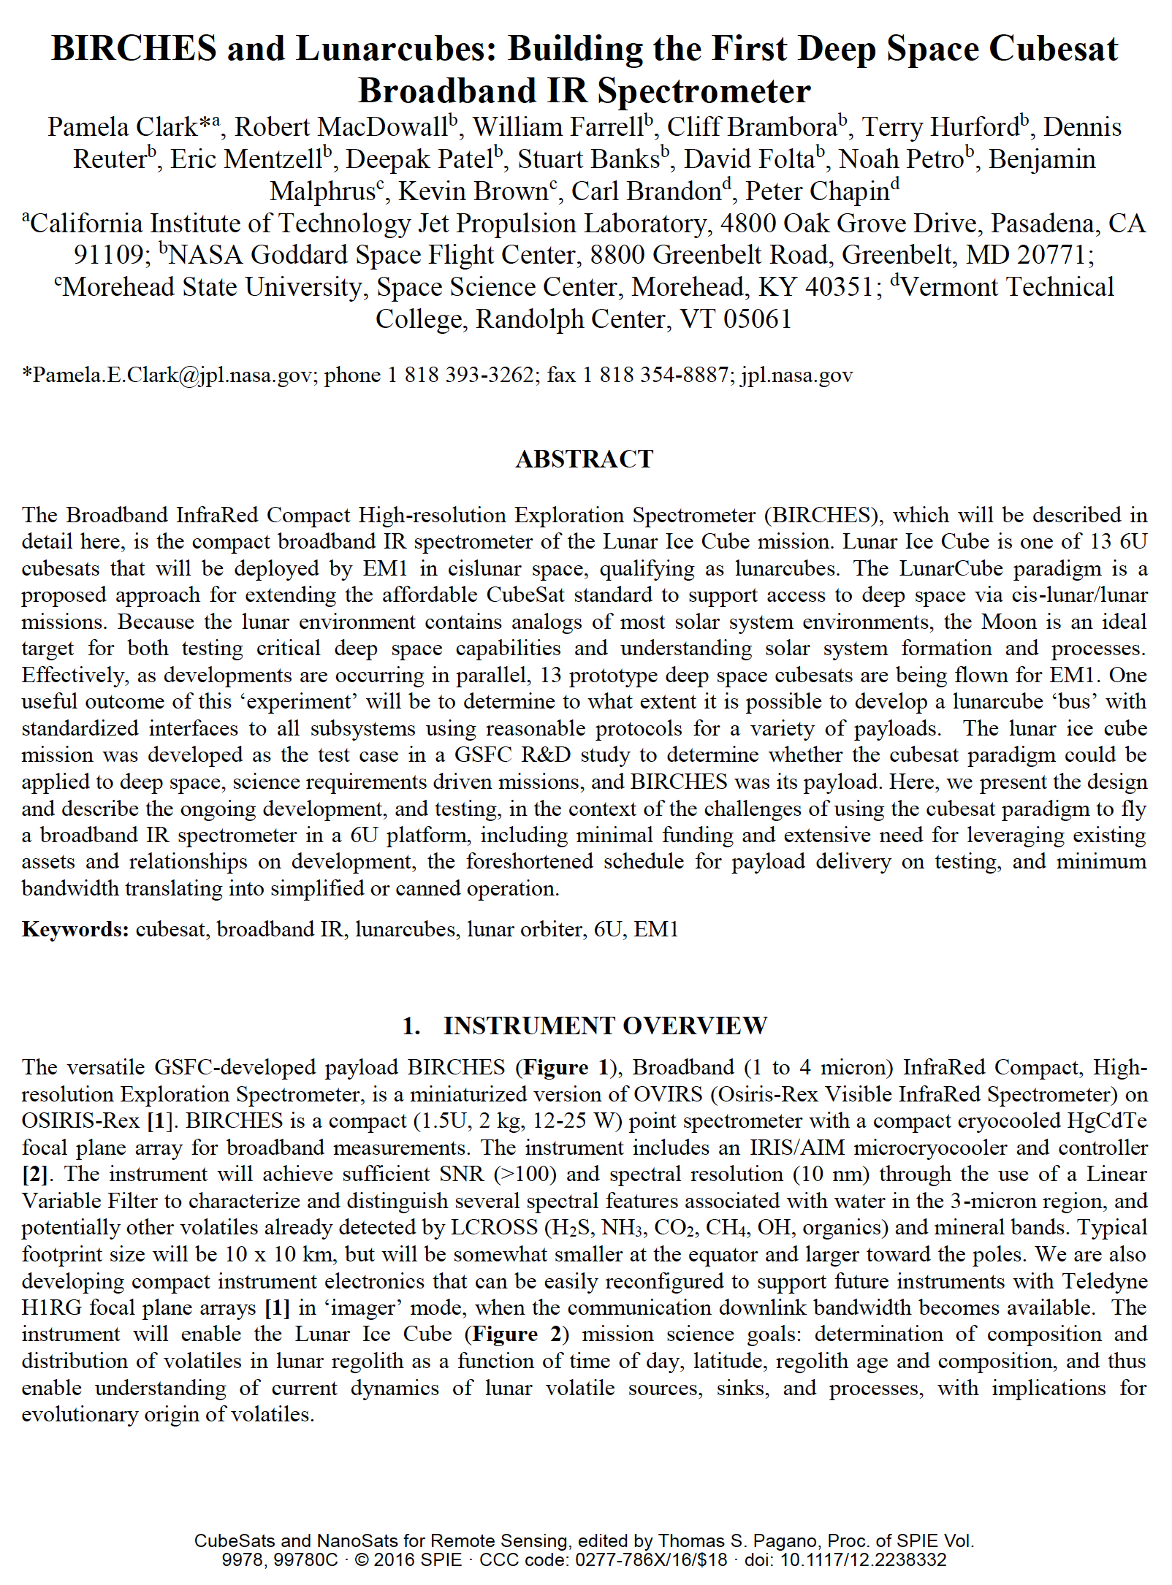
Current Status
EM1 Launch now 2020.
Publications (Source): Online Presentations, Short papers for 2015 at LPSC, LEAG, and Interplanetary SmallSat Conference. Papers, Clark et al, 2016, 2018, SPIE Optics; 2018 Small Satellite Conference
For Lunar Ice Cube Science:
Now completed or in I&T phase for all subsystems
BIRCHES now undergoing optical, digital, and radiometric calibration in simulated environment
FlatSat with emulators testing all subsystems
End to End tests scheduled for summer.
Ready for Data System testing for Level 0 data production this summer. Level 1 data analysis software development will begin this summer.

Slide 3
Significance of Water
Relevance to NASA | Growing Evidence for Global Distribution
HEOMD Strategic Knowledge Gaps: 1) Temporal Variability and Movement Dynamics of Surface-Correlated OH and H2O deposits toward permanently shadowed area retention (Lunar Ice Cube) 2) Composition, Form and Distribution of Polar Volatiles (Lunar Flashlight, LunaH Map) 3)Quality/quantity/distribution/form of H species and other volatiles in mare and highlands regolith (Lunar Ice Cube) SMD Decadal Survey: understanding solar system formation, and evolution of the lunar surface and atmosphere by further establishing the role of surface volatiles SMD Scientific Context for Exploration of the Moon: Using the Moon to study regolith, exosphere (including water vapor) processes on airless bodies | Evidence for surface ice near both poles (cold traps). Evidence for bound water in volcanic deposits. Evidence for hydroxyl (OH) and water varying as function of of temperature (local time of day) and illumination (slope orientation) in 100's of PPM range.

Slide 4
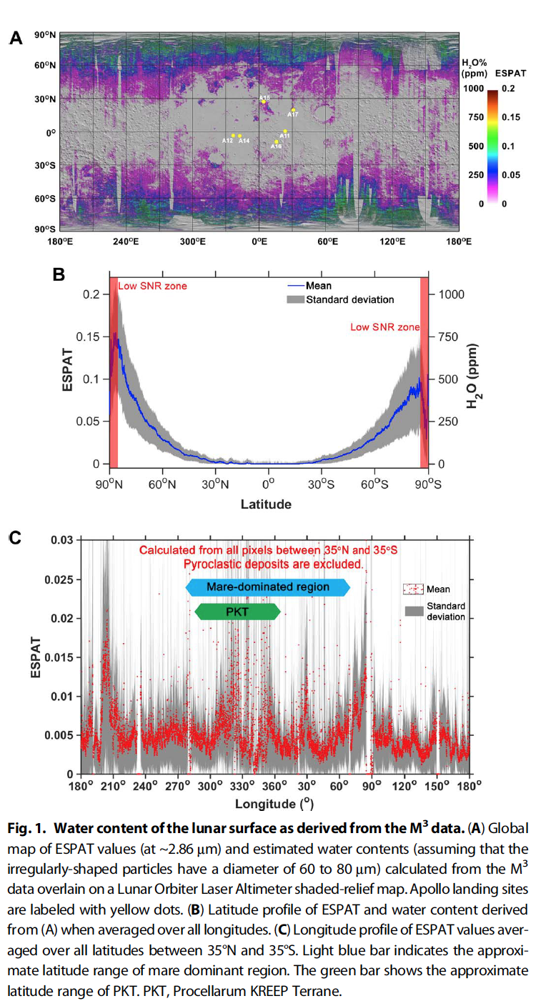
Further Evidence for Water
Map of 2.85 u Effective Single Particle Absorption Thickness (ESPAT) derived from M3 at low lunar latitudes. Features apparently associated with pyroclastic deposits, lending credence to hypothesis of volatile-rich (hundreds ppm) sources in mantle. A aristarchus; O orientale, RB Rima Bode, SG Sulpicius Gallus, TL Taur-Littrow. Milliken and Li, 2017.
M3 calculated ESPAT estimated water content (Apollo landing sites in yellow) map (A), all longitude-averaged latitude profile (B), and +/- 35 degree latitude-averaged longitude profile (C). Li and Milliken, 2017.
M3 calculated ESPAT estimated water content (Apollo landing sites in yellow) map (A), all longitude-averaged latitude profile (B), and +/- 35 degree latitude-averaged longitude profile (C). Li and Milliken, 2017.

Slide 5
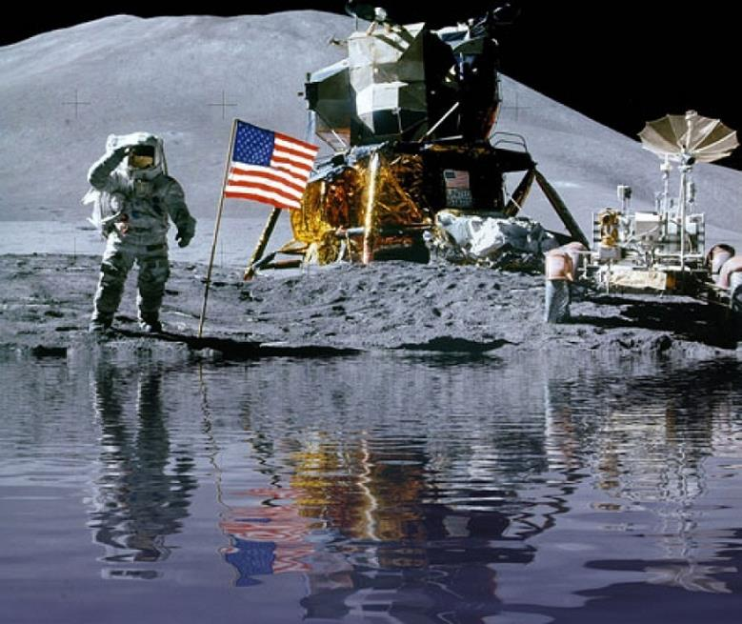
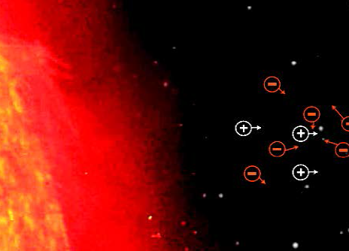
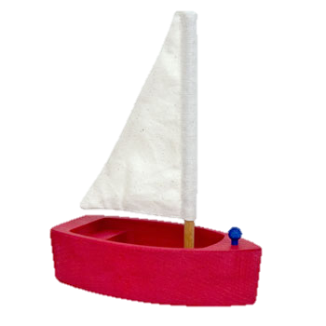
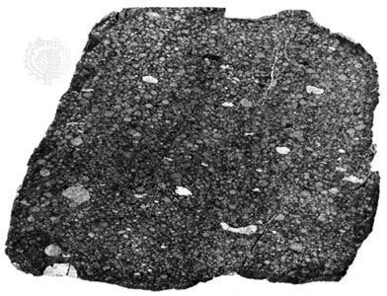
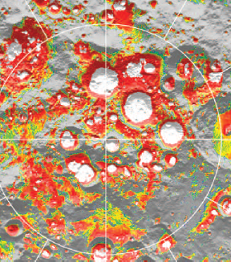
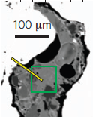
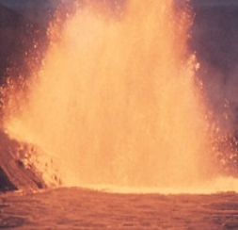
A Lunar Water System
∂ W/∂t + ∇• (Wv) = S_{SW} + S_{infall} + S_{poles}
- R_{desorp} – R_{photodiss} – R_{sputter} – R_{impactvapor}
W water V volatile S source R remove
IC Lunar Ice Cube LM LunaH-Map LF Lunar Flashlight
LM
LF
Solar
Wind (H+)
Meteoric
Infall (W, OH, V)
H⁺
Hydrogen
Sub-Cycle
W, OH, V
H
IC
LM
LF
H₂
W
V
OH
Thermal
Migration
W V V W OH OH
W
Poles
(W, OH,V)
W
W V OH W OH
IC
LM
LF
W V V
W OH
W V V
W OH
LM
LF
Mineralogy (OH)
W V OH
W OH
IC
Modified from Farrell et al, 2017, LEAG
IC
Pyroclastics
(Bound H2O)

Slide 6
Technology Goals
Demonstrate Enabling Technologies for Interplanetary Cubesats
Lunar Ice Cube and LunaH Map Busek BIT 3 - High isp RF Ion Engine
BIRCHES Miniaturized (from OVIRS) broadband IR Spectrometer with integrated microcryocooler completely capturing the 3 micron region with several features of interest.
Space Micro C&DH- Inexpensive Radiation-tolerant Subsystem
Lunar Ice Cube and LunaH Map: BCT- XACT/-XB1 bus ADCS (Star Tracker, Reaction Wheels)
Lunar Ice Cube and LunaH Map: JPL Iris v. 2.1 Ranging Transceiver
Planetary (PDS) Archiving on a limited budget

Slide 7
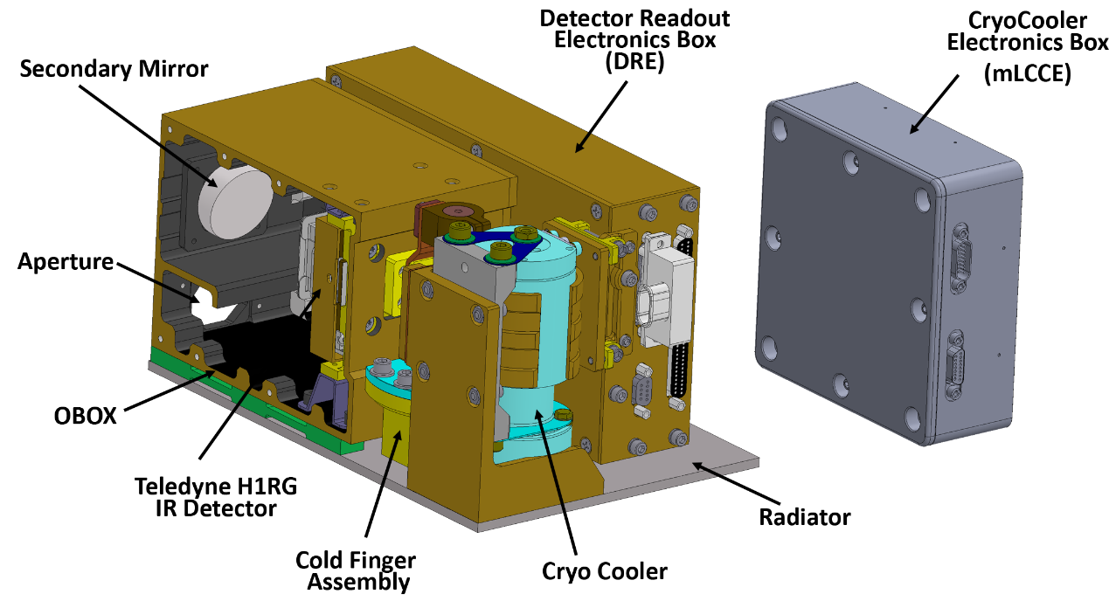
Lunar Ice Cube Instrument - BIRCHES IR SPECTROMETER
BIRCHES compactness
Property | Ralph | BIRCHES
Mass kg | 11 | 3
Power W | 5 | #10-20 W
Size cm | 49 x 40 x 29 | 10 x 10 x 15
# includes 3 W detector electronics, 1.5 W AFS controller, 5-10 W cryocooler

Slide 8
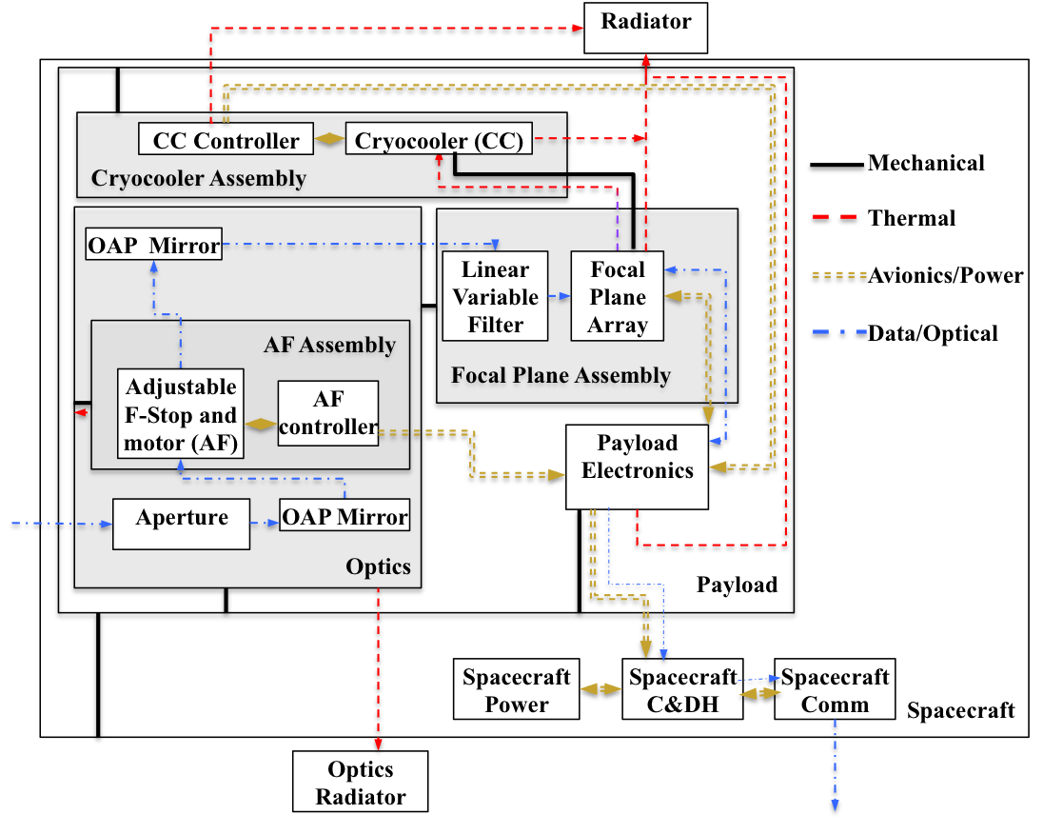
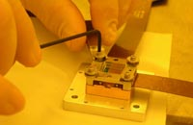
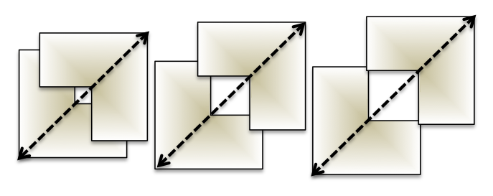
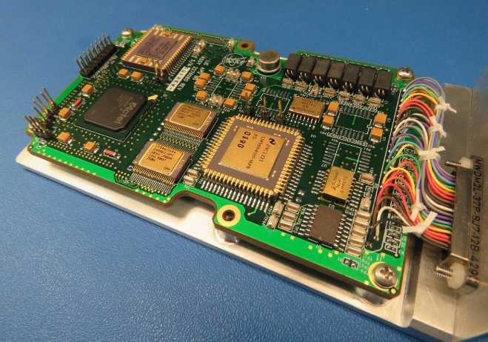
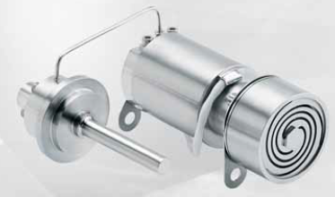
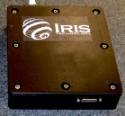
Spectrometer Schematic and Components
BIRCHES utilizes a compact Teledyne H1RG HgCdTe Focal Plane Array and JDSU linear variable filter leveraging OSIRIS REx OVIRS.
Adjustable Iris maintains footprint size at 10 km by varying FOV regardless of altitude
BIRCHES Analog Processing Unit (APU) (top)
COTS AFRL developed AIM SX030 microcryocooler with cold finger to maintain detector at ≤115K and iris controller

Slide 9
Species | μm | description
Water Form, Component
water vapor | 2.738 | OH stretch
 | 2.663 | OH stretch
liquid water | 3.106 | H-OH fundamental
 | 2.903 | H-OH fundamental
 | 1.4 | OH stretch overtone
 | 1.9 | HOH bend overtone
 | 2.85 | M3 Feature
 | 2.9 | total H2O
hydroxyl ion | 2.7-2.8 | OH stretch (mineral)
 | 2.81 | OH (surface or structural) stretches
 | 2.2-2.3 | cation-OH bend
 | 3.6 | structural OH
bound H2O | 2.85 | Milliken and Li
 | 3 | H2O of hydration
 | 2.95 | H2O stretch (Mars)
 | 3.14 | feature w/2.95
adsorbed H2O | 2.9-3.0 | R. Clark
ice | 1.5 | band depth-layer correlated
 | 2 | strong feature
 | 3.06 | Pieters et al
Other Volatiles
NH3 | 1.65, 2. 2.2 | N-H stretch
CO2 | 2, 2.7 | C-O vibration and overtones
H2S | 3
CH4/organics | 1.2, 1.7, 2.3, 3.3 | C-H stretch fundamental and overtones
Mineral Bands
pyroxene | 0.95-1 | crystal field effects, charge transfer
olivine | 1, 2, 2.9 | crystal field effects
spinels | 2 | crystal field effects
iron oxides | 1 | crystal field effects
carbonate | 2.35, 2.5 | overtone bands
sulfide | 3 | conduction bands
hydrated silicates | 3-3.5 | vibrational processes
anticipate wavelength of peak for water absorption band to be structural<bound<adsorbed<ice

Slide 10
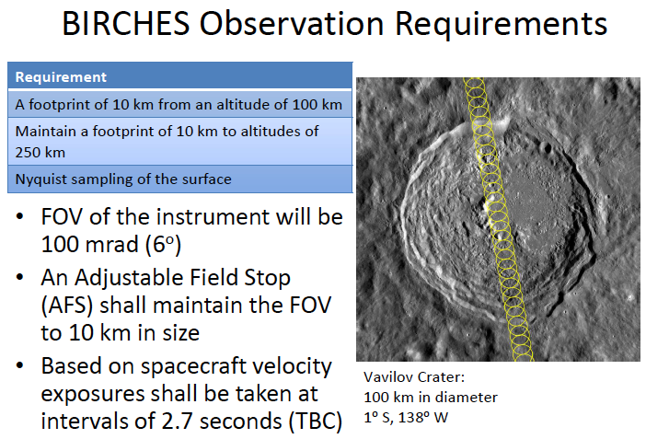
Footprint 10 km in along track direction regardless of altitude, consecutive observations separated by a couple of kilometers; greater overlap of consecutive tracks at poles, separted by a couple of kilometers

Slide 11
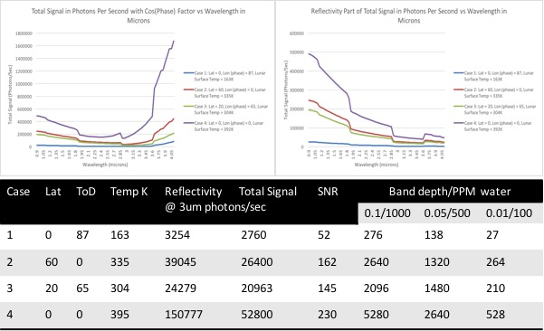

Slide 12
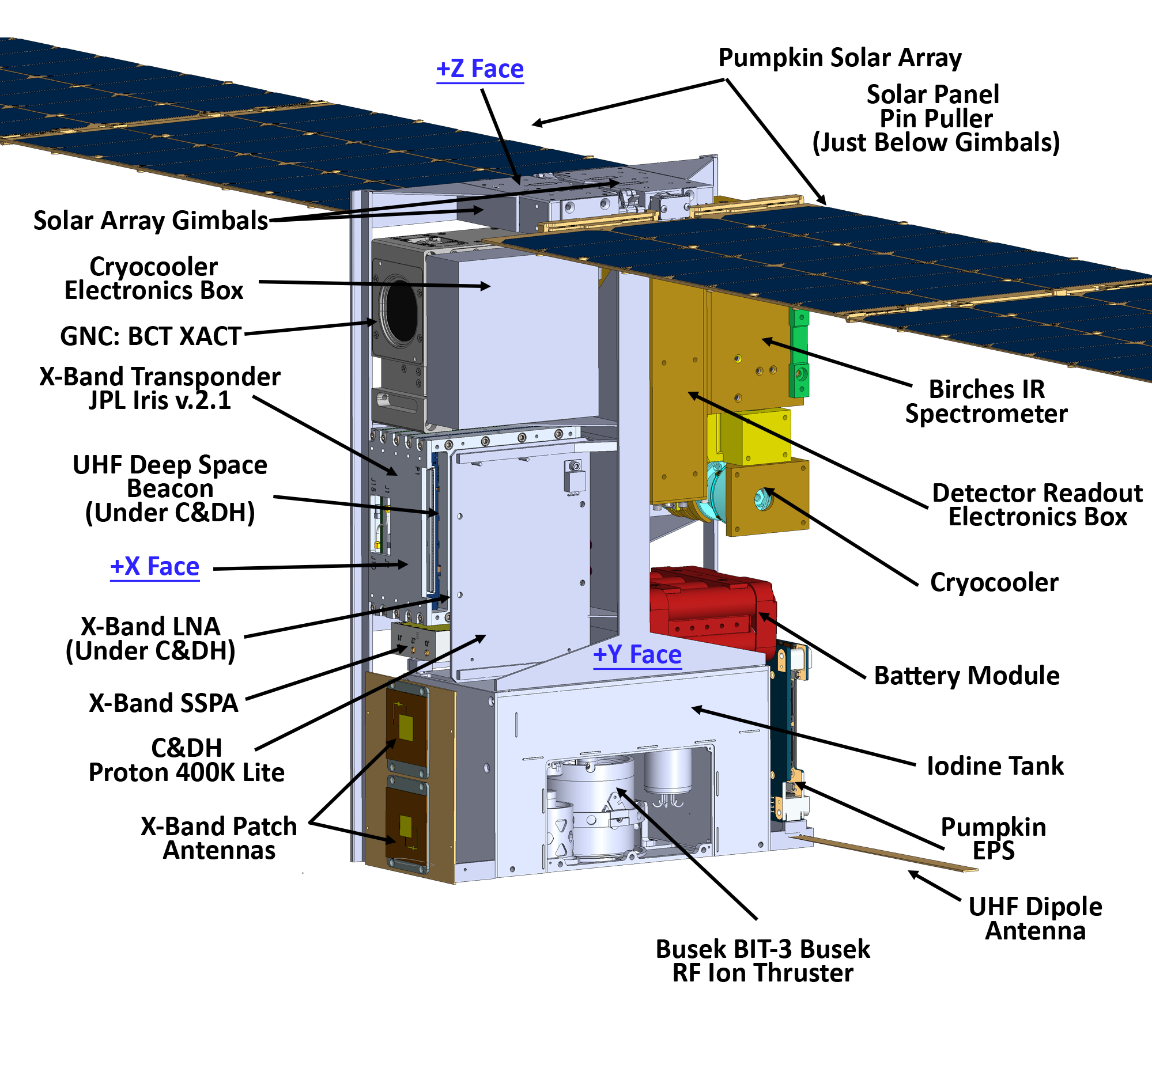
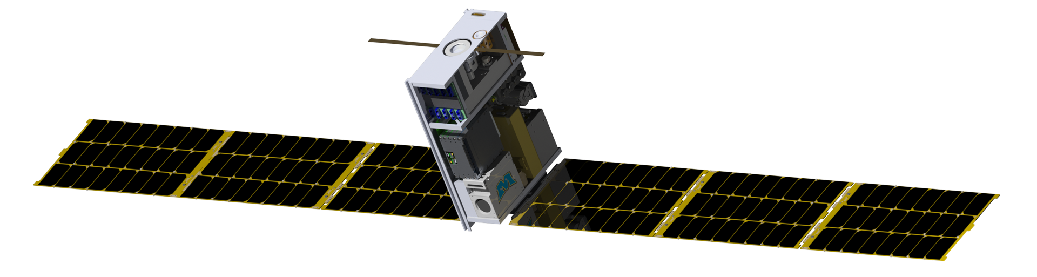
Lunar Ice Cube Bus
Pumpkin Solar Arrays
Cryocooler Electronics Box
GNC: BCT XACT
Solar Arrays Gimbals
Proton 400K Lite (Under Transponder)
X-Band Transponder
Pumpkin EPS
UHF Deep Space Beacon
UHF Dipole Antenna
Busek Bit-3 RF Ion Thruster
BIRCHES IR Spectrometer
Iodine Tank
Cryocooler
Battery Module
X-Band LNA
X-Band SSPA

Slide 13
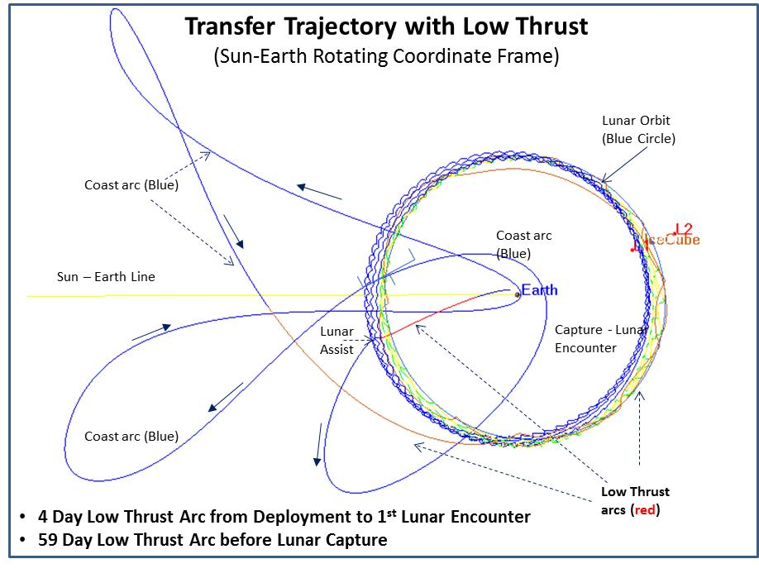
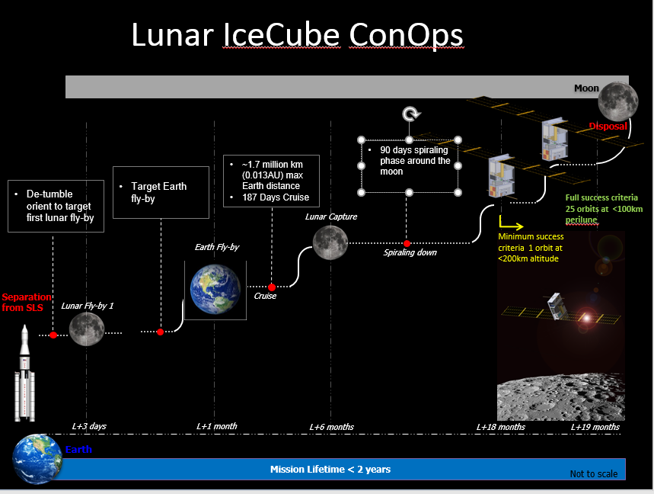
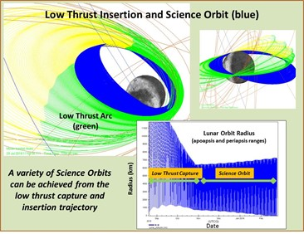
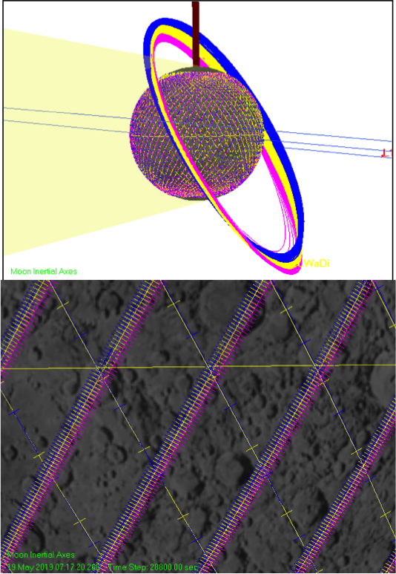
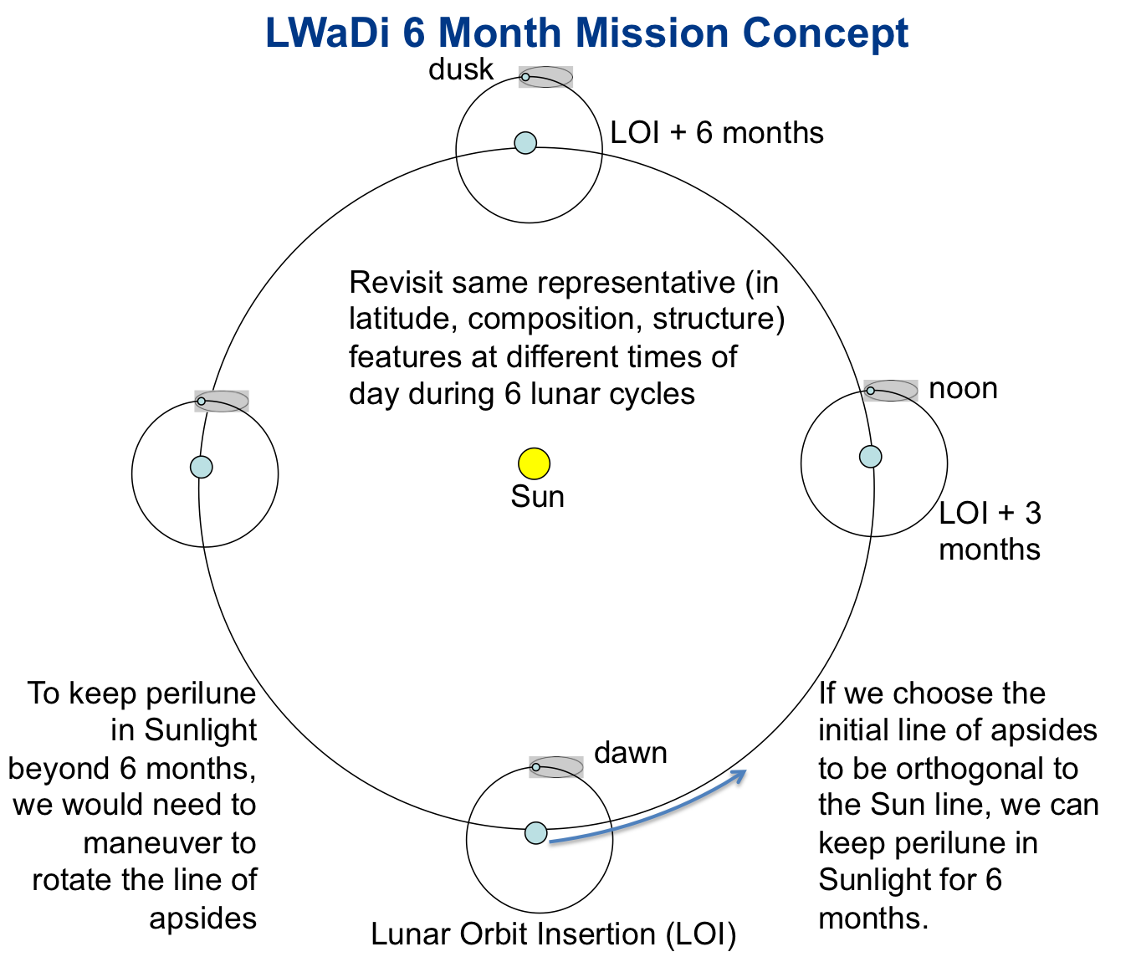
Lunar Ice Cube MIssion Concept

Slide 14
Planned Lunar Cubesat Payloads
Mission | Goal | Program
Lunar Ice Cube | Orbit, any form or state of water, as function of time of day | NASA HEOMD, EM1
Lunar Flashlight | Orbit, South Pole surface ice in PSRs | NASA HEOMD, EM1
LunaH-Map | Orbit, South Pole, ice on surface to 1 meter depth | NASA/SMD, EM1
LunIR | flyby, lunar regolith properties | NASA HEOMD, EM1
Omotenashi | impactor, radiation | JAXA (on EM1)
Team Miles | CubeQuest, demonstrate propulsion and communication milestones | NASA STMD, EM1
CUE3 | CubeQuest, demonstrate propulsion and communication milestones | NASA STMD, EM1
Cislunar Explorers | CubeQuest , demonstrate propulsion and communication milestones | NASA STMD, EM1
LUMIO | L2 orbit, camera, meteoroids impacting Moon from L2 | ESA LUCE
VMMO | Orbit, Shackleton, volatiles, radiation | ESA LUCE
Proposed NASA Lunar Smallsat/Cubesat Payloads
Mission | Goal
CLPS | Small Payloads for Commercial Lunar Landers, starting in 2020
Polar Mobile | NASA instrumented Rover 2024. Rover-mounted Payload opportunities TBD
Human Landing | Return to the Moon 2025. Handheld instrument opportunities TBD
CDW 2018
Clarketal Lunar Cubesat Cluster
14

Slide 15
Challenges Summary
Challenges and Mitigations
Payload Requirements Flow down process: Realization of the need for meshing of Maker and Aerospace Engineering cultures in a way that allows trace back to payload-driven mission goals, has version controlled design and interface control documentation, and scheduled essential reviews and deliverables, and yet maintains flexibility. Learning curve for 'first deep space qualification'. Define 'threshold' early and go to threshold as cost cap issues arise.
team membership: Project can work with student team provided 1) experienced leadership with systems orientation as well as 'fixers', and 2) 'deputies' for major roles to cope with high turn over.
dealing with external management with 'Class A+' orientation or 'out of scope' requests: Be prepared to leverage collaborations, identify and scramble for sources of additional funding
Thermal design (on-orbit heat removal an issue for 6U, and on-surface heat retention during lunar night an issue if minimum resource (including cost) solutions sought: Take advantage of High performance thermal solutions now being developed.
Non-scalable (in cost and schedule) development and operation: Support and utilize design, subsystem simulation and driver tools, operating systems, operations facilities, and data delivery pipeline tools already developed or under development for cubesats.
Large uncertainties in available Infrastructure (transportation and communication): More reasonable options should be evolving now.

Slide 16
Conclusions
Lunar Ice Cube is the most operationally complex cubesat to date.
Lunar Ice Cube will provide measurements for liquid water, ice, OH distribution across the lunar surface as function of time of day (temperature and illumination) for three or more lunar cycles for pole to pole swaths of the lunar surface to provide a basis for understanding global water dynamics.
Some temporal overlap between LunaH-Map and Lunar Ice Cube will be useful in constraining the water migration process. Spatial overlap between LunaH-Map and Lunar Flashlight will be useful in constraining cold trap evolutionary processes.
Regardless of the degree of overlap in space or time, these measurements when combined will provide far more systematic understanding of the water cycle, and the accessibility of water as a resource on the Moon.
We are doing what cubesats are supposed to do: creating an innovative and tailored solution with a standard platform.

Slide 17
On to the Moon in 2020!
Join us for LunarCubes Workshop and Interplanetary Small Satellite Conferences next year!
Your challenging payload requirements needed
pamela.e.clark@jpl.nasa.gov

Slide 18
Backup Slides

Slide 19
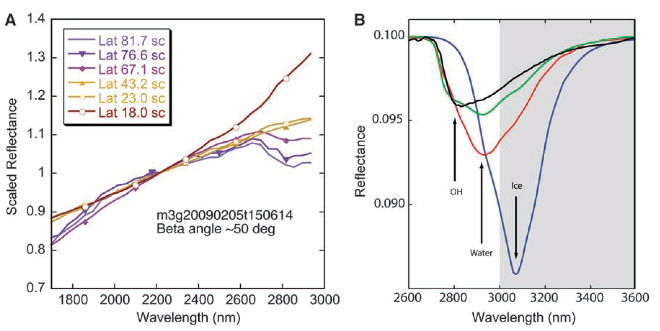
Evidence for Water
Reflectance spectra showing water and hydroxyl aborption features (near 3 microns) depth as a function of latitude. Chandrayaan M3, Pieters et al 2009
Water and Hydroxyl on Moon. Combined Red (Pyroxene), Green (Reflectance continuum), Blue (water and hydroxyl absorption) bands. Blue, Cyan, Magenta, Pink water indicators. Chandrayaan M3, Pieters et al 2009
Reflectance spectra with absorption feature strength correlated with time of day. Deep Impact Epoxi. Sunshine et al 2009

Slide 20
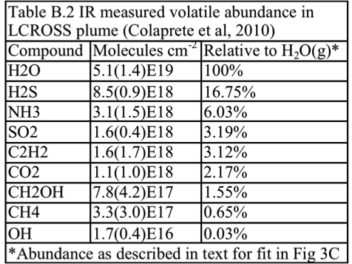
Evidence for Water

