Slide 1


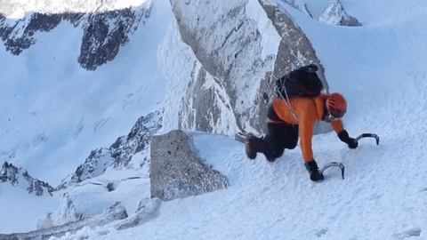
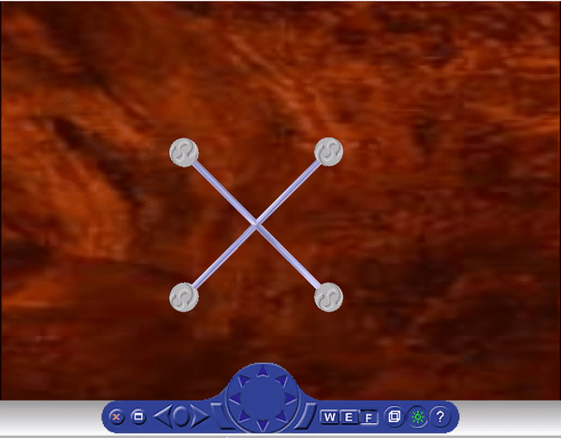
Planning and Navigation of Climbing Robots in Low-Gravity Environments
Steven Morad*, Himangshu Kalita, Jekan Thangavelautham
Space and Terrestrial Robotic Exploration Laboratory
University of Arizona
Notes:
Hi everyone, I’m steven morad and I’ll be talking to you about a robotic climbing system for low gravity environments

Slide 2
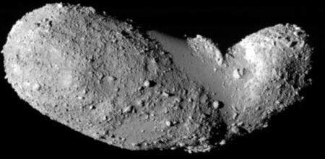
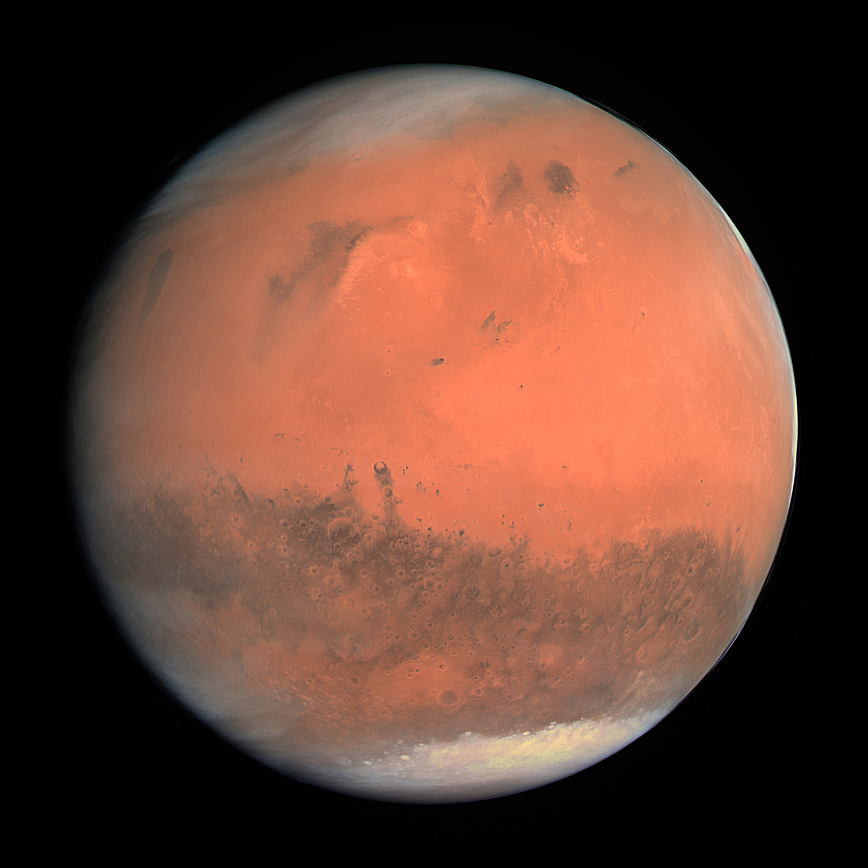
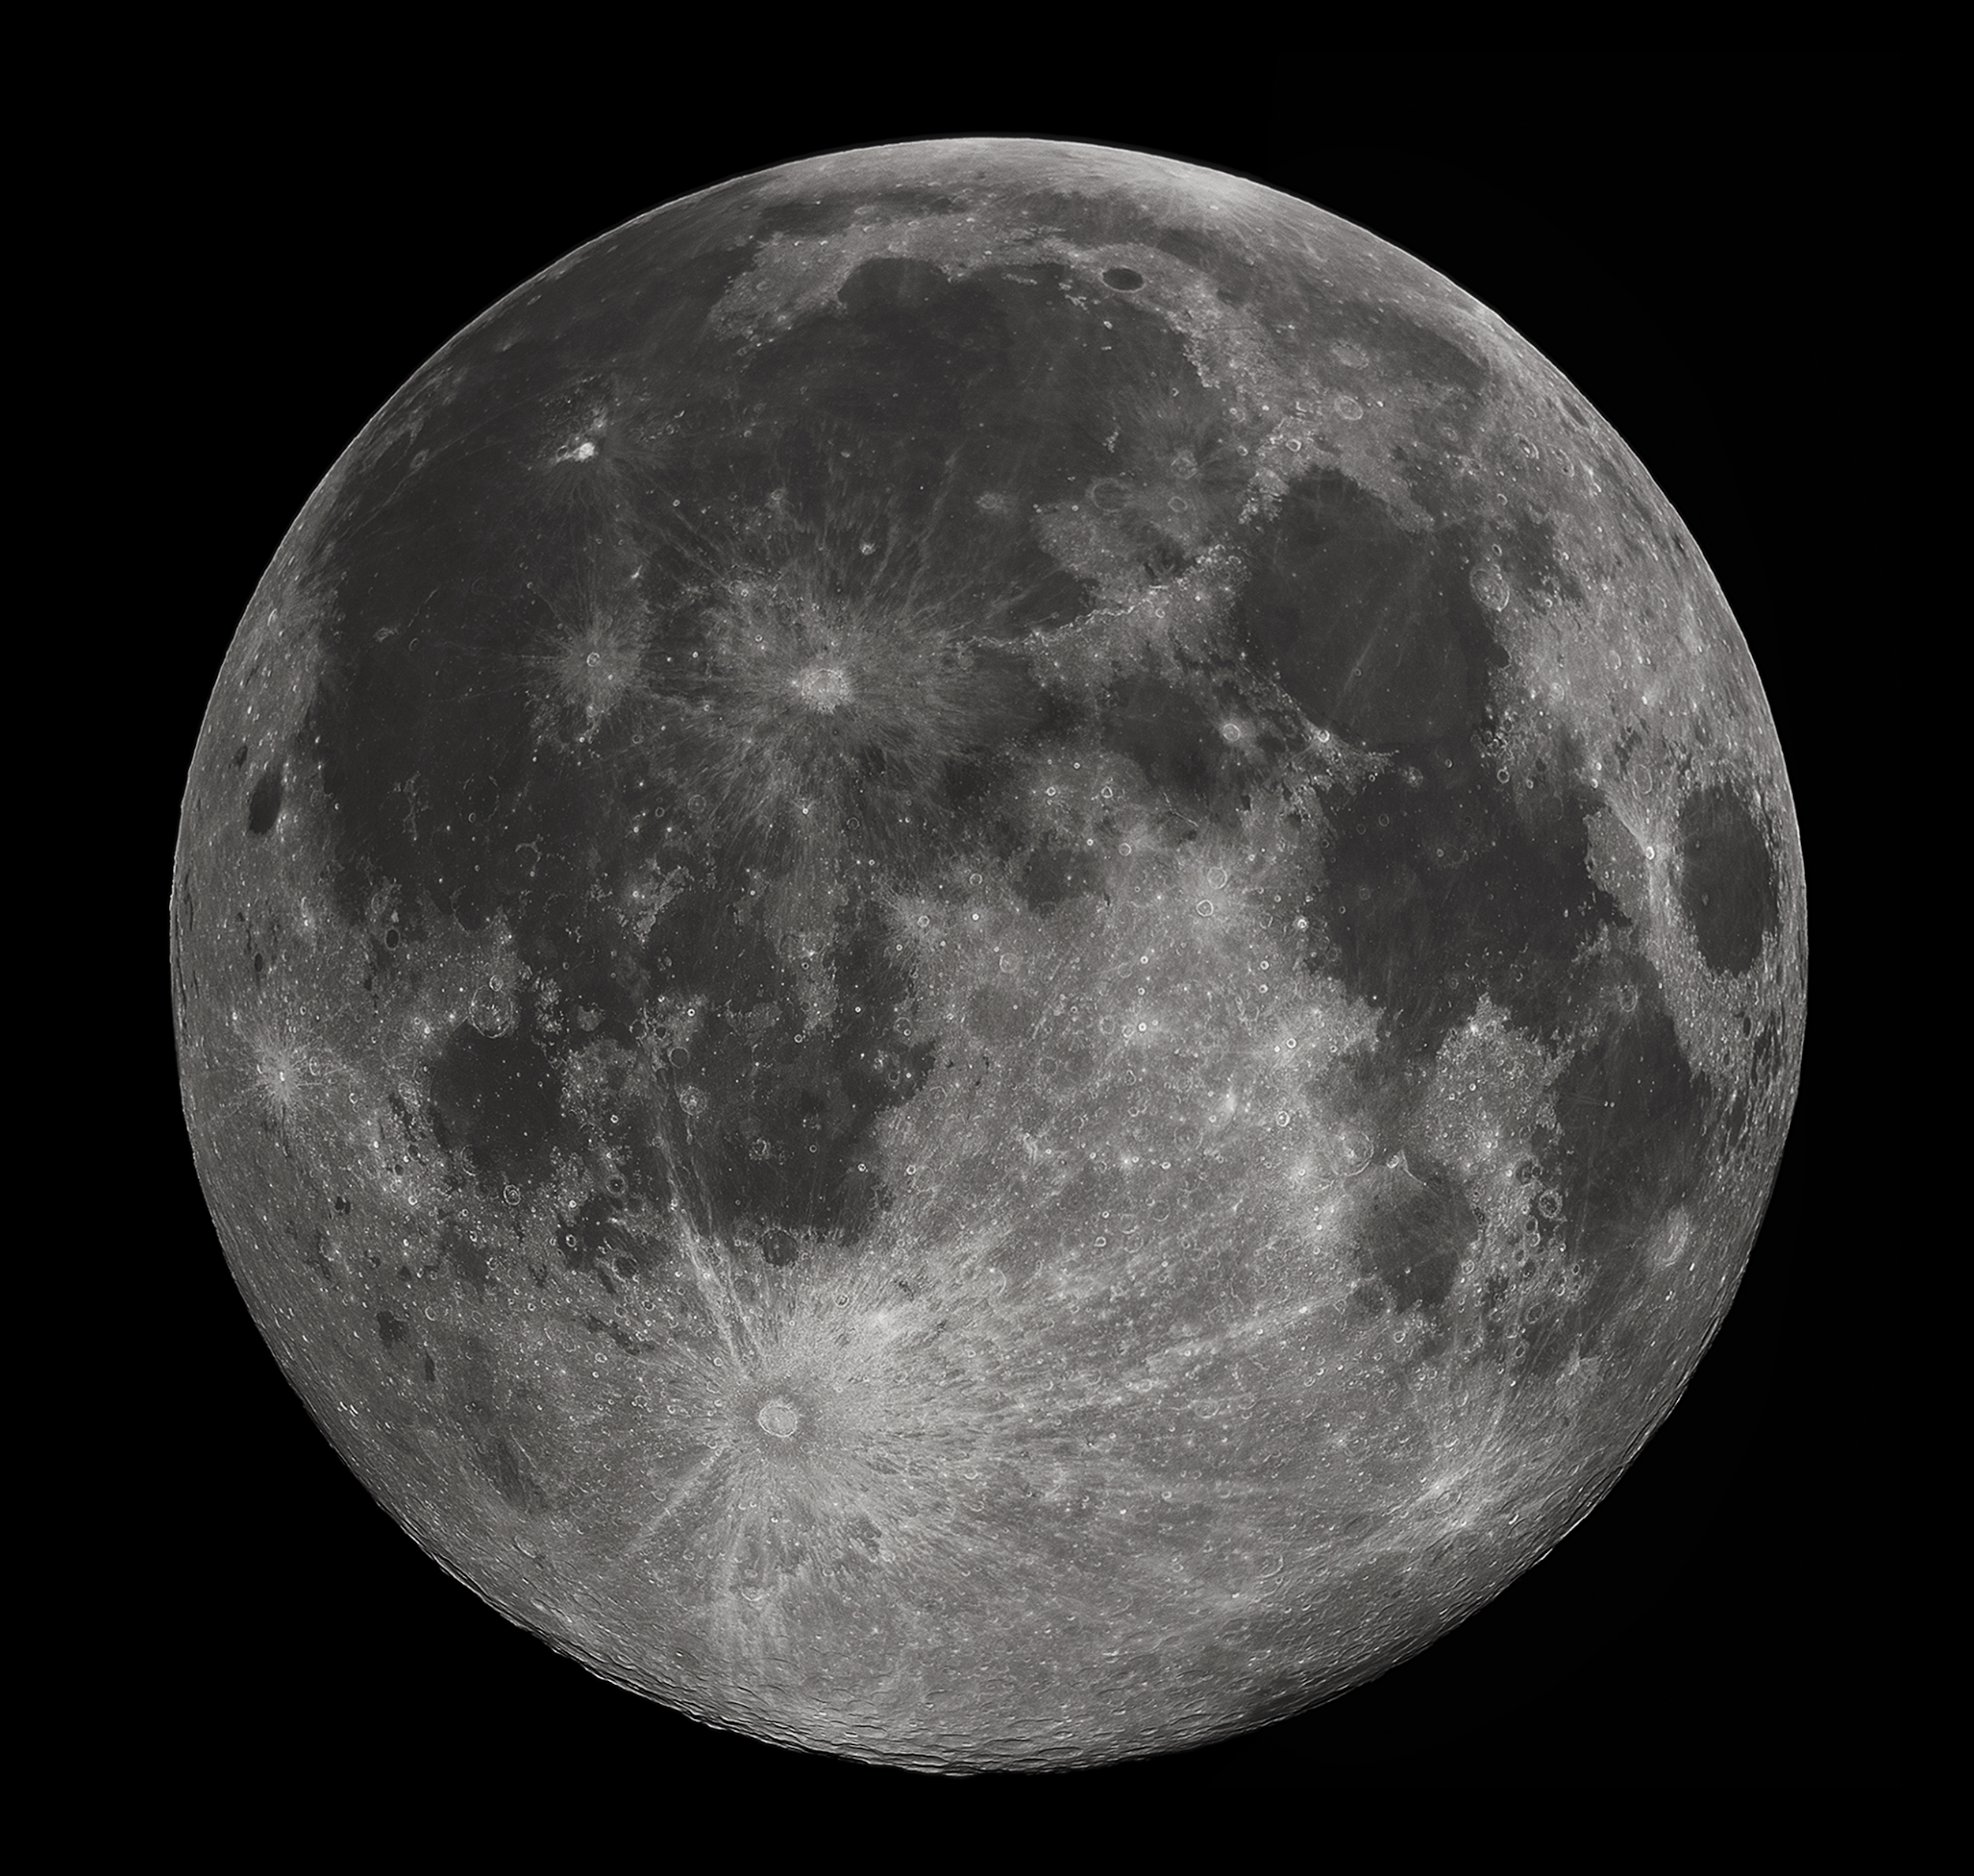
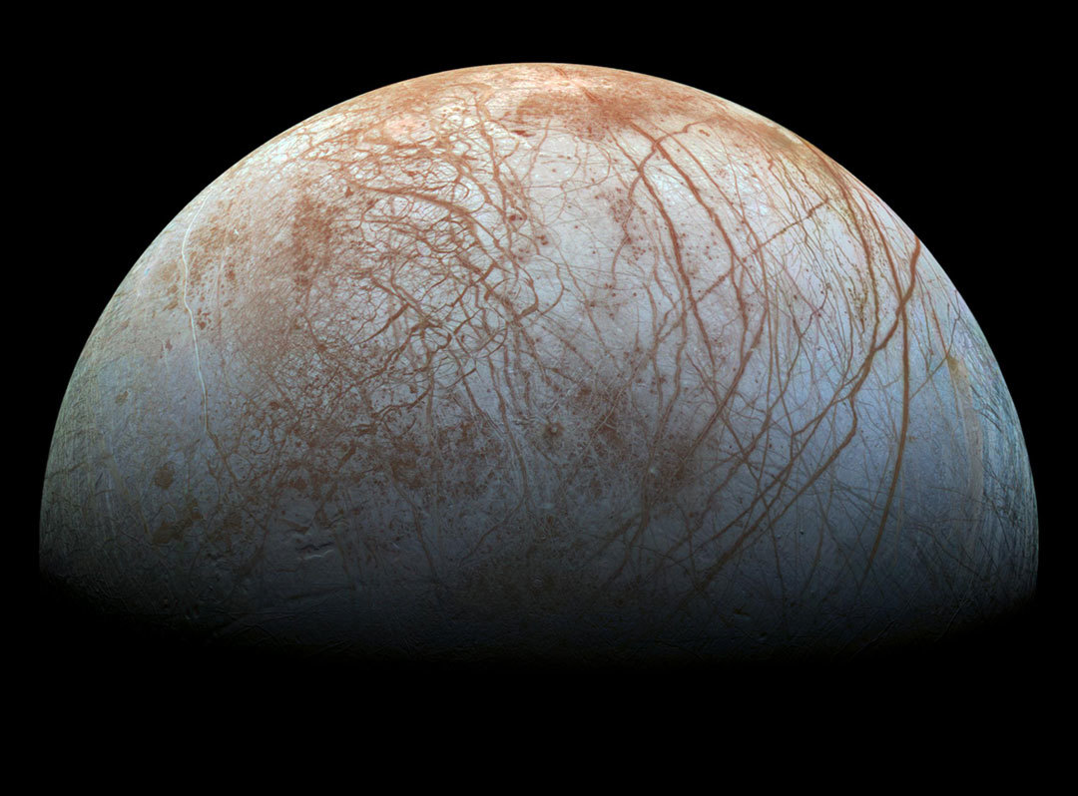
Low Gravity Environments
Notes:
So what are low gravity environments? Basically any rocky body in our solar system, it turns out Earth is pretty big.
A few examples are the asteroids, the moon, mars, and europa
Why are these places important?
They give us insight into how our solar system formed, and may one day be home to human settlements
Before that happens, we need to know more about the geological structure and formation of these bodies

Slide 3
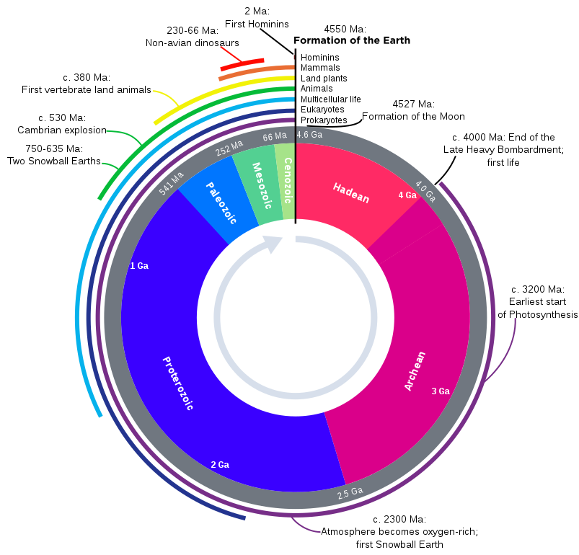
Planetary Science and Geology
Strata form the basis for the geological history of Earth
What if we could see these for other planets?
Notes:
We describe the geological history of Earth using something called the geologic time scale, shown on the right
Over billions of years, rock accumulates in layers called strata
By looking at these layers, scientists can determine the geological history of a planet using a process called stratigraphy
How can we look at these layers on other planets?

Slide 4
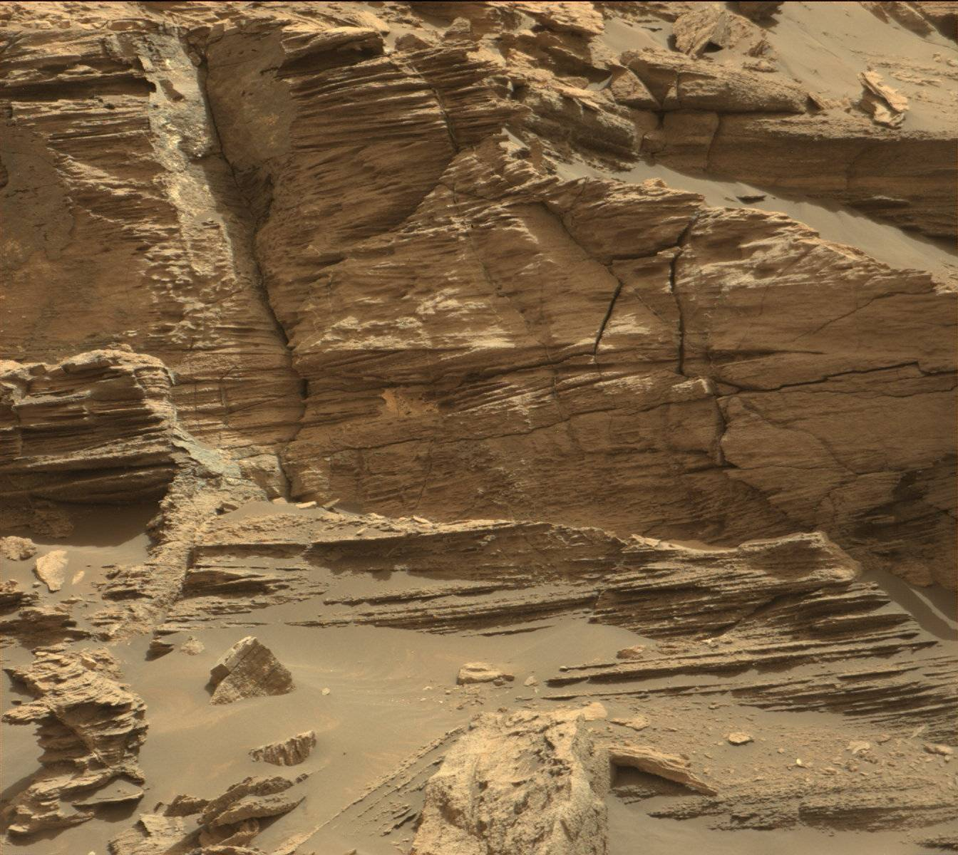
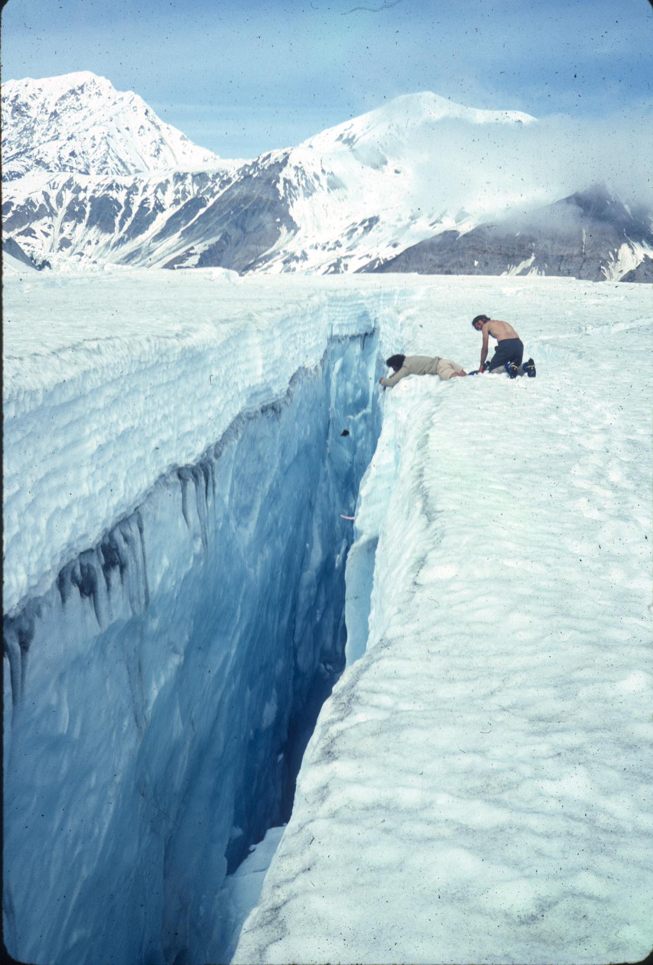
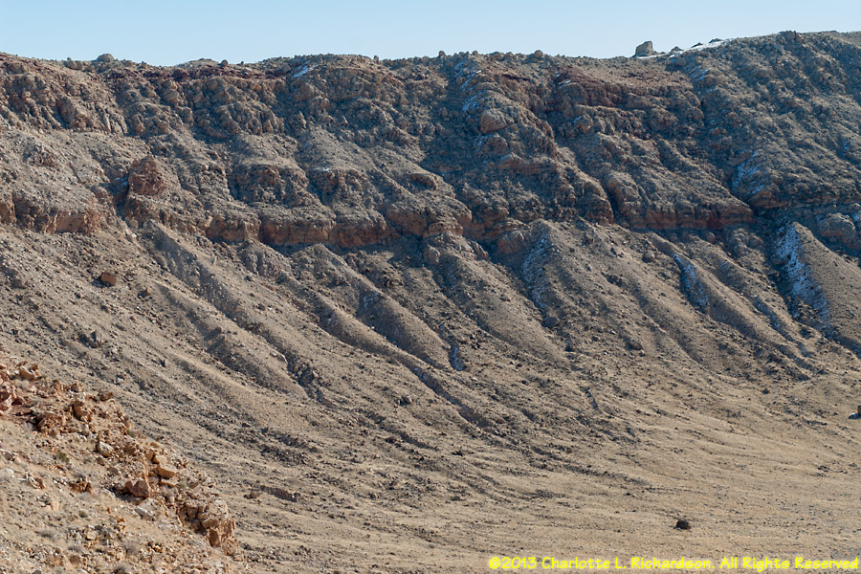
Science Targets
Cliffs
Crevasses
Crater walls
Caves
Notes:
On Earth we drill for core samples, but drilling machinery mass is in the metric tons, so good luck getting that to mars
It turns out, seismic activity, glacial tectonics, and asteroid impacts expose layers of rock or ice dating back Eons
These exposed layers are extremely useful to discovering the geological history of rocky bodies
The question is, how do we access these layers? The terrain formed by these processes is way too extreme for most wheeled rovers

Slide 5
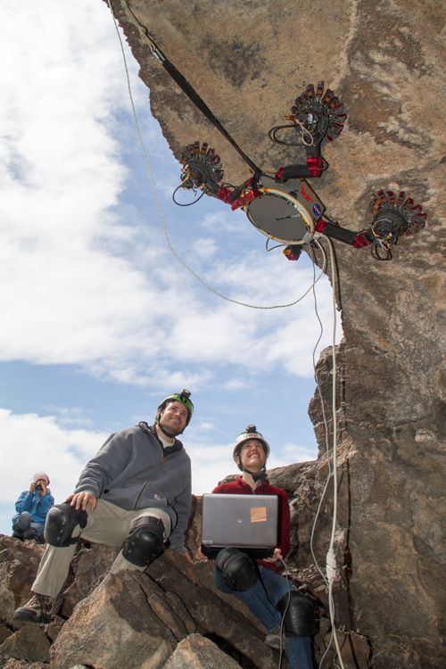
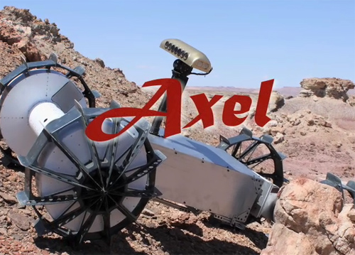
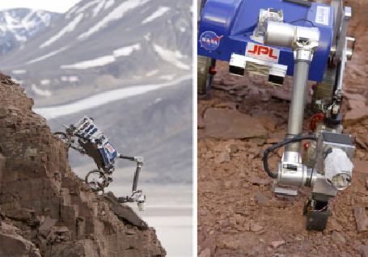
Related Work
JPL
  Axel
  TRESSA
  LEMUR-3
Notes:
JPL has a few ideas on how to reach these areas
Most of the research for extreme environment robotics has come out of either JPL or Ames
The Axel, TRESSA, and LEMUR-3 platforms are some of the more relevant projects
What other ways can we approach extreme environment exploration?

Slide 6
Alternate Means of Locomotion
What about glacial climbing?
“Rope team” robots
  Take turns moving
  Hop using microthrusters
  Cling using microspines
Notes:
What if we treat it like glacial climbing?
We’ve modeled a system based on a group of mountaineers tethered together, also known as a “rope team”
You can see the glacial climber at the top, and our robotic climbing system at the bottom
Each robot will take turns climbing
Each turn consists of two stages
The hop stage, using thrusters and reaction wheels
And the grip stage, using microspine grippers
It’s analogous to how this guy climbs using ice axes and crampons
He holds on with three limbs, and advances with the fourth limb

Slide 7
System of Autonomous Climbing Robots
Four linked hopping robots (nodes)
Redundancy allows for node failures
n0
n3
h̅
tgt
c
n1
n2
Notes:
Here is a high level diagram of our climbing system
We have four independent robots, or “nodes” n0 to n3 connected to a central floating point C using a spring-tether system
If a node fails to grip the system remains attached to the climbing surface
If a node has a system or hardware failure, it can be detached from the tether and left behind, allowing the other nodes to continue on

Slide 8
Objective
Navigate a team of climbing robots from point A to point B autonomously?
  Failure tolerant
  Close to realtime
Notes:
The question I’m here to answer, is how do we get these robots from point A to point B autonomously in a way that is failure tolerant and somewhat realtime

Slide 9
Challenges
Climbing is hard
Unknown environment beforehand
Reduced system awareness
Much more research done on driving/flying/walking
Notes:
Why is this hard?
Climbing is hard
Slipping and falling is always a concern
You have reduced vision due to terrain, which means you know less about the surrounding environment
Much more research has been done on driving, flying, walking, and other forms of locomotion
We assume the environment is not known beforehand

Slide 10
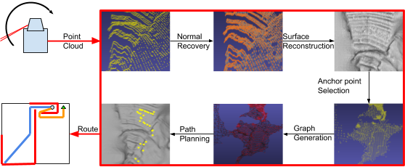
Pipeline
Notes:
So we’ve come up with a pipeline
Raw LiDAR data goes in, and routes come out
This is what I’ll be talking about for the rest of the presentation

Slide 11
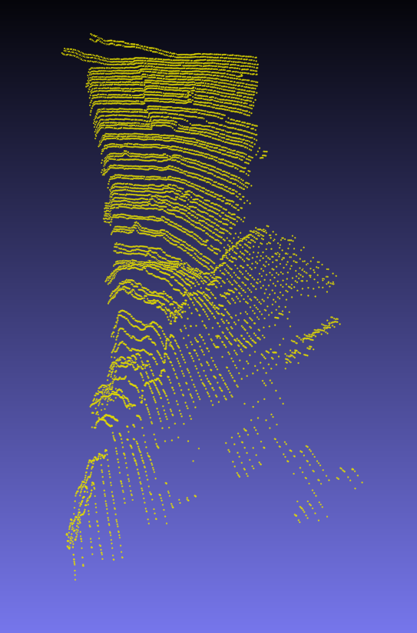
Step 1: Point Cloud Generation
Get LiDAR data
Notes:
Point cloud generation is the first step
This is just gathering raw data using LiDAR
This can also be done with a camera, but for our tests we used LiDAR
At the end of this stage we have a bunch of points in the XYZ plane

Slide 12
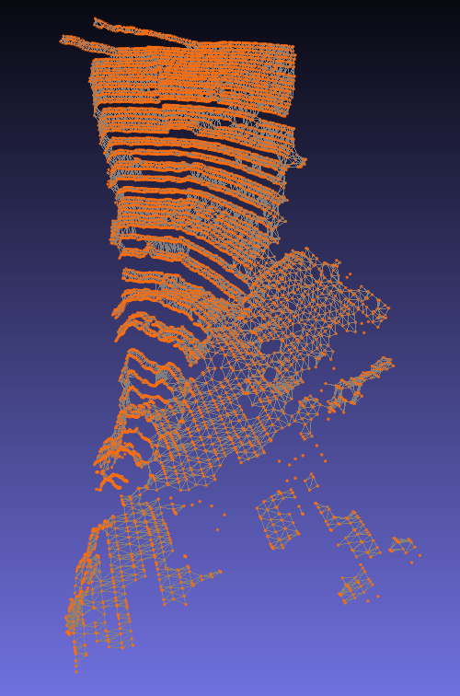
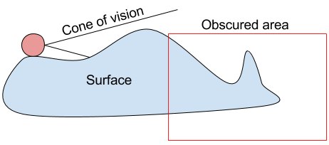
Step 2: Normal Vector
Reconstruction
Triangulation
Notes:
Next we build triangles connecting all the points, forming a mesh
We could potentially navigate across this mesh, but as you can see it’s full of holes, gaps, and noise
Holes and gaps are caused by various rock obstructions in the cone of vision, as pictured here
So instead we take the normal vectors from each triangle and use them in the next step

Slide 13
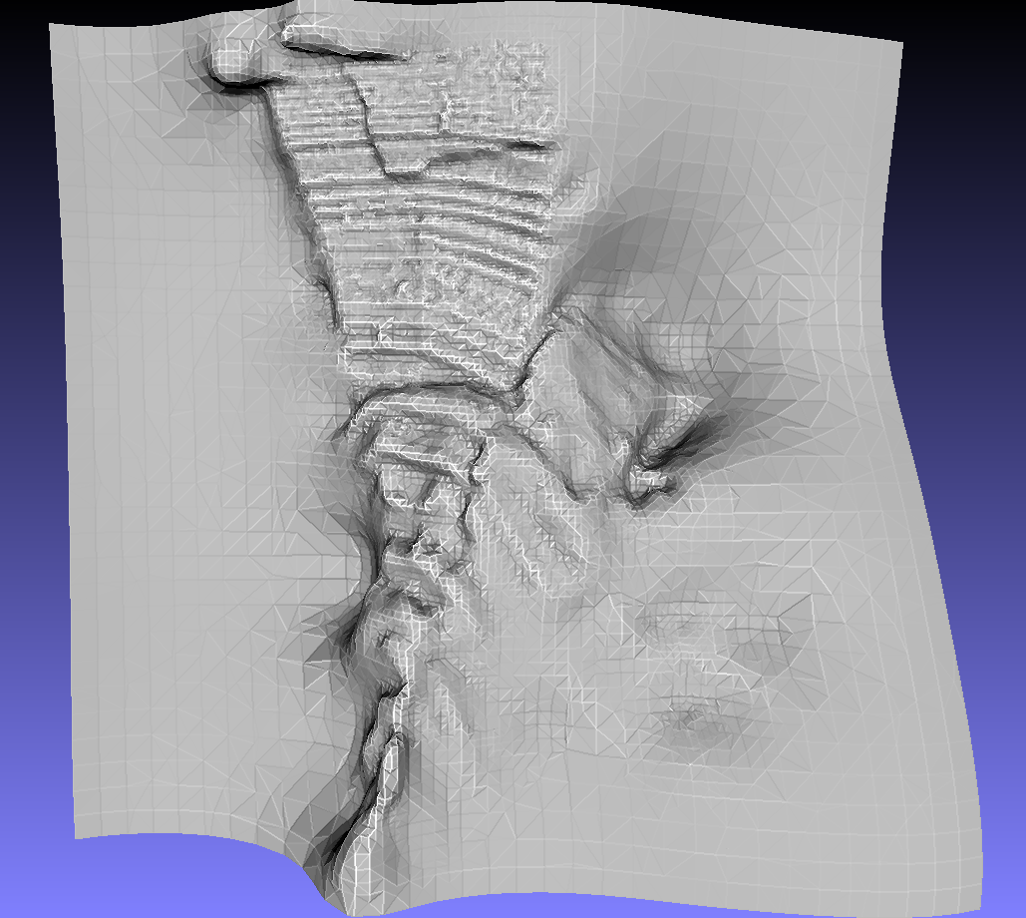
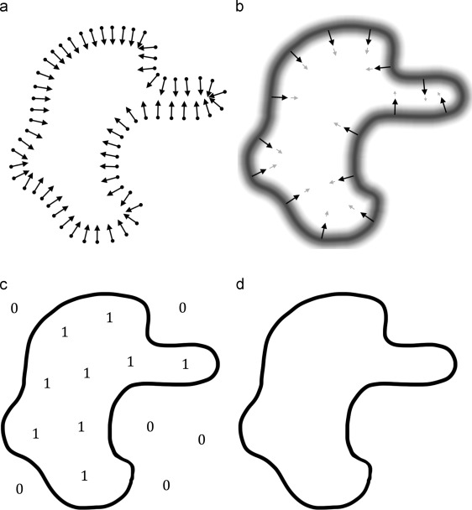
Step 3: Surface
Reconstruction
No gaps
Src: Lai et al
Notes:
With these normals we run screened poisson surface reconstruction
Given some points with normals, we can compute the gradient of X. We apply some transformations and solve the resulting Poisson’s equation, giving us a function for the surface
The final surface is guaranteed to be watertight, which means the holes and gaps are filled using the gradient information of the mesh
It takes about 200ms to build a model out of 38,000 points, so this is quick enough for real-time

Slide 14
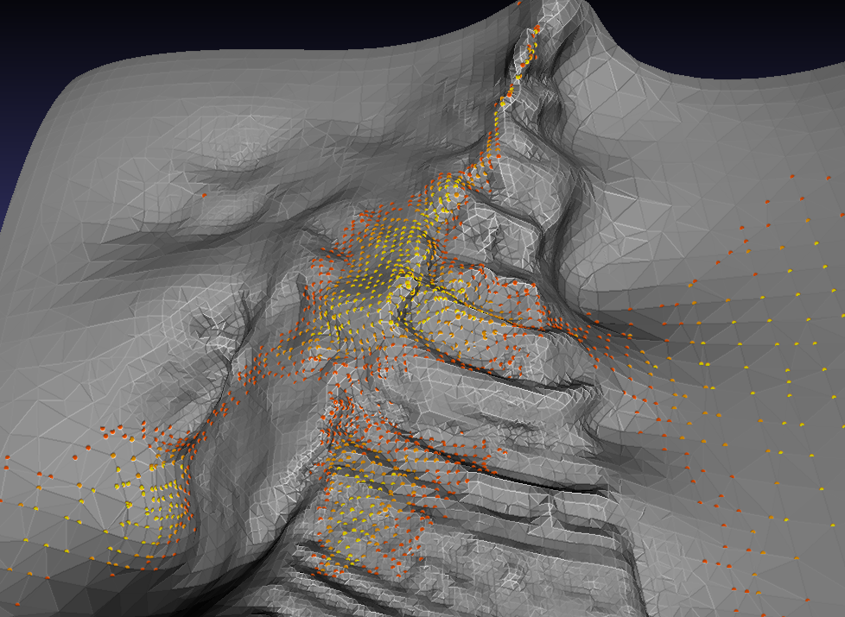
Step 4: Anchor Point Selection
Notes:
Now that we have a complete surface, we can search for grip points
We rank each point on the surface depending on the behavior of the surface near that point
Here on the right we have color coded the top 15% of grip points, with yellow being the best
We have two scoring criteria right now, but we’re actively looking for more criteria
The first criteria uses relative height to gauge traction
It’s known that microspine grippers function poorly on large deposits of regolith, and on low gravity bodies regolith migrates to areas of low potentially
So if we can stay to the high ground, we should get better traction
The second criteria is surface flatness for hazard avoidance
There is less to collide with in relatively planar areas
We want to avoid collisions with pointy rocks and other objects that could damage the system

Slide 15
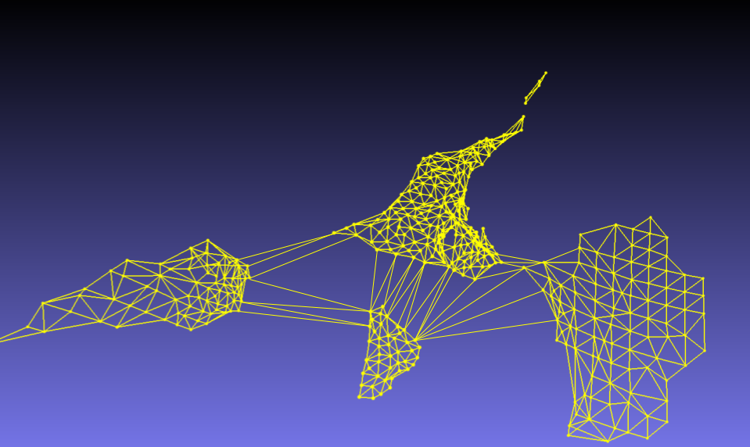
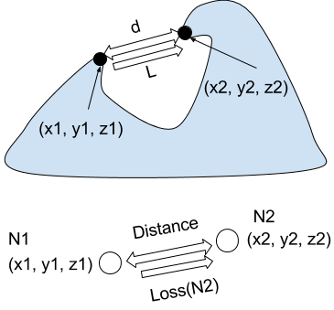
Step 5: Graph Generation
Note: Simple visualization, not all edges shown
Notes:
Those grip points we just found are used to form a graph
Each edge has two distinct weights, distance d and grip score L
Now that we’ve reduced the problem to a graph, we can run graph search algorithms

Slide 16
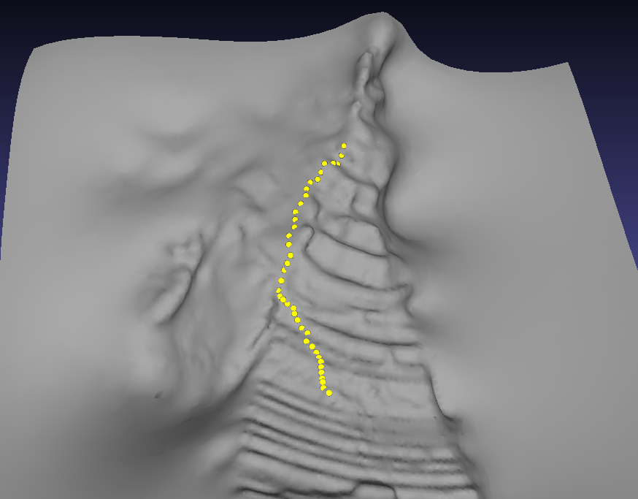
Step 6: Path Planning
Notes:
We use bounded-leg A* to plan a path through the generated graph
This allows the group of robots to reach the goal using a decentralized approach
Before I can explain bounded-leg A*, I’ll need to go over A* real quick

Slide 17
A* Refresher
Defacto path planning algorithm
Optimal path between two vertices in Euclidean space
Notes:
A* is the defacto algorithm for path planning
All you really need to know is that A* returns the optimal path between two points on our generated surface
It does this by at each step, choosing the path that minimizes the distance to the goal

Slide 18
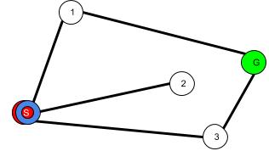
A* Refresher
Notes:
I’ll go through a simple example
We’re trying to get from the red vertex to the green vertex via the lines, or edges
The blue ring shows the vertex we are currently inspecting
The blue edges are edges that the algorithm has explored
We start at vertex S and see three edges to vertices 1, 2, and 3
Vertex 2 minimizes the distance to the goal, so we examine vertex 2

Slide 19
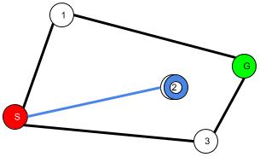
A* Refresher
Notes:
It turns out vertex 2 is a dead end
We look at our unexplored edges, which lead to vertex 1 and vertex 3
We choose 3, because it minimizes the total distance to the goal

Slide 20
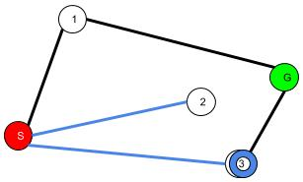
A* Refresher
Notes:
We look at our unexplored edges
We can go to vertex 1, or the goal vertex
To minimize the distance to the goal, we move to the goal

Slide 21
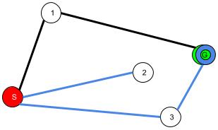
A* Refresher
Notes:
Once we find the goal, we trace our path backwards to obtain the optimal path
Now A* has computed the optimal path from S to G

Slide 22
Bounded-Leg A*
Remove
  Long edges
  Edges that exceed the tether
  Vertices that are occupied by other nodes
Run A*
n0
n3
h̅
tgt
c
n1
n2
Notes:
Bounded leg A* is a variation of A* that we’ve created
It’s A* but we remove all the impossible edges
First, we throw away all edges that are greater than our maximum hop distance h
If our robot can only hop 5 meters, it’s pointless to consider edges greater than five meters
Next, we need to make sure that we don’t hop further than the tethers allow
So we compute the position of the floating center C
Then we compute the distance from C to our hop target
If that distance is greater than the tether length, remove the edge
Now that we’ve removed all the bad moves just run A*
Each node will run this and generate their own unique path, while staying in tether range of the other nodes

Slide 23
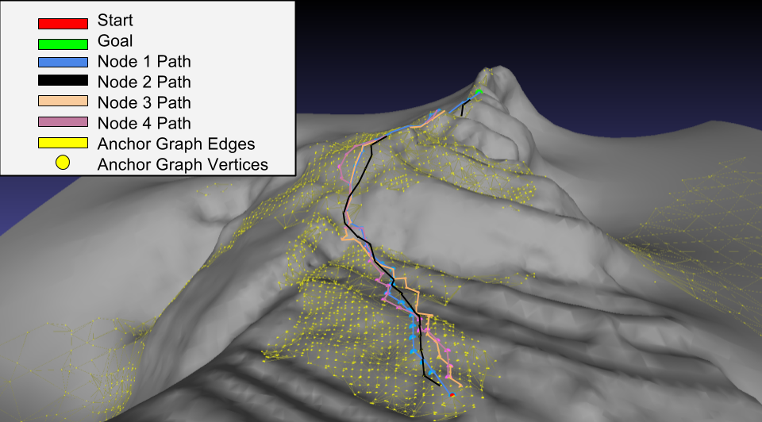
Results
Notes:
We obtained laser scan data from a rock wall and scaled it up to 500m
We set gave each node a max hop distance of 10m
We fed raw LiDAR data into the pipeline and this is what came out
The bots start at the red vertex near the bottom, and move to the green vertex at the top
The journey was a cumulative distance of 779m, or a little under 200m per node
The yellow dots and lines are vertices and edges in the graph overlaid on the grey surface
The other dots lines here denote the paths taken by each node
One thing to note here is that the back side of the rock wall was obscured during the scan. However, surface reconstruction was able to estimate the terrain in the obscured regions and we were able to chart a course through it. Since this algorithm runs after every hop, the model will be updated and the path will change if the estimate was wrong
Depending on how we select anchor points, we can get this down to 5s per iteration
After optimization, we think we can get it down to half a second

Slide 24
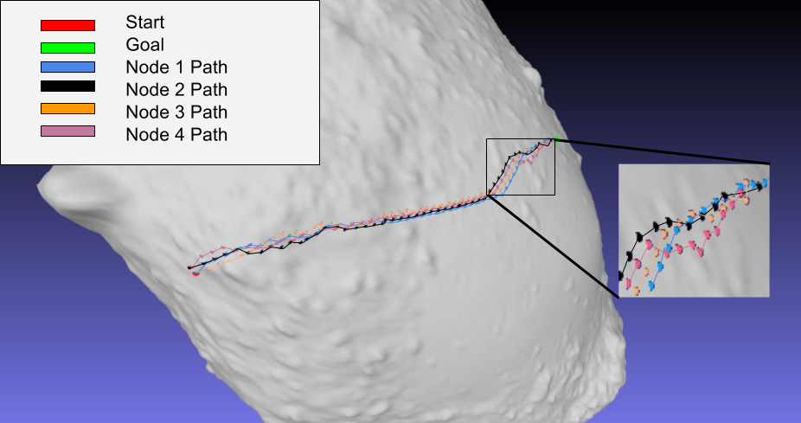
Results
Notes:
We also ran this pipeline on the asteroid Itokawa visited by JAXA’s Hayabusa mission
Hayabusa contained a hopping lander for surface exploration
Non-uniform gravitational fields make hopping across an asteroid potentially mission ending
You might hop over an area with weaker gravity, and escape the asteroid
Using a climbing approach, the other nodes will be anchored to the surface, preventing escape
Once again, we’re starting at the red vertex on the left, and heading to the green vertex on the right
Here we used a maximum hop distance of 30m
The cumulative distance was 839m, or a little over 200m per node

Slide 25
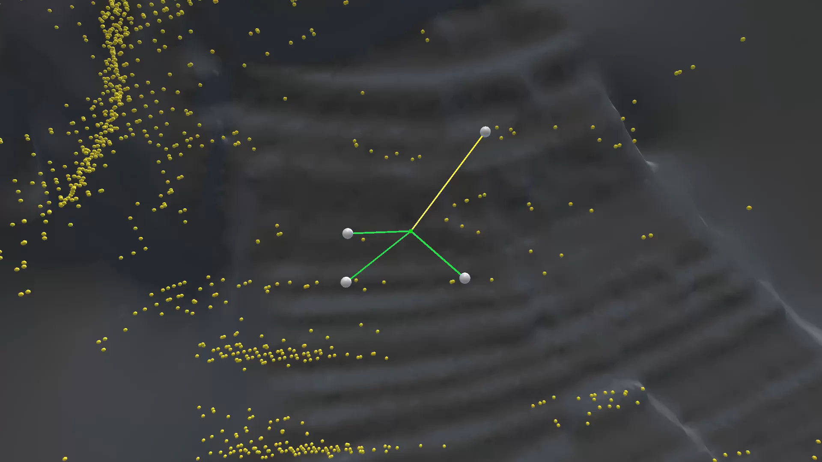
Results
Notes:
Here’s a simulation of some of our results
The color of the tether denotes the amount of tension in the tether
Remember that we throw away all edges that would break the tether, so we ensure it never snaps
Yellow dots denote nodes in the graph
The green cube is the floating tether hub C
As you probably saw, the nodes occasionally overlap
That’s because I made these nodes real big so you can see them, they’re actually holding onto different grip points

Slide 26
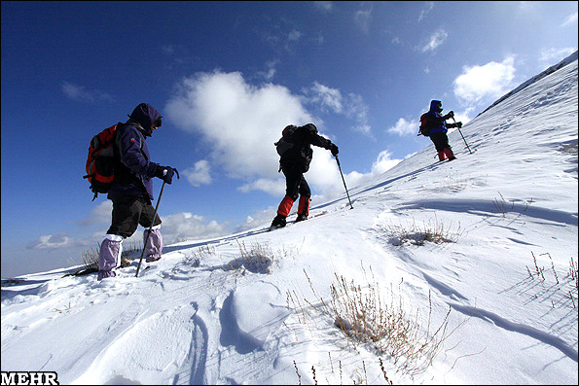
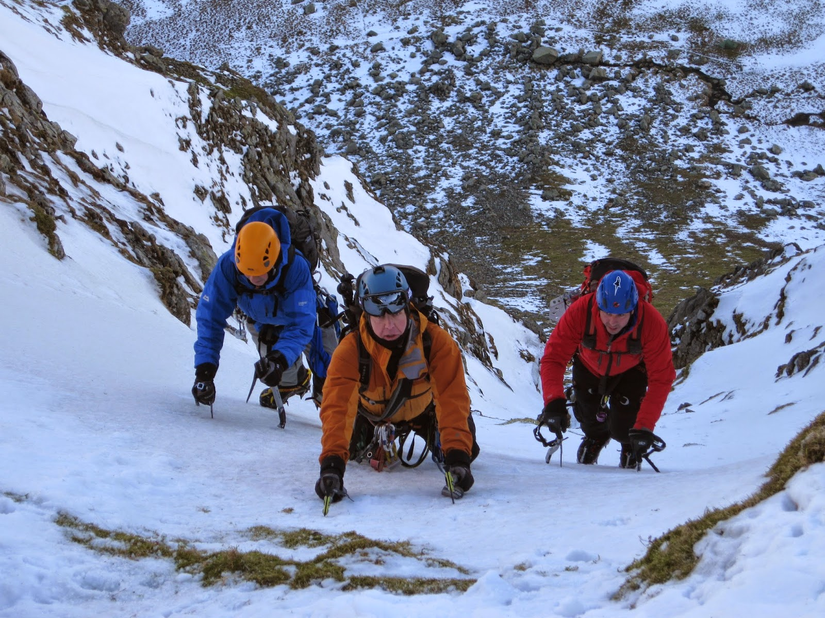
Analysis/Emergent Behavior
Longer tethers led to single-file climbing
Shorter tethers led to parallel climbing
Notes:
Something we noticed is by varying tether length, we would either get single file climbing or parallel climbing
Single file because certain anchor points would be ideal for gripping, a looser movement constraints means we have more anchor points to choose from for each hop
Parallel because we are overly constrained, and can’t select the best anchor points

Slide 27
Future Work
Fine tuning anchor point selection
  Optical granulometry
Hardware testing
Notes:
In the future we want to use something called optical granulometry to better assess regolith conditions at grip points
Finally we’re working on a hardware demo

Slide 28
Questions?

