Slide 1


Structurally reconfigurable modular inflatable reflectors
Aman Chandra
PhD student,
Space and Terrestrial Robotic Exploration Laboratory
Department of Aerospace and Mechanical Engineering
University of Arizona, Tucson
Notes:
1

Slide 2
Outline
Introduction
Motivation
Challenges
Objectives
Approach
Results and Discussions
Further Work
Conclusion
References

Slide 3
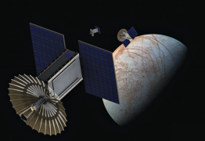
Introduction – High gain antennas (HGA)
Include reflectors and reflect-arrays.
Directional radiation minimizes losses.
Enable high data-rate communication.
JPL’s Ka Band reflector (Chahat et al., 2018)

Slide 4
Introduction - Reflectors
Larger surface area to volume ratio among HGA’s.
Better packing efficiency among deployable HGA’s.
Antenna Technology | Surface Area (m²) | Mass (kg) | Stowed Volume (m³) | Packing efficiency
Deployable parabolic reflectors | 1.0 | 1.5-2 | 0.04 | 5:1
Foldable reflect-arrays | 1.0 | 0.6 – 0.8 | 0.05 | 3:1
Comparison of HGA technologies for 1 m² reflective surface area (Chandra, 2015)

Slide 5
Introduction - reconfiguration
Reflector curvatures can be reconfigured.
Reconfiguration enhances reflector performance.
Can be used to correct shape errors.
Can assist with antenna fine pointing.

Slide 6
Motivation
Enhance deep space CubeSat communications by:
High gain reflector design.
Co-operative reflector systems between CubeSats.
Frequency band | Minimum required gain (dBi)
X - band | 28
Ka - band | 42
Interplanetary mission reflector gain requirements.

Slide 7
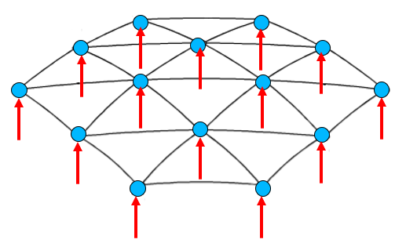
Related Work
Reconfiguration has been attempted using:
Piezo based linear actuators. (Datahvili, 2017)
Shape memory alloys. (Kalra et al., 2018)
Control points on surface
Point force application

Slide 8
Challenges
Mechanical actuators are bulky.
Large number of actuators are required.
Can be mechanically complex.
Metallic actuator parts cause signal interference.
(Datashvili et al., 2010)

Slide 9
Objectives
To develop a pneumatic actuation mechanism.
To design a reflector based on this mechanism.
Numerically analyze structural behavior.
Develop a reflector design using the mechanism.

Slide 10
Approach

Slide 11
Chemical sublimate gas generation
Sublimates undergo solid to gas transformation.
Pressure of gas able to inflate a membrane in space.
Solid to gas transformation
Applied heat of sublimation

Slide 12
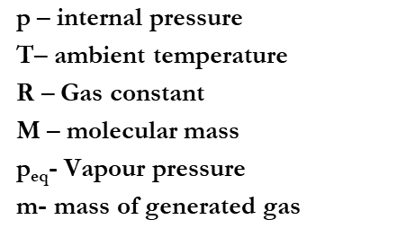
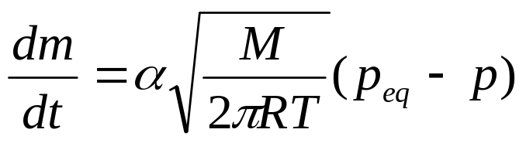
Sublimate gas pressure control
Pressure controlled by ambient pressure and temperature shown. (Babuscia et al., 2014)
At constant temperature, pressure reaches equilibrium

Slide 13
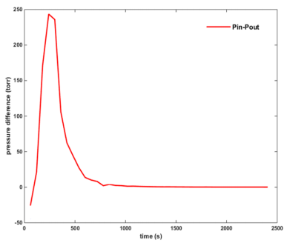
Sublimate gas pressure measurement
Sublimate benzoic acid yields a final stable pressure of 0.38 Pa at room temperature.
Benzoic acid gas pressures at room temperature vacuum (Chandra, 2015)

Slide 14
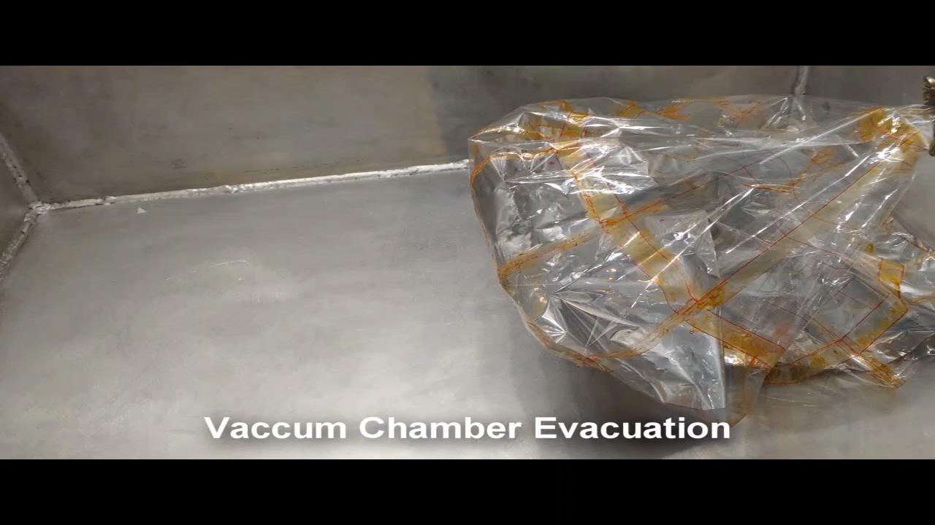
Sublimate gas membrane inflation

Slide 15
Pneumatic actuator
Sublimate incorporated into a Mylar membrane unit to form actuator.
P₁, T₁
P₂, T₂
Mylar membrane changing pressure state with temperature

Slide 16
Actuation stroke length
Numerical analysis carried out using LS-Dyna.
Stiffness and deflection behavior simulated.
Stroke length
P1
P2
Results extracted at central circumference

Slide 17
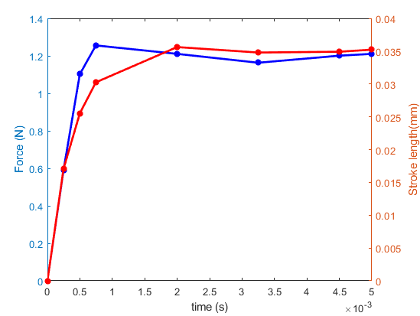
Numerical Results
Force and stroke length during inflation

Slide 18
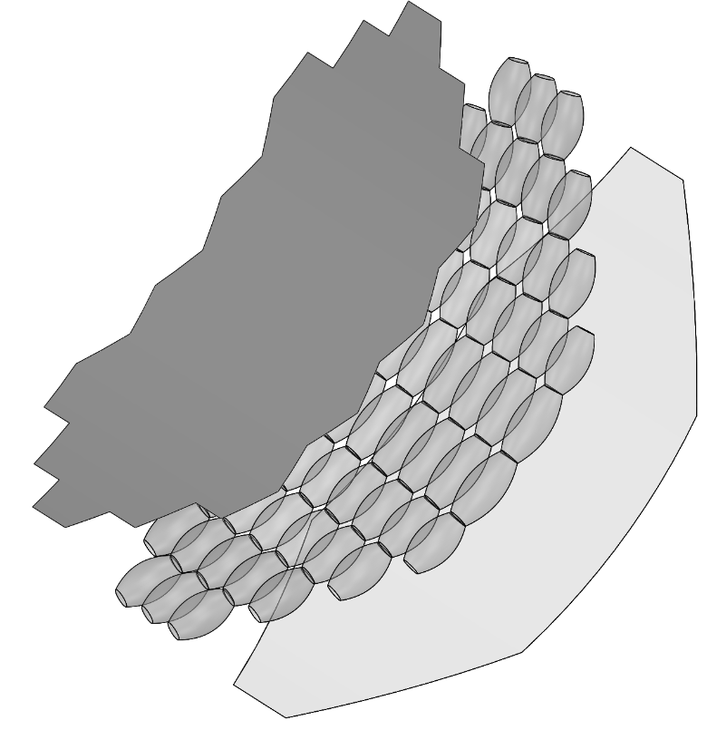
Composite inflatable reflector
Multiple units to form reflector structure (Chandra et al., 2018)
Reflective membrane
inflatable actuator layer
Backing layer

Slide 19
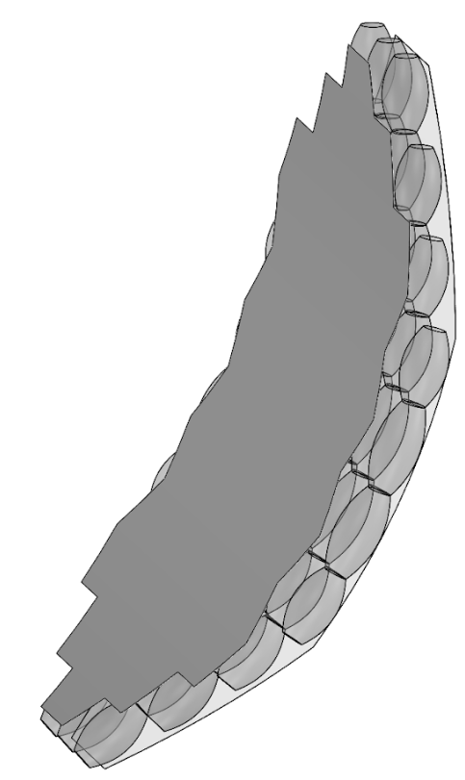
Composite inflatable reflector
Inflatable units can be used to modulate f/d ratios.
Patterned inflation can be used to obtain desired geometry
focus
f
d

Slide 20
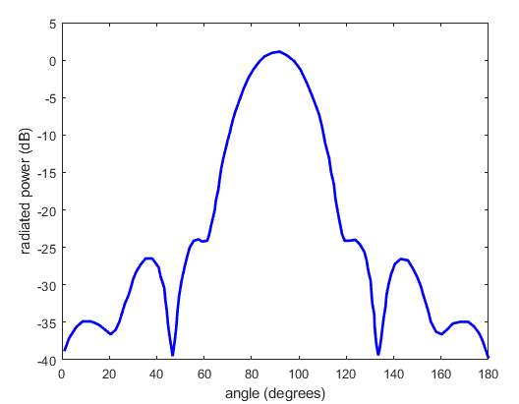
Further Work
Work underway to understand how focal length/ distance ratios change with actuation.
Radiation pattern analysis would be done for each case.
Radiation pattern for 1 m reflector

Slide 21
Conclusion
A pneumatic actuation mechanism has been developed.
Force and stroke length data show actuation feasibility.
A methodology towards application to parabolic reflectors has been proposed.

Slide 22
Thank you

Slide 23
References
Chahat, Nacer, et al. "The Deep-Space Network Telecommunication CubeSat Antenna: Using the deployable Ka-band mesh reflector antenna." IEEE Antennas and Propagation Magazine 59.2 (2017): 31-38.
Chandra, Aman. Inflatable Parabolic Reflectors for Small Satellite Communication. Diss. Arizona State University, 2015.
Datashvili, Leri, et al. Enabling Technologies and Architectures at LSS GmbH for European Large Deployable and Reconfigurable Reflector Antennas. Deutsche Gesellschaft für Luft-und Raumfahrt-Lilienthal-Oberth eV, 2017.
Boyarchuk, Mikhail Viktorovich, et al. "Investigation Testing of Structural Members of Large-sized Reconfigurable Spacecraft Antenna Reflectors." International Journal of Applied Engineering Research 12.8 (2017): 1529-1535.

Slide 24
References
Kalra, Sahil, et al. "Smart reconfigurable parabolic space antenna for variable electromagnetic patterns." IOP Conference Series: Materials Science and Engineering. Vol. 311. No. 1. IOP Publishing, 2018.
Babuscia, Alessandra, et al. "Inflatable antenna for CubeSat: A new spherical design for increased X-band gain." Aerospace Conference, 2017 IEEE. IEEE, 2017.
Aman, Chandra, et al. “Modular inflatable space structures." Aerospace Conference, 2018 IEEE. IEEE, 2018.
Datashvili, Leri, et al. Enabling Technologies and Architectures at LSS GmbH for European Large Deployable and Reconfigurable Reflector Antennas. Deutsche Gesellschaft für Luft-und Raumfahrt-Lilienthal-Oberth eV, 2017

