Slide 1

Advanced Multi-Mission Operations System Instrument Toolkit
An open source instrument and small satellite operations toolkit
Multimission Ground System and Services Office – Instrument Data Systems
Presented by Michael Joyce

Slide 2
AIT Overview
AIT is an instrument I&T and operations toolkit supporting uplink and downlink
Python-based GDS/MOS/EGSE, command, telemetry, and sequencing toolkit
Initially developed for Vehicle Cabin Atmosphere Monitor (VCAM) and Electronic Nose (ENose) ISS instruments circa 2008.
Updated and expanded for OCO-3 (TBD launch) and now ECOSTRESS (2018 launch). Baseline for ISS S.A.M instrument (a VCAM follow-on), Cold Atom Lab (CAL), M2020 MOXIE EGSE, MAIA IOS, and Lunar IceCube.
Extended to support CCSDS SLE and CFDP specifications for Small Satellites in 2017/18
Notes:
Electronic Ground Support Equipment

Slide 3
AIT Feature Highlights
Applicable in both EGSE (I&T) and Operations settings
Modern web-based interface (HTML5/CSS/JS)
Python scripting
Efficient packet evaluation
Standard file formats whenever possible (e.g. .pcap, .yaml)
YAML Command and Telemetry Dictionaries
  Used by AIT GDS tools for:
    CMD/TLM Processing and Validation
    Sequencing
    Command Builder UI
    Telemetry Display
    Monitoring
    Plotting
    etc.

Slide 4
AIT Component Architecture
Layered component architecture
Starts with a easily human readable, declarative configuration (what, not how)
Unix philosophy: Simple file formats (SQL/NoSQL, elastic DBs not precluded); small components and APIs that do one thing well
Centralized, syslog and pcap based logging (built in AIT API)
TCP, UDP/IP for real-time data transfer
Web-based Client / Server
  HTTP Web Servers
  REST APIs
GUI and REST Services
Tools
Scripts
Application Programming Interface
Configuration

Slide 5
AIT Commanding
Command Dictionary
Schema documents and represents commands with enough detail to verify units, ranges, etc. and encode to or decode from binary
Simple plain-text representation of schema in YAML (YAML Ain't Markup Language)
  Easy to view / edit with any text editor and many other tools
  Easy to compare and difference
  Track changes and evolution over time in SCM system
Single representation feeds many different tools
  Encode to / decode from binary format
  Validate syntax and parameters
  Monitoring GUI functionality
  Generate FSW source code
  LaTeX to PDF documentation
--- !Command
name: CORE_SET_OP_MODE
opcode: 0x1234
subsystem: CORE
desc: |
This command sets the operational mode.
arguments:
- !Argument
name: mode
desc: Mode
units: none
type: U8
bytes: 0
enum:
0: SAFE
1: IDLE
2: SCANNING
3: SCIENCE
config/cmd.yaml

Slide 6
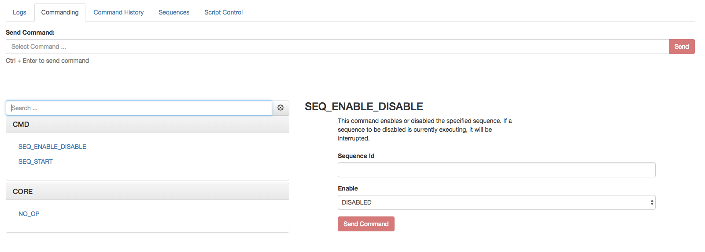
AIT Commanding
Monitoring GUI

Slide 7
AIT Commanding
Monitoring GUI
- !Command
name: SEQ_ENABLE_DISABLE
opcode: 0x0003
subsystem: CMD
title: Enable/Disable Sequence
desc: |
This command enables or disabled the specified
sequence. If a sequence to be disabled is
currently executing, it will be interrupted.
arguments:
- !Argument
name: sequence_id
units: none
type: MSB_U16
bytes: [0,1]
- !Argument
name: enable
units: none
type: U8
bytes: 2
enum:
0: DISABLED
1: ENABLED

Slide 8
AIT Sequencing
Relative-Time Sequences
Consists of time offset and command to execute
Can be executed from ground via Monitoring UI or API
Can be encoded for upload to FSW
2 CORE_SET_OP_MODE INSTRUMENT_SAFE
2 CORE_SET_OP_MODE SCIENCE
# boot V5 interface
2 CORE_BOOT_V5
15 CORE_NO_OP
# set GPS interface options
5 GPS_SET_PROGRAM_INTERFACE PVT_SOLUTION 0
5 GPS_SET_PROGRAM_INTERFACE GPS_TIME 0
5 GPS_SET_PROGRAM_INTERFACE SGR_STATUS 0

Slide 9
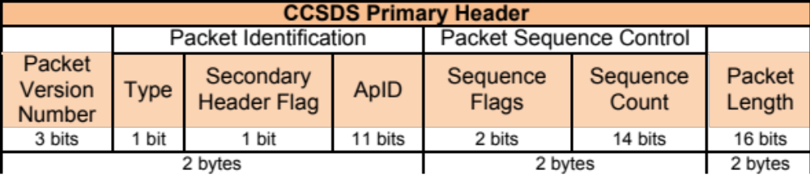
AIT Telemetry
Telemetry Dictionary
- !Packet
name: CCSDS_Packet
type: ethernet
desc: FSW 1553 Telemetry
headers:
- !Header
name: CCSDS_Primary
fields:
- !Field
name: version
desc: Indicates CCSDS Version-1 (does not change)
bytes: 0
type: U8
mask: 0xE0
- !Field
name: type
desc: |
Distinguishes between core and payload packet types
to extend the APID space to 4032
bytes: 0
type: U8
mask: 0x10
enum:
0: 'Core'
1: 'Payload’
- !Field
name: secondary_header_flag
desc: |
Indicates whether, or not, a Secondary Header follows
the primary header (always set to 1)
bytes: 0
type: U8
mask: 0x08
enum:
0: 'Not Present'
1: 'Present’
- !Field
name: apid
desc: |
Used in conjunction with Type to define the Logical
Data Path
bytes: [0, 1]
type: MSB_U16
mask: 0x07FF
- !Field
name: sequence_flags
desc: |
When sending commands, the sequence flags must be
marked as unsegmented data. All other PL packets may
be per source/destination ICDs.
bytes: 2
type: U8
mask: 0xC0
enum:
0: 'Continuation Segment'
1: 'First Segment'
2: 'Last Segment'
3: 'Unsegmented’
config/tlm.yaml

Slide 10
AIT Telemetry
Telemetry Dictionary Features
Telemetry dictionary also provides ability to specify:
Constants
Functions
History
DN to EU
Muxed Data
Masks
Imports
- !Packet
name: AMR_Standard_Telemetry
desc: |
See AMR Command and Telemetry Handbook (Doc D-12345)
constants:
A: 371.81
B: -4.850e-2
C: 1.086e-5
D: -1.239e-9
RL: 1000.0
RH: 5000.0
functions:
R(dn): RL + (dn - history.RT0) * (RH - RL) / (history.RT1 - history.RT0)
T(dn): A + (B * R(dn)) + (C * R(dn)**2) + (D * R(dn)**3)
history:
- VX0
- VX1
- VX2
- VX3
- VX4
!include 1553_ehs.yaml
- !Field
name: VX6
desc: VFC (+12V)
dntoeu:
equation: 11.53 * raw.VX6 / history.VX0
units: volts
when: history.VX0 > 2000
type: MSB_U16
when: HKMux1 == 0x6e
config/tlm.yaml

Slide 11
AIT Telemetry
Telemetry Dictionary Features
Telemetry dictionary also provides ability to specify:
Constants
Functions
History
DN to EU
Muxed Data
Masks
Imports
- !Packet
name: AMR_Standard_Telemetry
desc: |
See AMR Command and Telemetry Handbook (Doc D-12345)
constants:
A: 371.81
B: -4.850e-2
C: 1.086e-5
D: -1.239e-9
RL: 1000.0
RH: 5000.0
functions:
R(dn): RL + (dn - history.RT0) * (RH - RL) / (history.RT1 - history.RT0)
T(dn): A + (B * R(dn)) + (C * R(dn)**2) + (D * R(dn)**3)
history:
- VX0
- VX1
- VX2
- VX3
- VX4
!include 1553_ehs.yaml
- !Field
name: RT2
bytes: '@prev'
desc: RT2 External Temp
dntoeu:
equation: T(raw.RT2)
units: Kelvin
when: (history.RT1 - history.RT0) > 3000
type: MSB_U16
mask: 0xFF00
when: HKMux1 == 18
config/tlm.yaml

Slide 12
AIT Telemetry
Limits
Monitor telemetry streams for invalid values
Define “warning” and “error value
ranges
Specify mnemonics that are out
of limit
Notify users in Monitoring UI of
invalid values
Automatically send text and email
alerts when limit trips are detected.
- !Limit
source: 1553_EHS.AnalogsCurr_STAR_TRACKER
desc: Overcurrent - Star Tracker
units: amperes
upper:
warn: 0.43
error: 0.52
- !Limit
source: 1553_EHS.AnalogsVoltage_V_GA
desc: Voltage Bank A
units: volts
lower:
error: 23.0
warn: 27.0
upper:
warn: 29.0
error: 35.0
- !Limit
source: 1553_EHS.SRUSWBootFailure
desc: SRU S/W Boot Failure
value:
error: FAILED
config/limits.yaml

Slide 13
Configurable Telemetry Displays
It’s just HTML
gui/telem.html
<h4 class="telem-group-title">FSW</h4>
<table class="telem col2">
<tr> <td>Cmds Recv: <td><ait-field name="CmdsRcvd">
<td>Cmds Fail: <td><ait-field name="CmdsFailed">
<tr> <td>Cmds Exec: <td><ait-field name="CmdsExec">
<td>Curr Seq ID: <td><ait-field name="CurrSeqID">
<tr> <td>Seq Cmd: <td><ait-field name="SeqCmdOffset">
</table>
</div>
config/tlm.yaml
- !Field - !Field
name: CmdsRcvd name: CurrSeqID
bytes: [297,298] bytes: [303,304]
type: MSB_U16 type: MSB_U16
- !Field - !Field
name: CmdsFailed name: SeqCmdOffset
bytes: [299,300] bytes: [305,306]
type: MSB_U16 type: MSB_U16
- !Field
name: CmdsExec
bytes: [301,302]
type: MSB_U16

Slide 14
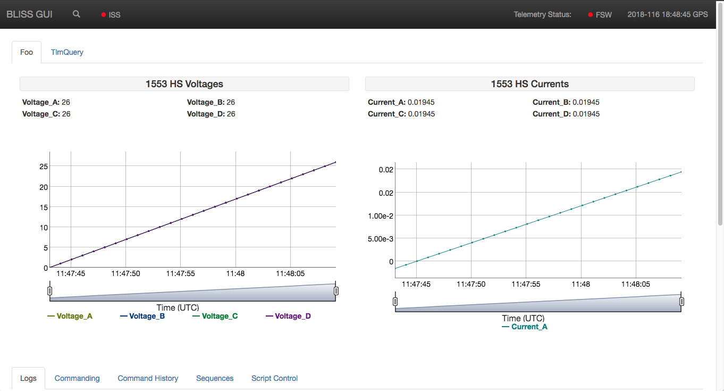
AIT Telemetry
Monitoring Display

Slide 15
AIT API and Payload Scripting
Low-Level Script Interface: It’s Python!
from ait.core import log
from ait.core.api import APITimeoutError, CmdExecError, wait
import myInstrument
try:
p = myInstrument.api.Payload()
p.OVERRIDE_NEXT_CMD()
wait("p.ehs.CmdOverrideEnabled == 'OVERRIDE_ENABLED'", timeout=15)
p.execute('RELEASE_LOCK SWITCH_ON PRIMARY')
wait("p.ehs.PMALockState == 'UNLOCKED'", timeout=15)
p.execute('SET_RELEASE_THRESHOLD', 0xffff)
wait("p.ehs.PMAReleaseThreshold == '0xffff'", timeout=15)
p.execute('SWITCH_POWER', 'SWITCH_ON')
wait("p.ehs.PCEPMAOn", timeout=15)
log.info("SUCCESS: Lock Deploy Executed")
except (APITimeoutError, CmdExecError) as e:
log.error(e.msg)

Slide 16
Scratching the Surface
Command and Data Handling Tables
  Configurable FSW data structures
Event Verification Records
  Decode FSW EVR codes into human-readable records
AIT – Goddard’s Core Flight Software bridge
  Building blocks for communication with open source FSW
DSN SLE and File Interfaces
  Return All Frames, Return Channel Frames, and Forward CLTU
  CFDP Class 1

Slide 17
AIT Documentation, Support, Installation
Visit
  https://github.com/NASA-AMMOS
Mailing Lists
  ait-dev@googlegroups.com
  https://groups.google.com/forum/#!forum/ait-dev
Documentation
  https://ait-core.readthedocs.io/en/latest/
  https://ait-gui.readthedocs.io/en/latest/
Install
$ pip install ait-core
$ pip install ait-gui

Slide 19
AIT Command and Data Handling Tables
Onboard Target Table
Binary Data
Target | Latitude | Longitude | Elevation
1 | 34.200° N | 118.18° W | 0.39 km
… | … | … | …
1335 | 34.406° S | 150.879° E | 0.03 km
typedef struct {
ushort16 targetID;
double64 latDegs;
double64 lonDegs;
double64 altitudeMeters;
uchar8 enabled;
} target_t;
…
AIT
Encode / Decode
config/table.yaml
--- !FSWTable
name: targets
delimiter: ","
columns:
- !FSWColumn
name: TARGET_ID
desc: Targets target ID
format: "%u"
units: none
type: MSB_U16
- !FSWColumn
name: LAT_DEGS
desc: Targets latitude degrees
format: "%20.6f"
units: deg
type: MSB_D64
- !FSWColumn
name: LON_DEGS
desc: Targets longitude degrees
format: "%20.6f"
units: deg
type: MSB_D64
- !FSWColumn
name: ALTITUDE_METERS
desc: Targets altitude meters
format: "%20.6f"
units: meters
type: MSB_D64

Slide 20
AIT Command and Data Handling Tables
Example Tables and Products
Onboard Target Table
Binary Data
Target | Latitude | Longitude | Elevation
1 | 34.200° N | 118.18° W | 0.39 km
… | … | … | …
1335 | 34.406° S | 150.879° E | 0.03 km
typedef struct {
ushort16 targetID;
double64 latDegs;
double64 lonDegs;
double64 altitudeMeters;
uchar8 enabled;
} target_t;
…
AIT
Encode / Decode
    Configuration-based approach allows projects to use the same AIT tools for multiple C&DH onboard data tables:
      CRC
      Downlink Windows
      Fault Response
      Keep Out Zones
      Line-of-Sight Errors
      Memory Scrub
      Schedule
      Targets
      Error Logs

