Slide 1




DTN for Interplanetary
SmallSat Missions
Nate Richard¹, Brenda Lyons², Adam Schlesinger², Scott Burleigh³, Gregory Miles³, Leigh Torgerson³, Jay WyaTT³
1: Morehead State University, Morehead, KY
2: NASA Johnson Space Center, Houston, TX
3: Jet Propulsion Laboratory, Pasadena, CA

Slide 2
What is DTN?
Benefits to SmallSats
In Space Experiment
Ongoing Work

Slide 3
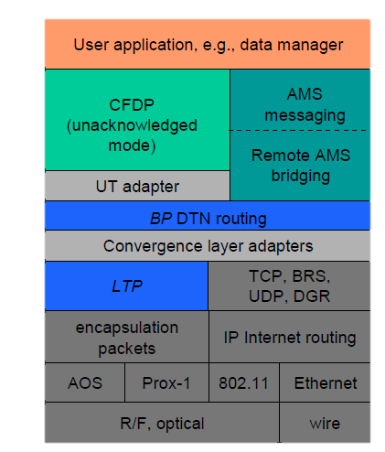
What is DTN?
Delay/Disruption-Tolerant Networking (DTN) can extend internet-like services to space
The Internet was developed assuming: Rich network connection, Short network delays, Symmetric and Bidirectional data links, and Low Error Rates
These assumptions don’t hold up in space, where communications are subject to frequent disruptions, possibly long delays, unidirectional links, and high error rates.
  DTN was developed to allow data transmissions to survive in this environment, storing bundles of data at nodes along the communication path until the next node is available
  DTN provides assured delivery of data using an automatic store-and-forward mechanism, significantly simplifying operations and increasing bandwidth efficiency
Reliability with DTN is achieved by automated retransmission between relay points within the network
The DTN protocols are being standardized within international standards community, making it interoperable and reusable

Slide 4
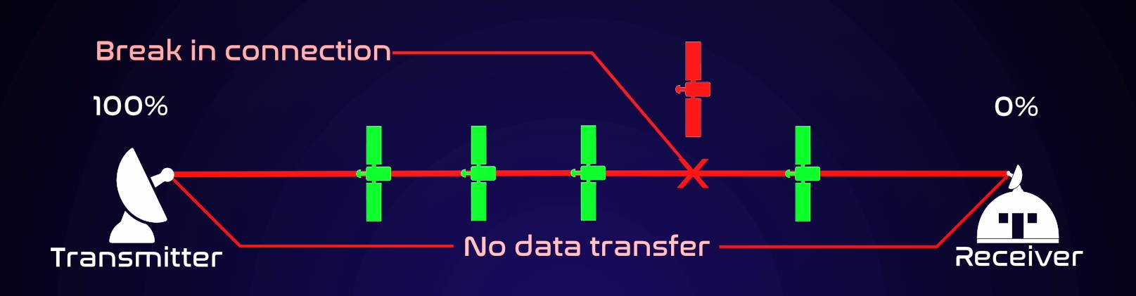
What is DTN?

Slide 5
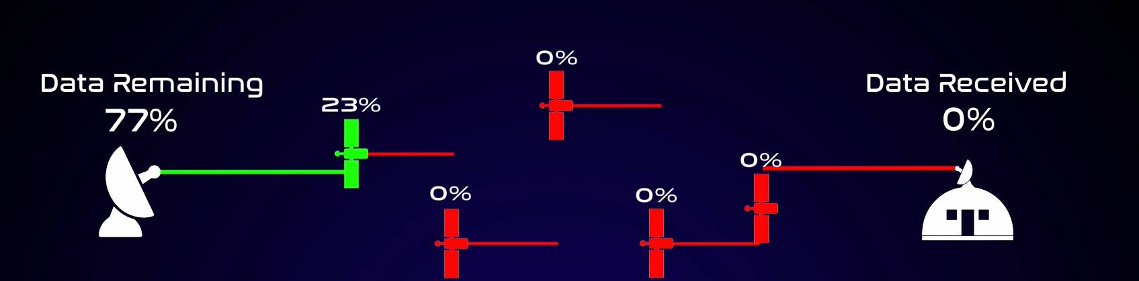
What is DTN?

Slide 6
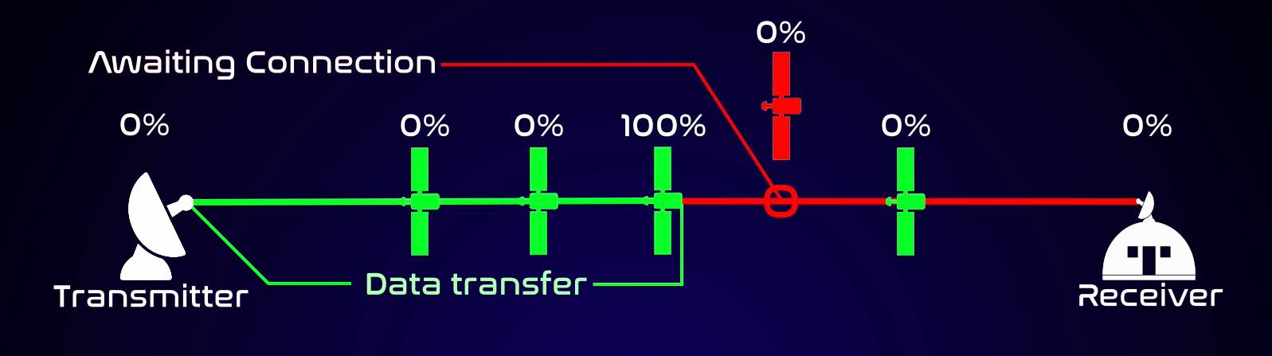
What is DTN?

Slide 7
Benefits to SmallSats
BP allows applications to produce and send data without any knowledge or management of the link schedule
BP will accept streaming data as well as file data and multiplex them into the outbound flow, with a multi-level priority scheme available that means neither the instrument nor the flight software has to manage multiplexing and data prioritization
With current coding techniques and a good understanding of the link propagation there can be virtually zero errors, but coding cannot make up for weather, pointing errors, or other phenomena so missing frames must be recovered manually in an unplanned session or automatically and in real time with LTP
Routing might not be necessary from spacecraft to ground, but BP routing can assist in terrestrial delivery especially if the MOC and PI are not co-located

Slide 8
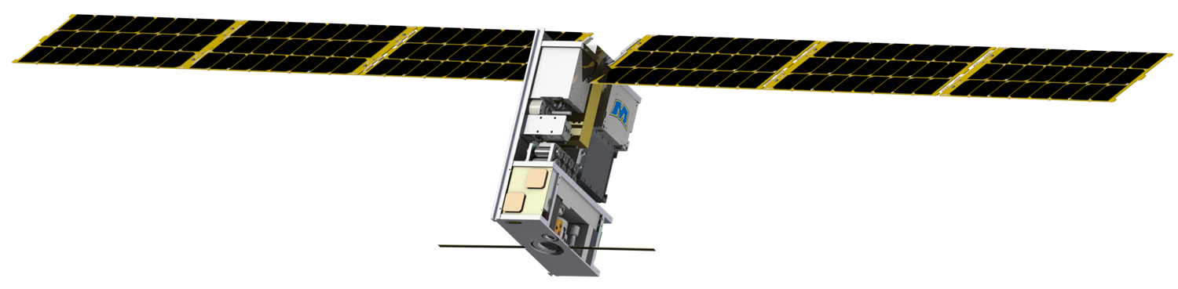
In Space Experiment
180 day coast time offers the opportunity to demonstrate DTN on a CubeSat without interfering with the primary mission
Morehead has control of a ground station capable of communicating with Lunar IceCube and a DTN node located on site
Lunar IceCube will use different data rates for different ground stations
  DSN Station: 128 kbps
  MSU Station : varies between 32 & 64 kbps depending on distance to ground station

Slide 9
Benefits of Experiment
Performing CFDP operations would serve to show Morehead’s ground station is capable of supporting Lunar IceCube’s required CFDP operations via DTN
Comparing data volume would serve to show how DTN streamlines mission operations and reduces the load on spacecraft operators
Assigning priorities to telemetry would show how DTN helps deliver critical information to spacecraft operators faster

Slide 10
Ongoing Work
A few demonstrations have been done or are in the process of being done to reduce risk for the in flight experiment
Demonstration was performed in August with L-IC’s previous Mission Operations Software, AMPCS
  While no longer using AMPCS, the demo serve to show DTN working with L-IC’s mission architecture
  L-IC’s new mission ops software operates on similar principles to AMPCS, so integration should be straight forward
Another demonstration is planned for July with Morehead’s ground station
  An intermediate demo is planned for May to verify that DTN can interface with the backend equipment
  The final demo will involve L-IC’s radio SDU serving as a “captive” spacecraft to represent L-IC

Slide 11
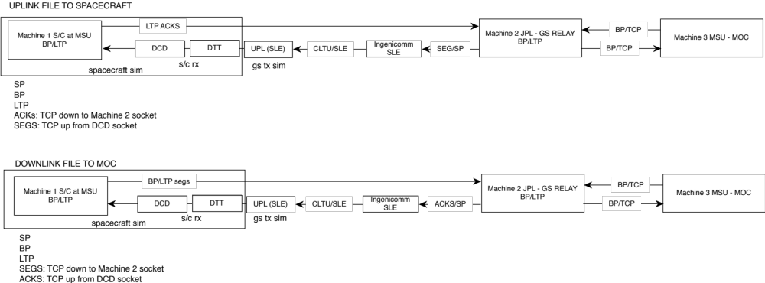
Ongoing Work
Spacecraft RX Sim

Slide 12
Ongoing Work

Slide 13
DTN Implementations
Interplanetary Overlay Network (ION):
  http://sourceforge.net/projects/ion-dtn
  NASA’s primary DTN implementation (developed by JPL)
  Includes implementations of BP and LTP as well as implementations of CFDP, BSS and AMS
  Supported by multiple Operating Systems
DTN2:
  http://sourceforge.net/projects/dtn/
  Includes an implementation of BP and BSP
  Used at the MSFC HOSC
Goddard has developed BP app for cFS

Slide 14

Questions?

