Slide 1
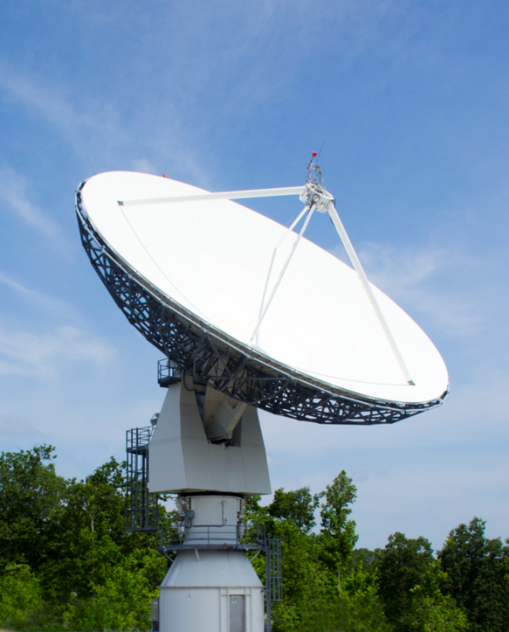
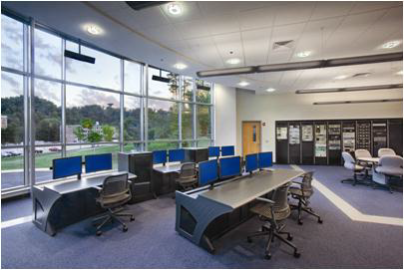
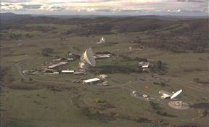
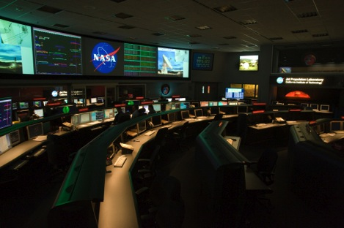
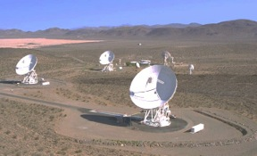
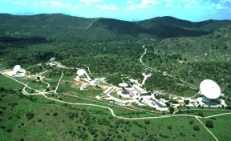


Progress Update on the Morehead State University Ground System Development for Interplanetary CubeSat Missions
Interplanetary Small Satellite Conference
May 8, 2017
Ben Malphrus, Jeff Kruth (MSU)
Tim Pham, Jay Wyatt, (JPL)
In Partnership with

Slide 2

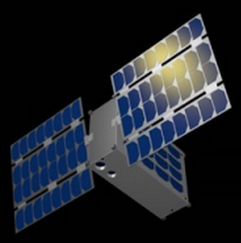
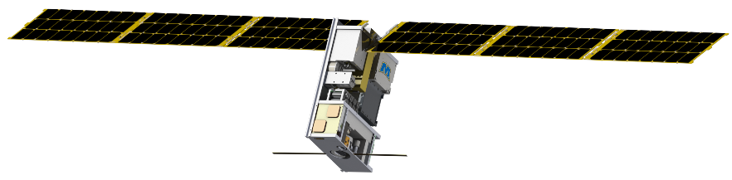
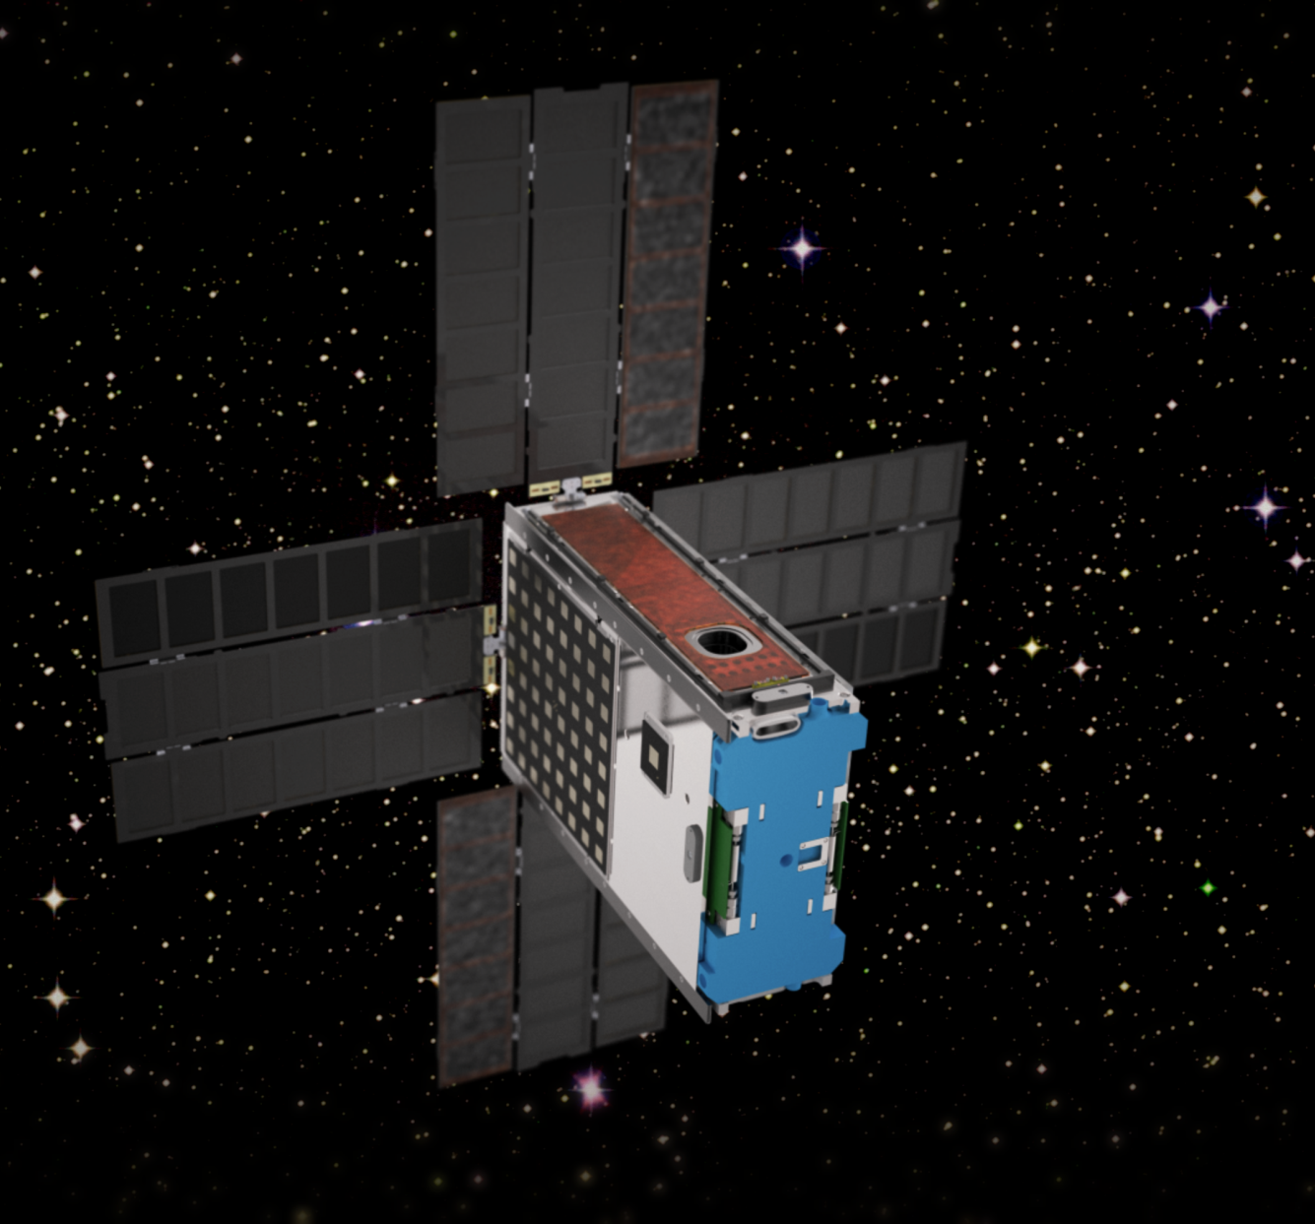
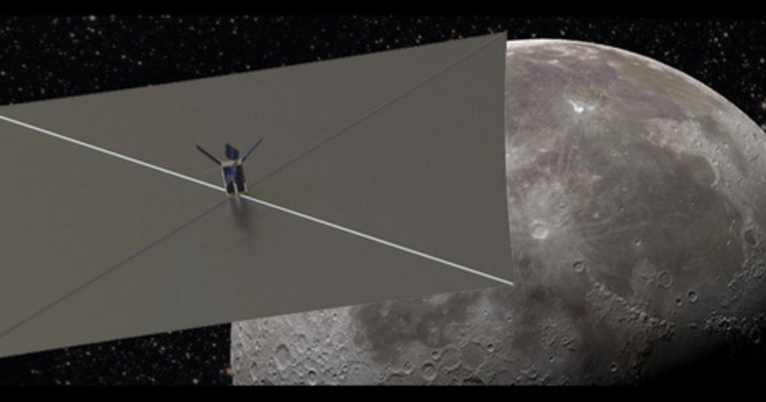
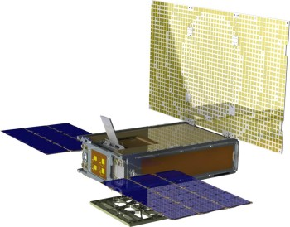
A New Era of Planetary Exploration with Small Satellite Platforms
History was Made on Saturday with the Launch of MarCO A and B
EM-1 will Launch 13 Interplanetary CubeSats
Numerous Interplanetary SmallSat Missions are in Planning (PSDS3 Studies, Others at NASA Centers and in the Private Sector)
All Need Deep Space Communications and Ranging Support
DSN is Heavily Subscribed
Idea Emerged to Utilize Large Aperture non-NASA Assets*
This Project Represents the Prototype Experiment
* Suggested by Rob Staehle JPL in 2014

Slide 3
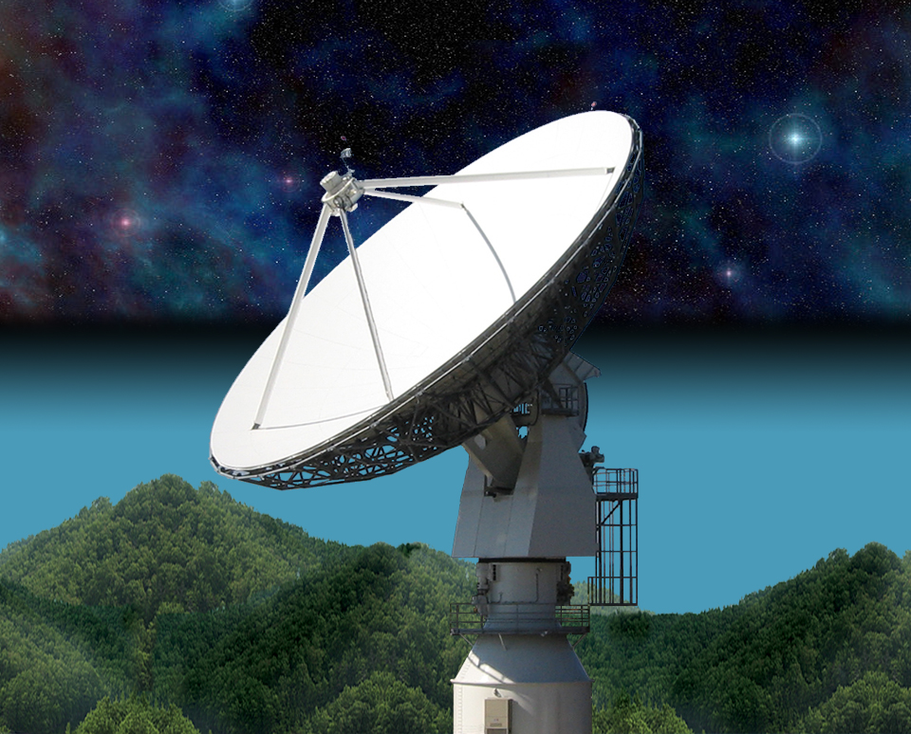
21 Meter Space Tracking Antenna
at Morehead State University
Specifications by MSU faculty with NASA assistance
Dual Purpose Instrument
  Ground Station for Smallsats
  Radio Telescope for Astronomy Research
Built and Installed by VertexRSI (General Dynamics)
Operational in 2006
Program Funded by AES in 2016 to Upgrade the 21 m Toward DSN Compatibility

Slide 4

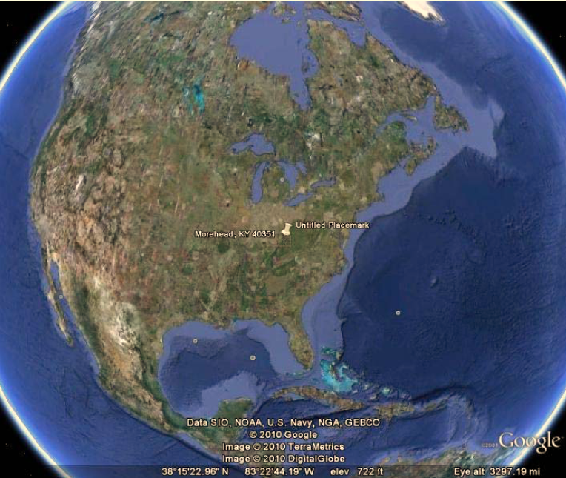
The Morehead State University Ground Station
Quiet RFI Environment in Eastern Kentucky (Southeastern US)
21 m Ground Station (few in the US large enough for DSN Work)
Staff Experienced in Mission Operations
Experienced RF and Telecom Engineers and Scientists
Talented, Intrepid Students

Slide 5
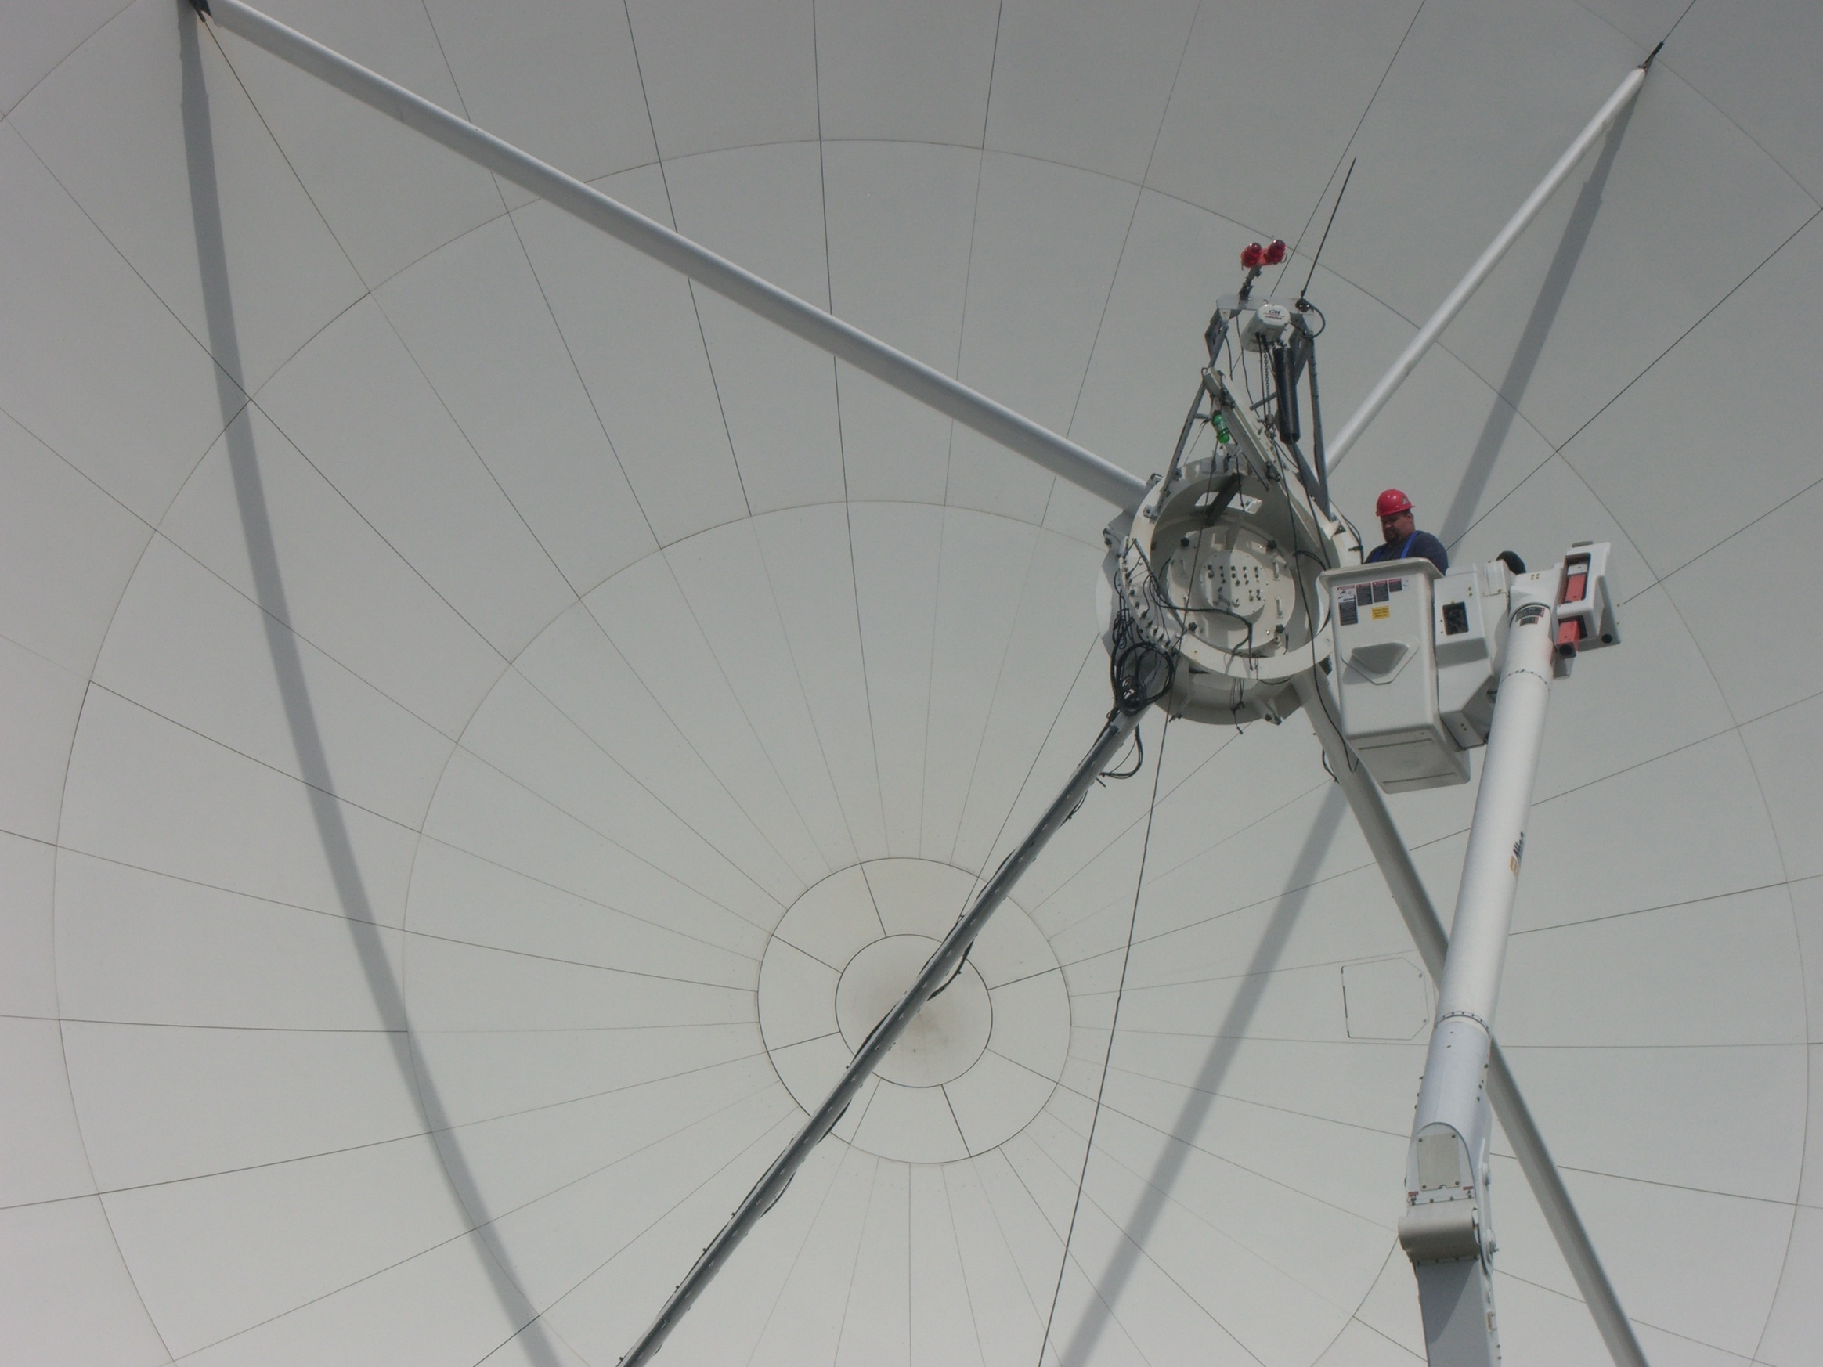
21 M Operations
Satellite Ground Station for Morehead State SmallSat Missions and Others
JPL ASTERIA Ground Station
Radio Telescope Mode for Research in Astrophysics
Test-Bed for Experimental Communication Systems

Slide 6
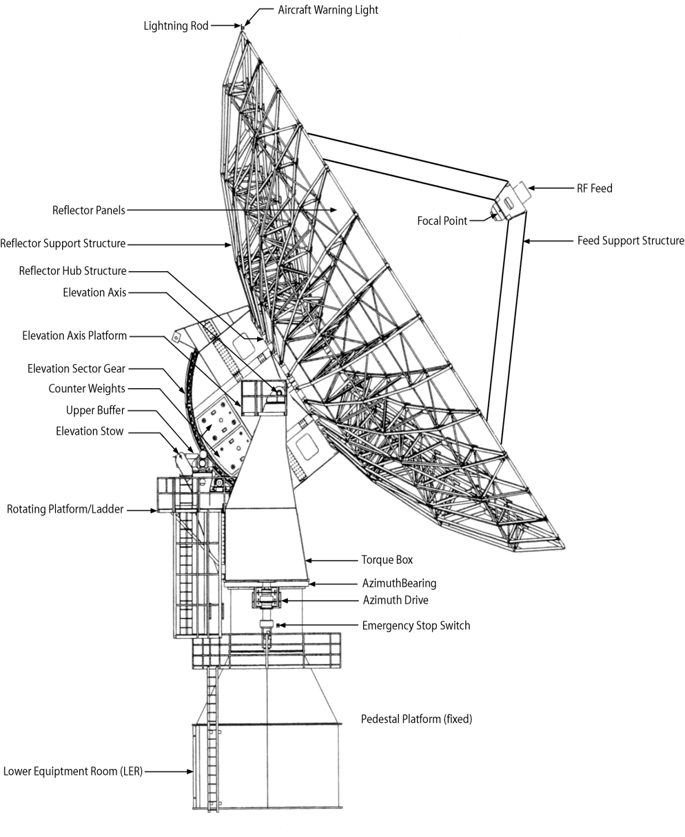
21 M Overview
Parameter | Measured Values
Axis Slew Velocity
Azimuth | > 3.0 º/sec minimum
Elevation | > 1.6 º/sec minimum
Polarization | > 0.7 º/sec minimum
Axis Acceleration
Azimuth | 1.0 º/sec²
Elevation | 0.6 º/sec²
Travel Range
Azimuth | ± 269.8º
Elevation | 1.0º to 90.3º
Polarization Range | ± 90º
Pointing Accuracy | 0.005º RMS
Tracking Accuracy | 0.0004º RMS
Aperture Efficiency, η (L/Ku) | 0.653/0.563
Surface Tolerance @ 35 mph wind | < 0.020” RMS

Slide 7
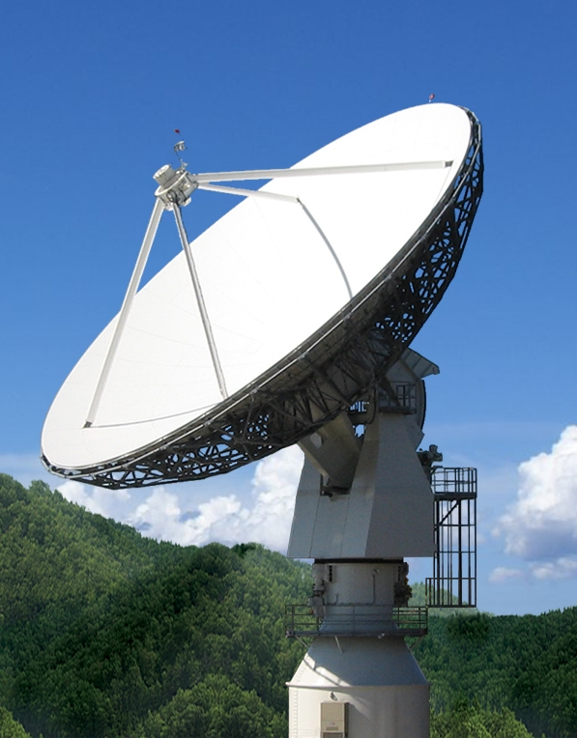
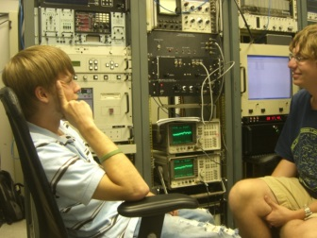
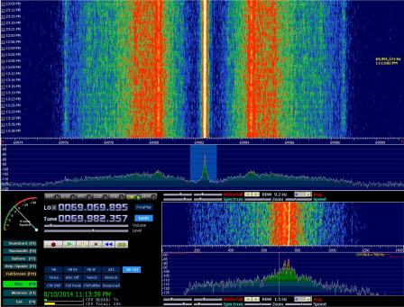
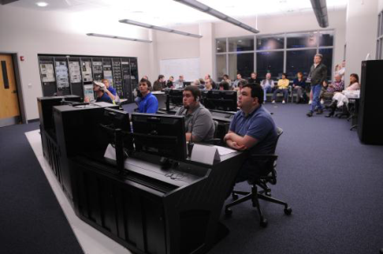
Interplanetary SmallSat Ground Ops: Morehead State 21 M Ground Station- Current Operational State
Fully Operational, Full-Motion, 21 M Antenna
Operational Experience: LRO, ISEE-3, Planet Labs, KySpace, JPL ASTERIA
High Gain, Pointing and Tracking Accuracy
Station is ideal for Inner Solar System Experiments
Full Remote Control of All Systems
  UHF and S-Band Uplink and Downlink
  NASA NEN Compatible
  Software-Defined TT&C Processor (SoftFEP) and High Data Rate Digitizer for Experimental Missions
  Extensive use of Student Operators (STEM Engagement)
Morehead State University
21 M Ground Station
MSU 21 Meter Current RF Capabilities
Student Operators in the MSU 21 M LER
Radio Band | Frequency Range | Gain | Uses of Band
UHF | 400-480 MHz | 30 dBi | Satellite Telecom
S-Band | 2.2-2.5 GHz | 52.8 dBi | Both Satellite Telecom and Radio Astronomy
Ku-Band | 11.2-12.7 GHz | 65.50 dBi | Primarily Satellite Telecom
ISEE-3 Carrier During Lunar Fly-by Sept 2014
Student Operators in the MSU Mission Ops Center

Slide 8


AES Program: 21 m DSN Station (DSS-17)
Project Description and Objectives Demonstrate a cost-effective process for expanding DSN capabilities by utilizing non-NASA assets to provide communication and navigation services to small spacecraft missions to the Moon and inner solar system, thereby enabling interplanetary research with small spacecraft platforms.
Technical Approach Develop and implement a strategy to transfer Deep Space Network (DSN) processes and protocols to the MSU 21 m antenna system to enable integration into the DSN as an auxiliary station to support small spacecraft missions. Implement deep space communications, tracking and navigation techniques as well as adoption of CCSDS standards. Implement systems upgrades, conduct tests/demonstrations, and transition to an operational capability.
Benefits Serves as a test-case for other non-NASA ground stations to provide auxiliary deep space navigation and tracking support for small spacecraft missions. Develops an operational capability to support EM-1 CubeSat missions in the 2018- 2019 timeframe Transparent to Missions Being Supported | Targets Full DSN Compatibility Scheduled by DSN Support CCSDS-SLE DSN Tracking and Ranging Support Lunar, NEA, Lagrange Point Missions at 64-256 kbps

Slide 9


Enabling Interplanetary Smallsat Ground Support- Toward DSN Compatibility
Primary Tasks
Design, Develop and Implement Single-channel, Customized “Lite” Versions of DSN Equipment:
  DTT- Downlink, Tracking and Telemetry
  DCD- Data Capture and Delivery
  UPL (USG- Uplink Signal Generator and UPA-Uplink Processing Assembly)
Develop a 21 m version of NMC
Implement 3 KW Power Amplifier
Implement Hydrogen MASER
Design and Fabricate Cryogenic X-Band Feed
Modify IF Stages
IT and Physical Security Upgraded
Implement DSN Ranging Techniques
Calibrate, Test and Validate System and all Subsystems
Perform a Series of Downlink, Uplink and Ranging Demonstrations
Commission as an Affiliated DSN station
Add DSS-17 to DSN Scheduling
Support Operational Readiness Review in Advance of EM-1

Slide 10
Enabling Interplanetary Smallsat Ground Support- Toward DSN Compatibility
Incremental Delivery and Testing
Delivery Increment | Test Focus
DSN-provided Uplink, Downlink and Data capture & delivery | Generation of command data Generation and correlation of ranging signal, for both sequential and pseudo-noise ranging Extraction of telemetry data Data transfer between the uplink and downlink equipment and the Data Capture & Delivery
Connection to NASA Mission Backbone Network | IP connection (after IT Security scan) Data delivery between the MSU DCD and JPL DCD (verifying all routing permissions in the firewall setting, both for MSU & JPL) Simulated data flow from DTT (at MSU) to TTD (at JPL)
Installation of downlink RF equipment at the antenna | Extraction of telemetry and delivery to JPL
Installation of uplink RF equipment and Transmitter at the antenna | Generation of command data with Transmitter in the loop, with connection from SLE user to MSU Uplink equipment Correlation of ranging signal, including the Transmitter and LNA components Radiometric (Doppler/Ranging) data delivery to JPL

Slide 11
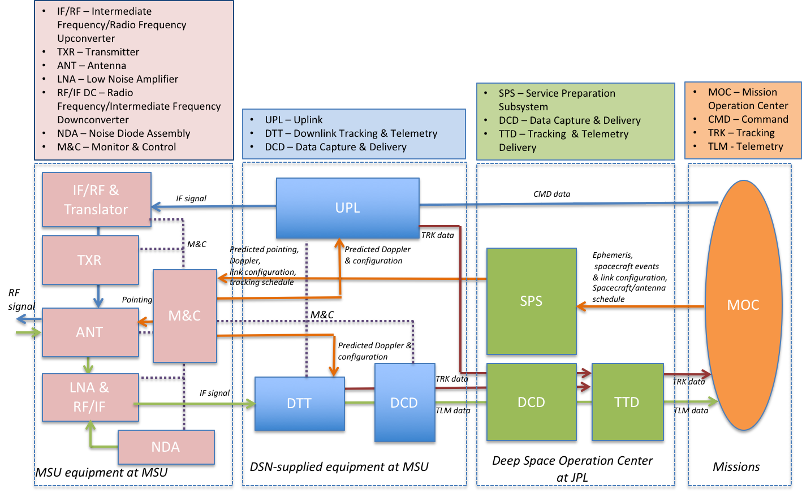
DSS-17 System Architecture
New System Architecture Required

Slide 12
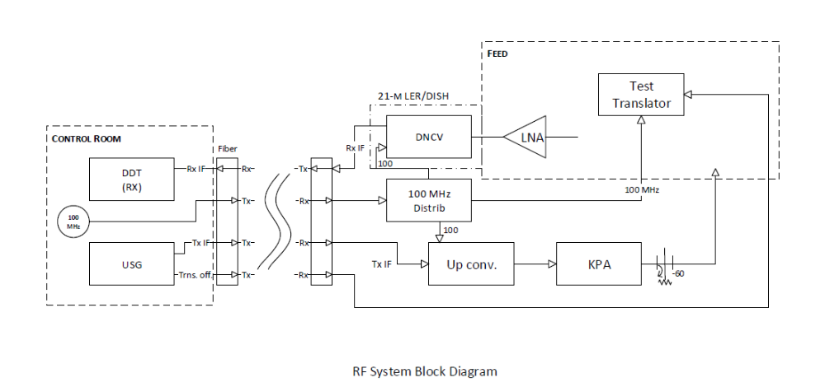
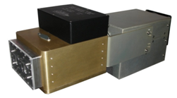
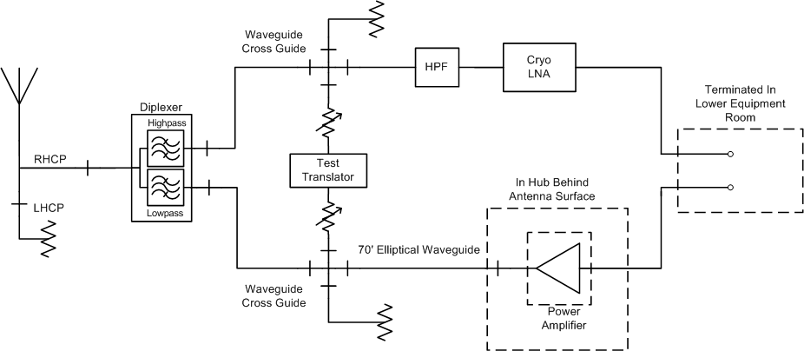
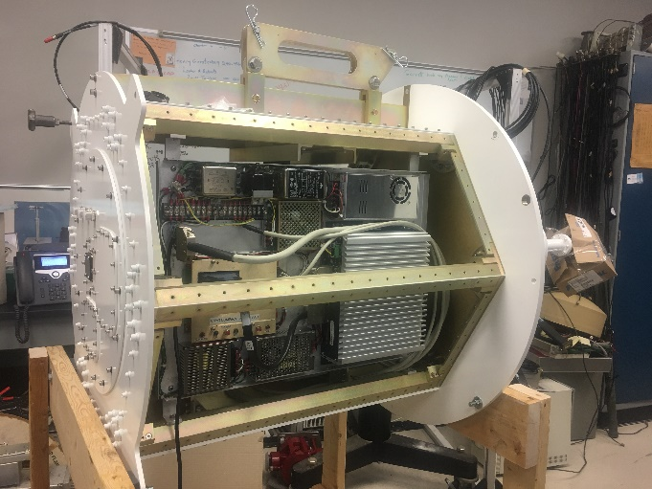
DSS-17 RF System and X-Band Feed
New X-Band Feed Required with Cryogenic LNA and High Power TX Capability
RF System Block Diagram
Cryogenic X-Band LNA <20K
X-Band Feed Diagram
X-Band Feed

Slide 13
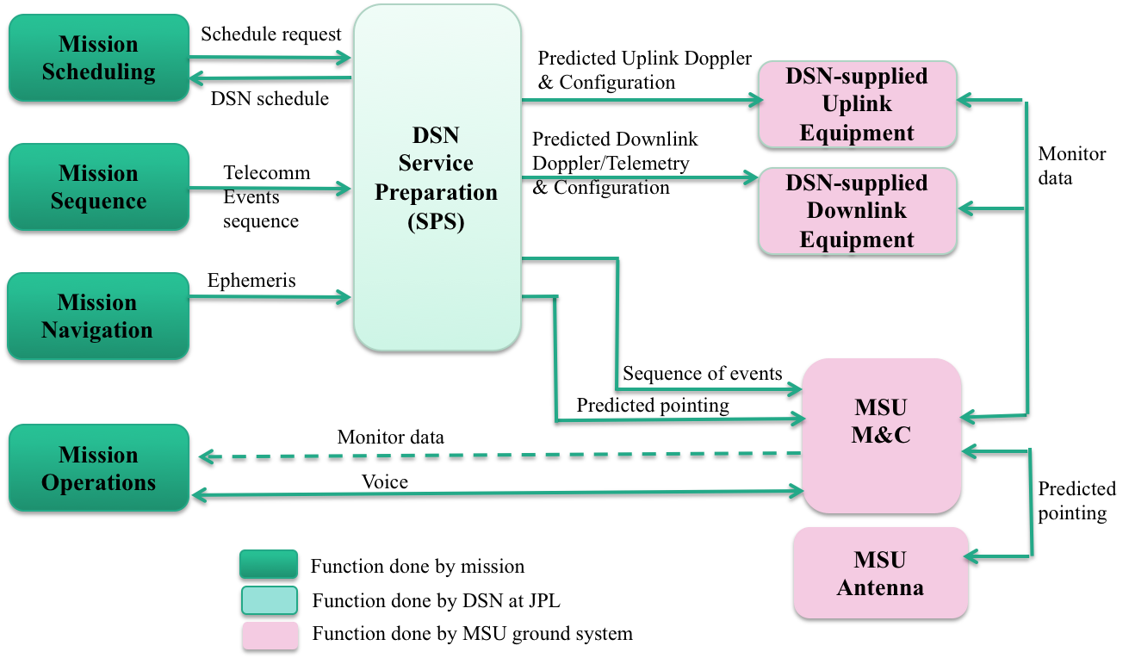
Service Management Data Flow

Slide 14
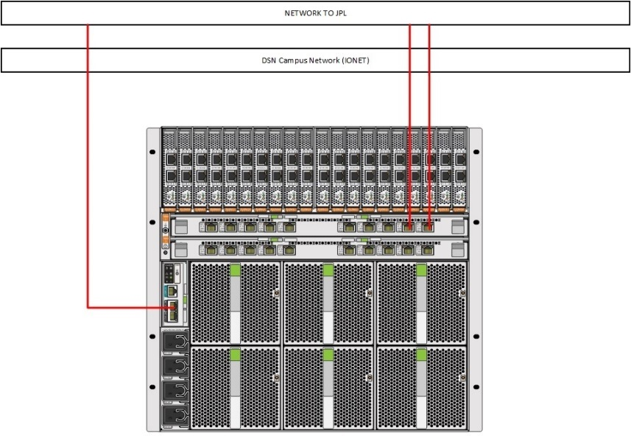
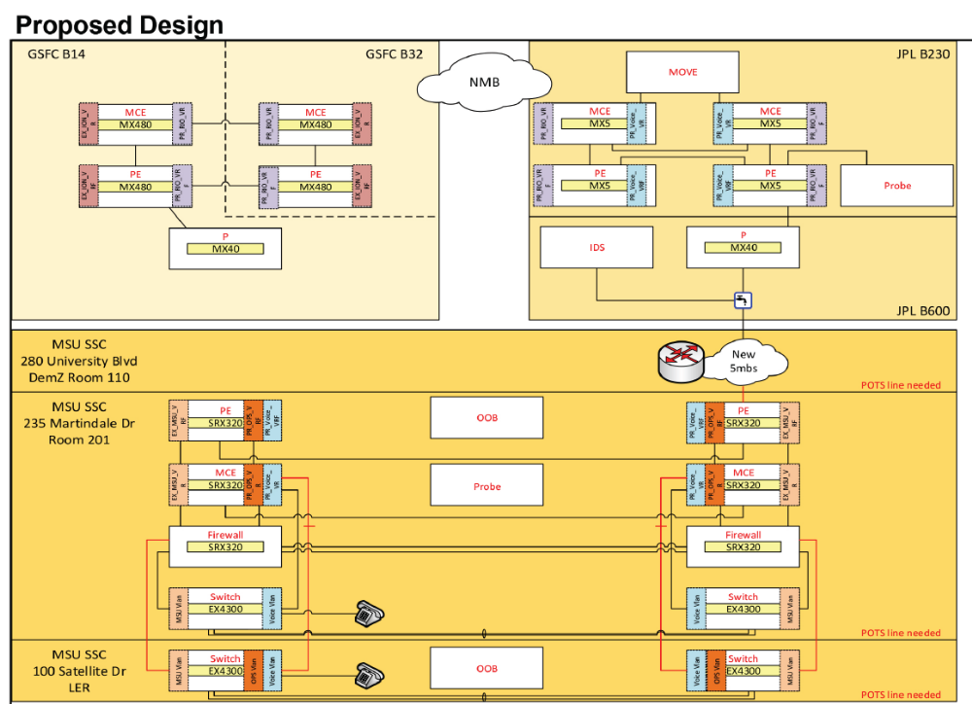
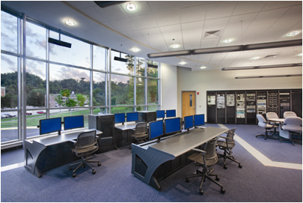
IT Security and NMB Connection
IT Security and Network Connection Required
  LAN Independent of University Network
  Architecture Designed with JPL and CSO
  Behind NASA Firewall
  Designed by NASA JPL and CSO
  Direct Connection to the NASA NMB

Slide 15
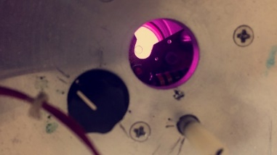
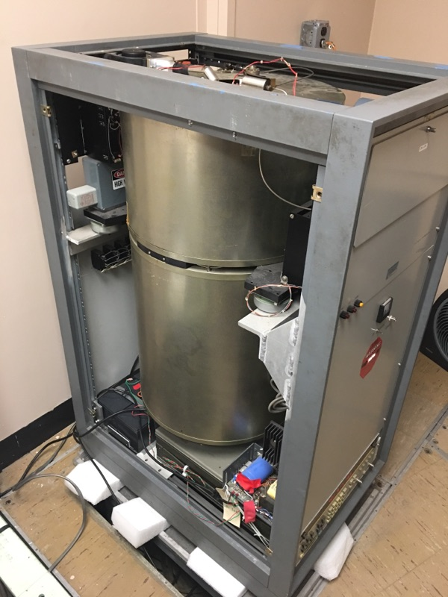
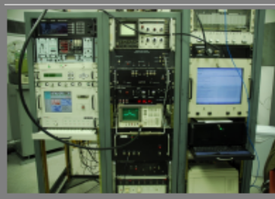
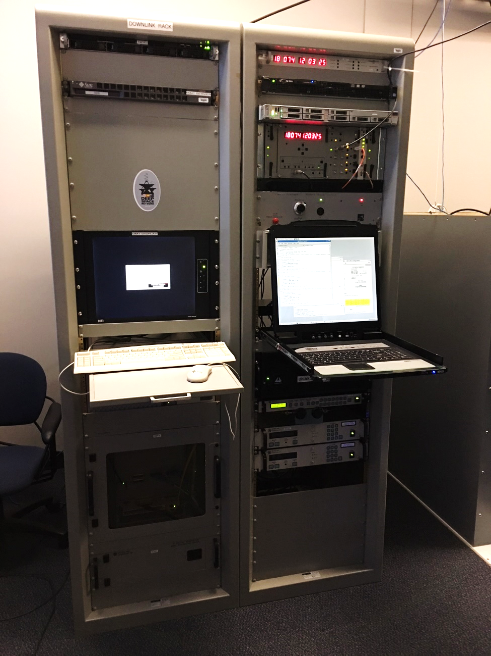
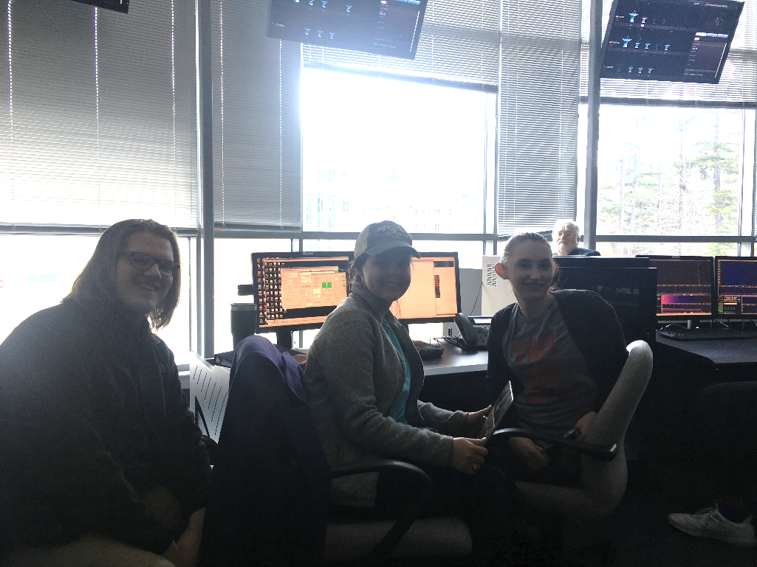
Project Status and Remaining Tasks
Primary Tasks Complete/In Process
  DSN Designation Assigned- DSS-17
  System Architecture Design Complete
  DSN Equipment Installed and In Testing
  Hydrogen MASER in Operation (on semi-permanent Loan from MIT)
  X-Band Feed Designed and Fabricated
  IF Systems Complete
  Antenna Control Systems Tested
  IT Security Scans Being Conducted
  Initial Staff and Student Training Conducted
  Major Tasks Remaining
  Implement and Test HPA
  Transfer Tracking and Ranging Processes
  Complete Staff and Student Training
  Implement Monitor Control
  Conduct Series of Validation Demonstrations
  Commissioning
  EM-1 ORR
Purple Glow from the Hyperfine Transition of Atomic Hydrogen
Duration (s) | Detector reading | Measured Allan Deviation | Required
1 | 4.50E-013 | 3.18198E-13 | 3.30E-13
10 | 6.00E-014 | 4.24264E-14 | 1.00E-13
100 | 2.00E-014 | 1.41421E-14 | 3.30E-14
Hydrogen MASER
21 m Station Control System
DSN Equipment at DSS-17
Morehead State Student Operators Gaining Invaluable Experience during JPL ASTERIA mission

Slide 16
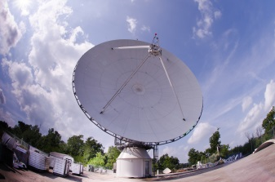
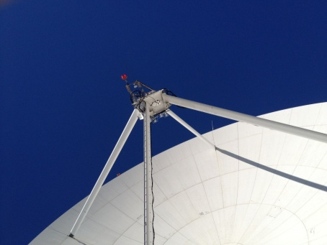
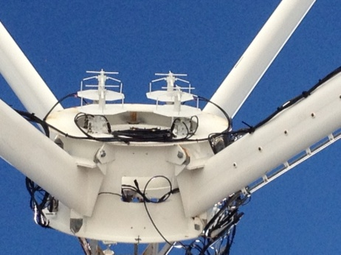
Expected 21m Performance
Performance Measure | Pre-Upgrade | Post-Upgrade
X-Band Frequency Range | 7.0 – 7.8 GHz | 7.0 – 8.5 GHz
LNA Temperature | 70 K | < 20 K
System Noise Temperature | 215 K | <100 K
Antenna Gain | 62 dBi (@7.7 GHz) | 62.7 dBi (@8.4 GHz)
System Noise Spectral Density | -175 dBm/Hz | <-178 dBm/Hz
G/T at 5° Elevation | 37.5 dB/K | 40.4 dB/K
Time Standard | GPS (40 ns) | Hydrogen maser (1 ns/day)
EIRP | N/A | 93.7 dBW
HPBW | 0.124 deg | 0.115 deg
SLE Compliance | N/A | Yes
CCSDS Compliance | N/A | Yes
Forward Error Coding | Reed Solomon/Convolutional | Reed Solomon/Convolutional, Turbo, Low Density Parity Check
Radiometric | Angle, Doppler | Angle, Doppler, Ranging

Slide 17
Planned Testing and Validation
Demonstrations
MarCO
  Downlink Using X-Band Feed and DSN Equipment
  Downlink Using X-Band Feed and MarCO Receiver System
  OMSPA Using X-Band Feed and Custom SDR-based Multiple Receiver System
  UHF Uplink Simulating Insight for MarCO Testing
  OSIRIS Rex and MAVEN
  Uplink Testing
  Downlink Testing
  Ranging Tests
  LRO
  Tracking Precision Testing
  SNR and CNR Measurements
  Lunar IceCube
  DTN Demonstration
Mission | Uplink Margin, dB | Downlink Margin, dB
Osiris Rex | 20.9 | 5.8
Maven | 17.3 | 5.5

Slide 18

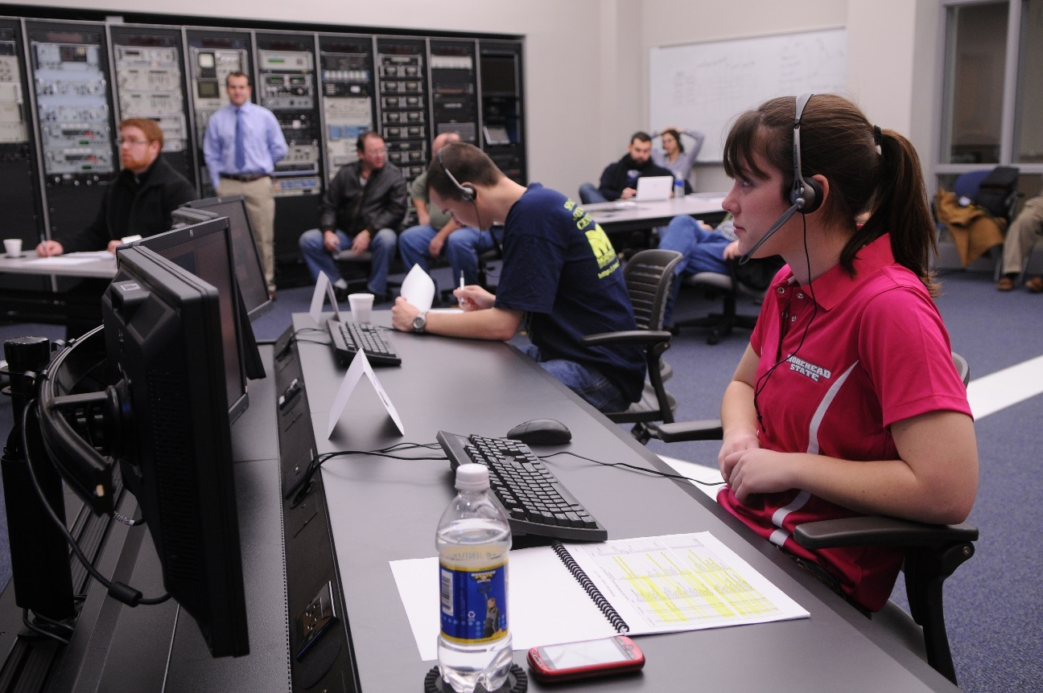
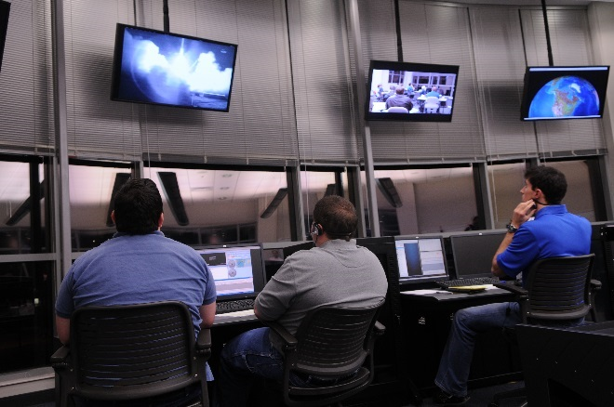
DSS-17 Next Steps
Remaining Critical Milestones
Downlink Demo | NASA NMB Connection | Downlink Demos | Uplink Demo | Ranging Demo | ORR | Operational | EM-1 Mission Ops | Mission Duration | Future Interplanetary Smallsats
5/5/2018 | 06/30/2018 | 2Q 2018 | 3Q 2018 | 4Q 2018 | Q3 2019 | Q4 2019 | Q4 2019 | EM-1 CubeSats Duration | Beyond EM-1

Slide 19
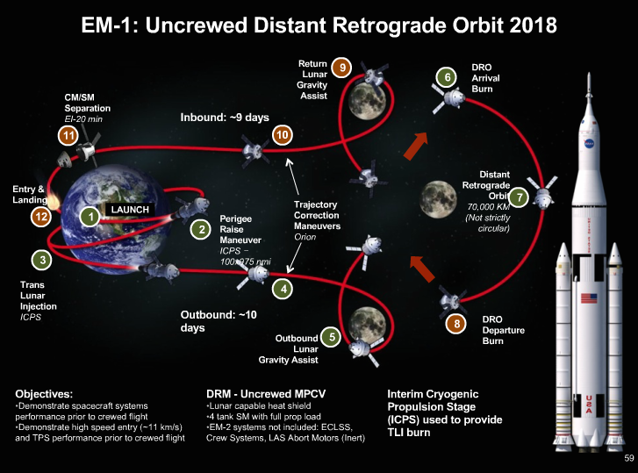
On Target for Operational Readiness for EM-1
Prepared to Provide Support for NASA EM-1 CubeSats
Lunar IceCube NEA Scout LunaH- Map
Lunar Flashlight Biosentinel

Slide 20
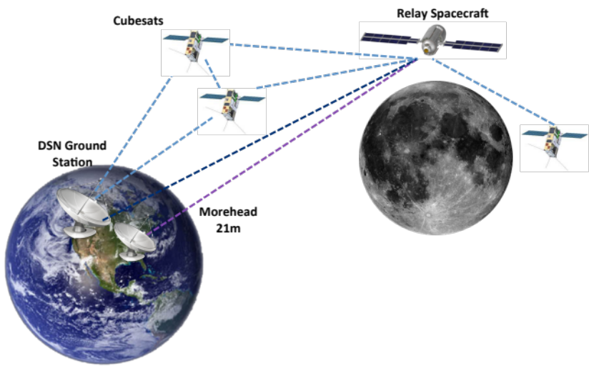
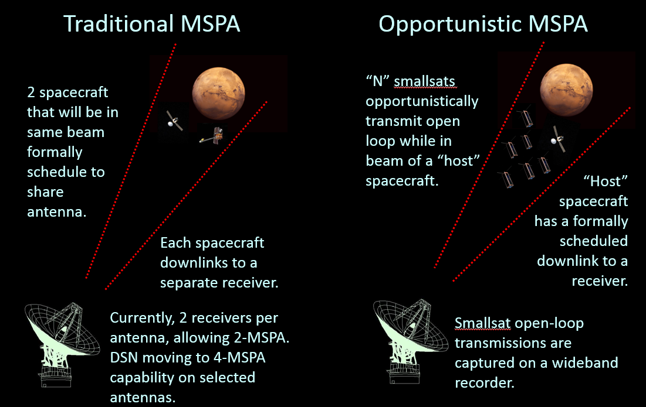
Future of DSS-17
Possible Extensions and Adaptations
Multiple Spacecraft per Aperture (MSPA) and Opportunistic MSPA (OMSPA)
Delay/Disruption Tolerant Networking (DTN)
UHF Uplink/X-band Downlink for MarCO Experiment
Support for Space Networking

Slide 21



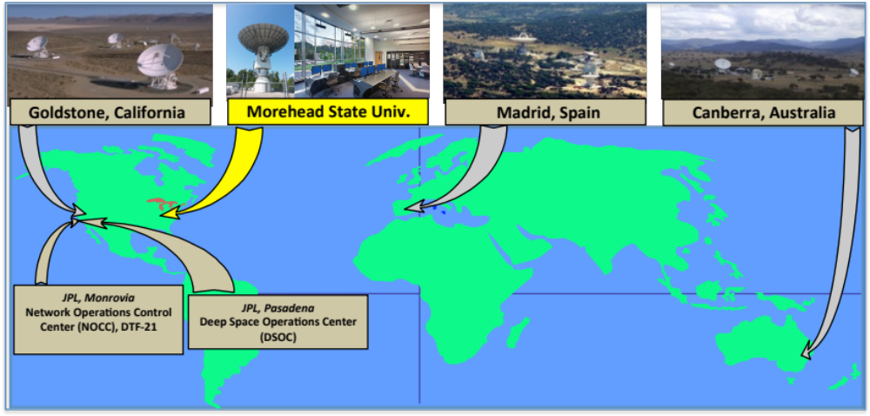
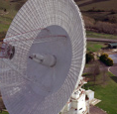
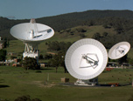
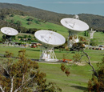
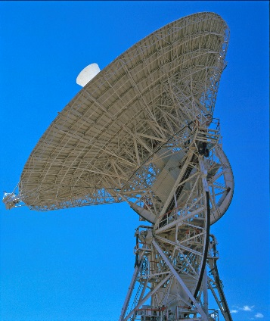
DSS-17 Affiliated Station
Fig. 1: LH2 Tank Installed at Test Site
Fig. 3new: C&C Trailer
Notes:
21

Slide 22
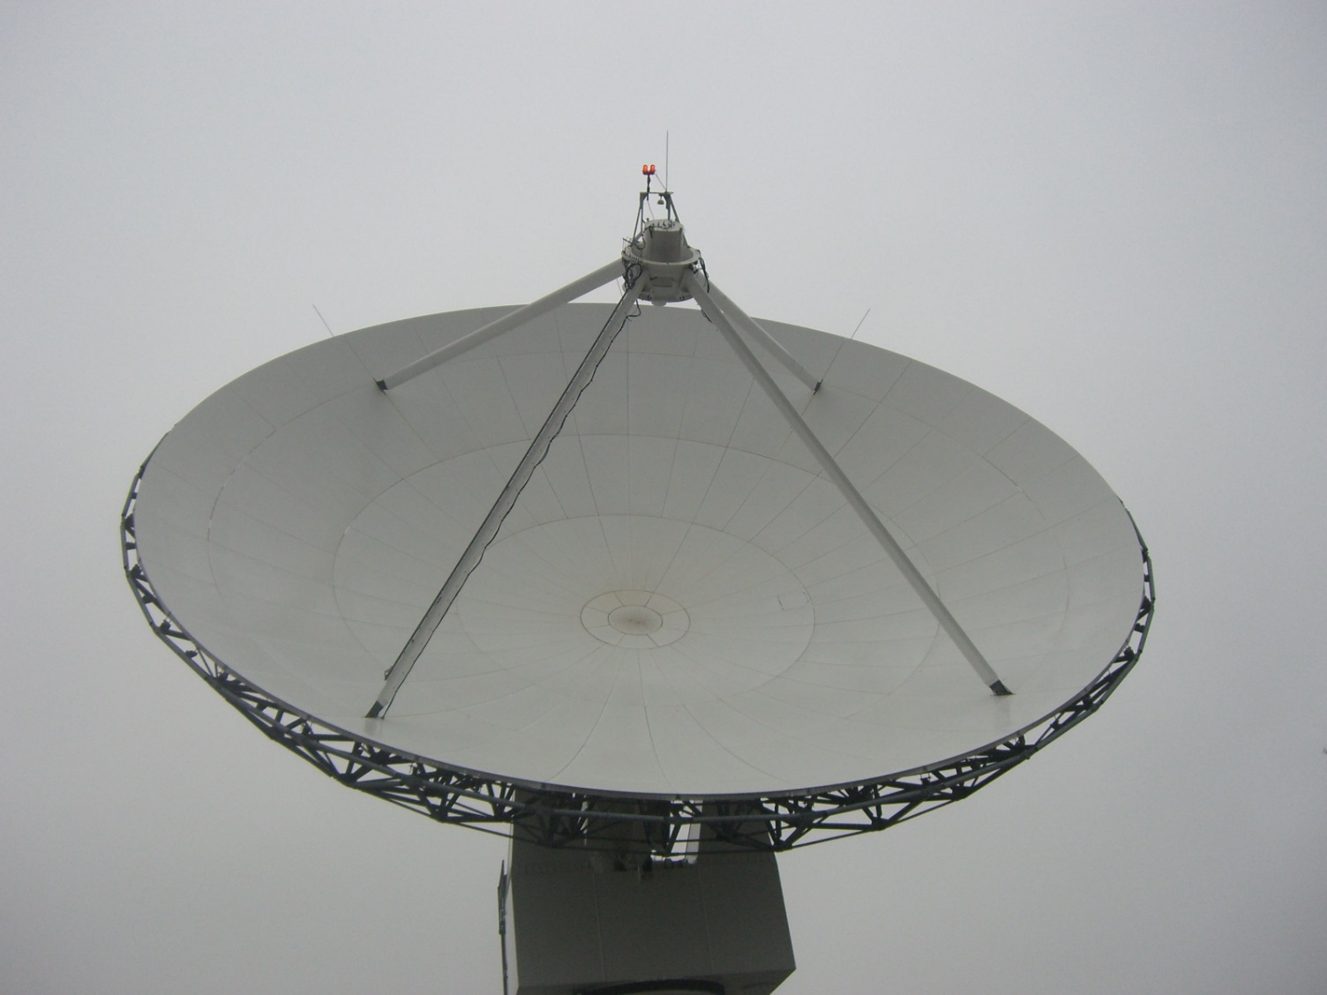
Questions?

