Slide 1
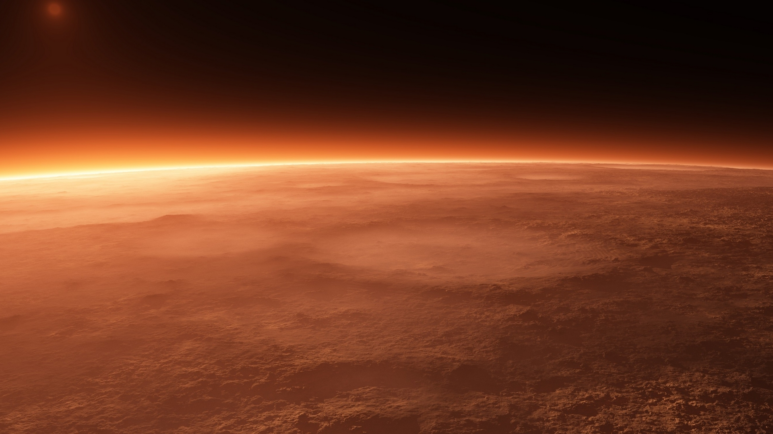
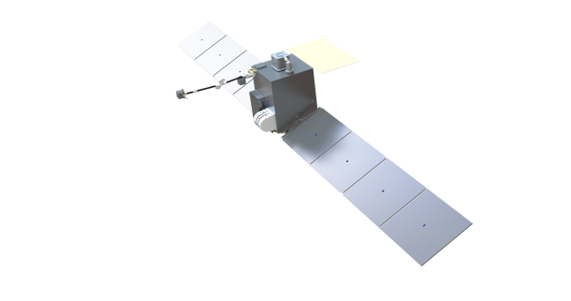


Mars Ion and Sputtering Escape Network (MISEN)
Rob Lillis¹, Jeff Parker², Shannon Curry¹, Jordi Puig-Suari³, Christopher Russell⁴, Janet Luhmann¹, David Brain⁵
¹UC Berkeley Space Sciences Laboratory
²Advanced Space LLC
³Tyvak LLC
⁴UCLA Dept of Earth and Space Sciences
⁵University of Colorado, Boulder
Interplanetary Small Satellite Conference,
May 8, 2018

Slide 2
Outline
The Science Gap: why planetary aeronomy needs multi-point measurements.
The MISEN Mission Concept for PSDS3
  Science Objectives
  Science Payload
  Mission Design/Architecture
  Mission ops & spacecraft
  Mission Team
NOTE: two other similar competing missions for SIMPLEX-II: some details omitted

Slide 3
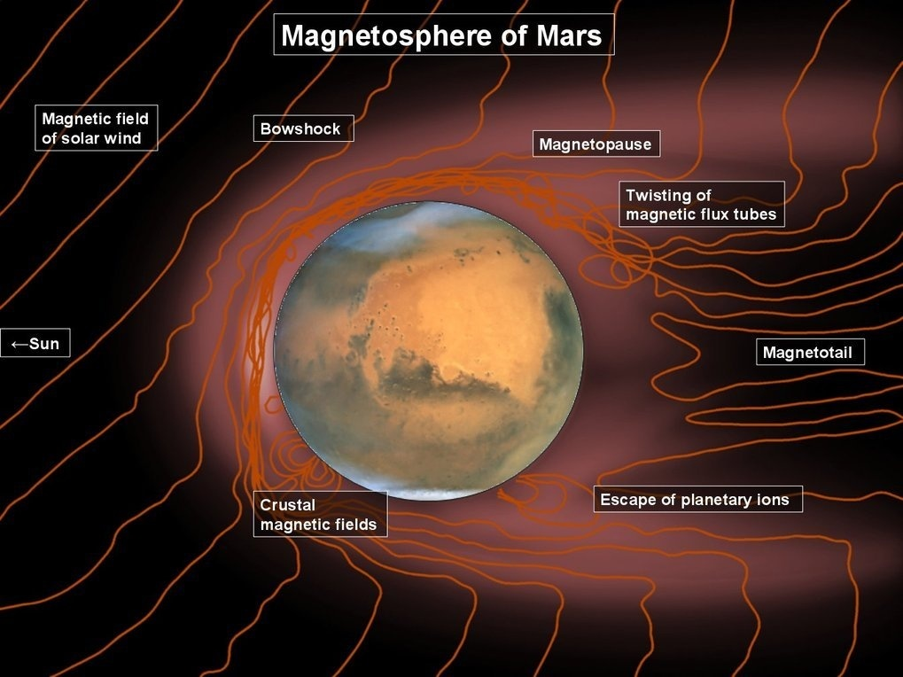
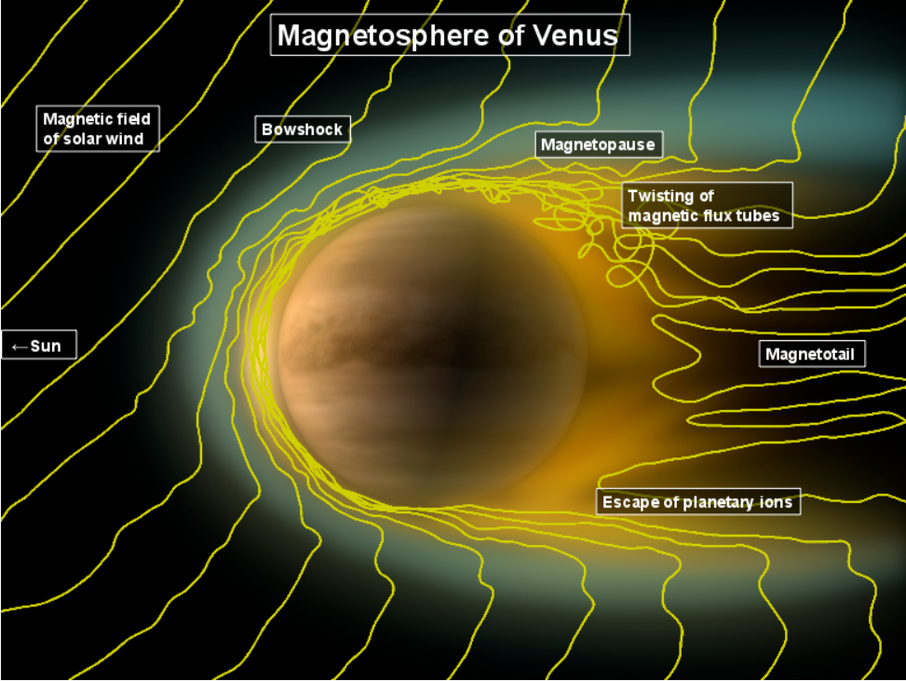
Plasma & magnetic field measurements in planetary environments: why do we care?
Understand the structure, composition, variability and dynamics of planetary magnetospheres (e.g. MAVEN).
Notes:
Mars’ interaction with the solar wind is notoriously complex and variable.

Slide 4
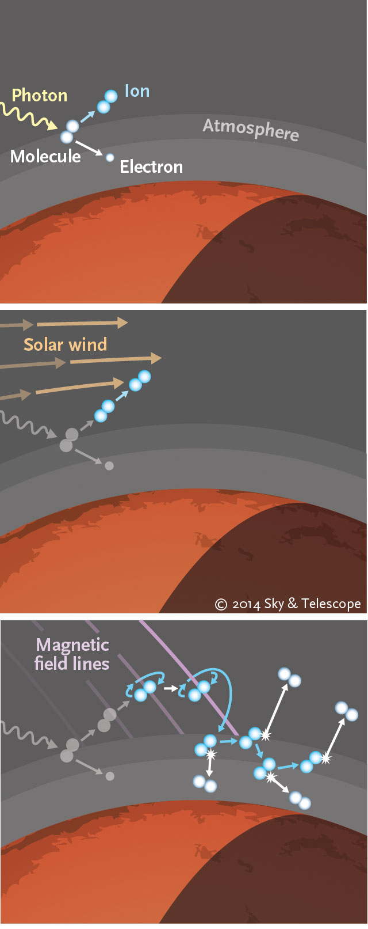
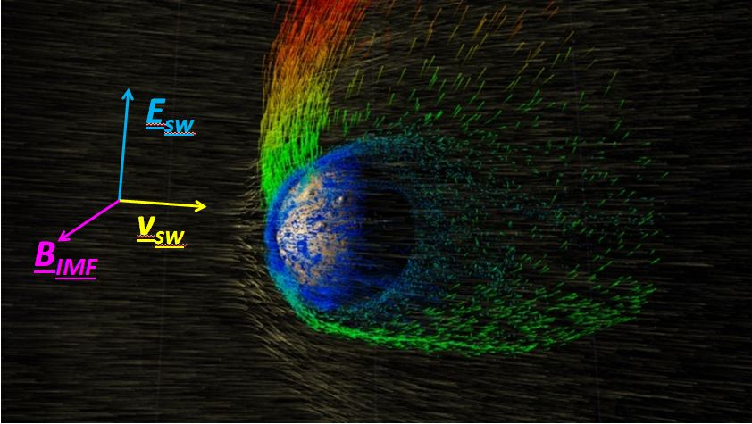
Plasma & magnetic field measurements in planetary environments: why do we care?
Understand the structure, composition, variability and dynamics of planetary magnetospheres (e.g. MAVEN).
Atmospheric Escape Processes: ion and sputtering escape are important for climate evolution of terrestrial planets
escape
1
2
3
Pickup Ion
Escape
Notes:
Mars’ interaction with the solar wind is notoriously complex and variable

Slide 5
Plasma & magnetic field measurements in planetary environments: why do we care?
Understand the structure, composition, variability and dynamics of planetary magnetospheres (e.g. MAVEN).
Atmospheric Escape Processes: ion and sputtering escape are important for climate evolution of terrestrial planets
1
2
3
Sputtering
Escape

Slide 6
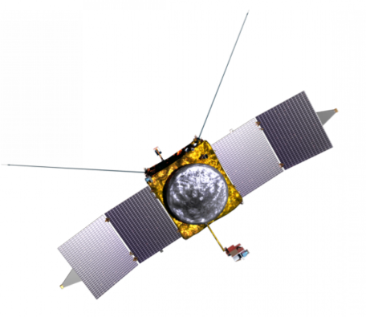
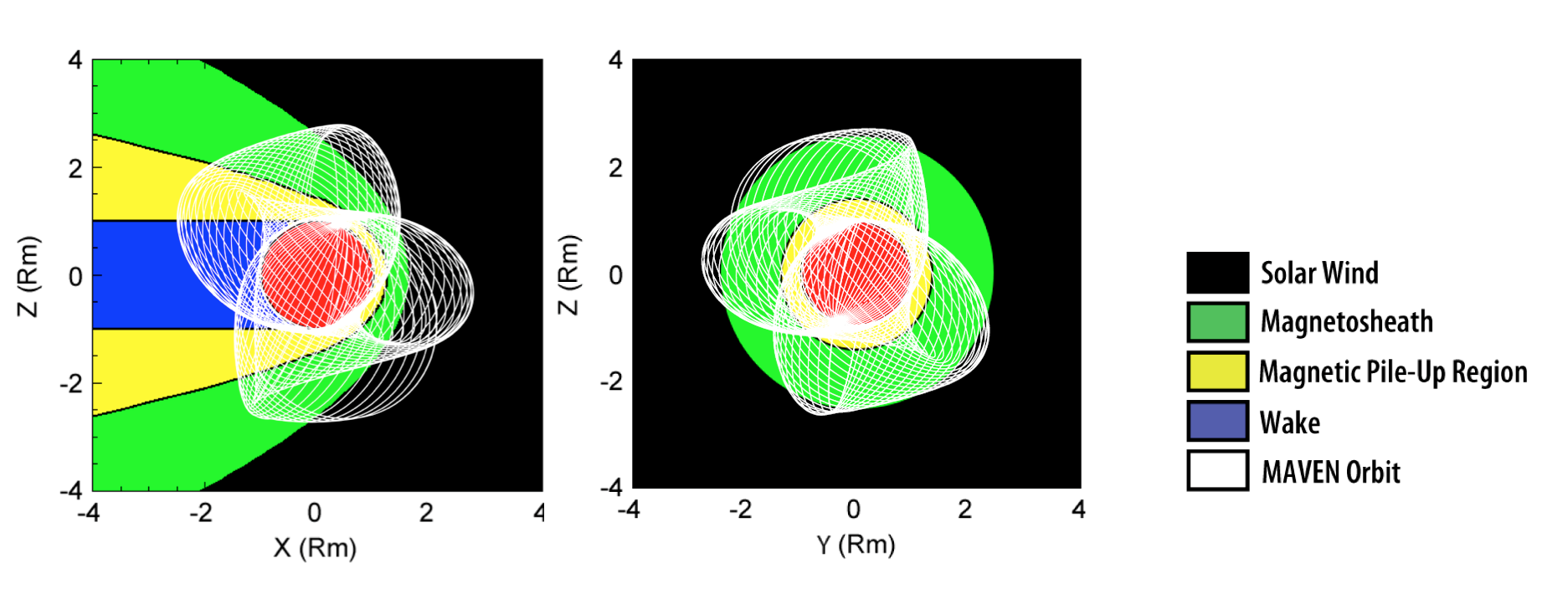
A single measurement platform leaves major questions unanswered
spatial and temporal variations in escape fluxes cannot be distinguished
responses of escape fluxes to changing solar wind conditions (~1 minute) can only be measured with a time-lag of an hour or (much) more
global escape rate variability in response to space weather “storms” (much more common and intense in the early solar system) must be estimated (poorly) from a single orbit track.
MAVEN’s precessing orbit
Notes:
The figure on the bottom shows the evolving orbit of MAVEN in MSO coordinates, or with respect to the sun, showing the nominal location of the various plasma regions and boundaries. Black is the undisturbed solar wind, behind which is the bow shock and the magnetosheath region where the solar wind plasma slows down, heats up, becomes turbulent and diverts around the conducting obstacle of the ionosphere. The yellow region is where the interplanetary magnetic field piles up and drapes around the planet. The blue region is the wake where the double-lobed magnetotail trips behind the planet. This is a highly simplistic representation of a very complex picture that displays enormous variability as the properties of the solar wind change: density, velocity, IMF magnitude and IMF cone and clock angle.

Slide 7
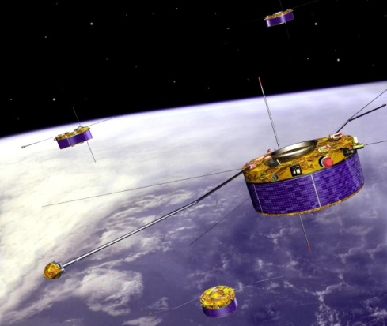
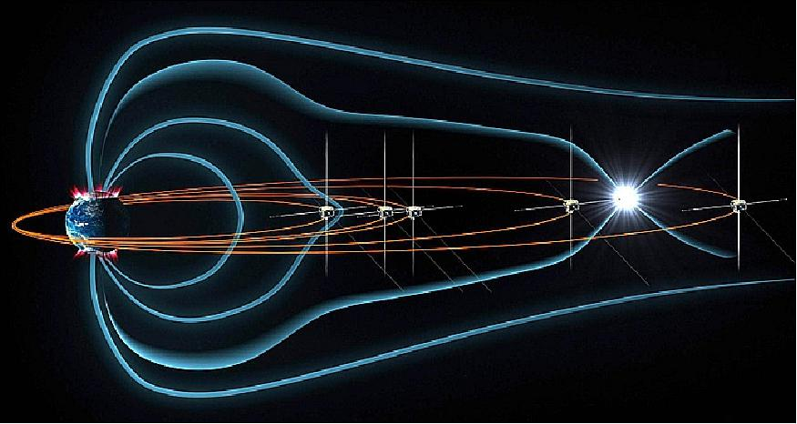
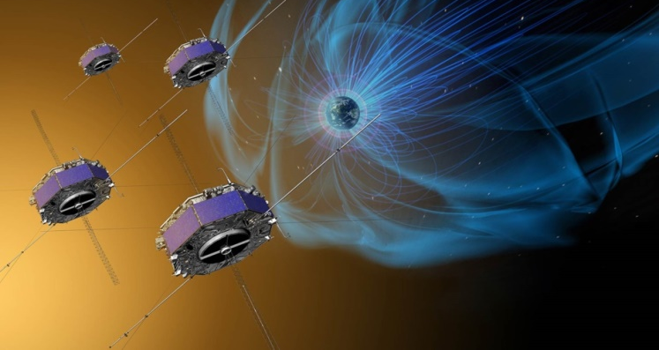
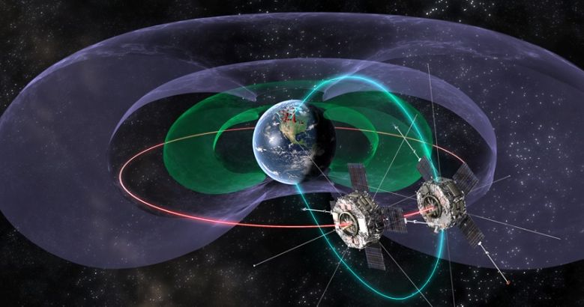
A Multi-spacecraft Revolution
Cluster II
THEMIS
Magnetospheric
Multi-Scale (MMS)
The same problem faced terrestrial space plasma physics in the 1980s, early 1990s.
Single spacecraft couldn’t characterize plasma boundary dynamics.
Multiple spacecraft allow the 3D, time-resolved measurements to create a realistic picture of the magnetosphere and how solar wind conditions affect it.
Similarly, multiple spacecraft are the next step in understanding the solar wind interaction with unmagnetized bodies like Mars.
Van Allen Probes
Notes:
The same problem faced terrestrial space plasma physics in the 1980s and early 1990s. Previous single-spacecraft missions did not allow sufficiently accurate measurements of the boundaries of the magnetosphere. Multiple spacecraft allow scientists make the 3D, time-resolved measurements needed to create a realistic picture of the complex plasma interactions occurring between regions of the magnetosphere and between the magnetosphere and the solar wind. Similarly, multiple spacecraft are the next step in understanding the solar wind interaction with unmagnetized bodies like Mars.

Slide 8
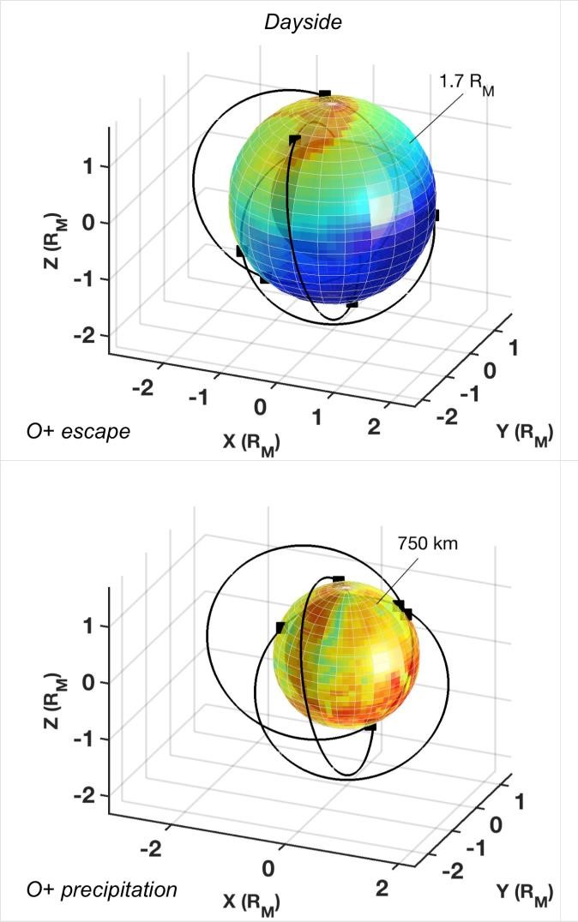

MISEN Objective and Concept
Science Objective: Characterize the magnitude, structure and variability and real-time response to changing solar wind conditions, of ion escape and precipitation at Mars.
In-situ measurements of ions, electrons and magnetic field.
Three smallsats:
  elliptical orbits (~250 x 7000 km)
  Spaced in argument of periapsis, RAAN, and phased to ensure:
    upstream solar wind measurements >90% of the time.
    Simultaneous measurements of the different plasma regimes surrounding Mars.

Slide 9
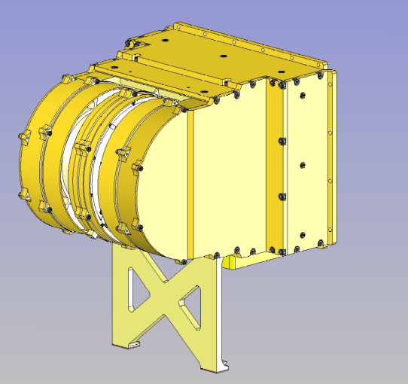
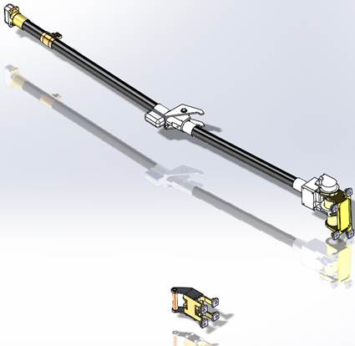
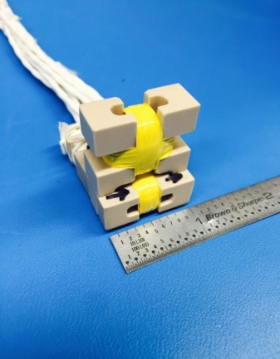
Science Payload
M-MAG (MISEN Magnetometer)
Developed by UCLA (C. Russell)
Clone of Insight Mars magnetometer
Two mounted on boom (90 cm) i.e. gradiometer configuration
0.3U, 144 g, 0.8 W per sensor
±8000 nT range
48 bits per readout up to 64 Hz
MESA (MISEN electrostatic analyzer)
UCB/SSL heritage design, ion & electron analyzer
1.8 kg, 1.7 W.
4π FOV via spinning platform
22.5° x 6°, 3 eV-25 keV range
DE/E = 18%
Light-vs-heavy mass differentiation achieved through pulse height analysis.

Slide 10
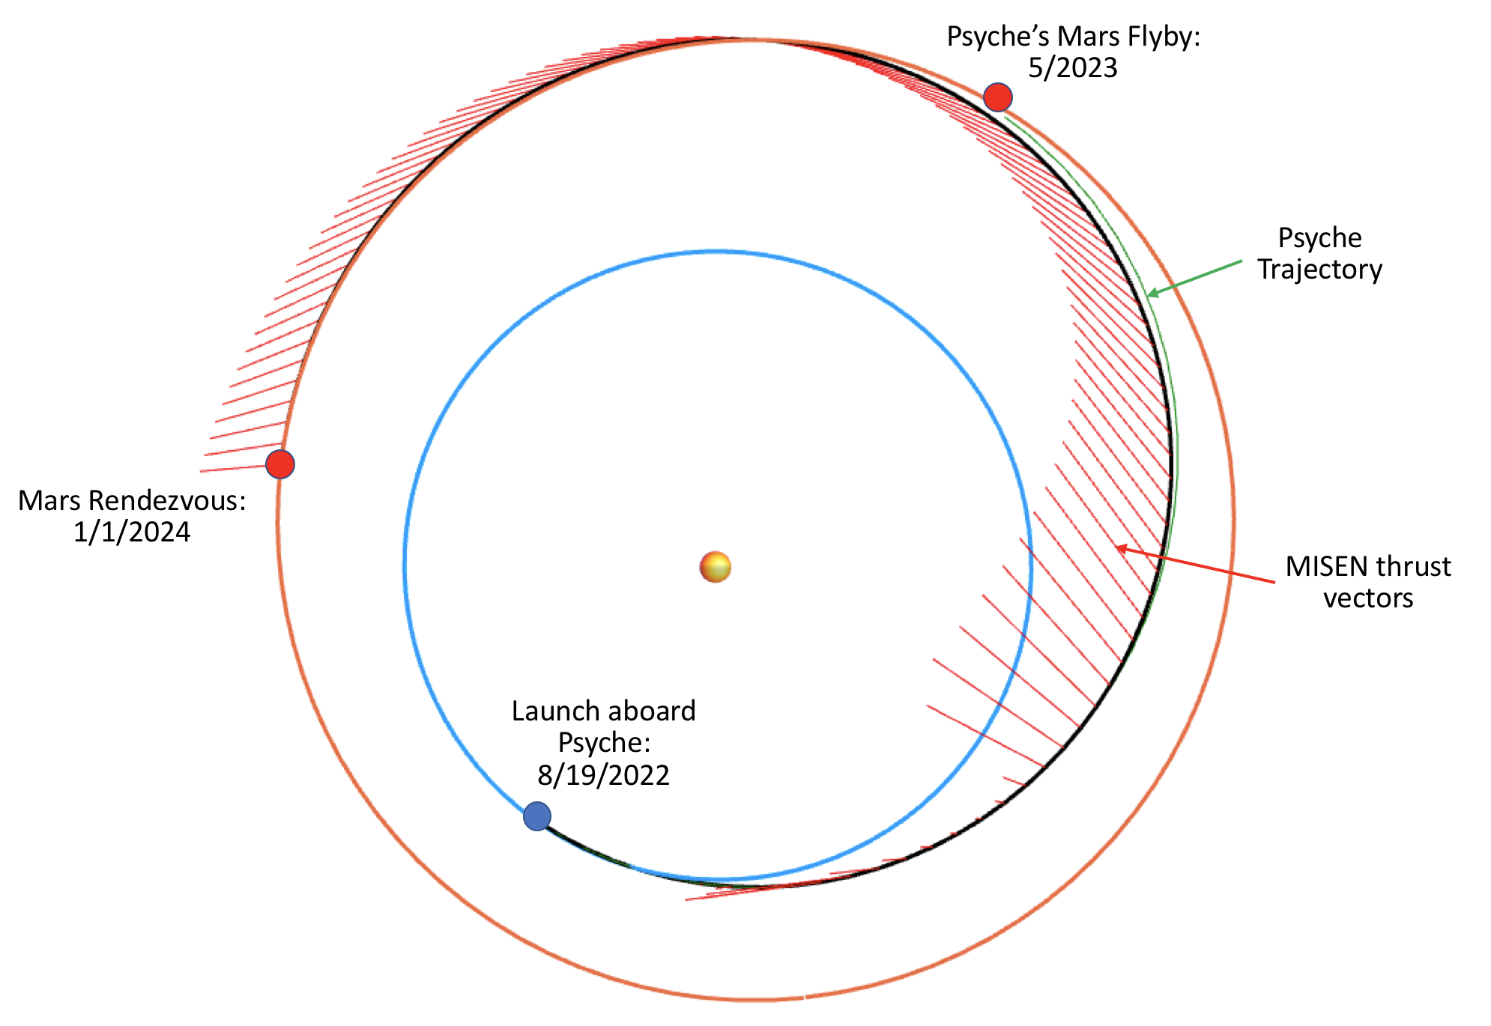
Mission Design 1: Cruise
Separate from primary on lunar or Earth-escape trajectory.
Point Mission Design is for Psyche ride-share (launch 08/2022).
15 month electric propulsion cruise to Mars rendezvous.
Near-constant thrusting, no spinning.
Regular DSN contacts.

Slide 11
Mission Design 2: Spiral Down to Science
Match Mars’ orbit and cross its sphere of influence.
Each spacecraft guided to its own orbital plane.
Switch to Mars-centered Conops/Nav
11 months of spiraling
End in science orbits
Full instrument commissioning
Each spacecraft approaches Mars in its own plane, spiraling to its own target orbit.
Target:
250 x 7000 km
~100,000 km

Slide 12
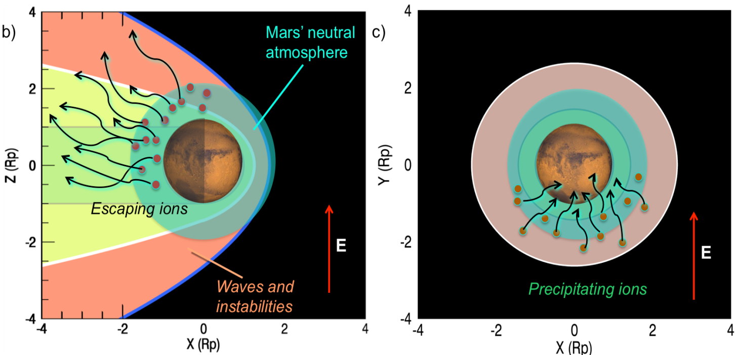
Mission Design 3: Science Orbits
Elliptical orbits:
  High enough to ensure outward particles are escaping.
  Low enough to ensure inward particles are precipitating.

Slide 13
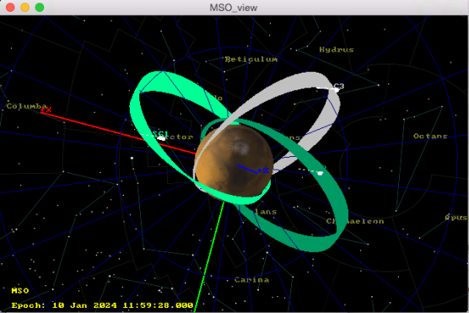
Mission Design 3: Science Orbits
Elliptical orbits:
  High enough to ensure outward particles are escaping.
  Low enough to ensure inward particles are precipitating.
  RAANs, AoPs chosen so sufficient coverage of Mars’ different plasma regions is maintained as orbits precess over a 1-year primary mission.
Orbits are stable, though will need ~monthly phasing maneuvers

Slide 14
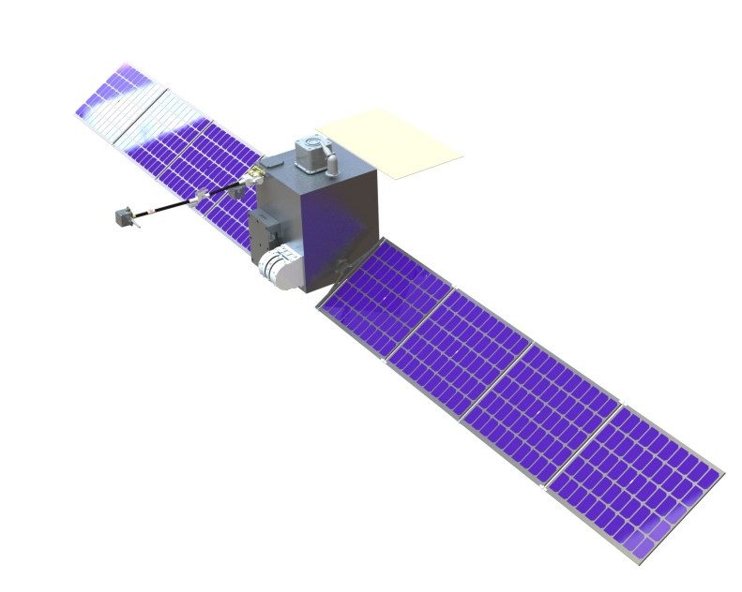
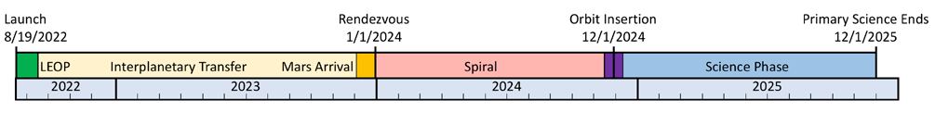
Spacecraft Ops and architecture
Ops:
Three axis stabilized until science orbit.
Spinning at 16s period after that
Ops are simple: data collection is ‘dumb’ and continues indefinitely
~Weekly downlinks
Spacecraft:
SC volume depends on launch point.
Gimballed solar panels
IRIS radio X or Ka-band
MarCO style antenna
Spin axis

Slide 15
MISEN Study Team
UC Berkeley Space Sciences Lab
PI: Rob Lillis
Project Scientist: Shannon Curry
Systems Engineering & Management: Dave Curtis
Ion & electron analyzer: Davin Larson, Roberto Livi, Phyllis Whittlesley
Science advisory: Janet Luhmann
UCLA Earth and Space Sciences
Magnetometer: Chris Russell
MHD modeling: Yingjuan Ma
Advanced Space LLC
Mission Design & Navigation: Jeff Parker & Nathan Parrish
Tyvak LLC
Spacecraft bus & subsystems: Jordi Suig-Puari, Angelo Lopez
University of Colorado Boulder
Science advisory: David Brain

Slide 16
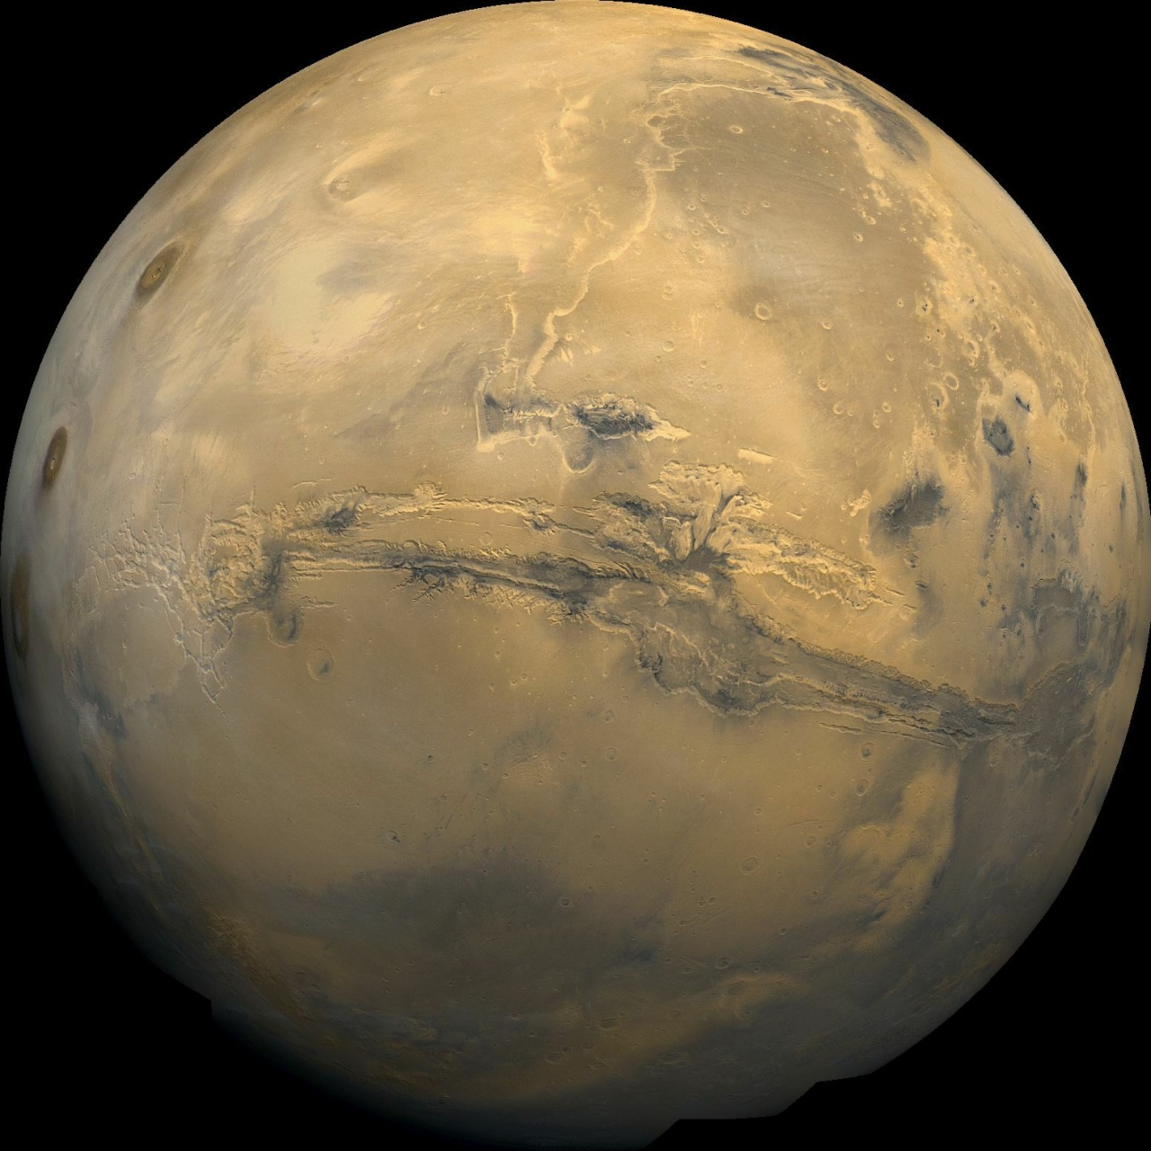
Summary
MISEN will:
Provide simultaneous multi-point measurements of the Martian plasma environment.
Elucidate the real-time response of the this environment to solar wind changes & disturbances (CMEs, SEPs etc)
Reveal for the first time the global structure of ion and sputtering escape and how and why it varies.
Build on MAVEN’s legacy for a fraction of the cost.
THANK YOU to the PSDS3 Program!

Slide 17
BACKUP SLIDES

Slide 18
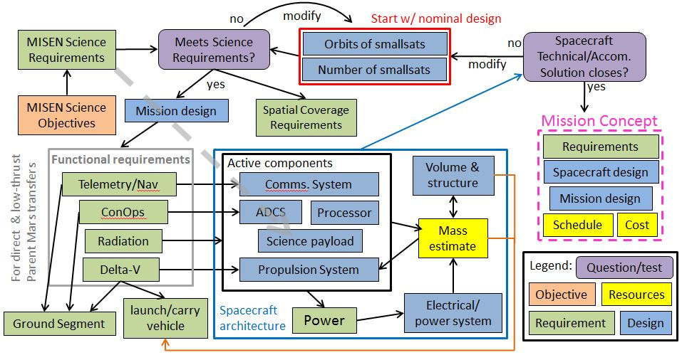
Feasibility Study flowchart

Slide 19
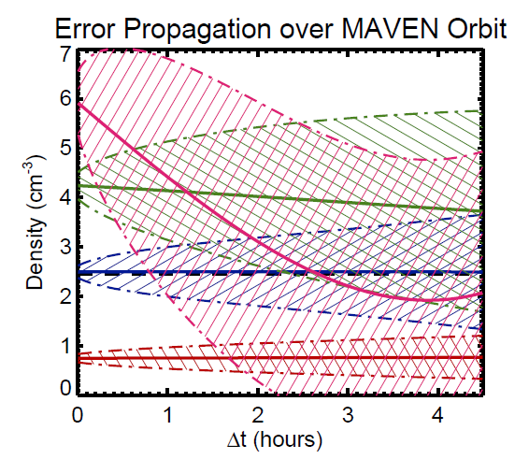
A single measurement platform leaves major questions unanswered
spatial and temporal variations in escape fluxes cannot be distinguished
responses of escape fluxes to changing solar wind conditions (~1 minute) can only be measured with a time-lag of an hour or (much) more
global escape rate variability in response to space weather “storms” (much more common and intense in the early solar system) must be estimated (poorly) from a single orbit track.
Credit: M. Marquette
Notes:
The figure on the bottom shows the evolving orbit of MAVEN in MSO coordinates, or with respect to the sun, showing the nominal location of the various plasma regions and boundaries. Black is the undisturbed solar wind, behind which is the bow shock and the magnetosheath region where the solar wind plasma slows down, heats up, becomes turbulent and diverts around the conducting obstacle of the ionosphere. The yellow region is where the interplanetary magnetic field piles up and drapes around the planet. The blue region is the wake where the double-lobed magnetotail trips behind the planet. This is a highly simplistic representation of a very complex picture that displays enormous variability as the properties of the solar wind change: density, velocity, IMF magnitude and IMF cone and clock angle.

