Slide 1
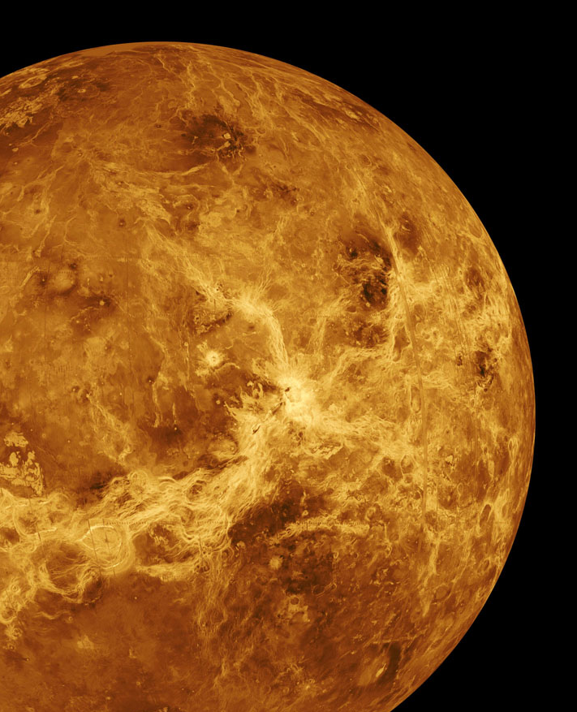
A Venus SmallSat Orbiter for Remote Sensing of Seismic Activity, the VAMOS Concept
Alan M. Didion, Systems Engineer
NASA Jet Propulsion Laboratory, Engineering and Science Directorate, Systems Engineering & Formulation Division
ISSC 2018, Pasadena, CA
As presented by:
Alex Austin, Systems Engineer
NASA Jet Propulsion Laboratory, Engineering and Science Directorate, Systems Engineering & Formulation Division
© 2018 California Institute of Technology. Government sponsorship acknowledged.

Slide 2
Introduction to the Planetary Science Deep Space SmallSats (PSDS3) Program
ROSES 2016
  Explore mission concepts for SmallSats (< 180 kg) at planetary targets, identify critical technology gaps
Proposed concepts:
  VAMOS
  Cupid’s Arrow
  CUVE
  CubeX
  BOLAS
  APEX
  CAESAR
  Chariot to the Moons of Mars
  Aeolus
  SNAP
  JUMPER
  …and others!
Notes:
PSDS3 was a 2016 ROSES solicitation for smallsat (< 180 kg, ESPA-class) mission concepts to planetary targets, specifically enumerating the technological gaps and barriers to this accomplishment.
This turned out to be, of course, no easy feat (hence the solicitation) and several technology gaps were identified such as (but not limited to): SmallSat EP maturity, SmallSat high-power computing, and the associated power/ADCS/ and thermal cascades.

Slide 3
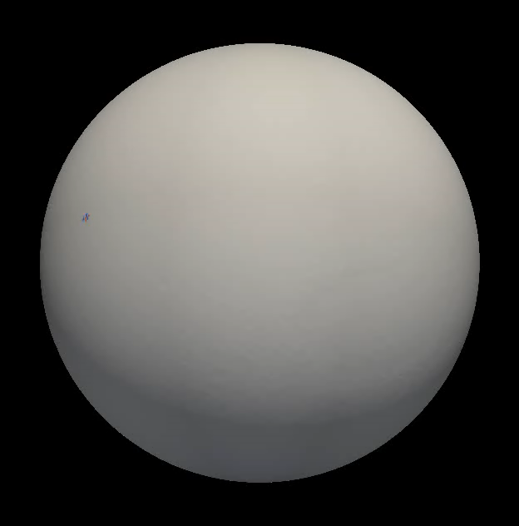

Planetary Quakes on Rocky Bodies
Deep Insight via Global Observations
Notes:
(Simulation)
Animation made for InSight, and depicts seismic waves on the surface of Mars. But, the idea is that it is the disturbance of the waves itself that yield the scientific discovery. As the waves pass through crustal material of different thickness, density and composition, the wave front distorts. THIS is the goal, in addition to the simple existence of Venusquakes in the first place. That said, confidence in our measurement technique coupled with LACK of phenomena is still a very interesting result.
InSight can get away with a “single” seismometer because it is incredibly sensitive, but more (in more places) would of course be helpful. InSight can locate the epicenter, but can’t see the “shape” (per se) of the Wavefront on a global scale. In situ seismic measurements at Venus (a la InSight) of course would be a very expensive endeavor due to the wildly inhospitable surface conditions at Venus. Our technology does not currently support such an implantation, and the expensive necessary developments are still a ways in the future.
Note that this dictates a wide field of view (FOV) in order to detect global variation in wave curvature.
THIS animation was just the Rayleigh waves conducted through the surface of the planet. From there, atmospheric pressure waves carry the vertical displacements to the surface of the atmosphere, amplifying it along the way.
*I took a lot of these animations and graphics from Philippe Lognonne (scientist for VAMOS and SEISmometer PI for InSight), so many thanks to him and his exciting presentation on VAMOS’s science.

Slide 4
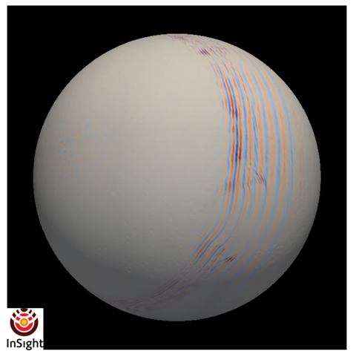
Planetary Quakes on Rocky Bodies
Deep Insight via Global Observations
Notes:
BACKUP IN CASE THE VIDEO BREAKS
(Simulation)
Animation made for InSight, and depicts seismic waves on the surface of Mars. But, the idea is that it is the disturbance of the waves itself that yield the scientific discovery. As the waves pass through crustal material of different thickness, density and composition, the wave front distorts. THIS is the goal, in addition to the simple existence of Venusquakes in the first place. That said, confidence in our measurement technique coupled with LACK of phenomena is still a very interesting result.
InSight can get away with a “single” seismometer because it is incredibly sensitive, but more (in more places) would of course be helpful. InSight can locate the epicenter, but can’t see the “shape” (per se) of the Wavefront on a global scale. In situ seismic measurements at Venus (a la InSight) of course would be a very expensive endeavor due to the wildly inhospitable surface conditions at Venus. Our technology does not currently support such an implantation, and the expensive necessary developments are still a ways in the future.
Note that this dictates a wide field of view (FOV) in order to detect global variation in wave curvature.
*I took a lot of these animations and graphics from Philippe Lognonne (scientist for VAMOS and SEISmometer PI for InSight), so many thanks to him and his exciting presentation on VAMOS’s science.

Slide 5
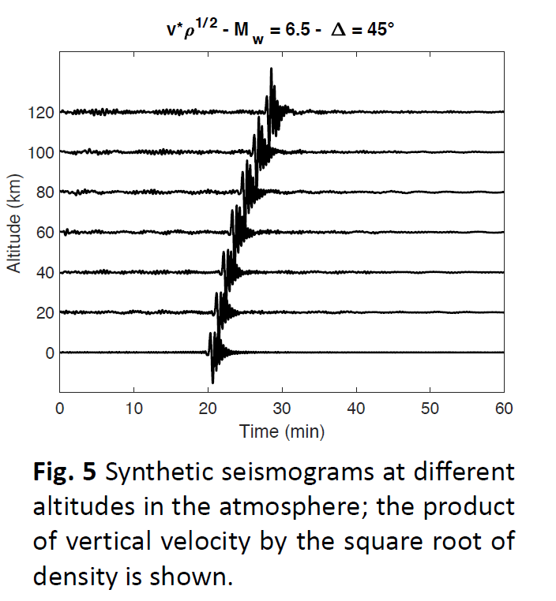
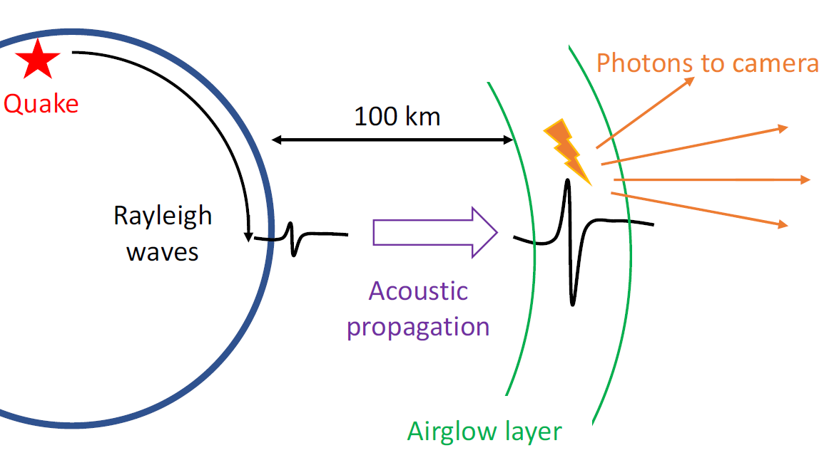
Planetary Quakes on Rocky Bodies
Deep Insight via Global Observations

Slide 6
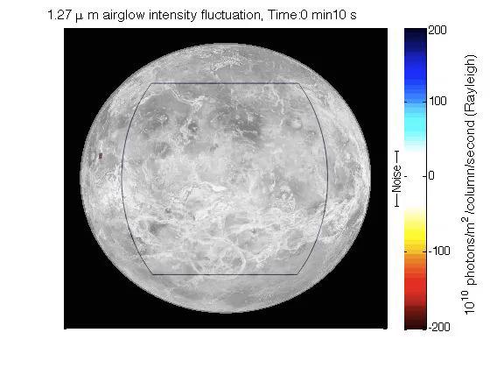
Atmospheric Airglow
Ionospheric Modulation Reveals Surface Displacement
Notes:
(Simulation)
This animation shows *a possible* FOV of the VAMOS IR instrument trained on the disc of Venus from high orbit. During the study, several fields of view were studied with factors including orbital altitude, optics size/mass, and resolution.
Watch as a simulated Venusquake is conducted into the ionosphere by Venus’ thick atmosphere and reveals itself in waves in the airglow intensity.
Note again the necessity for a wide-disc FOV in order to observe the global variations in Wavefront curvature across the disc.
Waves move at ~5-7 km/s

Slide 7
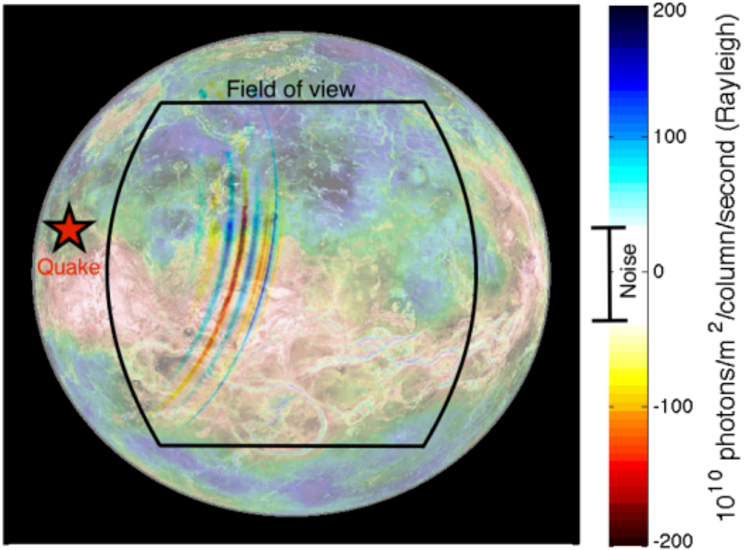
Atmospheric Airglow
Ionospheric Modulation Reveals Surface Displacement
Notes:
BACKUP IN CASE THE VIDEO BREAKS
(Simulation)
This animation shows *a possible* FOV of the VAMOS IR instrument trained on the disc of Venus from high orbit. During the study, several fields of view were studied with factors including orbital altitude, optics size/mass, and resolution.
Watch as a simulated Venusquake is conducted into the ionosphere by Venus’ thick atmosphere and reveals itself in Rayleigh waves in the airglow intensity.
Note again the necessity for a wide-disc FOV in order to observe the global variations in Wavefront curvature across the disc.

Slide 8
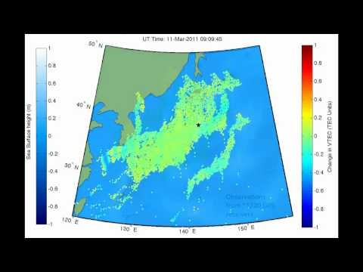
Atmospheric Excitation by Planetary Quakes
An Earth Analog- Japan Earthquake & Tsunami: March 11, 2011
Notes:
(This is real data, play the video)
Video shows GPS signals attenuated by atmospheric disturbance caused by an Earthquake and tsunami. (modulated TEC)
This effect is similar to how airglow is excited by gravity waves for the same reason.
Note that Earth’s atmosphere is thinner than Venus’s, and that Venus’s airglow layer is the brightest in the solar system.

Slide 9
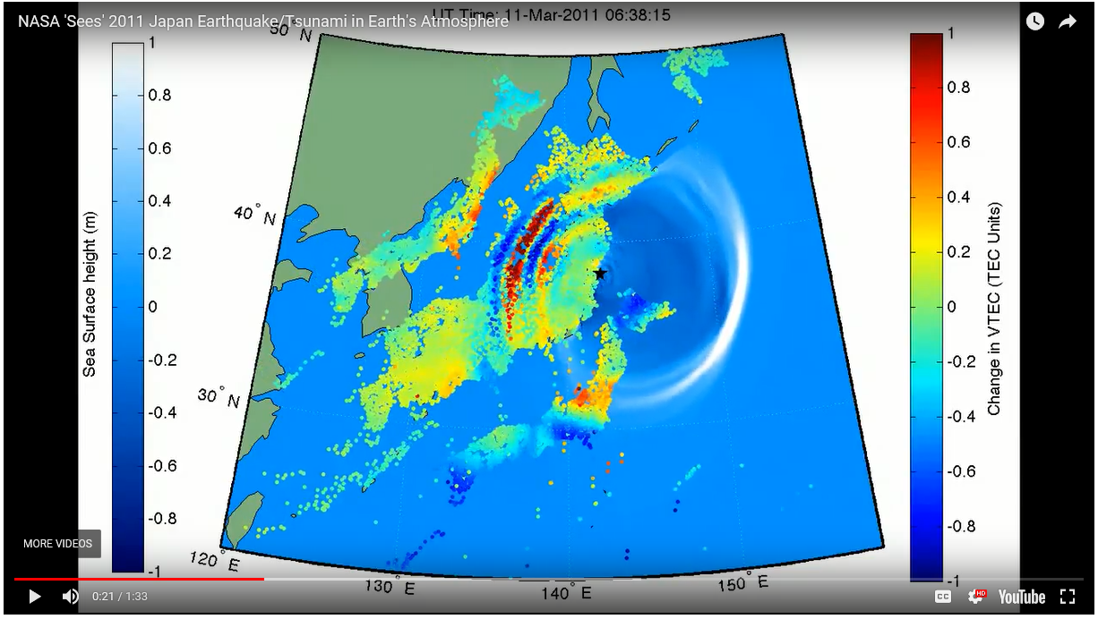
Atmospheric Excitation by Planetary Quakes
An Earth Analog- Japan Earthquake & Tsunami: March 11, 2011
Notes:
BACKUP IN CASE THE VIDEO BREAKS
(This is real data, play the video)
Video shows GPS signals attenuated by atmospheric disturbance caused by an Earthquake and tsunami. (modulated TEC)
This effect is similar to how airglow is excited by gravity waves for the same reason.
Note that Earth’s atmosphere is thinner than Venus’s, and that Venus’s airglow layer is the brightest in the solar system.

Slide 10
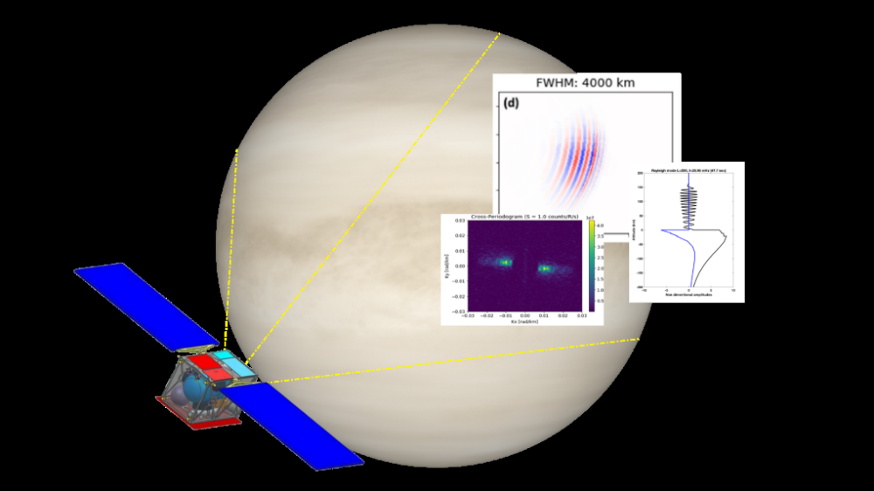
Mission Concept Overview
A Vigilant Small Spacecraft in High Circular Venusian Orbit
Notes:
-As will be discussed (for the remainder of this presentation), the VAMOS concept aims to make these observations with a Small Spacecraft in high circular orbit at Venus.
-High circular means we can:
-High: see a large portion of the planet at once
-also very stable wrt solar gravity perturbations
-Circular: keep the planet at a constant focal distance, and keep resolution steady
-Other benefits:
-supply in-situ or low-orbit missions with relay support

Slide 11
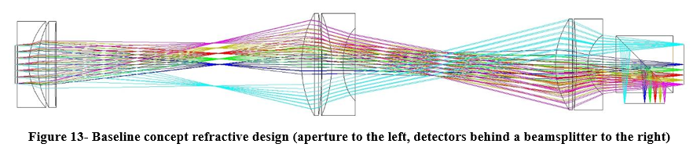

Instrument & Spacecraft Description
A Simple Infrared Telescope with Dual Detectors on a SEP SmallSat
Notes:
Instrument key features (image via Mayer Rud):
-The design for the infrared telescope is relatively simple, splitting the incoming image of the planet with a beamsplitter onto two detectors, one at 1.27 micron (non-sunlit regions) and one at 4.28 micron (for sunlit regions).
-Design is fully refractive, and is reminiscent of the DLR VIRTIS design (Venus Express), see Joern Helbert.
Spacecraft key features: (*this CAD was not ready when we wrote the paper, so maybe it will find its way into the updated [post-meeting] version of the paper. via Team X)
-Solar electric propulsion (SEP)
-Dictates large (relative to bus) solar arrays
-SEP allows VAMOS to enter a high-circular orbit much MUCH easier than a chemical system, which would prefer a highly elliptical orbit with low pericytherion.
-JPL MaSMi EP thruster (600-800 W) chosen as baseline main engine due to throughput constraints of comparable engines. Adding throughput spares would be prohibitively expensive to the mass budget.
-Real-time processing for event detection is the hardest constraint to contend with, and led us to identify CubeSat/SmallSat CDH systems as the biggest technology hurdle for this class of mission.
-Once processed, the data is more than compact enough to be returned to Earth via an X-band medium-gain antenna and IRIS CubeSat radio.
-Arrays dictate a higher ADCS capability than CuebSat hardware, but less than larger, more classical systems. This also represents a capability gap in industry offerings.

Slide 12
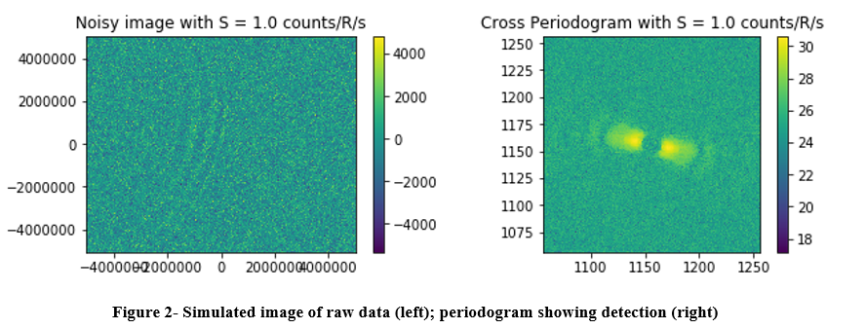
Event Detection Algorithms
Real-time Wavefront Detection
Notes:
(via Jonathan Makela and Matthew Grawe, University of Illinois at Urbana-Champaign)
-Data is taken continuously and processed through an on-board event detection algorithm to flag events for downlink. Much work was done to optimize this process and fit it onto spacecraft computing hardware, and this was identified as a major technology hurdle.
-It was found late in the study that this noise may actually be an issue. It is a topic of ongoing study how to sufficiently deal with this issue and ensure that our science sufficiency is guaranteed.
Note: This figure has been updated in the CSR, but I’m leaving this to be consistent with the paper. (may update paper before final submission)

Slide 13
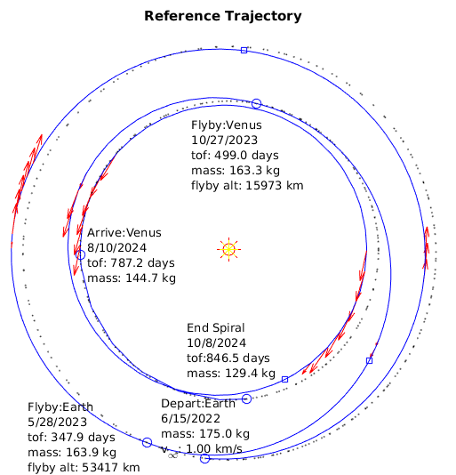
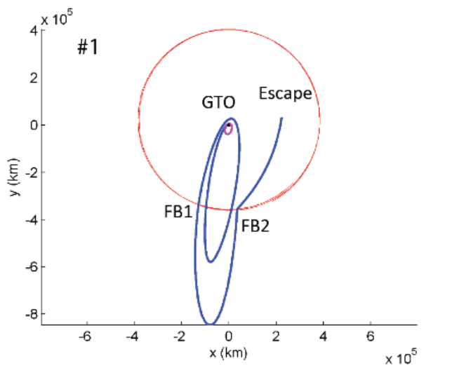
Trajectory Design
Solar Electric Propulsion- EEVV Transfer
Notes:
[Note: This is updated in CSR for new [larger] mass, etc.]
(image via Mark Wallace)
Left- MALTO plot of SEP transfer from Earth to EEVV transfer to Venus rendezvous
-Launch at 180 kg (for this case! Updates in CSR to 300 kg launch mass), with 5 kg decrement for GTO escape allocation (to be discussed next)
-Arrive having consumed ~30 kg of xenon propellant
Right- Top-down view of the Earth-moon system, showing a particular case of the GTO-to-lunar flyby escape sequence (via Gregory Lantoine) used by VAMOS to reach Earth-escape (C3 = 2) from a GTO rideshare.
-This is only one of many solutions, to be shown on the next slide
-This assumes it is OK for the centaur to re-light its engine to boost VAMOS up rather than down from GTO. (it is typical for the centaur to boost away from GTO to avoid interfering with the GEO ring after delivering its payload, we assume we can go the other way. From what we can tell so far, this may be a sound assumption.)

Slide 14
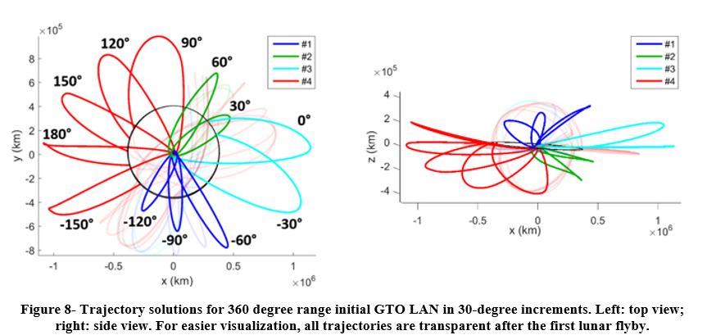
Trajectory Design
Rideshare Flexibility- GTO Escape from the Earth-Moon System
Notes:
During our study, it was determined that a valuable investigation would be that of secondary rideshare opportunities which ARE NOT already bound for Venus orbit insertion. An investigation was launched into the proper propellant allocation necessary to successfully boost a GTO secondary payload from GTO to a lunar-crossing orbit which could leverage lunar flybys to escape from the Earth and set itself on an interplanetary trajectory. This is highly desirable for a SEP transfer, and GTO launch flexibility represents an extreme broadening of the launch tradespace.
(via Gregory Lantoine)
Left- The first leg of a representative solution for each GTO LAN option (30 degree increments), with later legs faded out. This shows that solutions were found for each possible GTO LAN option, demonstrating vast secondary-payload launch flexibility for VAMOS, and really any small spacecraft wishing to eject from the Earth-Moon system.
Right- A plane-on view of the same information.

Slide 15
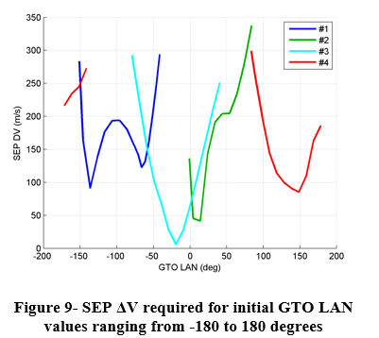
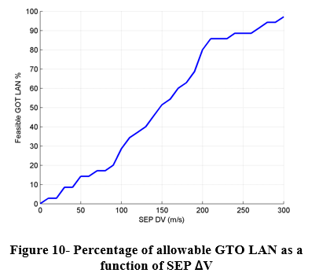
Trajectory Design
Rideshare Flexibility- GTO Escape from the Earth-Moon System
Notes:
(via Gregory Lantoine)
Left- The four families of trajectories span the entire LAN space, with obvious favorable and less-favorable points.
-This shows that the VAMOS concept is highly flexible to GTO launch opportunities, but obviously favors some over others.
Right- Cumulative distribution showing that ~90% of GTO LAN options can be accounted for with a <300 m/s SEP delta-v allocation. This has been baked into the VAMOS design by allocating 5 kg of xenon for this escape phase.

Slide 16
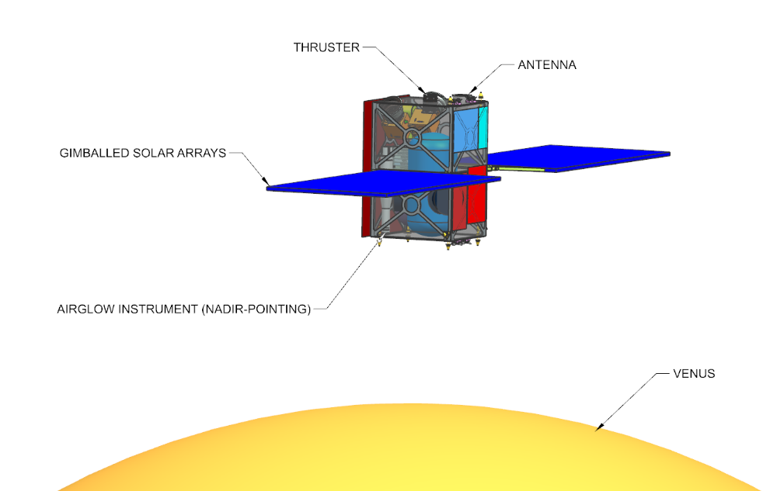
Concept of Operations
Constant Observation of the Venusian Disc
Not to scale!
Notes:
(image via Team X, Eric Sunada)
-This cartoon (not to scale, of course), shows how the VAMOS flight system will keep its arrays pointed to the sun (in this image, up) while keeping its instrument pointed nadir, to the Venus disc.
-The orbit is in the plane of the screen/page.
-The sun is roughly in the plane of the page, though trades were examined involving orbital inclinations to avoid eclipses, though this comes at the cost of thermal complexity (radiators are red patches on the sides, and would see the sun if inclination is too high)

Slide 17
Option Comparison & Major Trades
Chemical propulsion option for lower cost at the expense of suboptimal science orbit
Advanced CubeSat/SmallSat CDHS vs. RAD750-based systems
Possible commercial bus partnerships
Direct-delivery via Venus-bound mission
  Simplifies propulsion, power design, but drastically limits launch flexibility
  Unique VAMOS orbit further unlikely to be offered

Slide 18
Meet the Authors
Many thanks to them!
NASA JPL
  Alan Didion, Attila Komjathy, Brian Sutin, Barry Nakazono, Ashley Karp, Mark Wallace, Gregory Lantoine, Siddharth Krishnamoorthy, Mayer Rud, James Cutts
IPGP
  Philippe Lognonné, Balthasar Kenda, Mélanie Drilleau
University of Illinois at Urbana-Champaign
  Jonathan Makela, Matthew Grawe
DLR
  Jörn Helbert
A. Didion, A. Komjathy, B. Sutin, et al., (2018) “Remote Sensing of Venusian Seismic Activity with a Small Spacecraft, the VAMOS Mission Concept”, IEEE Aerospace Conference, Big Sky, MT, March 3-10.
Notes:
Institutions in no particular order (other than JPL first because PI institution)

Slide 19
Q&A, Acknowledgements
Contact Information:
  Alan Didion: presenter, systems engineer
    Alan.M.DIdion@jpl.nasa.gov
  Attila Komjathy: principal investigator
    Attila.Komjathy@jpl.nasa.gov
This material is based upon work supported by the National Aeronautics and Space Administration under ROSES 2016 NNH16ZDA001N-PSDS3 issued through the Planetary Science Deep Space SmallSat Studies Program. Support to the French team has been provided by CNES. This work was conducted at the NASA Jet Propulsion Laboratory, a division of California Institute of Technology.
Notes:
-Encourage contacting me for engineering, Attila for science/programmatics.
-Same statement as placed in acknowledgments section of paper, not sure if it should be different.
-Probably also need to add an export footer.

