Slide 1
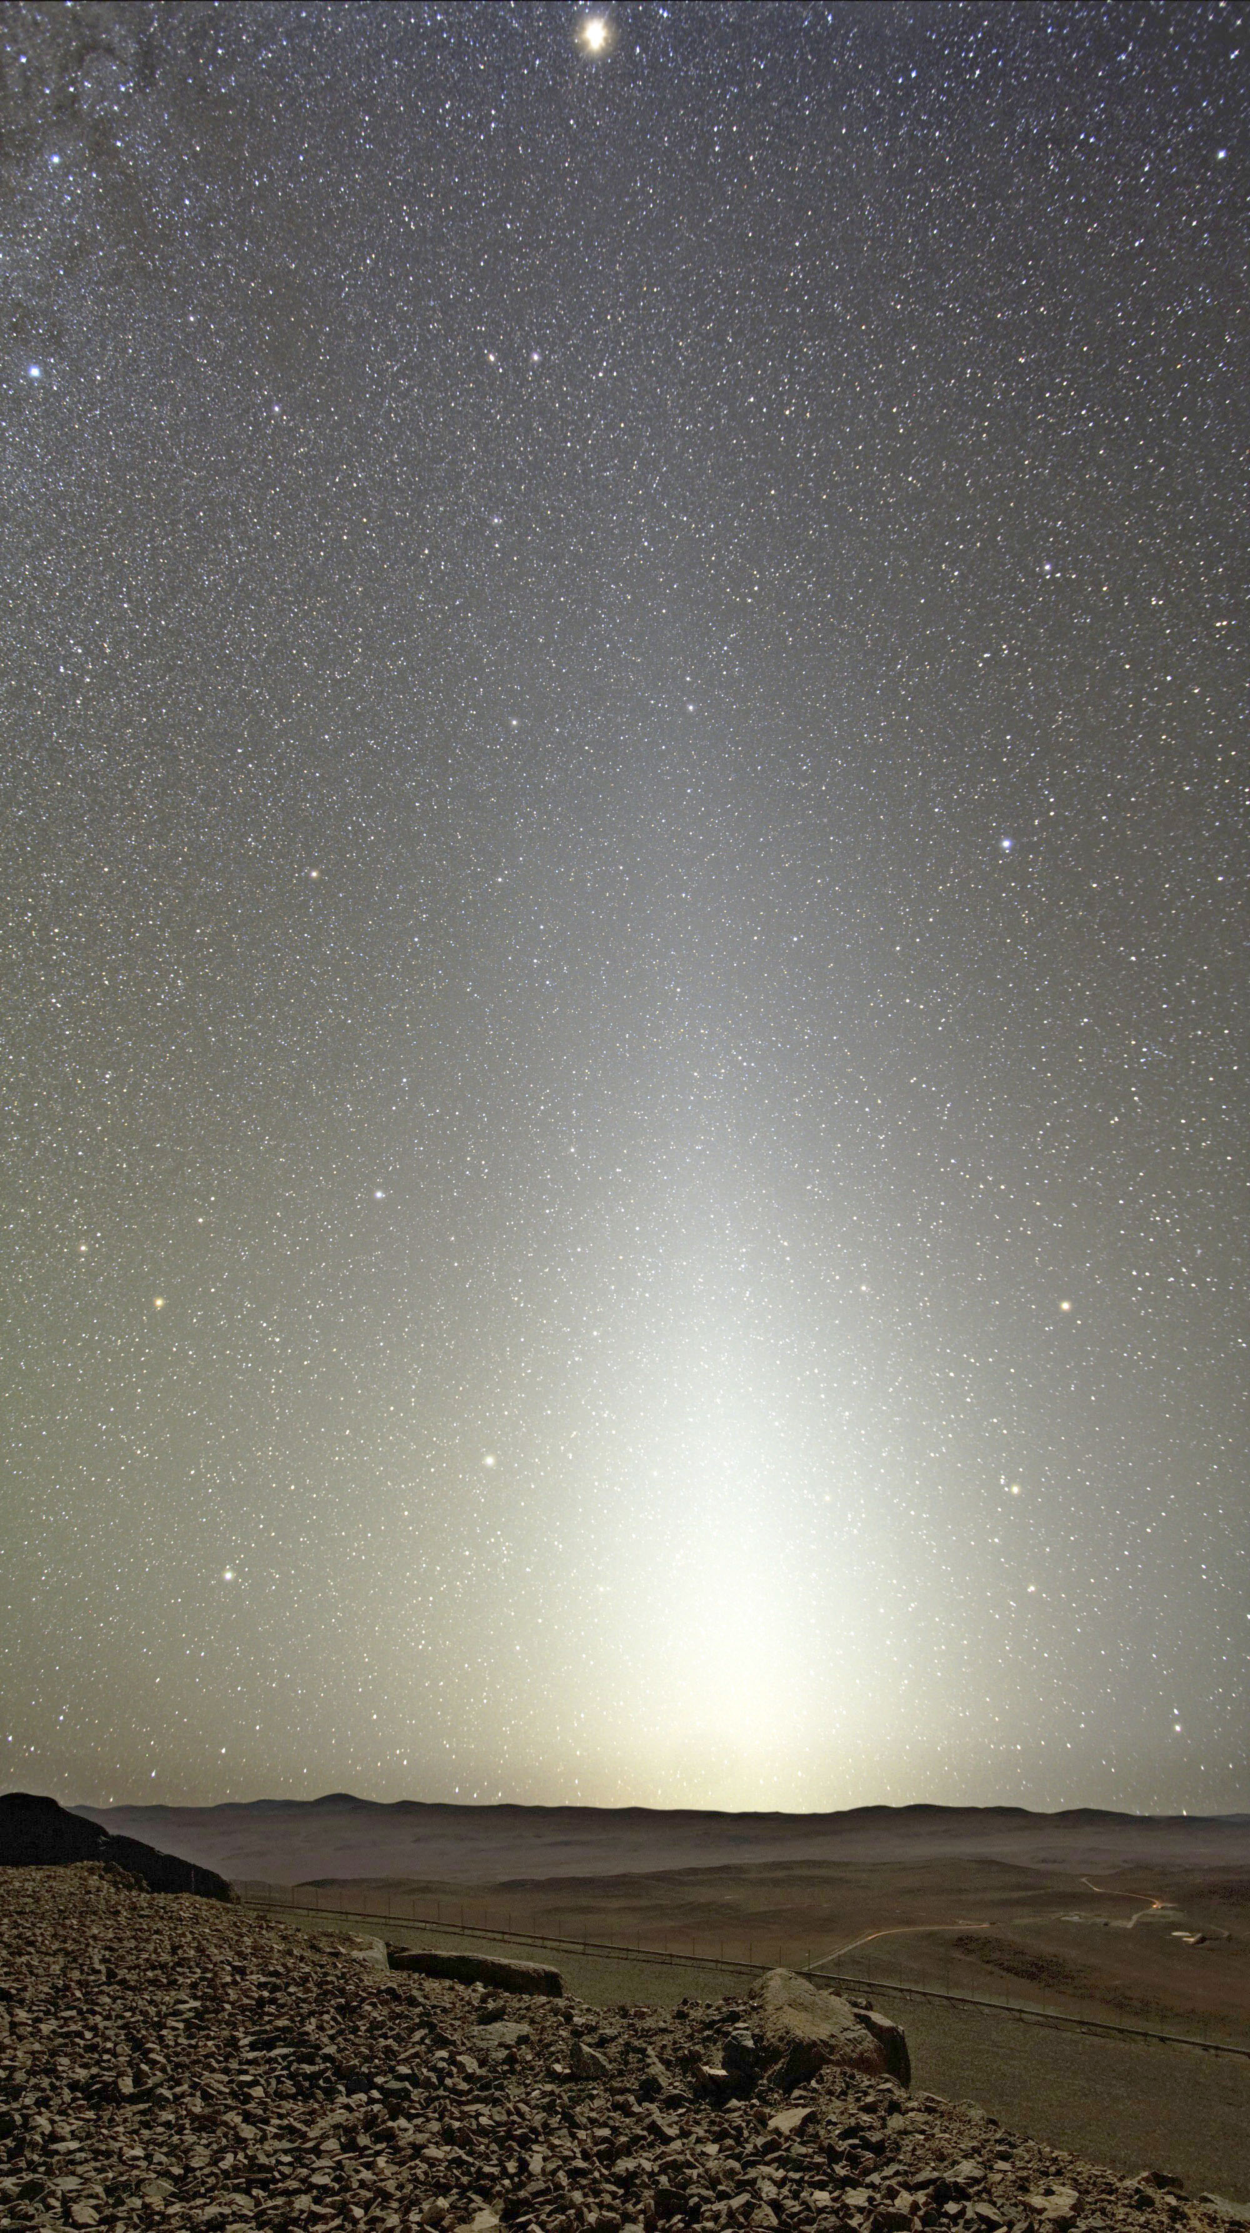
Zodiscout: A Small Satellite to Explore the Origins of the Interplanetary Dust in our Solar System
Varoujan Gorjian (JPL/Caltech)
With Neal Turner, Hien Nguyen, Geoffrey Bryden,
and Keith Grogan
(JPL/Caltech)

Slide 2
What we know about dust in our solar system
In 1683, Giovanni Domenico Cassini gave one of the first scientific explanations for the zodiacal light as sunlight scattered off dust particles in the solar system.
Zodiacal light seen over Cerro Paranal in Chile

Slide 3
What we know about dust in our solar system
Since then the zodiacal light’s extent, shape, composition, and the total amount of dust have continued to be debated.
Zodiacal light seen over Cerro Paranal in Chile

Slide 4
What we know about dust in our solar system
It is one of the largest structures in our solar system, yet one of the least understood.
The difficulty in studying it comes from being embedded within its diffuse extended structure

Slide 5
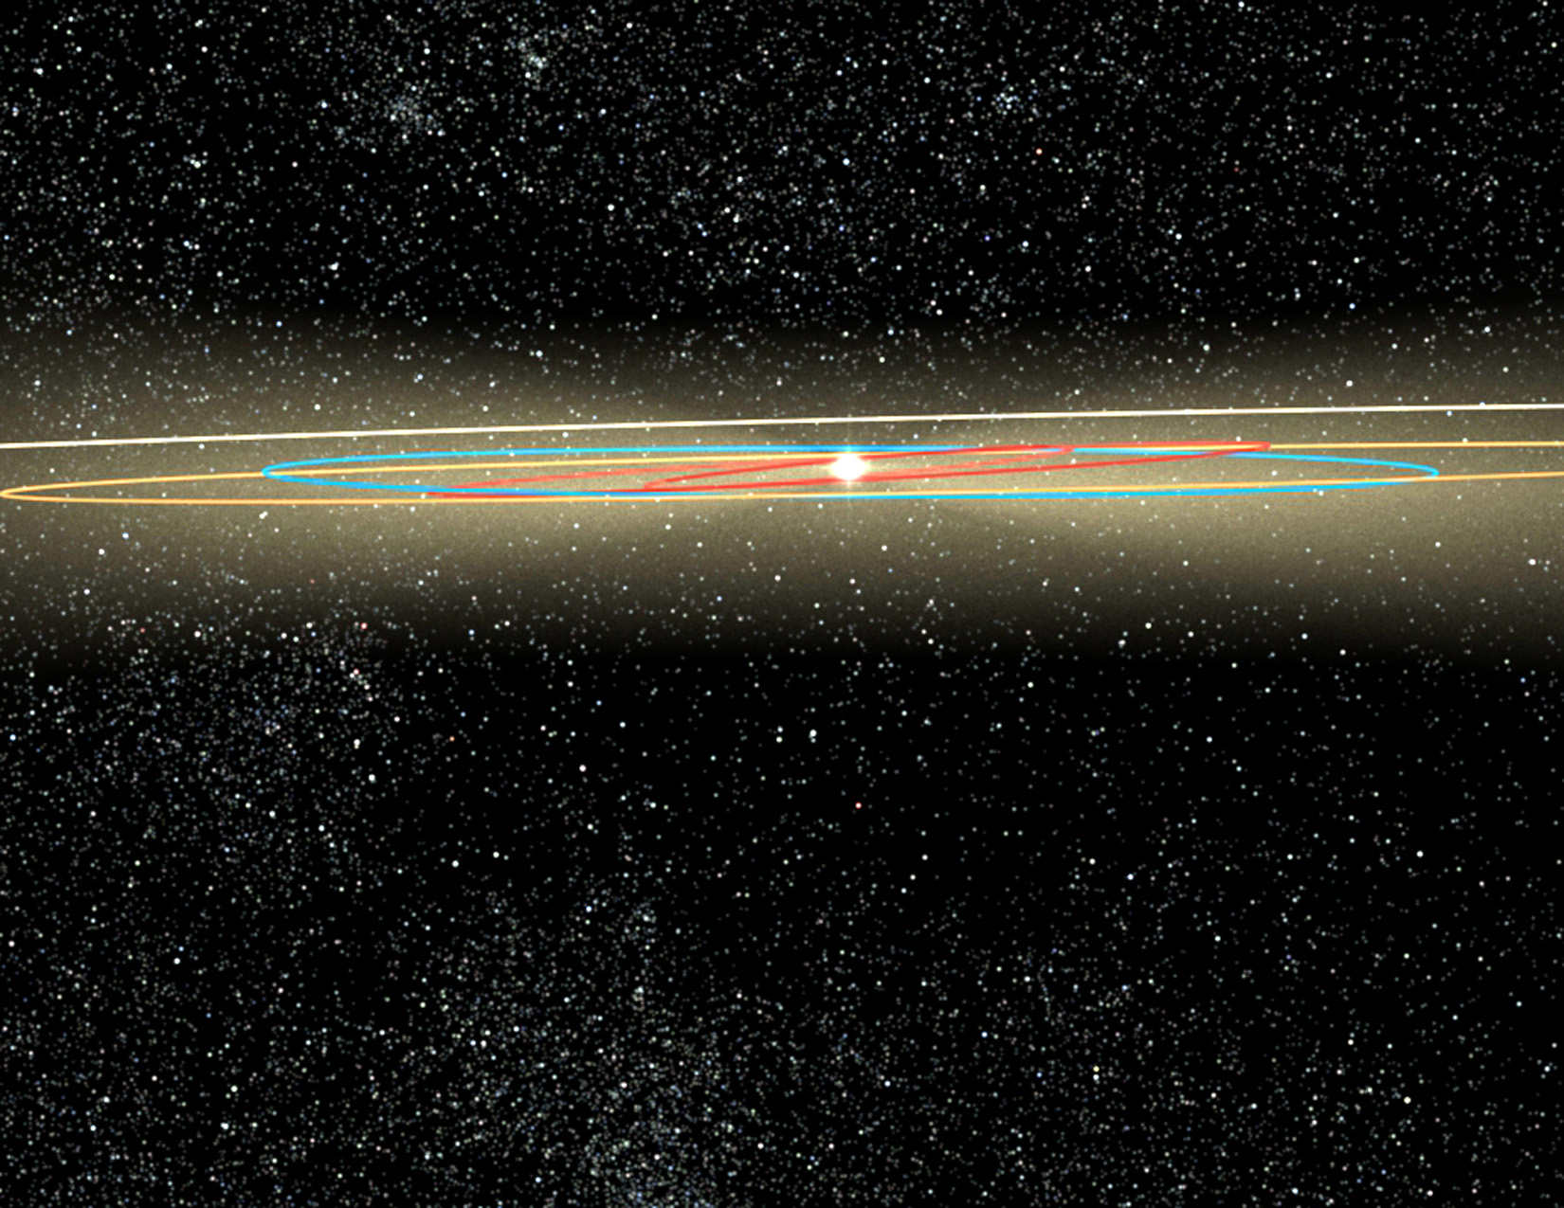
What we know about dust in our solar system
The cloud is made up of dust released by asteroids and comets, spiraling in towards the Sun under Poynting-Robertson (PR) drag.

Slide 6
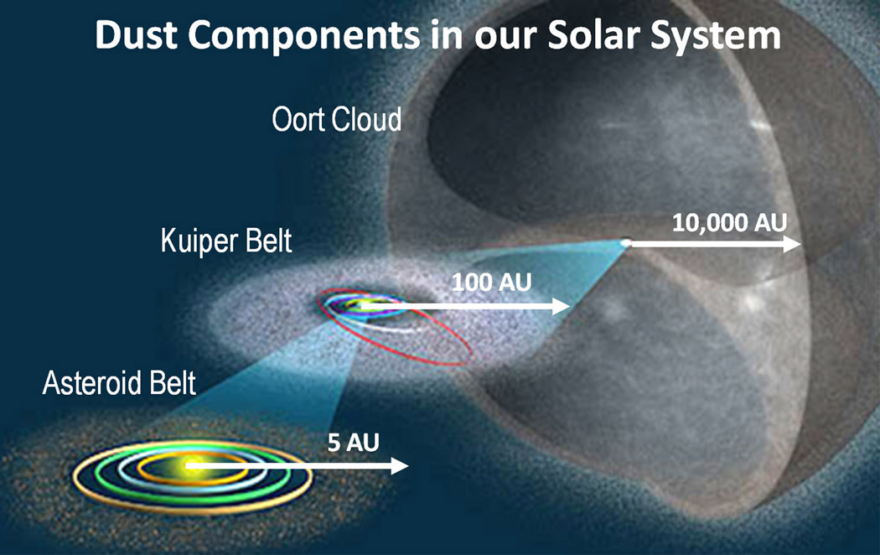
What we know about dust in our solar system
A pictorial breakdown of the dust producing bodies in our Solar system and the scales they occupy. Note in particular that studying the dust brought by comets from the Oort Cloud allows us to study a structure that is over 10,000 AU away from the Sun. (Bock et al. 2012)

Slide 7
Previous Observations
All outer planets missions have measured some aspect of the dust on their way out of the inner solar system
The Earth orbiting Cosmic Background Explorer Satellite had the Diffuse Infrared Background Experiment (DIRBE) which gave one of the best images of the dust from 1 AU

Slide 8
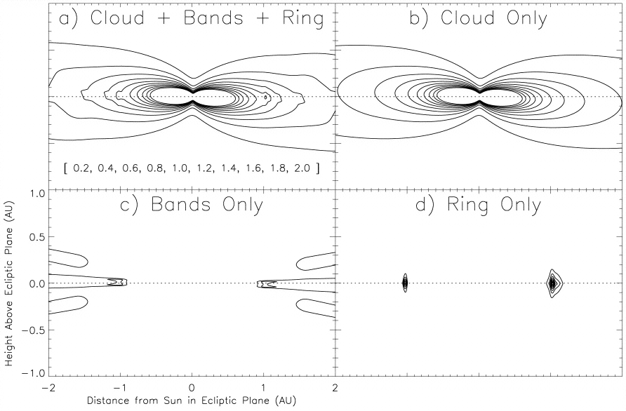
Previous Observations
DIRBE results
Isodensity contours of the IDP model components, shown for a cross-sectional slice perpendicular to the ecliptic plane looking towards the Sun at the center of each panel. The density contour levels used in (a) and (b) are listed in brackets at the bottom of (a), in units of 10⁻⁷ AU⁻¹. Contour levels used for (c) and (d) are a factor of 8 smaller. Kelsall et al (1998)

Slide 9
How to characterize the Zodiacal Dust
Since the asteroid belt is a significant source of the dust, taking measurements inside and outside of the asteroid belt will constrain the asteroid belt’s contribution
Going outside of the plane of the solar system will significantly reduce the contribution of the asteroid belt and the Kuiper belt.

Slide 10
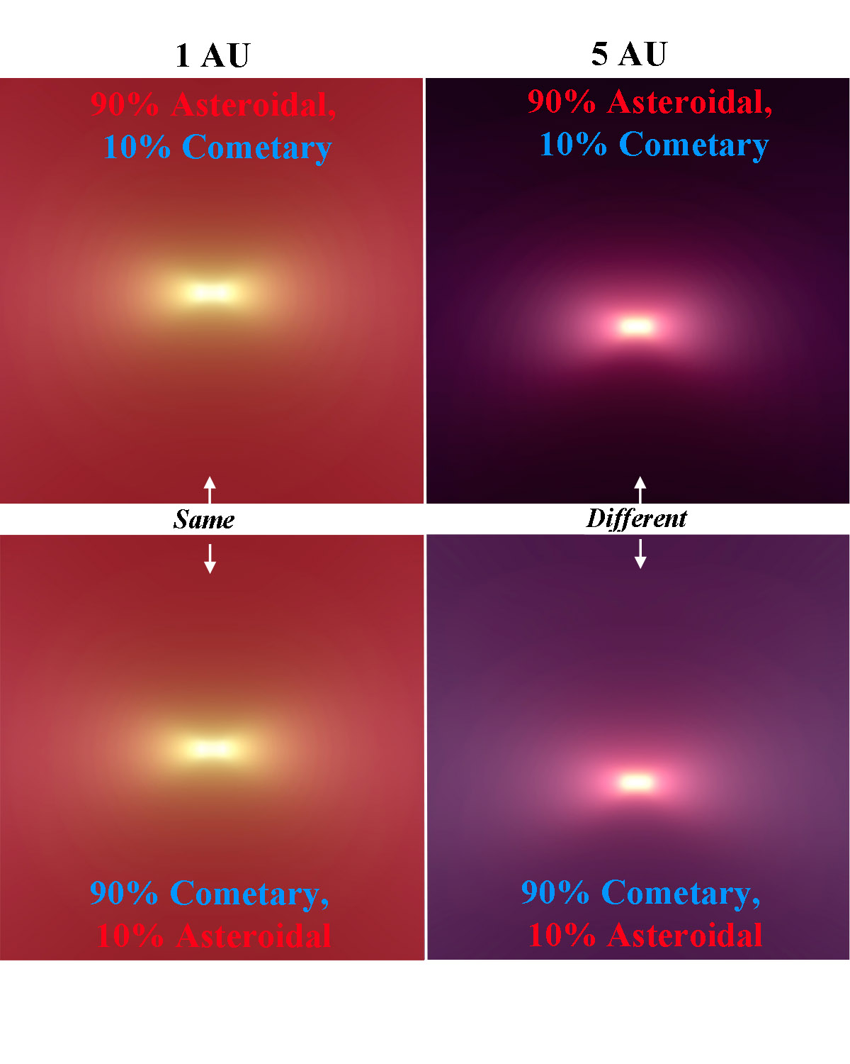
How to characterize the Zodiacal Dust
Leaving the ecliptic plane
A model by co-I Turner of the zodiacal dust viewed towards the Sun from 1 AU (left column) and from 5 AU and above the ecliptic (right column). From 1 AU the view is almost the same whether Kuiper belt or asteroidal dust dominates (top left vs. bottom left). From 5 AU there are striking differences, with the Kuiper belt dust still surrounding the spacecraft, while the asteroidal dust now lies only in the sunward direction. The sun is saturated since the color scale is chosen to show the much fainter zodiacal cloud. Color channels: blue = 1 μm, green = 2 μm, red = 5 μm.

Slide 11
What kind of measurements are required?
Small grains in the zodiacal dust are strongly forward scattering in the optical and hence to trace them we need optical monitoring

Slide 12
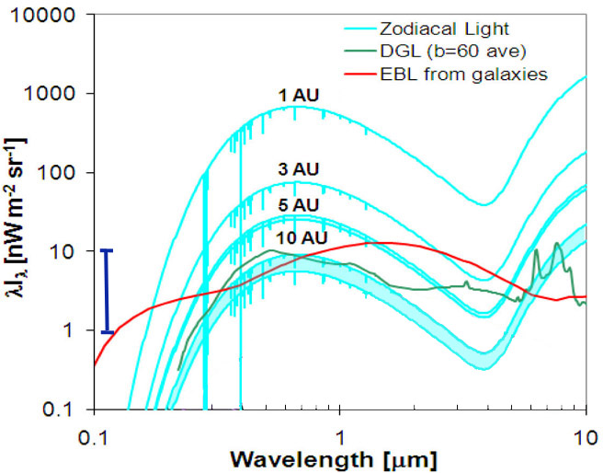
What kind of measurements are required?

Slide 13
What kind of measurements are required?
Small grains in the zodiacal dust are strongly forward scattering the optical and hence to trace them we need optical monitoring
Larger grains emit strongly in the infrared and so need infrared monitoring

Slide 14
What kind of measurements are required?

Slide 15
Zodiscout: A 6U Cubesat to Study the Zodiacal Dust
Two telescopes
  10 cm apertures
  6ºx6º FOV
  Low resolution spectra (R~100) covering 0.5-2 μm 2-5 μm

Slide 16
Zodiscout: A 6U Cubesat to Study the Zodiacal Dust
A high resolution spectrograph (R~3000) to monitor scattering of solar Fraunhofer lines to distinguish Zodiacal light from redshifted Extragalactic Background Light

Slide 17
Zodiscout: A 6U Cubesat to Study the Zodiacal Dust
How to get to the outer solar system
Launch with an outer planets mission. Once the mission has achieved a velocity sufficient to reach an outer planet like Jupiter, the cubesat will detach and fly independently
Launch with a mission going to the moon and use the interplanetary superhighway with some additional propulsion

Slide 18
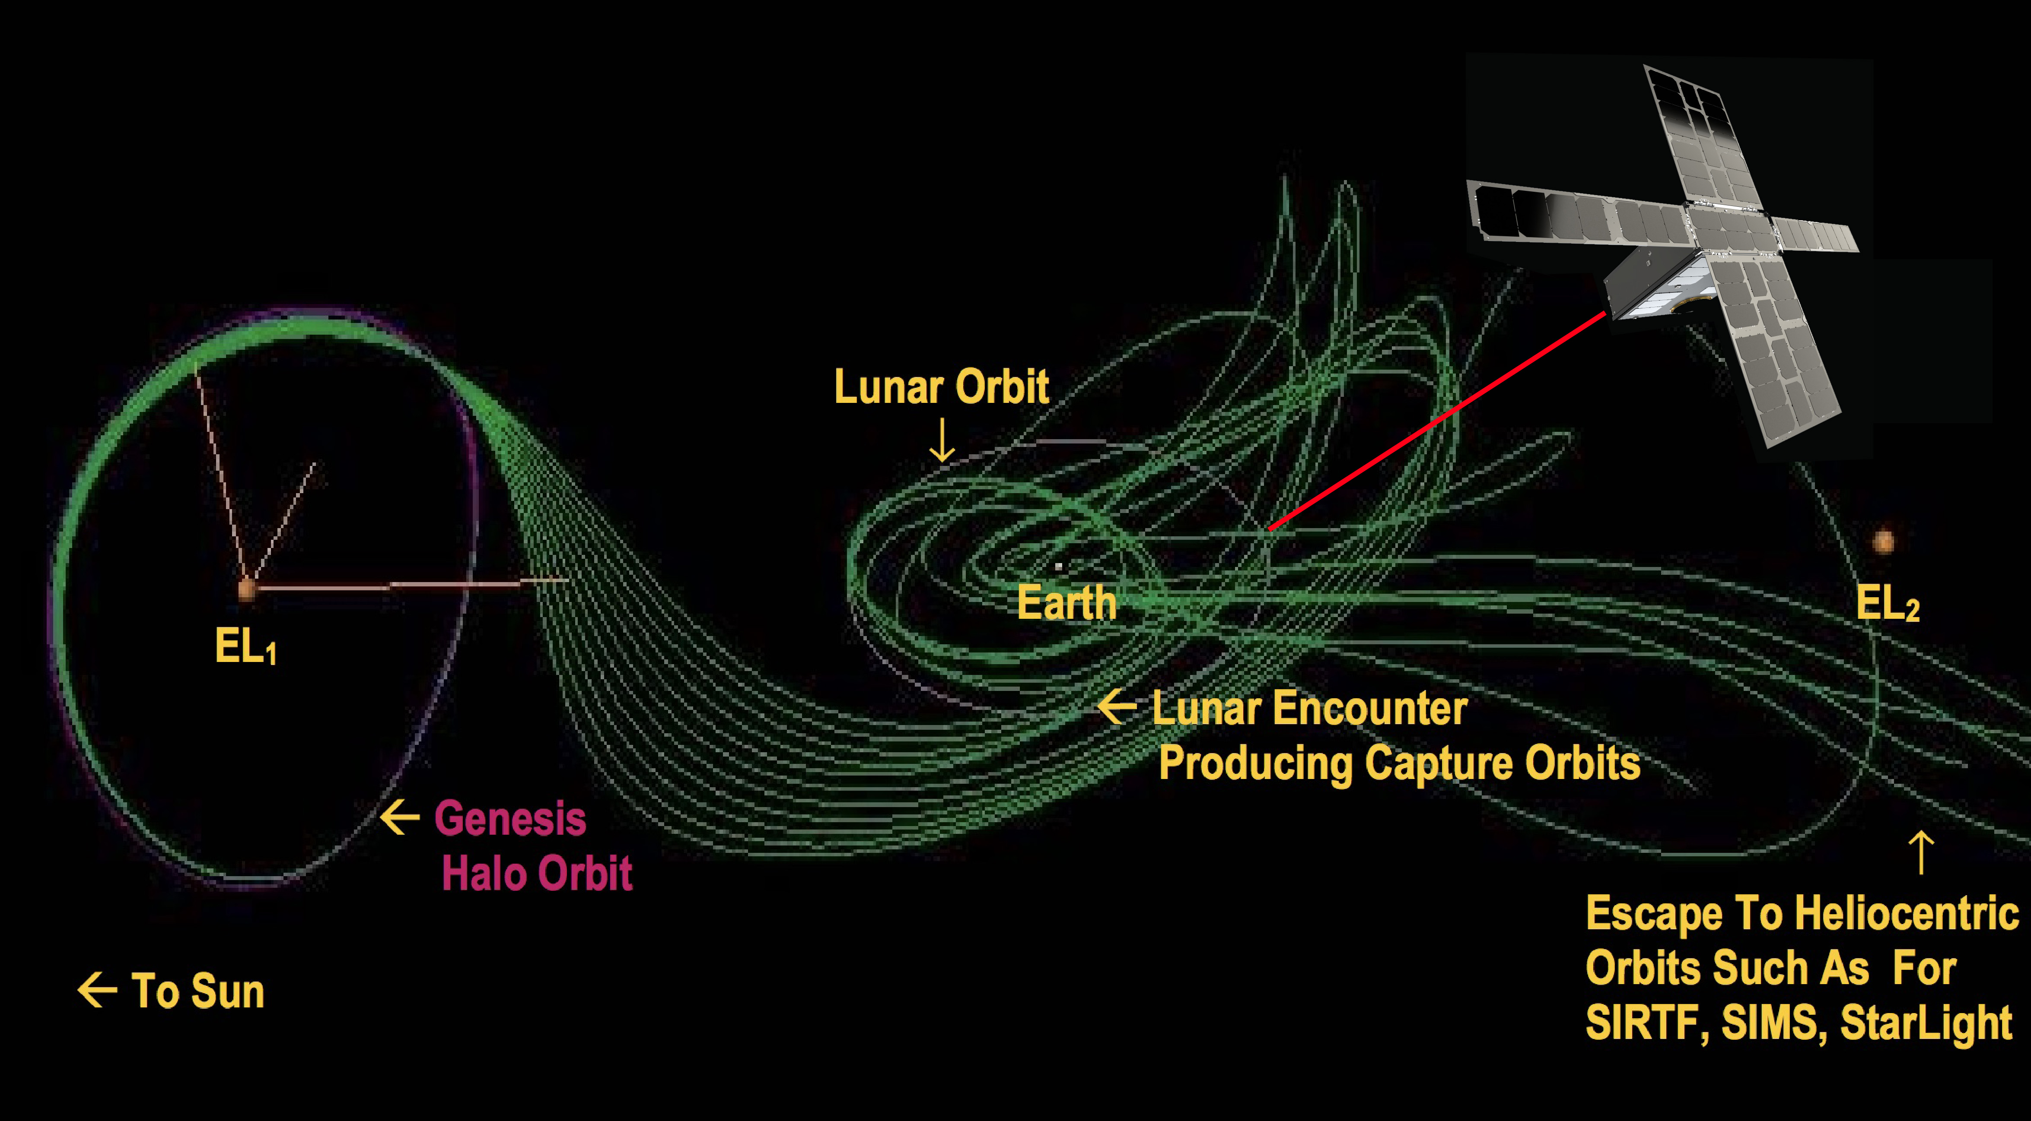
The Interplanetary Superhighway (ISP)

Slide 19
Zodiscout: A 6U Cubesat to Study the Zodiacal Dust
How to leave the ecliptic plane
Use a gravity assist from Jupiter to leave the ecliptic plane

Slide 20
Zodiscout: A 6U Cubesat to Study the Zodiacal Dust
Anticipated Results
How are interplanetary dust particles generated, how do they evolve dynamically?
What are the relative contributions of dust particles from each source to the zodiacal cloud as a whole and what limits can it set on the source population?
What is the global structure of the cloud and how does it compare to exo-zodiacal clouds?

Slide 21
Zodiscout: A 6U Cubesat to Study the Zodiacal Dust
Challenges
Telecommunications
  Data rates are low as it takes a long time to get a high signal to noise image

Slide 22
Zodiscout: A 6U Cubesat to Study the Zodiacal Dust
Challenges
Thermal
  We need cooled detectors for reaching the longer IR wavelengths but these can be achieved by passive cooling

Slide 23
Zodiscout: A 6U Cubesat to Study the Zodiacal Dust
Challenges
Power
  The spectrographs are low power instruments and only the telecom will need significant power but that is mitigated by a low data rate

Slide 24
Zodiscout: A 6U Cubesat to Study the Zodiacal Dust
Challenges
Longevity
  Cubesats/smallsats are not currently designed or built with long lifetimes in mind
  This mission will require a ~5 year primary mission

Slide 25
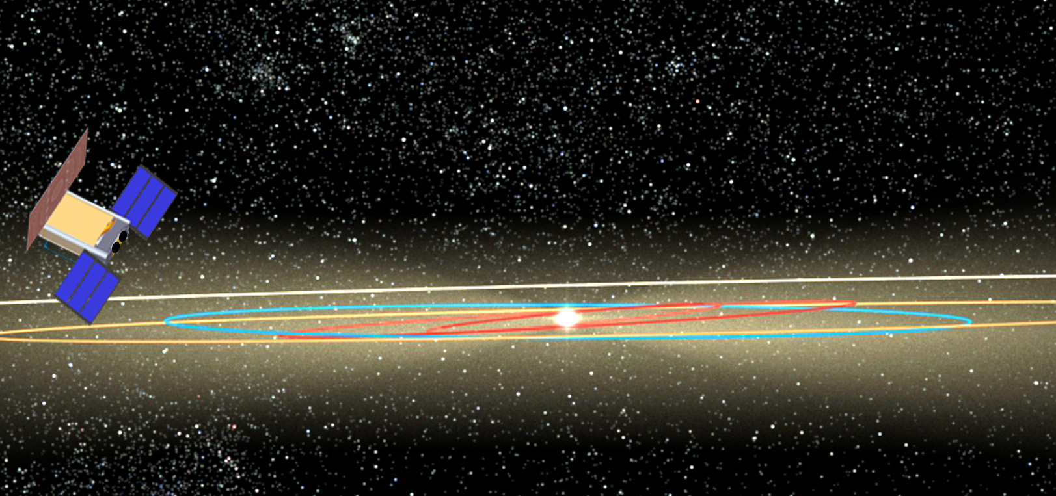
Zodiscout: A 6U Cubesat to Study the Zodiacal Dust
  Thus a small mission with the right vantage point will have a large impact on our understanding of the zodiacal cloud

