Slide 1
Overview of Phobos/Deimos Regolith Ion Sample Mission (PRISM): Determining Origins
Planetary Science Deep Space SmallSat Study (PSDS3):
Sampling the surface from above the surface without landing...
Michael R. Collier^{1,2}, Micah Schaible³, William M. Farrell^{1,2}, David Folta¹, Kyle M. Hughes¹,
John W. Keller^{1,2}, Ben Malphrus⁴, Aaron Zucherman⁴, Kevin Brown⁴, Andrew S. Rivkin⁵,
Scott Murchie⁵, Dana Hurley^{2,5}, Jasper Halekas^{2,6}, Pamela Clark⁷, Richard Vondrak^{1,2}, Timothy Stubbs^{1,2}, Rosemary Killen^{1,2}, Menelaos Sarantos^{1,2}, Sarah L. Jones¹, Jared Espley¹, Gina Dibraccio¹, Michael Choi¹, and Michael Tsay⁸
1. NASA/GSFC, Greenbelt, MD
2. SSERVI/DREAM2, Ames Research Center, Mountain View, CA
3. Georgia Institute of Technology, Atlanta, GA
4. Morehead State University, Morehead, KY
5. JHU/APL, Laurel, MD
6. University of Iowa, Iowa City, IA
7. Jet Propulsion Laboratory, Pasadena, CA
8. Busek Space Propulsion Systems, Natick, MA

Slide 2
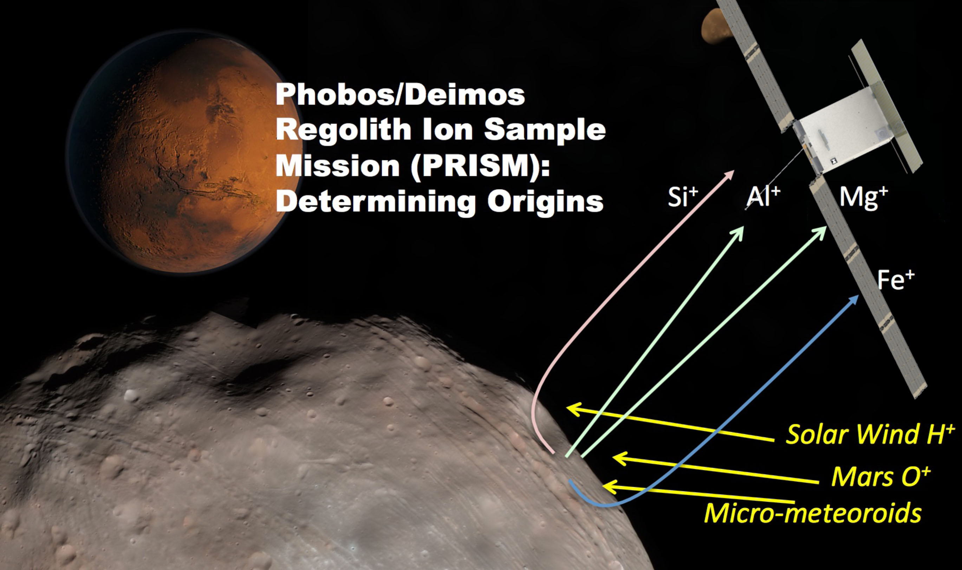
Sampling the surface from above the surface without landing...
Solar wind, energetic oxygen in the Martian magnetotail, and micrometeorites bombard the regolith continuously liberating material from the surface in a process called sputtering.
2 of 10

Slide 3
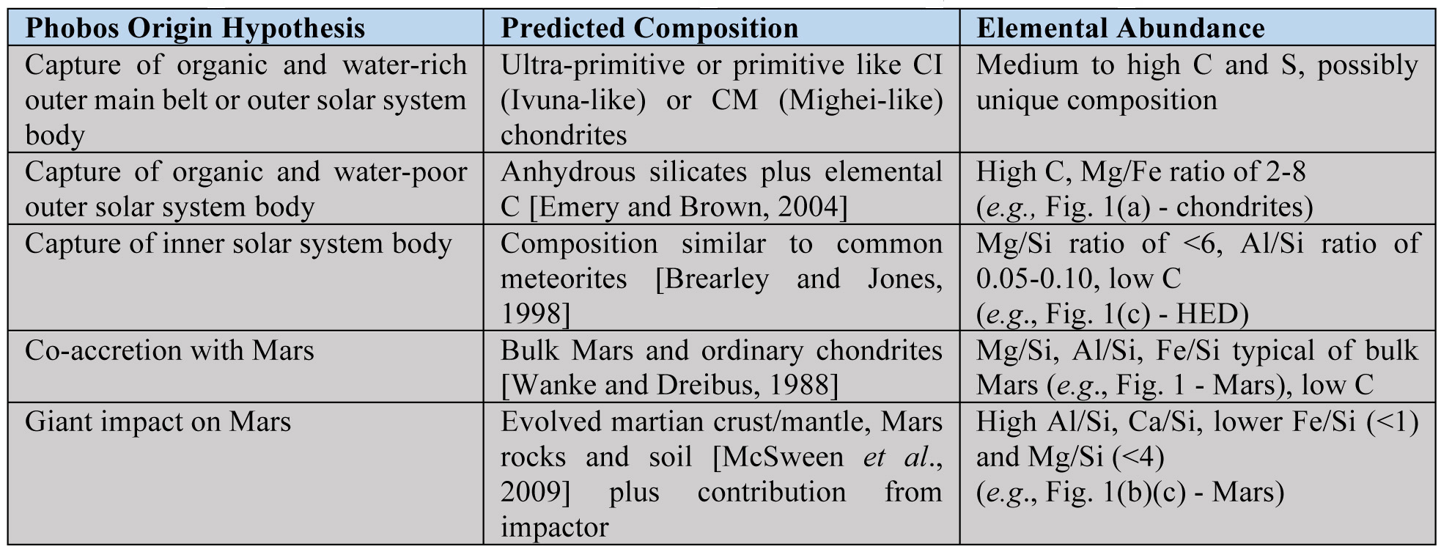
What is the Origin of Phobos/Deimos?
Composition provides the key to determining their origins
adapted from the Rivkin SSERVI Phobos talk
3 of 10

Slide 4
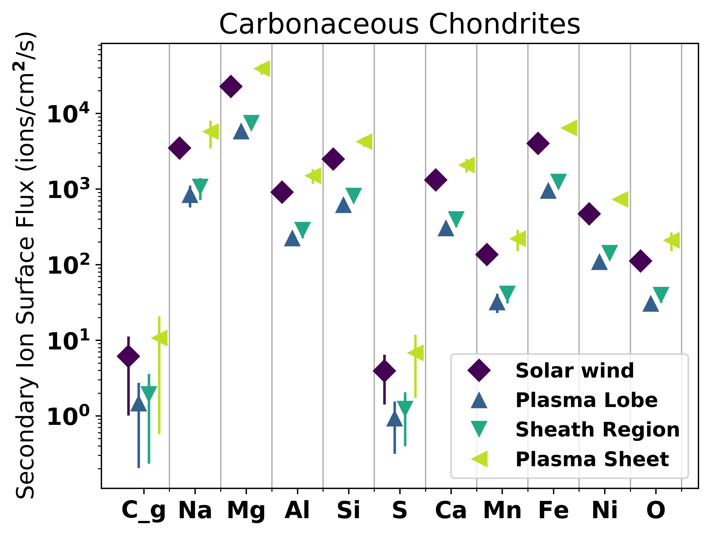
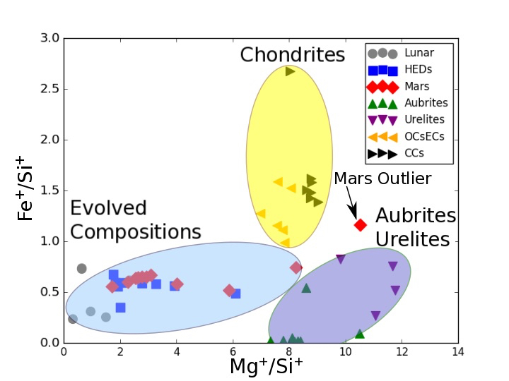
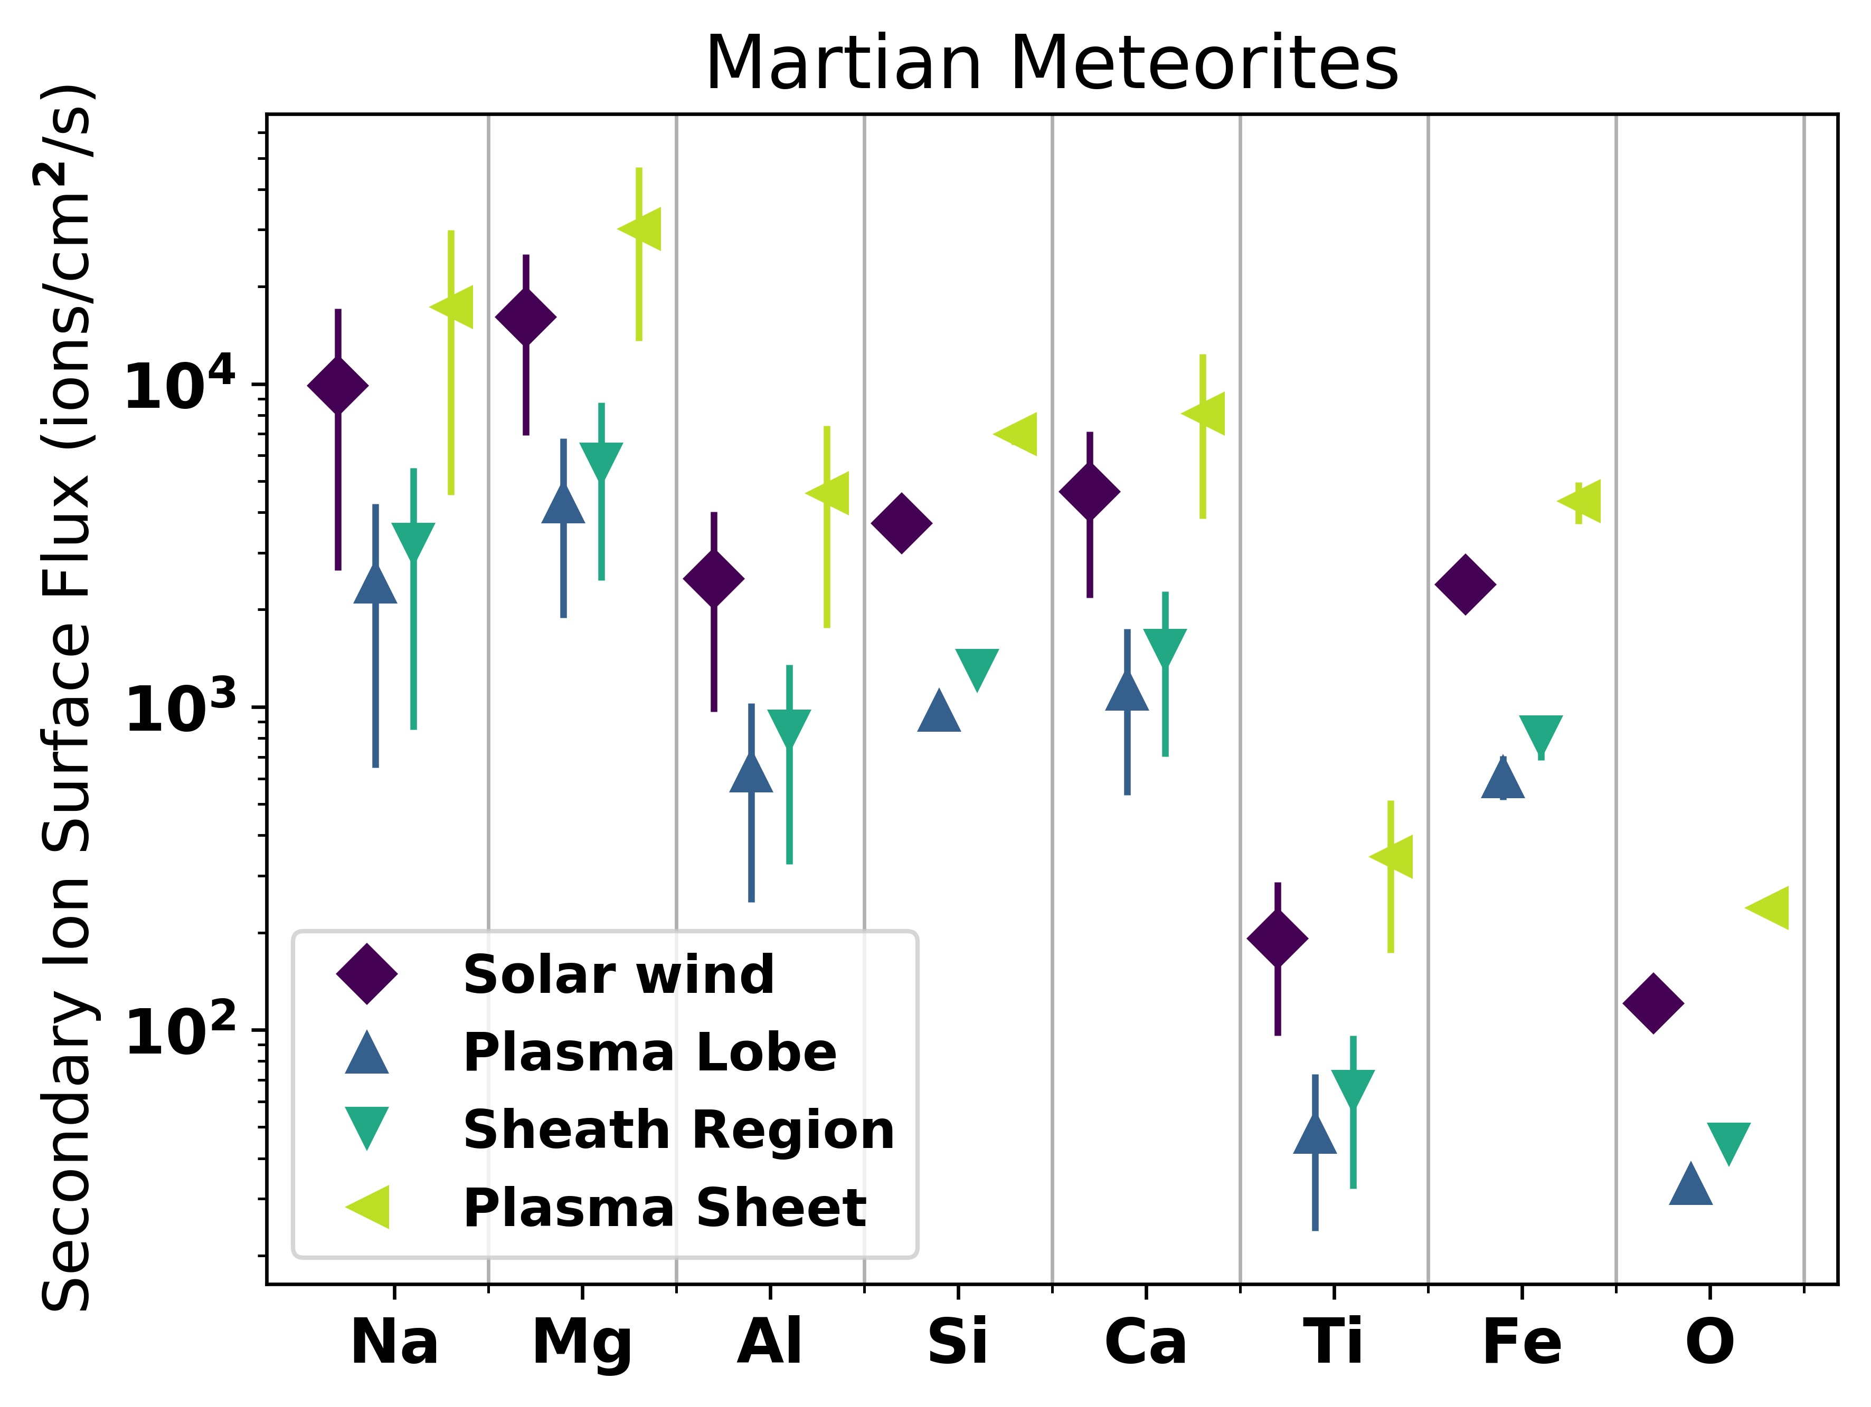
Composition Measurements Using SIMS
SIMS is a standard laboratory technique…
Schaible et al. (2017), JGR-Planets, 122, doi:10.1002/2017JE005359
The space environment continually liberates material from the regoliths of airless bodies throughout the solar system.
4 of 10

Slide 5
IMS: Ion Mass Spectrometer: Identity and direction secondary ions (e.g., solar wind generated 'pickup ions' )
Energy distribution of magnospheric O⁺, O₂⁺, and H⁺ ions at various locations in Phobos as measured by MAVEN mission.
IMS electrostatic analyzer Energy response with 7.2 (energy/voltage) analyzer constant
Mini-Mag Magnetometer: Direction of Magnetic Field and thus confirmation of pickup ions direction
IMS polar (top) and azimuthal (bottom) angular response

Slide 6
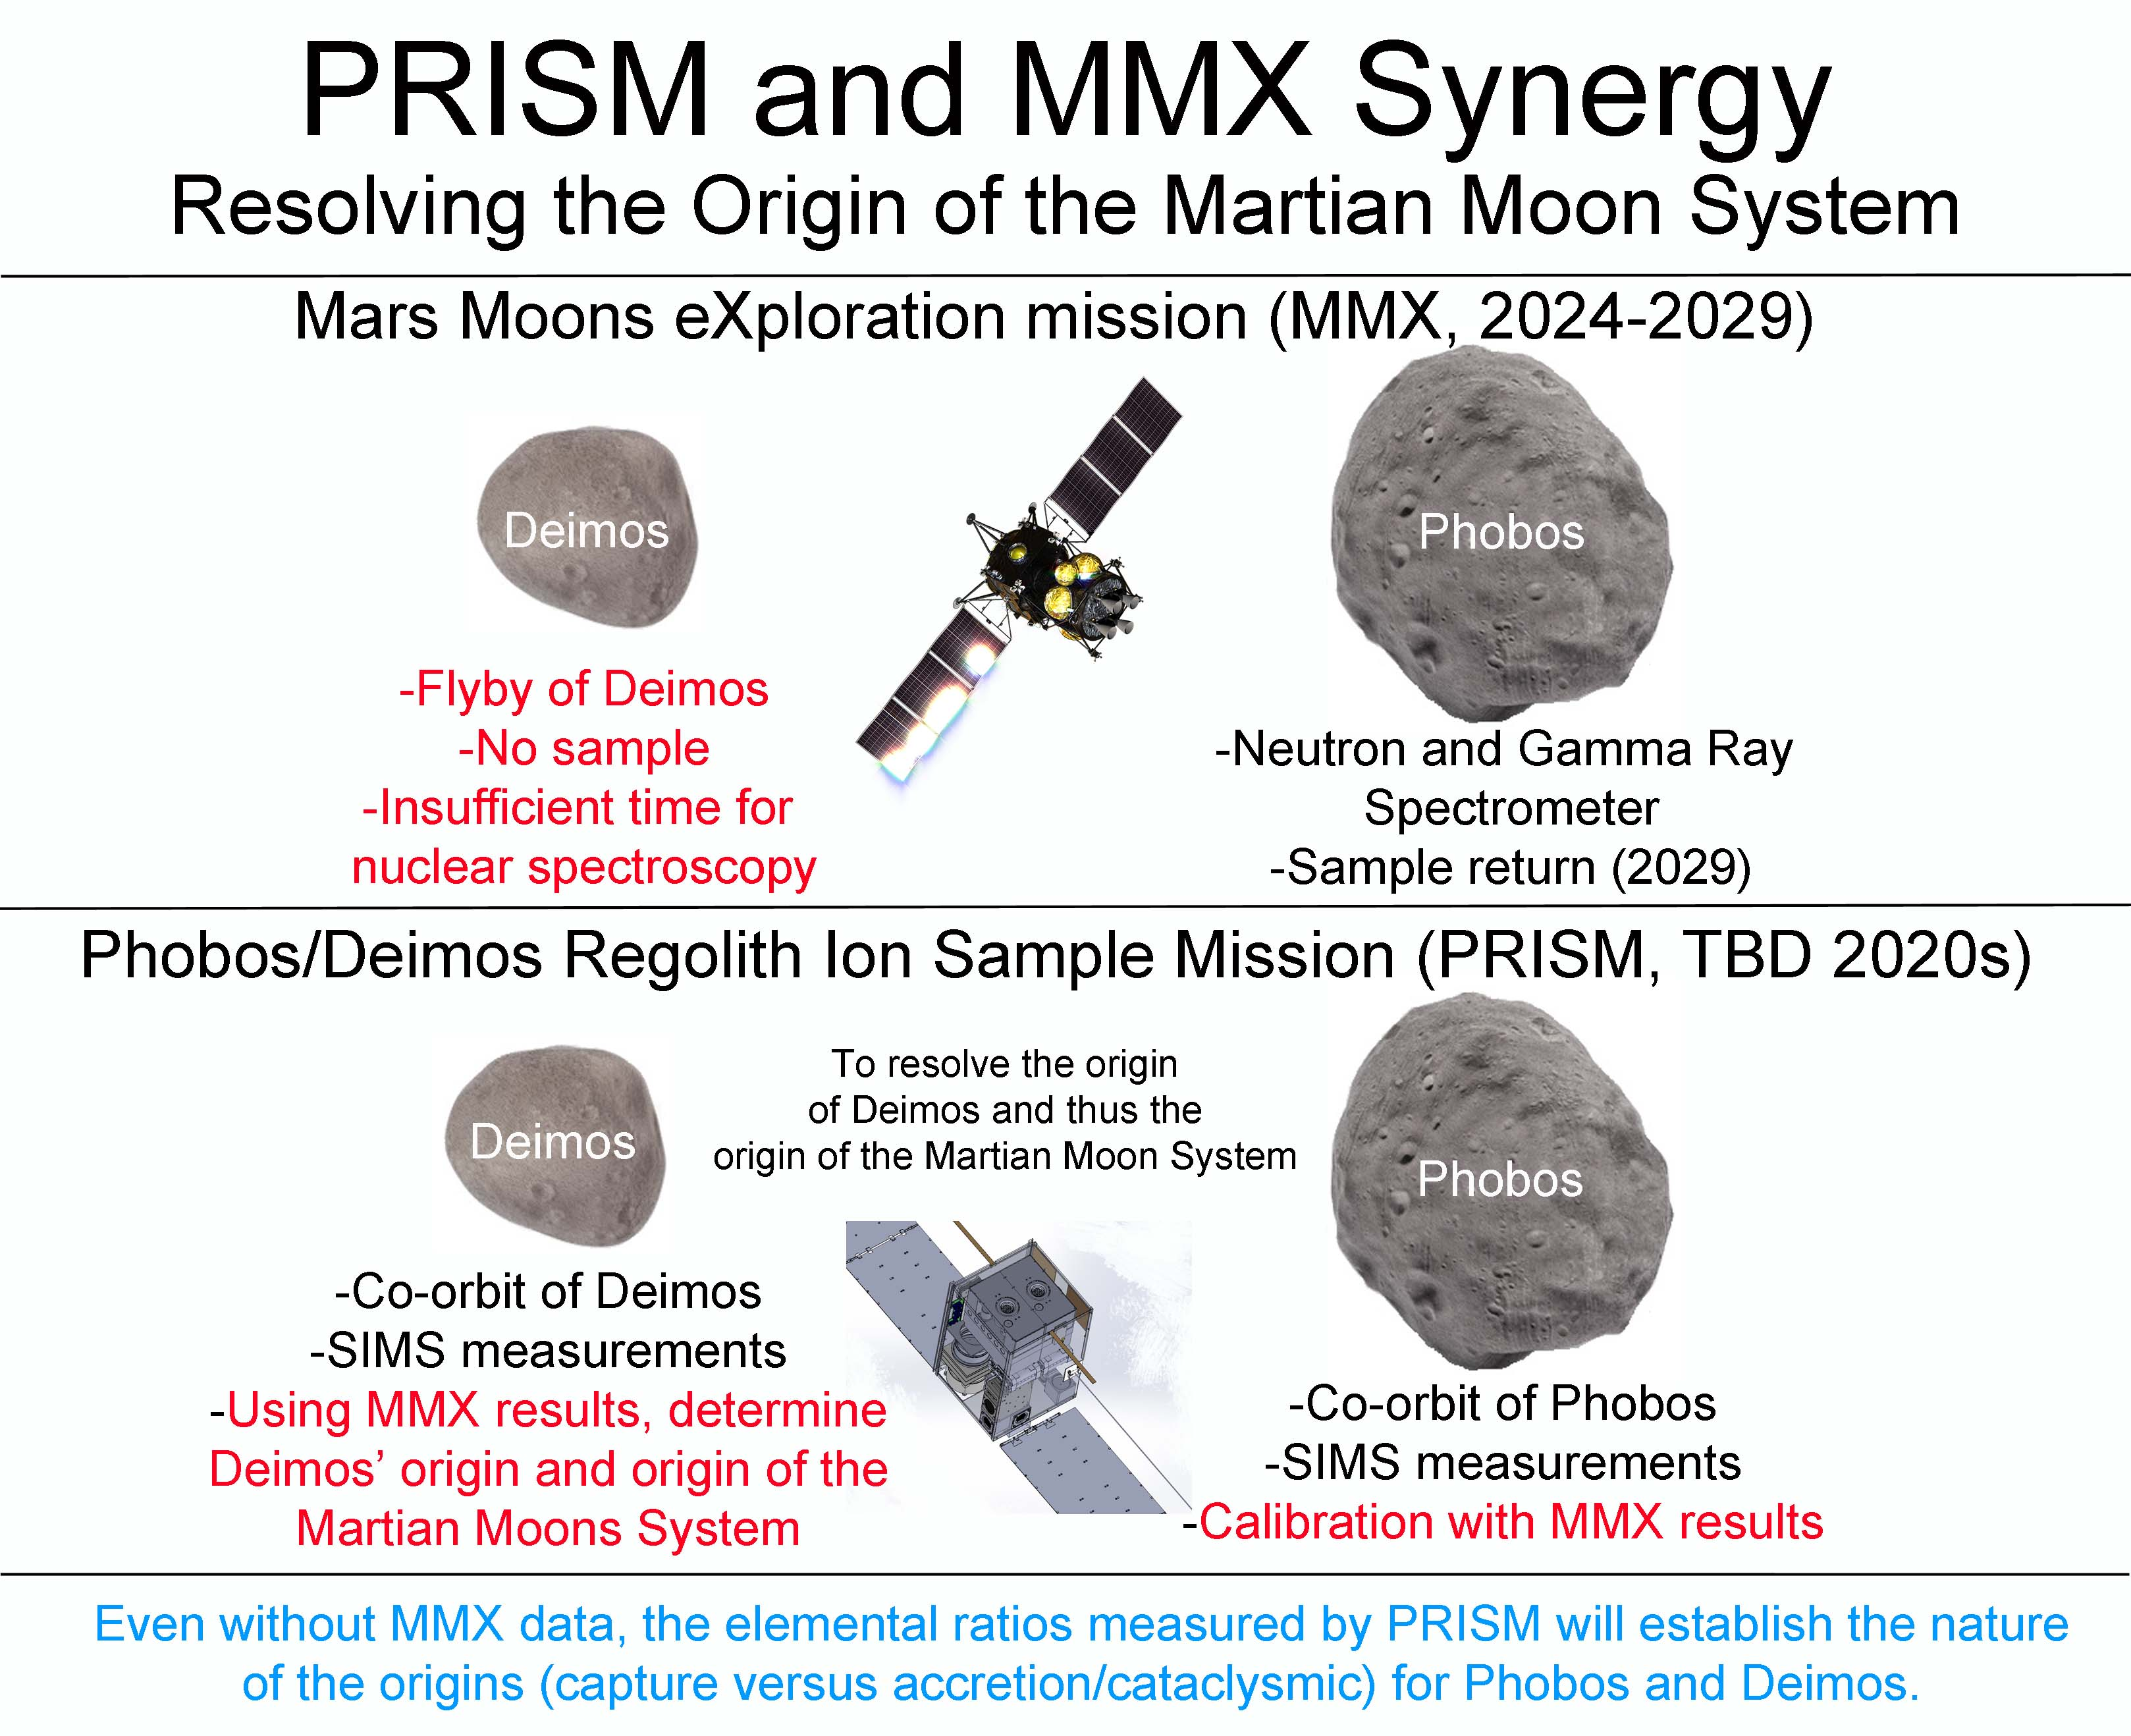
JAXA
6 of 10

Slide 7
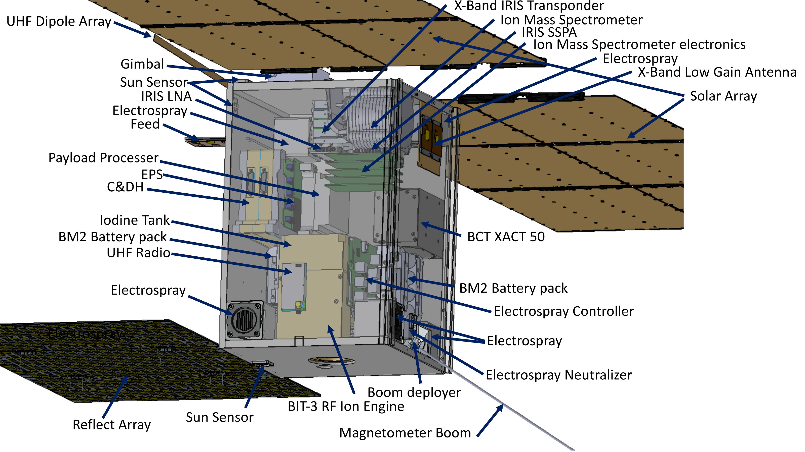
PRISM CubeSat Layout
The fluxes of sputtered ions from Phobos at an altitude of around 27 km are about 10-1000/cm²/s. Based on scaling published effective areas down to CubeSat form factors, these fluxes imply that between 0.01 and 1 counts per second per element will be observed. Even at a count rate as low as 0.01 Hz, this requires 10⁶ s or a bit over ten days to accumulate sufficient counts in all species shown in the figure, easily achievable over the mission lifetime. Some species will achieve the necessary statistics in hours allowing compositional mapping of the surface and the red and blue units.
7 of 10

Slide 8
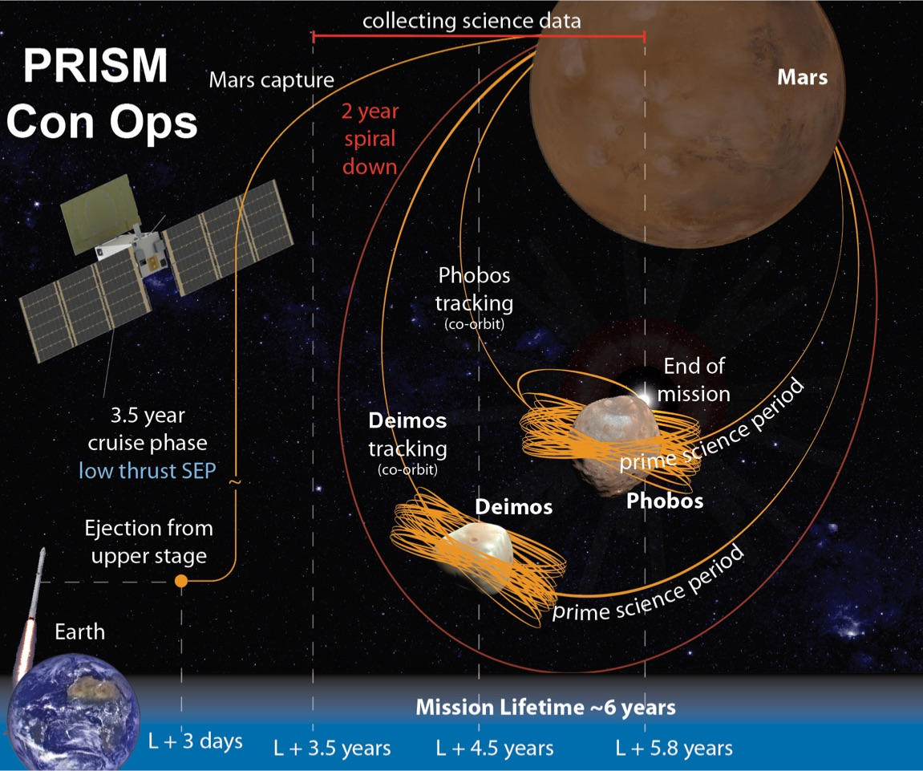
CONOPS Overview
9 of 10

Slide 9
Some Current Status Comments:
Instruments: Ion Mass Spectrometer compact version of MAVEN/SWIA operated at Mars; magnetometer, Polar Orbiting Geomagnetics Survey, 1990), high heritage, high TRL robust, experienced team.
Propulsion: Busek BIT-3, being used for Lunar Ice Cube. Useful to expand Busek BIT-3 power from 80 to 90 W to decrease flight time while remaining within same physical envelope
ACS: Further development to push Busek BET-3000-P electrospray ACS thrusters beyond current TRL 5 still needed. Should perform trade study re: adding larger reaction wheel with BCT XACT-50 or utilize XB1 to minimize and shorten desaturation periods.
Comm: deployable X-band reflectarray (MarCO) combined with low data rates make this doable even though at Mars.
Thermal: 12 U for multiple Deimos/Phobos encounters around Mars seems like a picnic after dealing with 6U lunar ice cube in LUNAR orbit

Slide 10
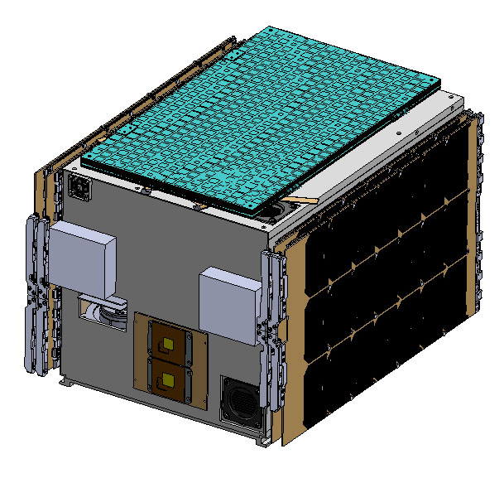
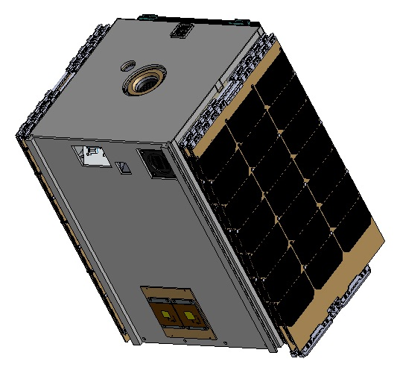
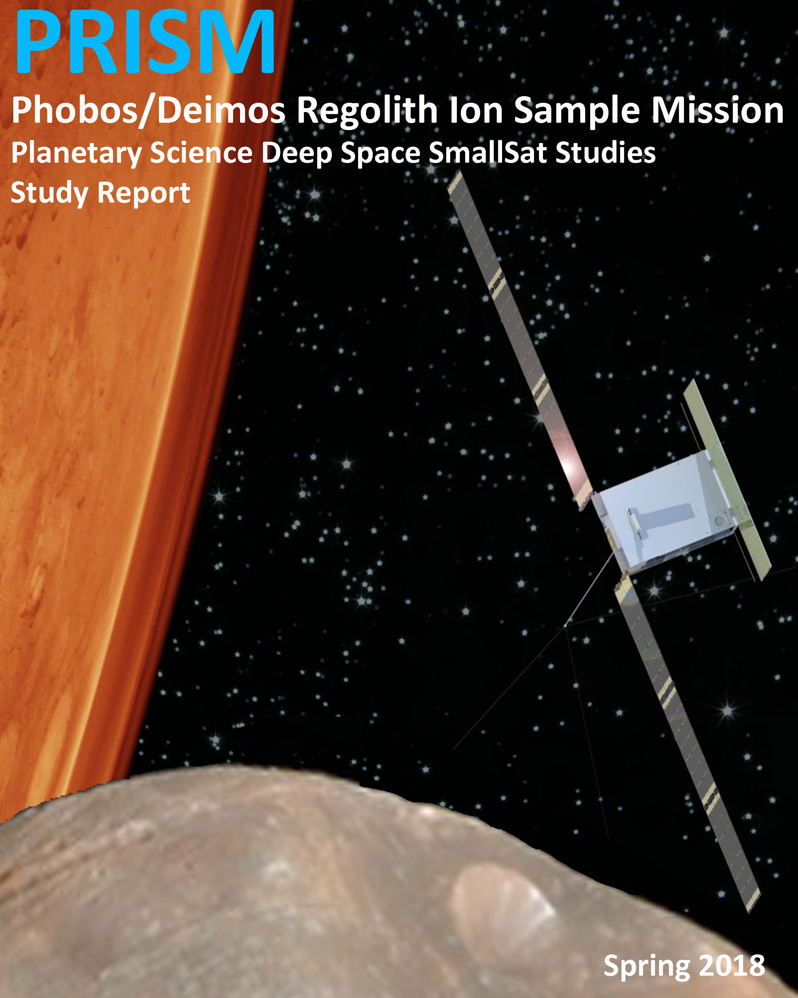
Conclusion
space environment to obtain In Situ samples of Phobos’ and Deimos’ composition to determine the origin of these satellites
secondary ion mass spectrometry alone can accomplish
within a CubeSat form factor, on a relatively small budget, and with current technology,
a CubeSat SIMS mission to Phobos and Deimos will provide the tremendous science return for very little investment.
Special Thanks To: Pascal Lee, Edward Guiness, Michael Whalen, Roy E. Gladden, Neil Chamberlain, Lauren McNally, Jacob Englander, Al Banjhi, Les Deutch, Jay Friedlander, John Ratliff, and Bob Johnson.

