Slide 1
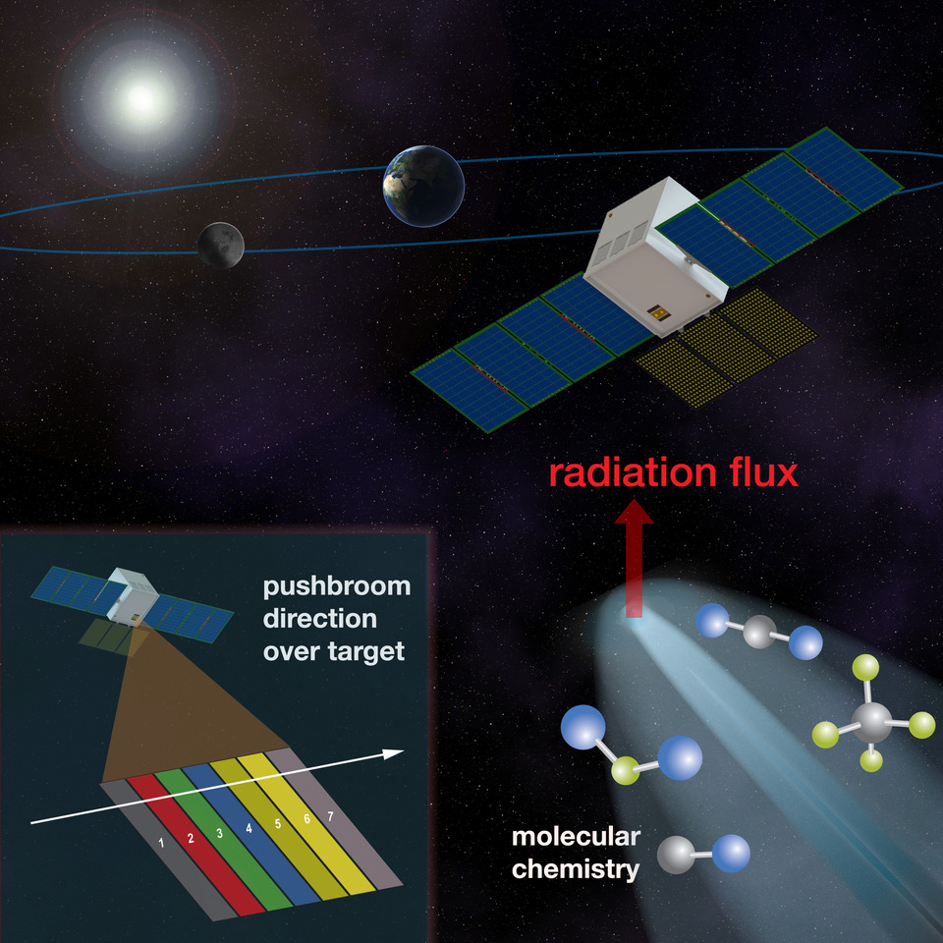
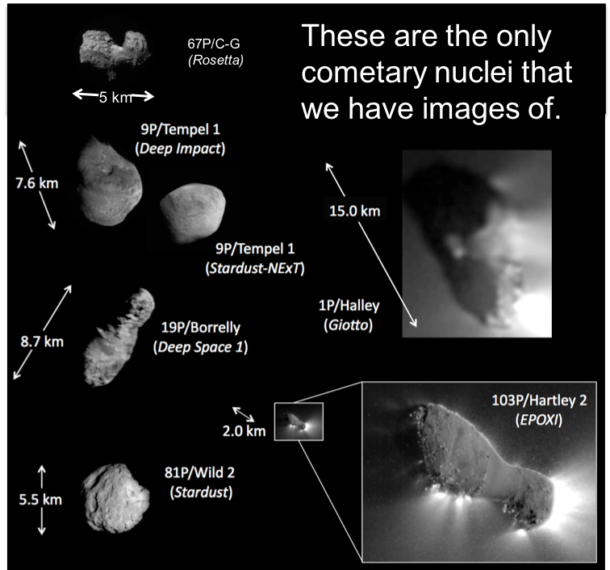
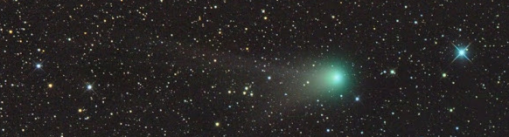
Overview of Primitive Object Volatile Explorer (PrOVE) –
Waypoints and Opportunistic Deep Space Missions to Comets
Planetary Science Deep Space SmallSat Study (PSDS3
First flyby of a pristine comet
Tilak Hewagama (PI), J. Bauer, L. Feaga, J. Sunshine, T. Livengood (U. Maryland)
S. Aslam, D. Folta, T. Hurford, M. Mumma, C. Nixon, G. Villanueva (GSFC)
B. Malphurs, A. Zucherman (Morehead State),
N. Gorius (CUA), P. Clark (JPL), M. Daly (York U.)
INO (Canada) IR Multispectral Camera, MSSS Visible Camera

Slide 2
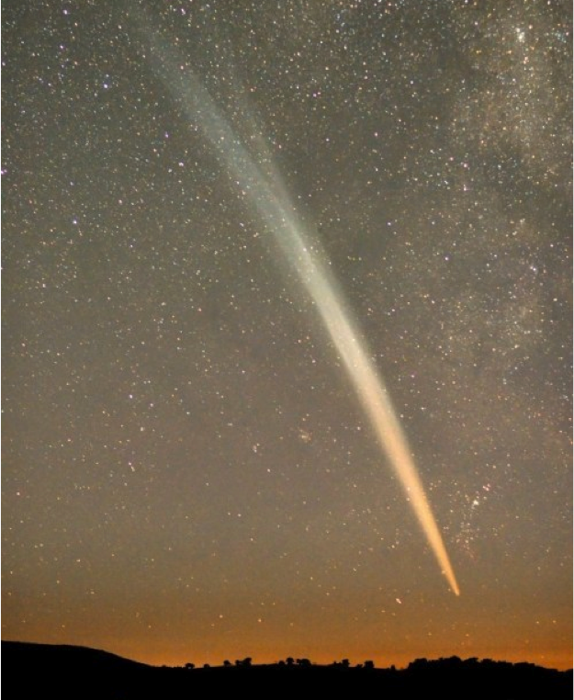
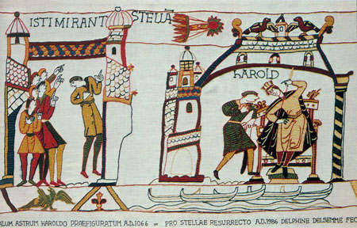
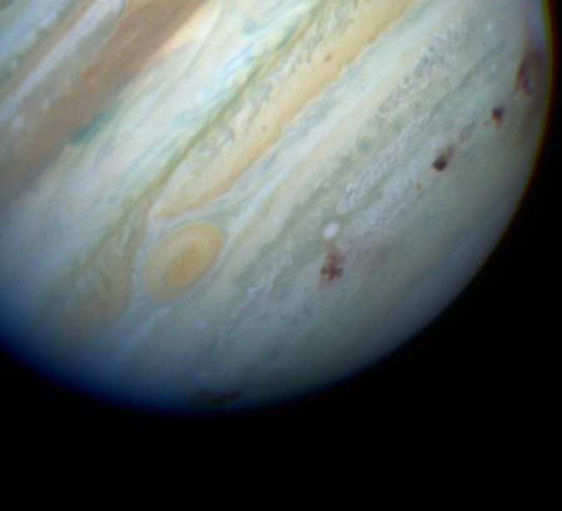
Why Study Comets?
Are among the most enigmatic and spectacular objects in the sky
  indelibly recorded throughout human history
Formed at the beginning of the
Solar System (4.6 billion years ago)
  record conditions, compositional variability,
  and processes in the protoplanetary disk
  preserve record of volatiles in the
  early solar nebula
  building blocks of the planets
  bearers of volatiles to inner solar system
“Stored” in outer Solar System freezer
  relatively unchanged since formation
Contain dust, organics, and ices
  contribute ingredients for life to Earth
Potentially hazardous to life on Earth
Comet Lovejoy, Dec 2011
Bayeux Tapestry: Battle Hastings 1066
Shoemaker-Levy 9, 1994
When beggars die, there are no comets seen….
Calpurnia in Shakespeare’s Julius Caesar
Image Credit: HST Comet Team & NASA

Slide 3
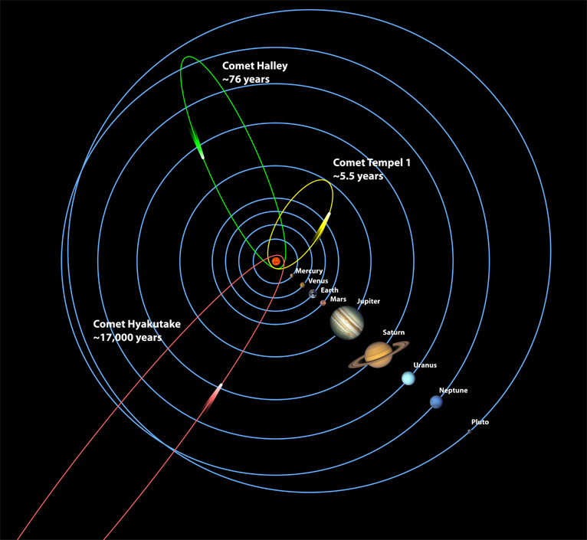
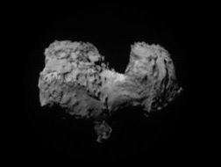
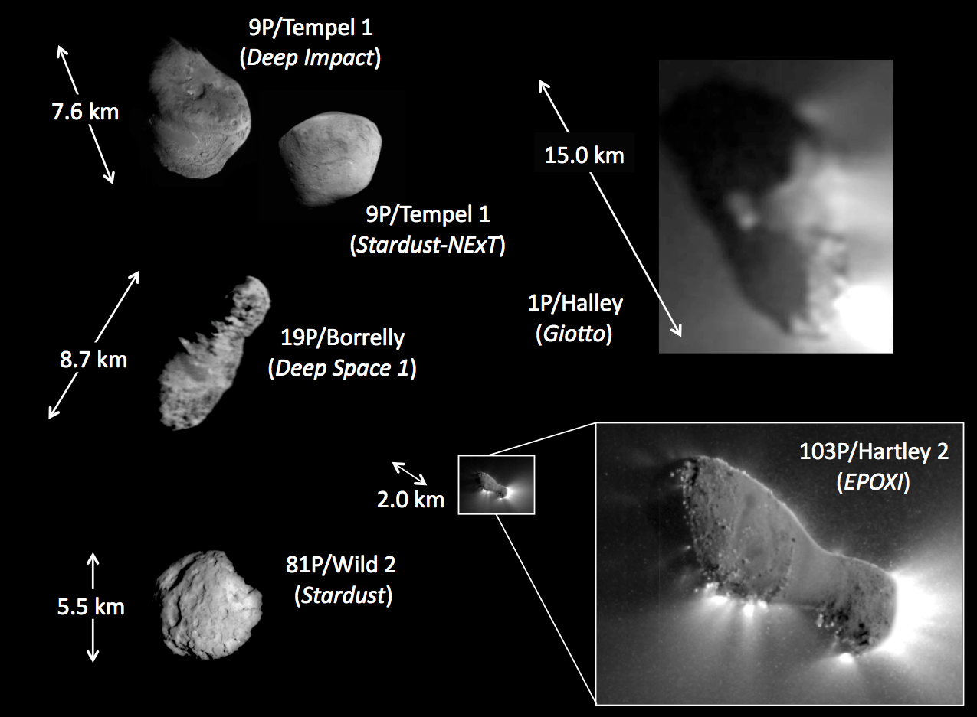
Types of Comets
These are the only cometary nuclei that we have images of.
67P/C-G
(Rosetta)
5 km
Short period (Jupiter-family)
  Orbit between Jupiter and the Sun
  Disturbed by the gravity of the planets
  Spacecraft have imaged 5
Halley type (every 50-200 years)
  Orbit between Pluto and the Sun
  Spacecraft have imaged 1
Long period (>> 200 years)
  “New” and “young” come from the Oort cloud when disturbed by a passing star
  None observed up close
Potential for high science return

Slide 4
Why Waypoints?
New comets:
Hale-Bopp discovery was 2 years prior to perihelion.
Many long-period comets are discovered with even shorter times.
Proposed solution:
Park a spacecraft in space.
Statistics of Oort cloud comets:
Statistics over past 10 years indicate 1 detected every 2 years.
Hughes (2001) estimates the historical long-period comet flux as ~1 per year.
Close flyby to study nucleus of a long-period comet:
Surface maps of ~8-m resolution and volatile inventory will yield compelling scientific results.
The PSDS3 effort showed that a mission to a new comet is within contemporary CubeSat/SmallSat technology!

Slide 5
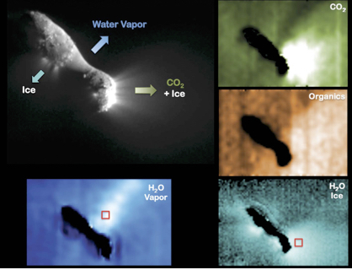
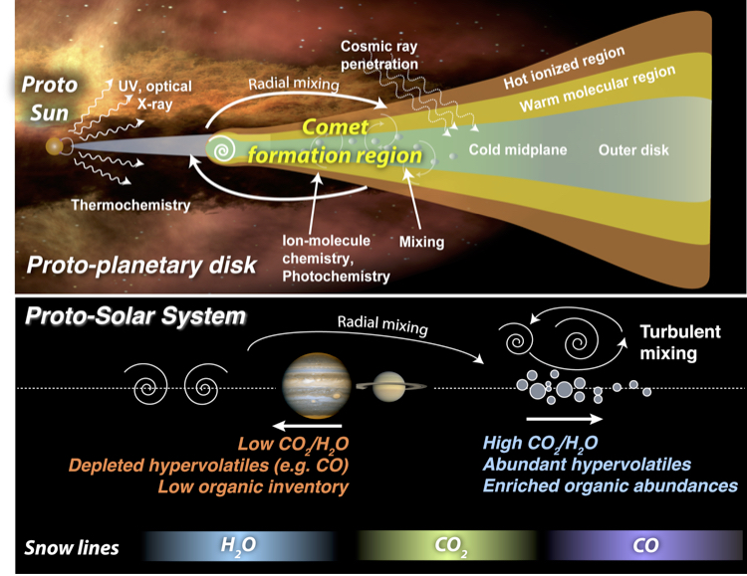
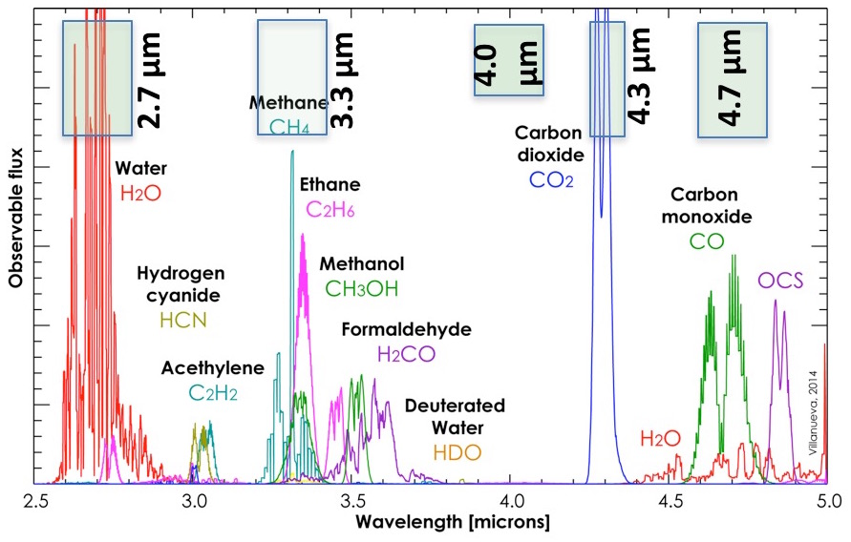
Mission Concept and Science Deliverables
Science Objectives:
PrOVE will perform a close flyby of a new or Jupiter-family comet near perihelion when surface processes and volatile activity are maximum, to probe the origin of the nucleus and the formation and evolution of our Solar System.
Investigate morphological and chemical heterogeneity of nucleus by quantifying surface fine structure and volatile species abundances, and how these depend on solar insolation;
Map surface relief and spatial distribution of volatiles, especially CO₂ (which cannot be measured from ground based telescopes), and determine any variations;
Determine the frequency and distribution of outbursts.
CHNOPS

Slide 6
PrOVE can address Priority Comet Science!
Ideal Criteria:
Flyby of a dynamically new (Oort cloud) or long period comet. Identify a waypoint/parking orbit in space, launch from an arbitrary platform and disposal above Earth’s gravity well, navigate to waypoint with on-board propulsion, indefinite residence with minimal station keeping, design a cruise trajectory to a newly acquired target or a known long period comet, navigate to a new target with on-board propulsion, flyby encounter with 5m optimum spatial resolution (visible imaging).
Minimum Criteria:
Flyby of a Jupiter Family comet and Near-Earth comet (q<1.3 AU, P<200 years).
SKG: https://www.nasa.gov/exploration/library/skg.html
SBAG report on venues/contexts for addressing SKGs “Space-based robotic missions which can be telescopic or precursor mission to a small body target” includes high priority for NEO albedos, size, rotation state, dust environment, resource identification.

Slide 7
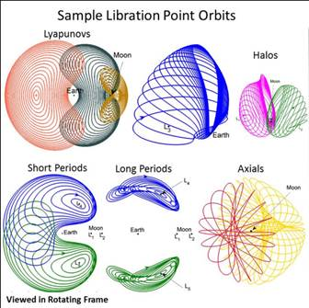
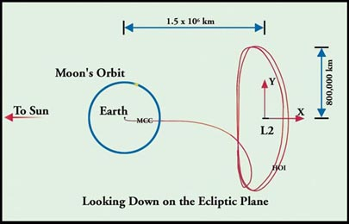
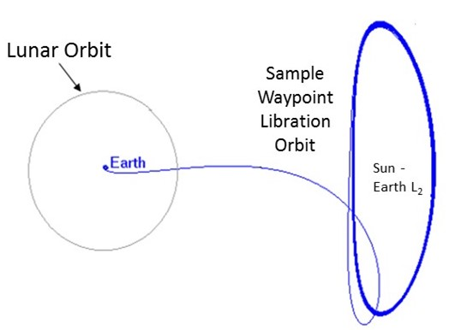
Waypoint examples examined in PSDS3
Sun-Earth Libration orbit
Other Libration orbit examples
Sun-Earth L1/L2 are good solutions
Station keeping is minimal

Slide 8
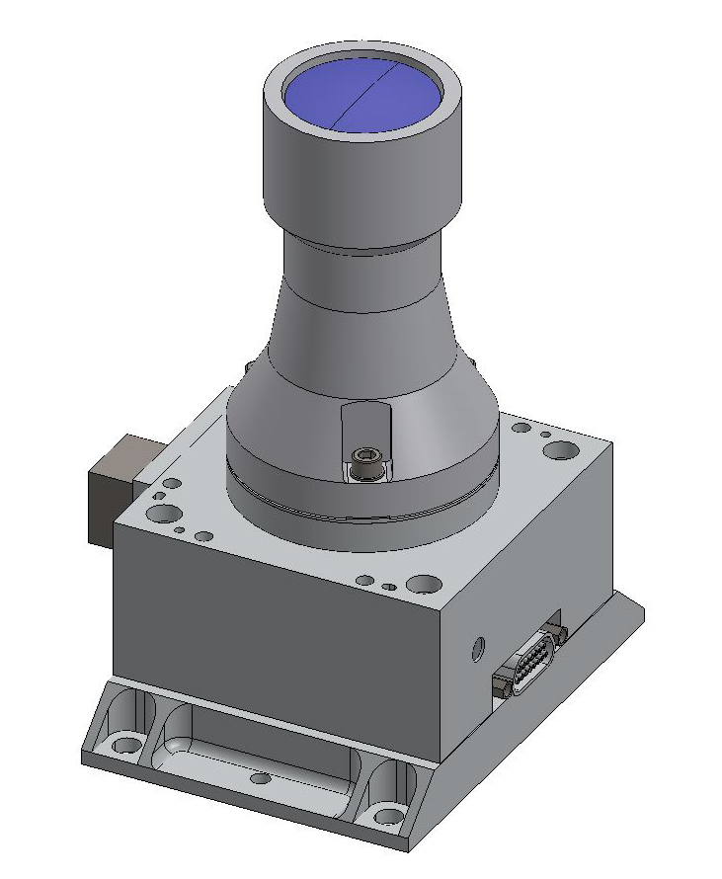
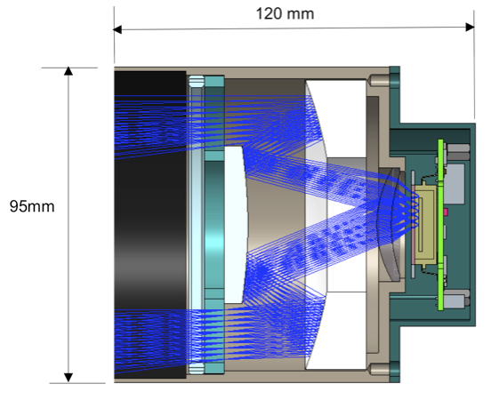
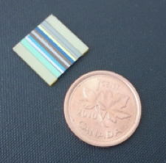
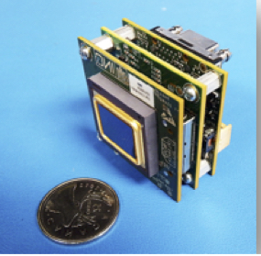
Payloads
Infrared Imager/radiometer
Visible Imager
ComCAM: IR microbolometer (with TEC) has broad spectral response (1-100 µm) which includes science requirements of 2-5 µm for molecular species and 8-12 µm for thermal.
384x288 pixels
IFOV = 120 m @300 km
1.2 kg, 2.5 W
VisCAM: High spatial resolution mapping of a Jupiter-family comet surface is optimum. Mapping of a new comet would be unprecedented.
2592x1944 pixels
IFOV= 8 m @ 300 km
0.4 kg, -30C<T_{oper}<40C
2.5 W imaging, 1.3 W idle
Compact 2-12 µm camera
Based on TAGCAMS instrument on OSIRIS—Rex
+

Slide 9
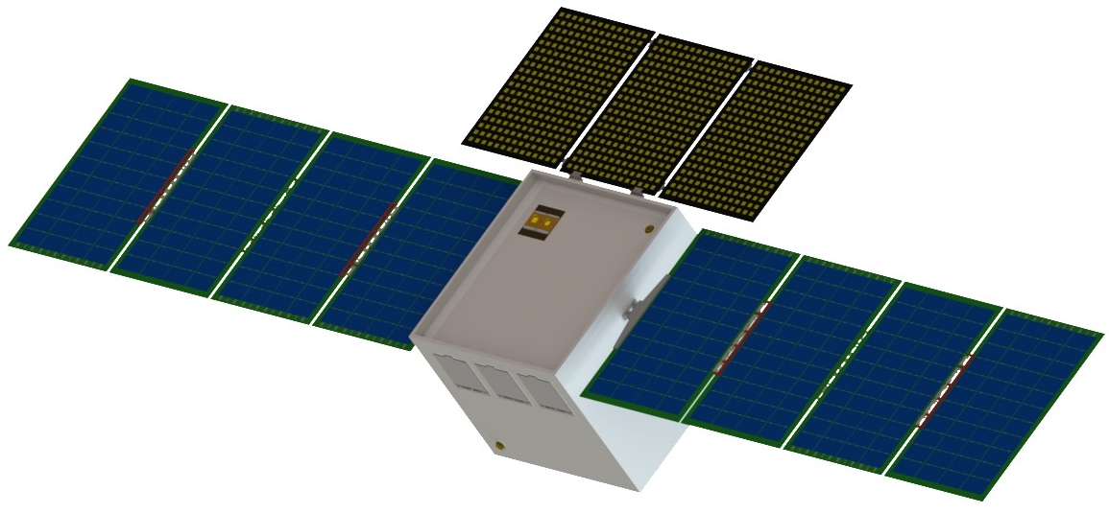
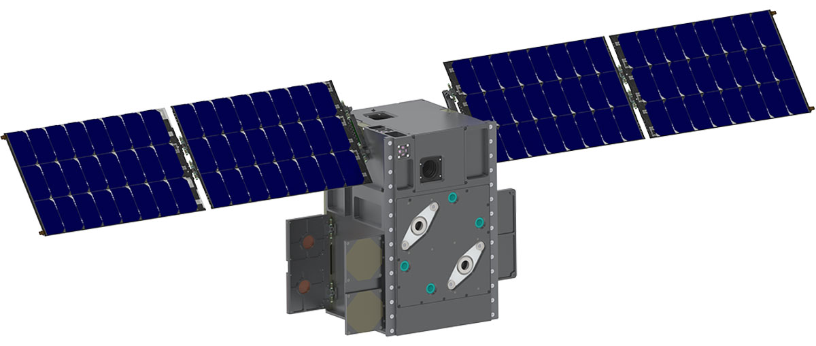
Spacecraft Concept
ABC/ESPA Bus Assembly
Stowed volume ~100-U or Stowed volume 12U?
?
ABC/ESPA
e.g., BCT XB12, MSU 12U bus

Slide 10
Conclusions
The standard spacecraft/waypoint approach, and the broad spectrum flyby coverage concept presented here has the best chance to produce ground breaking new comet science
PROVE is within current technological capabilities
Spacecraft bus: ~100 U initial recommendation, but 12U/24U bus concepts very likely an option, even with 4 year mission lifetime requirement (shielding and ongoing advancement in intrinsically radiation hard electronics architecture and components direction)

